Slide 1
2025/04/17
Fabricating New Lucas Cells at SNOLAB
Peter Qin (He/Him)
Scientific Support Student

Slide 2
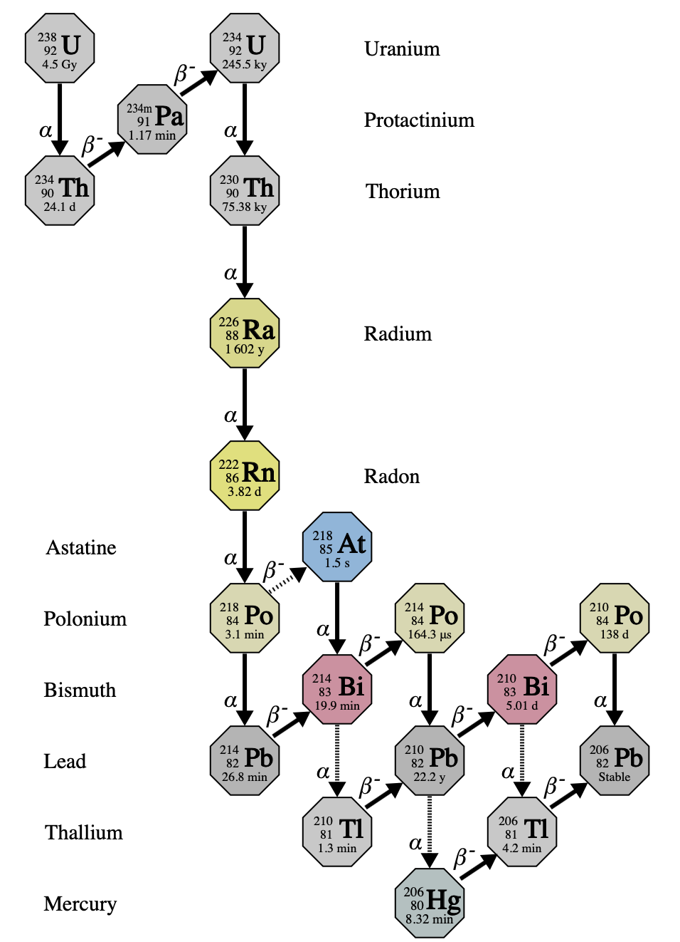
U-238 chain and Rn-222
Notes:
I’d like to begin my presentation with a bit of background on the Uranium 238 chain of which Radon 222 is a member. If you’ve been here any amount of time, you’ve heard of Radon. So why is it such a problem?

Slide 3
U-238 chain and Rn-222
Abundant underground
Notes:
Firstly, Uranium-238 is especially common underground owing to its abundance in the norite rock surrounding SNOLAB.

Slide 4
U-238 chain and Rn-222
Abundant underground
Background to rare-event searches
Notes:
Second, Radon daughters contribute direct background to rare event searches at SNOLAB including for 0vbb and WIMP DM

Slide 5
U-238 chain and Rn-222
Abundant underground
Background to rare-event searches
Gaseous
Notes:
Thirdly, Radon being gaseous means it is highly mobile and even small leaks can allow for ingress into otherwise clean or low-background systems

Slide 6
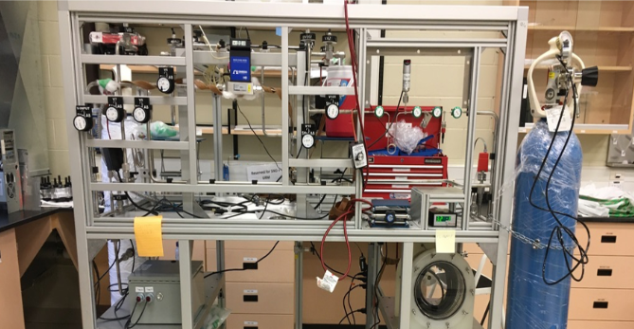
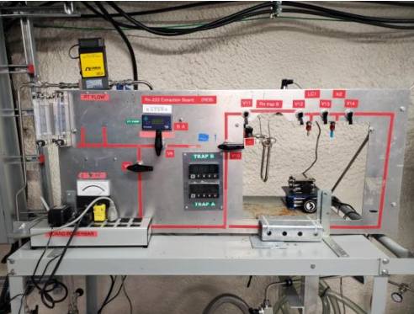
Radon assays
Notes:
A technique we have at SNOLAB for characterizing radon concentration and emanation rate of samples is the Radon assay. Radon is cryotrapped out of a sample media into a charcoal or bronze wool trap and transferred by volume-sharing into an alpha counting detector – the Lucas cell

Slide 7
Lucas cells: Key concepts
Notes:
I’ll now introduce Lucas cells – the who what where when why and how

Slide 8
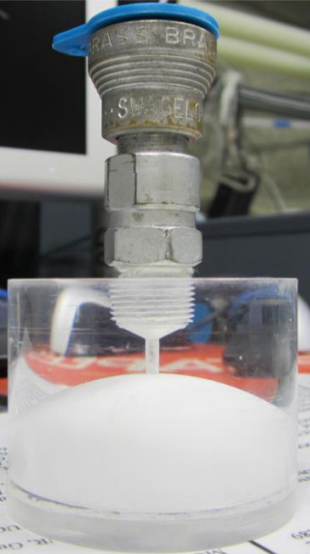
What are Lucas cells?
Scintillator alpha counter
ZnS(Ag) coated volume storing a gas sample
Used to count decays of Rn atoms trapped using assays
Notes:
What are Lucas cells? Lucas cells are a type of scintillator alpha counter. They consist of an acrylic body holding a gas sample, with that internal volume coated with silver-activated zinc sulfide which is a scintillator sensitive to alphas. As mentioned, they are used in the radon assay method to count trapped atoms.

Slide 9
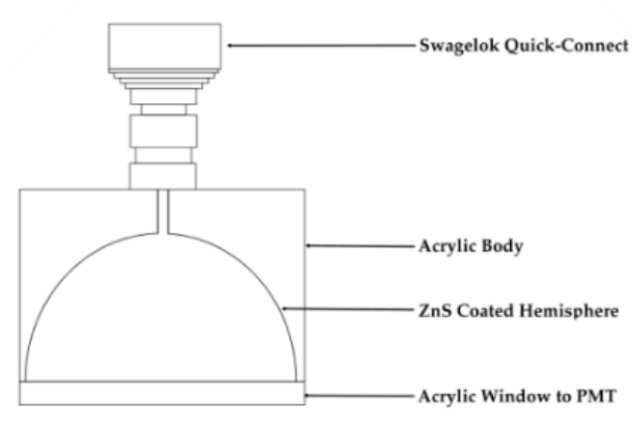
Principle of operation
Rn-222
Notes:
How do they work? I’ll use this representation of a Lucas cell to explain. Radon enters a Lucas cell at the end of an assay and is coupled to a PMT.

Slide 10
Principle of operation
α
Po-218
Notes:
Radon undergoes an alpha decay (in reality, it’s three in quick-succession) and the emitted alpha incident on the ZnS coating deposits its energy

Slide 11
Principle of operation
Notes:
The ZnS emits scintillation light which is read out by a PMT

Slide 12
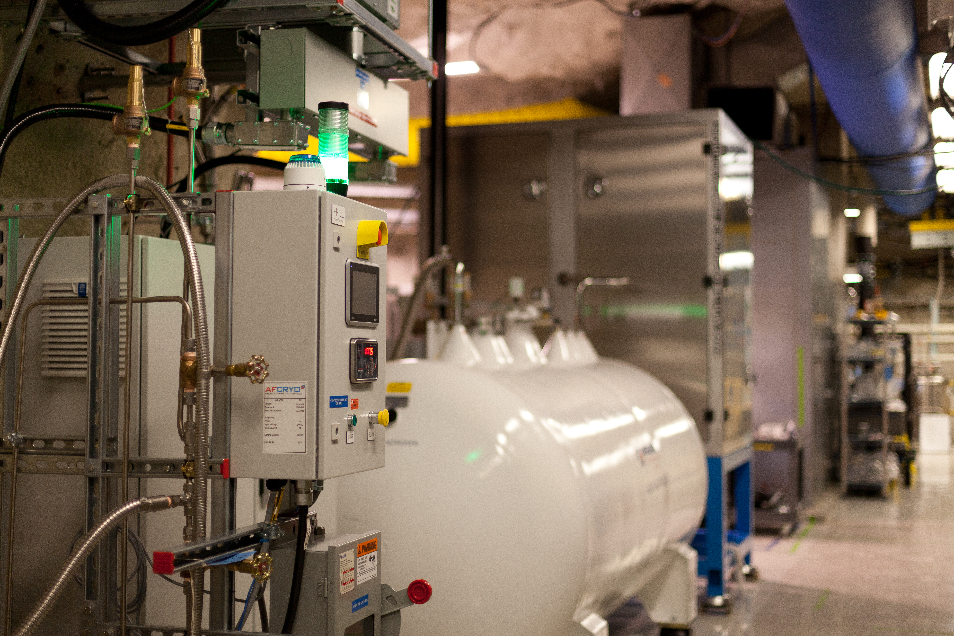
Lucas cells at SNOLAB
Rn assays for SNO+ UPW plant, cover gas
Enable QA measurements of LN2 plant
Rn emanation for low-background counting facility
Notes:
What are Lucas cells used for at SNOLAB?

Slide 13
Experiments using Rn emanation results
SNO+
CUTE
DAMIC
DarkSide
DEAP-3600
DM-Ice
EXO, nEXO

Slide 14
Experiments using Rn emanation results
SNO+
CUTE
DAMIC
DarkSide
DEAP-3600
DM-Ice
EXO, nEXO
HALO
NEWS-G
PICO
REPAIR
SBC
SENSEI
SuperCDMS

Slide 15
Experiments using Rn emanation results
SNO+
CUTE
DAMIC
DarkSide
DEAP-3600
DM-Ice
EXO, nEXO
HALO
NEWS-G
PICO
REPAIR
SBC
SENSEI
SuperCDMS
Every experiment at SNOLAB can benefit from better Lucas cells!

Slide 16
What can be improved for the next generation of Lucas cells?

Slide 17
Lucas cell backgrounds
Empty Lucas cells still produce counts
Older cells have higher backgrounds than newer cells
These counts arise from buildup of Pb-210 in cells
Sensitivity of assays is limited by Lucas cell background
Notes:
One key area of improvement is background
This is why we need Lucas cells younger than 12 years of age
Pb210 is a longlived decay product of the uranium chain which builds up and one of its daughters, po210 is an alphas emitter
We can only characterized Rn in sources more active than the cells

Slide 18
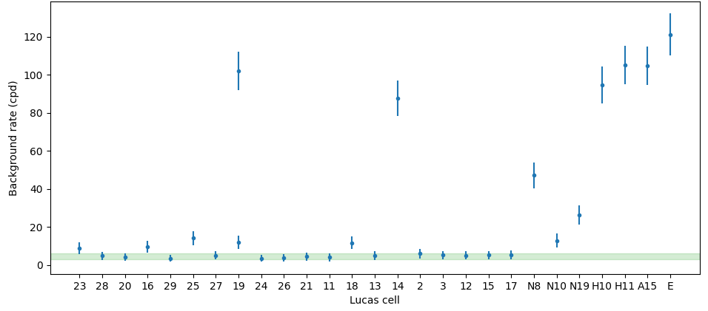
Lucas cell backgrounds
Notes:
This plot shows the backgrounds of all our Lucas cells. Although many cells are low background (in green region) there are many which are not or are borderline. And there’s a significant number of old cells with backgrounds that are unusably high

Slide 19
Lucas cell efficiency
Number of Radon atoms is inferred from decays counted
Relies on characterization of Rn transfer from source to cell and efficiency of decay counting
Alpha counting efficiency impacted by light yield and internal reflection properties of ZnS coating
Notes:
When we speak of efficiency for Lucas cells, we mean two quantities – efficiency of transferring Rn out of source into cells
and counting efficiency, which is the proportion of alpha decays which are counted by the DAQ
The first is a consequence of the radon assay method, and the second is affected by optical characteristics of the zinc sulfide coating
Can we improve the quality of our Zinc Sulfide coating? Let’s take a look at some older cells.

Slide 20
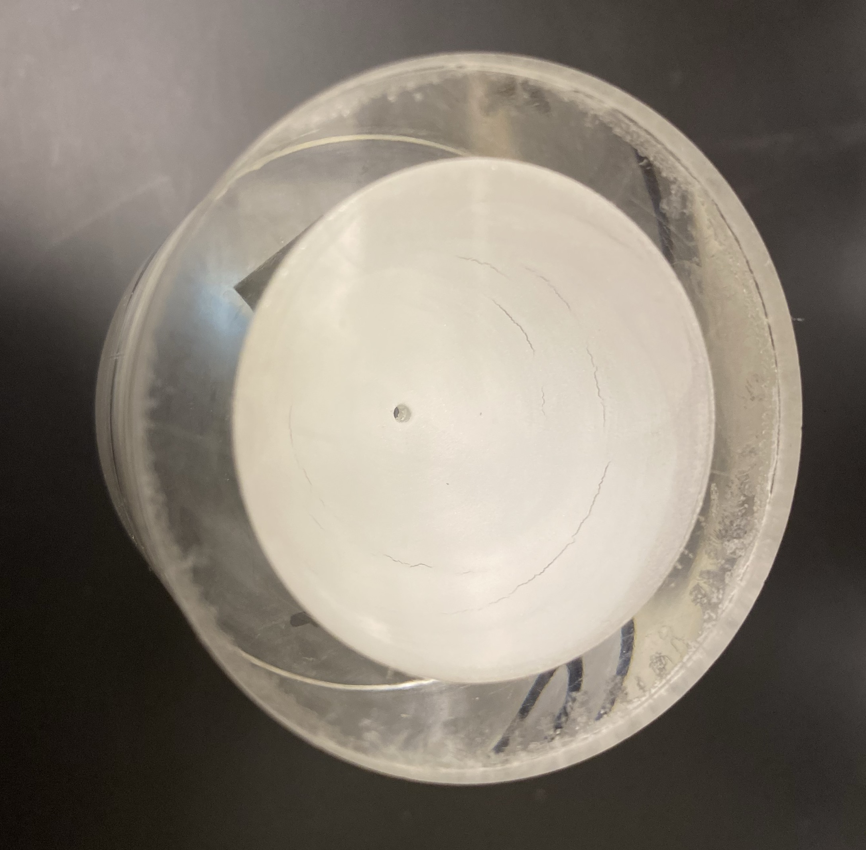
ZnS(Ag) coating in old Lucas cells
Lucas cell backgrounds range from 3-4 cpd to 15+ cpd
Many Lucas cells are no longer in use due to high background or leakrate
Quality of ZnS coating is not consistent from cell to cell
Notes:
There are clearly some qualitative differences between cells’ coatings, and we might imagine that the counting efficiencies can even vary cell to cell.

Slide 21
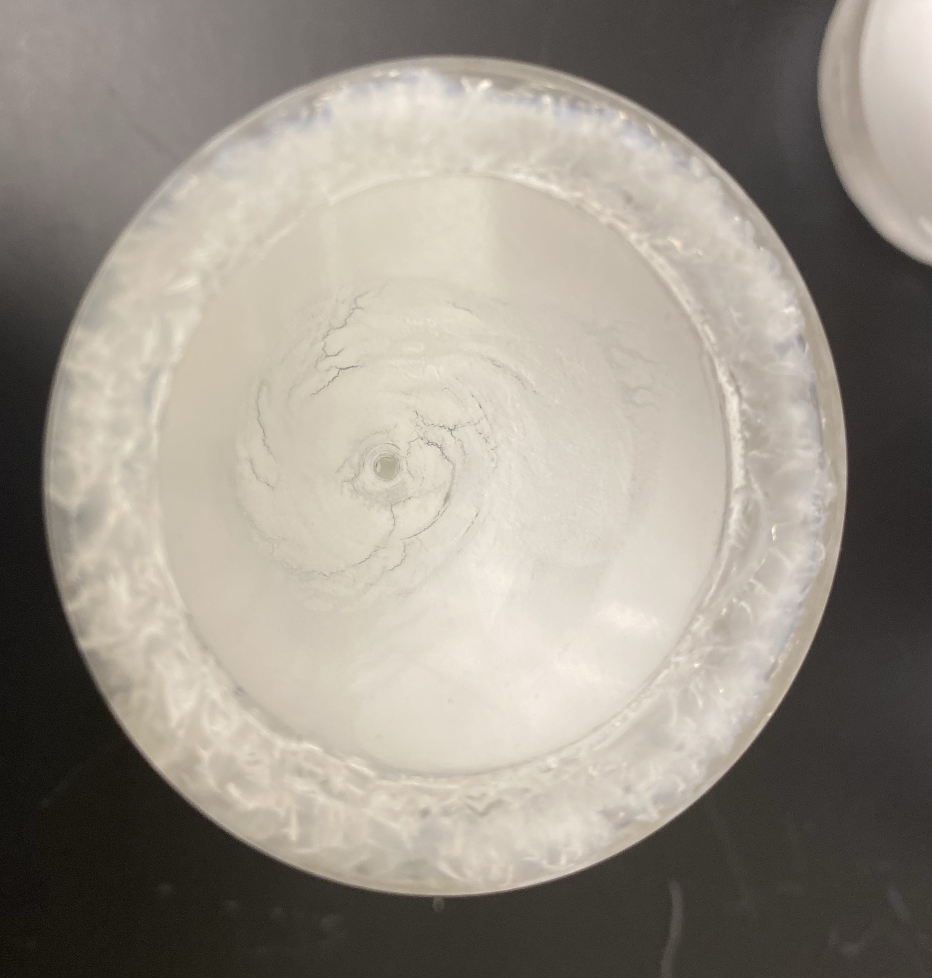
ZnS(Ag) coating in old Lucas cells
Notes:
It’s clear that not all Lucas cells were created equal

Slide 22
State of Lucas cells at start of term
Lucas cells in use are >12 years old
Many cells are no longer in use
Quality of ZnS coating not consistent from cell to cell
Limited records of how Lucas cells were once produced
Notes:
To summarize where we are with Lucas cells at the start of my term

Slide 23
State of Lucas cells at start of term
Lucas cells in use are >12 years old
Many cells are no longer in use
Quality of ZnS coating not consistent from cell to cell
Limited records of how Lucas cells were once produced
Motivates method for new and improved Lucas cells
Notes:
To summarize where we are with Lucas cells at the start of my term

Slide 24
New Lucas cells
Notes:
I’ll now talk about my work this term

Slide 25
New Lucas cells: challenges
Notes:
Our investigation starts with our acrylic Lucas cell bodies - they initially showed signs of damage and internal stress
We know from during construction of DEAP-3600 that we can anneal acrylic to relieve stress

Slide 26
Annealing Lucas Cells
Notes:
Unfortunately, using the annealing scheme for acrylic previously used at SNOLAB caused severe cracking in our acrylic

Slide 27
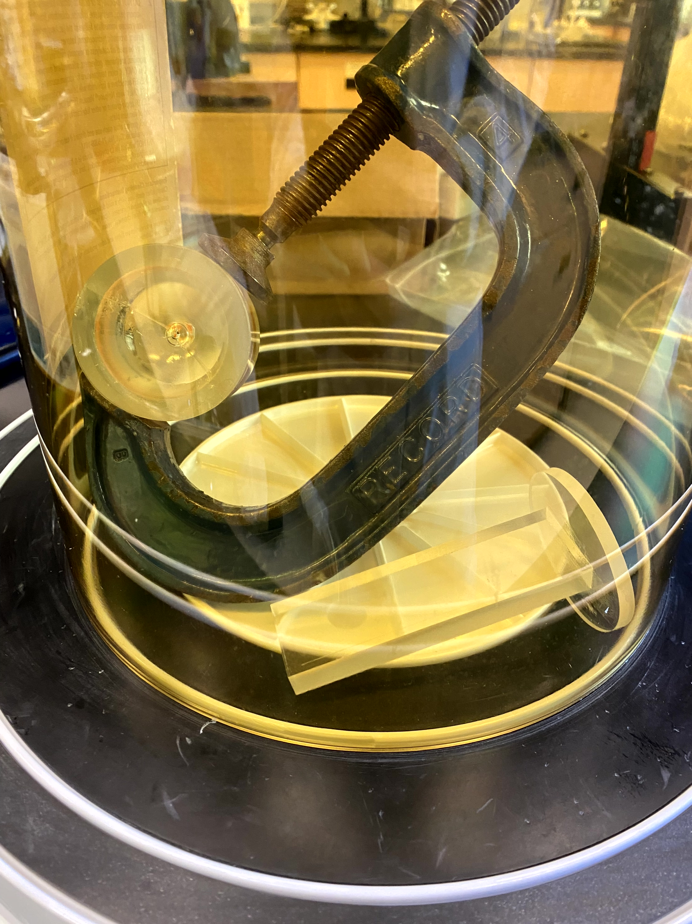
Lucas Cells Recovery
Notes:
We were able to use this result to investigate Lucas cells repair – by rebonding the acrylic with the solvent methylene chloride the cells were actually completed. We extended this method to recover some older cells with leaks, reducing leakrate to leak-checker sensitivity.
This was a major accomplishment providing us with more low-background, usable cells for the first time in 12 years

Slide 28
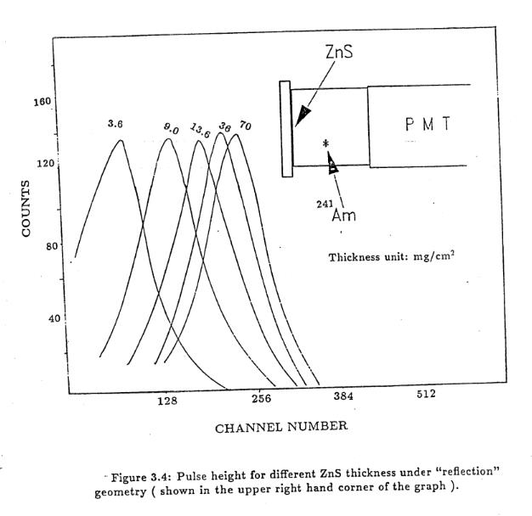
Counting efficiency investigation
Light yield is proportional to ZnS thickness
ZnS contributes background to Lucas cells (15 cpd/gram)
How thin of a coating will give acceptable efficiencies?
M. Liu (1991)
Notes:
With an intact acrylic body, we proceeded to cell coating. We know from previous Lucas cell studies at Queen’s that Light yield is roughly proportional to ZnS thickness and that Zinc Sulfide is a possible background contributor – this gives us an optimization problem where we must balance alpha counting efficiency with low background rates.

Slide 29
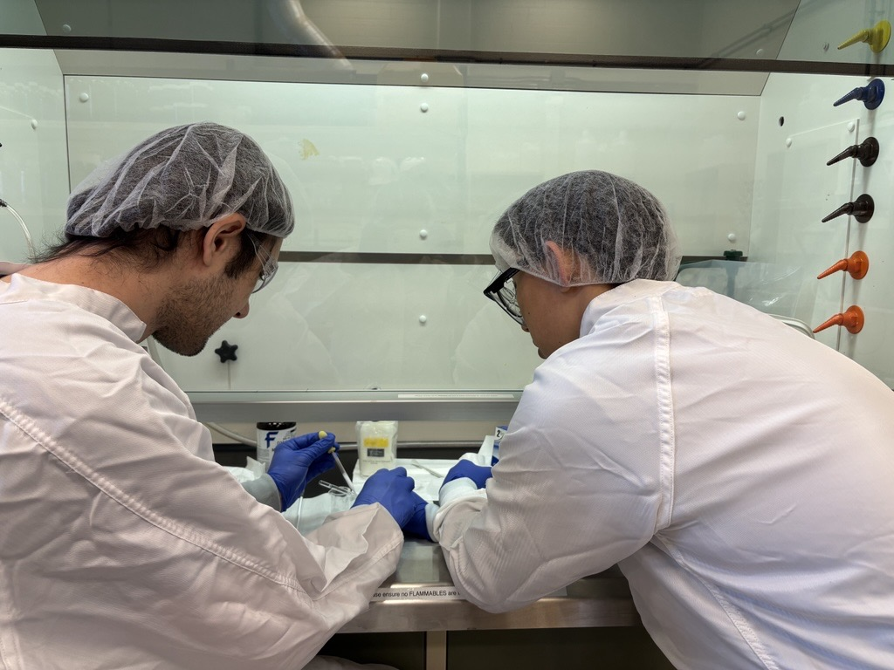
Lucas cell coating: process
Notes:
Here’s a photo of Keegan and I learning to coat Lucas cells. Once the cells were complete, we measured background by counting the cells empty cells and measured alpha counting efficiency by spiking the cells with radon from a known high activity source.

Slide 30
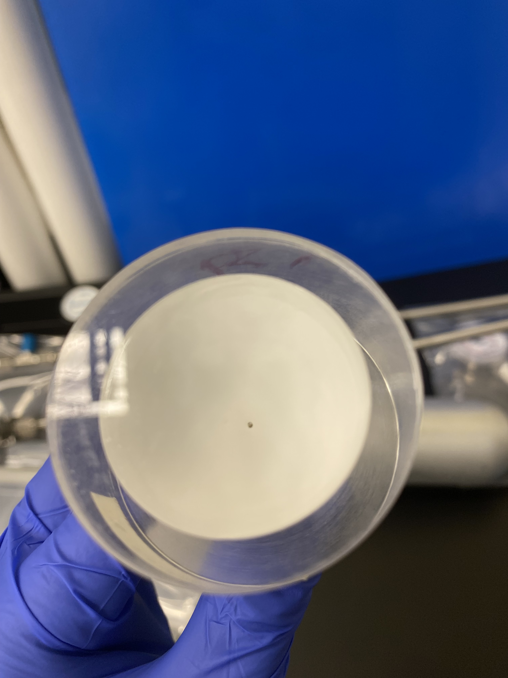
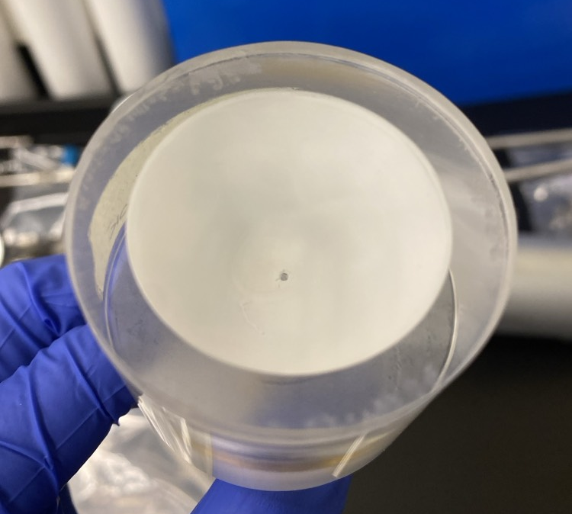
Lucas cell coating: goals
“R1”
“J1”
Notes:
These cells are not ones we made, but ones that we had identified as having pristine coatings which we selected for use as a benchmark to compare our own against

Slide 31
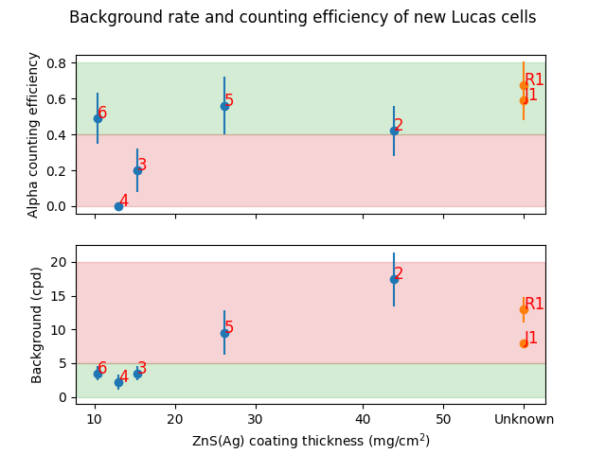
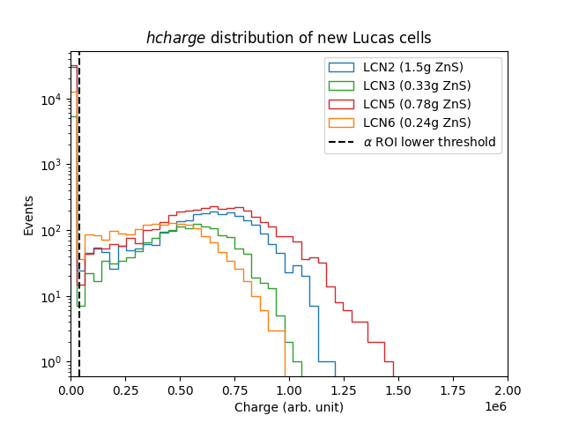
Notes:
These are the efficiency and background results from the cells we made. It does appear that background rate increases with ZnS used, in agreement with the idea that ZnS is a source of backgrounds
On the right is the pulse charge distribution of the Lucas cells, which is an estimator for energy deposited by alphas. We would like to connect features of the distribution to efficiency and to physical characteristics of the cells

Slide 32
New Lucas Cell 2
Notes:
New Lucas cell 1 is not included in this analysis as it was essentially sacrificed in our experimentation with Lucas cell development. Off the failure of our first cell, we coated New Lucas cell 2 very liberally to ensure the production of a working cell, although we had not yet nailed our technique. As a result, it has both high background rate and acceptable efficiency.

Slide 33
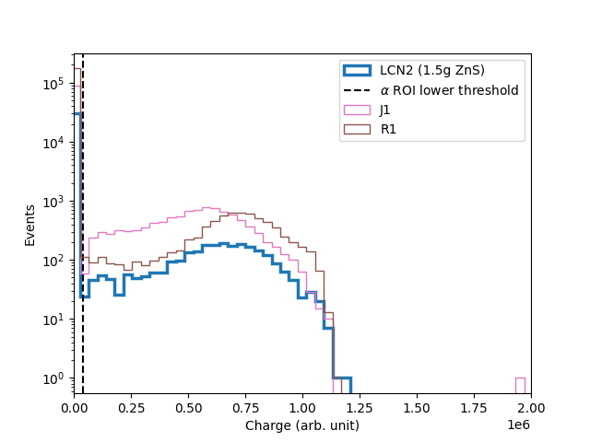
New Lucas Cell 2
Notes:
This cell has a distribution qualitatively similar to the model cells. Our current understanding is that we can use the distribution to as an evaluation of the quality of cell coating besides just the eye test.

Slide 34
New Lucas Cell 3
Notes:
In cell 3, we tried to reduce our ZnS use to the levels of previous cells – however, our coating process had not been refined, resulting in an uneven layer. The background is low, but so is the efficiency.

Slide 35
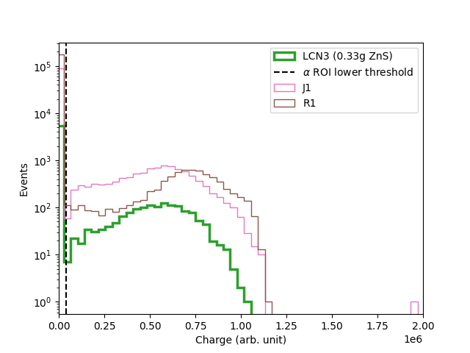
New Lucas Cell 3
Notes:
The charge distribution in cell 6 differs from the model cells in the lower energy region – we might relate that difference to the imperfections in the cell coating.

Slide 36
New Lucas Cell 4
Notes:
With cell 4, we experimented with producing the thinnest coating possible. You can see that the layer is almost transparent. Unfortunately, it seems to have been transparent to alphas as well - although it had the lowest background, it recorded no counts at all.

Slide 37
New Lucas Cell 5
Notes:
We produced cell 5 with twice the amount of ZnS used in cell 4. By then, our technique had improved enough that the alpha counting efficiency surpassed that of cell 2.

Slide 38
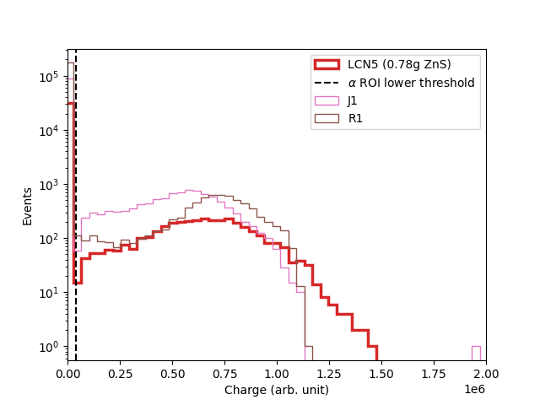
New Lucas Cell 5
Notes:
Cell 5 shows broadened distribution than the model, but still has high counting efficiency, so we currently don’t think we can draw conclusions about efficiency from the distirbution. It’s possible the width has to do with internal reflection effects of the crack down the cell.

Slide 39
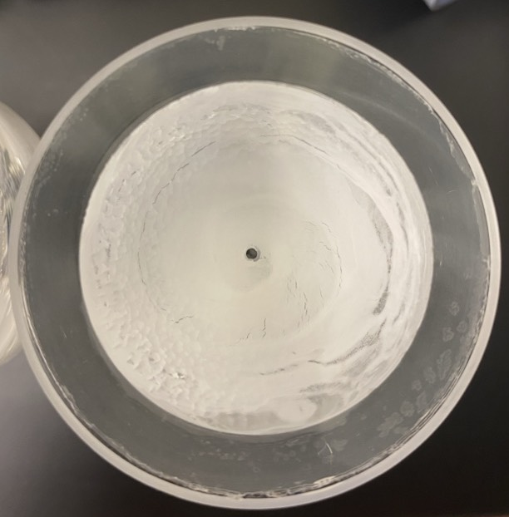
New Lucas Cell 6
Notes:
With cell 6, we modified our coating method and finally produced a superior Lucas cell with both low background and alpha counting efficiency on par with our model cells

Slide 40
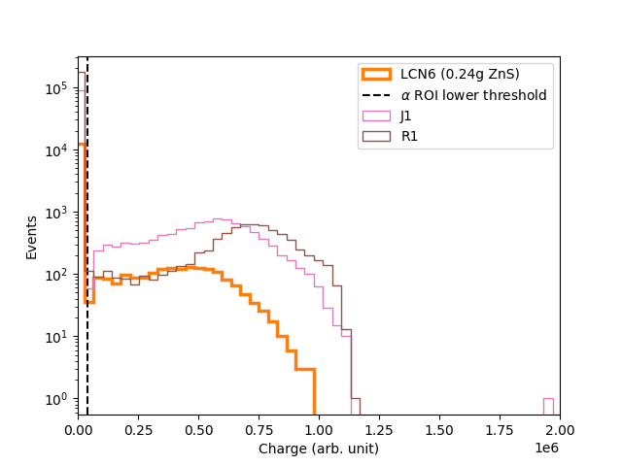
New Lucas Cell 6
Notes:
LCN6 has a distribution with a similar shape to the model cells shifted left – this is possibly due to the low amount of ZnS used and resulting lower light yield across the board. Again, since this cell has good counting efficiency, it’s likely not possible to draw conclusions about efficiency from the charge distribution.

Slide 41
Summary of outcomes
Established method for fabricating Lucas cells
Determined that ZnS(Ag) is background source in cells
Lucas cells can now be recovered by rebonding
Notes:
In summary, this term, we rediscovered the lost art of Lucas cell production giving us the capability to fabricate them here at SNOLAB for the first time
We determined that Zinc Sulfide is a background source in cells, motivated alternative suppliers or coating schemes
And we developed the ability to recover Lucas cells, allows us to fix leaky cells

Slide 42
Next steps and further investigations
Finalize optimal Lucas cell coating method
Identify source of backgrounds in Lucas cells
Producing radiopure ZnS(Ag) in-house at SNOLAB
Study light yield, background of ZnS(Ag) from other suppliers
Notes:
Next term, we’d like to finalize a method for coating Lucas cells and turn that into an SDR
Additionally, with the help of Steve Maguire we are considering producing and doping zinc sulfide in house at snolab
We also need to continue our investigation on identifying the source of backgrounds in Lucas cells

Slide 43
Acknowledgements
My supervisors, Nasim and Lina
Scientific Support
Ian Lawson
Local SNO+ group (LU)
Other students – Keegan Paleshi, Charles Liu, Justin Suys and more
Notes:
Before I conclude, I’d like to give special thanks to my supervisors, all of scientific support, Ian Lawson for helping with HPGe counting, the local SNO+ group for their contributions and other students who worked on many of aspects of this project.

Slide 44
Thank you!
Notes:
Thank you for listening, and I’d be happy to take questions now

