Slide 1
2025/04/17
The Radon Radar
Mann Gandhi
Research Assistant
Pierre Gorel
Research Scientist

Slide 2
What is it?

Slide 3
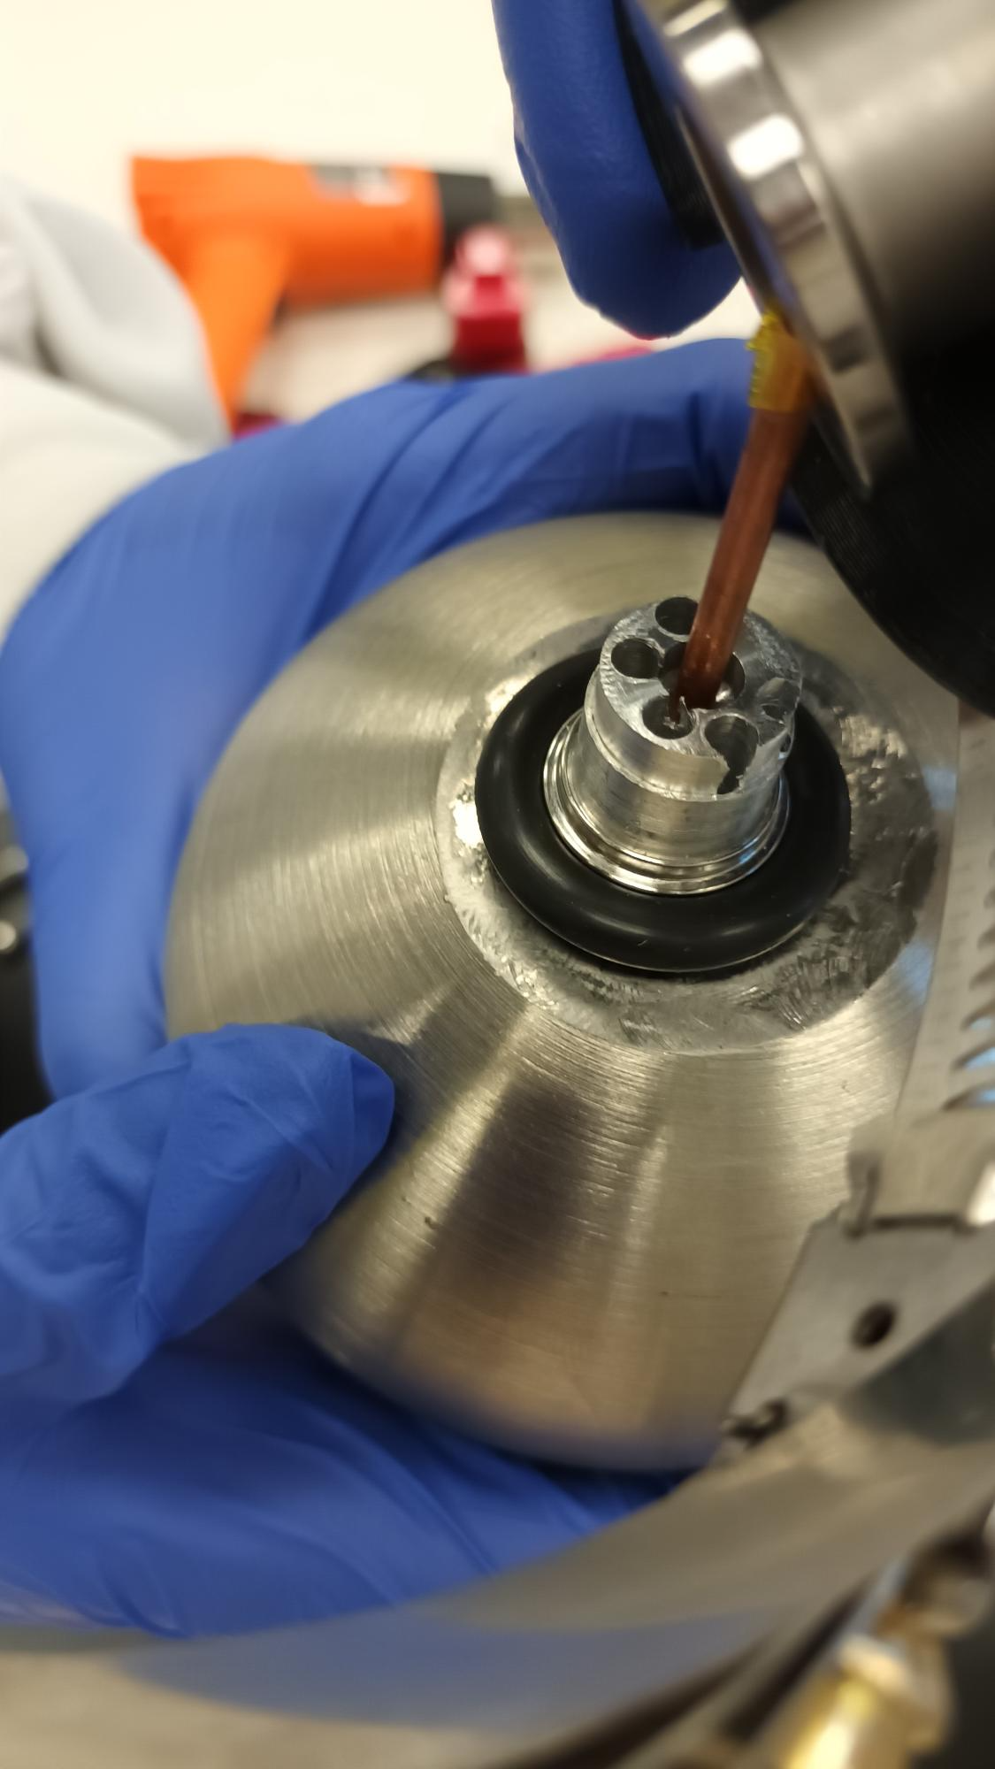
The Radon Spherical Proportional Counter (RnSPC):
Small, approximately 10cm diameter stainless-steel sphere
A high-voltage sensor sits at the center of the sphere called the anode
Filled with a mixture of gasses (Ar/CH4 in our case) to provide sensitivity to particle interactions in the detector volume
An Analog to Digital converter (ADC) is connected to collect data
Notes:
Proportion: 98% Ar, 2% CH4
Quencher gas: Methane -> prevent sparks (can be a target itself)

Slide 4
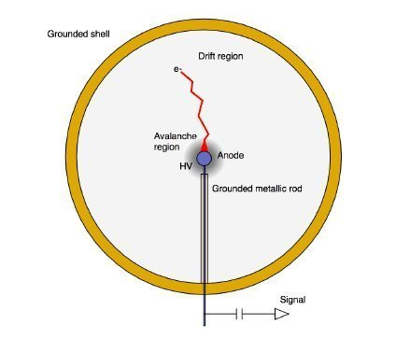
Notes:
A simple diagram to show the internal structure of the SPC

Slide 5
Principle of operation:
The sphere holds a gaseous target and acts as a cathode. It is also grounded
The small spherical sensor/anode is connected to a wire to establish bias voltage
This creates a (mostly) radial electric field. There are deviations closer to the center

Slide 6
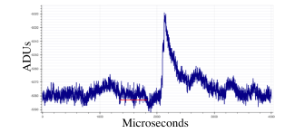
Ionizing radiation interacts with the gaseous target, producing electron-ion pairs
Ejected electrons that have enough energy can ionize further, producing more pairs
As the field grows stronger at the center of the sphere, electrons are accelerated, gaining enough energy to further ionize the gas
A combination of electron-movement, ion-drift and additional field effects create a signal

Slide 7
Why do we have this detector?

Slide 8
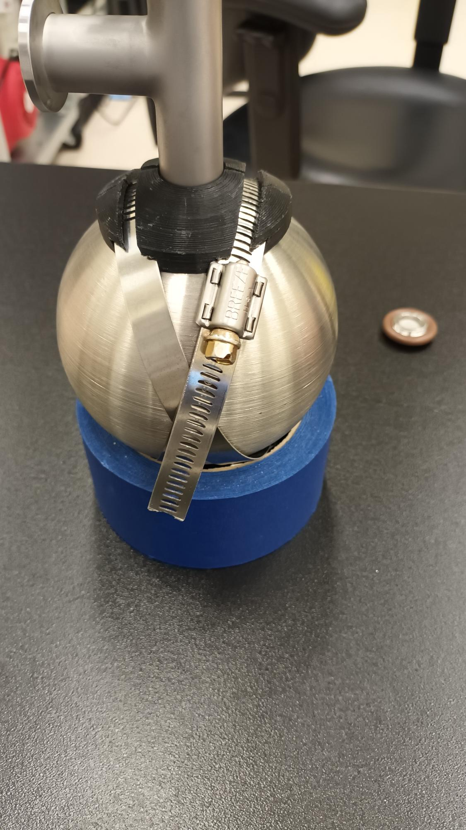
Some advantages of the RnSPC:
Very low-energy threshold
Lower noise
Easy to change target gas and sensor
Allows particle energy reconstruction
Easy to transport and set up
Easy to remove ²¹⁰Pb build-up by etching
Notes:
Since we can reconstruct particles' energy, we can differentiate alpha-particles based on their energy profiles. (unique to the SPC)
Disadvantages:
No data yet
Unknown detector efficiency
Might be leaks in apparatus if not checked/assembled properly

Slide 9
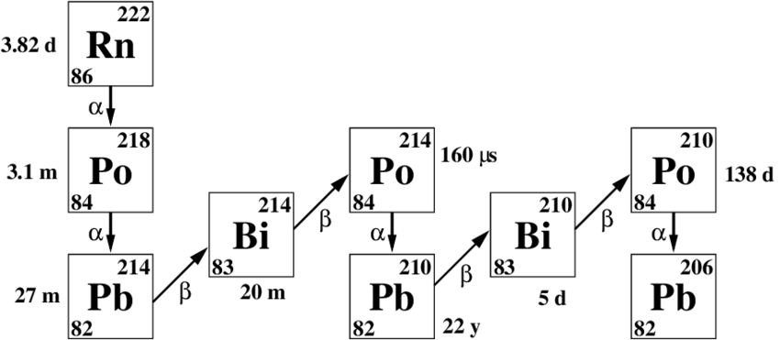
So what about Radon?
²²²Radon has a half-life of 3.8 days
It is a common source of background in experiments
It is essential to control Radon levels to reduce risk of decay mimicking target signal-events
The RnSPC is an attempt at particle-counting based on pulse detection and analysis in comparison to current scintillation-based counting methods

Slide 10
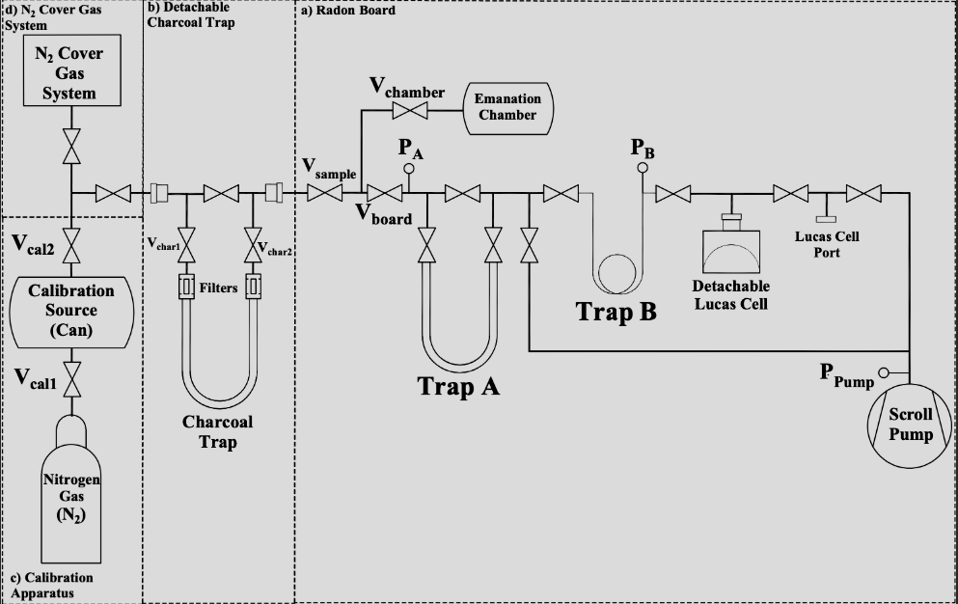
Current efforts at Radon Assays:
We currently use Radon boards on Surface and Underground.
Notes:
Trap A and B are cooled using liquid nitrogen for trapping radon. (cryo-pumping)
Lucas cell placed in DAQ for photon counting after being pumped with gas from trap B
We have a similar mechanism for the sphere

Slide 11
How is the RnSPC different?
Provides a more meaningful understanding of the particle count since we can differentiate particles and categorize interactions too
Higher energy resolution
Not constrained by Lucas cell geometry
Can be re-used easily unlike Lucas cells (old cells with higher backgrounds can no longer be used)

Slide 12
How do we capture the data?

Slide 13
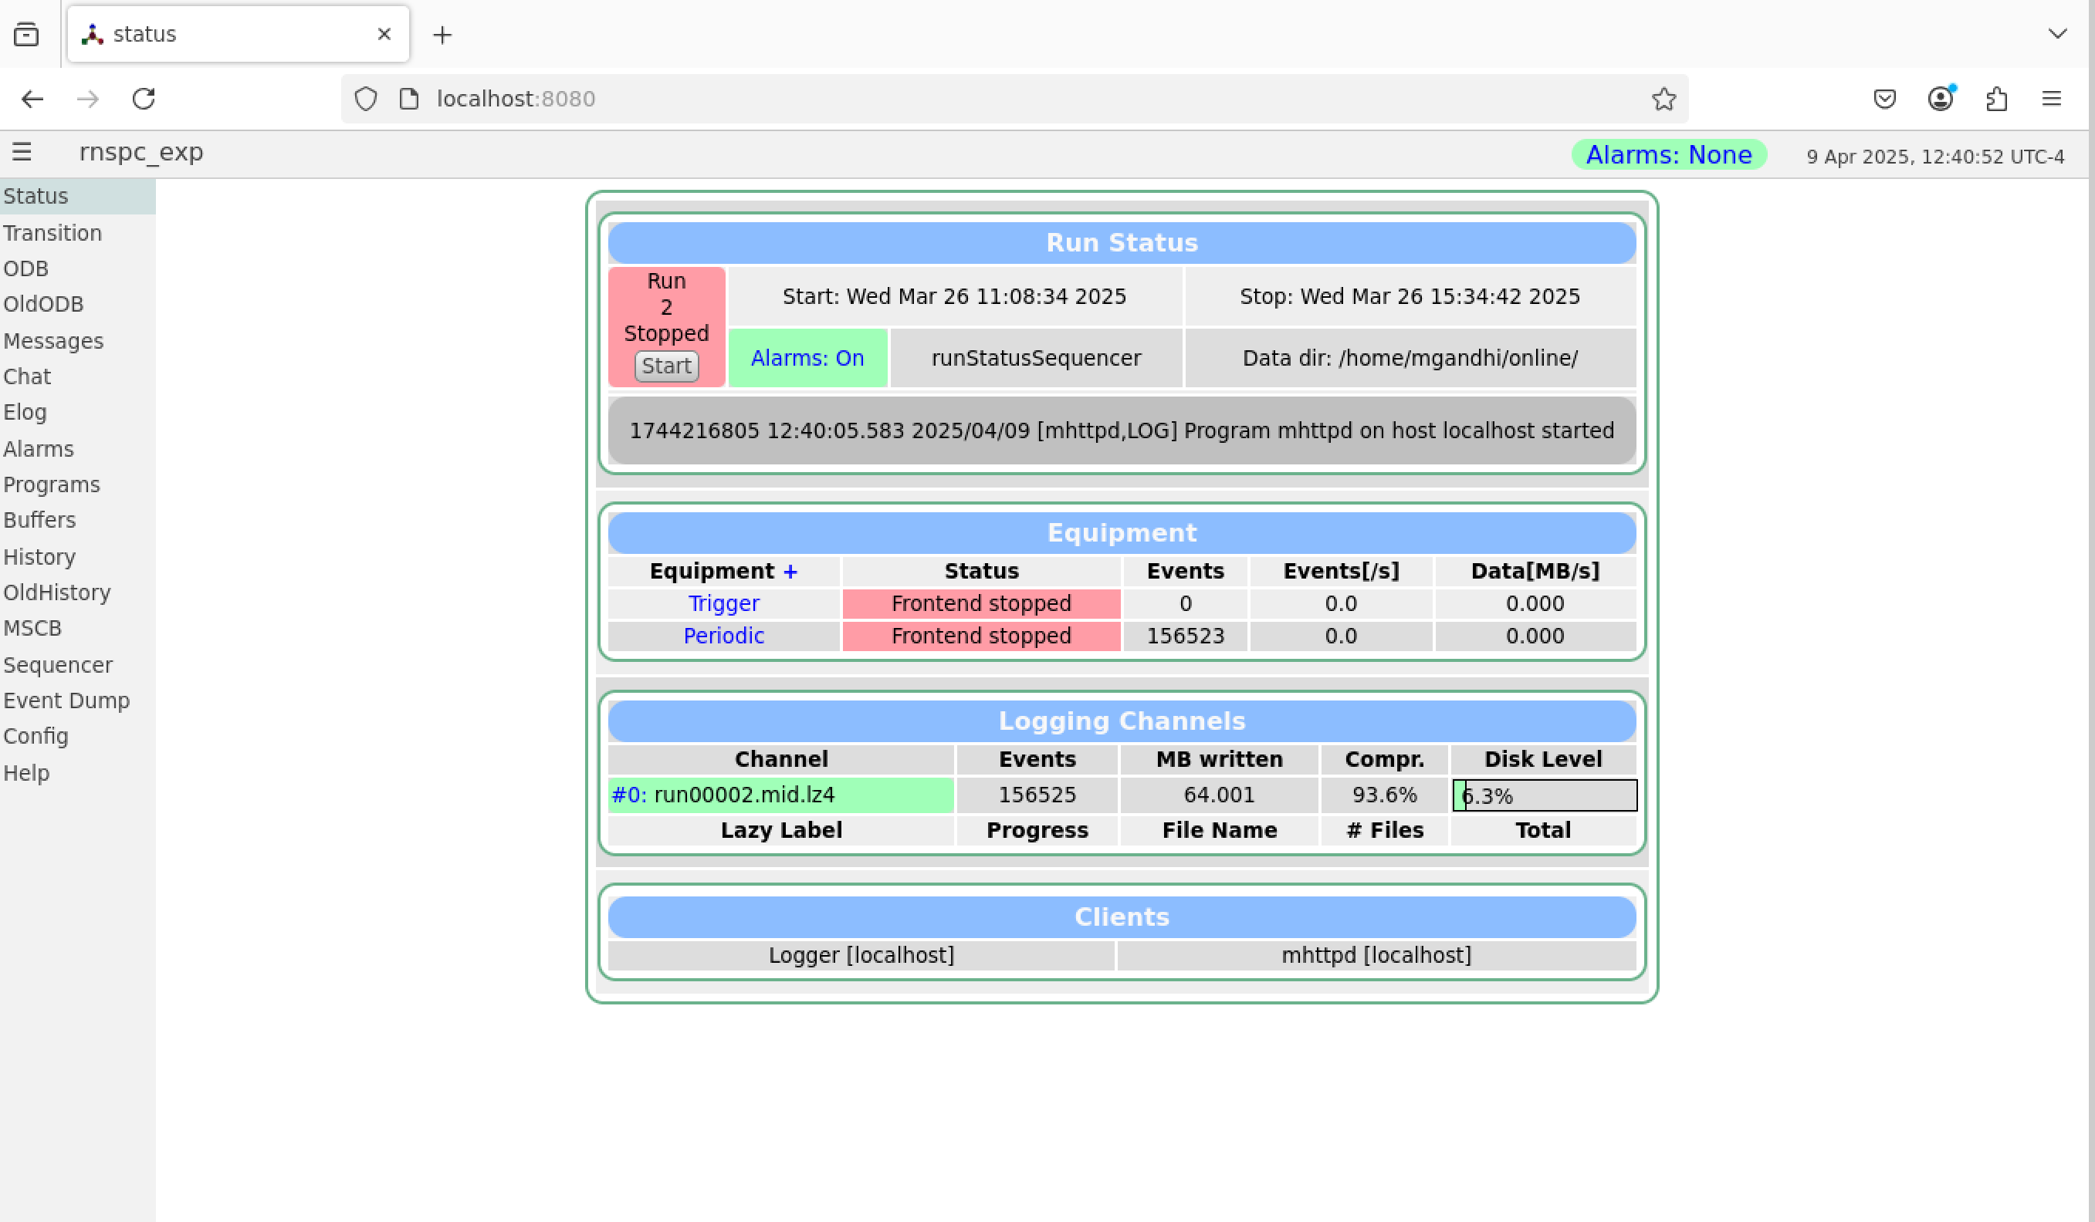
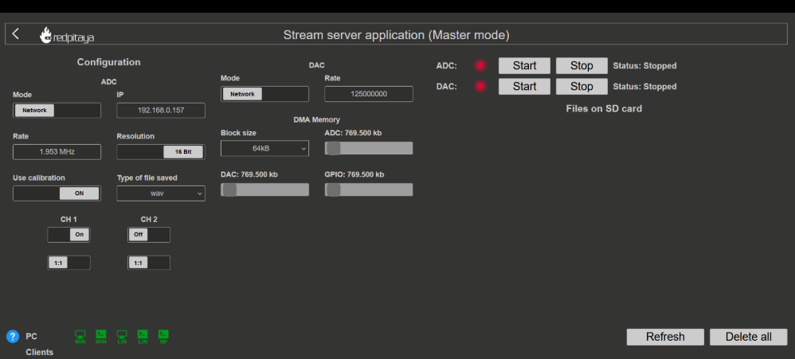
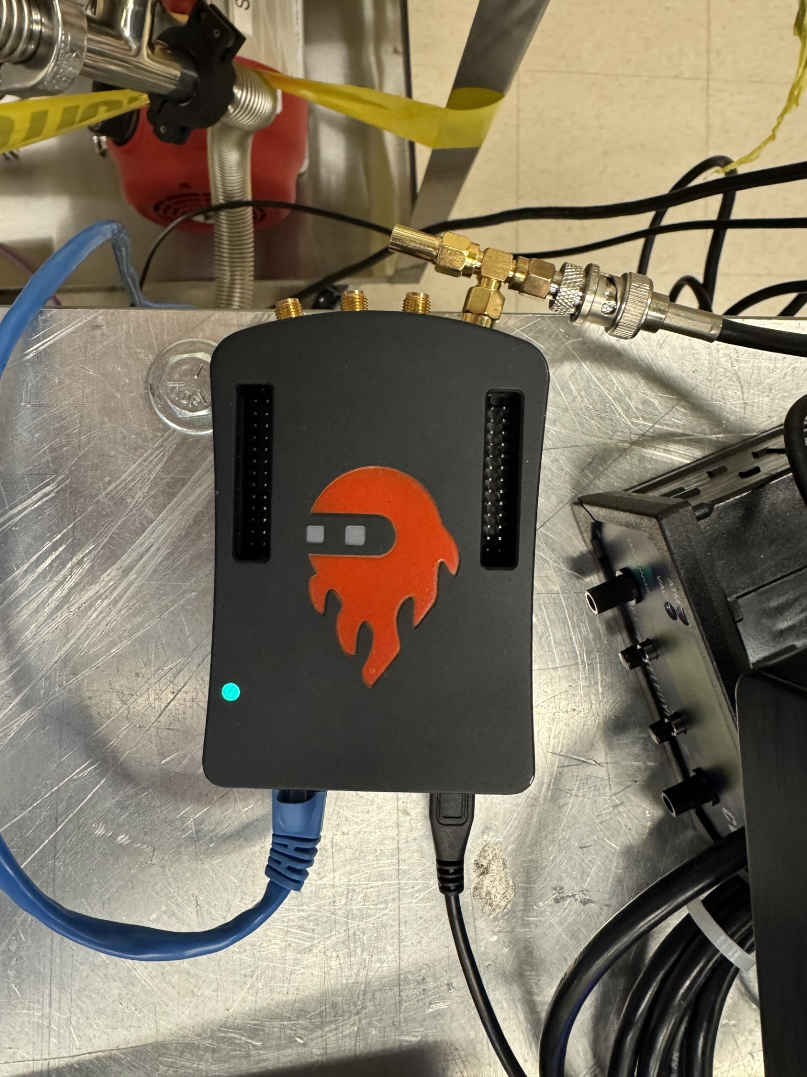
Using a combination of tools:
MIDAS DAQ Software
Red Pitaya (Data Streaming Client)

Slide 14
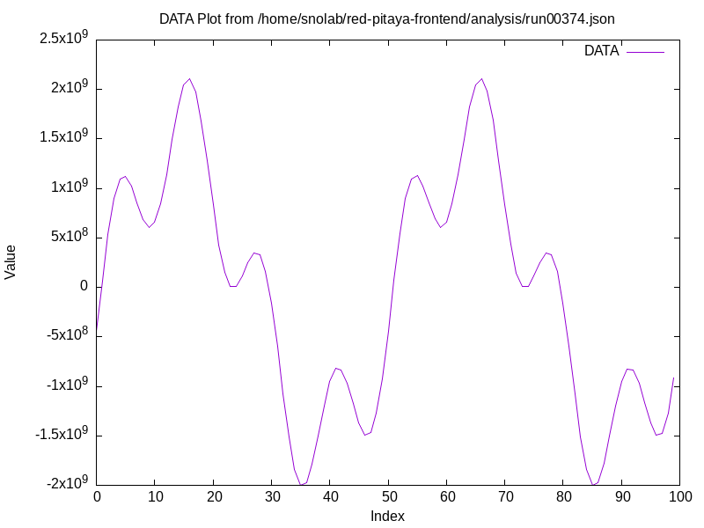
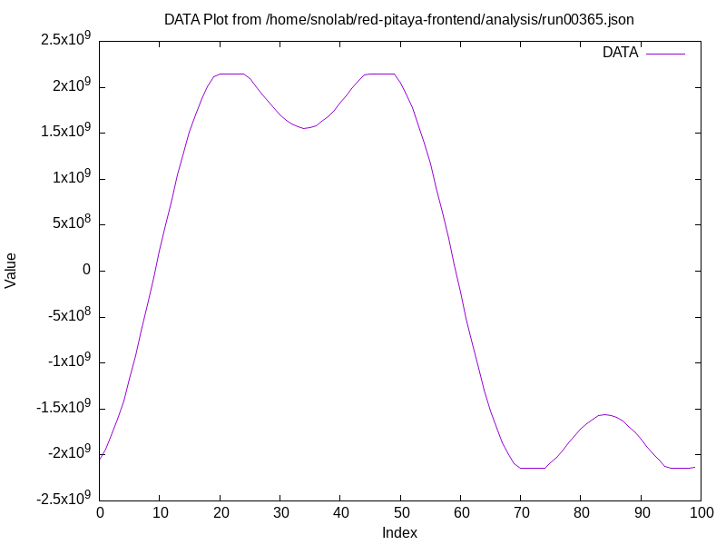
Updates on the MIDAS Frontend:
Frontend works as intended!!!
Tested using Arbitrary waveform generator and RnSPC
Can read up to 2000 values per second from the Red Pitaya
Run files are compressed and can be analyzed using python (specific MIDAS libs required)
Notes:
Last time, I was getting introduced to MIDAS and learning the structure
Now, we have a frontend set up
Figured out how to scale the live display
Configured the trigger event function to detect signals that cross the threshold
How did I figure it out?
Specific compiler flags in the Makefile
Read through MIDAS documentation to trace function calls
Ran memory tests to realize that my data was being overwritten

Slide 15
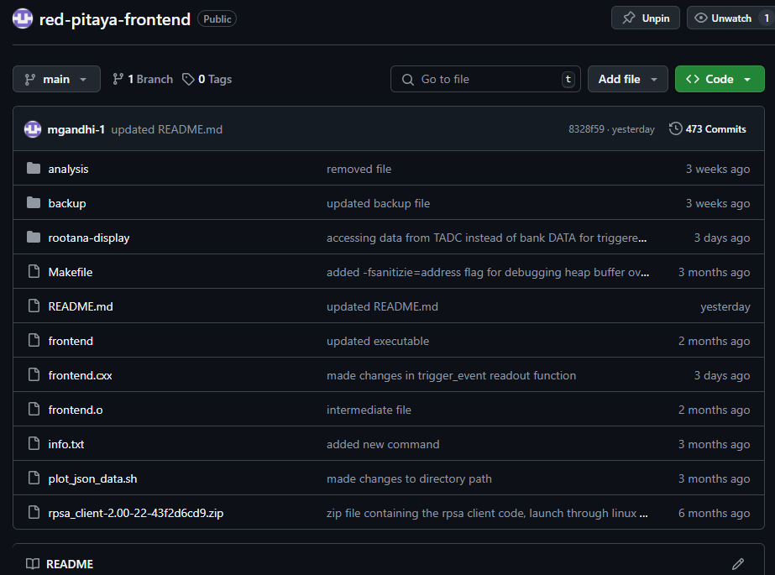
Notes:
The frontend is available publicly to build. Further instructions can be found on how to build the program and use it for data acquisition.
Serves as a general template for c++ MIDAS frontends that relies on a TCP connection
Fully documented as well for people who might work on it later
Can be forked/cloned and edited to make custom changes

Slide 16
The ROOTANA GUI:
Notes:
The ROOTANA live-display is stable (no more crashes)
TGraph updates every 500 events
origin of the TGraph updates every 100 events
live-display skips plotting of every 5 events
Can support high-frequency data streaming (upto 0.5 MHz)

Slide 17
Detector characterization:
The RnSPC produces a steady baseline noise signal fluctuating between ±2.5 mV
A container to hold the LN2 has been added to the setup
A scissor lift is being used so we can manually adjust exposure of LN2 to the sphere (our goal is to only submerge 1/3 of the sphere in LN2)
Want to add heating strips around O-ring to prevent freezing or possibly replace the O-ring/material of O-ring
Notes:
Cooling the sphere allows the maximization of radon concentration !!!
Sphere leaks around the O-ring when cooled using LN2 (not a good sealer)

Slide 18
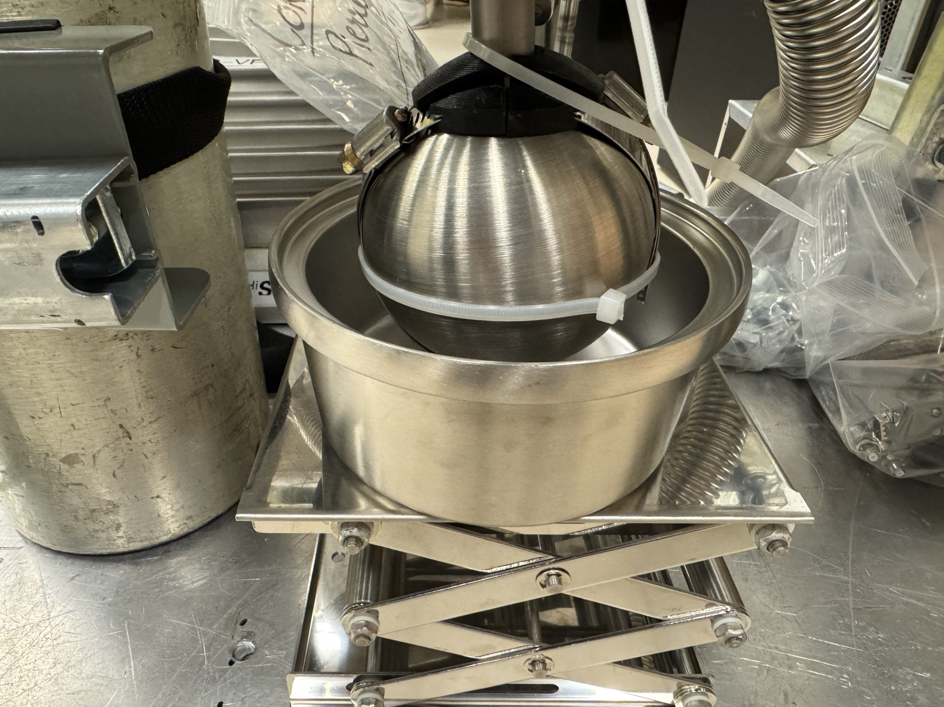
Detector characterization (cont'd):
Notes:
We attempted to measure the effect of cooling the sphere at vacuum to check for possible leaks. (still need to do more tests for data collection)
Thermocouple frontend set up to collect temperature data to monitor state and will be used to control the heating strips (K-type because of range)
We are investigating how to remotely control the power supply to the heating strips

Slide 19
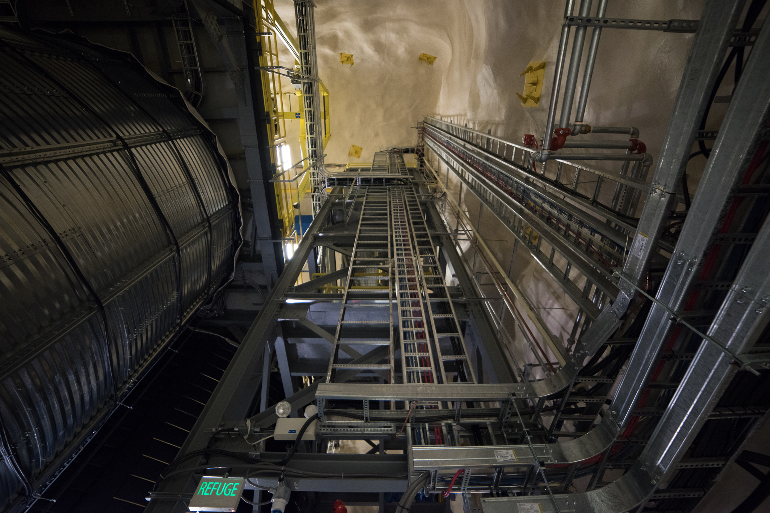
Future Work:
Test the sphere using the adhesive heating strips and LN2
Set up a frontend to control power supply to the heating strip
Test the sphere using a calibration source and compare to Lucas cell
Model the signal-amplification due to Townsend avalanche
Draft the standard operating procedure for an assay with the sphere

Slide 20
References:
[1] G.Savvidis,(2023). Sensor characterization and fiducial volume studies for the NEWS-G dark matter experiment (PhD thesis). Queen's University.
[2] In Compliance Magazine. (n.d.). Noise suppression techniques using capacitors. In Compliance Magazine. Retrieved April 10, 2025, from https://incompliancemag.com/noise-suppression-techniques-using-capacitors/
[3] N.Fatemighomi, Y.Ahmed, S. M. A.Hussain, J.Lu, A.Pearson, & J.Suys,(2025). Measurement of Radon-222 concentration in N₂ using an activated charcoal trap (arXiv:2501.14559v2 [physics.ins-det]). arXiv. https://arxiv.org/abs/2501.14559

Slide 21
QUESTIONS?

