Slide 1
Neutral Current Detector Calibration
Cody O’Neill

Slide 2
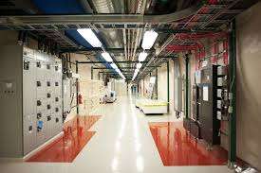
Overview
Underground Setting:
The surrounding rock as natural shielding to block cosmic ray interference
Radioactivity of Rock:
The surrounding rock contains trace amounts of Uranium and Thorium which can introduce background noise into experiments
Neutron Backgrounds:
Are detrimental to the precision of experiments investigating WIMPs due to their similar interactions with matter.

Slide 3
Neutron Sources
Neutron Yield per Year per cm per MeV
Neutrons are produced primarily in (α, n) reactions on light elements in the rock and shotcrete, with 10% accountable to ²³⁸U fission (1999 Measurement, SNO area )
Isotope | Norite Rock |  | Shotcrete
 | Concentration | Neutron Production (n/yr/cm³) | Concentration | Neutron Production (n/yr/cm³)
²³²Th | 5.10 ppm | 8.13 | 2.4 ppm | 0.99
²³⁸U | 1.10 ppm | 3.51 | 1.2 ppm | 1.05
Spontaneous Fission ²³⁸U |  | 1.19 |  | 1.03
Muon Spallation |  | negligible |  | negligible
Total |  | 12.83 |  | 3.07

Slide 4
Term Objective:
Calibrate Neutral Current Detectors for Neutron Flux Measurements

Slide 5
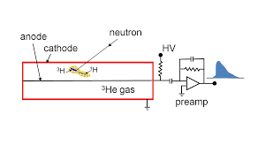
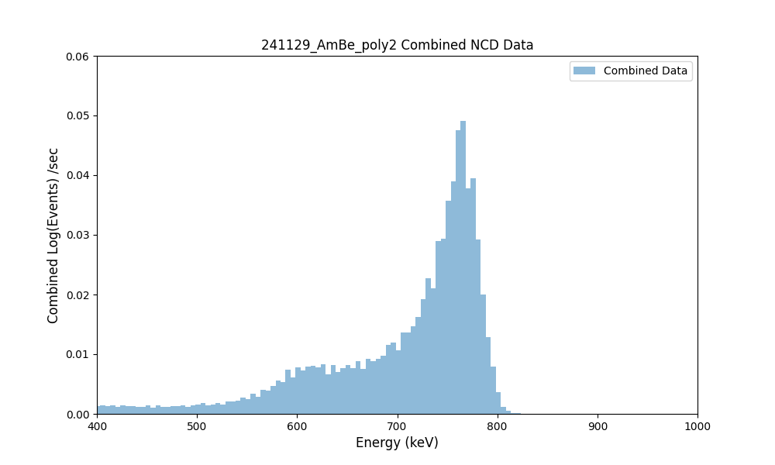
He-3 Proportional Counters
Incident Thermal Neutrons are Captured by ³He
Capture leads to the production of a proton and a triton (³H)
The proton and triton ionize the surrounding gas
This creates a pulse proportional to the deposited energy
Wall effects create shoulders on the primary peak

Slide 6
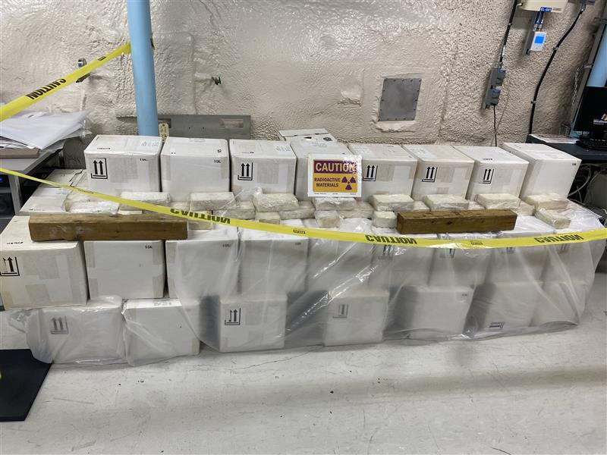
Calibration Data
Shielding Level | Bare | 0.5” Thickness | 1” Thickness | 1.5” thickness | 1.5” + 1’ Water Box
Run Dates | 2024/11/15 | 2024/11/26 | 2024/11/29 | 2024/12/10 | 2025/03/18
 | 2024/11/21 |  |  | 2024/12/12
 |  |  |  | 2024/12/17
Neutron
Production:
~67 Hz
Understanding Neutron Flux at different energies requires shielding
Higher energy neutrons require more shielding to be captured
Concentric 0.5” shells of poly + 1’ waterboxes as shielding
Channels | C1 / C4
Voltage | 1900 V
Source | AmBe

Slide 7
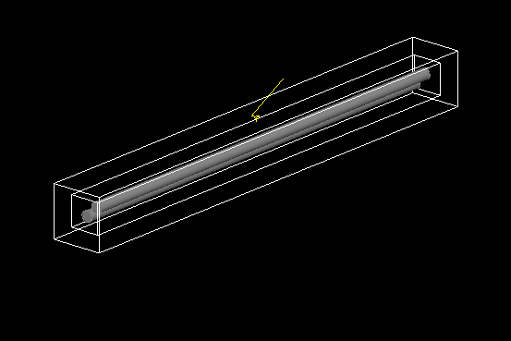
Simulation Work
Created Shielding Geometry
Adjustable Thickness Poly Shells
Source Position moves with thickness changes
Learned GEANT4 Fundamentals
Found problems with the event recording logic
Rebuilding the Simulation with the Help of Tom Sonley

Slide 8
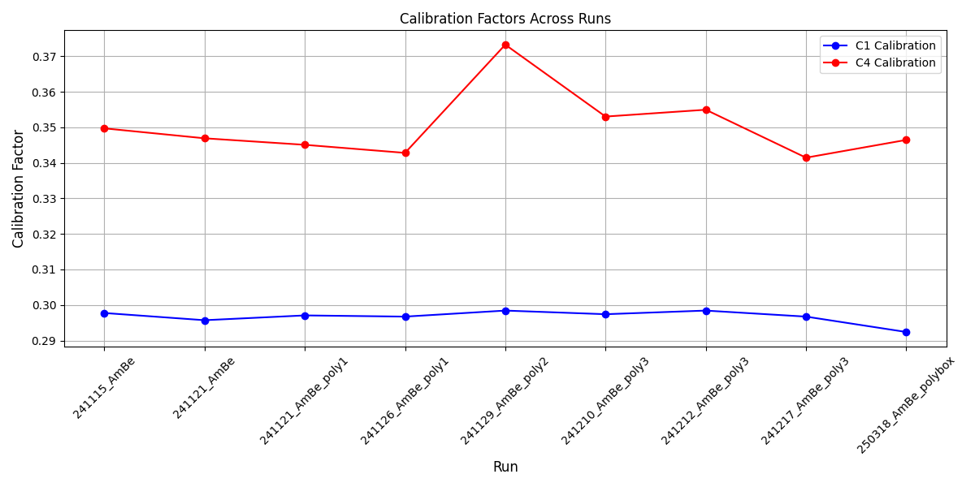
Calibration Factors
Linear scaling in x based on primary peak position
Matching peaks to Channel 1 as reference to compensate Electronic Drift
Additional source needed for nonlinear calibration (⁶⁰Co)

Slide 9
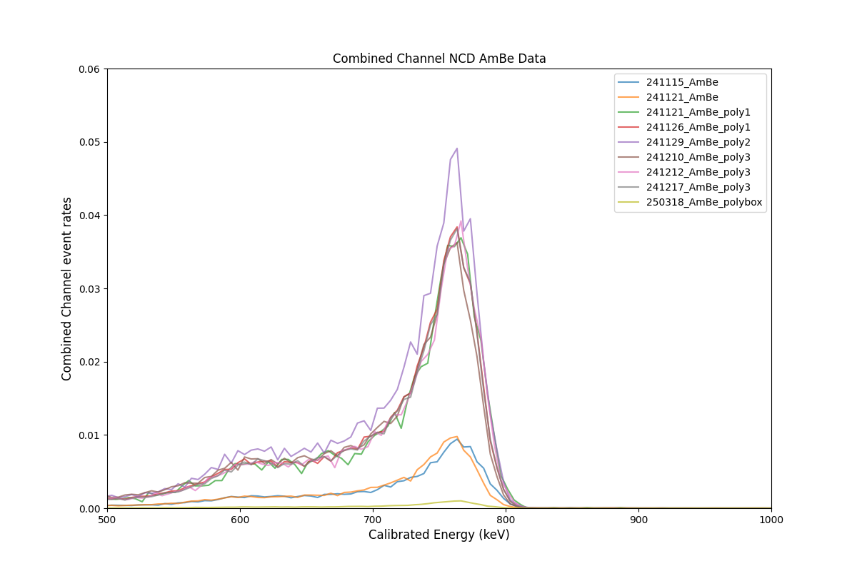
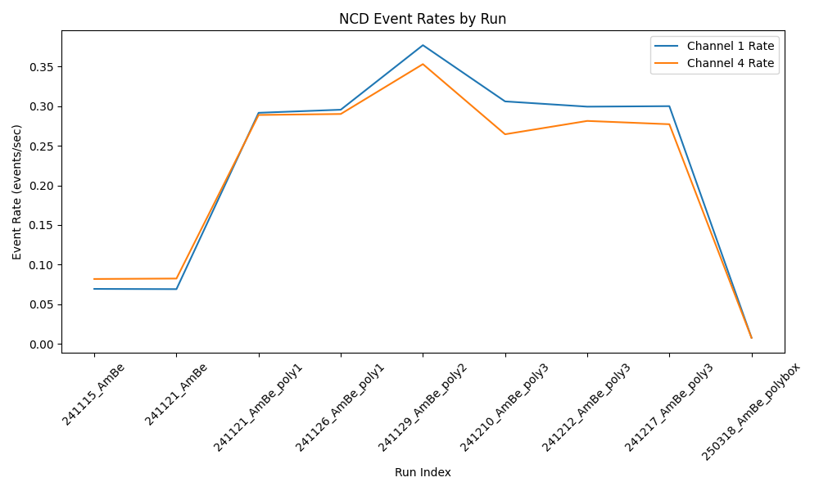
Results
Increase in neutron rate with thickness occurs as higher energy neutrons thermalize
Drop off occurs as near-all neutrons are stopped in the shielding

Slide 10
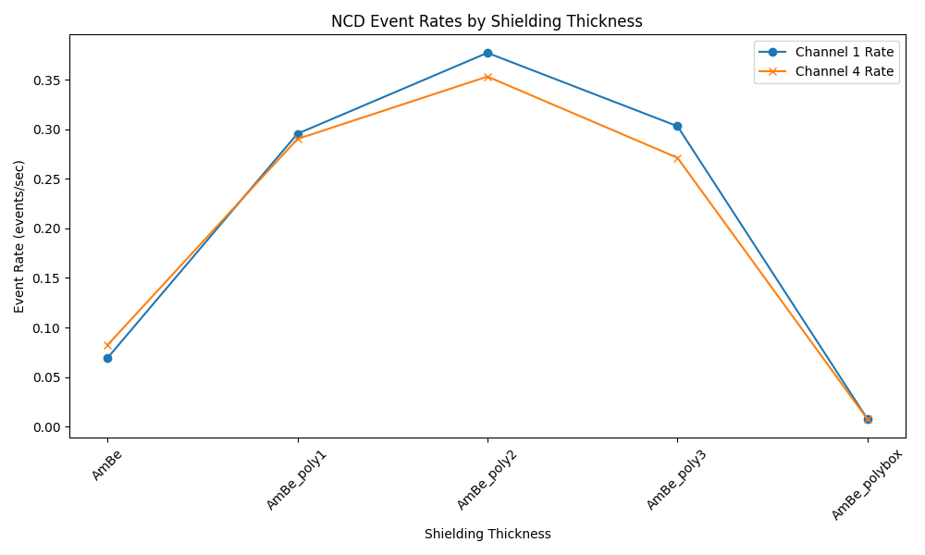
Effect of Shielding
Highest Detection Efficiency Seen at 1” Poly shielding
Rates Drop near 0 above 1’ water box hielding

Slide 11
Next Steps
Reference HALO code / Tom Sonley to rebuild broken simulations
Use simulation data to generate response matrix for counters
Take Measurements of neutron Flux throughout the Underground lab

Slide 12
Thanks to:
Ian Lawson - Supervisor
Dimpal Chauhan - Mentor / Sample collection
Steffon Luoma - Mentor / Proportional Counters
Tom Sonley - Geant 4 and Programming Advisor
Questions?

