Slide 1


CUTE:
Cryogenic, Underground and Totally Epic
By – Dev Chauhan
Supervisor – Matthew Stukel
1

Slide 2
Presentation Path
Dilution Fridge
Specialized Facility
CUTE
2

Slide 3

1
What is CUTE?
Cryogenic Underground TEsting facility
2

Slide 4
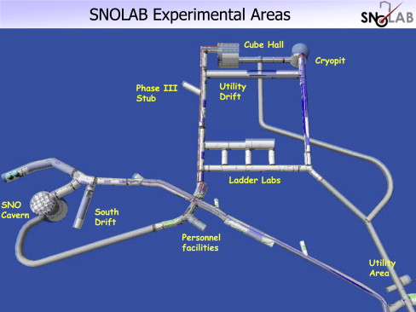
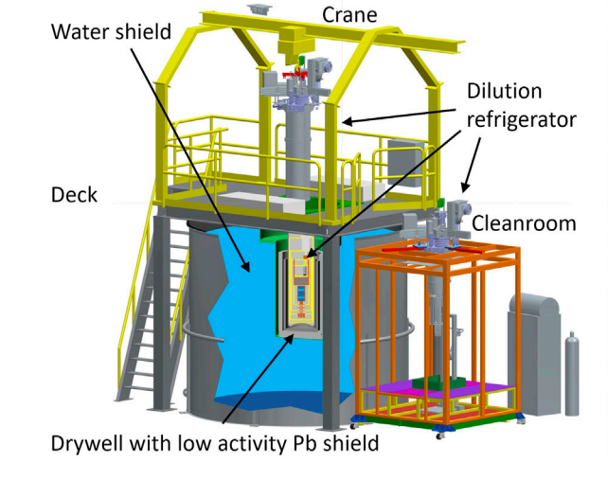
An extraordinary underground facility
CUTE
Built for ultra low background
detection and measurements
Originally commissioned as a
Testing facility for SuperCDMS
detector tower testing
3

Slide 5
2
Dilution Fridge
The Heart of CUTE
4

Slide 6
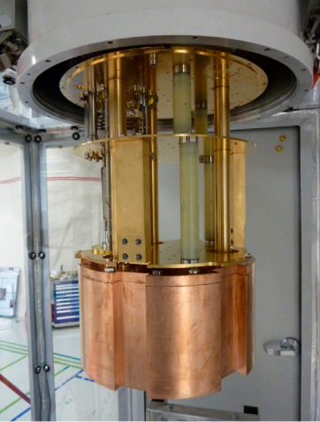
CUTE fridge
Dry Dilution Refrigerator
Reaches temperatures as low as 12 mK
This is over 100 times colder than outer space(2 K)
5

Slide 7
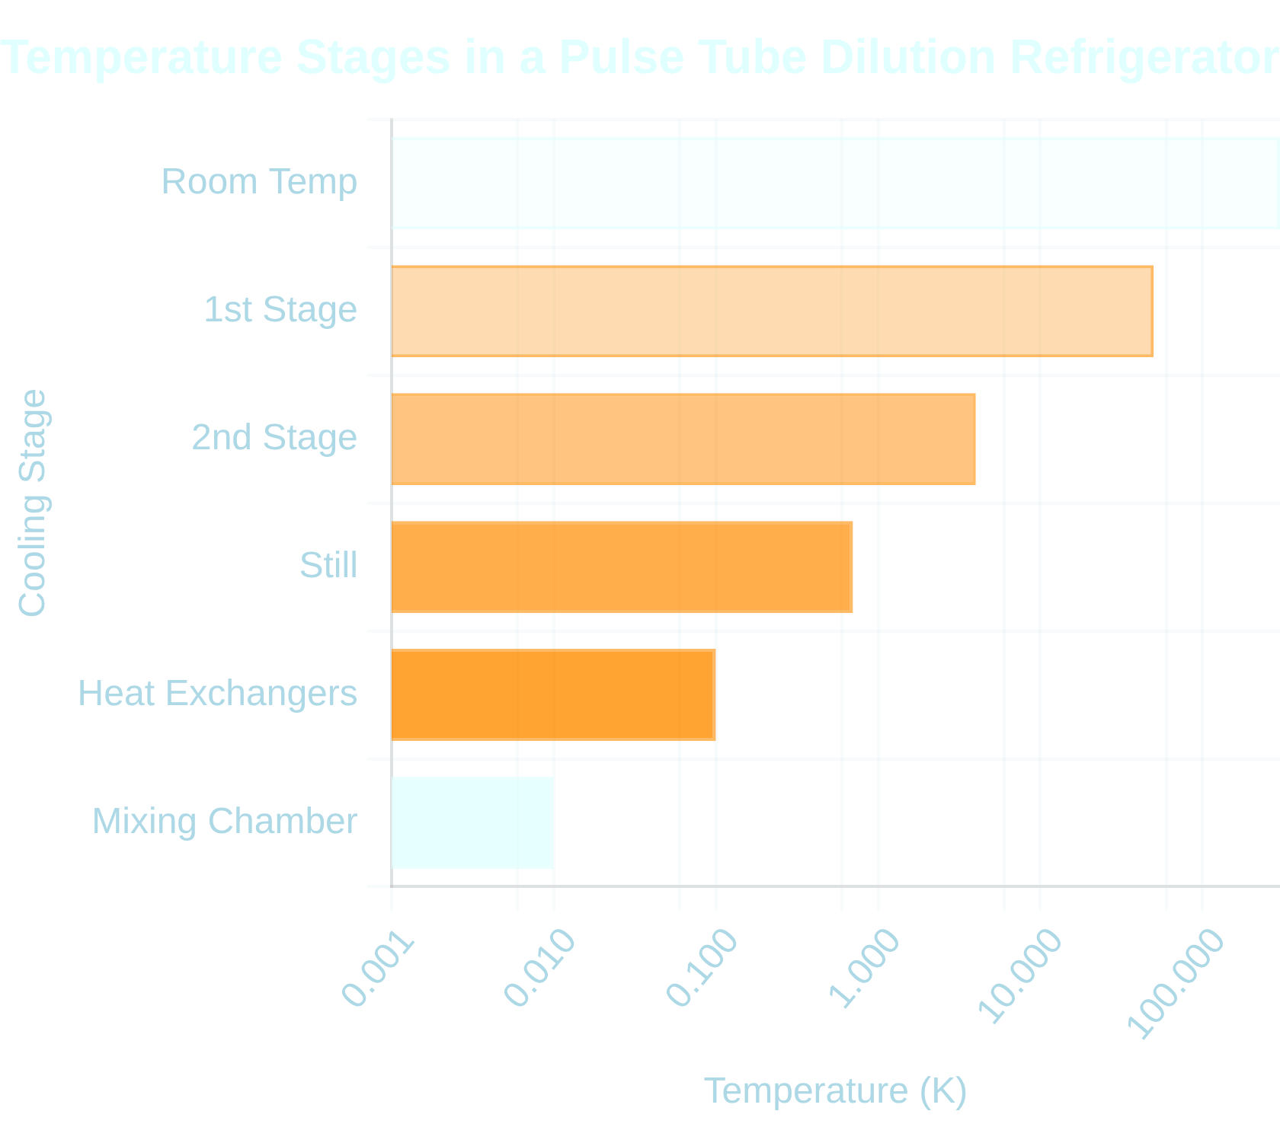





Stage 1 and 2: Pulse Tube cooling
Modern "Dry" Systems:
Eliminate need for liquid helium pre-cooling
Operating Principle:
Oscillating pressure waves and gas displacement
with no moving parts at cold end
Multi-Stage Cooling:
Provides 50K, 4K stages before dilution unit
Key Advantages
Cold Plate
No liquid cryogens required for precooling
Simplified operation and maintenance
6

Slide 8
-
-
Helium
+
+
El
+
+
-
-
Property | Helium-3 (³He) | Helium-4 (⁴He)
Number of Neutrons | 1 | 2
Natural Abundance | ~0.0001% of helium on Earth | ~99.9998% of helium on Earth
Quantum Statistics | Fermion (spin-½) | Boson (spin-0)
Boiling Point at 1 atm | 3.19 K | 4.22 K
Vapor pressure at 0.7 K | ~120 Pascal | Negligible
Mass | 3.016 u | 4.0026 u
Cost | ~2700$/Liter | ~50$/Liter
7

Slide 9

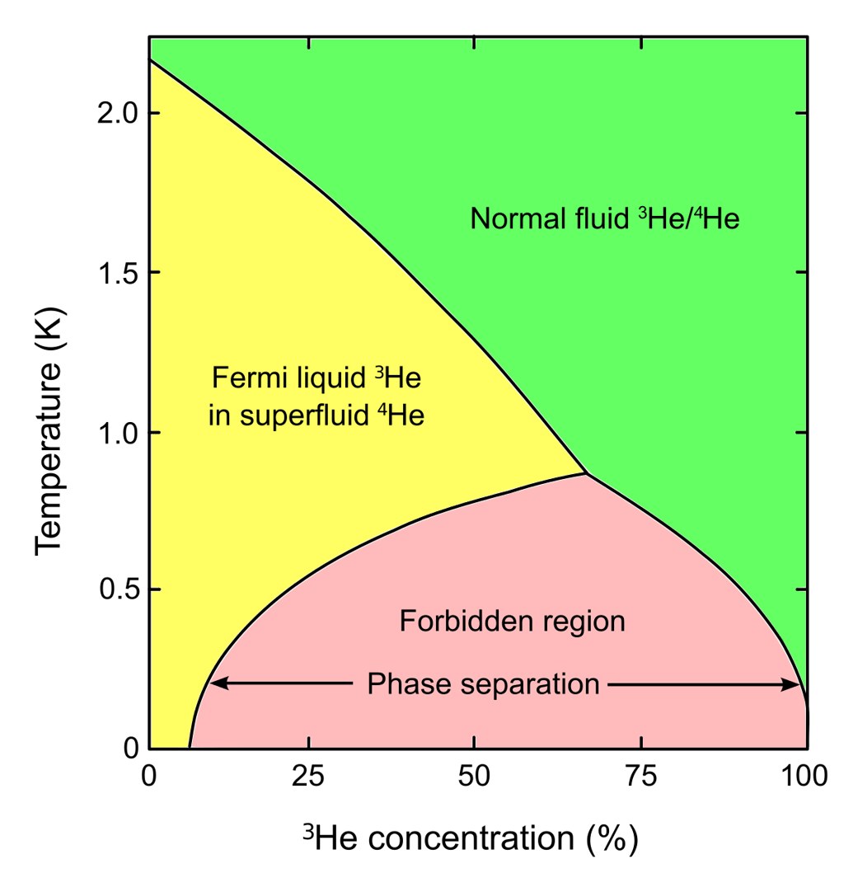


The Helium-3/Helium-4 Mixture
Below 0.87 K, ³He-⁴He mixture separates into two phases
Concentrated phase:
Nearly pure ³He
Dilute phase:
Contains 6.6% ³He in ⁴He
Key Thermodynamic Principle:
1. At He-3 concentrations below 6.6%, He-3 atoms exist in a lower energy state in the dilute phase than in the concentrated phase
2. The enthalpy of He-3 is higher in the dilute phase than in the concentrated phase
8

Slide 10
Mixing Chamber
He-4
He-3
Concentrated phase
Heat
To Still
1. The still removes He-3 from the dilute phase
(We will get to how in the next slide)
2. He-3 from the Concentrated phase replaces
the He-3, absorbing energy(heat) in the process
3. This process repeats to reach temperatures as low as 12 mK
Dilute phase
9

Slide 11
Still stage (0.7 K)
He-4
He-3
Vapor pressure at 0.7 K | Negligible | ~120 Pascal
Pump
2. The He-3 is replaced from an He-3
From the Mixing Chamber
3. The process keeps on repeating
1. At 0.7 K, ~all of the vapor is He-3
He-3 Vapour
From
Mixing Chamber
10
Heater

Slide 12
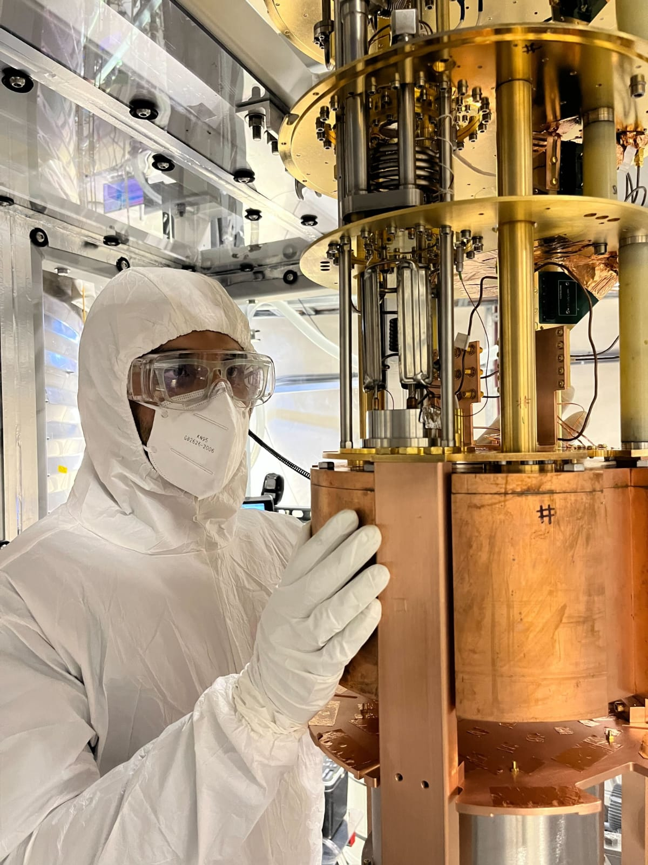
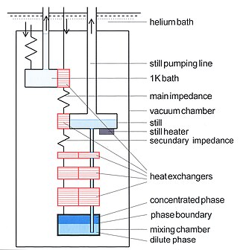
Putting it together
He-3
11

Slide 13
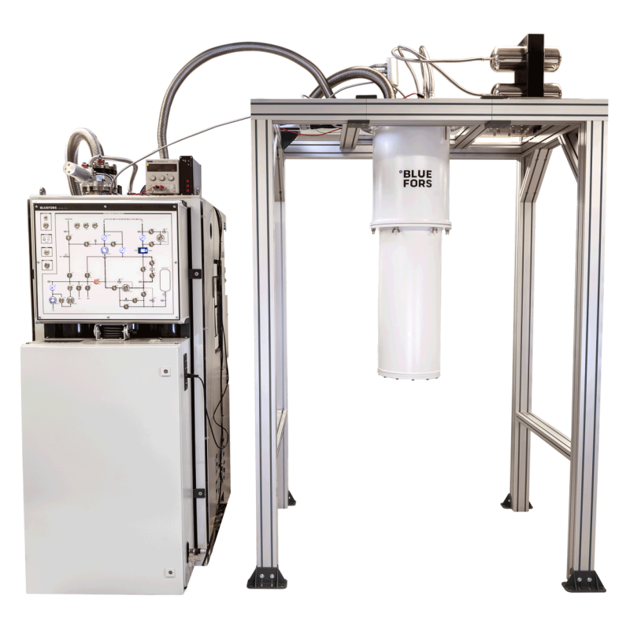




Gas Handling System
Circulation Pumps
Purification System
Pumps maintain ³He flow through the dilution circuit
Charcoal cold traps remove impurities from circulating ³He
Pressure Control
Storage Tanks
Regulates pressure and flow rates for optimal cooling performance
Store ³He inventory when system is warm or during maintenance
Gas Purity Requirements
He-3 purity is critical for performance. Even small amounts of impurities (⁴He, air, water vapor) can block circulation lines and reduce cooling power.
12

Slide 14
03
Facility
What makes CUTE unique
13

Slide 15
A unique low-background facility
Built to reduce background noise
Has a specialized class -100 cleanroom
with a radon reduced environment
Has special vibration dampers installed to minimize mechanical noise
14

Slide 16
Multiple layers of shielding
Shields
against
Layer
Material
3
Water
Neutrons
2
Lead
Gamma
Fridge
1
Mu-metal
Magnetic fields
15

Slide 17
A unique low-background facility
Built to reduce background noise
Has a specialized class -100 cleanroom
with a radon reduced environment
PE Neutron
shield
Has special vibration dampers installed to minimize mechanical noise
Lead and Mu-Metal shield
Lead shielding
16

Slide 18
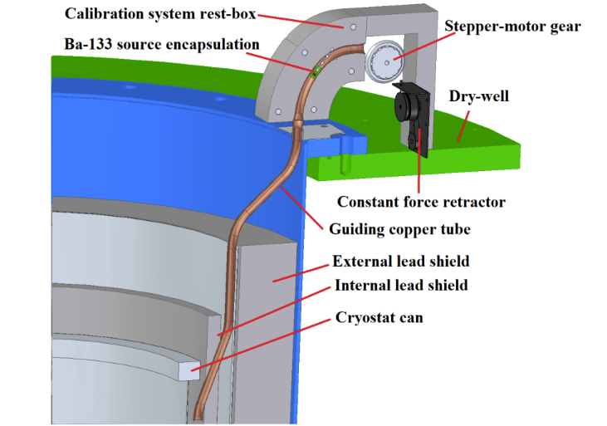
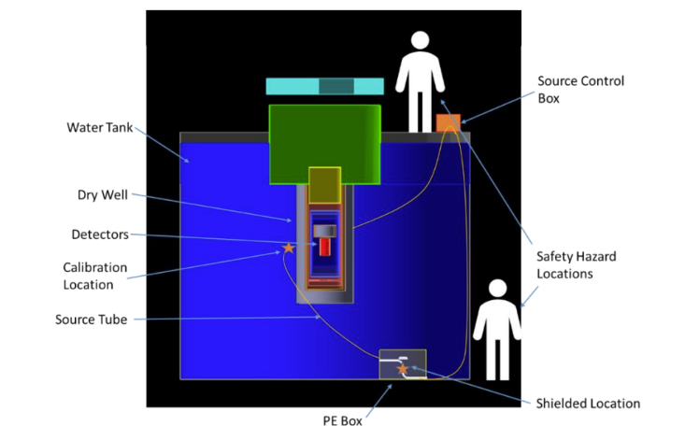
Calibration systems
Gamma Calibration system
Neutron Calibration system
37 kBq Ba-133 source
37.5 kBq Ca-252 source
17

Slide 19
Run history
Past
Supercdms tower testing
HVeV detector run
Present
Qubit
Future
TBD
18

Slide 20
Remarks
Nearly a year at the CUTE facility has been an extraordinary journey of discovery. Working with the project has not only expanded my technical expertise but also ignited a deeper passion for experimental physics. The knowledge gained here—from theoretical understanding to practical problem-solving—has been truly invaluable. I extend my heartfelt appreciation to everyone who made this incredible learning opportunity possible.
19

Slide 21
Thank you!!
To my supervisor Matthew Stukel
To everyone at the CUTE team, including Vijay, Marco, Andy and Wolfgang
To all of my fellow students, current and past, for an amazing term!
I would like to thank SNOLAB
20

Slide 22
References
Engert, Jost & Fellmuth, B. & Jousten, Karl. (2007). A new 3He vapour-pressure based temperature scale from 0.65 K to 3.2 K consistent with the PLTS-2000. Metrologia. 44. 40-52. 10.1088/0026-1394/44/1/006.

