Slide 1




Characterizing Bellows Nucleation Events in the PICO-40L Dark Matter Direct Detection Experiment
Presented by Mujtaniba Islam
Supervised by Derek Cranshaw
Canadian Astroparticle Physics Summer Student Talk (CASST) Symposium
August 12th - 13th, 2025
1

Slide 2
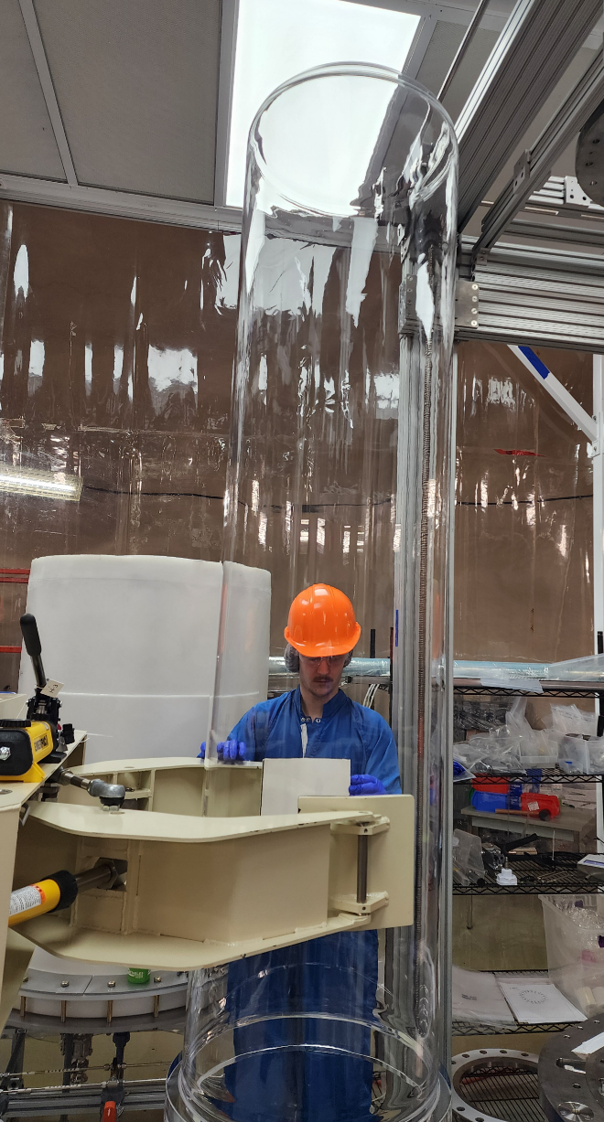
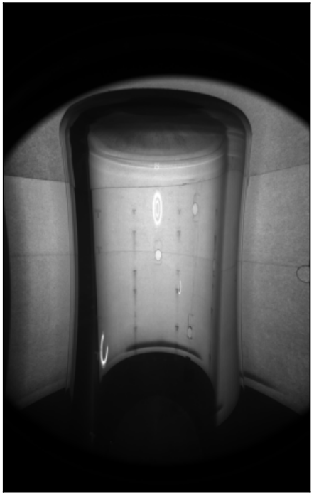
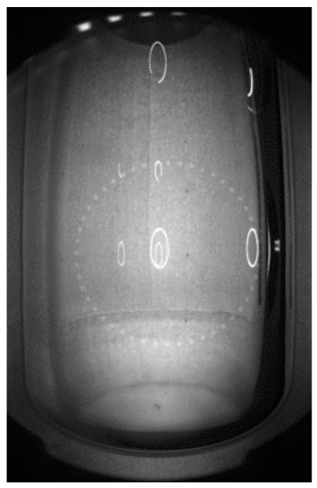
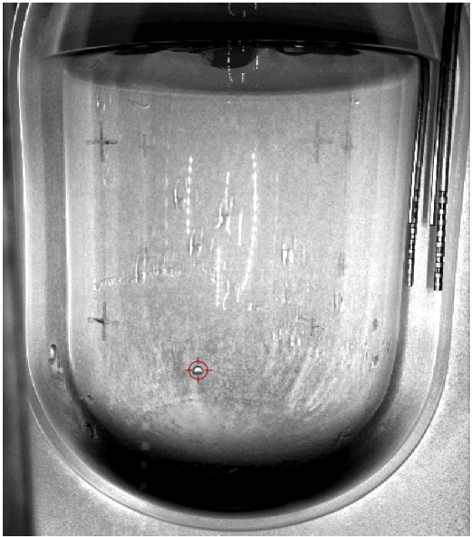
PICASSO + COUPP = PICO !
Project In CAnada to Search
for Supersymmetric Objects
Chicagoland Observatory for Underground Particle Physics
PICO-2L
PICO-60
PICO-40L
PICO-500
Canadian Astroparticle Physics Summer Student Talk (CASST) Symposium
August 12th - 13th, 2025
2

Slide 3
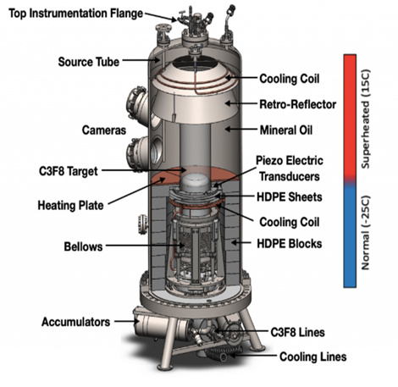
Motivation
Bubble nucleations at the bottom of the vessel housing the fluid
Below the field of view of the camera
Traditional optical position reconstruction is impossible
Canadian Astroparticle Physics Summer Student Talk (CASST) Symposium
August 12th - 13th, 2025
3

Slide 4
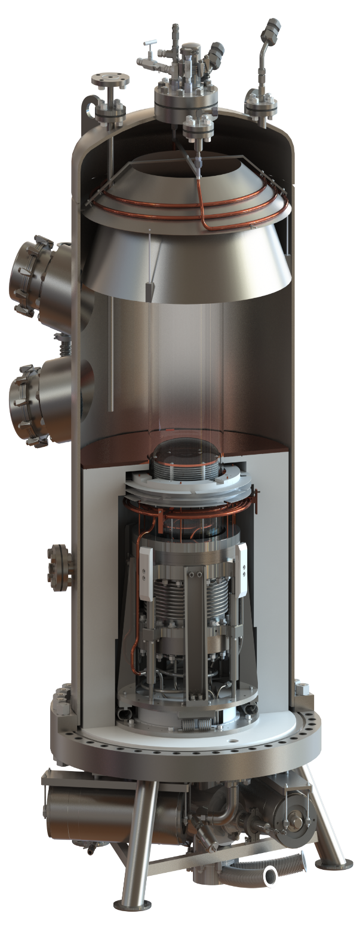
Data Acquisition
Two fast pressure transducers:
For nucleation-type discrimination.
Four cameras:
For bubble localization.
Ten piezoelectric transducers:
For particle identification.
Canadian Astroparticle Physics Summer Student Talk (CASST) Symposium
August 12th - 13th, 2025
4

Slide 5
Observations
bellows events are triggered much later in the bubble’s evolution compared to camera-triggered events
bubble in pressure-triggered events observed by the end of the acquired images
movement in the bellows can usually be seen to occur before the trigger frame
Canadian Astroparticle Physics Summer Student Talk (CASST) Symposium
August 12th - 13th, 2025
5

Slide 6
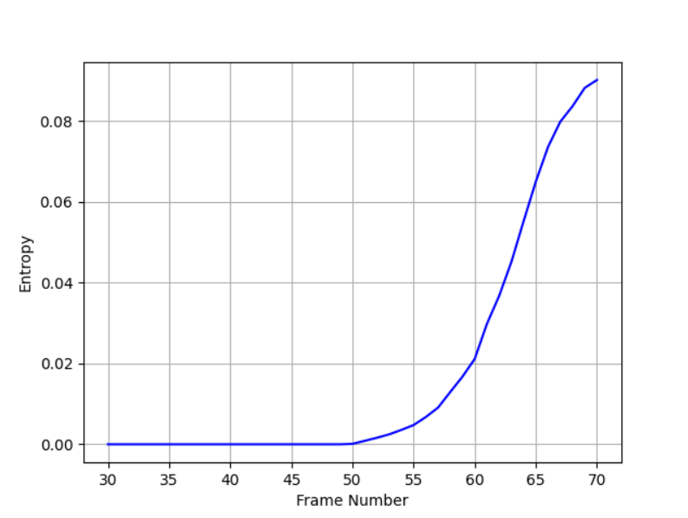
Algorithm
Subtract first frame
Separate pixels in difference frame into 16 bins
Entropy Calculation:
$H=\sum_{i}{{−p}_{i}\log_{2}{(p_{i})}}$,
where $p_{i}$ is the contents of bin i.
Entropy Calculation:
𝐻=∑_𝑖▒〖〖−𝑝〗_𝑖 log_2⁡〖(𝑝_𝑖)〗 〗,
where 𝑝_𝑖 is the contents of bin i.
Fig. Entropy growth for a camera-triggered event
Canadian Astroparticle Physics Summer Student Talk (CASST) Symposium
August 12th - 13th, 2025
6

Slide 7
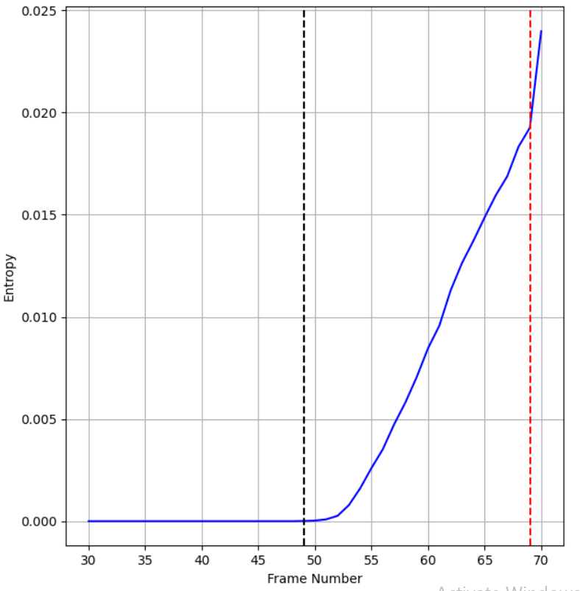
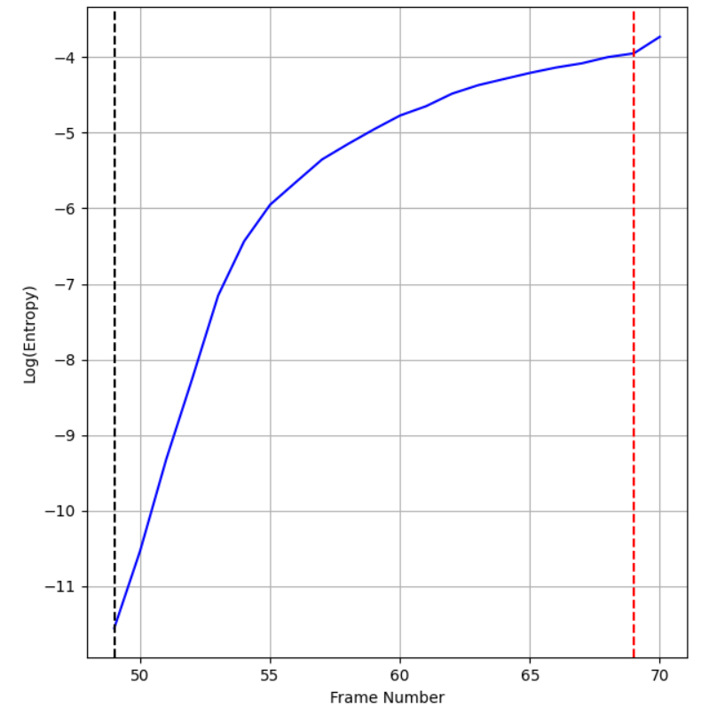
Results
> 3 standard deviations from mean of first 15 frames
Greatest increase in slope
Canadian Astroparticle Physics Summer Student Talk (CASST) Symposium
August 12th - 13th, 2025
7

Slide 8
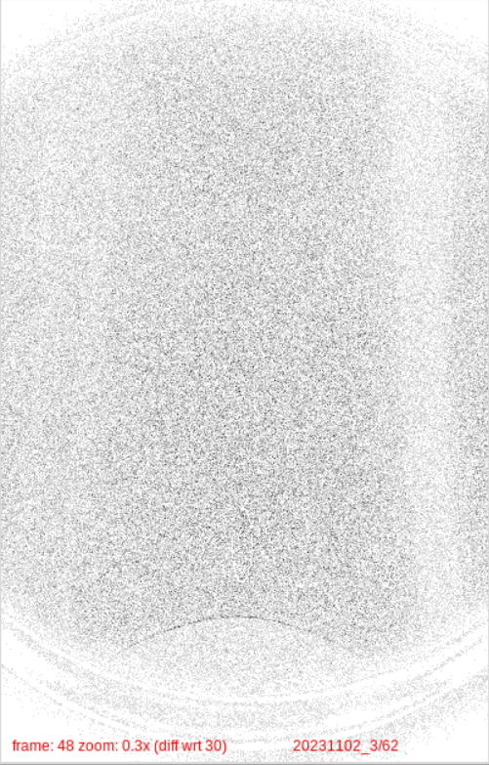
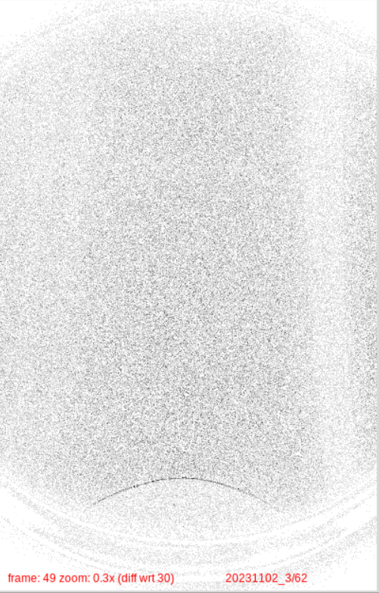
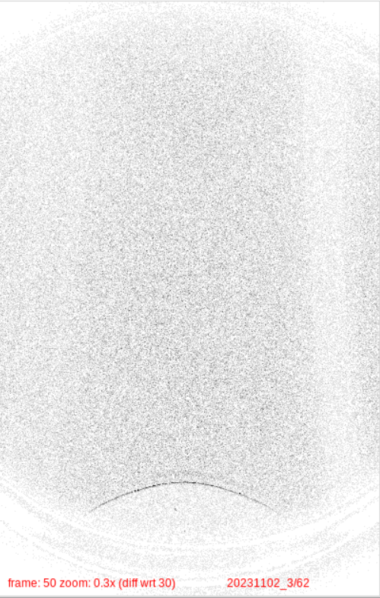
Results
Canadian Astroparticle Physics Summer Student Talk (CASST) Symposium
August 12th - 13th, 2025
8

Slide 9
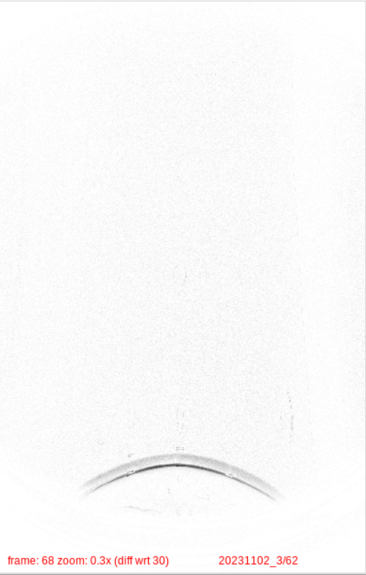
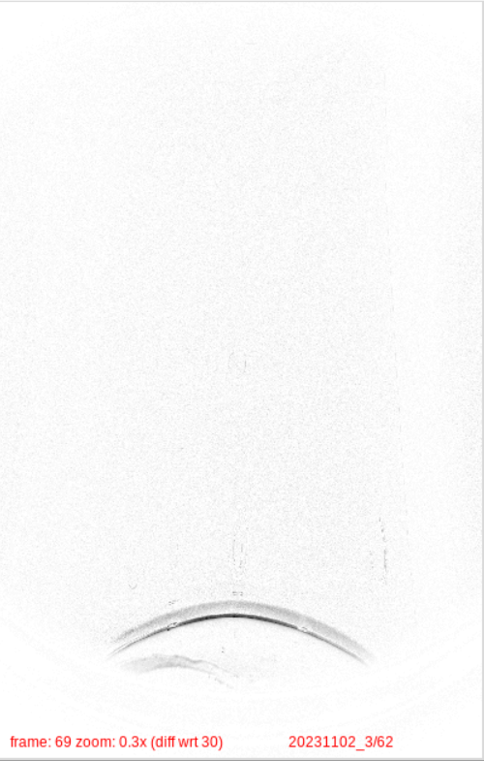
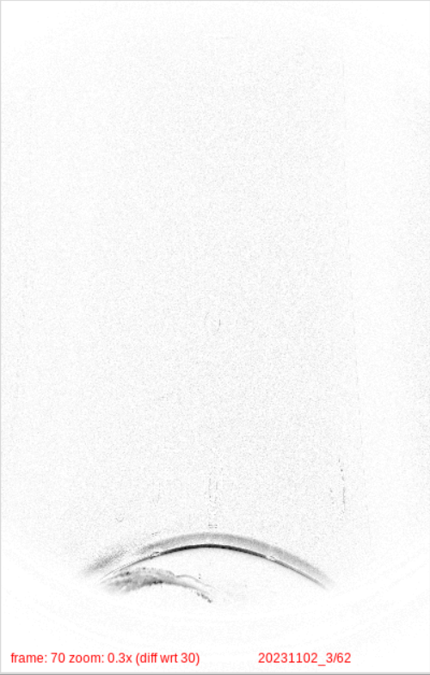
Results
Canadian Astroparticle Physics Summer Student Talk (CASST) Symposium
August 12th - 13th, 2025
9

Slide 10
Limitations
Events where…
Solution
the bubble only starts showing up at the very last frame, and the part of the bubble detected in the camera is so small that the change in frame entropy is not greater than when the bellows move downwards.
the camera system stops storing images before the bubble reaches the field of view of the camera.
Exclude if frame difference is less than 6 and the maximum log(entropy) over the entire set in less than -3.4
Canadian Astroparticle Physics Summer Student Talk (CASST) Symposium
August 12th - 13th, 2025
10

Slide 11
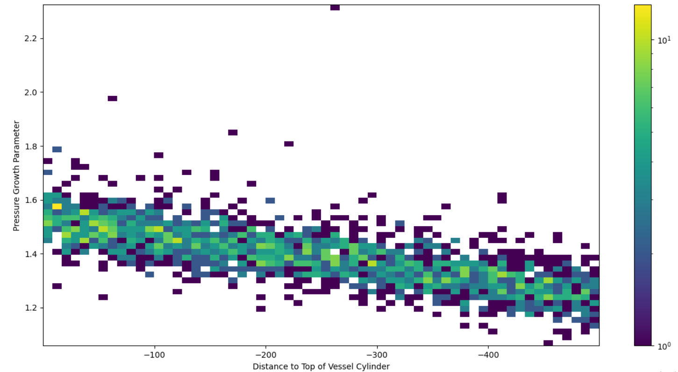
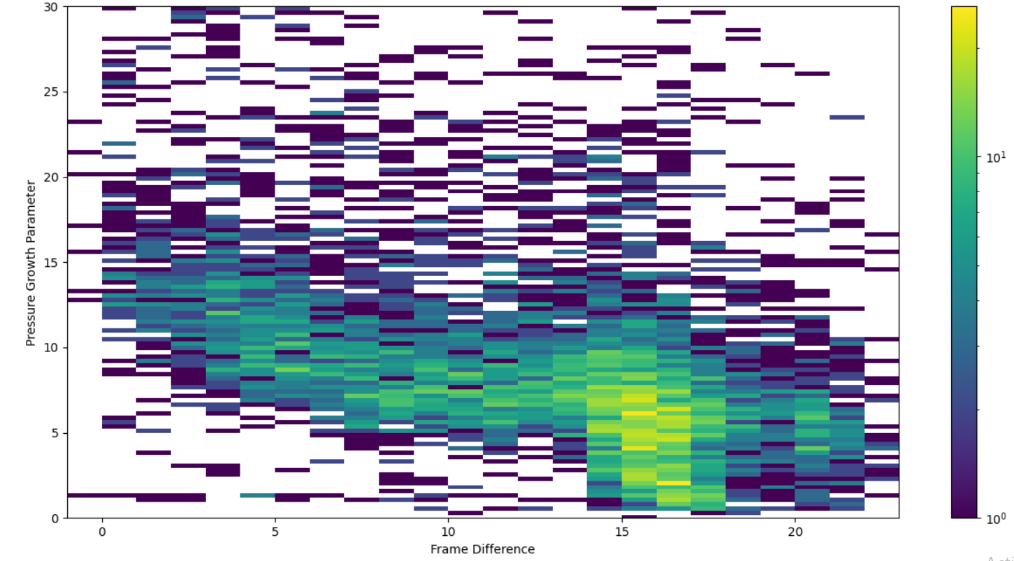
Validation
Canadian Astroparticle Physics Summer Student Talk (CASST) Symposium
August 12th - 13th, 2025
11

Slide 12
Summary and Conclusion
Estimating the number of frames it takes for the bubble to enter the field of view of cameras using an entropy algorithm
Can provide a reasonable estimate of the distance
Ongoing efforts: Separating frames into 6 columns to get a better estimate of position
Canadian Astroparticle Physics Summer Student Talk (CASST) Symposium
August 12th - 13th, 2025
12

Slide 13
Acknowledgements
This research is being undertaken thanks in part to funding from the Canada First Research Excellence Fund through the Arthur B. McDonald Canadian Astroparticle Physics Research Institute.
Canadian Astroparticle Physics Summer Student Talk (CASST) Symposium
August 12th - 13th, 2025
13

Slide 14
Thank You
Canadian Astroparticle Physics Summer Student Talk (CASST) Symposium
August 12th - 13th, 2025
14

