Slide 1


Modelling Sensor Performances Across Applied Voltages
NEWS-G
Sarena Sandhu

Slide 2
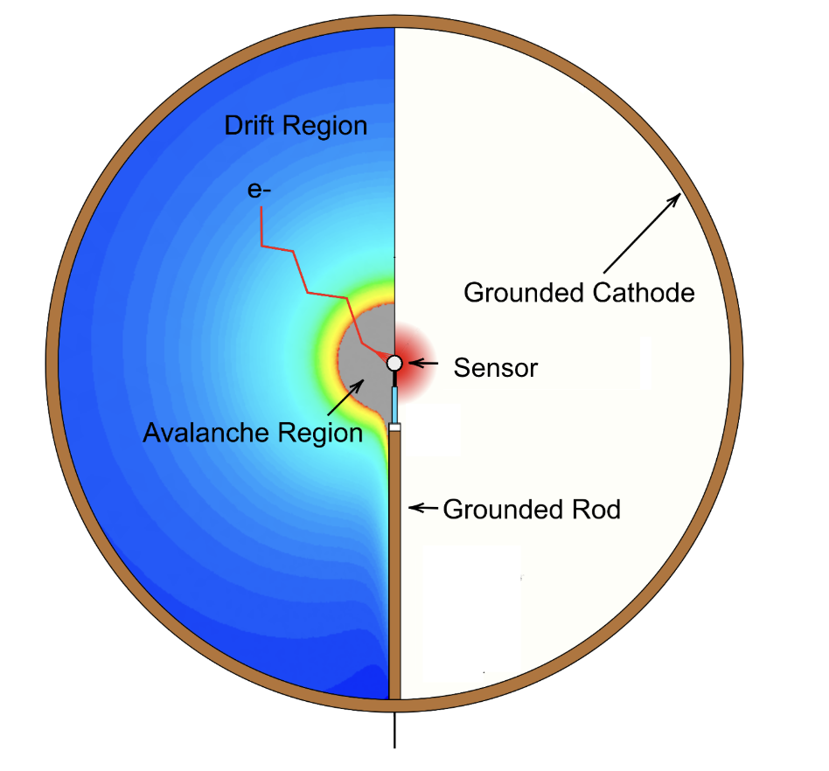
NEWS-G Introduction
Spherical detector filled with gas
Interactions within the sphere create ionization electrons
The sensor contains anodes which attract the ionization electrons
The signal is detected at the anode and analyzed to find original interaction strength
Notes:
Sphere filled with gas with a sensor at the center
Sensor contains anodes carries a higher voltage
Ionization electrons created by interactions within sphere
Electrons drift to center of sphere towards anodes
Electrons trigger an avalanche (cause further ionization events) amplifying the signal
Signal is detected at the anode and analyzed to find original interaction strength
Hope is to find a low mass dark matter interaction in the detector

Slide 3

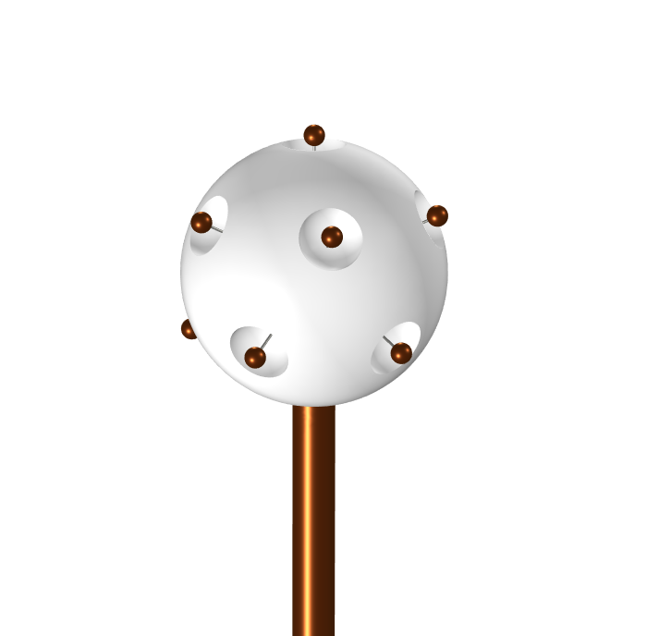
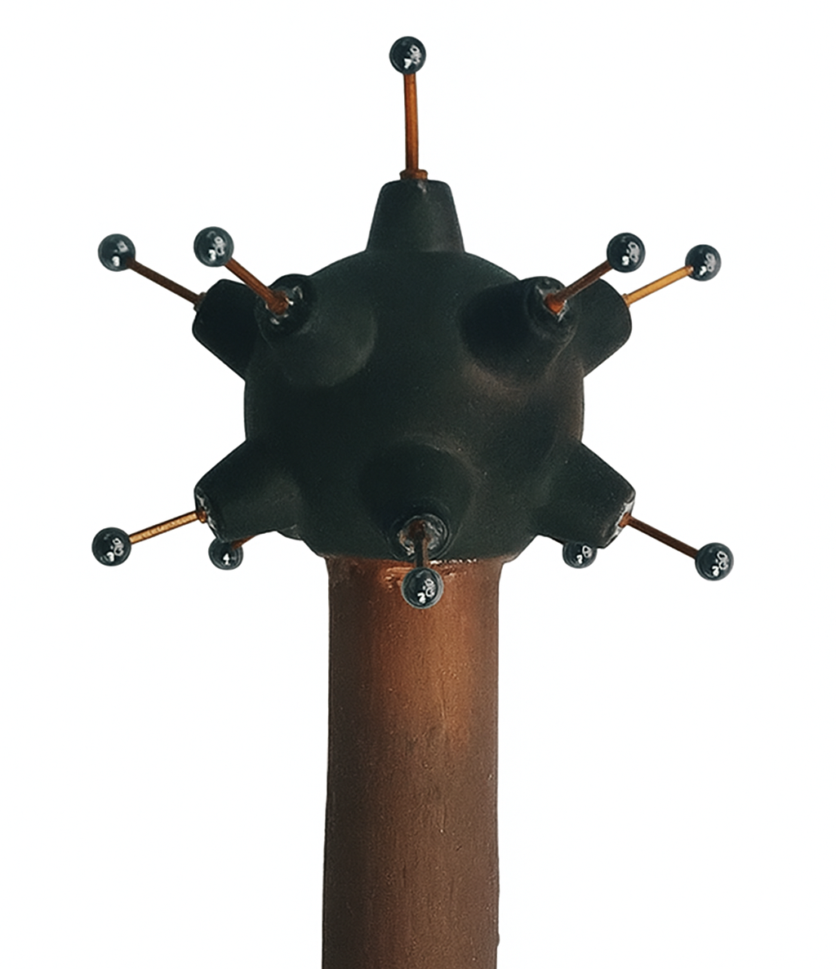
Sensor Geometry Introduction
Achinos Sensor
(currently in SNOLAB experiment)
Pressure Sensor
(new sensor design, in COMSOL)
Anodes
Umbrella
Support
Notes:
Diagram
Anode, Umbrella, Voltage applied to Anode / Umbrella
Electron Spends Majority of time far from sensor (moving the slowest then)
Electron feels drift field as though sensor is a point charge from far away in the detector
Anodes are evenly distributed about the sphere
Adding voltage to umbrella amplifies drift speeding electron to detector

Slide 4
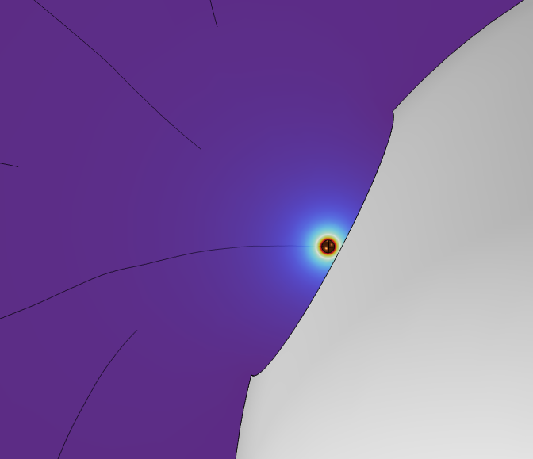
Research Goal: Modelling Novel Sensor Designs
Investigate ideas for new sensor geometries
Vary voltages on umbrella of sensor
Look at the effects on the electric field
Ensure no lost signal as the field increases
Notes:
Change voltages on umbrella of sensor
Investigate ideas for new sensor geometries
Look at their effect on electric field and how fast electrons drift
Ensure the sensor geometry does NOT lose signal from anodes to umbrella.

Slide 5
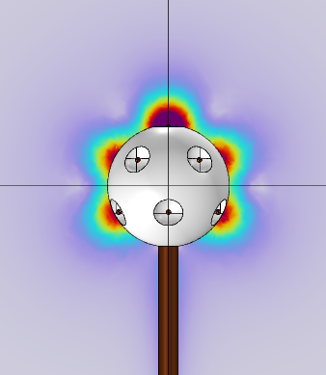
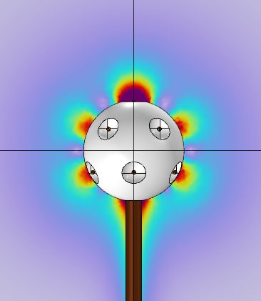
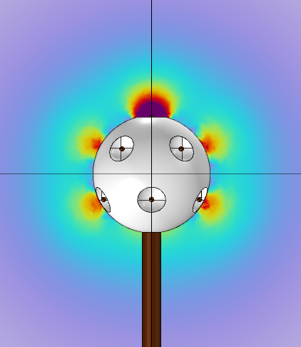
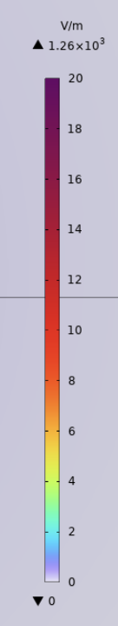
Electric Field Norm Results View One
Ground 50 V 100 V
Notes:
Increase in EFN as voltage applied to umbrella goes up

Slide 6
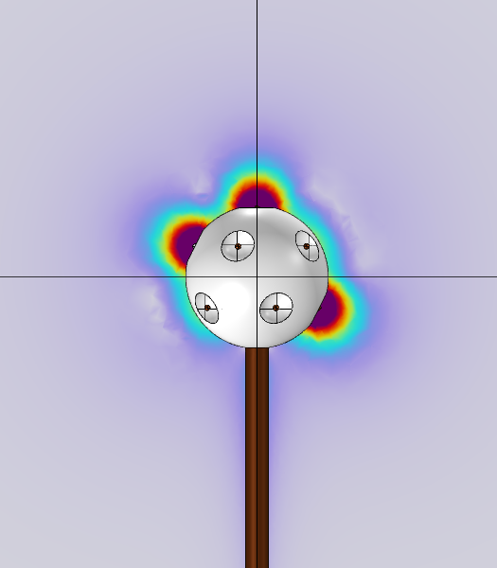
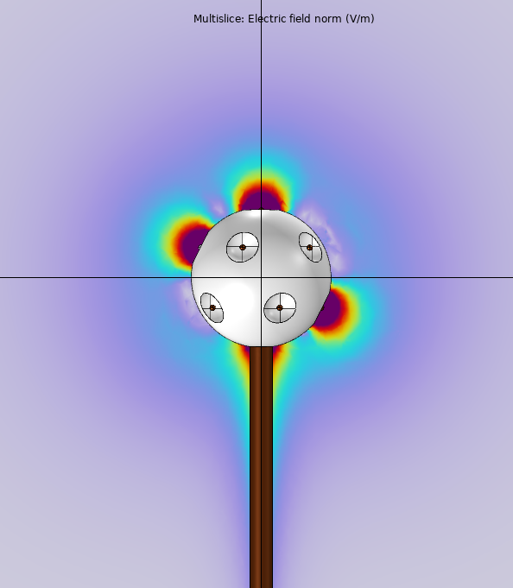
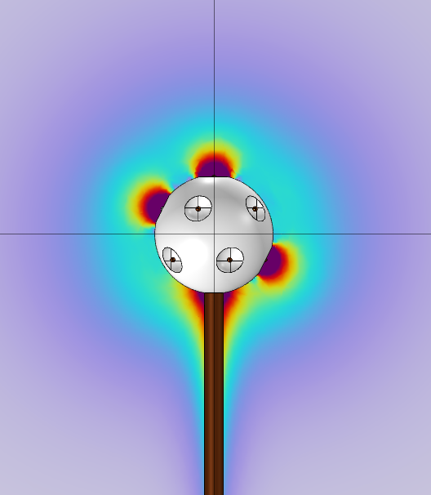
Electric Field Norm Results View Two
Ground 50 V 100 V
Notes:
Increase in EFN as voltage applied to umbrella goes up

Slide 7
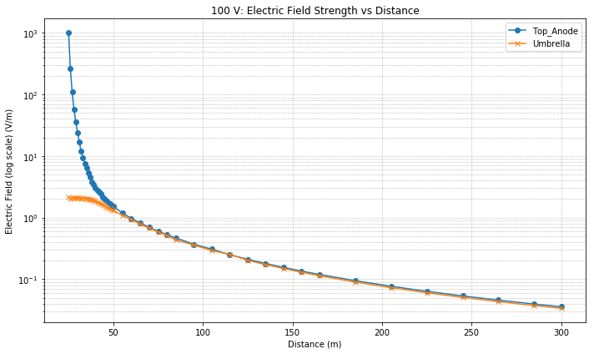
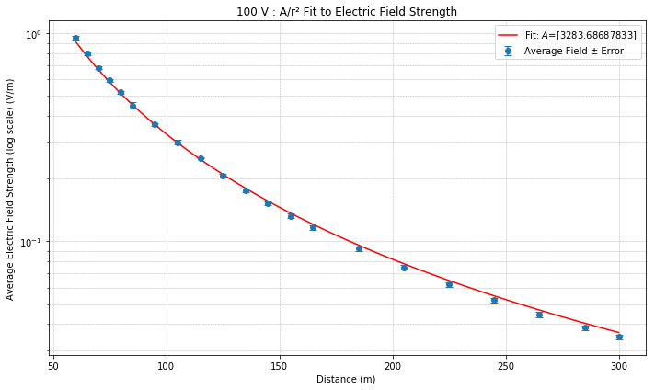
Finding the Drift Field for the Electron
Notes:
Probe data before cuts
Cut to agreement of 0.02 – double the uncertainty of comsol on EFN
Probe data after cuts fit to A/r^2
Strength of electric field for drift

Slide 8
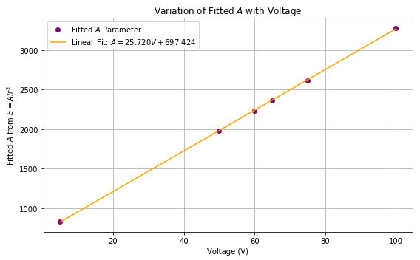
Drift Field Agreement
Notes:
Showing the fit of drift field coefficients to a line
Drift field allows further analysis of electron behaviour in simulations as well as an understanding of electron behaviour at large for all set voltages in detectors

Slide 9
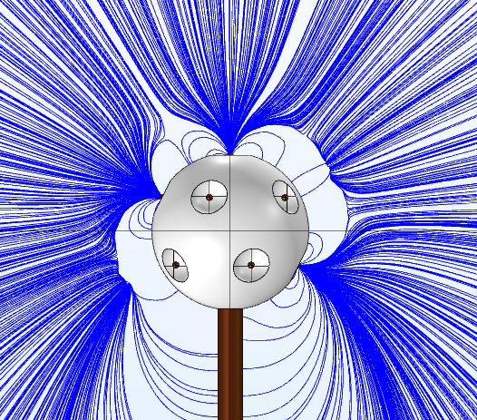
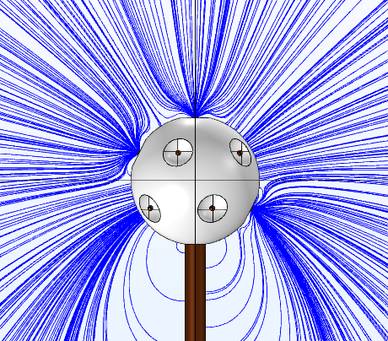
Electric Field Line Plots
Ground 100 V
Notes:
Point Controlled Electric Field Lines (standard number of points in cross section)
Highlight Change in Electric Field Line Endpoints as voltage increases
Highlight areas of loss directly in between anodes (where pull would be weakest)

Slide 10
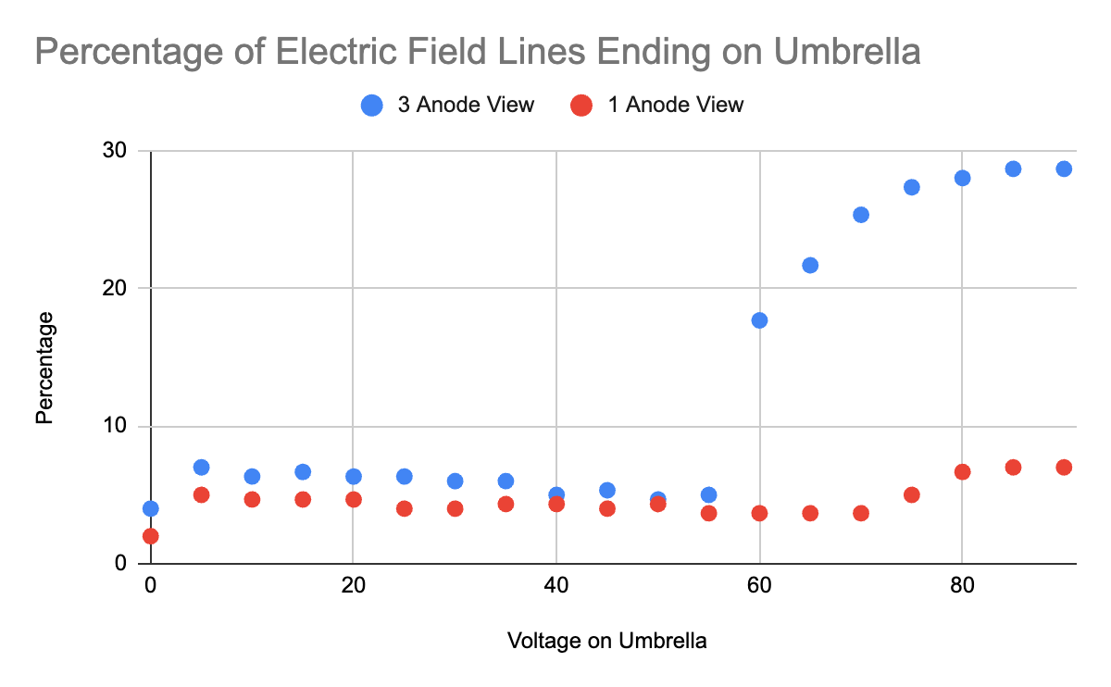
Signal Loss To Umbrella
Notes:
Percentage of signal lost to the umbrella as umbrella voltage increases
Clear spike at a certain voltage range, set as max limit for the certain sensor design
Will try (through multiple sensor designs) to see impact based on anode size, placement etc

Slide 11

Conclusion
Promising new pressure sensor designs
Better understanding of the electric field changes through umbrella charge
Lots of further avenues for potential sensor adjustments
Notes:
Lots of promising new information on sensor performance
Great potential in pressure sensor designs
Importance of understanding electric fields within each sensor model
Plenty of avenues of potential investigation as potential sensor adjustments

Slide 12

Thank
You

