Slide 1

Radon Mitigation, Removal, and Testing at SNO+
Julia Gorovitz
Supervisors – Dr. Christine Kraus, Dr. Nasim Fatemighomi, Juliette Deloye
CASST 2025
1

Slide 2
Table of contents
01.
02.
03.
04.
05.
Introduction
Radon Assays
Zeolite Traps
SNO+ Overview
Why is radon such a problem?
Zeolite trap system overview
Results and Future Directions
Acknowledgements and References
2

Slide 3

01.
Introduction
SNO+ Overview
3

Slide 4
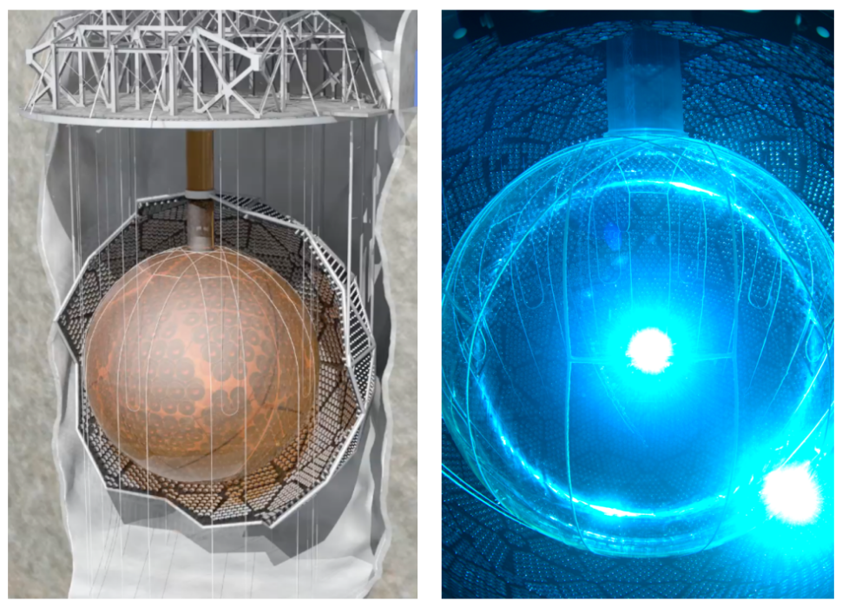
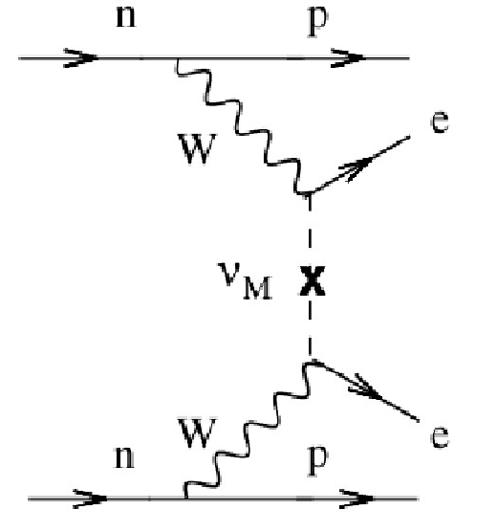
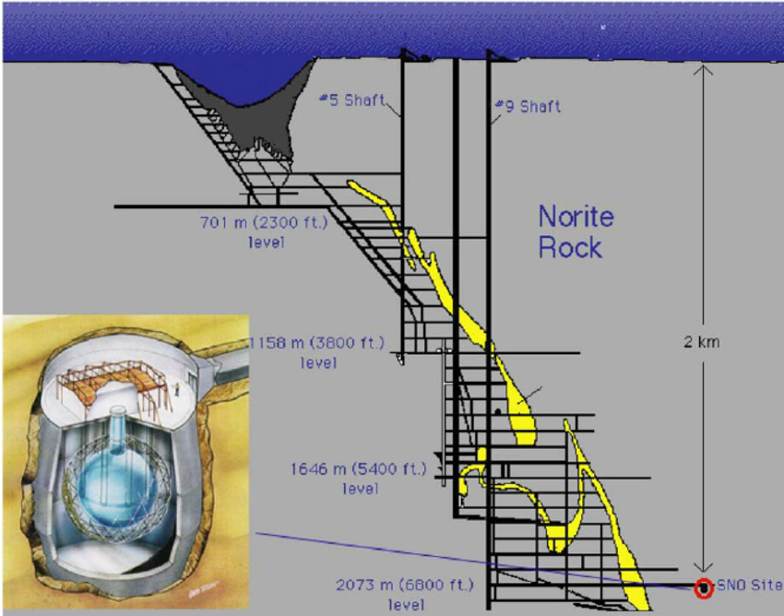



The SNO+ experiment
Overview Goals
Neutrinoless double beta decay (0νββ)
Solar neutrinos
Geo antineutrinos
Reactor antineutrinos
Supernova neutrinos
Cavity with 7400 tones of UPW
PSUP – Support structure with 9300 PMTs
Acrylic vessel (AV)
2 km rock overburden
Shielding from cosmic radiation
4
BNL | Chemistry | Neutrino and Nuclear Chemistry | Collaborations. Bnl.gov. https://www.bnl.gov/chemistry/nnc/collaborations.php (accessed 2025-08-09).
The SNO+ Experiment. Journal of Instrumentation 2021, 16 (08), P08059–P08059. https://doi.org/10.1088/1748-0221/16/08/p08059.
‌

Slide 5
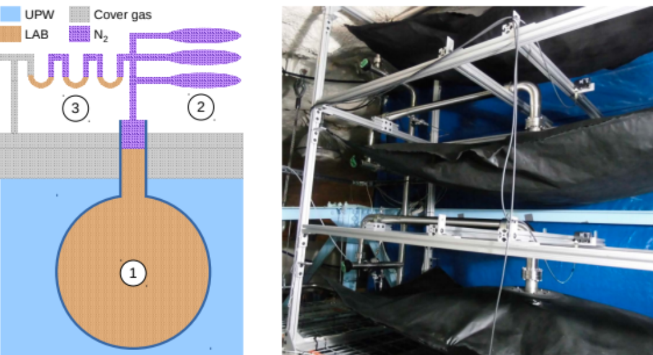
The SNO+ experiment
Radon mitigation techniques
High-purity Nitrogen Cover Gas with constant monitoring – 3000L!
→ 1.9 × 10⁻⁴ reduction relative to mine air
Nitrogen Purging and Overpressure
Radon Trap in Nitrogen Line
UPW Purification Systems
Radon assays
2) The SNO+ Experiment. Journal of Instrumentation 2021, 16 (08), P08059–P08059. https://doi.org/10.1088/1748-0221/16/08/p08059.
‌
5

Slide 6
02.
Radon Assays
Why is radon a problem in the SNO+ detector?
6

Slide 7
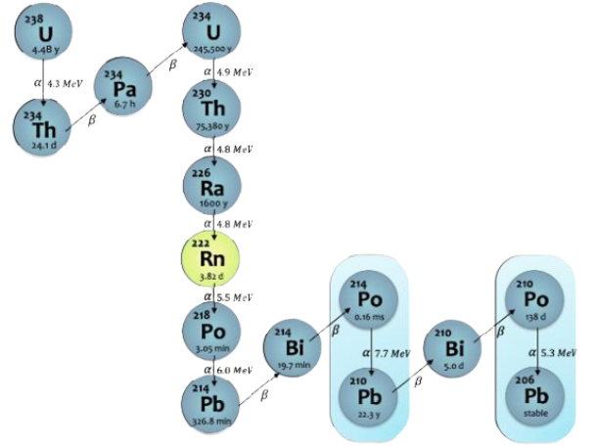
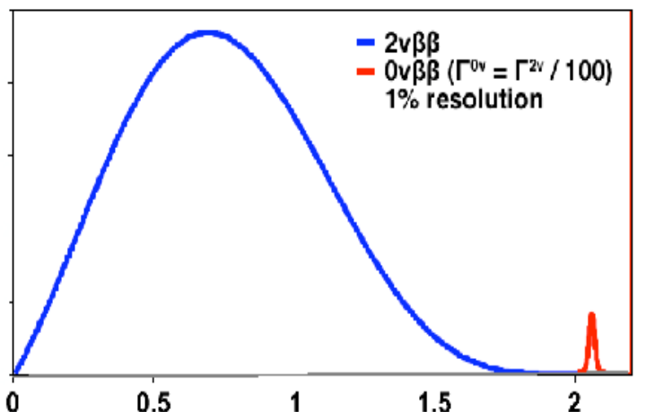


The Uranium-238 decay chain
Radon-222 isotope
Inert gas
Short half-life (3.82 days)
Three subsequent α-decays
Bismuth-214
Very short half-life (19.7 minutes)
BiPo β-decay can generate energy in the ROI for ¹³⁰Te 0νββ (red in the plot)
(Arbitrary Units) – log scale
Lead-210
Very long half-life
Deposits in the experiment
(MeV)
Sangam@hri, W. Neutrinoless Double Beta Decay. https://indico.cern.ch/event/218049/contributions/1519262/attachments/351513/489797/Warner_26th.pdf
Fang, F. Radon Plate-out and the Effects of Airflow and Electric Charge for Dark Matter Experiments. 2024, 8 (1, 2024). https://doi.org/10.25172/jour.8.1.1.
‌
‌
7

Slide 8
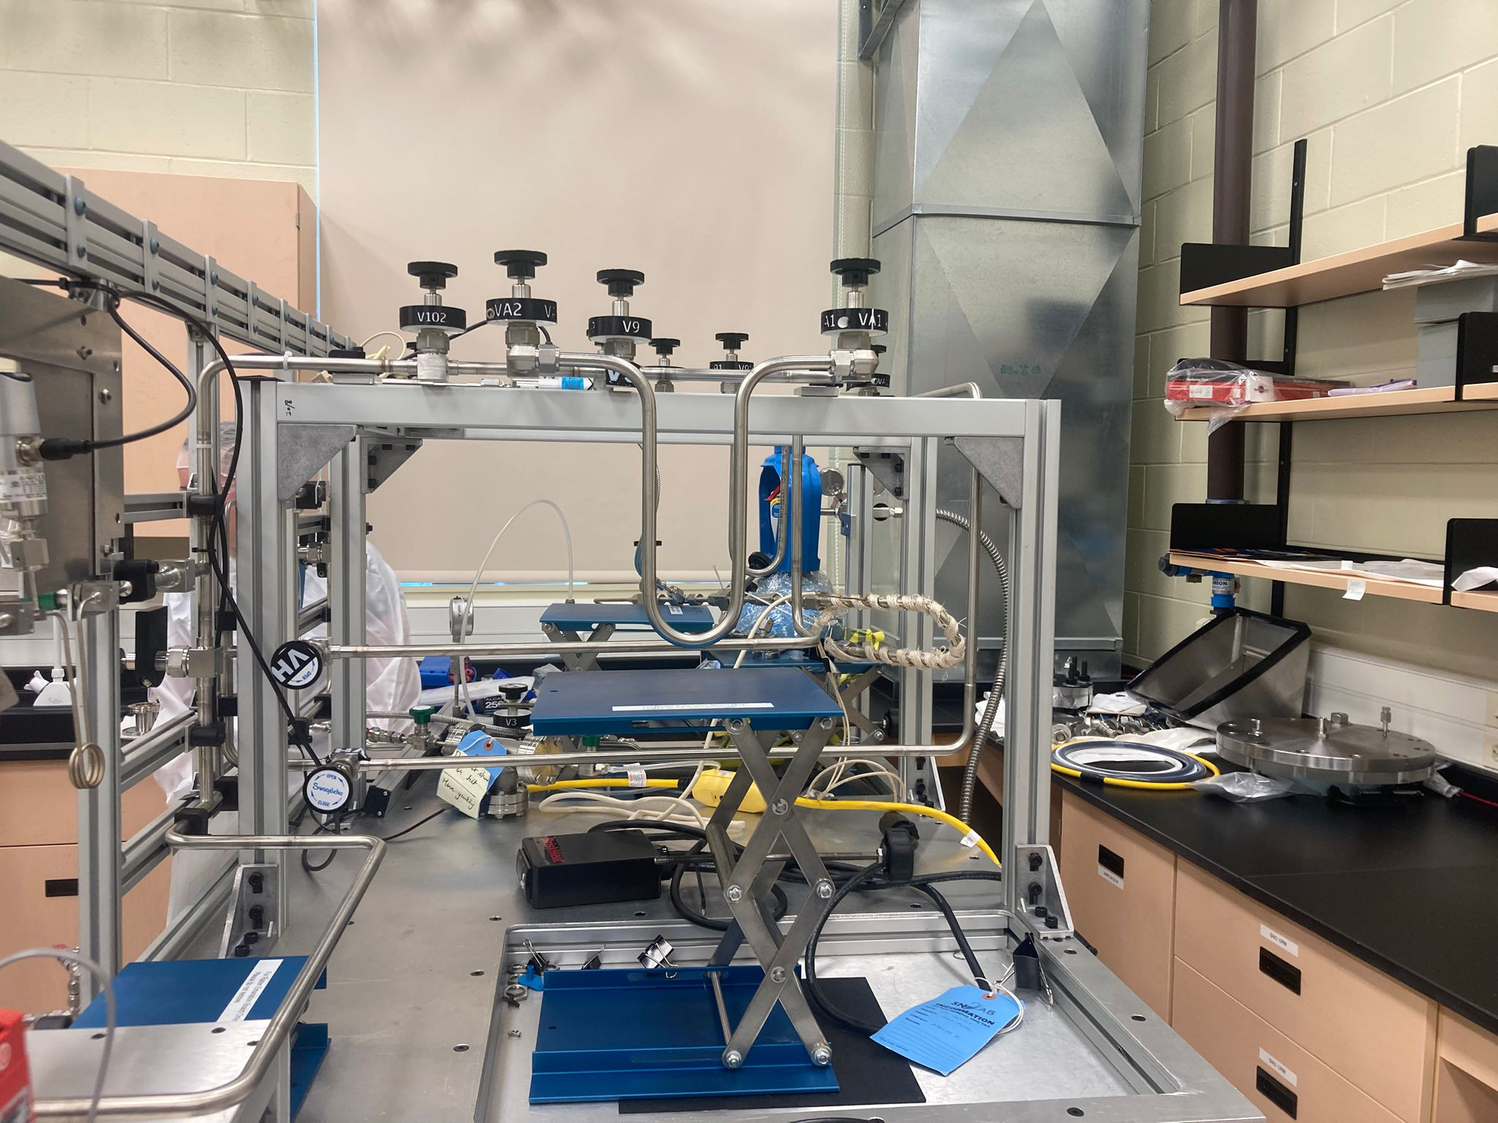
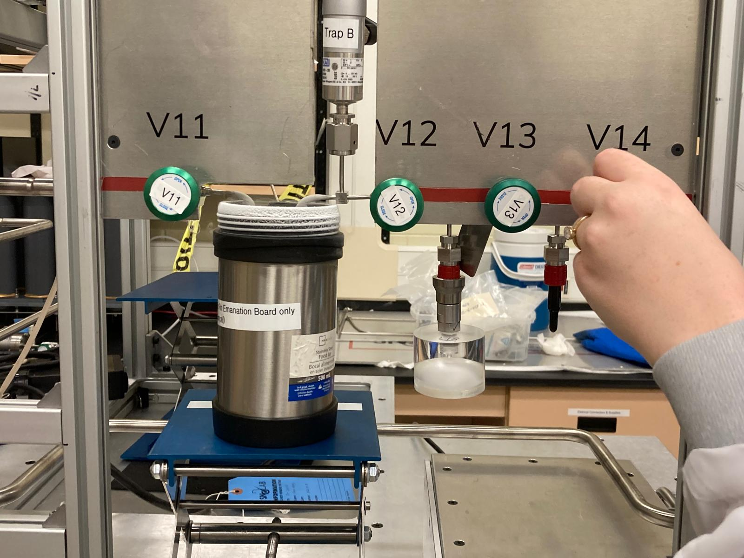
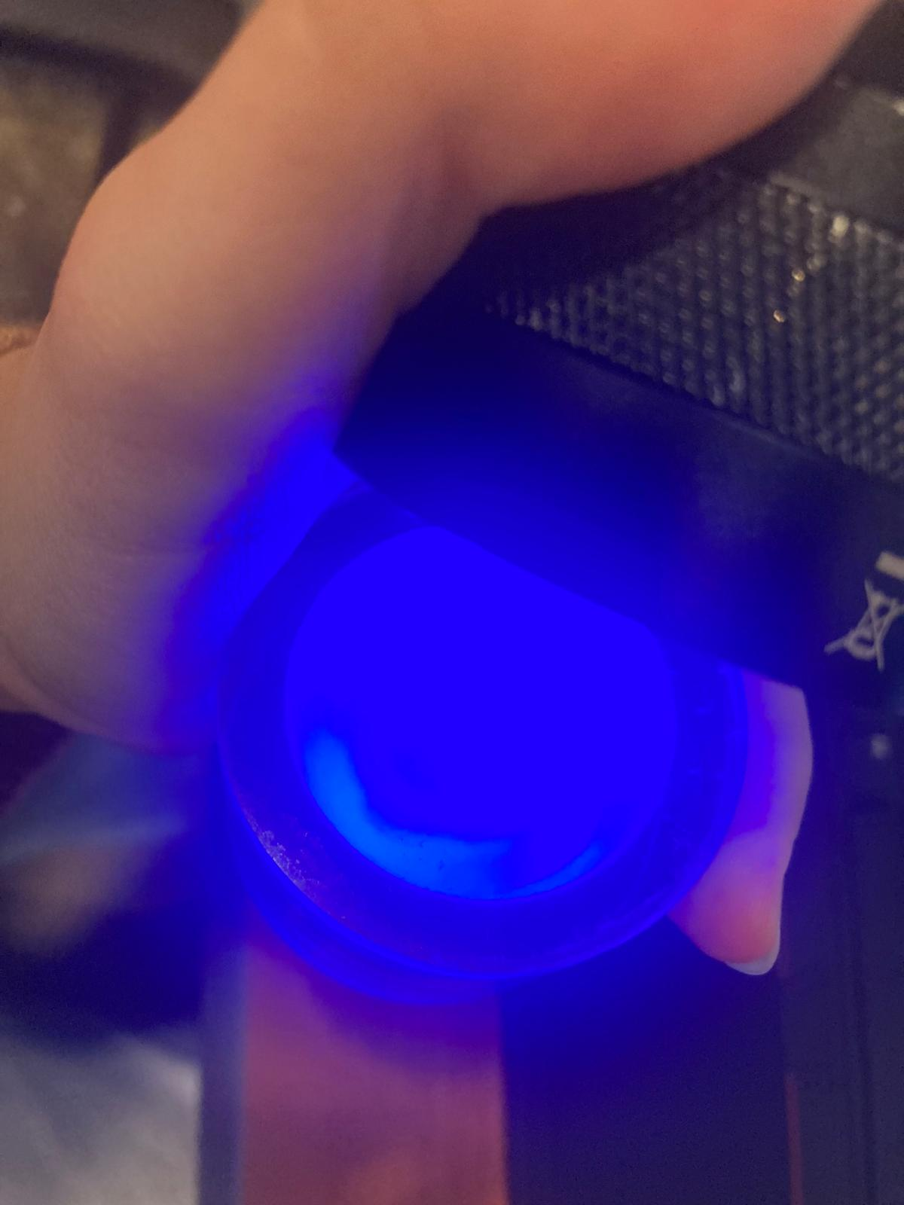
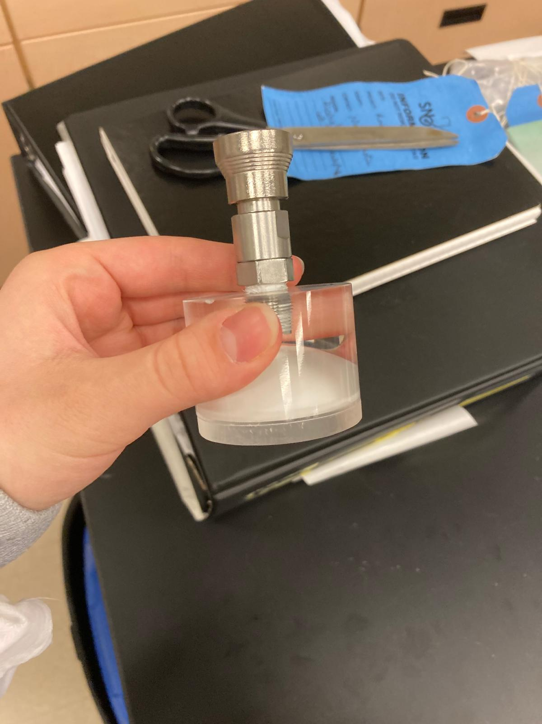
Radon Assays in SNO+
Gas Assays
8

Slide 9
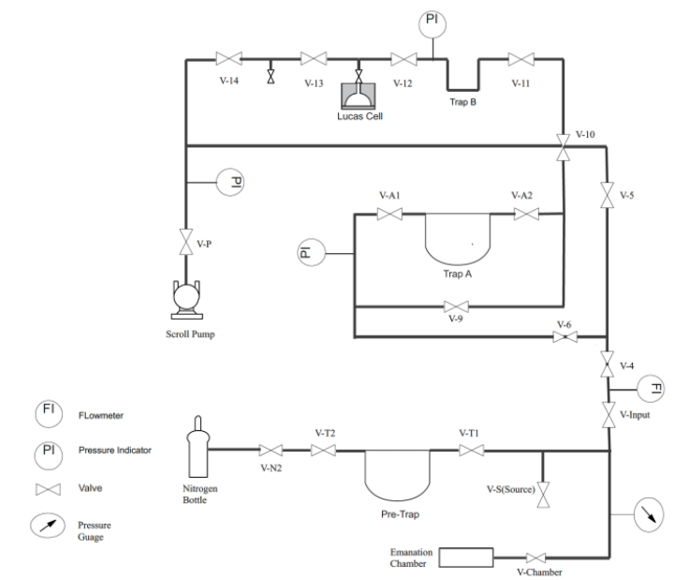

Radon Assays in SNO+
Gas Assays
*Charcoal trap attached
Sample path to Lucas Cell in purple
5) Hussain, A. Evaluating 238U external background for SNO+ experiment using radon Aasays and 214Bi analysis. Scholaris.ca. https://laurentian.scholaris.ca/items/1c991a03-7714-41fe-9080-59a11f9716e4 (accessed 2025-08-09).
‌
9

Slide 10
03.
Zeolites
Zeolite trap system overview
10

Slide 11
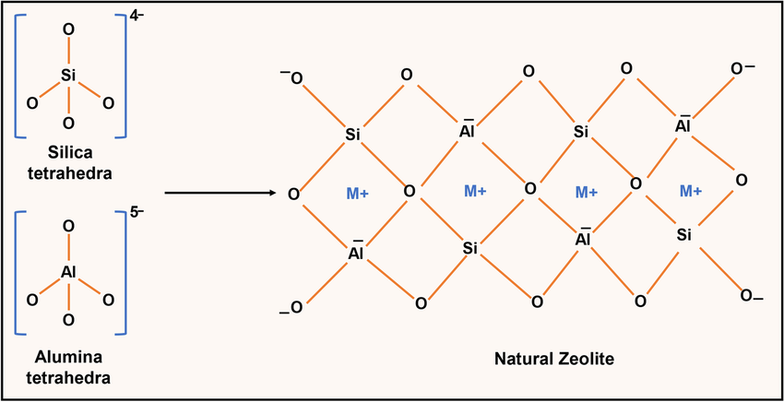
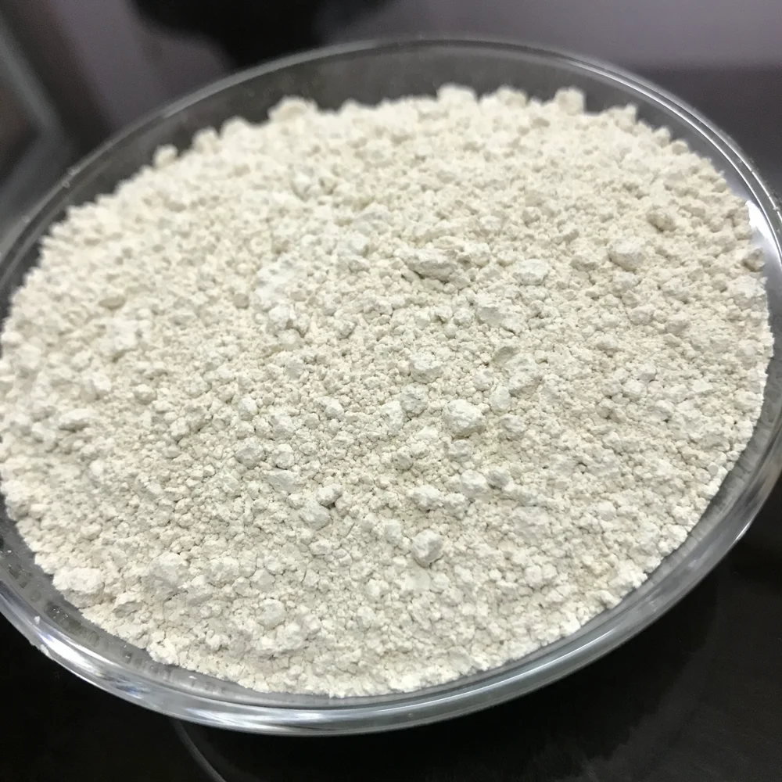
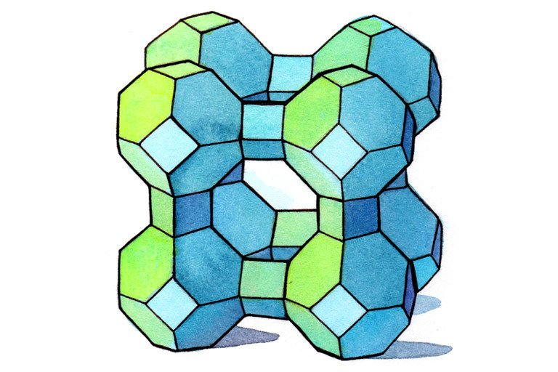
Zeolites
Zeolites are porous aluminosilicates
    → SiO₄ / AlO₄ tetrahedra
    Why use it in assays/ as a radon trap?
  High Adsorption Efficiency
Selective Trapping
Temperature Control
Re-generability
Effect of Surface Modification of Natural Zeolite on Ammonium Ion Removal from Water Using Batch Study: An Overview. Water, Air, & Soil Pollution 2022, 233 (11). https://doi.org/10.1007/s11270-022-05948-4.
What is Zeolite?_Chemicalbook. Chemicalbook.com. https://www.chemicalbook.com/Article/What-is-Zeolite.htm (accessed 2025-08-09).
‌
‌
11

Slide 12
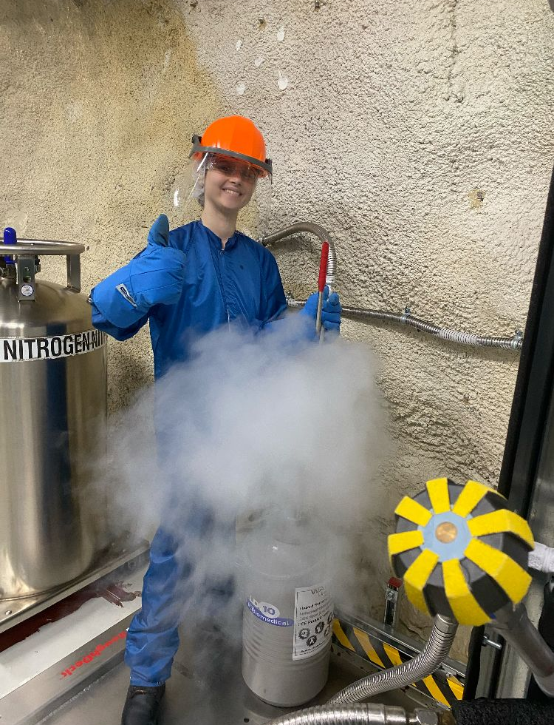
Motivation and Studies - Zeolites
→ Ag-ETS-10
High absorption capacity at room temperature
All other traps need cryogenic cooling
Higher trapping capacity
Radon filter for the nitrogen cover bags
  → Types of assays done to better understand the zeolite
Emanation at different temperatures
Calibration
Background
12

Slide 13
04.
Results and Future Directions
13

Slide 14
Zeolite – main assay results
Date | Assay type | Result (atoms/day)
May 27, 2025 | Emanation (150°C) | 2719.9
June 18, 2025 | Emanation (150°C) | 434.89
June 27, 2025 | Emanation (at room temp) | 34.51
July 31, 2025 | Calibration* (at 150°C) | 49.8
August 1, 2025 | Background (300°C) | 689.21
Emanation assay results:
At 150°C, 20h baking showed an improvement of 84% less atoms/day
Low counts for the calibration assay → high counts for the next day background
At calibration, comparing to 16000 atoms/day in calibration can
14

Slide 15
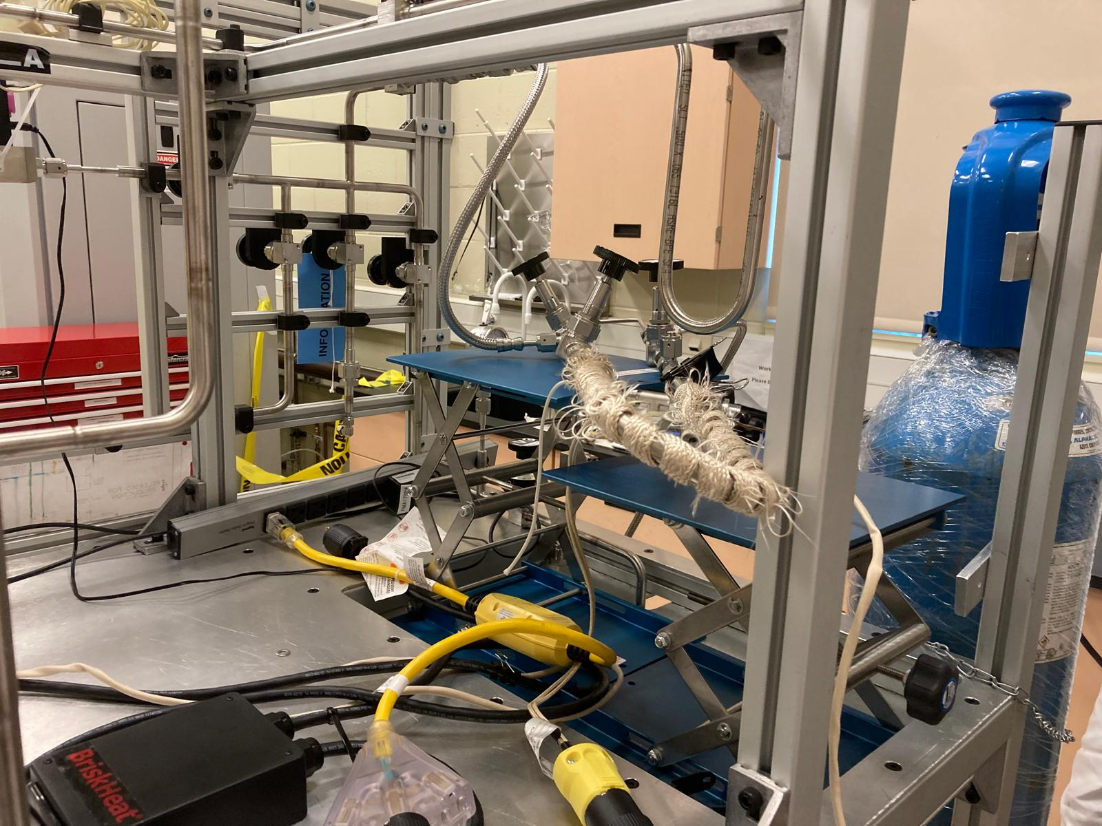
Next Steps for SNO+
Calibration assay done entirely at 300°C
  → Accurately analyze trapping capacity
  Re-do a background assay
  → Without the interference seen from the assay . done the day before
  Continue baking/ purging the zeolite to see how low the emanation/ background gets
  → Explore the possibility of using the zeolite for
  assays
15

Slide 16
Summary
Radon Problem – Rn-222 from U-238 decay chain produces backgrounds in the ROI through several α and β-decays
Mitigation Methods – Nitrogen cover gas, purging/overpressure, radon traps, and UPW purification
Radon Assays – Used the SNO+ gas assay board to analyze a new type of radon trap
Zeolite Choice – Silver-exchanged ETS-10 for high adsorption efficiency, noble gas selectivity, no need for cryogenic cooling
Assay Results – Baking at 150 °C reduced emanation by 84%; calibration and background assays show ambiguous results, need further examination
Next Steps – High-temp calibration at 300 °C, continued baking/purging to further reduce background, re-do background and emanation assays, evaluate trap for routine assays
16

Slide 17
05.
Aknowledgements
17

Slide 18
References
BNL | Chemistry | Neutrino and Nuclear Chemistry | Collaborations. Bnl.gov. https://www.bnl.gov/chemistry/nnc/collaborations.php (accessed 2025-08-09).
Albanese, V.; Alves, R.; Anderson, M. R.; Andringa, S.; Anselmo, L.; E. Arushanova; S. Asahi; Askins, M.; Auty, D. J.; Back, A.; Back, S.; F. Barão; Barnard, Z.; Barr, A. J.; Barros, N.; Bartlett, D. T.; Bayes, R.; Beaudoin, C.; Beier, E. W.; Berardi, G. The SNO+ Experiment. Journal of Instrumentation 2021, 16 (08), P08059–P08059. https://doi.org/10.1088/1748-0221/16/08/p08059.
Sangam@hri, W. Neutrinoless Double Beta Decay. https://indico.cern.ch/event/218049/contributions/1519262/attachments/351513/489797/Warner_26th.pdf
Fang, F. Radon Plate-out and the Effects of Airflow and Electric Charge for Dark Matter Experiments. 2024, 8 (1, 2024). https://doi.org/10.25172/jour.8.1.1.
Hussain, A. Evaluating 238U external background for SNO+ experiment using radon Aasays and 214Bi analysis. Scholaris.ca. https://laurentian.scholaris.ca/items/1c991a03-7714-41fe-9080-59a11f9716e4 (accessed 2025-08-09).
Yadav, V.; Rani, M.; Kumar, L.; Singh, N.; Ezhilselvi, V. Effect of Surface Modification of Natural Zeolite on Ammonium Ion Removal from Water Using Batch Study: An Overview. Water, Air, & Soil Pollution 2022, 233 (11). https://doi.org/10.1007/s11270-022-05948-4.
What is Zeolite?_Chemicalbook. Chemicalbook.com. https://www.chemicalbook.com/Article/What-is-Zeolite.htm (accessed 2025-08-09).
‌
‌
‌
18

Slide 19
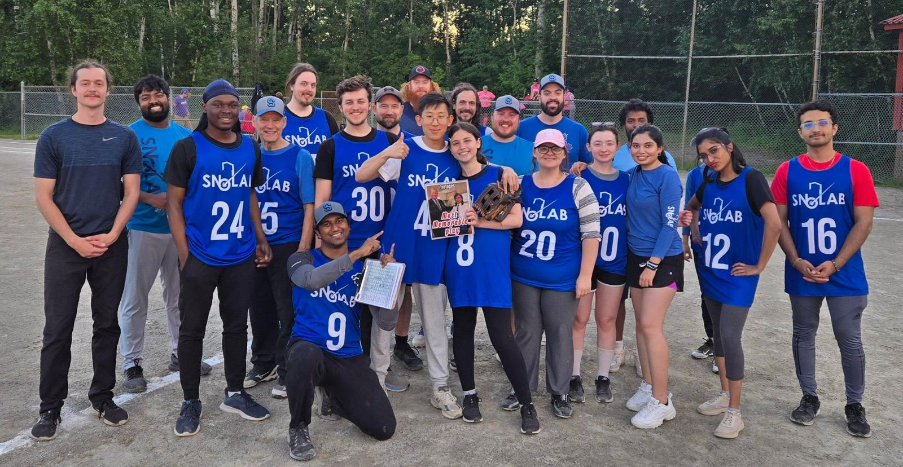
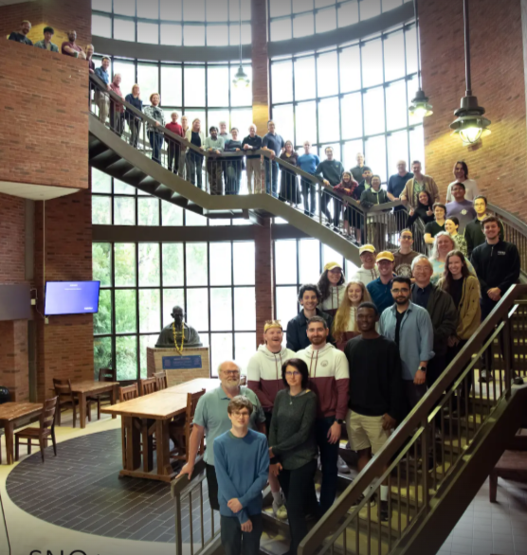
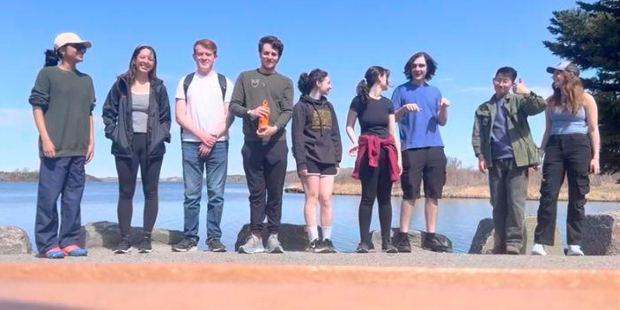
Special thanks to:
Dr. Christine Kraus
Dr. Nasim Fatemighomi
Juliette Deloye
Dr. Mark Ward
Adil Hussein
Peter Qin
Keegan Paleshi
Yusuf Ahmed
Dr. Aleksandra Bialek
Dr. Ryan Bayes
Matt Depatie
Noah Fenlon
Semoore Tijani
Emilio de la Cruz
Brianna Binoy
& All my other colleagues who made the semester unforgettable
19

