Slide 1

Keeping it Cool:
The SuperCDMS Chilled Water System
Zainab Ali

Slide 2
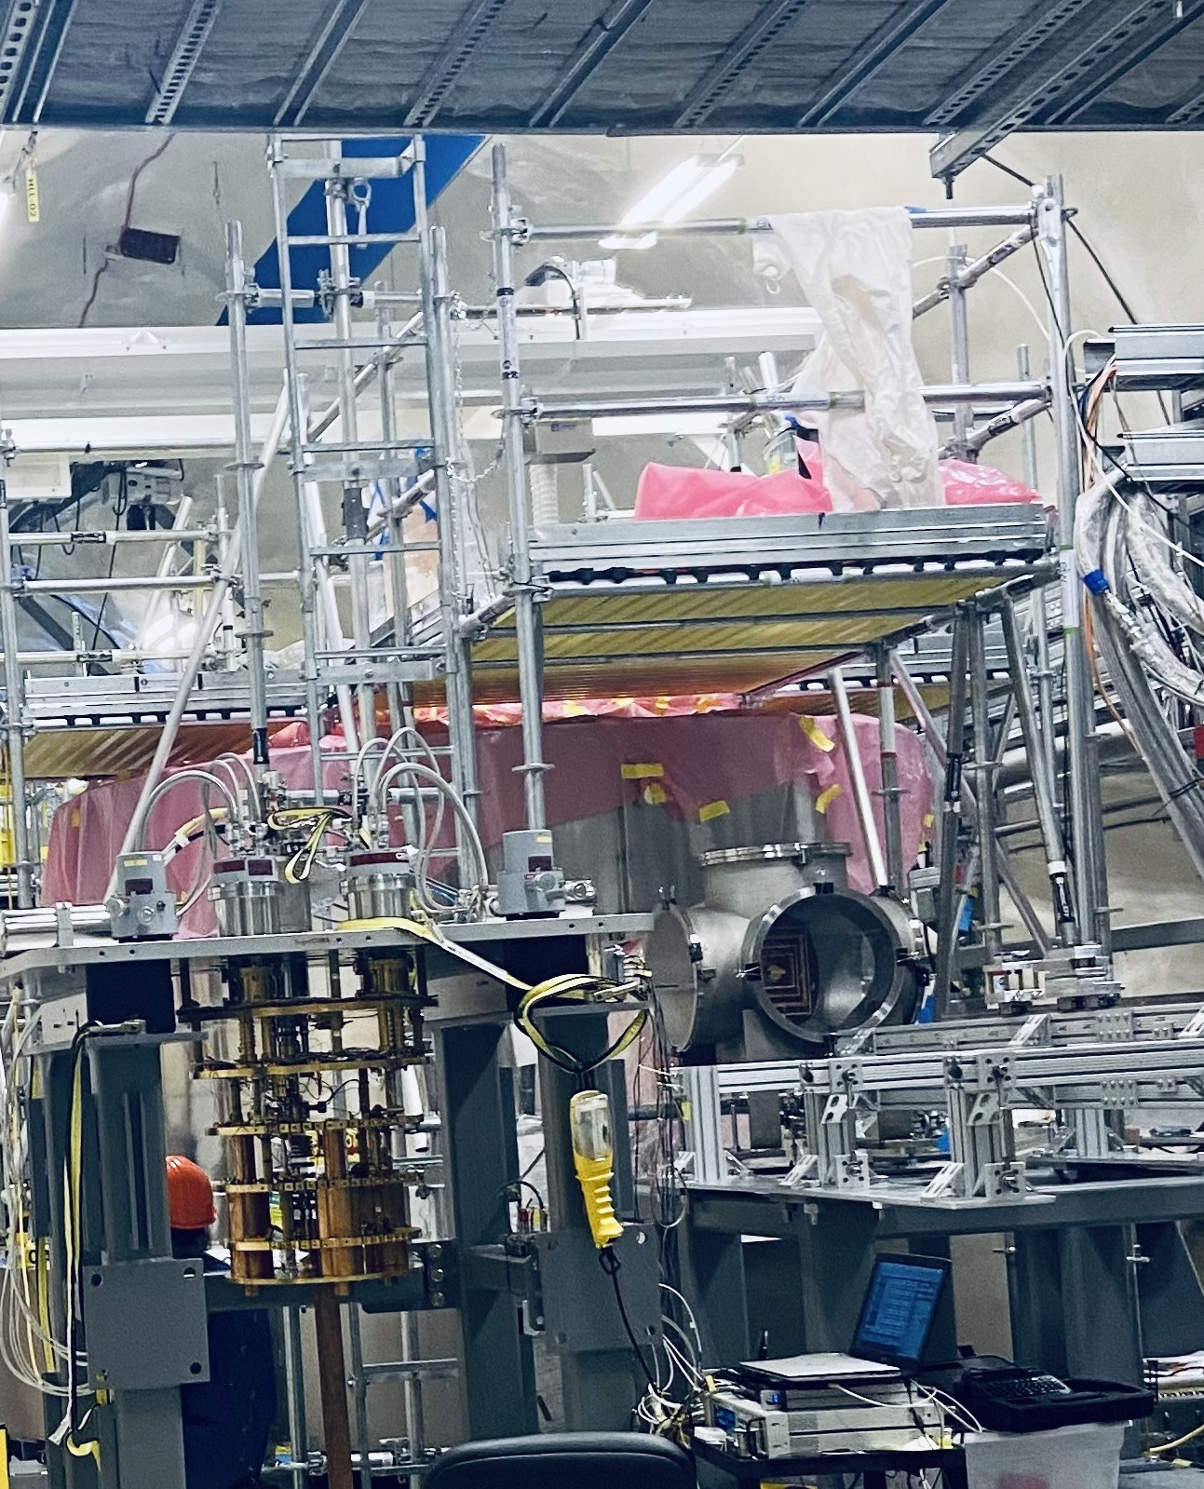
Super Cryogenic Dark Matter Search
Direct detection with Silicon and Germanium Crystal Detectors
Operates at 15 mK
Looking for ‘light’ dark matter in 0.5-5 GeV/c² range

Slide 3
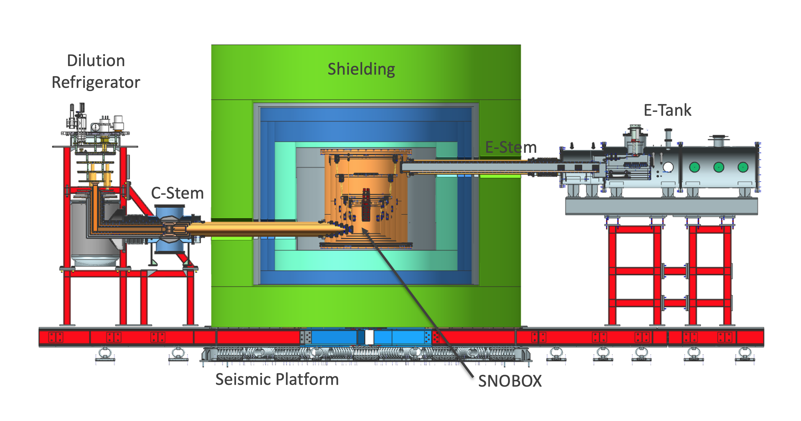
Experiment Setup

Slide 4
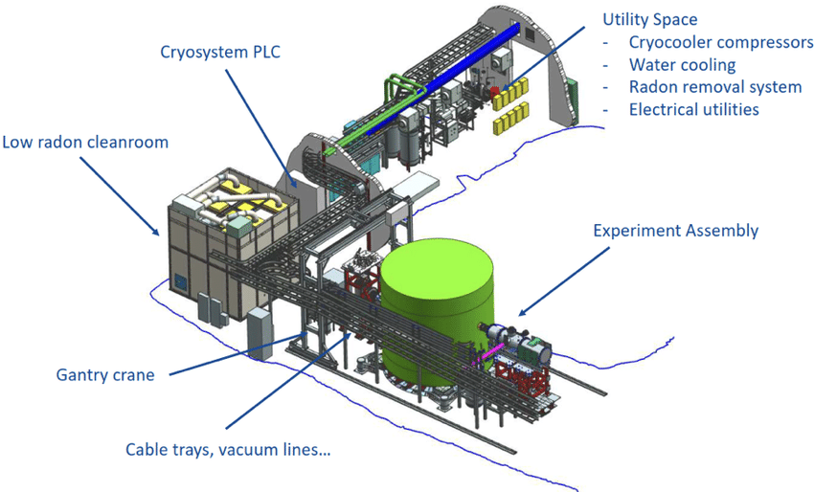
Experiment Setup

Slide 5
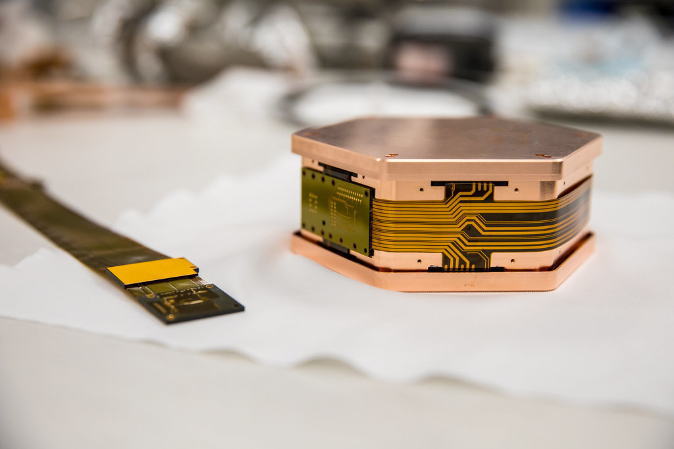
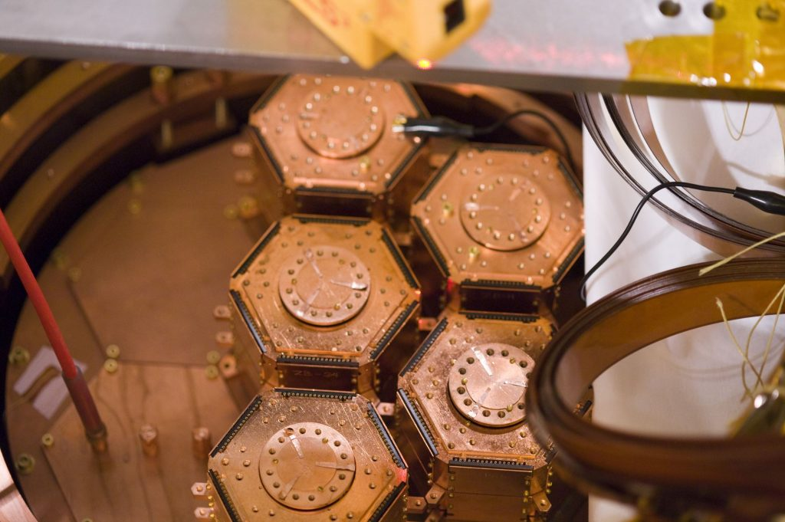
Detectors
Germanium (1.39kg) and Silicon (0.61kg)
4 Towers of 6 Detectors
12 iZip (Interleave Z-sensitive Ionization and Phonon) detectors
12 HV (High Voltage) detectors
Measure Heat and Ionization

Slide 6
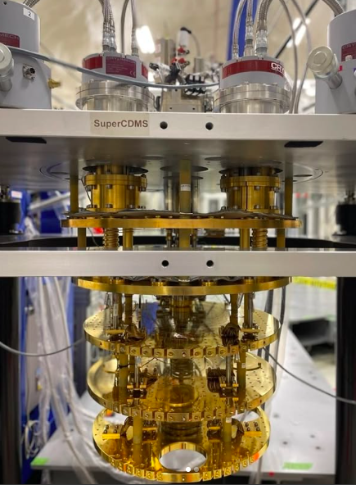
SuperCDMS Cryogenics
Dilution fridge cools detectors
4 Stages of Cooling
Starts at 60K and cools to ~10mK
Low temperature achieved using mixing chamber with He3 and He4

Slide 7
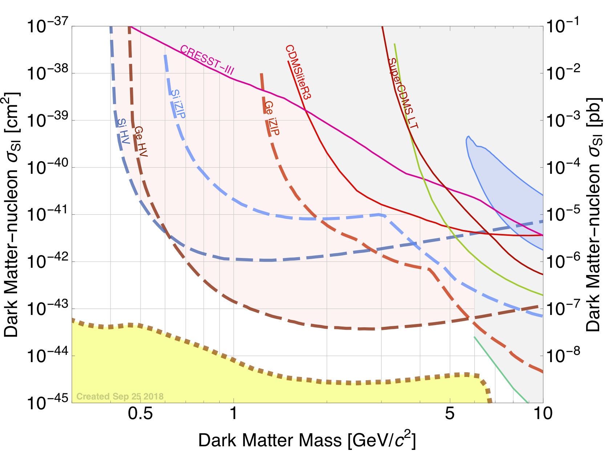
Physics Goals
Looking for nucleon-coupled dark matter
Mass is 0.5-5 GeV/c² range
This range allows search for nucleus scattering, electron scattering, and dark photons

Slide 8
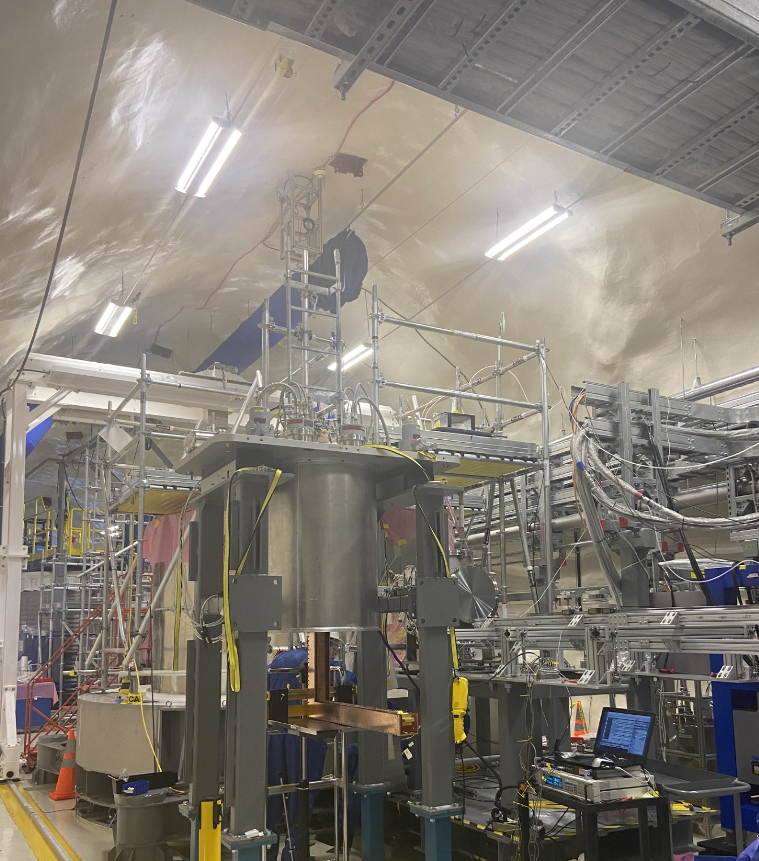
Experiment Status
Currently in Installation and Integration phase
Experiment will be fully built by September
Next step is to cool down and begin commissioning for first science run

Slide 9
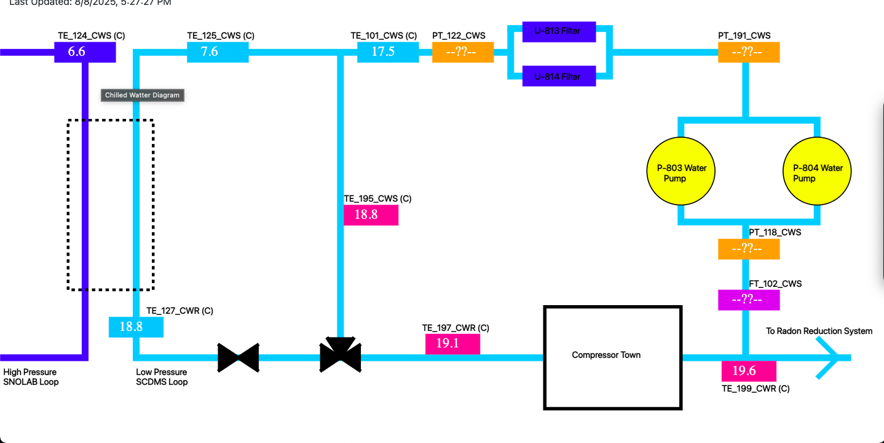
Chilled Water System
Removes heat via SNOLAB water
Cools compressors
Final sensors need to be connected

Slide 10
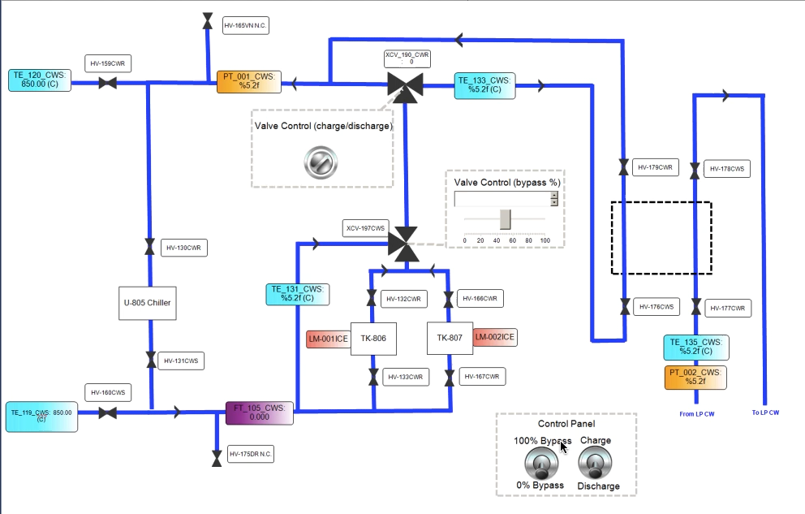
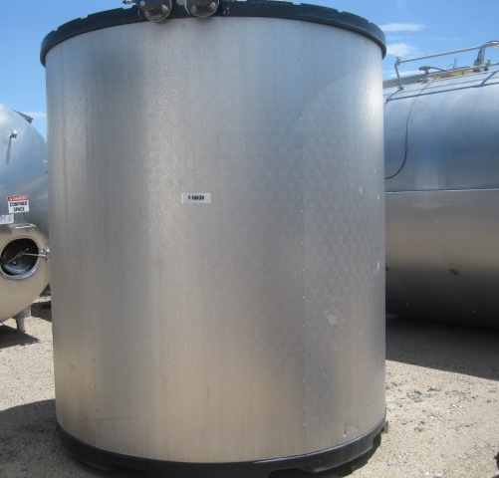
Ice Tank Back-up
Charging mode freezes ice in tanks
Discharge mode uses ice to cool water
Currently using MATLAB Simscape Fluids to run simulations

Slide 11
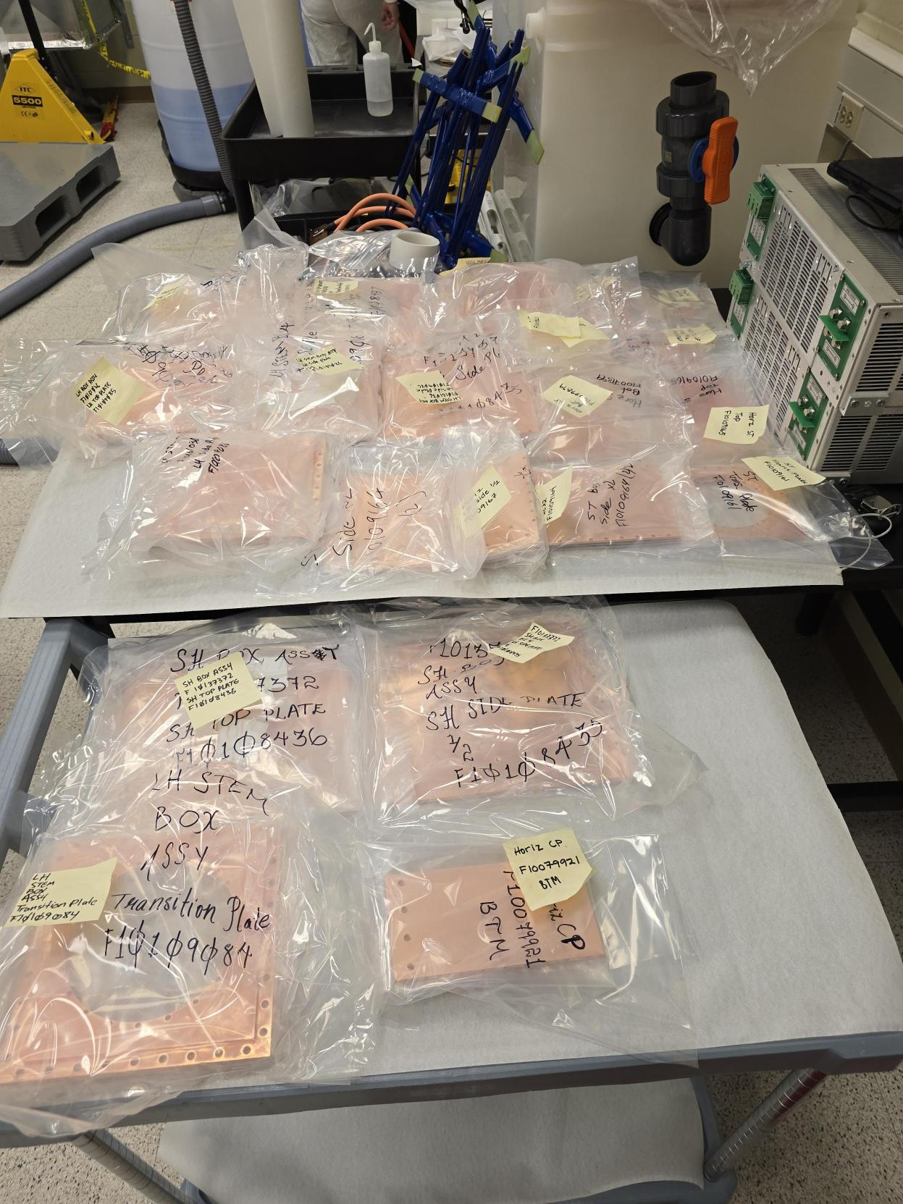
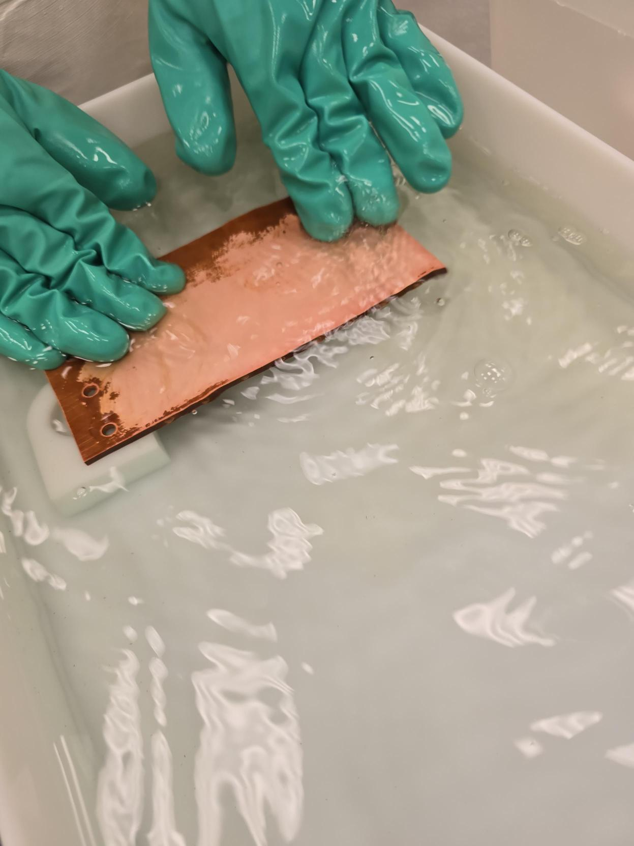
Etching
Copper
Helped degrease, etch, and passivate copper plates
Packed in nitrogen to ship underground

Slide 12
Conclusions
SuperCDMS is a cryogenic dark matter detection experiment and will start taking data this year
The experiment focuses on lighter dark matter than other experiments at SNOLAB
I worked on the chilled water system (reading P&IDs, learning about instrumentation/PLC, design HMI, creating simulations, etc.)
I also helped etch/passivate copper

Slide 13
Thank You!
Supervised by Matt Stukel, Andy Kubik, and Jeter Hall

