Slide 1
2025/08/12
Improving SNOLAB Radon counting sensitivity with low-background ZnS
Peter Qin (He/Him)
Scientific Support Student

Slide 2
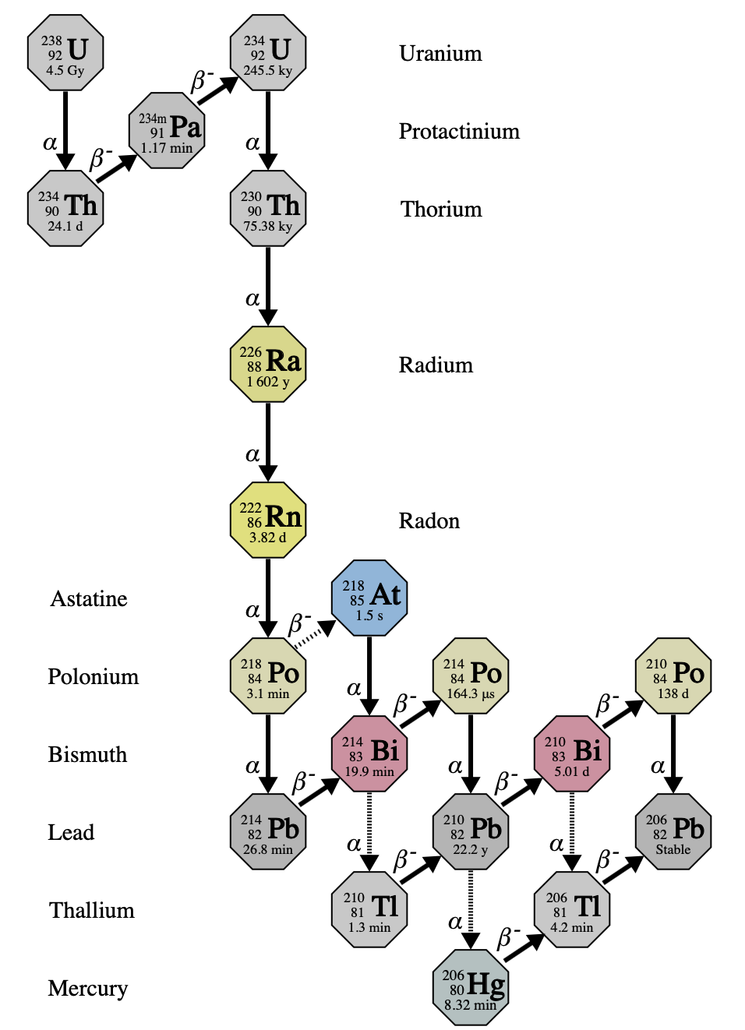
U-238 chain and Rn-222
Notes:
I’d like to begin my presentation with a bit of background on Radon-222, the first gaseous member of the U-238 chain. Radon is a perennial problem for low-background science, and I’ll start this presentation by talking about why that is.

Slide 3
U-238 chain and Rn-222
Abundant underground
Notes:
Firstly, Uranium-238 and therefore radon is especially common underground owing to its abundance in the norite rock surrounding SNOLAB.

Slide 4
U-238 chain and Rn-222
Abundant underground
Background to rare-event searches
Notes:
Second, Radon daughters contribute direct background to rare event searches at SNOLAB including for 0vbb and WIMP DM

Slide 5
U-238 chain and Rn-222
Abundant underground
Background to rare-event searches
Gaseous
Notes:
Thirdly, Radon being gaseous means it is highly mobile and even small leaks can allow for ingress into otherwise clean or low-background systems

Slide 6
How does SNOLAB deal with Radon?
Notes:
So we’ve established that U238 chain and Rn a priority for underground science. How does SNOLAB support Radon control the experiments hosted here?

Slide 7
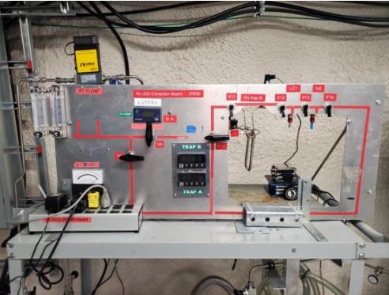
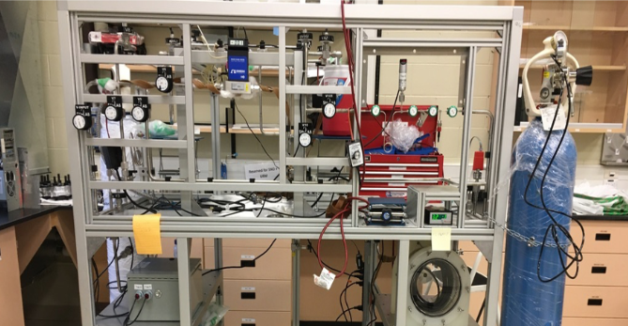
Radon assays
SNOLAB surface lab radon emanation board
Underground mobile radon assay board
Notes:
One way is the Radon assay. This is highly sensitive system for trapping and measuring radon out of gas samples. But its capability extends to radon emanation from solid samples as well, and liquid media can be sampled too through a degasser. The main idea is we cryotrap radon out of gas samples and transfer it into a Lucas cell for alpha counting.

Slide 8
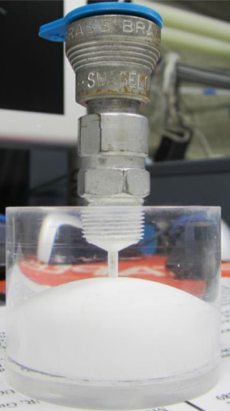
What are Lucas cells?
Scintillator alpha counter
ZnS(Ag)-coated inner volume stores Rn
Used to count decays of Rn atoms trapped using assays
Notes:
What are Lucas cells? Lucas cells are a type of scintillator alpha counter. They consist of an acrylic body holding a gas sample, with that internal volume coated with silver-activated zinc sulfide which is an inorganic scintillator sensitive to alphas. As mentioned, they are used in the radon assay method to count trapped atoms.

Slide 9
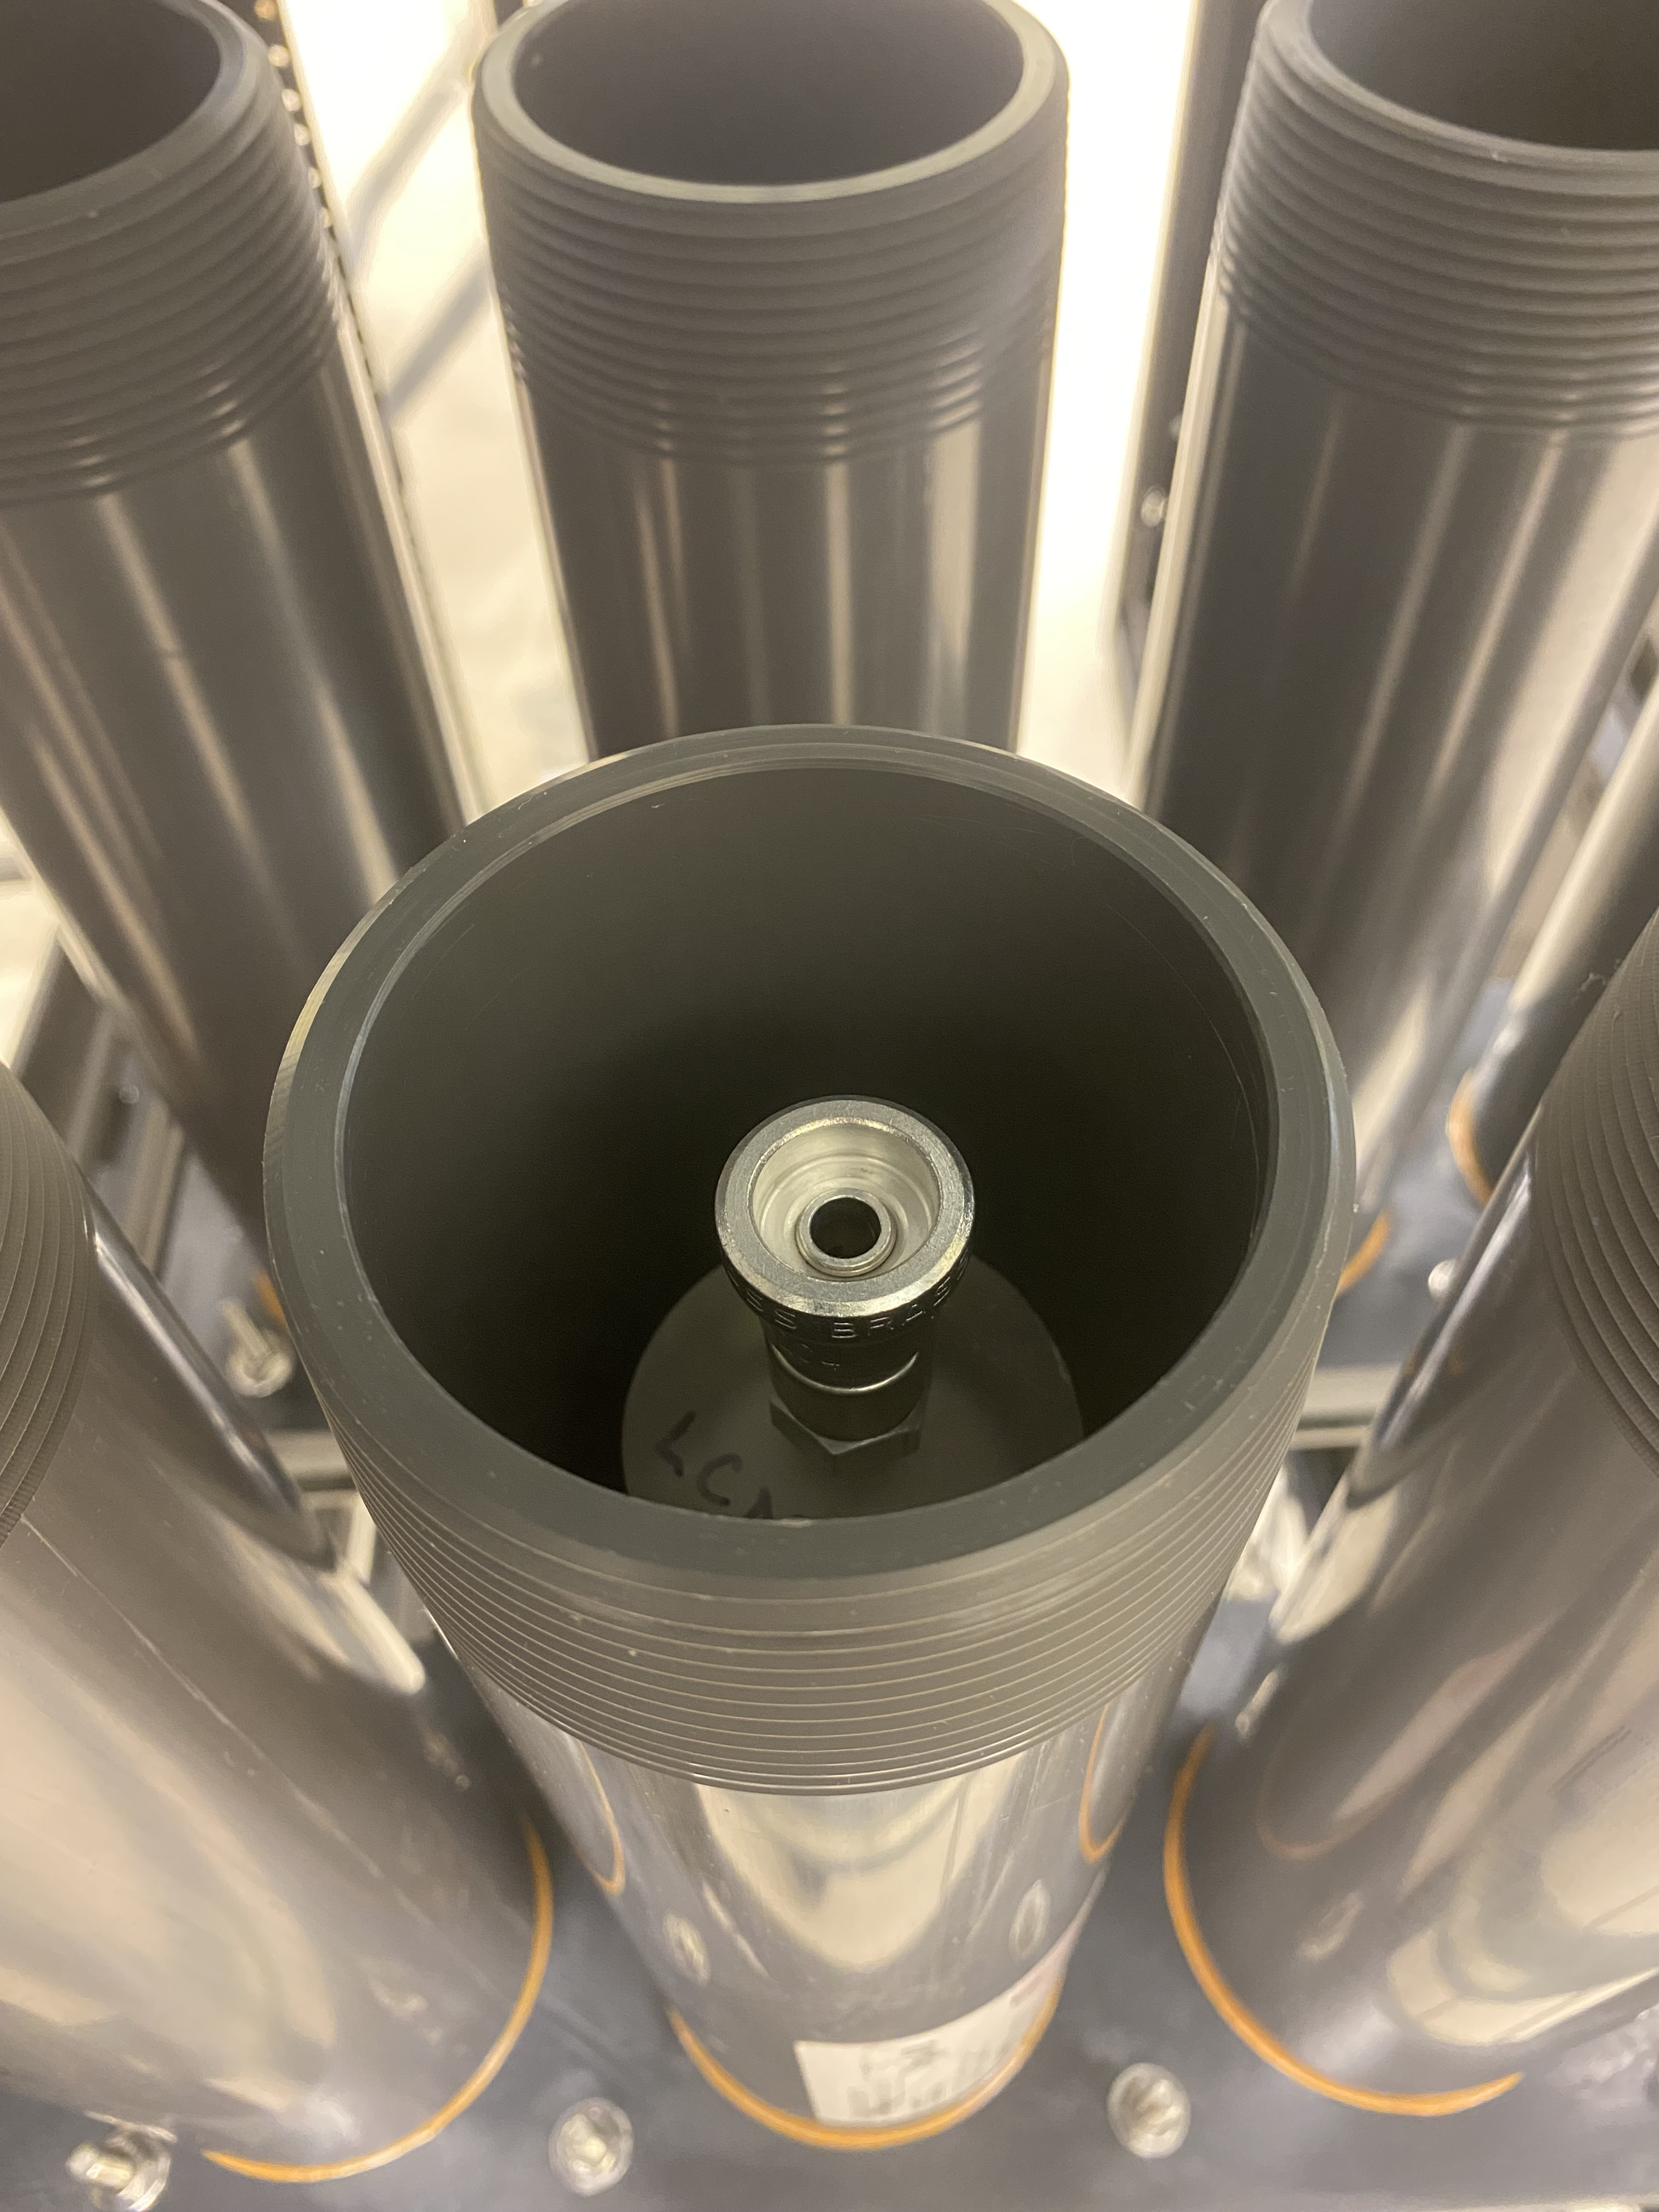
What are Lucas cells?
Scintillator alpha counter
ZnS(Ag)-coated inner volume stores Rn
Used to count decays of Rn atoms trapped using assays
Notes:
What are Lucas cells? Lucas cells are a type of scintillator alpha counter. They consist of an acrylic body holding a gas sample, with that internal volume coated with silver-activated zinc sulfide which is a scintillator sensitive to alphas. As mentioned, they are used in the radon assay method to count trapped atoms.

Slide 10
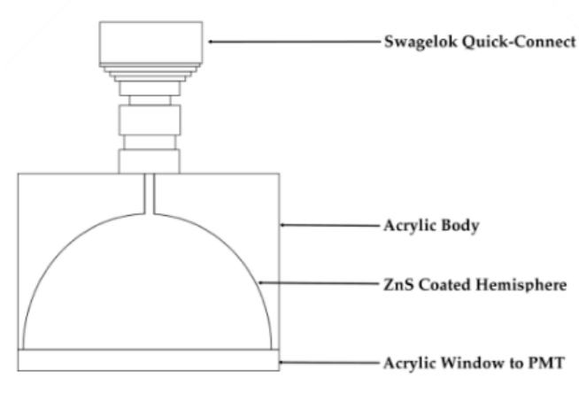
Principle of operation
Rn-222
PMT
Notes:
Radon enters a Lucas cell at the end of an assay and is coupled to a PMT.

Slide 11
Principle of operation
α
Po-218
PMT
Notes:
Radon undergoes an alpha decay (in reality, it’s three in quick-succession) and the emitted alpha incident on the ZnS coating deposits its energy

Slide 12
Principle of operation
PMT
Notes:
The ZnS emits scintillation light which is read out by the PMT

Slide 13
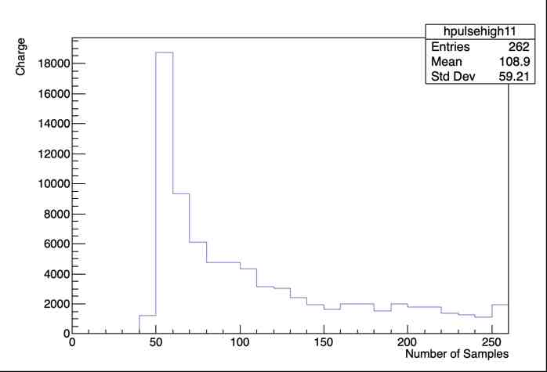
Principle of operation
PMT
Notes:
The ZnS emits scintillation light which is read out by the PMT as an electronic pulse

Slide 14
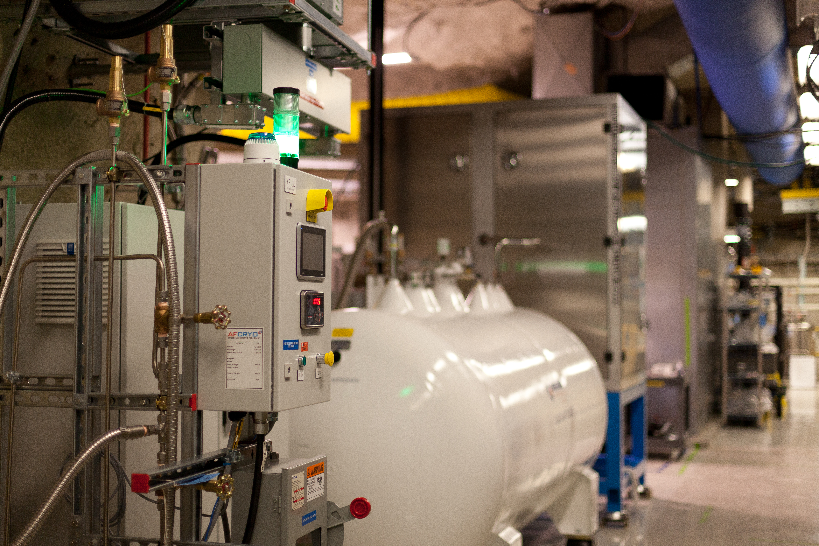
Radon assays at SNOLAB
Rn measurements for SNO+ UPW plant, cover gas
Radon content in SNOLAB LN2
Rn emanation as part of low-background counting facility
Notes:
What are Lucas cells used for at SNOLAB?

Slide 15
Experiments using Rn emanation results
SNO+
CUTE
DAMIC
DarkSide
DEAP-3600
DM-Ice
EXO, nEXO

Slide 16
Experiments using Rn emanation results
SNO+
CUTE
DAMIC
DarkSide
DEAP-3600
DM-Ice
EXO, nEXO
HALO
NEWS-G
PICO
REPAIR
SBC
SENSEI
SuperCDMS

Slide 17
Experiments using Rn emanation results
SNO+
CUTE
DAMIC
DarkSide
DEAP-3600
DM-Ice
EXO, nEXO
HALO
NEWS-G
PICO
REPAIR
SBC
SENSEI
SuperCDMS
Improvements to SNOLAB Rn counting have far-reaching benefits for low-background science!

Slide 18
How are we improving Radon counting?
Notes:
Where can we improve Rn counting at SNOLAB? My work this term focused on two major areas

Slide 19
Upgrades to SNOLAB alpha-counting
Reducing Lucas cell background
Notes:
I worked on a lot of elements of the Radon assay - chiefly

Slide 20
Upgrades to SNOLAB alpha-counting
Reducing Lucas cell background -> improves Rn assay sensitivity
Notes:
LC background is currently the bottleneck for sensitivity of the radon assay method – lower background LCs will allow more accurate measurements of yet cleaner systems. If we want to be able to make measurements of the world’s lowest background experiments here at SNOLAB, we’re going to need the most sensitive radon assay technique possible.

Slide 21
Upgrades to SNOLAB alpha-counting
Reducing Lucas cell background -> improves Rn assay sensitivity
New DAQ hardware
Notes:
We are extending and expanding our Rn counting data acquisition system, doubling the number of assays that can count concurrently

Slide 22
Upgrades to SNOLAB alpha-counting
Reducing Lucas cell background -> improves Rn assay sensitivity
New DAQ hardware -> improves assay capacity, statistics
Notes:
This means we can count more assays longer, giving us better statistics on our measurements

Slide 23
Upgrades to SNOLAB alpha-counting
Reducing Lucas cell background -> improves Rn assay sensitivity
New DAQ hardware -> improves assay capacity, statistics
Notes:
In this talk though, I’m going to concentrate mostly on reduction of Lucas cell background. If you have questions on our new DAQ hardware though, I’m happy to answer them at the end of my talk

Slide 24
Reducing Lucas Cell Background
Notes:
Let’s talk about reducing Lucas cell background

Slide 25
Lucas cell backgrounds
Empty Lucas cells still produce counts
Intrinsic background due to Lucas cell materials
Radon plateout and Pb-210 buildup increase background with time
Found last term intrinsic background largely contributed by ZnS
Notes:
Empty Lucas cells still contribute counts. These come from two sources – one is the materials used to construct them, which contain some proportion impurities in the form of radionuclides.
The other source requires a little explanation. As we use Lucas cells, radon decays and embeds daughters on the inner surface of the cell. A problematic radon descendant here is Pb-210 which has a very long half-life so it builds up over time. It also decays into Po-210, an alpha emitter.
Our target this term was to reduce background in brand new Lucas cells. To that end, we determined last term that this background is contributed largely by ZnS, not other components like acrylic

Slide 26
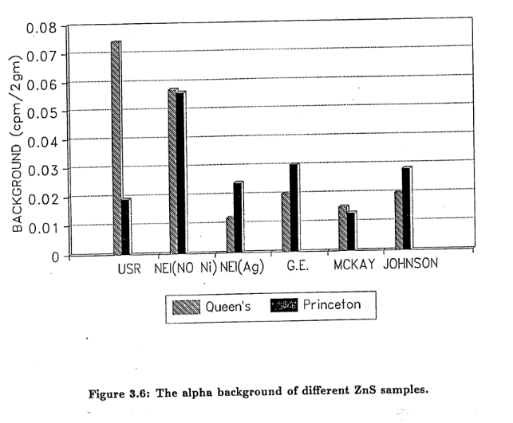
ZnS alpha background
ZnS alpha background varies by manufacturer
Current standard for Lucas cells is 3-4 cpd
Motivates us to investigate synthesizing our own
M. Liu (1991)
Notes:
We know from both our own work last term and previous studies that ZnS background can vary quite a lot between manufacturers. Even the lowest background ZnS tested yields LCs with alpha background 4 cps. We concluded that if we want to push for a zero-background Lucas cell, we would need to make our own ZnS

Slide 27
How do we produce low-background ZnS?
Notes:
So how do we do that?

Slide 28
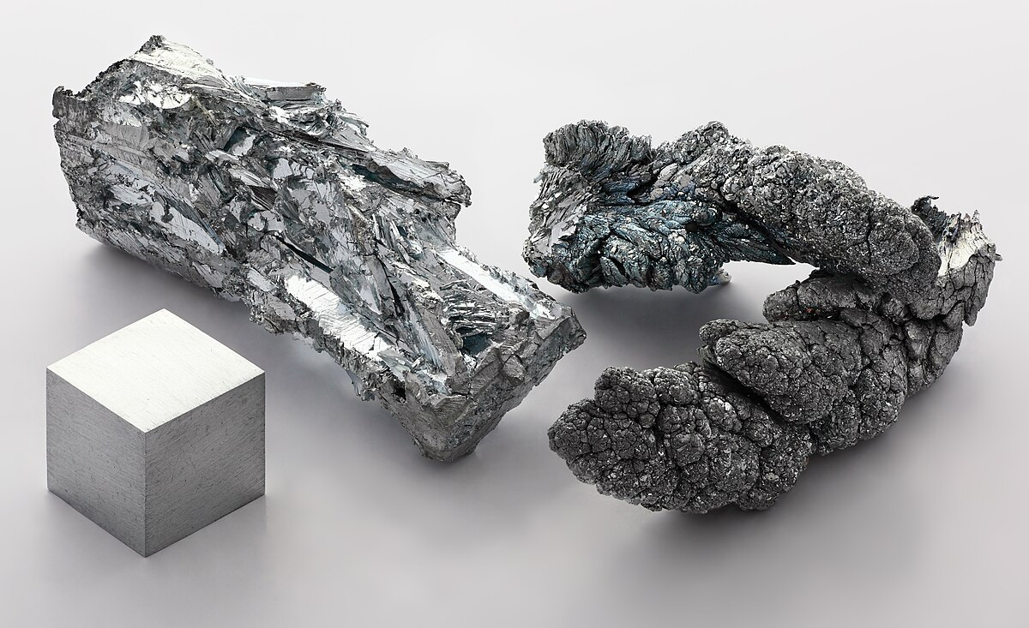
ZnS synthesis – background
Image: Pniok (2010)
Notes:
To make background-free ZnS, we need to understand where this alpha background is coming from. Our existing hypothesis is that since zinc is a mined material, whenever manufacturers extract zinc, they might be getting u-238 chain impurities with it, and those impurities might persist in whatever zinc compounds are then made.

Slide 29
ZnS synthesis – main idea
Selectively precipitate Pb-210 from Zn(CH₃CO₂)₂
Add enough Na₂S to precipitate 95% of Zn, leaving behind U
Dope with between 200ppm and 5% Ag by weight
Notes:
This lead us to develop a technique where we begin by selectively precipitating U and Pb out of zinc acetate. We then react the purified zinc acetate with sodium sulfide to produce a ZnS with reduced alpha background.
It’s worth noting that silver is also a mined material, but the amount we use is so miniscule that we did not attempt to reduce its background contribution

Slide 30






Preliminary ZnS synthesis
Notes:
This term, we performed a trial run of the reaction, without the selective precipitation steps. This animation demonstrates how it proceeds. Two solutions of Zinc acetate and sodium sulfide in UPW are prepared, each dissociates into its constituent ions

Slide 31
Notes:
The two solutions are then mixed

Slide 32


Notes:
Upon mixing a double displacement reaction occurs forming aqueous sodium acetate and with zinc sulfide precipitating out. The next step is to silver-dope, which we do by adding silver acetate and stirring so that silver ions are incorporated as the zinc sulfide agglomerates.

Slide 33
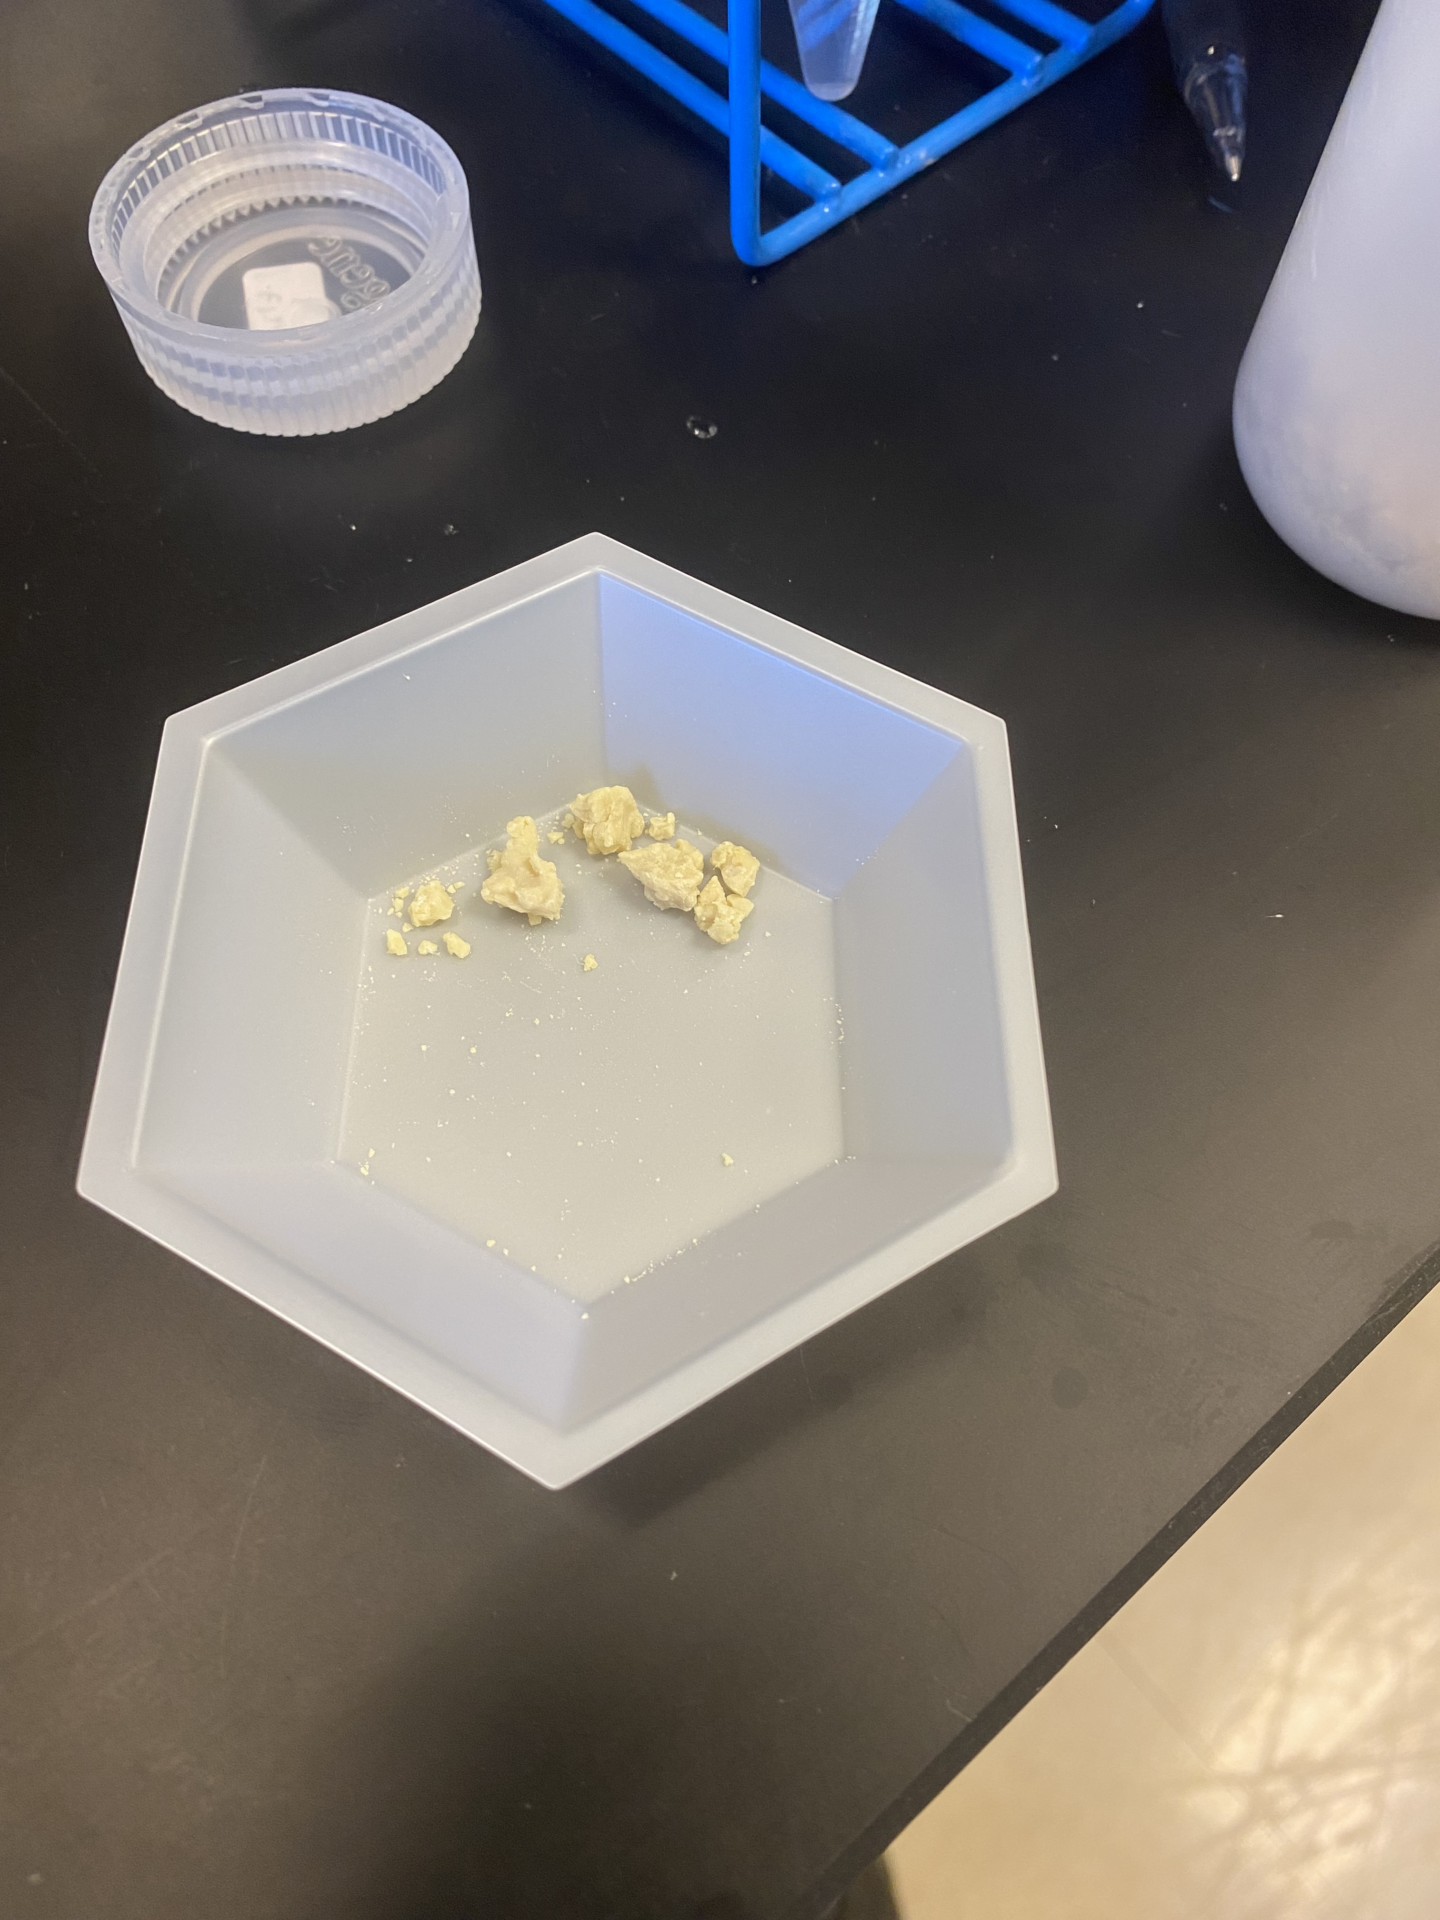
Result
Notes:
This is our product after filtering rinsing and drying. There are a couple things to note which we didn’t expect.

Slide 34
Result
Impurities potentially introduced – ZnS is supposed to be pure white
Notes:
It has a yellow tint, leading us to believe we may have introduced some kind of impurity

Slide 35
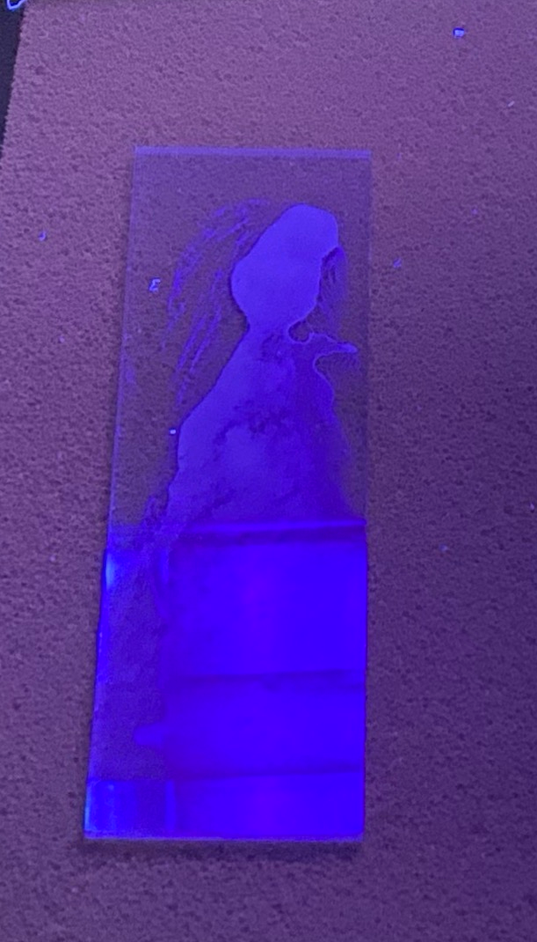
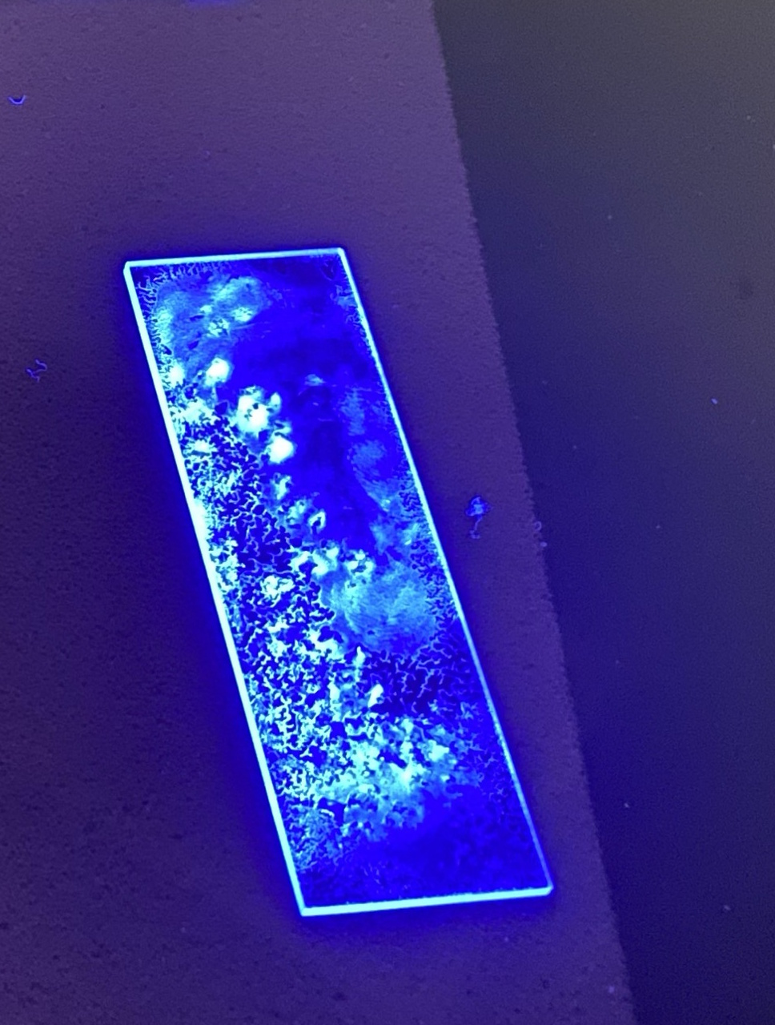
Result
Impurities potentially introduced – ZnS is supposed to be pure white
No fluorescence at this stage
SNOLAB ZnS
Eljen ZnS
Notes:
And our product also does not fluoresce, which commercial ZnS:ag does. While fluorescence isn’t a key trait, to be usable as an alpha scintillator, our zinc sulfide needs certain light emission characteristics.

Slide 36
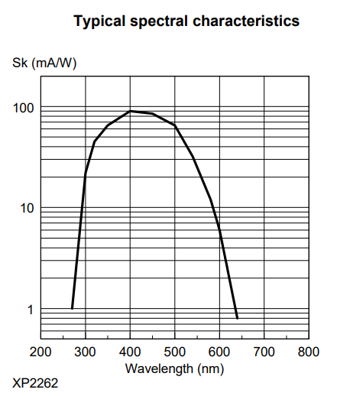
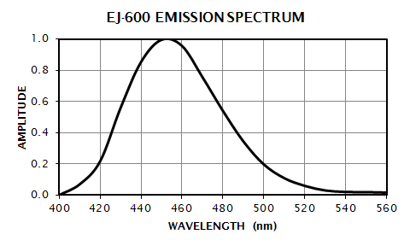
ZnS luminescence goals
Commercial ZnS emits around 450nm, while our PMTs are most sensitive around 420 nm
Light sensitivity of Philips XP2262 PMTs
Commercial ZnS(Ag) emission spectrum
Notes:
We need our ZnS to emit light in a wavelength that our PMTs are sensitive to. According to the PMT datasheet, that means the optimal emission should be 420nm wavelength light. For comparison, the commercial ZnS we use emits in a spectrum peaking at 450nm

Slide 37
Annealing ZnS
Annealing results in crystal defects which permit atomic transitions in visible range
Used as a step in certain doping procedures
Some impurities may be calcined off at 900C
Ozawa et al. (2005)
Sharma et al. (2019)
Notes:
To make our ZnS luminant, we added the subsequent step of annealing it at 900C. This is for three reasons - in undoped ZnS, annealing can induce crystal defects which permit energy transitions corresponding to luminance in the visible range. Annealing is also the final step in some silver doping procedures, which if successful would also make our ZnS luminant. Lastly, it could have the additional effect of calcining or burning off impurities.

Slide 38
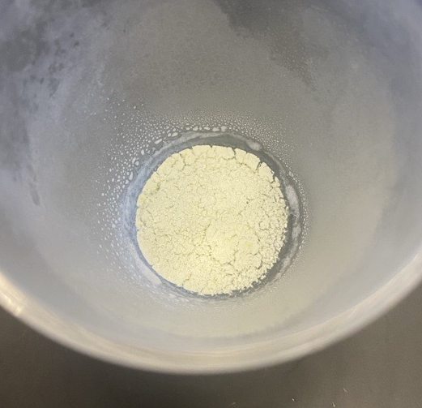
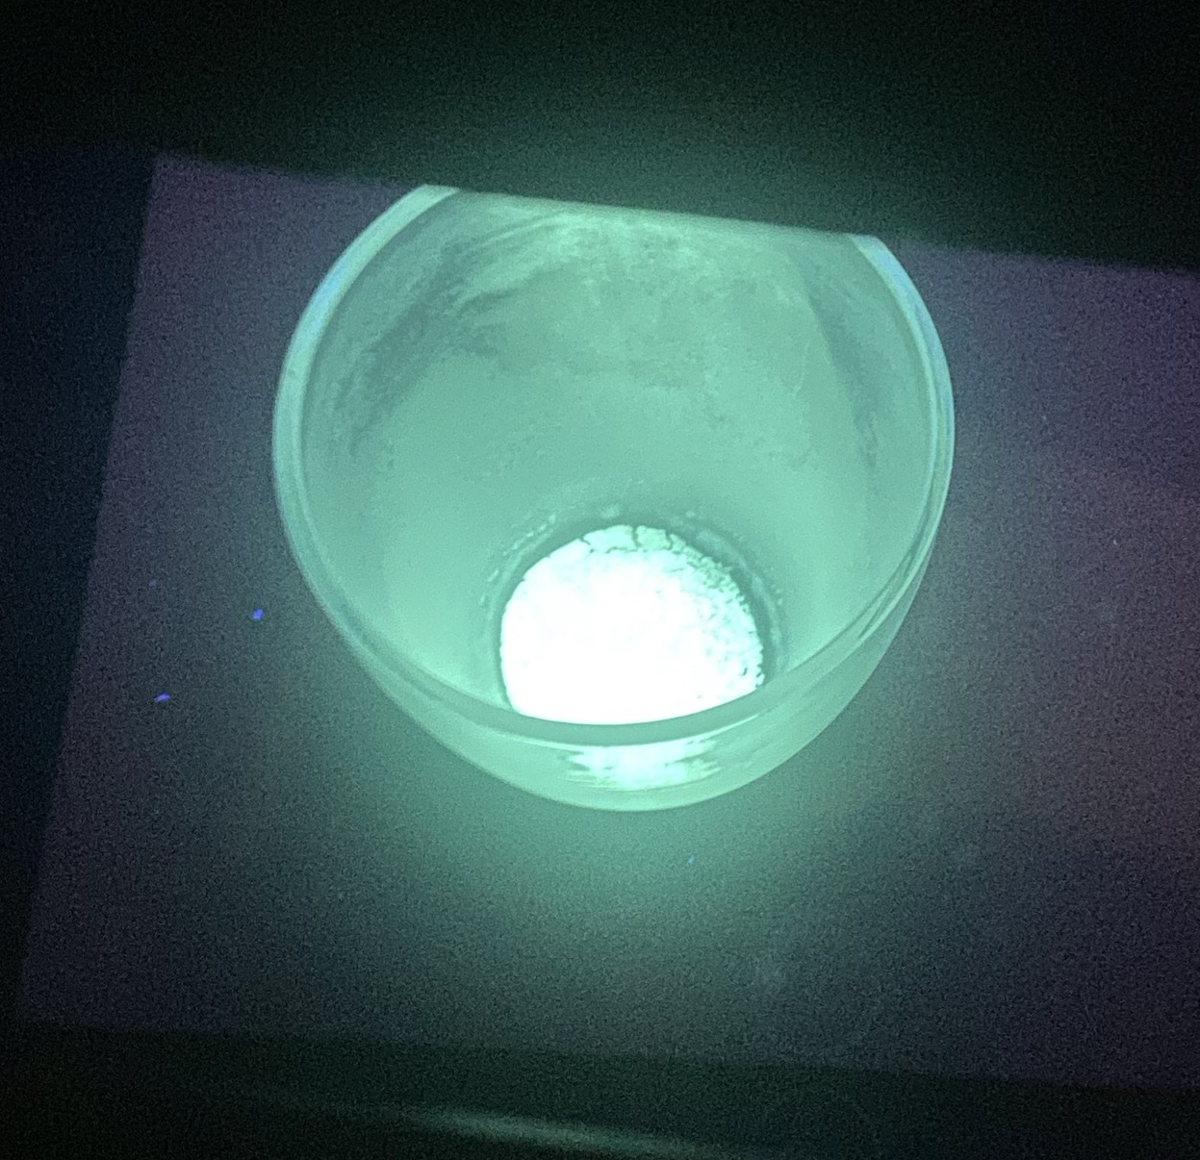
Success!
Product after annealing at 900C
Product under 365 nm UV light
Notes:
Annealing succeeded in giving us a product that looks almost pure white, so we might tentatively conclude that the calcination was successful. More importantly, we observe the luminance we were looking for!

Slide 39

rgb(0, 255, 203)
Hex: #00ffcb
λ = 495 nm
Notes:
It’s apparent that our product emits a different color than the commercial ZnS. Using software tools, we get a naïve conversion of the color to wavelength, giving us an estimate of 495 nm light. Reading off the PMT datasheet, our PMT is 90% as efficient at converting this light to current compared to the commercial ZnS

Slide 40
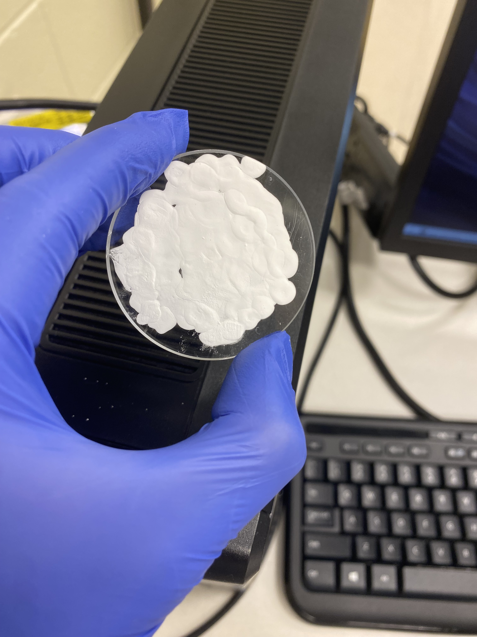
Alpha scintillation test
ZnS painted on an acrylic disk may scintillate in response to alphas
If PMTs detect alpha pulse:
  Our ZnS is sensitive to alphas, AND
  Our PMTs are sensitive to light emitted by our ZnS
Notes:
So we have reason to believe our PMTs are sensitive to the light our ZnS emits. But that was under UV and what we are interested in is whether the ZnS scintillates in response to alphas. To answer that we conducted this test. ZnS is painted onto an acrylic window. If we couple this window to a PMT, Rn present in lab air should decay and cause the zinc sulfide to scintillate. If we read that scintillation light from the PMT, our product is usable for Lucas cells

Slide 41
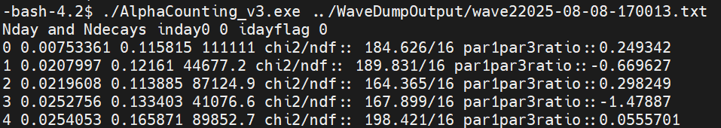
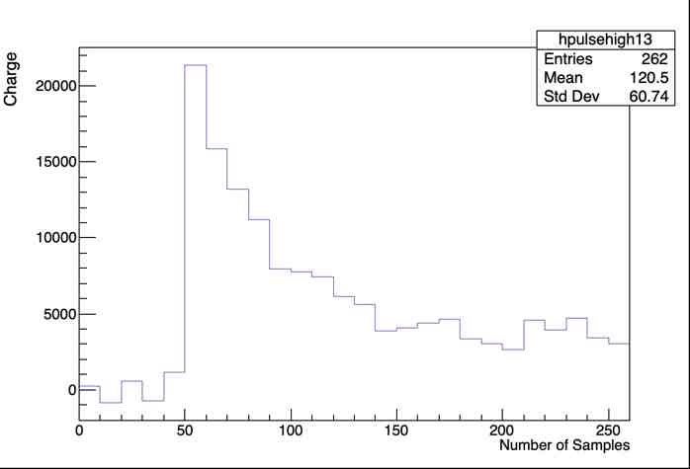
A working Rn counter
These are alphas!
Sample alpha trace
4 μs window
Notes:
And we achieved a positive result! That means we developed a technique that produces ZnS with all the traits we need to use in coating Lucas cells! We’ve just fabricated a Lucas cell with this zinc sulfide, so that when we do it all again with the selective precipitation, we can see what background reduction factor we achieved.

Slide 42
Summary
Developed method to produce clean ZnS
Performed a small-scale pilot run
Developed annealing campaign to improve light yield of product
Verified sensitivity of produced ZnS phosphors to Rn alphas
Notes:
In summary, following our finding last winter that ZnS is the primary contributor of alpha background in Lucas cells, we developed a method to produce ZnS at SNOLAB. We verified that this ZnS is usable as an alpha counter and are now ready to begin a larger-scale production involving steps to eliminate ZnS background .

Slide 43
Next steps
Fabricating a Lucas cell
Performing ZnS synthesis with selective precipitation steps
Background counting
Investigate alpha-counting efficiency
Understand physical characteristics of our product
Pursue refinements to light-yield, emission spectrum
Notes:
So what’s next? We are going to make a Lucas cell with the ZnS we produced so that we later understand the background reduction factor we achieve with the selective precipitation technique.
We determined that the ZnS is somewhat sensitive to alphas, but we would like to understand the alpha-counting efficiency to know how many alphas are potentially being missed.
After that, we can investigate whether we can affect the factors in alpha counting efficiency such as by improving light yield or finetuning the emission spectrum. Further a question that remains is whether our silver-doping was effective. We want to use techniques such as electron microscopy and electron diffraction spectroscopy to answer that and to better understand our product.

Slide 44
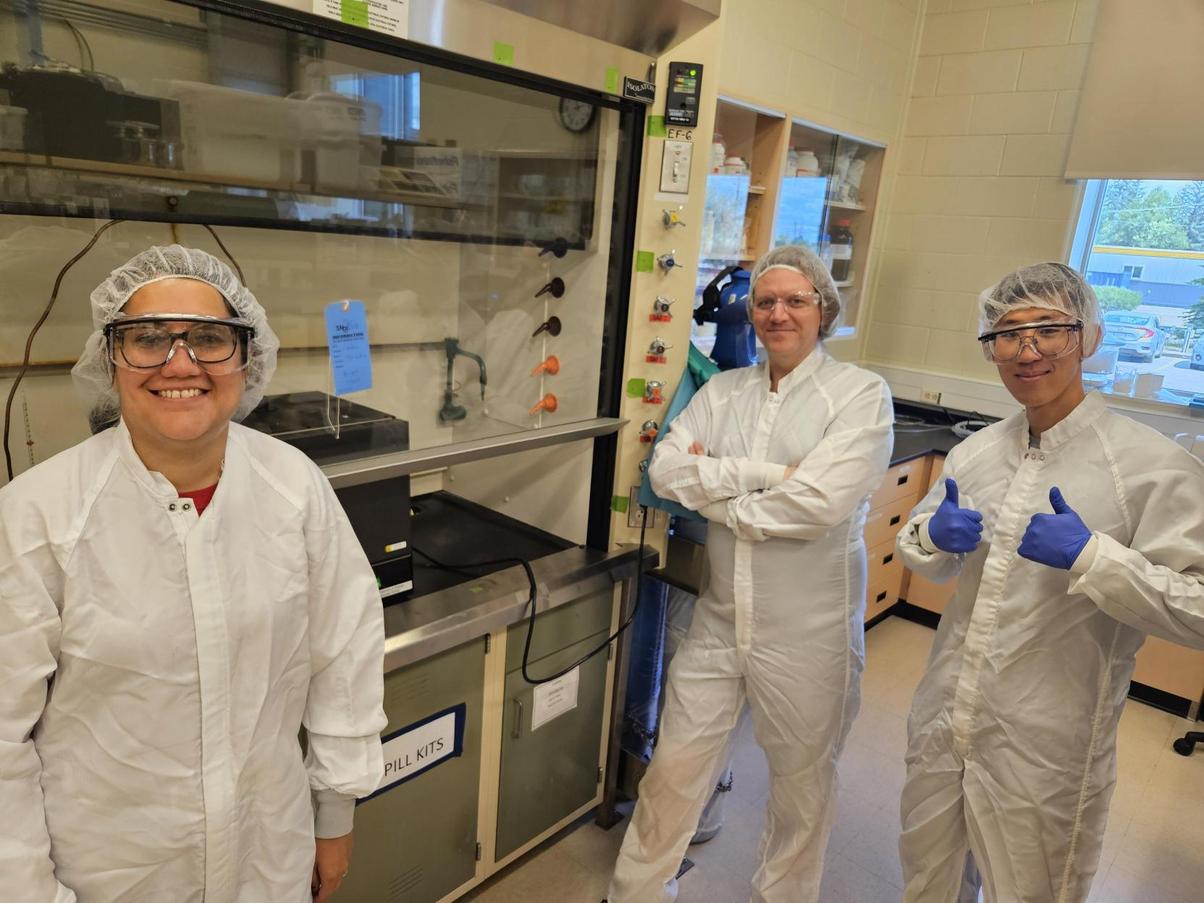
Acknowledgements
My supervisors, Nasim and Lina
Steve Maguire
Scientific Support
Keegan Paleshi
Adam Gionet
Mark Ward
Local SNO+ group (LU)
Notes:
Before I conclude my talk, I want to thank my supervisors, Lina and Nasim, Steve for his chemistry expertise which provided the foundation for this project, the chemical technologists who were always there to answer questions or help out

Slide 45
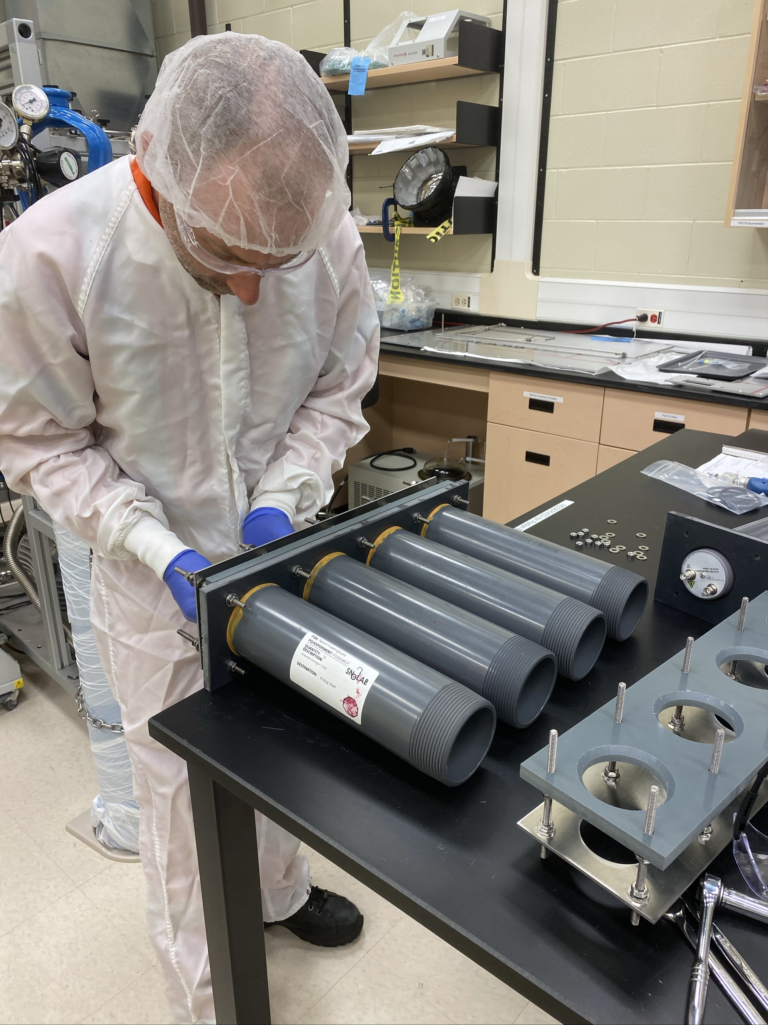
Acknowledgements
My supervisors, Nasim and Lina
Steve Maguire
Scientific Support
Keegan Paleshi
Adam Gionet
Mark Ward
Local SNO+ group (LU)
Notes:
I also want to thank to Mark and Adam the industrial technologist for their help installing new DAQ hardware

Slide 46
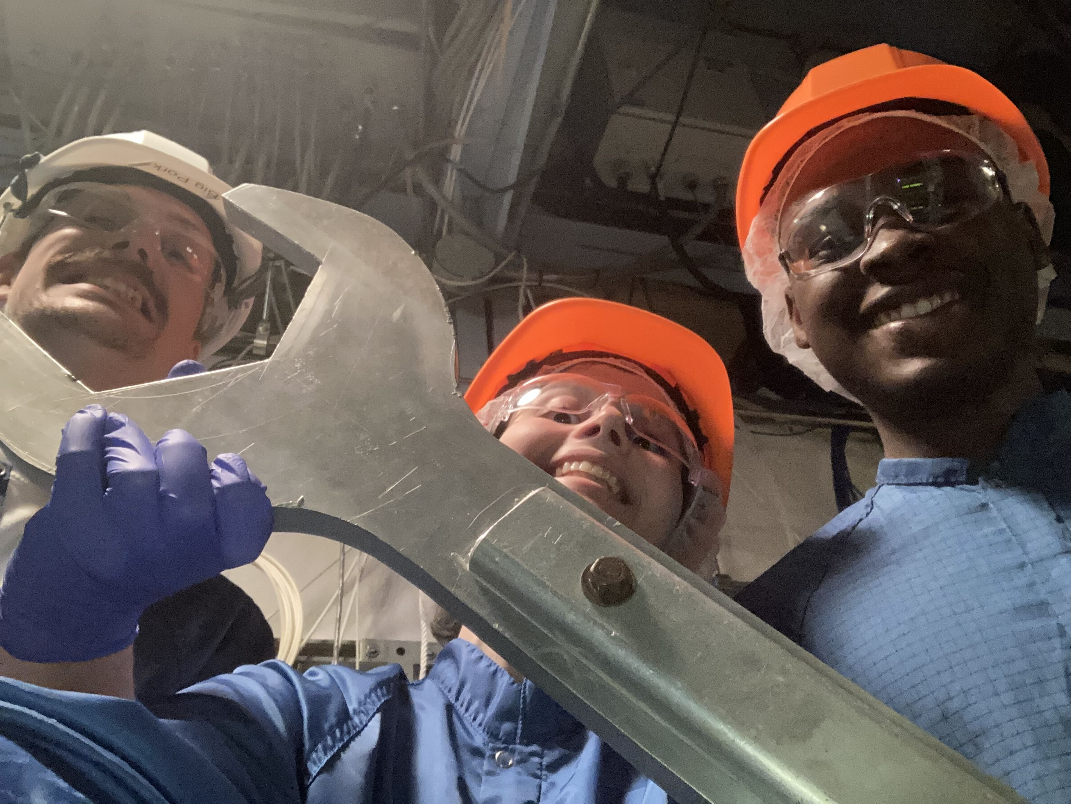
Acknowledgements
My supervisors, Nasim and Lina
Steve Maguire
Scientific Support
Keegan Paleshi
Adam Gionet
Mark Ward
Local SNO+ group (LU)
Notes:
Lastly I want to thank the local SNO+ group for their various ideas and contributions to assay and Lucas cell research and development

Slide 47
Thanks for listening!
Notes:
Thank you for listening! Before taking questions, I’d like to give some acknowledgments

Slide 48
Questions?
Notes:
Before I field questions, I’ll say that for more technical chemistry questions, I will answer them as best I can but they really are best directed to Steve Maguire. Other than that, I’m happy to go into more detail about my work this term.

Slide 49
Backup slides

Slide 50
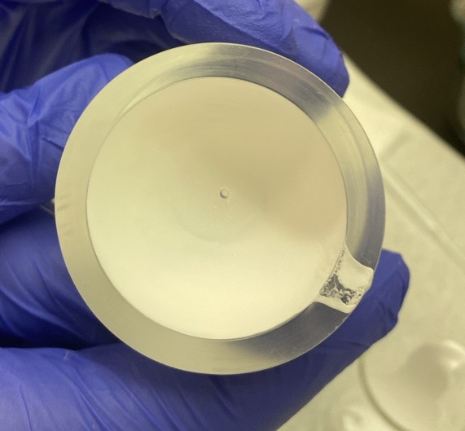
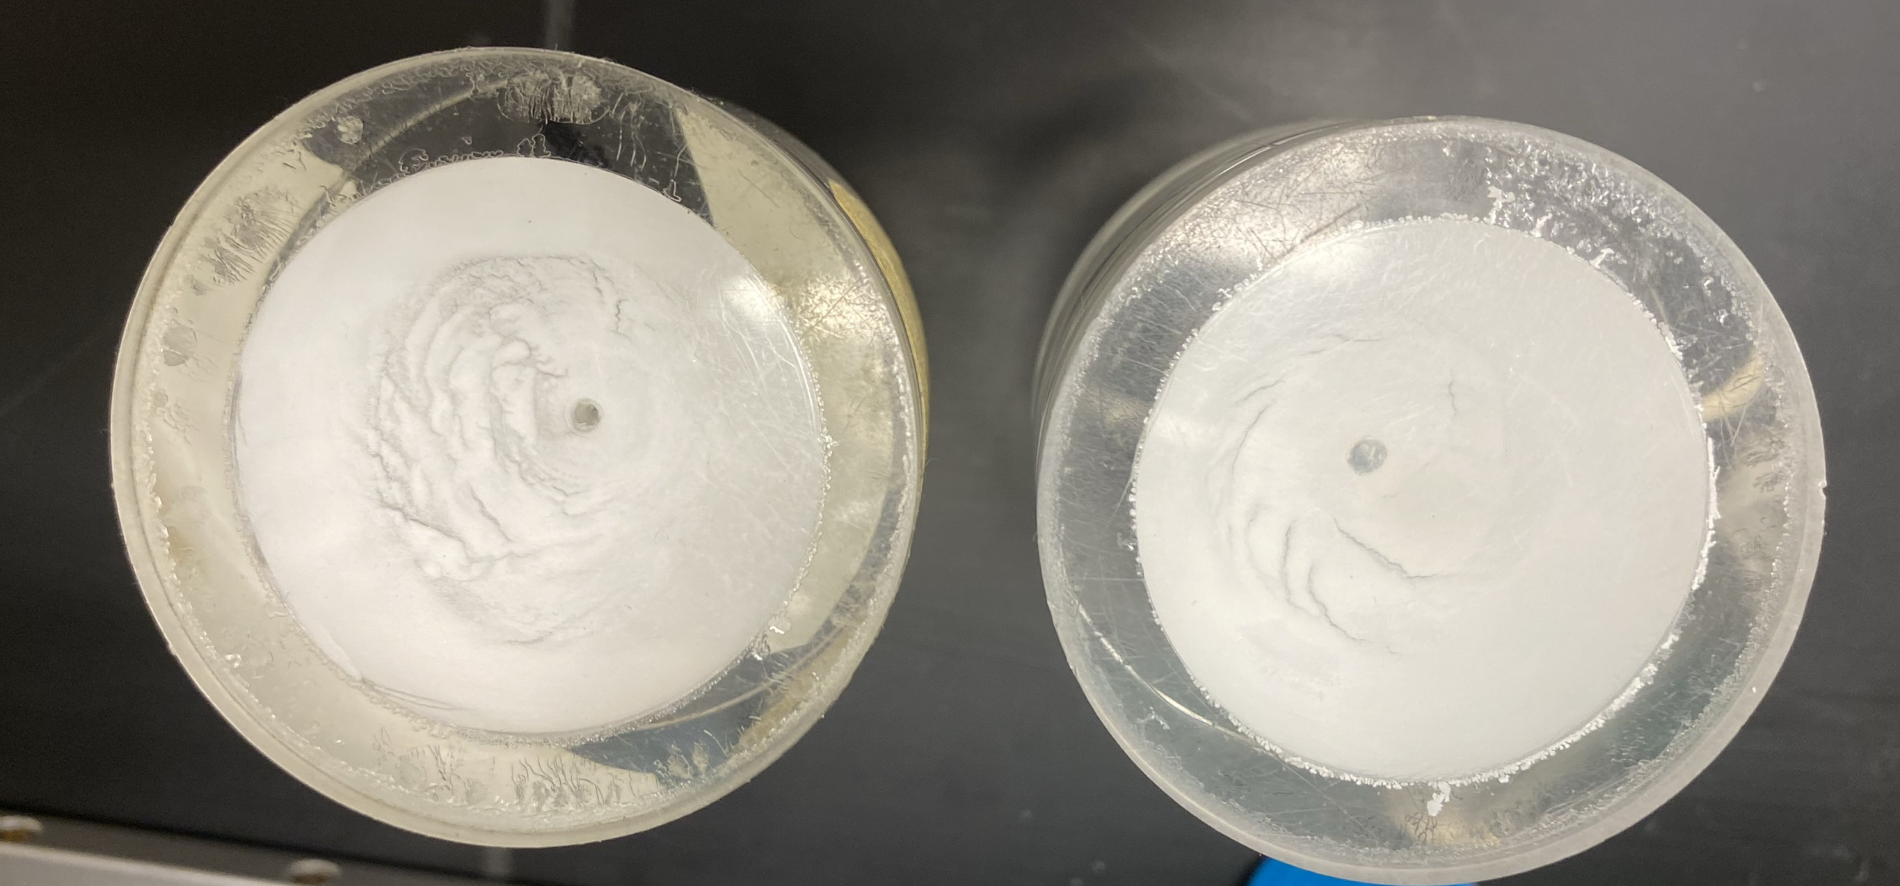
Last term
Developed capability to fabricate Lucas cells at SNOLAB
Refined Lucas cell coating technique
Found that Lucas cell background largely contributed by ZnS
Notes:
Last term, I focused on bringing the ability to fabricate Lucas cells to SNOLAB, where previously they had only been made at Queens. We made some refinements to our coating process and most importantly found that Lucas cell background is contributed largely by ZnS, not other components like acrylic

Slide 51
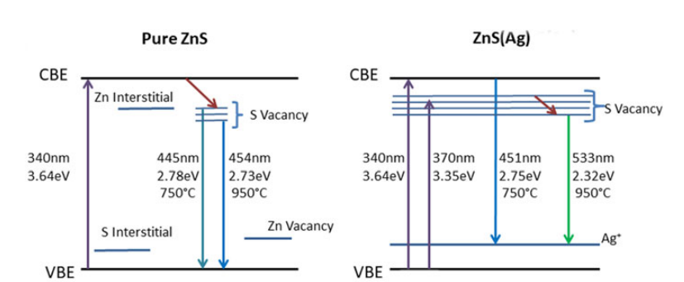
ZnS luminescence theory
From Sharma et al. (2019)
Notes:
This 450nm emission comes from the doping of ZnS with silver ions. These ions provide an intermediate energy level for electrons between the conductance and valence bands which permit energy transitions that correspond to light emission. However, other crystal defects in undoped ZnS can provide these intermediate energy levels too.

Slide 52
Alpha pulse profile
Notes:
We’d used the zinc sulfide painted acrylic window as a test bed for commercial ZnS as well. One difference that can be observed is that the pulse profile is slightly different. The fall time of alpha pulses in our product is visibly longer.

Slide 53
New DAQ hardware
Notes:
Before I end my talk, I’ll talk a little bit about the new DAQ hardware we installed

Slide 54
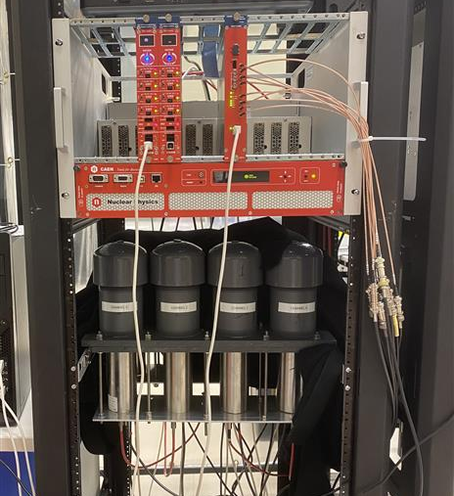
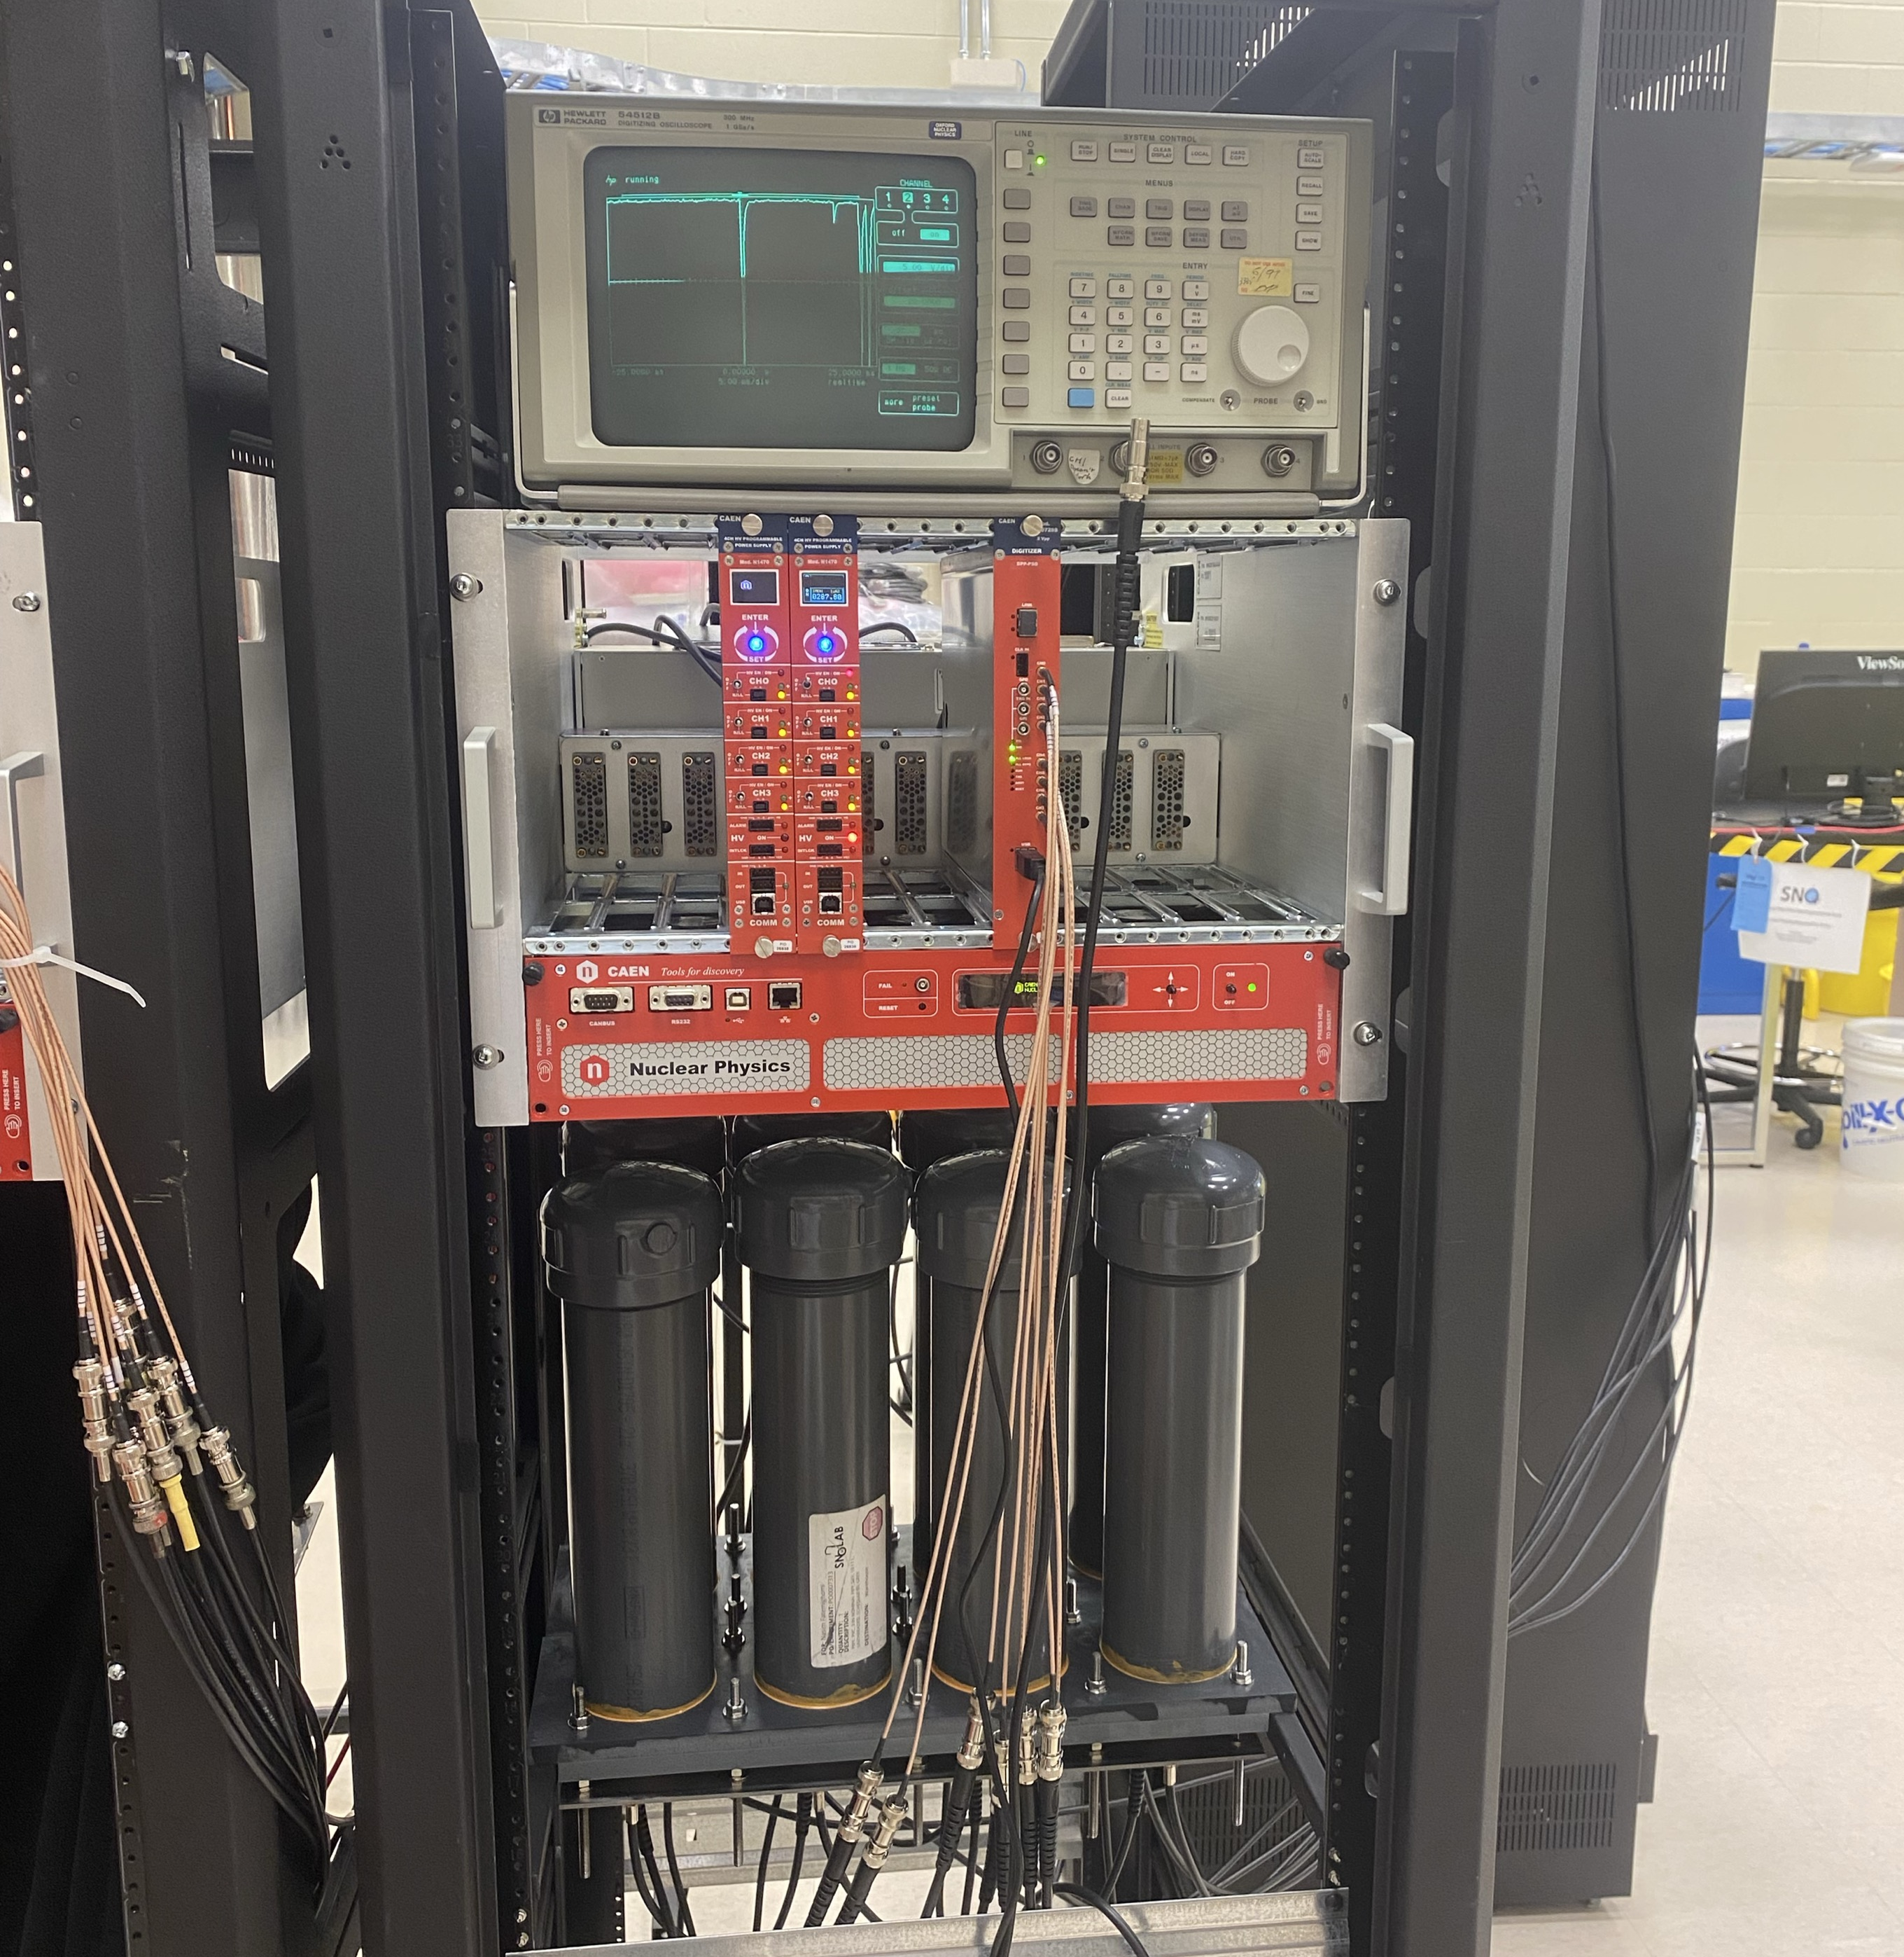
Hardware installation
Existing DAQ
Additional channels added this term
Notes:
The goal here was to just to replicate our existing DAQ setup, which you can see on the left. Visually, there’s not much difference as the hardware is almost all the same. But the new digitizer we bought actually shipped with a new firmware, which affects the kind of readout software we’re able to use

Slide 55
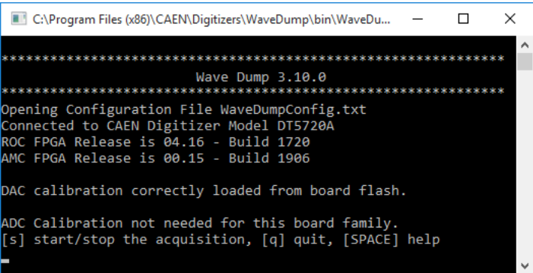
Generations of CAEN digitizer readout software
Trusted ally since 2019
Doesn’t work with new firmware
Notes:
This is WaveDump, the software we have been using since 2019. It works with the waveform reading firmware old digitizers shipped with but not the digital pulse processing firmware that new ones do. However, we are still able to use it by flashing the digitizer with old firmware.

Slide 56
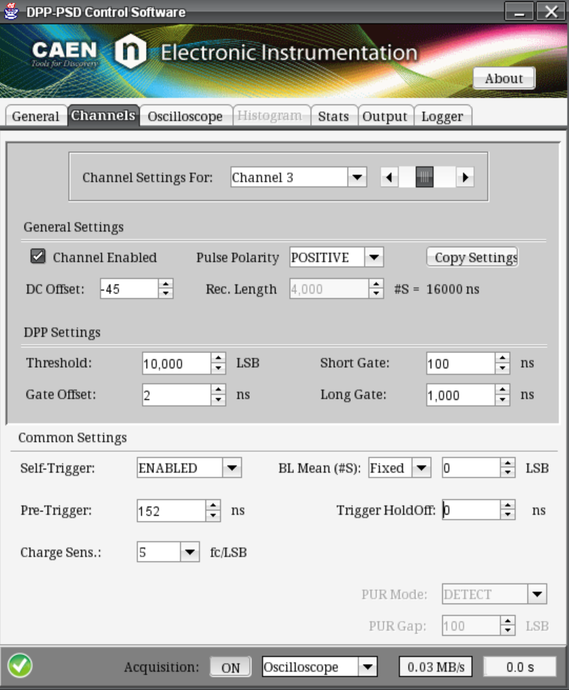
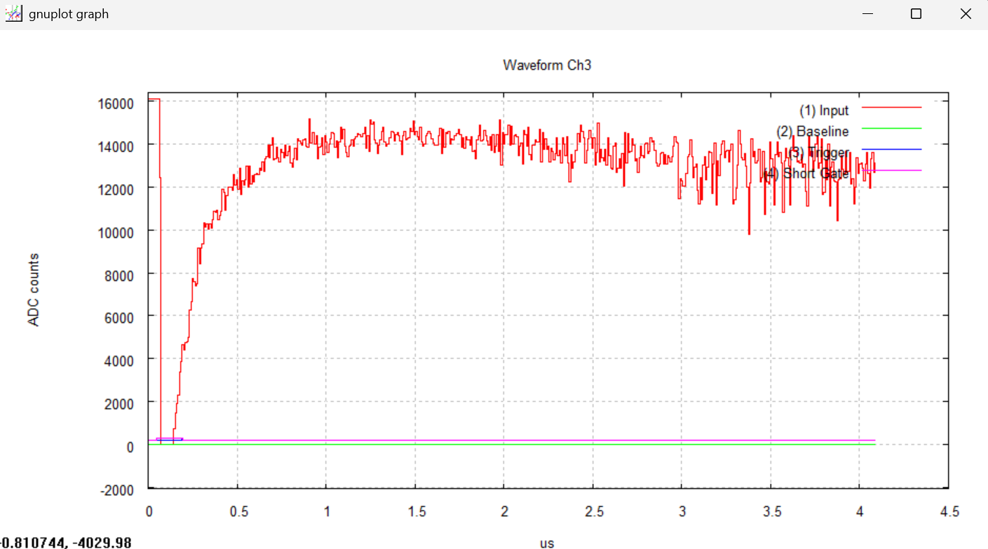
Generations of CAEN digitizer readout software
Discontinued, sparse documentation
Notes:
This was the control software that the new firmware shipped with when it was released. It’s mostly irrelevant, but I tried it anyways.

Slide 57
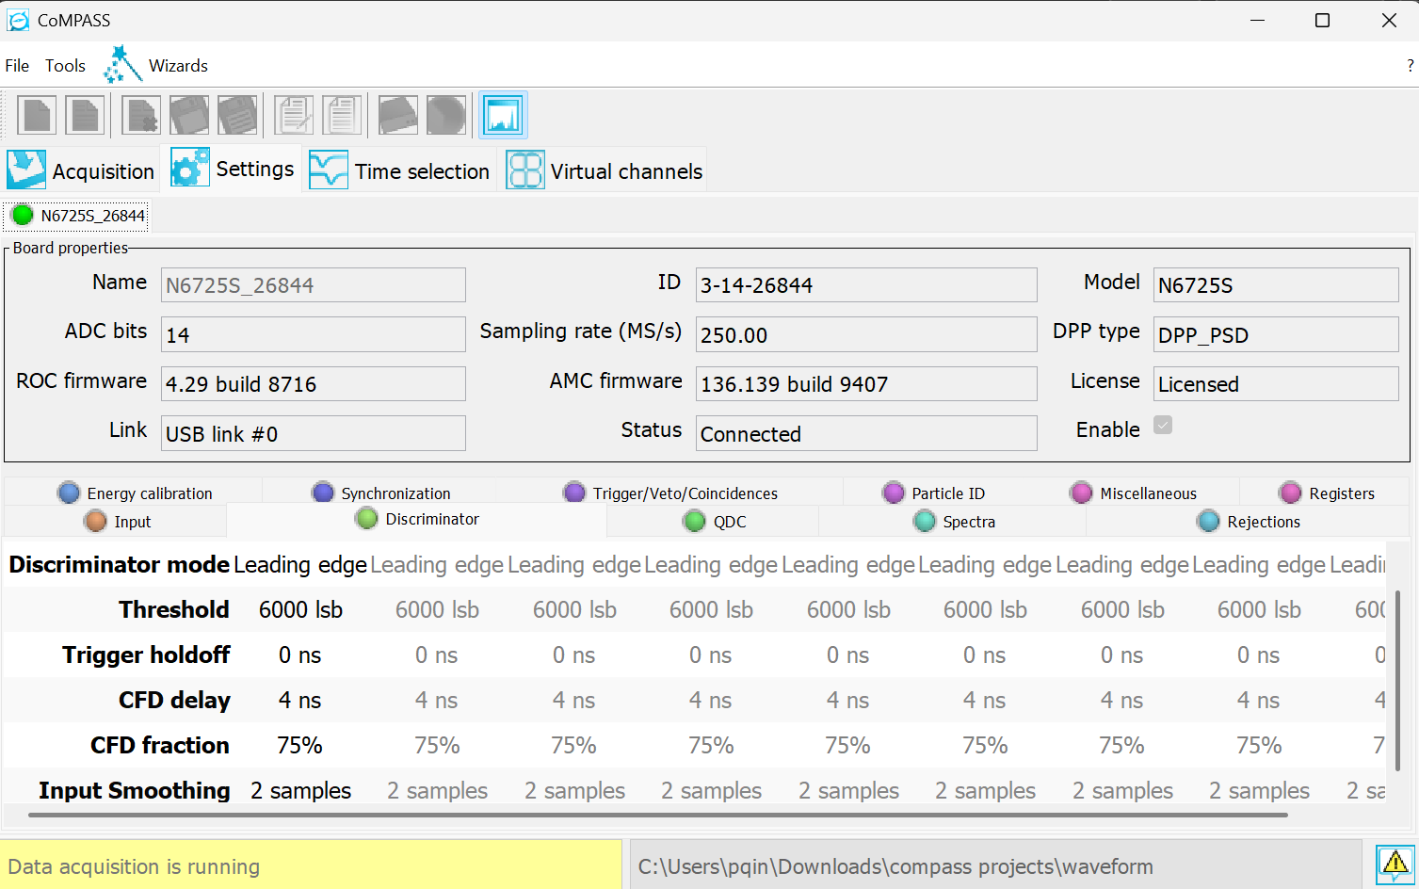
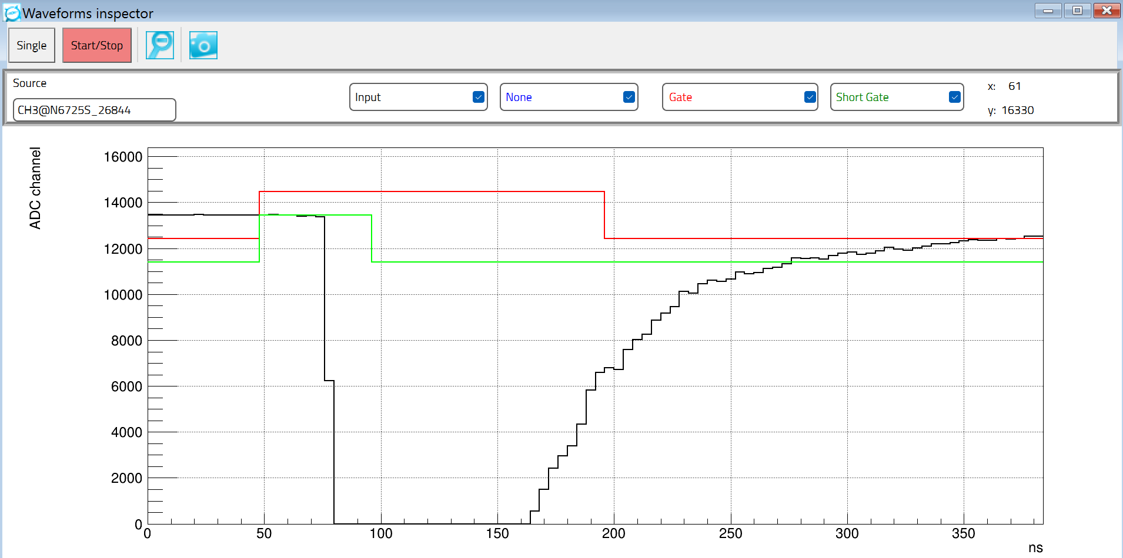
Generations of CAEN digitizer readout software
Current-generation CAEN digitizer readout software
Notes:
And this CoMPASS, the newest software CAEN want us to use. It has plenty of fancy features like built in tools for energy calibration, ROOT file output, pulse shape discrimination and coincidence counting. However, it’s not open source and we can’t make code changes to it. It also crashes more frequently than wavedump. So for now, we’ve opted to use the same control software we always have, but this is definitely an interesting direction open for us to take in terms of future development

Slide 58
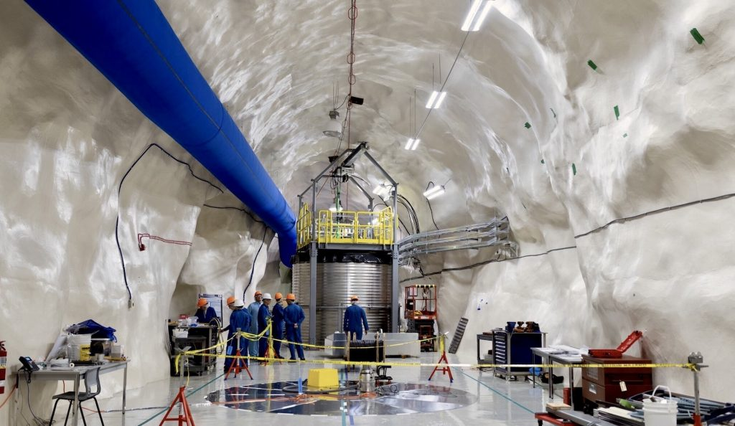
Radon control at SNOLAB
Lab infrastructure
Cleanroom fabrication, surface prep (etching/passivation)
LBL capabilities including ICP-MS, HPGe, XIA and more
Notes:
As their hosts, SNOLAB also makes efforts to minimize Rn and through the Low Background Lab

Slide 59
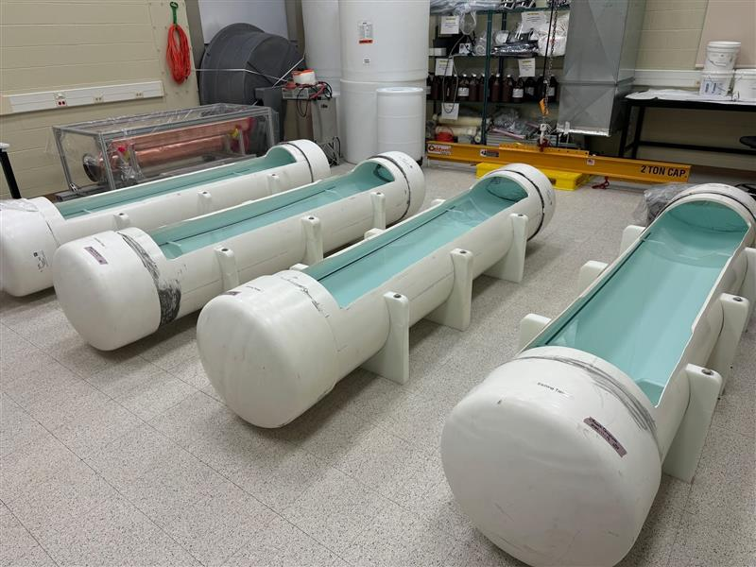
Radon control at SNOLAB
Lab infrastructure
Cleanroom fabrication, surface prep (etching/passivation)
LBL capabilities including ICP-MS, HPGe, XIA and more
Notes:
As their hosts, SNOLAB also makes efforts to minimize Rn and through the Low Background Lab

Slide 60
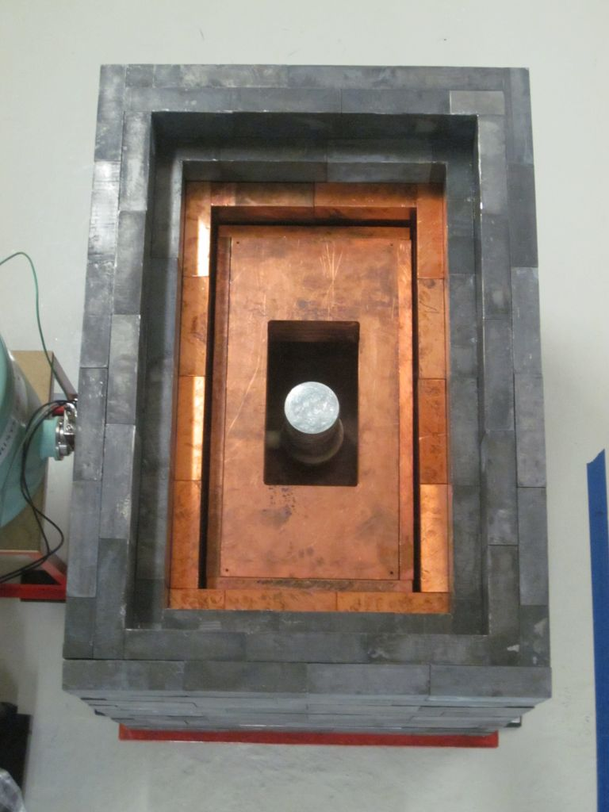
Radon control at SNOLAB
Lab infrastructure
Cleanroom fabrication, surface prep (etching/passivation)
LBL capabilities including ICP-MS, HPGe, XIA and more
Notes:
As their hosts, SNOLAB also makes efforts to minimize Rn and through the Low Background Lab

Slide 61
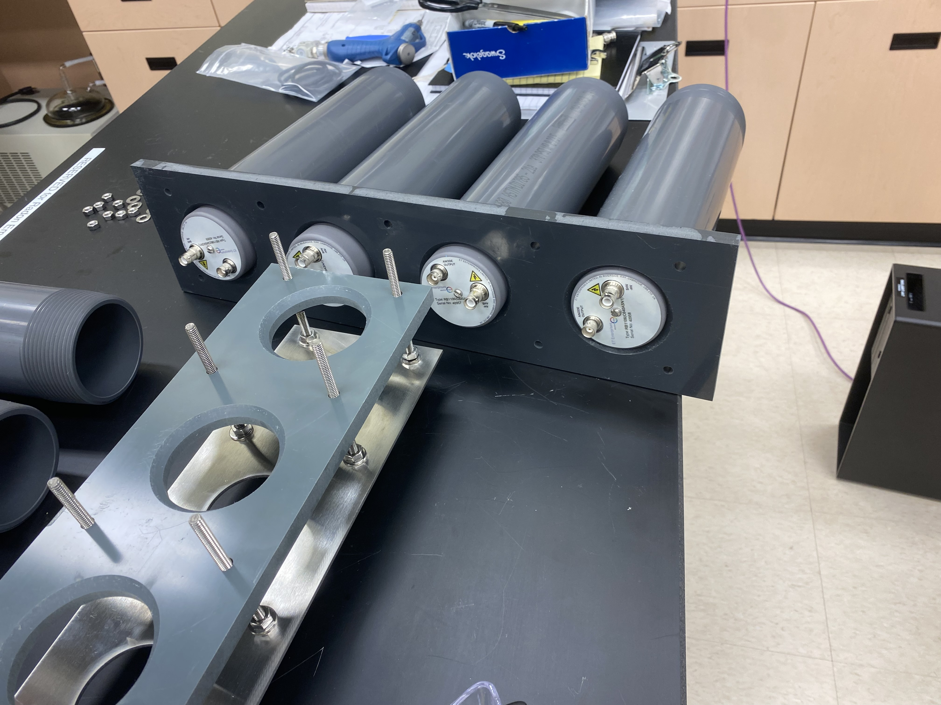
Hardware installation

Slide 62
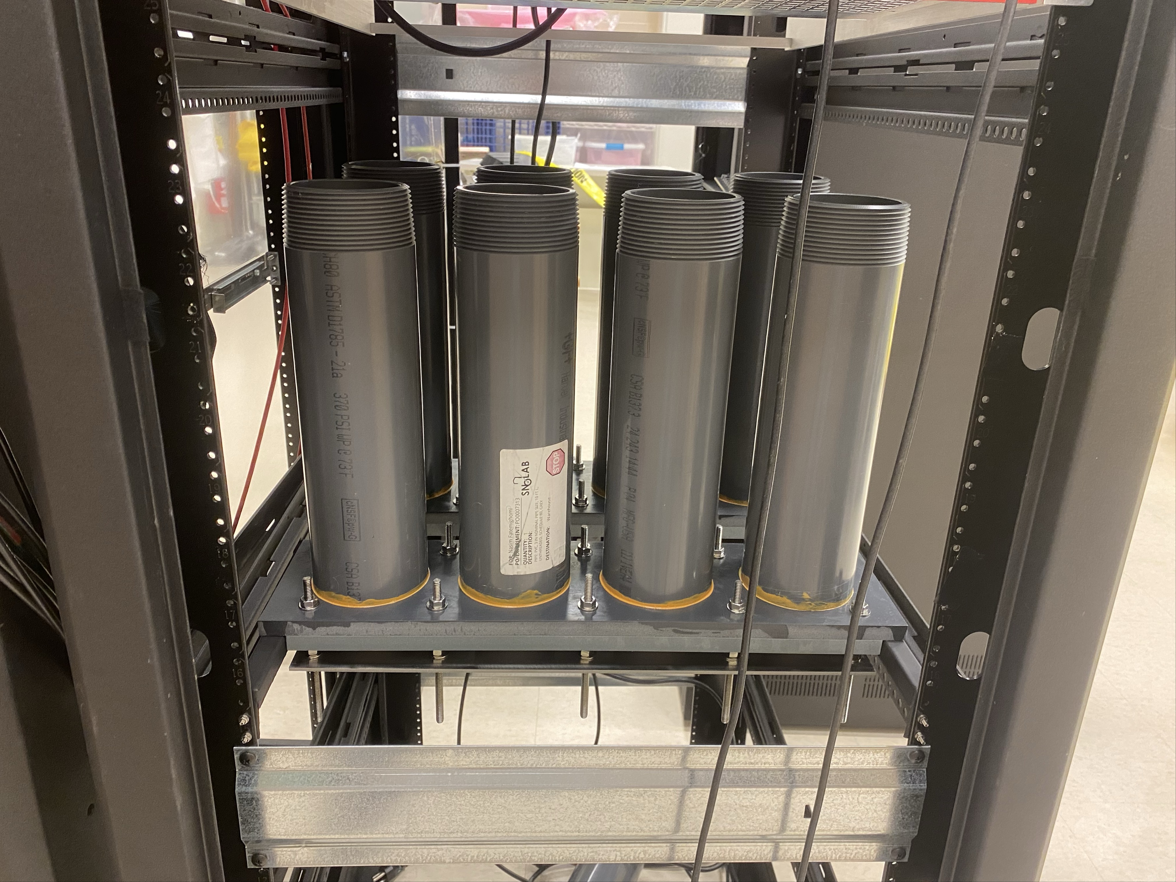
Hardware installation

Slide 63
Future Directions
Notes:
I’ll now introduce Lucas cells – the who what where when why and how

