Slide 1

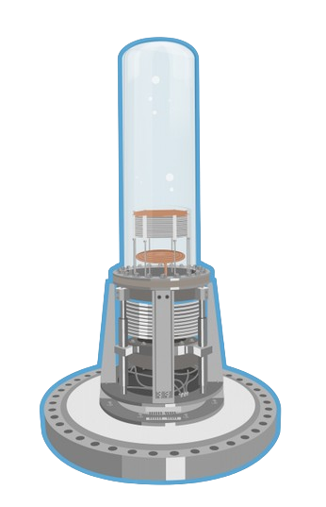
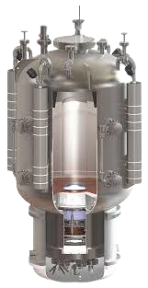

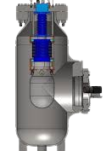
Prepare for Trouble
and make it
Bubble
Cody O’Neill — SNOLAB / PICO — Dr. Ian Lawson

Slide 2

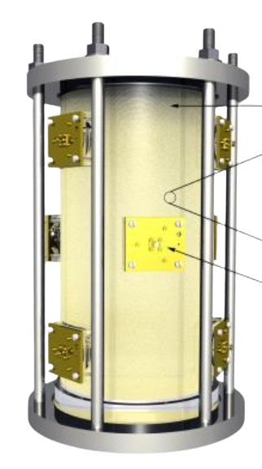
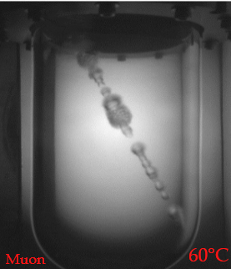
What is the PICO Collaboration?
Direct Detection of Dark Matter
Spin-Dependent WIMP Proton Scattering
Adjustable Event Threshold
PICASSO + COUPP → PICO

Slide 3
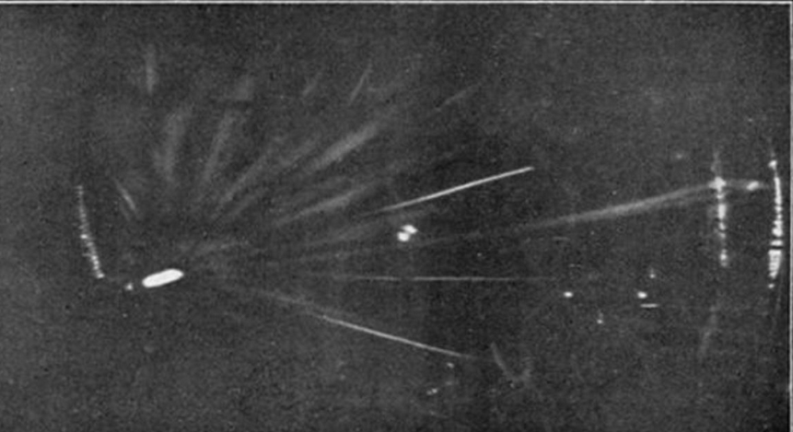
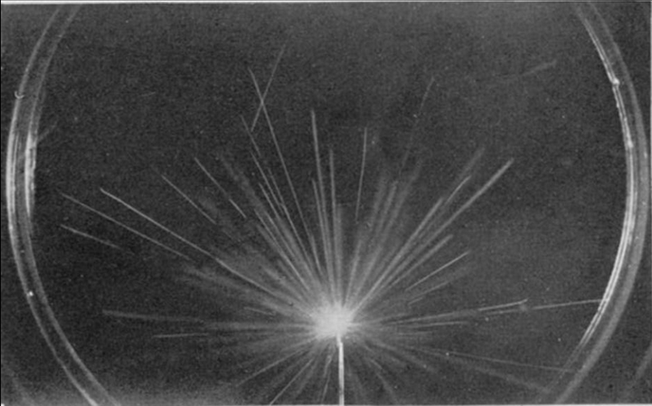
A Brief History of Bubble Chambers
100 Year Old Technology that’s steadily Improving
Superheated fluid
Fluid held near Phase Transition
Metastable state between liquid and gas
Bubble Formation
Local Shifts in Energy can trigger phase change
Energy deposited differs by particle LET
Radium Source in a Wilson Cloud Chamber (1911 / 1912)

Slide 4
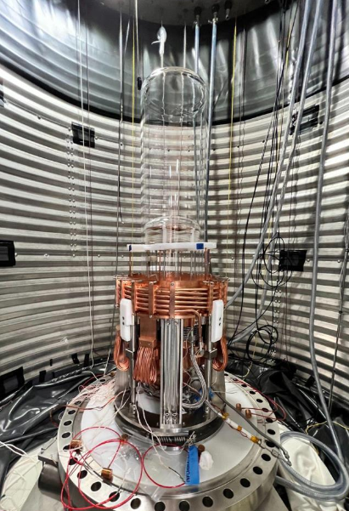
PICO-40 A Modern Bubble Chamber
Superheated C₃F₈
F¹⁹ → Spin-Dependent Target
Synthetic Quartz Glass Jar
Eliminate nucleation and Radioactivity
Cameras and Acoustic Sensors
Detect bubbles from particle interactions
Thermodynamic Rejection
Filters low energy electron recoils

Slide 5
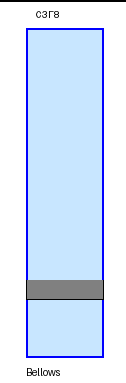
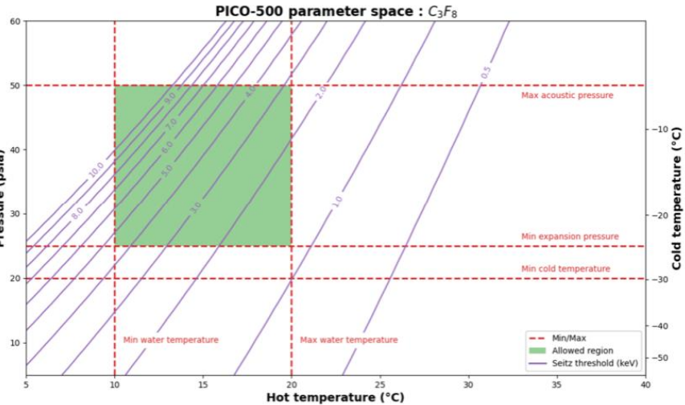
PICO-40 A Modern Bubble Chamber
Setiz Threshold for ~25nm regions

Slide 6

PICO-40 A Modern Bubble Chamber

Slide 7
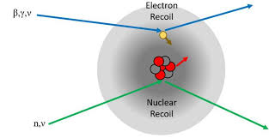
Events in PICO
Electron Recoils
Gammas / Betas
Low Energy
Doesn’t nucleate bubbles
Alphas / High E Neutrons
Multi Bubble Events
High Acoustic Parameter
Thermal Neutrons / WIMPs
Single Bubble Events
Indiscriminable
Identified by event rates through calibration

Slide 8
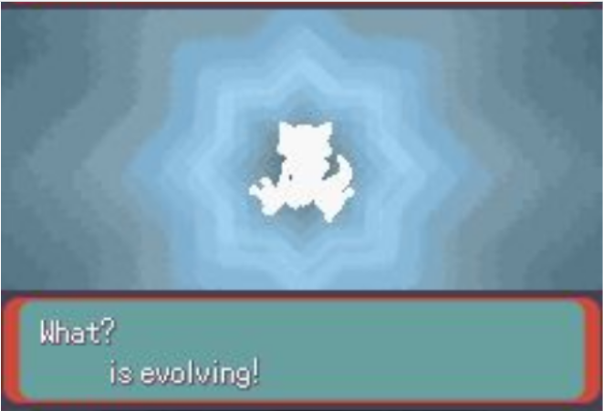

PICO-40

Slide 9
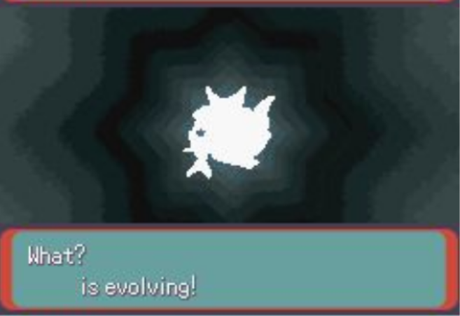
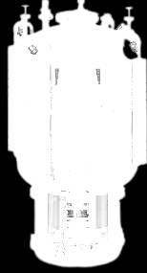
PICO-40

Slide 10
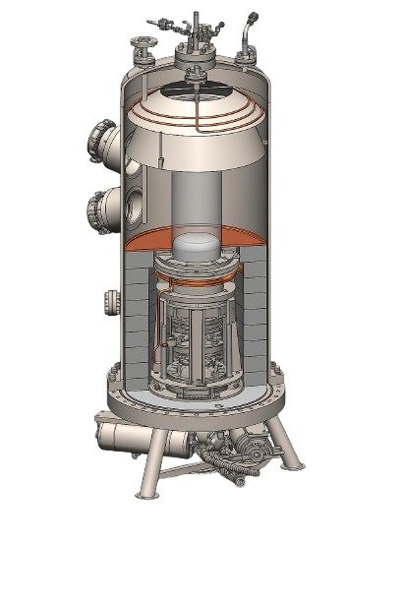
Scaling Up For Sensitivity
PICO 40L:
~40 Litres
~52 Kg C₃F₈
PICO 500:
~250 Litres
~325 Kg C₃F₈

Slide 11
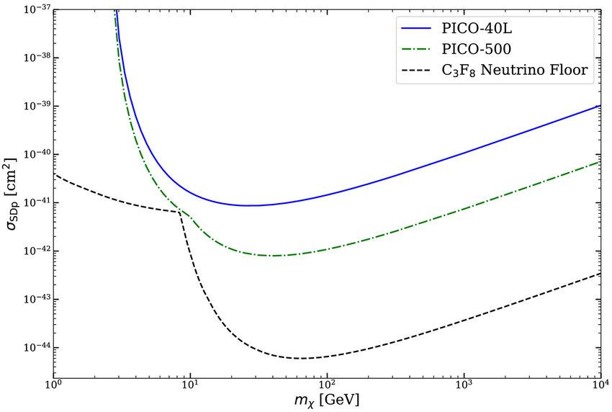
Scaling Up For Sensitivity
2-5x Background Reduction
30-50% uptime increase
6x larger target Volume
Higher Sensitivity → New Goals!
~3 GeV WIMP mass Threshold
CEvNS SN Neutrinos

Slide 12
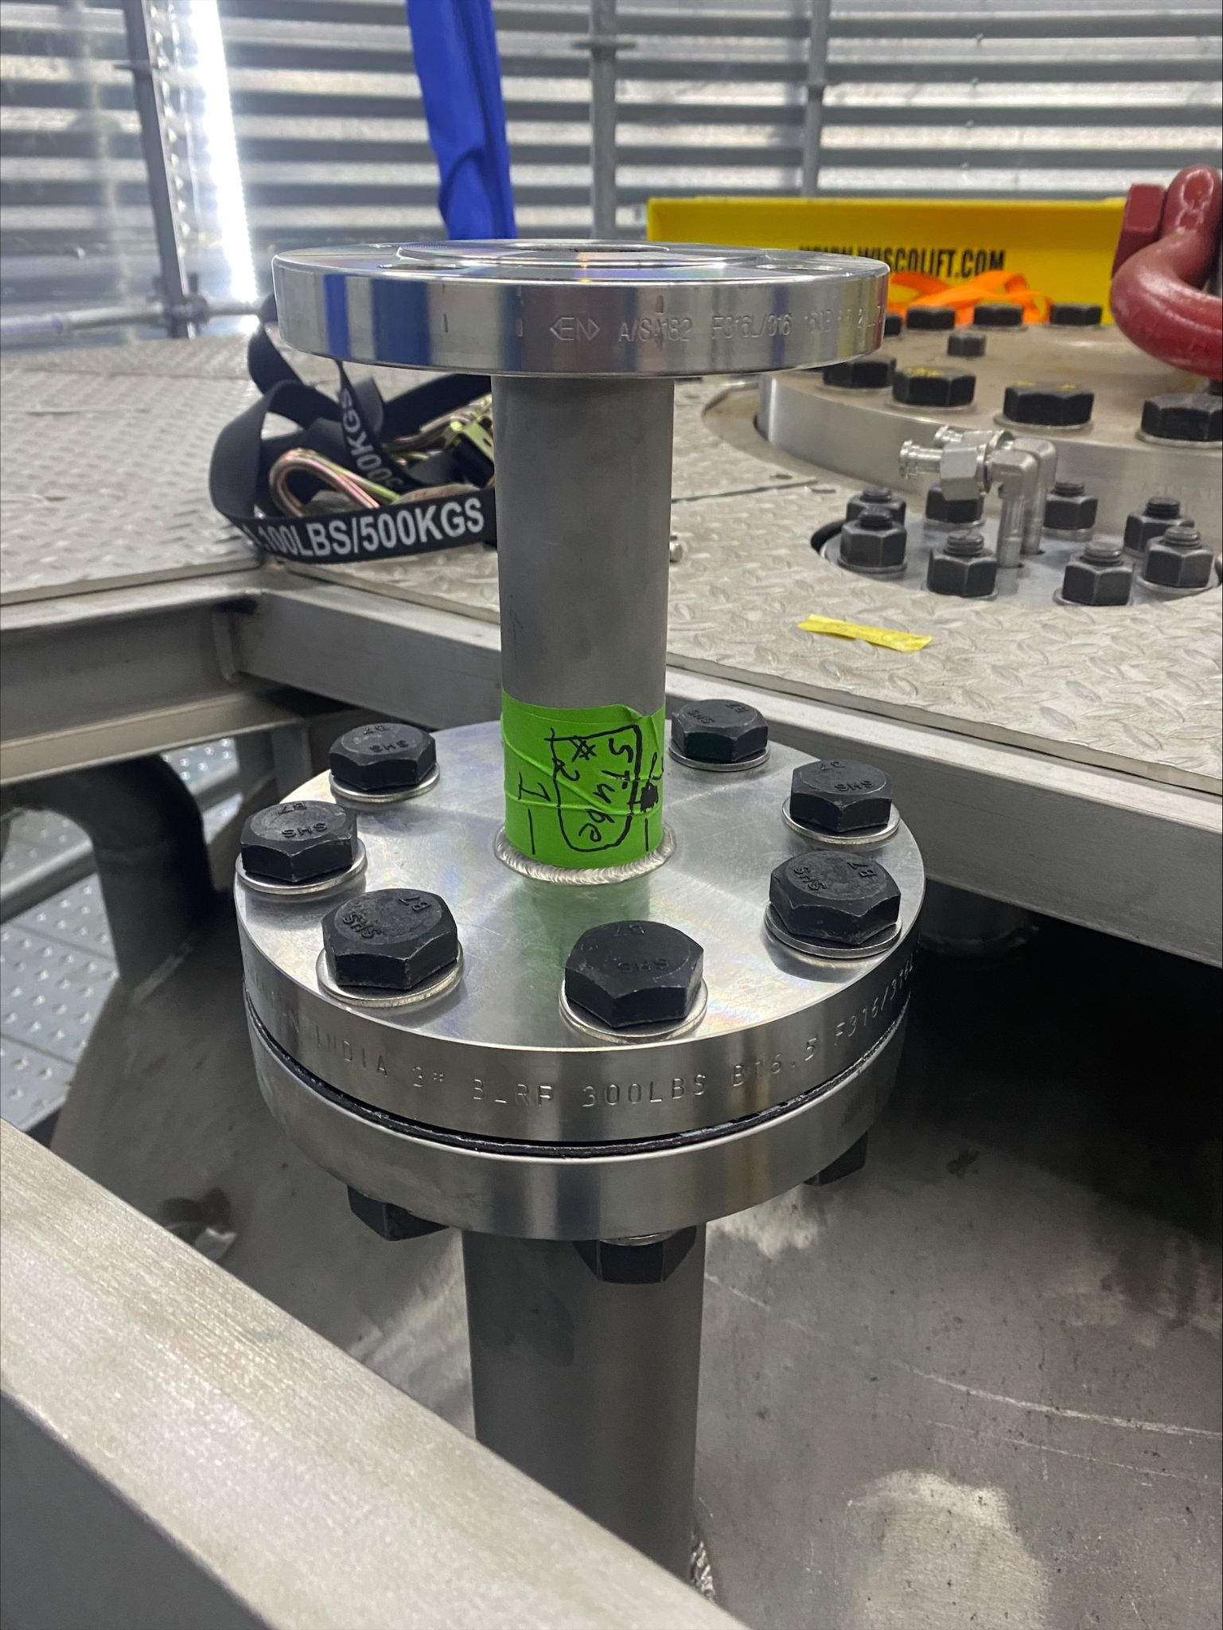
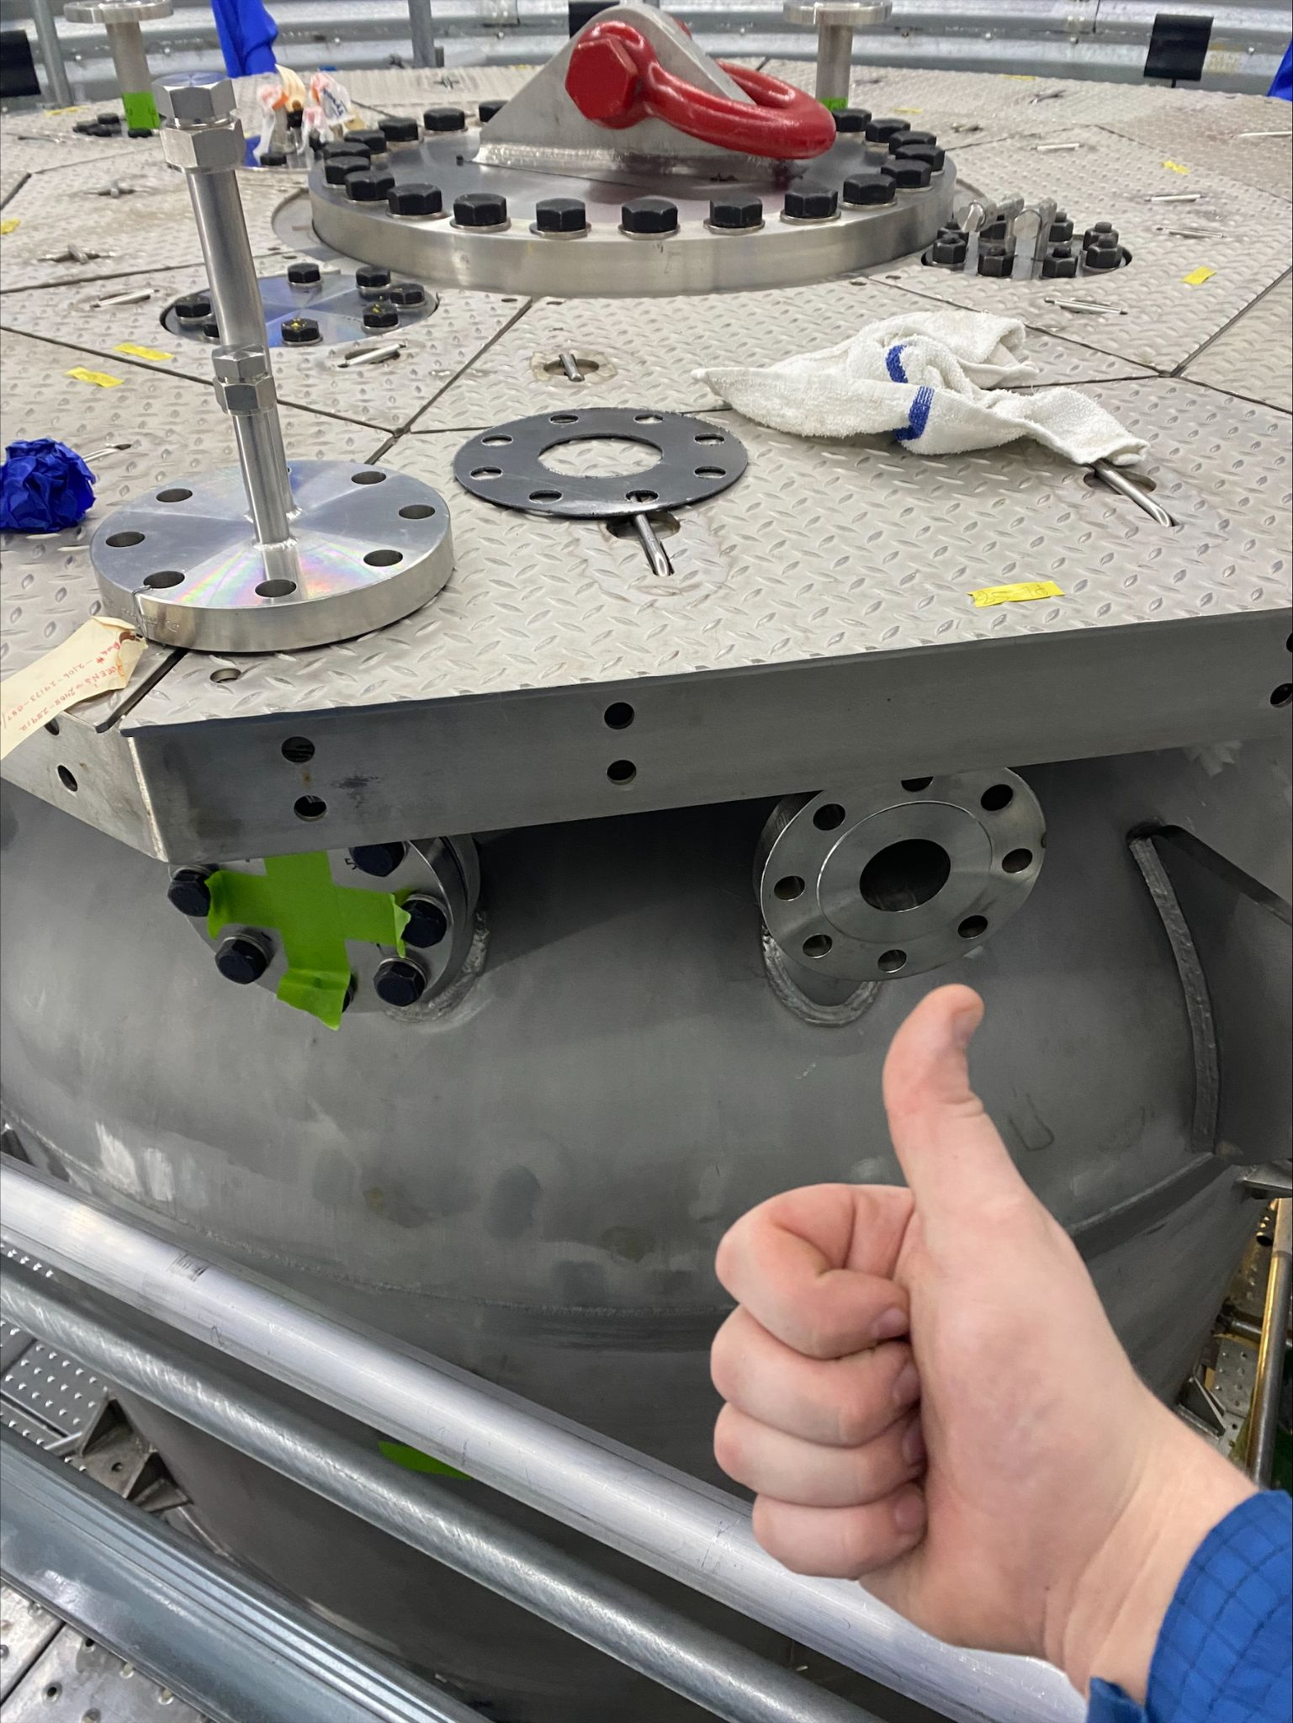
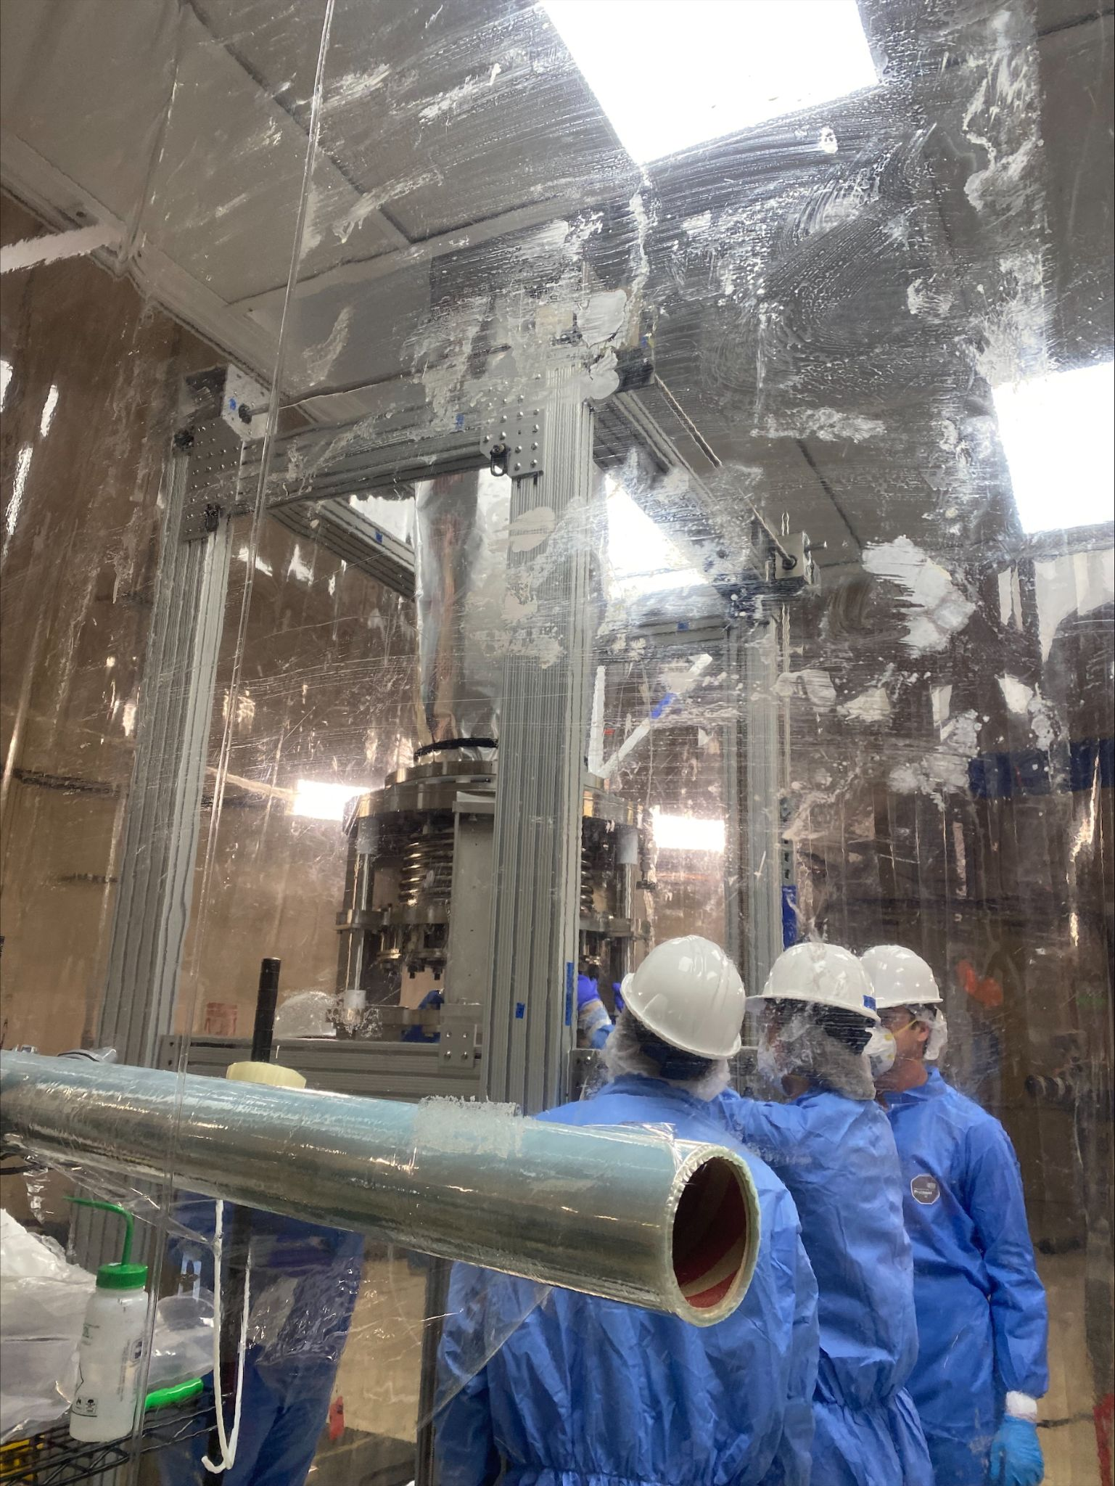
From Parts to Particles - Hardware & Inventory

Slide 13
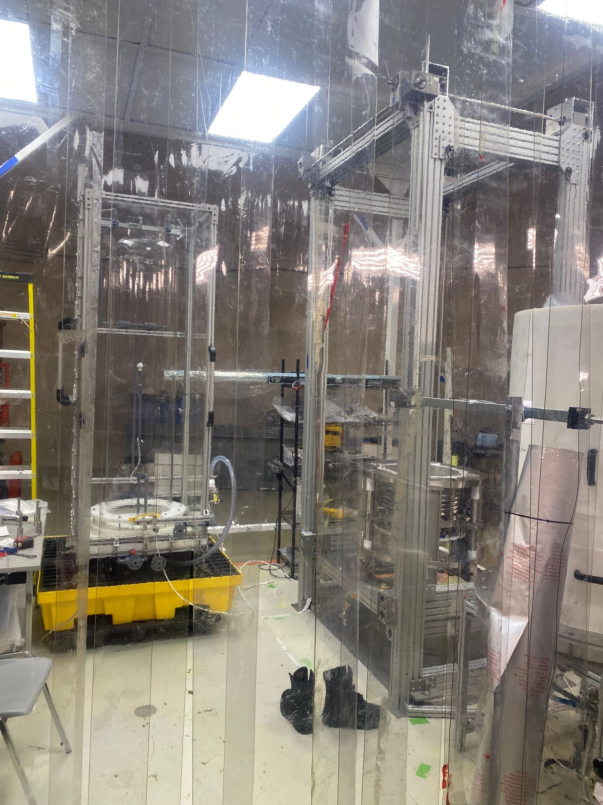
Radiological Controls in PICO-500
Neutrons as Primary Background
Create Single Bubble Events
Secondary Product of Alpha Decays
Cube Hall Cleanroom
Protects Inner components from Rn
Sealed with a N2 flow
Regularly Cleaned
Assays for Rn Contamination
Rn emanates from Material Surfaces
Must be Quantified for Inner jars and Pressure Vessel

Slide 14
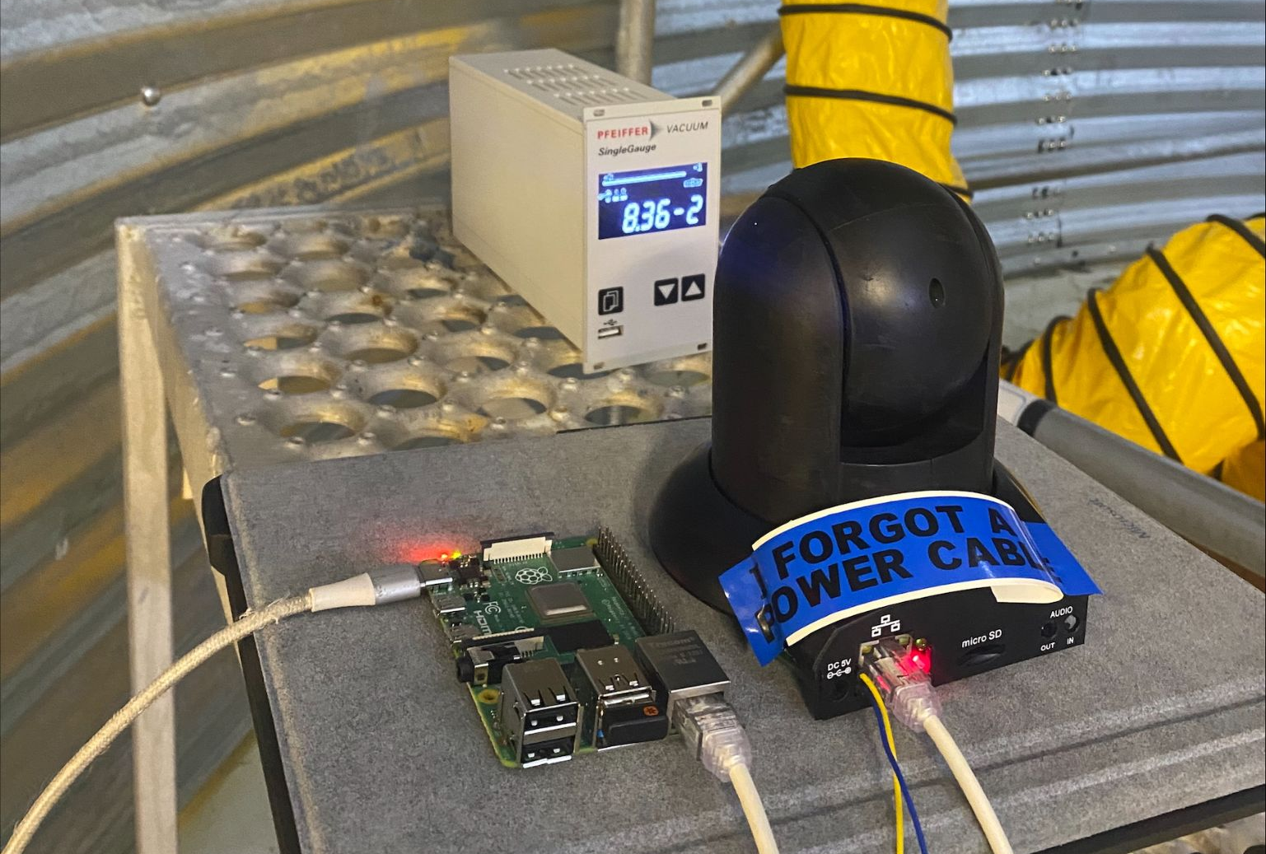
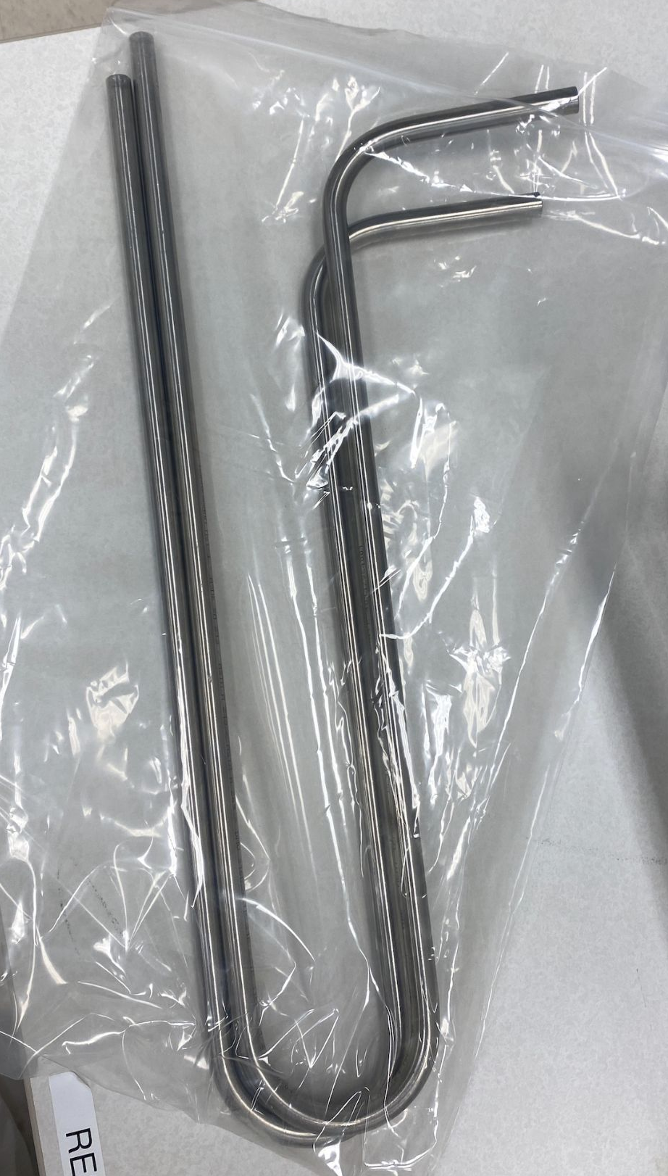
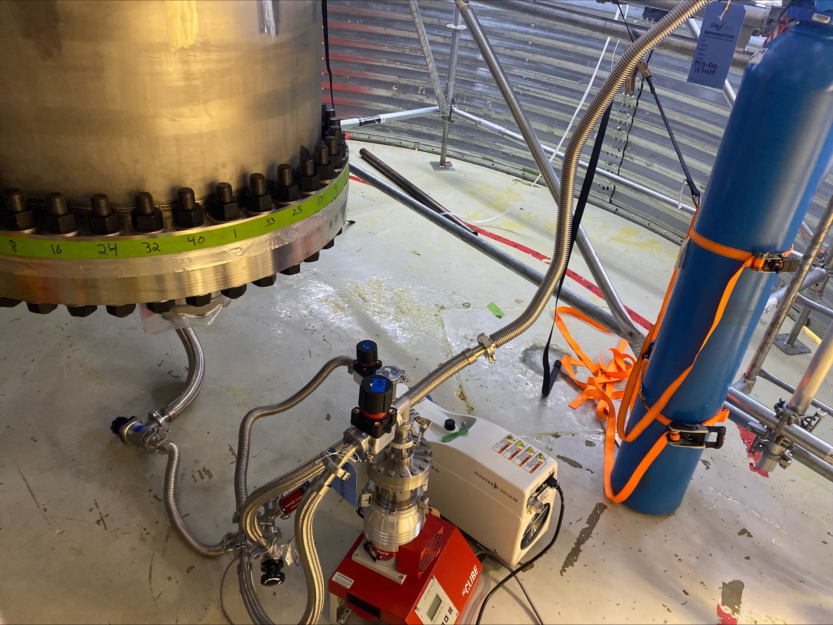
PICO 500 Rn Assays
With Hantz Nozard (UdeM) and the SNOLAB Radon Team
Developed Emanation and Assay Procedures
Implemented remote monitoring Camera
Pressure Vessel Actively Emanating
Building Charcoal Traps

Slide 15
Big Thanks to:
Dr. Ian Lawson
Dr. Nasim Fatemighomi
Peter Qin
Dimpal Chauhan
Hantz Nozard (UdeM)
Keegan Paleshi
i
For their involvement in the Rn Assay Work
Alongside
Paul Grylls
Ashley Matthewson
Quinn Malin
Christian Gaudreau
Shane Meister
Remington Hill
For inviting me to participate in Hardware, Analysis, and Maintenance

Slide 16
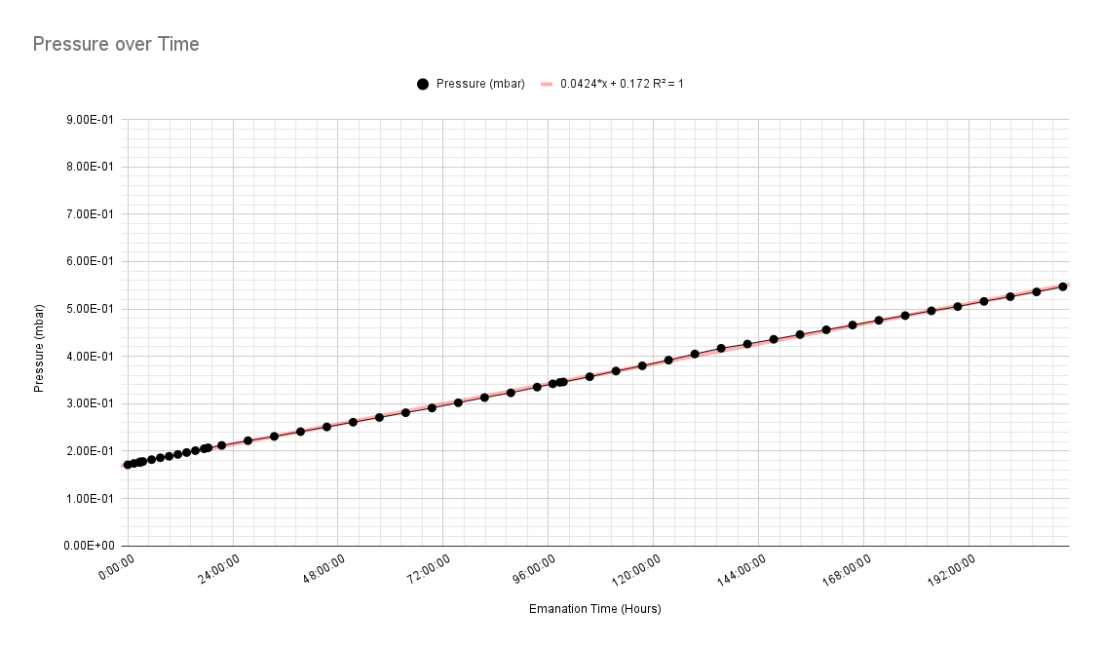
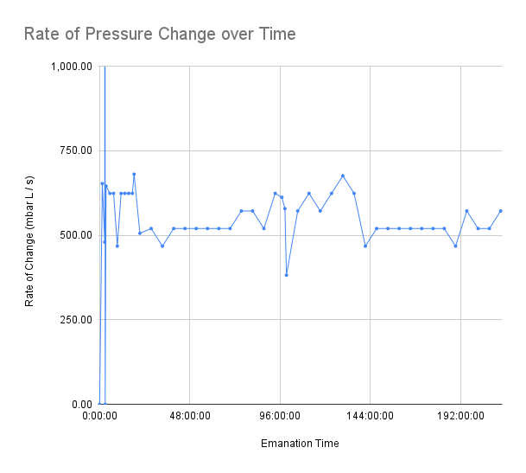
PV Emanation Data

