Slide 1



Particle Tracking and Event Reconstruction using Gas Electron Multipliers for DarkLight
Huajian (Andy) Yang
NSERC COOP at TRIUMF

Slide 2
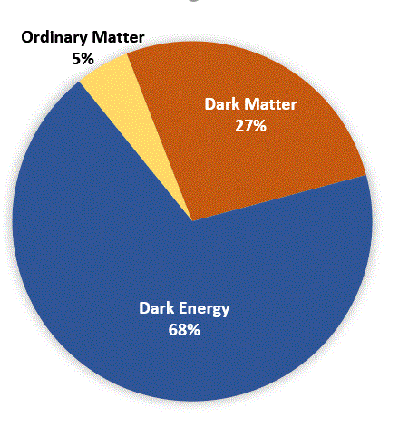
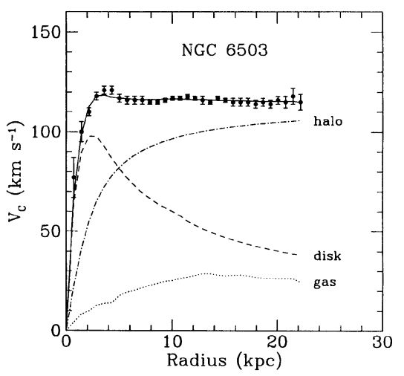

Dark Matter $∈$ a 🥜
(Dark Matter in a Nutshell)
From NASA
If DM is a particle, what are its properties?
How does DM interact with the standard model?
We are trying to solve this
10.3367/UFNr.0182.201201a.0003
Notes:
Dark Matter was first measured in galaxy rotation curves
Accounts for alot of the universe
Humans are curious people
We want to ask questions

Slide 3
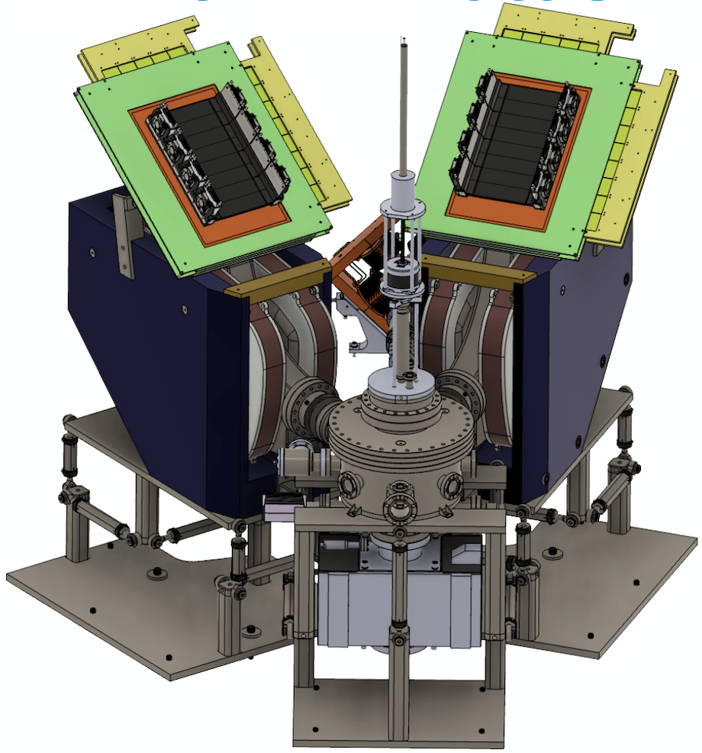
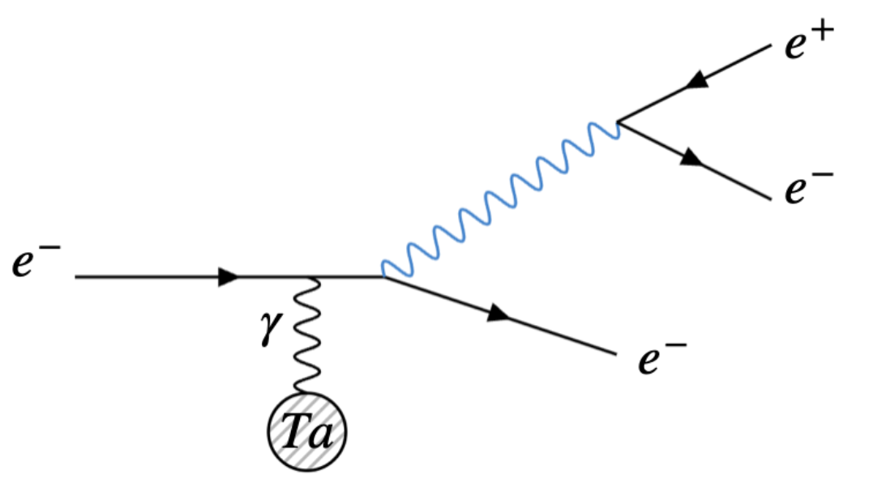




DarkLight
Lepton based dark boson search experiment at TRIUMF
Trigger Scintillators
Gas Electron Multipliers (GEM) x2
$$e^{−}$$
$$e^{+}$$
$$A^{′}$$
Mass Spectrometers
Incoming $e^{−}$ beam
Notes:
Particle scattering experiment to conduct a resonance search for an X17-like boson
Aim to detect the process described on the left
(Explain Feynman diagram)
(Explain experiment diagram)
GEMs used to reconstruct tracks
Tracks used to determine momentum and reconstruct mass of parent particle
Conduct resonance search in mass spectrum

Slide 4
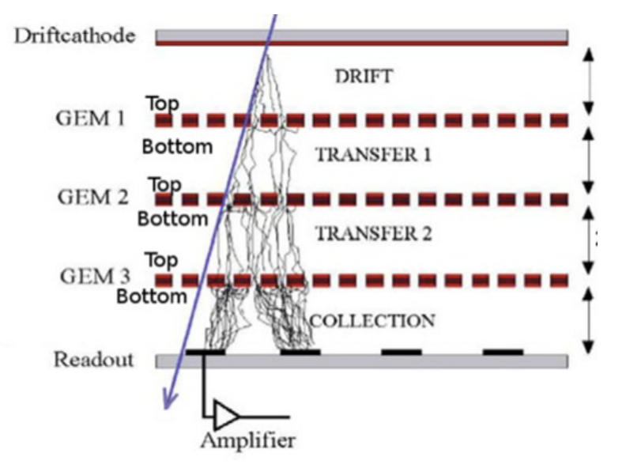
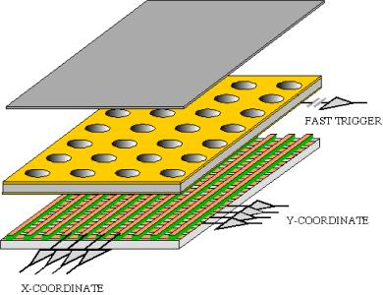
Gas Electron Multipliers (GEMs)
Some Terminology (used later):
  Hit: The event that a particle passes through a GEM
  Cluster: The collection of readout channels that are “lit up” by a hit
Notes:
Quick detour on explaining how detector works
GEMs are very important for darklight
Use them for track reconstruction
Has a Cathode and an anode, filled with a gas that particles can ionize
Particles drift through multiple multiplying layers,
Anode is a wire grid at the bottom, which collects charge

Slide 5
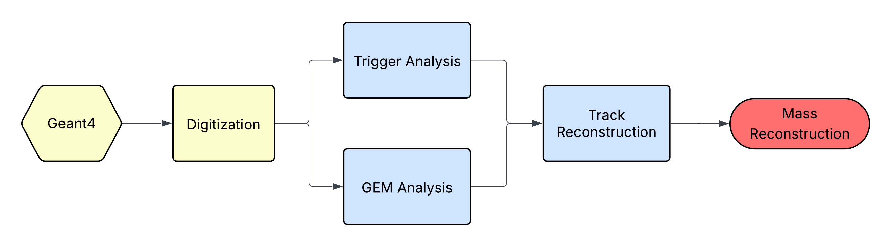
DarkLight Simulation/Analysis Framework
(Oversimplified)
Data Analysis
Monte Carlo Simulations
What we will be talking about today
Notes:
Important simulate process to get rough idea of analysis
(Explain framework)
G4 Simulation -> simulate detector readout -> analyze data -> get mass
What I work on
simulating GEM readout Locating and detecting hits in GEMs reconstructing particle tracks

Slide 6
GEM Data Analysis Pipeline
Trigger Data
Digitized GEM Signal
Identify hits from readout channels
Cluster identification
Hit Reconstruction
Track Reconstruction
Extract hit positions from clusters
Mass Recon
Real Experimental Data
Notes:
Cluster identification locates which channels belong to signal left by particle track
Hit extracts the precise location of where the track is in the middle of the GEM from multiple channels
Track reconstruction combines trigger hits and GEM hits to construct tracks

Slide 7
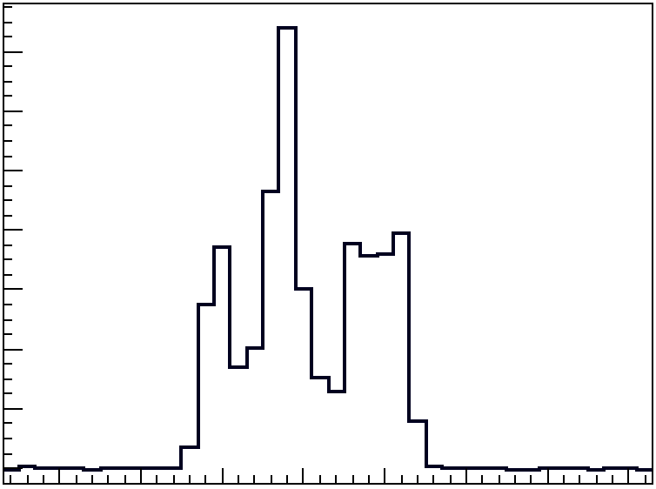
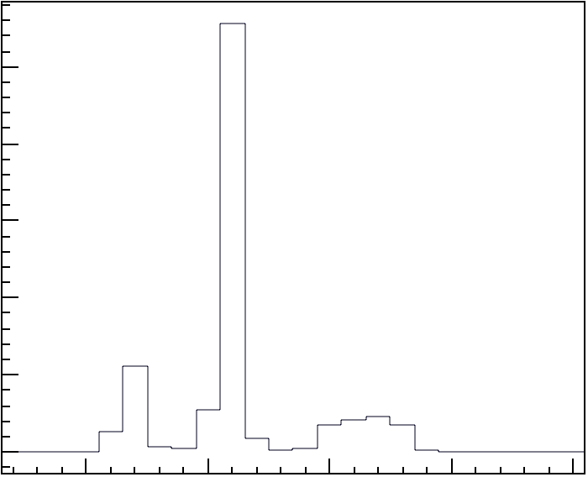
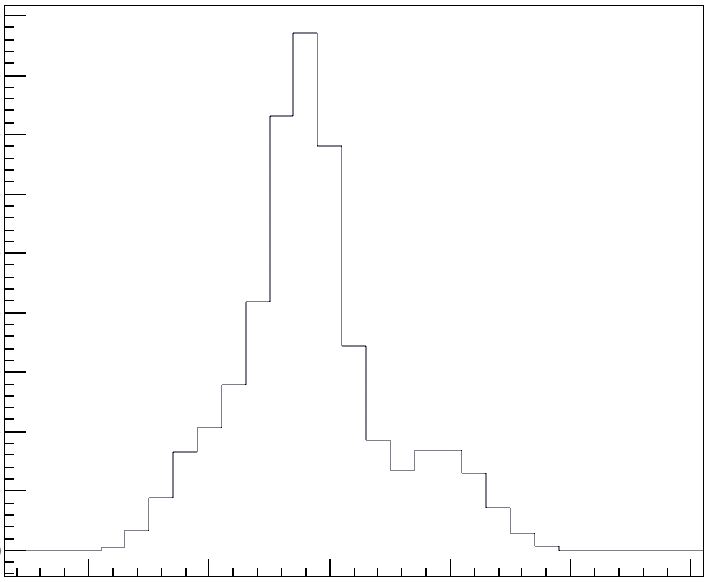
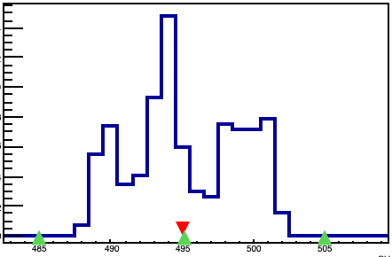



Cluster Identification Process
Digitized Signal
Uses dynamic thresholds
Parameters tuned for detecting cluster width and multitrack accuracy
Readout
Convoluted $χ^{2}$
Gaussian Convolution
Peak Finding
Channels
Use $σ=0.2$mm Gaussian
Use $σ=2$ Channel Gaussian
Identified Cluster Size
Increases Signal to Noise
Gaussian size optimized for multitrack resolution
Position Reconstruction
Notes:
Digitized signal from top left
Passes through convoluted chi2 test. Increases SNR and detects gaussian peaks
Passes through another Gaussian convolution which helps increase the multitrack resolution of the peak finding algorithm.
- means the peak finder can better distinguish which peaks belong to which clusters
The peak finding algorithm uses the convoluted signal and decides where the cluster is and how wide the cluster is
Sends info to position recon

Slide 8
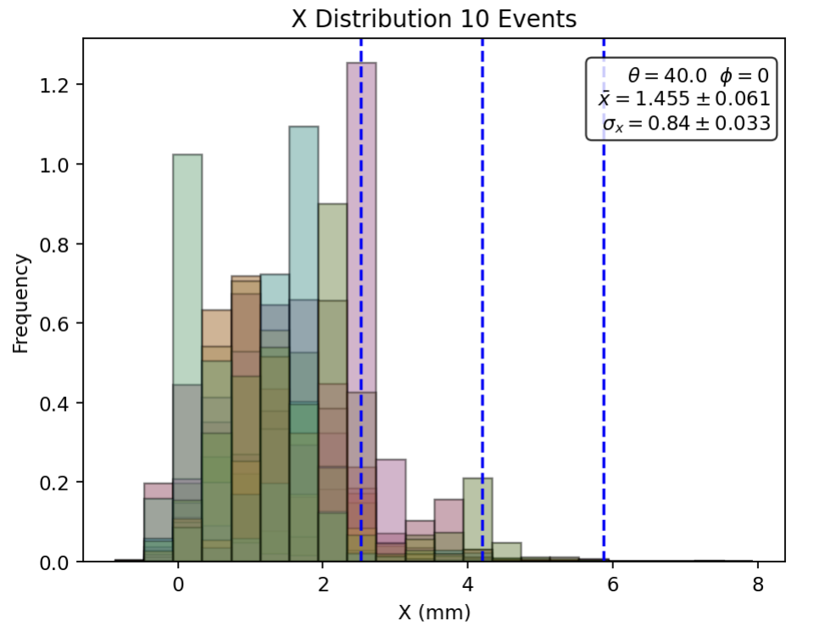
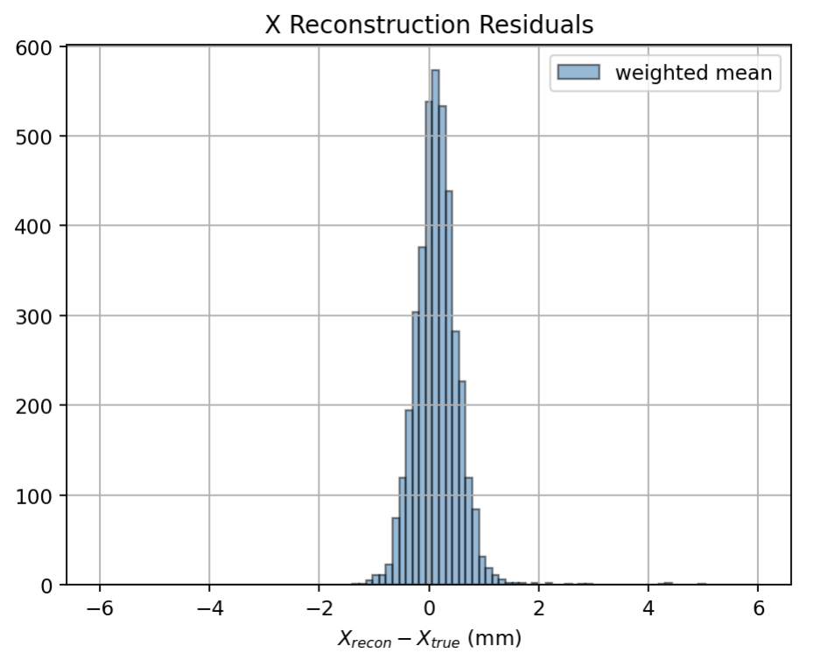



Position Reconstruction
Use Charge Centroid Method
Can get to submillimeter accuracy
Take weighted average between green markers
$$x_{f}=\frac{∑x_{i}q_{i}}{∑q_{i}}$$
$$q_{i}$$
Counts
$$x_{i}$$
Identified Cluster Size
Notes:
Tracks in darklight can “light up” alot of readout channels (4-6mm worth of readoutchannels)
Need to get to <1mm accuracy
Because readout distribution almost follows uniform, can simply take weighted average

Slide 9
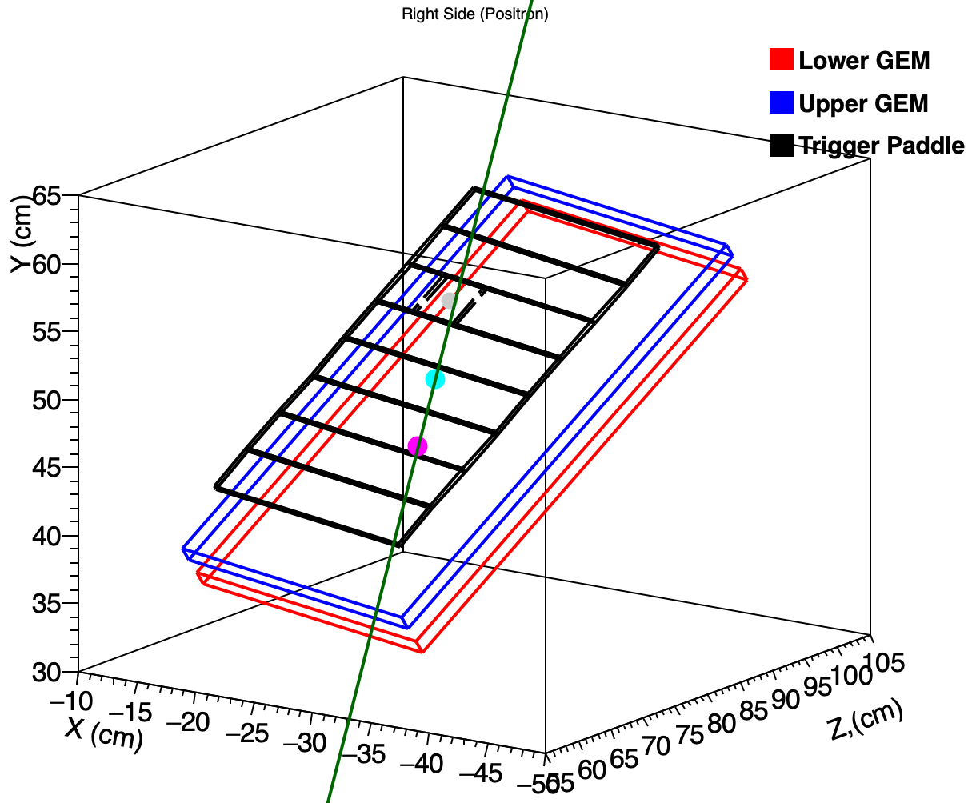
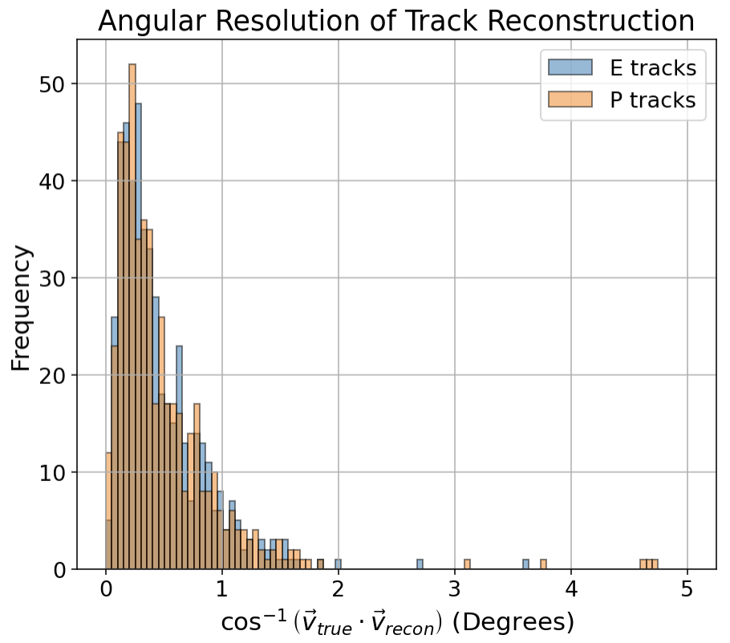
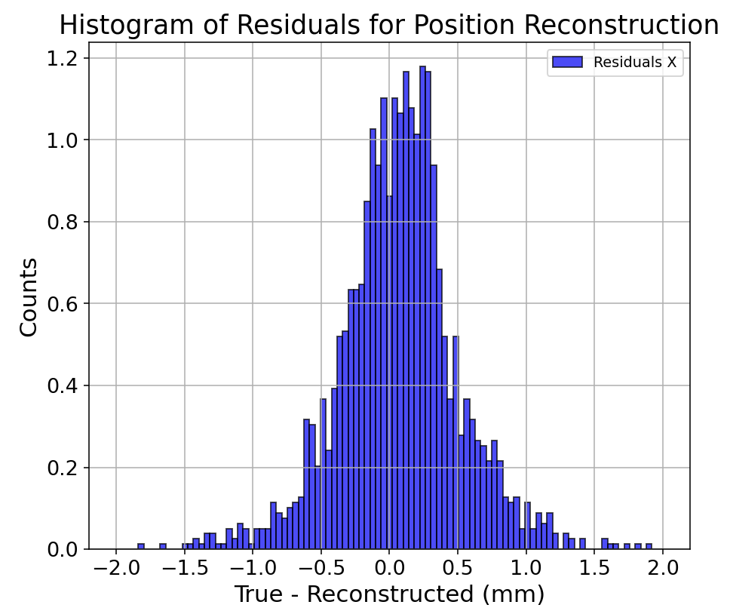
Track Reconstruction
Positron Side
Connect all hits between two GEM layers
Filter out any tracks that dont have corresponding trigger hits
Simple & fast reconstruction
Does not need very sophisticated algorithm due to low event rate
High angular and position resolution

Slide 10







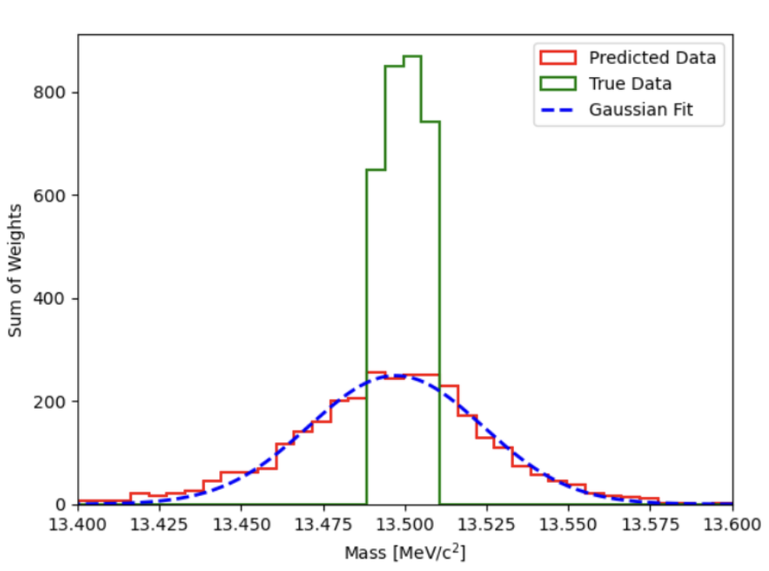




Summary
Perhaps the new boson will shine light on SM and dark matter interactions
Reconstruction of particle tracks by GEMs is crucial in accurately measuring and finding the dark boson
Accurate mass reconstruction can be acheived
Reconstructed Mass
$$σ=26.6\text{keV}/c^{2}$$

Slide 11
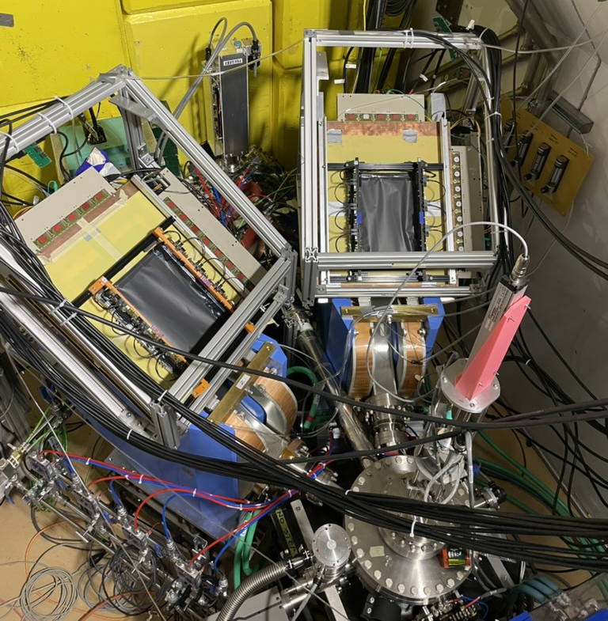
DarkLight Timeline
Everything is sitting in a beamline at TRIUMF
Undergoing beam commissioning
Will be taking beam very soon!
Commissioning Detectors
Data taking
May
July
August
October
2026+
Installation
Beam Commissioning
Analysis
Notes:
Experiment already deployed at TRIUMF (Installed from may to June, currently doing beam commissioning)
We are very excited to be taking data soon
Hope in near future hear more interesting results from our collab

Slide 12




Thank you
Merci
www.triumf.ca
Follow us @TRIUMFLab

Slide 13
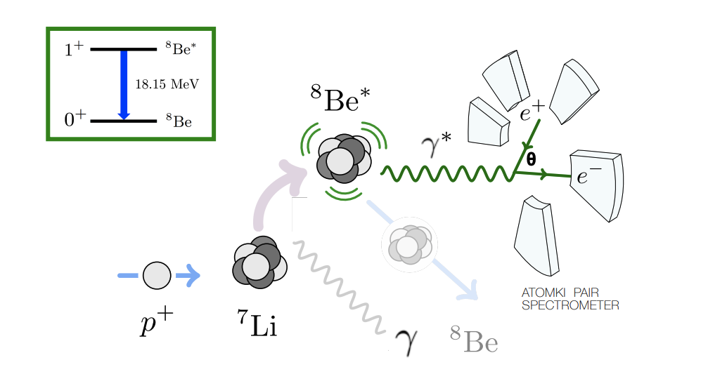
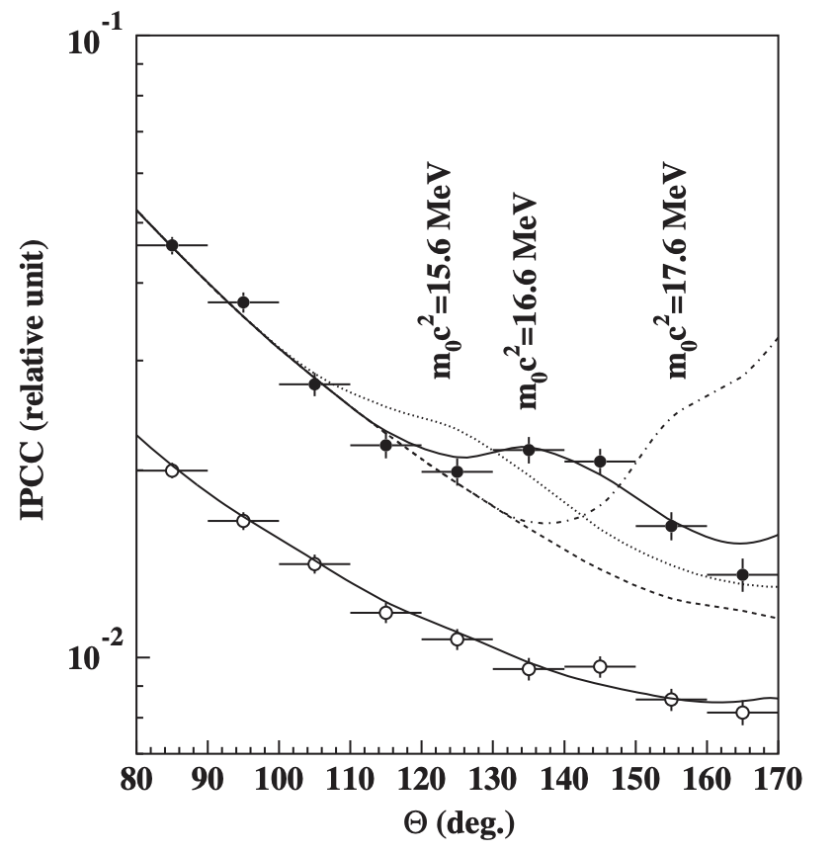
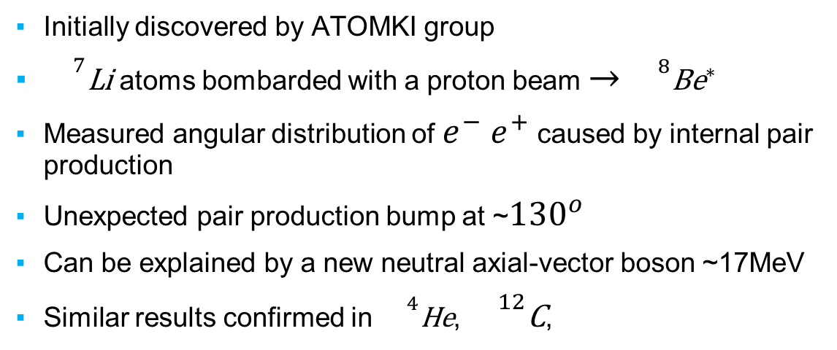
X17 Anomaly
doi.org/10.1140/epjc/s10052-023-11271-x
DarkLight Lore/Motivation
Initially discovered by ATOMKI group
${}^{7}\text{Li}$ atoms bombarded with a proton beam $→$ ${}^{8}{\text{Be}}^{∗}$
Measured angular distribution of $e^{−}$ $e^{+}$ caused by internal pair production
Unexpected pair production bump at ~${130}^{o}$
Can be explained by a new neutral axial-vector boson ~17MeV
Similar results confirmed in ${}^{4}\text{He}$, ${}^{12}\text{C}$,
Needs independent confirmation
If there is an X17-like boson, could it couple to dark matter?
https://doi.org/10.1103/PhysRevLett.116.042501
Notes:
Assume the audience is semi-familiar with particle physics and have heard of dark matter
Get

Slide 14
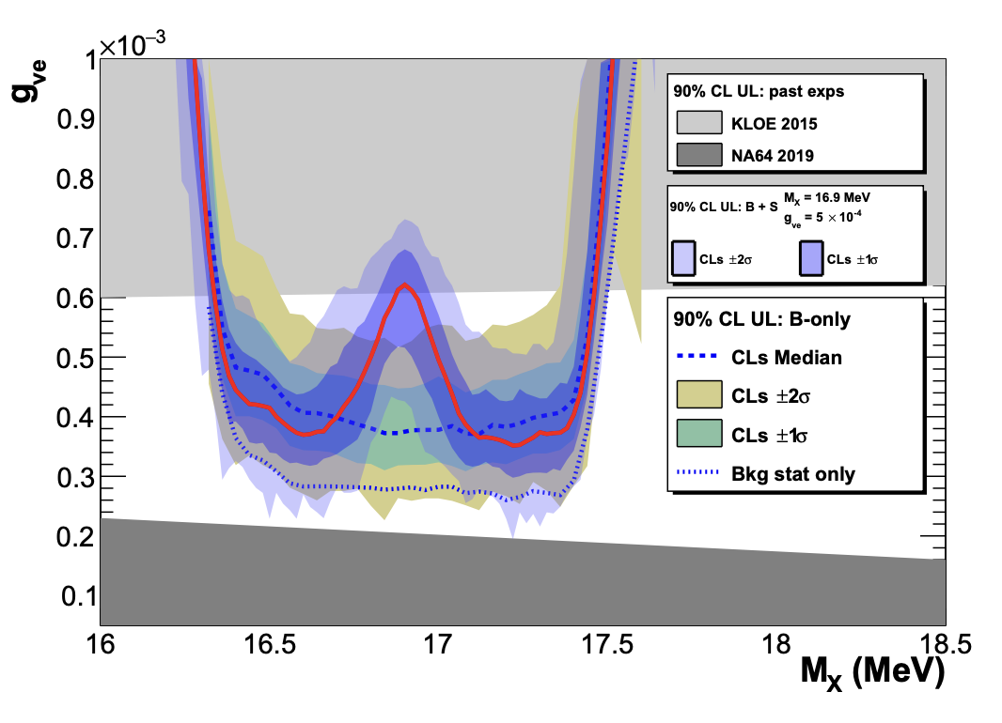
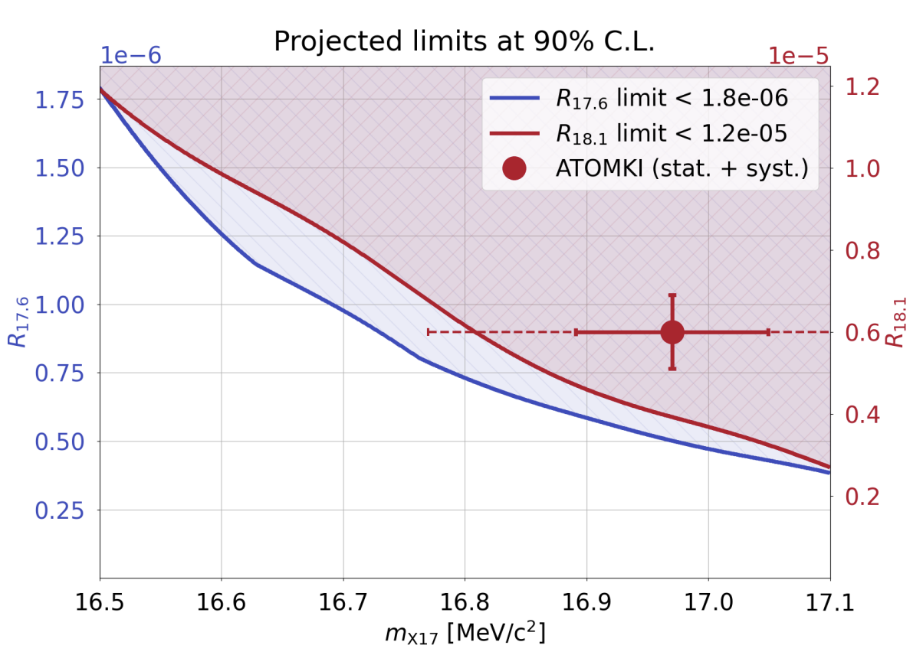
Other Experimental Efforts
PADME
MEG-II
Saw X17 Signal with $>2σ$
Did not see X17 signal

Slide 15
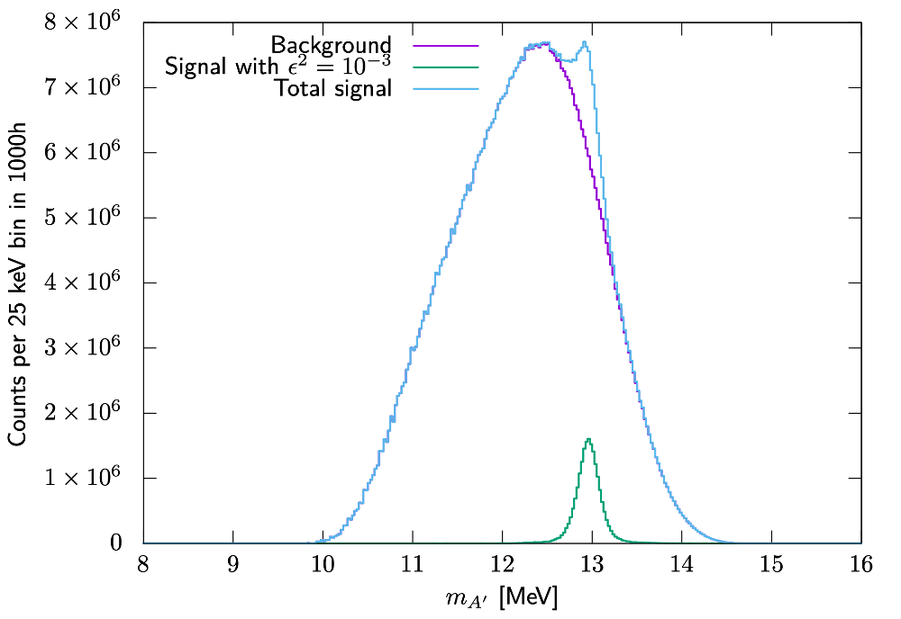
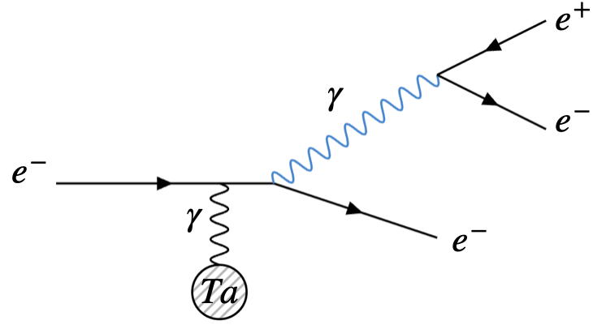
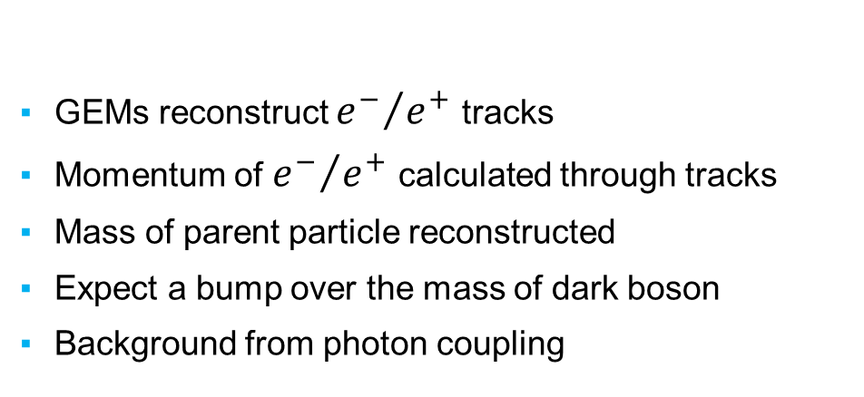
Expected Signal
GEMs reconstruct ${e^{−}}/{e^{+}}$ tracks
Momentum of ${e^{−}}/{e^{+}}$ calculated through tracks
Mass of parent particle reconstructed
Expect a bump over the mass of dark boson
Background from photon coupling

Slide 16
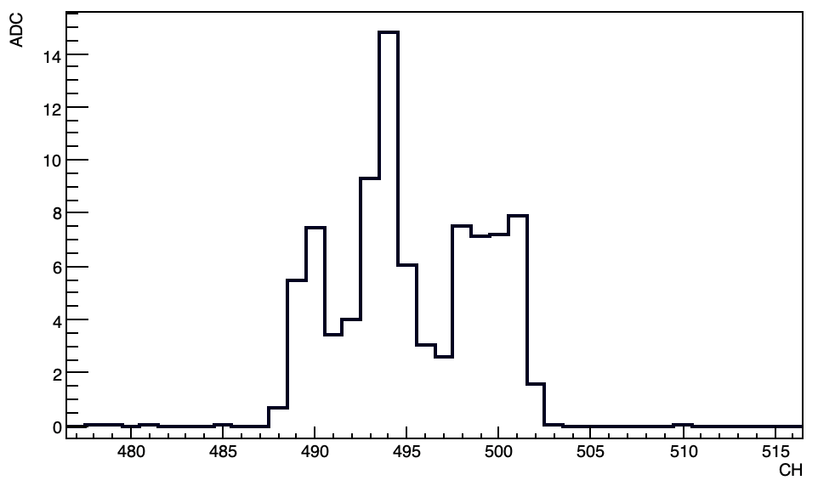
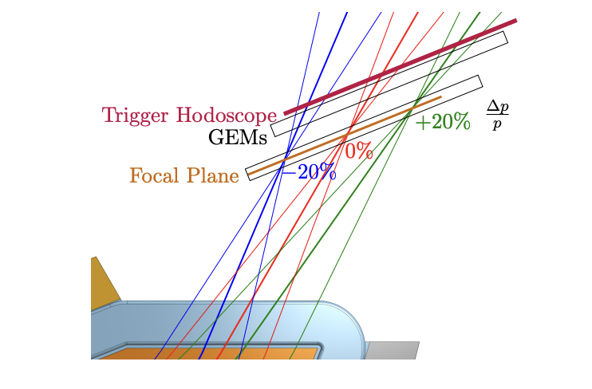
GEM Digitization
Initially done in Garfield++
A faster and simpler script was made for generating showers
The digitization script accounts for angle of impact and smear of tracks over readout
Arb. Units
~5mm
Channel #
Spectrometer
Notes:
Digitization script simulates what each readout channel should readout
Showers inside GEMs initially done by Garfieldpp
Feature of script is that it accounts for impact angle of tracks

