Slide 1
The LiNEAr Project: Removal of Argon from Nitrogen
Sahara Rahimani
Supervised by: Aleksandra
Bialek, Shaun Hall, Tristan Hillier, Chris Jillings & Tom Sonley
August 12th, 2025
Notes:
Good afternoon, everyone. Today, I’ll be presenting my work on The LiNEAr Project, which stands for Liquid Nitrogen Excluding Argon.
This project focuses on removing argon from nitrogen produced by SNOLAB’s underground liquid nitrogen plant.
Let’s begin by looking at why argon needs to be removed.

Slide 2
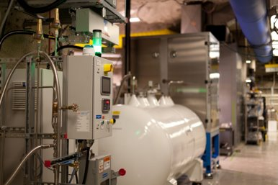
Why Remove Argon from Nitrogen?
The underground LN₂ plant supplies nitrogen for purification, cover gas, and cooling.
Nitrogen produced underground contains about 3% argon, including radioactive Ar-42, which can introduce background signals in low-background experiments.
Current purification removes particulates and oxygen (down to ~2 ppm O₂).
Noble gas impurities are not removed and remain in the final product.
Figure 1:Underground Liquid Nitrogen Plant (SNOLAB)
1
Notes:
SNOLAB experiments rely heavily on liquid nitrogen—not just for cooling, but also as a high-purity inert cover gas and it is also used during the purification process in the ultrapure water plant.
However, the nitrogen gas produced by the LN2 plant contains about three percent argon. This includes the radioactive isotope Argon forty-two, which can introduce background signals that can interfere with detecting rare events in low-background experiments.
The current purification system is designed to remove particulate matter and oxygen from the air before liquefaction. While it reduces oxygen concentrations to approximately two ppm, it does not target noble gas impurities, such as argon, which remains in the final product.

Slide 3
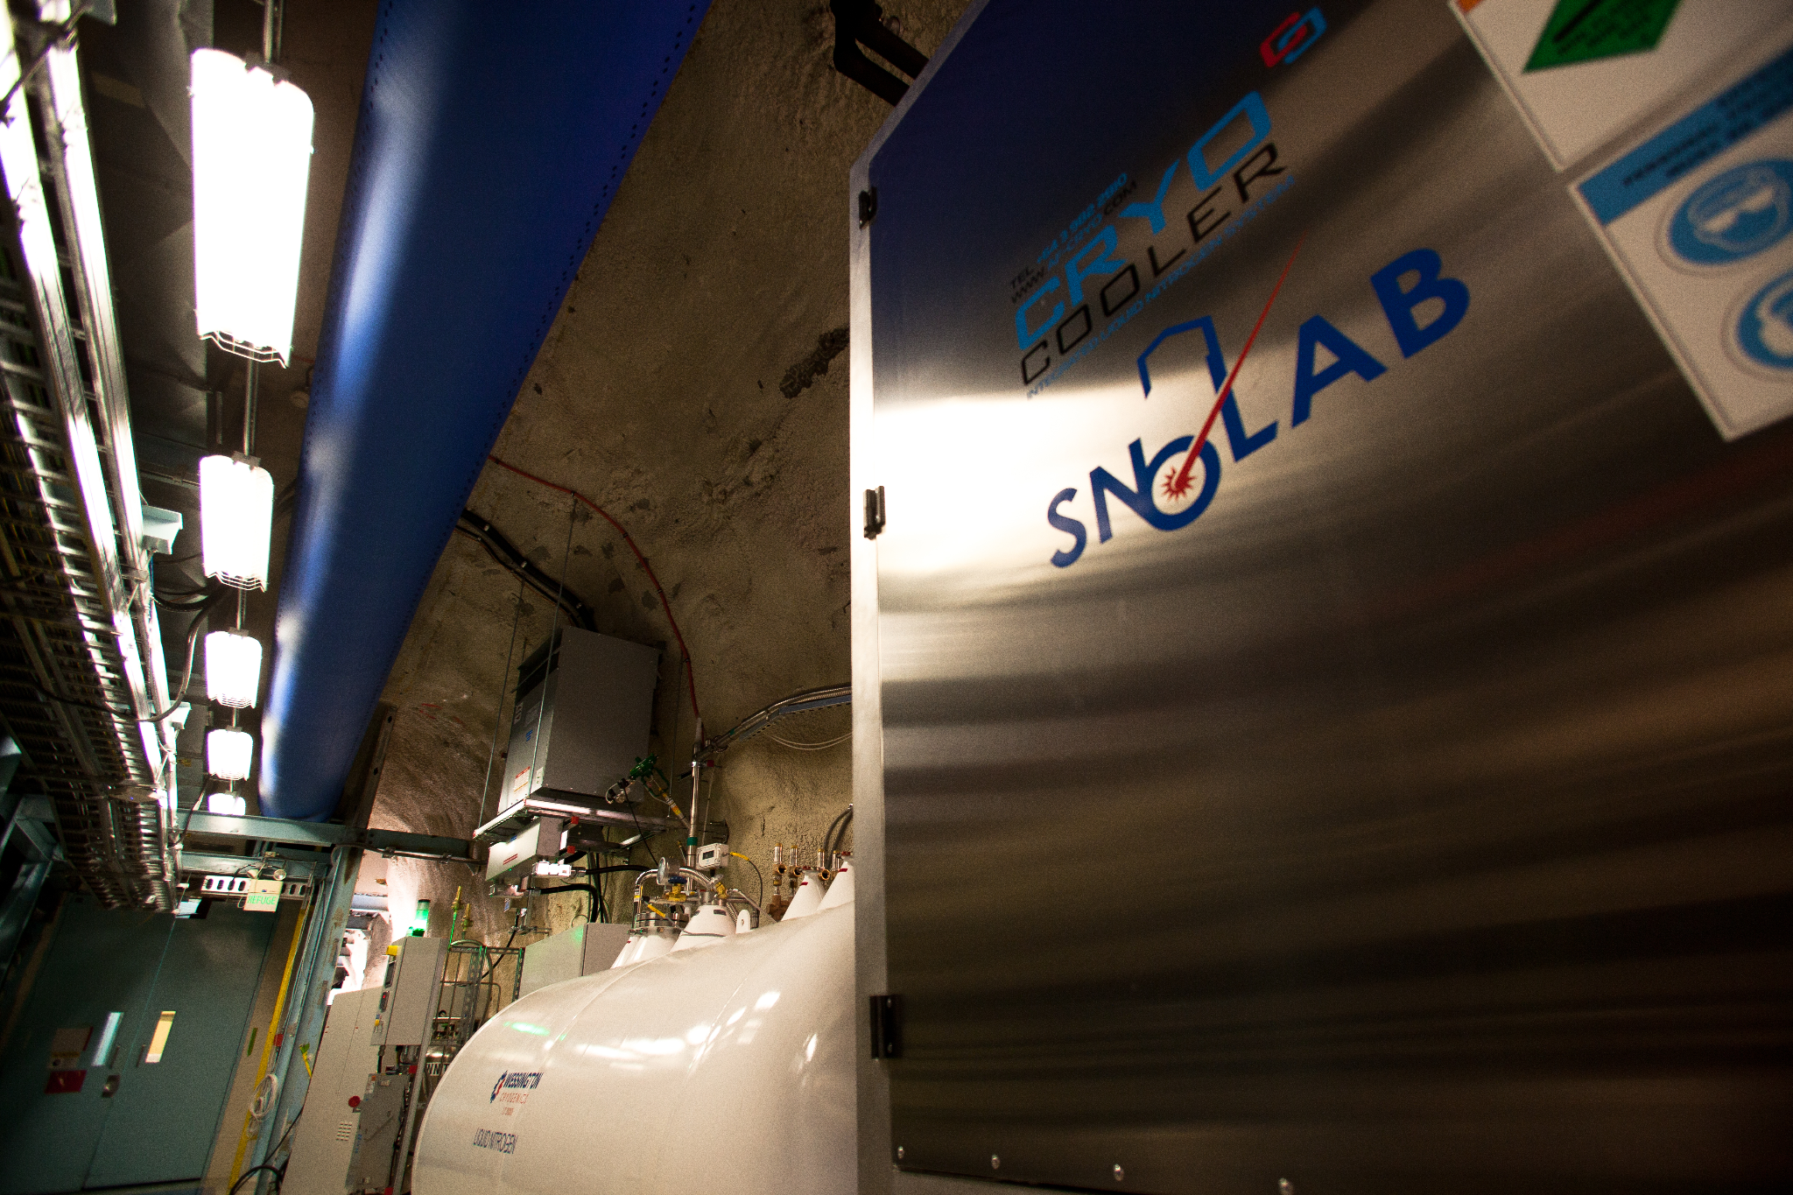
The LiNEAr Project at SNOLAB
The goal is to increase nitrogen purity by reducing argon levels to 1 ppm.
Two active approaches:
  Cryogenic distillation, under development by the engineering team at SNOLAB
  Silver-doped zeolite adsorption
Key Focus Areas:
  Testing zeolite adsorption efficiency using surface Residual Gas Analyzer (RGA).
  Calibrating underground RGA for argon and nitrogen detection.
Figure 2: Underground Liquid Nitrogen Plant (SNOLAB)
2
Notes:
The goal of the LiNEAr project is to increase nitrogen purity by reducing argon levels to one ppm.
Two main approaches are being explored: to achieve this cryogenic distillation, which is led by SNOLAB engineering and silver-doped zeolite adsorption.
My work centers on two key areas: testing the adsorption efficiency of silver-doped zeolites using the surface Residual Gas Analyzer (RGA), and calibrating the underground RGA for precise argon and nitrogen detection.
For today’s presentation, I will focus on the zeolite testing.

Slide 4
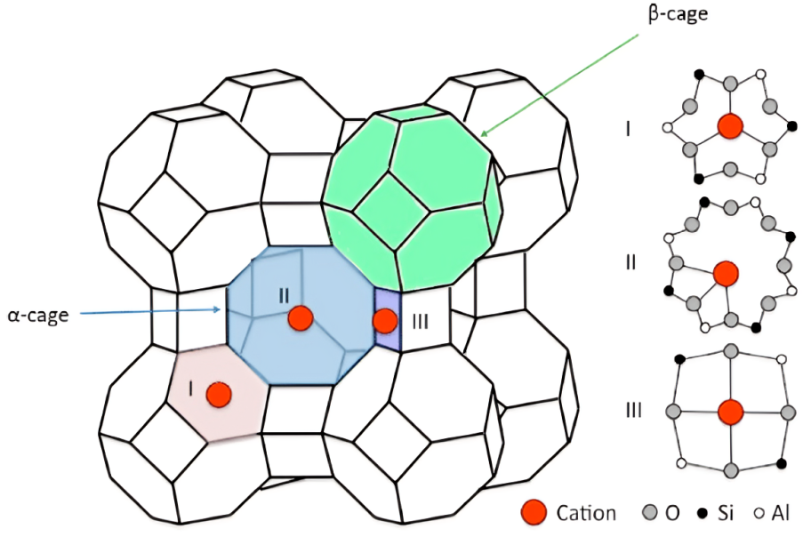
Zeolites for Argon Separation
Microporous, crystalline minerals made of silicon, aluminum, and oxygen.
High surface area; act as molecular sieves for gas separation.
Exchanging Ag⁺ into the framework, enhances the adsorption of noble gases.
Ag⁺ Cation
Figure 3: Silver-doped Linde Type A (LTA) zeolite structure (Al-Ezzi, 2017)​
3
Notes:
So what are zeolites? Zeolites are microporous crystalline minerals made primarily of silicon, aluminum, and oxygen. Their highly ordered structure provides a large surface area, enabling them to function as molecular sieves that separate gases based on size and chemical properties.
For this project, we use the 3A Linde Type A (LTA) zeolites, which have pore openings of approximately three angstroms in diameter. These were selected for their controllable pore size, cost-effectiveness, and suitability for extensive testing. The zeolites have a uniform pore structure into which we exchange silver ions. As shown in the graph, the red particles represent the silver cations within the framework.
Silver doping enhances the zeolite’s ability to selectively adsorb noble gases like argon and radon by strengthening interactions between the gas molecules and the material. This makes silver-doped zeolites a promising option for removing argon from nitrogen.

Slide 5
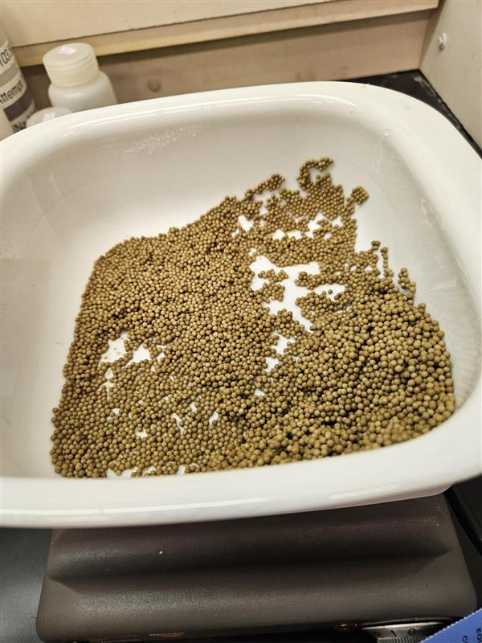
Preparation of Silver-Doped Zeolites
Wet impregnation using silver nitrate (AgNO₃) solution.
Careful pH adjustment to neutral (pH 7) for optimal doping.
Dried and activated samples under controlled conditions.
Goal: produce stable, active adsorbents for gas testing.
Figure 4: Silver-Doped Zeolites
4
Notes:
The silver doping process begins with wet impregnation, where we dissolve silver nitrate in water to create our doping solution. Before adding the zeolites, we carefully adjust the solution’s pH to neutral to ensure the silver ions interact properly with the zeolite framework. The zeolites are then stirred in this solution for twenty-four hours at room temperature, allowing the silver ions to exchange into the pores. After stirring, the zeolites are rinsed with UPW, and the resulting doping solution wastewater is saved for later analysis. The zeolites are then baked at two hundred degrees Celsius under flowing nitrogen for eight hours to activate the material. The resulting zeolites are stable and ready for gas adsorption testing.

Slide 6
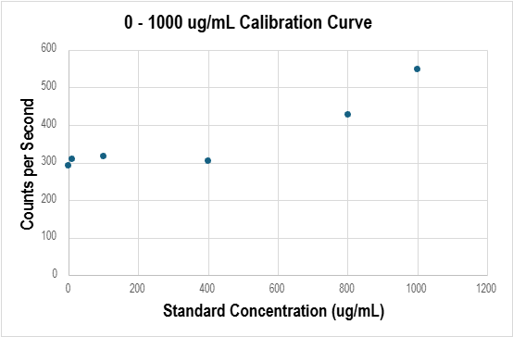
XRF Calibration for Silver Quantification
X-ray fluorescence (XRF) is a technique to measure elemental concentrations.
Prepared silver nitrate calibration solutions of known concentrations.
Measured XRF response of standards at known concentrations.
Created calibration curve to ensure accurate silver quantification.
Figure 5: Silver Nitrate XRF Calibration Curve (Sharayah Reed)​
5
Notes:
After preparing the zeolites, it was essential to quantify how much silver had been incorporated into the material. To achieve this, we used X-ray fluorescence, a non-destructive technique that measures elemental concentrations in samples.
We first created a calibration curve using silver nitrate solutions of known concentrations, prepared by accurately diluting silver nitrate in upw.

Slide 7
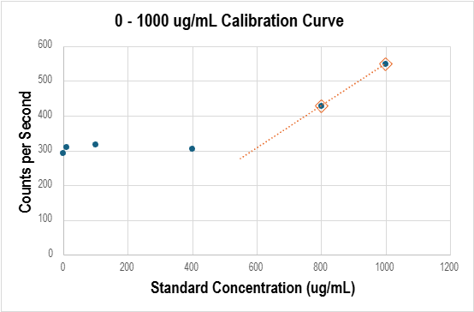
Measuring Zeolite Doping Efficiency
Measured silver concentration in wastewater using XRF and calibration curve.
Calculated silver adsorbed by subtracting silver in wastewater from the initial silver nitrate used.
Achieved approximately 95% silver uptake, indicating effective doping.
Figure 6: Silver Nitrate XRF Calibration Curve (blue) and Zeolite Waste Trendline (orange)
6
Notes:
After measuring the silver concentration in the wastewater using XRF and applying our calibration curve, we subtracted the silver remaining in the wastewater from the initial amount of silver nitrate used. The doping efficiency was about ninety-five percent, showing that most of the silver was successfully incorporated into the zeolite framework.

Slide 8
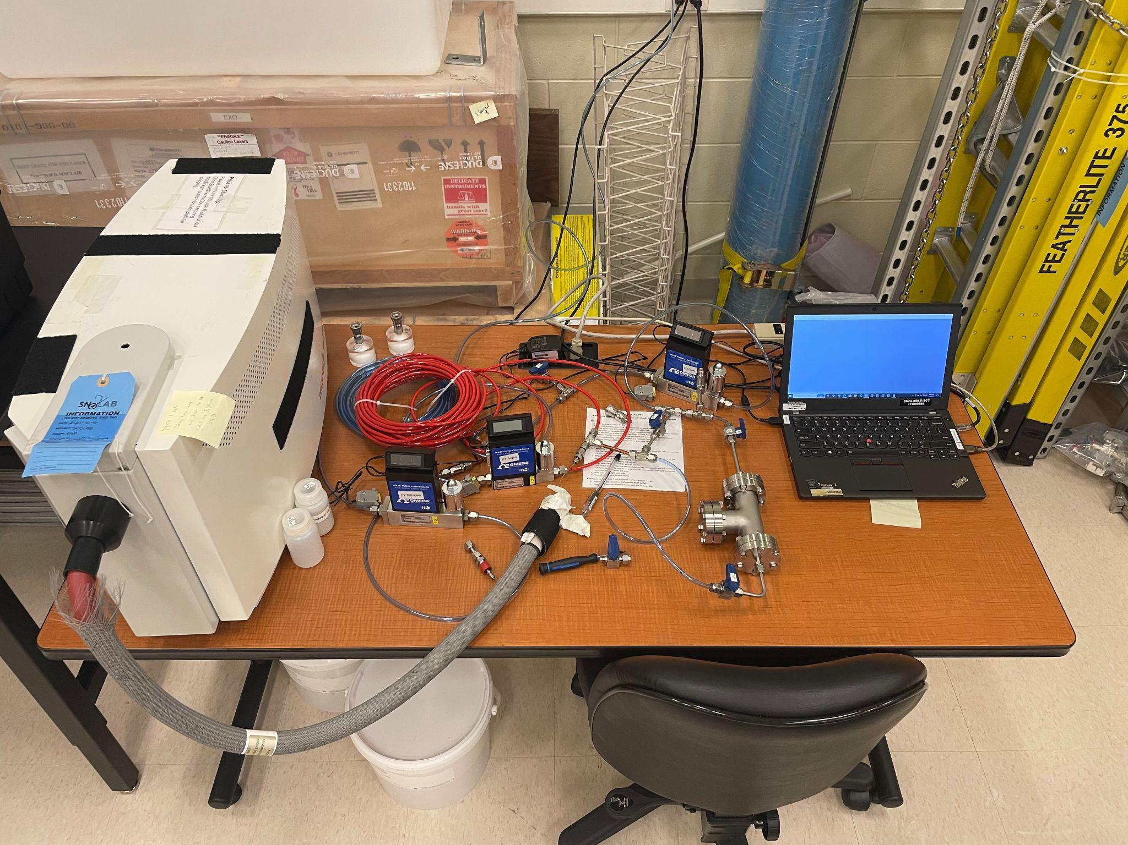
Experimental Testing of Zeolites
110 g of silver-doped Linde Type A zeolite packed into a 200 mL metal test chamber.
Mixed gas stream of nitrogen and argon flows through the chamber.
Analyzing the output with a Residual Gas Analyzer (RGA) to detect gas composition.
Figure 7: Zeolite Testing Experimental Setup
7
Notes:
In the surface lab, we test the silver-doped zeolites using a flow-through chamber setup. We pack about one hundred and ten grams of these zeolites into a two-hundred-millilitre metal test chamber. A gas mixture—nitrogen containing between one and ten percent argon—is passed through the chamber. The goal is to observe how effectively the zeolites adsorb argon from the gas mixture. After it exits the chamber, the gas composition is continuously monitored by the (RGA). This setup allows us to evaluate the adsorption efficiency of our materials under controlled and reproducible conditions.

Slide 9
Argon ¼- In Turn Valve
Argon Gas
Nitrogen Gas
Relief Valve
Nitrogen ¼- In Turn Valve
Flow Controller
— Closed
— Open
Flow Controller
Flow Controller
Gas Outlet
15 PSI Check Valve
RGA
Zeolite Chamber
8
Figure 8: Zeolite Testing Experimental Setup​
Notes:
This is what a broad view of the experimental setup would look like

Slide 10
Argon ¼- In Turn Valve
Argon Gas
Nitrogen Gas
Relief Valve
Nitrogen ¼- In Turn Valve
Flow Controller
— Closed
— Open
Flow Controller
Flow Controller
Gas Outlet
15 PSI Check Valve
RGA
Zeolite Chamber
8
Notes:
we begin on the left with two gas sources: nitrogen and argon.

Slide 11
Argon ¼- In Turn Valve
Argon Gas
Nitrogen Gas
Relief Valve
Nitrogen ¼- In Turn Valve
Flow Controller
— Closed
— Open
Flow Controller
Flow Controller
Gas Outlet
15 PSI Check Valve
RGA
Zeolite Chamber
8
Notes:
Each line includes a quarter-turn valve for manual control

Slide 12
Argon ¼- In Turn Valve
Argon Gas
Nitrogen Gas
Relief Valve
Nitrogen ¼- In Turn Valve
Flow Controller
— Closed
— Open
Flow Controller
Flow Controller
Gas Outlet
15 PSI Check Valve
RGA
Zeolite Chamber
8
Notes:
and a flow controller for precise regulation of the flowrate

Slide 13
Argon ¼- In Turn Valve
Argon Gas
Nitrogen Gas
Relief Valve
Nitrogen ¼- In Turn Valve
Flow Controller
— Closed
— Open
Flow Controller
Flow Controller
Gas Outlet
15 PSI Check Valve
RGA
Zeolite Chamber
8
Notes:
The gas streams are merged via a T-connect

Slide 14
Argon ¼- In Turn Valve
Argon Gas
Nitrogen Gas
Relief Valve
Nitrogen ¼- In Turn Valve
Flow Controller
— Closed
— Open
Flow Controller
Flow Controller
Gas Outlet
15 PSI Check Valve
RGA
Zeolite Chamber
8
Notes:
followed by a relief valve that helps protect the system from pressure build up and allows us to adjust the flow rate of the mixed gas manually. After the nitrogen and argon streams are merged, the mixed gas passes through an additional flow controller to precisely regulate the flow rate.

Slide 15
Argon ¼- In Turn Valve
Argon Gas
Nitrogen Gas
Relief Valve
Nitrogen ¼- In Turn Valve
Flow Controller
— Closed
— Open
Flow Controller
Flow Controller
Gas Outlet
15 PSI Check Valve
RGA
Zeolite Chamber
8
Notes:
Then the gas mixture enters the zeolite chamber, which is protected by a fifteen psi check valve. This valve prevents pressure buildup and backflow, ensuring safe and stable operation.

Slide 16
Argon ¼- In Turn Valve
Argon Gas
Nitrogen Gas
Relief Valve
Nitrogen ¼- In Turn Valve
Flow Controller
— Closed
— Open
Flow Controller
Flow Controller
Gas Outlet
15 PSI Check Valve
RGA
Zeolite Chamber
8
Notes:
Once it exits the zeolite chamber analysis is performed using an RGA, this setup also incorporates an outlet that vents the gas to the atmosphere.

Slide 17
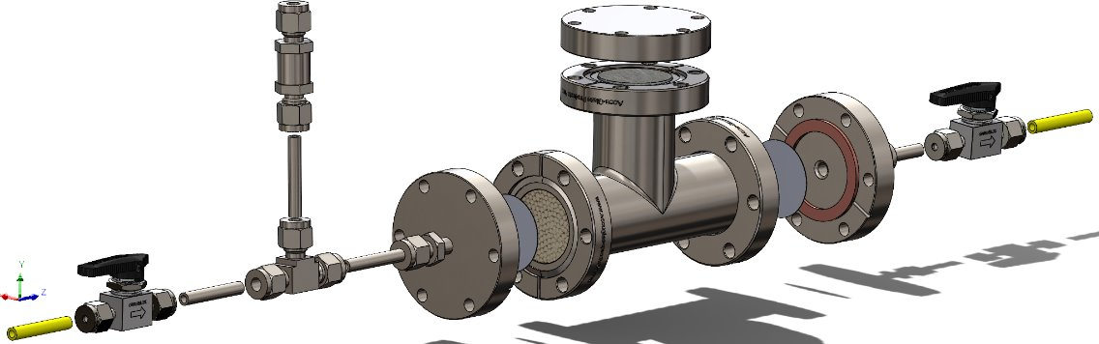
Zooming In: The Zeolite Chamber
Figure 9: Zeolite Test Chamber (John Deligiannis)​
9
Notes:
Now, zooming into the chamber setup, here’s a brief overview of the testing system:

Slide 18
Zooming In: The Zeolite Chamber
Contaminated Nitrogen Inlet
9
Notes:
The argon-contaminated nitrogen gas first enters the system

Slide 19
Zooming In: The Zeolite Chamber
Contaminated Nitrogen Inlet
¼- In Turn Valve
9
Notes:
and passes through a quarter inch turn valve,

Slide 20
Zooming In: The Zeolite Chamber
15 PSI Check
Valve
Contaminated Nitrogen Inlet
¼- In Turn Valve
9
Notes:
followed by a fifteen PSI check valve for safety.”

Slide 21
Zooming In: The Zeolite Chamber
15 PSI Check
Valve
Zeolite Chamber
Contaminated Nitrogen Inlet
¼- In Turn Valve
9
Notes:
It then flows into the zeolite chamber, where argon is adsorbed.

Slide 22
Zooming In: The Zeolite Chamber
15 PSI Check
Valve
Zeolite Chamber
Contaminated Nitrogen Inlet
¼- In Turn Valve
0.2-Micron Filters
9
Notes:
Filters prevent any particles from entering the Residual Gas Analyzer.

Slide 23
Zooming In: The Zeolite Chamber
15 PSI Check
Valve
Zeolite Chamber
Contaminated Nitrogen Inlet
¼- In Turn Valve
¼- In Turn Valve
0.2-Micron Filters
9
Notes:
Afterward, the purified nitrogen passes through another quarter inch turn valve

Slide 24
Zooming In: The Zeolite Chamber
15 PSI Check
Valve
Purified Nitrogen to RGA
Zeolite Chamber
Contaminated Nitrogen Inlet
¼- In Turn Valve
¼- In Turn Valve
0.2-Micron Filters
9
Notes:
Then the gas exits purified, and its composition is finally measured by the RGA.”

Slide 25
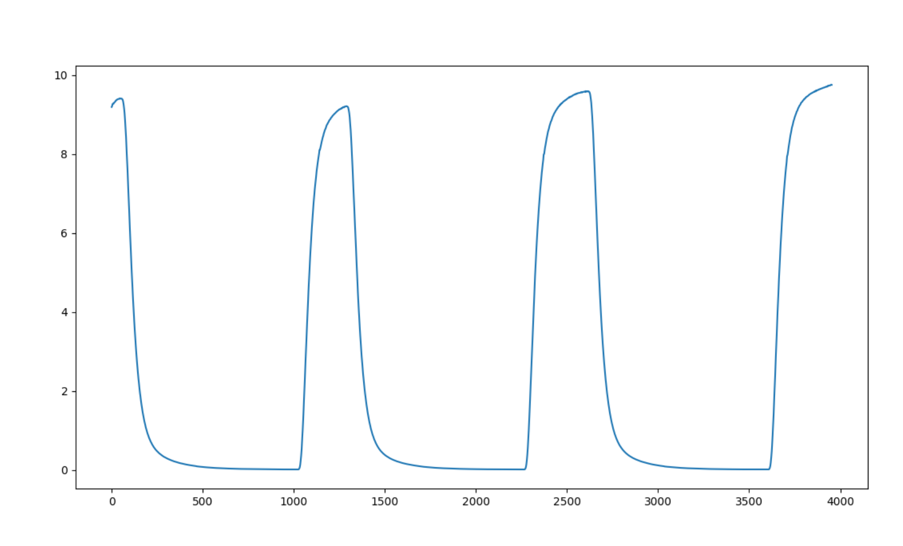
Zeolite Testing Results
Composition of Argon vs Time at 0.4 L/min
10% Ar
90% N2
10% Ar
90% N2
10% Ar
90% N2
Composition of Ar (%)
0% Ar
100% N2
0% Ar
100% N2
0% Ar
100% N2
Time (s)
Figure 10: Sample test run for Argon at 10%​
10
Notes:
So here’s what a typical test looks like.
We start with the argon valve closed, so the concentration is at zero percent. Then, we open the valve and allow argon to flow into the system. In this particular example, the flow rate is point four liters per minute—but it’s important to note that we ran tests at multiple flow rates to evaluate how the system performs under different conditions.
As the argon flows in, the concentration rises until it reaches ten percent and stabilizes. Once it’s stable, we close the valve again, and the concentration drops back down to zero.
This cycle is repeated three times, which produces three distinct peaks in the graph, and it helps us confirm that the system is both repeatable and responsive.
These tests were also repeated at a one percent argon concentration across multiple flow rates to evaluate how the system performs under lower argon levels and to compare the behavior with ten percent argon.

Slide 26
Zeolite Testing Results
Composition of Argon vs Time at 0.4 L/min
Composition of Ar (%)
Time (s)
Figure 10: Sample test run for Argon at 10%​
11
Notes:
Now let’s zoom in and focus on this peak

Slide 27
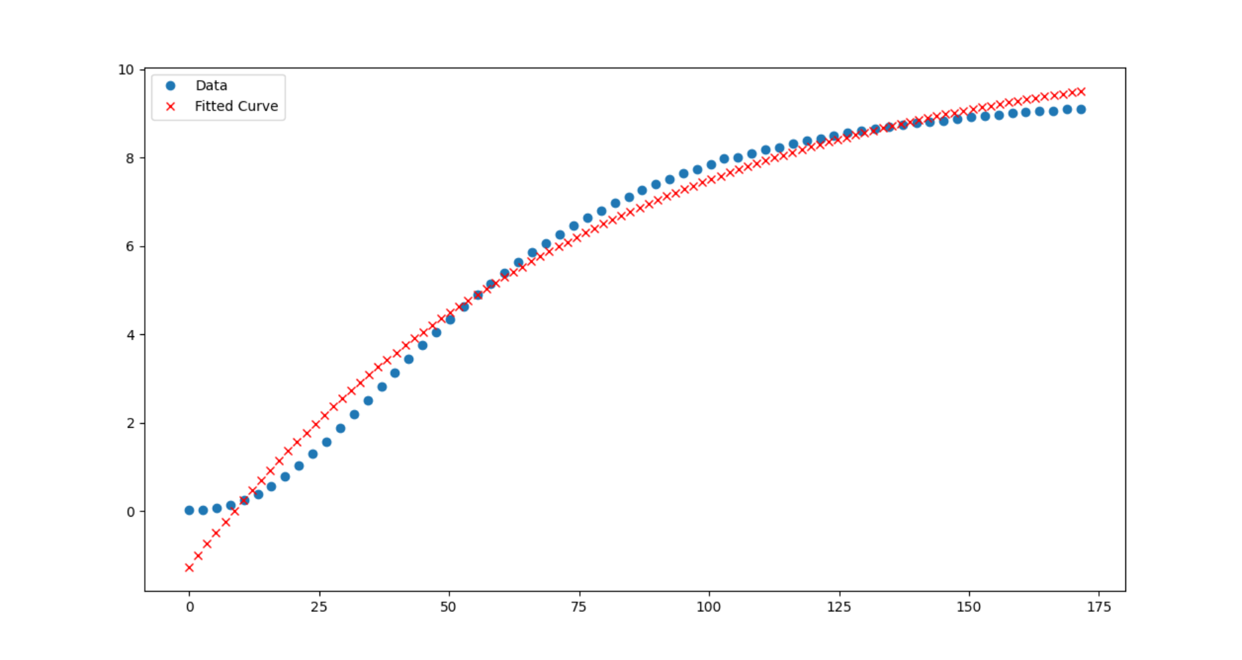
Zeolite Testing Results
Run 2 Fit at 0.4 L/min and 10%
Composition of Ar (%)
T=77.5 s
Time (s)
12
Figure 11: Exponential fit of Run 2
Notes:
This is a fit of the second run I did at ten percent argon concentration, which was discussed in the previous slide.
The graph shows the argon composition over time during the test. The blue circles represent the actual data collected during the experiment, and the red crosses show the fitted curve.
We extract the time constant from this fit to quantify how quickly argon concentration changes in the system. A smaller time constant indicates faster uptake.
Although we cannot yet confirm whether this change is due to adsorption or other processes, the time constant provides a useful metric for comparing different zeolite samples under similar conditions.

Slide 28
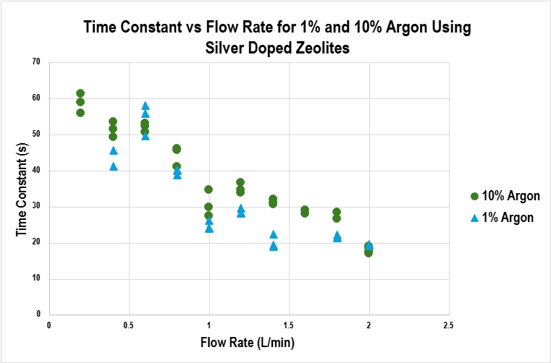
Higher Ar Concentration Increases Time Constant
13
Figure 12: Time Constant vs Flow Rate
Notes:
This graph shows how the time constant varies with flow rate for two different argon concentrations—one and ten percent—using silver-doped zeolites.
On the x-axis, we have the flow rate in liters per minute, and on the y-axis, the time constant in seconds. The green dots represent the data for ten percent argon, and the blue dots are for one percent argon.
What we see is a clear trend: as the flow rate increases, the time constant decreases for both concentrations. That means the system responds faster when the gas is flowing more quickly, which is expected.
Comparing the two concentrations, the ten percent argon runs generally have slightly higher time constants than the one percent runs at the same flow rates. That could suggest that reaching higher concentrations takes a bit longer, possibly due to saturation effects or slower diffusion dynamics in the zeolite material.
Overall, this plot helps us understand how system responsiveness depends on both flow rate and target concentration, which is crucial for tuning the setup in real-world applications like gas separation.

Slide 29
Summary
Zeolite doping is effective, with approximately 95% of the silver nitrate successfully incorporated into the zeolite framework.
Time constant decreases with increasing flow rate for both 1% and 10% Argon, indicating faster system response at higher flow rates.
At all flow rates, 10% Argon has a higher time constant than 1% Argon, This suggests possible saturation effects at higher concentrations.
The non-linear trend in time constants suggests potential mass transfer or adsorption/desorption limitations.
Data is fairly consistent with minimal scatter, indicating good reproducibility.
14
Notes:
From the plots, we can draw several insightful conclusions:
Zeolite doping is effective, with approximately ninety-five percent of the silver nitrate being incorporated into the zeolite framework.
The time constant decreases with increasing flow rate for both one percent and ten percent argon, indicating a faster system response at higher flow rates.
At all flow rates, ten percent argon has a higher time constant than one percent argon.
The non-linear trend in time constants points to potential mass transfer limitations or adsorption/desorption effects in the system.
Lastly, the data is fairly consistent, with minimal scatter, which indicates good reproducibility of the experiments.

Slide 30
Next Steps
Conduct medium-scale experiments using a larger zeolite chamber and 5A zeolites.
Evaluate adsorption performance across various argon concentration levels.
01
02
Compare adsorption using undoped zeolites versus silver-doped samples.
03
04
Verify results using simulations.
15
Notes:
Looking ahead, here are the next steps that will be completed in the fall:
We’ll start medium-scale experiments using a larger zeolite chamber and 5A zeolites. These experiments will help us determine how effectively this setup adsorbs argon.
Another goal is to evaluate adsorption performance across a wider range of argon concentrations, beyond the one percent and ten percent tested so far.
We also plan to compare the adsorption behavior of undoped zeolites to silver-doped samples, to better understand the role of silver in enhancing selectivity.
Finally, we’ll develop simulations to verify results obtained during experimental testing. My colleague Brayden will discuss this in more detail during his presentation.

Slide 31
Thanks!
Do you have any questions?
Sahara.Rahimani@snolab.ca
Thanks to Aleksandra
Bialek, Shaun Hall, Tristan Hillier, Chris Jillings & Tom Sonley for their support throughout the project
Please keep this slide for attribution
Notes:
I would like to thank Aleksandra, Tom, Tristan, Chris, and Shaun for their support throughout the project
Thank you for your time and attention!
I’d be happy to take any questions.

