Slide 1
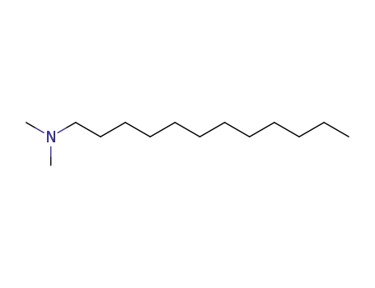
DDA Purification
For 0vββ Search
Noah Fenlon
Supervisor: Szymon Manecki
SNO+
August 12, 2025

Slide 2
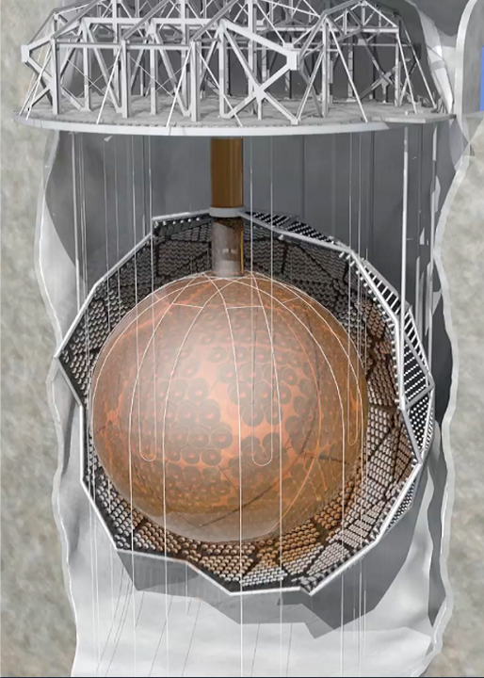
A brief introduction to SNO+
6m radius spherical neutrino detector
Instrumented by ~9000 PMTs
Filled with liquid scintillator, Linear Alkyl-Benzene (LAB)
Submerged in ultra-pure water
Ultimate goal of SNO+ is to search for neutrinoless double-beta decay (0vββ)
https://snoplus.phy.queensu.ca/about.html

Slide 3
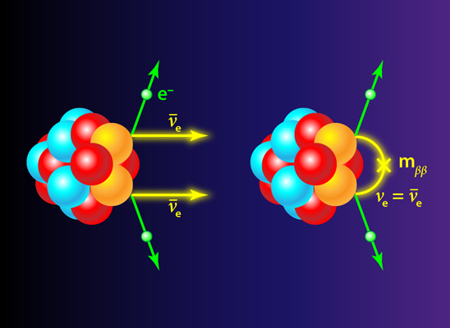
Double beta decay
Two versions of double beta decay
If neutrinos are majorana particles, 0vββ exists
Would violate lepton-number conservation
Since in liquid scintillator, looking for electron signature
Tellurium-130 decay results in 2vββ and can result in 0vββ
APS/Alan Stonebraker

Slide 4
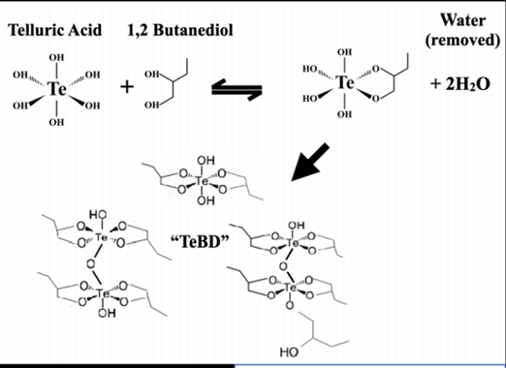
Tellurium Cocktail
Telluric acid (TeA) is insoluble with LAB
Need to bond Telluric acid to Butane-Diol (BD) first, make TeBD
This chemical reaction is a reverse hydration reaction, creates water - insoluble in mixture, bad for physics

Slide 5
The role of DDA in the search for 0vββ
TeBD - 3 parts TeA to 1 part BD
DDA plays a crucial role as an amine neutralizer, stabilizes cocktail
DDA neutralization and temperature + pressure controls prevent reverse hydration reaction, solution is then soluble in LAB

Slide 6

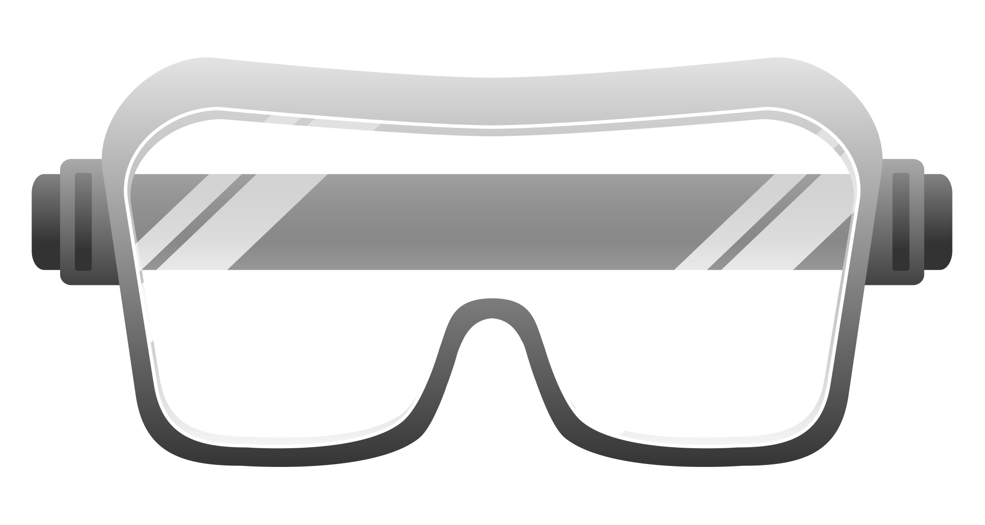
But what is DDA? PPE and Handling
N, N-DimethylDodecylAmine
Clear liquid, irritant, smells like fish
Requires protection from contact and extended inhalation when handling
PPE: Vest, goggles, thick nitrile gloves and face shield when transporting
https://openclipart.org/detail/196256/safety-goggles
https://www.vexels.com/png-svg/preview/318801/green-cleaning-gloves

Slide 7
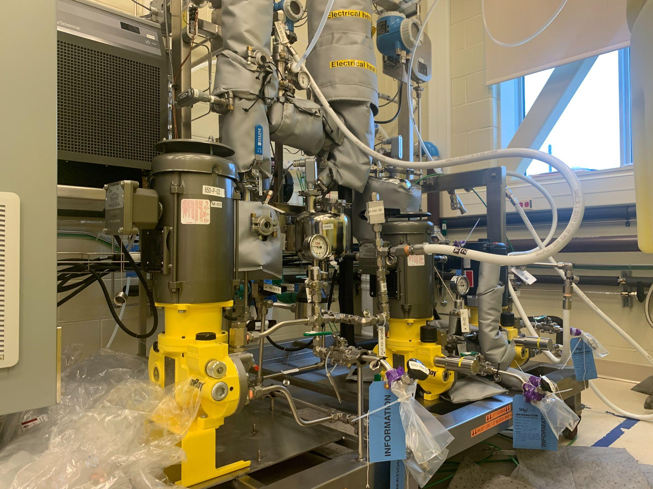
DDA Distillation
DDA still intakes industrial DDA
Removes water and radioactive isotopes with distillation, collects clean DDA
Chemical cleanliness dependent on still parameters, needs Quality Assurance (QA)

Slide 8
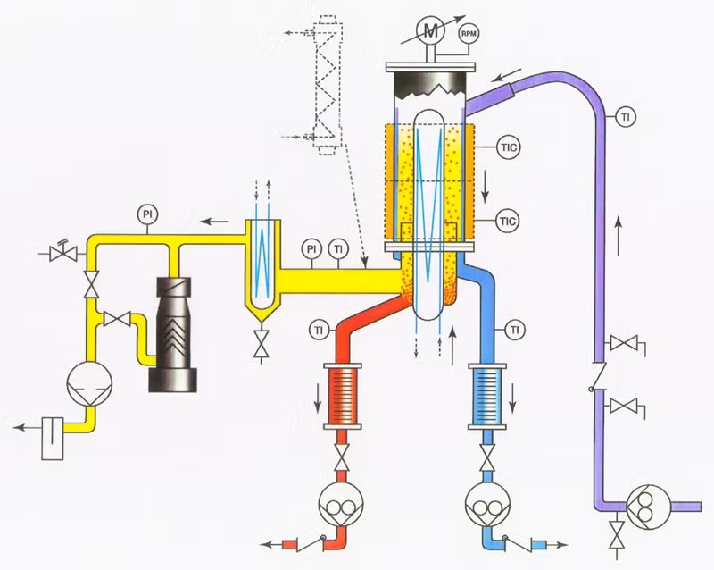
Tube Feed

Slide 9
Distillation Column and Wiper
Cold Trap
Tube Feed

Slide 10
Distillation Column and Wiper
Cold Trap
Residue Pump
Tube Feed
Distillate Pump
https://www.popeinc.com/equipment/wiped-film-distillation-equipment/process/

Slide 11
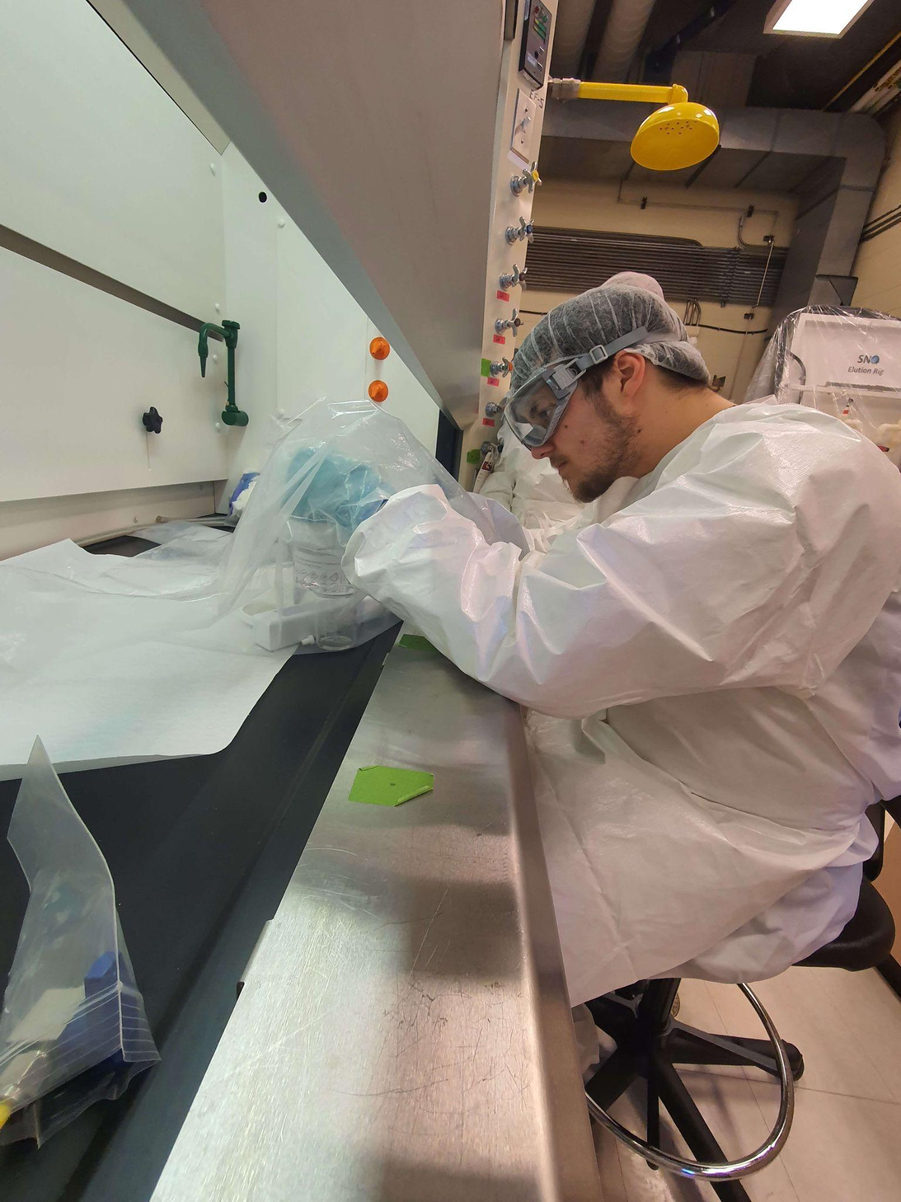
Quality Assurance (QA)
Currently takes place in glove bag
ultraviolet-visible spectroscopy (UV-VIS) and turbidity measurements taken from sample
Results reflect how effective distillation parameters were
Goal for distillation is effective AND efficient

Slide 12
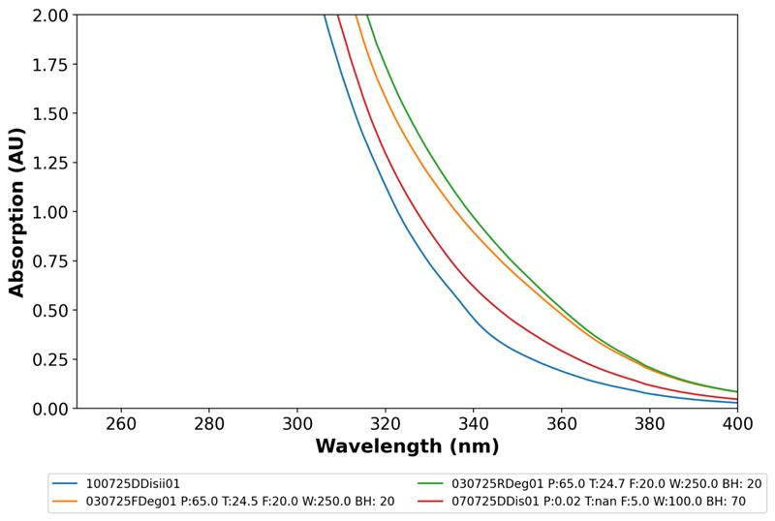
DDA Test Batch
Two week period running the DDA still in 12 hour shifts
Frequent sampling
A test run to make sure final batch passes QA and better assess still parameters
Successful, with successive samples having lower absorption features
Feed sample
Degassed sample
Distilled samples

Slide 13
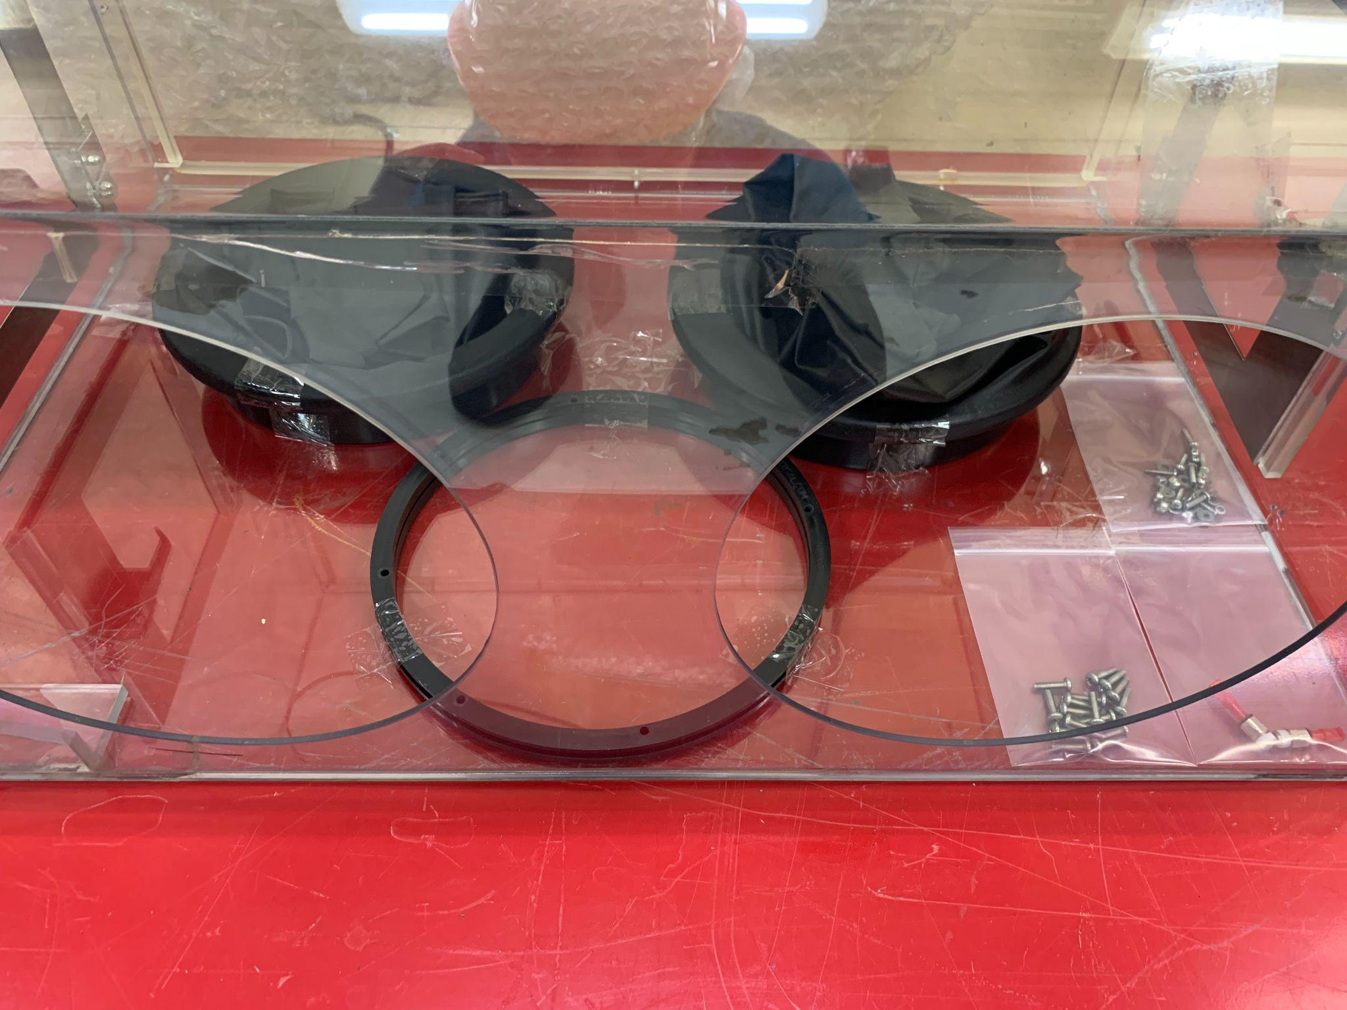
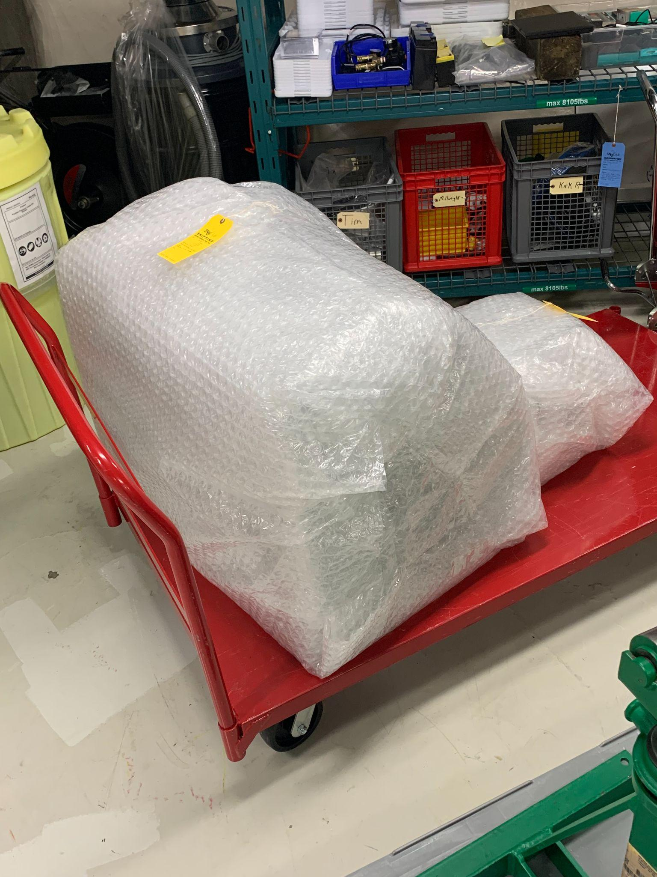
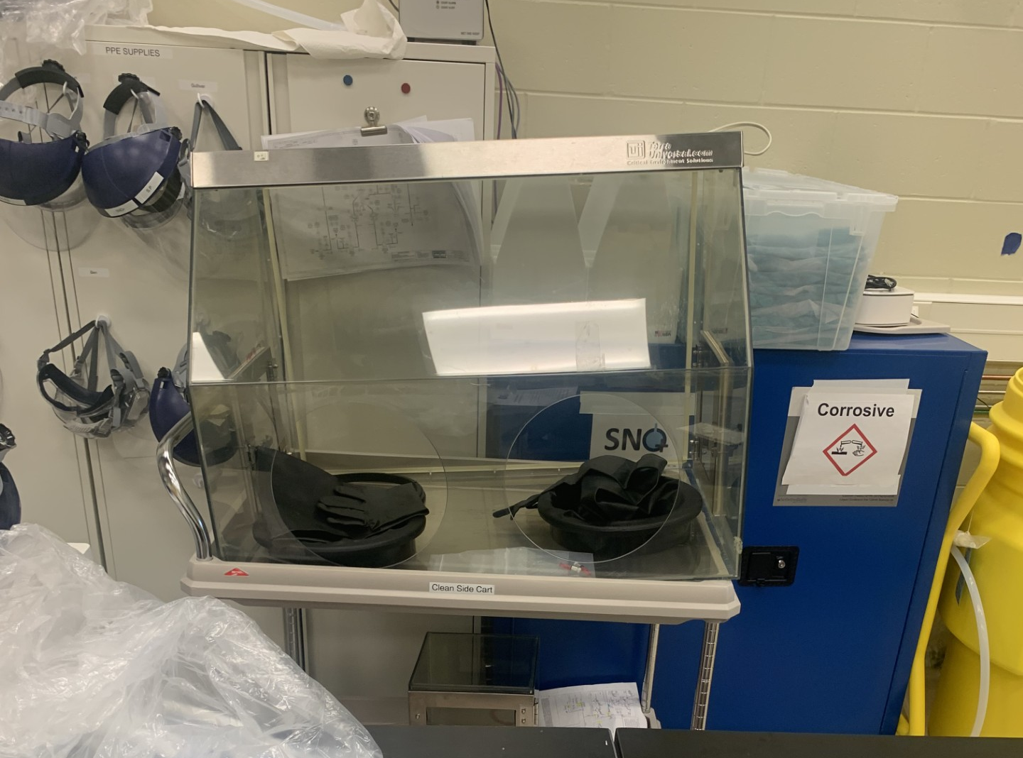
Glovebox Efforts
Glovebag is incredibly unwieldy
My project was to ship NEWS-G glovebox from underground to surface and repurpose for DDA QA
Will reduce spills and allow for QA to be done more precisely and comfortably

Slide 14
Summary and Closing Remarks
Analyzed DDA quality with QA work throughout summer
Worked throughout test batch to get a better sense of still parameters for DDA loading phase. Successful full run with reasonable QA results
Disassembled, shipped above ground and refurbished glovebox for improved QA in future, working to get new parts for chemical compatibility with DDA

Slide 15
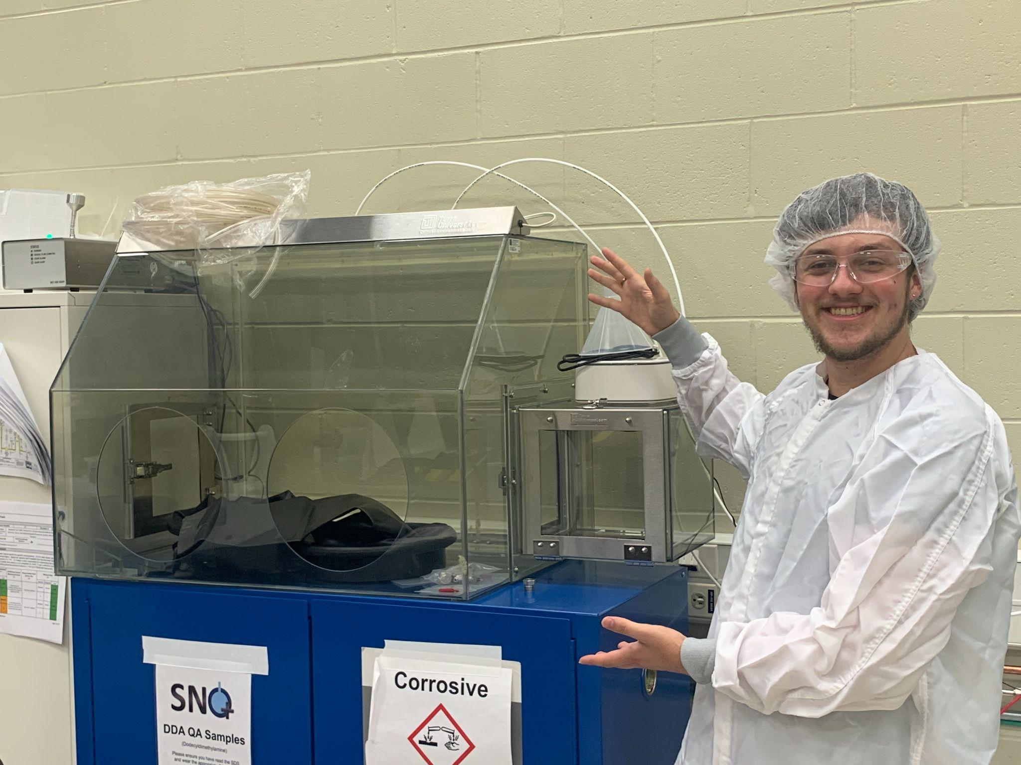
Thank you! Questions?

Slide 16
Additional work for SNO+
Assisted with assembly of AmBe calibration source in detector, prepared DCR for internal deployment
Worked on analysis of high energy events in detector, data cutting to look for trends (currently incomplete!)
Catalogued and prepared for SNO+ spare parts for purchase
Worked at underground transfer station, neutralizing dilute acid

Slide 17
Resources
https://snoplus.phy.queensu.ca/about.html
APS/Alan Stonebraker - https://legend-exp.org/science/neutrinoless-bb-decay/neutrinos-vs-no-neutrinos
https://www.echemi.com/produce/pr22080127786-n-n-dimethyldodecylamine.html
https://openclipart.org/detail/196256/safety-goggles
https://www.vexels.com/png-svg/preview/318801/green-cleaning-gloves
https://www.popeinc.com/equipment/wiped-film-distillation-equipment/process/

