Slide 1
Can SuperCDMS Detect a Supernova?
Evaluating SuperCDMS’s Sensitivity to CEvNS from Core-Collapse Supernovae
By: Lily Hines
Supervisors: Matthew Stukel and Jodi Cooley

Slide 2
TABLE OF CONTENTS
01
02
03
04
05
06
SUPERNOVA NEUTRINOS
WHY SUPER CDMS?
What are they and why are they special
Isn’t SuperCDMS a dark matter detector?
CEvNS
Si and Ge ANALYSIS
What are they and why do we care?
CEvNS interaction in the SCDMS detectors
LEAD ANALYSIS
CONCLUSIONS
Neutrino interactions in the Lead Castle
Results!

Slide 3
INTRODUCTION
This project explores whether SuperCDMS, a cryogenic dark matter detector at SNOLAB, is also capable of detecting neutrinos from core-collapse supernovae via coherent elastic neutrino-nucleus scattering (CEvNS). While not designed for neutrino detection, its low energy threshold and sensitivity to nuclear recoils make it a promising candidate for dual-purpose physics. This work evaluates expected signal rates, energy spectra, and detector response to assess SuperCDMS’s potential role in future supernova observations.

Slide 4
01
Why Supernova Neutrinos Matter
Notes:
The catch? They’re rare. In the Milky Way, we expect maybe two or three per century. The last one we saw was SN1987A, and even though it was in the Large Magellanic Cloud — outside our galaxy — only a few dozen neutrinos were detected worldwide.
If we want to get the most physics out of the next one, we need as many detectors as possible ready to catch those few seconds of neutrino data."

Slide 5
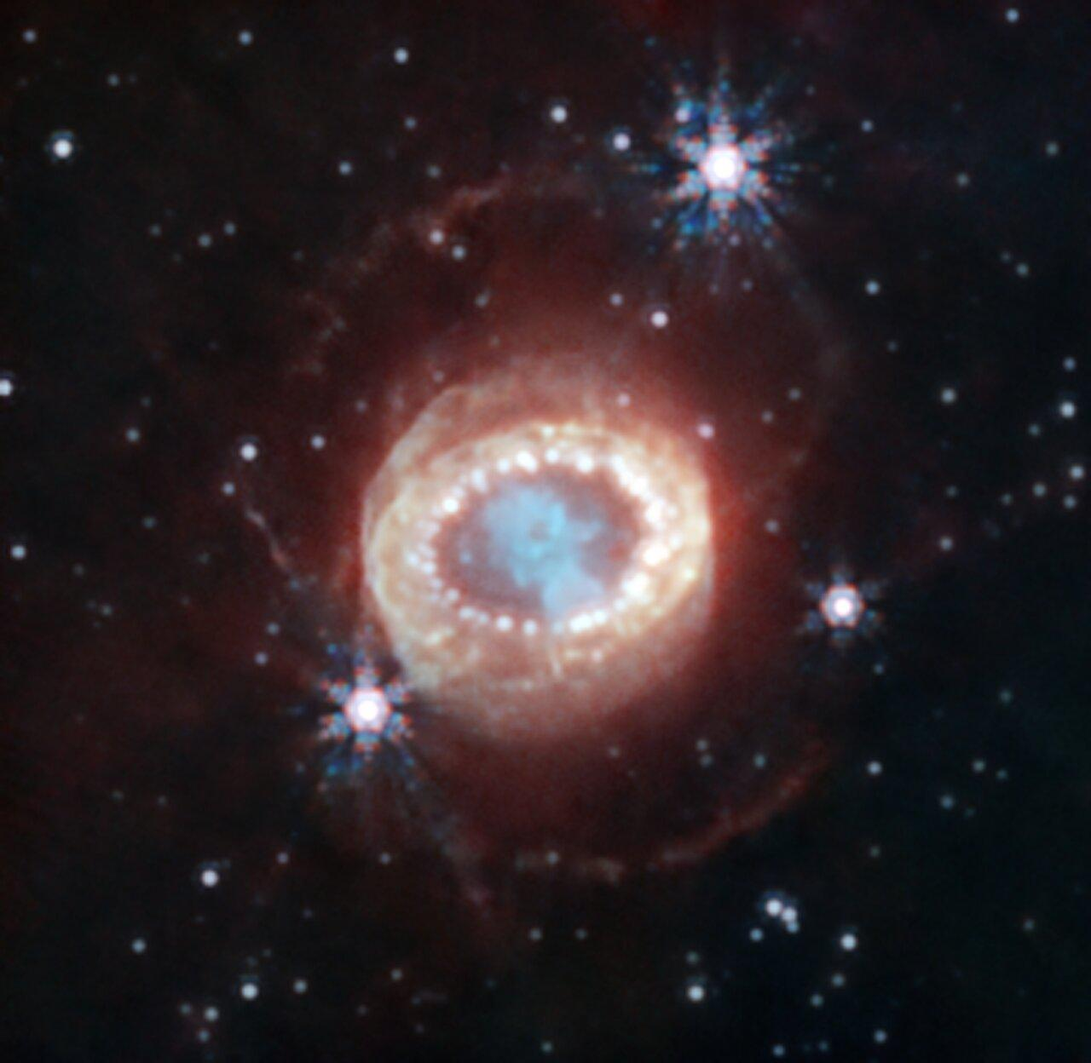
SN1987A
Notes:
Core-collapse supernovae are some of the most energetic events in the universe. When a massive star’s core collapses, almost all the gravitational binding energy — 99% of it — is released in neutrinos.
These neutrinos escape almost instantly, hours before any light from the explosion makes it to us. That means they can give us a unique early warning and a direct probe of what’s happening deep in the star’s core.
The catch? They’re rare. In the Milky Way, we expect maybe two or three per century. The last one we saw was SN1987A, and even though it was in the Large Magellanic Cloud — outside our galaxy — only a few dozen neutrinos were detected worldwide.
If we want to get the most physics out of the next one, we need as many detectors as possible ready to catch those few seconds of neutrino data."

Slide 6
02
Why Look at SuperCDMS?
Not Just for Dark Matter

Slide 7
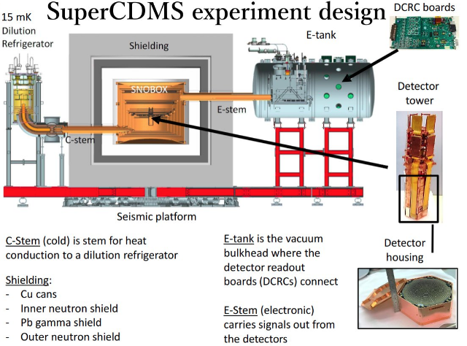
Notes:
SuperCDMS is a dark matter experiment — but it has a key superpower that’s also perfect for supernova neutrino detection: extremely low recoil energy thresholds.
Supernova neutrinos interact with matter in many ways, but for our purposes, the dominant one is Coherent Elastic Neutrino–Nucleus Scattering, or CEνNS. That’s exactly the kind of low-energy nuclear recoil signal SuperCDMS is optimized to detect.
So the question becomes: could a detector sitting deep underground in Sudbury, shielded from backgrounds, not only search for dark matter but also join the global network of neutrino detectors?

Slide 8
03
CEvNS in a Nutshell

Slide 9
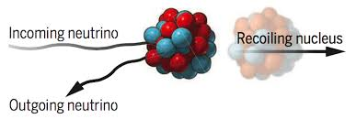
Coherent Elastic Neutrino Nucleus Scattering
Notes:
CEνNS works like this: a neutrino comes in, interacts with an entire nucleus, and makes it recoil just a tiny bit.
The nice part is that it’s flavor-blind — so we get signals from electron, muon, and tau neutrinos equally. The cross section scales with the square of the neutron number, which means heavier elements like germanium have a big advantage.
The tricky part is that these recoils are tiny — just a few hundred electronvolts. That’s far below the threshold of most detectors… but not SuperCDMS.

Slide 10
04
Modelling the Signal

Slide 11
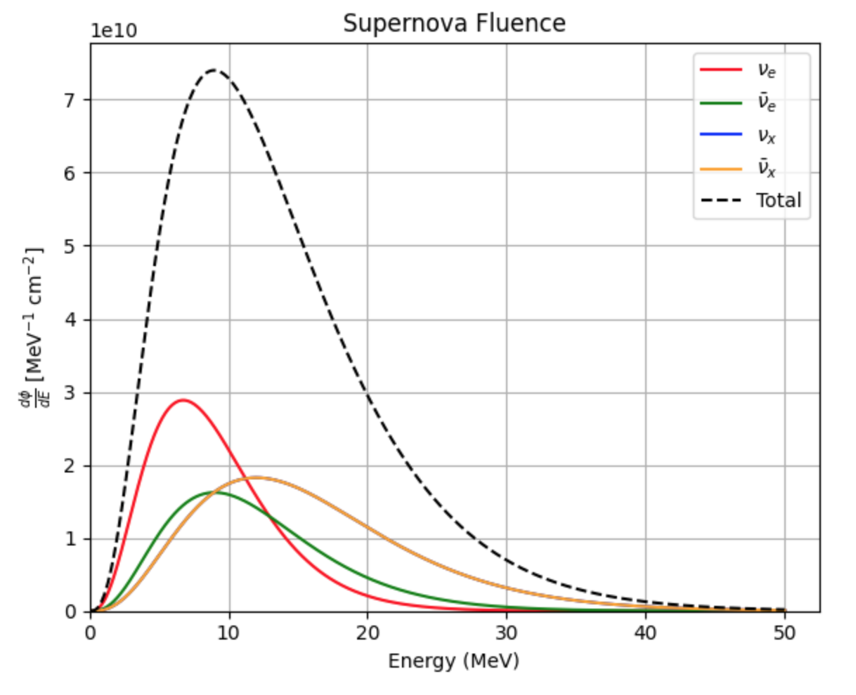
Notes:
To estimate what SuperCDMS might see, I first modeled the neutrino fluence from a standard core-collapse supernova at a distance of 10 kiloparsecs — roughly the distance to the galactic center.
This plot shows the fluence for each neutrino flavor. Since CEνNS doesn’t care about flavor, we can sum them all to get the total fluence relevant to us.
This fluence distribution is the starting point for calculating expected signals in our detectors.

Slide 12
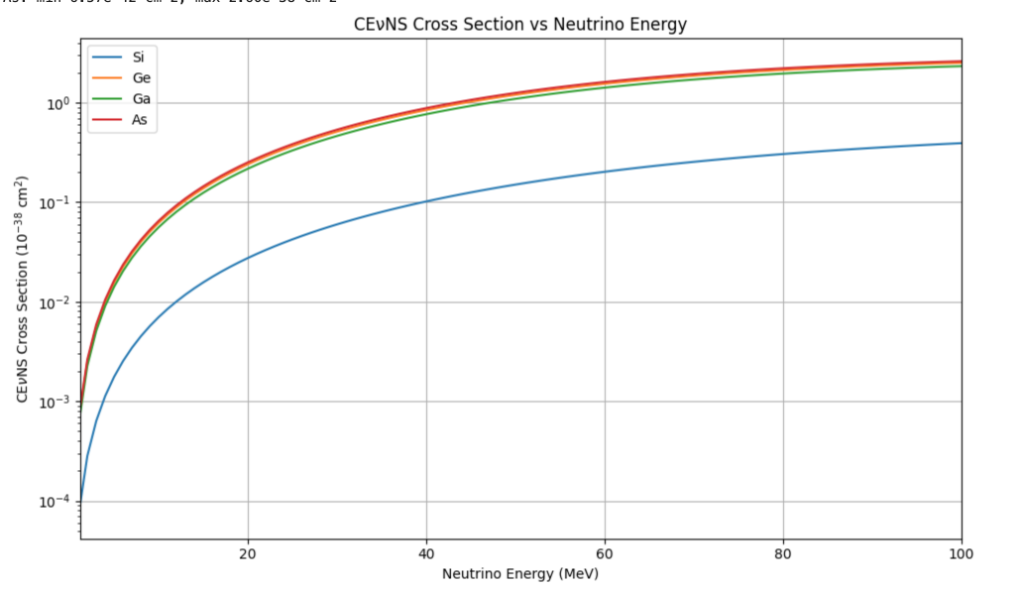
Notes:
Next, we fold in the physics of CEνNS. This plot shows the differential cross section for germanium and silicon. You can see it rises with neutrino energy — but supernova neutrinos sit mostly in the 5–30 MeV range, which means we’re looking at the lower end of this curve.
Even though the cross sections are small, the sheer number of neutrinos from a supernova means we can still get measurable rates.

Slide 13
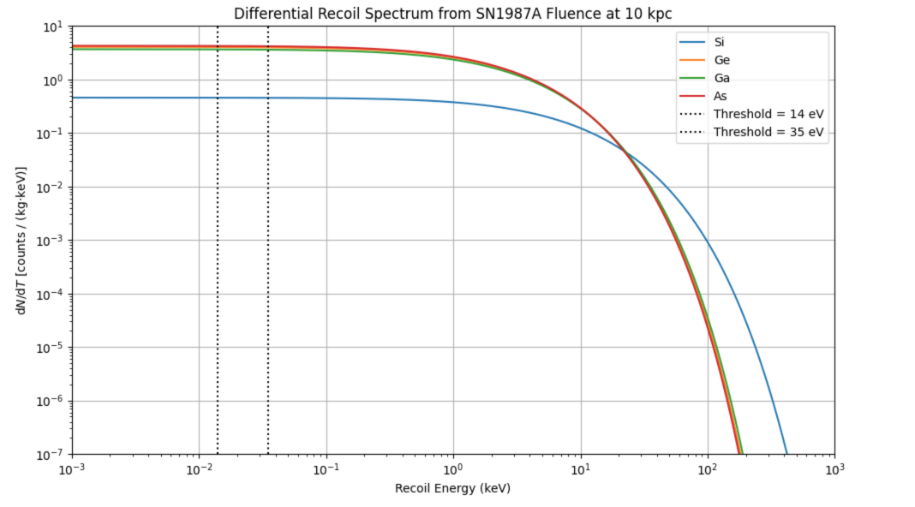
Notes:
Combining the fluence with the cross section gives us the recoil spectrum — the expected number of recoils per energy bin.
Most of these events are below 1 keV. The dashed lines here are the SuperCDMS HV mode thresholds. You can see that other detectors wouldn’t even register most of these events — but SuperCDMS can reach well into this low-energy regime

Slide 14
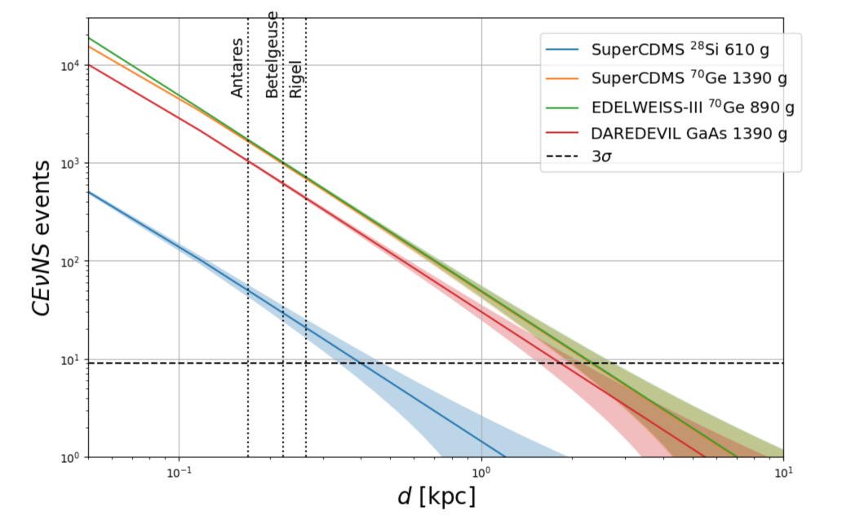
Expected Number of CEvNS Events for Different Supernova Distances
Notes:
If we integrate the recoil spectrum above threshold, we get the total expected event counts.
At 10 kpc, we expect on the order of a few tens of events in both Ge and Si. That’s not a huge number, but it’s a very distinct burst — clustered in time, lasting just a few seconds. That timing signature is exactly what you’d expect from a supernova.

Slide 15
05
Interactions in the Lead Castle
Notes:
Of course, we can’t ignore the detector environment. SuperCDMS is surrounded by a thick lead shield — referred to as the ‘lead castle.’ as it is made up of nearly 120 tonnes of lead.
Neutrinos can also interact in that lead, through both charged-current and neutral-current interactions. Those interactions can produce neutrons, which can then travel into the detector volume and mimic CEνNS events. Not all of those neutrons make it into the detectors — many are absorbed or scatter harmlessly. But some fraction do get through.
So I estimated the number of neutrino–lead interactions that could happen during a supernova burst.

Slide 16
Notes:
SuperCDMS is a dark matter experiment — but it has a key superpower that’s also perfect for supernova neutrino detection: extremely low recoil energy thresholds.
Supernova neutrinos interact with matter in many ways, but for our purposes, the dominant one is Coherent Elastic Neutrino–Nucleus Scattering, or CEνNS. That’s exactly the kind of low-energy nuclear recoil signal SuperCDMS is optimized to detect.
So the question becomes: could a detector sitting deep underground in Sudbury, shielded from backgrounds, not only search for dark matter but also join the global network of neutrino detectors?

Slide 17
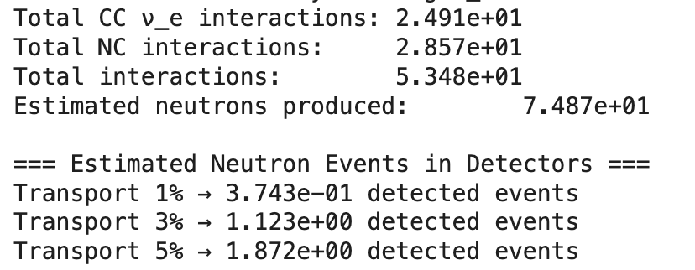
Estimated Number of Neutrino Interactions and Number of Neutrons Produced
Notes:
So my goal was to estimate how many neutrons a core-collapse supernova at 10 kiloparsecs would produce in the SuperCDMS lead shielding, and then how many of those neutrons might be detected. Each interaction can produce one or more neutrons. Based on HALO results (and HALO is a neutron capture supernova detector), we use an average of 1.4 neutrons per interaction — about 60% single-neutron events and 40% double-neutron events.
I estimated the number of detected events by applying two efficiency factors: a neutron transport efficiency, which is the fraction of produced neutrons that actually reach the detectors — here we test values of 1, 3, and 5 percent — and a detector efficiency, which is the fraction of those that deposit enough energy to be seen. For this first pass, we assume 50 percent.
The result is a set of detected-event estimates that depend strongly on the transport fraction and could be refined with full neutron transport simulations and realistic detector-response modeling.
For a supernova at 10 kiloparsecs, our scaled model predicts about 75 total neutrons produced in the 108.5 tonnes of lead shielding. This comes from roughly 25 charged-current and 29 neutral-current interactions, each producing an average of 1.4 neutrons.
The key takeaway: even with the optimistic 5% transport case, we are in the range of only one to two detected events for a typical galactic supernova. This means that SuperCDMS is unlikely to detect a supernova via Neutron interactions unless the event is closer than 10 kiloparsecs.
However, if these events are also time-correlated with the neutrino burst, with careful modeling, they could possibly serve as a secondary confirmation signal.

Slide 18
06
Summary and Conclusion
Notes:
So, to wrap up:
• SuperCDMS can detect supernova neutrinos via CEνNS.
• We expect small but measurable signals — a few tens of events for a typical galactic supernova.
• The lead shielding will produce additional neutrons during the burst — they’re a complication, but also a possible signature.
• This gives SuperCDMS a dual science case — dark matter and astrophysical neutrinos — without changing the hardware.
The next galactic supernova might be decades away — or it could happen tomorrow. And when it does, we want as many eyes — and detectors — on it as possible.

Slide 19
Next Steps
Neutrino-Electron Scattering
Solar Neutrino Rates

Slide 20
Thank You!
Questions?

Slide 21
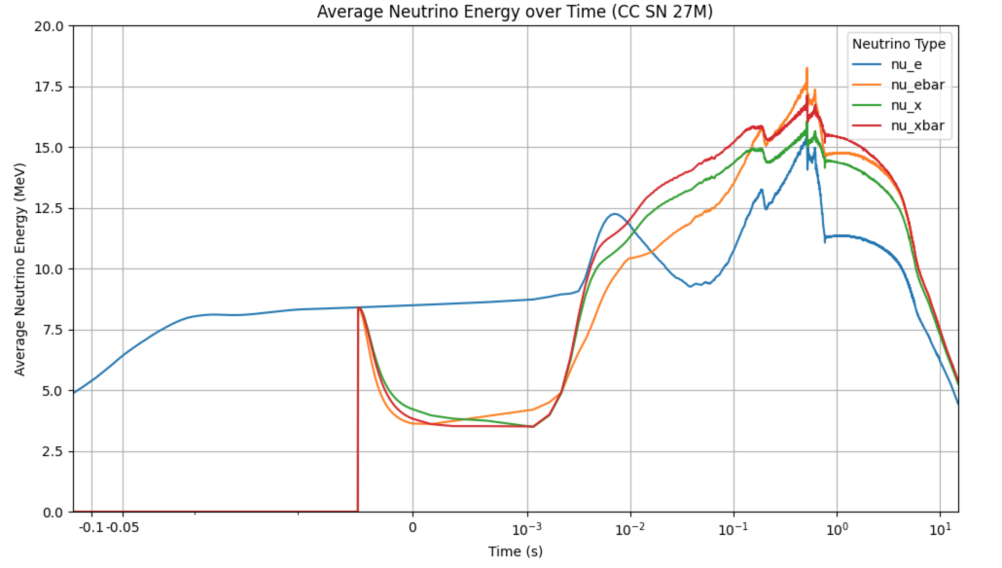

Slide 22
