Slide 1
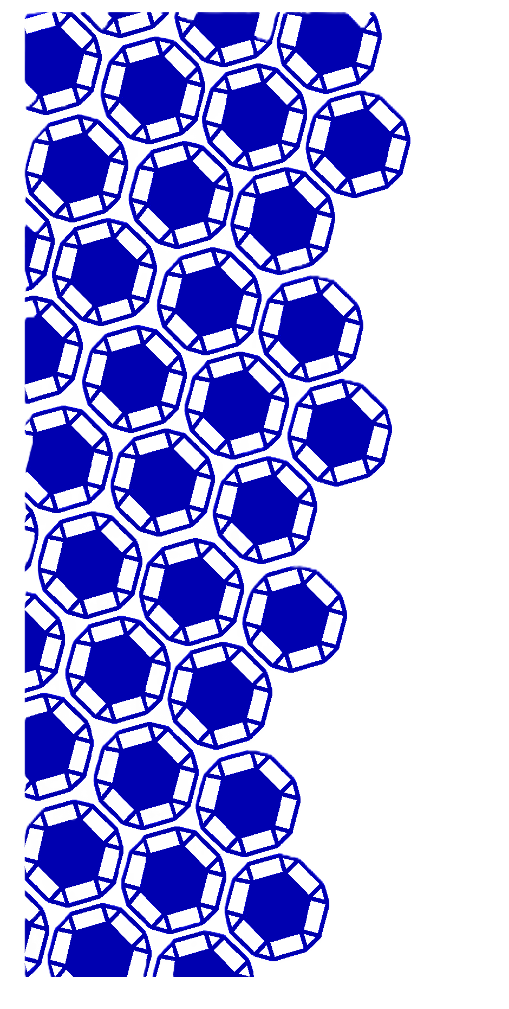
Argon Removal with Zeolites
The Role of Simulations and the Problems We Face
Brayden Bouffard
3rd Year Chemical Engineering Student

Slide 2
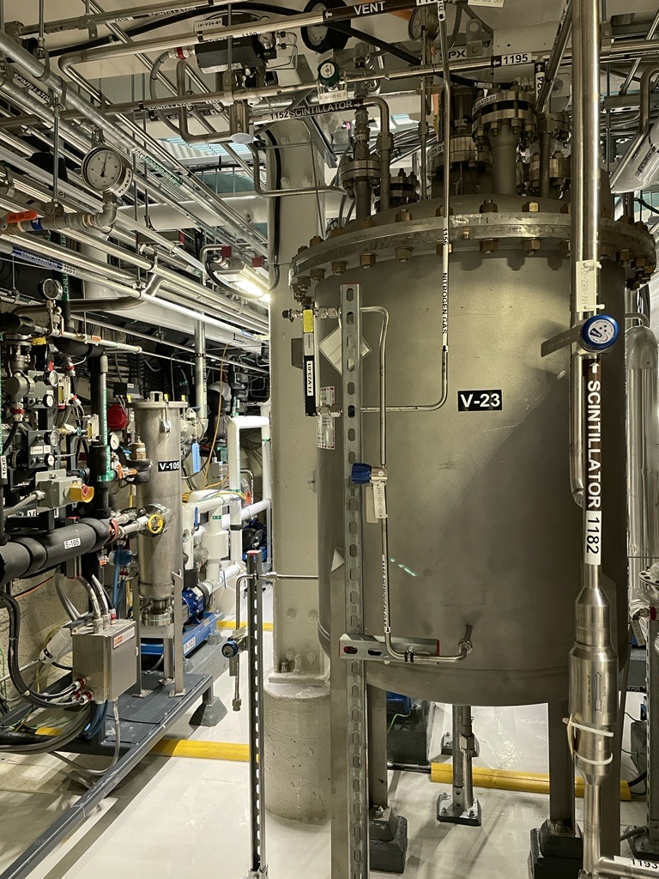
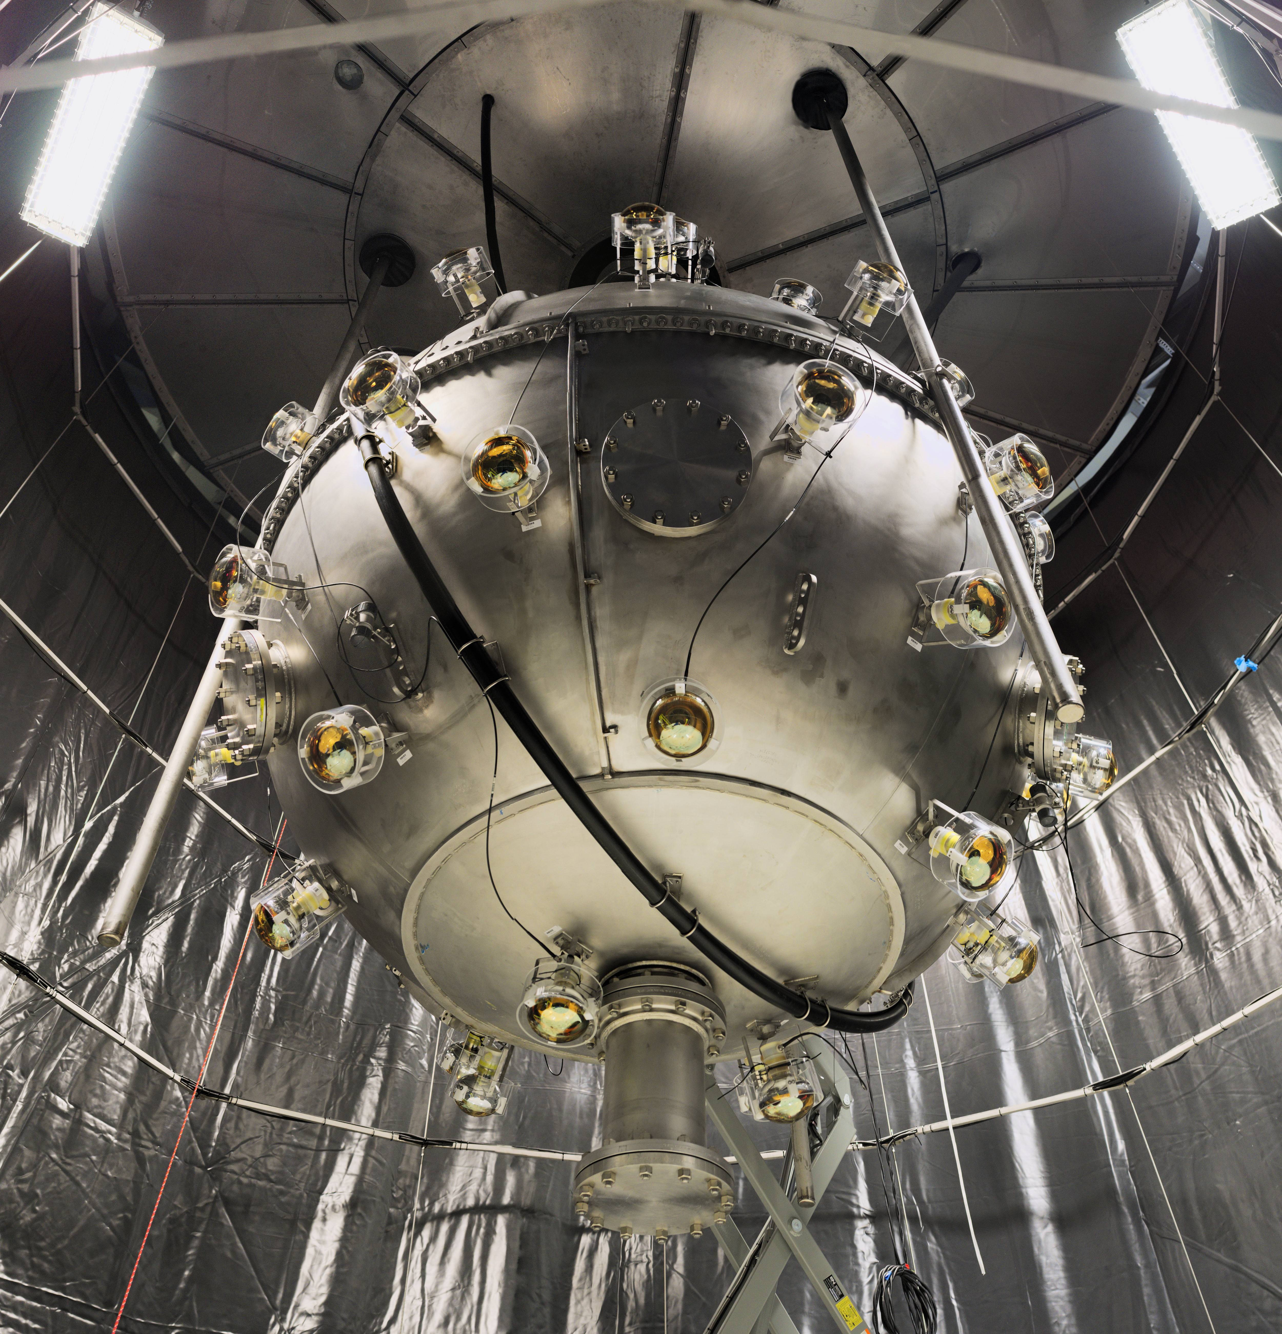
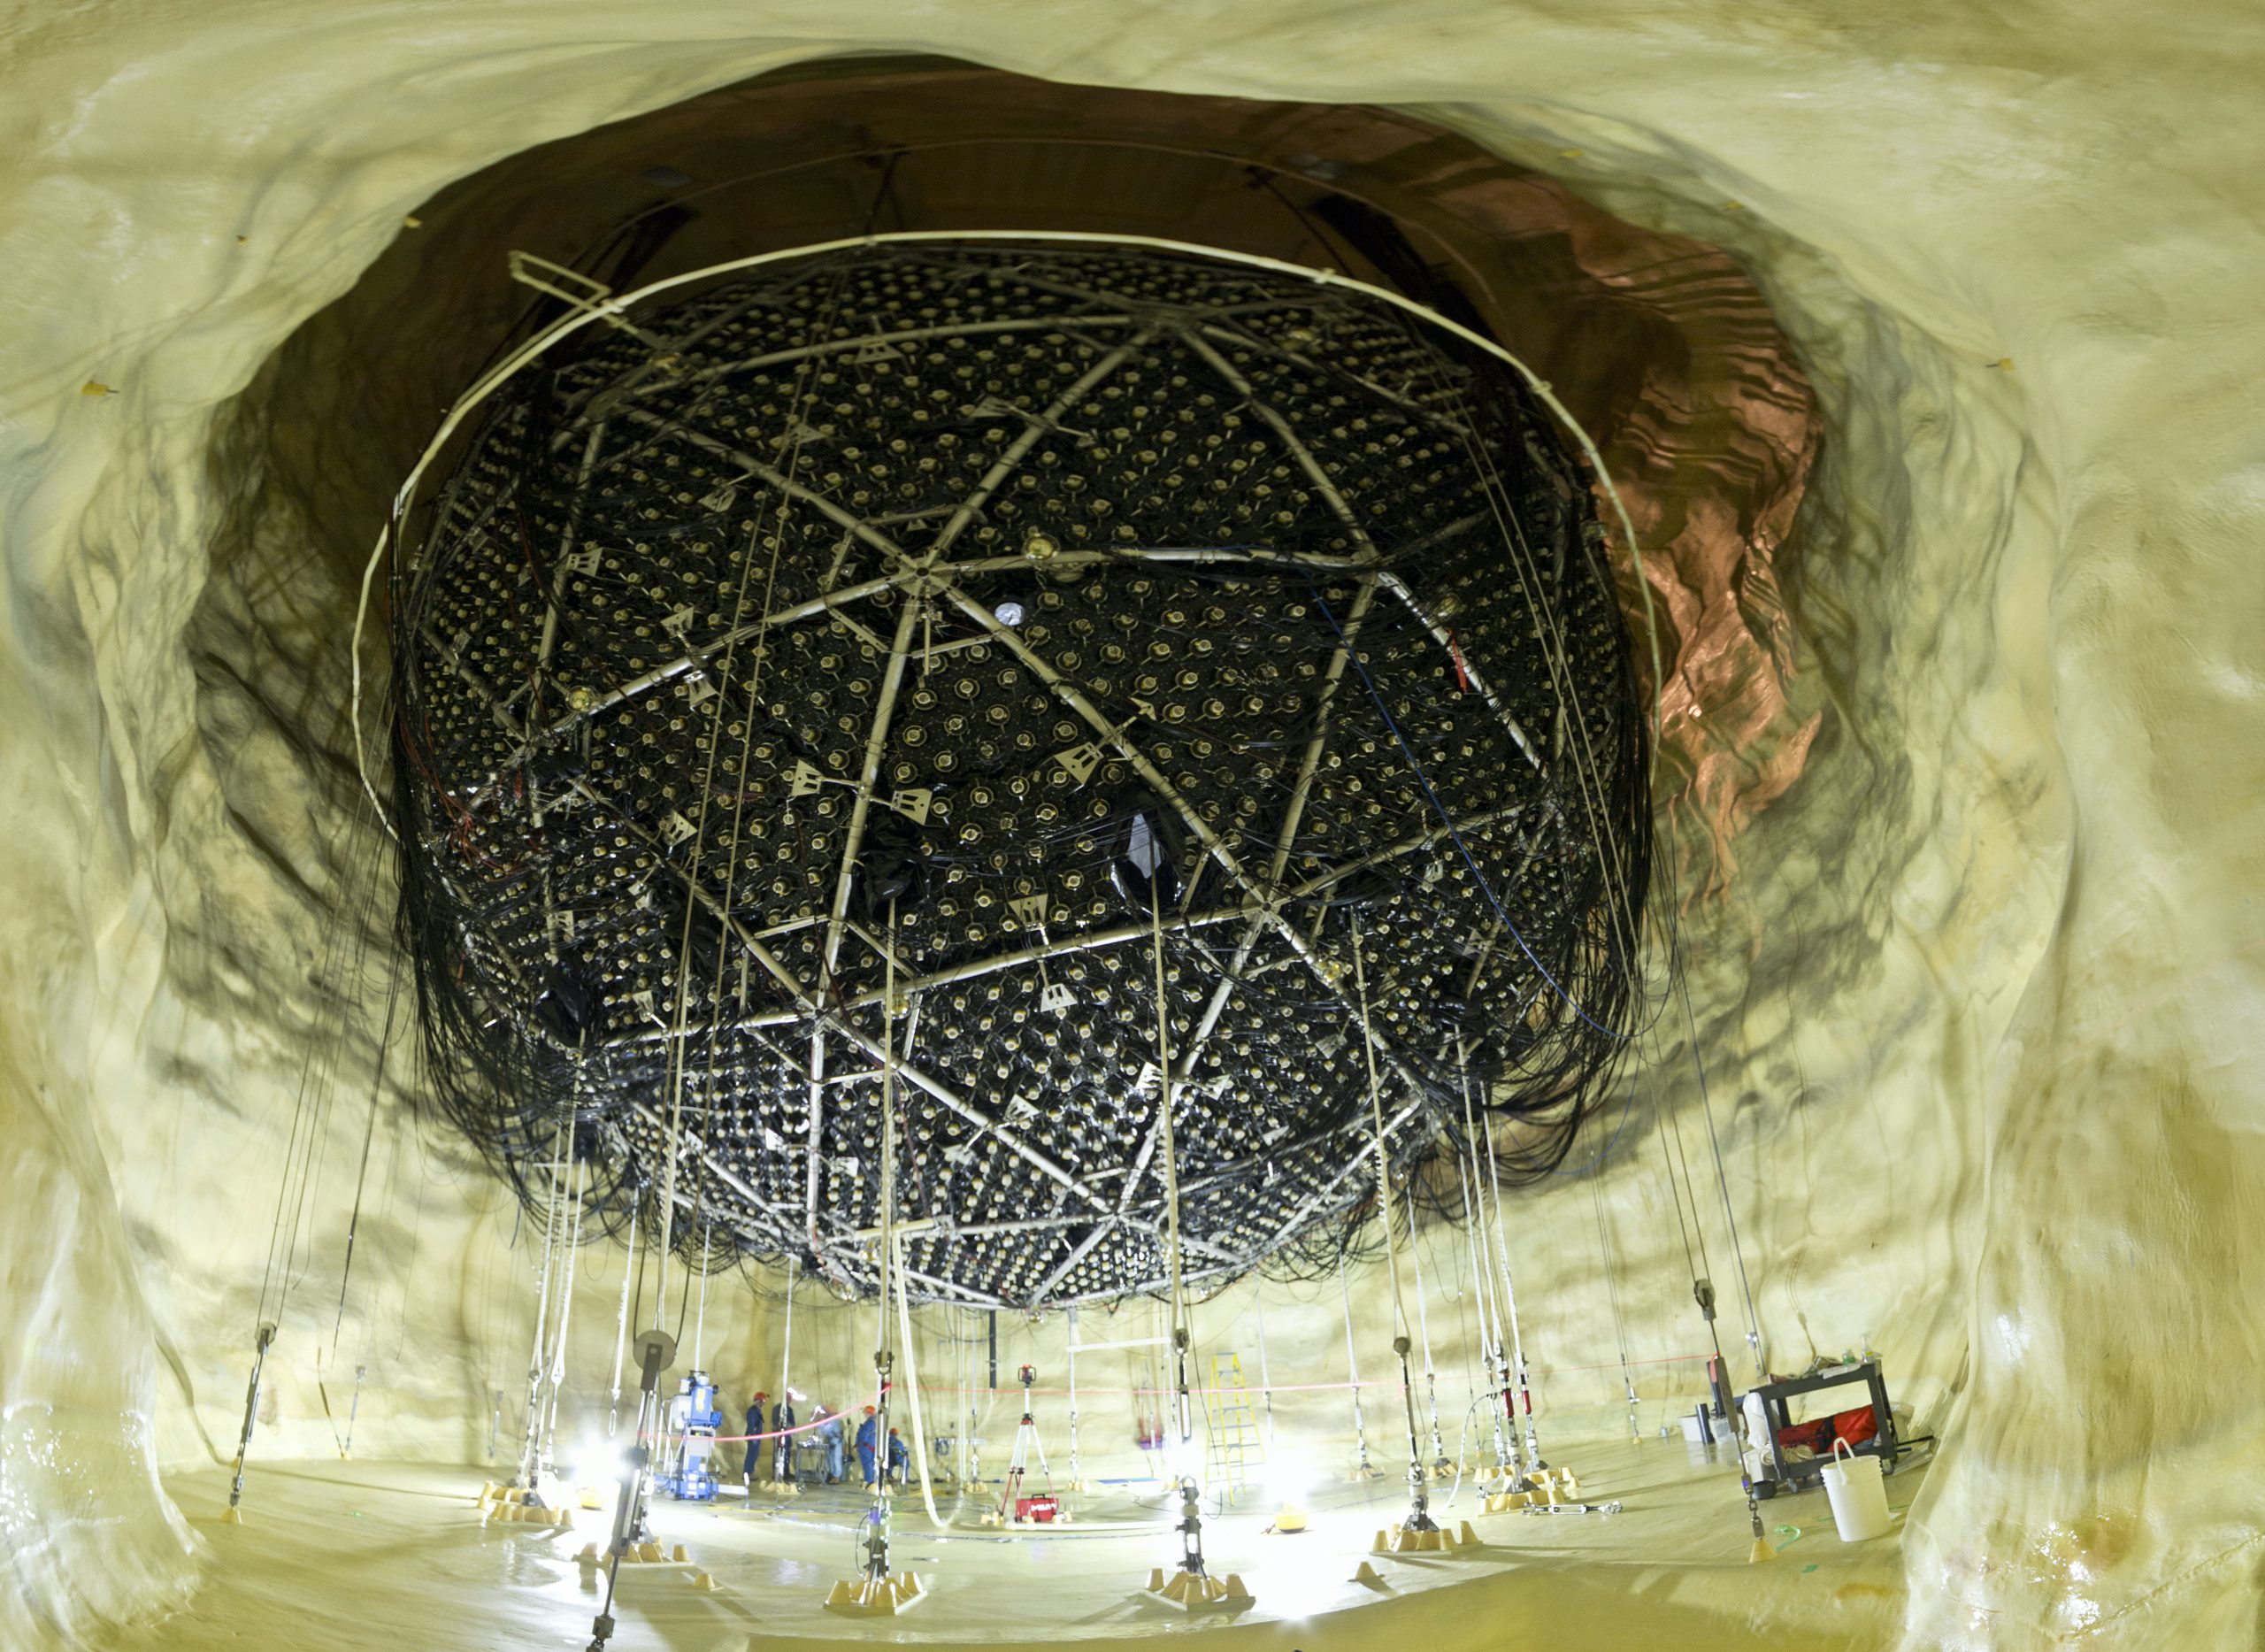
Nitrogen is essential at SNOLAB
Especially underground
  Cryogenic cooling for DEAP-3600
  Cover gas for SNO+
  Stripping gas for scintillator and UPW plants
Steel Shell with Veto PMTs. deap3600.ca, 2018
The SNO+ cavity during upgrade work. snolab.ca, 2023
The underground scintillator plant. snolab.ca, 2022

Slide 3
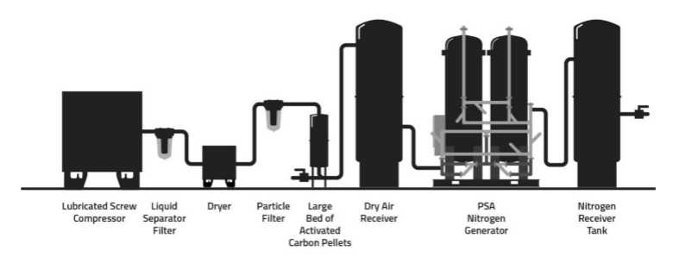
Nitrogen is Derived From Air Underground
Lubricated Screw Compressor
Liquid Separator Filter
Dryer
Particle
Filter
Large
Bed of
Activated
Carbon Pellets
Dry Air
Receiver
PSA
Nitrogen
Generator
Nitrogen
Receiver
Tank
Order of, and stages in a liquid nitrogen generation plant. Holtec Gas Systems. Holtec NitroBreeze(TM) Series ”HNBS”- PSA NITROGEN GENERATOR: Operating and Maintenance Manual, 2020
But this process does not strip argon

Slide 4
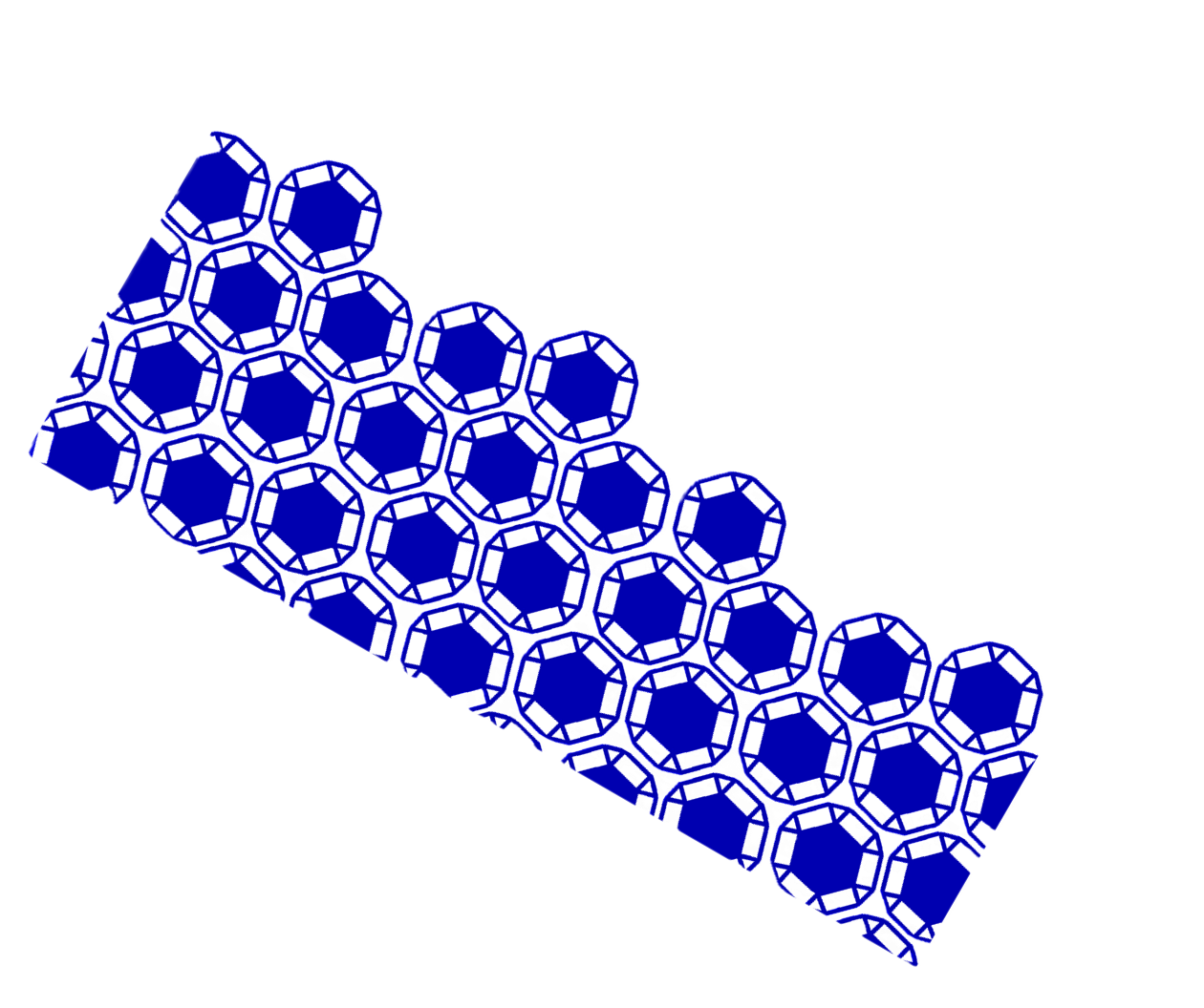
Argon is a problem
Unstable isotopes create radiation
  ³⁹Ar
  ⁴²Ar, especially with SNO+ ⁴²K is a problem
This radiation is detrimental
The argon must be removed... but how?

Slide 5
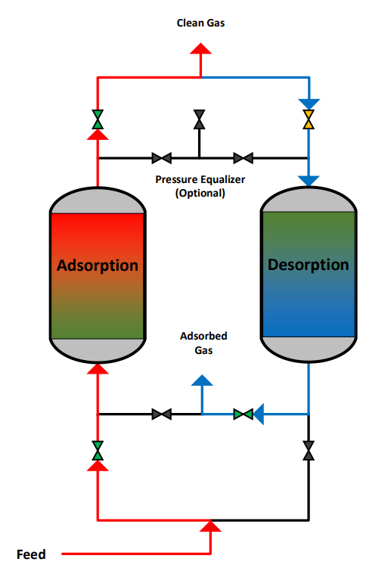
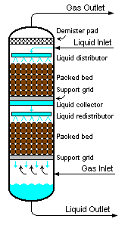
There are potential solutions
Fractional distillation
  Designed by previous students
  Now in the hands of SNOLAB engineering
Zeolites are useful as an adsorbent for gas separation
Process flow diagram for a typical two-column pressure swing adsorption system. Modeling Pressure Swing Adsorption Using Computational Fluid Dynamics. 2018
Schematic diagram of a typical packed bed adsorption column. citizendium.org, 2024

Slide 6
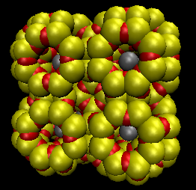
What are zeolites?
Zeolites are Si-O or Si-Al-O crystals with pores
  LTA zeolites have controllable pore sizes and inexpensive
When doped with silver, useful as adsorbent for argon
Testing is required to know how they work
Ag-doped, Si-O Linde Type A zeolite, showing alpha cages

Slide 7
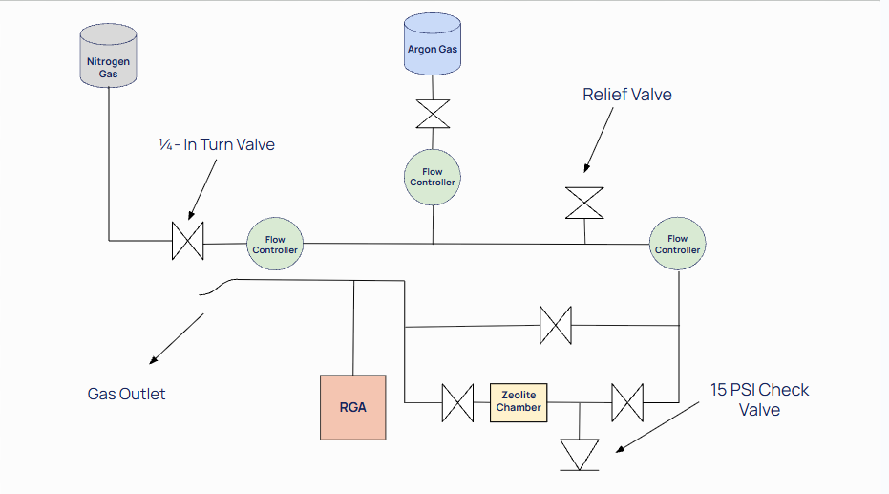
Tests with hardware can only tell us so much
Tests need simulations to verify results
When measurements and simulations match, we have a model
Zeolite Testing Experimental Setup. Sahara Rahimani, 2025

Slide 8

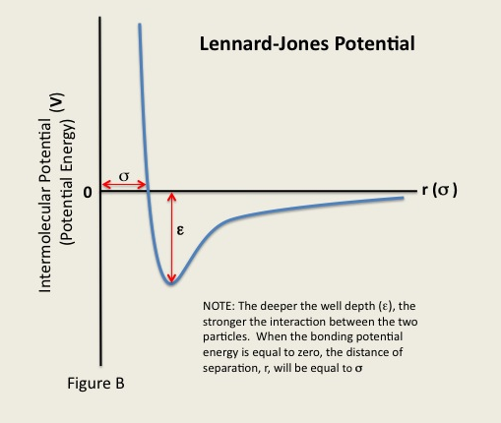
CP2K is needed to study interactions
Lennard-Jones Potentials are the driving interactions
Lennard-Jones Potential attracts Ag (grey) and Ar (red) towards an equilibrium distance
The potential holding Ag and Ar at equilibrium is greater than N₂ (blue) potential with Ag or Ar
Lennard-Jones Potential figure showing equilibrium distance (sigma) and the potential well (epsilon). Libretexts.org.

Slide 9
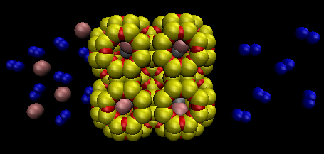
What do we need to see from a simulation?
N₂ -Ar gas mixture moves at flowrate, F, into zeolite
Argon is captured in pores.
Also check for special occurrences
Pure N₂ gas exits zeolite

Slide 10
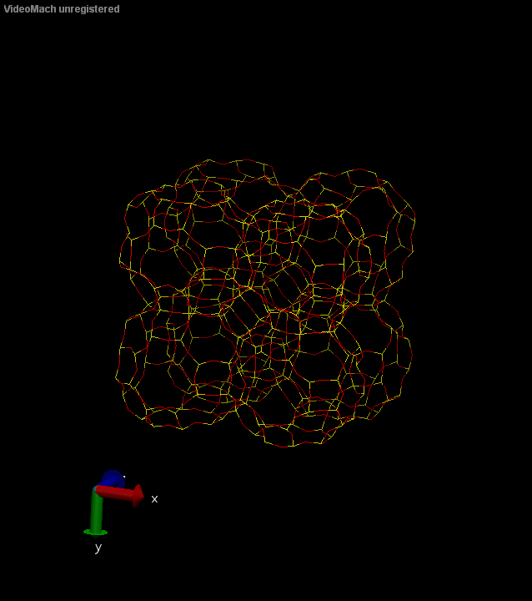
Simulations are difficult to set up
One of the hardest things I have ever done
CP2K is old, picky, and confusing
.GIF of one of my first "successful" simulations of undoped LTA zeolite.

Slide 11
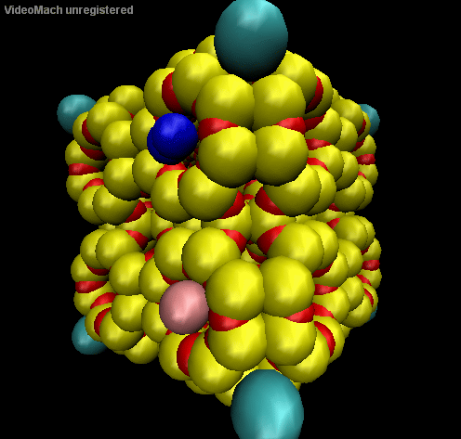
There is no working simulation
Known Lennard-Jones potentials do not work here
Unaccounted forces cause the collapse
.GIF of my last simulation attempt of Ag-doped LTA zeolite with nitrogen and argon at pore entrance: turquoise = Cl, blue = nitrogen molecule, pink = Ar

Slide 12
We know this will work, it's only a matter of how!
What we have learned:
ETS-10 zeolites work*
Pore size is important
Zeolite-doping is necessary
Matching doping to target (i.e., Ag to Ar)
What we still need:
Lennard-Jones parameters
How LTA and ETS-10 zeolites differ
Verify hardware tests to ensure measurements make sense
*According to Adsorption of argon, oxygen, and nitrogen on silver exchanged ETS-10 molecular sieve. Ansón A. et al., 2006

Slide 13
Any Questions?
bbouffard@snolab.ca
Thanks to everyone that helped me through this project and for the opportunity to work at SNOLAB!

