Slide 1
Detecting the unseen:
Neutron unfolding with Helium-3 counters
Kishan Chaudhary
Undergraduate Research Assistant, SNOLAB
Supervisor: Dr. Ian Lawson
CASST 2025

Slide 2
Introduction:
Ambient neutrons a background for SNOLAB experiments:
→ Limit detector sensitivity of PICO, DEAP, SUPERCDMS, SNO+
Objective:
→ Prepare method and analysis to measure neutron counts in range 0 to 11 MeV.
Notes:
Use unfolding along with moderators to detect higher energy neutrons(up to 11 MeV).

Slide 3
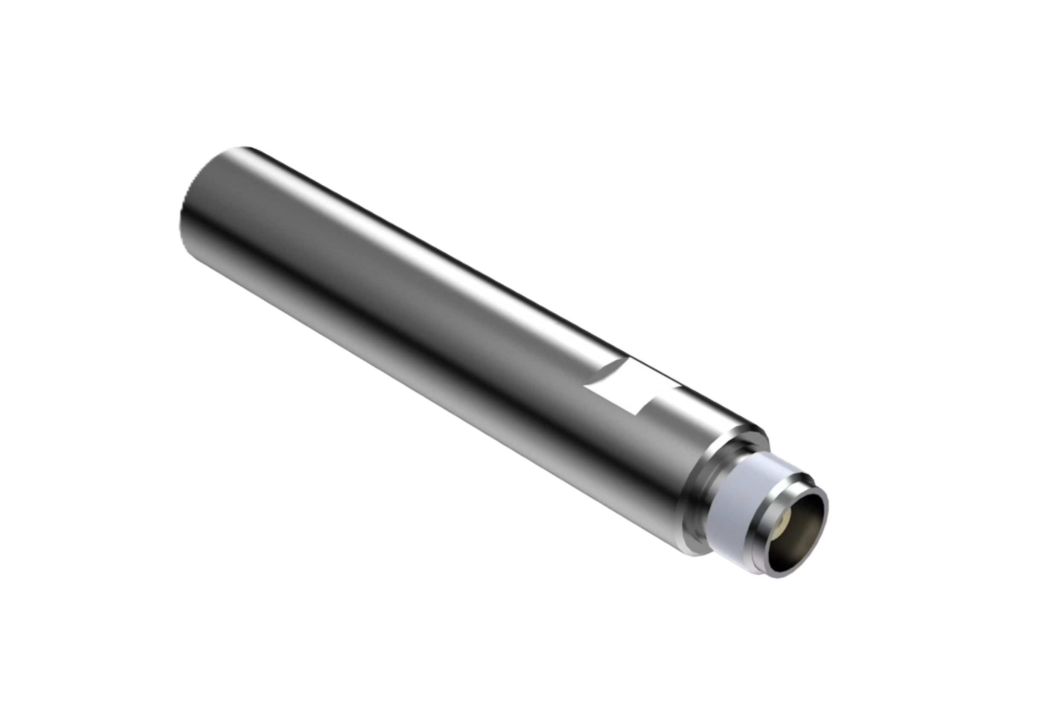

Helium-3 counters: Neutron detection
Fig: PNH ${25}^{TM}$ Helium-3 proportional counter tube. Image credit: Mirion Technologies

Slide 4
Helium-3 counters: Neutron detection
Fig: PNH ${25}^{TM}$ Helium-3 proportional counter tube. Image credit: Mirion Technologies
Triton(H-3)
K.E. 191 keV
Slow neutron
Helium-3
Proton(H-1)
K.E. 573 keV
Fig: Neutron capture diagram

Slide 5

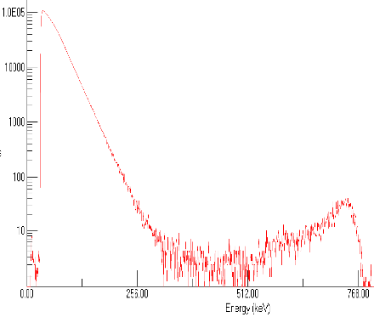
Helium-3 counters: Neutron detection
Ionized charges
Fig: PNH ${25}^{TM}$ Helium-3 proportional counter tube. Image credit: Mirion Technologies
Pre-Amplifier
Amplifier
Triton(H-3)
K.E: 191 keV
Slow neutron
Helium-3
Proton(H-1)
K.E: 573 keV
Fig: Simplified neutron counting flow diagram
Fig: Neutron capture diagram

Slide 6
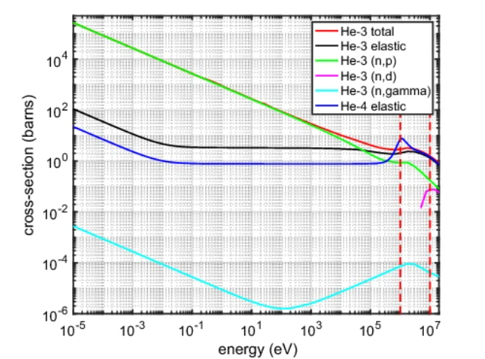
Limitation of Helium-3:
→Slow neutrons only
Fig: Cross-Section plot for He-3 and He-4 interactions (Piscitelli et.al, Eur. Phys. J. Plus 135, 577, 2020)
Cross-section (barns)
Energy (eV)
Notes:
r^-1 electric field, electron drift, high voltage near wires, charge pairs multiply proportionally, UG

Slide 7
Limitation of Helium-3:
→Slow neutrons only
0
0.025 eV
0.1 MeV
11 MeV
Slow neutrons
Epithermal neutrons
Fast neutrons
How to measure 0 - 11 MeV neutron counts with a detector that only detects slow neutrons
Notes:
r^-1 electric field, electron drift, high voltage near wires, charge pairs multiply proportionally, UG

Slide 8
How do we detect fast neutrons:
→Slow Them down!
Fast neutrons + scattering → Slow neutrons (Moderation: M. Joyce (Ed.), Nuclear Engineering)
Best moderation materials: Hydrogenous materials, example polyethylene and water

Slide 9
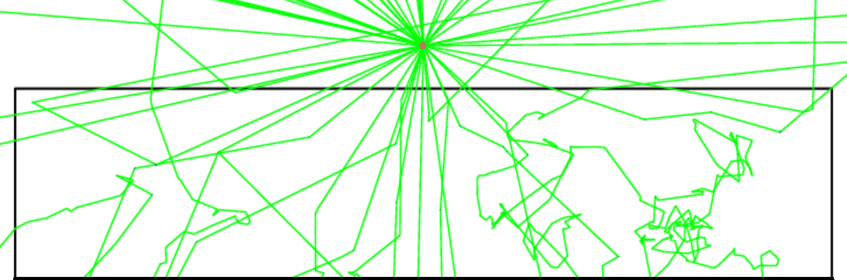
How do we detect fast neutrons:
→Slow Them down!
Fast neutrons + scattering → Slow neutrons (Moderation: M. Joyce (Ed.), Nuclear Engineering)
Best moderation materials: Hydrogenous materials, example polyethylene and water
Neutron source (AmBe)
Neutron tracks
Polyethylene brick
Fig: 2-D Neutron scattering tracks in a polyethylene brick using GEANT4

Slide 10

How do we detect fast neutrons?
→Moderation Cases
Moderation Cases
Bare(No moderation)
1-inch Polyethylene
2-inch Polyethylene
3-inch Polyethylene
4-inch Polyethylene
5-inch Polyethylene
The Idea:
Use multiple polyethylene moderation setup
Fast Neutrons → Slow Neutrons → Detect
Polyethylene thickness ∝ Neutron’s final energies
But how do we reconstruct the source spectrum?

Slide 11
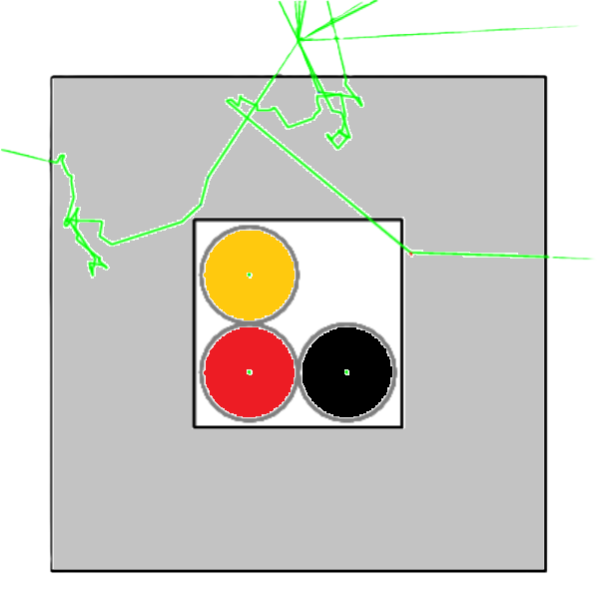
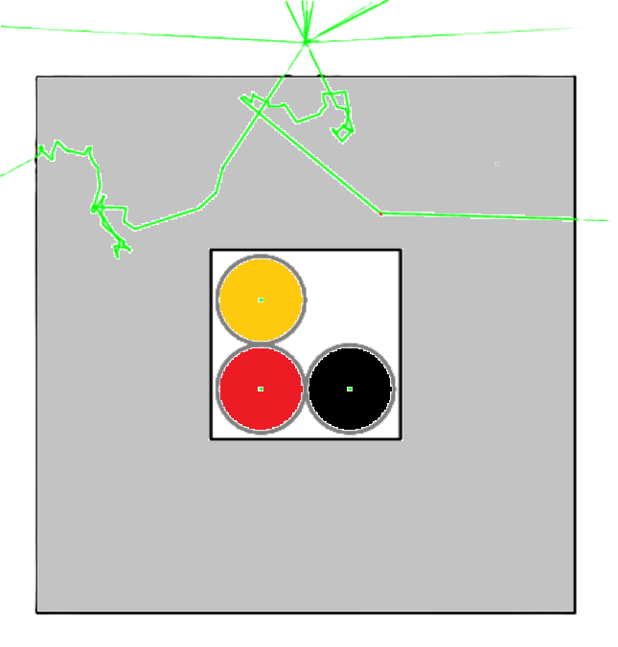
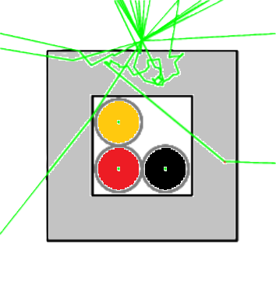

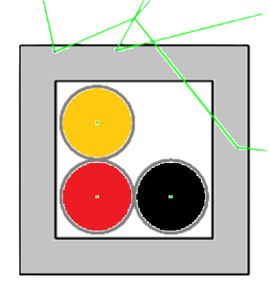
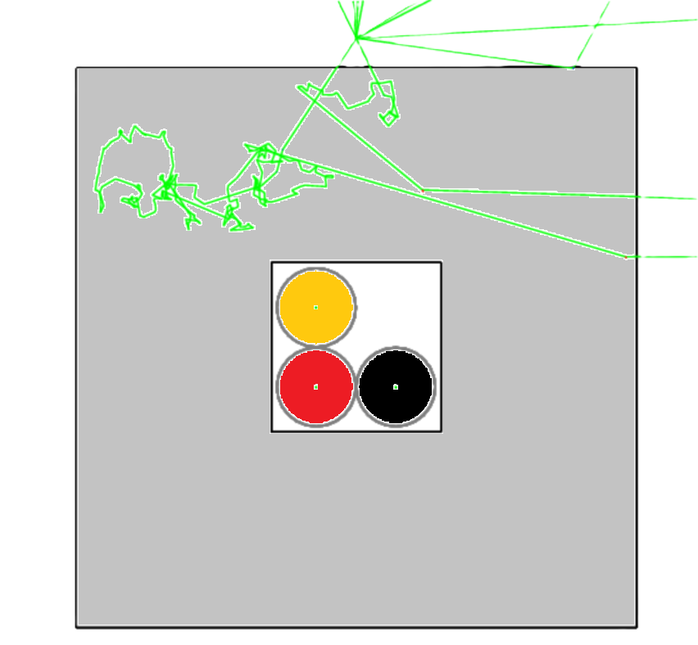
Moderation cases:
Bare
1-inch
2-inch
3-inch
4-inch
Moderation Cases
Bare(No moderation)
1-inch Polyethylene
2-inch Polyethylene
3-inch Polyethylene
4-inch Polyethylene
5-inch Polyethylene
Neutron source
Polyethylene
5-inch

Slide 12

Detector slow neutrons count matrix:
Bare
1-inch
2-inch
$$\left[ \begin{aligned}C_{B} \\ C_{1} \\ C_{2} \\ C_{3} \\ C_{4} \\ C_{5}\end{aligned} \right]$$
3-inch
4-inch
Count Matrix
(for 6 moderation cases)
5-inch

Slide 13

What we need:
Bare
1-inch
2-inch
$$\left[ \begin{aligned}C_{B} \\ C_{1} \\ C_{2} \\ C_{3} \\ C_{4} \\ C_{5}\end{aligned} \right] \left[ \begin{aligned}S_{1} \\ S_{2} \\ S_{3} \\ ⋮ \\ S_{j−1} \\ S_{j}\end{aligned} \right]$$
3-inch
4-inch
Source Counts Matrix
(for j energy bins in 0-11 MeV)
5-inch

Slide 14

How Do We Detect Fast Neutrons?
→Response
Bare
1-inch
2-inch
$$\left[ \begin{aligned}C_{B} \\ C_{1} \\ C_{2} \\ C_{3} \\ C_{4} \\ C_{5}\end{aligned} \right]= \left[ \begin{matrix}R_{1,1} & ⋯ & R_{1, j} \\ ⋮ & ⋱ & ⋮ \\ R_{6,1} & ⋯ & R_{6,j}\end{matrix} \right] \left[ \begin{aligned}S_{1} \\ S_{2} \\ S_{3} \\ ⋮ \\ S_{j−1} \\ S_{j}\end{aligned} \right]$$
3-inch
4-inch
Response Matrix
(for 6 moderations and
j energy bins)
5-inch

Slide 15

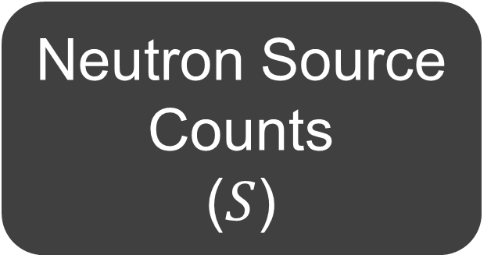
How Do We Detect Fast Neutrons:
→Unfolding
Counts in Detector (C)
Response
(R)
$$\left[ \begin{aligned}C_{B} \\ C_{1} \\ C_{2} \\ C_{3} \\ C_{4} \\ C_{5}\end{aligned} \right] ≈ \left[ \begin{matrix}R_{1,1} & ⋯ & R_{1,j} \\ ⋮ & ⋱ & ⋮ \\ R_{6,1} & ⋯ & R_{6,j}\end{matrix} \right] \left[ \begin{aligned}S_{1} \\ S_{2} \\ S_{3} \\ ⋮ \\ S_{j−1} \\ S_{j}\end{aligned} \right]$$
Unfolding Algorithms
Neutron Source Counts
($S$)

Slide 16
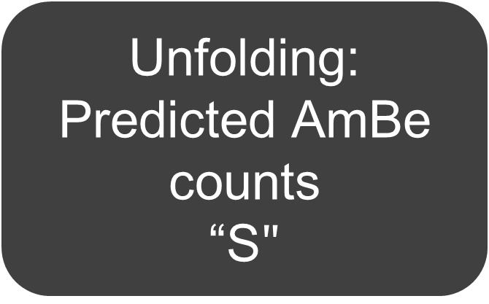

Test:
$$\left[ \begin{aligned}C_{B} \\ C_{1} \\ C_{2} \\ C_{3} \\ C_{4} \\ C_{5}\end{aligned} \right]≈ \left[ \begin{matrix}R_{1,1} & ⋯ & R_{1,j} \\ ⋮ & ⋱ & ⋮ \\ R_{6,1} & ⋯ & R_{6,j}\end{matrix} \right] \left[ \begin{aligned}S_{1} \\ S_{2} \\ S_{3} \\ ⋮ \\ S_{j−1} \\ S_{j}\end{aligned} \right]$$
Find AmBe Spectra using unfolding algorithm:
Unfolding:
Predicted AmBe counts
“S$"$
Check simulations validity
Calculate matrix “R”
(using GEANT4)
Measure counts
for AmBe “C”
(using GEANT4)
Check results

Slide 17
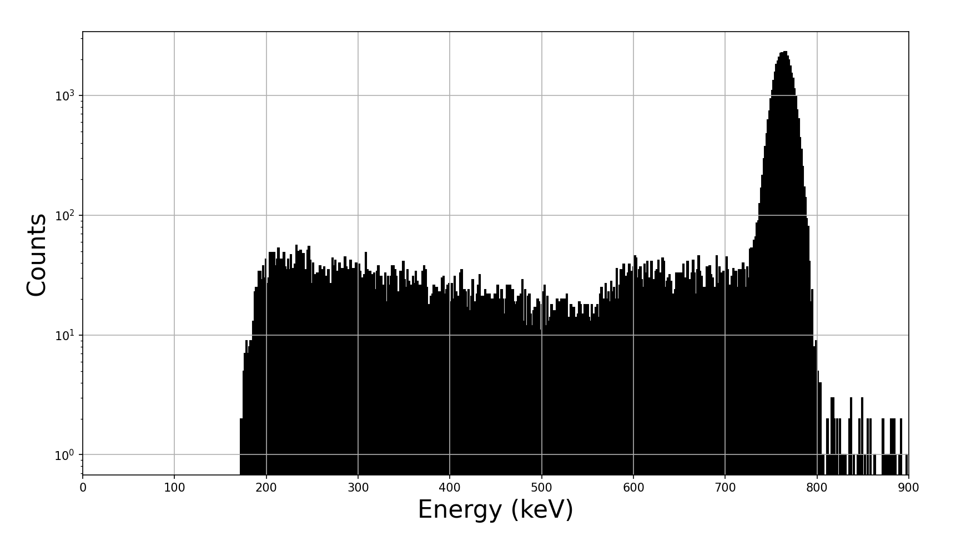
Check simulations validity
Fig: GEANT4’s neutron capture energy deposition with 10 keV gaussian noise

Slide 18
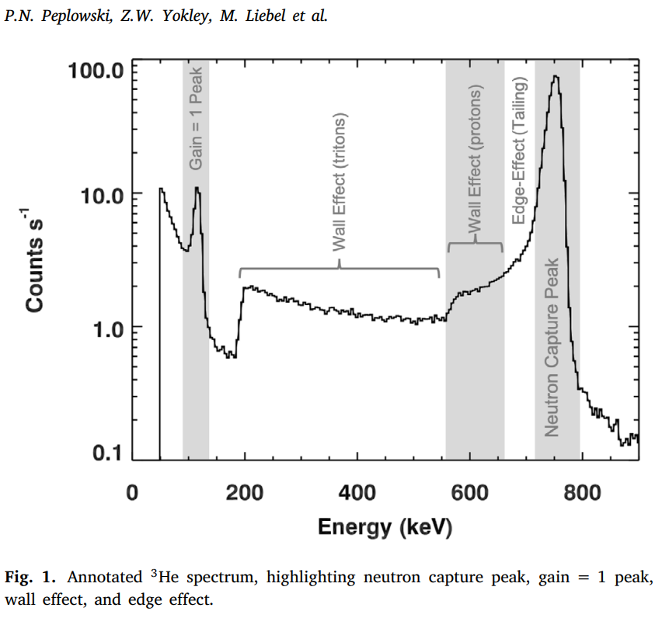
Check simulations validity
Fig: Experimental energy deposition data
(Peplowski et al., NIM A, 982, 164574, 2020)
Fig: GEANT4’s neutron capture energy deposition with 10 keV gaussian noise

Slide 19
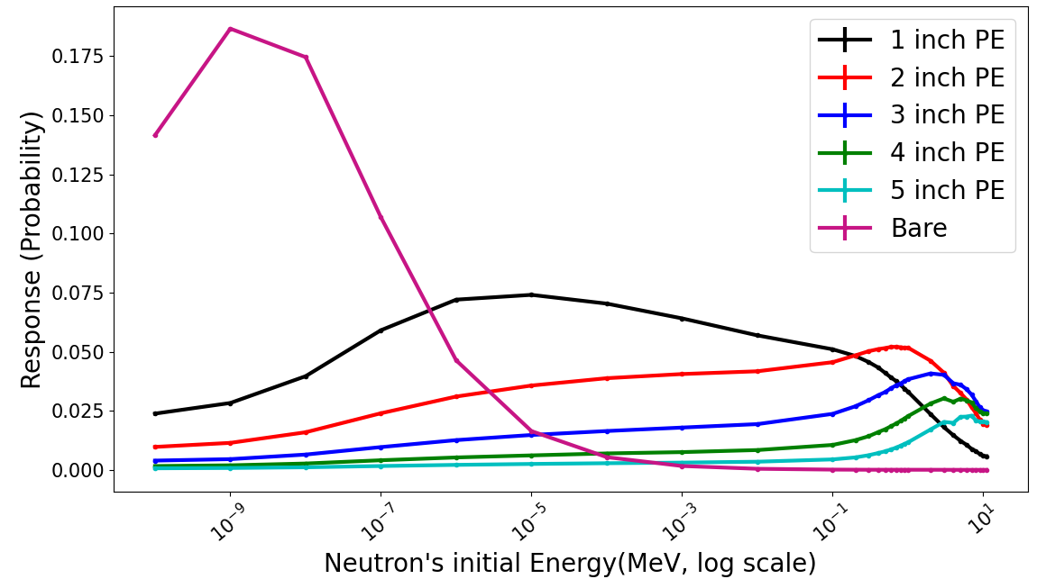

Check Simulations validity
Calculate “R”
(using GEANT4)
$$\left[ \begin{matrix}R_{1,1} & ⋯ & R_{1,29} \\ ⋮ & ⋱ & ⋮ \\ R_{6,1} & ⋯ & R_{6,29}\end{matrix} \right]$$
Fig: Response plot for the AmBe test

Slide 20
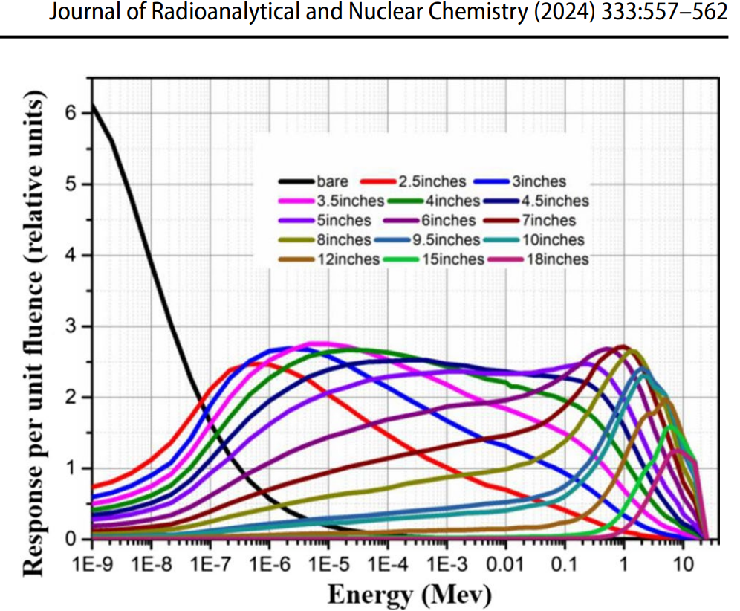
Check Simulations validity
Calculate “R”
(using GEANT4)
Fig: Response plot for the AmBe test
Fig: Response Plot from Yang-Yang laboratory for BSS (Yoon et al., Astroparticle Physics, 126, 2021)

Slide 21

Measure “C” for AmBe
(using GEANT4)
Check Simulations validity
Calculate “R”
(using GEANT4)
$$\left[ \begin{aligned}C_{B} \\ C_{1} \\ C_{2} \\ C_{3} \\ C_{4} \\ C_{5}\end{aligned} \right]=\left[ \begin{aligned}367 \\ 178956 \\ 365467 \\ 351517 \\ 268617 \\ 185942\end{aligned} \right]$$
From 10 Million event run(AmBe)
Equivalent to ~44 hours of actual AmBe run

Slide 22

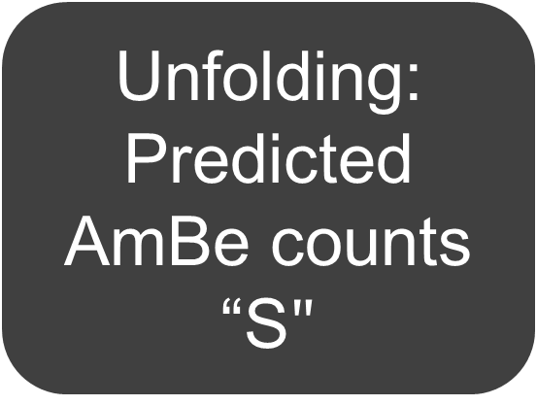
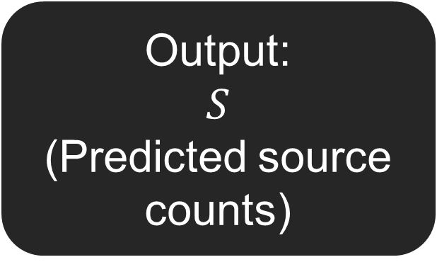
Measure “C” for AmBe
(using GEANT4)
Unfolding:
Predicted AmBe counts
“S$"$
Check Simulations validity
Calculate “R”
(using GEANT4)
$$\left[ \begin{aligned}C_{B} \\ C_{1} \\ C_{2} \\ C_{3} \\ C_{4} \\ C_{5}\end{aligned} \right] ≈ \left[ \begin{matrix}R_{1,1} & ⋯ & R_{1,6} \\ ⋮ & ⋱ & ⋮ \\ R_{6,1} & ⋯ & R_{6,6}\end{matrix} \right] \left[ \begin{aligned}S_{1} \\ S_{2} \\ S_{3} \\ S_{4} \\ S_{5} \\ S_{6}\end{aligned} \right]$$
Counts
(GEANT4)
Response
(GEANT4)
Use unfolding
algorithm
Output:
$S$
(Predicted source counts)

Slide 23
Measure “C” for AmBe
(using GEANT4)
Unfolding:
Predicted AmBe counts
“S$"$
Check simulations validity
Calculate “R”
(using GEANT4)
Check results!
GRAVEL algorithm results:
During the test period:
The AmBe source emitted 10 000 000 fast neutrons
The algorithm predicted 9 893 254 fast neutrons, about 99%!
→Takeaway: The Helium-3 counter successfully counts for fast neutrons!

Slide 24
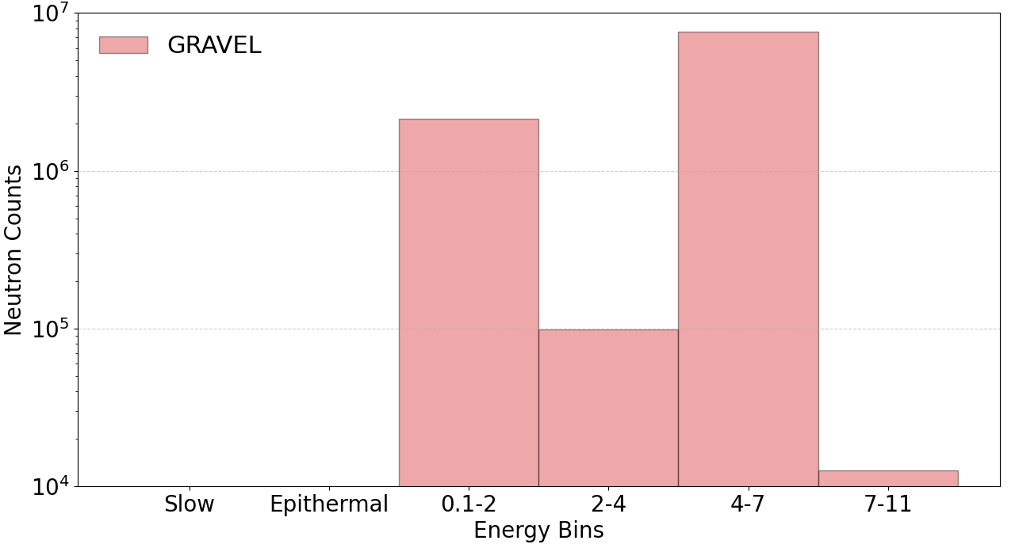
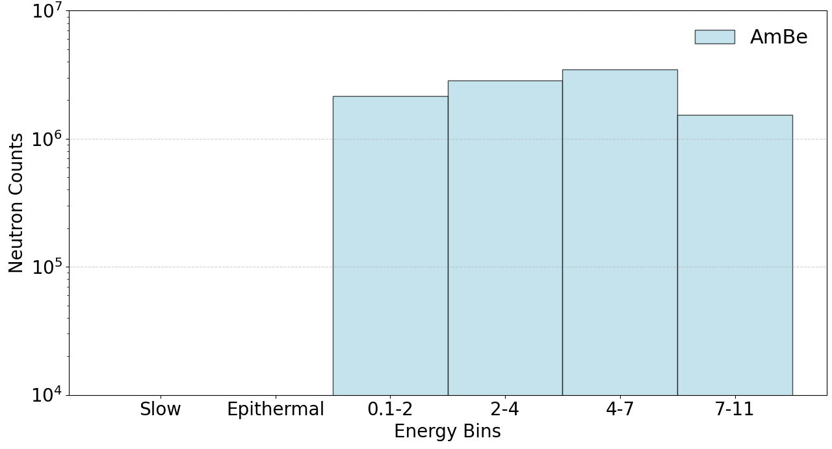
Measure “C” for AmBe
(using GEANT4)
Unfolding:
Predicted AmBe counts
“S$"$
Check simulations validity
Calculate “R”
(using GEANT4)
Check results!
Fig: Unfolded neutron source spectra (6 bins)
Fig: Actual AmBe spectra (6 bins)
0
0.025 eV
0.1 MeV
11 MeV
Slow neutrons
Epithermal neutrons
Fast neutrons

Slide 25
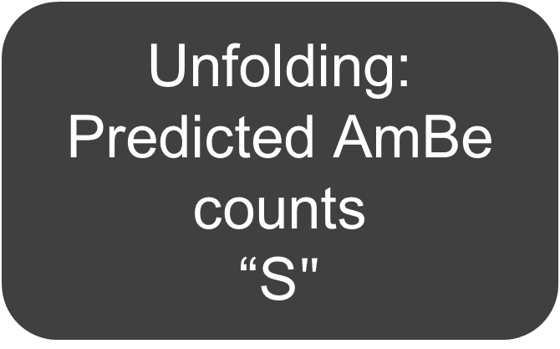
Test complete:
Results:
→Can “see” the fast neutrons
→But can't tell apart their initial energy accurately
If not-sufficient:
Try again!
Unfolding:
Predicted AmBe counts
“S$"$
Check simulations validity
Calculate matrix “R”
(using GEANT4)
Measure counts
for AmBe “C”
(using GEANT4)
If sufficient:
Success!

Slide 26
Summary:
In 4 months, prepared and tested a method to detect 0-11 MeV neutrons using point source.
Continuing the project in Fall term.
Ultimate objective: Measure ambient neutron flux using Neutral Current Detectors in 0-11 MeV.

Slide 27
Thank you for listening!
Special Thanks to:
→Thomas Sonley: Unfolding advisor
→Ian Lawson and Steffon Luoma: Supervision
→Vijay I., Arina, Abhipsha, Peter, Dimpal, Keegan, Bilal

Slide 28
Questions?

Slide 29
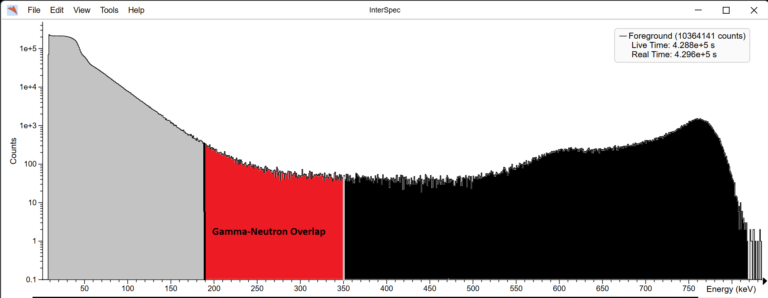
Limitations of NCDs:
→Slow neutrons only
→ Background-neutron overlap
Fig: Experimental AmBe data, background overlap with neutron capture data
Gamma Backgrounds
Counts
Neutron capture events
Gamma-Neutron Overlap
Energy (keV)
Notes:
r^-1 electric field, electron drift, high voltage near wires, charge pairs multiply proportionally, UG

Slide 30
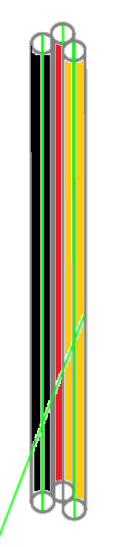
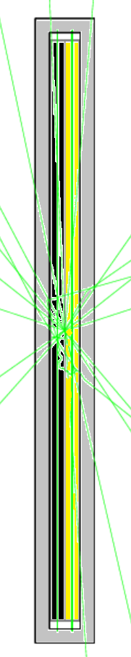
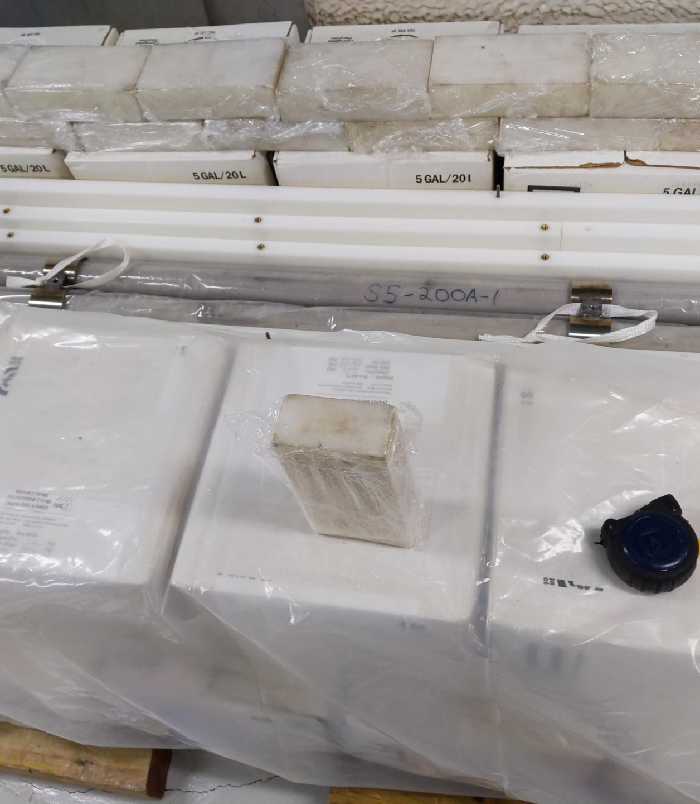
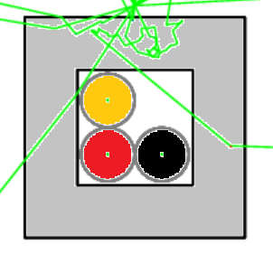

Calculate
“R”
(GEANT4)
Fig: Picture of the Helium-3 Counters
Fig: No polyethylene Geometry
(GEANT4)
Fig: 2inch Polyethylene Geometry
(GEANT4)

Slide 31
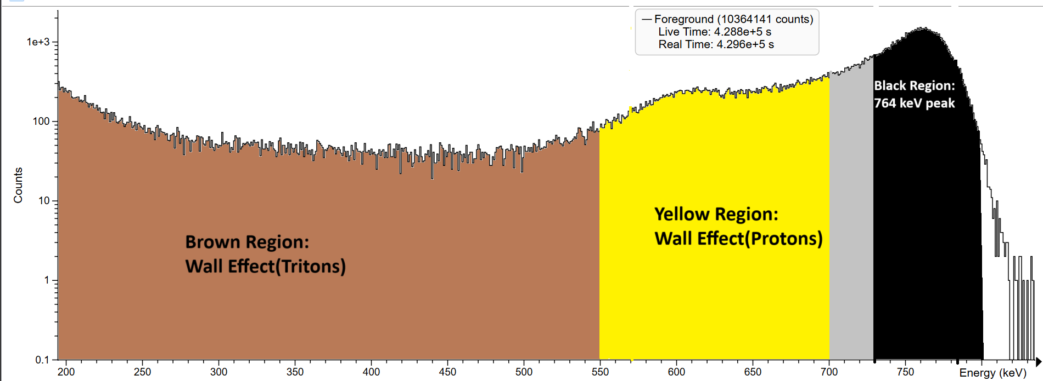
Calculate
“R”
(GEANT4)
Counts
Energy (keV)
Fig: GEANT4’s triton and proton energy deposition per event
with 10 keV gaussian noise
Fig: Experimental Data, 3-inch Polyethylene

Slide 32
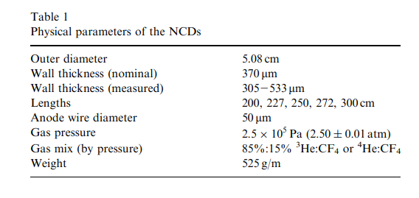

Neutral Current Detectors: Helium-3 Counters:
Custom Counters, used in SNO experiment.(Amsbaugh et al., 2007)
$v^{−1}$ cross-section dependance, negligible for fast neutrons.
Gamma interference, can either:
1). Make a cut to remove gammas(lose neutron efficiency)
or 2). Subtract background

Slide 33

How Do We Detect Fast Neutrons:
→Convolution
Response:
Moderation effects,
Geometry,
Detector intrinsic Efficiency
Neutron Source Flux
Detector’s Neutron Counts
(Convolution)
$$\left[ \begin{aligned}C_{B} \\ C_{1} \\ C_{2} \\ C_{3} \\ C_{4} \\ C_{5}\end{aligned} \right]= \left[ \begin{matrix}R_{1,1} & ⋯ & R_{1, j} \\ ⋮ & ⋱ & ⋮ \\ R_{6,1} & ⋯ & R_{6,j}\end{matrix} \right] \left[ \begin{aligned}S_{1} \\ S_{2} \\ S_{3} \\ ⋮ \\ S_{j−1} \\ S_{j}\end{aligned} \right]$$

Slide 34
How Do We Detect Fast Neutrons:
→Convolution
Response:
Moderation effects,
Geometry,
Detector intrinsic Efficiency
Neutron Source Flux
Detector’s Neutron Counts
(Convolution)
Response:
Moderation effects,
Geometry,
Detector intrinsic Efficiency
Detector’s Neutron Counts
Neutron Source Flux
(De-Convolution)

Slide 35
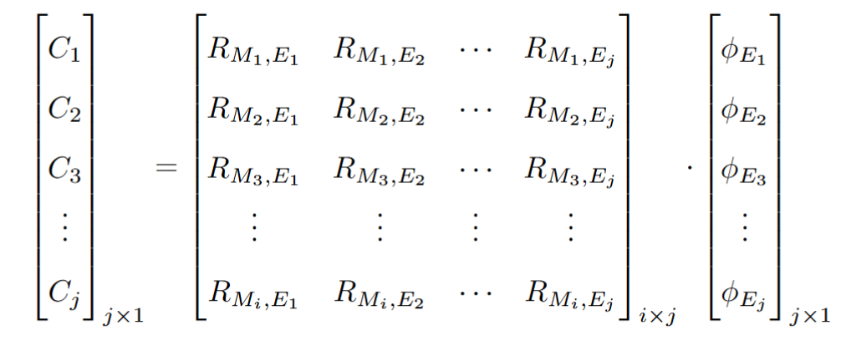

De-Convolution→ Unfolding
The neutron convolution is governed by Fredholm Integral (first kind, ill-posed). Binned or Discretized version is a linear algebra problem(ill-imposed kernel matrix).
$C(E)=\int_{E(min)}^{E(max)}{k\left(E\right)∗T\left(E\right)∗dE}$
“Unfolding” problem, requires algorithms to solve un-determined linear equations.

Slide 36





Unfolding using GRAVEL:
Requires algorithms to find suitable $φ$ solutions for C and R.
Example, GRAVEL
$$\left[ \begin{aligned}C_{B} \\ C_{1} \\ C_{2} \\ C_{3} \\ C_{4} \\ C_{5}\end{aligned} \right]= \left[ \begin{matrix}R_{1,1} & ⋯ & R_{1, j} \\ ⋮ & ⋱ & ⋮ \\ R_{6,1} & ⋯ & R_{6,j}\end{matrix} \right] \left[ \begin{aligned}φ_{1} \\ φ_{2} \\ φ_{3} \\ ⋮ \\ φ_{j−1} \\ φ_{j}\end{aligned} \right]$$
$$φ_{j}^{(k+1)}=φ_{j}^{\left(k\right)}exp⁡\left(\frac{\sum_{i}{W_{ij}^{k}\ln\left(\frac{C_{i}}{\sum_{l}{R_{il}φ_{l}^{k}}}\right)}}{\sum_{i}{W_{ij}^{k}}}\right)$$
$$W_{ij}^{k}=C_{i}\frac{{R_{ij}φ}_{j}^{k}}{\sum_{l}{R_{il}φ_{l}^{k}}}$$
$$J^{k}=\frac{\sum_{i}{\left(C_{i}−\sum_{j}{R_{ij}φ_{j}^{k}}\right)}}{\sum_{i}{R_{il}φ_{l}^{k}}}$$

Slide 37
GEANT4(11.1.1) simulation:
Physics list: HadronElasticPhysicsHP, G4HadronPhysicsQGSP_BIC_HP, G4IonPhysicsXS, G4StoppingPhysics, ElectromagneticPhysics, GammaNuclearPhysicsLEND(LEND_GND1.3_ENDF.BVII.1), G4DecayPhysics, G4RadioactiveDecayPhysics
Tracking: Sensitive Volume: Inner Tube(He-3) Physical Volume, track individual tritons(use fStopAndKill) on every hit!
Energy Deposition: Edep from Tritons and Protons summed until event ends.

Slide 38
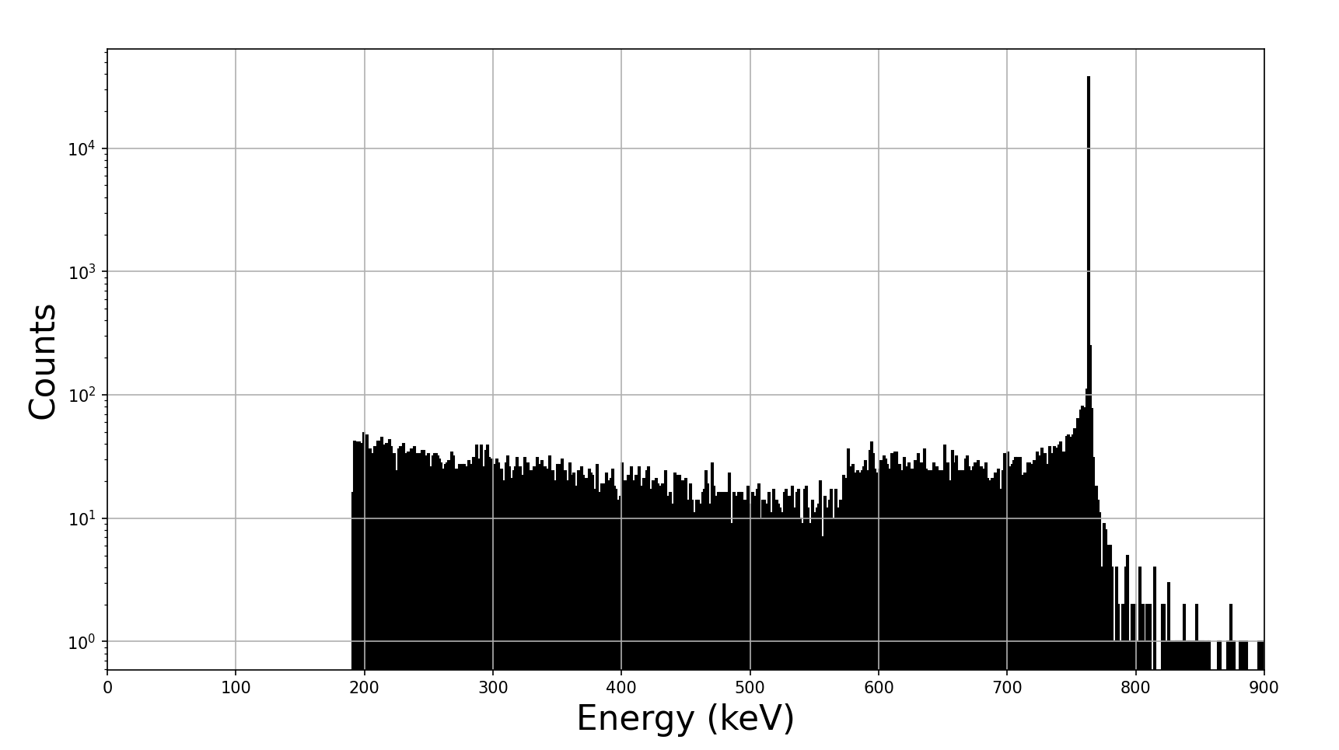
Check simulations validity
Fig: Experimental low background data
(Peplowski et al., NIM A, 982, 164574, 2020)
Fig: GEANT4’s Triton and Proton Energy Deposition per event

Slide 39
Check simulations validity
Fig: Experimental energy deposition data
(Peplowski et al., NIM A, 982, 164574, 2020)
Fig: GEANT4’s neutron capture energy deposition with 10 keV gaussian noise

Slide 40
References:
[1] Piscitelli, F., Mauri, G., Laloni, A. et al. Verification of He-3 proportional counters’ fast neutron sensitivity through a comparison with He-4 detectors. Eur. Phys. J. Plus 135, 577 (2020). https://doi.org/10.1140/epjp/s13360-020-00600-8
[2] Joyce, M. (2018). Chapter 6 – Moderation. In M. Joyce (Ed.), Nuclear Engineering (pp. 111–127). Butterworth-Heinemann. https://doi.org/10.1016/B978-0-08-100962-8.00006-8
[3] Peplowski, P. N., Yokley, Z. W., Liebel, M., Cheng, S., Elphic, R. C., Hoogerheide, S. F., Lawrence, D. J., & Nico, J. S. (2020). Position-dependent neutron detection efficiency loss in 3He gas proportional counters. Nuclear Instruments and Methods in Physics Research Section A, 982, 164574. https://doi.org/10.1016/j.nima.2020.164574
[4] Yoon, Y. S., Kim, J., & Park, H. (2021). Neutron background measurement for rare event search experiments in the YangYang underground laboratory. Astroparticle Physics, 126, 102533. https://doi.org/10.1016/j.astropartphys.2020.102533
[5] Amsbaugh, J. F., Anaya, J. M., Banar, J., Bowles, T. J., Browne, M. C., Bullard, T. V., Burritt, T. H., Cox-Mobrand, G. A., Dai, X., Deng, H., et al. (2007). An array of low-background 3He proportional counters for the Sudbury Neutrino Observatory. Nuclear Instruments and Methods in Physics Research Section A, 579(3), 1054–1080. https://doi.org/10.1016/j.nima.2007.05.321

