Slide 1


A new electronic readout for the ATLAS liquid argon calorimeter
Presented by Emma Rancourt
2025/08/13
With supervision from Prof. Brigitte Vachon & Dr. Raphaël Hulsken

Slide 2
Outline
Background information about CERN
  Large Hadron Collider (LHC)
  ATLAS Detector
  Liquid Argon (LAr) Calorimeter Readout
Purpose of the analysis tool
Structure of the analysis tool
Outputs from the analysis tool
Summary

Slide 3
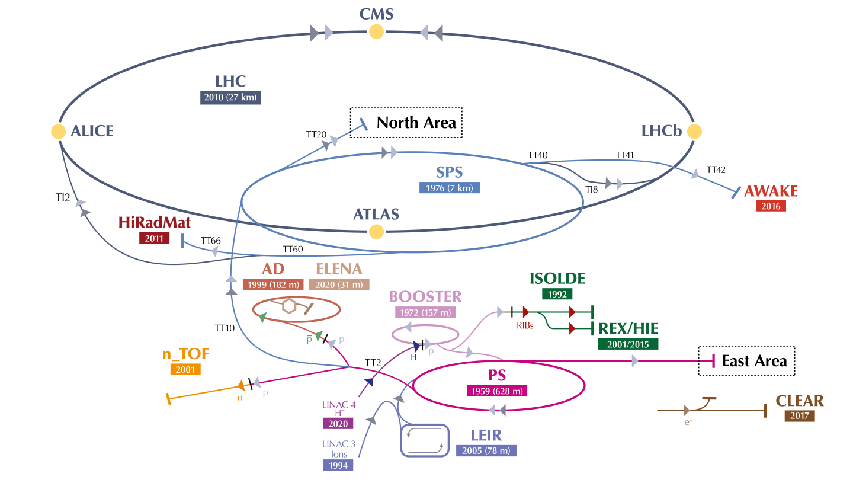
Large Hadron collider (lhc)
[1]
Purpose: proton-proton collisions, chain of accelerators boosting particle energy in stages
ATLAS: General-purpose detector, Higgs boson studies & beyond the standard model searches
High-Luminosity LHC: Extends discovery potential by increasing the number of collisions per seconds
LHC
ATLAS
Notes:
picture: https://cds.cern.ch/record/2684277/files/CCC-v2019-final-white.png?subformat=icon-1440&version=1

Slide 4
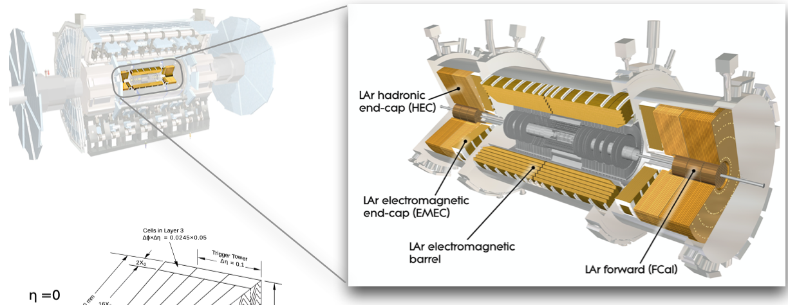
Liquid Argon (lar) calorimeter
Sampling calorimeter measuring the energy of electrons, photons and hadrons.
Number of cell readout channels : 182,468
ATLAS Liquid Argon calorimeter Phase-II upgrade project: New readout electronics system tolerating increased radiation and compatible with the trigger system.
[2]
Notes:
picture: source?

Slide 5
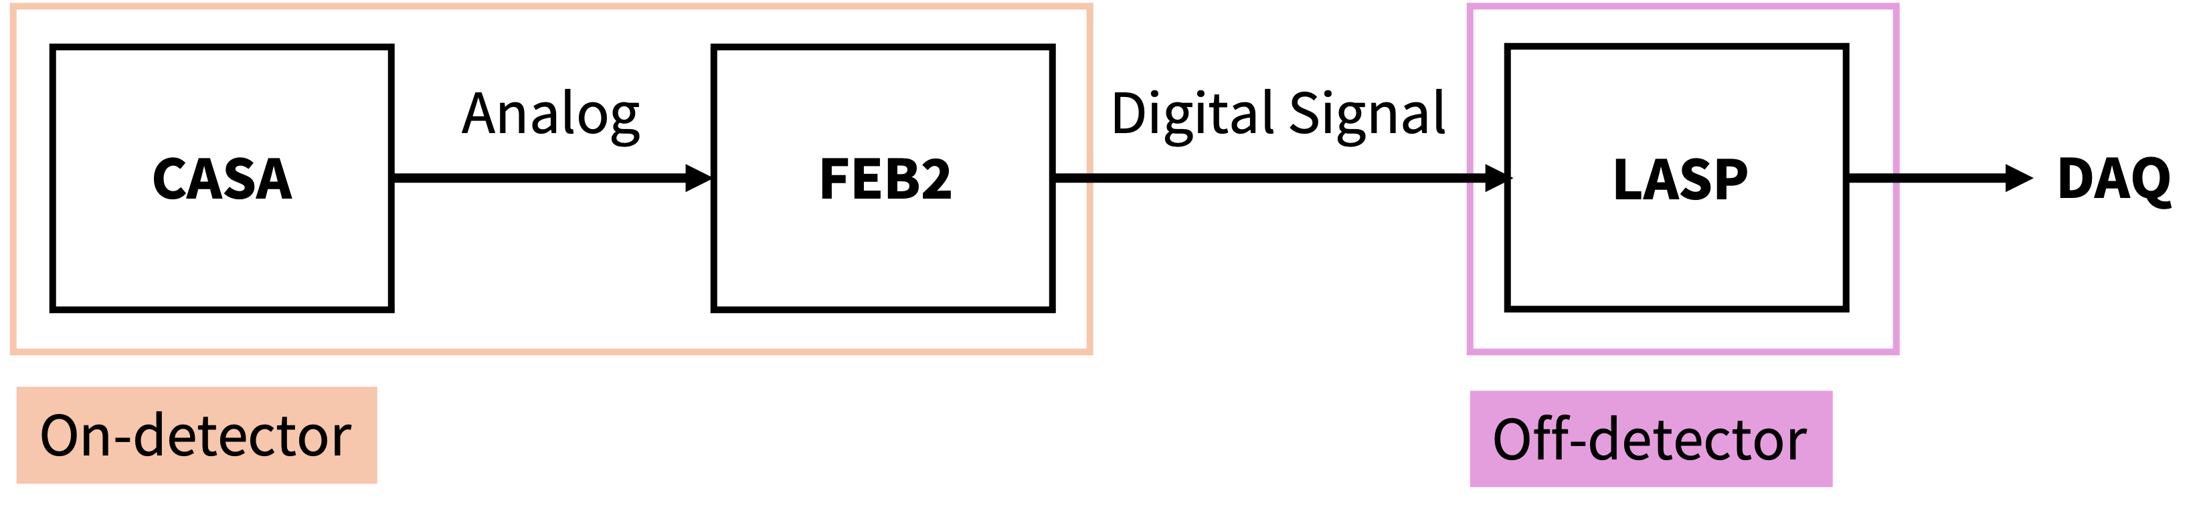
LAr calorimeter readout architecture (simplified)
Front-end electronics
Calibration board (CASA):
  Injects detector-like signals
Front-end boards (FEB2):
  Amplify and shape analog pulses, apply dual gain, digitize and serialize the signals.
Off-detector electronics
LAr Signal Processor Boards (LASP):
  Perform signal processing, energy reconstruction and buffering.
Data Acquisition (DAQ):
  Results are sent to the data acquisition system.

Slide 6
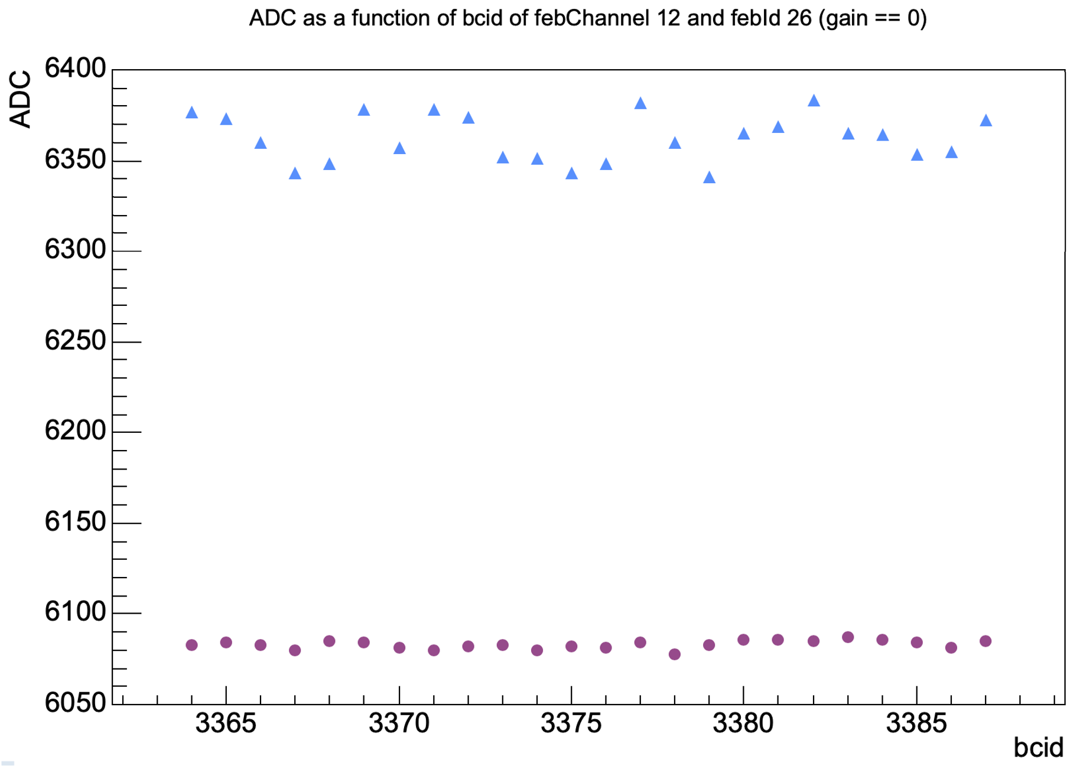
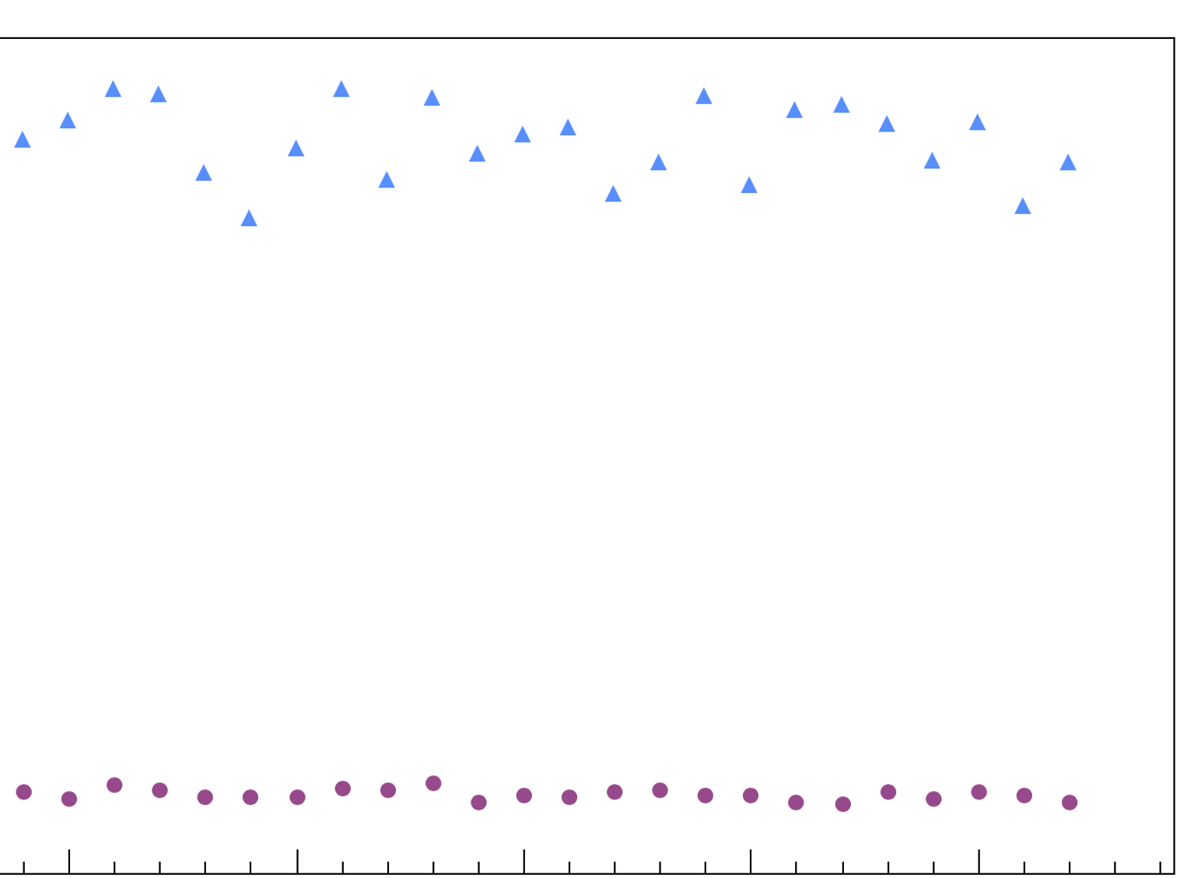
Structure of the test data
Analog-to-Digital Converter (ADC) values as a function of time sample for the first two events of channel 12
: High gain
: Low gain
ADC
Time Samples
(Sampling rate = 40 MHz)
Event 1
(24 time samples)
Gap
(Level 1 Acceptance rate = 200 Hz)
Event 2
(24 time samples)
Notes:
Path data: /eos/atlas/atlascerngroupdisk/larg-upgrade/phase-2/EMF-SystemTest/DataTaking-testbothgain-2025-05-21/processing/output-testbothgain-BOTH-hct22l-2025-05-21.root
Corresponds to the pedestal data of channel 12 for the first and second event.

Slide 7
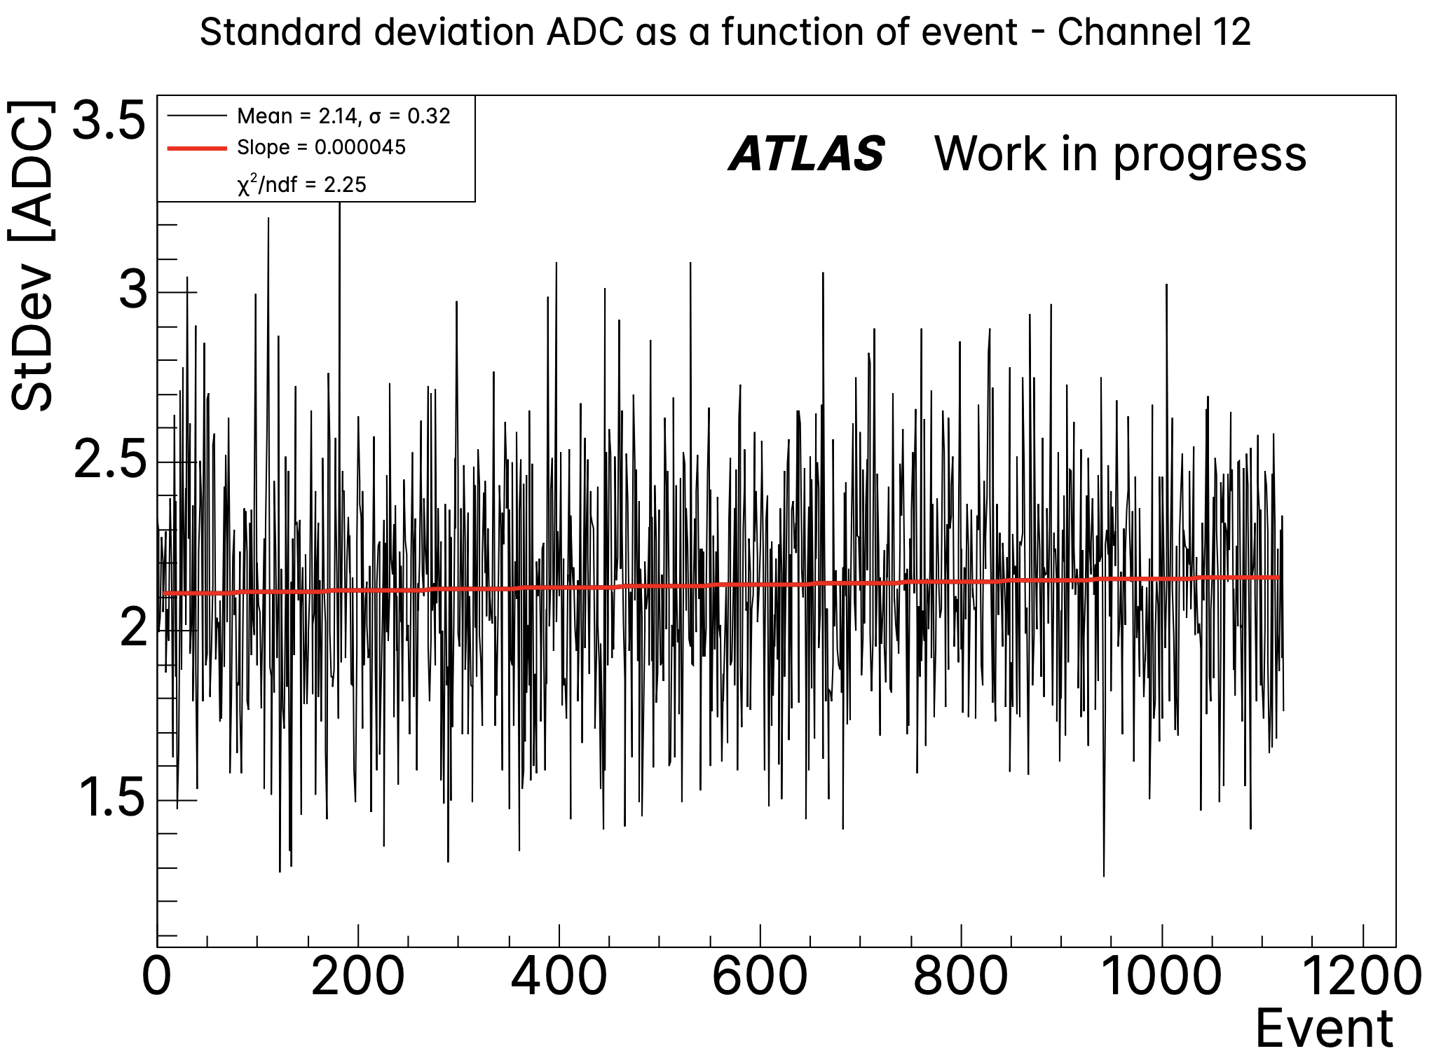
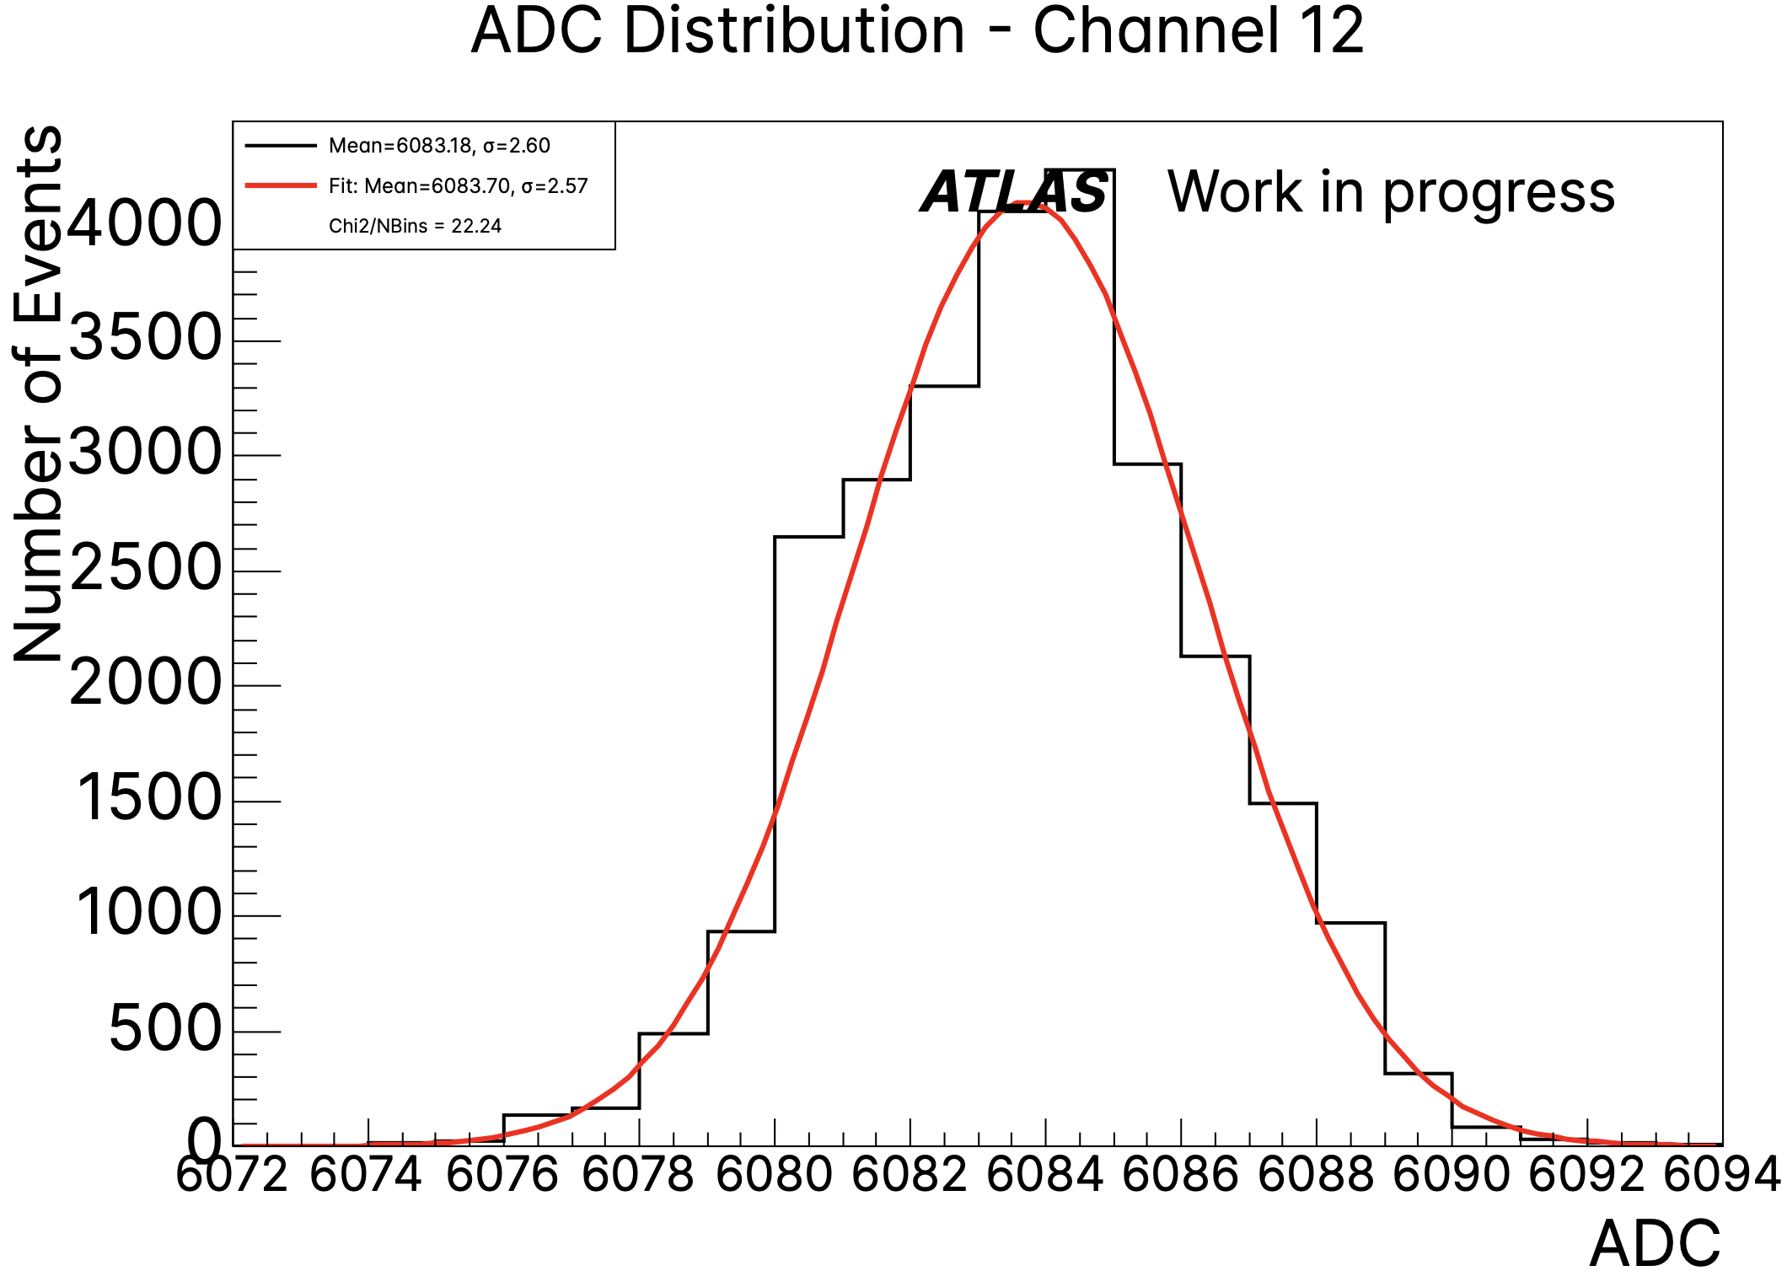
Purpose of the analysis tool
Analysis of the data coming from the new readout system:
Pedestal runs: no injected signals
RAMP and Delay runs: injected calibrated pulses
Detection of unexpected behaviours by investigating:
Mean
Standard deviation
Amplitude
etc.
Notes:
Path data: /eos/atlas/atlascerngroupdisk/larg-upgrade/phase-2/EMF-SystemTest/DataTaking-testbothgain-2025-05-21/processing/output-testbothgain-BOTH-hct22l-2025-05-21.root
Both low gain

Slide 8
Functional Structure of the Analysis tool
FileDataLoading
Raw data
doDataChecks
doLocalChecks
doPlots
doPulseShapeChecks
analyse.cpp
Function
Function for pulse
ROOT file
Log file
File

Slide 9
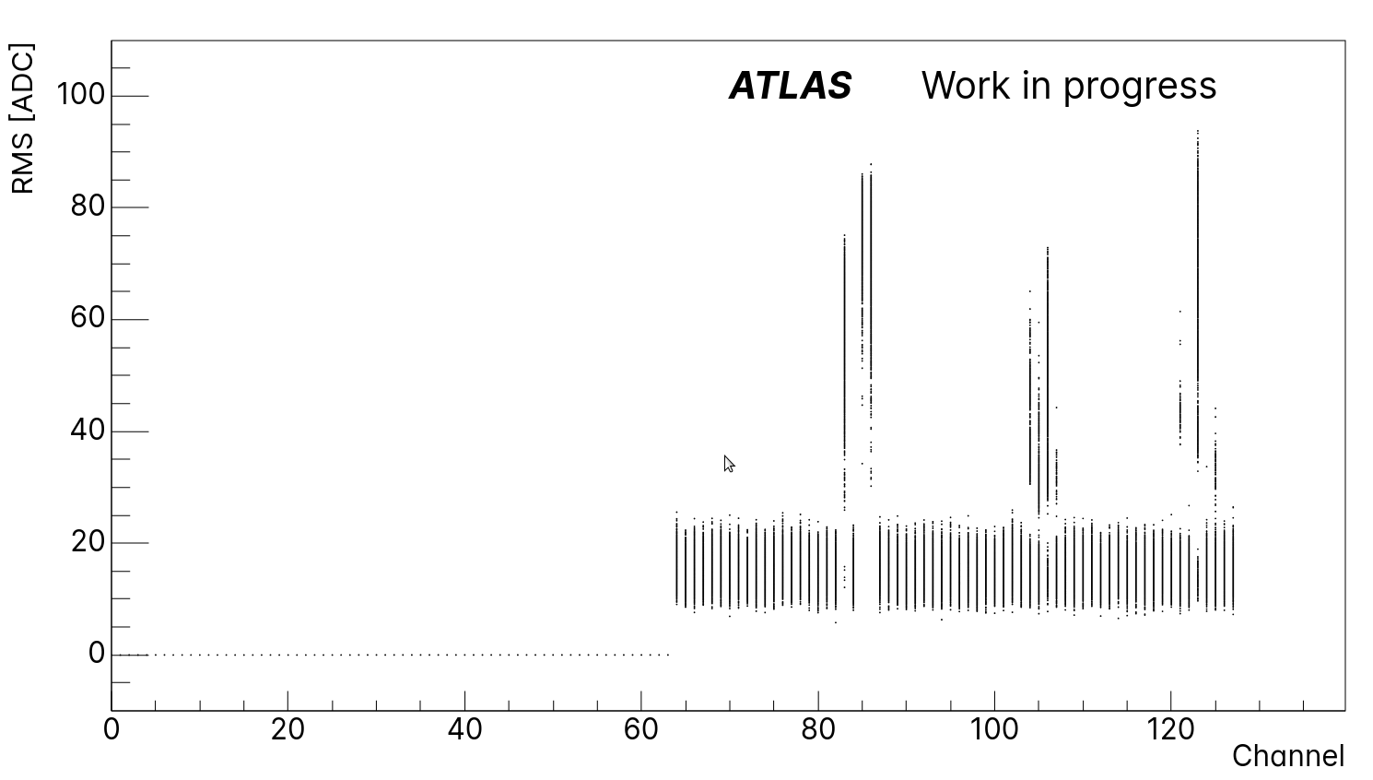
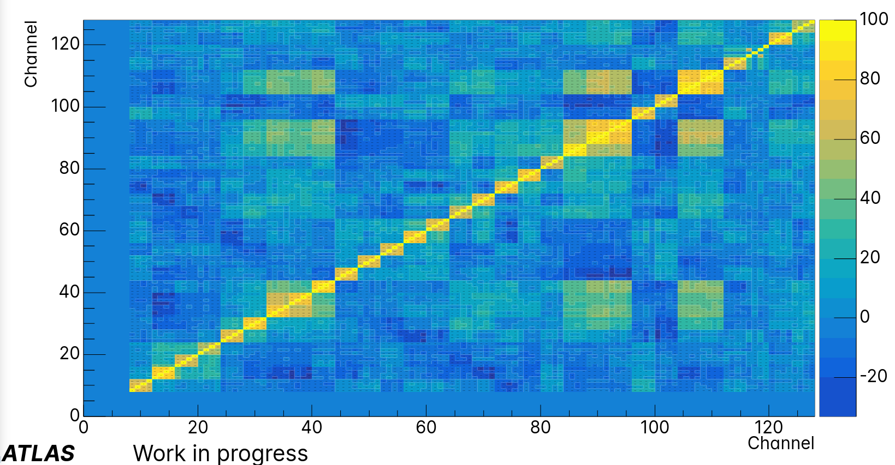
summary plots
RMS per event as a function of channels
Pearson Correlation Coefficient of the mean ADC between channels
ATLAS Work in progress
RMS per event [ADC]
Pearson Correlation Coefficient [%]
Representative plots offering a global overview of the data:
RMS per Event vs. Channel: Highlights event-wise anomalies across channels.
Pearson Correlation Coefficient of Mean ADC: Reveals linear correlation between channels that could be due to electronics cross-talk.
Notes:
path data [1]: /eos/atlas/atlascerngroupdisk/larg-upgrade/phase-2/EMF-SystemTest/DataTaking-pedestalFEBv3-2025-05-14/processing/output-pedestalFEBv3-HG-hct22l-2025-05-14.root
path data [2]: /eos/user/r/rhulsken/For_Other/For_Emma/output-test-LTI-multiphases-2-HG-hct22l-2025-06-24.root

Slide 10
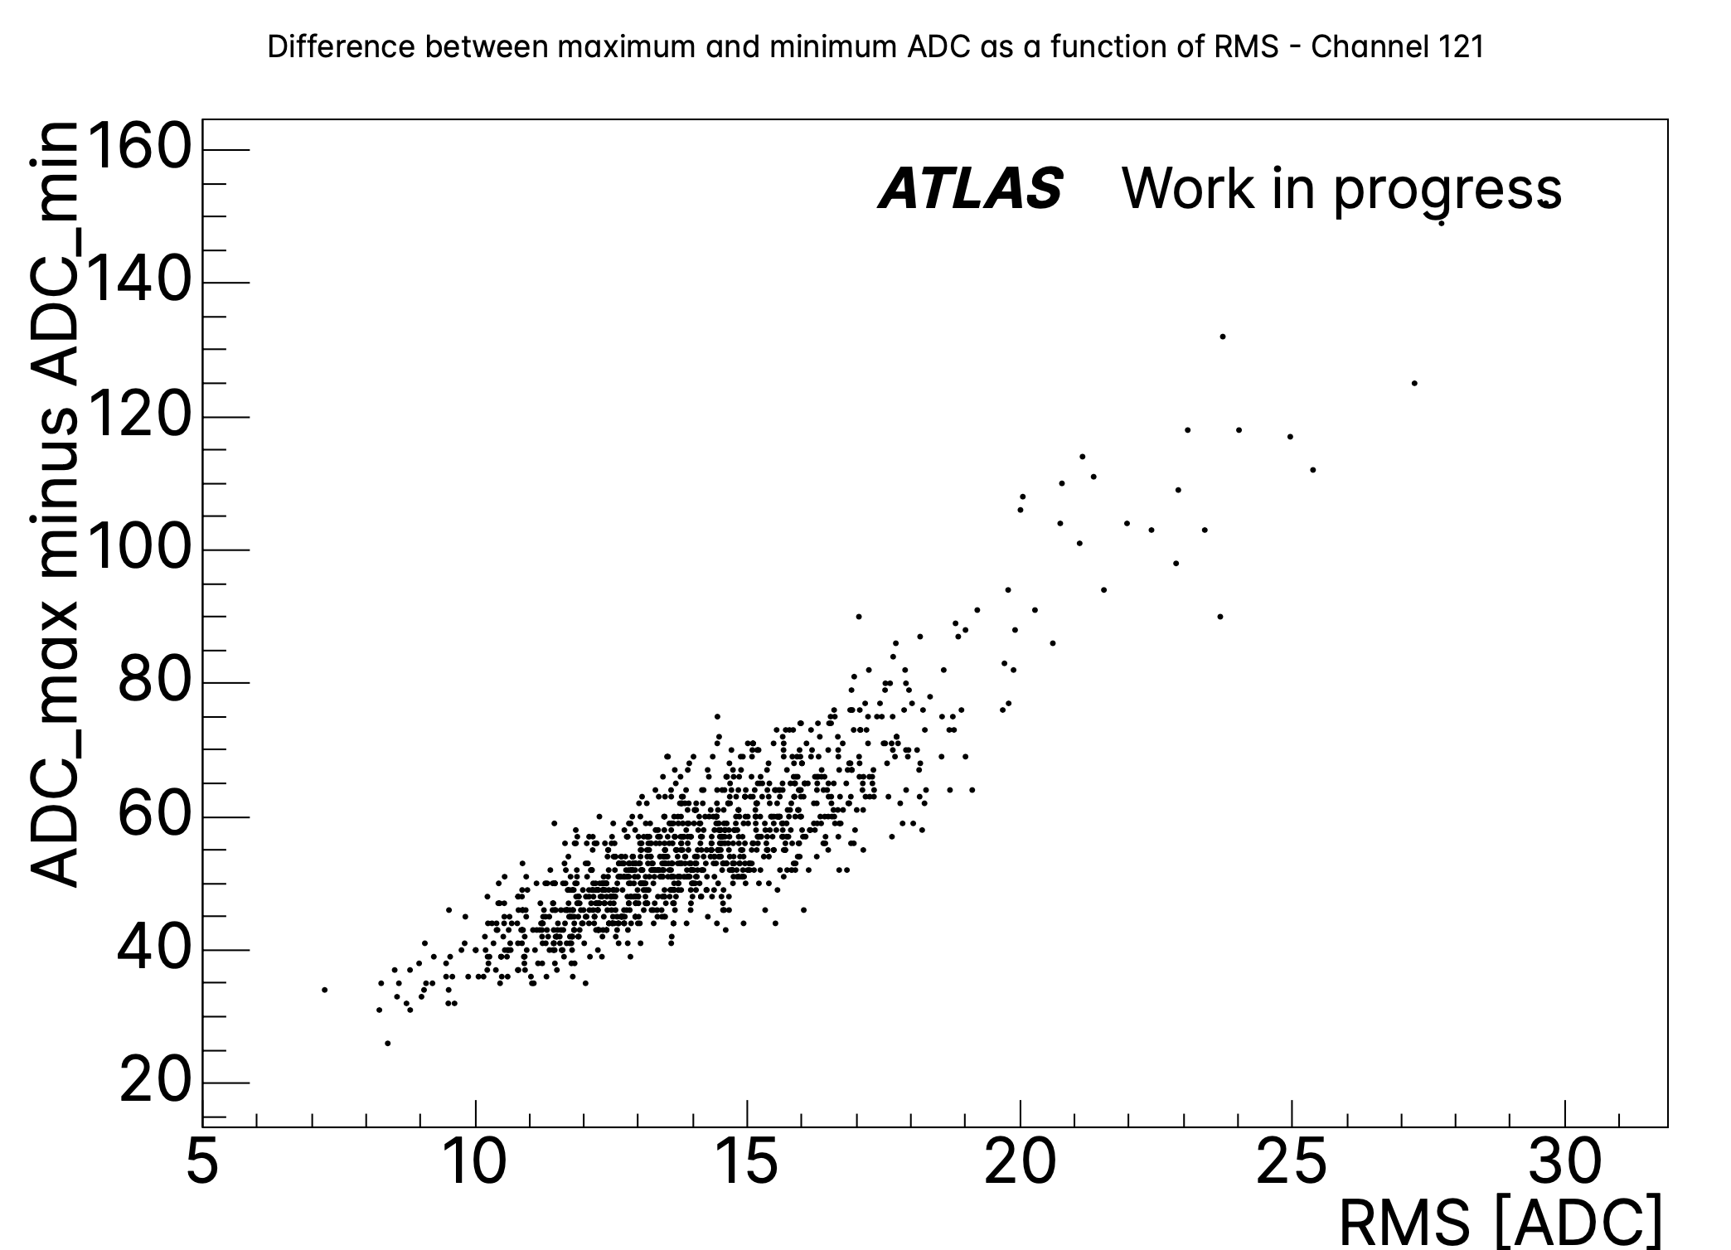
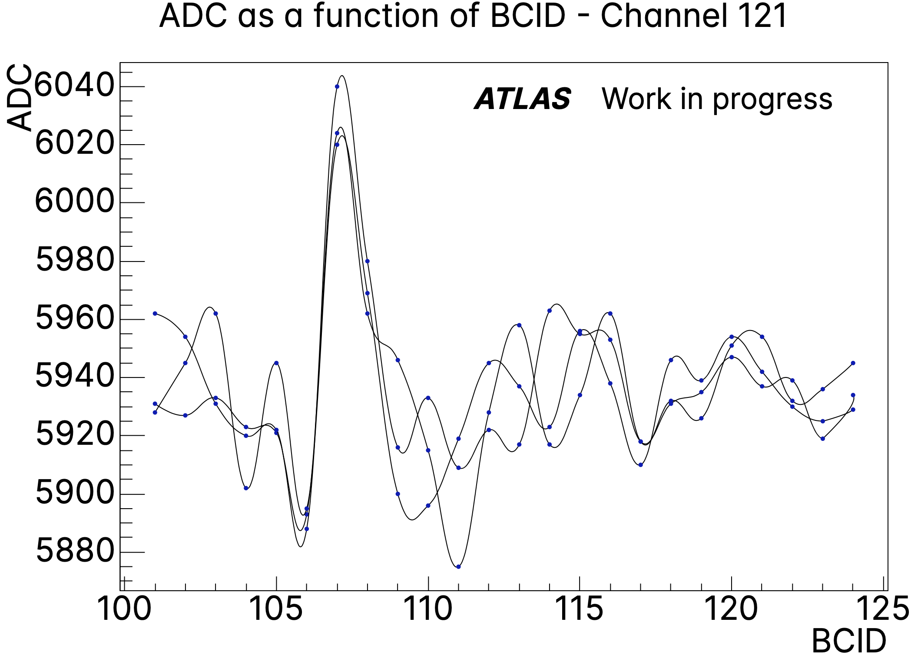
Channel-Specific plots
ADC Range as a function of RMS – Channel 121
ADC as a function of time samples – Channel 121
RMS per event [ADC]
Time Samples
Illustrative plots generated for individual channels:
ΔADC vs. RMS: Shows how ADC range varies with RMS, revealing fluctuations and potential signal anomalies.
ADC vs. time sample (Anomalous Events): Visualizes time-domain behavior for events exhibiting irregularities.
Notes:
path data: /eos/user/r/rhulsken/For_Other/For_Emma/output-test-LTI-multiphases-2-HG-hct22l-2025-06-24.root

Slide 11

Summary
Development of new electronics readout for the ATLAS Liquid Argon calorimeter in preparation for High-Luminosity LHC.
Development of tools to facilitate the detection and visualization of anomalies in data recorded by a readout test system at CERN.
Outlook
Development of a website to display results, and integration of automated analysis execution.

Slide 12
References
[1] Mobs, E. (2019). The CERN accelerator complex in 2019. CERN. https://cds.cern.ch/record/2684277
[2] Pequenao, J. (2008). Computer generated image of the ATLAS Liquid Argon. CERN. https://cds.cern.ch/record/1095928
[3] EMF. (2025). LAr Phase-II system test setup and interconnections. LAr HL-LHC integration & operation documentation. https://atlas-lar-hl-lhc.docs.cern.ch/Doc-EMF-setup.html

Slide 13
Backup slides

Slide 14
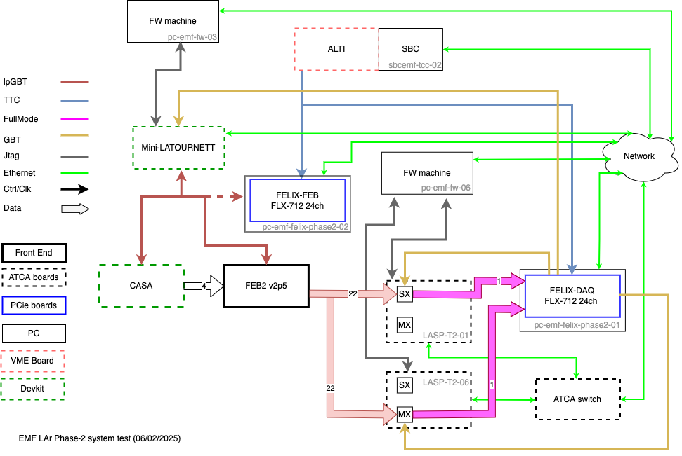
LAr calorimeter readout architecture (Phase-II upgrade)
[3]
Front-end electronics
Front-end boards (FEB2):
  Amplify and shape analog pulses, apply dual gain, digitize, and serialize the signals.
CASA (calibration board):
  Injects calibrated signals for both amplitude and timing.
Off-detector electronics
LAr Signal Processor Boards (LASP):
  Perform signal processing, buffering, synchronization, and BCID alignment before sending data to the DAQ.
ALTI (Atlas Local Trigger Interface):
  Generate a common clock for the system
Mini-LATOURNETT (Lar Timing System):
  Configures the FEB2 and CASA boards.

Slide 15
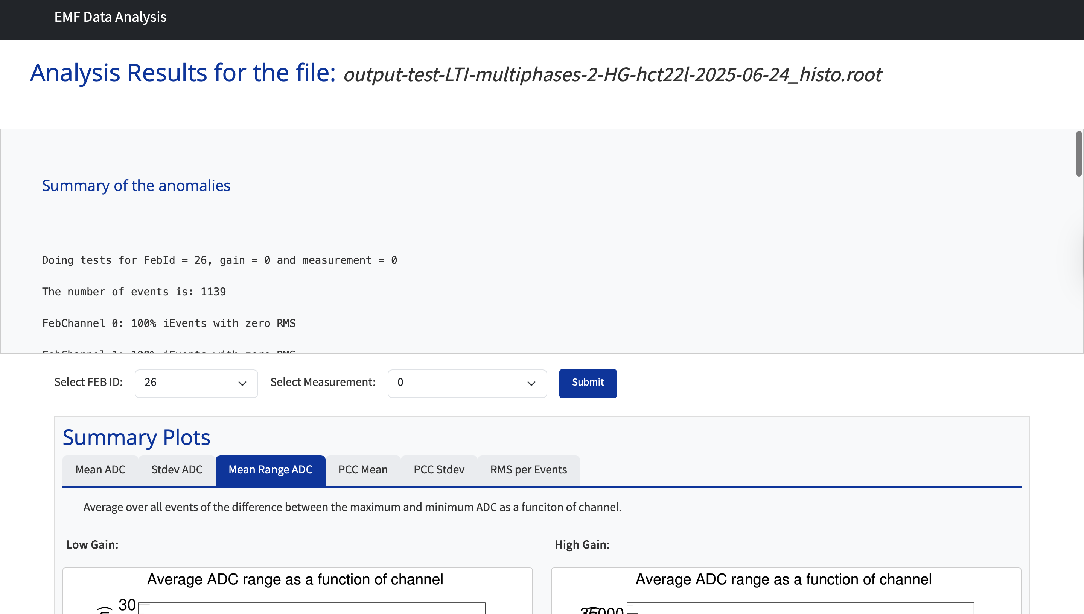
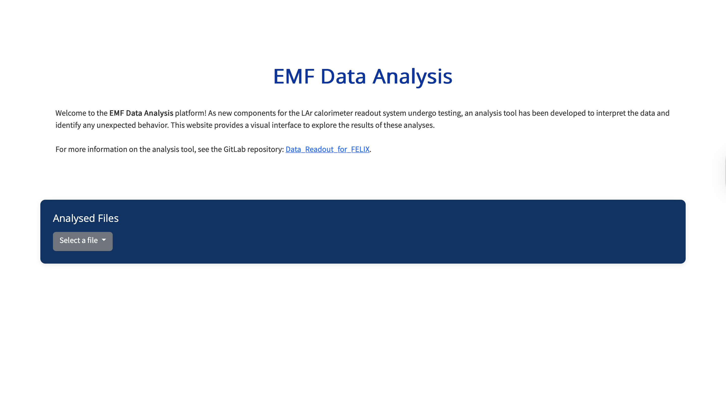
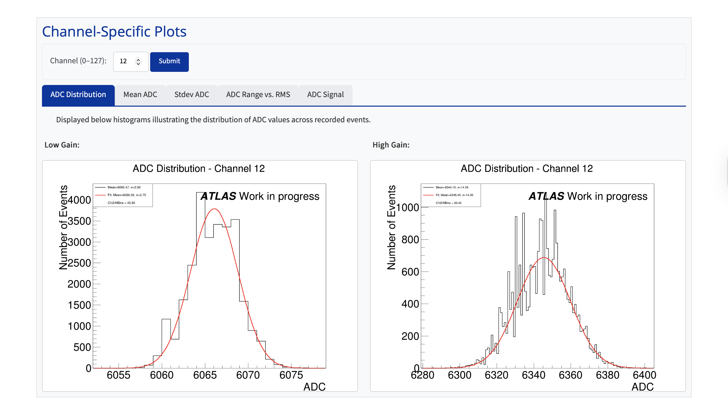
Website on development
Platform for visualizing analysis results:
https://emf-data-analysis.web.cern.ch

