Slide 1
Time of Flight Calibration for HELIX
Lily Moss
Student Research Assistant
Queen's University
Notes:
Hello everyone, my name is Lily Moss and I am a summer student working at Queen's University for Dr. Nahee Park. The project I have been working on is called HELIX and my task was calibrating the Time of Flight Detector.

Slide 2
OUTLINE
01
02
03
HELIX Overview
TOF Detector
Initial Calibration
04
05
Iterations
Current Status
Components of the detector.
Specifications for the Time of Flight detector.
Theory for the calibration procedure.
The challenges encountered and their solutions.
The results to date and next steps.
Slide 2
Notes:
My talk will provide a brief description of what HELIX is and explain the workings of the relevant detector. Then I will explain my procedure for calibration, some challenges encountered and where we are now.

Slide 3
HELIX Overview
01
Goal: better understand the cosmic ray propagation model.
Slide 3
Notes:
First off, HELIX is the High Energy Light Isotope eXperiment. The goal of HELIX is to better understand the cosmic ray propagation model. This is done by particle detection; for HELIX, specifically Beryllium 9 and 10 isotopes. These particle abundances can be related to the quantity of cosmic rays that are near and far. With this information we can have more insight into where they came from and how they travel. To achieve this goal it is crucial to differentiate between the two isotopes of the same element. This is done by comparing precisely measured values and separating the slightly different values. Some of the key measurements include the particle's mass, velocity and charge. The instrument is very careful to retain the precision as it measures these values. And as a result, it also retains confidence in the isotope separation which is the key to better understanding the abundance of cosmic rays in our galaxy.

Slide 4
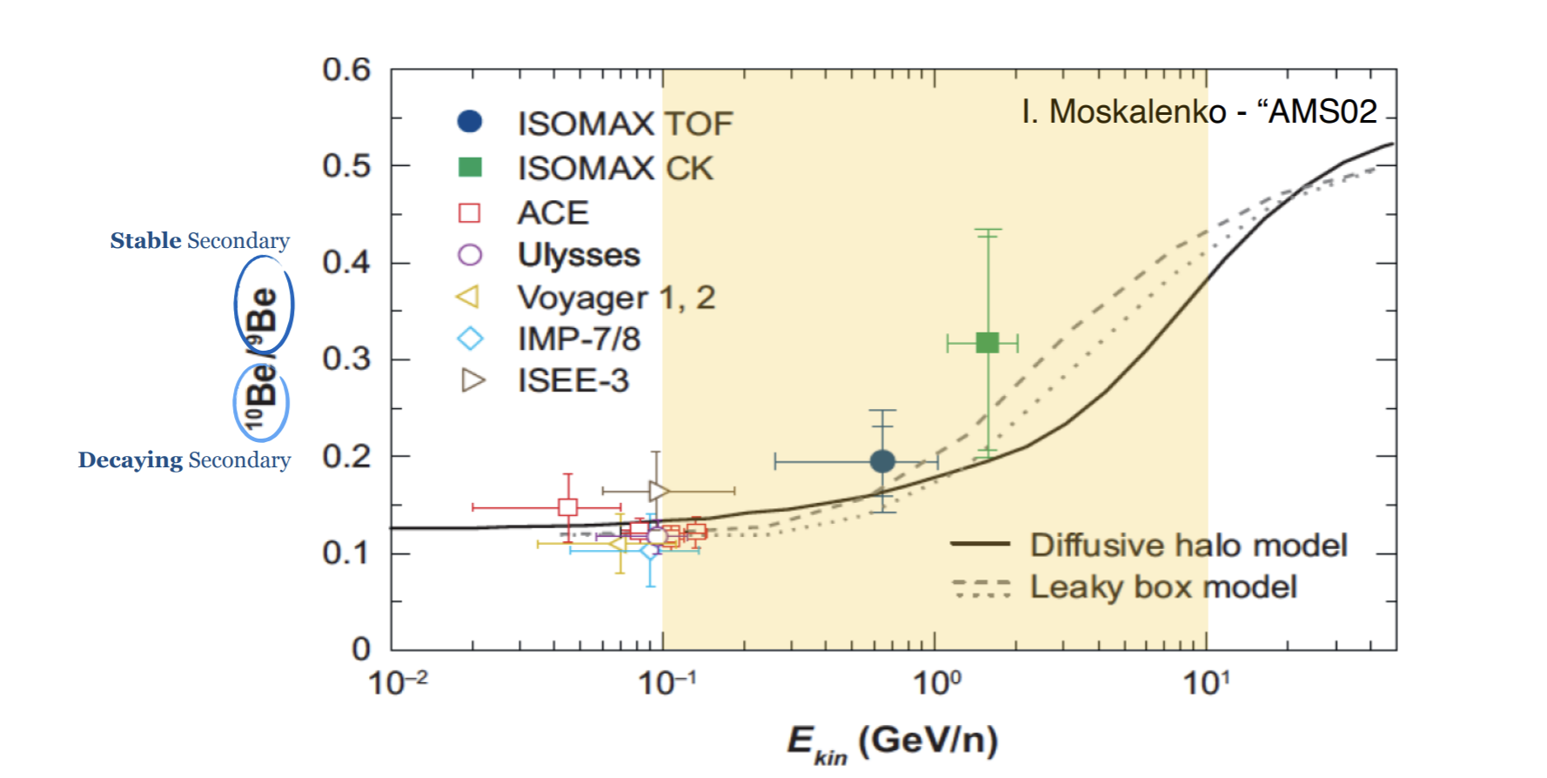
Scientific Motivation
Motivation: expand the knowledge of higher energy cosmic rays.
Measurements: momentum, velocity and charge for Beryllium-9 and Beryllium-10.

Slide 5
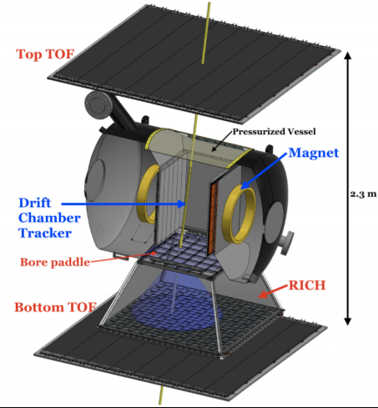
Components of HELIX
Top TOF
Momentum
Drift Chamber Tracker (DCT)
Ring Imaging Cherenkov Detector (RICH)
Velocity
DCT
RICH
Time of Flight Detector (TOF)
Charge
Bottom TOF
Image credit: University of Chicago, HELIX Team.
Slide 4
Notes:
The custom design of the instrument has a specialised detector for each of those key measured values. HELIX is a large instrument with many components, but the main three for detection purposes are the Time-of-Flight detector, the Drift Chamber Tracker, and the Ring Imaging Cherenkov detector. The DCT is a gas chamber inside a superconducting magnet. It’s goal is to track the particles path as they pass through. With the tracking information we can find the velocity and rigidity of the particle, and from there the mass as well. After the DCT the particles go through the RICH. This consists of a layer of aerogel tiles to induce cherenkov light, then an array of Silicon Photomultipliers which detect the light. With that information from the Silicon Photomultipliers about the cherenkov light, the velocity of the particle can be calculated again. Finally, the Time of flight detector is composed of three panels, the Top TOF, the bore paddle and the bottom TOF.

Slide 6
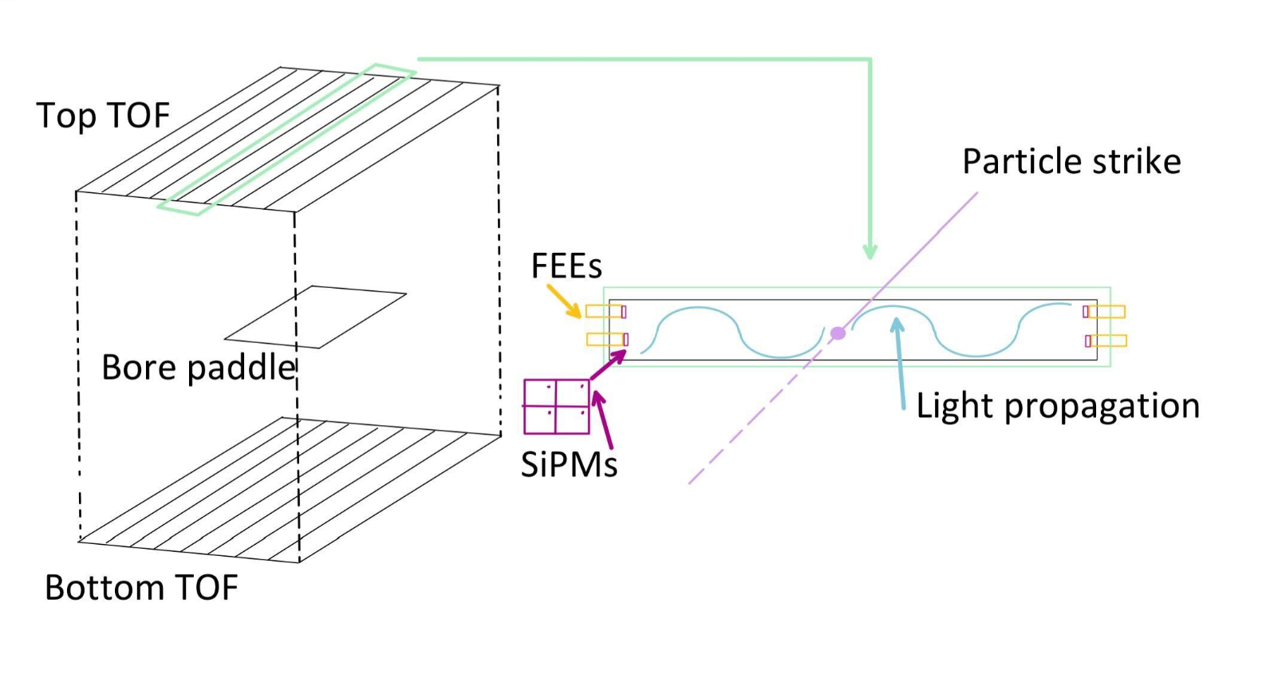
TOF Detector
SiPMs
02
Paddles
FEEs
01
03
Top TOF
Particle Strike
Goal: Measure charge and velocity of particles.
FEEs
Bore
Light Signal
SiPMs
Silicon Photo Multipliers amplify the light signal
Bottom TOF
8 Top and 8 Bottom TOF paddles
Strike on top triggers data taking
Strike on all three layers saves an event
Front End Electronics interpret the light signal
Get charge, position and time of signal propagation
Slide 5
Notes:
Here is a more detailed look at the TOF detector. There are 8 paddles on the top TOF and 8 on the bottom TOF, there is also a single large paddle at the centre called the Bore paddle. The three layers act as a trigger so when the first panel is struck it begins recording, then in order to count as an event all three panels must be hit by the particle. For each strike the detector collects information based on the signals emmited in light. When a particle hit the scintillating paddle it loses energy to the medium. This energy dissipates and as it returns to the ground state the scintillating paddle illuminates, sending a signal with the light. Silicon photomulitpliers are used to amplify that original light and maximize the information collected. There are four groups of four Silicon PMs for a total of 16 on each paddle. Each group of four Silicon PMs is received by a Front End Electronic, or a FEE. For each particle strike every FEE records data for the charge of the particle, the time of signal propagation, and the position along the paddle where it landed. There are 4 FEE on each paddle so for 16 paddles that means 64 FEEs, and here's where my work started; the FEEs were giving different values for the same event.

Slide 7
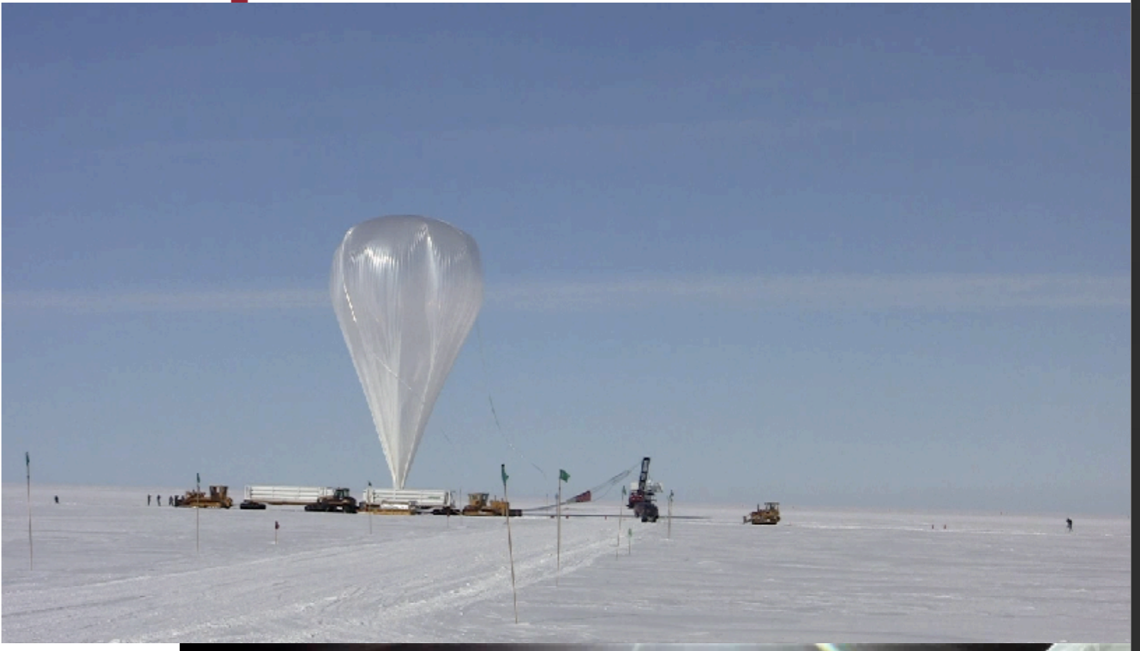
HELIX flight 2024
Flew for 6 days from Kiruna, Sweden to Ellesmere Island in Nunavut.
Image credit: HELIX launch team.

Slide 8
Initial Calibration
03
SiPMs performance varies with temperature, but ground calibrations were not perfect.
Slide 6
Notes:
So, the FEEs were reading different values for the same event. The FEEs should be calibrated because the fluctuations did not indicate a systematic problem. The differences were likely due to differences in manufacturing, position and temperature. These differences exist and are true but for the sake of accuracy they can be calibrated out. The FEEs provide data for charge, position and time. The time calibrations were underway before I arrived, so I began calibrating the charge values.

Slide 9
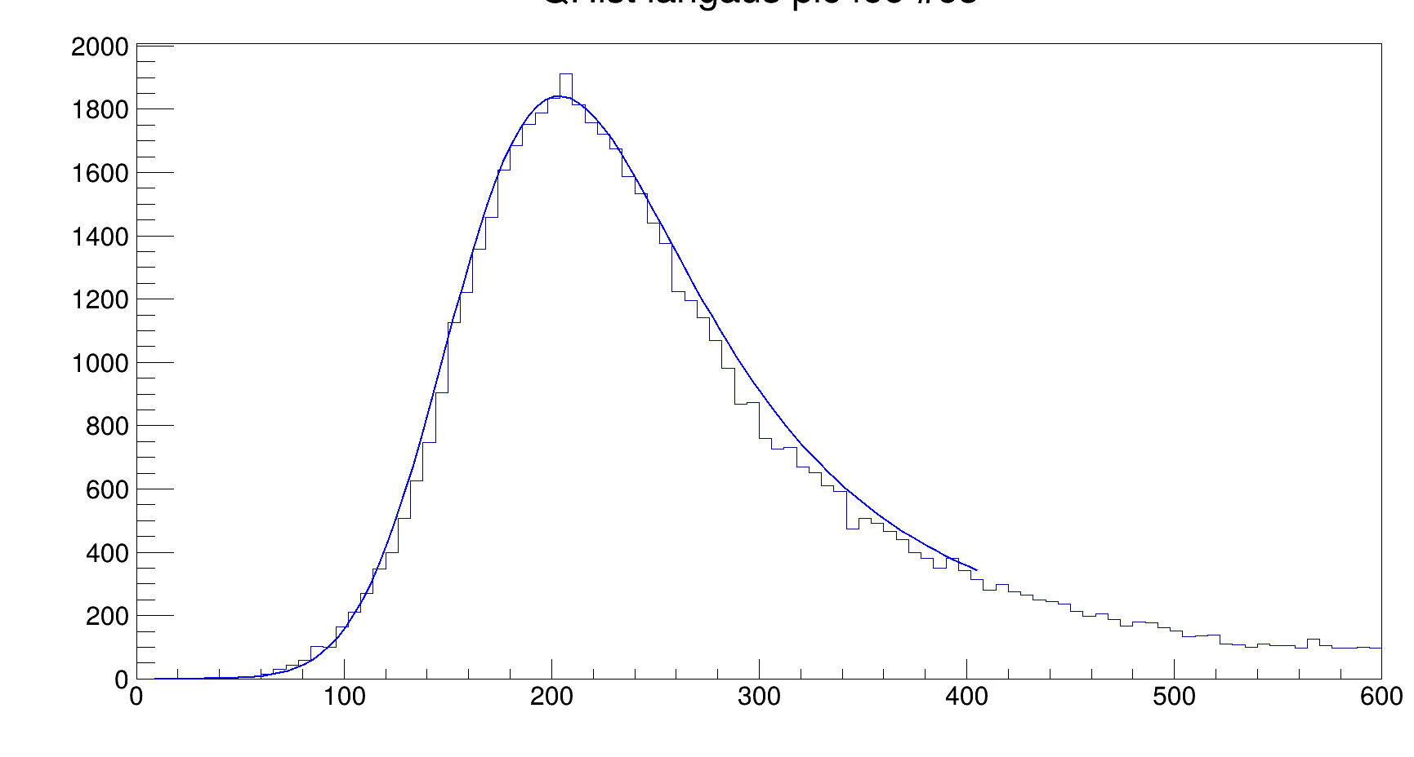
01
Calibration Procedure
03
Histogram
Correction
MPV
02
Fill a histogram with all the charge readings from one FEE of proton events.
Calculate a correction factor that scales the MPV to 220 from all FEEs.
The most probable value of proton charges should follow a landau function.
Charge readings at one FEE
Slide 7
Notes:
To calibrate the FEEs I first made 64 histograms, one for each FEE on the TOF. I filled these histograms with the corresponding charge values. I only used events that struck near the centre of the paddle, since these positions are more accurate and this avoids relying on the uncalibrated position readings. Then, I fitted the histograms with a landau function to extract the most probable value for each FEE. Based on these statistically most probable values, the correction can be made to shift the MPV of each FEE to an average value. The correction factor is a value that scales the original FEE MPV and adjusts it to the average. The correction is calculated by dividing the goal MPV by the original FEE MPV. Then to implement the corrections you multiply every charge reading as it is filled into the histogram. So to check that the corrections were working I made these histograms per run instead of per FEE. Then I plotted MPV over time, and after being corrected you would expect it to be a flat horizontal line, but it wasn’t.

Slide 10
Iterations
04
The problems encountered and their solutions.
Slide 8
Notes:
Despite the correction factors being applied, the histograms per run were peaking in different locations. So I had to investigate different possible sources for this discrepancy and try to improve the effectiveness of the corrections.

Slide 11
Improvements
PLC
Langaus
Temperature
There is a Path Length Correction factor, which could improve the calibration.
The temperature is variable within the detector. But there is no direct relationship between MPV and temperature.
The histogram fitting was done with a landau function, but the noise made the function more gaussian.
Slide 9
Notes:
These are some of the likely culprits that were still causing variation after the corrections. To start, there is a path length correction that is calculated based on the track of the particle through the DCT. This is supposed to make the readings more accurate by accounting for time and distance variations between tracks. I repeated the calibration steps after including the plc, but the variations were still present. Another possible discrepancy was the histogram fitting, the fits originally used a landau function. But these are quite specific so I had to restrict the fitting range. This led to the histogram being poorly defined since it was only looking at a very small region. So, I was introduced to the langaus function which combines the landau and gaussian. I repeated the calibration steps again with two series, one for the landau and one for langaus. This comparison showed that the langaus was a much better fit and was more consistently getting the MPV accurately. With the langaus now properly fitting and retrieving the MPVs the magnitude of variations decreased significantly but not entirely. Another source of fluctuation is temperature. There are many temperature detectors within the instrument, some one each face of the device for north, south east and west, and more on each FEE as well as the readout boards. I investigated each of these temperatures and looked for a correlation with the MPVs. First I used the north/south/east/west temperatures and plotted the MPV of the run against the temperature for the same run. This was a very random plot with no obvious trend, so I moved on to the FEE specific and readout board temperatures. I did a similar process of getting the MPV and temperature for each run, but I had two series one for FEEs and one for readout board. Unfortunately this was equally as random. After all these iterations the best solution involved the langaus fit, but it seems there are no other systematic issues.

Slide 12
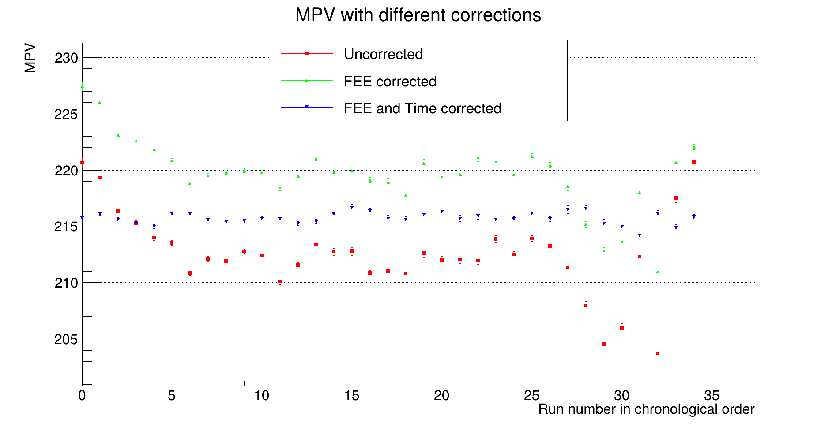
Time Based Corrections
Calculating the correction factors for separate intervals of time instead of all at once.
Uncorrected
Corrected only by FEE
Time based corrections by FEE
MPV
Run groups in chronological order
Slide 10
Notes:
From the iterations I learned to implement plc and fit the histograms with a langaus instead of a landau. But after having little luck with the temperature studies I tried doing time based corrections to minimize the remaining fluctuations. Originally, the correction factors were calculated using all the runs and as much information as possible for each FEE. But this assumes that there is no wear and tear to the electronics over time, which may not be entirely true. So instead of using all the runs, I tried grouping them. Then within each group I calculated a new set of correction factors, making them time dependent. Now, the plot onscreen summarizes what I've just said very nicely. This shows the MPV of a file group based on their group number, in chronological order. The red series has no corrections and is just the raw charge readings for each group of runs. The green series is using the first method of corrections. This takes all the information from all 35 groups and calculates one correction factor for each FEE. Then the blue series is the most current which uses the personalized time-based correction factors for each group of runs. There is a clear improvement between each iteration, but even the best series is not perfect.

Slide 13
Current Status
05
The up to date corrections and next steps.
Slide 11
Notes:
Having learned a lot from the problems I encountered the key takeaways, are to use PLC, fit with a langaus and calculate correction factors for intervals of time.

Slide 14
Latest Flight Data
Iterations provided helpful insight
The corrections have been calculated and applied to the whole flight
Further study the small fluctuations in MPV over time
Slide 12
Notes:
The iterations were incredibly useful for increasing understanding of the data. The takeaways have proven to be accurate and ensure the analysis is simple but correct. Most of the work was done with a subset of the flight, but it has recently been extended to all of the data and the corrections were calculated and successfully implemented. However, there are still small deviations in MPV over time, which requires further study.

Slide 15
THANKS
Do you have any questions?
Lily Moss
Student Research Assistant
Queen's University
lily.moss@queensu.ca
Please keep this slide for attribution
Notes:
Thank you for your attention. If you have questions feel free to ask now, talk to me after or send me an email.

