Slide 1
Using Radium Dials for Radon Calibration
2025/08/13
Keegan Paleshi
Student, Laurentian University
Supervised by: Christine Kraus

Slide 2
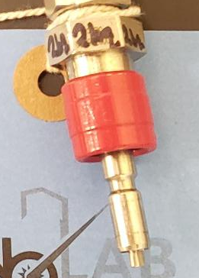
New Radon Samples
Faster spike recharge time
Larger spikes:
Short Dial - 2.184 ± 0.0932 Bq
Long Dial - 379.50 ± 11.31 Bq
Compact, Cheap, easy to make
Suitable for new calibration methods
Notes:
Germanium detector double-check

Slide 3
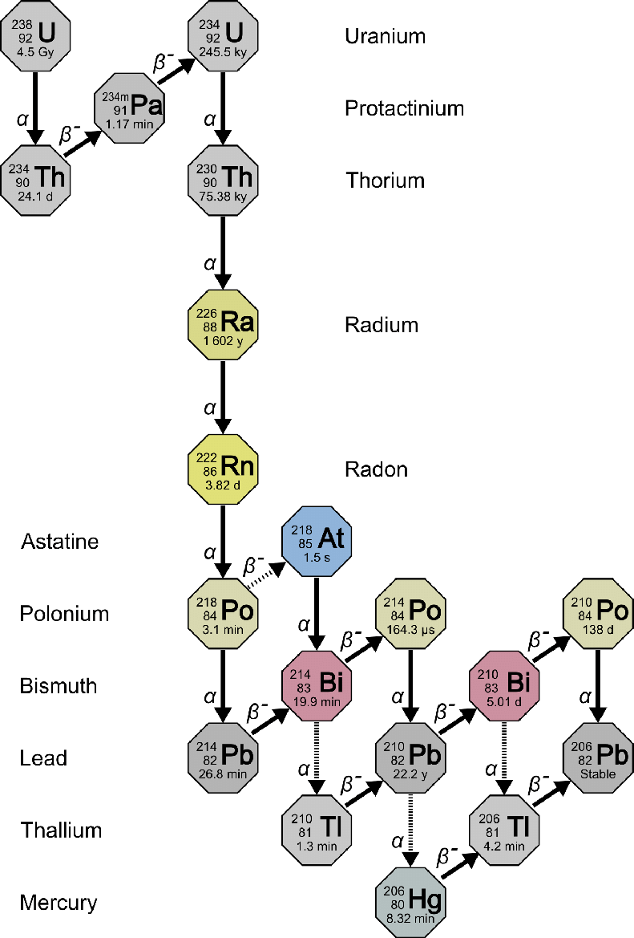
Radon, Radium, and Radioactivity
Dirt, rock, and dust
Radon vs Parents
Measuring radon is tough
https://www.epa.gov/sites/default/files/styles/medium/public/2015-05/u-238_decay.png?itok=558OwVAJ
Notes:
Radon comes from Uranium, Uranium is everywhere, radon emanates

Slide 4
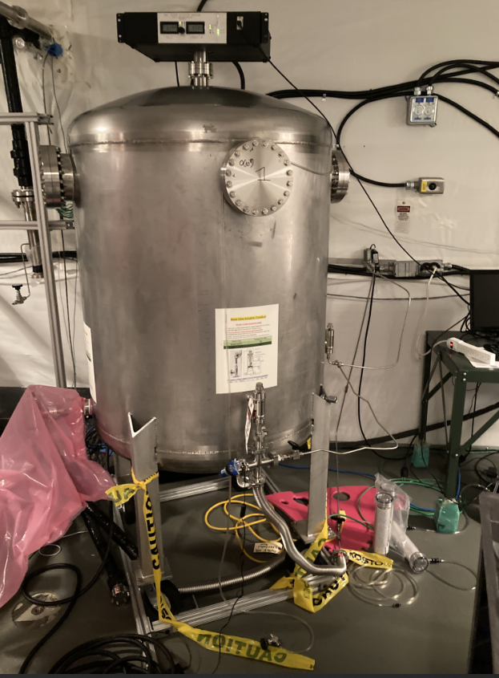
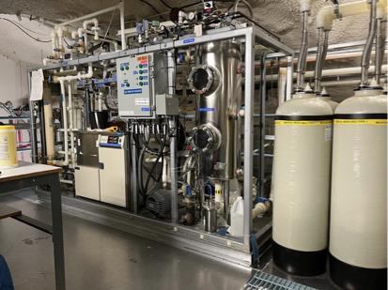
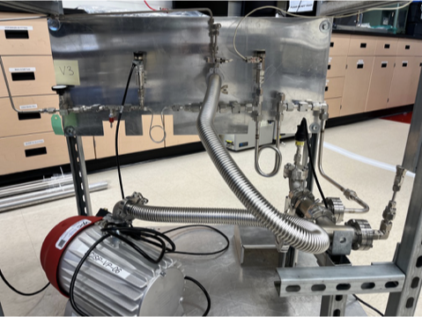
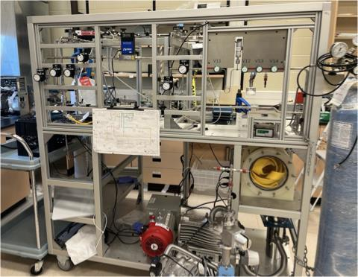
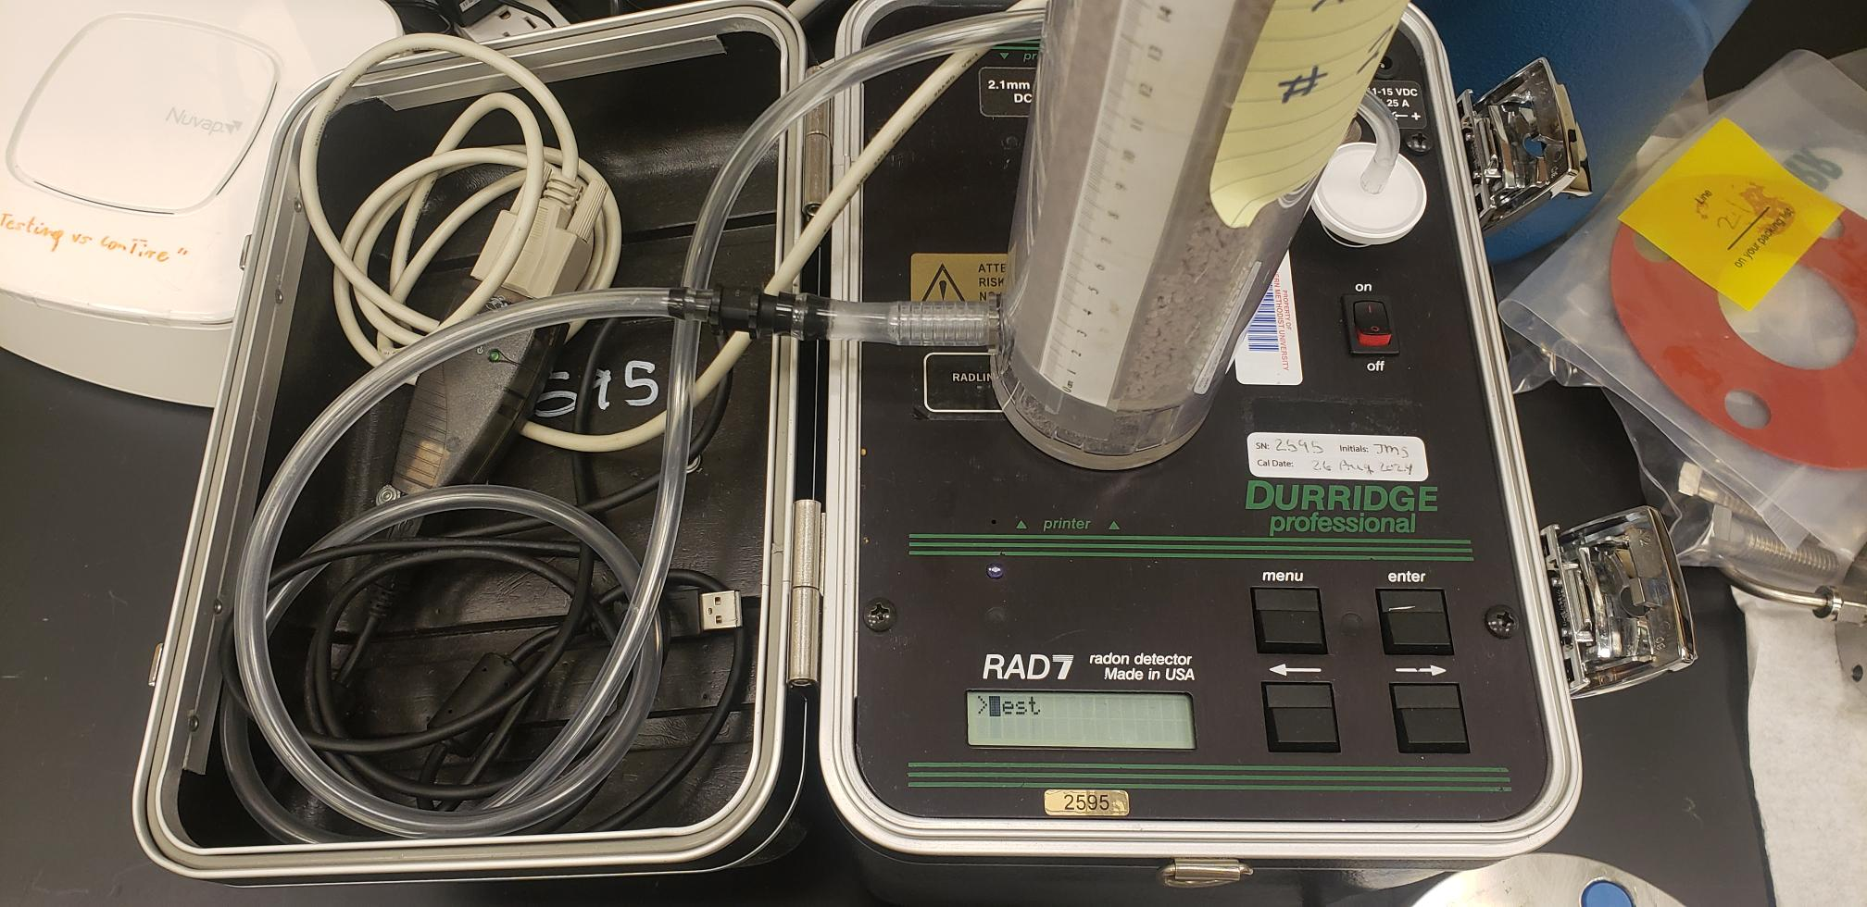
Radon Systems at SNOLAB

Slide 5
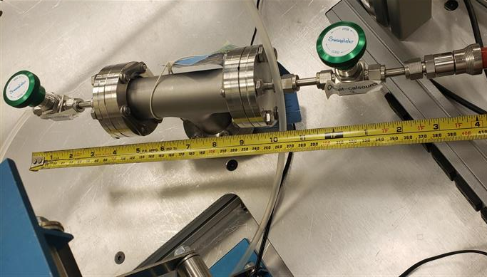
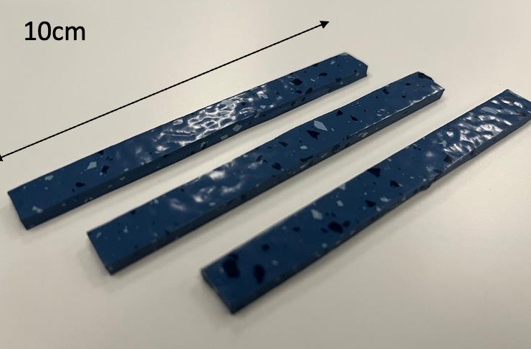
Gas Assay Calibration
Radon from floor tiles
Background of carrier gas understood
Emanation curve characterized
Calibration Can Picture
Credit to Yusuf Ahmed and Nasim Fatemighomi

Slide 6
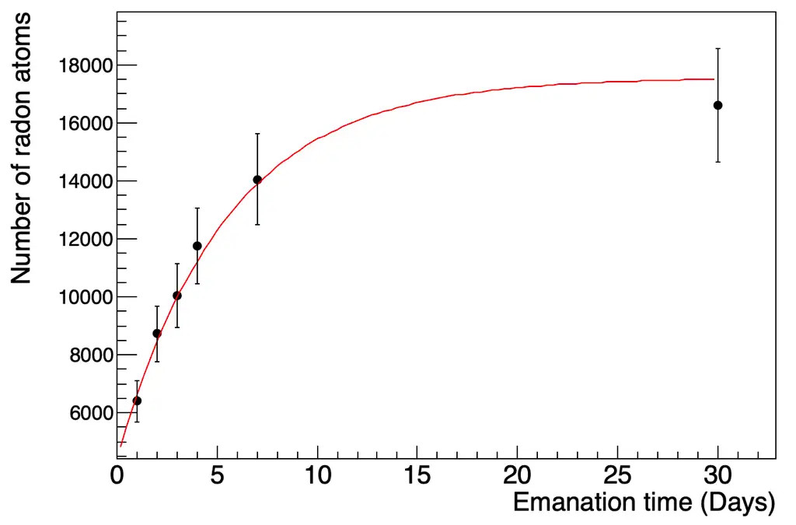
Calibration Challenges
Calibration Can Radon Emanation Curve
Available emanation source
Uncertainties are high - Lucas Cell uncertainty
Long emanation time
Credit to Yusuf Ahmed and Nasim Fatemighomi
Notes:
Say “its been a while since cross calibrations are done and its good practice to do again”

Slide 7
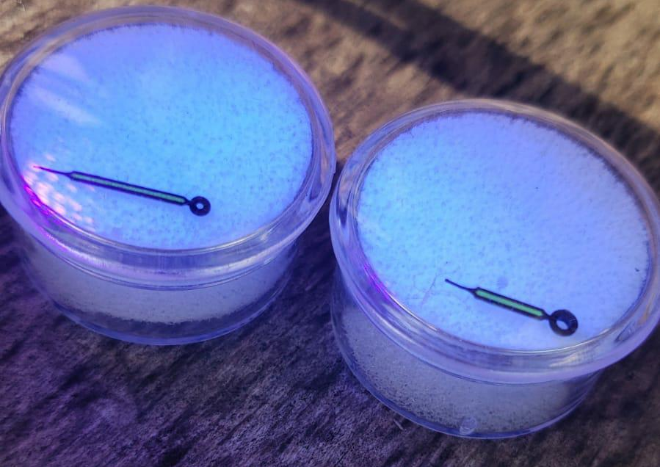
Improved Characteristics
Shorter emanation time
Increased activity
Significantly reduced size

Slide 8
Luminescent Dials
Ra226 and ZnS
Radium safety
Canadian law on Radium dials

Slide 9
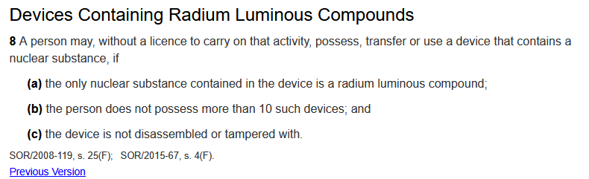
Luminescent Dials
Ra226 and ZnS
Radium safety
Canadian law on Radium dials
https://laws-lois.justice.gc.ca/eng/regulations/sor-2000-207/FullText.html

Slide 10
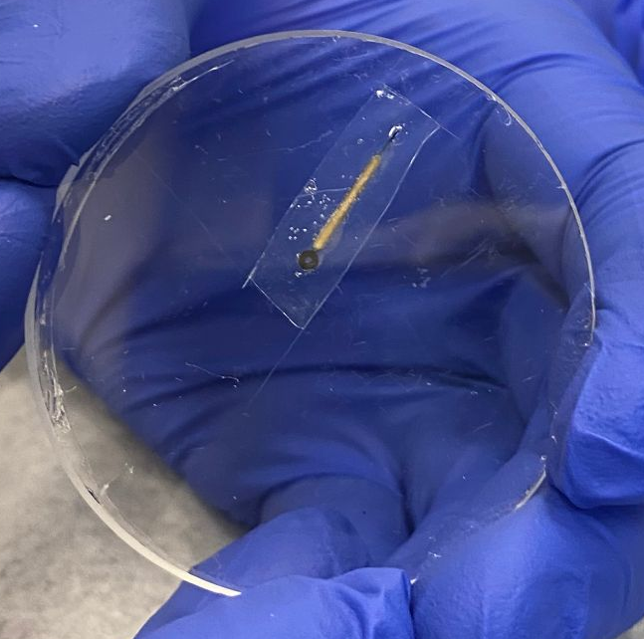
Dial Encapsulation
PDMS is diffusive - short lag time
Durable and waterproof
Cheap and easy to apply

Slide 11
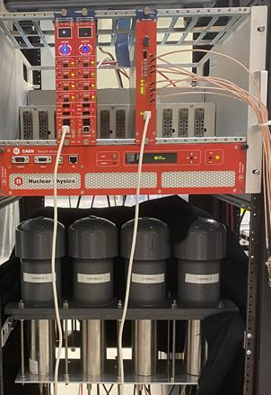
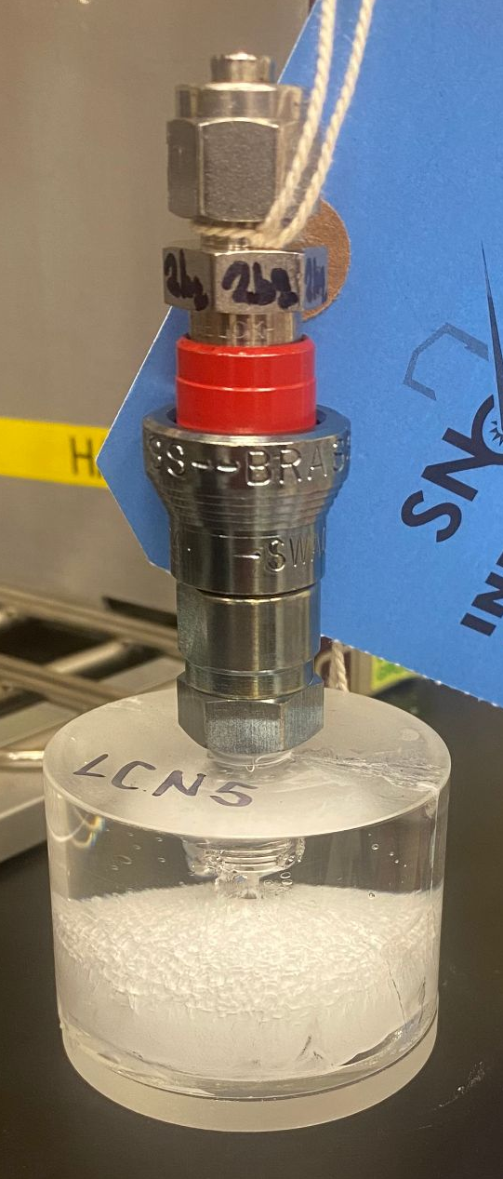
Lucas Cells
Acrylic based
ZnS:Ag scintillator
Coupled with Photomultiplier tube
Notes:
Highlight that this is what the source can do - lower uncertainty - new scintillator new cells

Slide 12
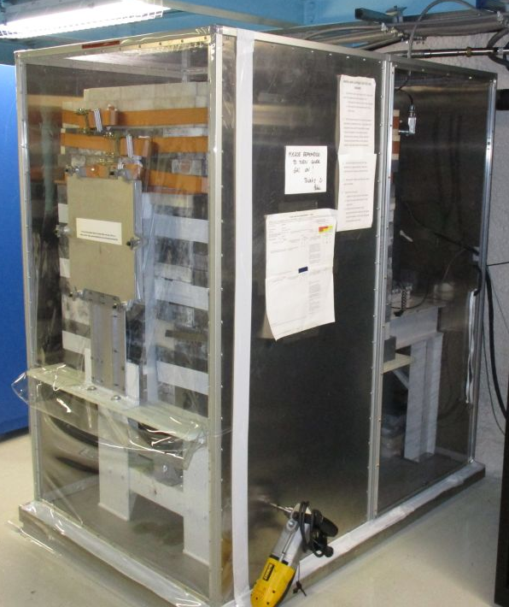
High-Purity Germanium Detector - Gopher
Very well understood efficiencies
Shielded low background detector
Radon is suppressed in volume
Notes:
1.5hours
10 hours for full

Slide 13
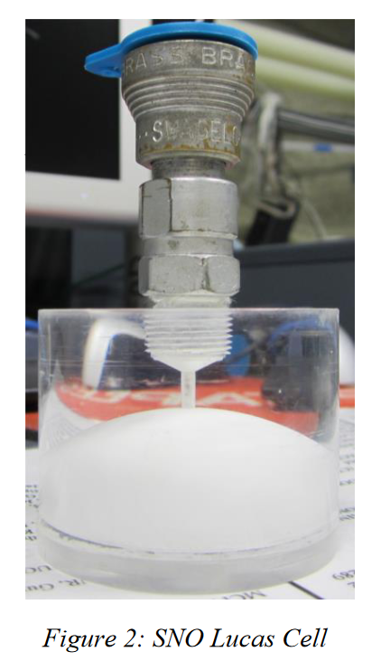
Lucas Cell and PMT x
High-Purity Germanium Detector
Compare HPGe derived Radon activity to Lucas cell PMT counts
HPGe counts 214Pb and 214Bi gammas
PMT counts alphas from Radon, 218Po, and 214Po - 3 alphas per Radon decay
https://www.snolab.ca/users/services/gamma-assay/
Notes:
1.5hours
10 hours for full

Slide 14
Lucas Cell and PMT x
High-Purity Germanium Detector
Compare HPGe derived Radon activity to Lucas cell PMT counts
HPGe counts 214Pb and 214Bi gammas
PMT counts alphas from Radon, 218Po, and 214Po - 3 alphas per Radon decay
https://www.snolab.ca/users/services/gamma-assay/
Notes:
1.5hours
10 hours for full

Slide 15
Lucas Cell and PMT x
High-Purity Germanium Detector
Compare HPGe derived Radon activity to Lucas cell PMT counts
HPGe counts 214Pb and 214Bi gammas
PMT counts alphas from Radon, 218Po, and 214Po - 3 alphas per Radon decay
https://www.snolab.ca/users/services/gamma-assay/
Notes:
1.5hours
10 hours for full

Slide 16
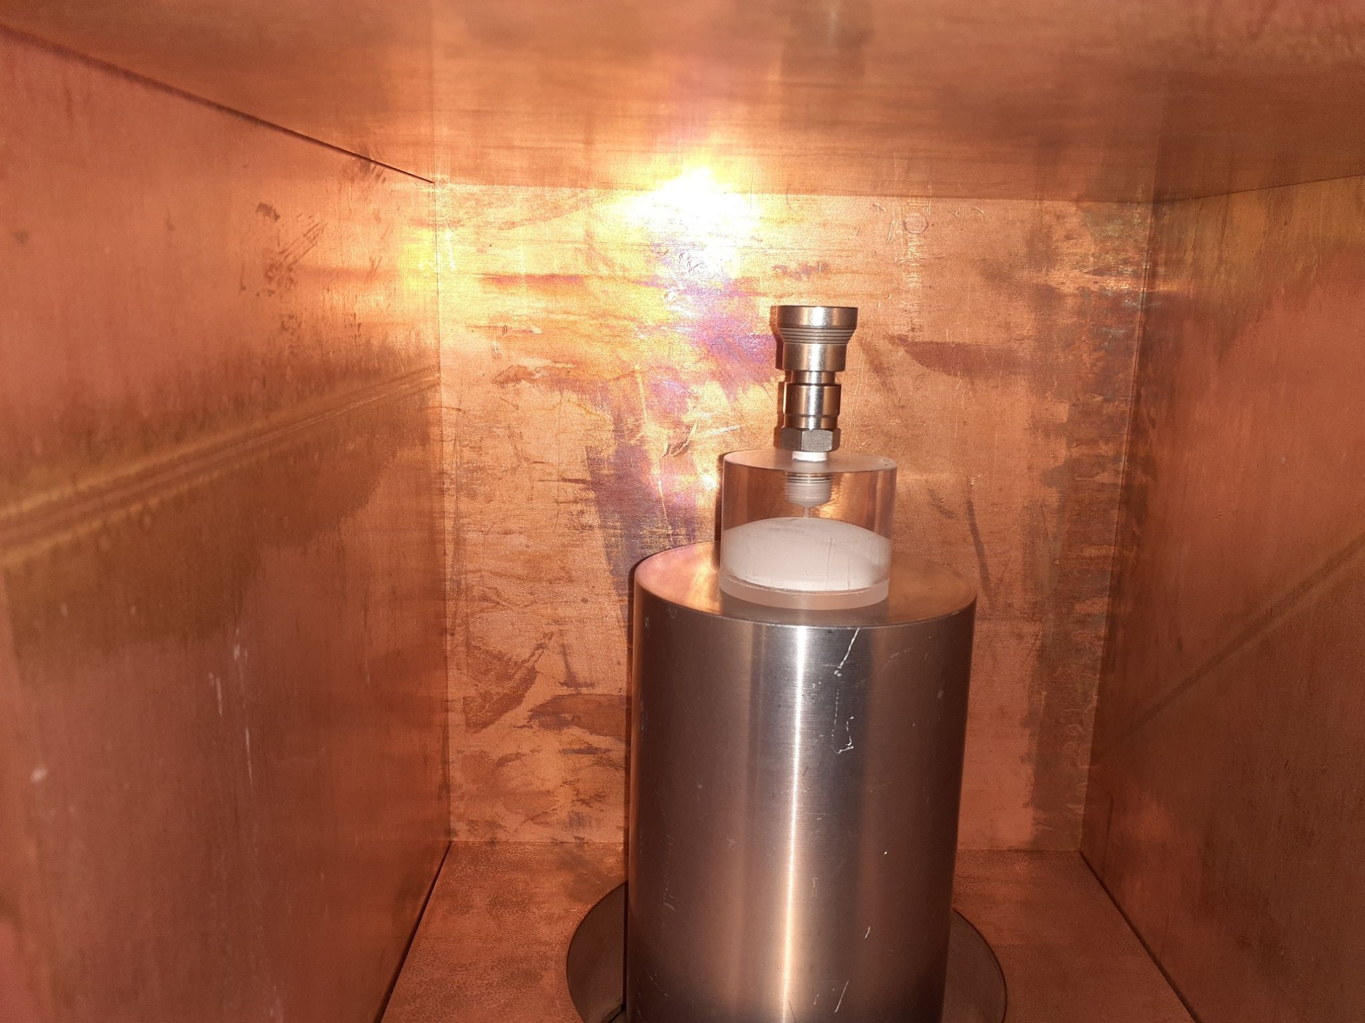
Lucas Cell HPGe Cross-Calibration - G01
Lucas Cell background measured
Background below HPGe sensitivity
Lucas Cell Efficiency = 59.4% +/- 1.7%
https://www.snolab.ca/users/services/gamma-assay/
Notes:
1.5hours
10 hours for full

Slide 17
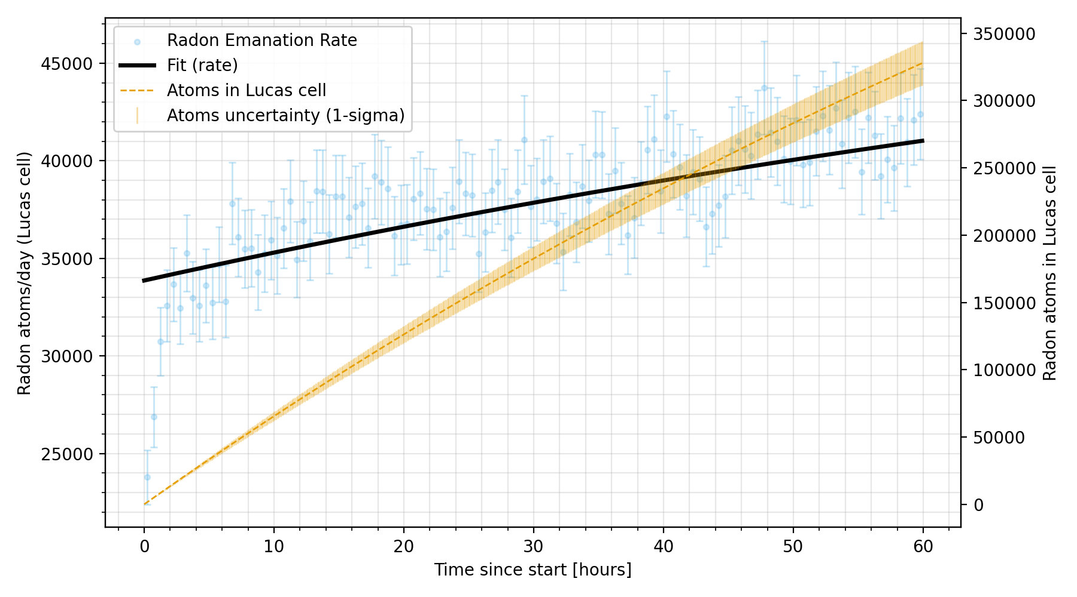
Dial Emanation Curve
Radon Emanation from Short Radium Dial
Encapsulated dial connected
30 minute time bins
Short lag time
Notes:
1.5hours
10 hours for full

Slide 18
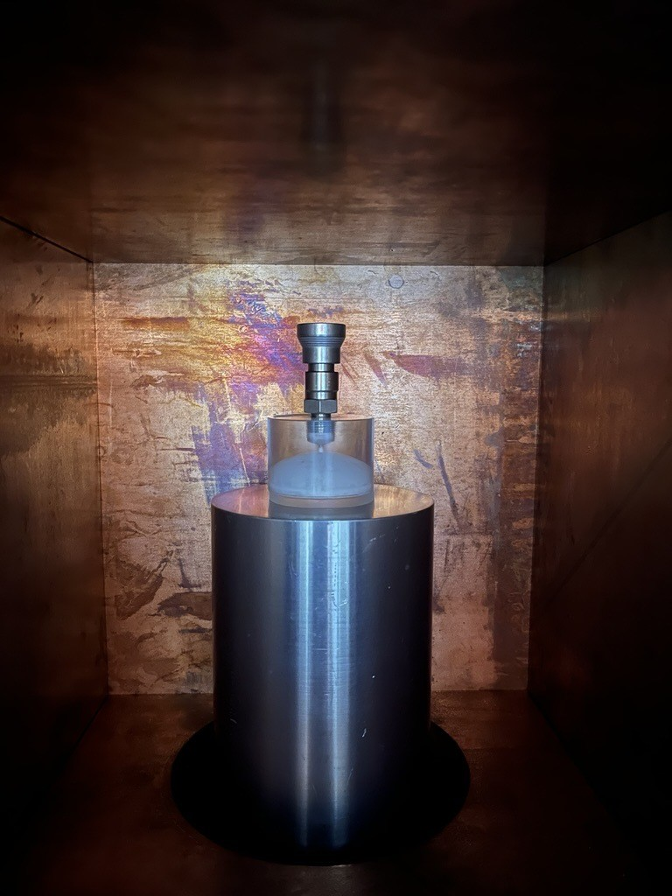
Summary
New cross calibration method was successful
Radium dial radon calibration tool performs as expected
Emanation has been characterized
https://www.snolab.ca/users/services/gamma-assay/
Notes:
Germanium detector double-check

Slide 19
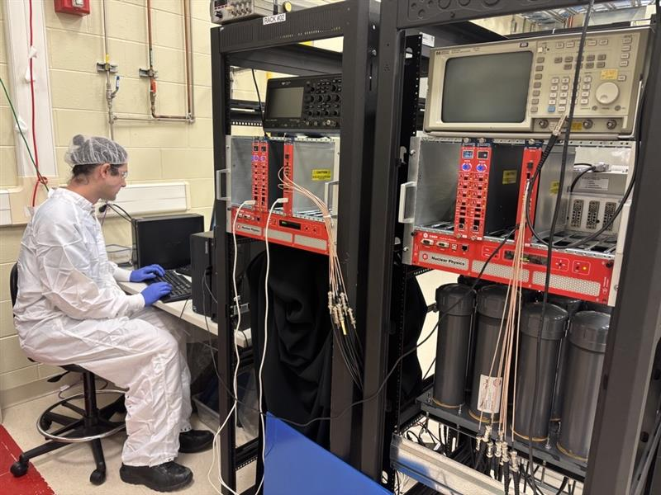
Next Steps
Calibrate Lucas Cells
Evaluate new PMT efficiencies
Drive down uncertainties with 379.50 +/- 11.31 Bq dial
Cross calibrate different systems
Notes:
Germanium detector double-check

Slide 20
Special Thanks!
Christine Kraus
Nasim Fatemighomi
Peter Qin
Ian Lawson
Mark Ward
Matt Depatie
Aleksandra Bialek
Low background group

Slide 21
Lucas Cell HPGe Cross-Calibration - G01
HPGe: start 2025-07-11 12:55:10, live 4.014 d, midpoint 2025-07-13 13:05:14.8
HPGe activity: 1523.00 +/- 41.58 mBq/kg.
Lucas cell mass: 0.13550 kg.
PMT: start 2025-07-17 16:48:45, window T = 24.4518 h, counts C = 13,926.
T1/2 = 3.8235 d. lambda_d = 0.18105 d^-1. lambda_s = 2.0947e-6 s^-1.
Calculating Number of atoms at PMT start
A_mid_total = (1523.00 mBq/kg)/1000 * 0.13550 kg = 0.2063665 Bq.
Delta_t = t_PMT_start - t_HPGe_mid = +4.15521 d.
A0 = A_mid_total * exp( -lambda_d * Delta_t ) = 0.0971613 Bq.
N0 = A0 / lambda_s = 46,306.56 atoms.
Fraction of chains that decay during PMT window:
T = 24.4518 h = 1.018825 d.
p = 1 - exp( -lambda_d * T ) = 0.168645.
N_dec = N0 * p = 7,809.384.
Efficiency = Counts / (3 * N_dec) = 13,926 / (3 * 7,809.384) = 0.59441.
Uncertainty on Efficiency:
sigma_A/A = 41.58 / 1523.00 = 2.7301%.
1/sqrt(C) = 0.8474%.
Combined = sqrt(0.027301^2 + 0.008474^2) = 2.857%.
sigma_epsilon = 0.59441 * 0.02857 = 0.01699.
Alpha counting efficiency of 59.4% +/- 1.7%
https://www.snolab.ca/users/services/gamma-assay/
Notes:
1.5hours
10 hours for full

Slide 22
Lucas Cell HPGe Cross-Calibration - G02
HPGe: start 2024-11-26 11:56:26, live 13.854 d, midpoint 2024-12-03 10:11:18.8
HPGe activity: 940.40 +/- 22.36 mBq/kg.
Lucas cell mass: 0.13682 kg.
PMT: start 2024-11-15 16:49:19, window T = 5.17671 h, counts C = 53,324.
T1/2 = 3.8235 d. lambda_d = 0.18105 d^-1. lambda_s = 2.0947e-6 s^-1.
Calculating Number of atoms at PMT start
A_mid_total = (940.40 mBq/kg)/1000 * 0.13682 kg = 0.1286655 Bq.
Delta_t = t_PMT_start - t_HPGe_mid = -17.72361 d.
A0 = A_mid_total * exp( -lambda_d * Delta_t ) = 3.197930 Bq.
N0 = A0 / lambda_s = 1,524,117 atoms.
Fraction of chains that decay during PMT window:
T = 5.17671 h = 0.215696 d.
p = 1 - exp( -lambda_d * T ) = 0.0383481.
N_dec = N0 * p = 58,446.96.
Efficiency = Counts / (3 * N_dec) = 53,324 / (3 * 58,446.96) = 0.30412.
Uncertainty on Efficiency:
sigma_A/A = 22.36 / 940.40 = 2.3777%.
1/sqrt(C) = 0.4331%.
Combined = sqrt(0.023777^2 + 0.004331^2) = 2.416%.
sigma_epsilon = 0.30412 * 0.02416 = 0.00735.
Alpha counting efficiency of 30.4 +/- 0.7%
https://www.snolab.ca/users/services/gamma-assay/
Notes:
1.5hours
10 hours for full

Slide 23
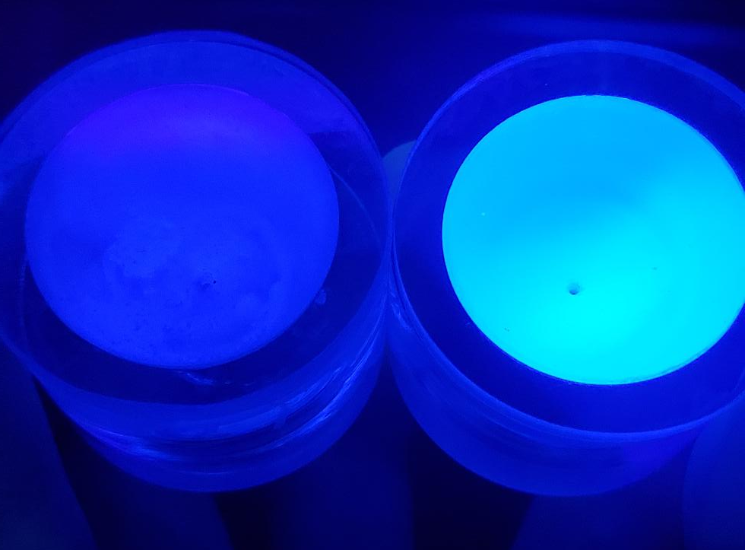
Lucas Cell Comparison
Different brands of ZnS:Ag have been used for various Lucas Cell
“series”
Brands have dramatically different light yield - changes PMT efficiency
Coatings have different thicknesses - alters alpha efficiency
G02
G01
Notes:
1.5hours
10 hours for full

Slide 24
Volume Sharing
Volume of QC4 and and cap:
0.30 mL
Volume of Lucas Cell:
34.3 mL
Lucas Cell is 99.1% of volume,
0.866% is endcap
https://www.swagelok.com/downloads/webcatalogs/en/ms-01-138.pdf

Slide 25
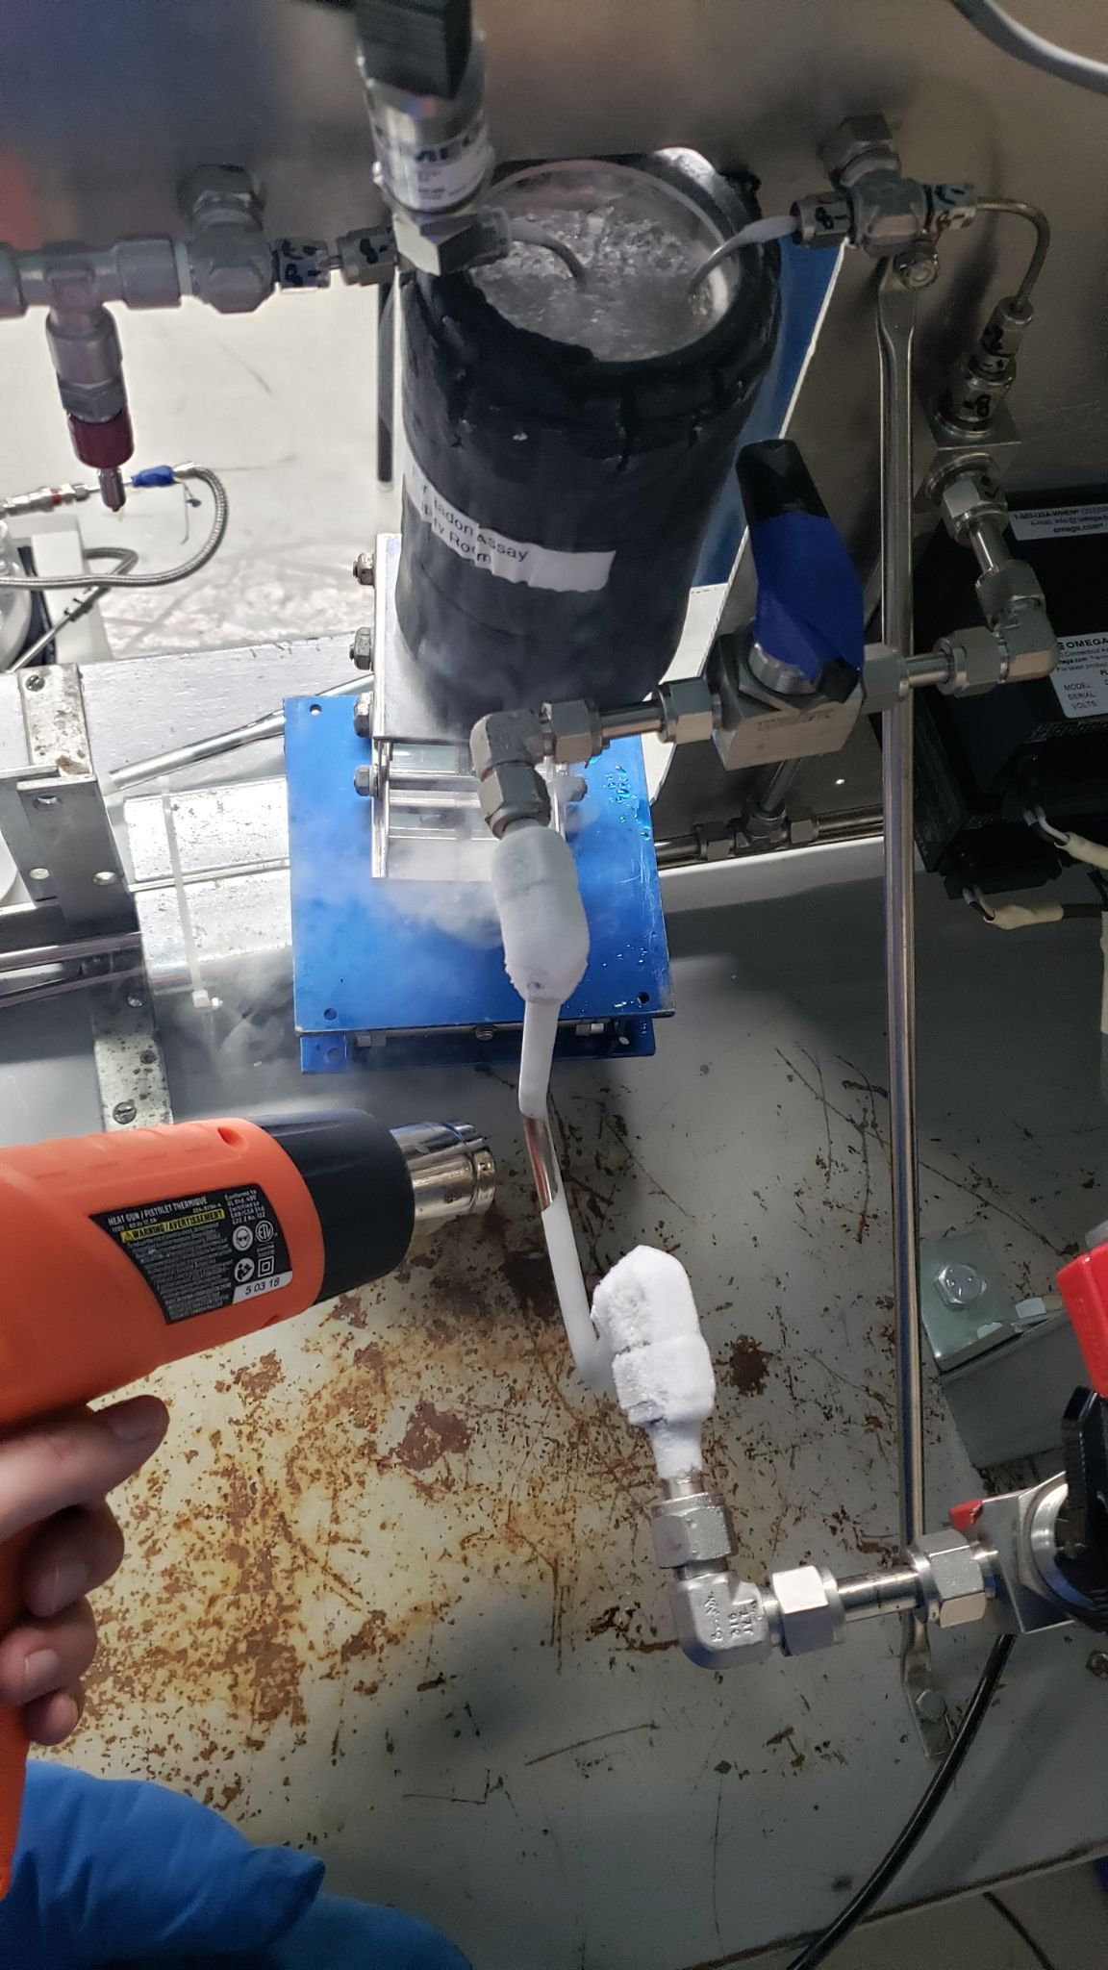
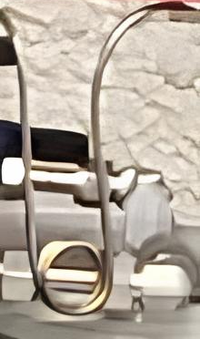
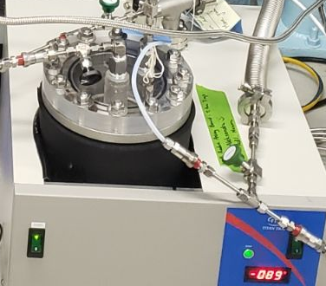
What is a Radon Assay Cross Calibration?
Primary Trap
Lucas Cell
Concentrator Trap
Water Trapping
Gas from Radon Monitor

Slide 26
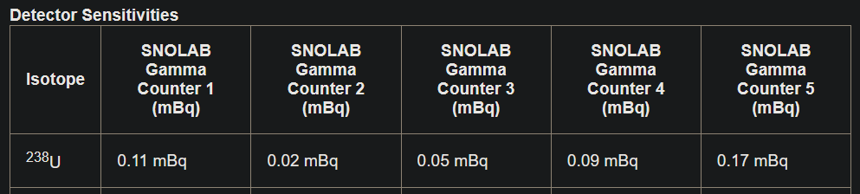
Lucas Cell Backgrounds and
HPGe Sensitivity
https://www.snolab.ca/users/services/gamma-assay/
Notes:
1.5hours
10 hours for full

