Slide 1

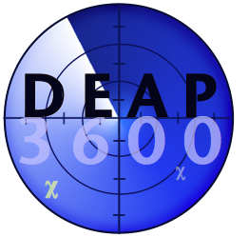
Background Reductions and Fill of the DEAP-3600 Dark Matter Detector
Cheyanne Monk
CASST 2025

Slide 2
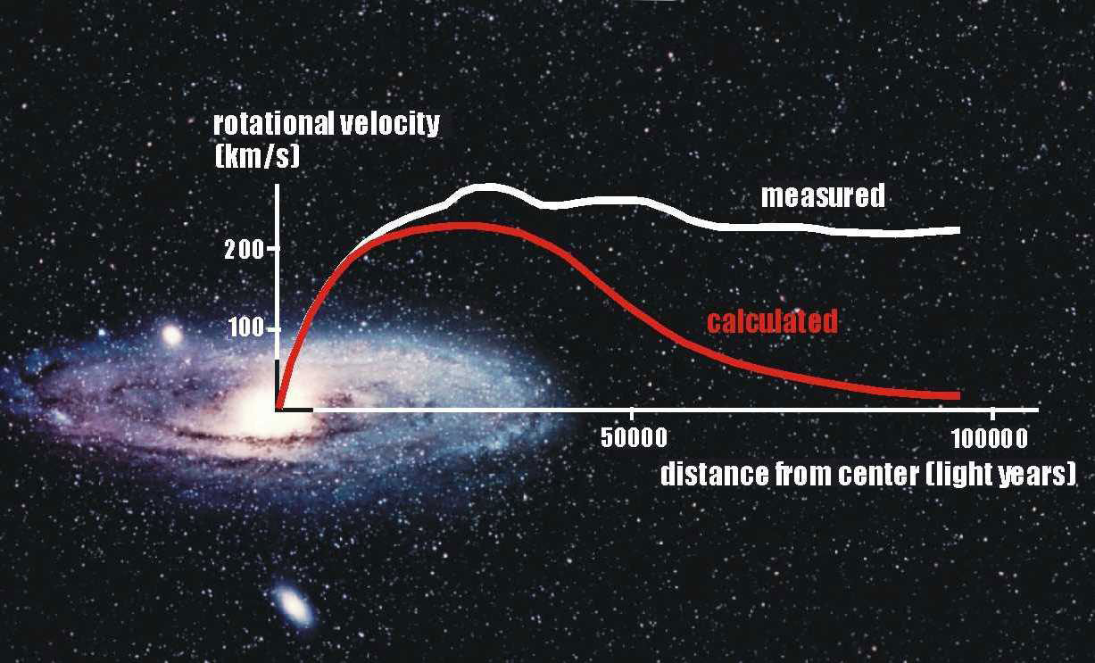
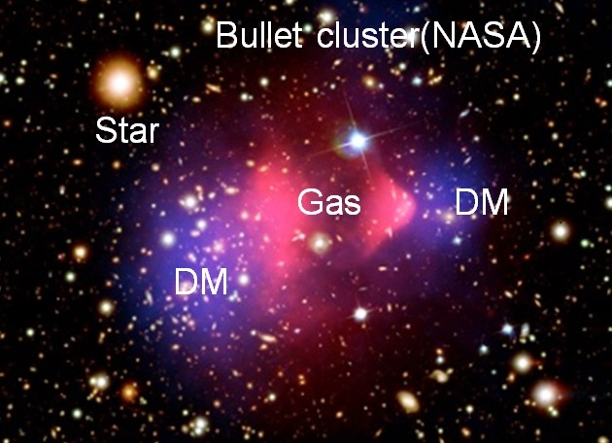
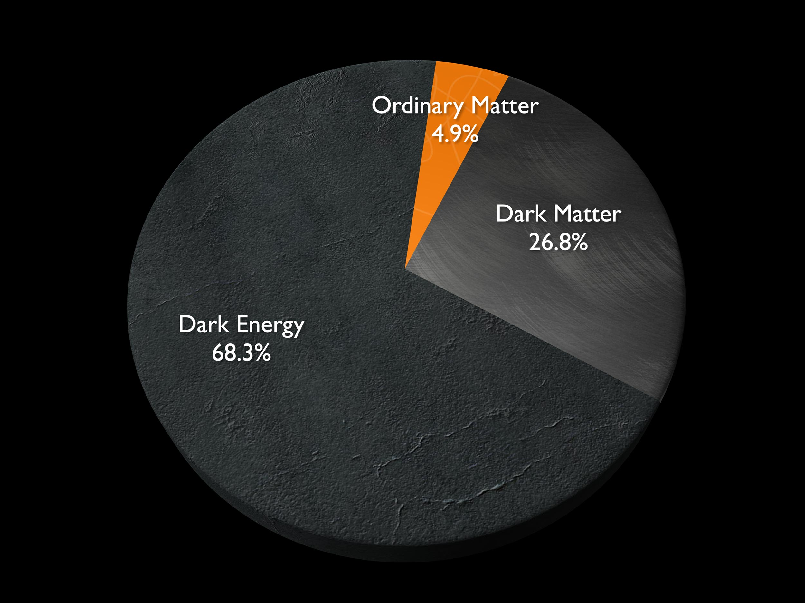
Dark Matter
We can observe its effects… but what is it?

Slide 3
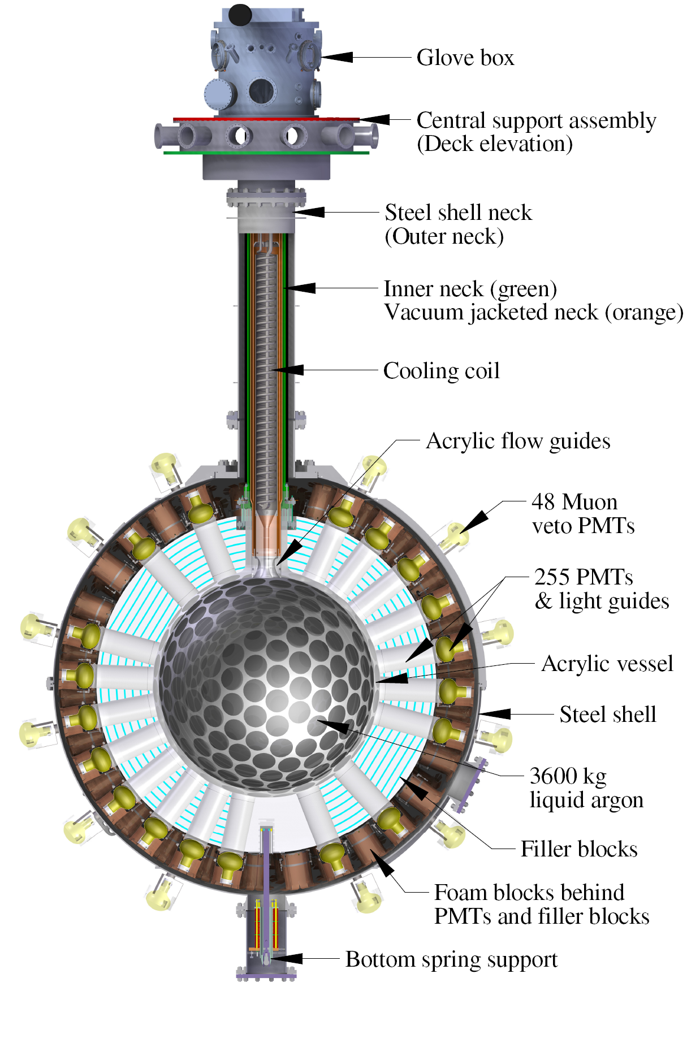
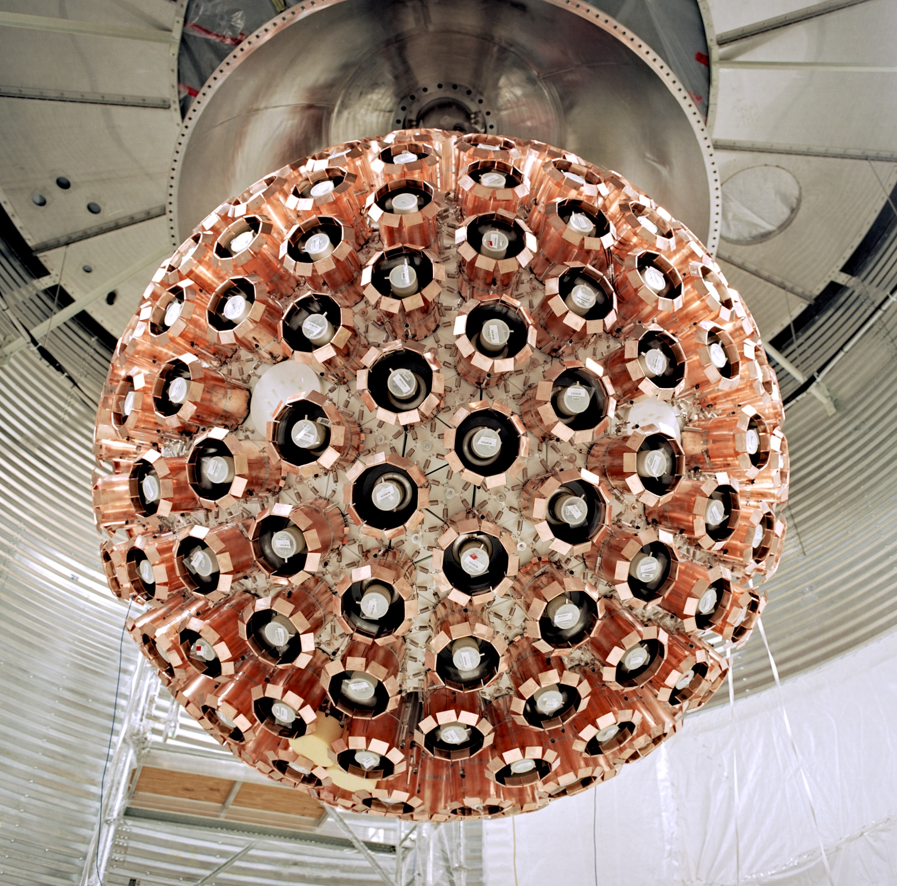
DEAP-3600
Timing characteristics in LAr scintillation:
Electron recoils - microseconds
Nuclear recoils – nanoseconds
W
I
M
P
eakly
nteracting
assive
articles

Slide 4
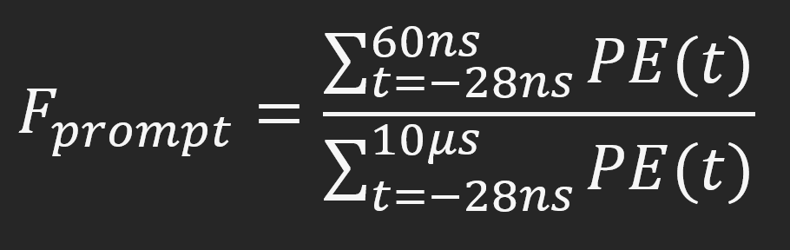
Pulse Shape Discrimination
Pulse Shape Discrimination (PSD):
  Define region of interest (ROI)
  Eliminate background events from ROI by factor of ~10 billion
Fprompt:
  PSD parameter to distinguish event types & reject background
  Ratio of prompt light over total light

Slide 5
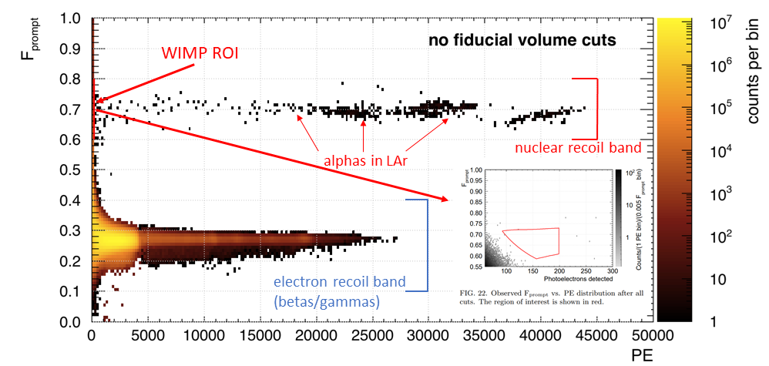
ROI
WIMPS: high Fprompt, low energy

Slide 6
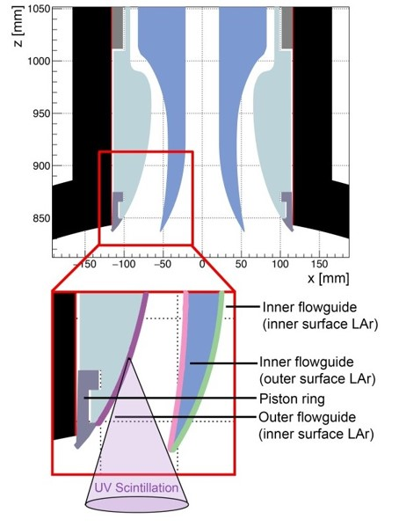
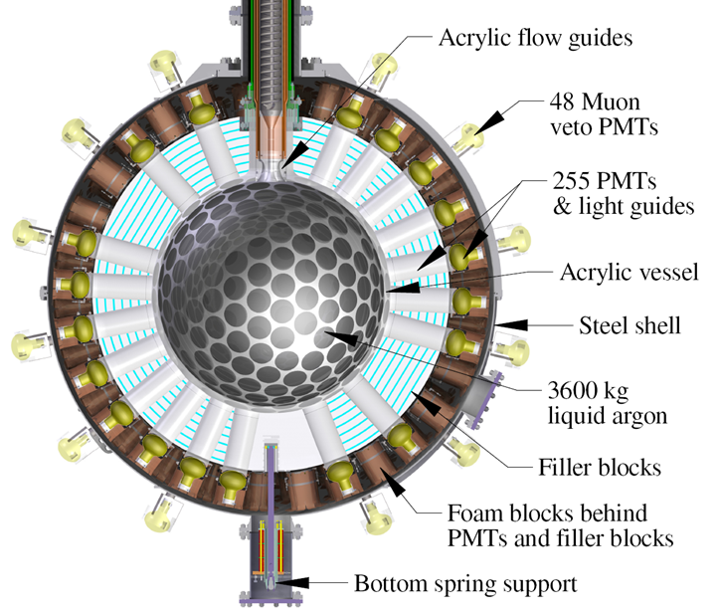
Neck Events
Problem: Surface alphas from flow guides sending reduced light, mimicking WIMPs

Slide 7
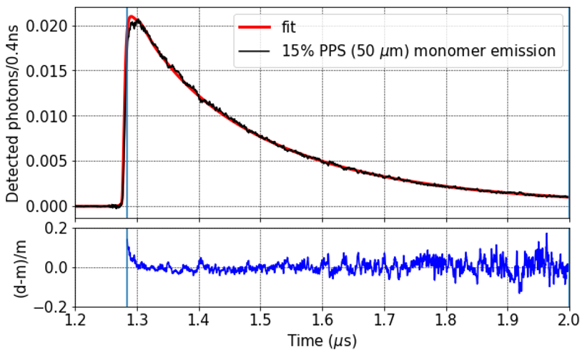
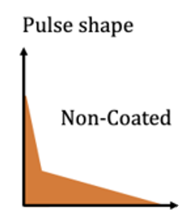
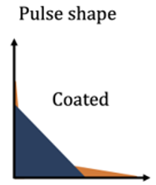
Neck Events
Solution: Pyrene
  Delayed photoluminescence
  Tag & remove from ROI
Pyrene monomer photoluminescence decay at 87K

Slide 8
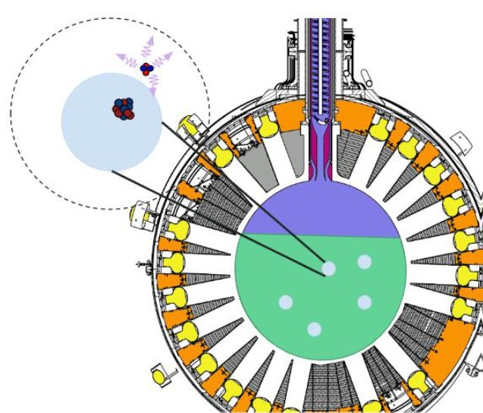
Dust
Problem: Alpha decays inside dust, scintillation at lower energy, mimicking WIMPs

Slide 9
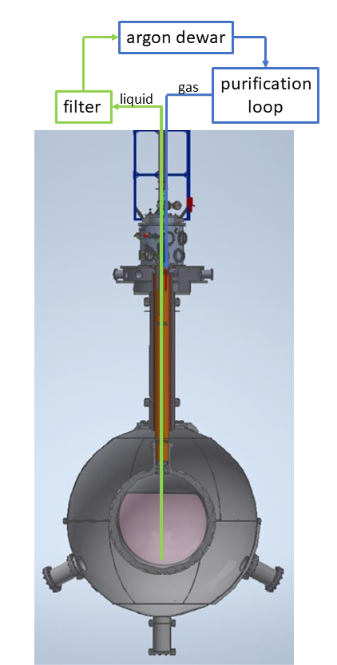
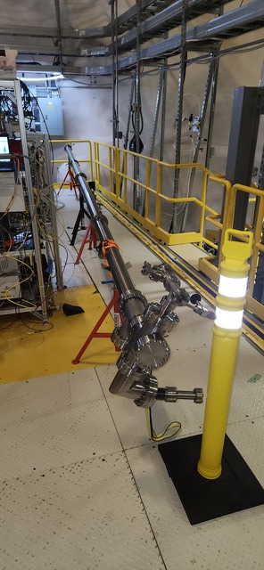
Dust
Solution: Dust Extraction Pipe
  Circulate through p-trap & dust filter
  Into purification loop:
    Chemical getter
    Radon Trap
  Back into detector
  Deployment plan: after fill

Slide 10
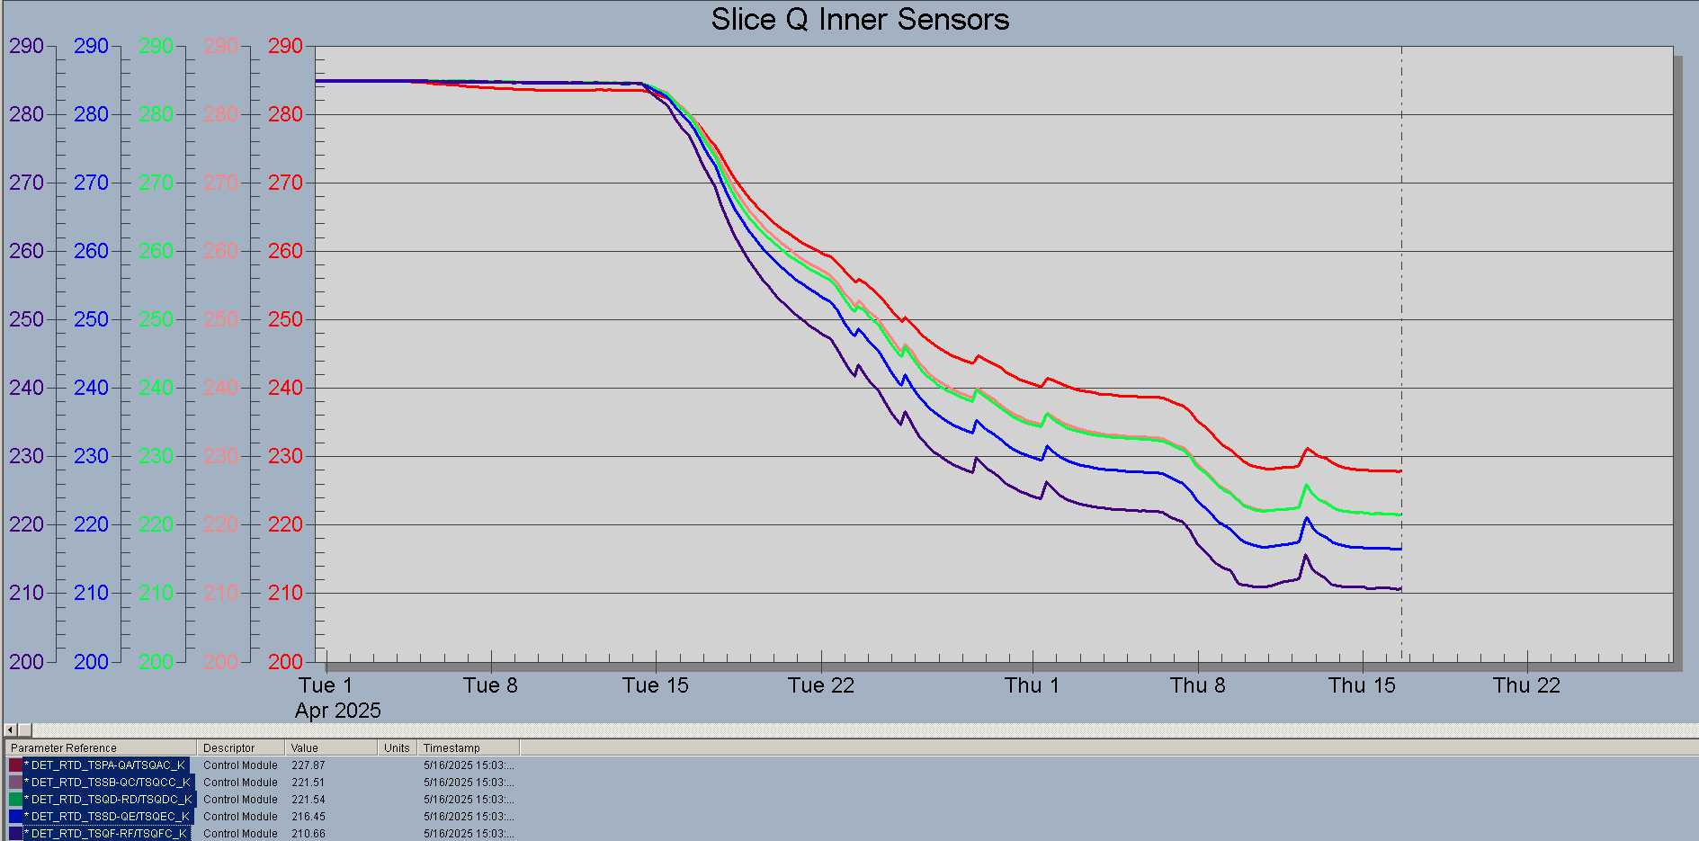
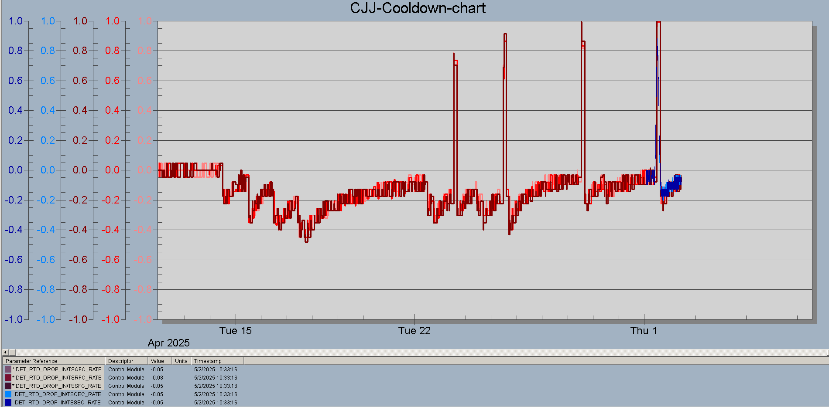
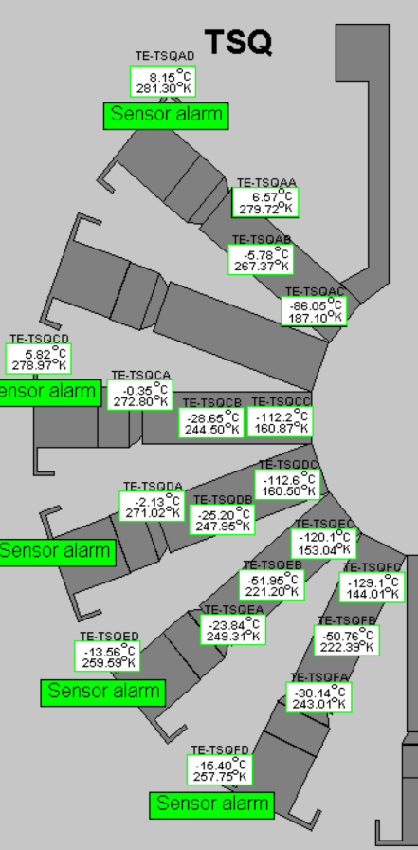
Cooldown
Gas injections
Mist
Liquid

Slide 11
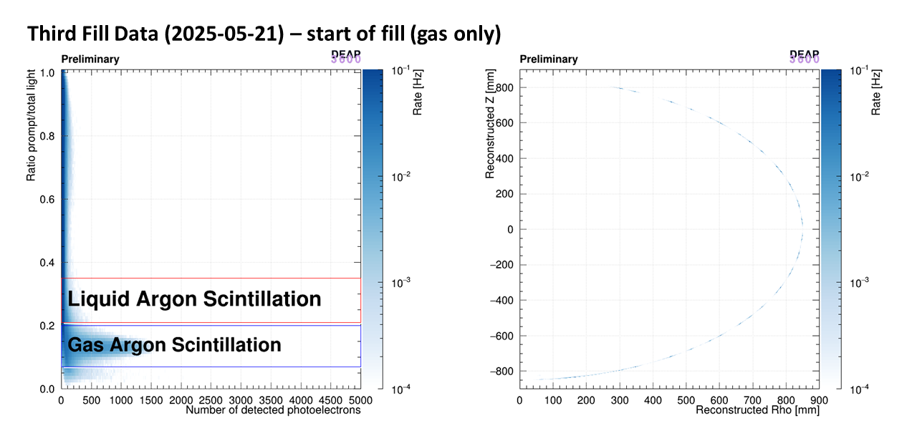
Continuous fill – May

Slide 12
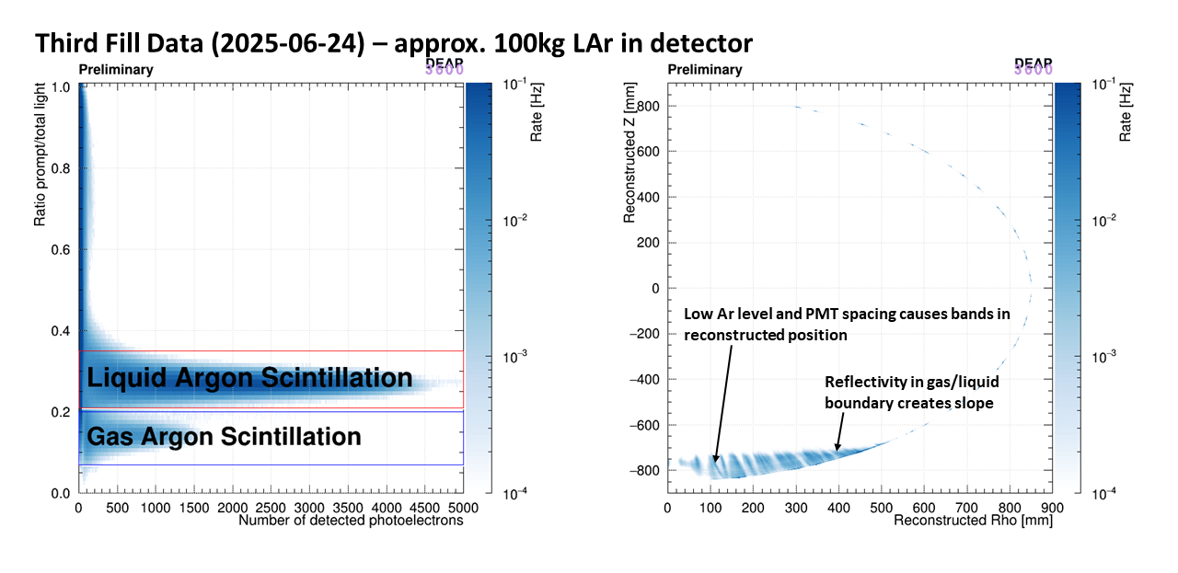
Continuous fill – June

Slide 13
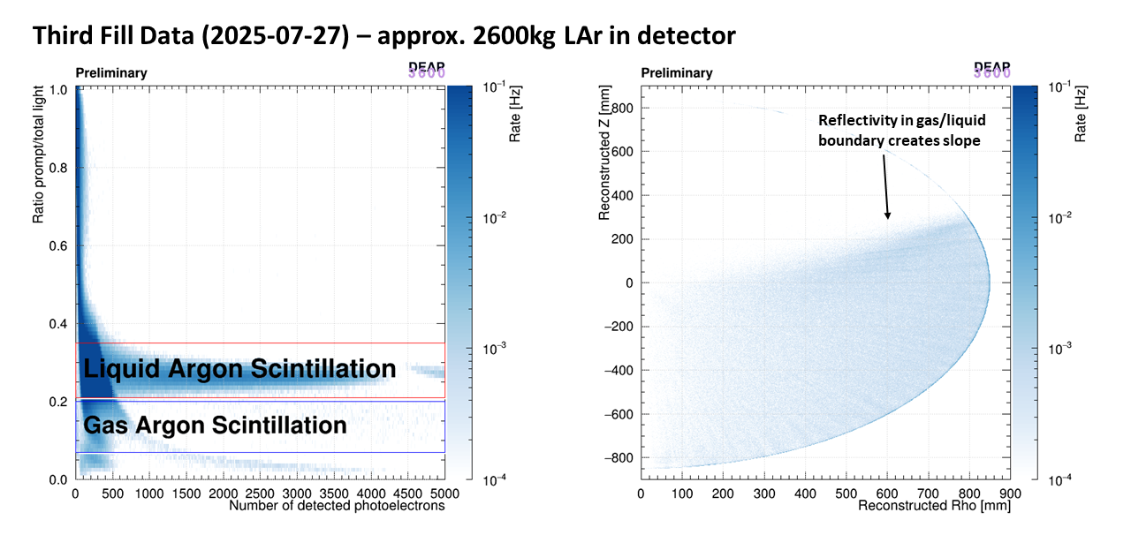
Continuous fill – July

Slide 14
The Plan
Fill detector to same level as previous fill
Deploy dust pipe when detector is full
Take data for ~1 year
Calibrate for low energy with Kr-83m

Slide 15
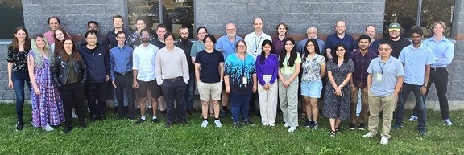
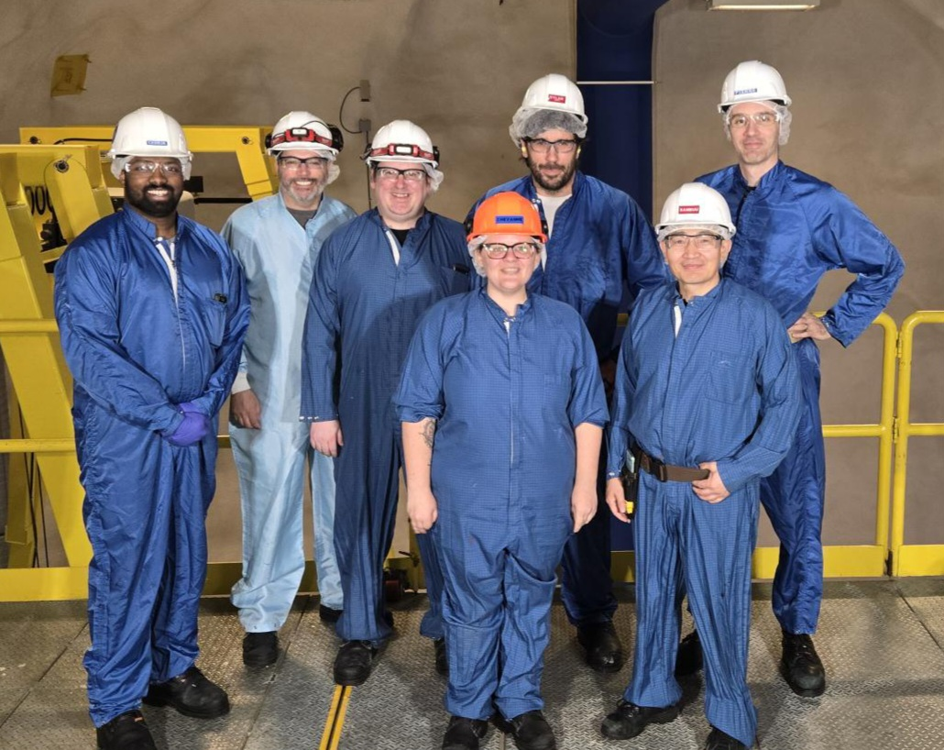
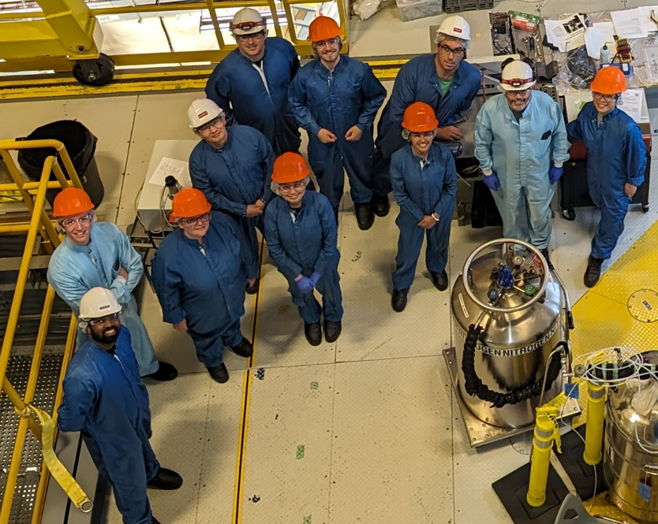
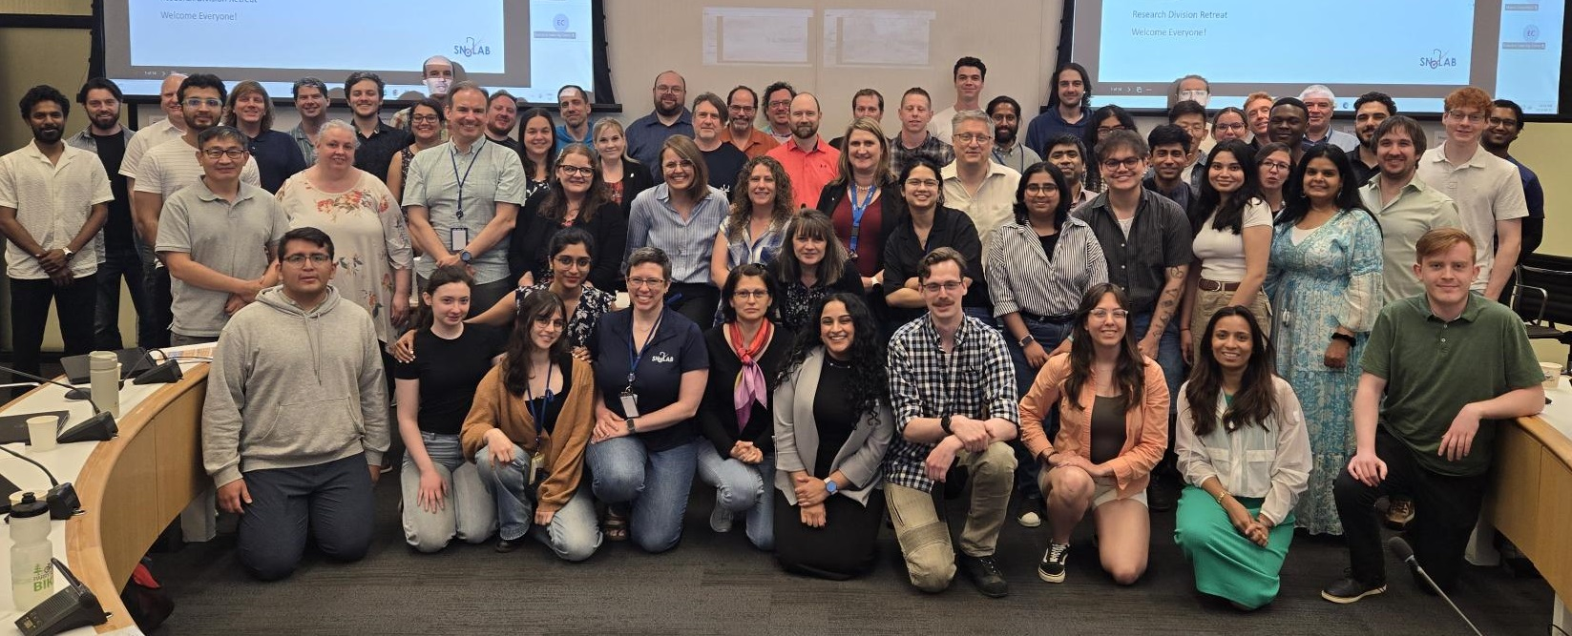
Thank you

Slide 16
Questions?

Slide 17
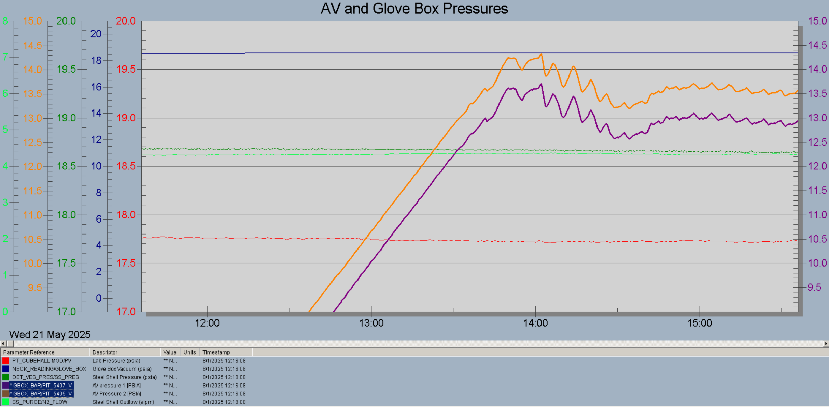
Additional Slides

Slide 18
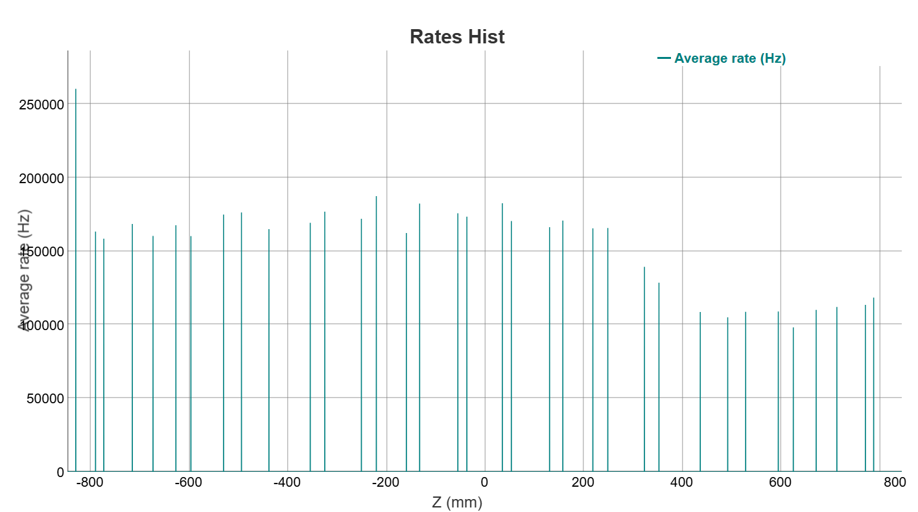
Additional Slides

Slide 19
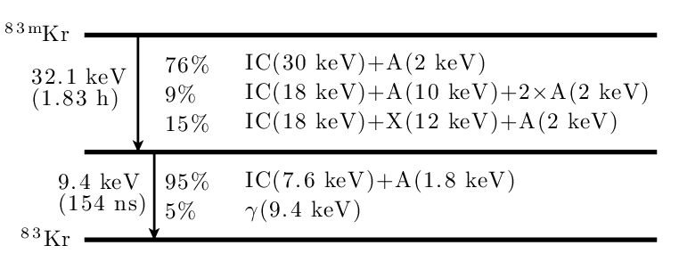
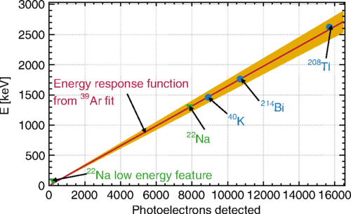
Additional Slides
The decay scheme and branching ratios of 83m Kr. The decay always passes through two transitions, giving mostly internal conversion (IC) and Auger (A) electrons. A small amount of the energy is carried by gamma-(γ) and X-rays (X)

