Slide 1
Novas
and Neutrons
Zoe Shipp-Wiedersprecher
Supervised by Dr. Stephen Sekula
SNOLAB, HALO
1
Notes:
Highschool student in kingston ontario
Dream of being an astrophysicist

Slide 2
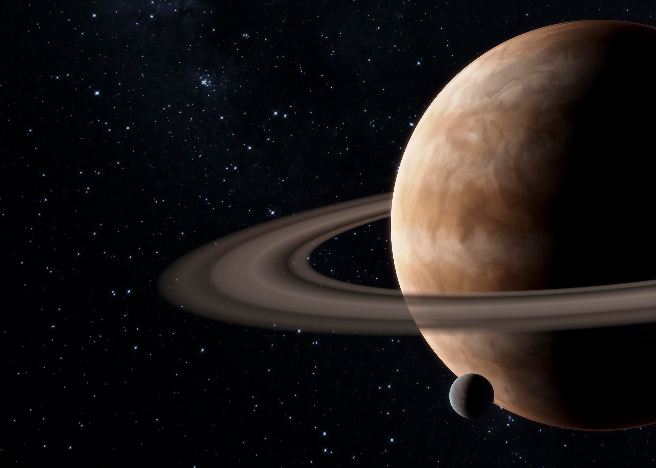
Introduction
Novas and Neutrons; a HALO collaboration project working to assess the relationship between electron neutrinos burst data and galactic novae
2

Slide 3
Table of contents
01
02
03
04
Galactic Novae
HALO
What is a nova? What is its importance and significance?
HALO, HALO data, and analysis
Light Curves
The Hunt for Variable Stars
AAVSO contributions to magnitude data and light curve graphs
What is a light curve?
The fun stuff.
3

Slide 4
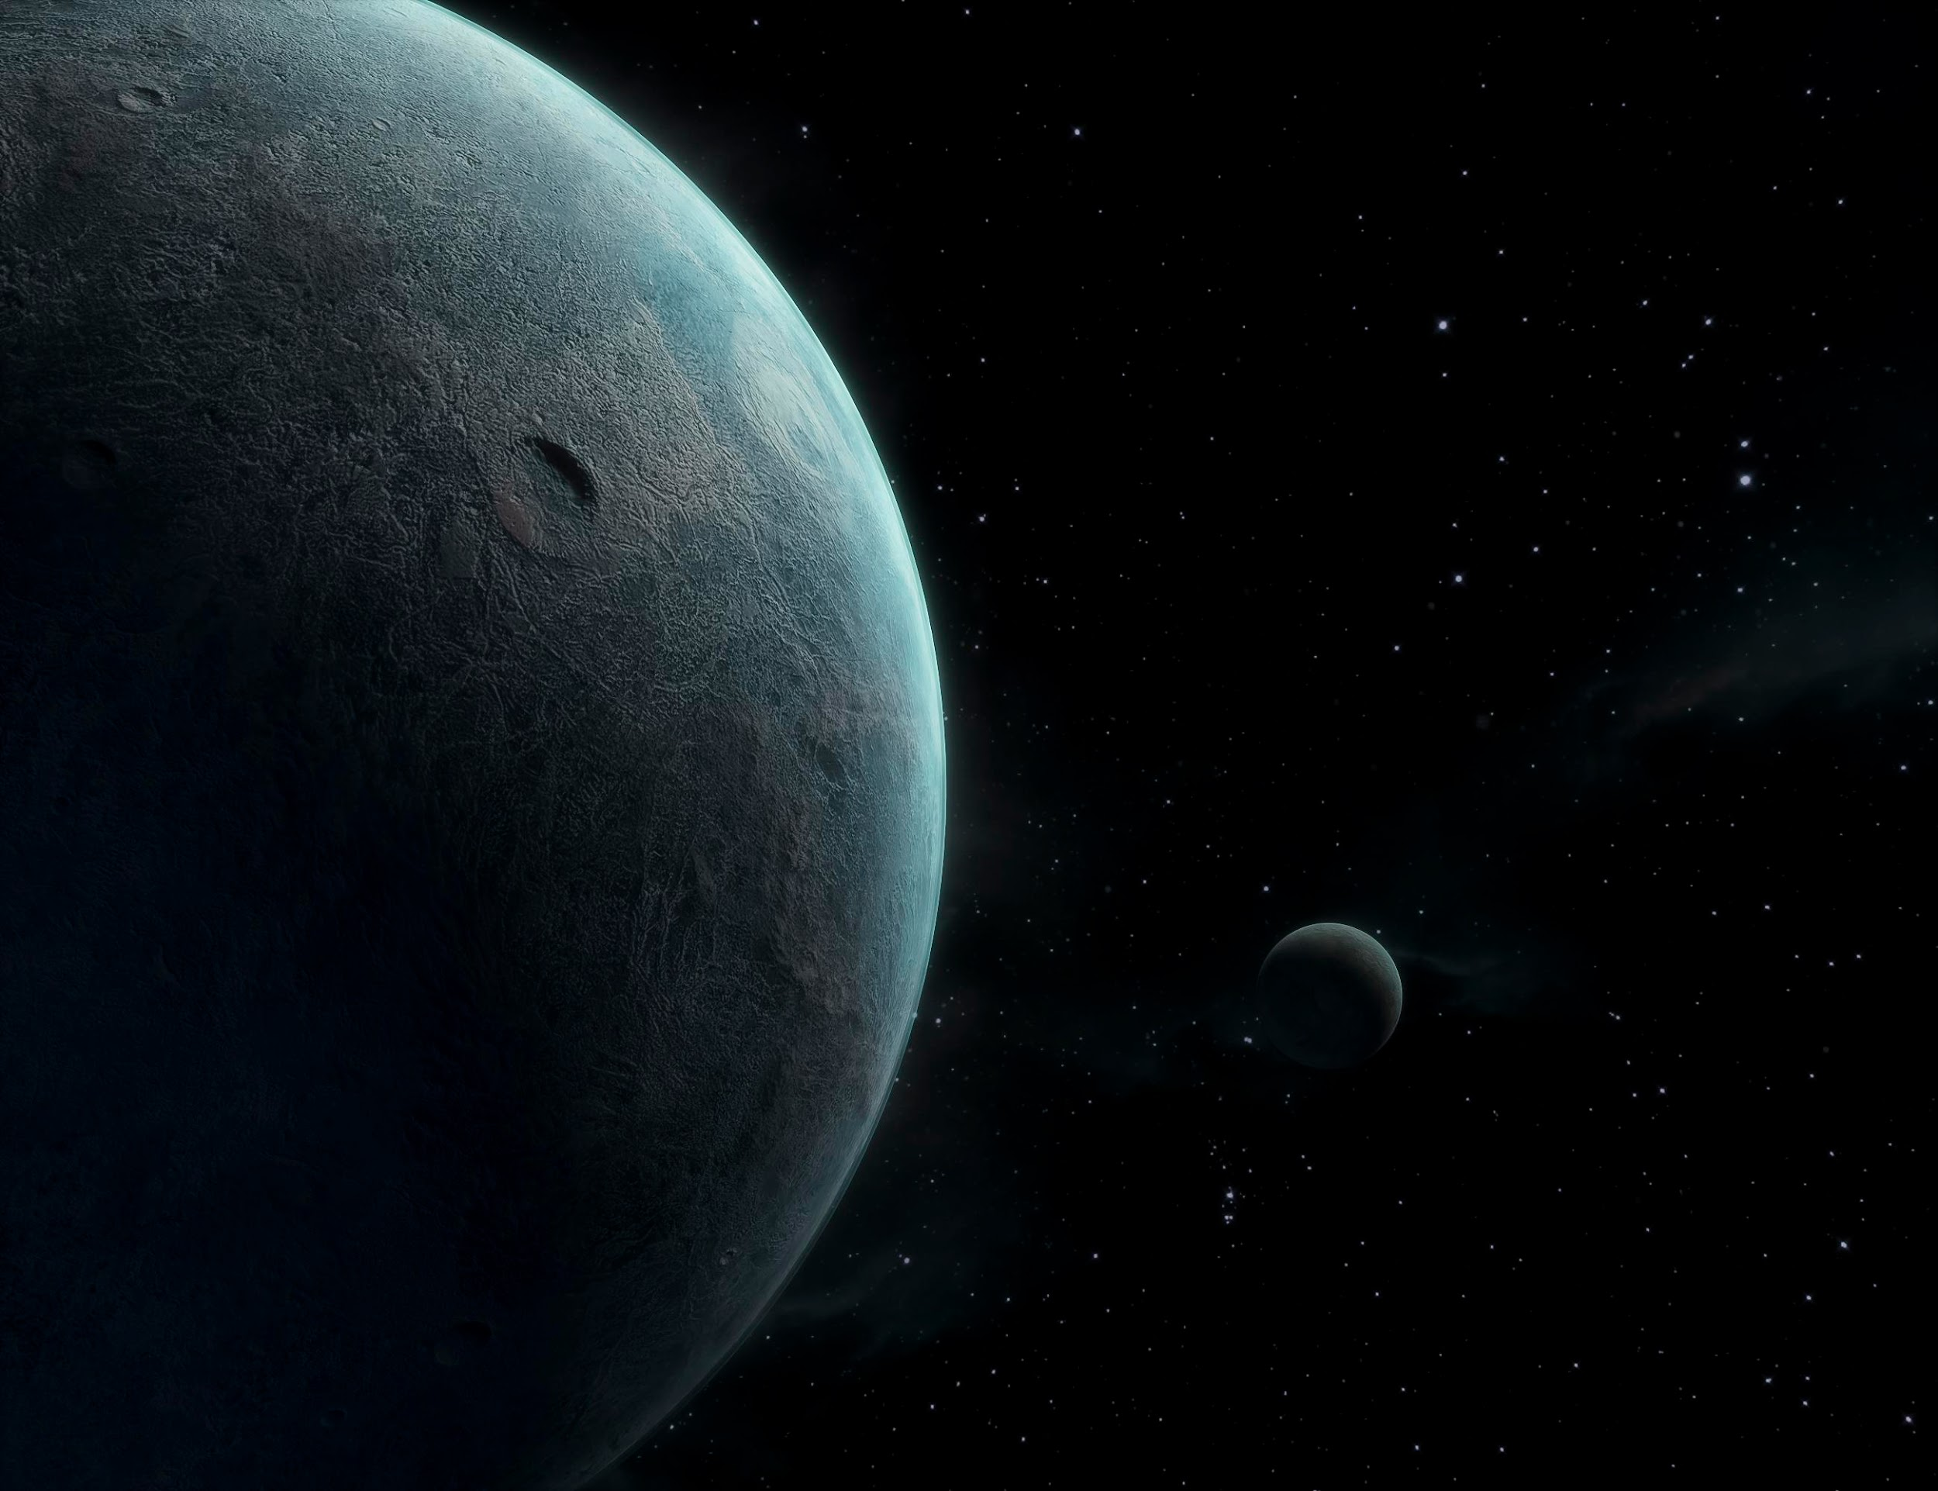
01
Galactic Novae
What’s a Nova?
4

Slide 5
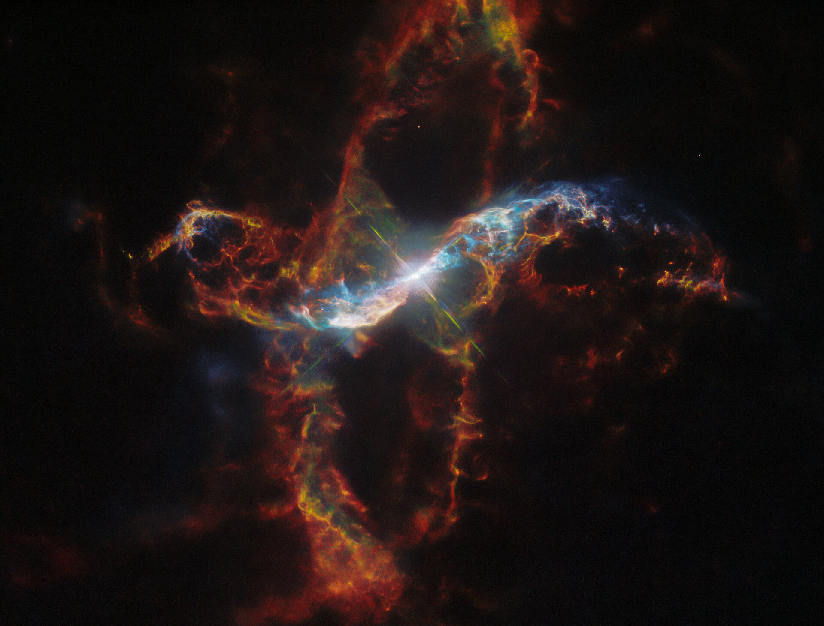
What is a nova; the leading theory
Binary Star Systems
Novas are fusion reactions occurring as a result of two orbiting stars, particularly one red giant, and one white dwarf, this is necessary for the process of the white dwarf accreting matter from the red giant.This results in a flare/burst that from the fusion reaction in the red giant that potentially produce an influx of gravitational potential energy, released as neutrinos
NASA, ESA, M. Stute, M. Karovska, D. de Martin & M. Zamani (ESA/Hubble)
5
Notes:
Furthermore
- supernovae
- chandrasekhar limit
- correspondences to HALO
- magnitude change
- sheer number of binary systems
- why might finding these be difficult
- TCrB
- spontaneous vs periodic

Slide 6
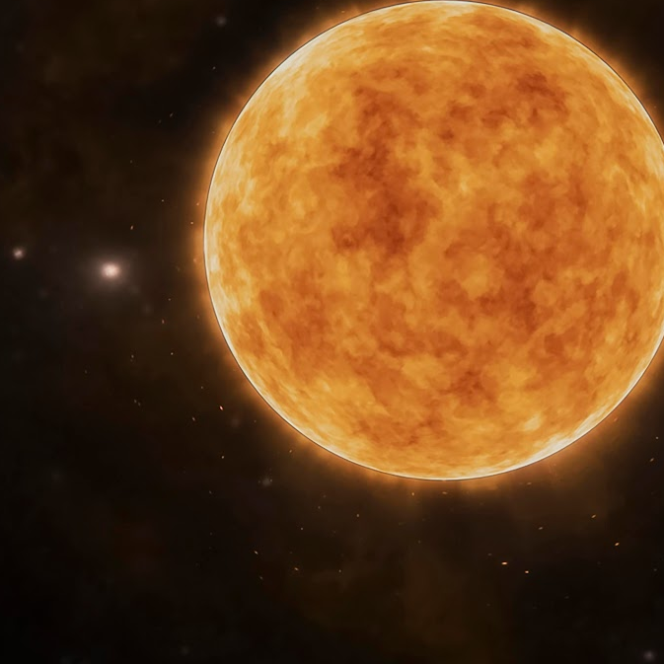
02
HALO
What is HALO? What data does it give us?
6

Slide 7
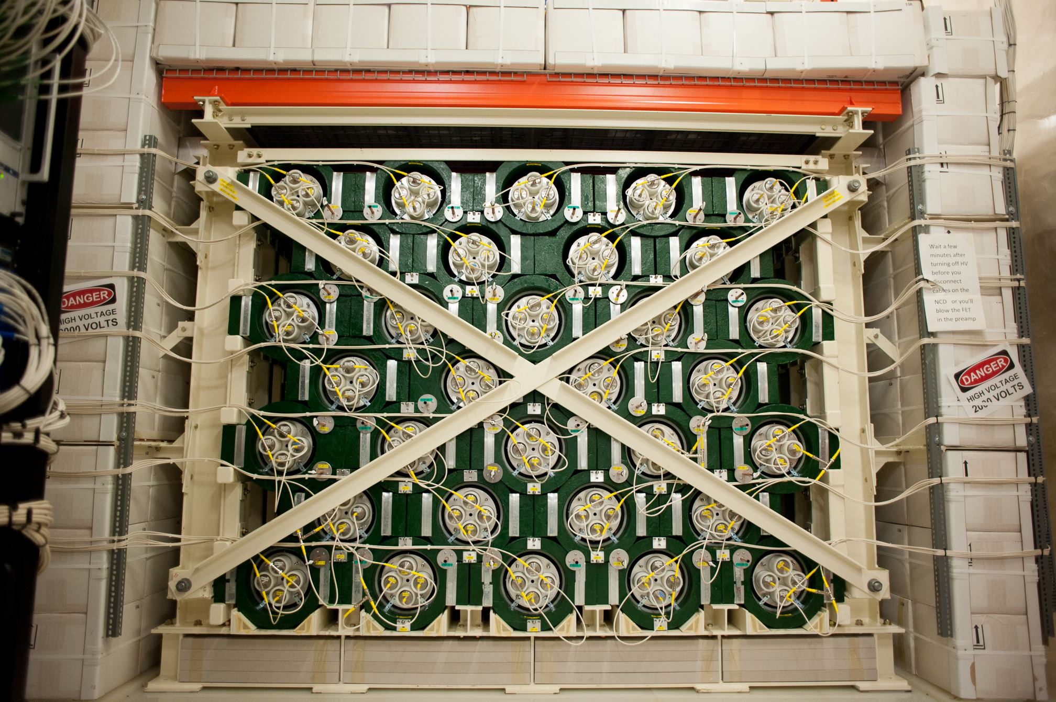
What is HALO?
The Helium and Lead
Observatory
HALO is a detector located in snolab that uses lead and helium to detect neutrons produced when a burst of νₑ interacts with ²⁰⁸Pb, this produces the reaction:
²⁰⁸Pb(νₑ​,e⁻)²⁰⁸→Bi*
This then promptly de-excites by releasing no more than a few neutrons
Image credit: SNOLAB. (2020, December). HALO visual. Retrieved from https://www.snolab.ca/wp-content/uploads/2020/12/thumbnail.jpeg
7

Slide 8
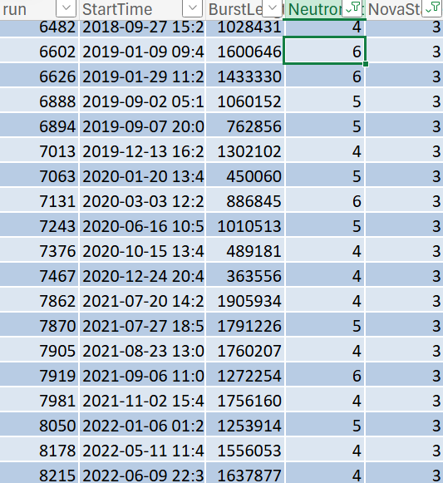
What is HALO?
What’s a Burst?
What then would qualify as a burst in neutrons in the HALO database?
Novastate one corresponds to coincidental detections, two means spontaneous fission or muon spallation, and 3 being something supernova, or nova like. (Zero on the other hand is messy catchall of anomalistic bursts)
Novastate two are bursts that occur in the first 10-millisecond of the two second window
Novastate three are bursts that are spread over the course of the two second window, thus not being indicative of fission or spallation
8
Notes:
Note steve and tom's work on the burst database and the qualification of each novastate, this could not have been done without them
A burst comes down to being 2 or 3 neutron candidates in a 2 second period, these can be sorted in to subclasses such as; novastate 1, 2, 3, and 0.

Slide 9

What is HALO?
Variable Stars and Supernovae
HALO has the ability to observe intense, time-dependent neutrino emissions, whether this is related to novae is unknown; and with the limits to the speed of light, neutrinos give us what is essentially I pre warning to the explosion or brightening of a star. Telling observers across the world, “Hey! Look Here!” With a large aim of HALO being supernova detection, this allowed it to become a part of SNEWS, aka the Supernova Early Warning System - a global network for neutrino detectors that allow for the detection of supernovae
“SNEWS logo.” SNEWS, n.d., https://snews.bnl.gov/images/new_snews_logo.jpg.
9

Slide 10
Light Curves and Variable Star Data
10

Slide 11
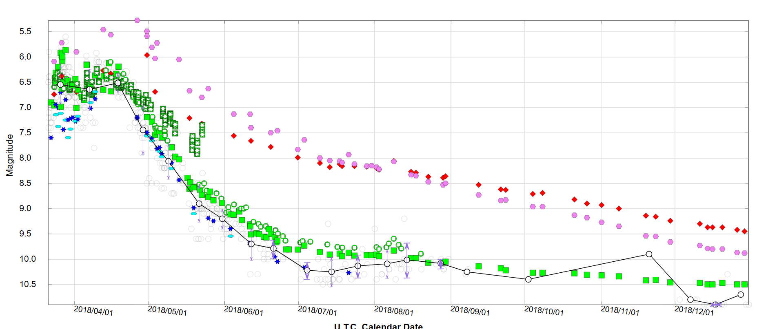
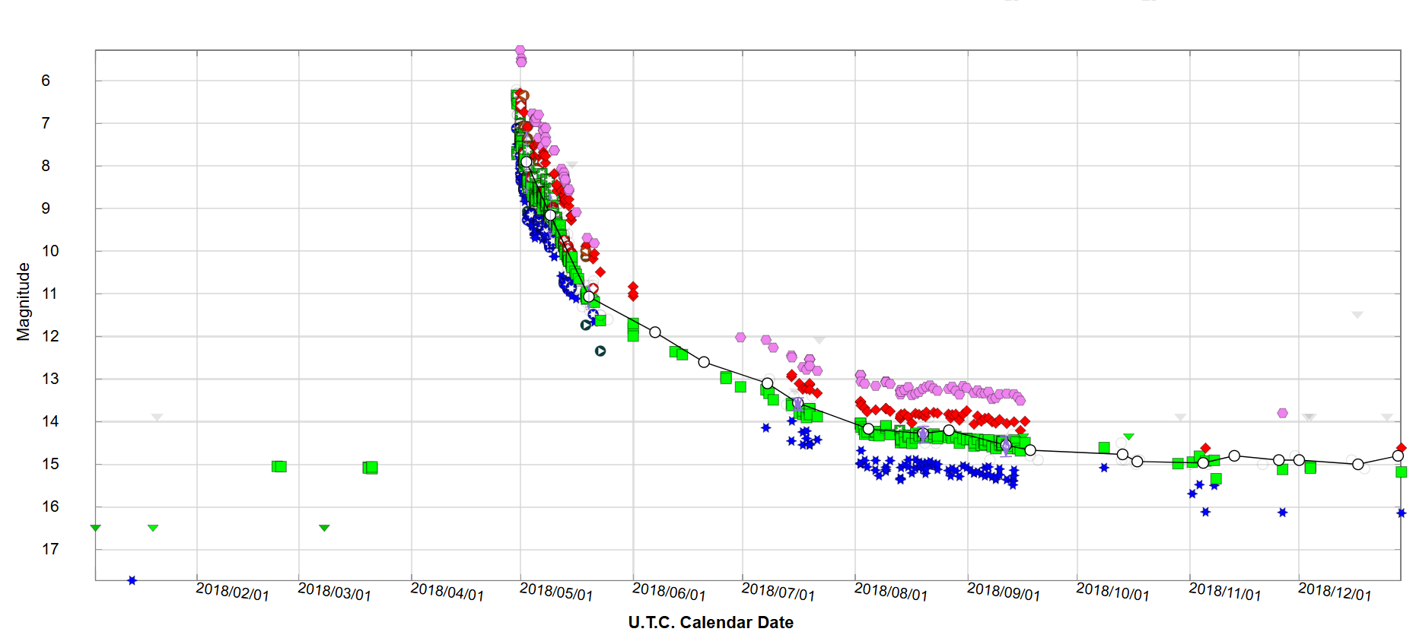
Light Curves
How do we identify when a star is flaring or in a nova state?
These ranges are immense and cause a definite raise in eyebrows when a new star seems to suddenly appear in the sky. Hundreds of observers document these changes in magnitude allowing us to assess their light curves, looking something like this:
11
Notes:
Aavso database
1st V906 Car
2nd V392 Per
It all comes down to magnitude, the flux of magnitude is typically drastic and start anywhere from 14-12 and end anywhere from 7-3,

Slide 12
Novas Identified
This number fluctuates as technology advances and identifying star magnitude becomes easier but on average astronomers detect around 6-10 nova a year with a detection efficiency of around 20-30%. Meaning data retrieved from both AAVSO and HALO can be highly subjective a difficult to analyze. The ultimate goal is to see if theres a relationship in HALO burst data to nova flares, and this is the preliminary look we’ve had
12

Slide 13
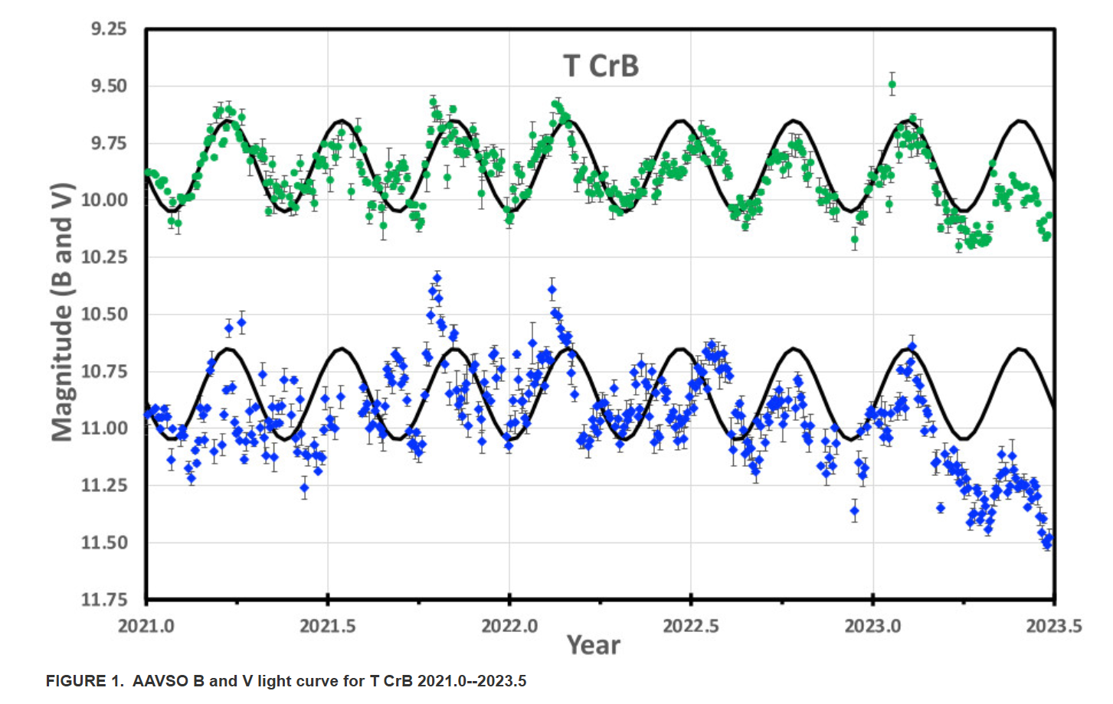
13
Notes:
Discuss the phenomenon of the “pre eruption dip”, how this affects data especially with naturally dim stars and how novas might be identified solely AFTER nova-ing, this is particularly strange in TCrB because its pre eruption dip indicated it should have erupted already

Slide 14

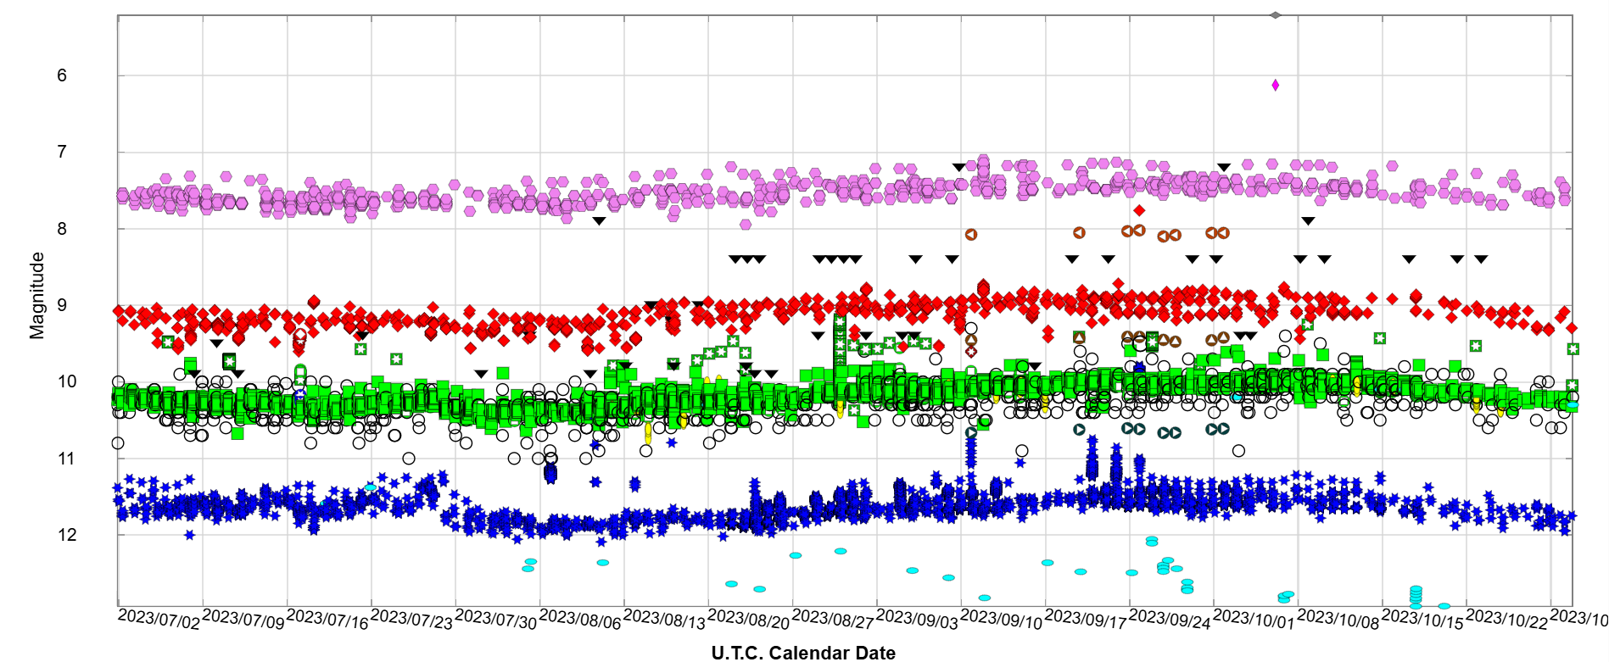
Wise Words…
“Research is 2 steps forward, 1 step back” - Dr. Sekula
While looking through the burst data and comparing and contrasting light data with HALO data, I found somethings peculiar.
14
Notes:
352 neutron count, amazing! I think not.
- this led to the discovery that the pulses sent through the detector that signify the detector can detect neutrons are leaking through to the actual neutron detections and disguising themselves as bursts (which they aren’t) ultimately skewing data

Slide 15
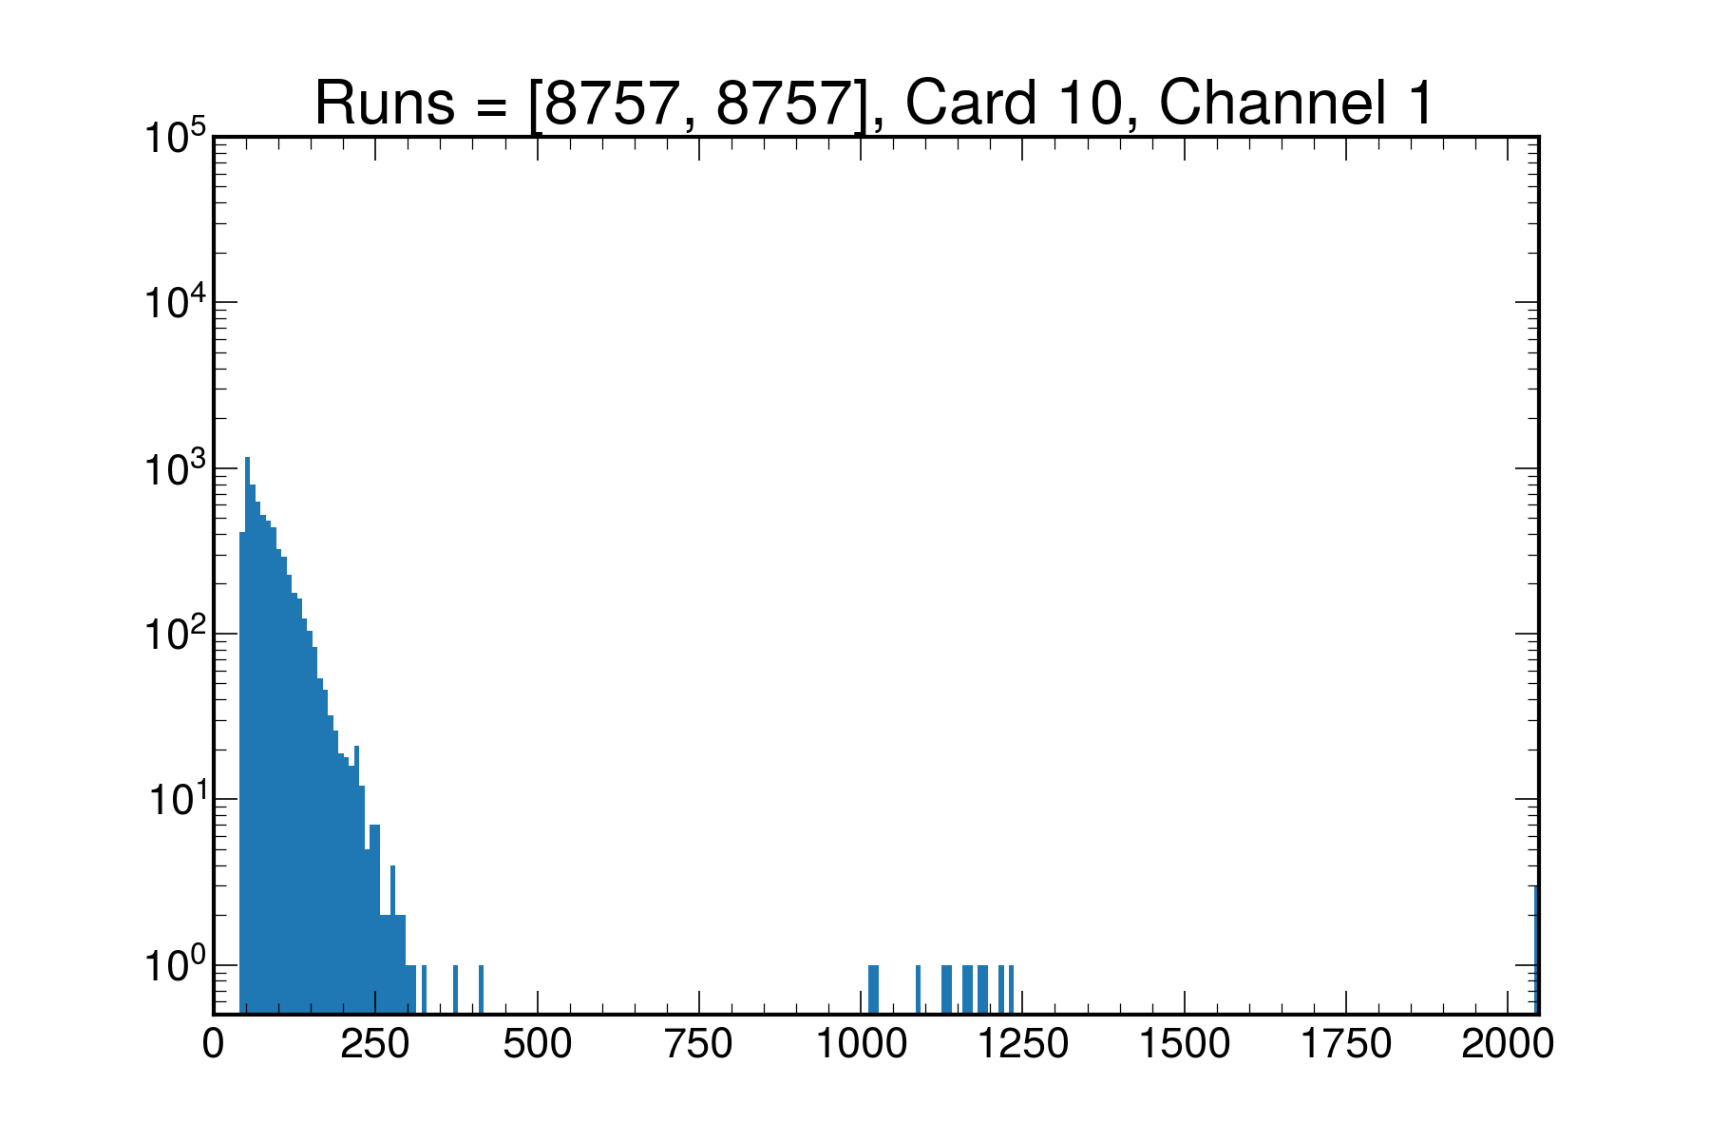
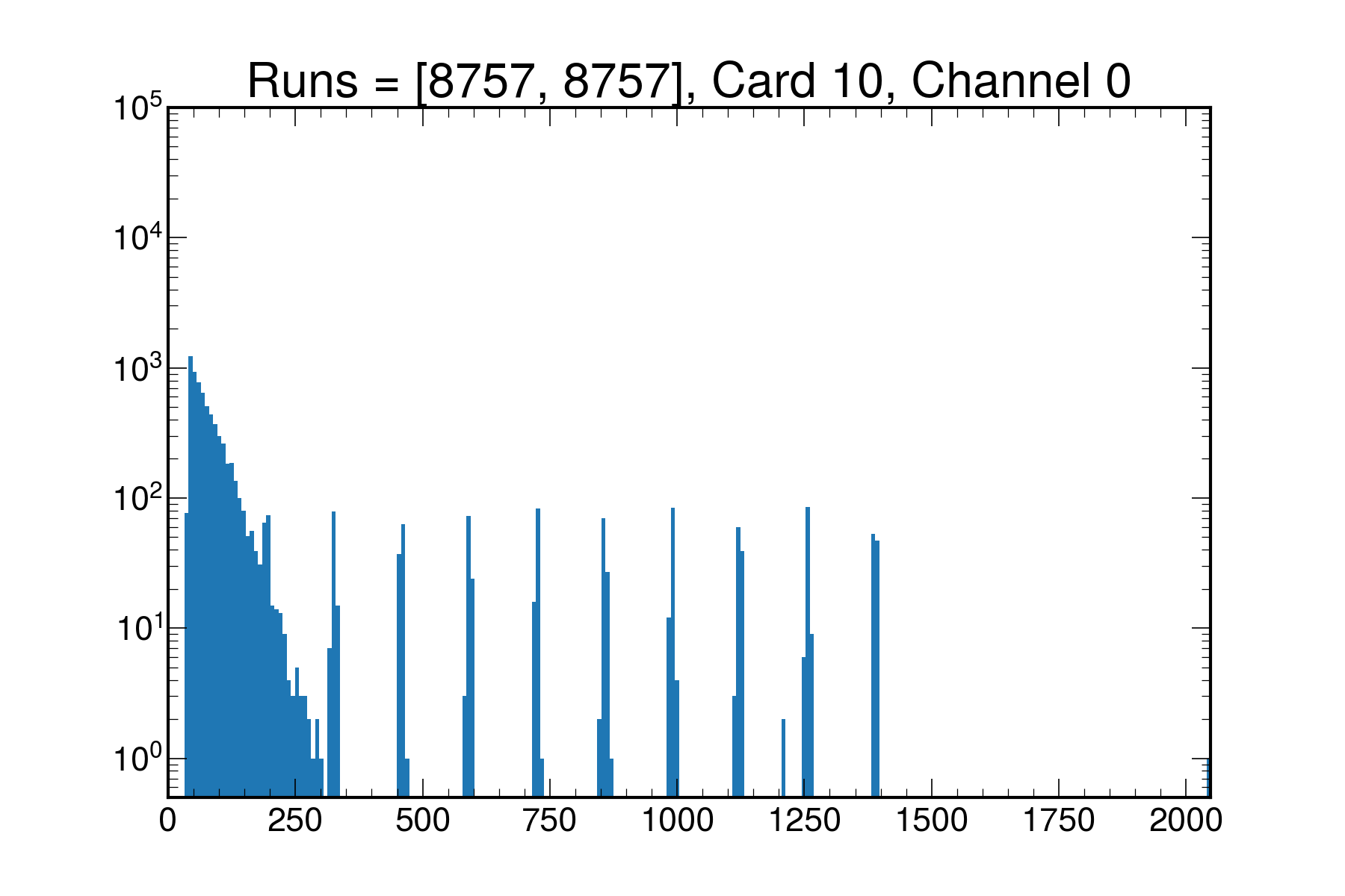
15
Notes:
One of the culprits! The tagging system was failing to filter out the pulses, and thus returning extremely high neutron counts with no bursts being present - while I was excited at the fact these data sets seemingly corresponded, it ultimately led to something different, yet still helpful

Slide 16
What’s Next?
Time dependent searches with narrowed results
How can variables be minimized on the hunt for variable star candidates?
The Chandrasekhar limit and novas
Nova frequency and burst data
16
Notes:
Now that we have the results from burst data narrowed, further time dependant searches can be conducted with stronger validity
Are their common denominators between these variable star systems that cause them to nova? Orbit, mass, etc
Is there a relationship between the chandrasekhar limit, novas, and supernovae
With the frequence of novas each year and burst data, comparing and contrasting is difficult, even considering the novas we haven’t detected, just a tedious process involving looking at a lot of data sets for novae

Slide 17
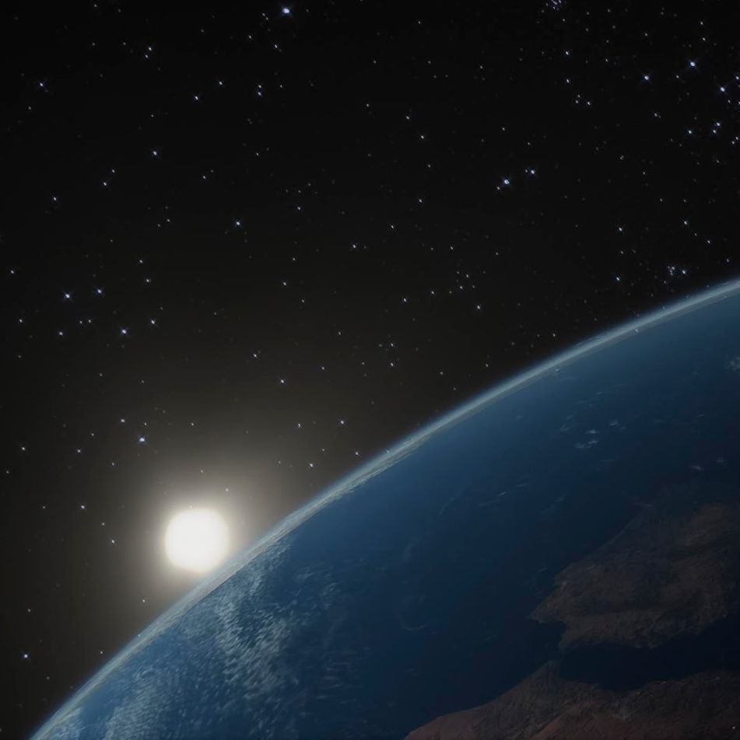
Thanks!
Data from the AAVSO International Database (observer contributions acknowledged)
Images courtesy of NASA, ESA, M. Stute, M. Karovska, D. de Martin, M. Zamani (ESA/Hubble), SNOLAB, and SNEWS (BNL)
Supported by: SNOLAB, HALO, Laurentian University
Special thanks to: Thomas Sonley, Remington Hill, Irina Nitu, McDonald Institute, Dr. Brian Kloppenborg
Utmost thanks to: Dr. Stephen Sekula
Notes:
CREDITS: This presentation template was created by Slidesgo, including icons by Flaticon, and infographics & images by Freepik

