Slide 1
2025 / 08 / 13
The Invisible Infrastructure
Muhammad Bilal Naseem – PMO Student
Supervisor:
Mehwish Obaid

Slide 2
Agenda
Sides of a Research
Information Security Project – P2102
Project Management
  Vendor Management
  Operations Management
  Project Tracking and Lifecycle
Future Steps

Slide 3
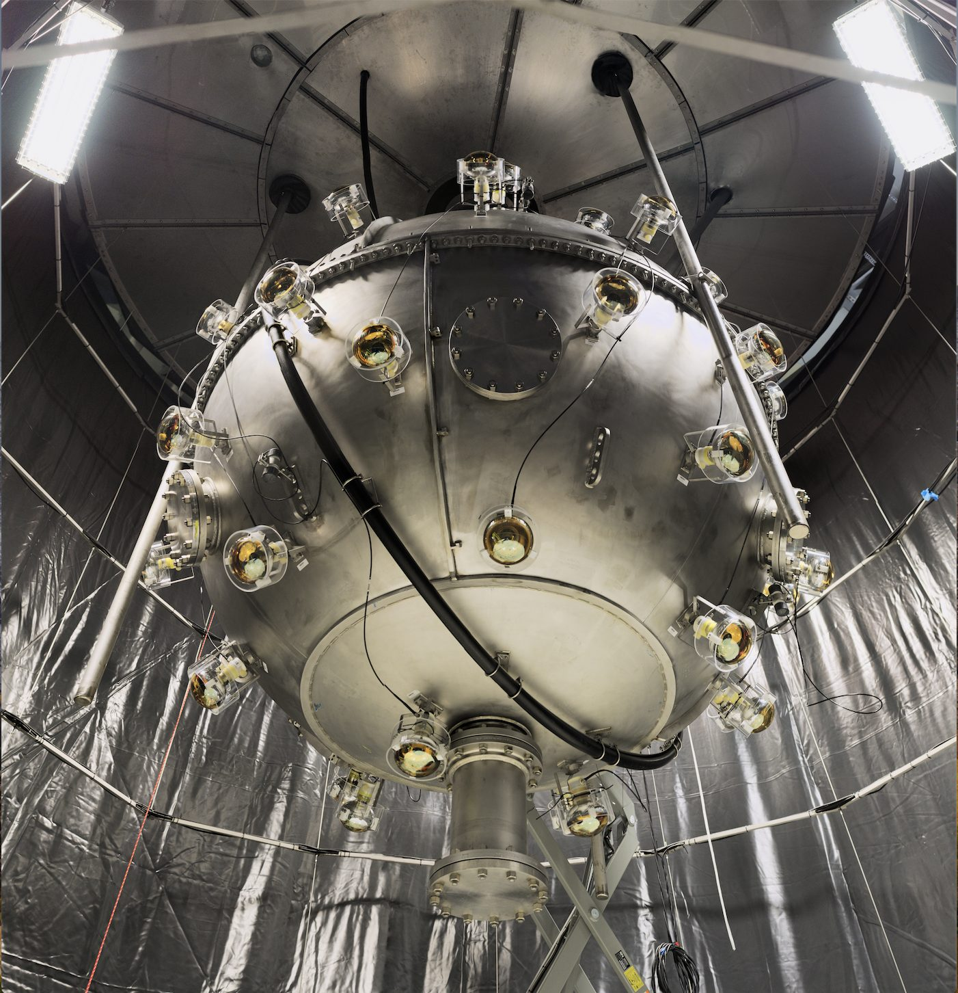

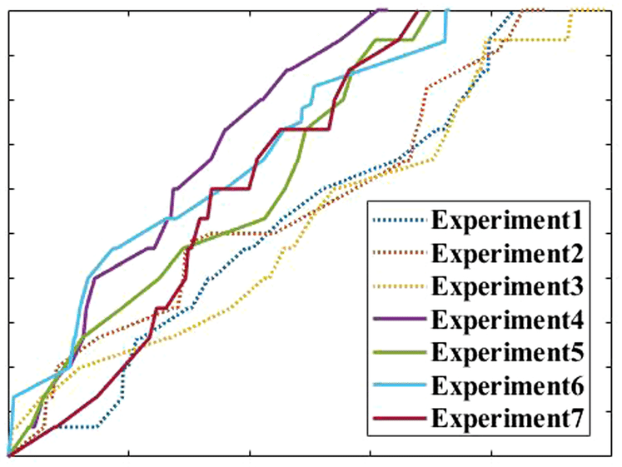
Visible Side of a Research
Observations
The Model
Laboratory

Slide 4

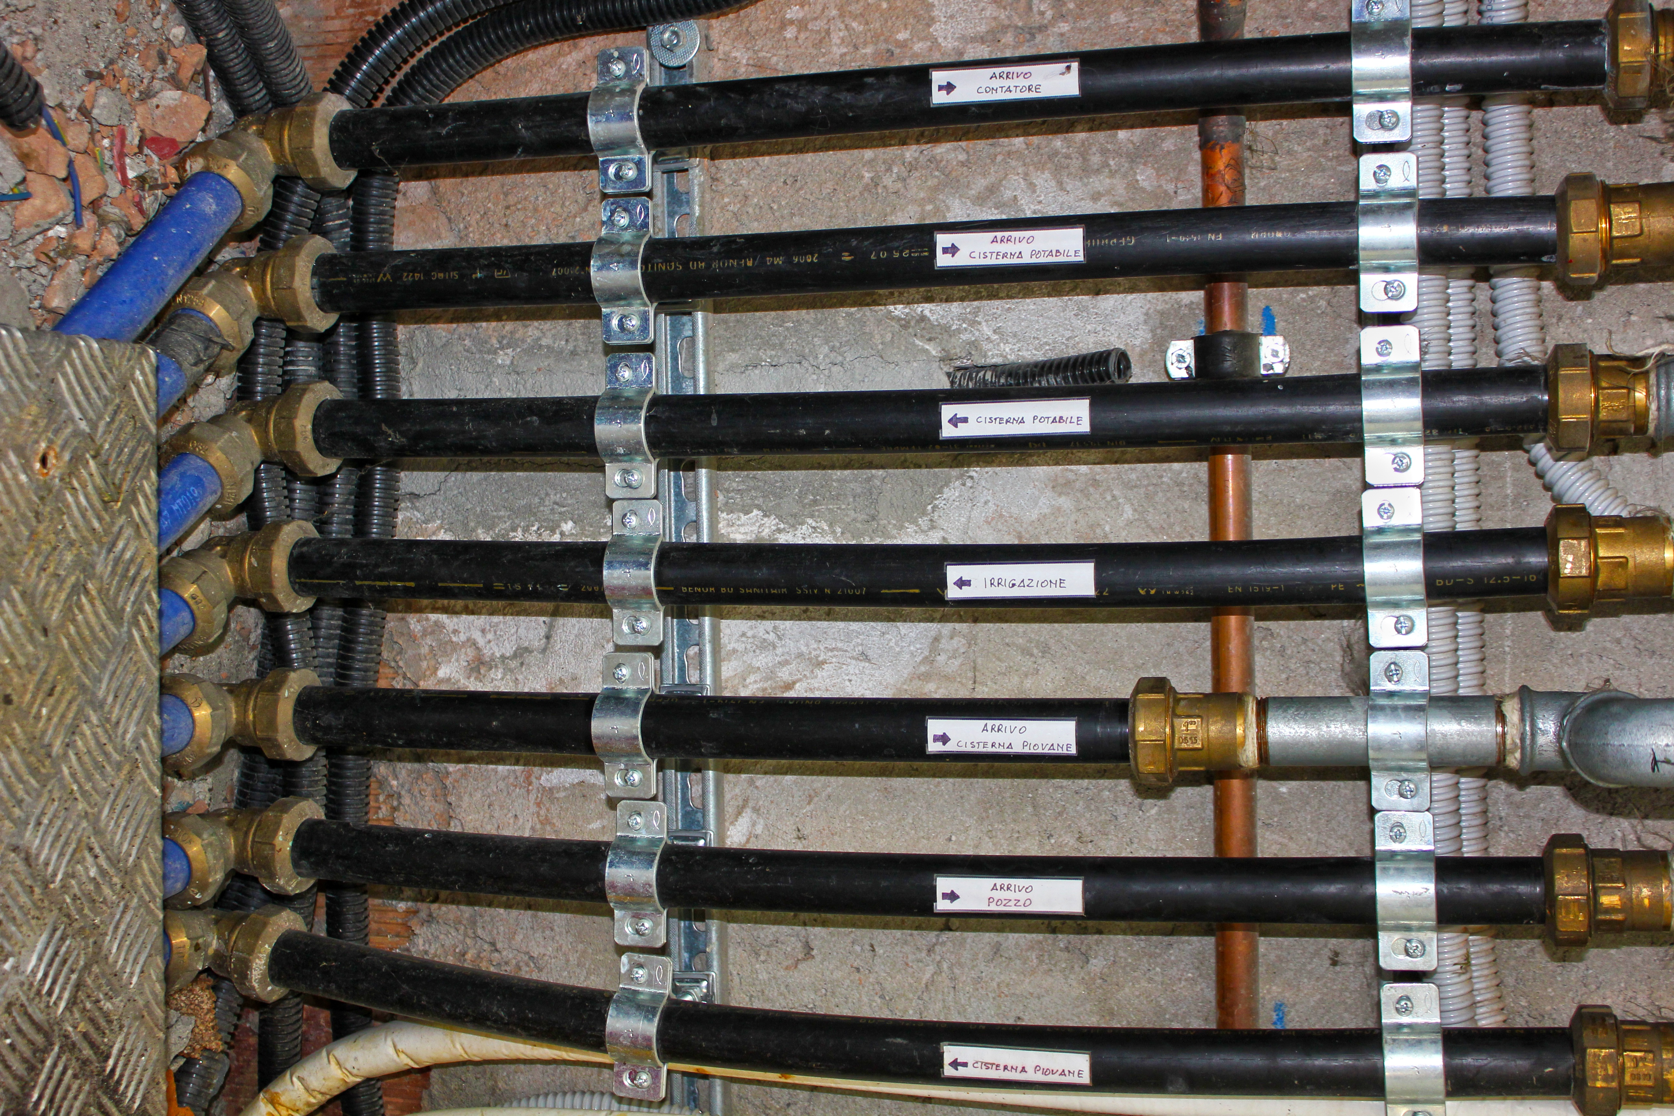
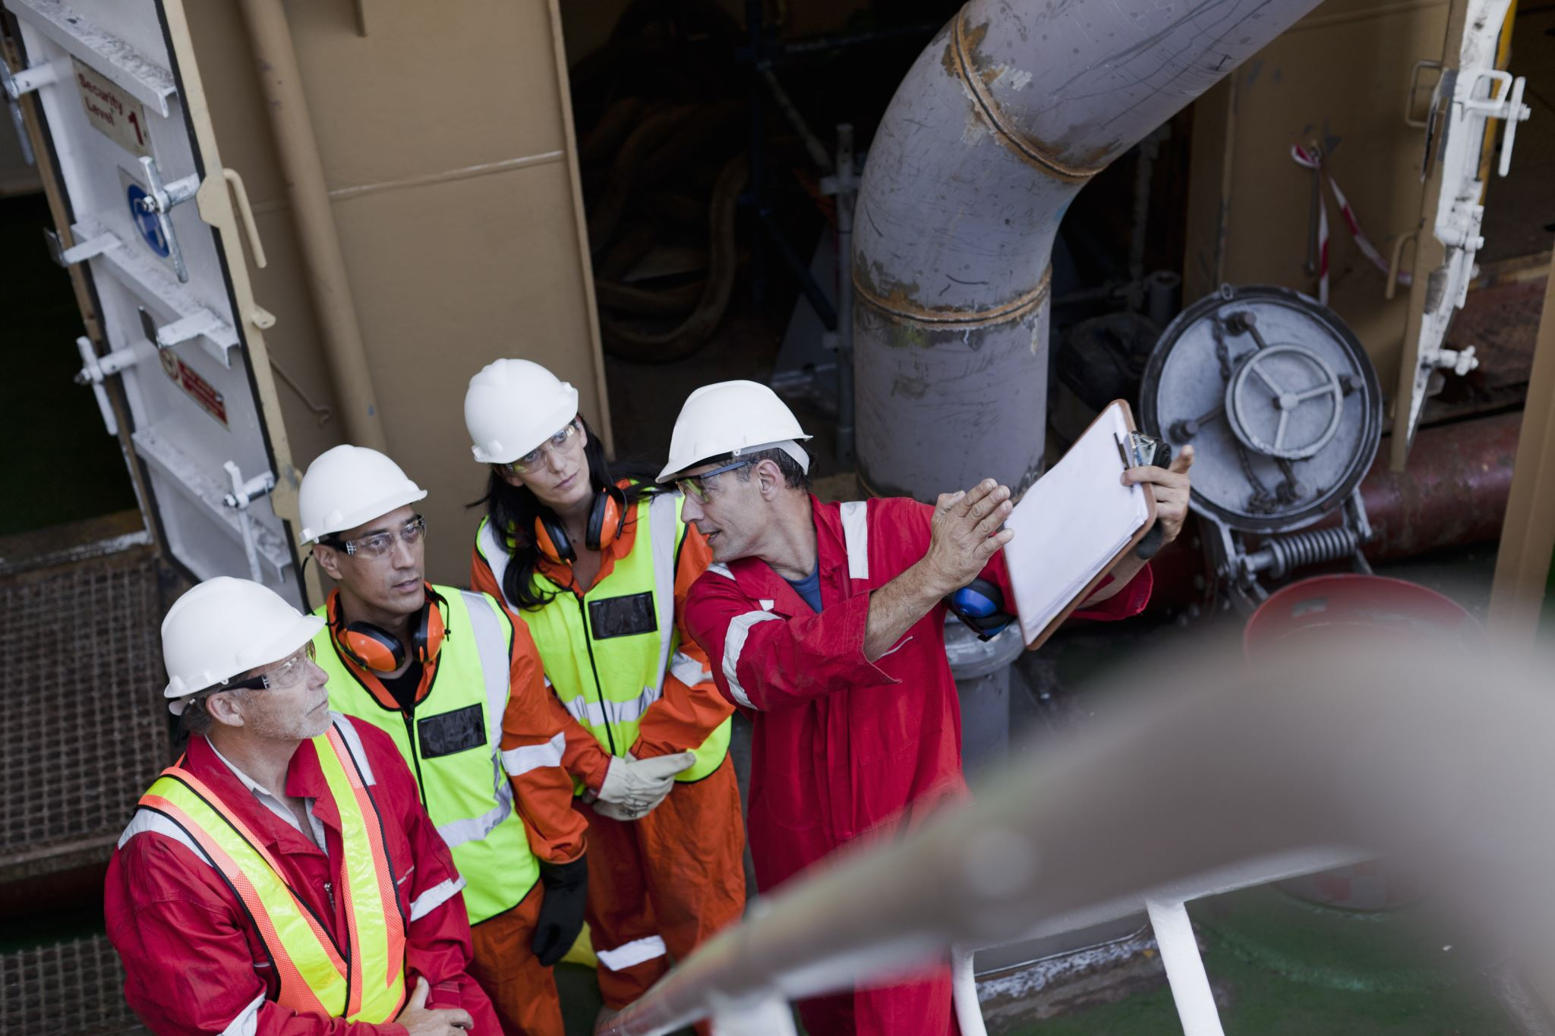
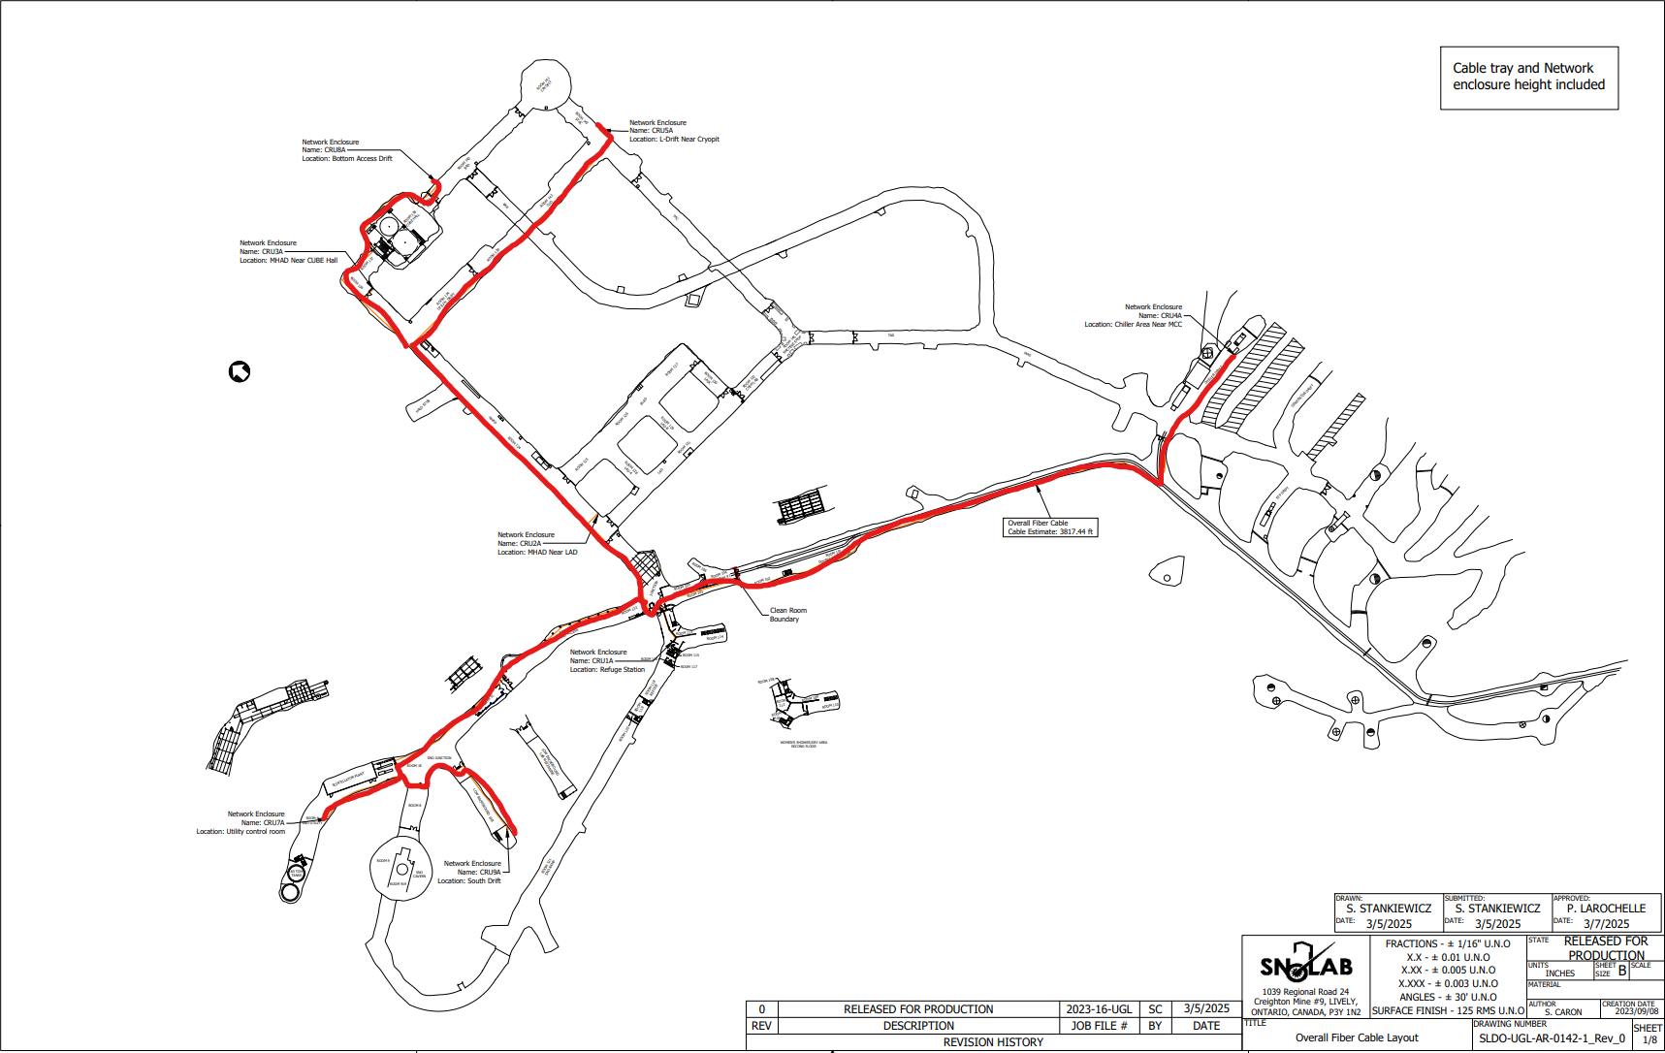
Invisible Side of a Research
Information System
MEP System
Collaborations
Drawings
This Photo by Unknown Author is licensed under CC BY-NC-ND

Slide 5
Information Security Infrastructure
Project – (P2102)
This Photo by Unknown Author is licensed under CC BY-NC-ND

Slide 6





Why?
🔓 Firewall & VPN
🛑 Centralized Monitoring/Logging
🧩 Asset & Vulnerability Management
📄 Incident Response Plan
🔐 MFA
📧 External Email Forwarding
📡 Wireless Security

Slide 7
What?
Project Breakdown
  Surface Wi‐Fi FY25 Complete
  Network Remediation FY25 complete
  Next Generation Firewall - FY25 Ongoing
  Interim Network Hardware Modifications - FY25 Ongoing
  Fiber Optic Cable Upgrades - FY25 Ongoing
  Underground Voice Paging System - New Scope addition to Project 7
  Underground Wi‐Fi – Future (FY27)
  10G Network Hardware Deployment – Future (FY27)

Slide 8
Fiber Optic Cable Upgrades
10000 ft of Fiber Optics
2.5G to 10G Upgrade
2.5 Gbps → 2.5 billion bits/second.
10 Gbps → Moves 4× more data in the same time
Refuge Station

Slide 9
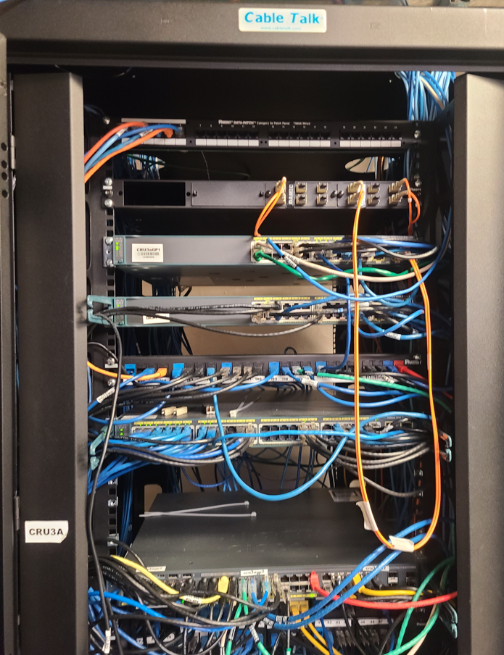

Interim Network Hardware Modifications
  Modification of Network Hardware
  Industry Standard Setting across all panels
  Pre-Work for Fiber Optics Termination
  Labelling of each Unit within Panel

Slide 10
Stakeholders
Internal Stakeholders (SNOLAB)
  PMO
  IT Department
  Health & Safety
  Operations
  External Stakeholders (Contractors)
  NVD - Interim Network Hardware Modifications
  ECM - Fiber Optic Cable Upgrades

Slide 11

  Vendor Management
  Operations Management
    Logistics
    Cleaning
    Safety Protocols
  Project Tracking and Lifecycle

Slide 12
Vendor Management
Fiber Optics Upgrade : ECM Networks (Enabling Communities and Marketplaces)
Network Hardware Upgrade : Northern Voice Data (NVD)
Vendor Selection : UG Walkthrough →Turnkey Bid → Quotation → Scoring Matrix
Vendor Site Access : Site & Equipment Trainings , Access Cards
Vendor Engagement : Collaboration with PMO, IT and Operations Team

Slide 13


Operations Management - Cleaning
SNOLAB Car Wash
Cleaning requires respooling cable from one reel to another for thorough cleaning
Cable Handling Challenges
Minimum Bending Radius > 20 inches
Flange Diameter > ~ 3.5 ft (Difficult to procure)
Solution
Use 2 spare reels to respool cable, then reuse emptied reels.
Additional Support
Cleaning team performs flash cuts to prevent dust inside lab
Saved ECM from extra respooling for cutting
Cut lengths verified by PMO to match re-reeling plan
Outcome
10,000 ft cable is cut and respooled into 12 smaller reels for clean and quicker installation
Cable Length: 10,000 ft divided into 4 reels
Bore Diameter > 20 in

Slide 14
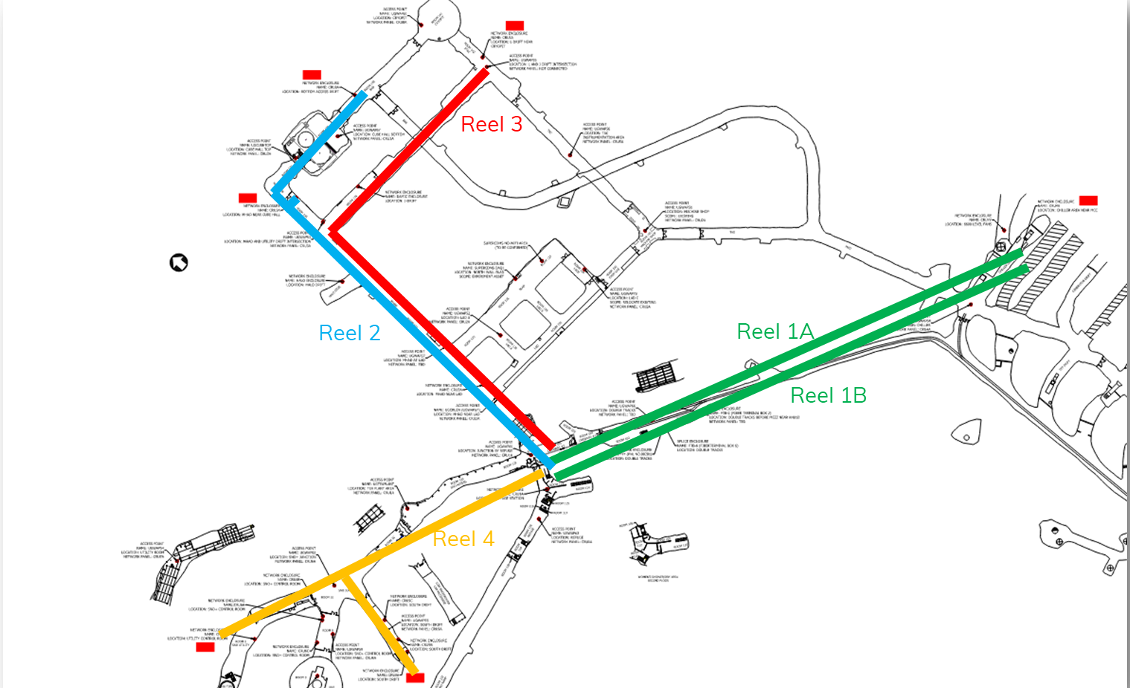
Operations Management - Logistics
Genie GR26J Aerial Lift Storage J-drift
Underground Delivery
  Shipped and made it inside the clean lab
  Fiber Cable – 4 Reels
    ECM Tools – Toolboxes & Cable Stand
    NVD Tools – Toolboxes
Designated Storage space for Sub Projects
SNOLAB Resource Allocation
Scissor Lift Cube Hall
Mine Forklift W/T Personnel Basket Chiller Drift
Genie GR26J Aerial Lift: SNO Junction
UG Forklift With Personnel Basket Double Track
Project Specific Shelf Space

Slide 15
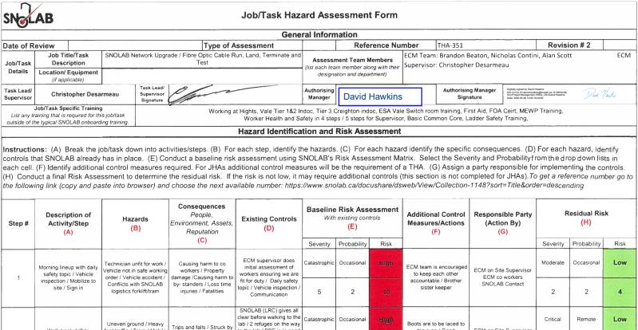
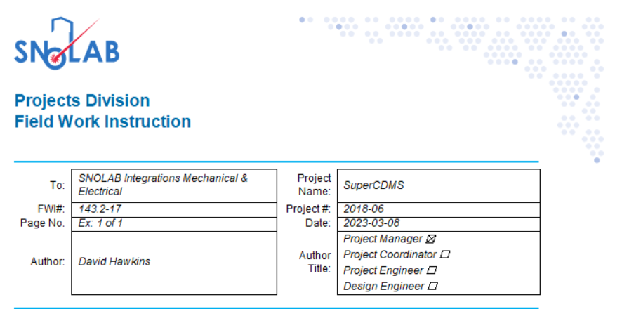
Health & Safety

Slide 16
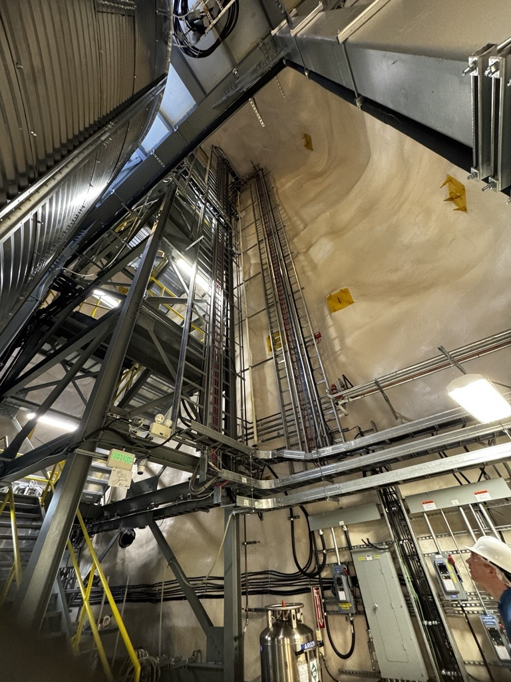
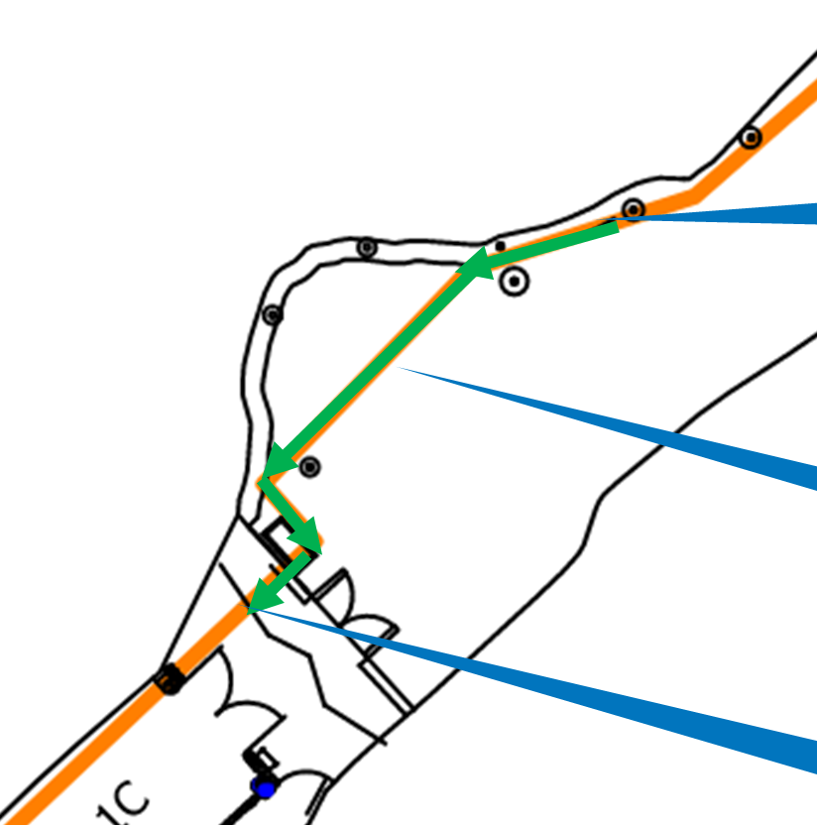
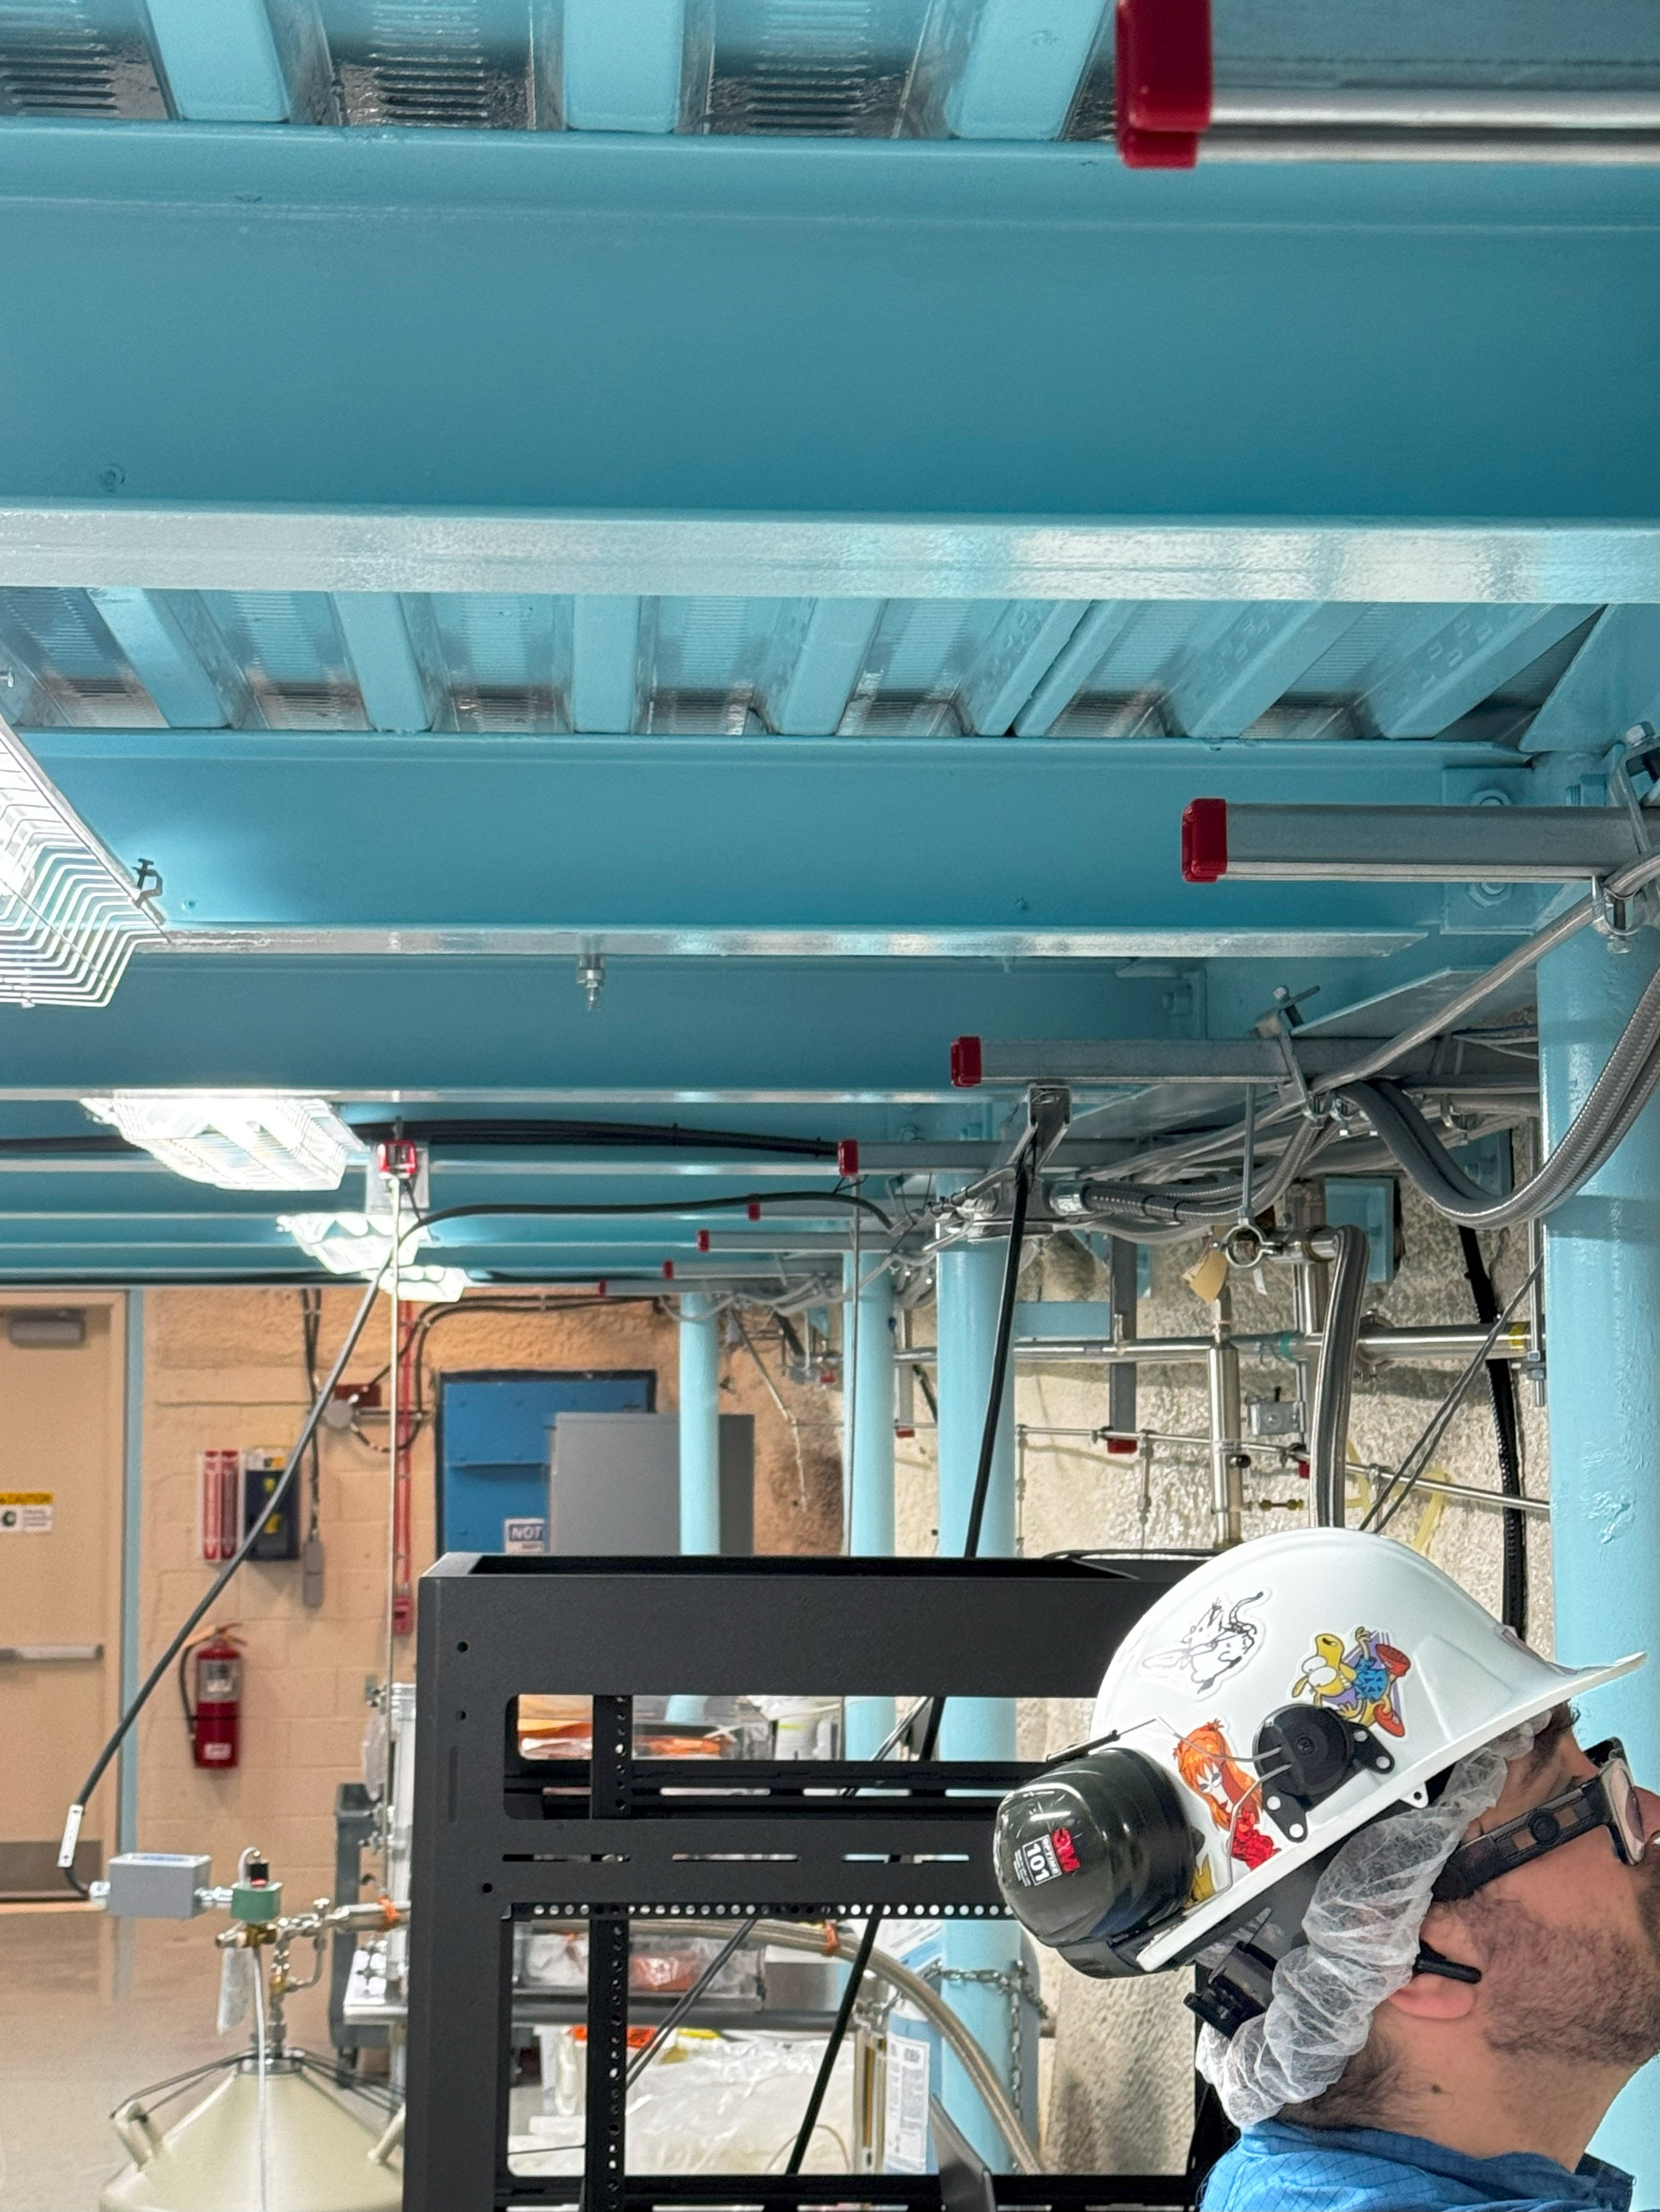

Health & Safety
Cube Hall
SNO+ Te Plant
Low Background Lab:
Existing Unistrut
Long Vertical cable tray
Acid Plant
Cable pull above the LN2 Pipe

Slide 17
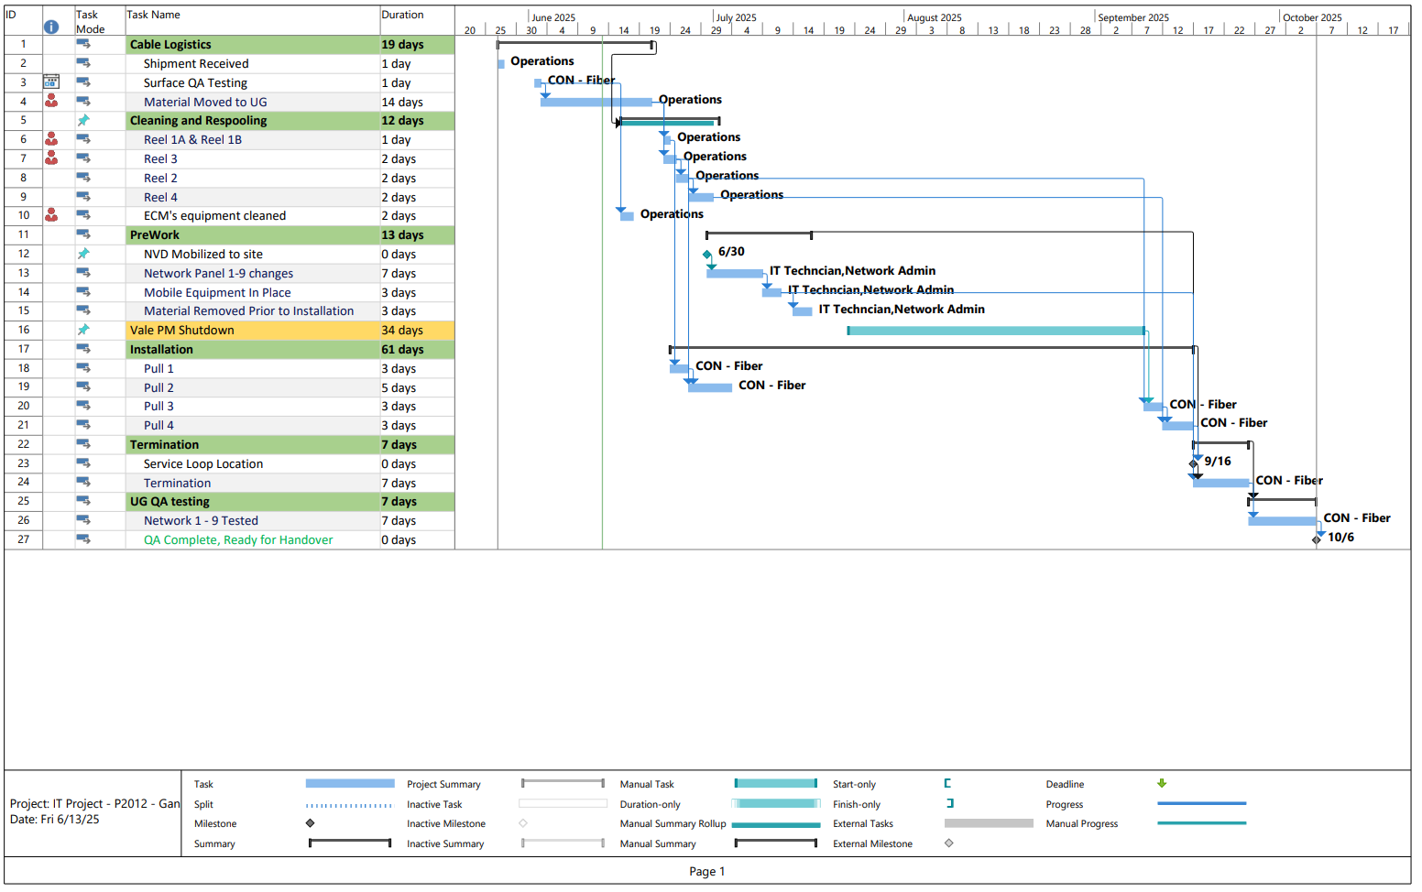
Project Tracking and Lifecycle
Initiation
Planning
Execution
Closure
GW2
–
GW4
GW0
–
–
Project
GW1
–
Space
GW1a
–
Proposal
GW3
Deployment
–
Operations
Decommissioning
Initiation
Allocation
Approval
Approval
Approval
Approval
Phase 0
–
Project
Phase 1
–
Project
Phase 1a
–
Project
Phase 2
–
Phase 3
-
Phase
4
-
Initiation
Definition
Proposal
Development
Implementation
Operations
PMP Shutdown
13th August
Current Status: ECM mobilize after PMP Sep 8th

Slide 18
Future Steps
Sep 2nd Kick Off Meeting
Sep 8th Contractor Mobilize
Anticipated QA complete: Oct. 6th
Moving on to PA System Upgrade

Slide 19
You Can’t See It, But You Can Feel It
Infrastructure upgrades silently
IT supports almost every experiment at SNOLAB
PMO’s impact happens behind the scenes

Slide 20
Thankyou

