Slide 1

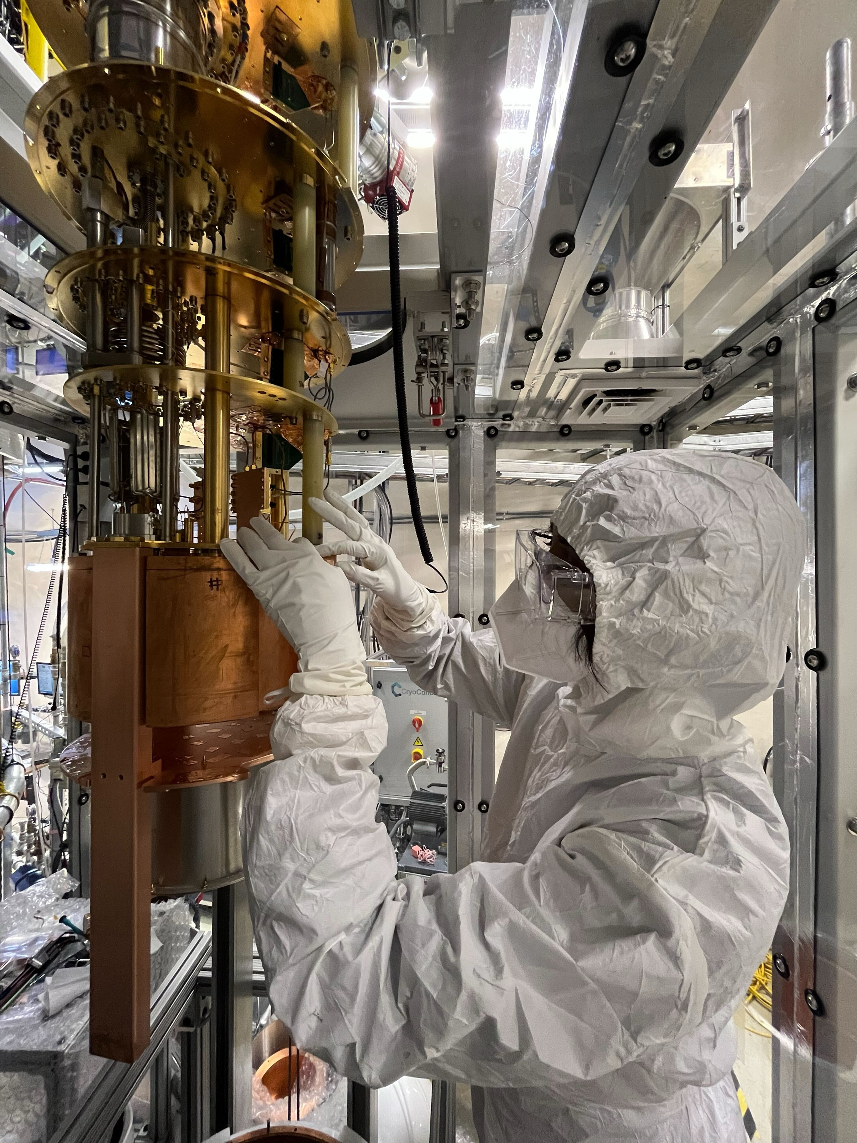

The CUTE Way to Detect Neutrons
Brianna Liz
Supervisor: Prof. Matthew Stukel
Notes:
If you’ve ever tried to hear a whisper in a noisy room, you know how hard it is to pick out something rare and faint from all the background chaos. At SNOLAB, we’re trying to hear some of the faintest ‘whispers’ in the universe but the ‘noise’ comes from particles like neutrons. So we go somewhere super quiet… two kilometers underground… and then bring out some very clever tools to find them

Slide 2


CUTE
What is it?

Slide 3
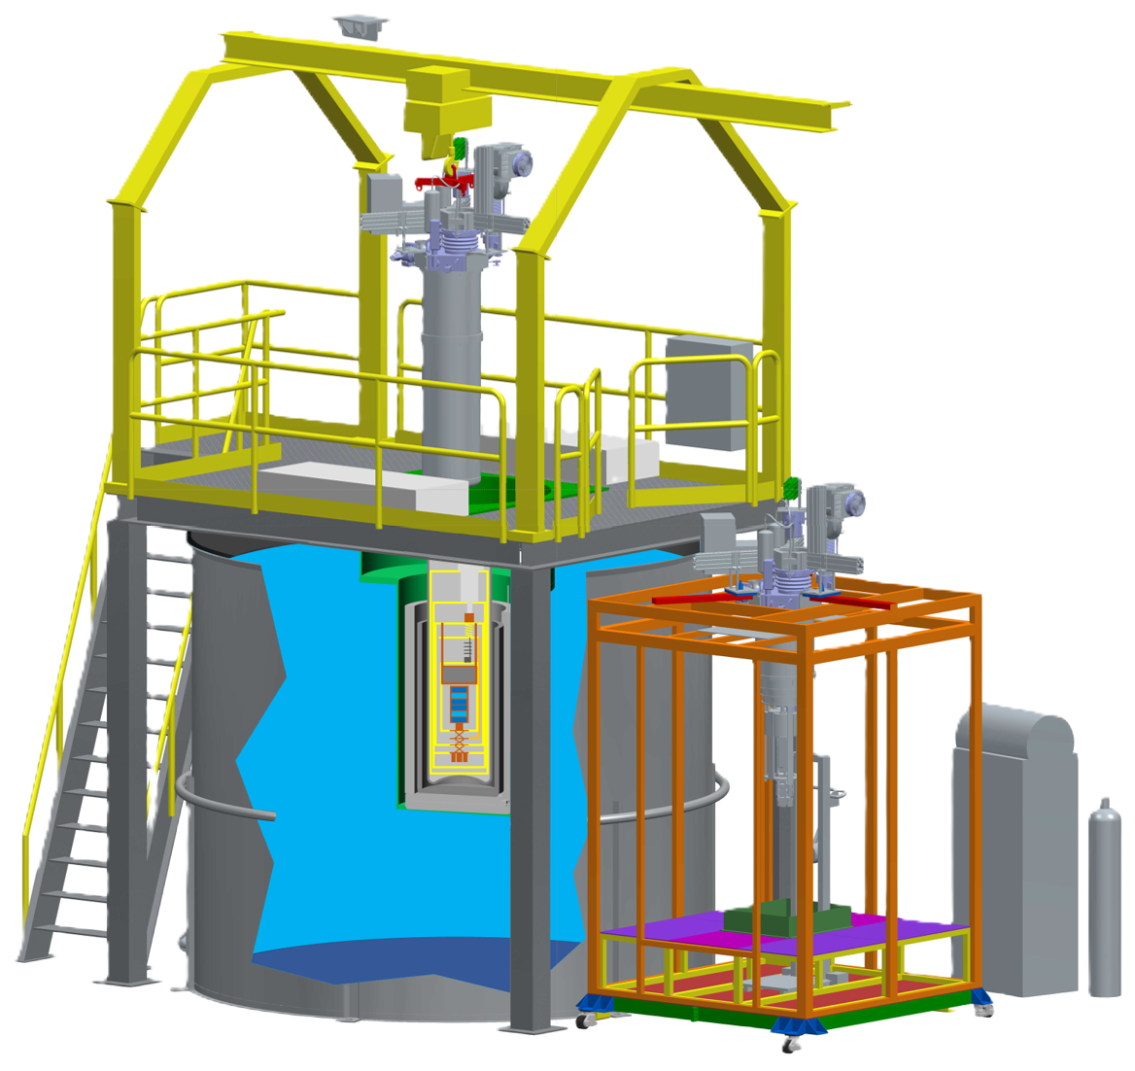
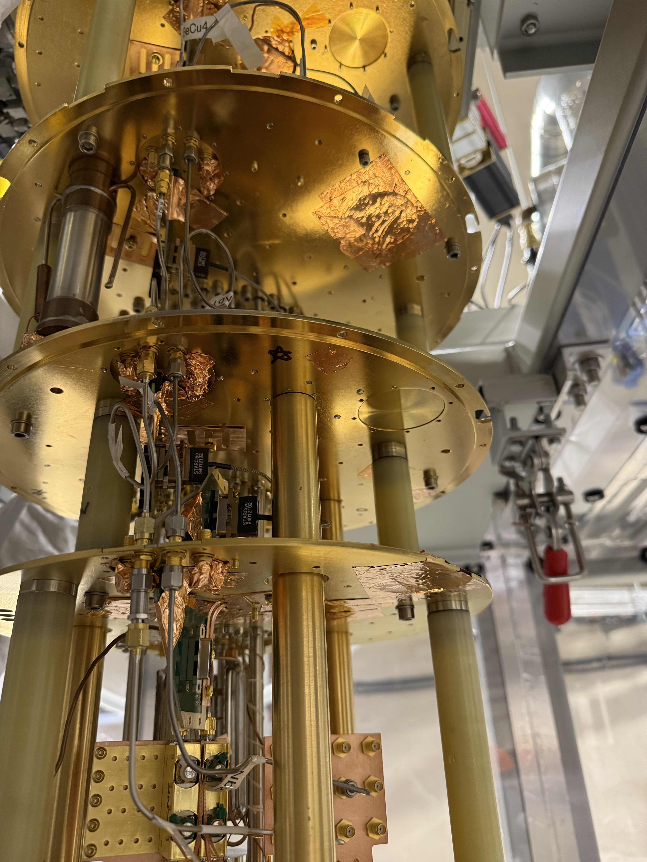
Cryogenic Underground TEsting facility
Dry dilution fridge
Ultra pure water
Cleanroom
Dry dilution fridge
Notes:
The full form of CUTE is Cryogenic undergroudn testing facitily and it is located 2 kilometers underground at SNOLAB. But CUTE isn’t a detector itself. Instead, it’s a testing ground for experiments like dark matter and qubits.
CUTE consists of a clean room, a dilution fridge, a big tank of ultra pure water.
Because it’s so far underground, CUTE is shielded from cosmic radiation. And to test detectors that are supposed to catch very rare signals, we need to make sure the environment is as “quiet” as possible—no noise, no heat, and no shaking. That’s why CUTE is designed to be very still and very cold. CUTE uses a dilution refrigerator, clever trick with helium-3 and helium-4 gases to reach mind-blowing temperatures—down to 12 millikelvin, or about -273°C.
Here’s a fun way to imagine that: if absolute zero is the coldest anything can possibly be, CUTE is just a hair’s width above that!
Formerly used for testing SuperCDMS dark matter detectors, CUTE now examines quantum chip performance in the absence of cosmic radiation.

Slide 4
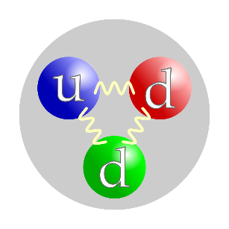
Neutron background at SNOLAB
Being underground doesn’t mean that we’re free of all radiation

Slide 5
Cf-252
1. Calibration Sources
Neutron Sources At SNOLAB
2. Surrounding Rock/Shotcrete
(Alpha, n) reactions
Fission reactions

Slide 6
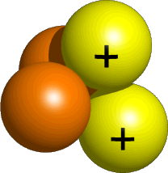
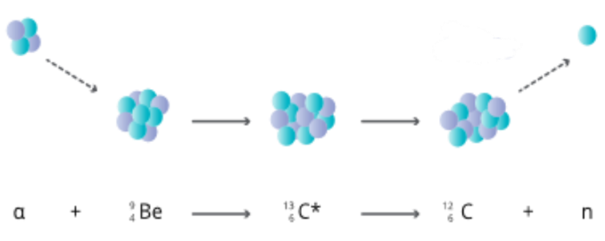
(Alpha, n) reactions
Reacts with elements like Carbon, oxygen and beryllium
¹₀ n
⁴₂ He
End product: fast neutron

Slide 7
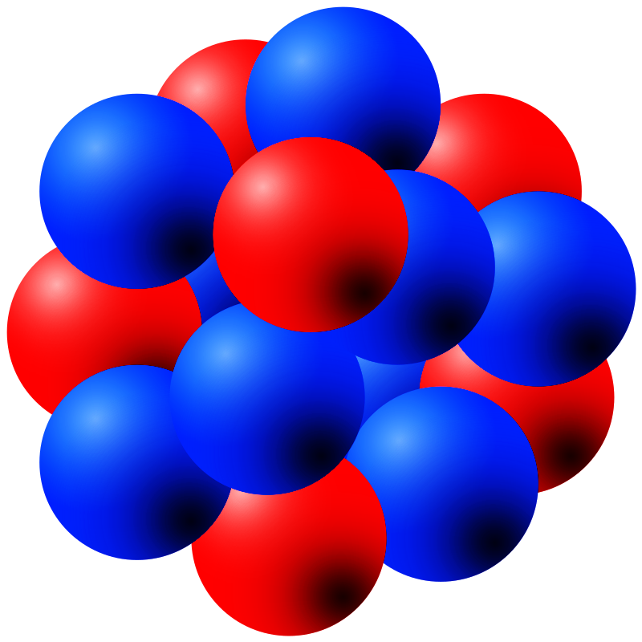
(Alpha, n) reactions
Reacts with elements like Carbon, oxygen and beryllium
¹₀ n
⁴₂ He
End product: fast neutron
²³⁵₉₂ U
Uranium in the rocks
²³¹₉₀ Th

Slide 8
Fission reactions
¹₀ n
^{Lighter element}
¹₀ n
¹₀ n
Neutron from other
reactions
²³⁵₉₂ U
¹₀ n
Uranium in the rocks
^{Lighter element}

Slide 9
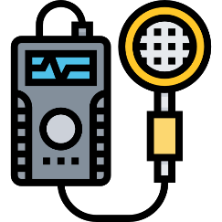
NEUTRON DETECTION
IT IS IMPORTANT WE DETECT THEM

Slide 10
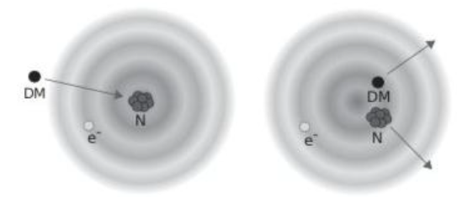
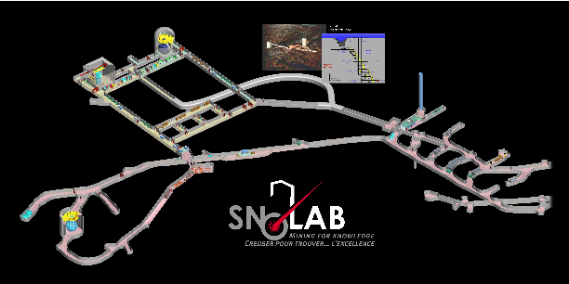
1. Neutron signals similar to dark matter signals
Importance of Neutron Detection At SNOLAB
2. Is the neutron background homogenous across the lab?
Estimated flux :
4000 n/m2/day
Different locations at
CUTE

Slide 11
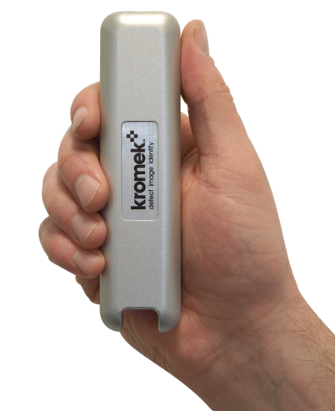
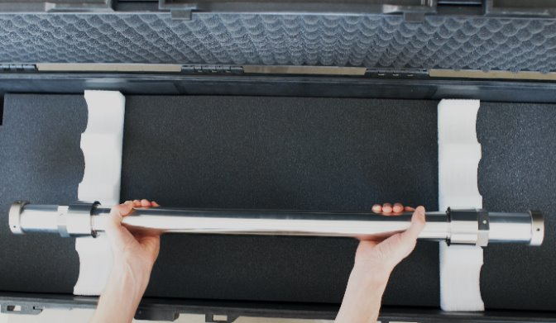
Neutron Detector
Current neutron detector
Upcoming neutron detector
Kromek TN detector
Thermal
Li-6
SiPM
S670e detector from Arktis
Fast and thermal
24 SiPMs
Li-6
180 bar He-4

Slide 12

How Arktis detects FAST neutrons
Electronic board
The S-670e produces TTL pulses of different widths
He-4 nucleus in detector
SiPM
Fast neutron
Detector wall

Slide 13

How Arktis Detects FAST Neutrons
Fast neutron
He-4 nucleus in detector
Detector wall

Slide 14
How Arktis Detects FAST Neutrons
Fast neutron
He-4 nucleus in detector
Detector wall

Slide 15
How Arktis Detects FAST Neutrons
Fast neutron
--------------------------->
---------->
He-4 nucleus in detector
Detector wall

Slide 16
How Arktis Detects FAST Neutrons
Electronic board
The S-670e produces pulses of different widths
SiPM
Scintillating light

Slide 17
How Arktis Detects THERMAL Neutrons
Thermal neutron
Li-6 nucleus in detector
Detector wall

Slide 18
How Arktis Detects THERMAL Neutrons
Thermal neutron
Li-6 nucleus in detector
Detector wall

Slide 19
How Arktis Detects THERMAL Neutrons
---------->
Triton nucleus
--------------------------->
High-energy alpha particle
Detector wall

Slide 20
How Arktis Detects THERMAL Neutrons
Electronic board
The S-670e produces pulses of different widths
SiPM
Scintillating light
High-energy alpha particle

Slide 21
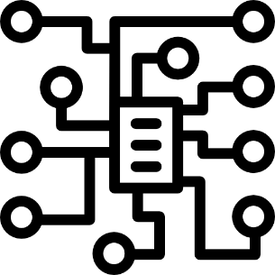
How Do SIPMs & Electronics Know It’s a Neutron?

Slide 22
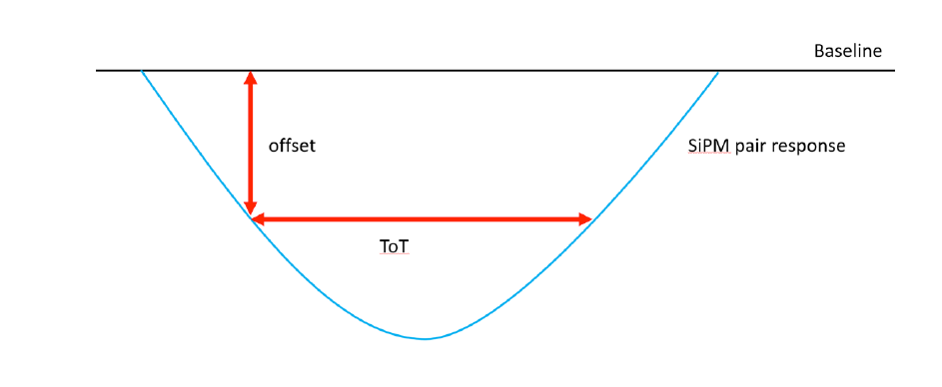
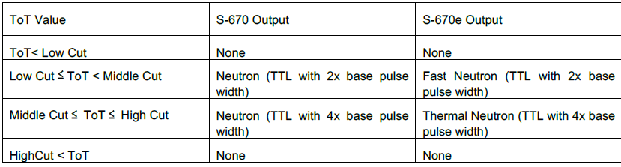

Time over Threshold Parameter
The Time over Threshold (ToT) parameter
Measures how long the signal amplitude stays above a certain offset (the “threshold”)
If the signal amplitude is tall and wide—possibly by a neutron
If it’s small and quick—possibly just noise or a gamma ray
Cuts can be set to determine the characteristic of the neutrons

Slide 23
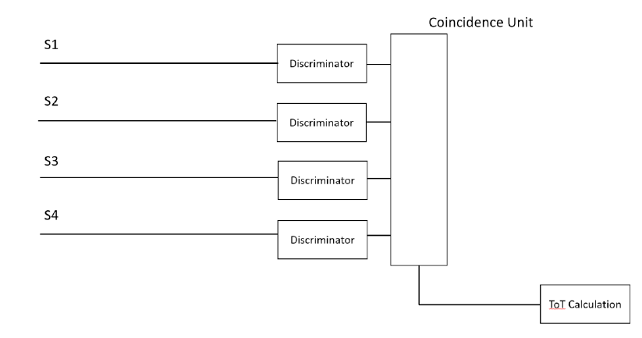
How the detector knows it’s a neutron
Signal capture
Threshold check
Coincidence requirement
Decision
Each SiPM pair sends its signal to a discriminator
If signal > offset threshold → line is set to HIGH in Coincidence Unit
If 2 lines are high within 30 ns, ToT counter starts
If ToT > cut → likely a neutron → pulse produced
If ToT =< cut → not a neutron → no signal sent

Slide 24
Simulation of neutron detection
DISCRIMINATORS
COINCIDENCE UNIT
HIGH
HIGH
ToT CALCULATION COUNTER
Pulse produced based on ToT value
24

Slide 25
Simulation of Neutron Detection
DISCRIMINATORS
COINCIDENCE UNIT
HIGH
HIGH
ToT CALCULATION COUNTER
Pulse produced based on ToT value

Slide 26
Arktis S670e Project Timeline
July 2025
Complete project review and approval
Initiate detector procurement
September 2025
Receive detector and conduct initial surface tests
Secure all required certifications
October 2025 – March 2026
Perform underground testing: begin in the low-background laboratory, followed by multiple locations within the CUTE facility

Slide 27
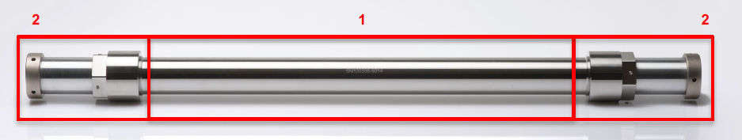
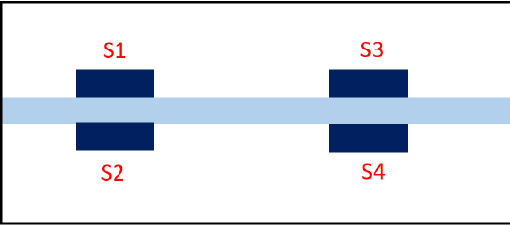
How the neutron signal is read

Slide 28


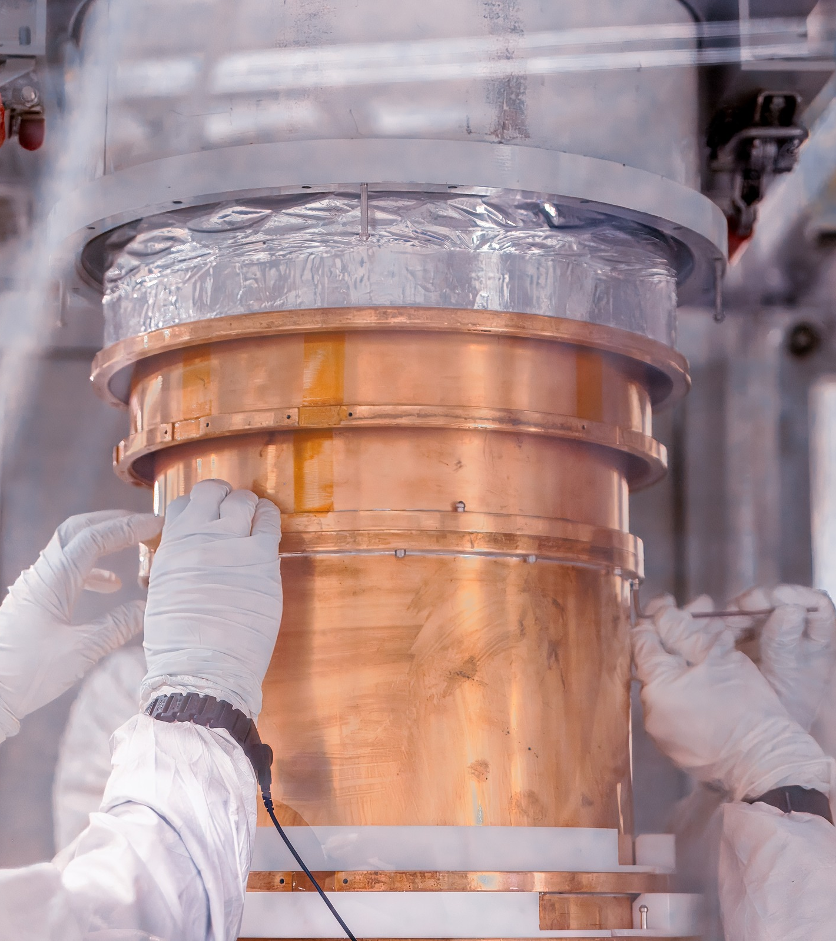
THANK YOu

Slide 29
REFERENCES
Camus, P., Corbett, J., Crawford, S., Dering, K., Fascione, E., Gerbier, G., Germond, R., Ghaith, M., Hall, J., Hong, Z., Kubik, A., Mayer, A., Nagorny, S., Pakarha, P., Rau, W., Scorza, S., & Underwood, R. (2024). CUTE: A Cryogenic Underground TEst facility at SNOLAB. Frontiers in Physics, 11, 1319879. https://doi.org/10.3389/fphy.2023.1319879
Arktis Radiation Detectors Ltd. (2018). Arktis S-670(e) detector series: Operating manual (Version 7, ID-No. AM0022). Zurich, Switzerland: Arktis Radiation Detectors Ltd.
Kelley, R. P., Murer, D., Ray, H., & Jordan, K. A. (2015). Analysis of the scintillation mechanism in a pressurized 4He fast neutron detector using pulse shape fitting. AIP Advances, 5(3), 037144. https://doi.org/10.1063/1.4916904

