Slide 1
Reducing Backgrounds Using Gamma-Gamma Coincidences
CASST 2025
Abhipsha Sahu
Supervised by: Chris Jillings & Steffon Luoma

Slide 2
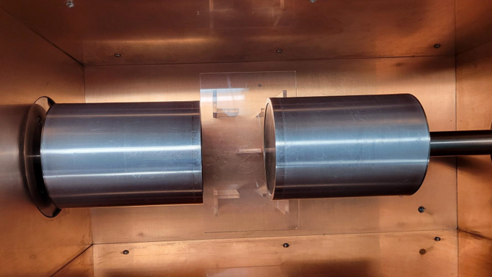
The CTBT Detectors Use Coincidences to Minimize Backgrounds
Dual High-Purity Germanium (HPGe) Detectors
1
2
CTBT Detectors in SNOLAB's Low Background Laboratory
Notes:
Intro -> HPGe -> high resolution for Gamma Rays

Slide 3
The CTBT Detectors Use Coincidences to Minimize Backgrounds
Backgrounds are not correlated with an isotope's energies
1
2
Sample
Coincidence events are seen in isotopes with multiple peaks
Notes:
Coincidence: events from one isotope are more likely to occur together than events from an isotope and background

Slide 4
Everything In and Around a Detector Contributes to its Background
Shielding
Detector
Components
The Sample
Notes:
Shielding (lead – xrays), detector materials – impurities (minute), and sample – continuum – focus

Slide 5
Other Isotopes in a Sample Can Hide Low-Activity Signals
Consider: a biological sample with some Cs134 contamination
Cs134:
Photopeaks at
604 keV
796 keV
802 keV
others
K40: 0.1% of all Potassium
Photopeak at
1.4 MeV
All organisms contain lots of Potassium
This sample was then modeled with a Geant4 Monte Carlo simulation
Notes:
Example sample – biological specimens – k40 is in everything

Slide 6
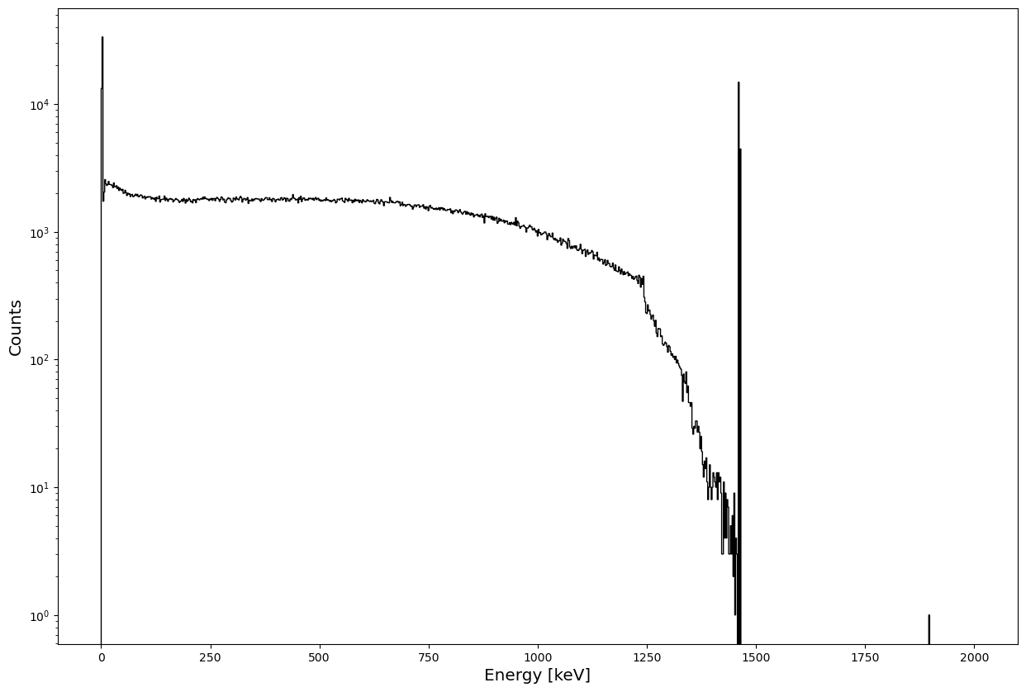
Other Isotopes in a Sample Can Hide Low-Activity Signals
????? Where's the Cs134
K40 1.4MeV Peak
Backscatter Continuum
Simulated Gamma Spectrum – Biological Sample with Cs134 Contamination
Notes:
Backscatter hides a lot of the peaks

Slide 7
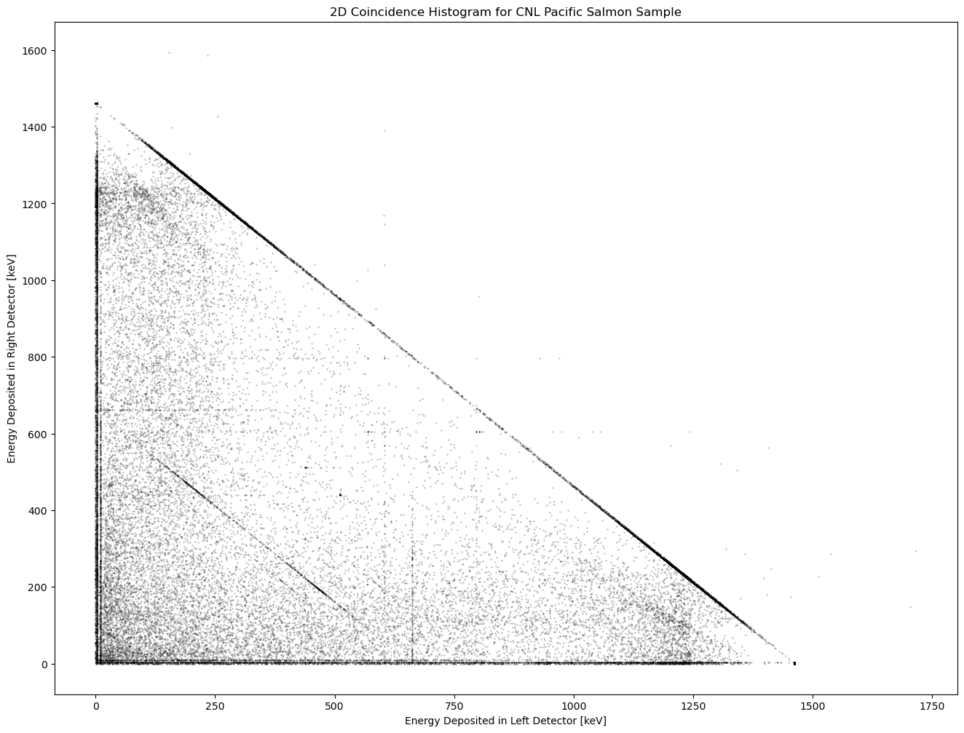
Coincidence Events are Plotted to Identify Key Coincidences
Diagonal lines represent scattered electrons
Backscatter from K40
604keV-796keV Coincidence from Cs134
Individual points represent a coincidence event
Cs134 Lines
Vertical and Horizontal Lines represent emission lines
2D Coincidence Plot – Geant4 Simulation with 10⁸ K40 decays and 10⁵ Cs134 Decays
Notes:
Faint coincidence points, identifying points of interest

Slide 8
Sensitivity is Characterized by the Minimum Detectable Activity
Eg.: Simulation run with 10⁵ Cs134 decays and 10⁸ K40 decays
Given:
LD = 2.71 (for 95% confidence), branching ratio b = 0.9762
Assuming a counting time t of 14 days, for a sample with mass m = 30g:
For a single detector, the calculation looks at one emission line: 604keV (97.62% of all Cs134 decays)
Number of events at 604keV = 12695
Efficiency 𝜀 = 0.013%
MDA = LD/(𝜀 b t m) = 607 mBq/kg
Notes:
Example

Slide 9
Sensitivity is Characterized by the Minimum Detectable Activity
Eg.: Simulation run with 10⁵ Cs134 decays and 10⁸ K40 decays
Singles MDA = 607 mBq/kg
Given:
LD = 2.71 (for 95% confidence), branching ratio b₁ = 0.9762, b₂ = 0.8546
Assuming a counting time t of 14 days, for a sample with mass m = 30g:
For a coincidence detector, the calculation looks at the coincidence pair : 604keV (97.62% of all Cs134 decays) with 796keV (85.46% of all Cs134 decays)
Number of 604keV-796keV coincidences = 8
Efficiency 𝜀 = 0.0001%
MDA = LD/(𝜀 b₁ b₂ t m) = 88000 mBq/kg
For the CTBT detectors, coincidence analysis is significantly worse

Slide 10
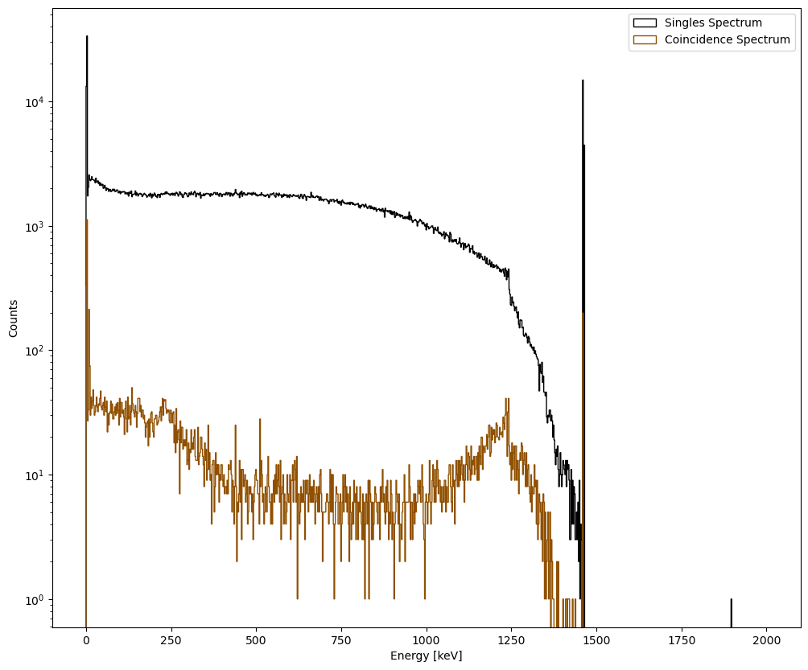
Continuum Background Reduces With Coincidence Analysis
No Cs134 line :(
Sensitivity to Cs134 is Still Low – High Activity of K40 is a problem
Cs134 Line still unclear
Simulated Gamma Spectrum – Comparison of Coincidence and Singles Spectra

Slide 11
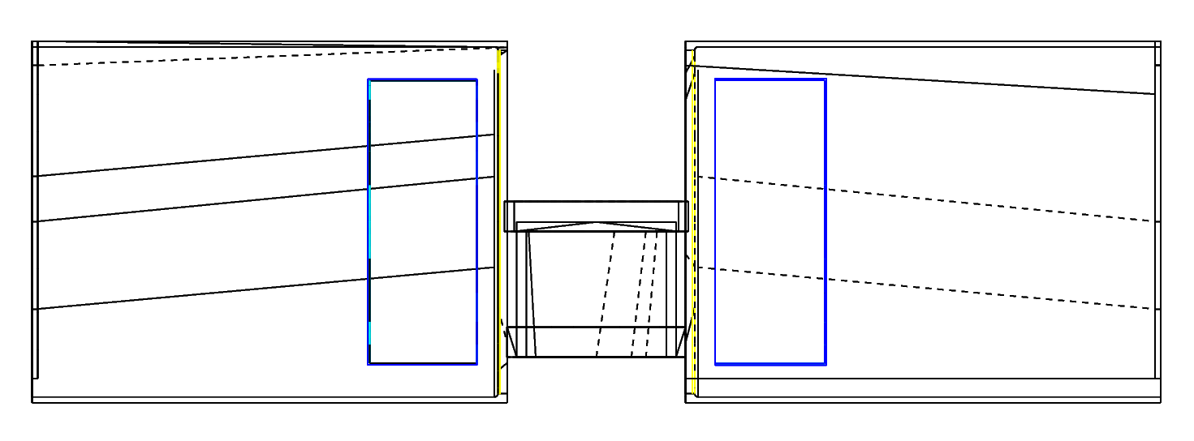
Increasing the Size of Germanium Crystals Improves Sensitivity
~80 mm
~30 mm
Simulated CTBT Detector Geometry – Current Dimensions

Slide 12
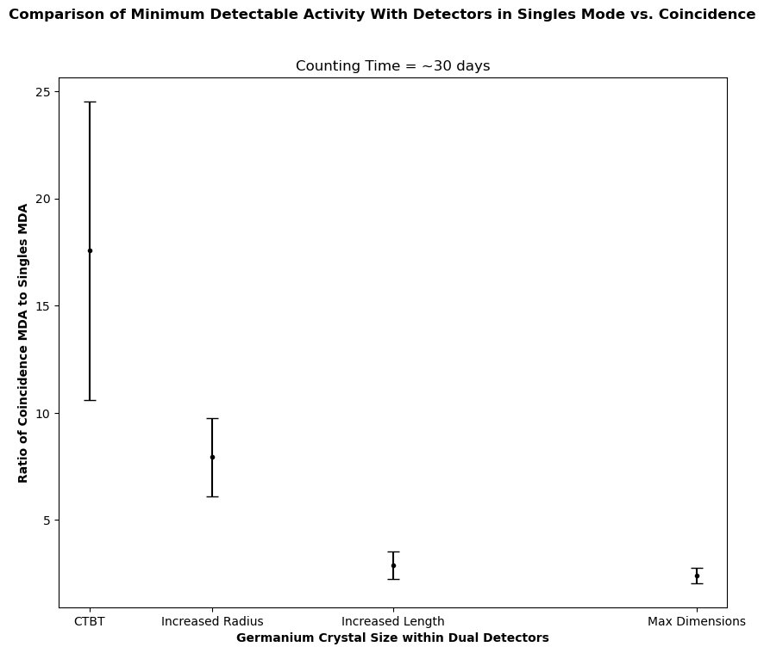
Increasing the Size of Germanium Crystals Improves Sensitivity
Simulation Suggests Current Geometry Makes Coincidences Less Useful
A ratio of <1 indicates that coincidence method improves sensitivity
Future work: optimize setup and quantify improvement
Variation in Detector Sensitivity with Ge Crystal Size

Slide 13
Thank you for listening!
A special thanks to – My supervisors, Chris & Steffon, Ian Lawson, and Arina Tseragotin

Slide 14
Questions?

