Slide 1
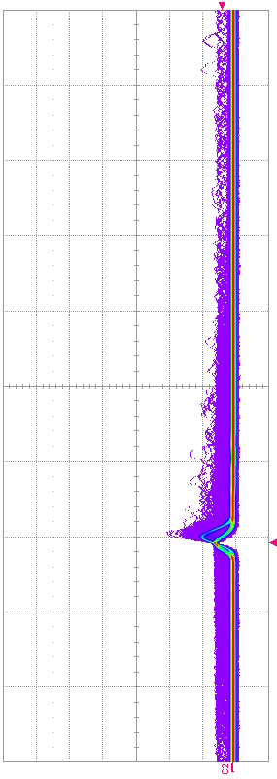

Building the RAMP towards locating the Electron Capture of Lutetium 176
CASST 2025
August 12-13, 2025
Arina Tseragotin – Co-op Summer Term
Supervisor: Dr. Matthew Stukel

Slide 2
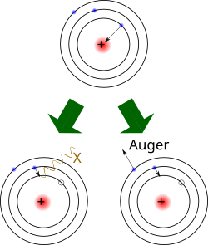
Theory
Electron capture (EC): A nucleus absorbs an inner atomic electron. Results in either:
  Radiation emission, an electron switches shells to replace the absorbed electron(gamma rays for this experiment)
  An Auger Electron which will eject itself to make a positive ion again.
Forbidden transition: decays have a very rare chance of occurring due to parity violation (the weak force being asymmetric) results in longer decay time
Electron capture scheme.
Wikimedia Commons (2015).

Slide 3
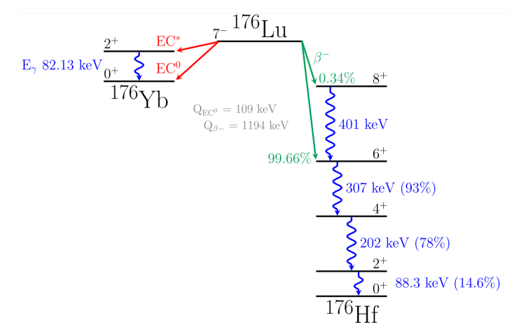
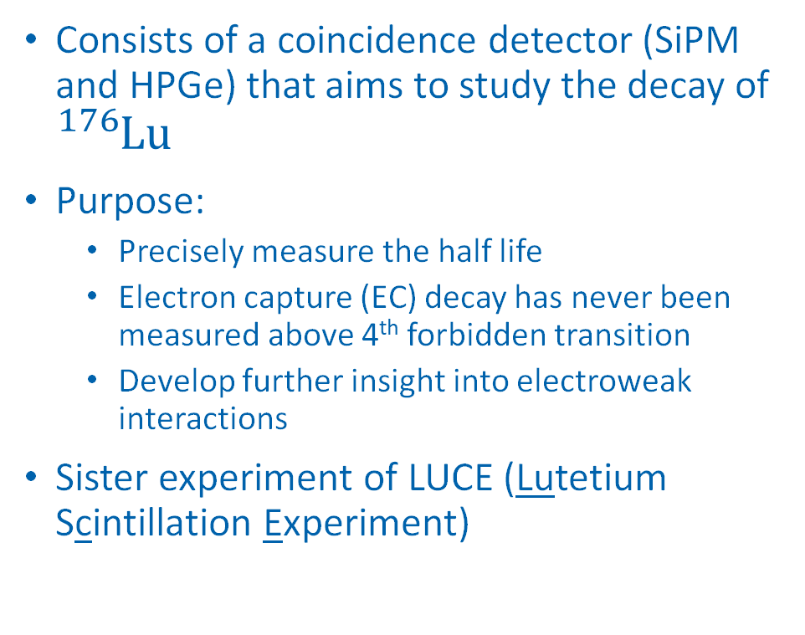
Radioisotope Measurement Project at SNOLAB
Consists of a coincidence detector (SiPM and HPGe) that aims to study the decay of ${}_{}^{176}{Lu}$
Purpose:
  Precisely measure the half life
  Electron capture (EC) decay has never been measured above 4th forbidden transition
  Develop further insight into electroweak interactions
Sister experiment of LUCE (Lutetium Scintillation Experiment)
Case 1:
Case 2:
RAMPS Project Proposal. Decay scheme of ${}_{}^{176}{Lu}$

Slide 4

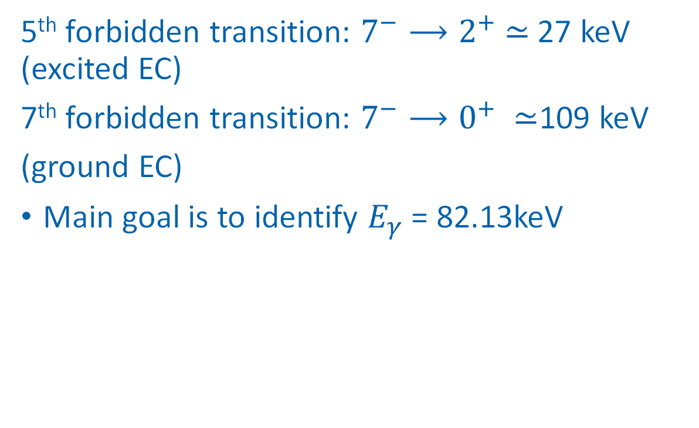
Case 1: EC ${}_{}^{176}{Yb}$ Decay Process
5th forbidden transition: $7^{−}⟶2^{+}$ $≃$ 27 keV (excited EC)
7th forbidden transition: $7^{−}⟶0^{+} ≃$109 keV
(ground EC)
Main goal is to identify $E_{γ}$ = 82.13keV

Slide 5


Case 2 :${}_{}^{176}{Hf}$ Decay Chain
Continuous outpour of beta decay events
Do not want the beta decay interfering with EC from ${}_{}^{176}{Yb}$

Slide 6
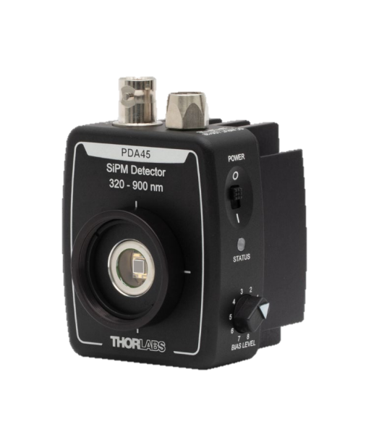
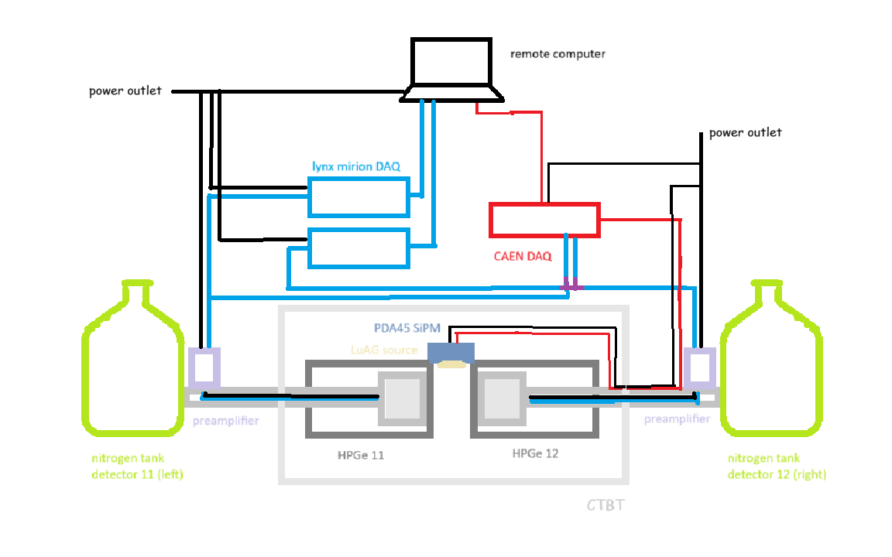
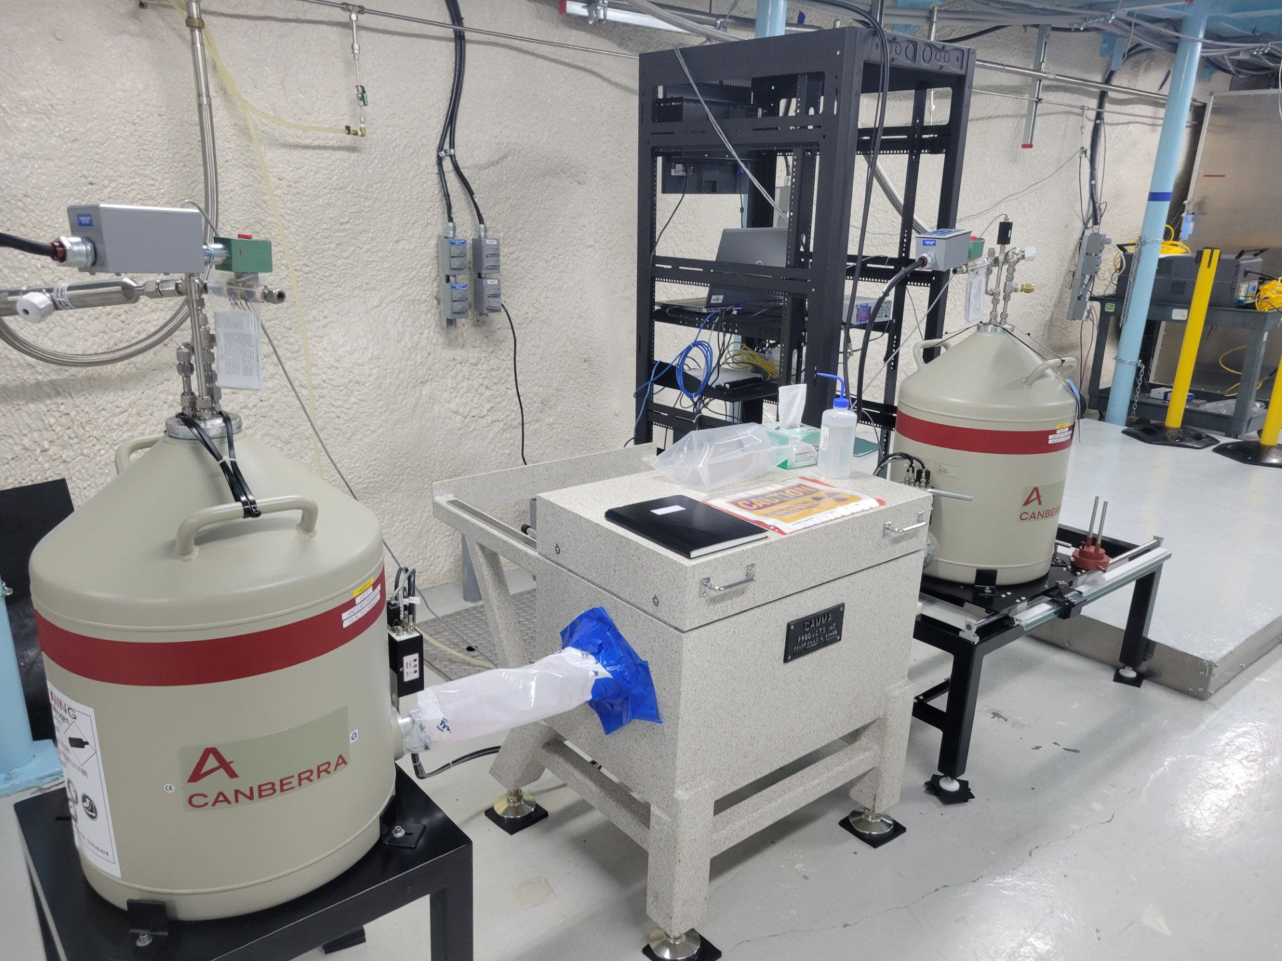
Experiment

Slide 7
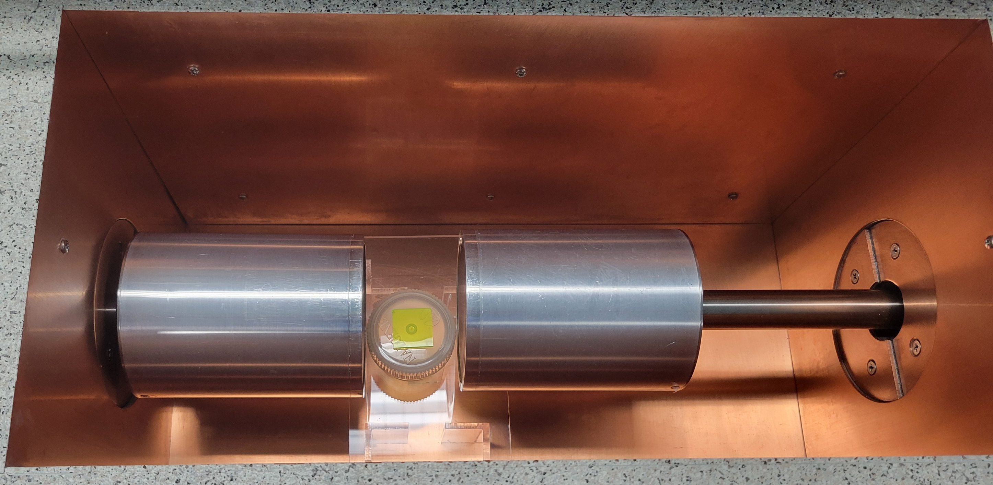
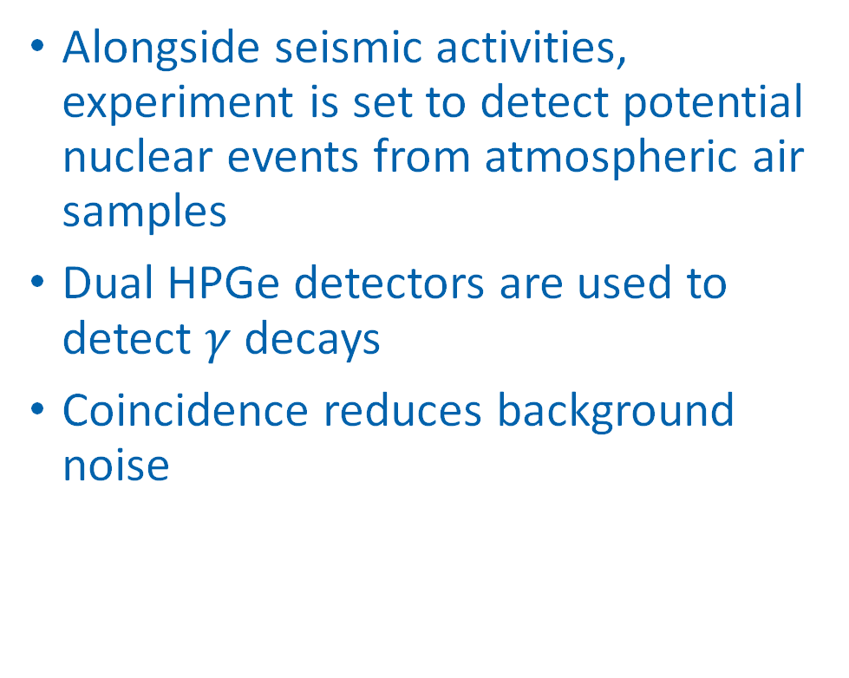
Comprehensive Nuclear Test Ban Treaty
Alongside seismic activities, experiment is set to detect potential nuclear events from atmospheric air samples
Dual HPGe detectors are used to detect $γ$ decays
Coincidence reduces background noise

Slide 8
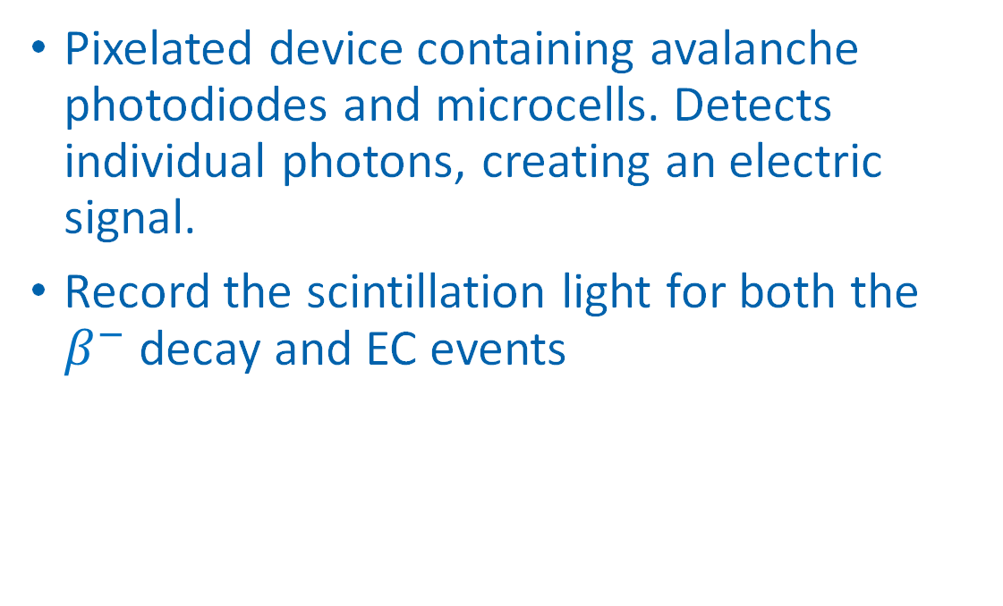
Silicon PhotoMultiplier Amplified Detector
Pixelated device containing avalanche photodiodes and microcells. Detects individual photons, creating an electric signal.
Record the scintillation light for both the $β^{−}$ decay and EC events
PDA 45 SiPM, manufactured by THORLABS

Slide 9
Silicon PhotoMultiplier Amplified Detector
Higher photon detection efficiency than PMTs (☺)
Higher dark counts and cases of optical crosstalk (☹)
PDA 45 SiPM, manufactured by THORLABS

Slide 10
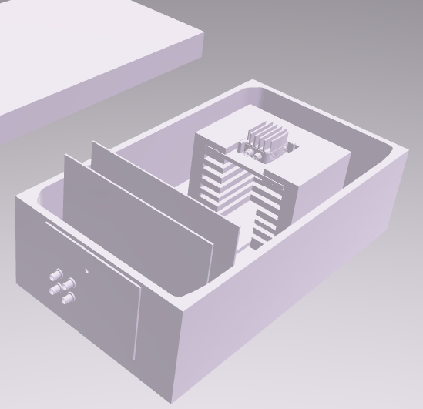
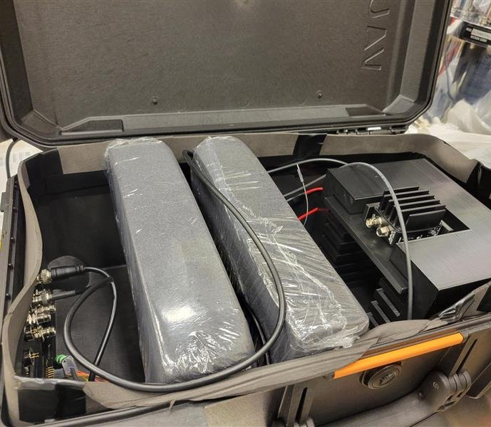
Dark Box
SiPM Module
LED Breadboard
SiPM Holder
Foam Light Damper
Dark Box
Bulkhead Feedthrough
Dark box design by Milan Novakovic

Slide 11
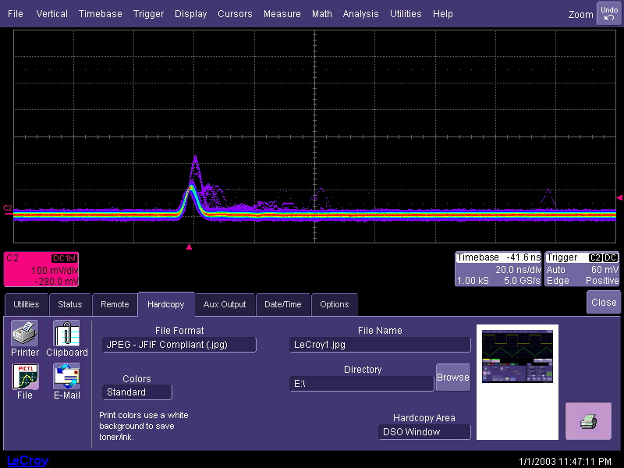
Results
Noise Reduction
2 p.e.
Optical Crosstalk
1 p.e.
Dark counts

Slide 12
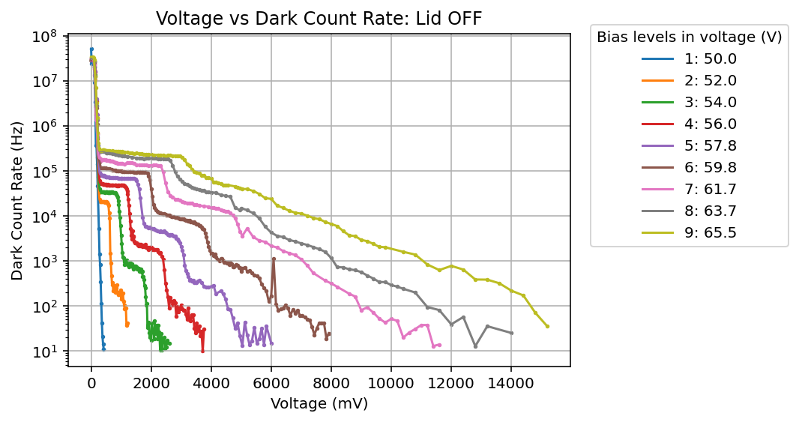
Noise Reduction
1 pe
2 pe
3 pe

Slide 13
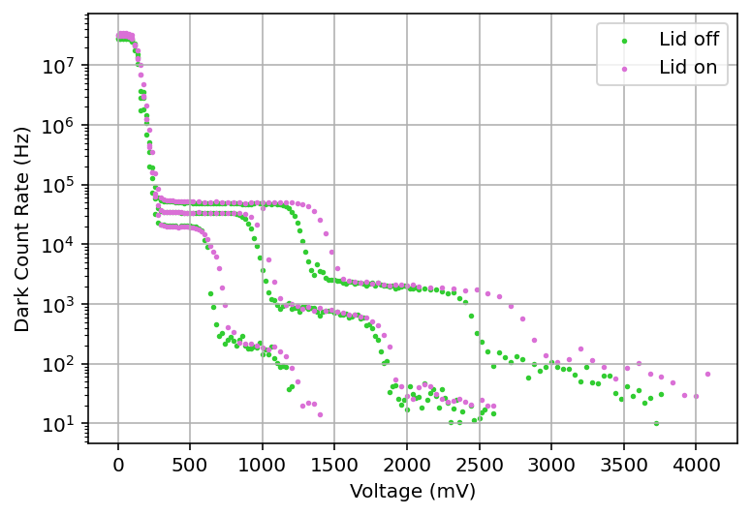
Noise Reduction
Comparison between results, using bias voltages 2, 3, and 4. 3 is the most recommended by the manual
1 pe
2 pe
3 pe

Slide 14
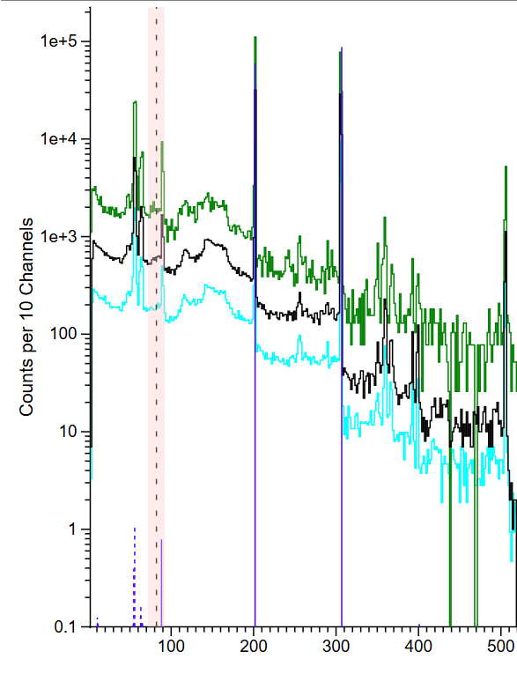
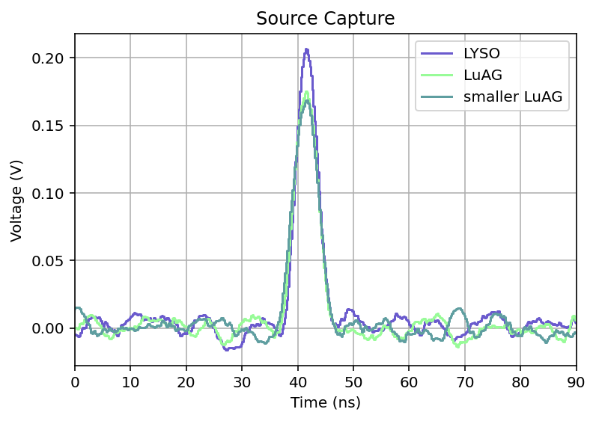
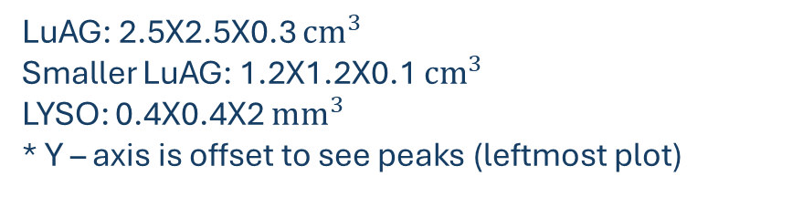
LYSO
LuAG
Smaller LuAG
Lu176
Source Pulse
ROI (𝐸𝛾)
LuAG: 2.5X2.5X0.3 ${cm}^{3}$
Smaller LuAG: 1.2X1.2X0.1 ${cm}^{3}$
LYSO: 0.4X0.4X2 ${mm}^{3}$
* Y – axis is offset to see peaks (leftmost plot)
Energy (kev)

Slide 15
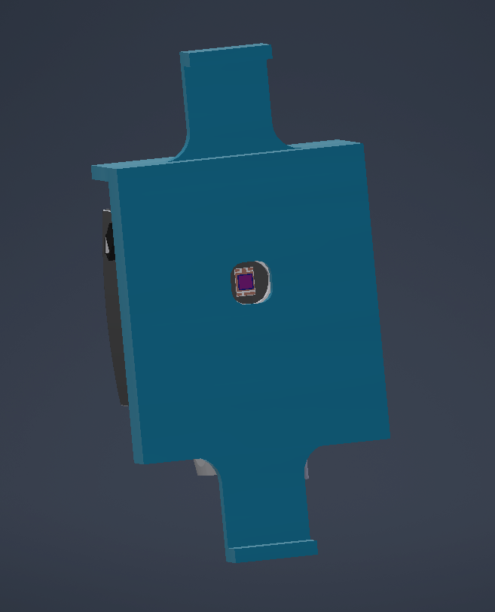
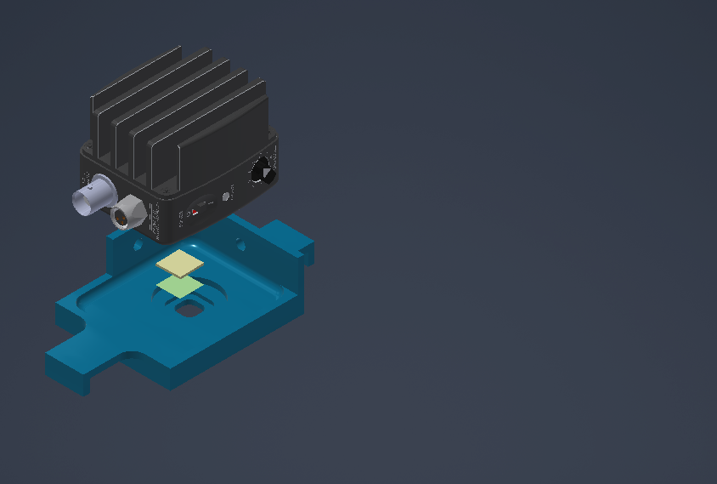



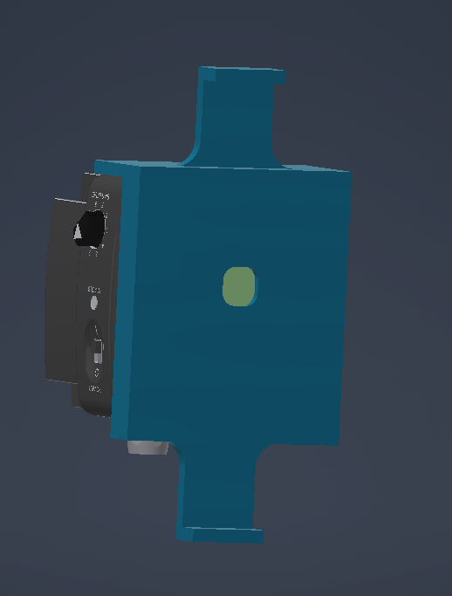

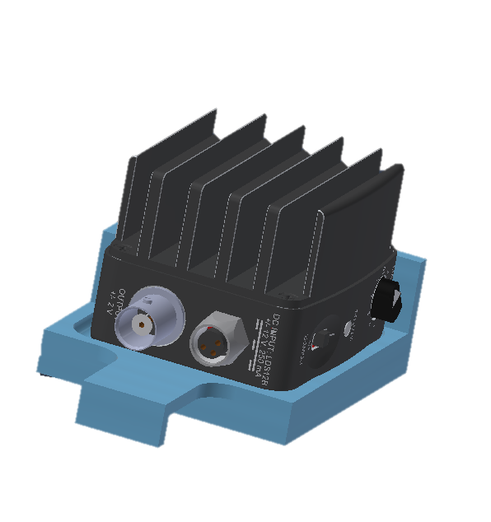
Design: Inside CTBT
SiPM
LuAg source
Mylar foil
SiPM Holder

Slide 16
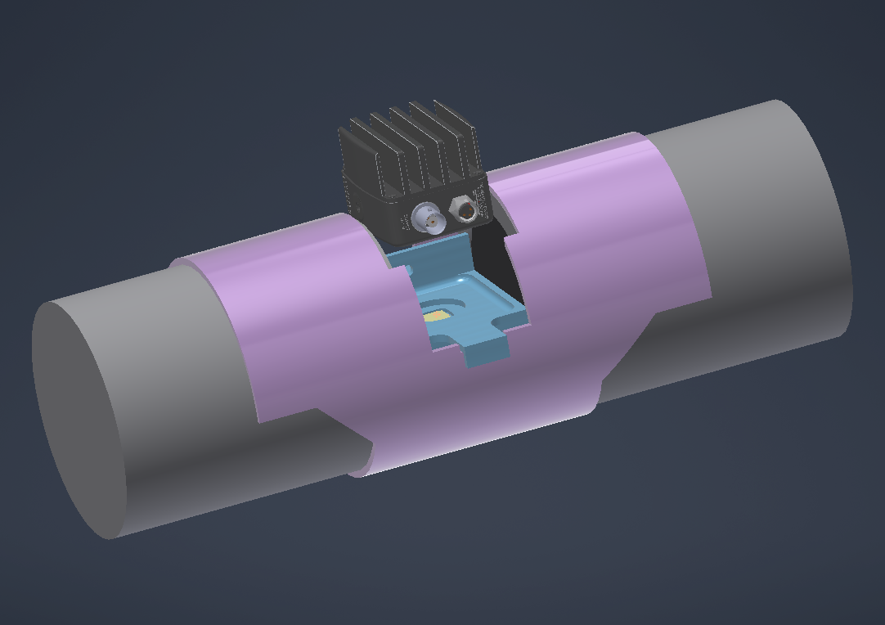





Design: Inside CTBT
Detector 12
Special thanks to Stephen Stankiewicz for the design and CAM aspect
Detector 11
Mylar foil
SiPM
SiPM Holder
LuAg source
SiPM Collar

Slide 17

Design: Inside CTBT
Mass attenuation coefficient for the SiPM handle: 5.083 ${cm}^{2}/g$ at 82keV
Material: Acrylic Plastic (attenuation length: 0.23cm)
Need to consider 3 designs:
Light guides
Facing only a singular HPGe detector
Strap

Slide 18
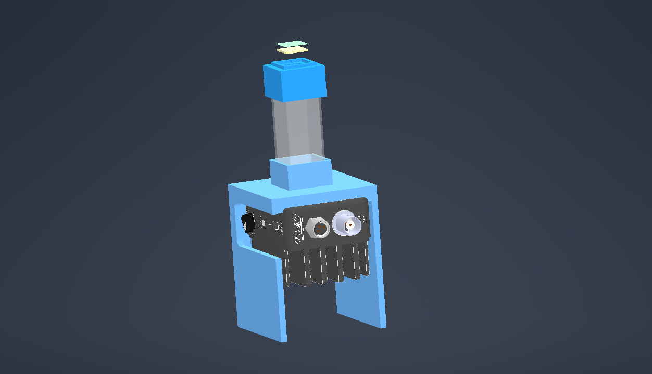
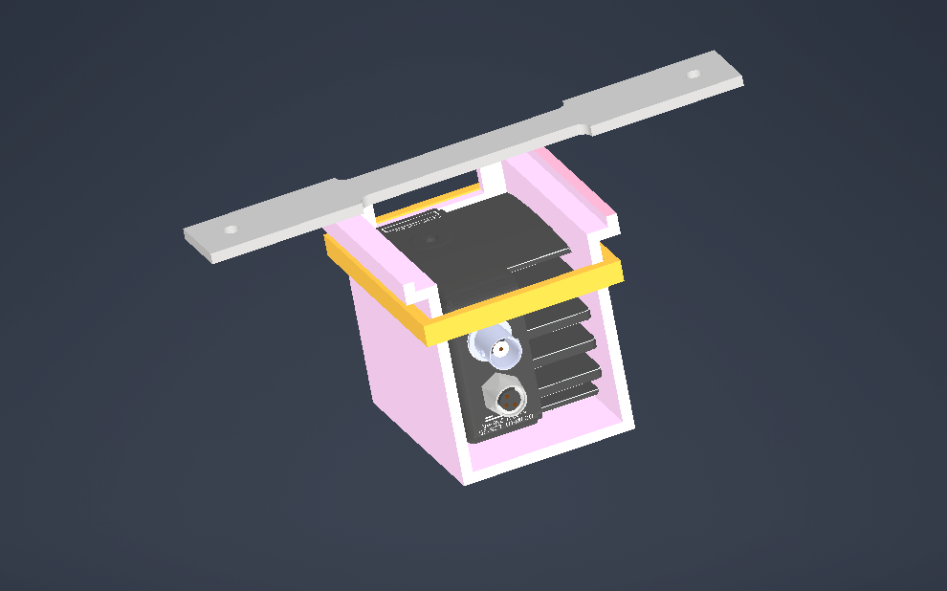
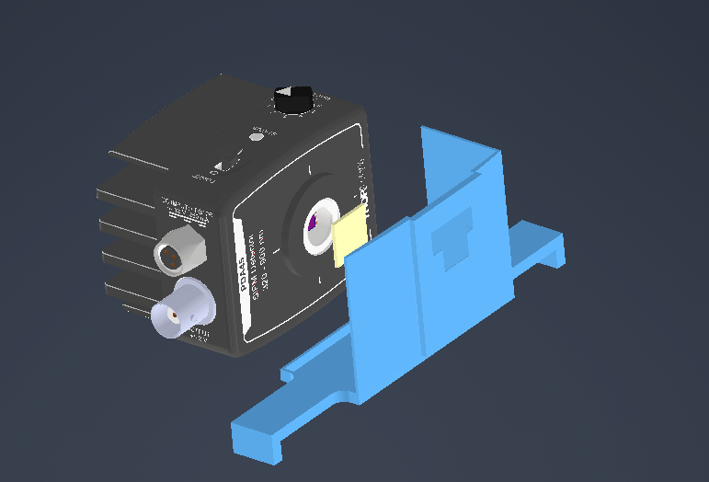
Design: Inside CTBT
Light guides
Strap
Facing only a singular HPGe detector

Slide 19
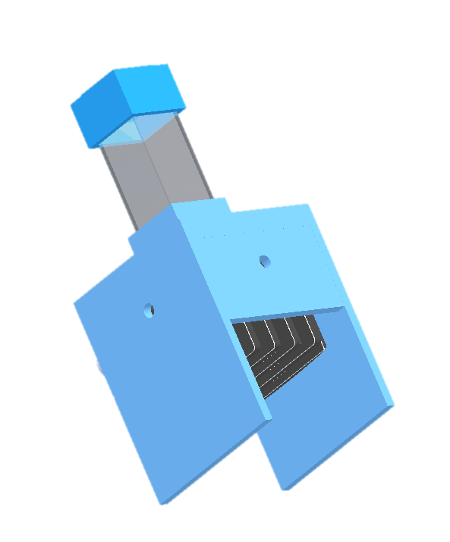



SiPM
LuAg source
Mylar foil
LuAG clip
Lightguide
SiPM Stand

Slide 20
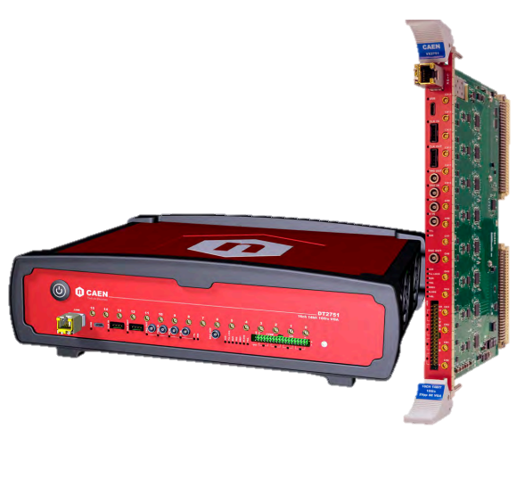
What’s Next ?
Continue surface testing with newly arriving DAQ system
Set up the system underground
Experiment is set to run for 60 days – sharing the CTBT with other experiments

Slide 21
Conclusion
Identify EC through a system of detectors and Lutetium 176
SiPM testing
  Noise
  Photoelectron spectrum
  Sources
Design a holder and collar for the system

Slide 22
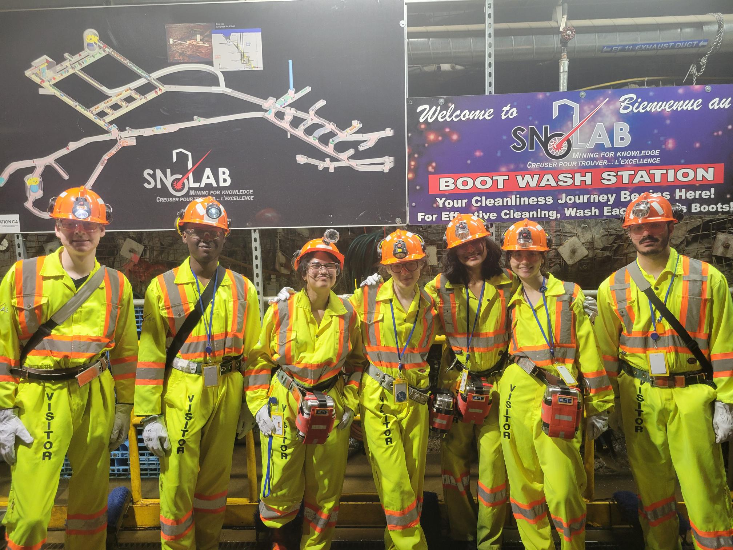
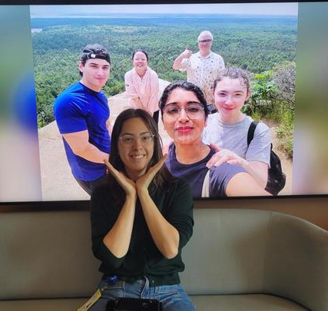


Acknowledgments
Low Background Lab (CTBT): Steffon Luoma, Ian Lawson, Chris Jillings
Design: Stephen Stankiewicz
Technical help: Mark Ward, Tom Sonley, Krina Patel
Previous RAMPS undergraduates: Mario Buffone, Milan Novakovic
Honourable mentions: Abhipsha Sahu, 104Xi WaveRunner Oscilloscope, and fellow undergraduates
educated!

Slide 23
Citations
Bridgewater, M. Preliminary Investigation Towards Analysing Coincidence Events in the CTBT Detector.
Fu, S., Benato, G., Bucci, C. et al. LUCE: A Milli-Kelvin Calorimeter Experiment to Study
the Electron Capture of Lu. J Low Temp Phys 218, 12–20 (2025). https://doi.org/10.1007/s10909-024-03231-w.
G.F. Knoll. Radiation and Detection Measurement, 4th ed. Wiley. 2010.
Laweson I, Steffon Luoma, Matthew Stukel. RAMPS Project Proposal (PROP-2604). 2025.
Luigi Ernesto Ghezzer, Francesco Nozzoli,∗ Riccardo Nicolaidis, Roberto Iuppa, and Paolo Zuccon. Search for Electron Capture in 176Lu with LYSO scintillator. INFN- TIFPA & Phys. Dep. Trento University (2023). https://arxiv.org/abs/2211.15203.

Slide 24
Citations
Onsemi. Introduction to the Silicon Photomultiplier (SiPM) AND9770/D. 2023. https://www.onsemi.com/pub/collateral/and9770-d.pdf.
Teledyne LeCroy. LeCroy WAVERUNNER 104XI-A Datasheet. 2012. https://www.testequipmenthq.com/datasheets/LECROY- WAVERUNNER%20104XI-A-Datasheet.pdf.
THORLABS. PDA40, PDA41, PDA42, PDA43, PDA44, PDA45 SiPM Amplified Detectors – User Guide. 2023. https://www.thorlabs.com/drawings/371bdc0775f3d6ef- B509CB7B-DBB9-4F56-2D14056DB52400EF/PDA45-Manual.pdf.

Slide 25
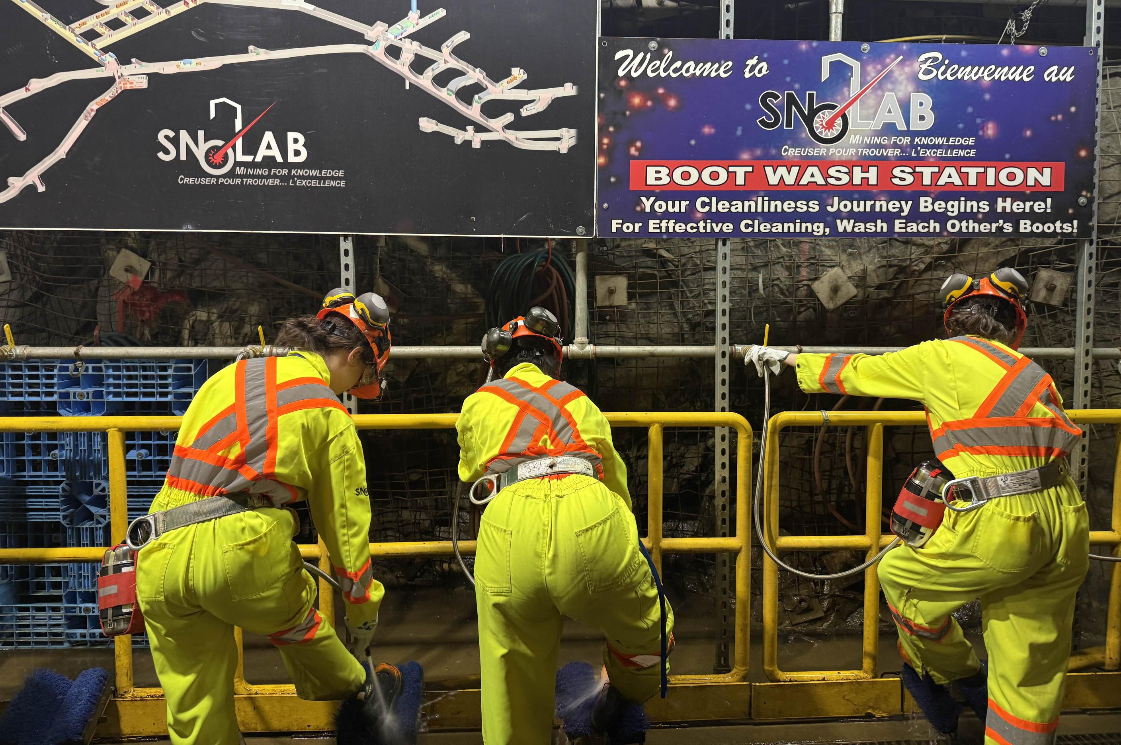
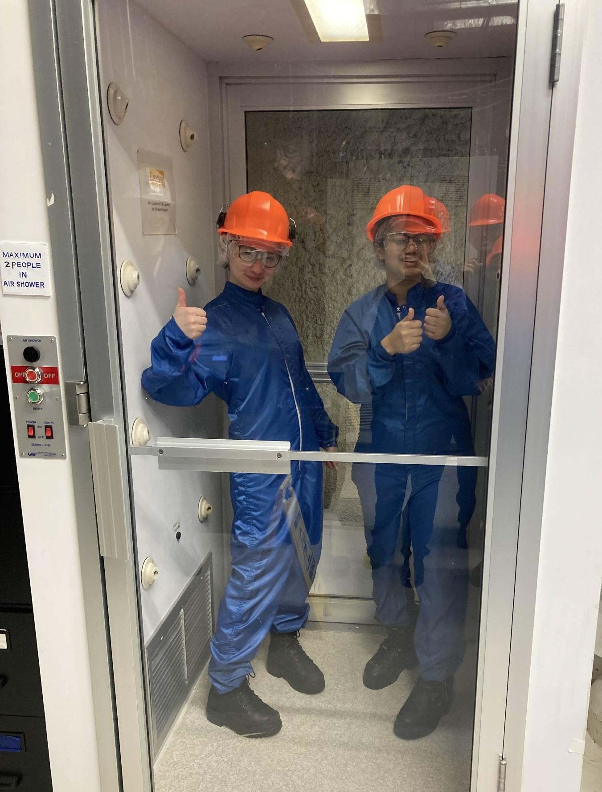
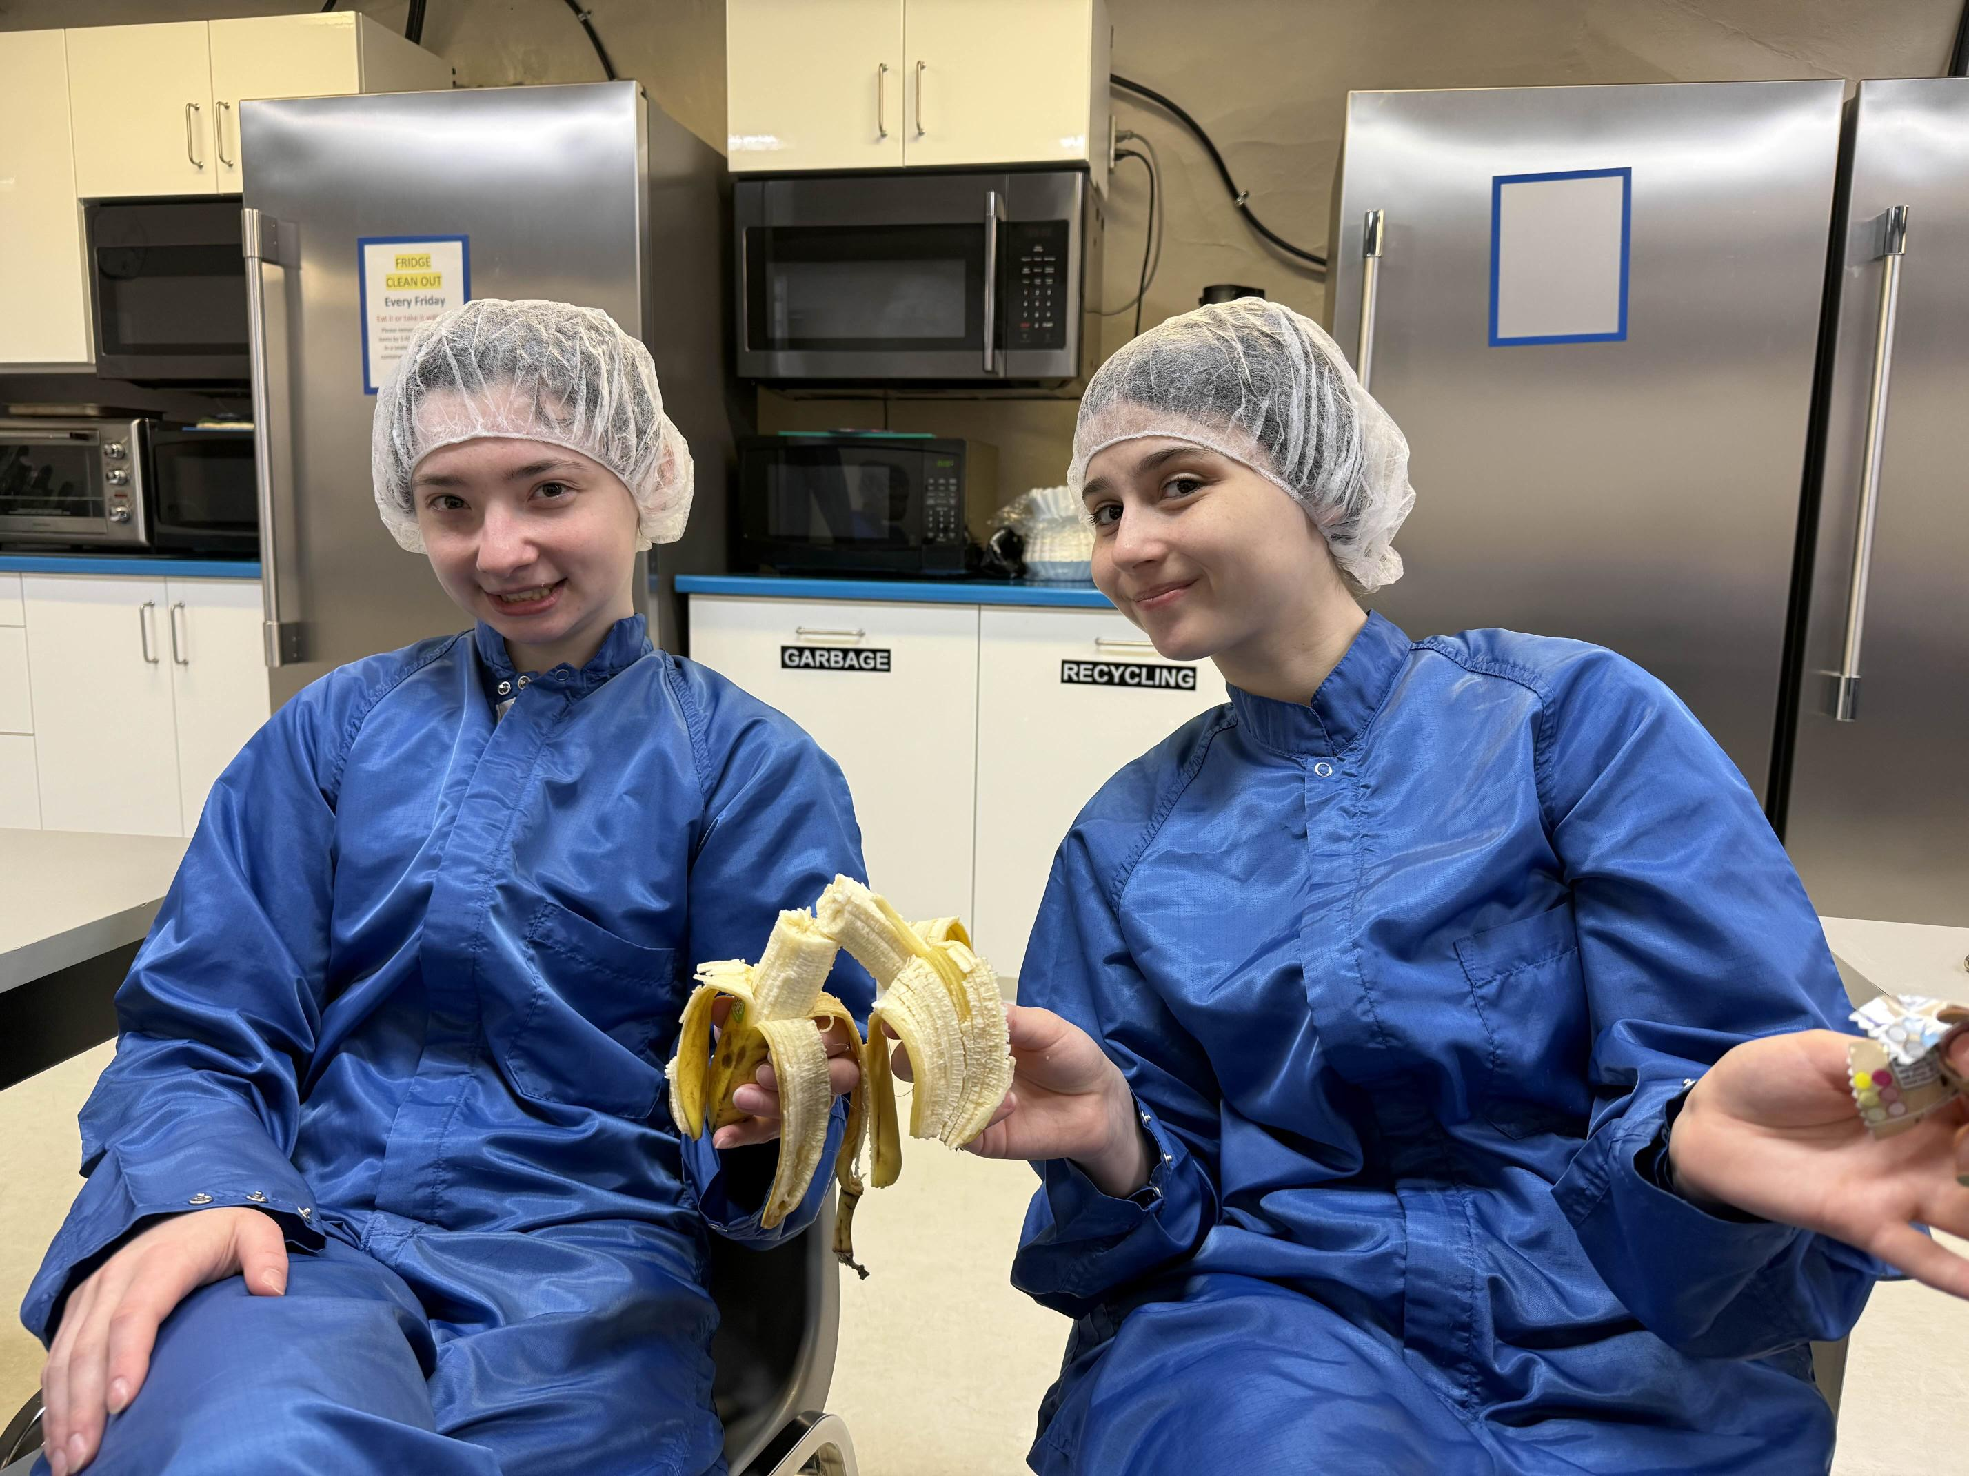
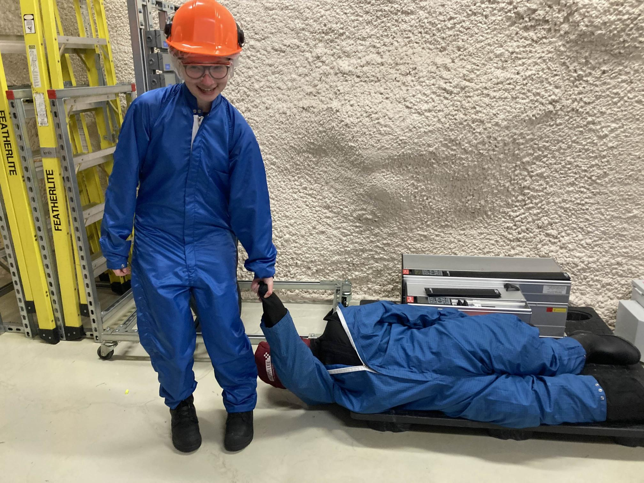
Questions?
Thank you for listening!

Slide 26
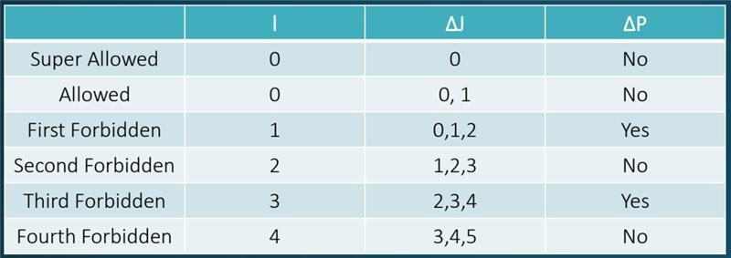

Slide 27
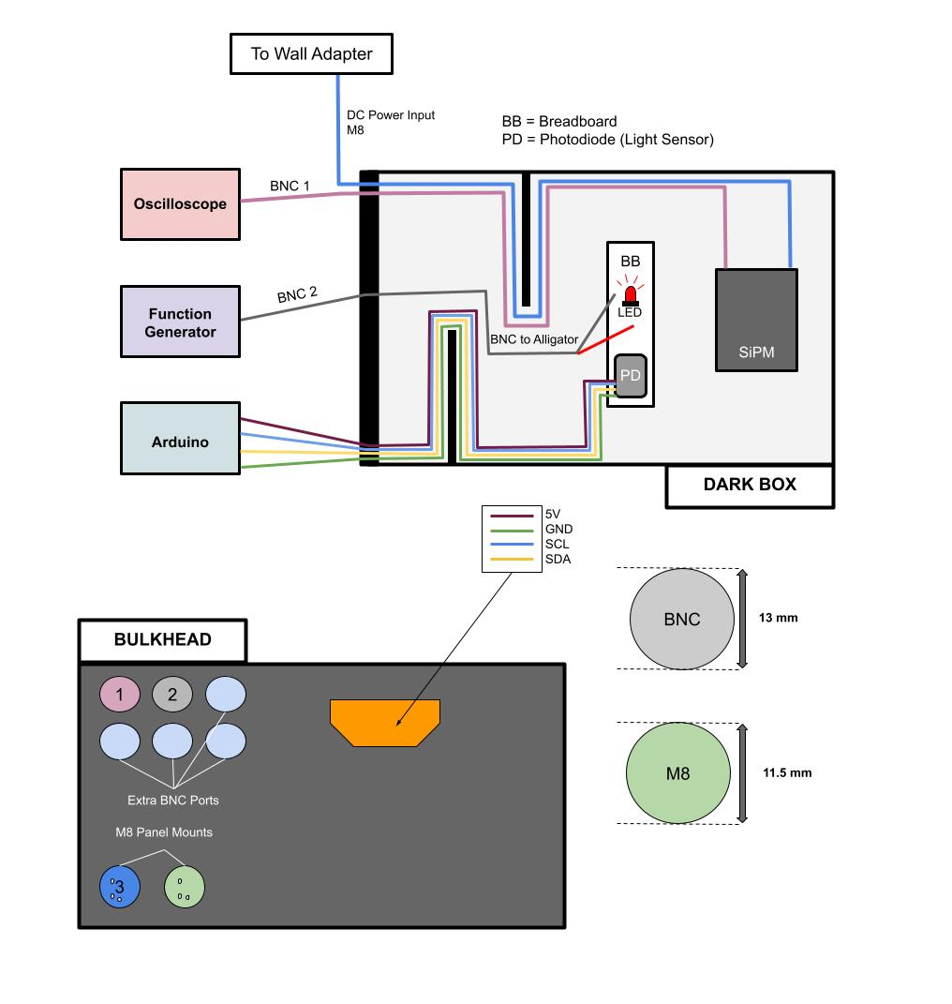
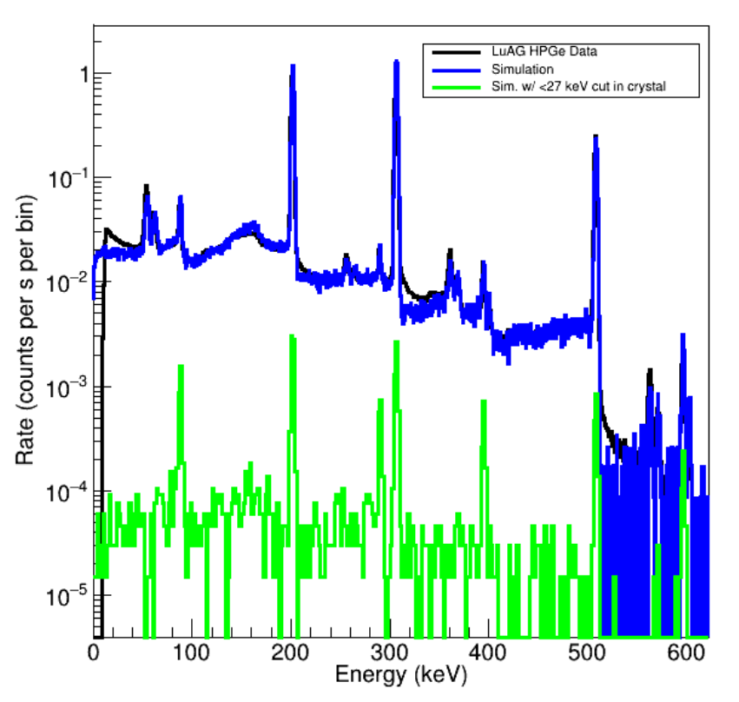
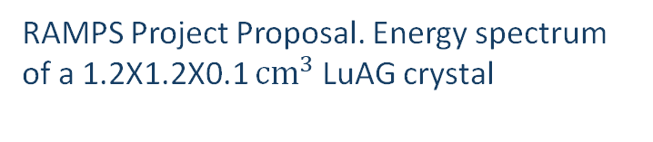
Simulated Results
Escaped x-rays
88keV
ROI (𝐸𝛾)
202 keV
307 keV
401 keV
(rare)
202+307 keV
RAMPS Project Proposal. Energy spectrum of a 1.2X1.2X0.1 ${cm}^{3}$ LuAG crystal

Slide 28
