Slide 1




Searching for Gravitational Wave Events with HALO, and Other Projects
Irina Nitu
McGill University
Supervised by Prof. Thomas Brunner and Prof. Stephen Sekula

Slide 2
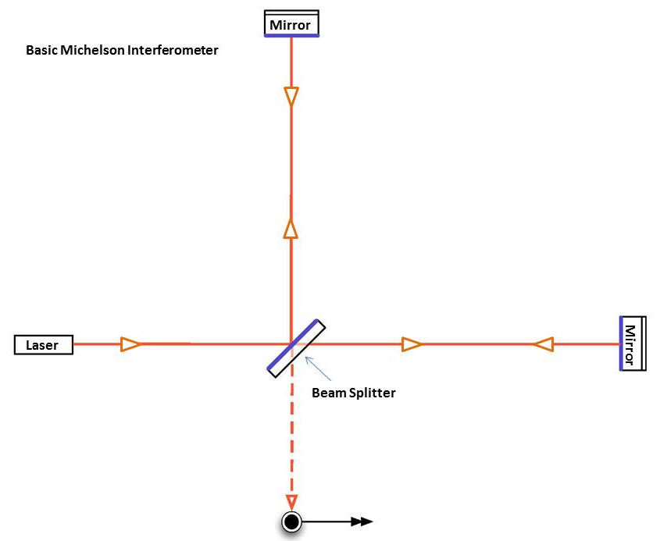
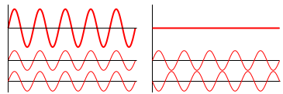
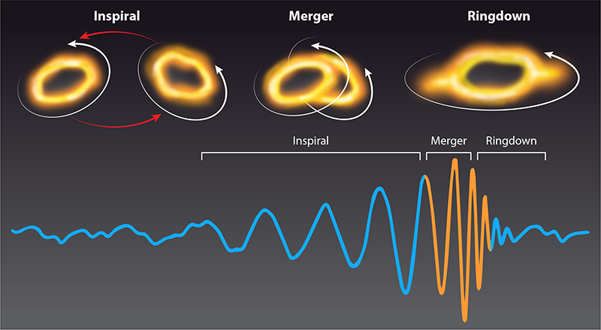
Gravitational Waves
https://www.ligo.caltech.edu/page/what-is-interferometer
https://en.wikipedia.org/wiki/Wave_interference
https://link.aps.org/doi/10.1103/Physics.16.29
Irina Nitu
Notes:
Ripples in spacetime
Created by mergers, supernovae
Direct detections through laser interferometry (LIGO, VIRGO, KAGRA)

Slide 3
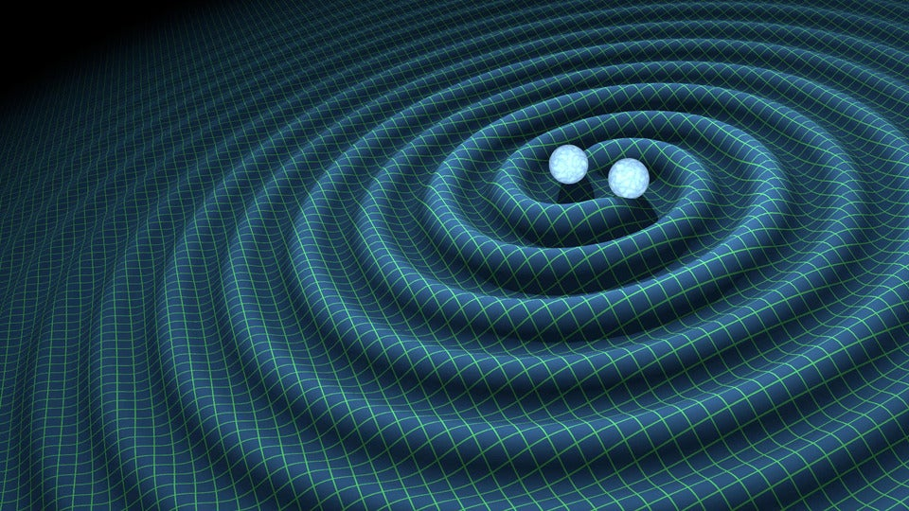


Neutrino Signal Time Delay
𝜈
$$Δt$$
https://www.scientificamerican.com/article/gravitational-waves-discovered-from-colliding-black-holes1/
https://stock.adobe.com/search?k=cartoon+earth

Slide 4
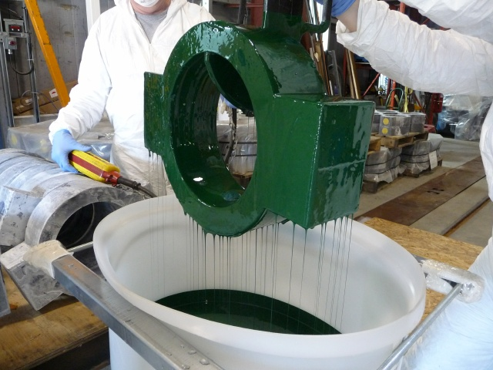
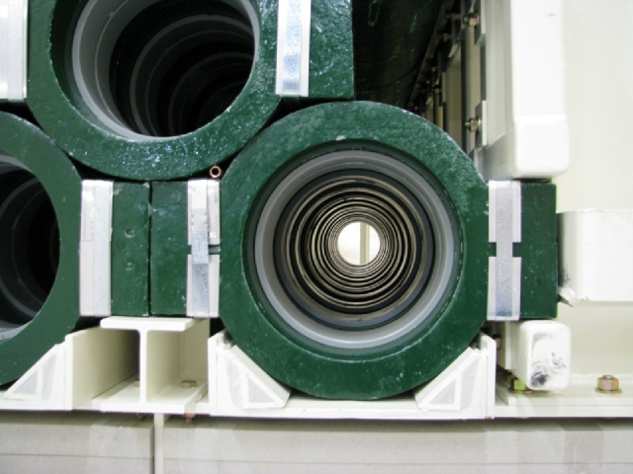
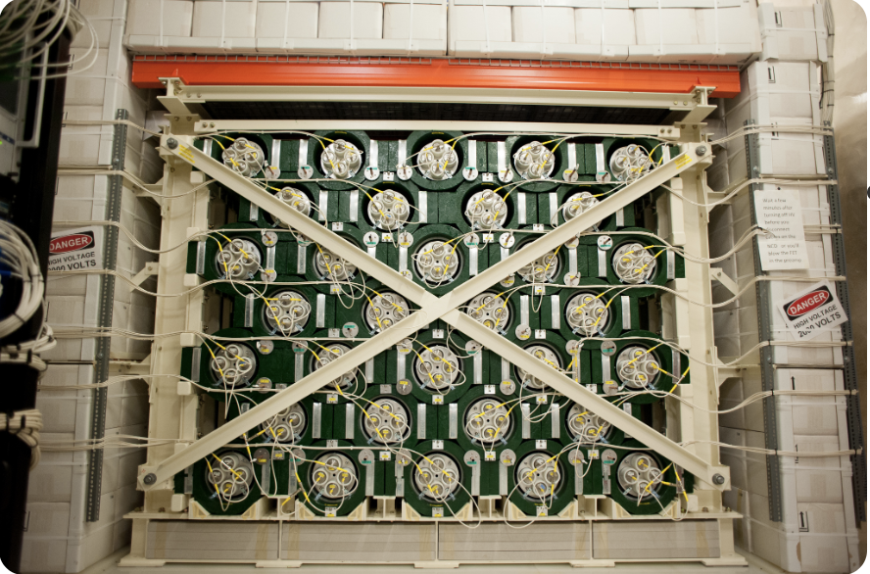
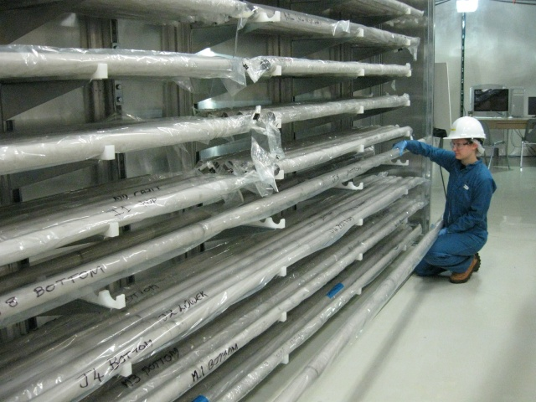
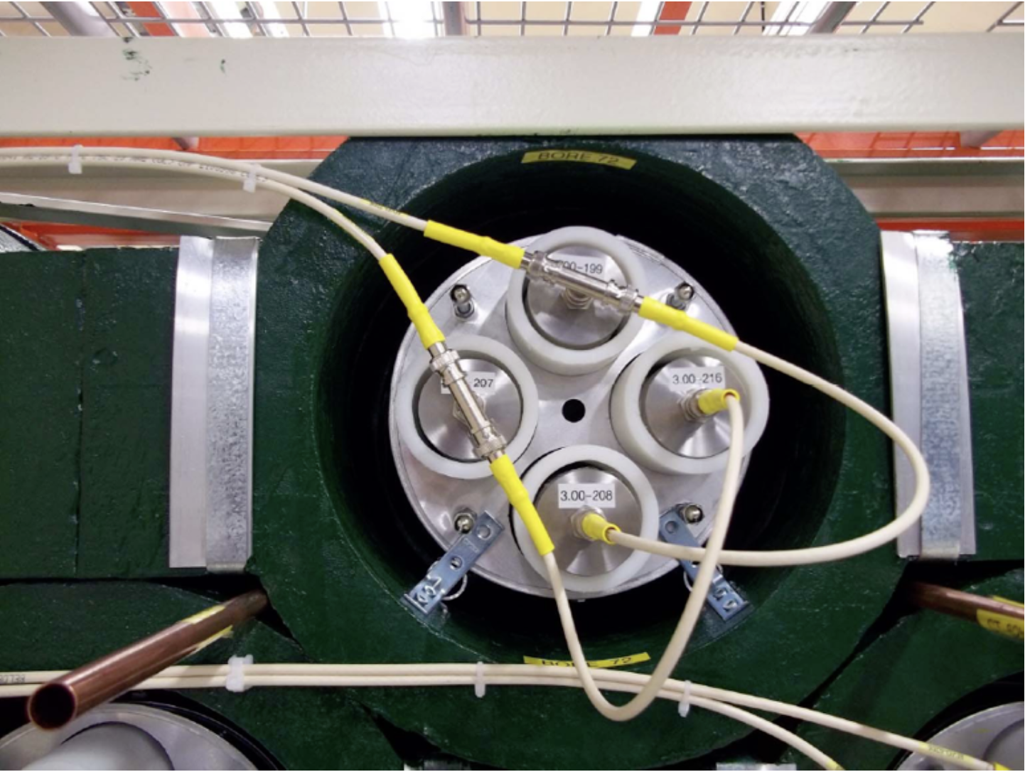
HALO – Helium And Lead Observatory
https://www.snolab.ca/halo/gallery.html
https://www.snolab.ca/experiment/halo/
Irina Nitu
Notes:
Add picture of HALO
Neutrino detector
Located underground, talk about shielding provided by overburden
talk about specs
- Water shielding – this is why when you go underground you don’t see the
128 ncds from sno experiment
79 tonnes of lead
HDPE surrounding counters
Ncds readout
Then talk about physics
Neutrino interactions in lead
Then travel through detector
Mention thermalization through hdpe
Mention cross section for thermal neutron capture in helium
Ionization in gas

Slide 5
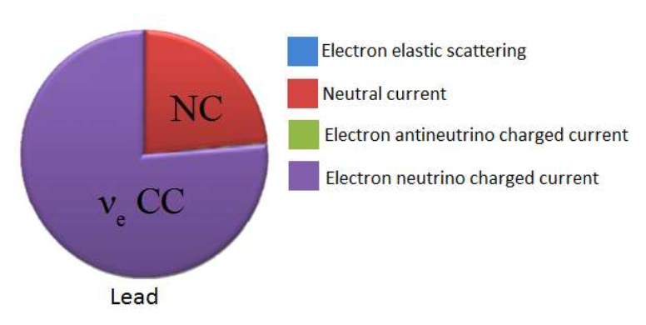
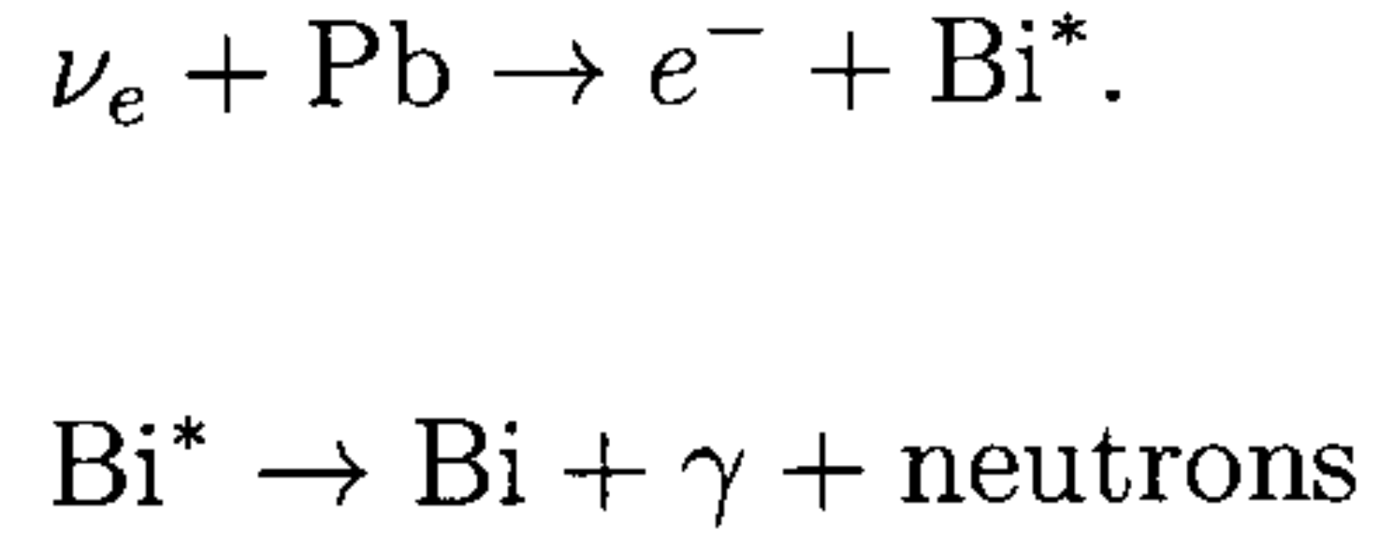
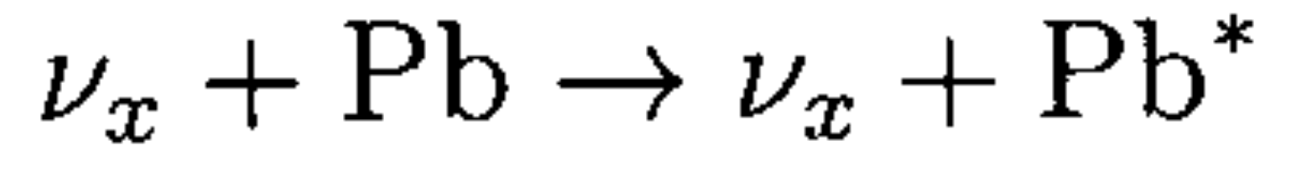
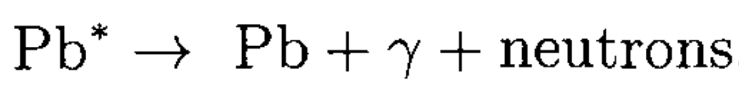
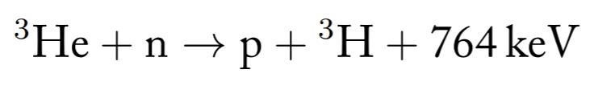
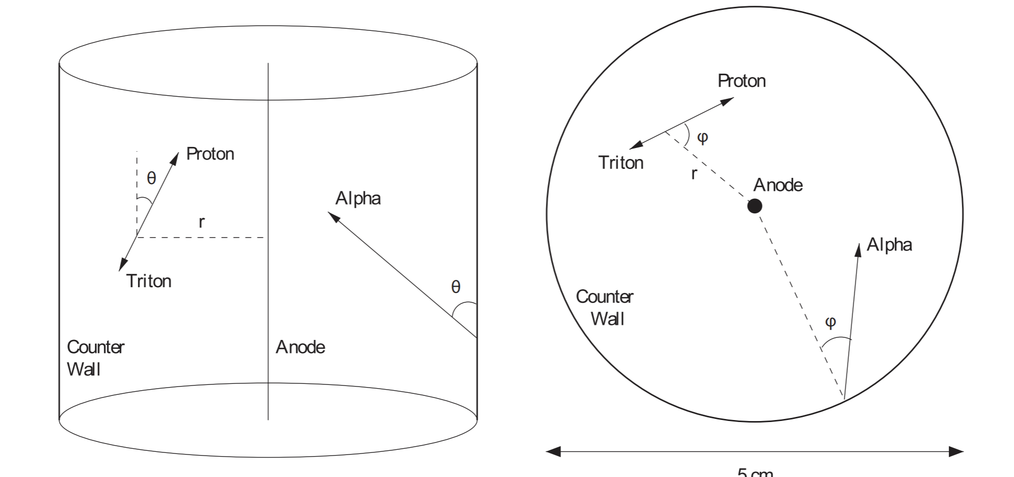
HALO Neutrino Detection
https://www.snolab.ca/experiment/halo/
Irina Nitu
Notes:
Steve’s comment – complementary to liquid-based detectors sensitive to anti electron neutrinos
Charged current (CC) interactions: W+/- exchange
Neutral current (NC) interactions: Zº exchange
Elastic scattering
Snolab neutron flux of 8000 m^−2day^−1
Water shielding reduces that to ~1300 m^−2day^−1
573 keV 191 keV
3He has a non-elastic cross-section for thermal neutrons of 5300 barns, giving thermal neutrons within the counters an absorption length of 3.5 cm
Neutral current interaction:
Neutrino interacts with lead, putting the lead into an excited state. The lead de-excites, emitting a gamma and a neutron
Charged current interaction:

Slide 6
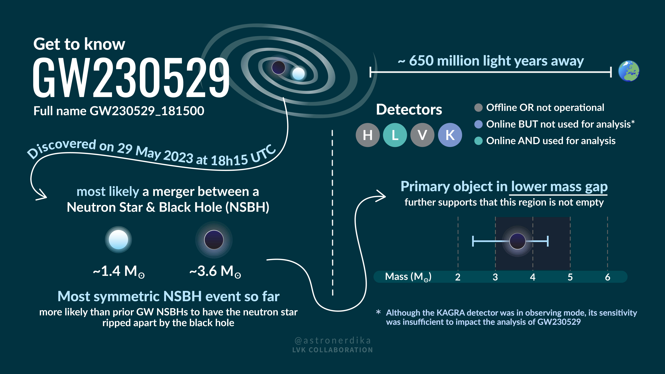

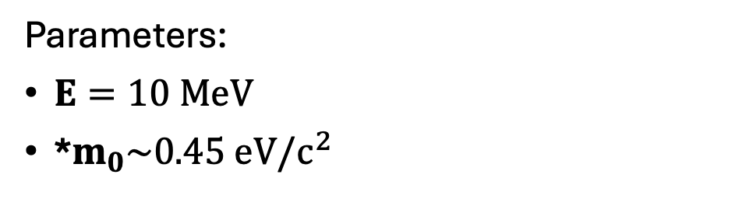


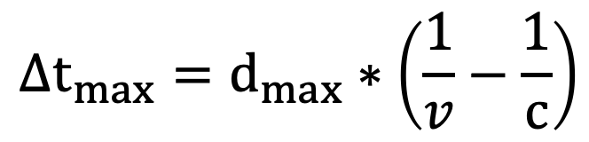


Neutrino Signal Time Delay
Time window for neutrino signal:
$$[t_{0}, t_{0}+Δt_{max}]$$
$$Δt_{max}=d_{max}∗\left(\frac{1}{v}−\frac{1}{c}\right)$$
$$d=201±63 Mpc$$
$$E^{2}={\left(pc\right)}^{2}+{\left(m_{0}c^{2}\right)}^{2}$$
$$p=mv=m_{0}γv$$
Parameters:
$E=10 MeV$
*$m_{0}\sim 0.45 eV/c^{2}$
$d_{max}=201+63 Mpc⇒Δtmax=24 s$
*KATRIN upper limit, April 2025
Irina Nitu
https://arxiv.org/pdf/2406.13516

Slide 7
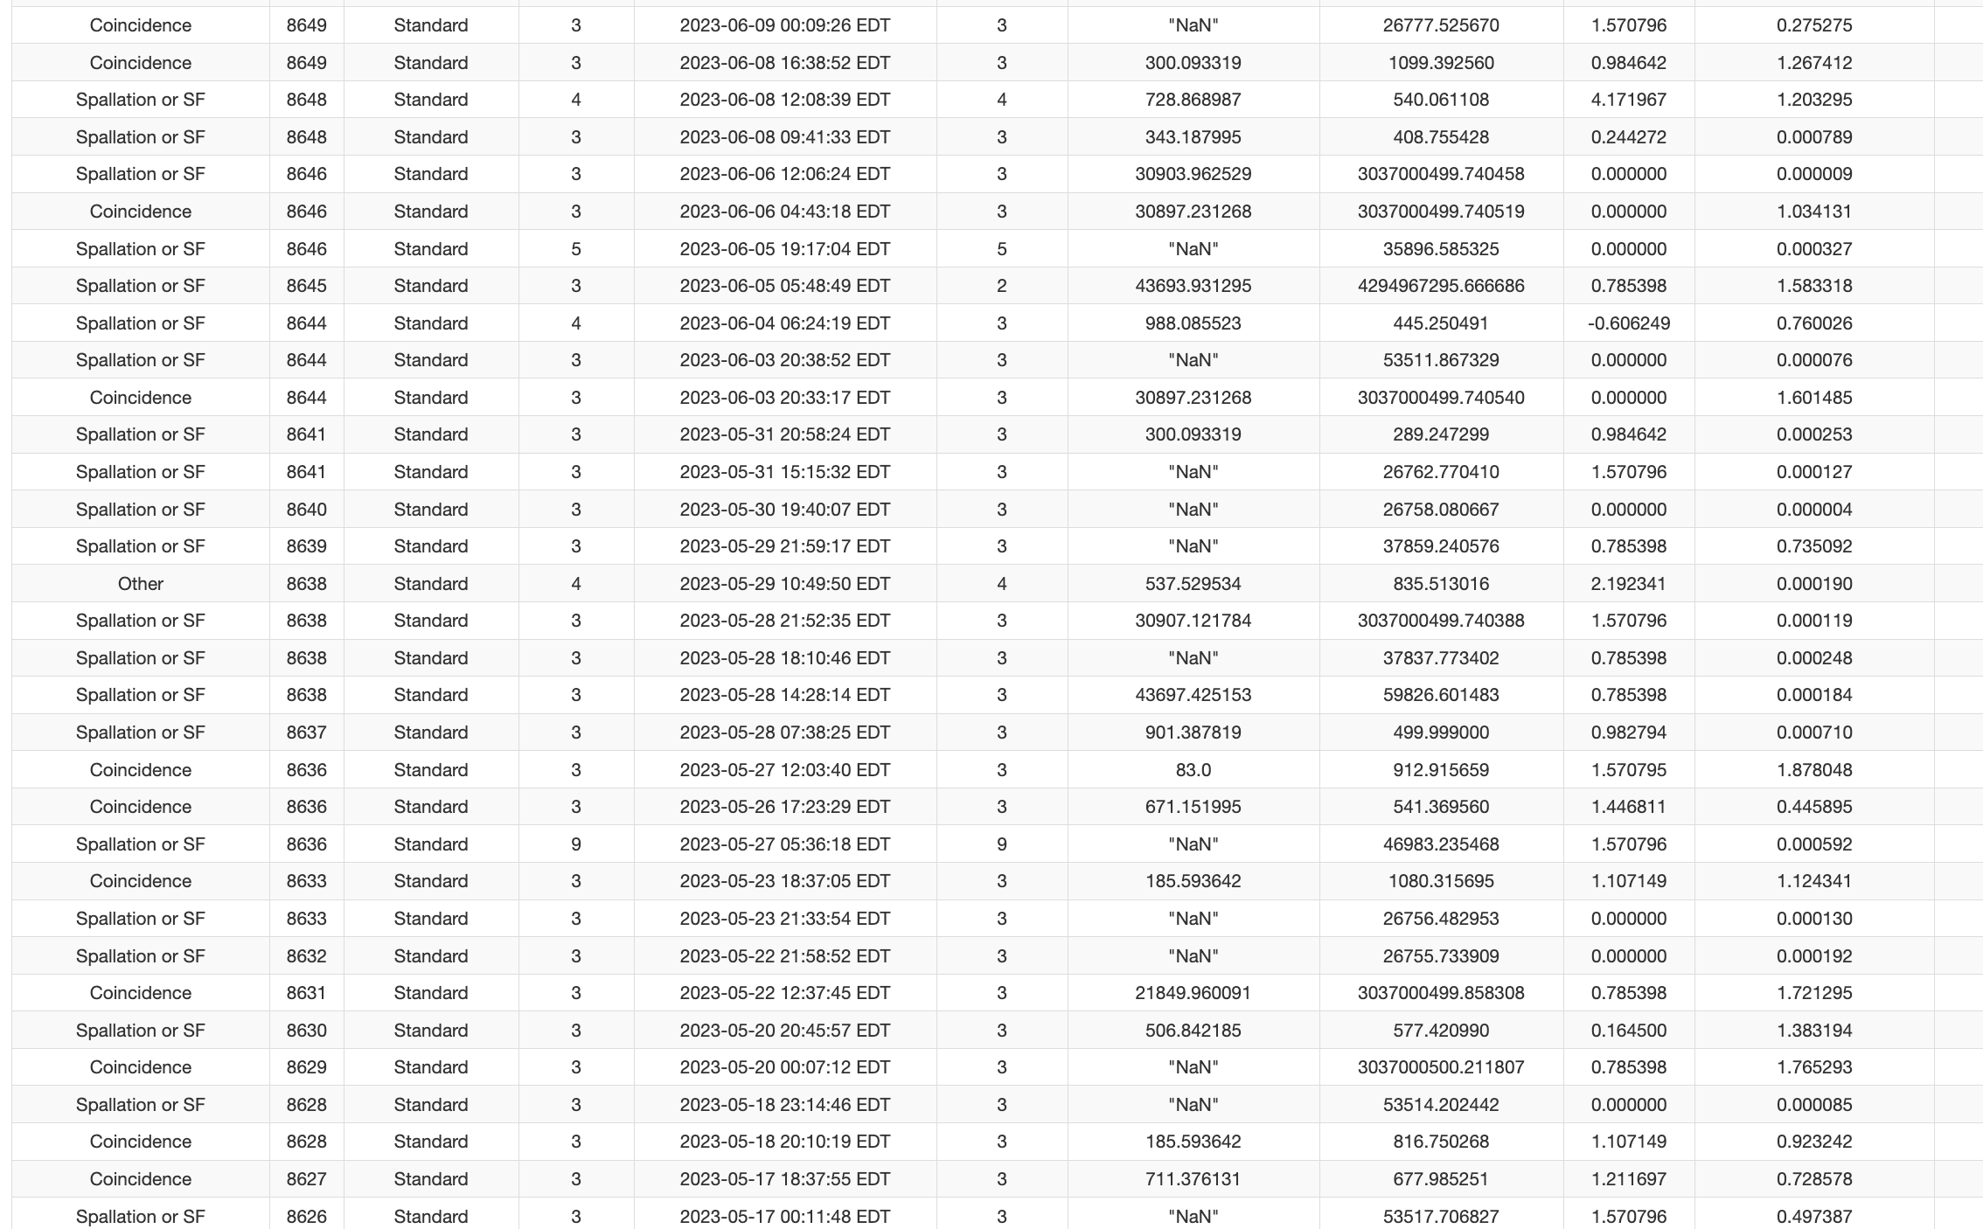



Look for Neutron Burst Events in HALO
Time window for neutrino signal:
$$[t_{0}, t_{0}+Δt_{max}]$$
$t_{0}=\text{2023−05−29 14:15:16 }\text{EDT}$ $Δt_{max}=24 s$
Too late:
$$Δt_{max}>7 hrs$$
Too early:
$$Δt_{max} \sim −3 hrs$$
Irina Nitu
Notes:
2023-05-29 14:15:16 EDT

Slide 8
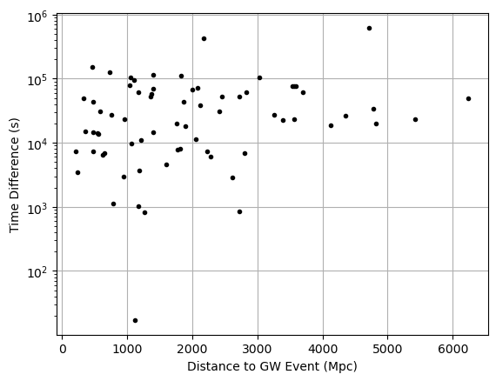
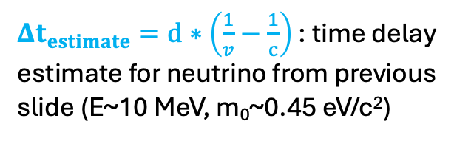
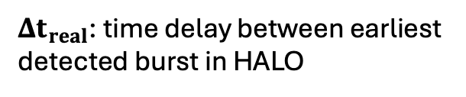

Neutron Bursts from Gravitational Wave Events
$$Time Difference=Δt_{real}−Δt_{estimate}$$
$Δt_{real}$: time delay between earliest detected burst in HALO
$Δt_{estimate}=d∗\left(\frac{1}{v}−\frac{1}{c}\right)$ : time delay estimate for neutrino from previous slide (E~10 MeV, m₀~0.45 eV/c²)
No events from gravitational waves?
Irina Nitu
Notes:
Look into why we have that one point at the bottom

Slide 9
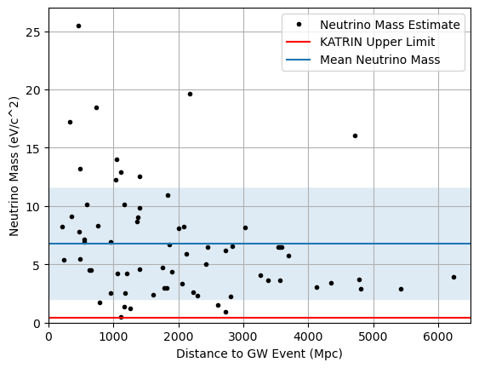
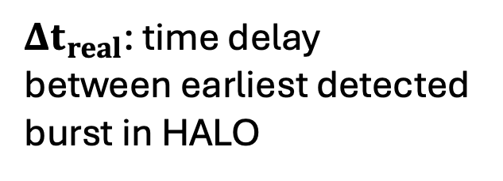

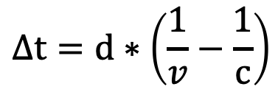

Do the Reverse: Estimate Neutrino Mass from Data
$Δt_{real}$: time delay between earliest detected burst in HALO
$$Δt=d∗\left(\frac{1}{v}−\frac{1}{c}\right)$$
$$E^{2}={\left(pc\right)}^{2}+{\left(m_{0}c^{2}\right)}^{2}$$
$$p=mv=m_{0}γv$$
No gravitational wave events?
Irina Nitu
Notes:
Fix labels (c^2)

Slide 10
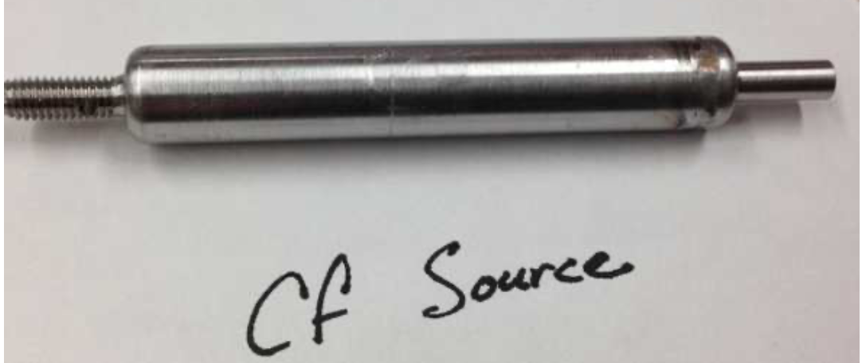
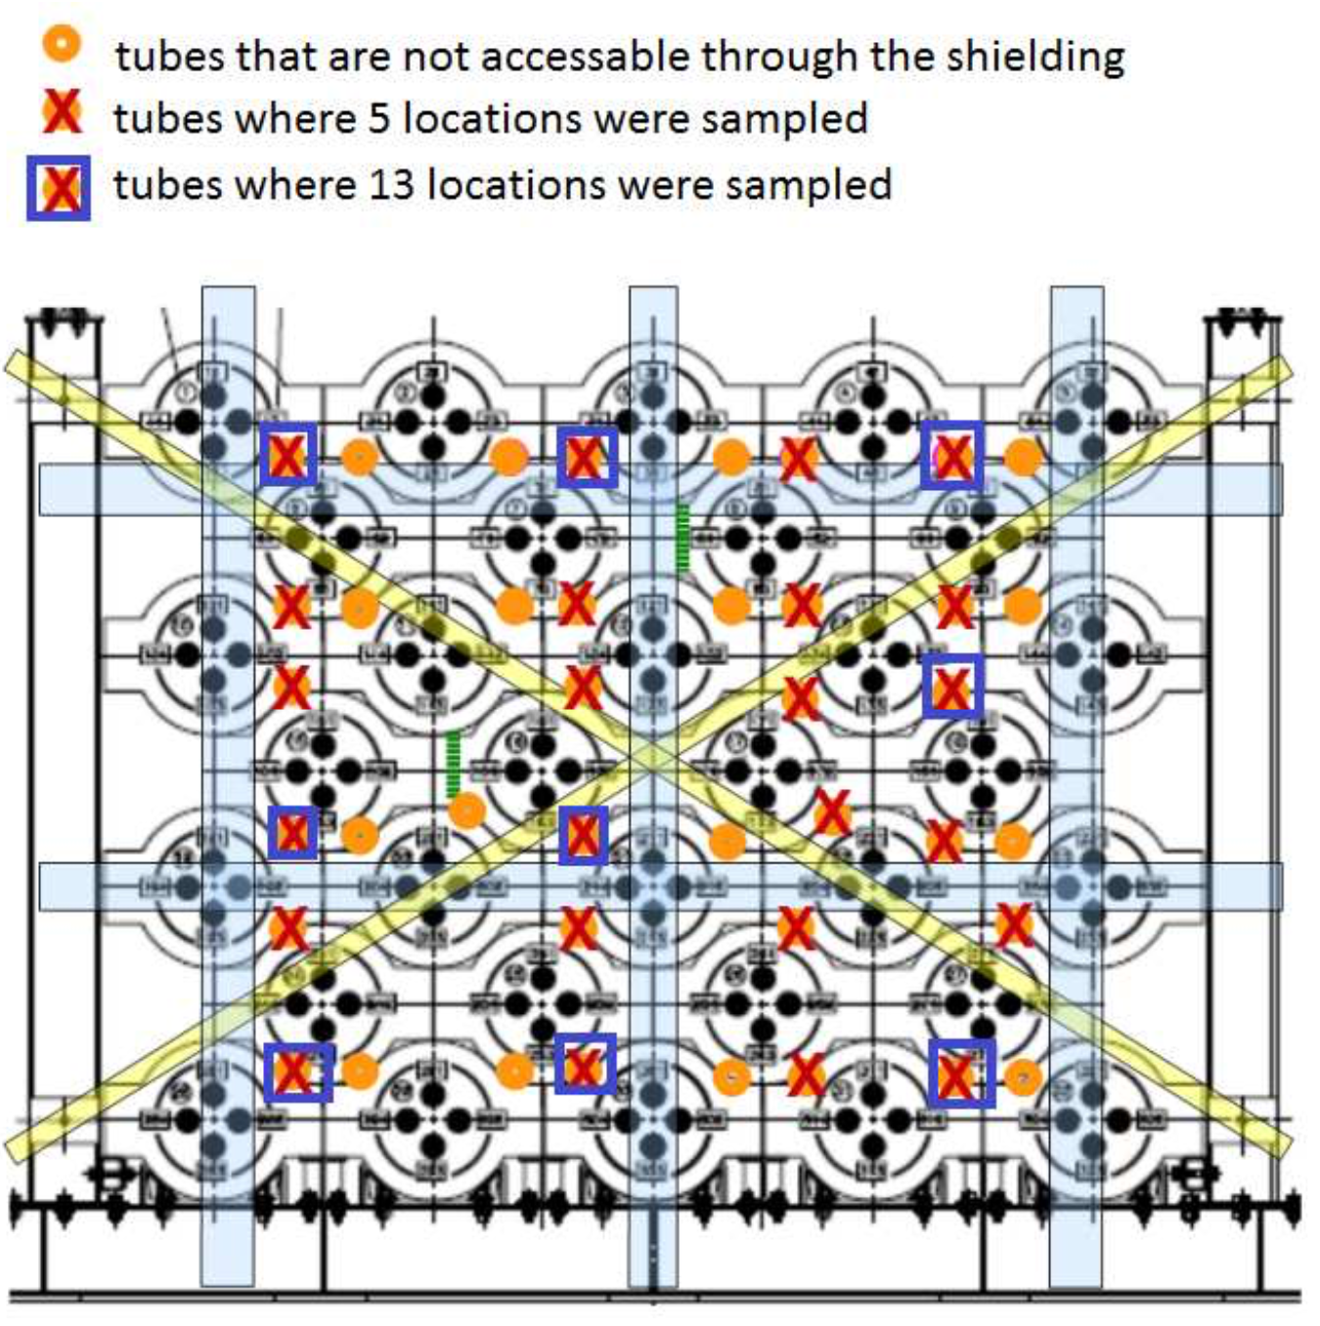
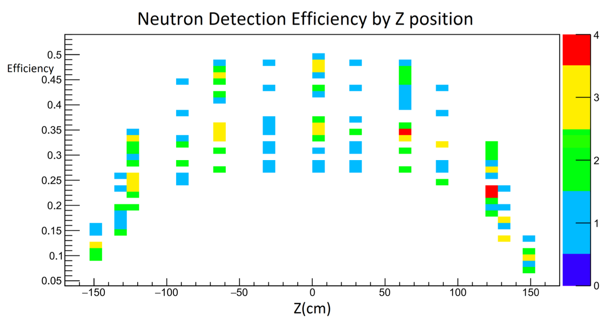
HALO Detection Efficiency
Credits: Colin Bruulsema
Irina Nitu

Slide 11
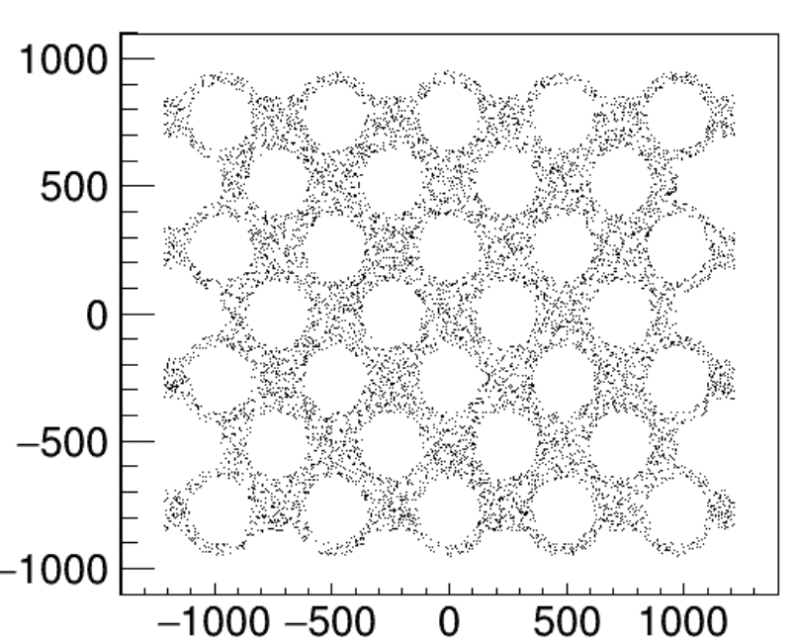
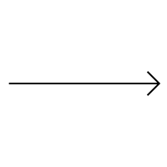

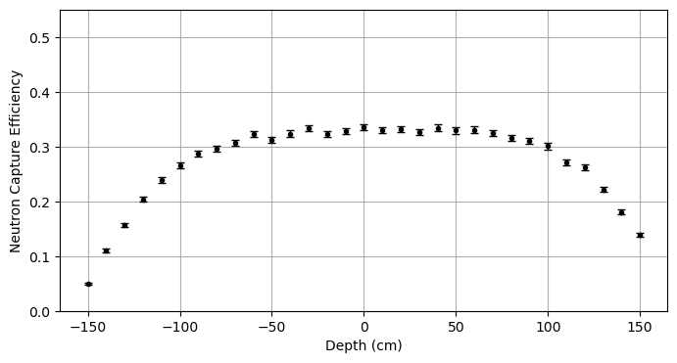
HALO Simulations: Efficiency vs. Detector Depth
y-position
y
x
x-position
z
Credit: Colin Bruulsema
Notes:
# of calibration runs – what is a calibration run
cjv@snolab.ca – ask abt color codes in plots, or remi

Slide 12
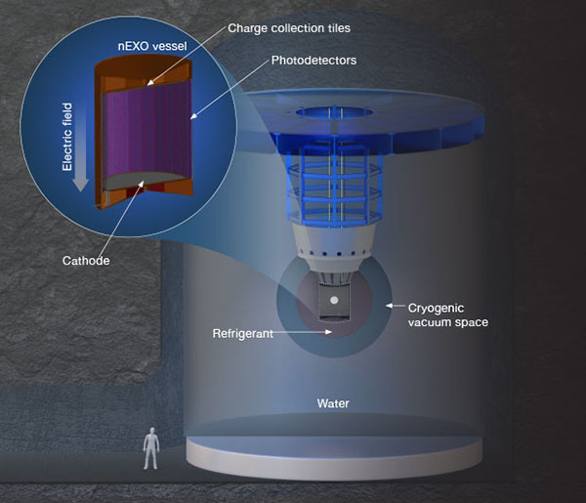
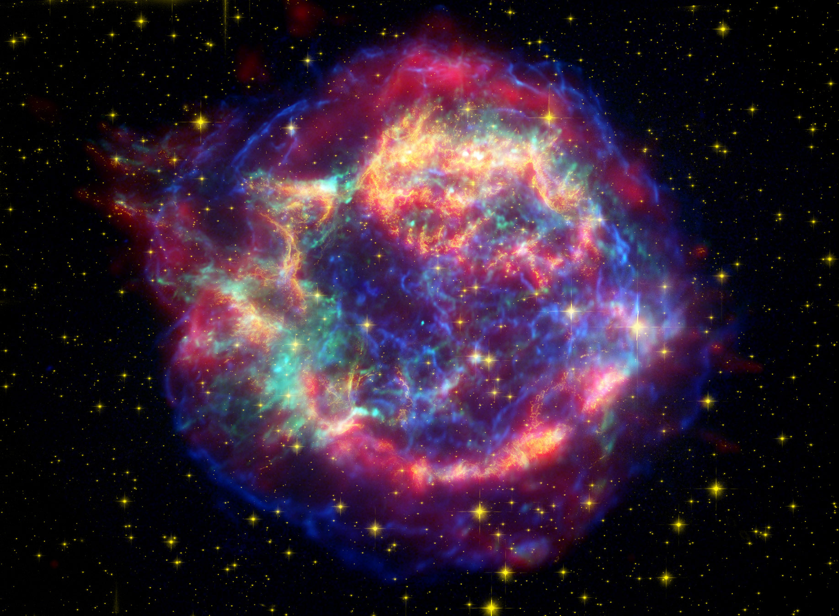
nEXO Simulations (Software Installation…)
https://www.scientificamerican.com/article/bizarre-supernova-defies-understanding/
https://nexo.llnl.gov/nexo-overview
Irina Nitu
Notes:
nEXO proposed nubb detector
Large tank of upw surrounding inner components, shields from various backgrounds
CCSN neutrino detection with outer detector?
Can we see light produced by IBD given PMT noise?

Slide 13
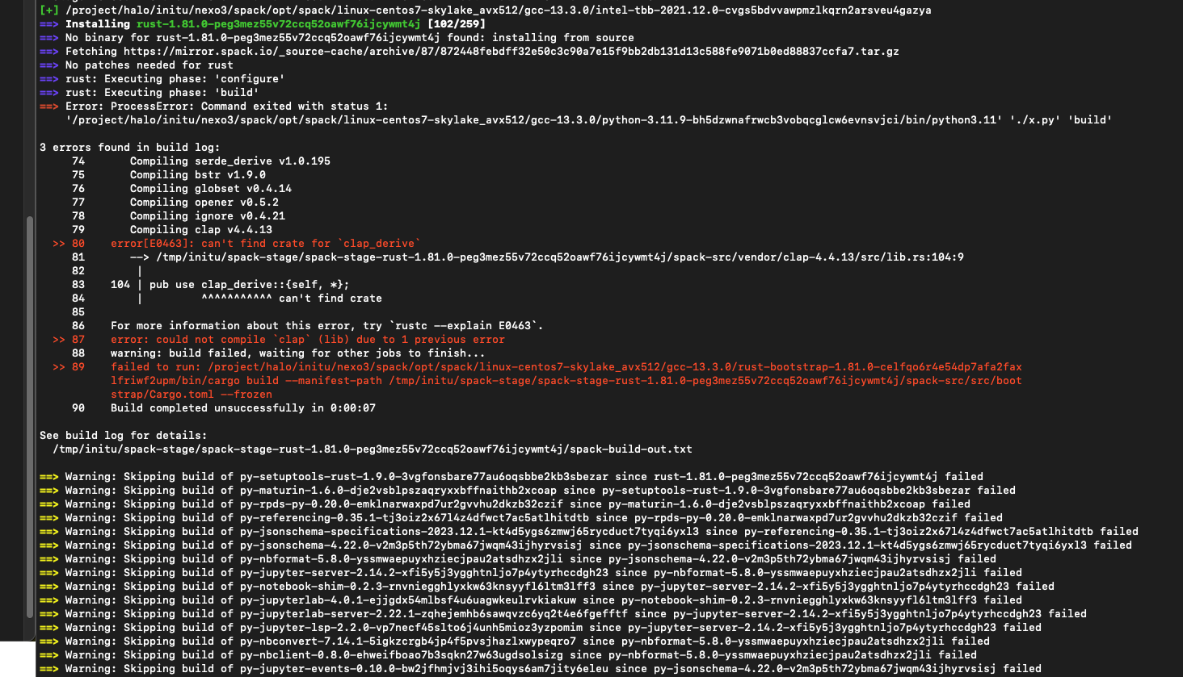
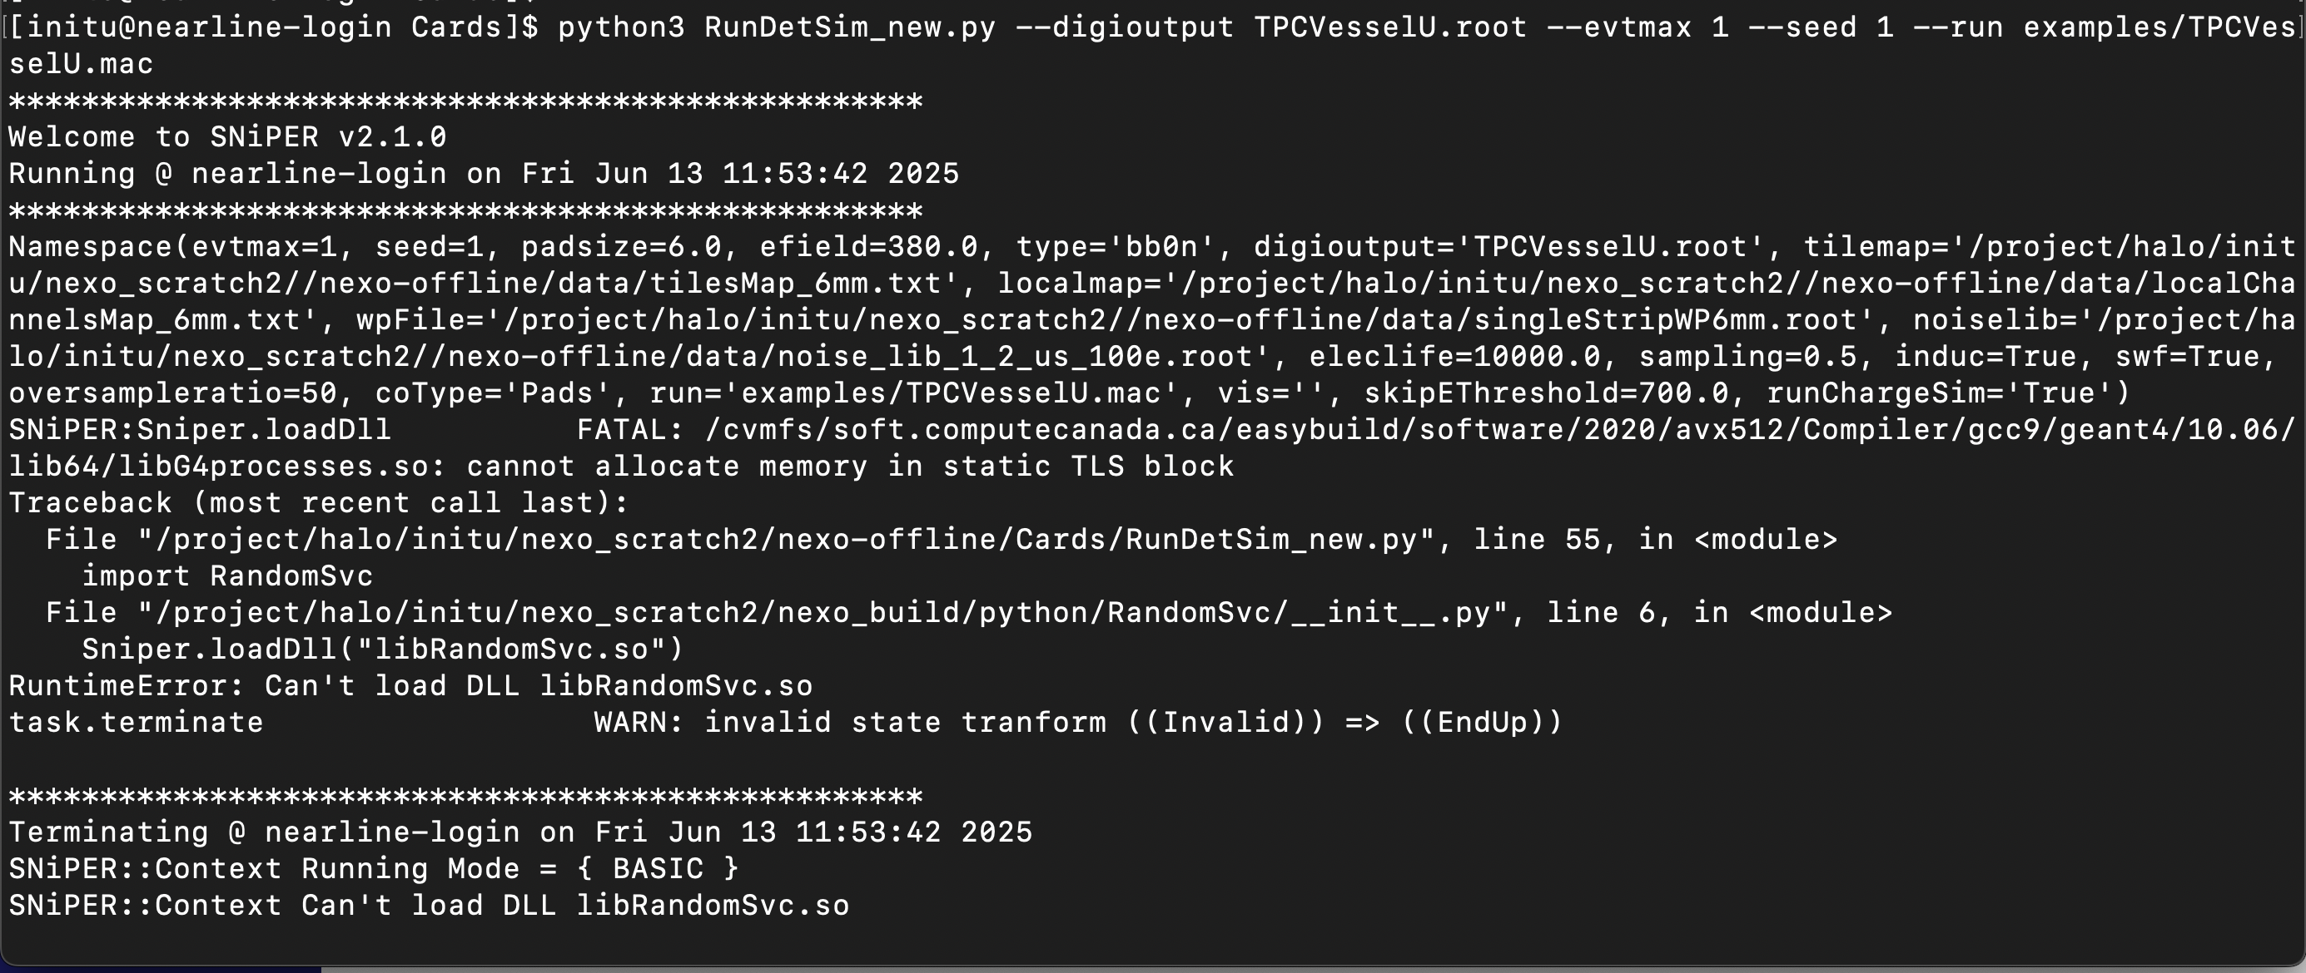
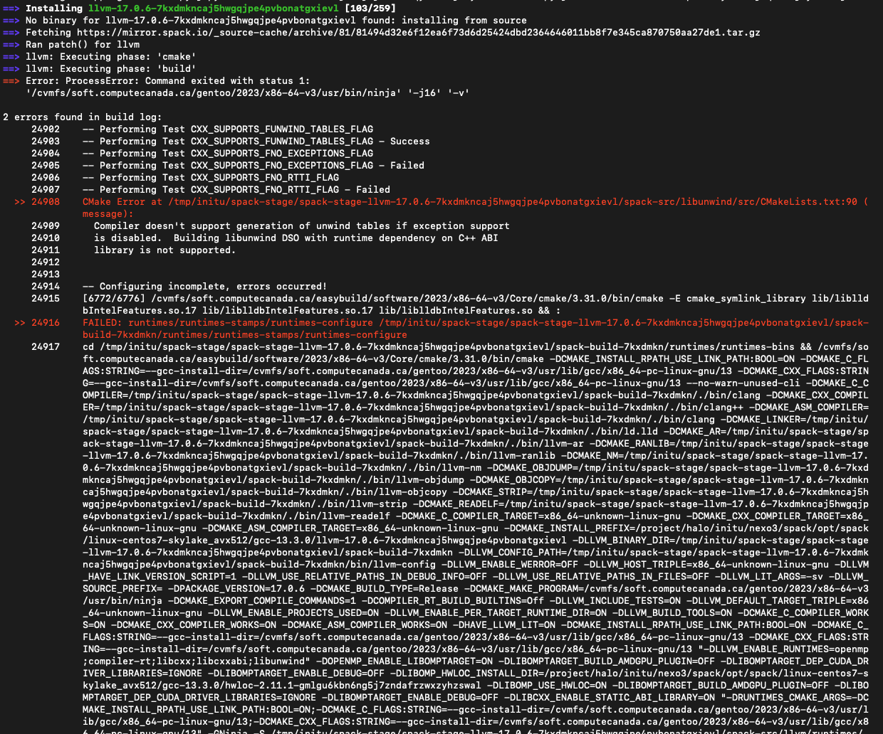
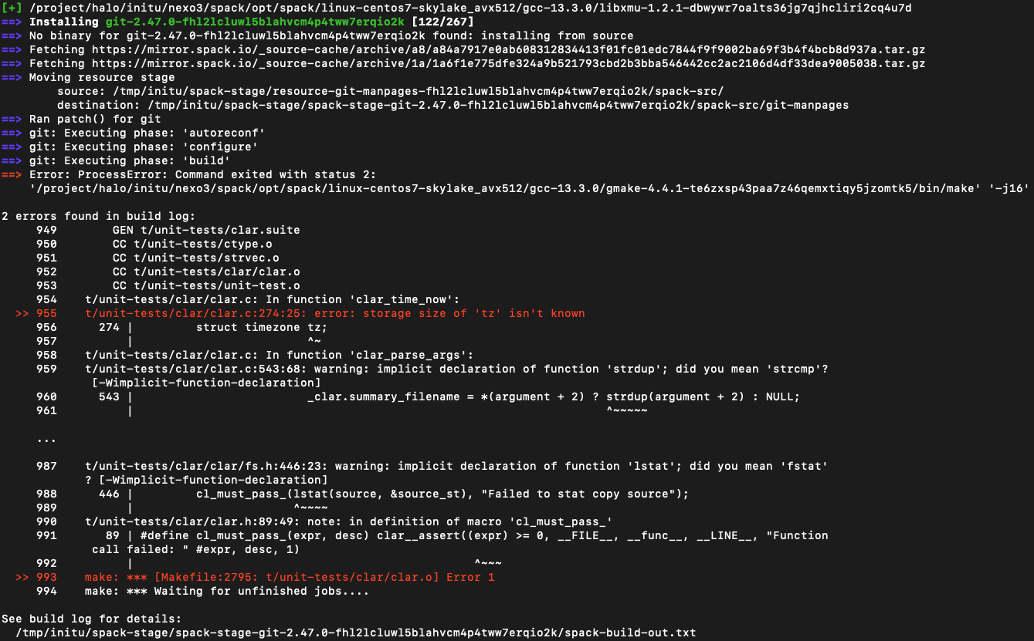
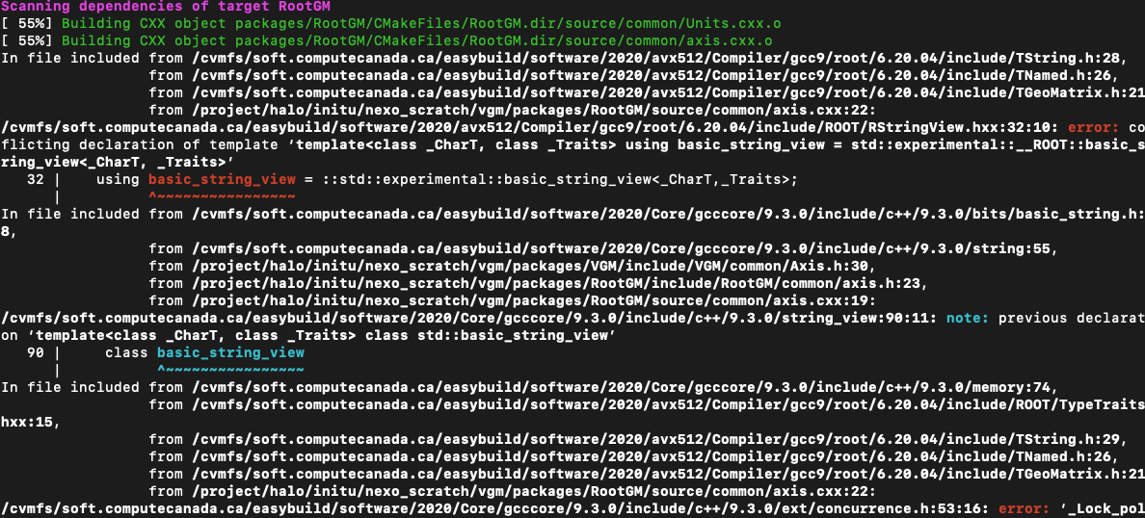
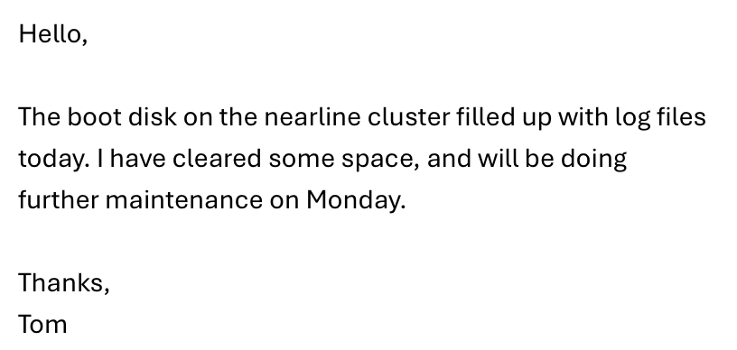
Anyone across Canada can now install and run nEXO simulation software!

Slide 14

Thank you!
irina.nitu@mail.mcgill.ca
Irina Nitu

Slide 15

Appendix: Neutrino Velocity Estimate
$$E^{2}={\left(pc\right)}^{2}+{\left(m_{0}c^{2}\right)}^{2}$$
$$p=mv=m_{0}γv$$
$$E^{2}={\left(m_{0}γvc\right)}^{2}+{\left(m_{0}c^{2}\right)}^{2}$$
$${\left(vγ\right)}^{2}=\frac{E^{2}−{\left(m_{0}c^{2}\right)}^{2}}{{\left(m_{0}c\right)}^{2}}$$
$${\left(vγ\right)}^{2}=\frac{v^{2}}{1−v^{2}/c^{2}}=\frac{1}{\frac{1}{v^{2}}−\frac{1}{c^{2}}}$$
Irina Nitu

Slide 16
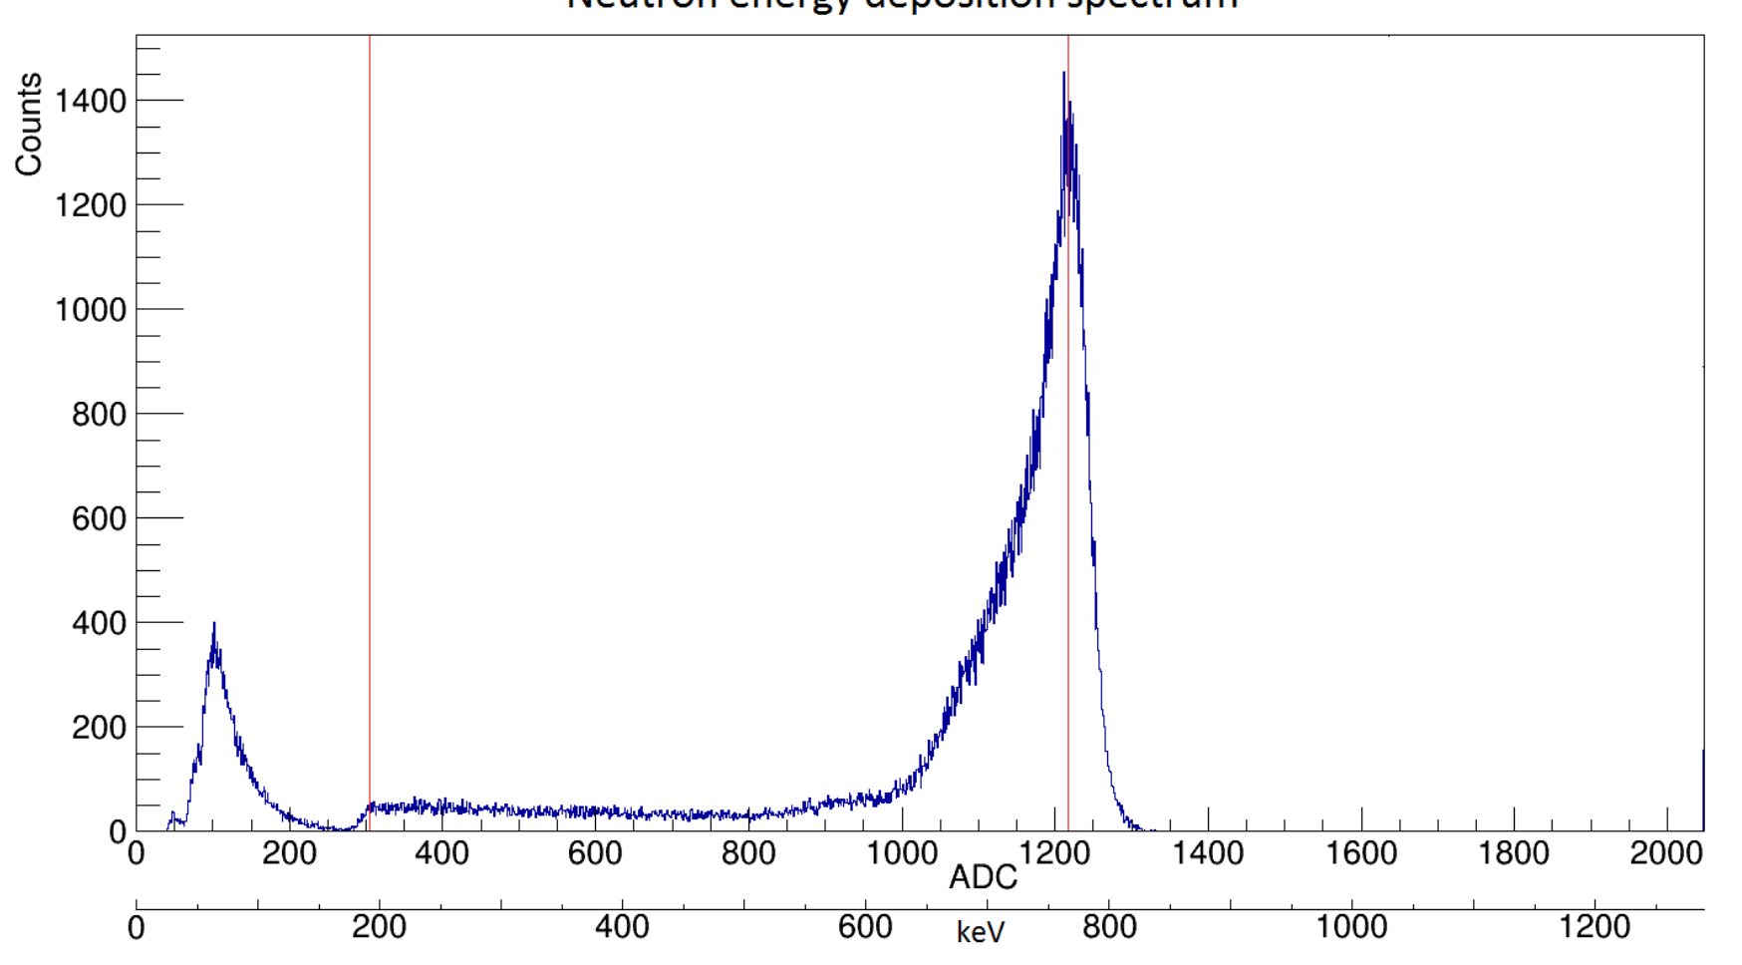
Appendix: Neutron Energy Deposition Spectrum
Irina Nitu

Slide 17
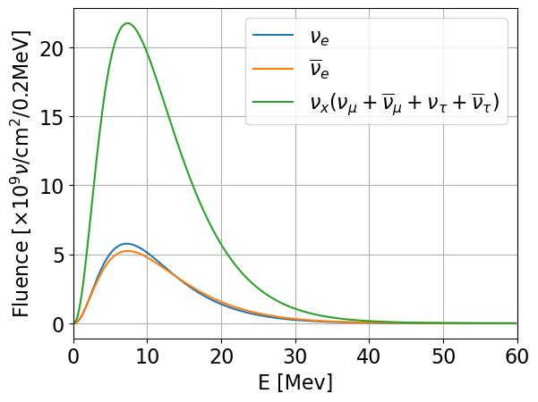
Appendix: Neutrino Spectrum
Irina Nitu

Slide 18
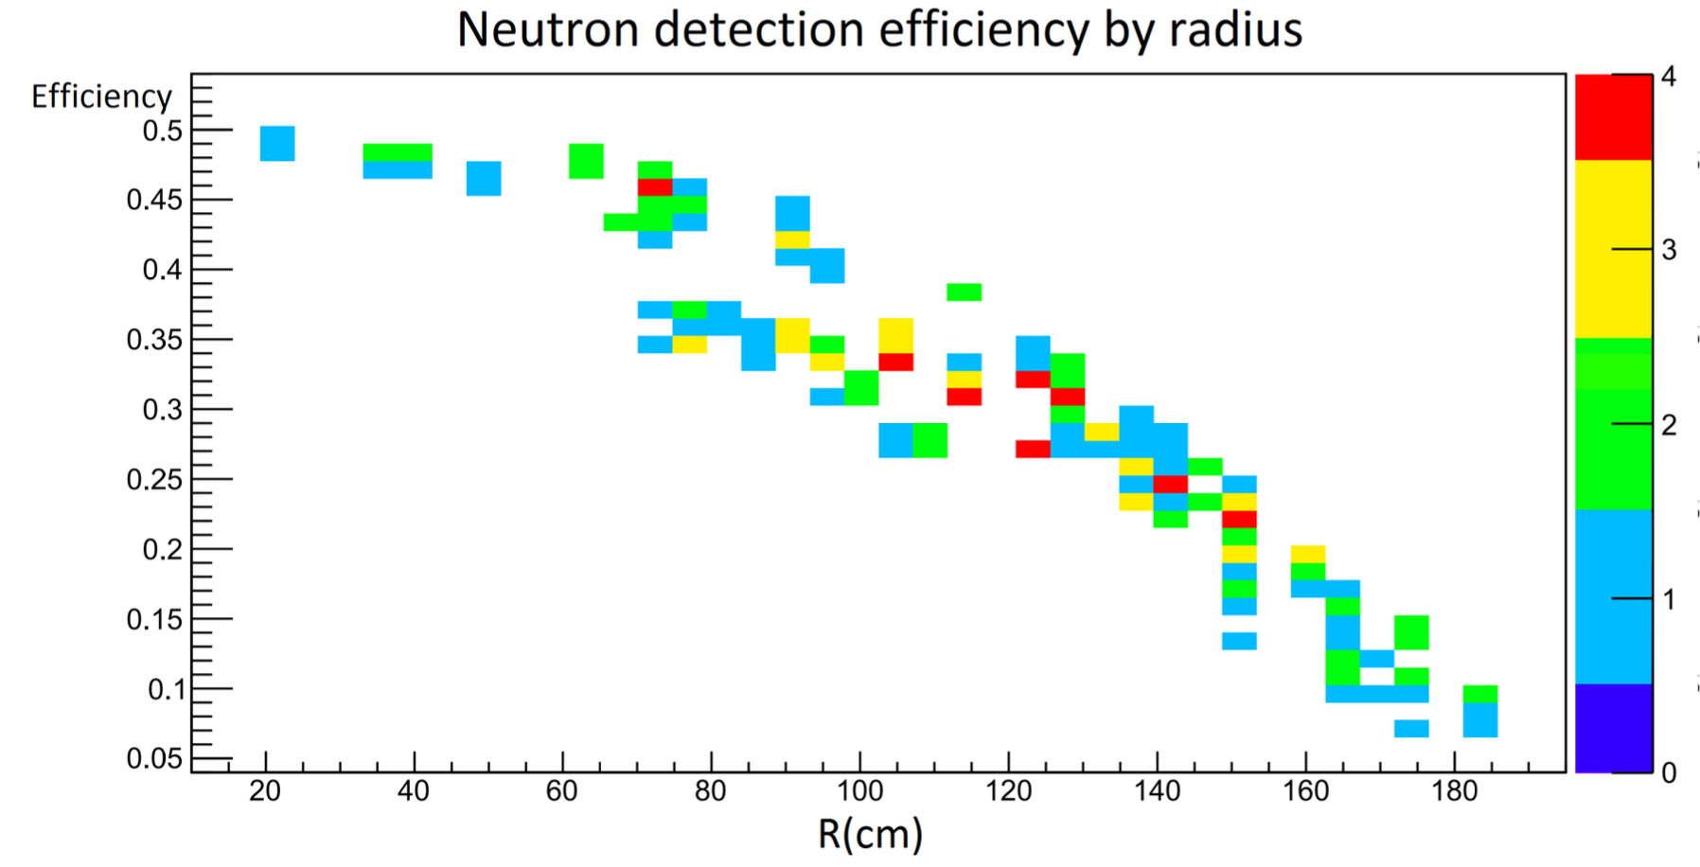
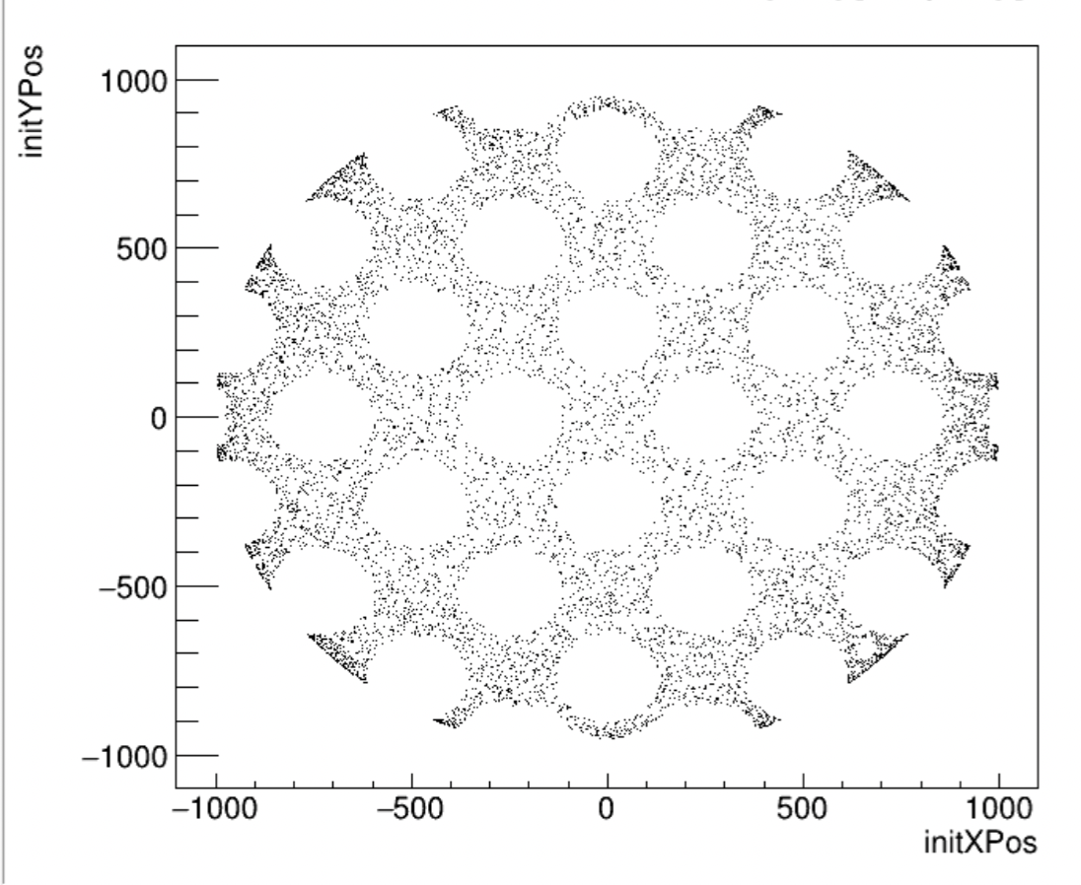
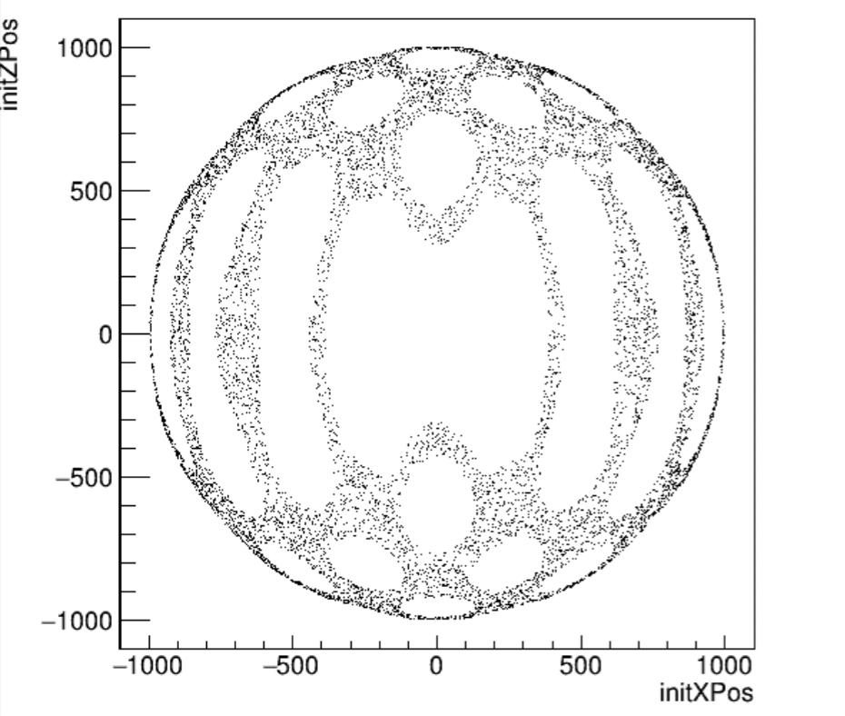
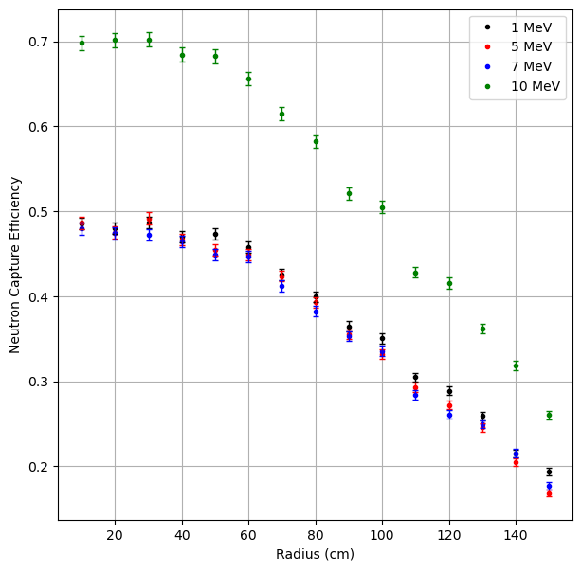
Appendix: HALO Simulations: Efficiency vs. Distance from Detector Center
Irina Nitu
Notes:
10000 monoenergetic neutrons

Slide 19
Multi-Messenger Astronomy with HALO
Can we detect neutrinos from GW events with HALO?
Neutrinos have mass, slightly slower than GW which travels at the speed of light c
Methodology:
  Look for GW events
  Estimate neutrino signal time delay
  Look for neutron bursts in HALO
Irina Nitu
Notes:
Can we detect neutrinos from GW events with HALO?
Neutrinos have mass, slightly slower than GW which travels at the speed of light c
Methodology:
Look for GW events
Estimate neutrino signal time delay
Look for neutron bursts in HALO

