Slide 1
Communications at
SNOLAB

Slide 2
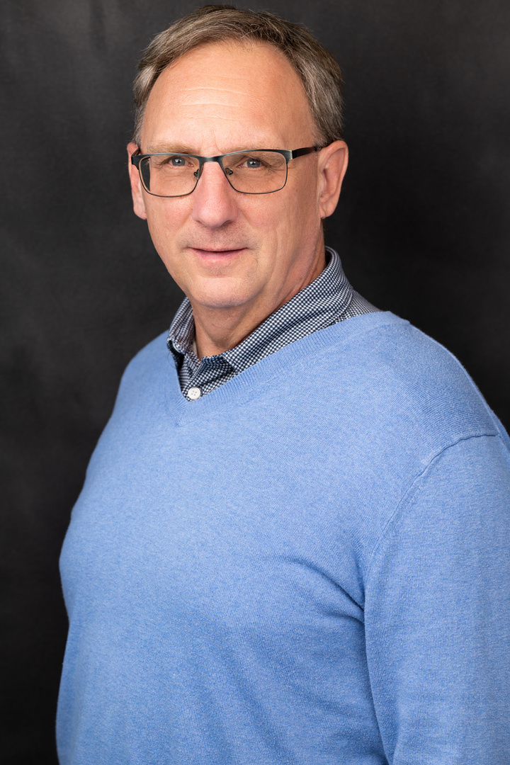
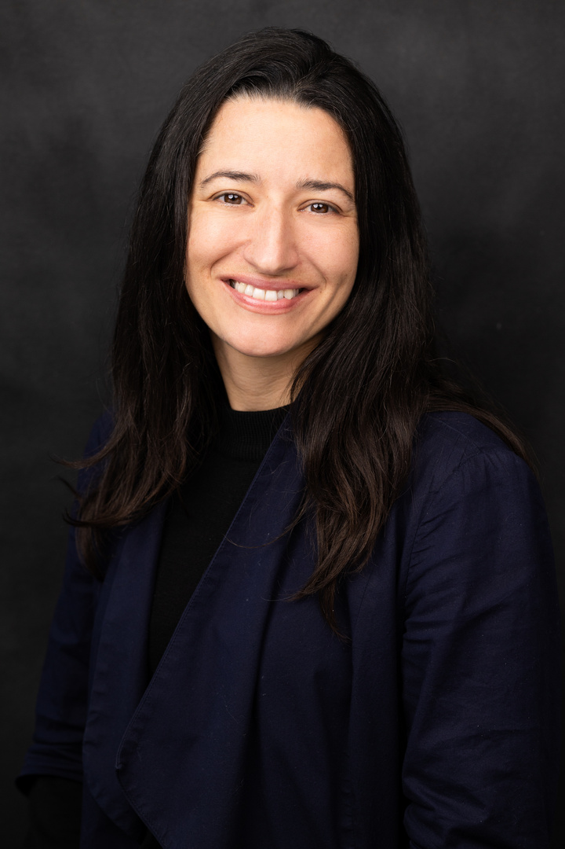
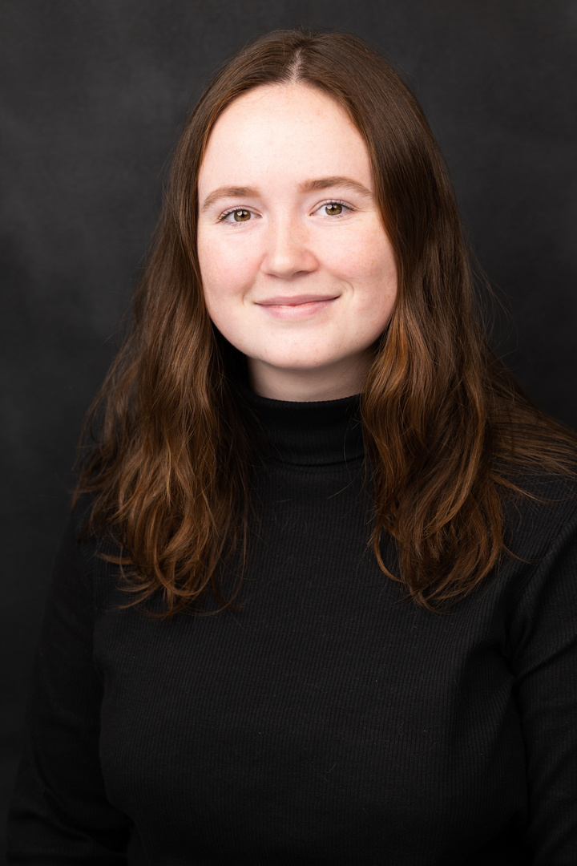
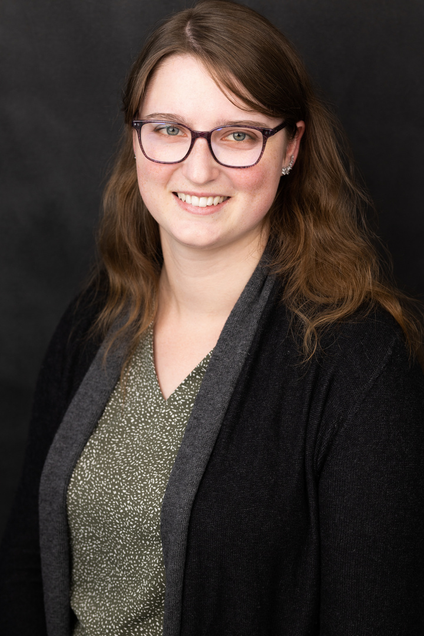
Mike Whitehouse (he/him)
Blaire Flynn (she/her)
Juliette DeLoye (she/her)
Rachel Richardson (she/her)
Senior Public Relations Officer
Senior Education & Outreach Officer
Education & Outreach Coordinator
Education & Outreach Coordinator

Slide 3


SNOLAB Style Guide & Assests
Provides information on how to communicate
  consistent with SNOLAB standards
Includes document templates and logos
Guide for creating SNOLAB email signature
On SharePoint, search "Communications”
https://snolab.sharepoint.com/sites/Communications
Notes:
Then show the actual SharePoint site and poke around a bit – we can cover:
The actual style guide + highlight areas from the table of contents
The email signature info
Logos
Templates

Slide 4
How should you refer to your new workplace?
The SNOLAB
Snolab
SNOLAB
All of the above
Notes:
Then show the actual SharePoint site and poke around a bit – we can cover:
The actual style guide + highlight areas from the table of contents
The email signature info
Logos
Templates

Slide 5
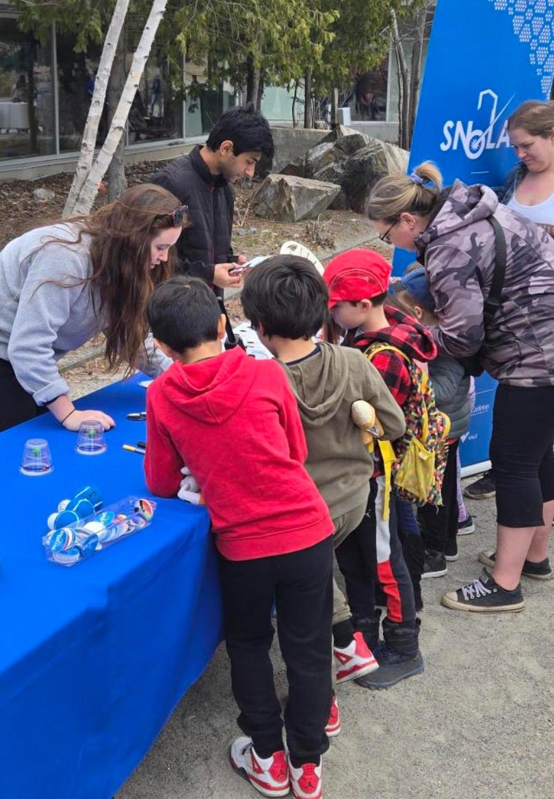
Outreach opportunities
Look for emails from E&O about
  opportunities
We can provide support for
  virtual classroom visits
Let us know if outreach is
  something you are interested in

Slide 6
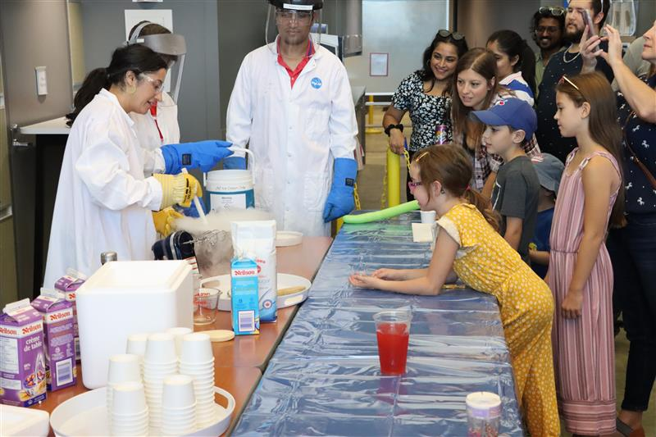
Outreach opportunities
Creighton Mine Friends & Family Day
  Saturday, September 20th
  1 - 6pm
Let us know if you want to come help out!

Slide 7

SEEDLING Program
For students in Grade 4 – 8 to explore scientific inquiry and propose small experiments underground
Pilot program to launch this Fall
Opportunities for SNOLAB students to get involved!

Slide 8
Social media best practices
You are responsible for all content you post on the web and to social platforms – never speak on behalf of SNOLAB
You are expected to demonstrate best practices and appropriate etiquette
Follow the SNOLAB social media policy and our best practices
Sharing pictures/ content from your time at SNOLAB is encouraged
  @SNOLABscience
  #SNOLABscience
  #StudentsAtSNOLAB

Slide 9
Social media best practices
Some things to keep in mind:
  Check with your supervisor when sharing details of an experiment
  Make sure that you and everyone in the photo are wearing ALL required PPE (put on hard hats at desks)
  Be respectful when taking photos underground – not everyone wants to be photographed
  Only take photos on SNOLAB property
  Review the Social Media Policy and Procedure on Docushare
Notes:
Social media policy Docushare Link:
https://www.snolab.ca/docushare/dsweb/Get/ControlledDocument-1532/SL-MCS-COM-30-003-PO-Social-Media-Policy_Rev_00%20(2022-06-01).pdf
Social media procedure in DocuShare:
https://www.snolab.ca/docushare/dsweb/Get/ControlledDocument-1124/SL-MCS-COM-30-003-P-Social-Media-Procedure_Rev_00%20(2022-06-01).pdf

Slide 10
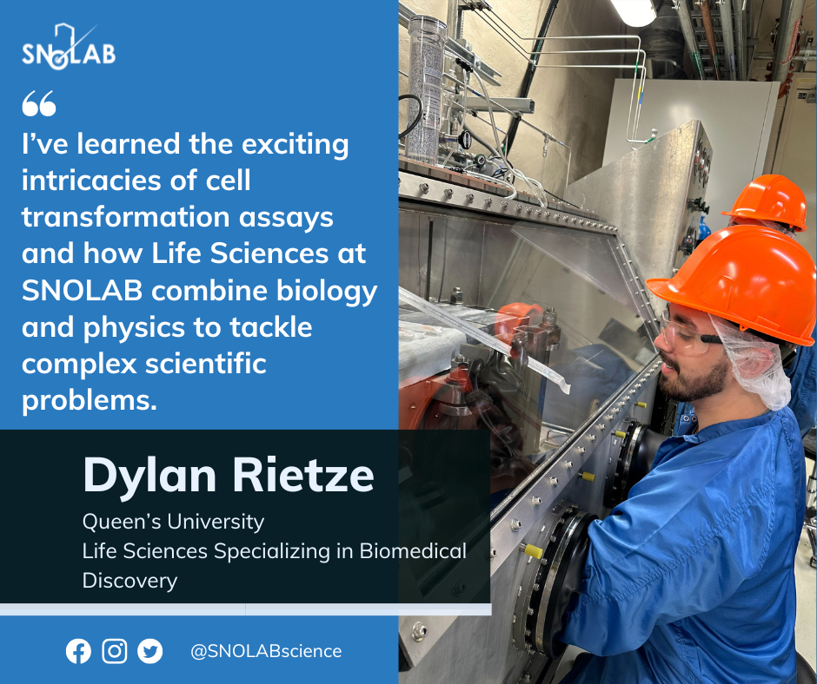
Student profiles
Features for students on SNOLAB social media - highlights important work that you are all taking part in
We will reach out during your term and ask for information and a photo – we can help take photos of you at SNOLAB

Slide 11
Communicating your science
  Sit in on practice talks
  Provide slide design help
  Review poster designs
  Share your photos
Notes:
Maybe a photo from a previous student talk?

Slide 12
Check out our webpage!
  Experiment posters
  Virtual tour
  Lesson plans
  Presentation request form
  https://www.snolab.ca/outreach/snolab-outreach/
Notes:
Maybe a photo from a previous student talk?

Slide 13
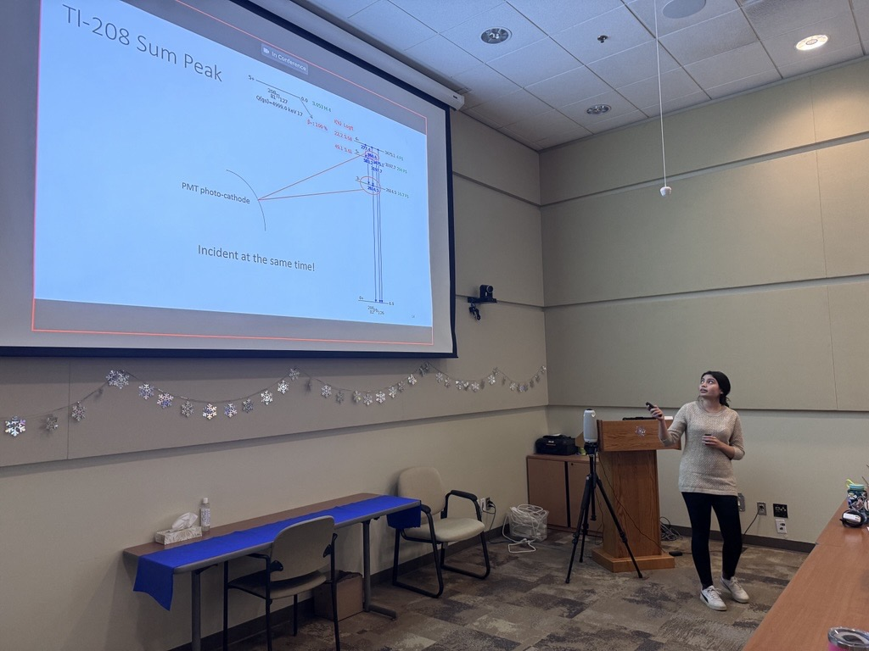
Workshop on presentations
  Workshop will be focused on:
    Slide design
    Effective delivery
    Planning the workshop before student talks

Slide 14
Questions?

