Slide 1

SuperCDMS Update
Miriam Diamond, University of Toronto
(for the SuperCDMS Collaboration)
SEF Meeting
Feb 11 2026
Toronto, ON

Slide 2
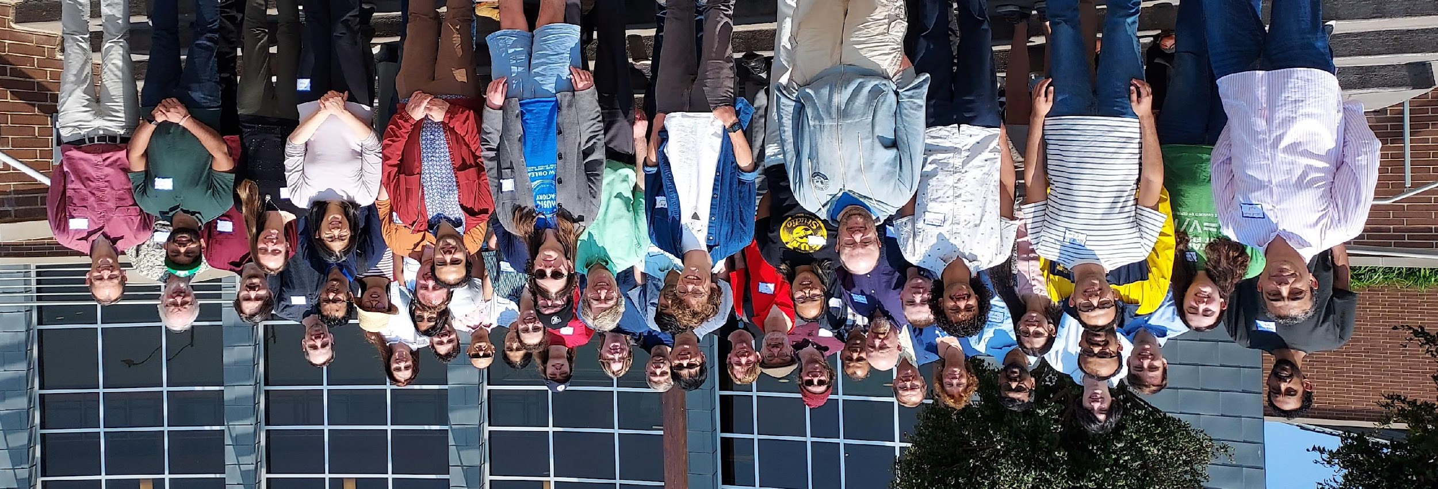

THE SUPERCDMS COLLABORATION
2025 SUMMER COLLABORATION MEETING AT UNIVERSITY OF SOUTH DAKOTA
>130 SCIENTISTS AT 28 INSTITUTIONS, 6 COUNTRIES

Slide 3
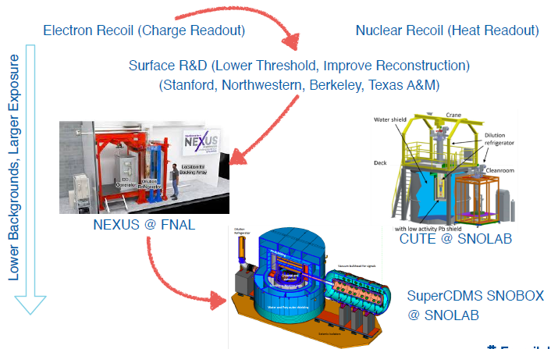
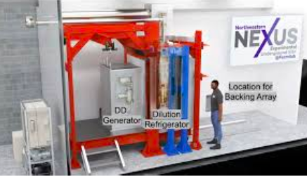
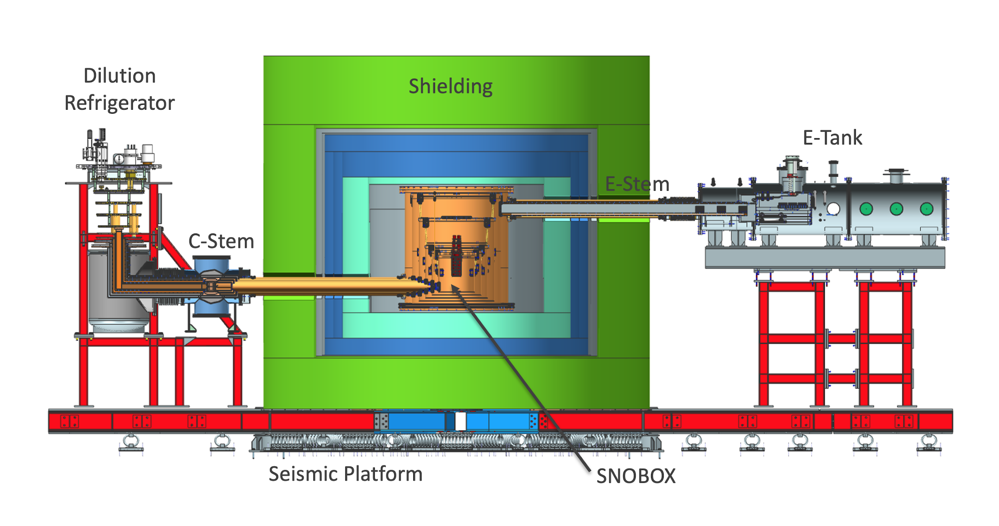
Multiple test facilities, channels, and R&D programs provide science leading to SuperCDMS SNOLAB
Surface R&D Facilities
Operational
Commissioning
NEXUS @FNAL
CUTE @SNOLAB
SuperCDMS SNOLAB

Slide 4
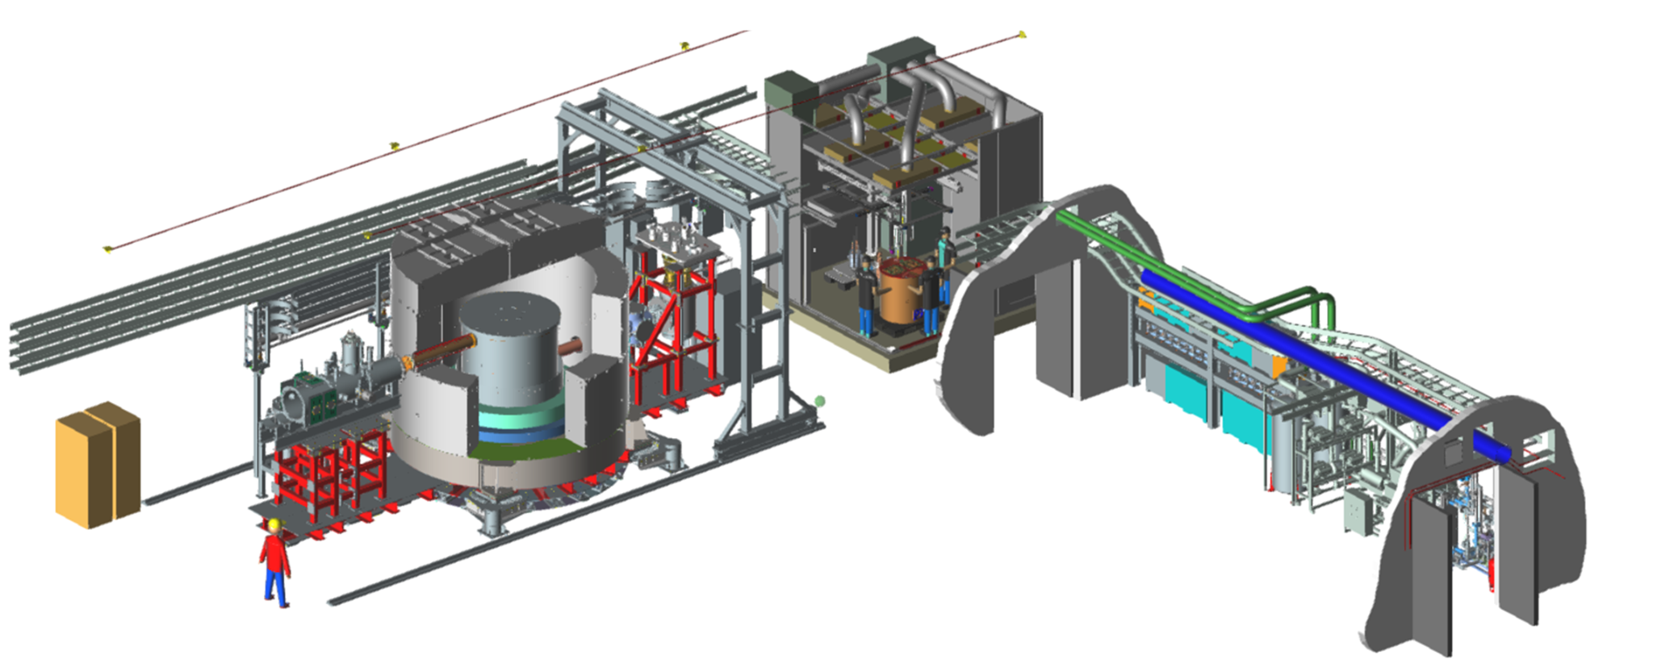
SuperCDMS SNOLAB experiment layout in Ladder Lab
E-Tank provides 50K cooling, houses Electronics, supports Calibration System
Low Radon Clean Room for component assembly
Utility Drift with Radon Reduction System
Dilution Refrigerator
DAQ
Copper Cryostat enclosing Detector Towers
Background Shield

Slide 5
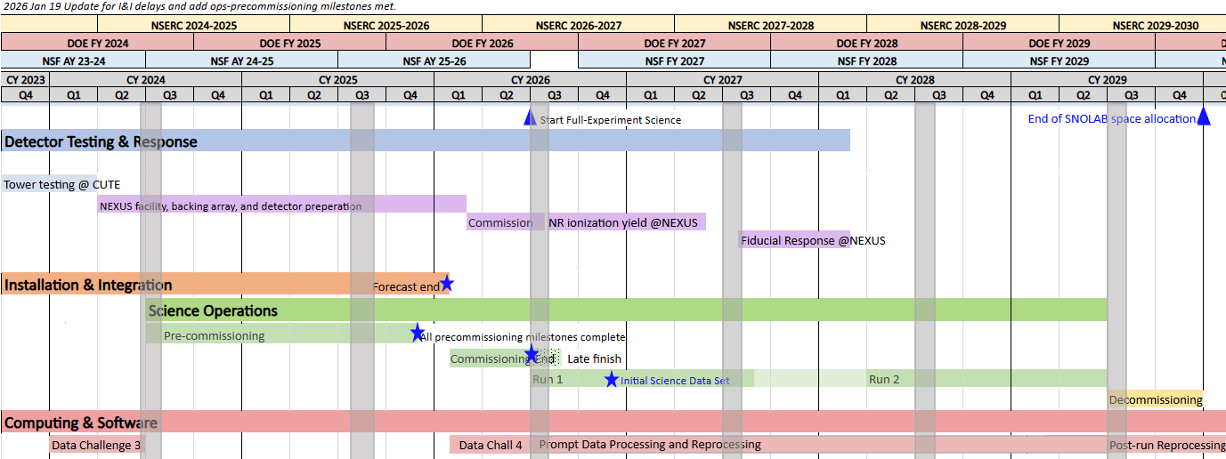
Multi-pronged approach: Test facility results help us maximize discovery reach of SNOLAB experiment

Slide 6
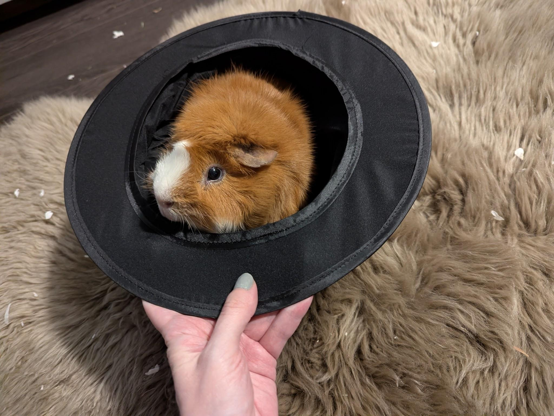
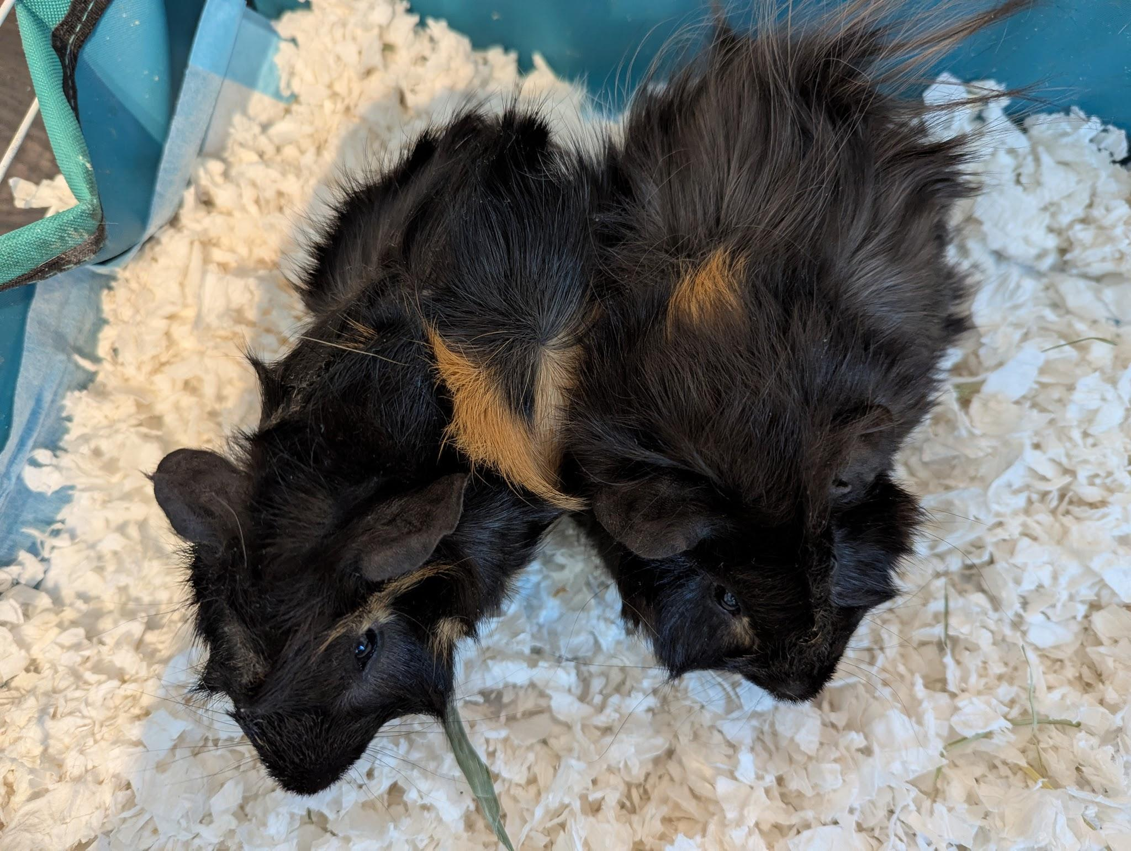
Outline
SuperCDMS strategy & science goals
SuperCDMS SNOLAB Installation & Integration: just completed
SuperCDMS SNOLAB Commissioning: just began
Recent publications & in-progress analyses from Test Facilities

Slide 7
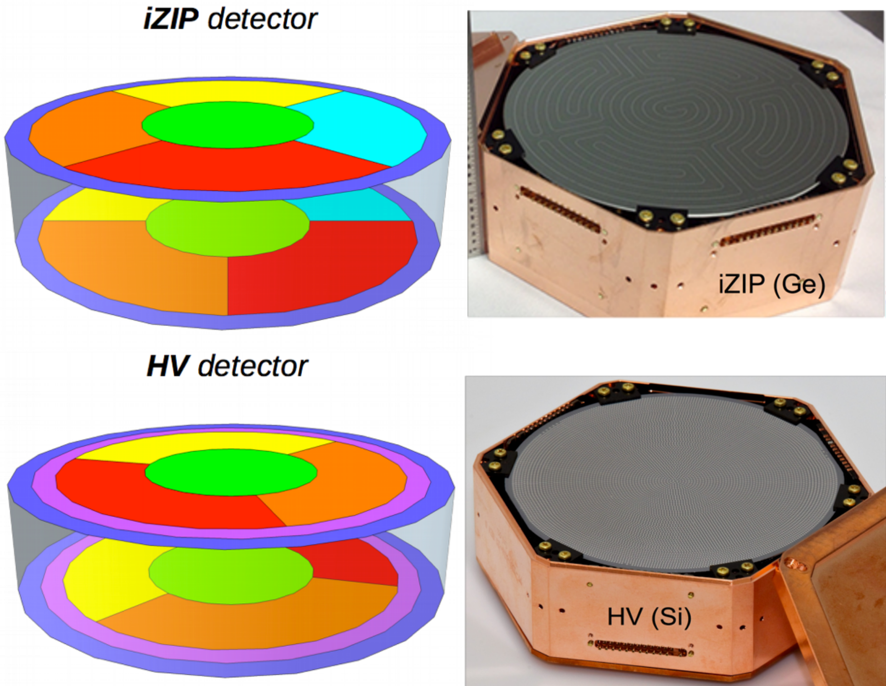
SuperCDMS strategy: 2 detector types, 2 target materials perform complementary functions
Type | Germanium | Silicon
HV | Lowest threshold for low mass DM Larger exposure, no ³²Si backgrond | Lowest threshold for low mass DM Sensitive to lowest DM masses
iZIP | Nuclear Recoil Discrimination Ge background analyses, ⁸B ν-scatter | Nuclear Recoil Discrimination Si background analyses, ⁸B ν-scatter
Tower 1
6 Ge iZIP
Tower 2
4 Ge HV
2 Si HV
Tower 3
4 Ge HV
2 Si HV
Tower 4
4 Ge iZIP
2 Si iZIP

Slide 8
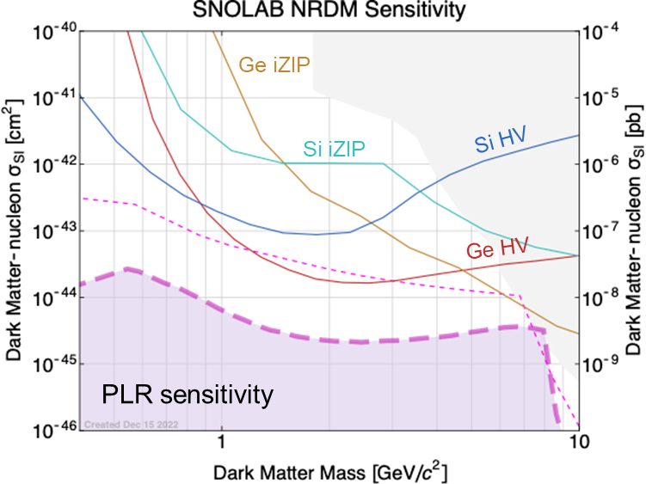
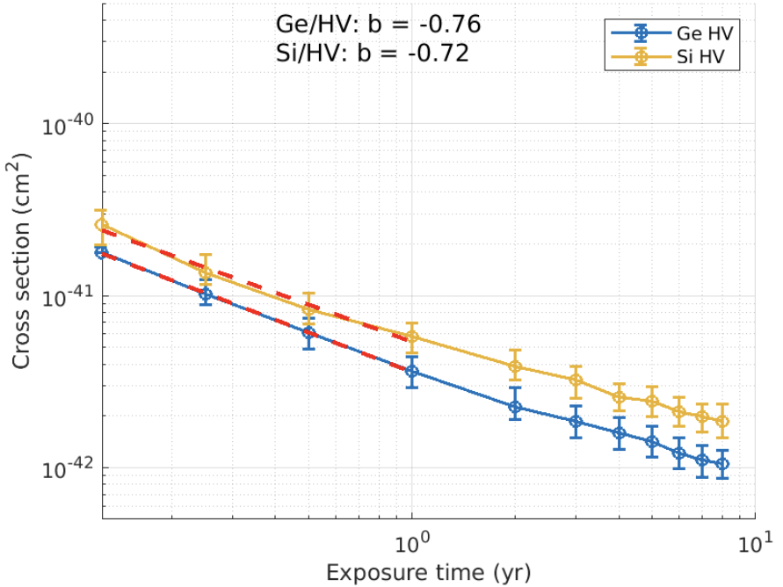
SuperCDMS goals: Coverage of low-mass WIMP region + sensitivity to electron-recoiling DM
ERDM Sensitivity,
F = 1, DM Mass 0.01 GeV

Slide 9
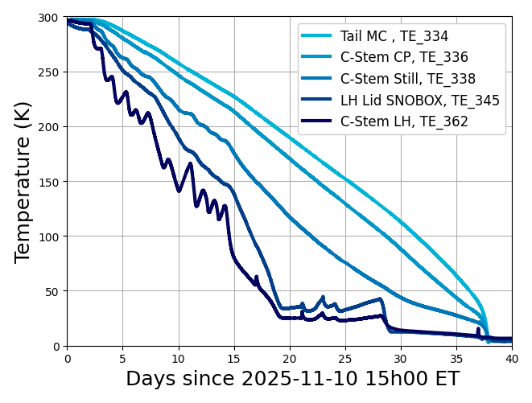
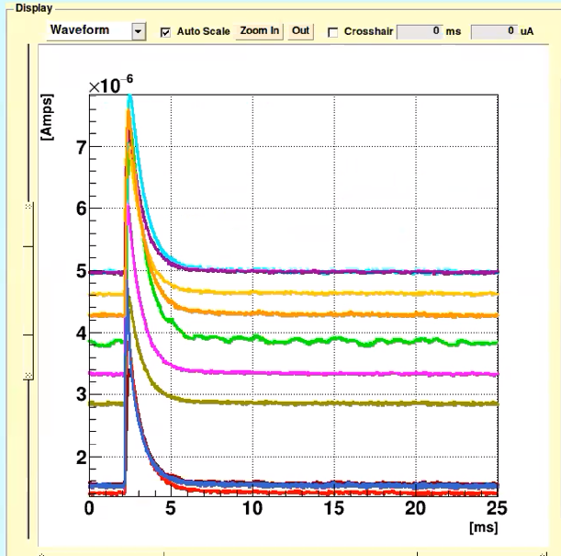
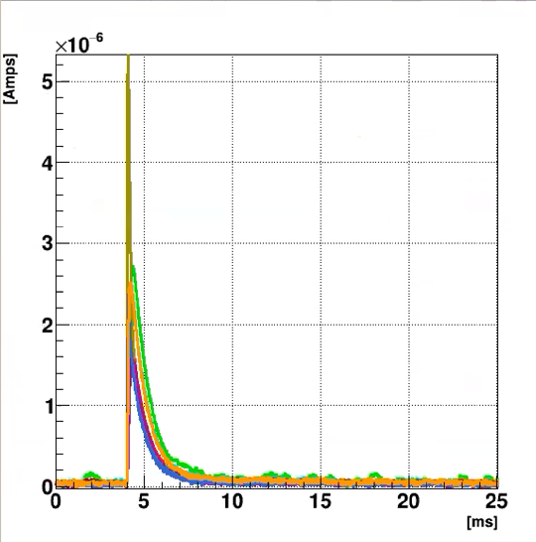
SuperCDMS SNOLAB “Installation & Integration” just finished!
11/10: Cooldown started
12/14: Reached < 70K
12/18: Reached < 4K
1/9: Condensing LHe
1/13: Base temp first reached
1/29: First pulses from superconducting TESs! End of I&I
Detectors currently operating at 35-40 mK

Slide 10
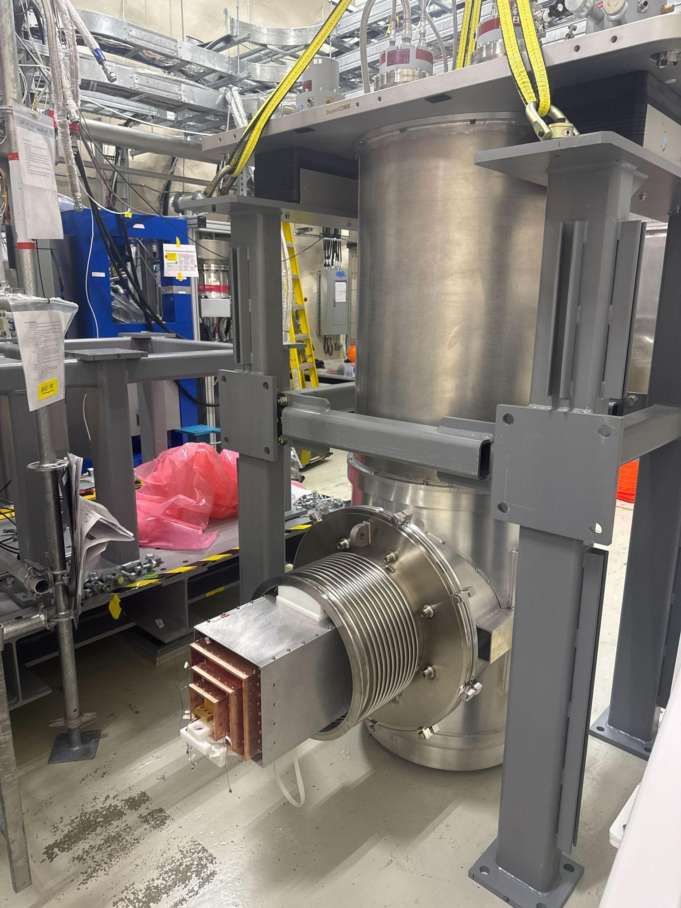
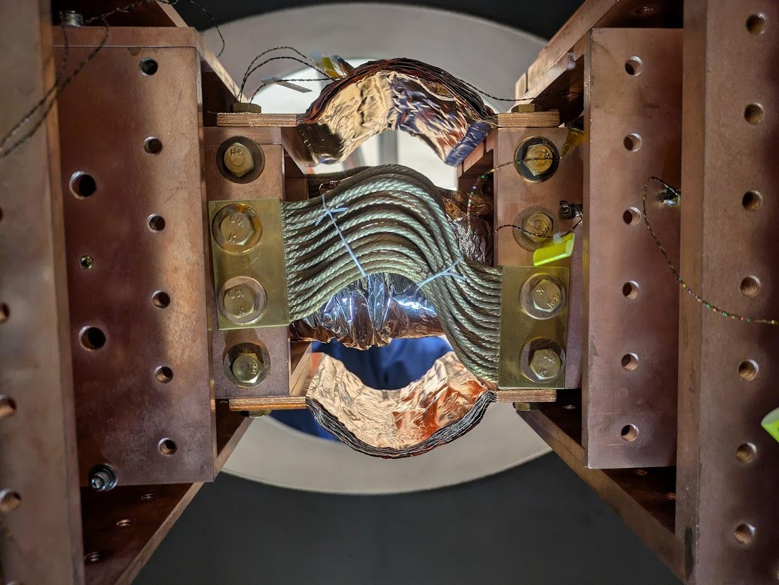
Dilution Refrigerator (DR) with cryogenic tails, just prior to its installation
Thermal straps providing thermal connection from the DR to cryostat (Cold Plate thermal stage shown)

Slide 11
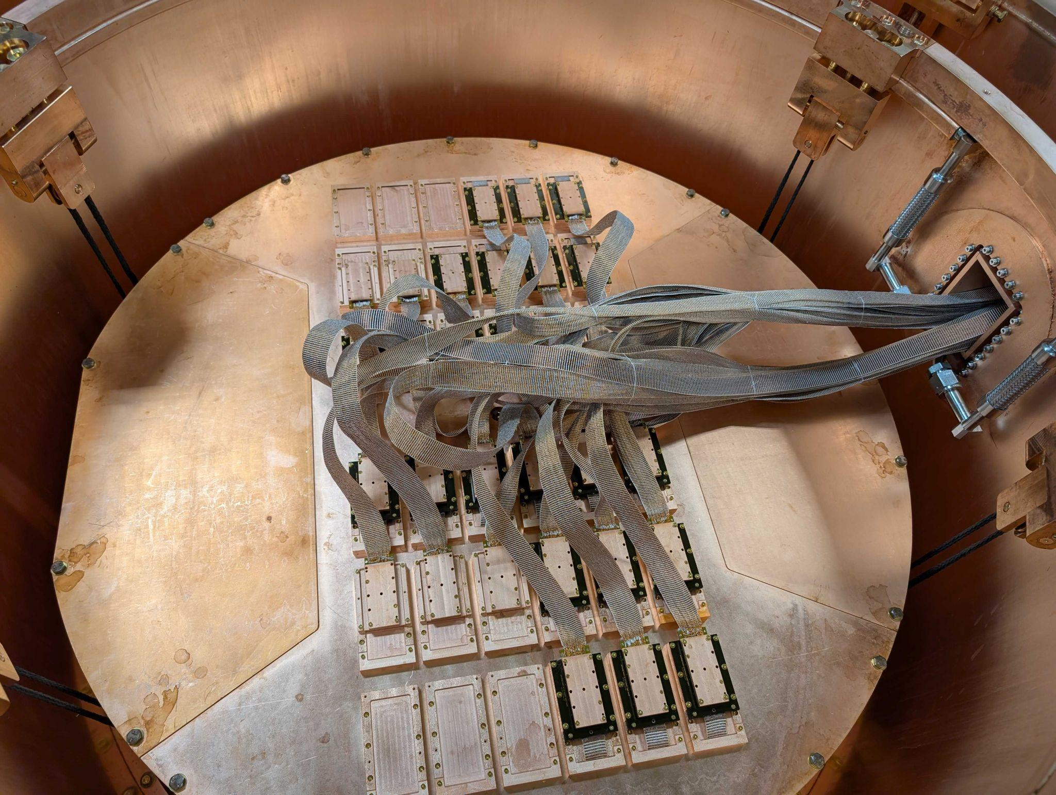
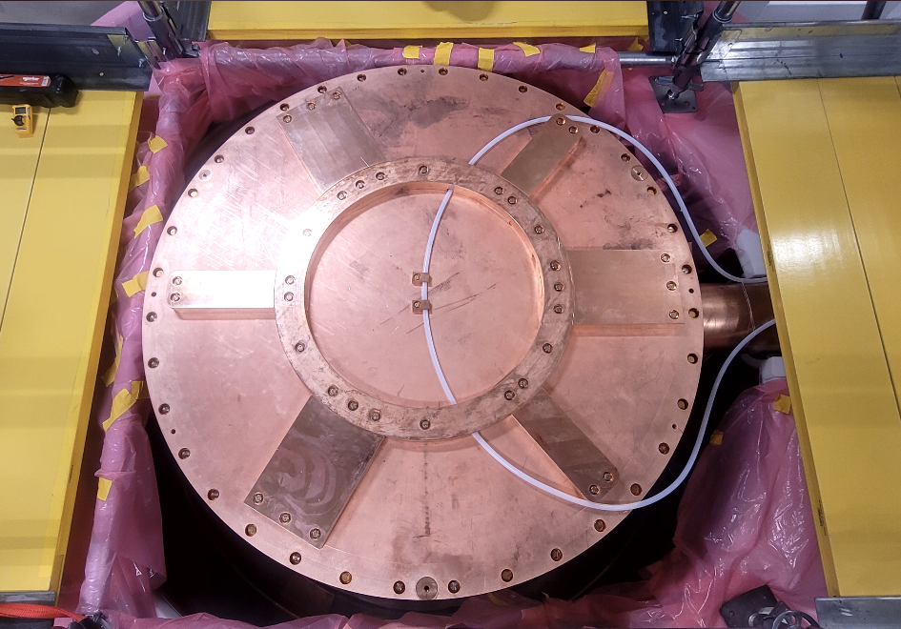
Cables connecting the detectors to E-Tank vacuum feedthroughs & readout electronics boards
Closed cryostat, with nylon guide tube for deploying Ba calibration source

Slide 12
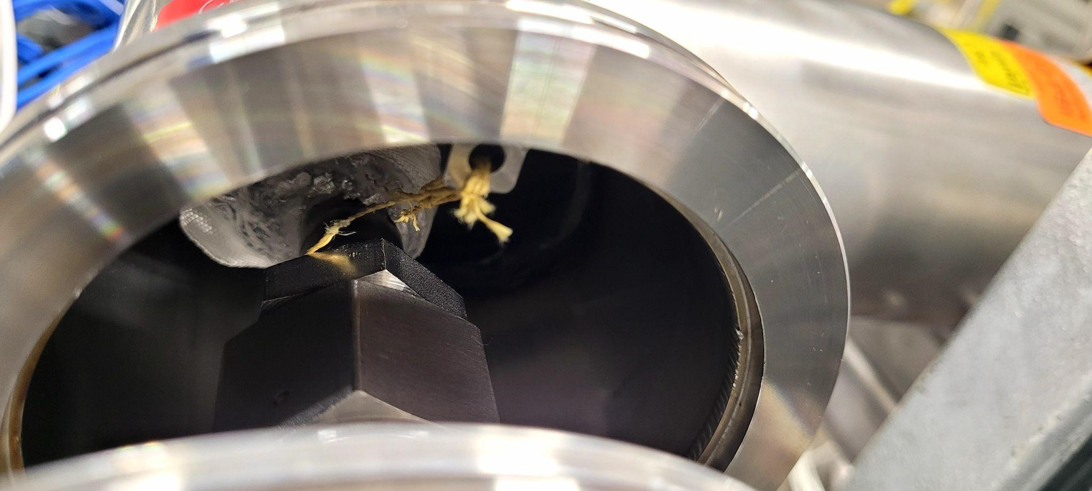
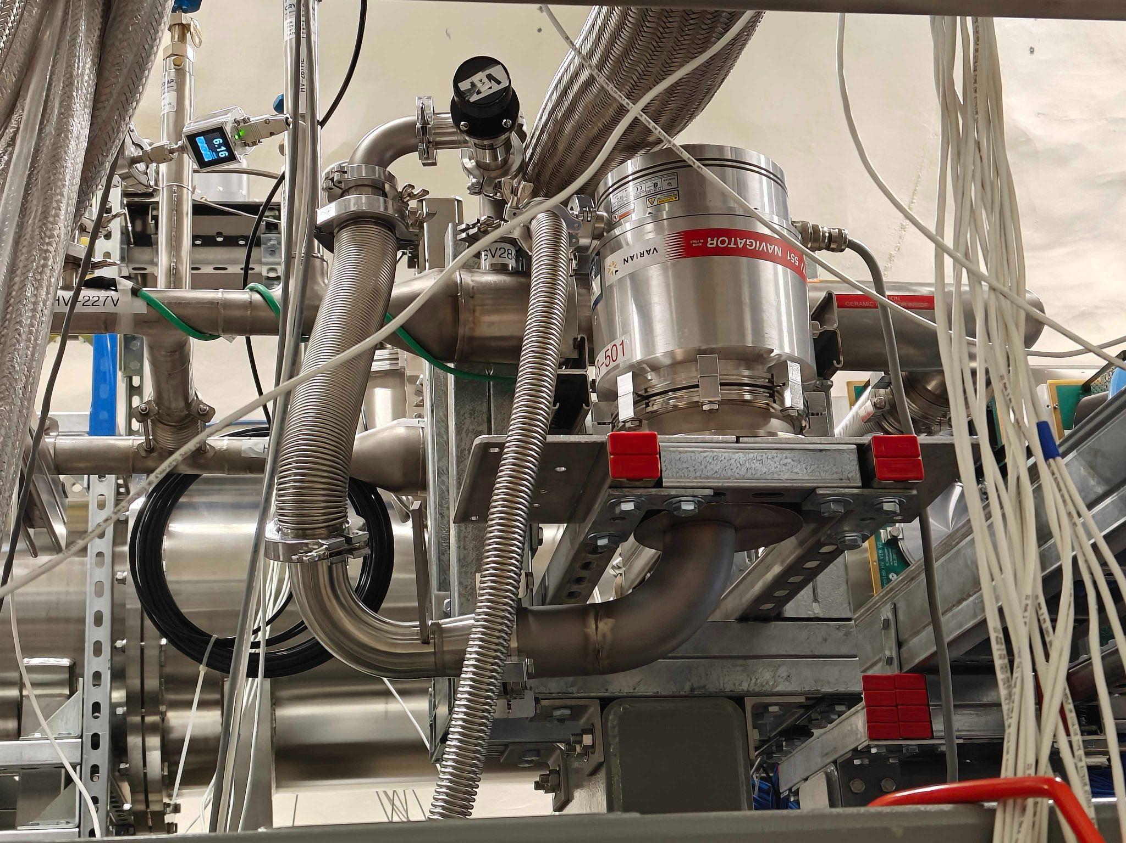
Temporary vacuum pumping setup out-pumps the bayonet leak, until bayonet can be replaced in a few months
There’s a small leak in the 50K He cooling line, in “bayonet” connecting 50K cooler to E-Tank

Slide 13
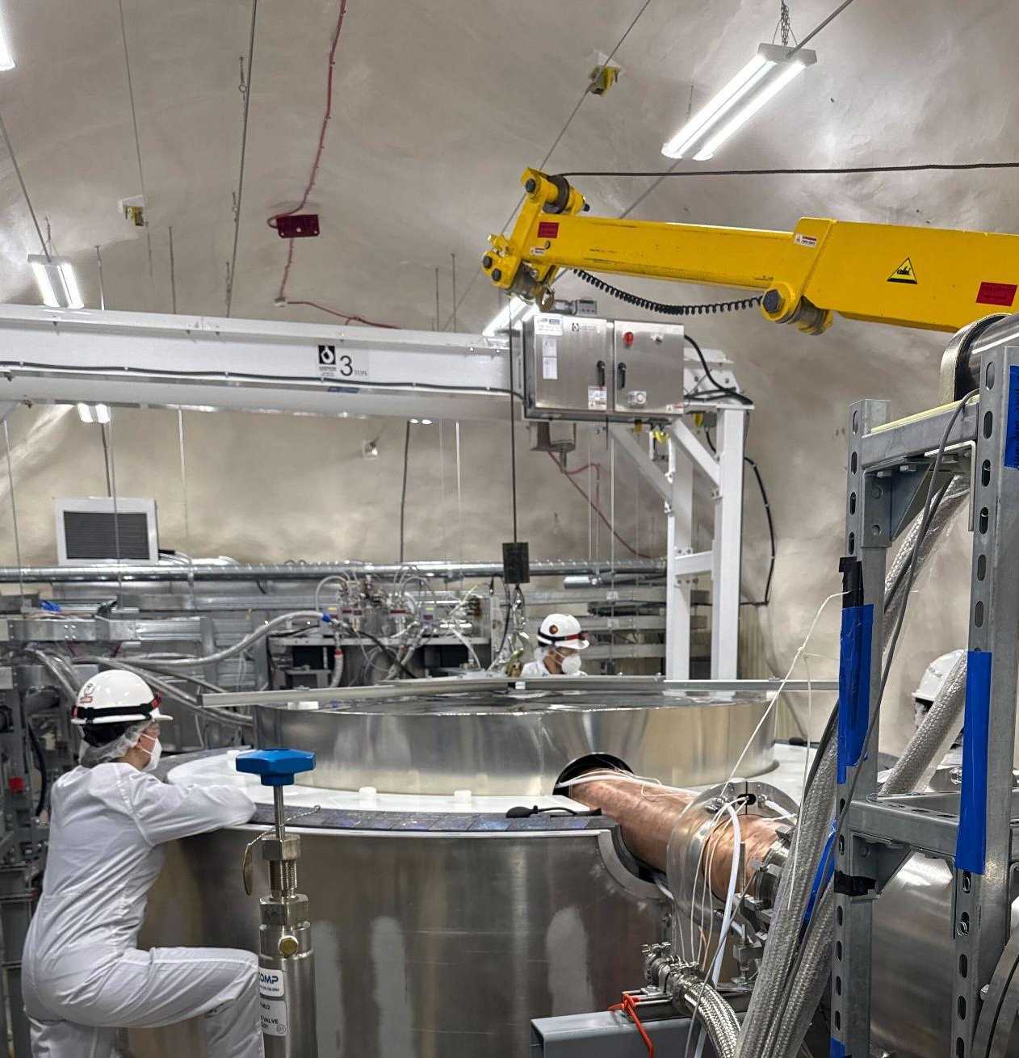
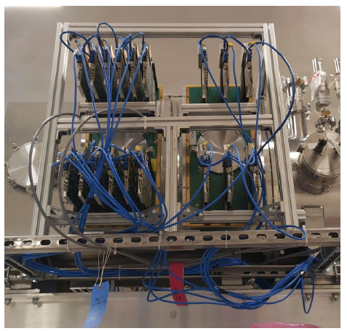
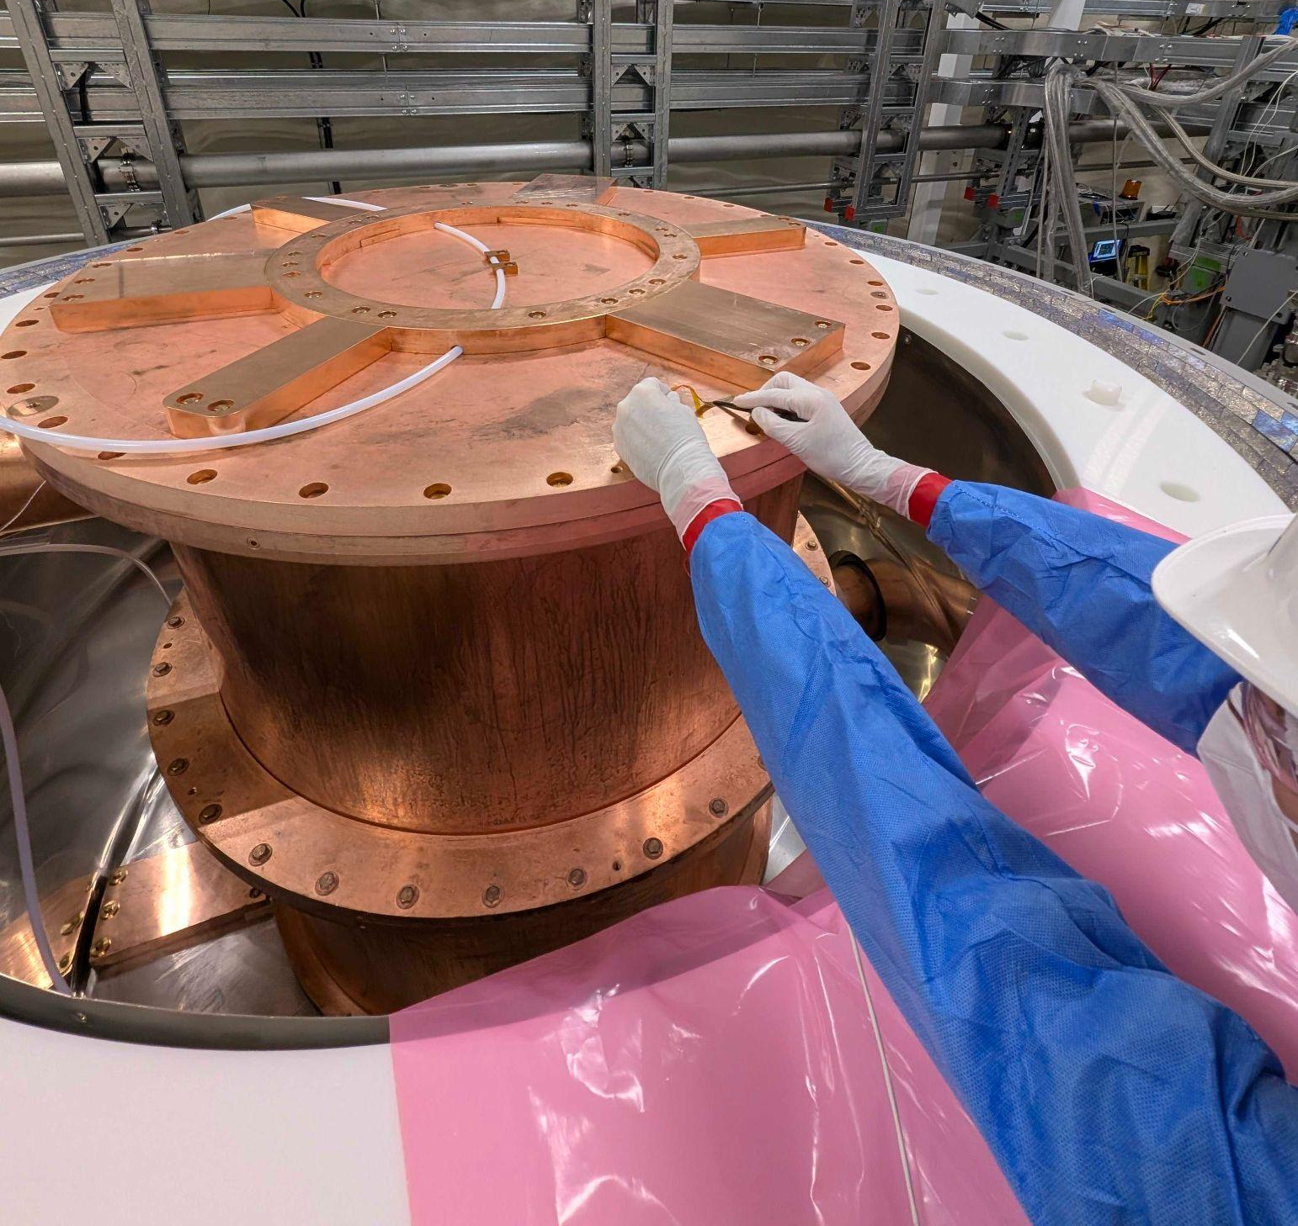
Installing top section of 𝜇-metal shield to protect detectors from Earth’s magnetic field
Readout electronics cards mounted to the E-Tank vacuum feedthrough
Installing heaters to offset radiative cooling

Slide 14
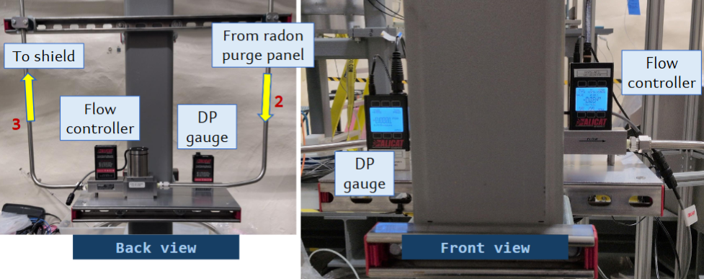
Radon purge subsystem: differential pressure gauge + flow controller

Slide 15
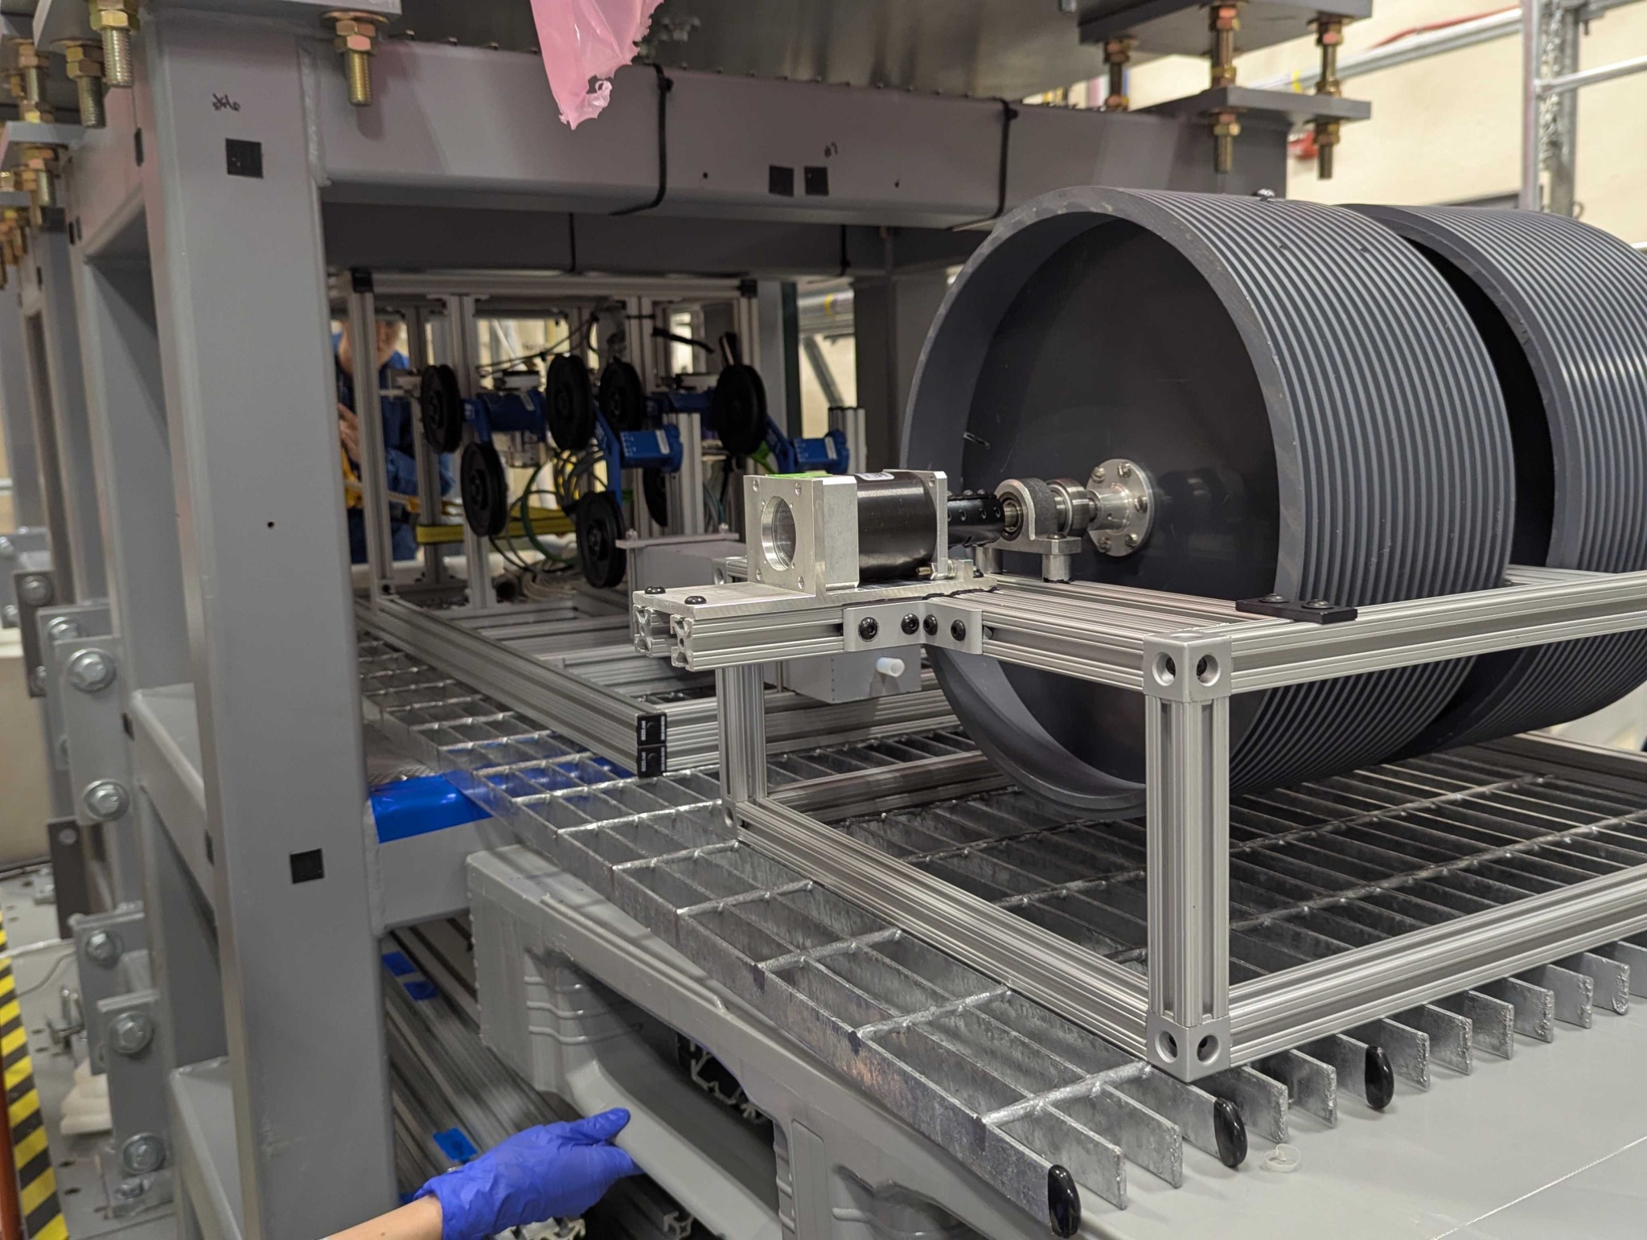
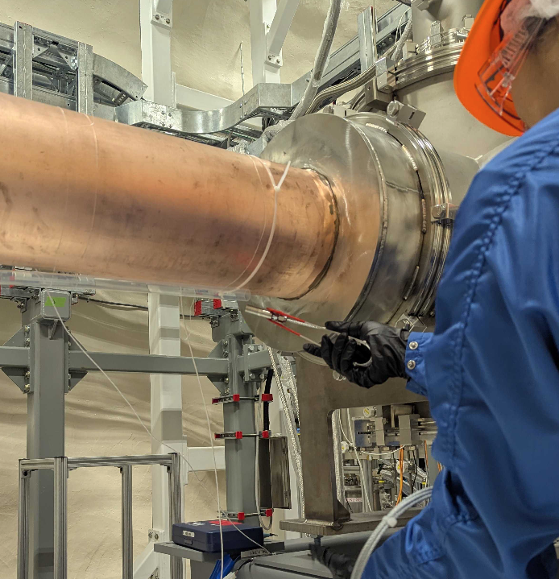
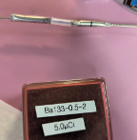
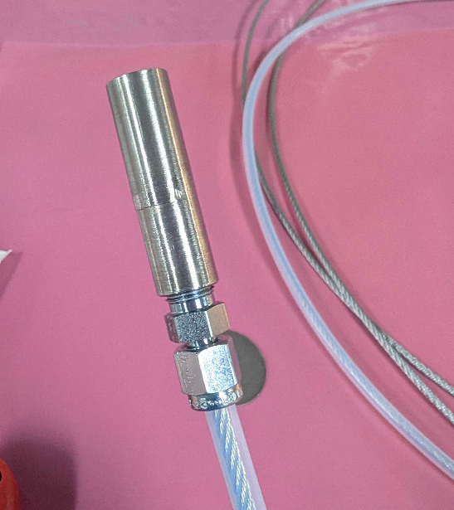
Automatic system for deploying gamma calibration system: Ba sources on steel cable driven by stepper motor, goes along E-stem and across top & bottom of cryostat
Neutron calibration system: encapsulated Cf sources attached to flexible “wands” inserted into shield manually, with guide tubes running along C-stem and E-stem
Motion controls
Source capsules
Guide Tube
Source capsule

Slide 16
SuperCDMS SNOLAB Commissioning just began!
Known issues requiring troubleshooting: higher temperatures in some parts of DR than desired, electrical grounding / ground-loops
Planned Campaigns: detector characterization, optimization, trigger setup, calibration source deployment, activation, neutralization, noise-hunting
Careful remote monitoring as we validate safety and alarm systems
Some installation items deferred to preserve access during early Commissioning
  Upper section and lid of lead/poly shielding wall
  Radon purge system, upper section of radon barrier
  Water tank background shield
Some repair / backup / modifications will happen during Commissioning
  Replacement of 50K cooler bayonet
  Modification of Detector Control & Readout Cards to address charge readout oscillations
  Ice-tank chilled water backup
  Additional electronics filtering

Slide 17
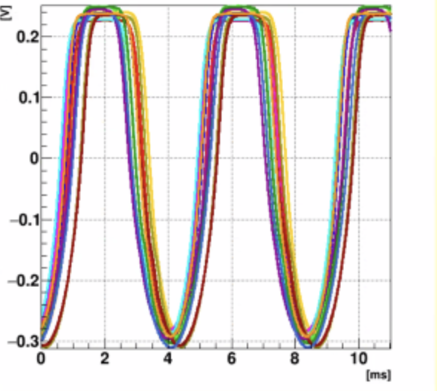
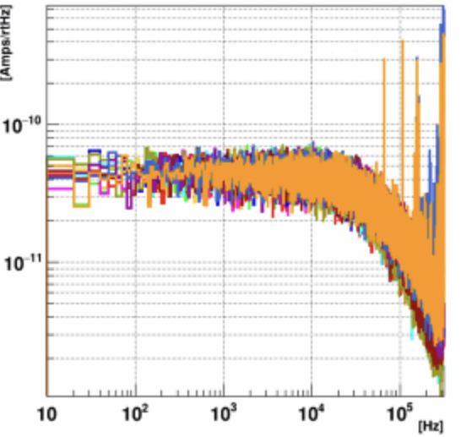
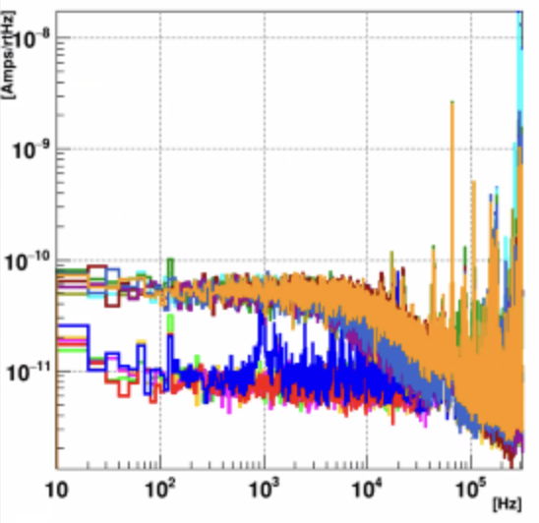
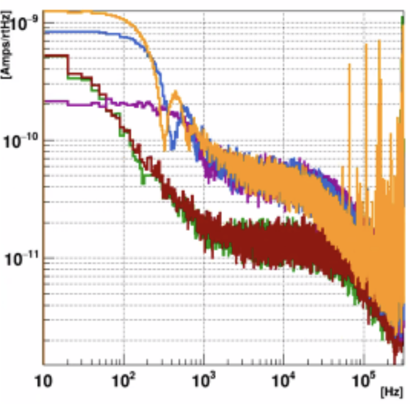
Preliminary results/highlights from Jan 2026 “first commissioning campaign”, overlapping with end of I&I
SQUID testing and characterization performed at 4K: >99% operational
~80% of TESs were superconducting within 2 days of condensing, despite not being at base temp yet
Several detectors measuring large (~10 - 20 mOhm) parasitic resistances, probably due to higher-than-expected “4K still” temp
SQUID oscillations
Superconducting (SC) noise
Noise with 50% SC, 50% Normal
Transition noise with some pulses

Slide 18
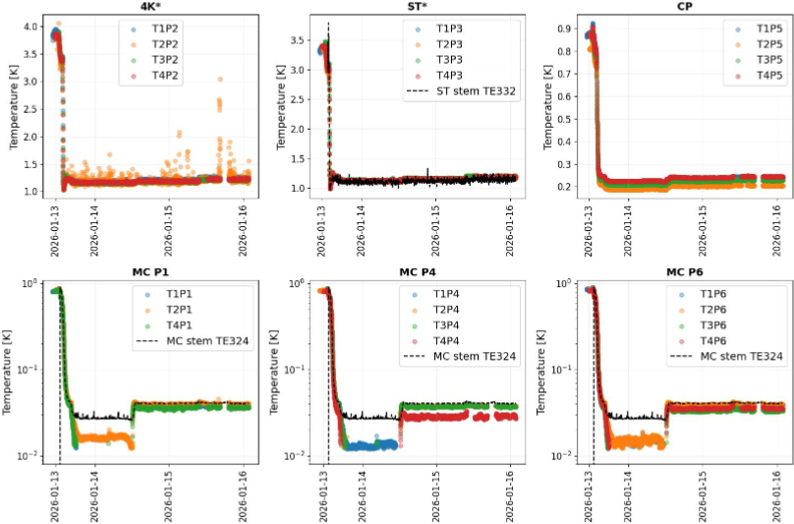
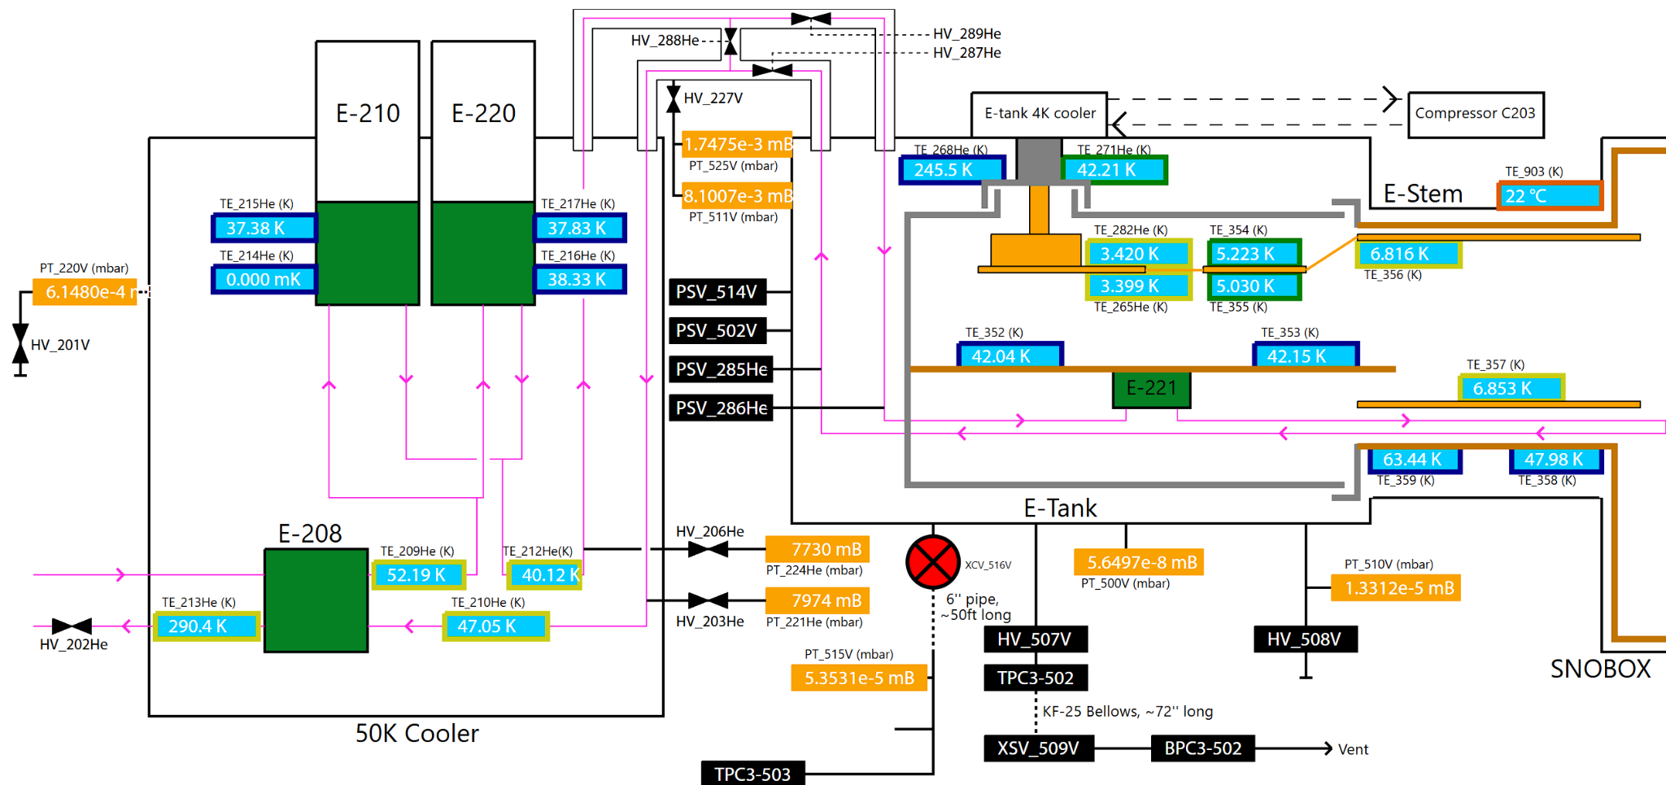
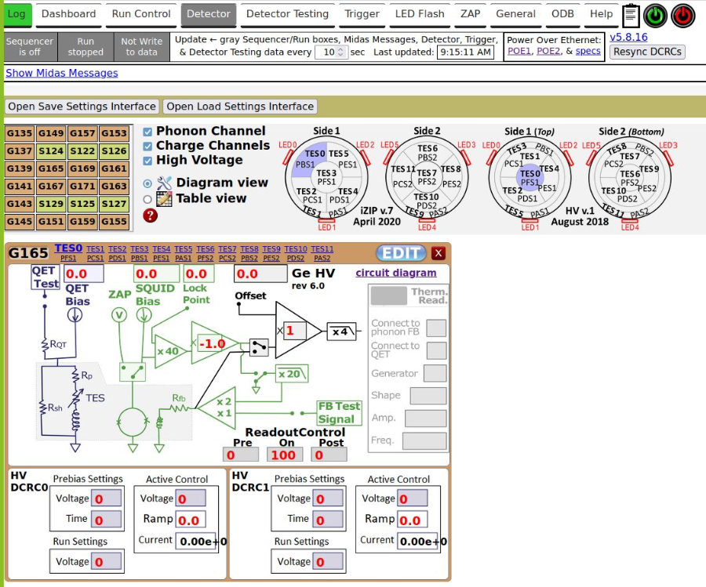
Thermometry on detector towers, with readout through DAQ, enabled remote monitoring of condensing
Online monitoring interface
Detector operation UI

Slide 19
Recent & upcoming SuperCDMS publications: exciting test facility analyses & results
Event reconstruction: Multi-channel, multi-template, using machine learning arXiv:2508.20090, submitted to NIM A (Jan 2026)
HVeV Run 4 @NEXUS test facility
Si detector calibration using Compton steps: Energy signatures at ~100eV E_{ee} (L shell steps), ~2keV E_{ee} (K shell step) arXiv:2508.02402, Phys. Rev. D 112, 092014 (Nov 2025)
ERDM search: re-designed detector holder eliminated luminescence background from PCBs arXiv:2509.03608, accepted for publication in PRD (Jan 2026)
HV Tower test @CUTE: internal analyses underway (noise modeling, background rates, calibrations, etc.)
HVeV Run 5 @CUTE
Device performance characterization: sub-eV energy resolution and single charge sensitivity arXiv:2601.16307 (Jan 2026)
ERDM search: analysis in final stages
HVeV 2mm 2-channel Prototype Run @NEXUS: data-taking just completed

Slide 20
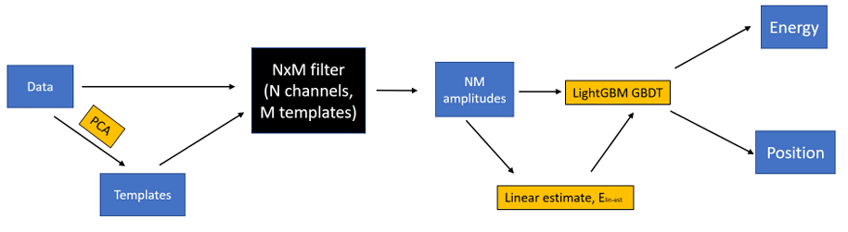
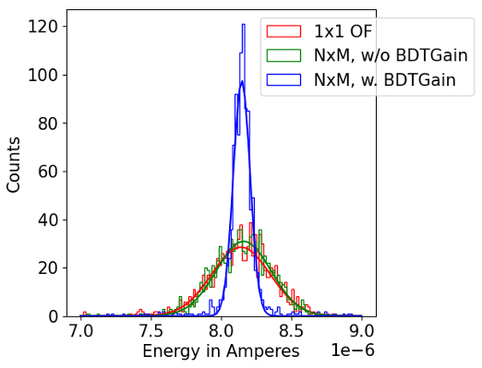
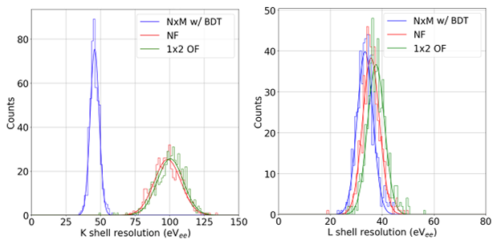
Event reconstruction: “N channels x M templates” Optimal Filter with machine-learning boost, validated on old CDMSlite data
Goal: accounting for correlated noise between channels and for position-dependent variations in pulse shape

Slide 21
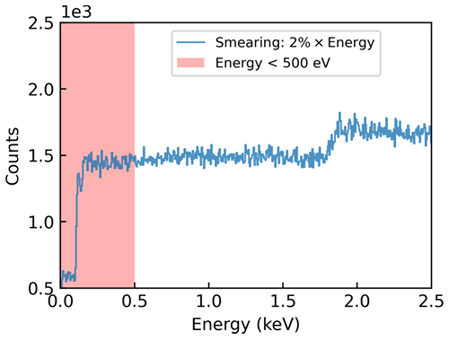
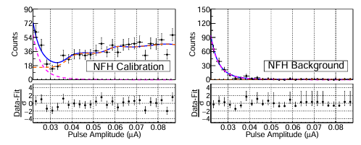
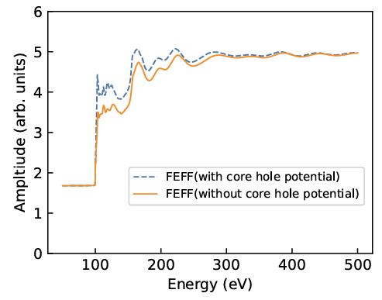
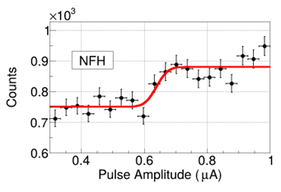
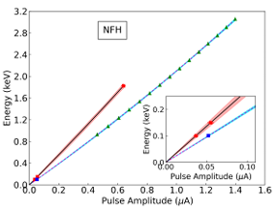
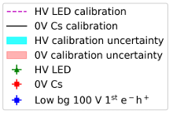
HVeV Run 4 @NEXUS: Si calibration using Compton steps
Simultaneous fit of datasets for L-steps: Compton + LEE
Simulated energy deposition spectrum:
GEANT4
Fit near K-shell step
Simulated energy deposition spectrum:

Slide 22
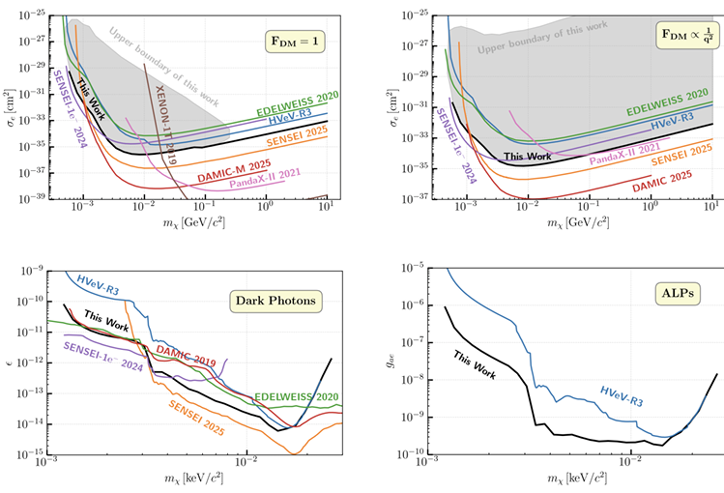
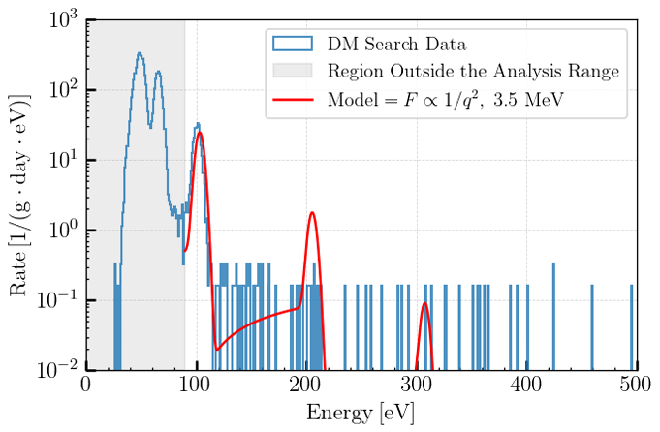
HVeV Run 4 @NEXUS: ERDM searches

Slide 23
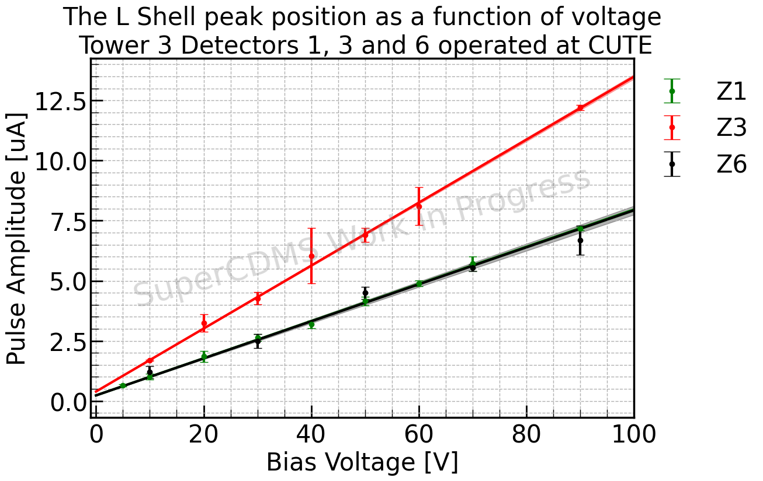
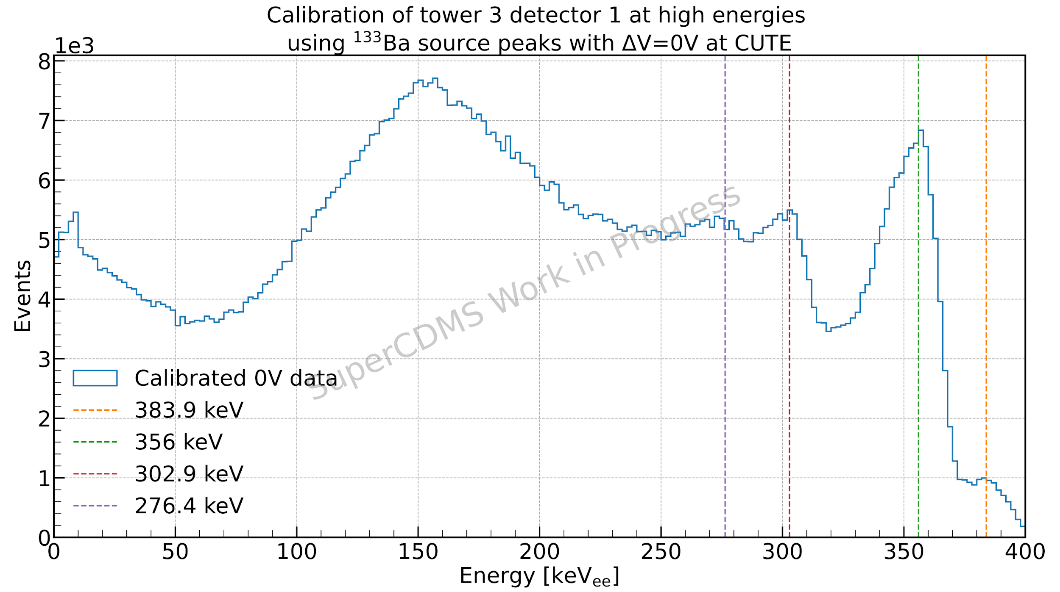
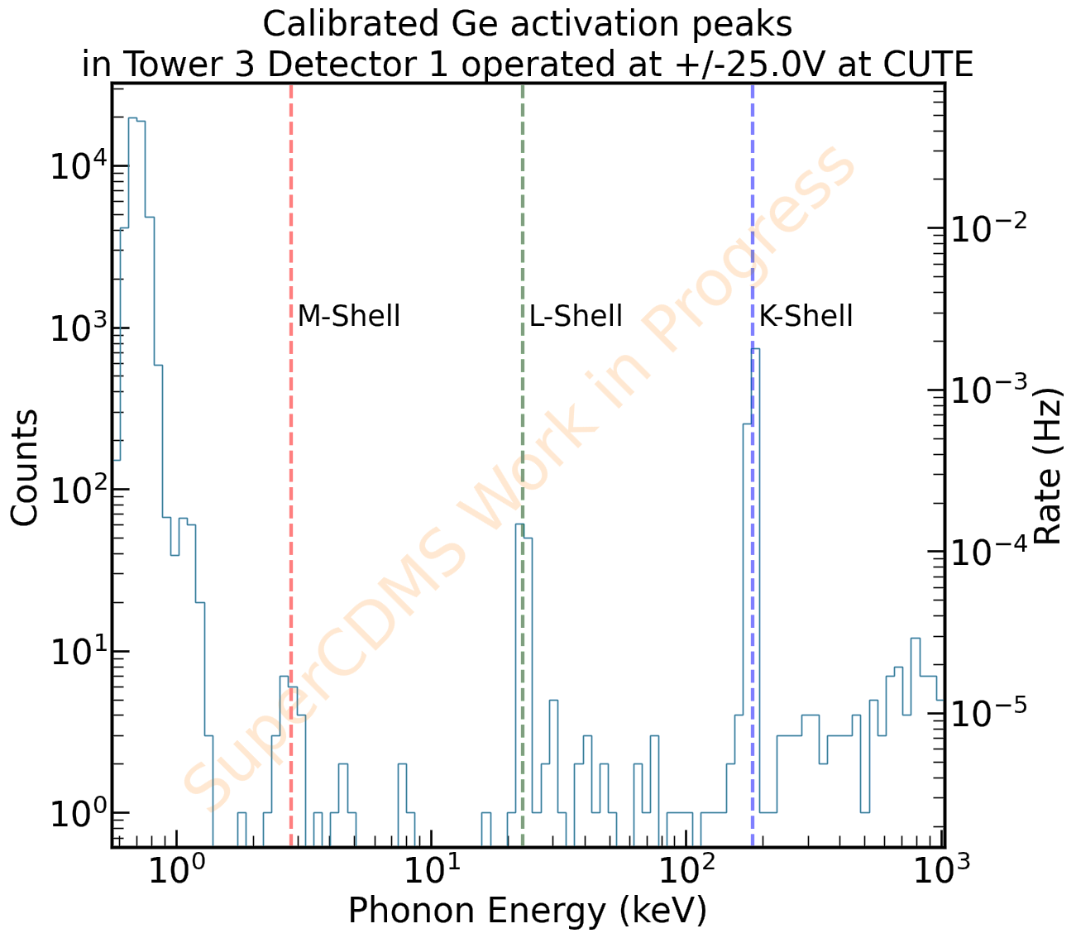
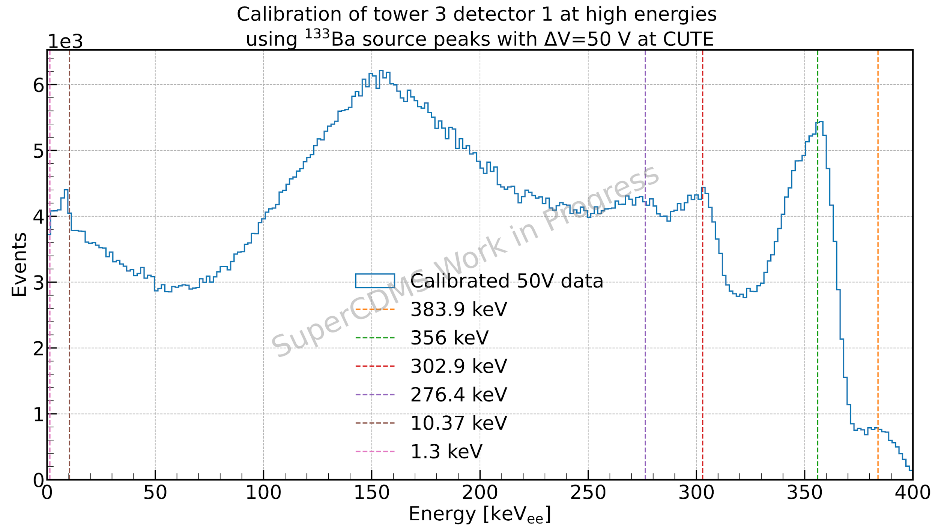
HV Tower test at CUTE: Ge Calibration results

Slide 24






HVeV Run 5 @CUTE: device characterization, in comparison to run at SLAC surface facility
NFC NFH
TES Bias Point
TES Bias Point

Slide 25


HVeV Run 5 @CUTE: analysis underway for ERDM search

Slide 26



NEXUS facility: preparation for Ge HV energy calibration campaigns
Tower Preparation
Single HV detector installed in a Tower at SNOLAB - Jan. 2026.
Planning shipment to Fermilab and installation in NEXUS test stand
Backing Array at Northwestern:
First data with beam array - Fall 2025
Integration of full array now complete
Trigger settings need optimization
DD generator Commissioning:
Operational since late 2024
Electrical issues resolved Jan. 2026
Full integration underway:
Check alignment of the DD generator.
Installation of tower and backing array at NEXUS
Commissioning in Spring
Beam Array Data

Slide 27



Conclusion …
Or, the Beginning!
SuperCDMS SNOLAB commissioning over the next few months
Stay tuned for first science-quality dataset by the end of the year!
And we’re still learning from test facility runs – about detector response, low-energy backgrounds, etc.
Thanks to SNOLAB for hugely valuable assistance in completing I&I !

