Slide 1

QUTEbits - Status and Future Plans
Tyler Reynolds
on behalf of the QUTEbits Collaboration
SEF 2026

Slide 2
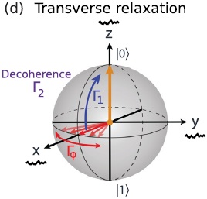
Qubits and Coherence
Superconducting qubits exploit quantum superpositions to carry out complex quantum algorithms
Superposition states decohere in time
  T₁ – relaxation
  T₂ – decoherence
Interactions with the environment → decoherence → errors
Appl. Phys. Rev. 6, 021318 (2019)

Slide 3
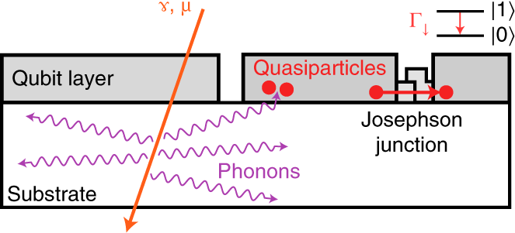
Coherence Times and Cosmic Rays
Coherence times still limited by several sources
Correlated errors = no error correction
Larger than expected populations of non-equilibrium quasiparticles observed (Serniak 2018)
Ionizing radiation can contribute to this population
  Material contamination
  IR radiation
  Cosmic rays
Nat. 18 107 (2022)

Slide 4




The QUTEbits Collaboration
QUTEbits Collaboration
  SNOLAB
  Chalmers University of Technology
  Institute for Quantum Computing at University of Waterloo
Goals
  Study impact of cosmic rays on qubit decoherence
  Explore qubit performance in different radiation environments
  Kickstart quantum computing program at SNOLAB

Slide 5
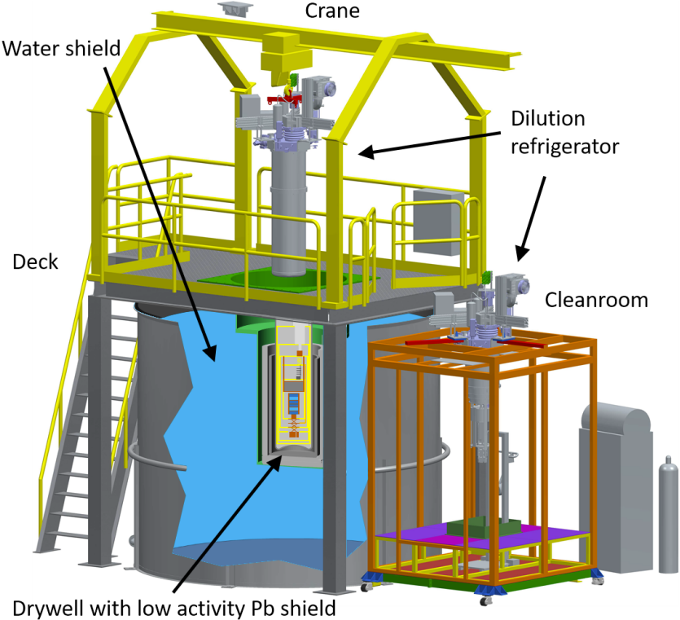
CUTE Facility
Cryogenic Underground Test Facility
Dilution refrigerator
  Base temperature: 12 mK
Class-300 clean room
Low background test facility
Access to two calibration sources
  ²⁵²Cf (37.5 kBq*) for neutrons
  ¹³³Ba (37 kBq*) for gammas
For more info see Front. Phys. 10
*initial activities in 2018

Slide 6
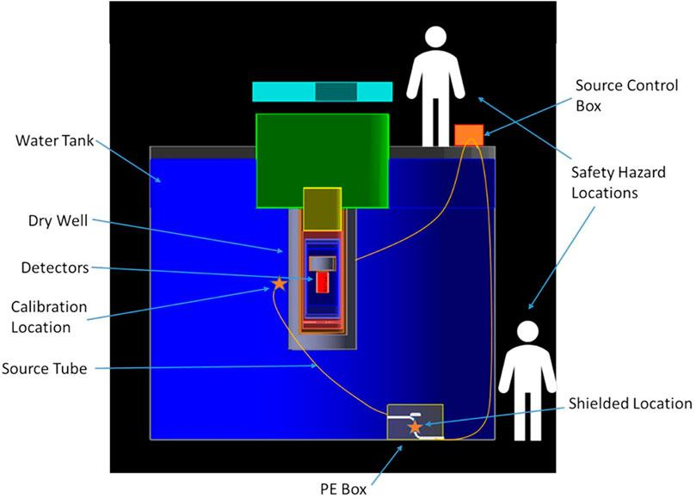
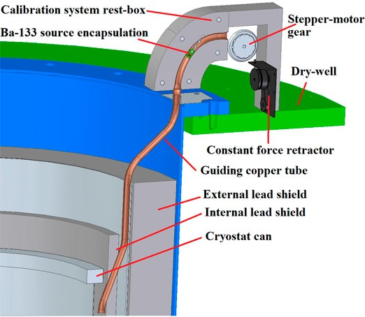
CUTE Calibration Sources
Neutron source
Barium source
Front Phys. 11:1319879 (2023)

Slide 7
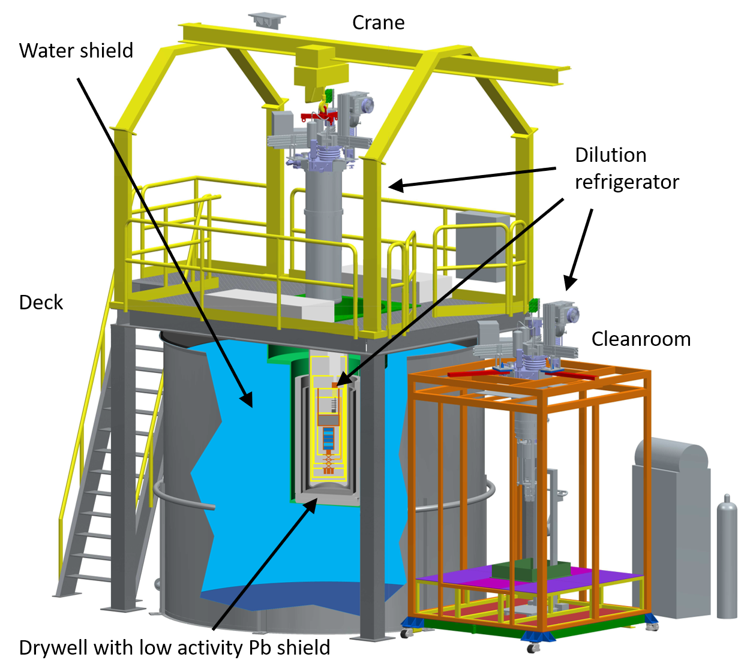
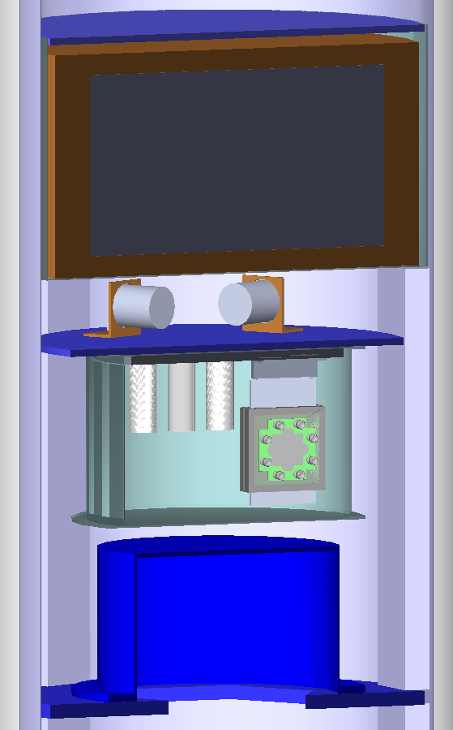
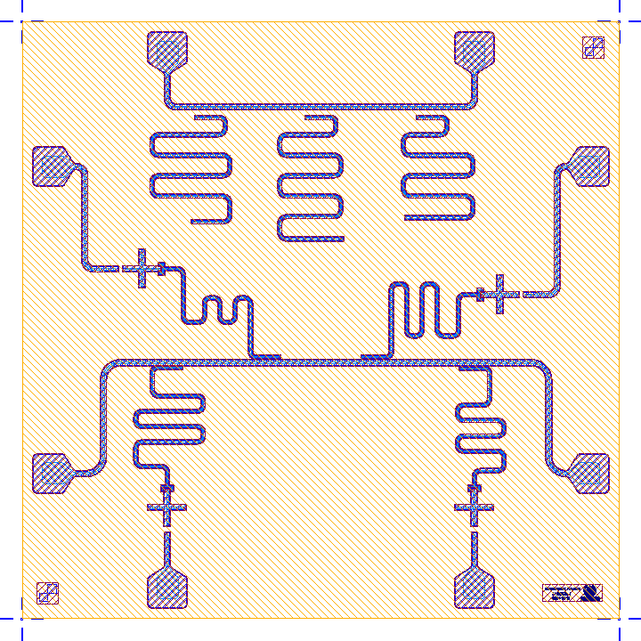
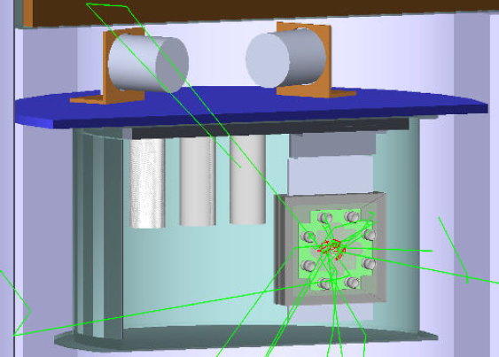
Simulation Campaign
Implementation of geometry in Geant4
  Cryostat
  Multi-layer shield
  Qubit payload

Slide 8
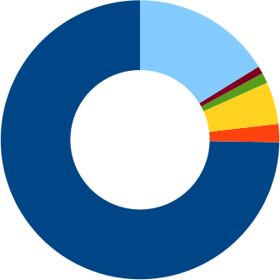
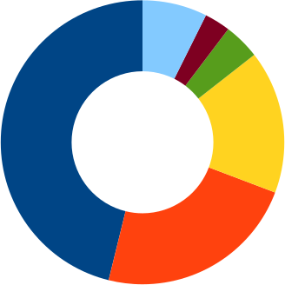
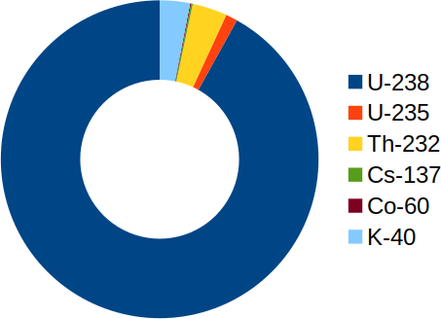
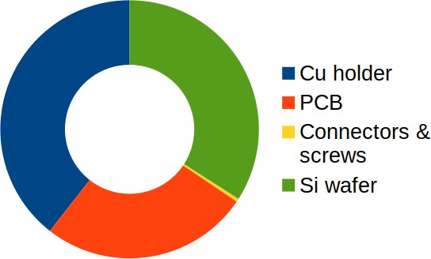
Simulation Campaign
Si wafer
Cu holder
Connectors & screws
Backgrounds informed from radiopurity assays
  Components screened with HPGe detectors at SNOLAB and LSM
  Materials selected based on assay results
  Results publicly available at radiopurity.org
Radioactive contaminants and resulting hits in sensitive Si substrates simulated in Geant4
  Rates normalized based on exposure history and assay results
Total (conservative) expected background rate in Si: 1-6 mHz
0.12 mHz
0.14 mHz
<0.01 mHz
Qubit assembly
0.35 mHz

Slide 9
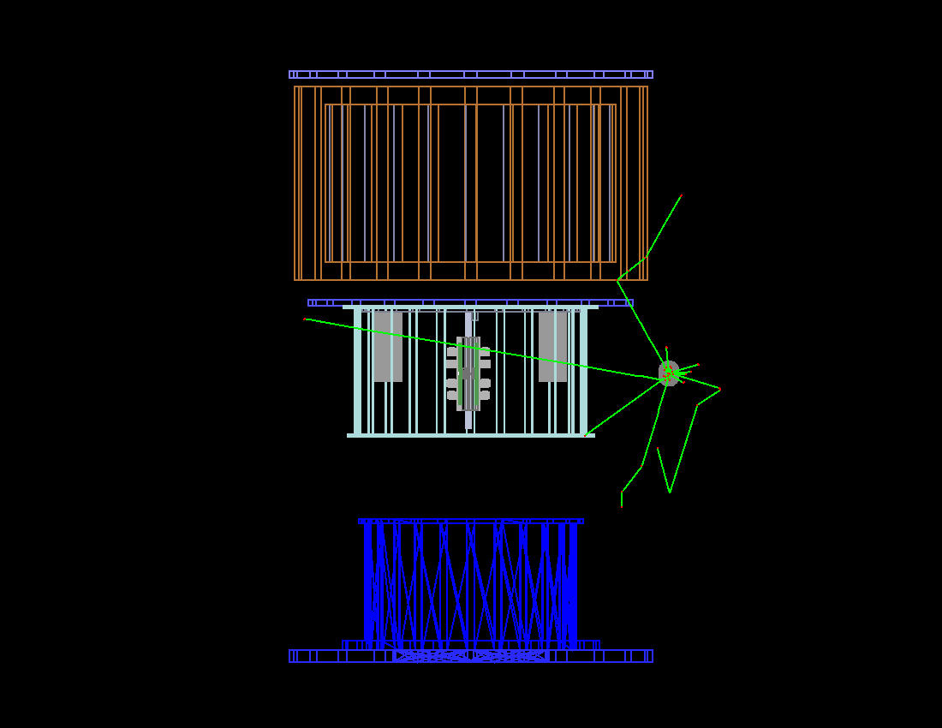
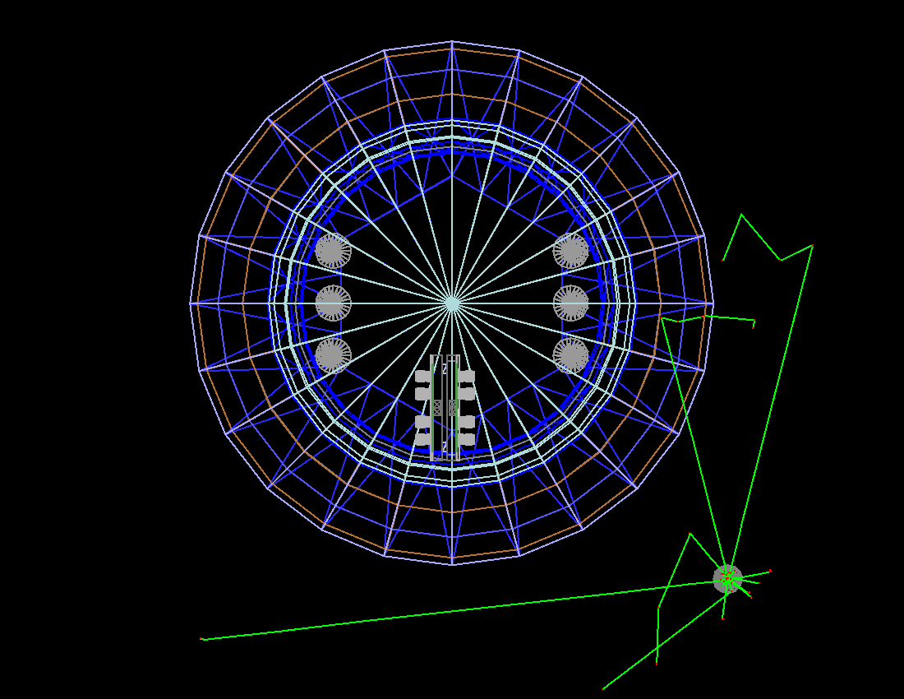
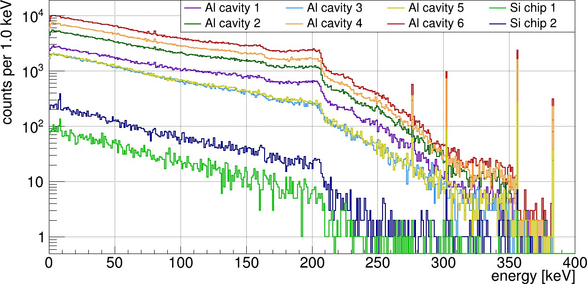
Simulation Campaign
Barium source simulations
  Included all potential payloads
    2 Si chips
    6 Al cavities
  Expected rate in Si chips: 40 mHz
  Background rate: 1-6 mHz

Slide 10
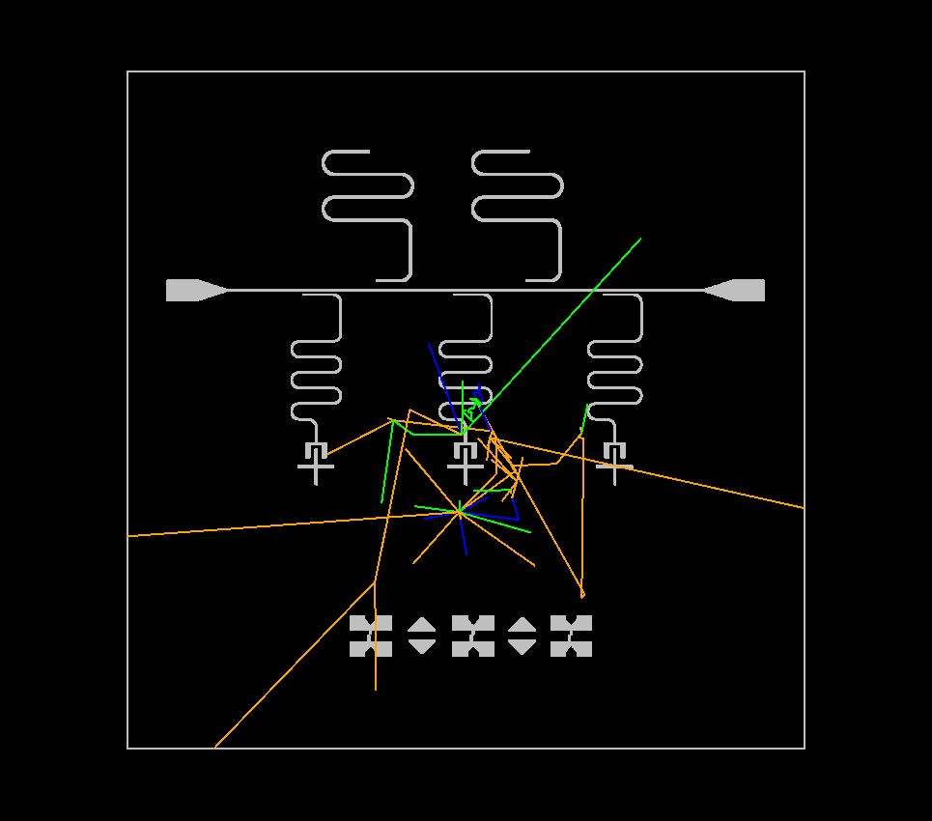
Simulation Campaign – G4CMP Work
Studies with G4CMP looking at:
  Effect of radiation on quantum circuitry
  Energy deposited in circuit elements
  Cause of correlated errors on same chip
Mask design imported from GDS file
  Circuitry implemented as 300 nm thick Al film
Phonons and electron-hole pairs modeled

Slide 11
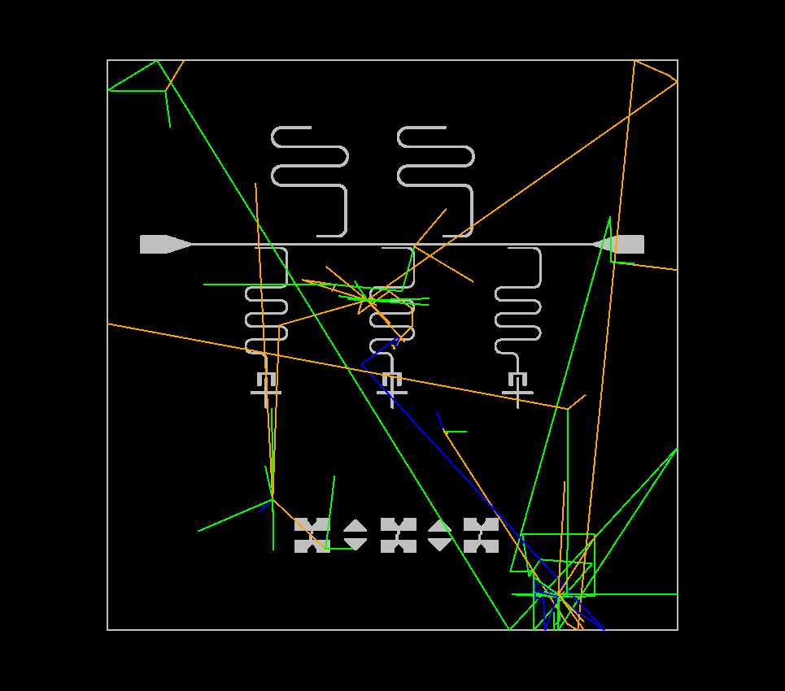
Simulation Campaign – G4CMP Work
Studies with G4CMP looking at:
  Effect of radiation on quantum circuitry
  Energy deposited in circuit elements
  Cause of correlated errors on same chip
Mask design imported from GDS file
  Circuitry implemented as 300 nm thick Al film
Phonons and electron-hole pairs modeled

Slide 12
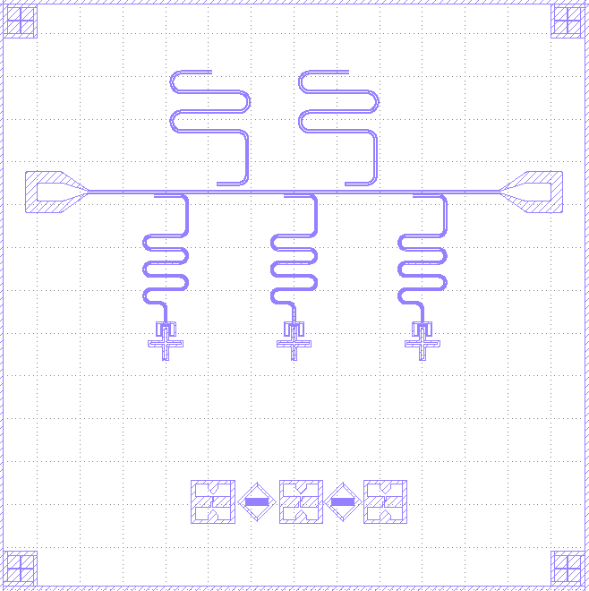
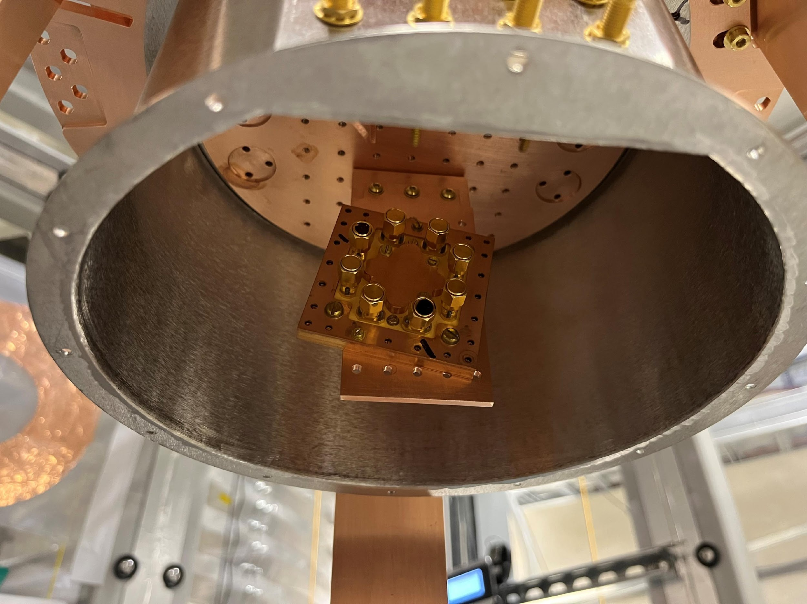
Payload
University of Waterloo EQSL qubit sample
  Two operable qubits (Q1 and Q3)
  Two high Q_{C} resonators
Qubit | EJ/EC | f01 (GHz)
Q1 | 28.29 | 3.371
Q3 | 19.05 | 2.916

Slide 13
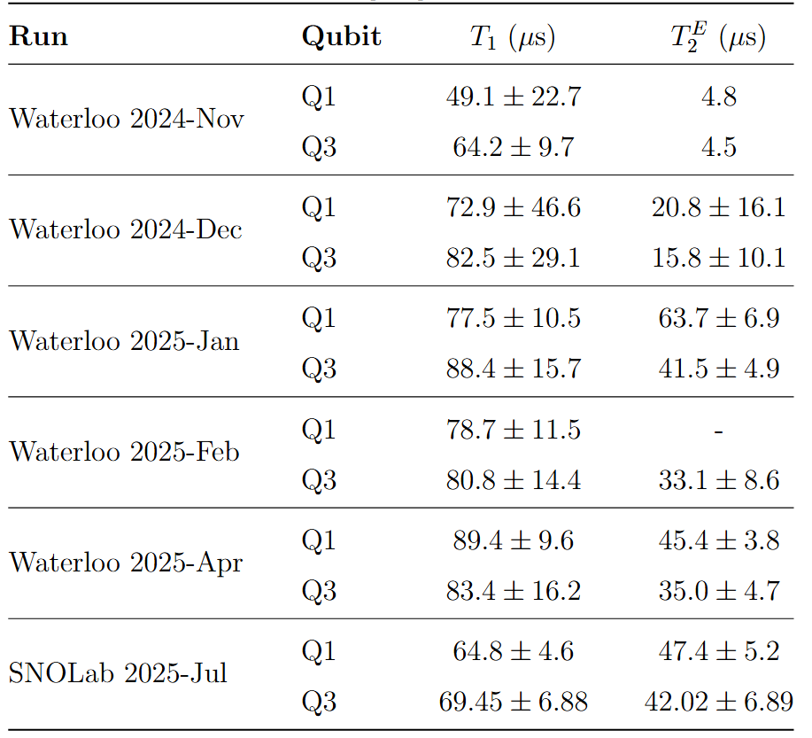
First Surface Measurements
Measured at University of Waterloo
Series of improvements aimed at reducing system noise and improving coherence times
  Rearrangement of circuit components
  Improved IR filtering

Slide 14
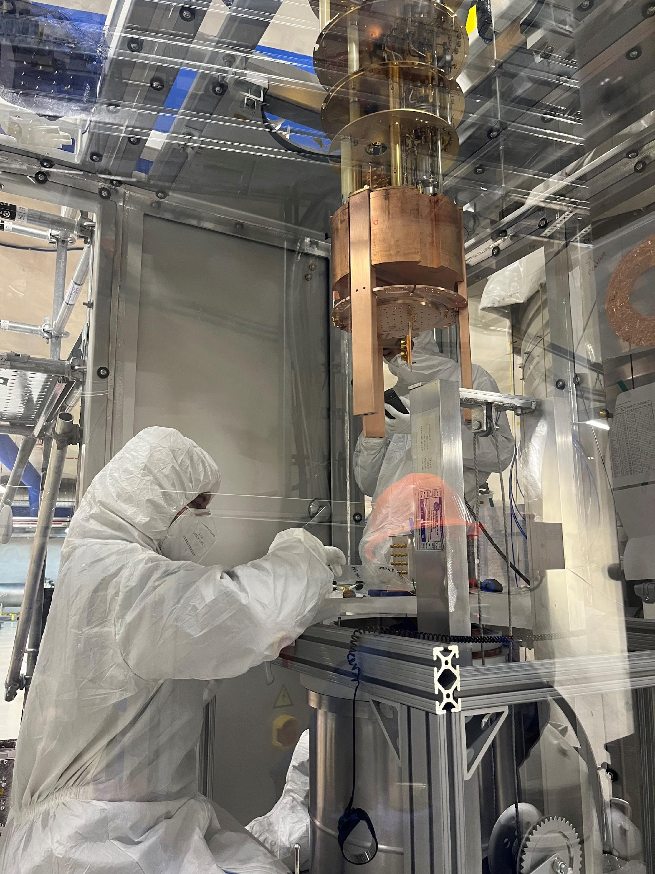
Run 1 – Underground
Same hardware setup as used at UWaterloo
2 weeks of data taking in July 2025
  Underground qubit characterization
  Interleaved T₁ and T₂ measurements
  One measurement with ¹³³Ba source deployed
  Measurements of T₁ and T₂ fluctuations over time

Slide 15
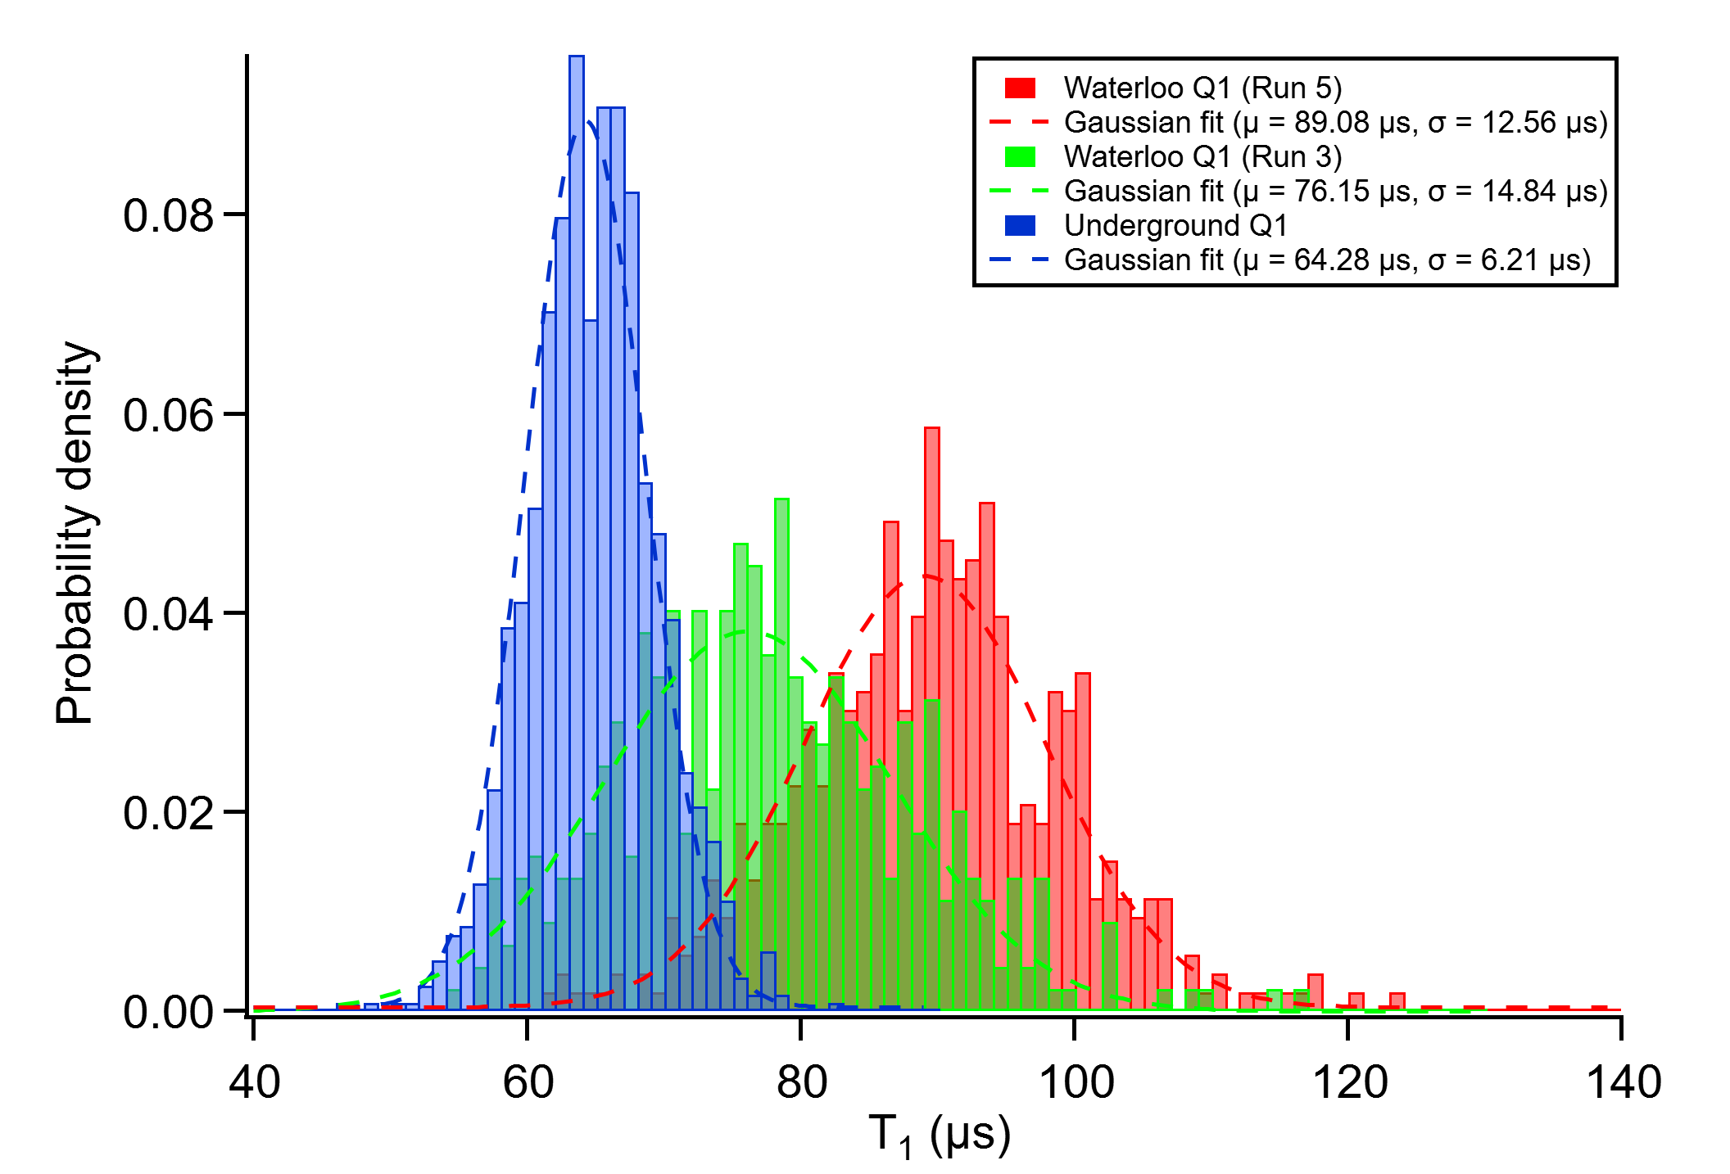
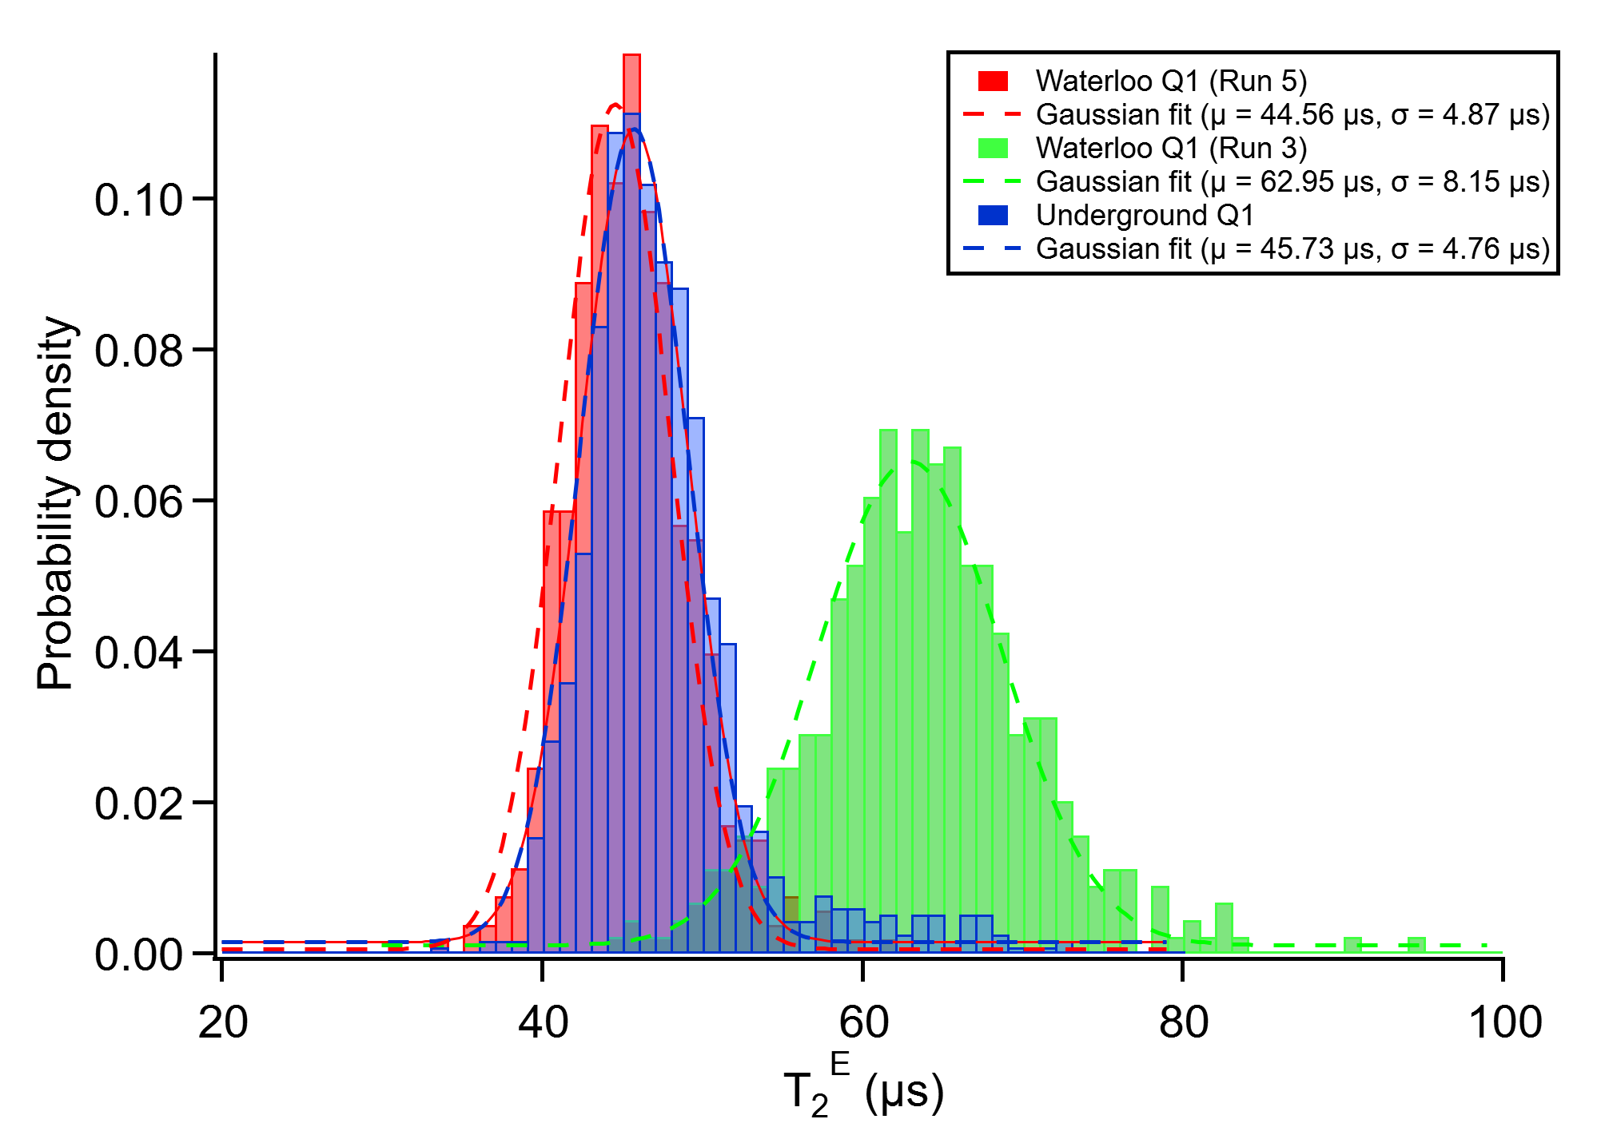
Run 1 – Underground
Surface R1 89.08 ± 12.56 us
UG R1 64.28 ± 6.21 us
Surface R1 44.56 ± 4.87 us
UG R1 45.73 ± 4.76 us
Lower standard
deviation underground!
(Green is old, obsolete surface measurement)

Slide 16
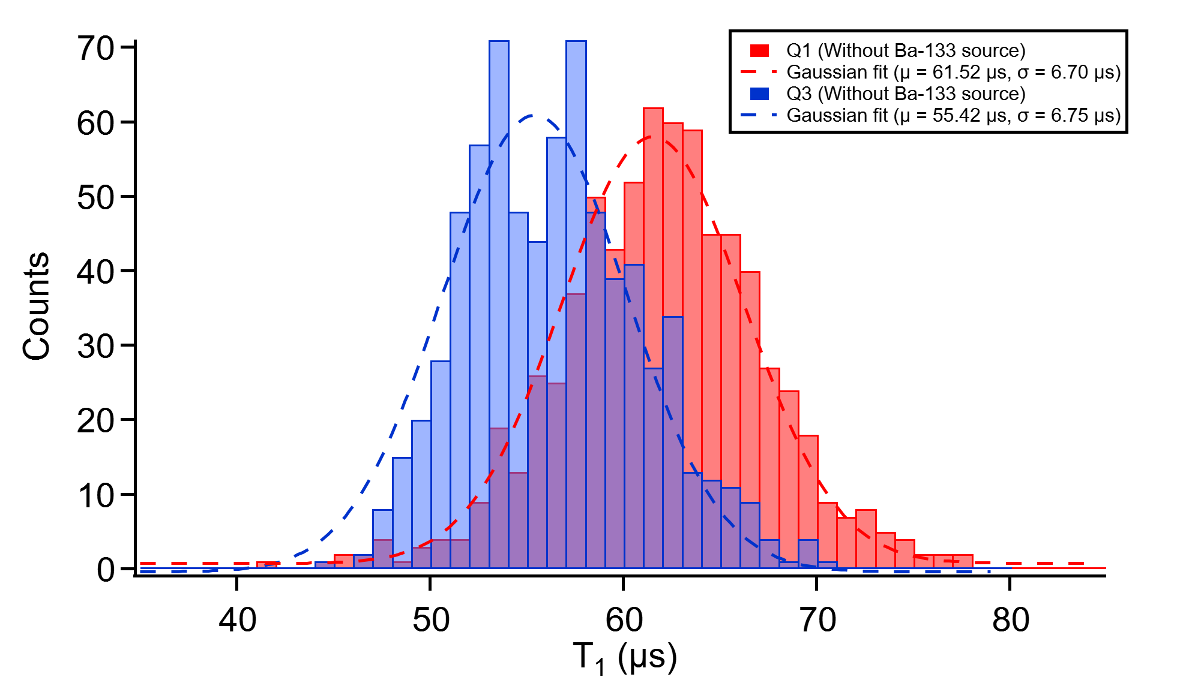
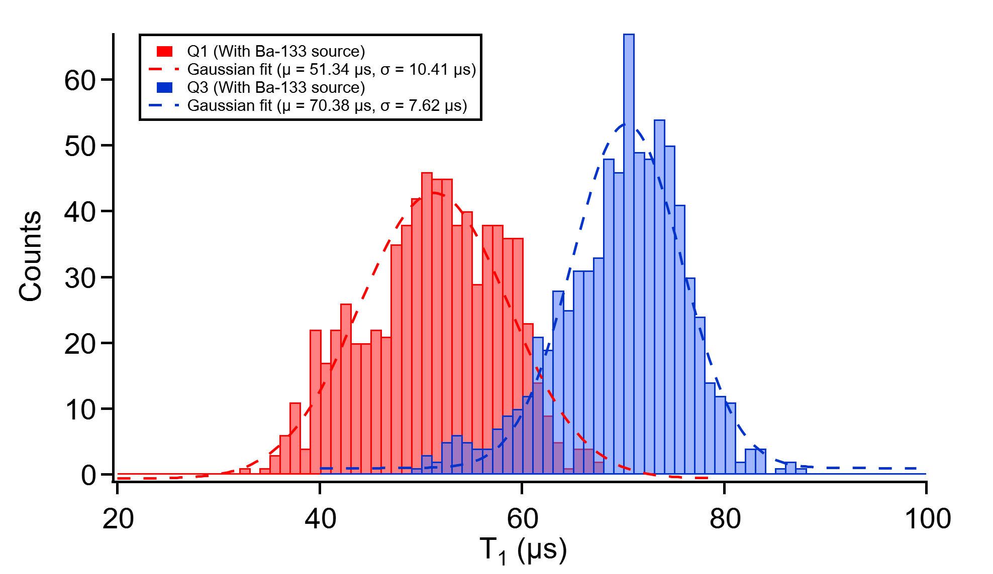
Run 1 – Underground
Without Ba source, 24 hr
With Ba source, 26 hr
Q1 61.52 ± 6.70 us
Q3 55.42 ± 6.72 us
Q1 51.34 ± 10.41 us
Q3 70.38 ± 7.62 us
Wider distribution
with source

Slide 17
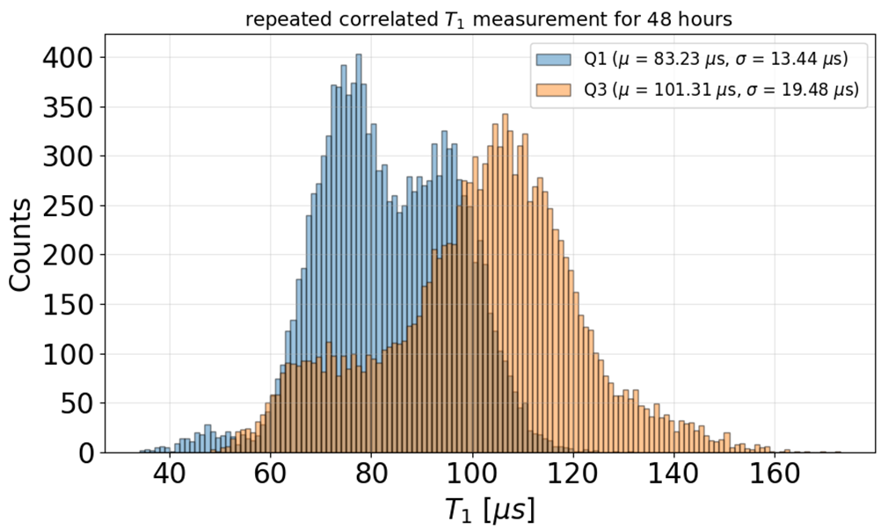
Run 2 – Surface
New noise reduction improvements
  DC line filtering
  IR coating inside magnetic shield
  Improved thermalization of components
Correlated T1 measurements
  Still see T₁ standard deviations consistent with previous surface runs

Slide 18
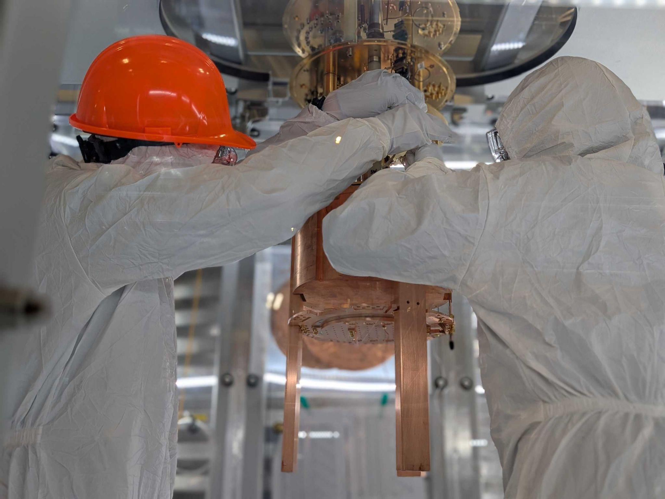
Run 2 – Underground
Payload – same qubit as R1
Planned 8-10 week campaign
Primary objectives
  Correlated interleaved coherence time measurements with shorter repetition time
  Test for charge parity measurement feasibility
  High Q_{C} resonator measurements

Slide 19
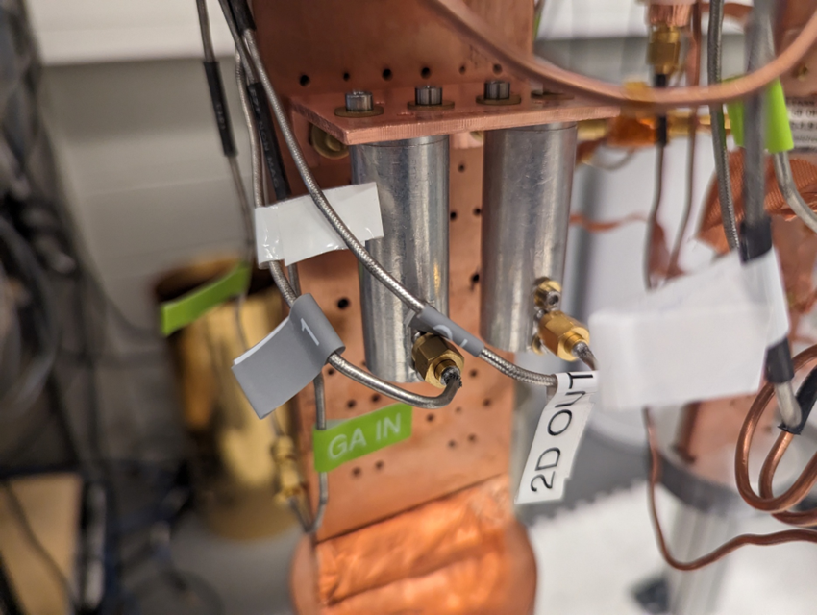
Future Studies
Testing new qubit designs
  Higher coherence designs
  Designs with smaller E_{J}/E_{C} ratio
Measurements of 3D resonators
  Characterize two level system losses
Coincidence measurements between
physically separated chips
Development of mitigation techniques

Slide 20
Summary
Facility is ready to go for qubit payloads
Background estimates informed from a robust simulation and assay campaign
  Paper in progress
Run 1 completed July 2025
  Smaller T₁ standard deviation underground hints at something interesting…
  Still a lot to understand!
Run 2 underground installation is underway
  Data taking starts in a few weeks
  Hopefully a paper to follow soon after!

Slide 21
Backup Slides

Slide 22
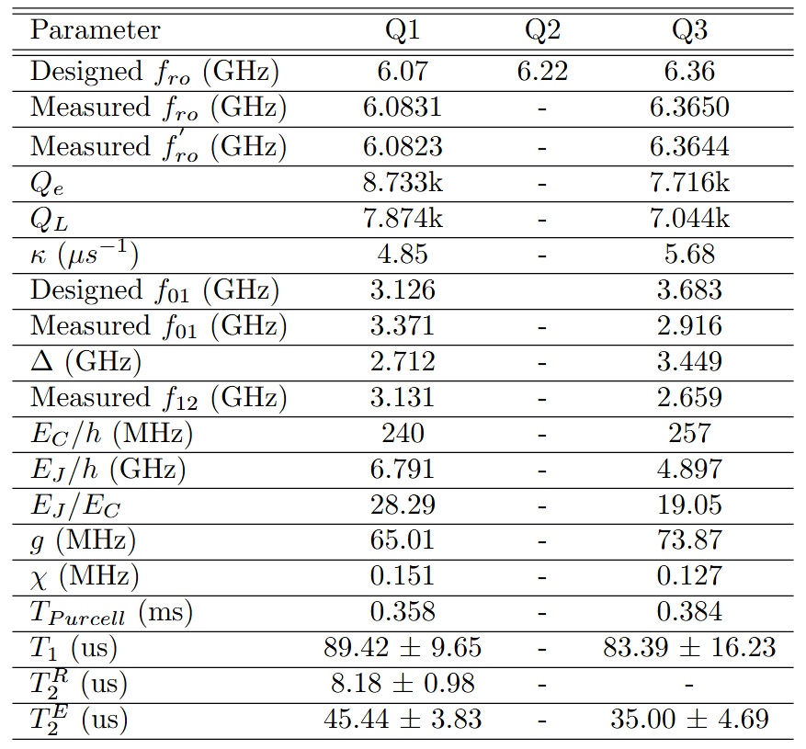
UW-EQSL Parameters

Slide 23
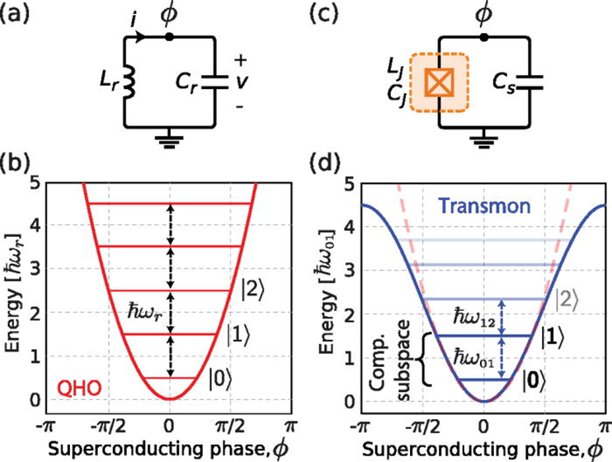

Transmon Qubit

Slide 24
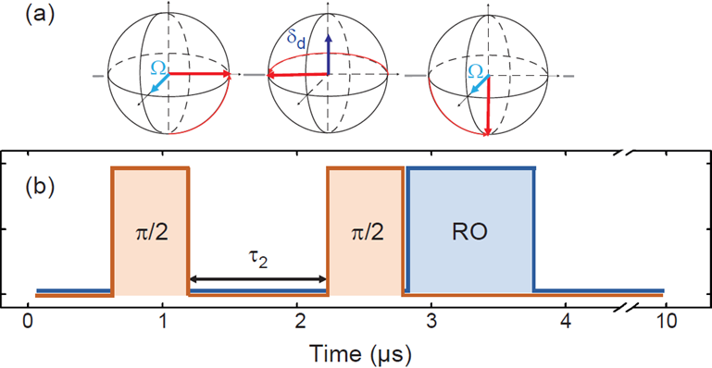
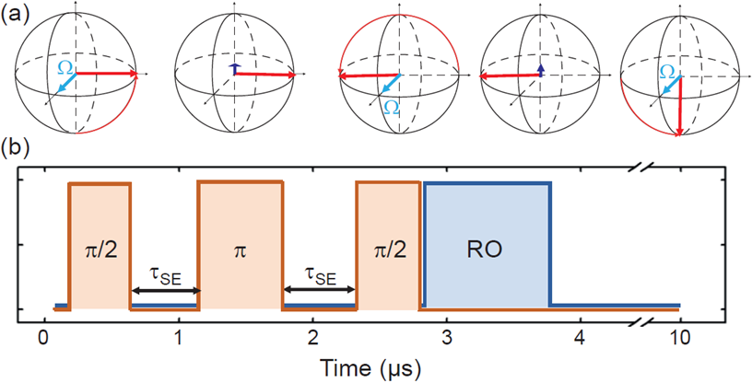
T₂ Measurements
Ramsey
Echo

