Slide 1
The future is xenon
SNOLAB SEF, February 11, 2026
Thomas Brunner
McGill University

Slide 2
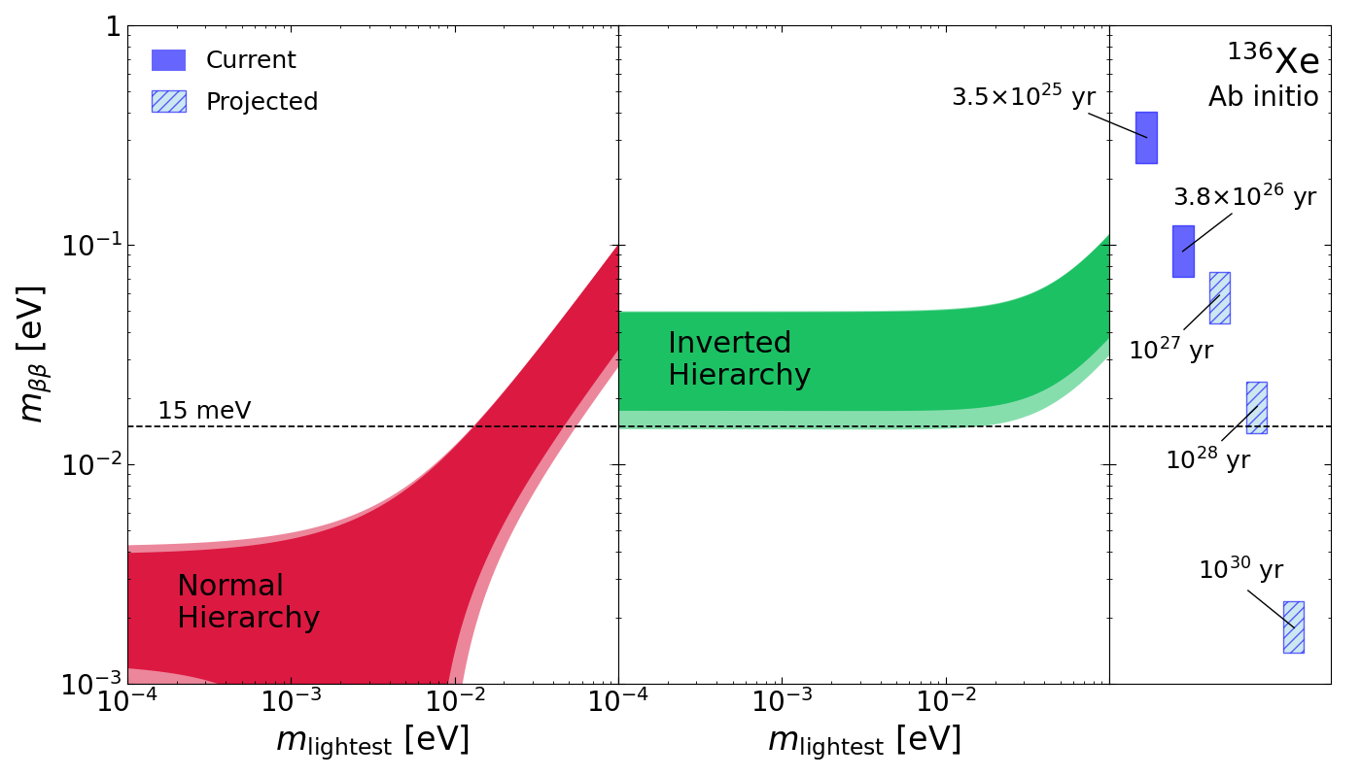
Scientific Goal: Sensitivity Beyond 10²⁸ yrs
Next generation experiments aim for a sensitivity goal of 15 meV, which in the case of Xe-136 requires a sensitivity beyond 10²⁸ yrs ← This is our benchmark!
Final EXO-200 limit
Current best limit in Xe from KamLAND ZEN
Deeper Physics Reach
Reach of 5T experiment with natural Xe
Reach of 5T experiment with 90% Xe-136
or ~80T natural Xe
The ultimate goal in 0νββ of ~1 meV
Need to invest in forward looking technologies that are scalable to go far beyond 15 meV.
Liquid Xe TPCs are currently the only viable path to go way beyond 10²⁸ years.
Figure courtesy to TRIUMF ab initio theory group

Slide 3


Strategy to reach 10²⁸ years: More Isotope
Ultimately, even a background free experiment is limited by exposure, i.e., by the number of atoms → a global approach is ideal to procure sufficient Xe-136 for next-generation and future experiments.
$\frac{dN}{dt} = \frac{ln⁡(2)}{T_{1/2}} N=0.693 \frac{N}{T_{1/2}}$
¹³⁶Xe Rate at 10²⁸ years:
~0.3 decays/tonne/yr
Mass required for 1 decay/year (average)
Half life [yr] | Atoms | ⁷⁶Ge [t] | ¹⁰⁰Mo [t] | ¹³⁰Te [t] | ¹³⁶Xe [t]
10²⁷ years | 1.4x10²⁷ | 0.18 | 0.24 | 0.31 | 0.32
10²⁸ years | 1.4x10²⁸ | 1.82 | 2.4 | 3.11 | 3.26
10²⁹ years | 1.4x10²⁹ | 18.2 | 24 | 31.1 | 32.6
10³⁰ years | 1.4x10³⁰ | 182 | 240 | 311 | 326
~10 decays/s
Notes:
A very effective way to increase the sensitivity is simple, almost boring. Add mass. Kamland-zen showed everyone how powerful this is. You can look at the simple case of zero background to see that you will not reach the targeted sensitivity without a lot of mass.
The only way to make progress is to get more mass
This is comparable to accelerator field where you increase luminosity

Slide 4
Where we are!
nEXO is not viable without support from the US DOE Office of Science!
0νββ remains one of the most compelling physics searches of our time.
Liquid xenon technology extremely powerful at the tonne-scale level.
LXe offers plausible path to even go significantly beyond 10²⁸ years.
Canadian Xe-enthusiasts are joining XLZD.
CFI made $1M available for SNOLAB to develop a concept for hosting XLZD through the MSI program, to apply for in an expedited review process.

Slide 5
XLZD – a multi-physics observatory
A xenon-based low-background observatory for rare events.

Slide 6
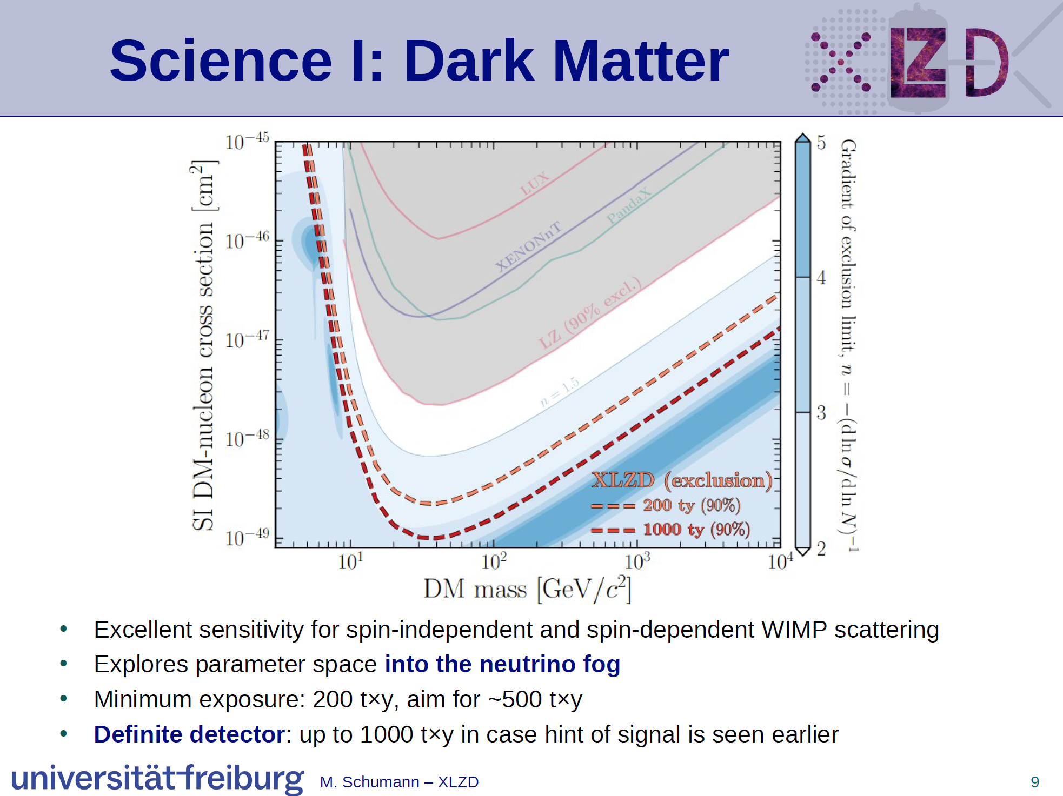
Source: XLZD slides at 2024 0νββ summit

Slide 7
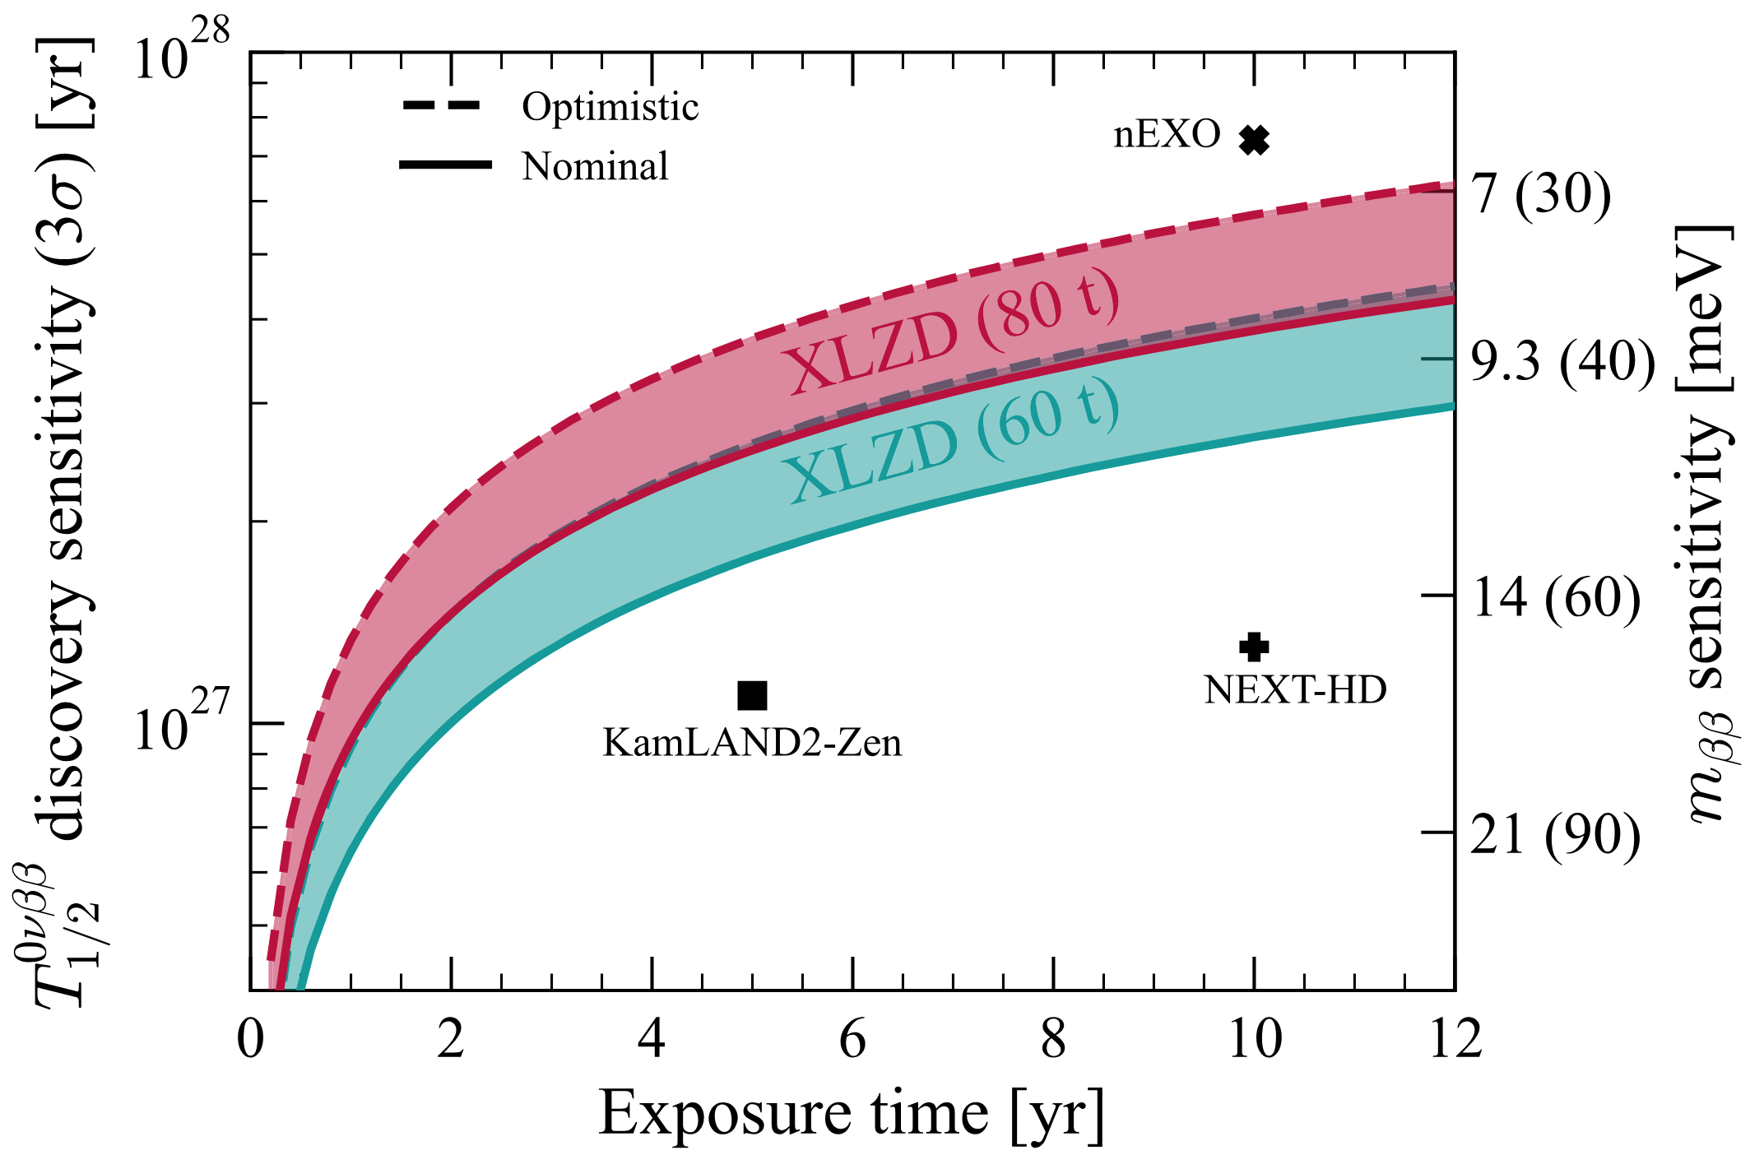
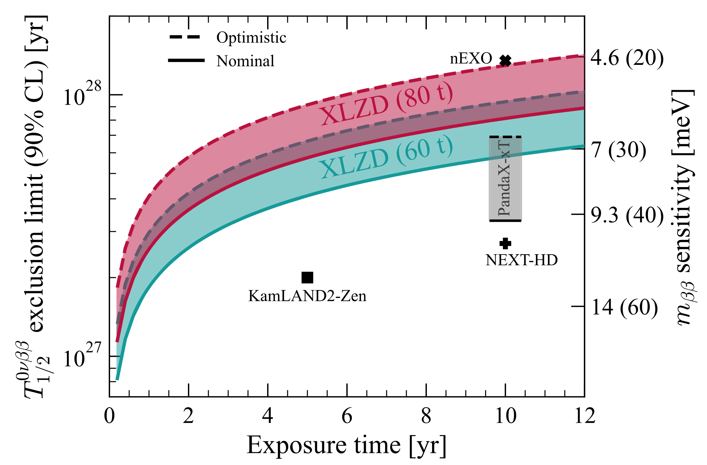
0νββ Sensitivity Projections
J. Phys. G 52, 045102 (2025)
Experiment | Natural Xe | Xe-136 in detector
XLZD | 60 t | 5.3 t
XLZD | 80 t | 7.1 t
PandaX-xT | 43 t | 3.8 t
Experiment | Xe-136 in detector
KL2Z | 0.68 t
nEXO | 3.4 t (90% enr.)
NEXT-HD | 0.9 t*
DM/MP
0νββ
Sensitivity/Xe-136 is a factor of 2 to a few higher in optimized detectors → potential to improve XLZD design!
Notes:
Note that the nEXO projections were obtained using a profile likelihood ratio test while those for XLZD use the figure-of-merit estimator.
PandaX-xT: 43 t active target

Slide 8
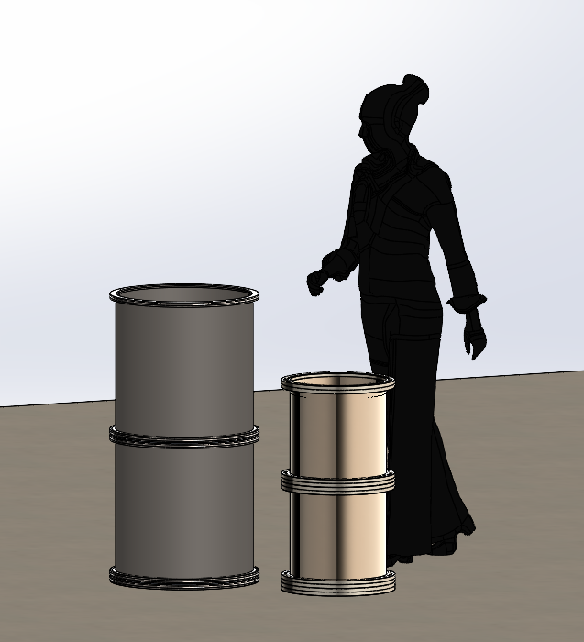
CFI IF 2027 Proposal
Title: Advancing Canadian technology to enhance XLZD’s physics reach.
Leverage past investments in technology development in Canada.
Coales our universities behind one future flagship project.
Several R&D axes in CFI proposal:
Low background material production (CVD Ni&EFCu) and assaying capabilities.
Photon detection including readout. Is it possible to replace the well-established PMTs with radiopure Si solutions → Drive PDC development.
“Small-scale” TPC to establish know-how in Canada on:
Purification and recirculation.
Microphysics studies
Demonstrate CVD Ni as viable pressure-vessel material.
[Your Idea Here] (reach out to us)

Slide 9
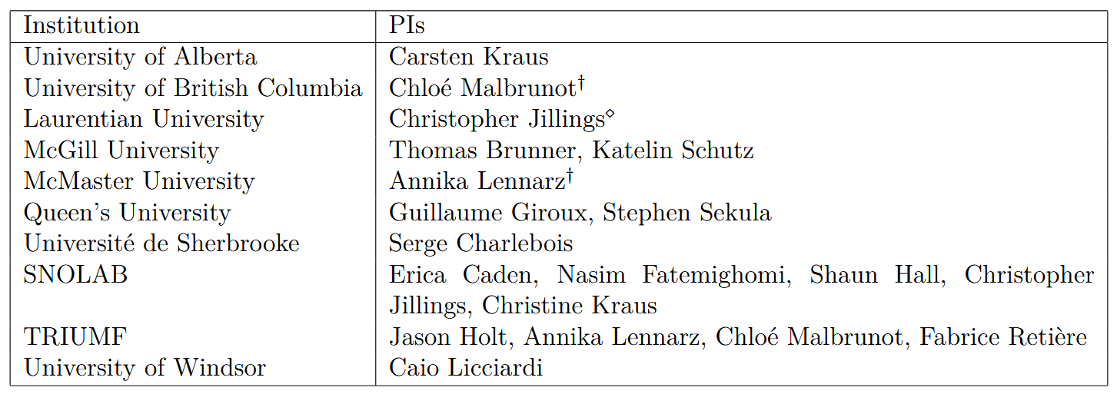
Canadian PIs applying for XLZD membership
The nEXO Canada team decided to join forces with XLZD with these goals:
Realize a detector capable of reaching a sensitivity of 10²⁸ years.
Realize the ultimate DM experiment capable of reaching the neutrino fog.
Preferentially site the experiment at SNOLAB.
10 Institutions
16 Researcher
We are looking for more Canadian collaborators to join our new efforts!

Slide 10
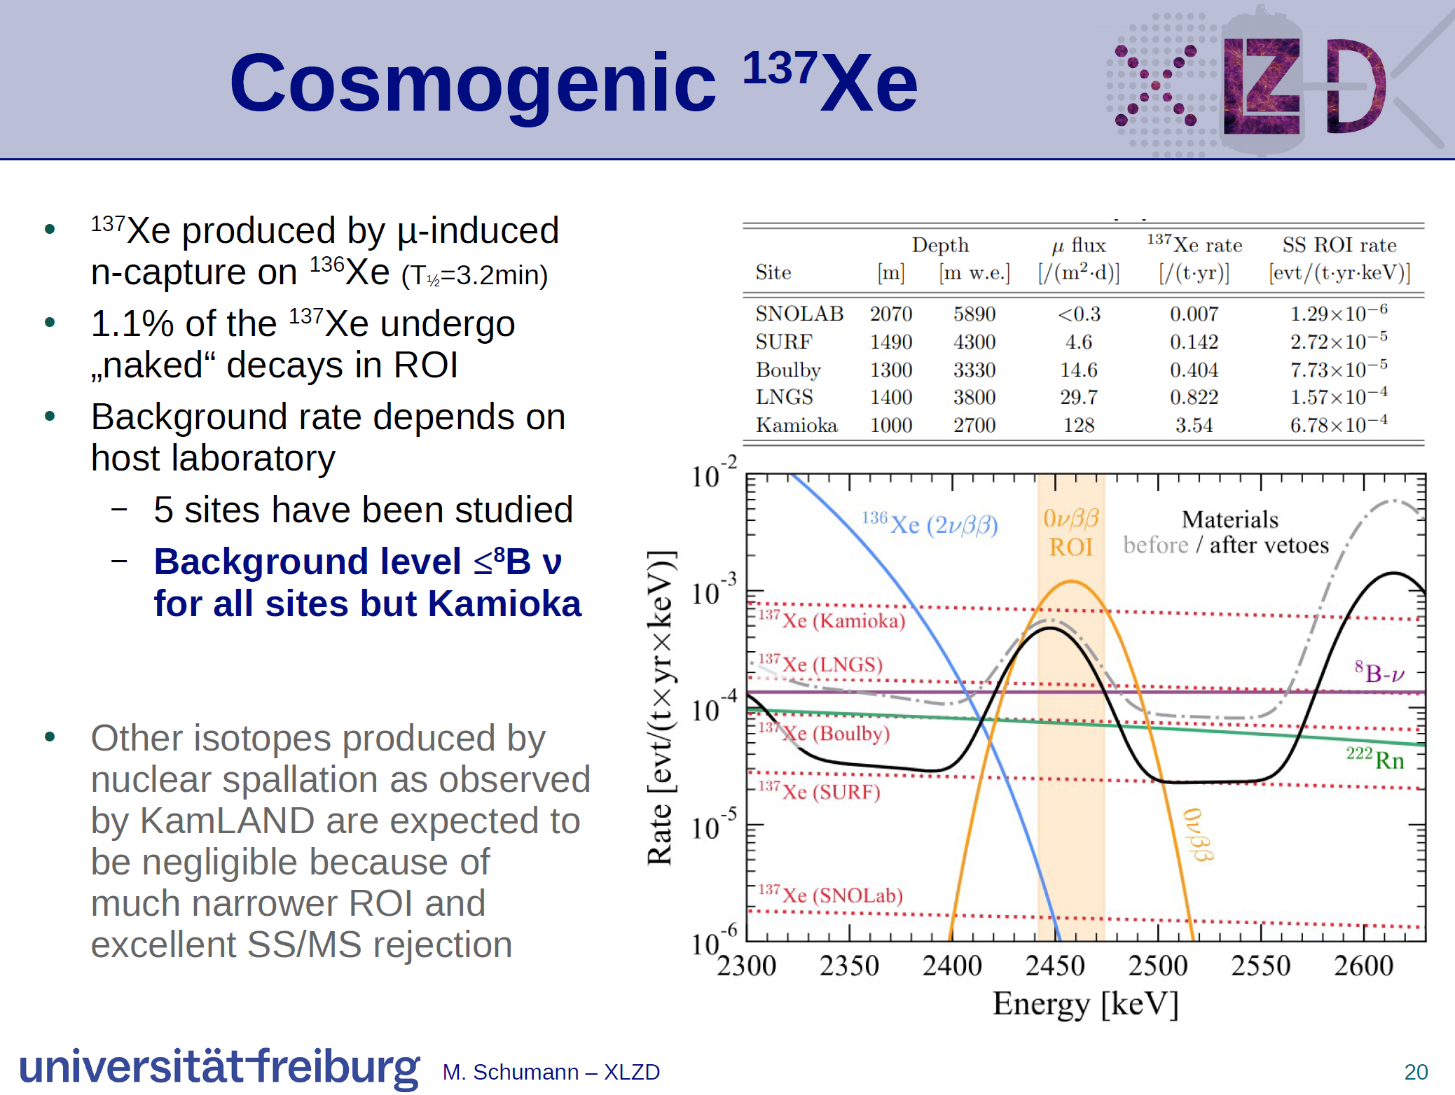
M.w.e. of LNGS or deeper is sufficient for 0νββ sensitivity of 10²⁸ years.
To go beyond 10²⁸ years, one could imagine replacing the natural Xe in XLZD with Xe enriched in Xe-136 → increases Xe-137 rate.
Considering the significant investment of XLZD, siting the experiment at SNOLAB is the only forward-looking option.

Slide 11
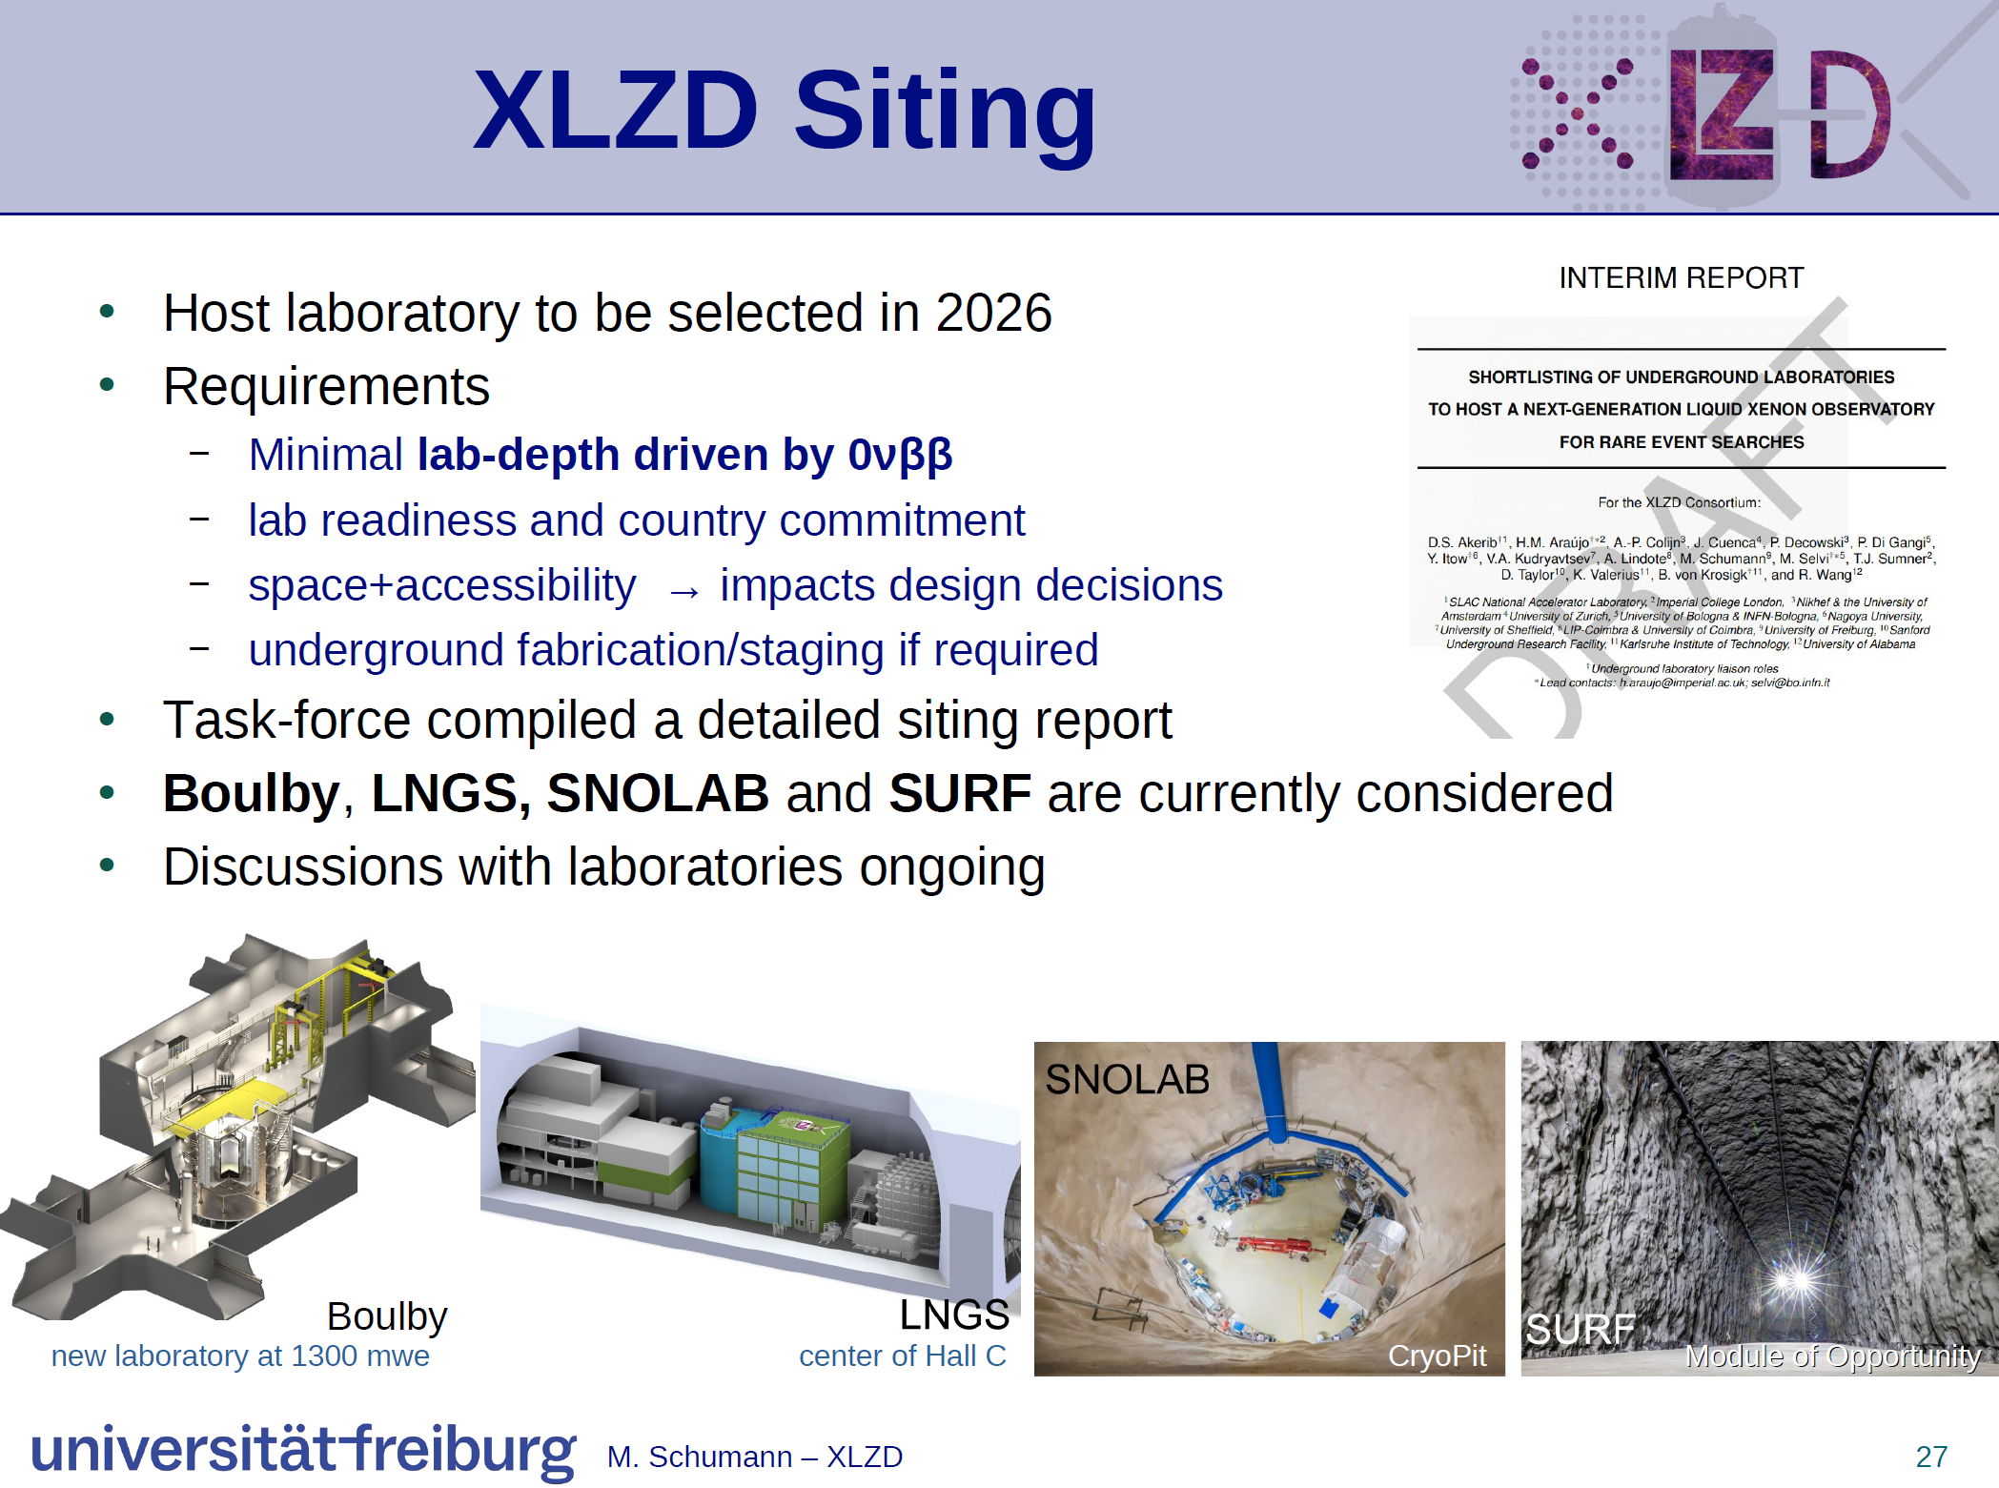
SNOLAB is the best location:
Future proof!
Cryopit available!
SNOLAB expertise!
Scientific expertise!
Ultimately the decision to site XLZD will be a political decision.

Slide 12
What’s next?
We (Brunner, Cooley, McDonald, Noble, Smith) submitted a 2-page pitch to the Canadian government for it to make a bid to host XLZD (Nov. 2025). Federal investment is required to attract XLZD to Canada! → Feedback from Minister Joly’s office very positive!
Canadian team to officially join XLZD → application to join submitted.
→ Reach out to me if you are interested in joining as well!
Integrate Canadian scientists in XLZD.
Develop project, cost model, and governance for a scenario where XLZD is sited at SNOLAB.
Team to apply for NSERC project funding for XLZD in the fall of 2026.
Submit a CFI proposal to the IF 2027 round requesting support to advance Canadian technology to enhance XLZD’s 0νββ sensitivity → planning started.
Expand strength of Canadian team and develop additional expertise.
Continue lobbying with the Canadian government to commit to host XLZD.
Time

Slide 13
Conclusion
XLZD is the most promising next generation flagship experiment.
XLZD aims for world-leading sensitivities in two mayor physics channels: 0νββ and Dark Matter
A team of Xe-enthusiast is forming within Canada to realize XLZD at SNOLAB.
We are starting to develop plan and strategy → the time is now to get involved and join our efforts!

