Slide 1

SNO+ DAQ Chain from Pulses to Analysis ready data
Mark Ward
SNOLAB Users meeting MAY 26, 2026

Slide 2
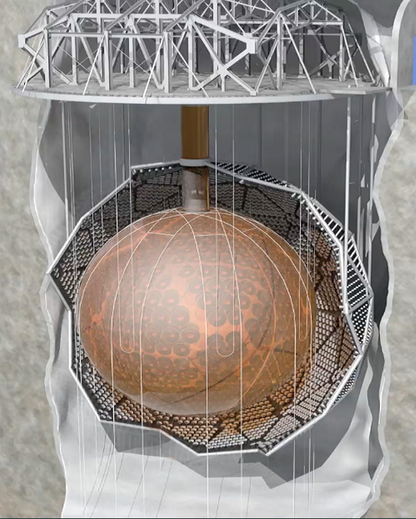
The SNO+ Detector
2Km Underground
(6000 mwe Shielding)
12m Acrylic Vessel
780T of organic liquid scintillator (LAB)
7000T UPW Shielding
Detector held down to the cavity floor via rope net
Stainless Steel PMT Support structure
9362 8inch Photomultiplier Tubes (R1408) providing 54% photocoverage
Outward looking muon veto.

Slide 3
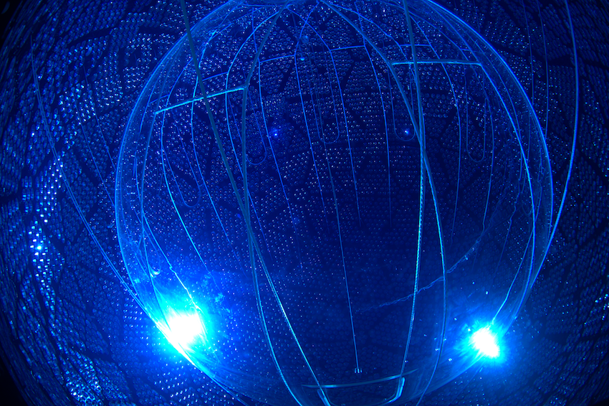






Physics Goals
$$β$$
$$β$$
$$ν$$
Multi-Purpose neutrino physics detector
  Solar neutrinos
  Reactor neutrinos
  Geoneutrinos
Primary goal is a neutrinoless double beta decay search using Tellurium-130
  ¹³⁰Te selected for favorable Q value (2.53MeV)
  and natural abundance (34.08%)
  3.9 T of natural Tellurium, 1.3 T of target isotope
  Double beta lifetime measurement
  T_{1/2} ~8.2x10²⁰ years
  Neutrinoless double beta decay mode 5 year sensitivity target of T_{1/2} ~2.1x10²⁶ years
$$ν$$
$$β$$
$$β$$

Slide 4
How do we go from Physics to data
Get Signal from Detector
Is signal interesting?
Yes
Save Signal
PHYSICS!
WITNESS ME!
No
But what is the signal?
  In SNO+ we get Voltage pulses from PMTs
How do we define interesting?
  There are ~9400 PMTs, this is a lot of information
Do we save everything?
  No…

Slide 5
In SNO+
Monolithic target
  Energy deposited in the LAB produces ionization and scintillation, this is our raw physics.
~9400 inward facing PMTs observe the Photons.
  Convert the photons into a readable electrical signal.
  Light yield of 330 PMT hits / MeV. (N.B. NOT photoelectrons!)
Determine if something happened worth recording.
  Most useful metric is ~ NHITS / Time window ~ dE/dT
SO lets go for a dive

Slide 6
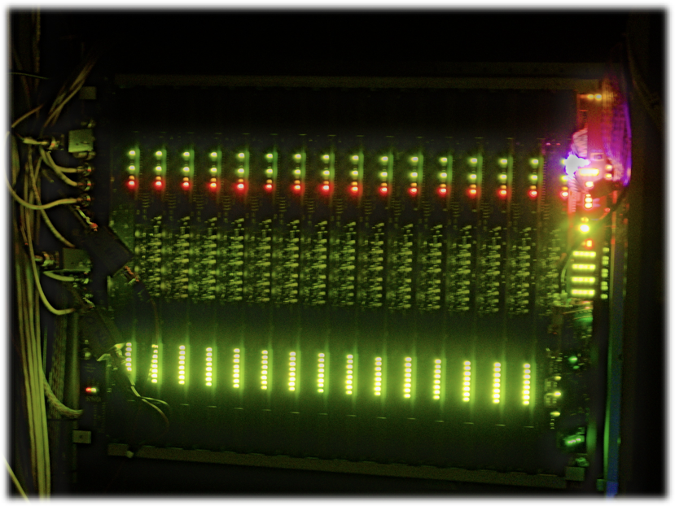
Divide up the channels
A single Crate
The deck area of SNO+ is not as tidy as shown in the diagram, also the support is baby blue.
9400 inward facing PMTs are divided into 19 crates
19 crates distributed among 11 Racks around the detector
Each crate divided into 16 ‘slots’ each with 32 channels
Each slot is composed of a PMT-interface Card and Front End Card
Each Front end card has 4 daughterboards, addressing 8 PMTs
Some LEDs even flash!

Slide 7
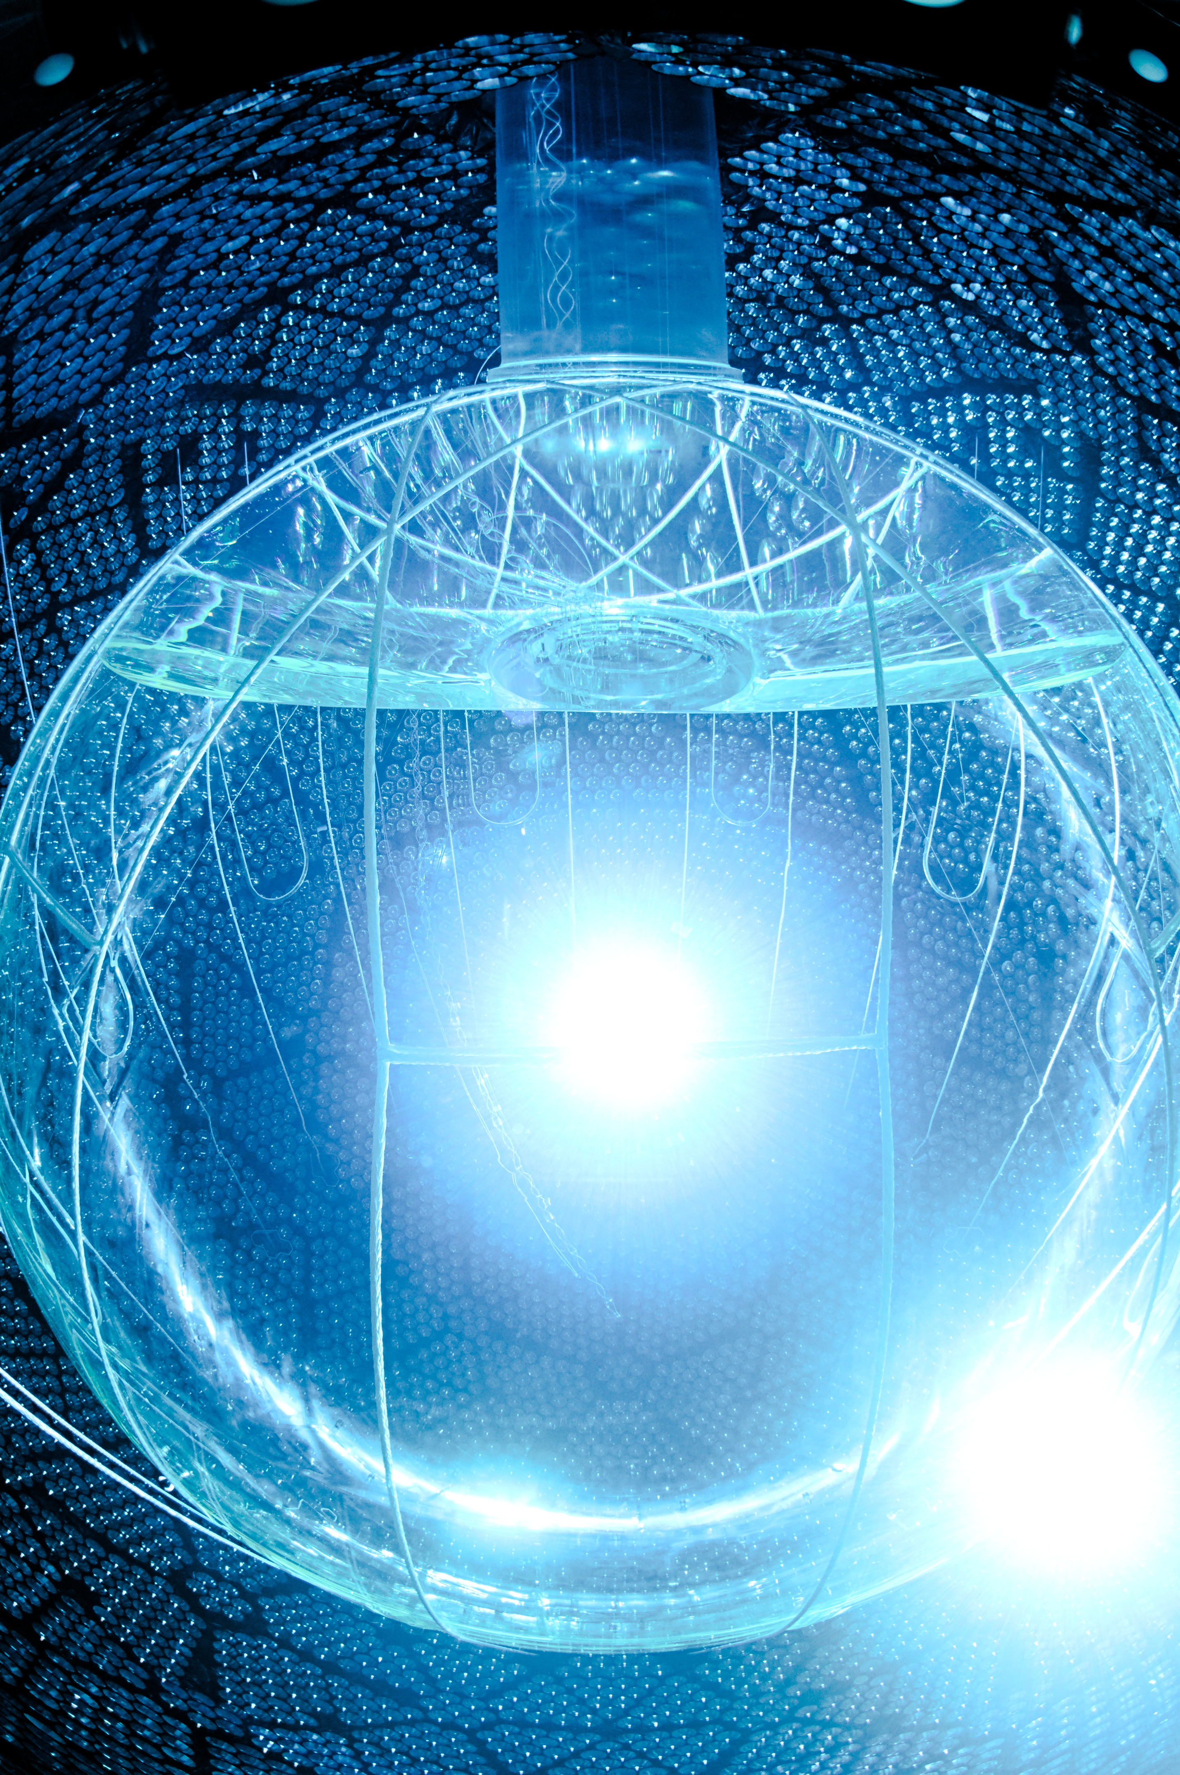
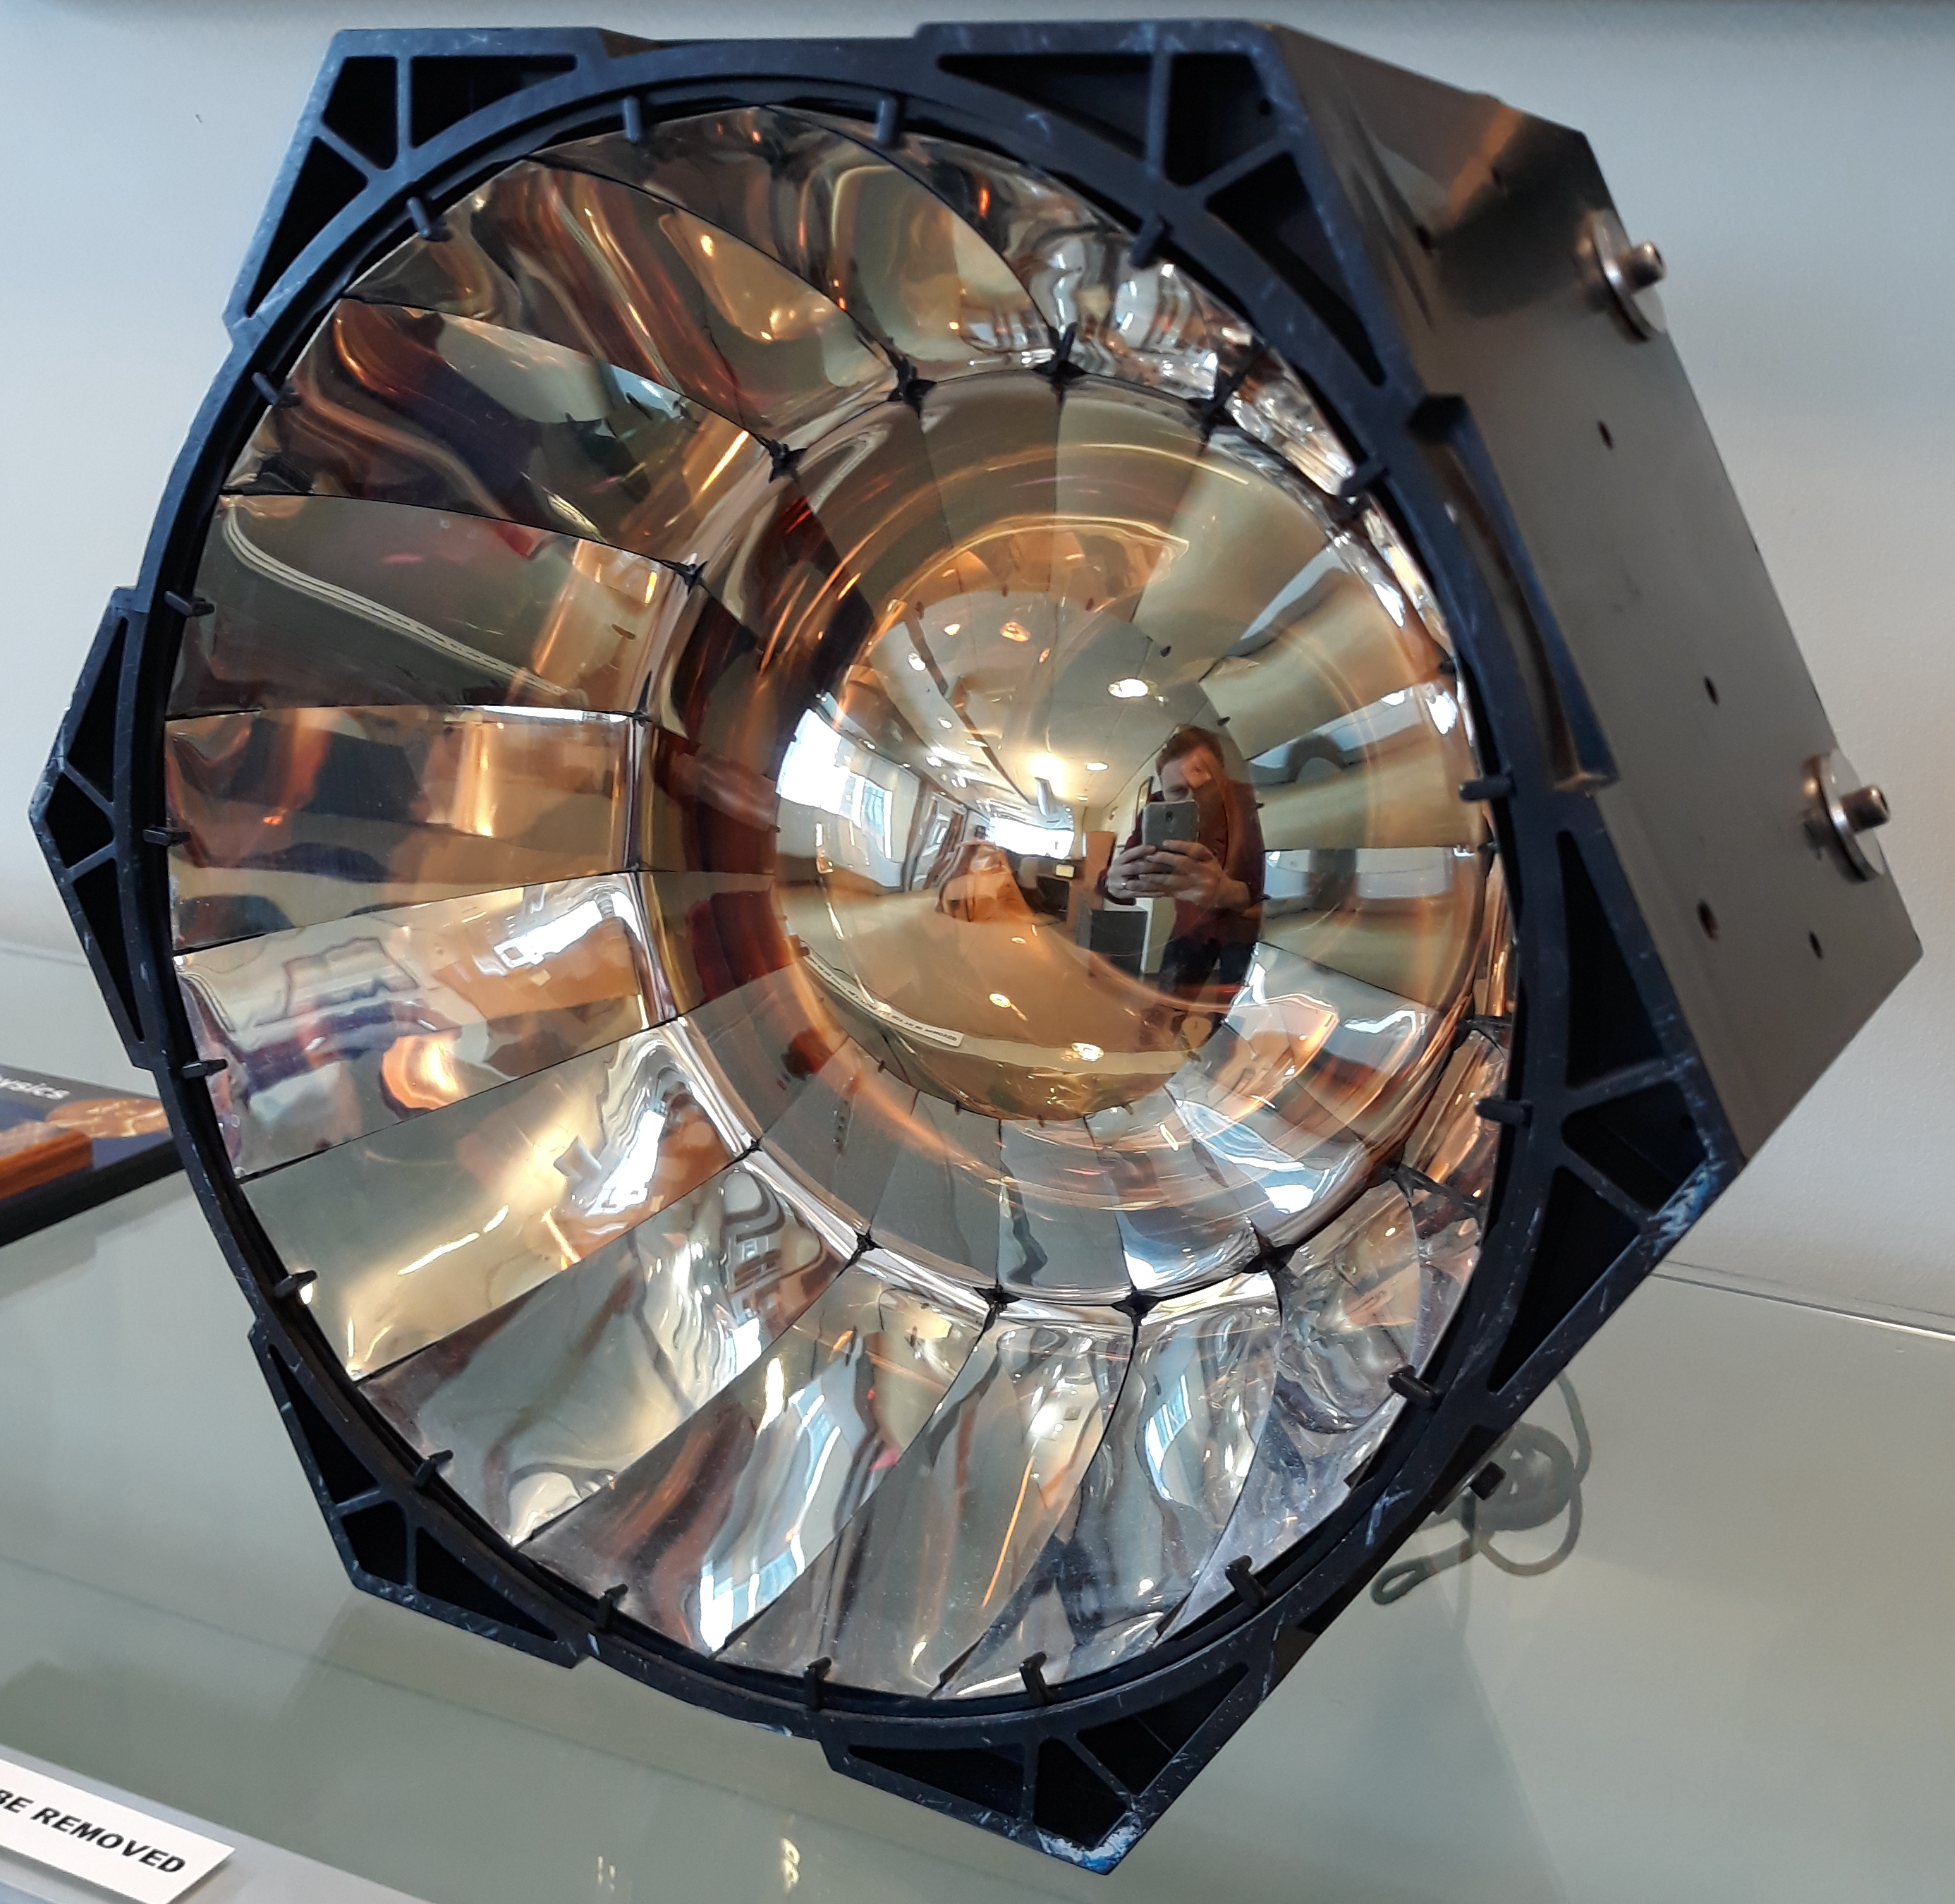


From scintillation to ‘Event’
Under the water
pmt
e⁻
Photon(s) produced by the detector are absorbed by PMTs, and an photoelectrons produced by the photoelectric effect
Photoelectrons are multiplied by the PMT
Induced signal travels along the HV cable toward the deck
$$β$$
$$ν$$
$$ν$$
$$β$$
HEX cell
330 ‘hits’ / MeV
NOT
330 photons/Mev
(the glowing orb is not typical, its a lamp)

Slide 8
From scintillation to ‘Event’ – To the Deck
Electronics Rack
Cables are bundled in groups of 8 and come through between the deck and the cavity wall.

Slide 9
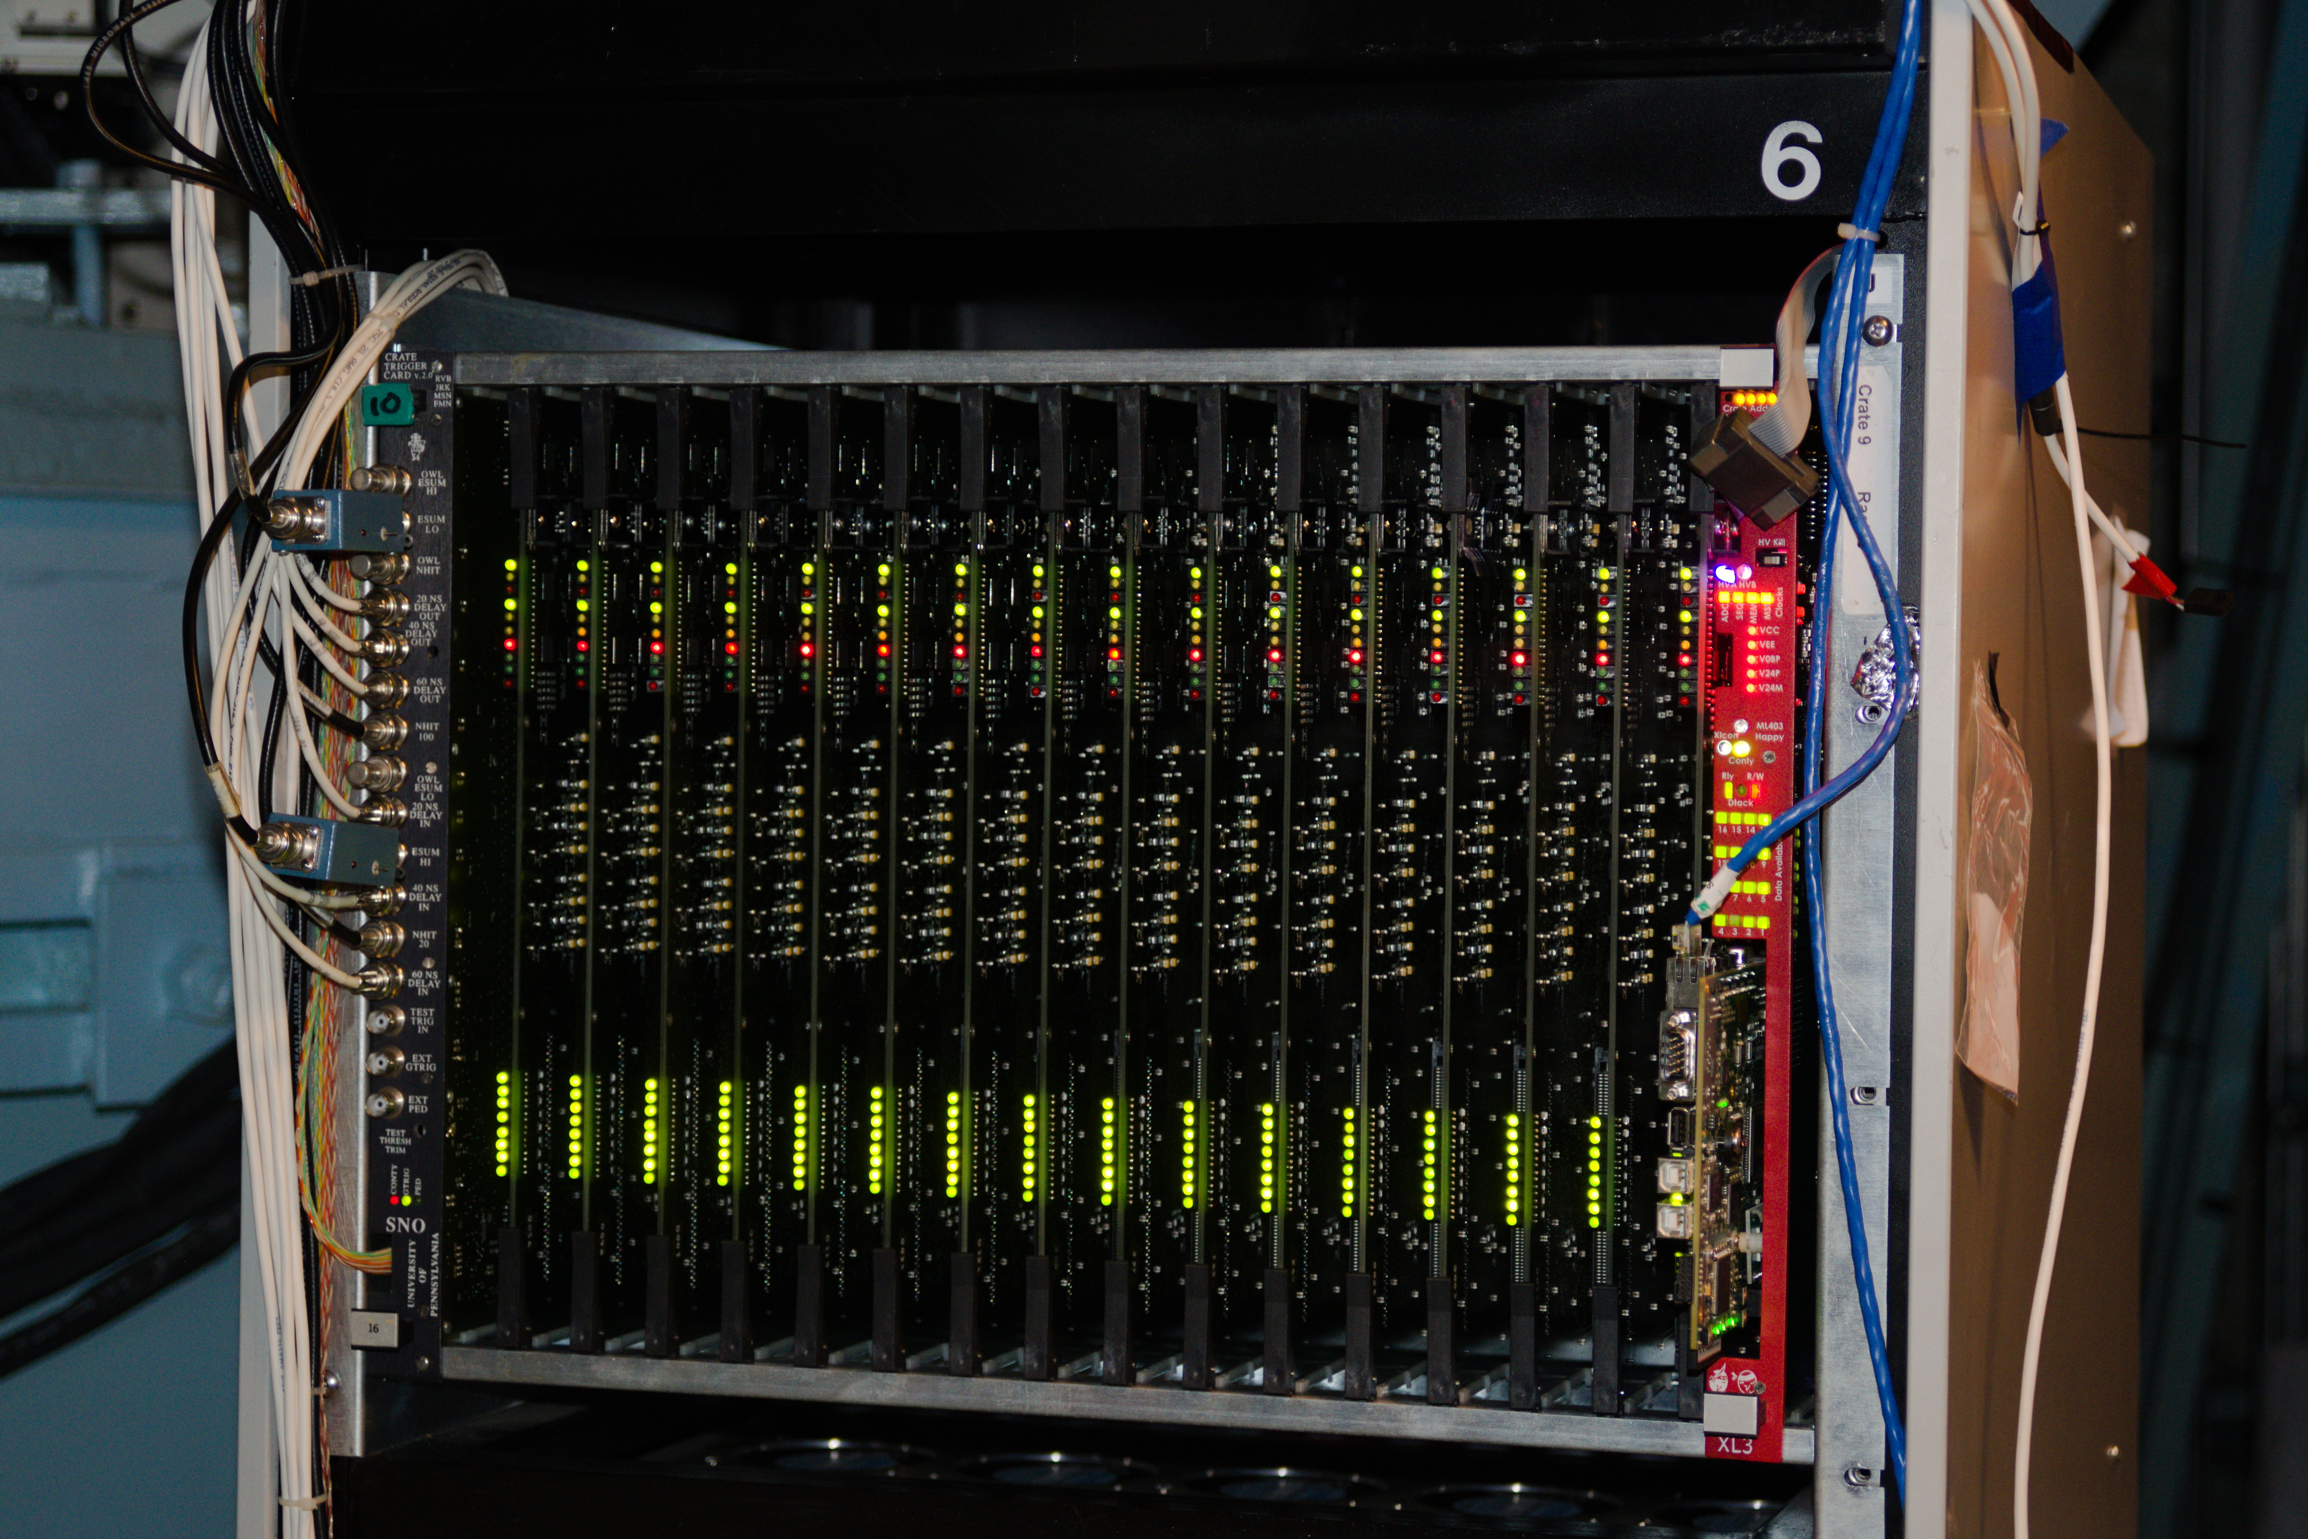
An example Crate

Slide 10
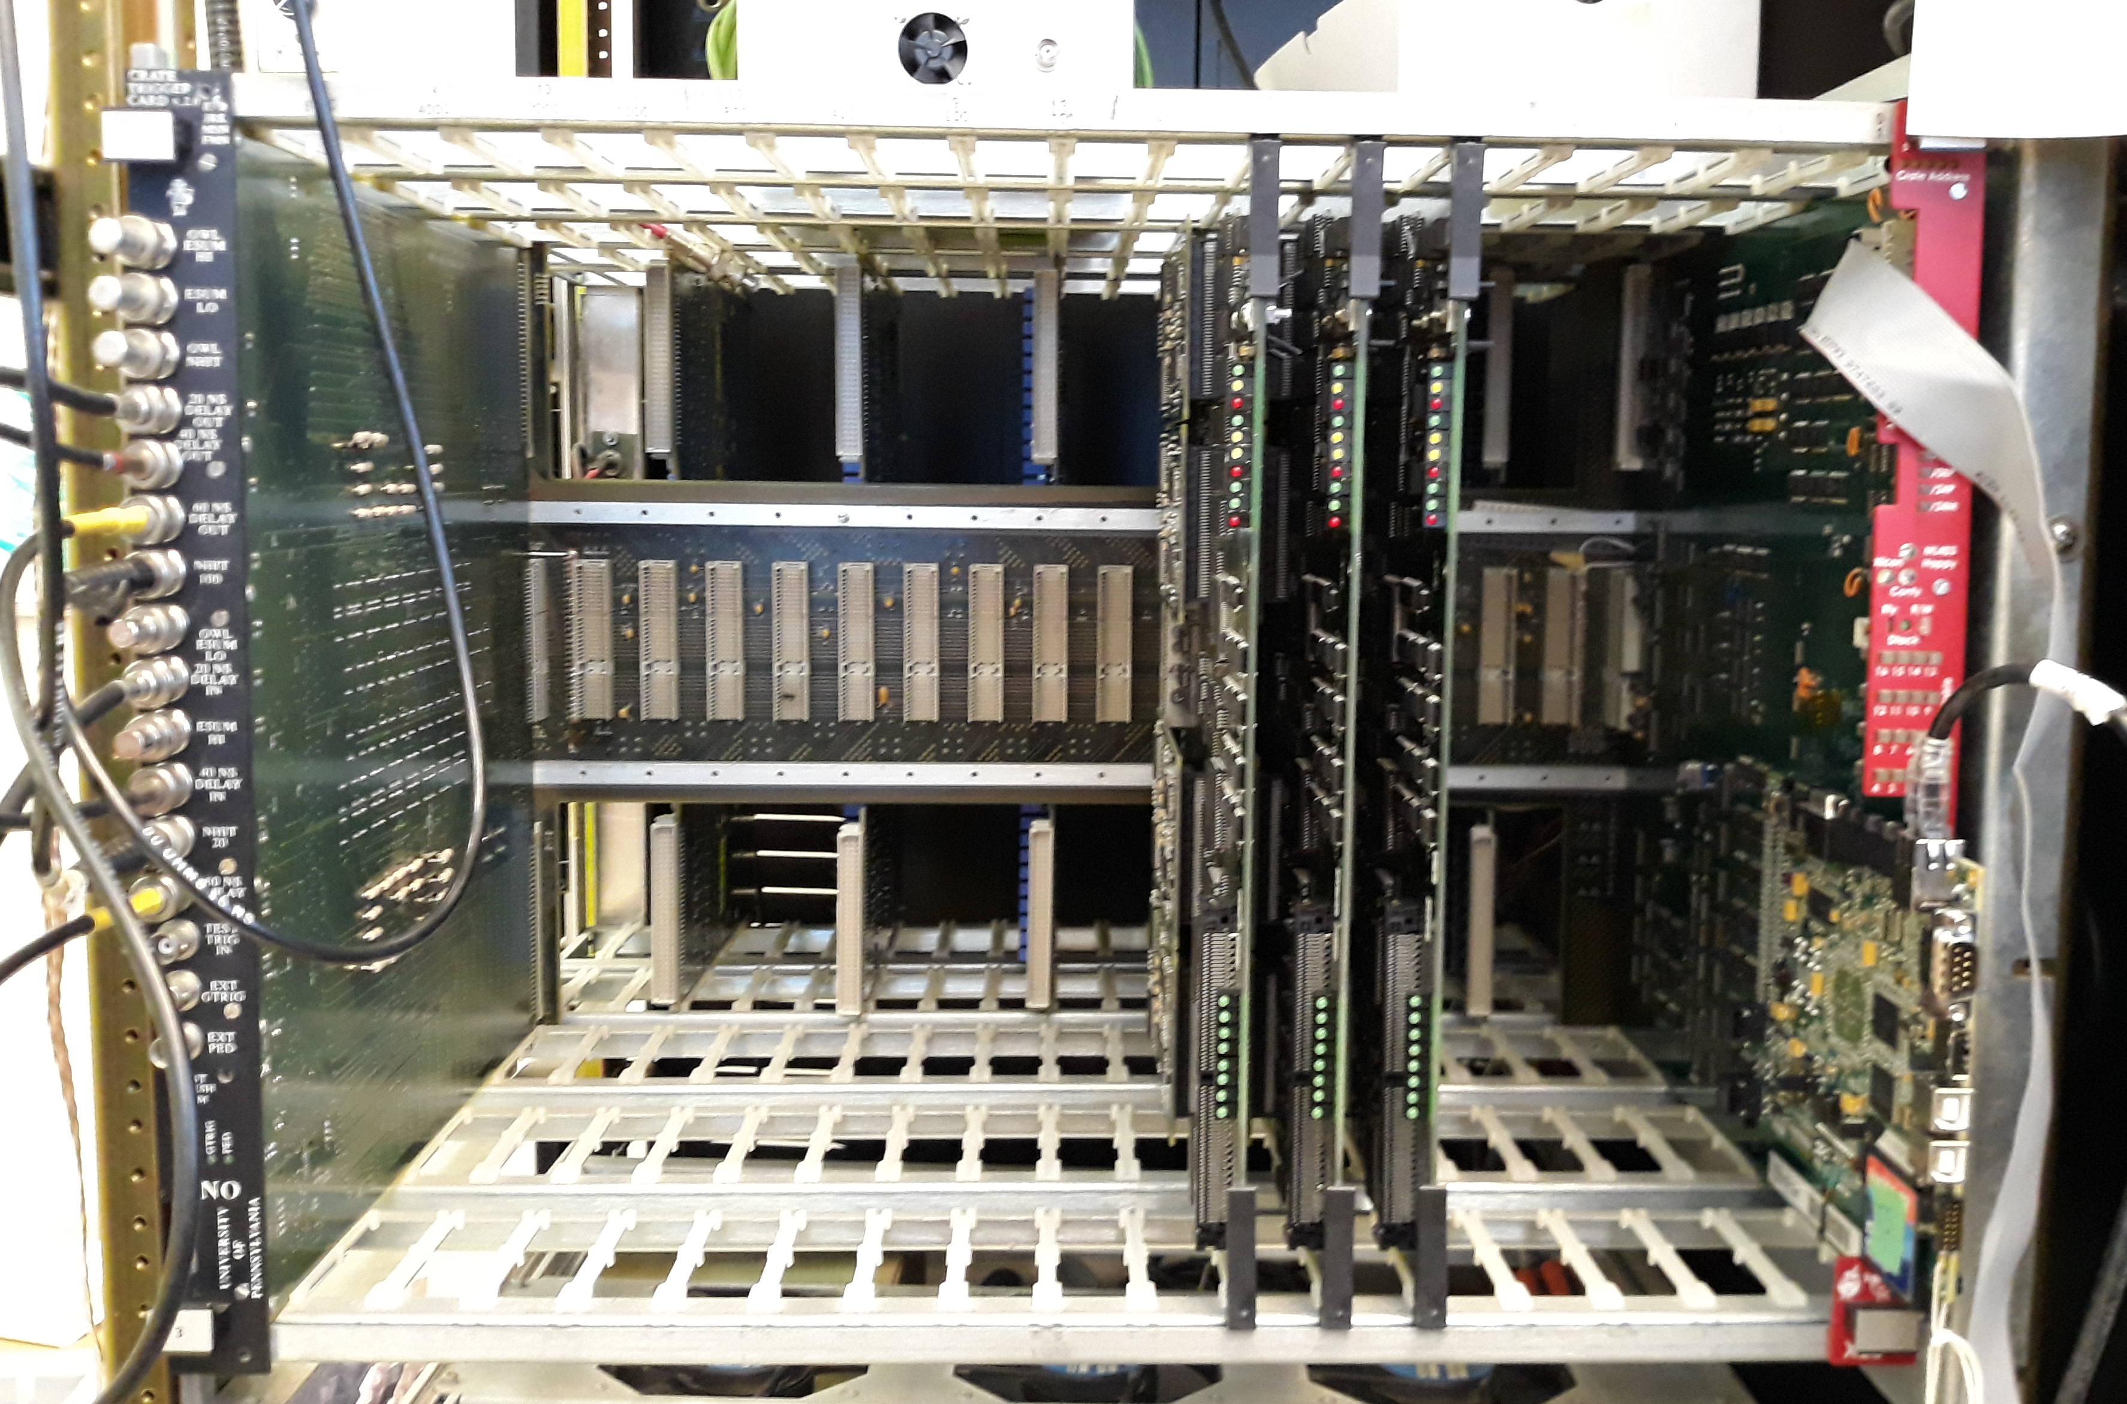
An example Crate - The Test stand
XL3
PMTIC Sockets
Back Plane
with Sockets
Crate Trigger Card
3 Front end Cards

Slide 11
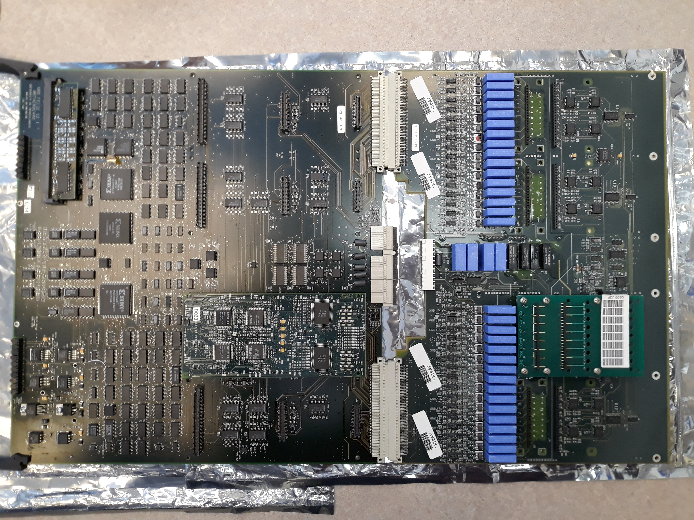
Front End Card PMT Interface Card
Back Plane
Socket
4 HV relays
TO/FROM PMT
Daughter Board
Paddle Card

Slide 12
From scintillation to ‘Event’ - PMT Triggers
Back Plane
Socket
4 HV relays
TO/FROM PMT
Daughter Board
Paddle Card

Slide 13





From scintillation to ‘Event’ - Daughter Boards
Discriminator
8ch
$$Σ$$
N20
RAW PMT
Create
N100
N20
x2
x8
8ch
$$Σ$$
N100
x8
4 in
TAC
Start/Stop
4ch
ESUMH
$$Σ$$
ESUMH
$$Σ$$
4ch
ESUML
4ch
$$Σ$$
ESUML
4 in
x2
4ch
Integrator
4ch
Each Daughter Board deals with 8 channels in 2 lanes
On A threshold cross, we start TAC for that channel
The output is ESUMHI, ESUMLOW, N100 and N20 analog sums
Charge integration in two windows, Short…70ns (QHS) and long 400ns (QHL) and QHX (we ignore this one)

Slide 14





From scintillation to ‘Event’ - FEC level sums go to the backplane
$$Σ$$
$$Σ$$
$$Σ$$
$$Σ$$
Back Plane
Socket
TO/FROM PMT
$$Σ$$
$$Σ$$
$$Σ$$
$$Σ$$
Paddle Card

Slide 15
From scintillation to ‘Event’ - Daughter Boards
XL3
All FECs send ESUMH
ESUML
N20
N100
to the Crate Trigger card
Back Plane
Crate Trigger Card
3 Front end Cards

Slide 16
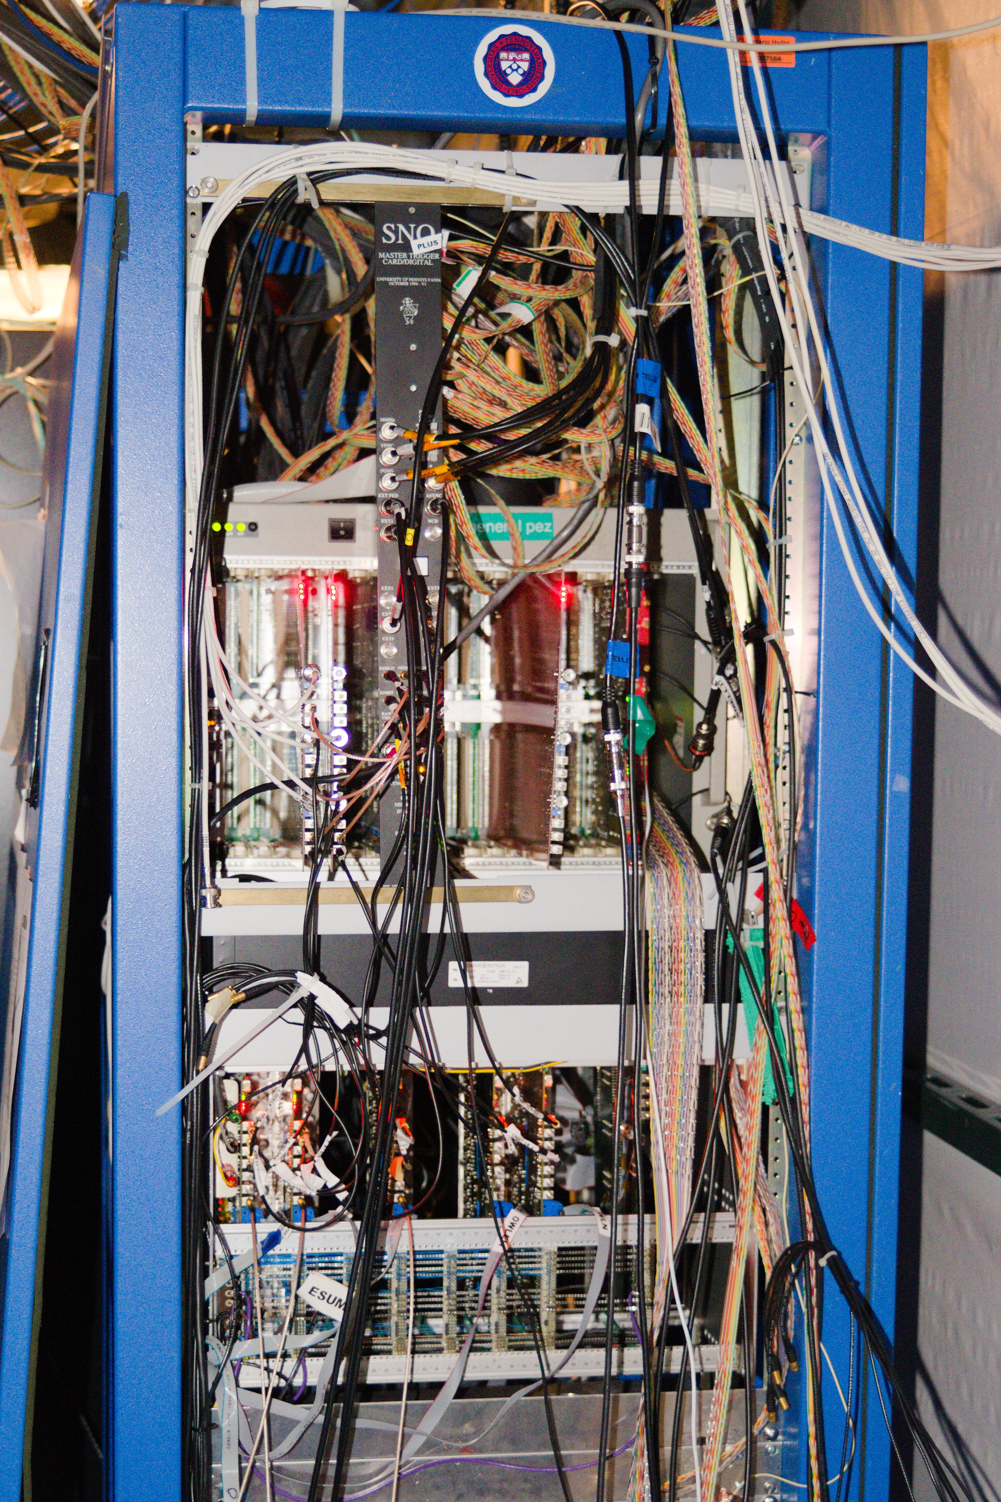
From scintillation to ‘Event’ -
Analog Sum of whole detector!
Not one Unit, but 7 Master Trigger cards, (MTC/A*)
Analog sum each Crate Trigger Card output.
At this point, we have a final total analog sum of the whole detector in 10 different paths.
Here we have a final threshold applied which generates one final trigger pulse which we send to the Master Trigger Card / Digital+
Send to MTC/D+
n100 Threshold

Slide 17
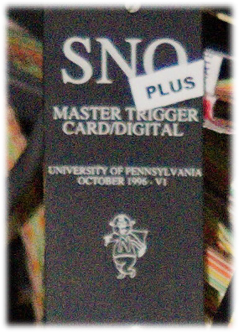
From scintillation to ‘Event’ -
Make a trigger decision
1996!!!!
Takes care of timing and synchronization
This card generates the Global Trigger!
This is based on which trigger paths are active on the MTC/A+ or from other sources.
Global trigger is sent back to the Crate trigger cards and distributed to each Front End Card

Slide 18
From scintillation to ‘Event’ – Form events on FECs
Each Front end Card gets signalled by the Global Trigger to save data to a buffer
Data Produced
TAC voltage ramp stops, giving the hit time relative to the global trigger
Short and Long charge integration data
Note if a hit doesn’t result in observing a Global Trigger The daughterboards will discard the data after 420ns

Slide 19
From scintillation to ‘Event’ – Send hits to the Builder
We have Data on each FEC
So how do we get it out?
THE XL3!
The XL3 checks the cmos data status on each FEC. If data is available the XL3 will read it out
Data travels along the backplane to the right
The brain of the XL3 is a FPGA and PPC processor which provides a tcp/ip interface and routes the data to the builder which will create an Event for each Global Trigger
  Event = Global Trigger ID, MTC/D clock time, Trigger Flags, GPS clock time, Digitized Trigger waveforms x3,
  PMT hit info = 3 Charge integrals, relative hit time and status per hit.
DONE!…. Next event…
XL3

Slide 20
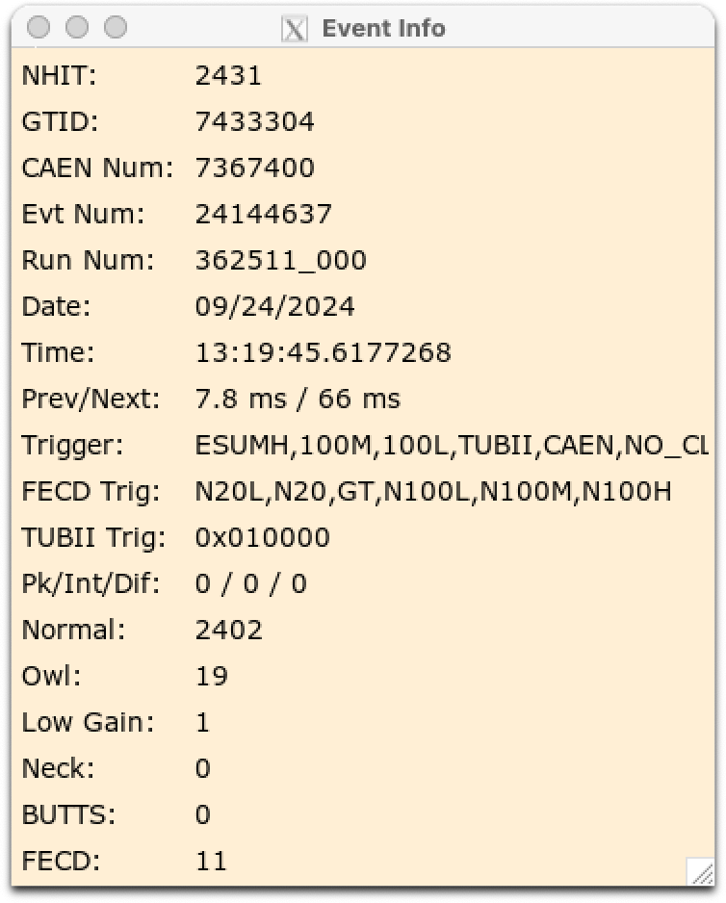
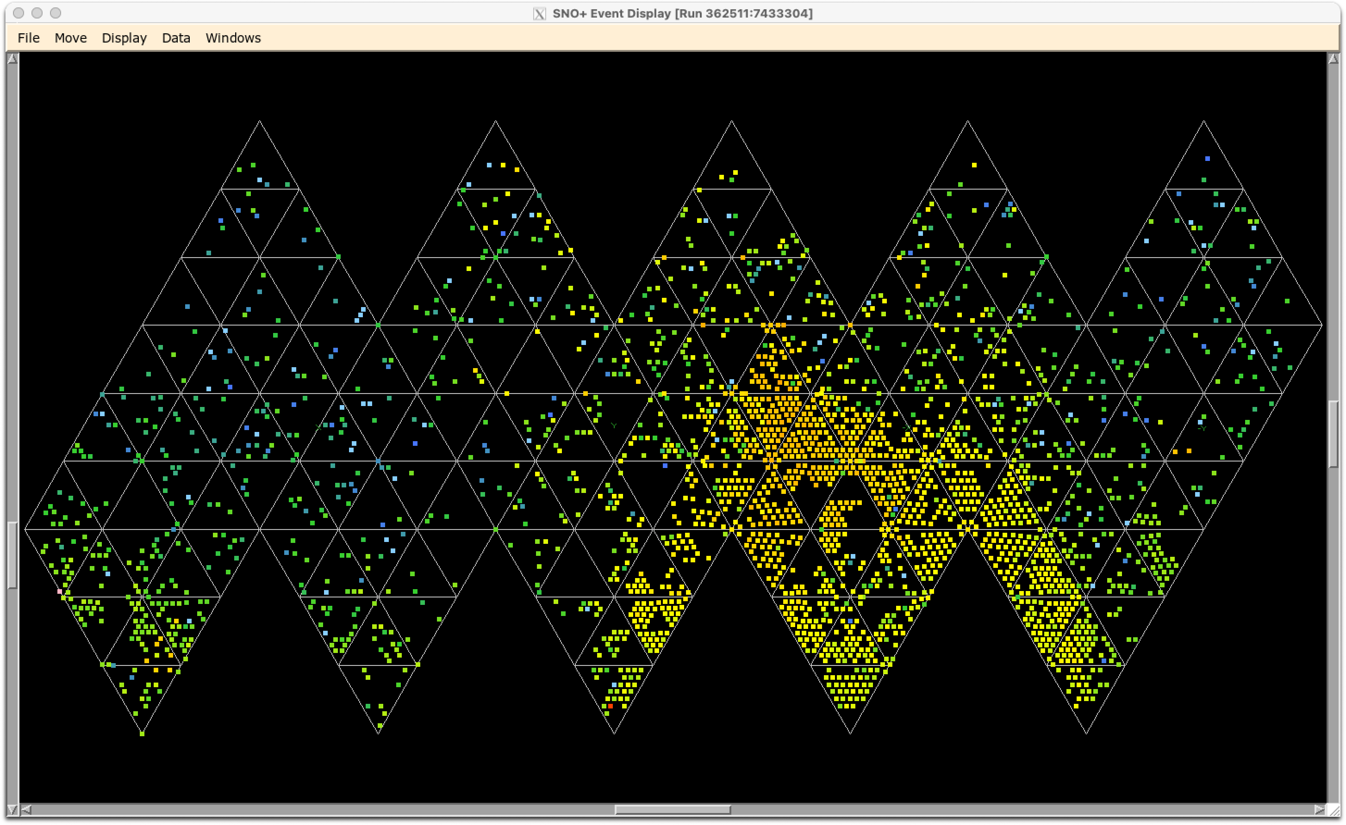
Example event

Slide 21

In Step Run-Selection
We perform a set high level data processing on each run and classify the quality of the data based on what criteria it meets
In total there are 57 properties of the data that we look at and slot it into… We need to meet all/most conditions.
  Gold : Perfect as good as its going to get, All crates on and enough PMTs are working.
  Silver: Good… but more offline channels than gold
  Bronze: Crate off? No worries just not too many please.
  Nickel : Is the detector on and not going crazy? Cool!
N.B. – this is a gross over simplification.

Slide 22

So coverage determines most of it?.... Yes… but also no.
  Gold/Silver/Bronze/Nickel largely fall into dqhl differences.
  dqhl – data quality high level
    Are trigger rates normal?
      Are we above pulse GT… (10Hz)
    Is timing in the detector alright?
      Is the clock ticking?
      Do we see any large clock jumps?
    Do we have enough PMTs on?
      Are any crates off?
      Are there any panel gaps that are too large?

Slide 23
So coverage determines most of it?.... Yes… but also no… part 2
Some flags can cause us to fail runs outright…
Detector state
  Do we have blind flashers?
  Is data being written in an orderly manner?
  Is data piling up on the FECs?
  Is the detector able to count properly
  Are the FECs able to see the correct global trigger number.
  Are there any critical alarms active?

Slide 24
So coverage determines most of it… fine… it’s a big part but still no
Did any crates randomly stop talking to the builder?
Is the run longer than 30 minutes
Is anyone on deck… hitting things?
Does the run belong to a runtype that should not be used for physics.
Do we see too many muon like events?
Did any FECs have an identity crisis?
Does someone just not think the run should pass for reasons they note in the shift report?
Im the FEC in 12/8 and I’m going to be a issue!

Slide 25
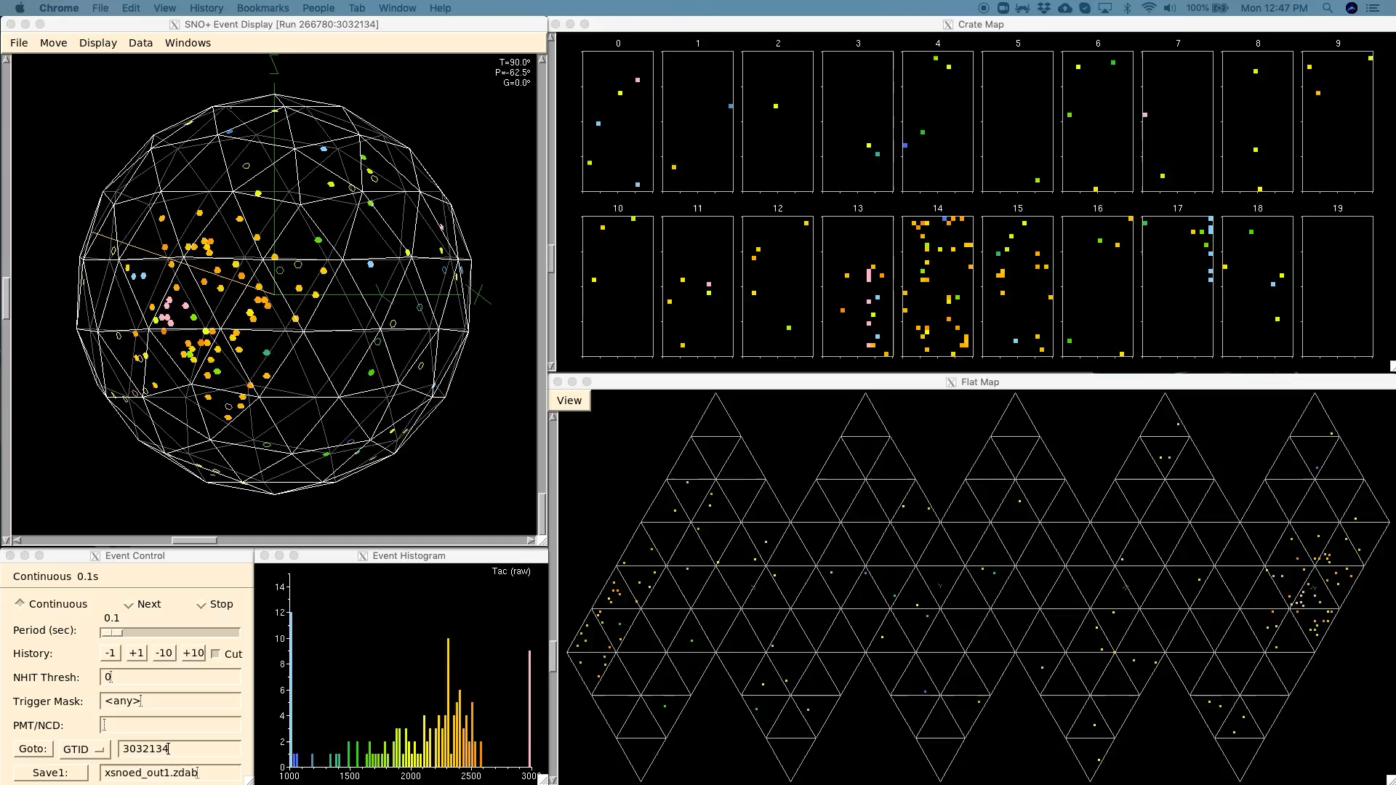
Things that cause bad runs… Example 1 : PMT breakdown
When PMTs breakdown, they typically produce a lot of light in the detector, and a large amount of events.
This is ok and can be classified, if it’s a short burst.
Can raise an alarm
  Channel/daughterboard/slot going offline gets flagged daq side
  Sustained bursts can flood front end electronics, causing daq alarms
  Breakdowns can look like Muons, No… we didn’t get 1000 muons in a few seconds.

Slide 26
Things that cause bad runs… Example 2 : Bad Data
It is possible for a Front End Card to ‘forget’ where it is in the detector.
  This can be due to a failing component on the card that causes its ‘reset on power on’ circuit to fire.
  The builder is able to tell when this happens and produces an alarm.
Im the FEC in 12/8 and Im suddenly going to tell the builder im actually in 0/0

Slide 27
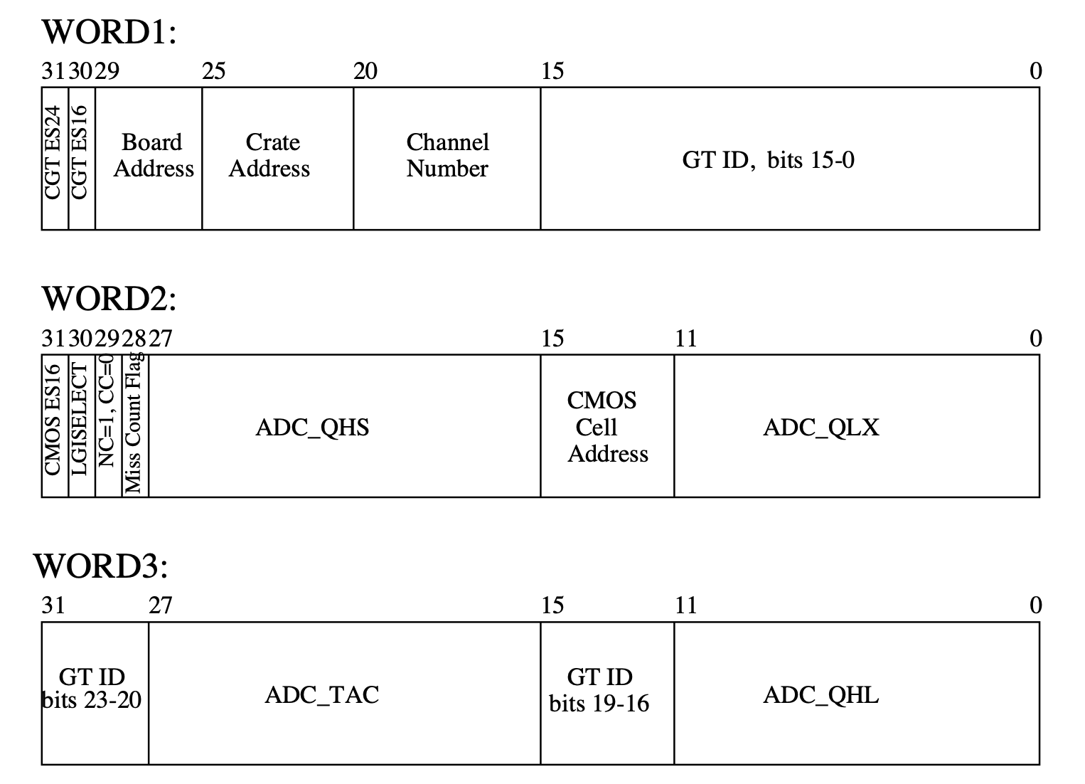
Things that cause bad runs… Example 3 : Mega bundles go bad
If a front end card produces a PMT ‘mega-bundle’ which makes no sense, the builder will raise an alarm, typically like the previous example, flagging bad data.
Typically words 1 and 3 are vital and will cause most of the issues if there are any
  Huge GTID jumps get flagged, if it occurs too much, the run will fail.
Can occur both front end and transferring information from the FEC to the XL3 to the builder.
If a FEC doesn’t receive a Sync16 or Sync24 flag it means the FEC is not recording GTID correctly data will go out of sync with respect o the detector – it will cause issues and gets flagged.

Slide 28
Run Selection – The on going task for a mature DAQ
Run Selection and Data Quality monitoring is a on-going task
It changes as we uncover new and interesting ways we can define how good data is and what the DAQ does.
The local team is tasked with not only uptime, but producing analyzable data!
  The largest challenge we face is that of PMT coverage, and is completely dominated by environmental factors and our ability to mitigate it.
  The underground environment is harsh on electronics.
  The electronics is being pushed beyond its intended operation from SNO, which has, produced new and ‘interesting’ failure modes which require sometimes innovative solutions.
  Electronics older than many in this room is also a reality we need to deal with.
SNO+ has produced a flurry of publications over its run time thus far!

