Slide 1
SuperCDMS: Commissioning Status
SNOLAB User Meeting 2026
Prof Miriam Diamond, University of Toronto
May 26-27 2026

Slide 2
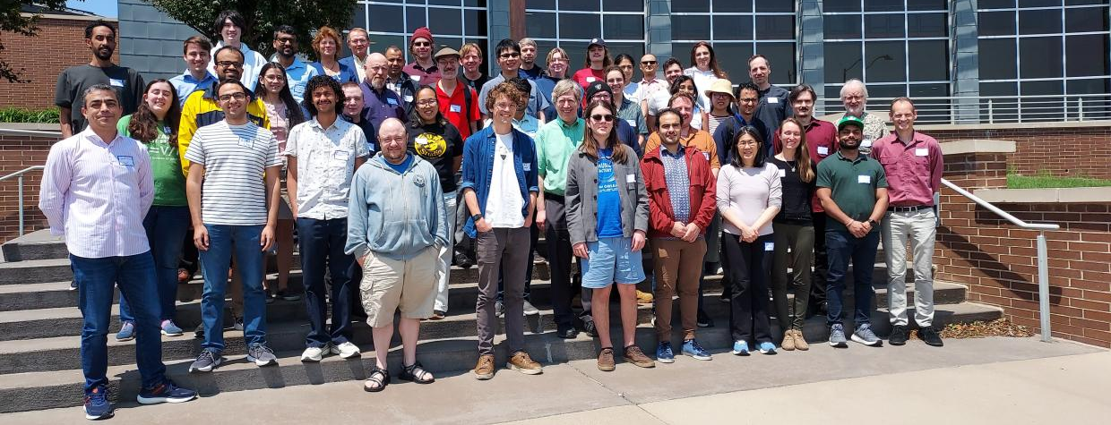

SuperCDMS Collaboration

Slide 3
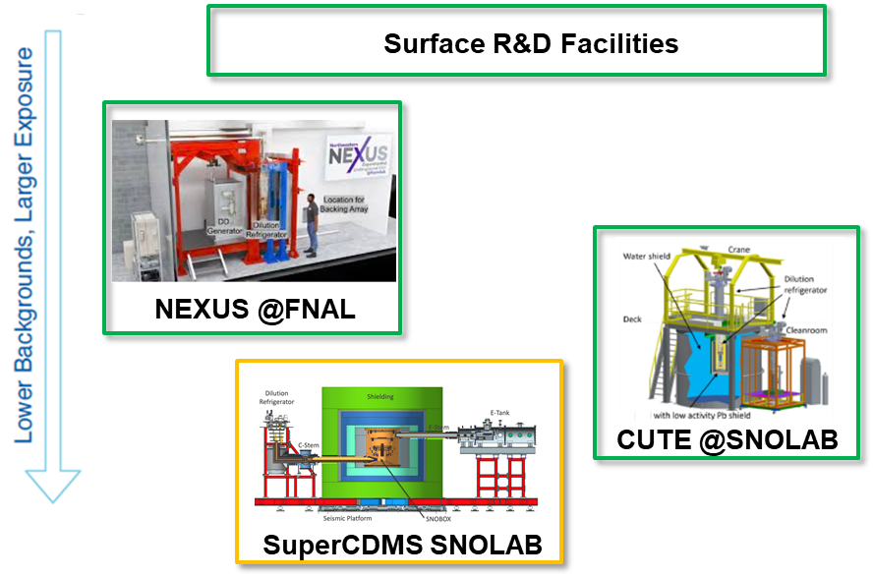
Multiple test facilities and R&D programs provide science maximizing SuperCDMS SNOLAB reach
Operational
Commissioning

Slide 4

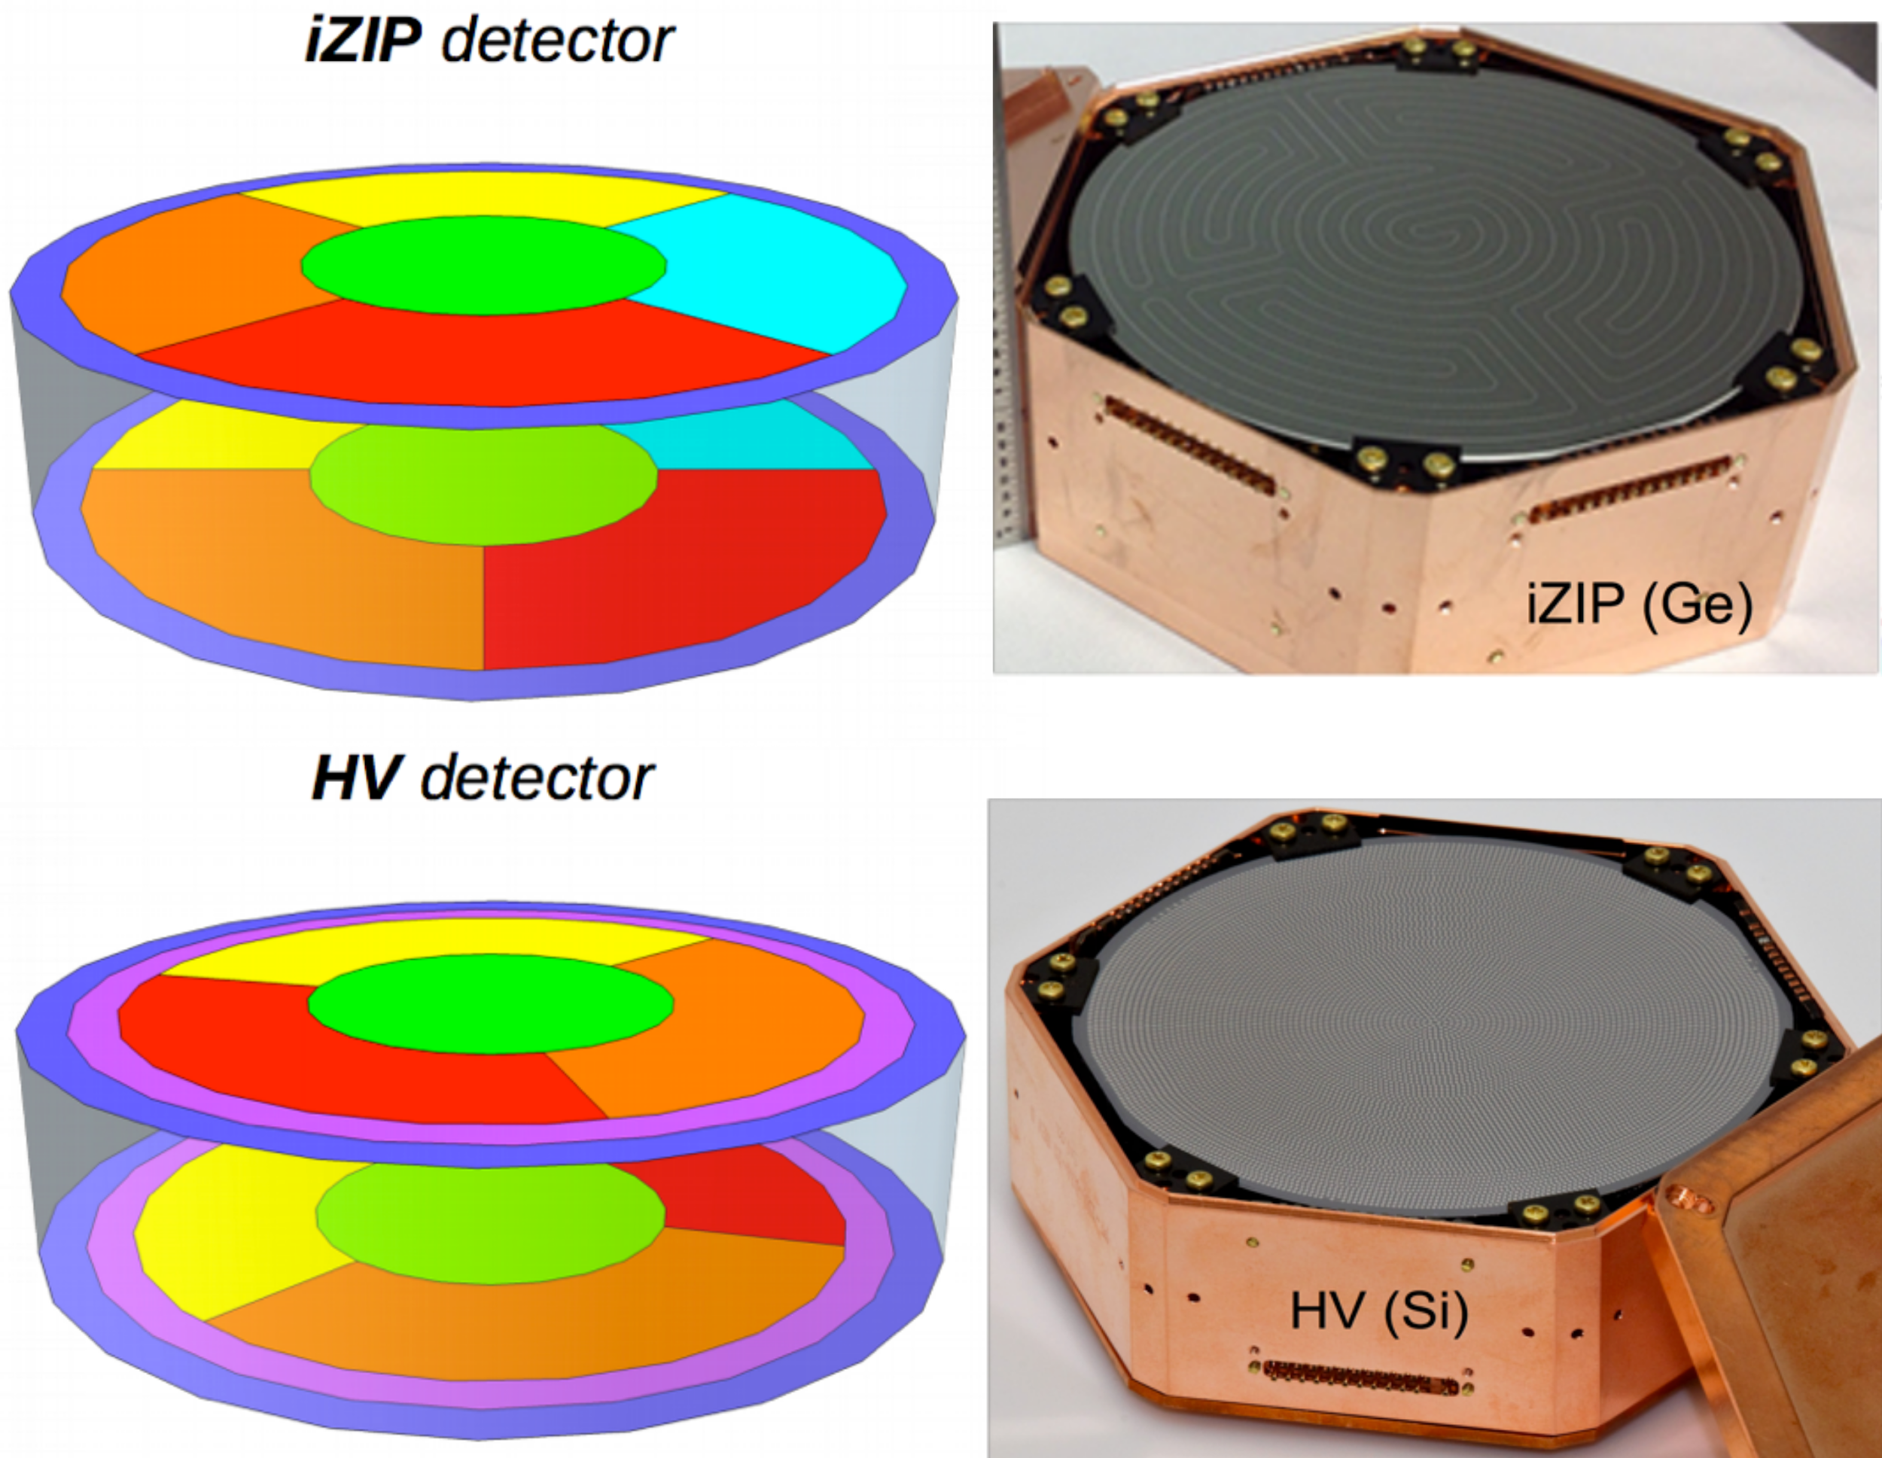
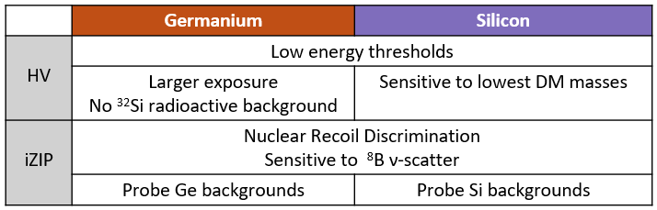
Complementary targets and technologies maximize coverage for low-mass WIMPs and electron-recoil DM
Payload: 24 detectors (4 towers)
Some iZIP (Interleaved Z-sensitive Ionization & Phonon),
some HV (High Voltage, phonon-only)

Slide 5
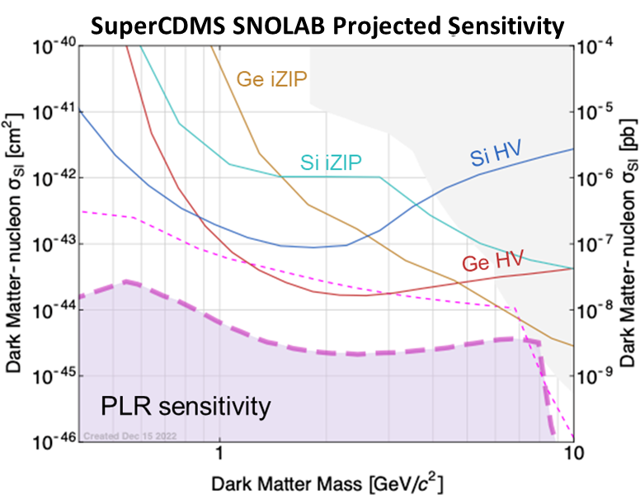
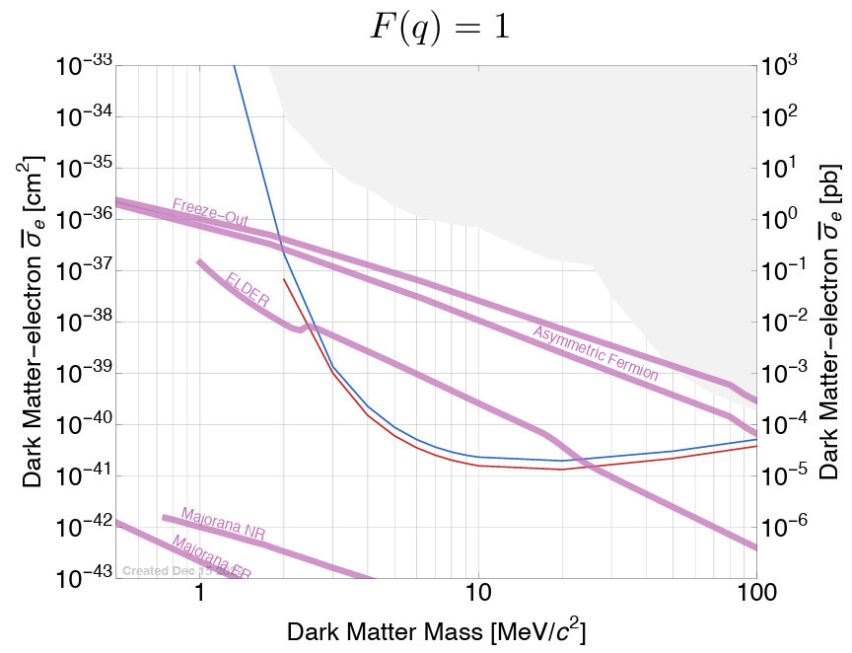
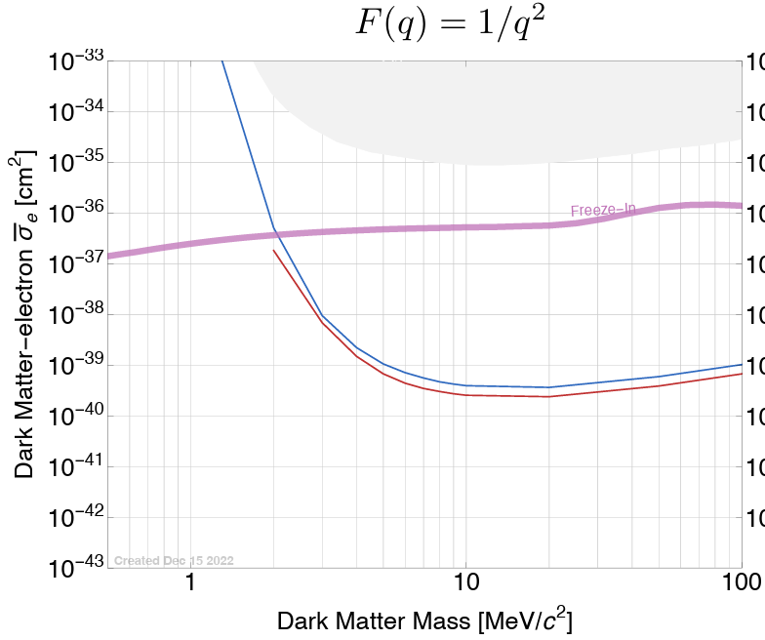
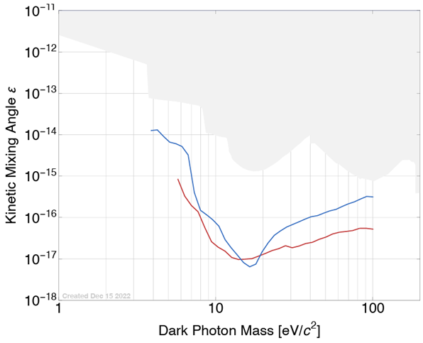
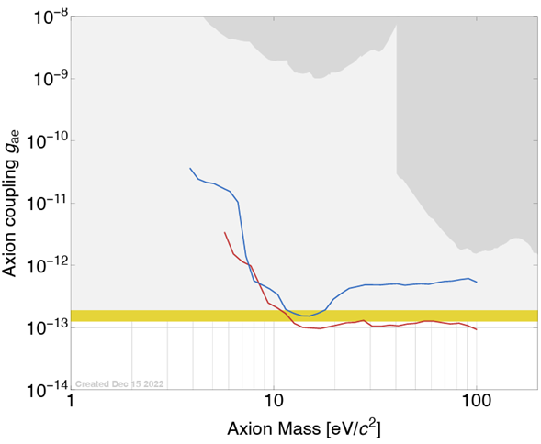
Complementary targets and technologies maximize coverage for low-mass WIMPs and electron-recoil DM
see 1 neutrino
Si
Ge
Si
Ge
neutrino fog
disfavoured by astrophysics
laboratory constraints
Si
Si
Ge
Ge
favoured by stellar cooling
arXiv:2203.08463

Slide 6
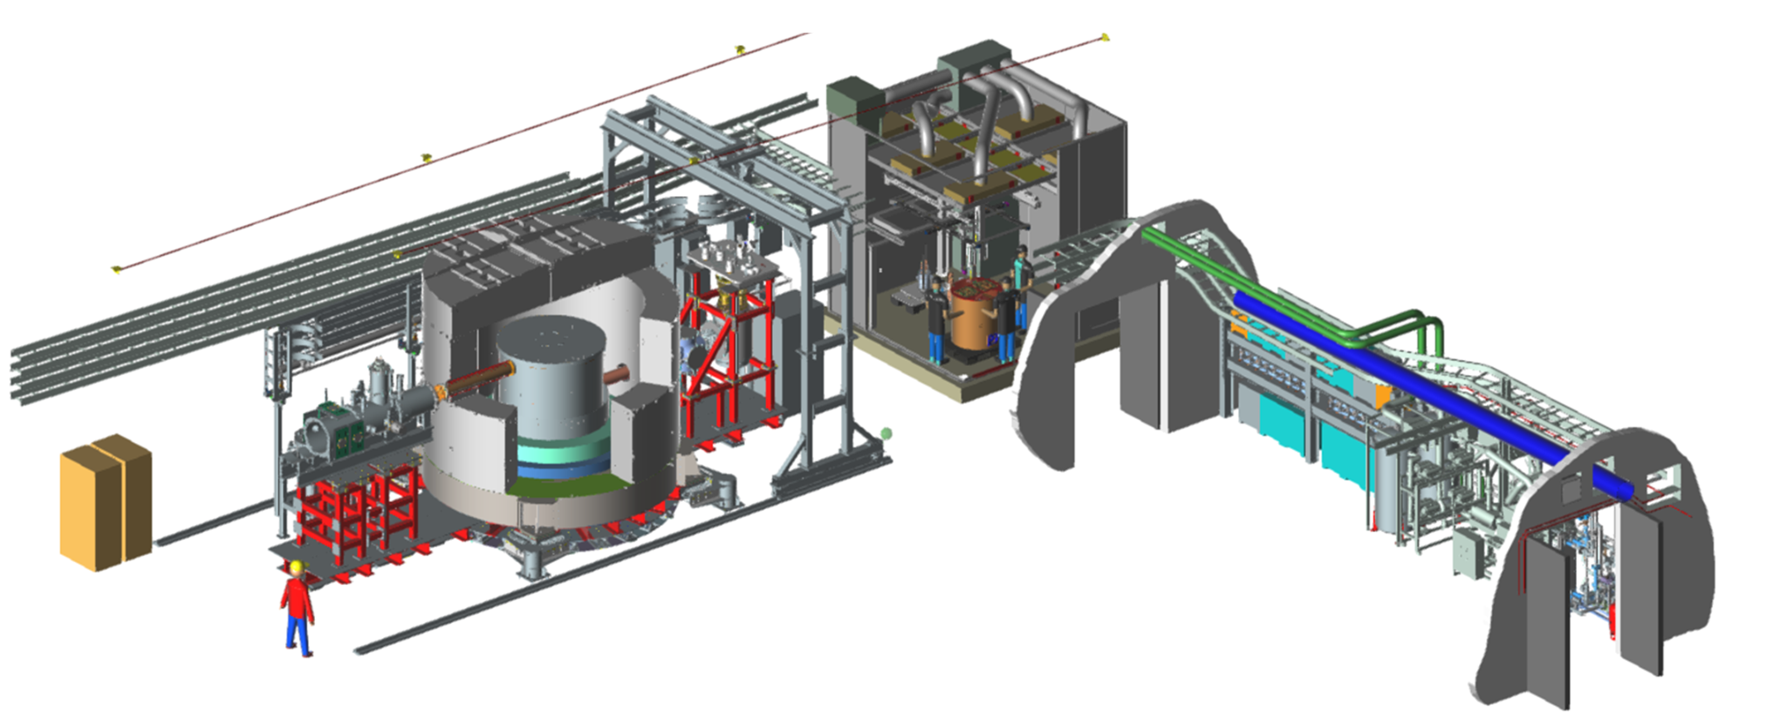
SuperCDMS SNOLAB experiment layout in Ladder Lab
E-Tank provides 50K cooling, houses Electronics, supports Calibration System
Low Radon Clean Room for component assembly
Utility Drift with Radon Reduction System
Dilution Refrigerator
DAQ
Copper Cryostat enclosing Detector Towers
Background Shield

Slide 7
SuperCDMS SNOLAB commissioning underway, first Science Run coming later this year!
Commissioning milestones completed
Path to Science Run (SR) 1a
Path from SR 1a to 1b
Updated sensitivity projections & long-range publications plan
Other SuperCDMS activities
  Improved event reconstruction with Machine Learning
  HVeV program
  Data analysis from CUTE HV Tower Testing
  NEXUS program

Slide 8
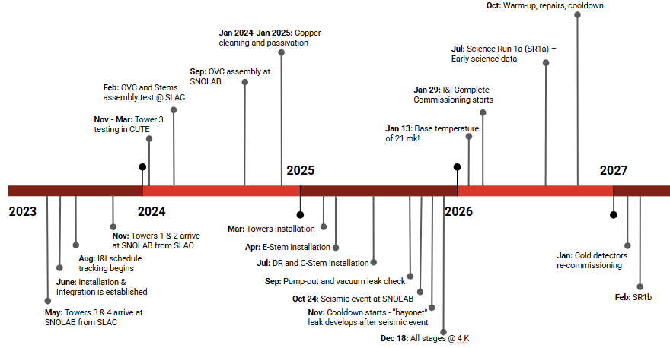
SuperCDMS SNOLAB commissioning underway, first Science Run coming later this year!
…
NOW

Slide 9
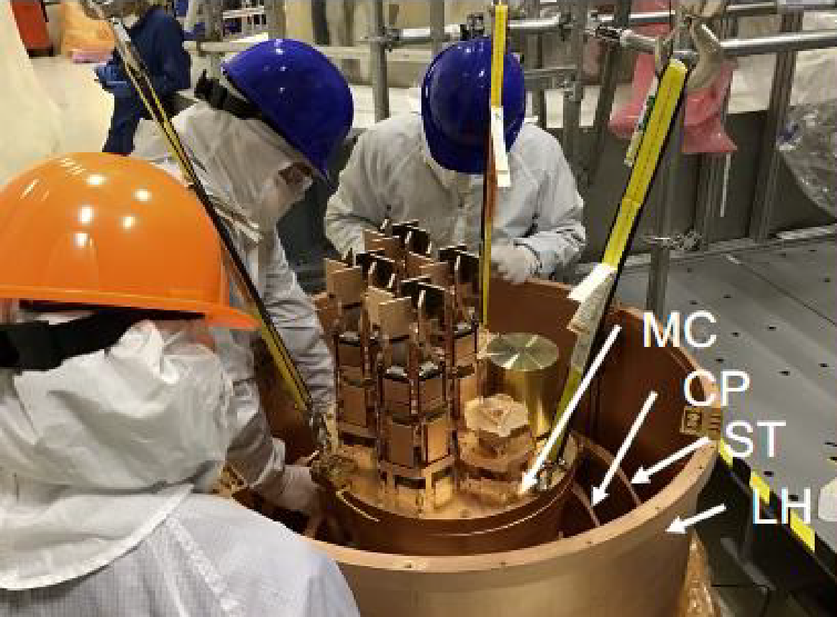
Installation & Integration milestones completed
Summer 2025: detector towers installed in “SNOBOX”
Cryostat C-stem & E-stems installed and aligned: Completed Jul 17, 2025
Dilution fridge ready for installation with cryostat: Completed Aug 19, 2025
GW3 review completed: Completed Sep 11, 2025

Slide 10
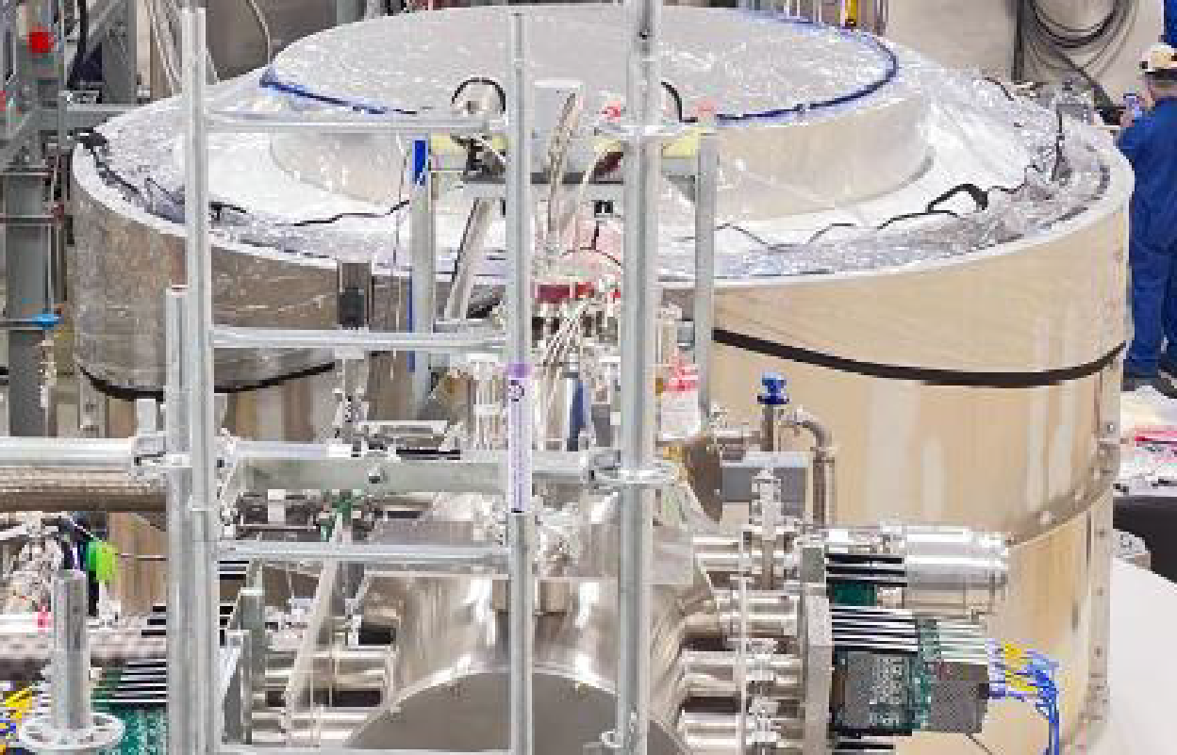
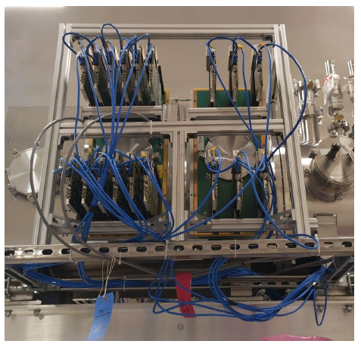
Installation & Integration milestones completed
50K cooler installation: Completed Sep 12, 2025
E-Tank installation: Completed Sep 16, 2025
Long readout cables installation in Cryostat / E-Tank: Completed Sep 17, 2025
Readout cables connected: Completed Oct 9, 2025
Readout electronics ready for commissioning: Completed Oct 17, 2025
(shown in May JOG report)

Slide 11
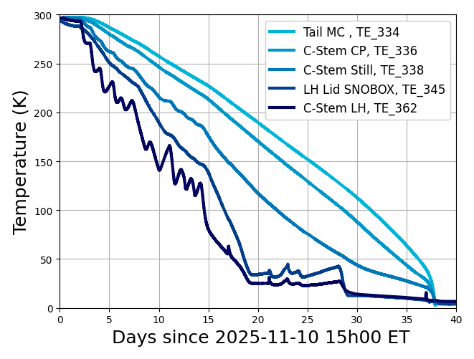
Installation & Integration milestones completed: timeline of first full cooldown
11/10: Cooldown started
12/14: Reached < 70K
12/18: Reached < 4K
1/9: Condensing LHe
1/13: Base temp first reached
Thermometry on towers, read out through DAQ, enables remote cooldown monitoring
During first cooldown, calibration system installed & tested: Completed Dec 11, 2025

Slide 12
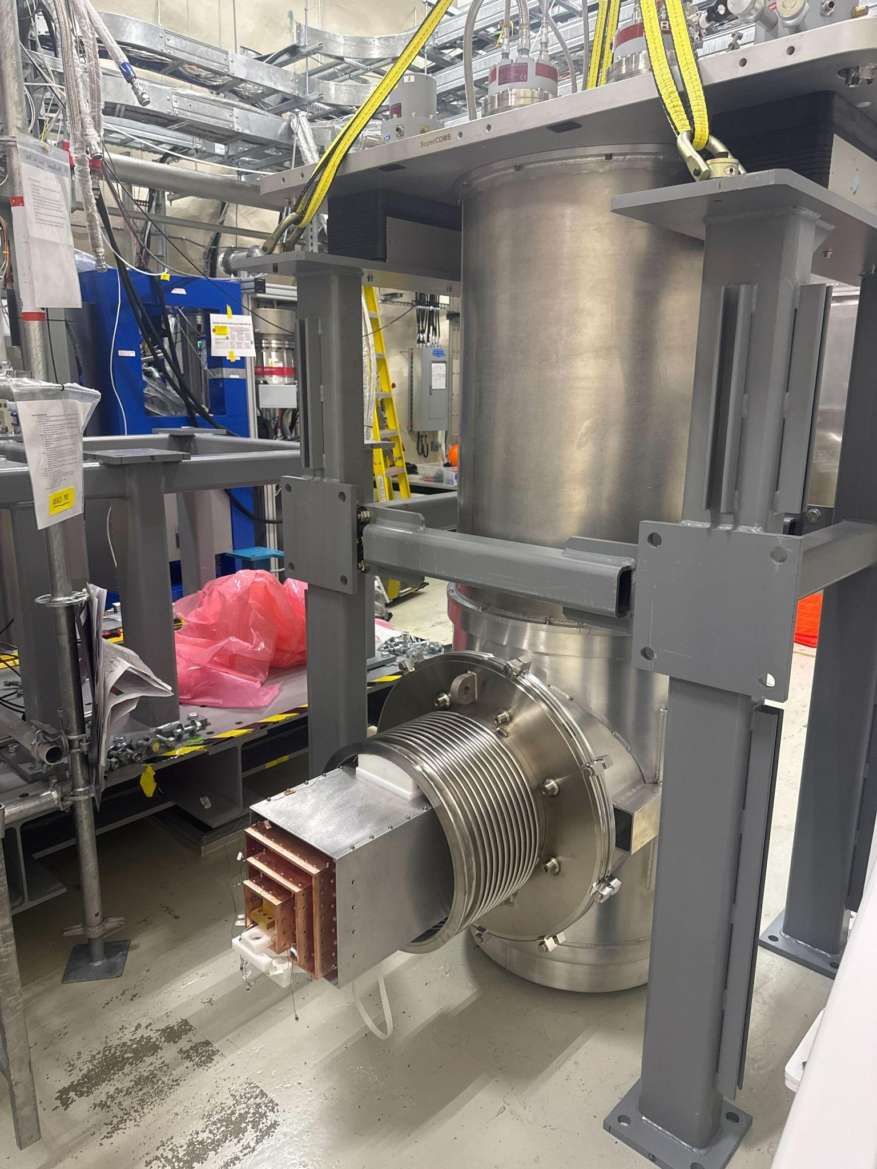
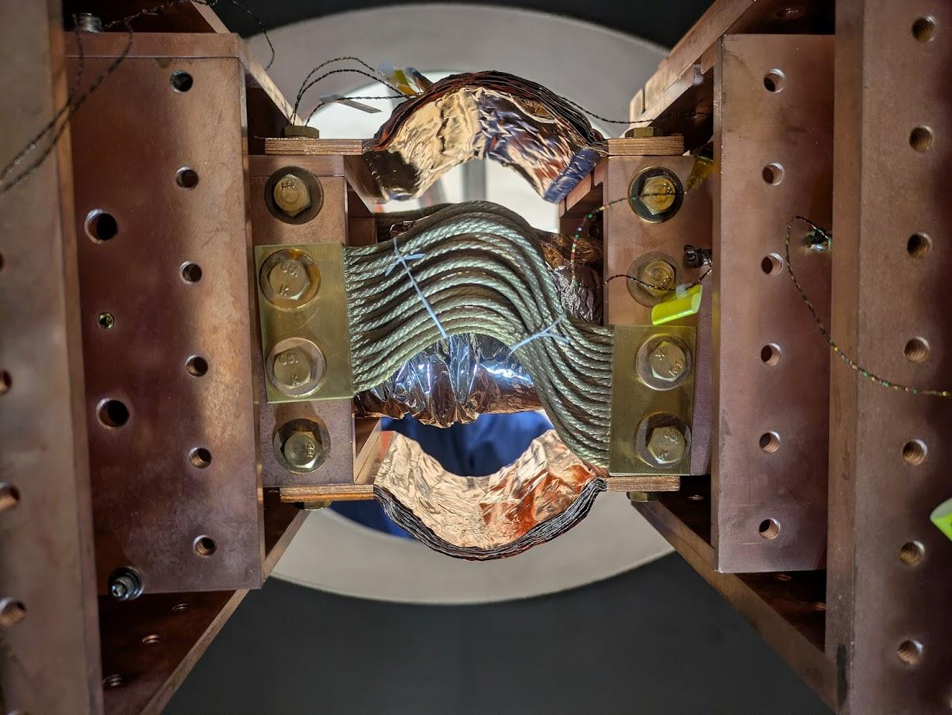
Installation & Integration photos
Dilution fridge with cryogenic tails, just prior to its installation
Straps providing thermal connection from dilution fridge to cryostat (Cold Plate thermal stage shown)
(shown at Feb 2026 EAC review)

Slide 13
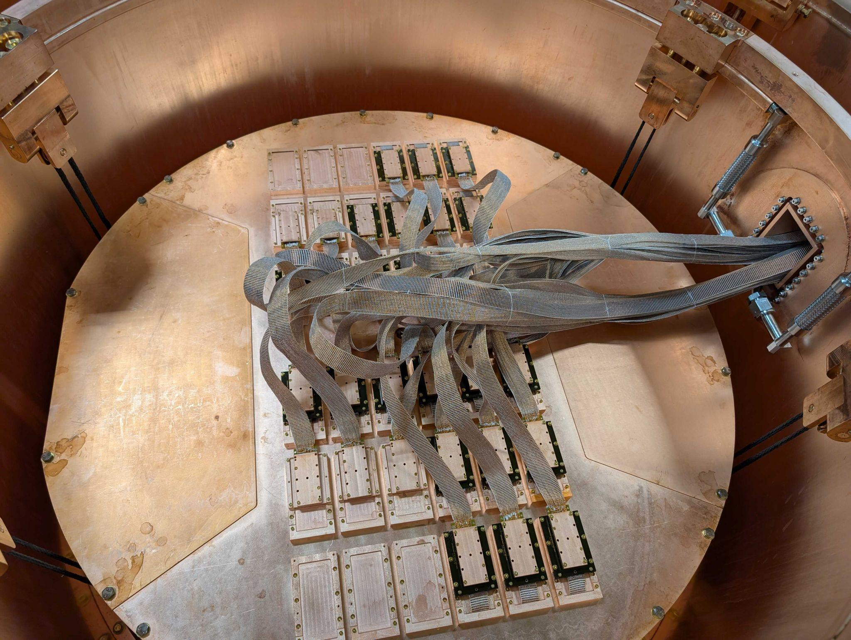
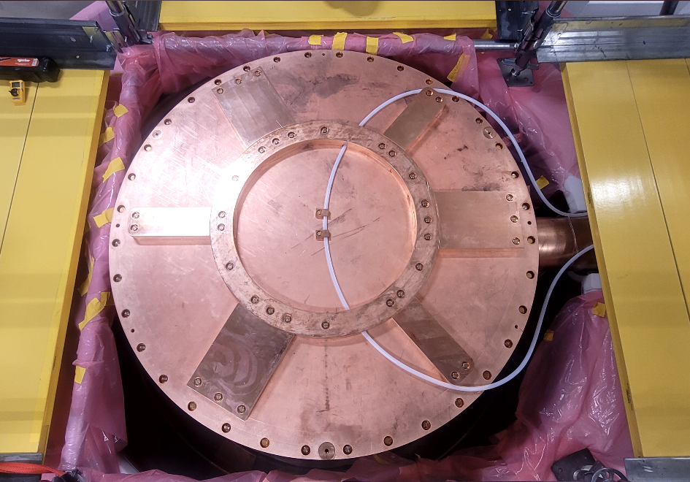
Installation & Integration photos
Cables from detectors to E-Tank vacuum feedthroughs
Closed cryostat, with nylon guide tube for deploying Ba calibration source
(shown at Feb 2026 EAC review)

Slide 14
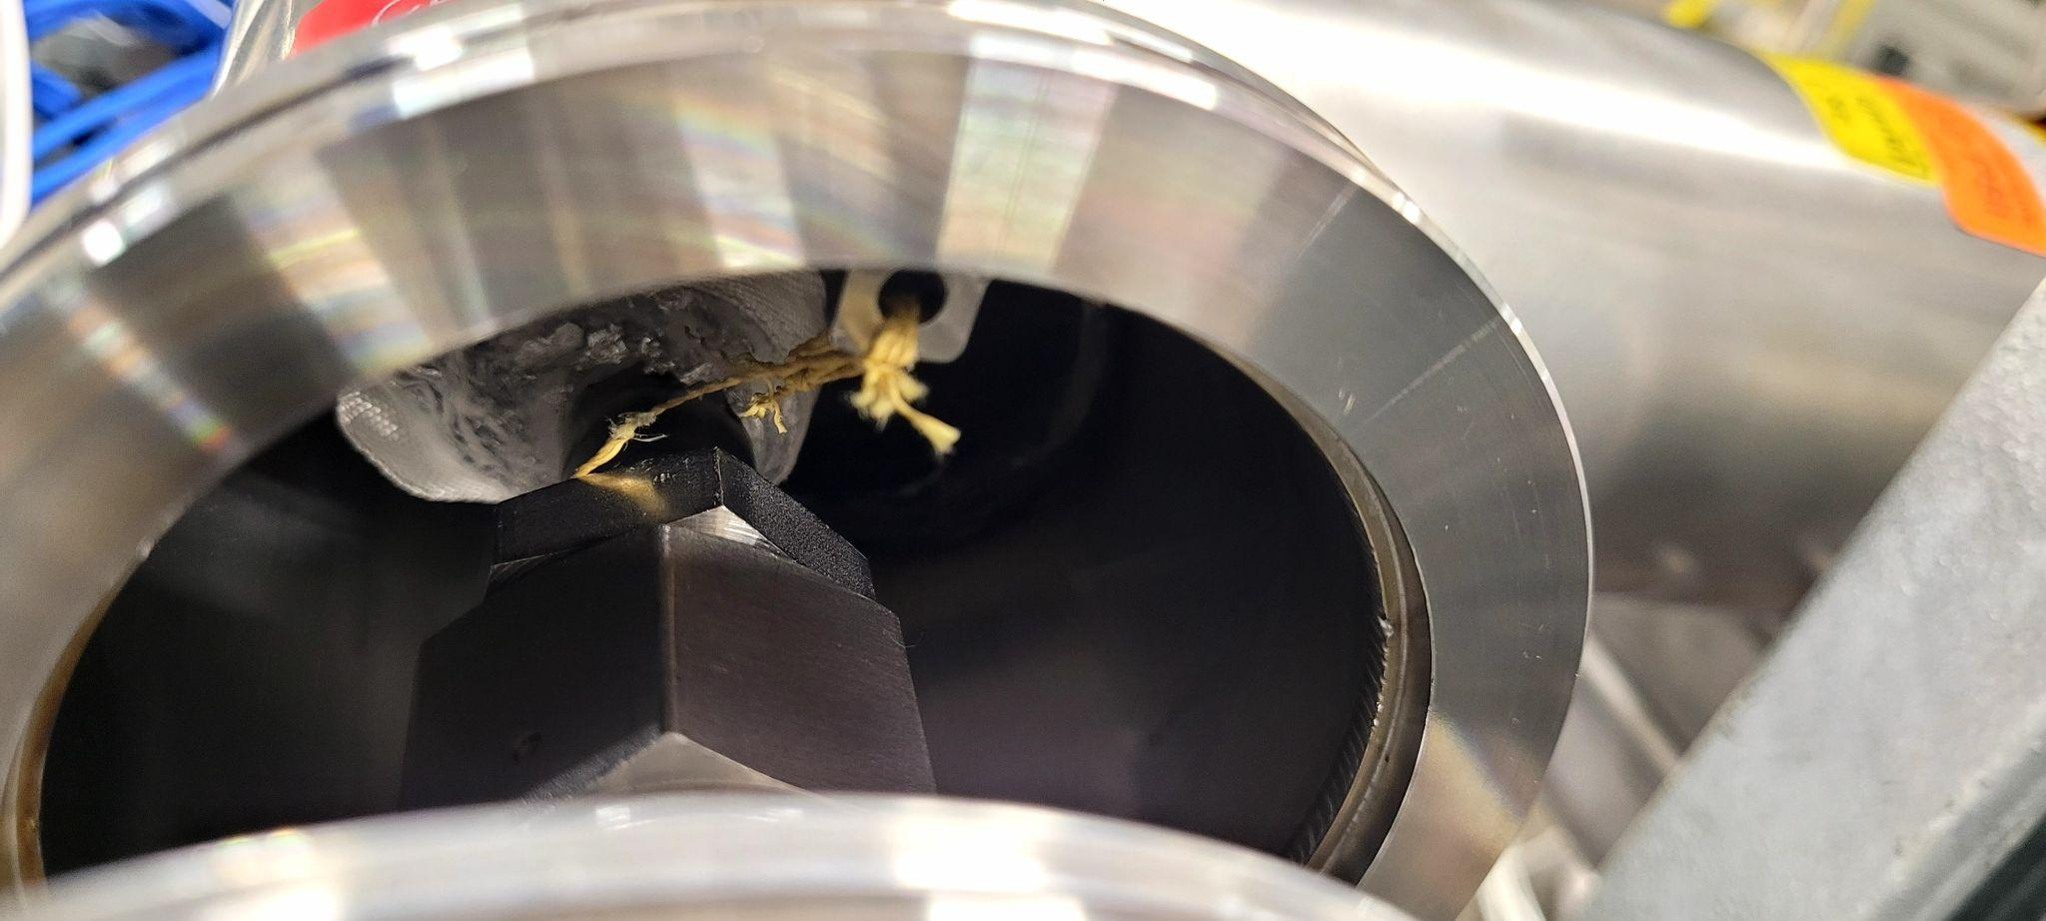
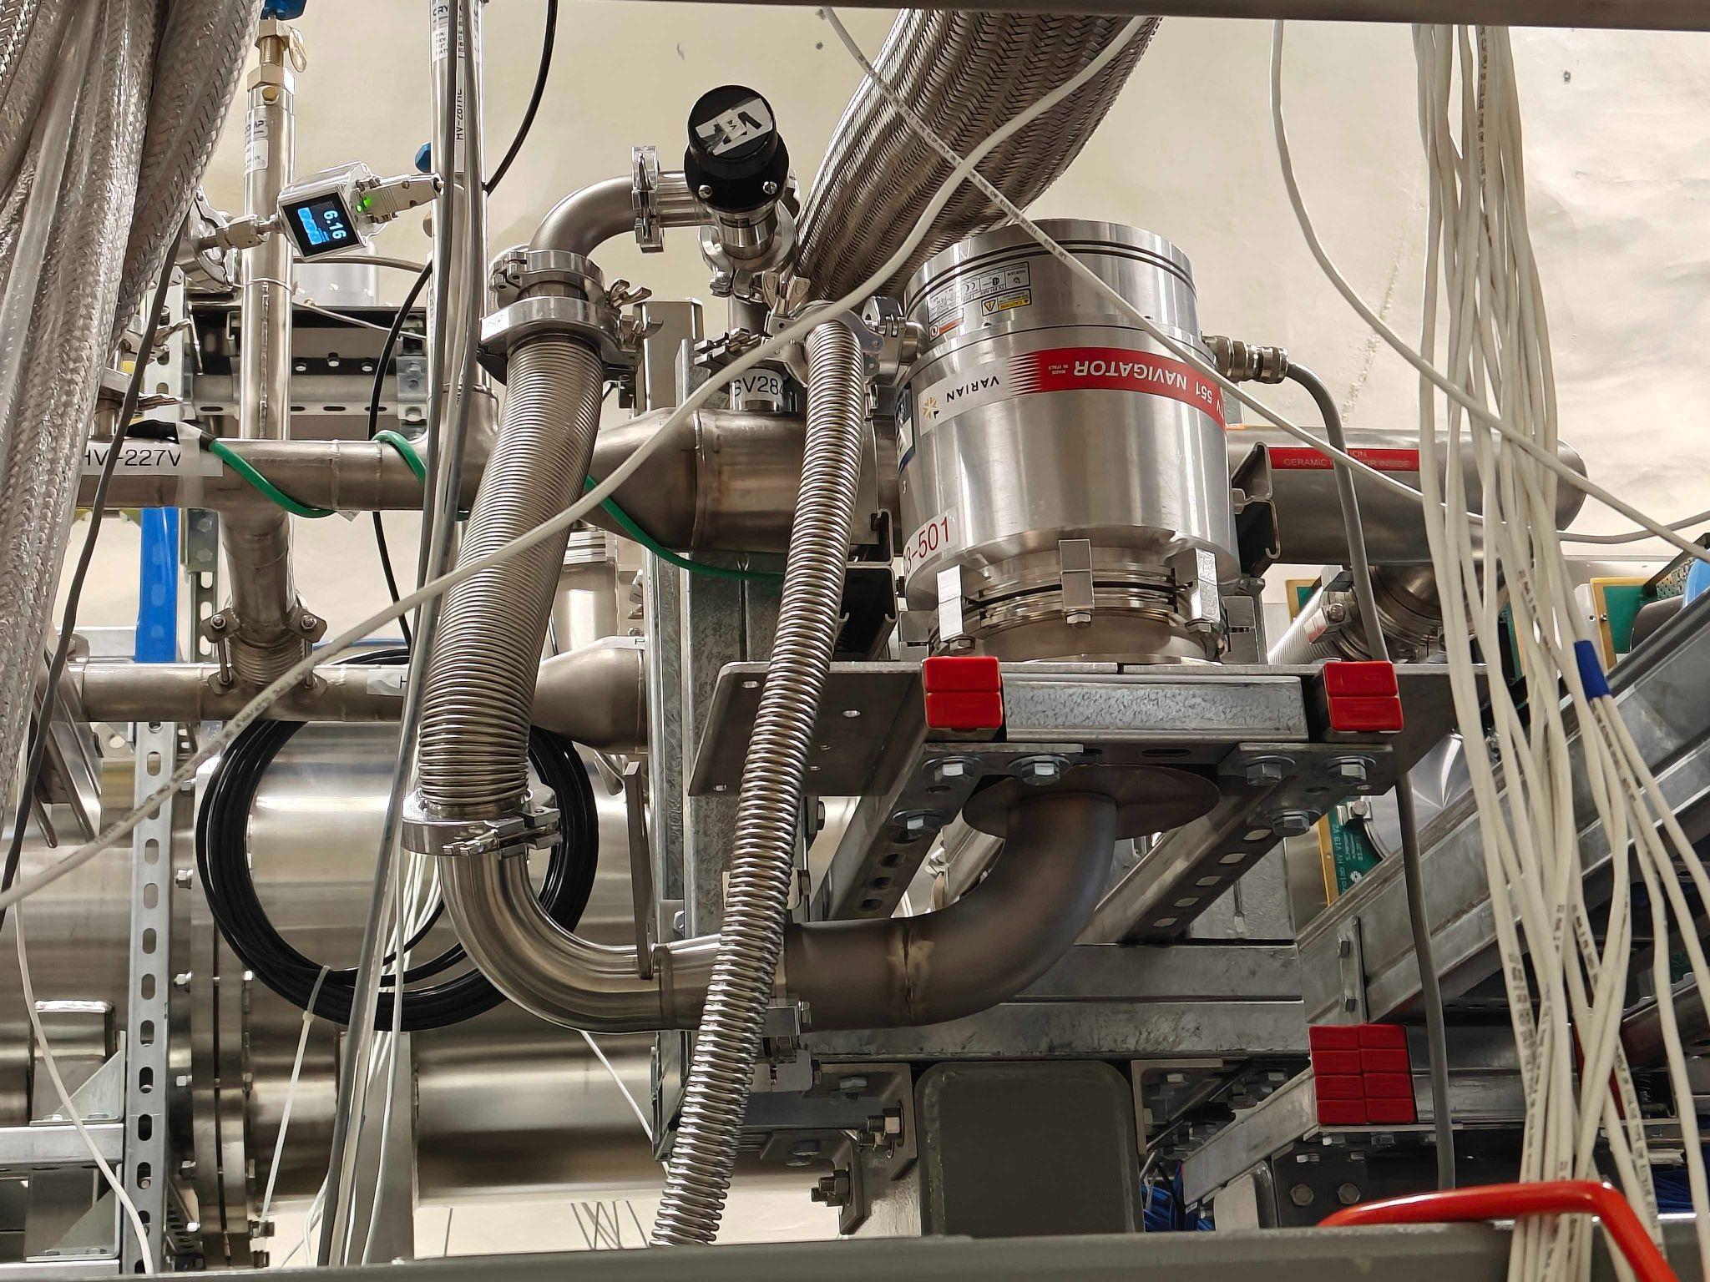
Installation & Integration photos
“Bayonet”, connecting 50K cooler to E-Tank, has He leak
Temporary setup out-pumps the leak, until bayonet can be replaced
(shown at Feb 2026 EAC review)

Slide 15
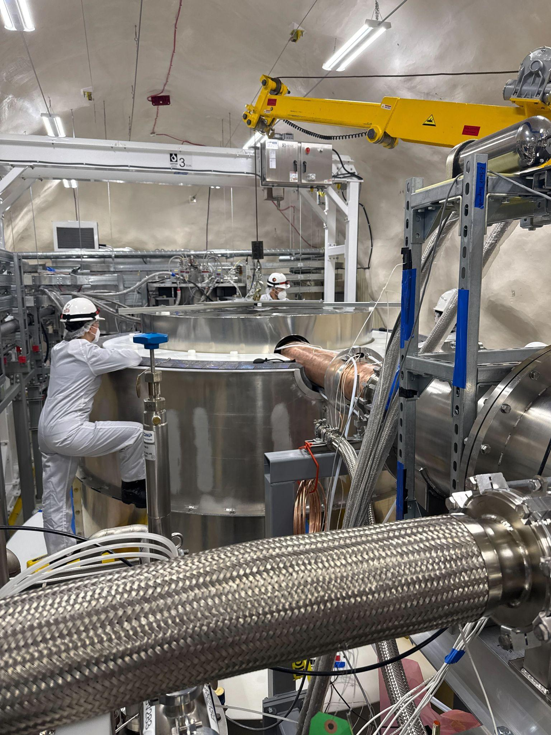
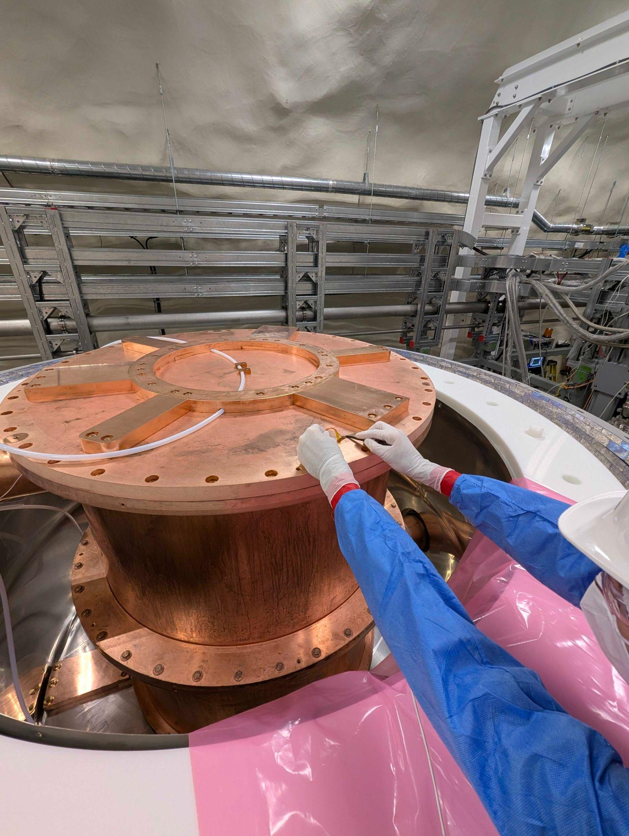
Installation & Integration photos
Installing top section of 𝜇-metal shield to protect detectors from Earth’s magnetic field
Installing heaters to offset radiative cooling
(shown at Feb 2026 EAC review)

Slide 16
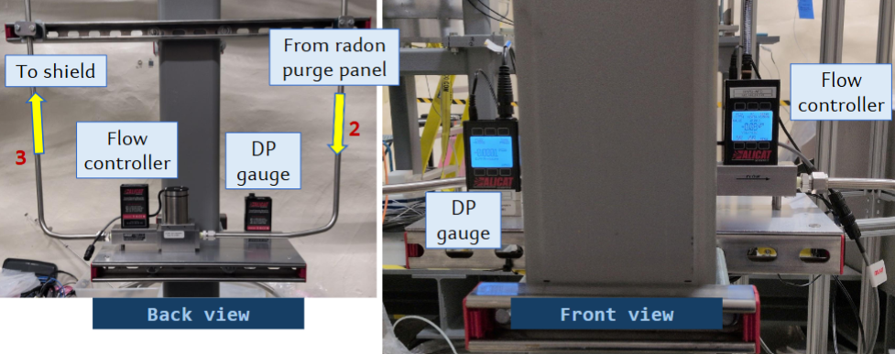
Radon purge subsystem: differential pressure gauge + flow controller
Installation & Integration photos
(shown at Feb 2026 EAC review)

Slide 17
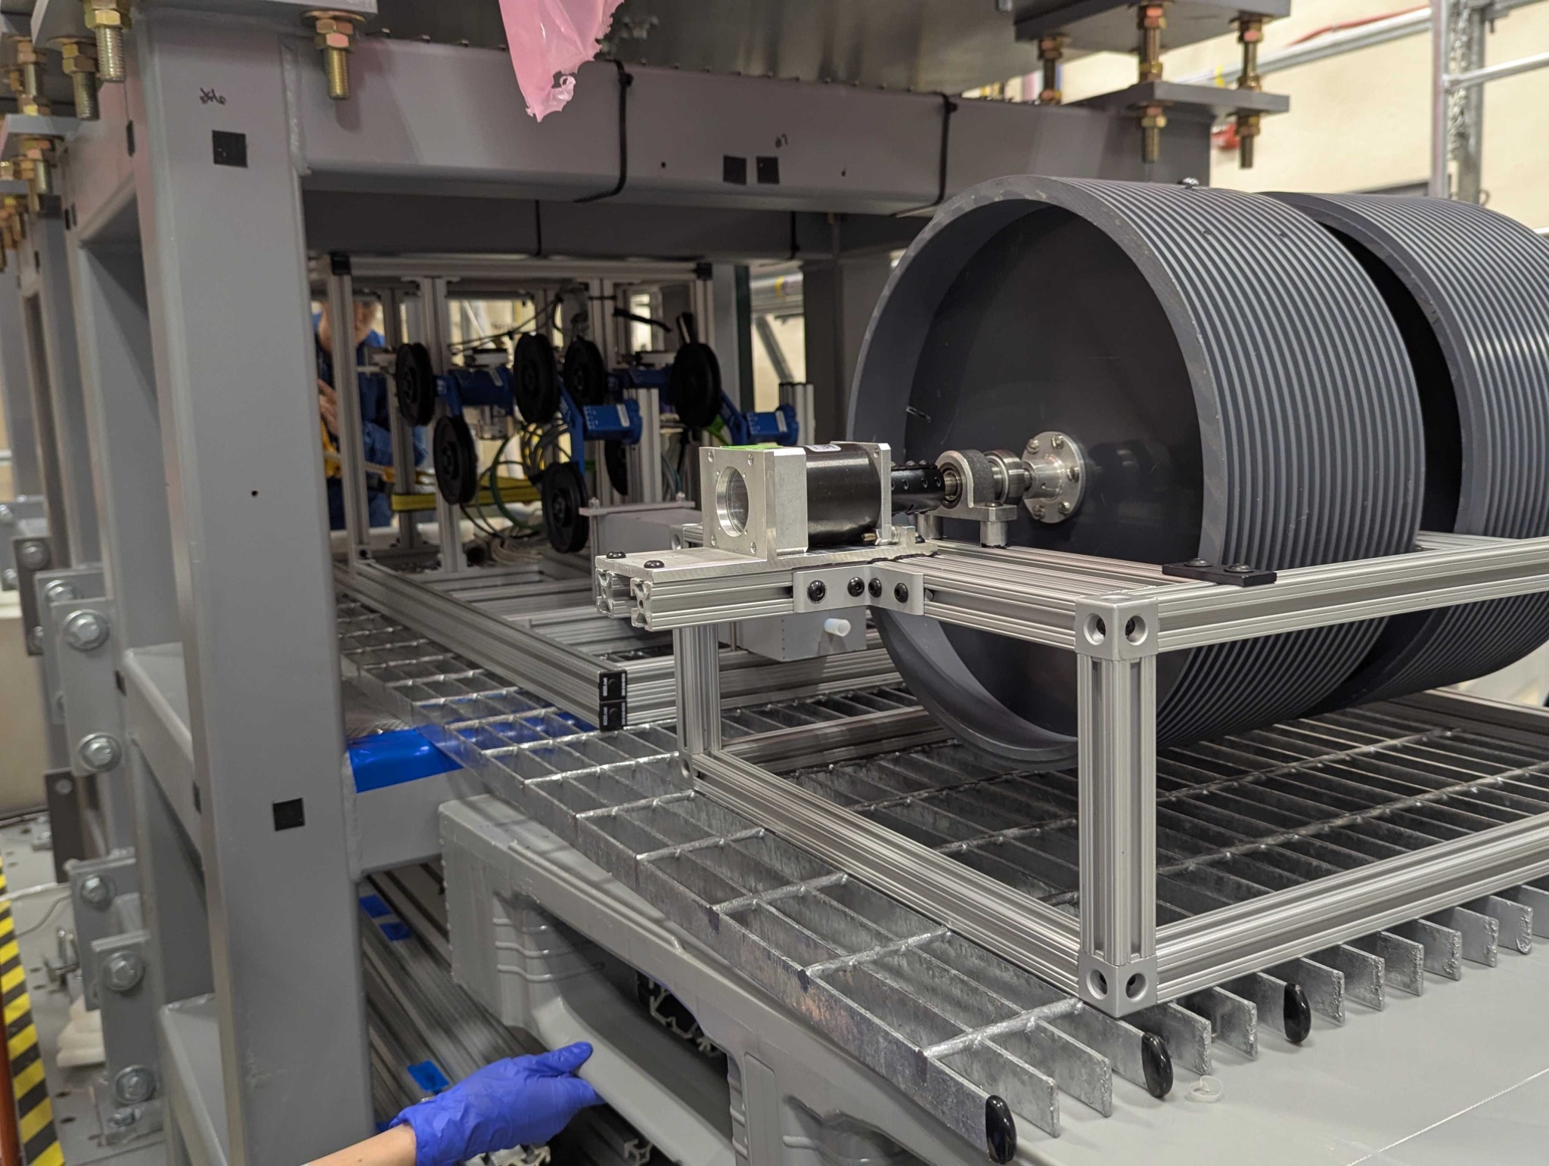
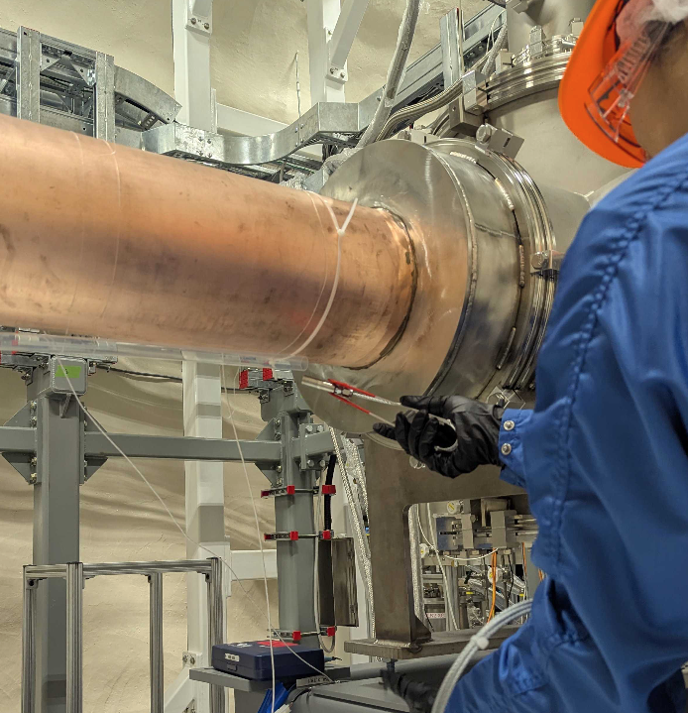
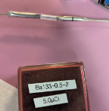
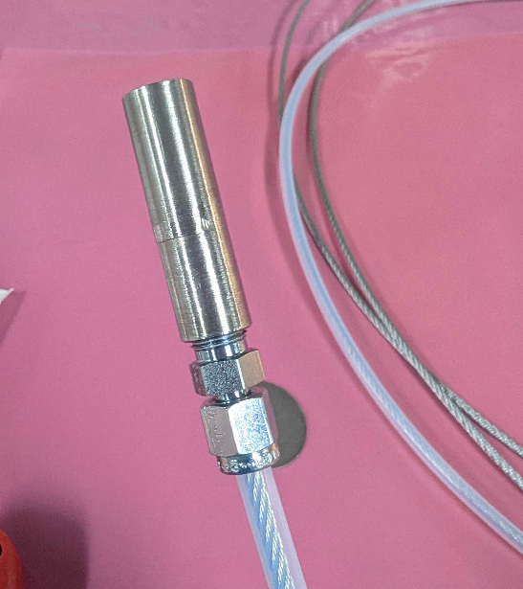
Installation & Integration photos
System for γ calibration deployment: Ba sources on steel cable (driven by motor), which goes along E-stem and across top & bottom of cryostat
Neutron calibration system: encapsulated Cf sources attached to flexible “wands” inserted into shield manually, with guide tubes running along C-stem and E-stem
Motion controls
Source capsules
Guide Tube
Source capsule
(shown at Feb 2026 EAC review)

Slide 18
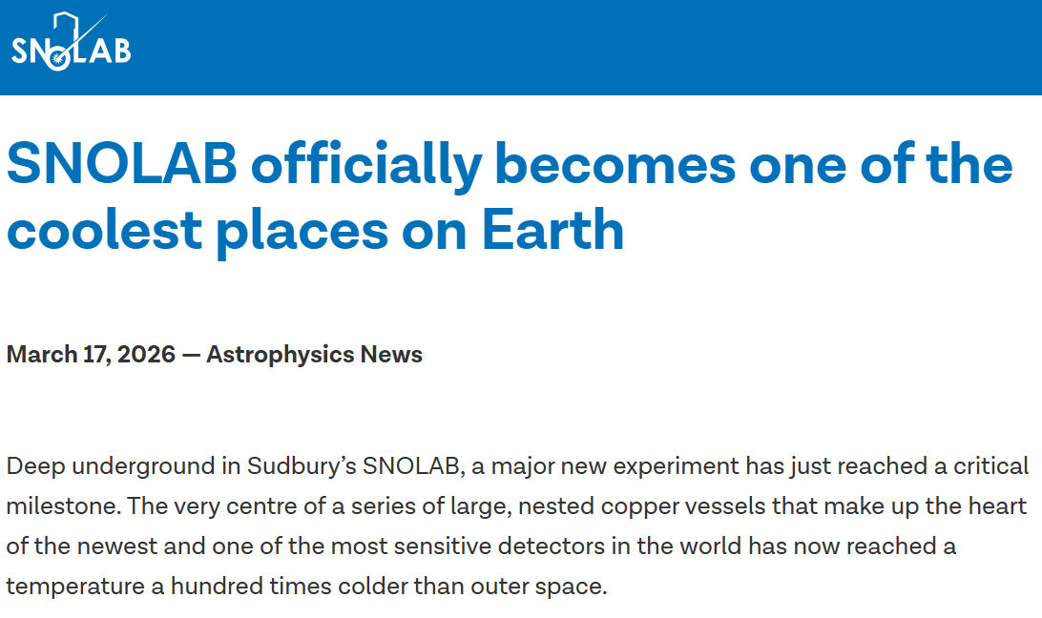
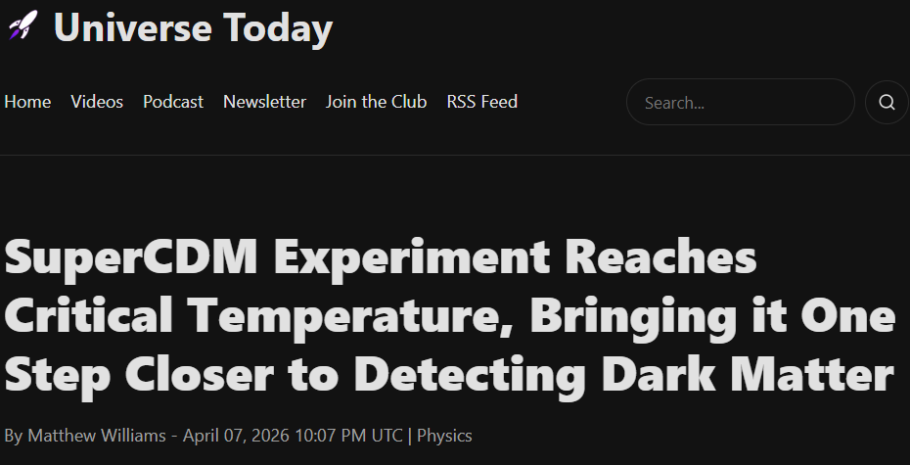
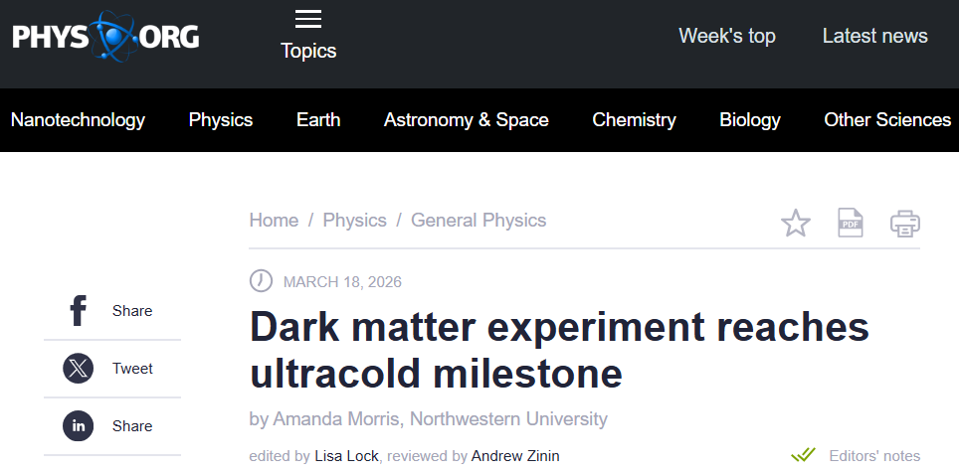
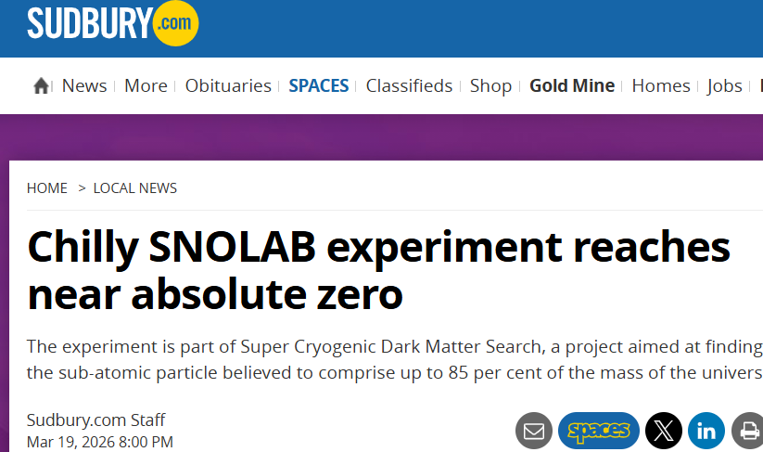
Reaching base temperature: media blitz!
News release: https://www6.slac.stanford.edu/news/2026-03-17-supercdms-cools-down-near-absolute-zero-setting-stage-one-worlds-most-sensitive

Slide 19
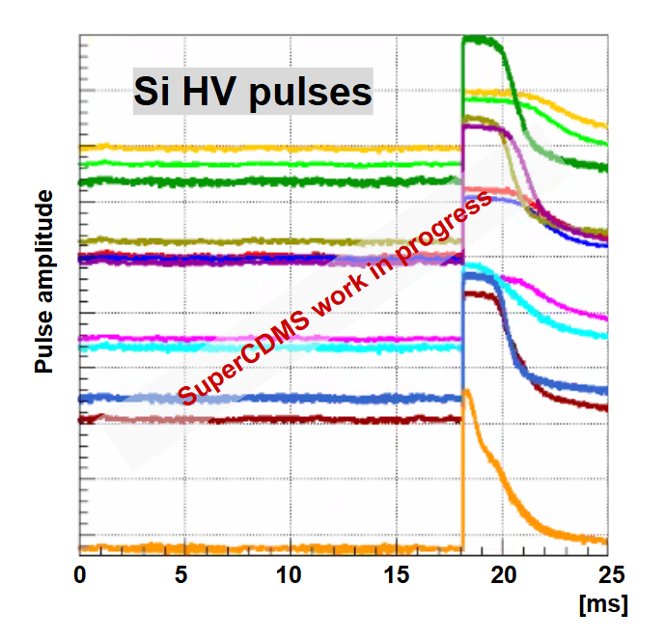
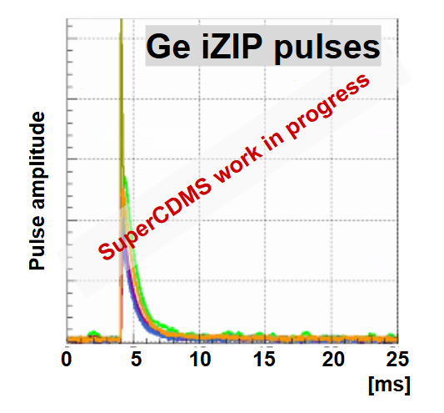
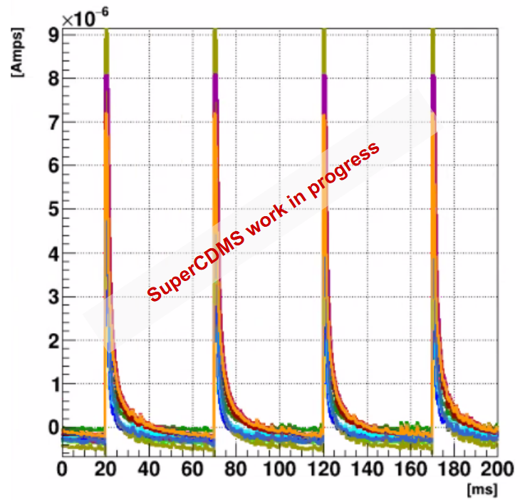
First pulses in Jan: “Installation & Integration” completed, Commissioning started
On all phonon channels of a detector, ambient background events:
LED events in a Ge HV
detector:

Slide 20
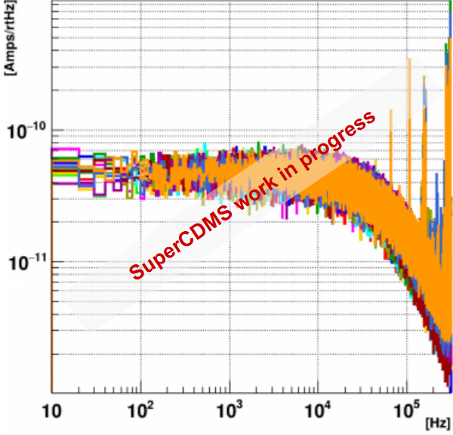
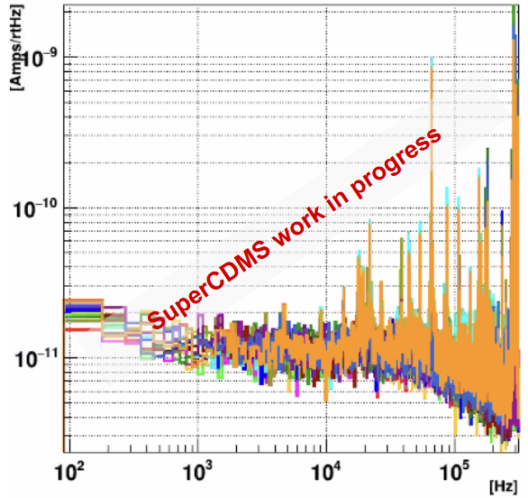
First pulses in Jan: “Installation & Integration” completed, Commissioning started
Noise Power Spectral Density, Ge iZIP detector:
All channels superconducting All channels normal

Slide 21
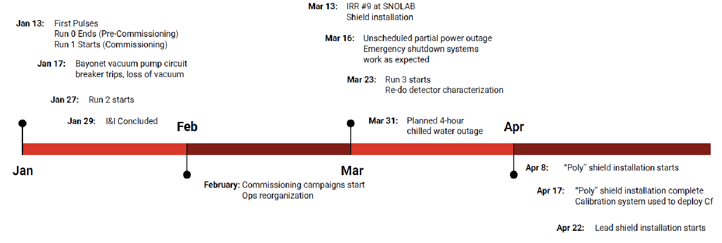
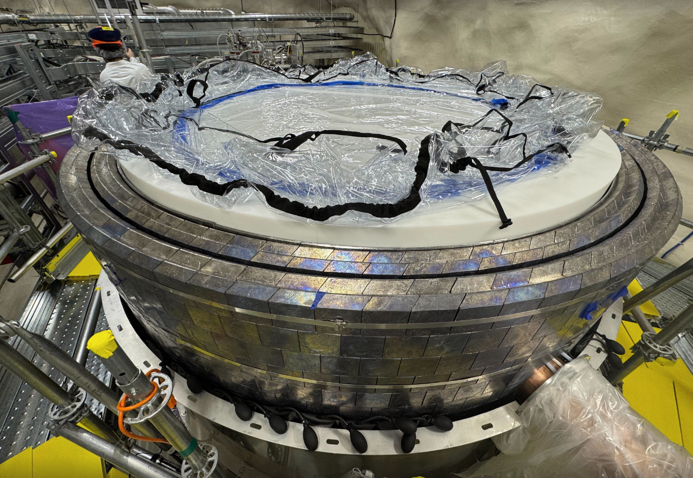
Since first pulses, Commissioning has made great progress
Just finished (in May): Upper section & lid of lead/poly shielding wall

Slide 22
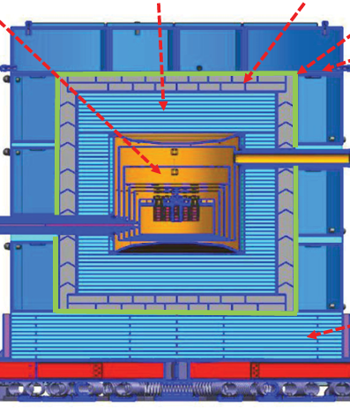
“Science Run 1a”: planned for mid-Jul through Sep, taking advantage of PMP quiet time
HDPE shield
Pb shield
Remaining tasks before Science Run 1a:
Completion of radon barrier (upper section) & purge system
Data-taking with Ba source deployed, for calibration based on γ lines
Troubleshooting high-voltage issues
Investigating possible vibration-induced & blackbody radiation-induced heating
Deciding which detectors to use in the Run
Optimization: noise-hunting, trigger setup, neutralization procedures, detector settings
SNOBOX
Rn purge barrier
Water tanks, not installed yet!
HDPE bottom plates
During Science Run 1a:
Data-taking, no calibration sources deployed
Cf source deployment (shortly after PMP), data-taking to calibrate Ge detectors based on n activation
Tower 1
6 Ge iZIP
Tower 2
4 Ge HV
2 Si HV
Tower 3
4 Ge HV
2 Si HV
Tower 4
4 Ge iZIP
2 Si iZIP

Slide 23
Tasks already planned for post-SR 1a, to maximize discovery potential of subsequent SRs
Full warmup after SR 1a, lasting 3-4 months
Ice-tank chilled-water backup
Testing additional electronics filtering schemes
Replacing leaky 50K cooler “bayonet”
“6-way-cross” improvements to prevent thermal touches and shield against blackbody radiation
Re-cooling, then brief detector re-characterization period
HDPE shield
Then SR 1b early 2027 !
Between start of SR 1b and start of SR 2: Water tank (outer n shield) installation
SNOBOX
Pb shield
Rn purge barrier
Water tanks!
HDPE bottom plates

Slide 24
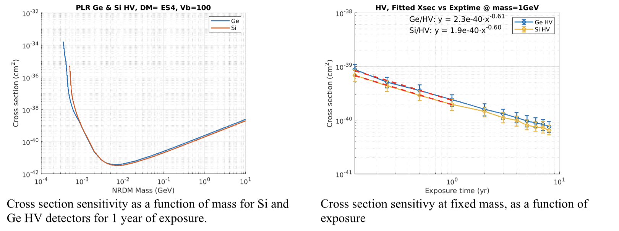
Updated sensitivity projections for Nuclear Recoil DM searches
Vb = bias voltage across crystal (V)
PLR = Profile Likelihood limit-setting, with background model

Slide 25
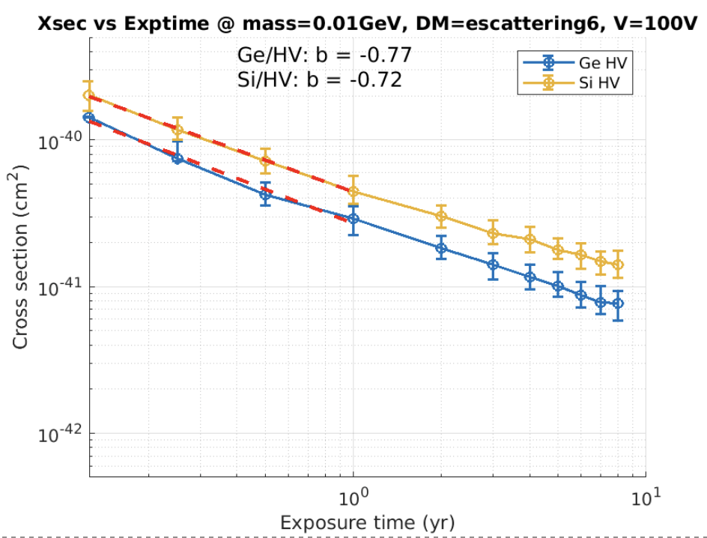
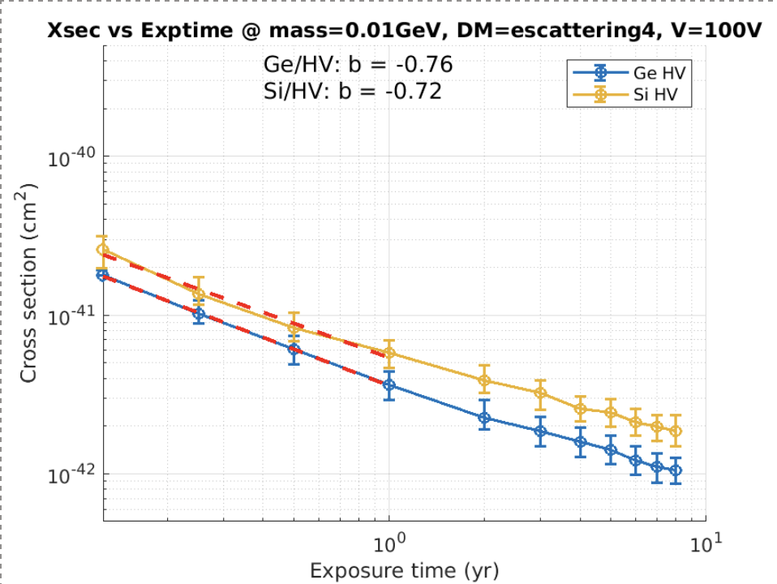
Updated sensitivity projections for Electron Recoil DM searches
F = 1/q²
F = 1
At DM mass ~10 MeV (where ER reach is ~best)

Slide 26
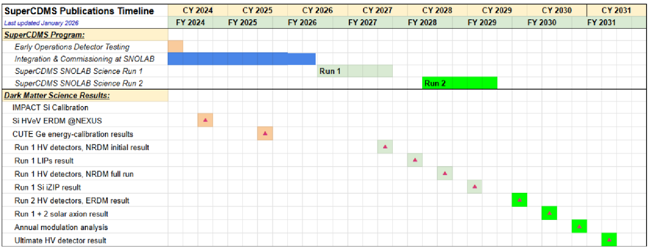
Updated long-range publications plan

Slide 27
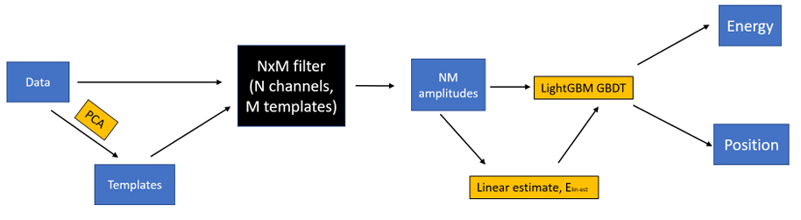
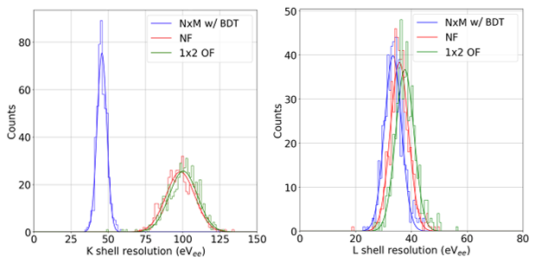
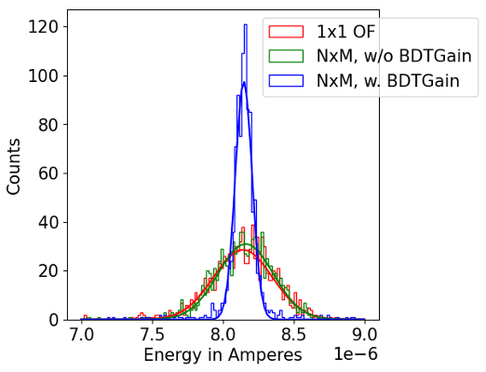
Other SuperCDMS activities:
Improved event reconstruction
“N channels x M templates” Optimal Filter with machine-learning boost, validated on old CDMSlite data NIM A 1087 (2026) 171437
Goal: accounting for correlated noise between channels, and for position-dependent variations in pulse shape

Slide 28
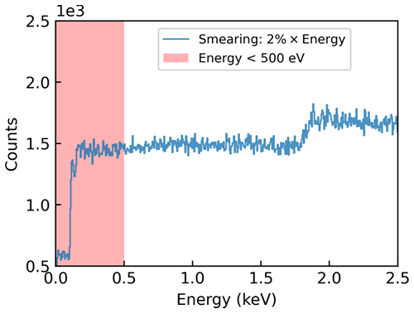
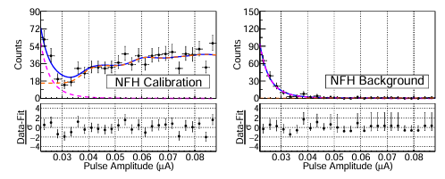
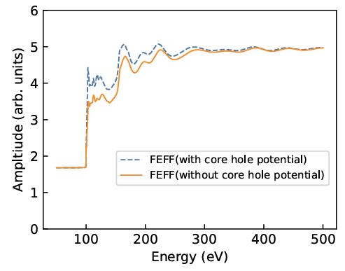



Other SuperCDMS activities: Si calibration using Compton steps in HVeV Run 4 @NEXUS
Energy signatures at ~100eV E_{ee} (L shell steps), ~2keV E_{ee} (K shell step) Phys. Rev. D 112 (2025) 092014
Simultaneous fit of datasets for L-steps: Compton + Low-Energy Excess
Simulated energy deposition spectrum:
GEANT4
Fit near K-shell step
Simulated energy deposition spectrum:

Slide 29

Other SuperCDMS activities: ERDM searches in HVeV Run 4 @NEXUS
Re-designed detector holder eliminated luminescence background from PCBs Phys. Rev. D 113 (2026) 032001

Slide 30






Other SuperCDMS activities: HVeV Run 5 @CUTE device characterization
Sub-eV energy resolution, single charge sensitivity arXiv:2601.16307 (Jan 2026), accepted NIM A
Including comparisons to previous HVeV runs in SLAC surface lab
NFC NFH
TES Bias Point
TES Bias Point

Slide 31


HVeV Run 5 @CUTE: ERDM search
(work-in-progress)
Plus: HVeV 2mm 2-channel Prototype Run @NEXUS: data-taking just completed

Slide 32




Other SuperCDMS activities: Ge Calibration results in HV Tower Testing at CUTE (work-in-progress)
(Data collected Fall 2023)

Slide 33



Other SuperCDMS activities: preparation for Ge HV
energy calibration campaigns @NEXUS
Backing Array: 14 scintillator rings, to tag recoil angles corresponding to 14 different energies
First data with beam taken in Fall 2025
Integration of full array now complete, optimization in-progress
Single HV detector:
Installed in a Tower at SNOLAB in Jan
Just shipped to Fermilab
Installation in NEXUS next month
Tower Preparation
Beam Array Data
DD Generator: Pulsing generator needs repair over the summer

Slide 34


Conclusion … or just the start
Stay tuned for…
End of Commissioning (Jul)
Science Run 1a (July – Oct)
Full warmup for repairs & enhancements
Science Run 1b
Science Run 2
Plus…
Detector characterization & calibration from CUTE Tower Testing
NEXUS HVeV runs & Ge HV energy calibration

