Slide 1




Directional DM detectors:
anisotropic scintillating crystals with CCDs
SNOLAB User Meeting, May 2026
Miriam Diamond & Yonatan Kahn (University of Toronto),
Brandon Roach & Daniel Baxter & Alex Drlica-Wagner (Fermilab),
Nora Hoch & Dane Johnson & Danna Freedman & Lindley Winslow (MIT),
Benjamin Lillard & Carlos Blanco (Penn State)

Slide 2
Challenges for direct detection of low-mass DM with low-threshold detectors
Low Energy Excess: seen by multiple experiments, probably from multiple sources
Backgrounds: neutrino fog, cosmogenic activation floor
Scalability: cost per unit target mass

Slide 3
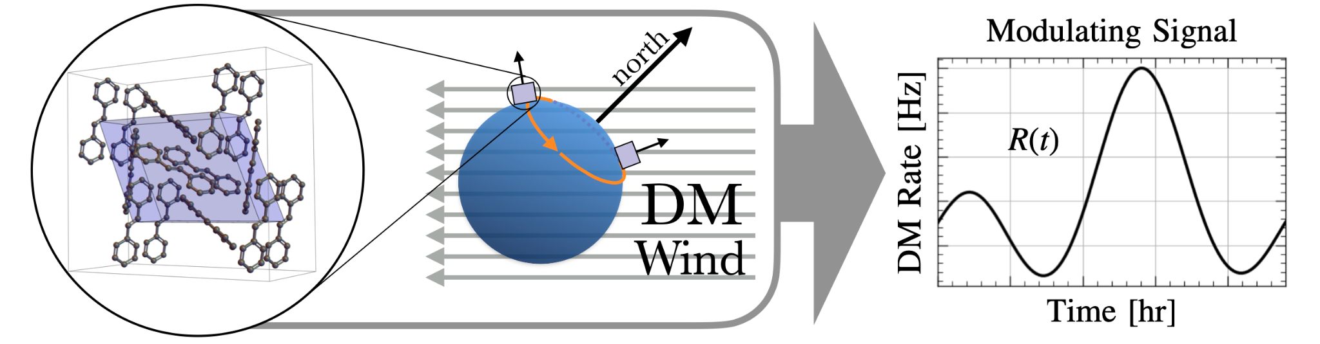
Challenges for direct detection of low-mass DM with low-threshold detectors
Low Energy Excess
Neutrino fog, cosmogenic activation floor
Exploit Earth’s daily rotation w.r.t. DM wind direction -> daily modulation signal rate, distinct from all known background sources
Anisotropic scintillating crystals

Slide 4
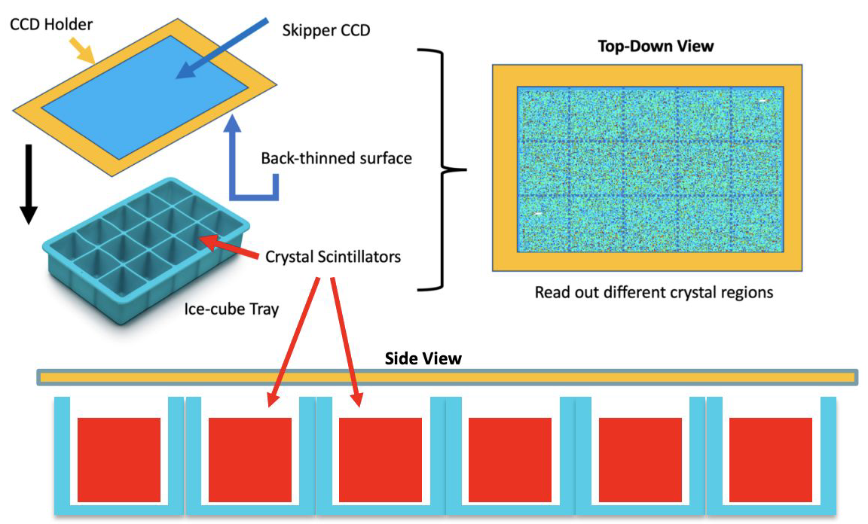
Challenges for direct detection of low-mass DM with low-threshold detectors
Scalability (cost per unit target mass)
Decouple scattering target from readout sensors
Crystals optically coupled to Skipper-CCD photosensors

Slide 5
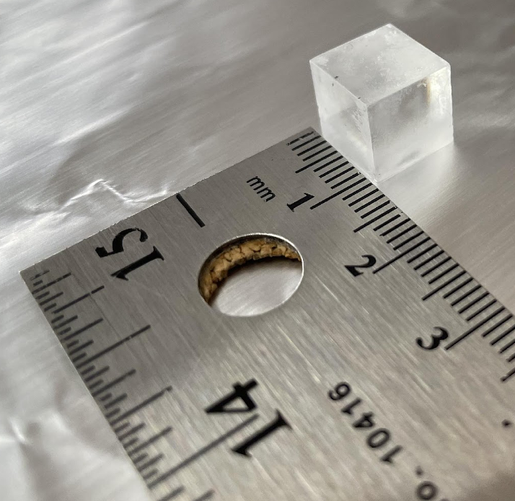
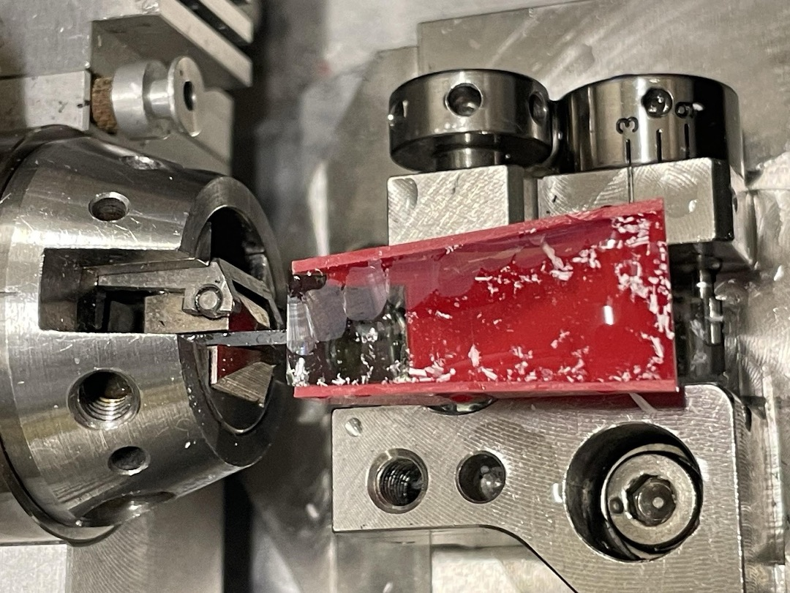
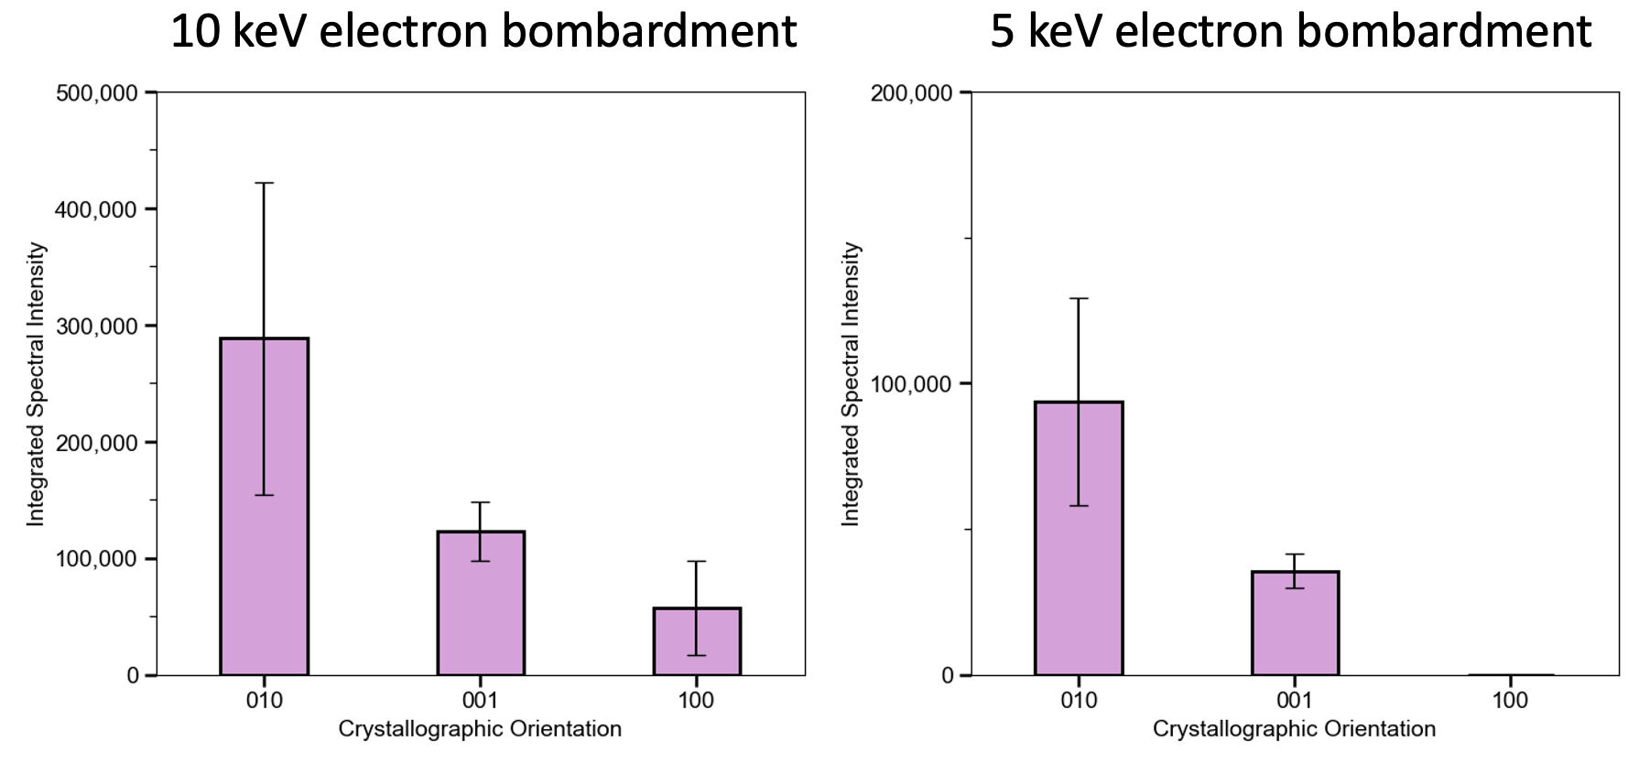
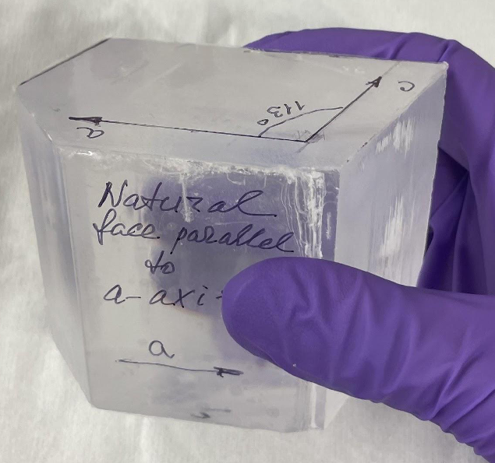
Organic Scintillator Crystal
For proof-of-concept prototype, trans-stilbene (C₁₄H₁₂)
Fairly generic, with gram-scale single crystals commercially-available
Can grow ourselves -> control radiopurity and select primary crystal axis
Scintillation light peaks ~380 nm (deep-purple to near-UV, ideal for CCDs)
Good anisotropic response at the energies of interest
ML framework to identify other (better?) crystal materials for future
microtome
trans-stillbene thin film

Slide 6
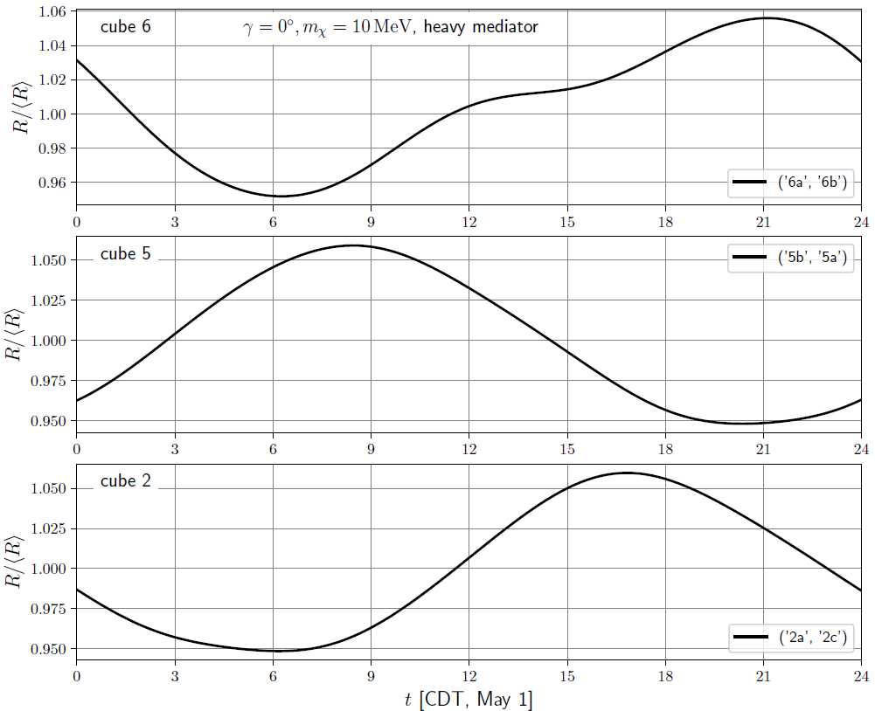
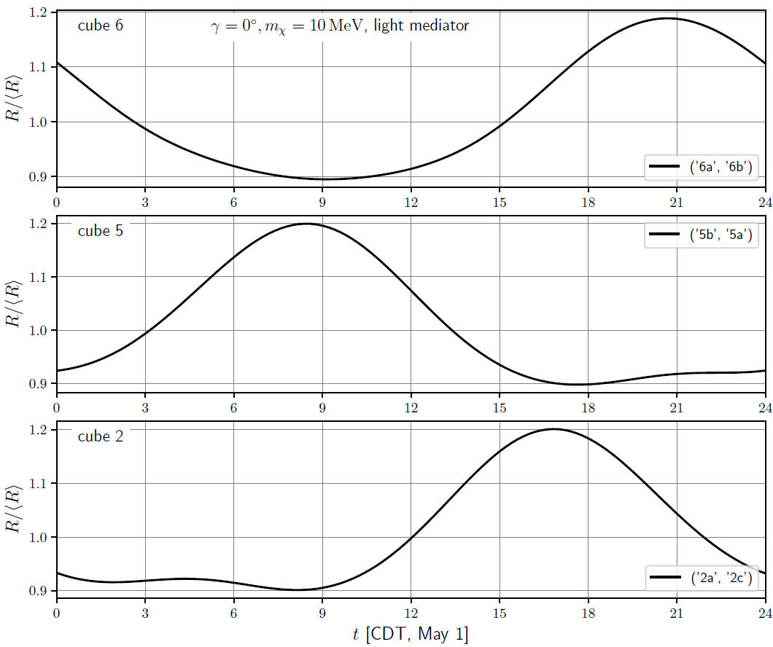
Expected trans-stilbene anisotropic signal
Daily modulation: predicted normalized rate R(t)/<R(t)> for particular orientations of sample cubes, at Fermilab location

Slide 7
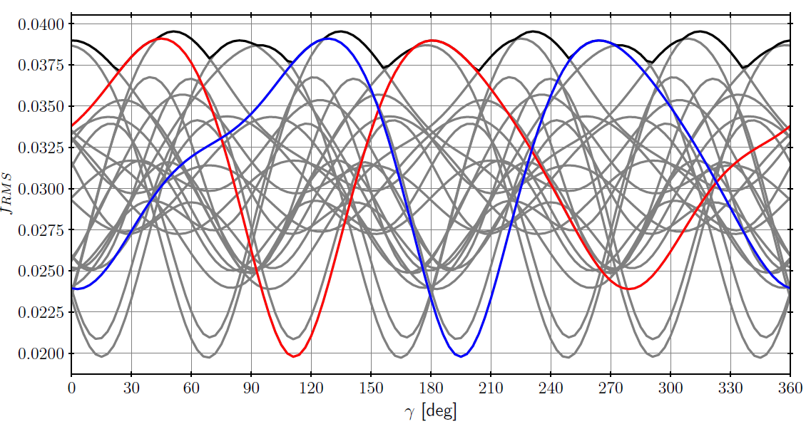
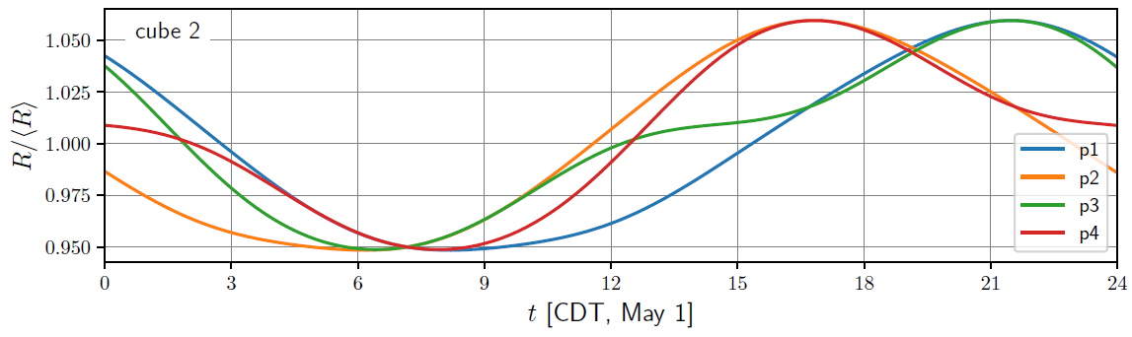
Expected trans-stilbene anisotropic signal
Modulation amplitude f_{RMS}, for each of 24 possible cube orientations, vs CCD angle ℽ.
Red and blue highlight two particular orientations
Heavy DM mediator,
m_{DM} = 10 MeV
Predicted normalized rate R(t)/<R(t)> for the 4 cube orientations p that give greatest modulation (ranked 1-4) by f_{RMS}
Heavy DM mediator,
ℽ=0, m_{DM} = 10 MeV

Slide 8
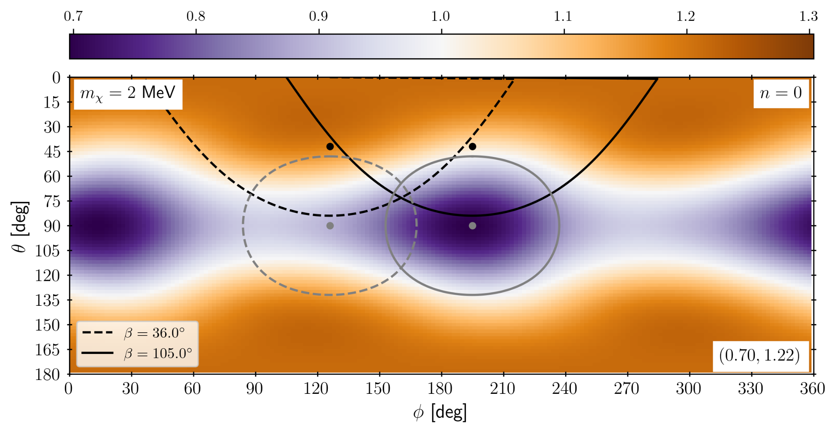
Expected trans-stilbene anisotropic signal
R(t)/<R(t)>
Heavy DM mediator
(R_{max} , R_{min})

Slide 9
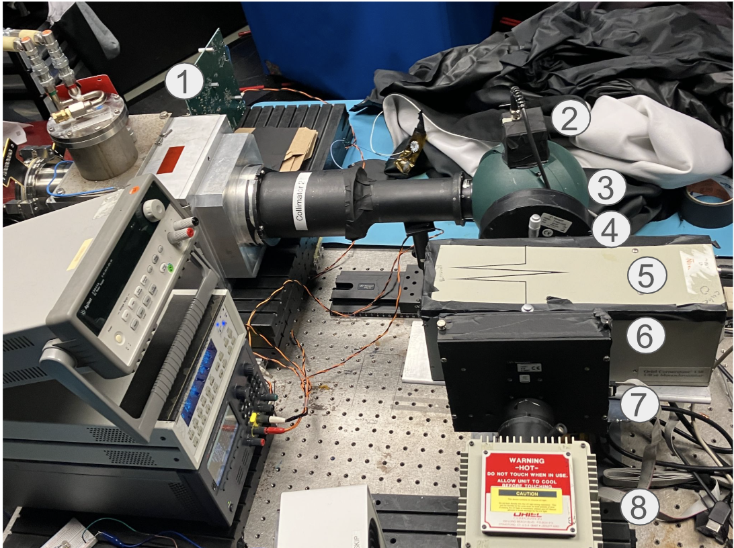
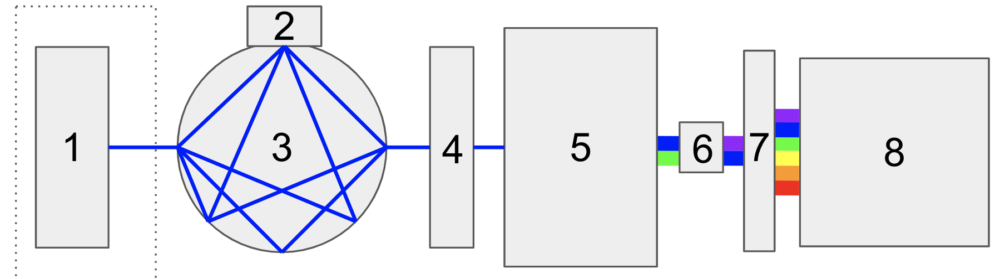
Optical testing setup
Vacuum chamber containing CCD
Photodiode attached to top of …
… integrating sphere
Optical shutter
Monochromator
3 g trans-stilbene sample
Filter wheel
Broadband Xe lamp

Slide 10
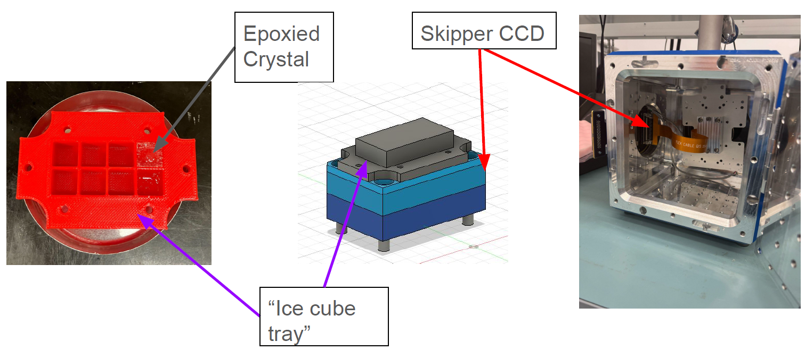
Prototype detector setup

Slide 11
Upcoming paper
Selection & preparation of organic scintillator target crystals
Skipper CCD calibration & response to near-UV scintillation light
Direct measurement of spectral shape of the crystal scintillation light using CCDs
Measurement of crystal’s anisotropy to scintillation production
Prototype detector design integrating these components, to be deployed underground at MINOS@Fermilab this summer
Sensitivity projections for DM-electron scattering, for the various phases of a full experiment

Slide 12
Eventually, run in SNOLAB
Following end of DAMIC SNOLAB runs: reuse their cryostat and readout
Significant interest from DAMIC collaboration
Exciting science potential, logical extension of CCD program at SNOLAB
Scaleable!

