Slide 1
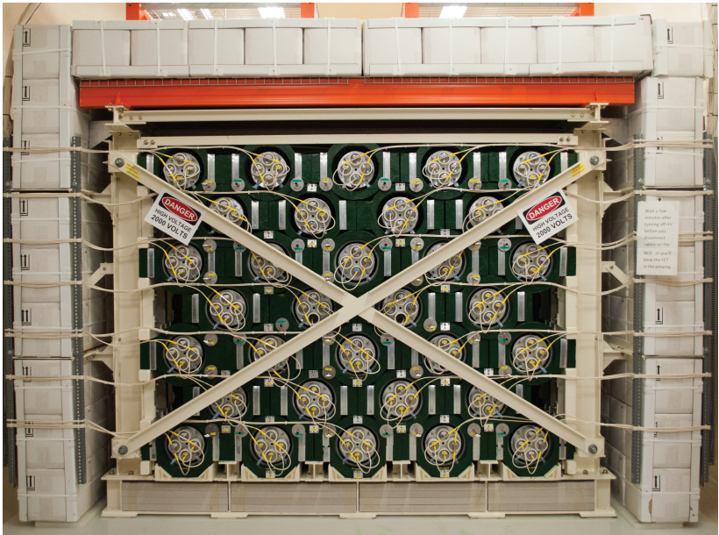
May 25, 2026
The HALO Supernova Neutrino Detector
Tom Sonley
Staff Scientist, SNOLAB
For the HALO Collaboration

Slide 2
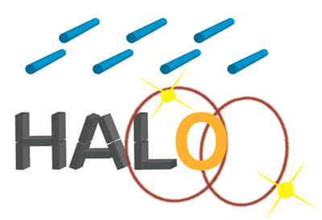
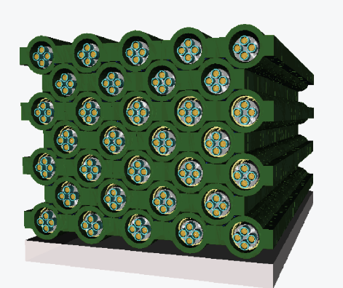
HALO – The Helium And Lead Observatory
A “SN detector of opportunity” / An evolution of LAND – the Lead Astronomical Neutrino Detector,
C.K. Hargrove et al., Astropart. Phys. 5 183, 1996.
Helium – availability of ³He neutron detectors from the final phase of SNO
Lead – high ν-Pb cross-sections, low n-capture cross-sections, complementary sensitivity to water Cerenkov and liquid scintillator SN detectors, available from decommissioned cosmic-ray station
Review: E. Caden et al. Canadian Journal of Physics. 103(8): 763-774

Slide 3
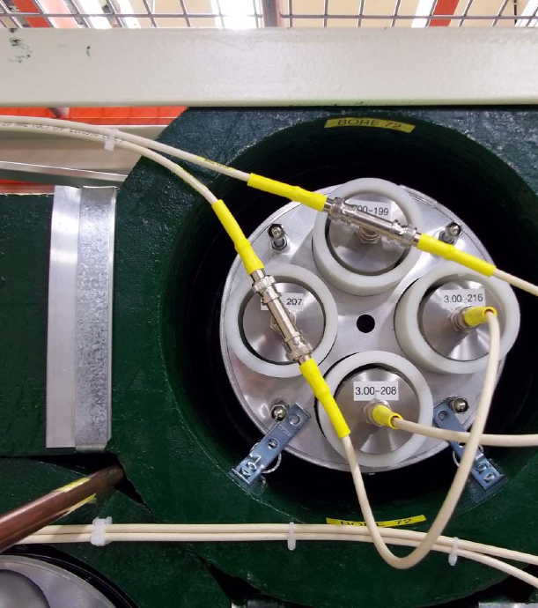
HALO Neutrino Detection
Neutrinos interact on lead, producing neutrons
  1 or 2 with energy thresholds
Neutrons thermalize
Neutrons capture on ³He
  τ ~ 200 us
Neutron counting only
No prompt signal
15 mHz background neutrons
  1/minute

Slide 4
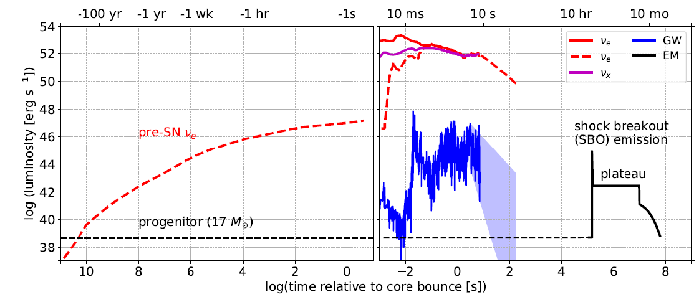
Multi-Messenger Astronomy with Supernovae
Nakamura et al,
MNRAS 161, 3296 (2016)
Galactic Supernova Rate is 1.6 ± 0.5 per Century
Rozwadowska, Vissani, & Cappellaro, New. Astron. 83, 101498 (2020)

Slide 5
Multi-Messenger Astronomy with Supernovae
Nakamura et al,
MNRAS 161, 3296 (2016)
Galactic Supernova Rate is 1.6 ± 0.5 per Century
Rozwadowska, Vissani, & Cappellaro, New. Astron. 83, 101498 (2020)

Slide 6
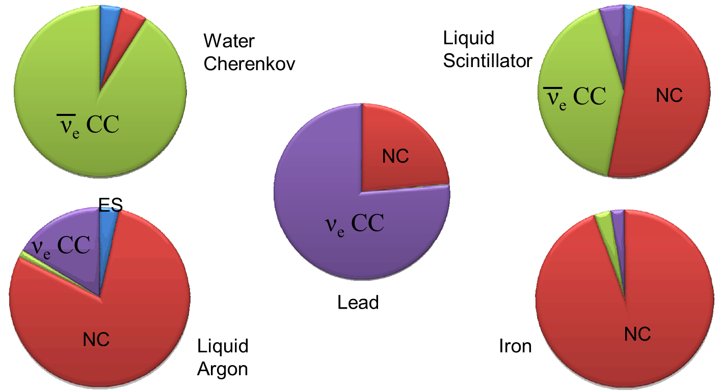
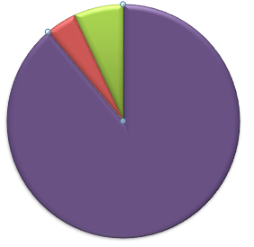
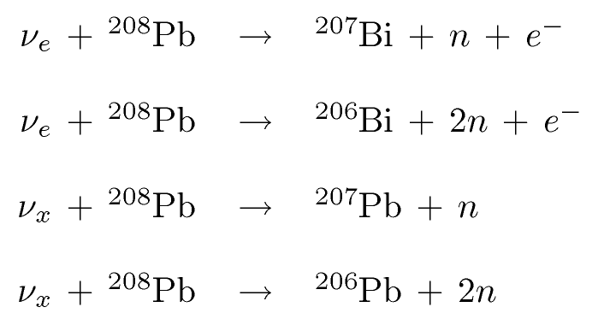
Flavour Complementarity
(w/o Gd)
Strong threshold dependence
ν_{e} CC
NC
Low thresholds see NC
coherent scattering
ν_{e} CC
CC:
NC:

Slide 7
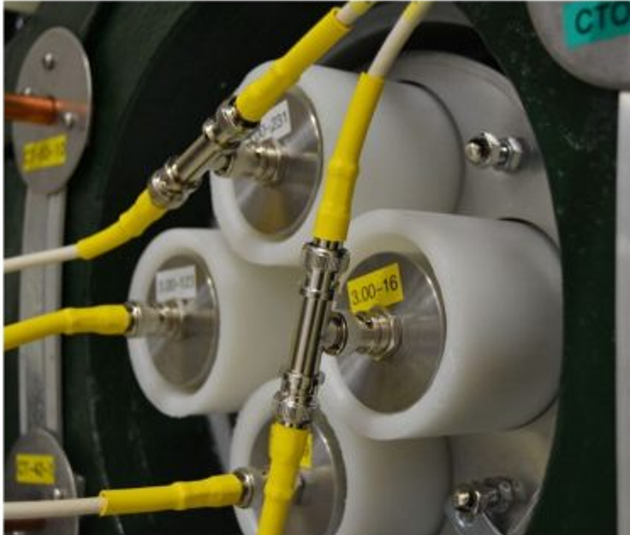
HALO Details
Re-using SNO’s “NCD” ³He proportional counters
5 cm diameter x 3m and 2.5m in length, ultra-pure CVD Ni tube (600 micron wall thickness)
2.5 atm (85% ³He, 15% CF₄, by pressure)
Four detectors with HDPE moderator tubes in each of 32 columns of lead rings
128 counters (368 m) paired for 64 channels of readout
Roughly 12” of water as reflector/shielding around sides
79 tonnes of lead

Slide 8
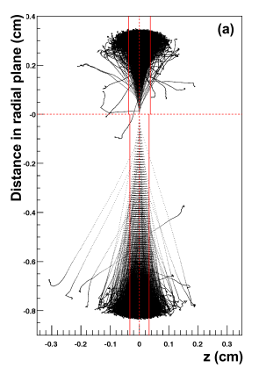
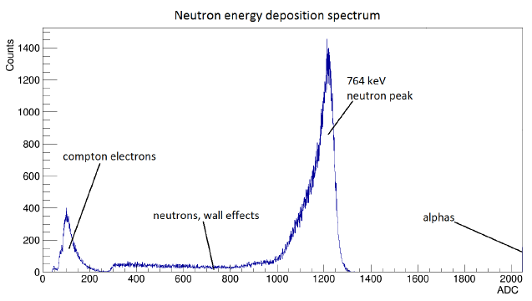

³He Proportional Tubes
191 keV
= 300 ADC
573 keV
= 900 ADC
B. Beltran et al New J. Phys. 13, 073006 (2011)

Slide 9
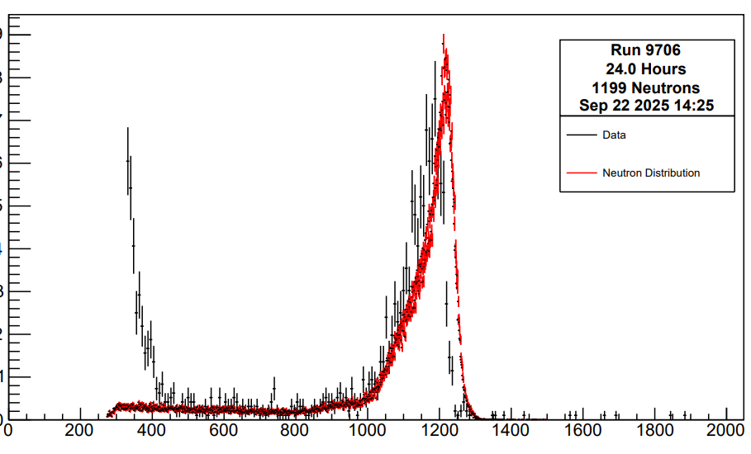
Electronics
Simple + Stable Readout:
AC Coupled pre-amplifiers on each channel
~2kV HV tuned to put peak at 1200 ADC counts
Discriminators set to detect 5 Hz of beta/gamma events total
Electronic calibration pulses injected at pre-amplifier on each channel every 4-8 hours
Highly redundant system:
2 DAQ machines trade off every 3 days (hot spare)
Separate HV + ADCs for right and left halves
Robust email alerts
Monitoring shifts require 10 minutes/day
95% of issues can be resolved remotely
Counts (AU)
Current Run
2016 Calibration
ADC Channel

Slide 10
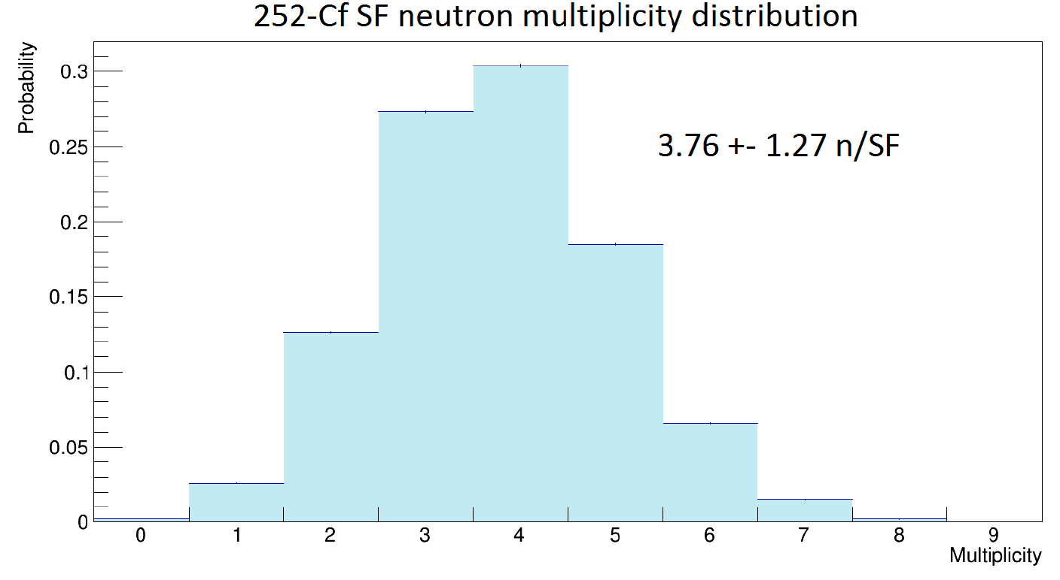
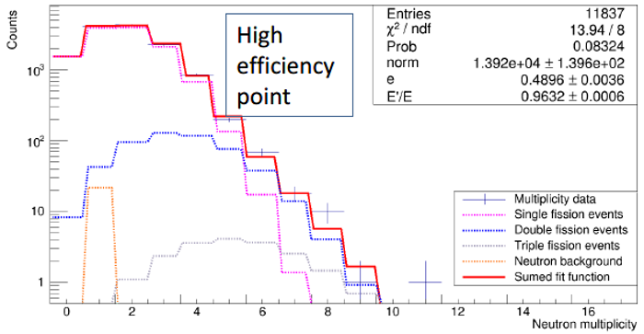
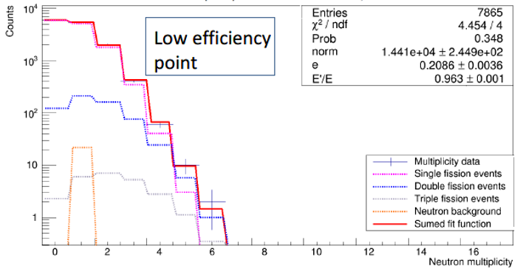
Calibration Method
Centre
48.9 ± 0.4%
Use distortion of multiplicity distribution to fit efficiency
20 Bq ²⁵²Cf / ²⁵⁰Cf source
~ 4 neutrons per fission
192 locations
~ 5 days of livetime
Edge
20.9 ± 0.4%
C. Bruulsema MSc Thesis, 2017

Slide 11
Calibration Results
Front
Efficiency vs Depth
Center
Back
Efficiency at Centre Depth
Corners
Average efficiency of 28% for neutrino-induced neutrons.
C. Bruulsema

Slide 12
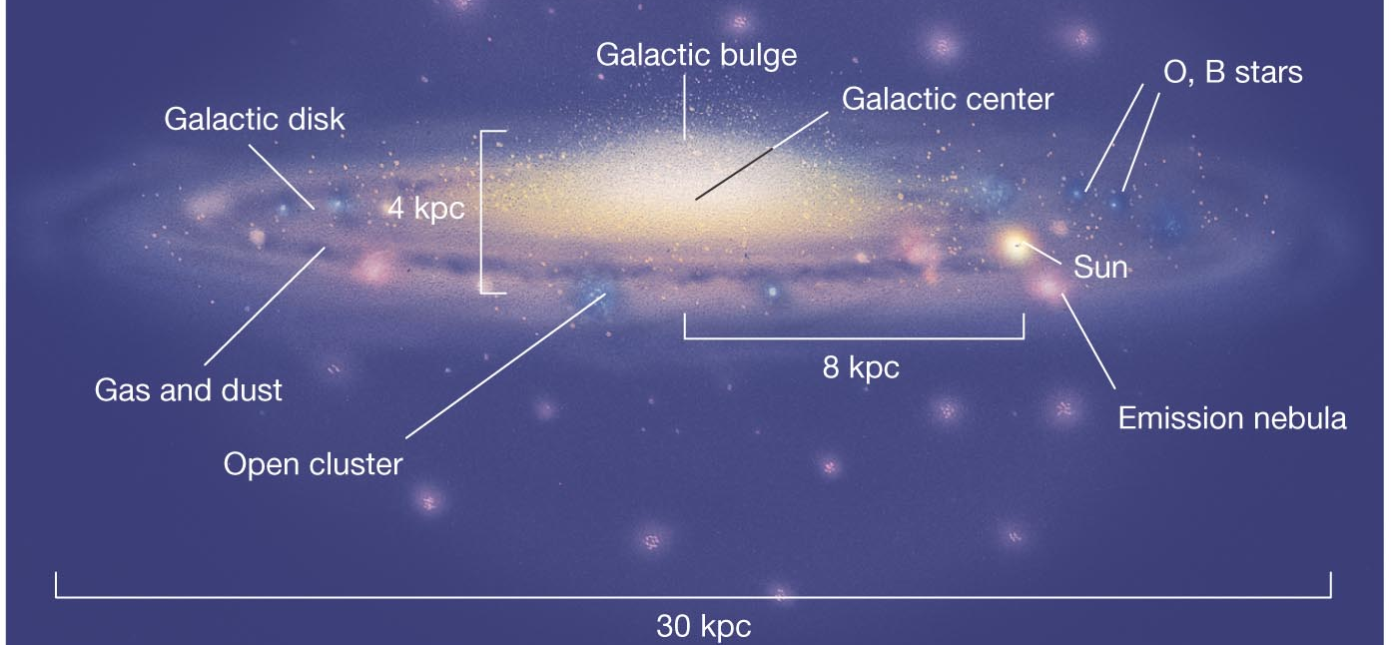





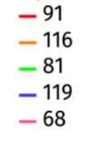
Roughly 10 neutrons @ 10 kpc
 NC 1n
 CC 1n
A. Gallo Rosso
Total HALO-1kT
neutrons
 CC 2n
 NC 2n
LS220-z9.6co spectrum
@ 10 kpc for HALO-1kT design
HALO has ~10 x less target

Slide 13
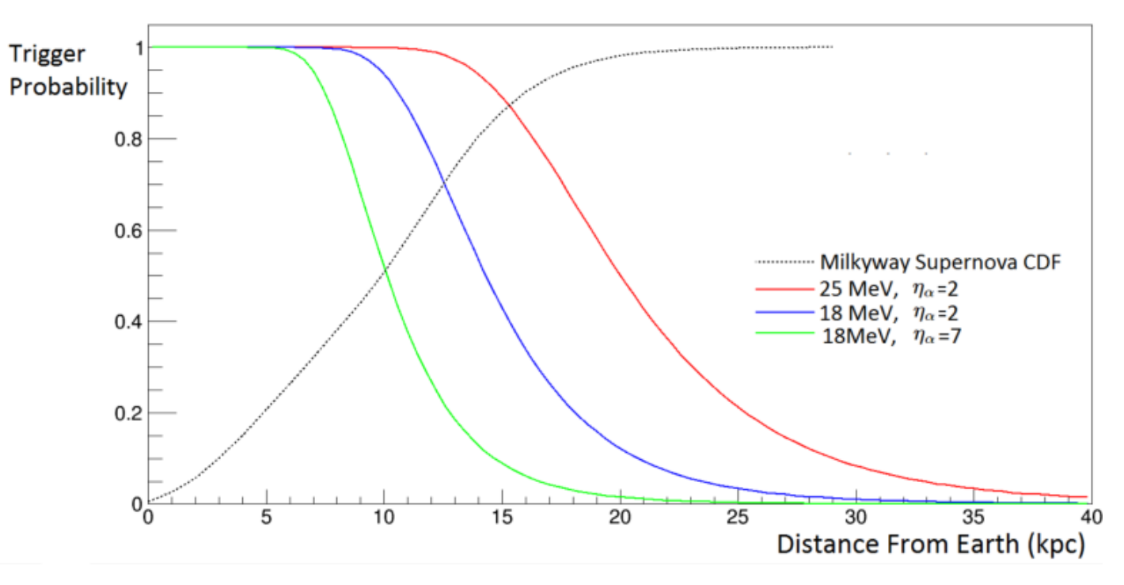
Coincidence Number | Rate
2 | 2 / hour
3 | 1 /day
4 | 1 / month
4 – Neutron Trigger Probability
J. Brau
High Energy Spectrum
Medium Energy Spectrum
Low Energy Spectrum
15 mHz background neutrons 2 second window
τ >> 200 us (non-spallation)
C. Bruulsema

Slide 14
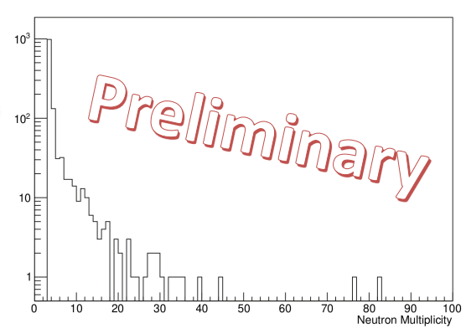
Spallation Neutron Multiplicity

Slide 15
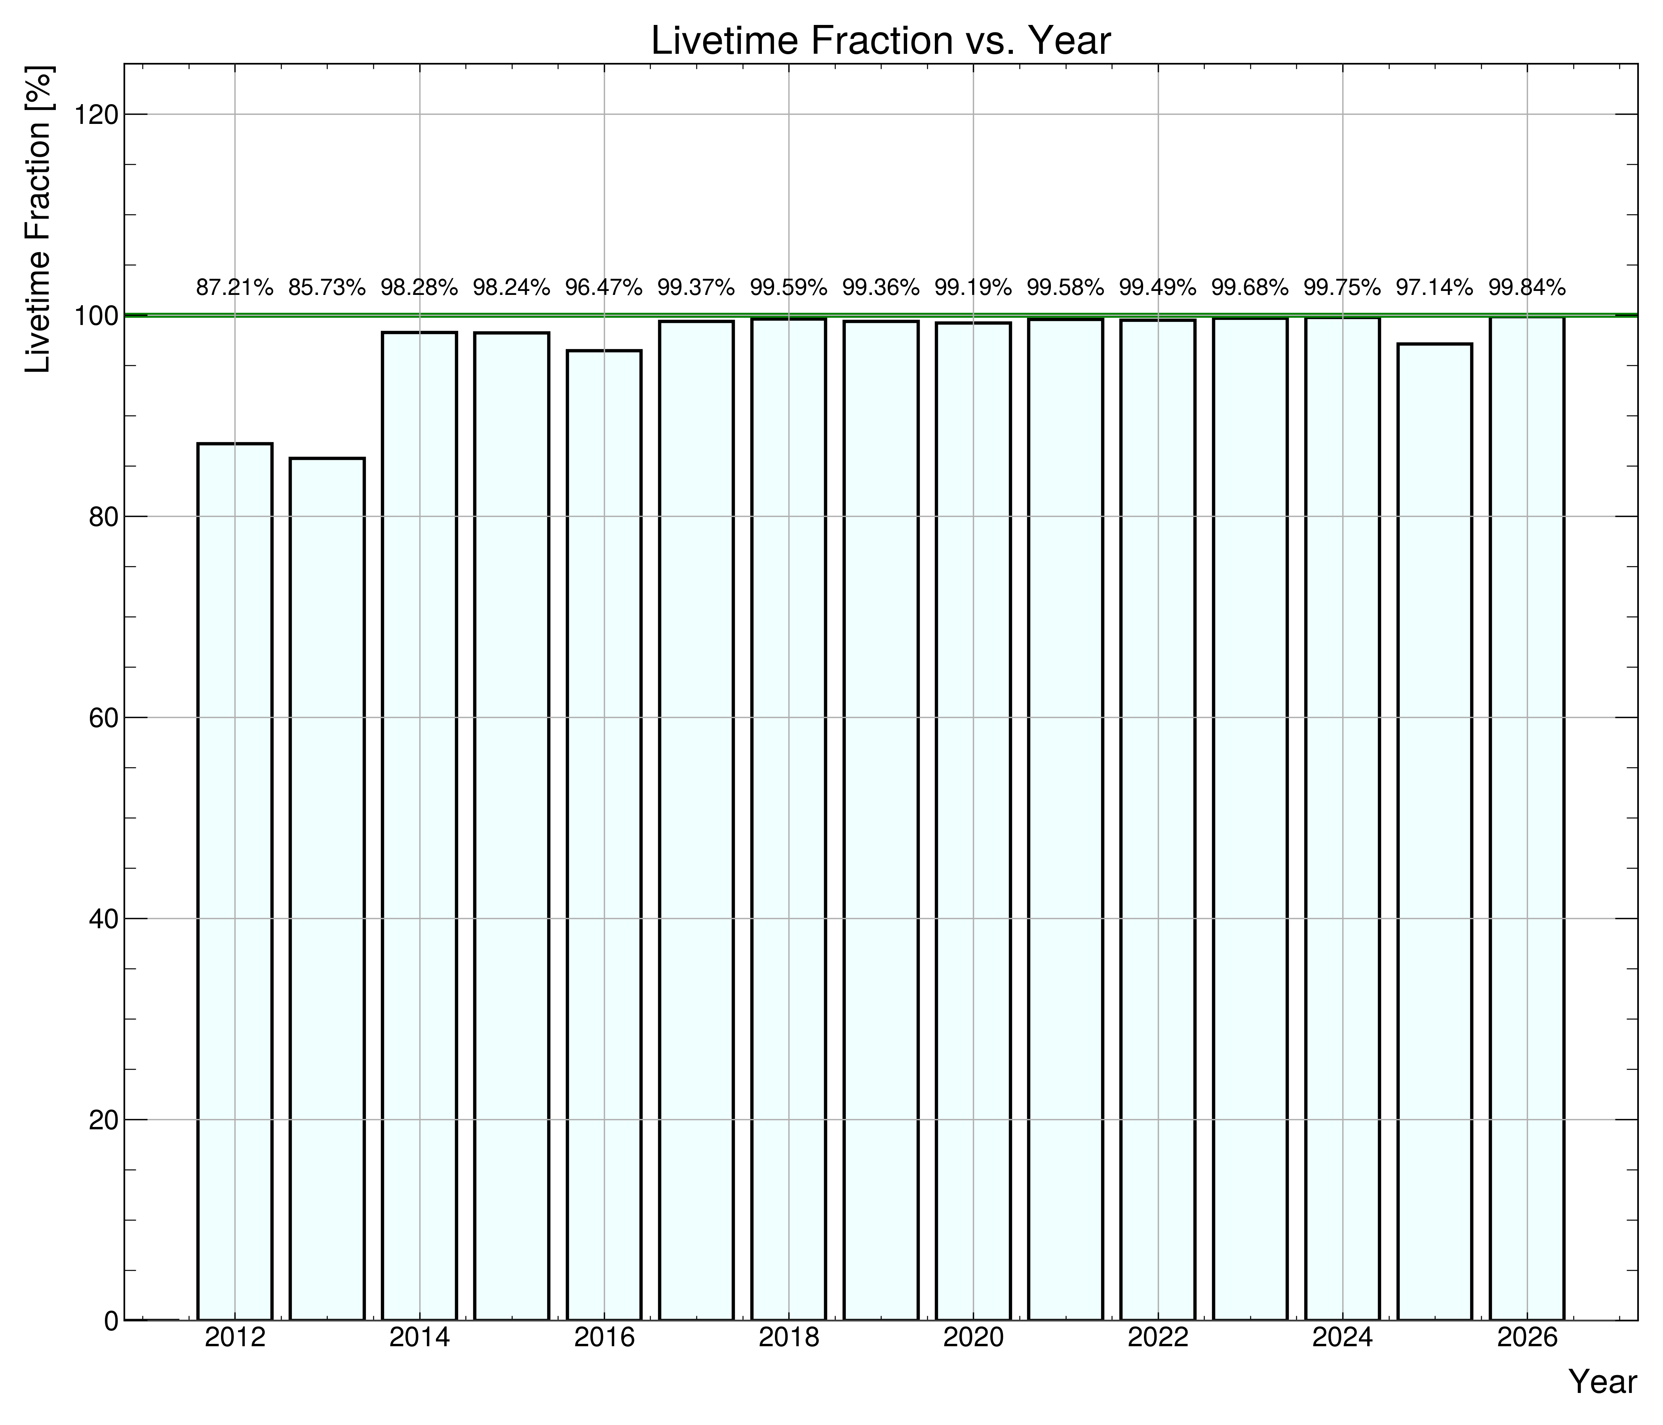
Detector Status
Full detector being read-out since May 8th 2012.
Daily shift-taking since July 27th 2012.
Burst trigger implemented and connected to SNEWS since October 8, 2015
Full calibration done with and without front shielding wall April 2016
DAQ overhaul in 2020
Year | 2012 | 2013 | 2014 | 2015 | 2016 | 2017 | 2018 | 2019 | 2020 | 2021 | 2022 | 2023 | 2024 | 2025 | 2026
Livetime (%) | 87.2 | 85.7 | 98.3 | 98.2 | 96.5 | 99.4 | 99.6 | 99.4 | 99.2 | 99.6 | 99.5 | 99.7 | 99.8 | 97.1 | 99.8

Slide 16

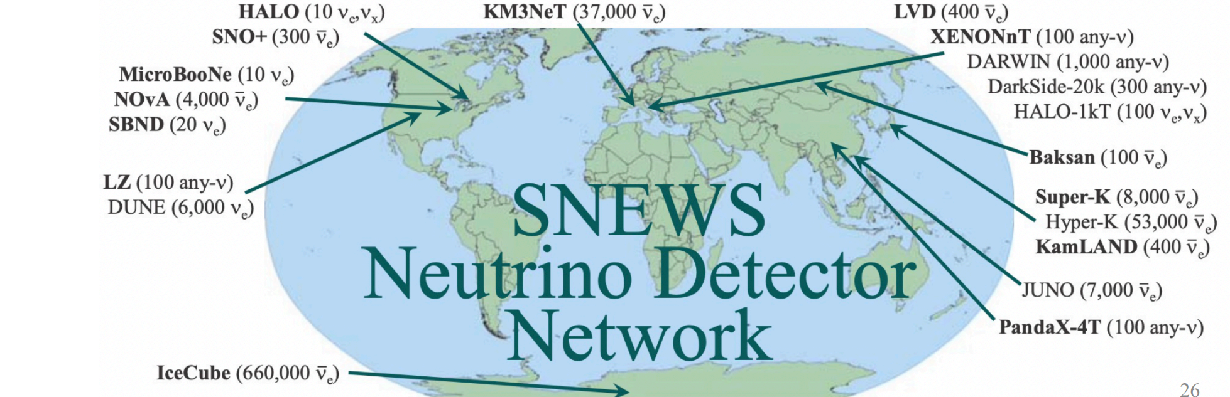
SuperNova Early Warning System
Server receives independent reports from many experiments
Issues Alerts if multiple experiments are in coincidence
SNEWS 1.0 in operation since July 1, 2005
SNEWS 2.0 in testing. Whitepaper: https://arxiv.org/abs/2011.00035
K. Scholberg 2023

Slide 17
Muon Tagger
Would like to correlate multi-neutron bursts with muons
Roughly 3 muons per day through HALO
3 tonnes of thick plastic scintillator + PMTs from CNL Chalk River
40 m² of coverage
HALO top = 15 m²
HALO sides = 10 m² each
Goal of installation in 2027

Slide 18















HALO Status
Commissioned in May 2012
Connected to SNEWS in October 2015
Calibration Run Spring and Summer 2016
1st Maintenance Campaign Completed 2021
> 98% average live fraction for 12 years
No supernova neutrino bursts detected yet…
Funded by:

Slide 19
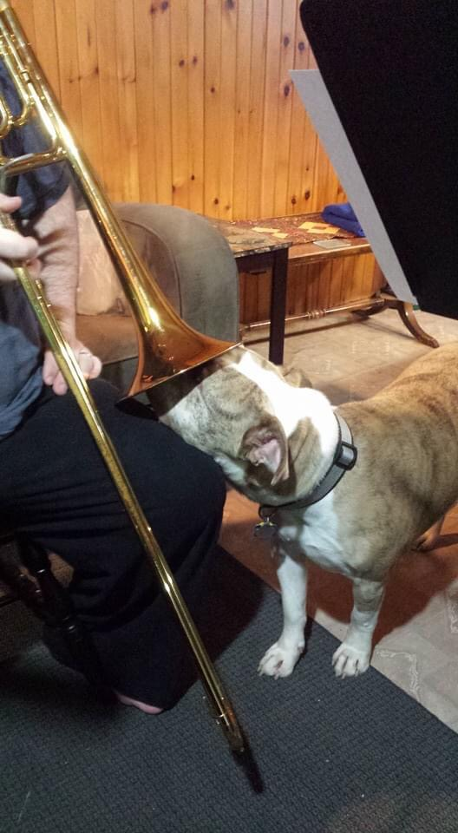
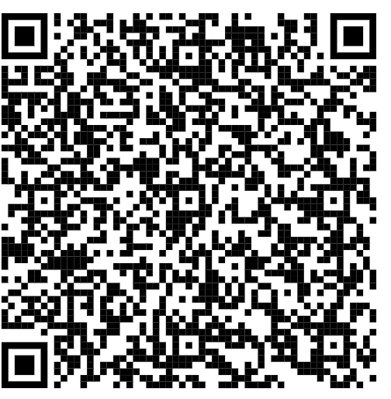
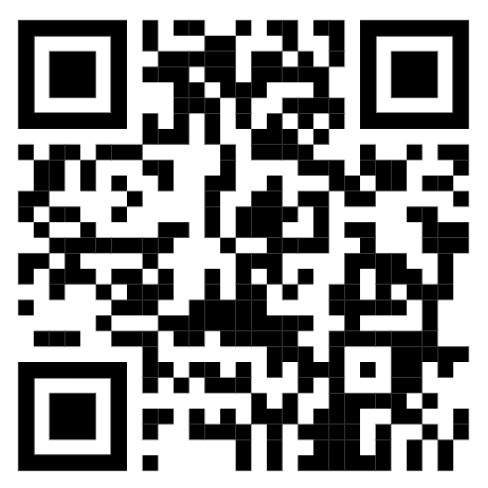
Northen Brass Choir
  2 pm Sunday – Lockerby
  Pay what you will
  Facebook Event
Sudbury Symphony Orchestra
  Matinee 2 pm Saturday Sud Sec
  https://sudburysymphony.com/events/2v/

