Slide 1
GPS Timing at SNOLAB
2026/05/27
Tom Sonley
Staff Scientist

Slide 2
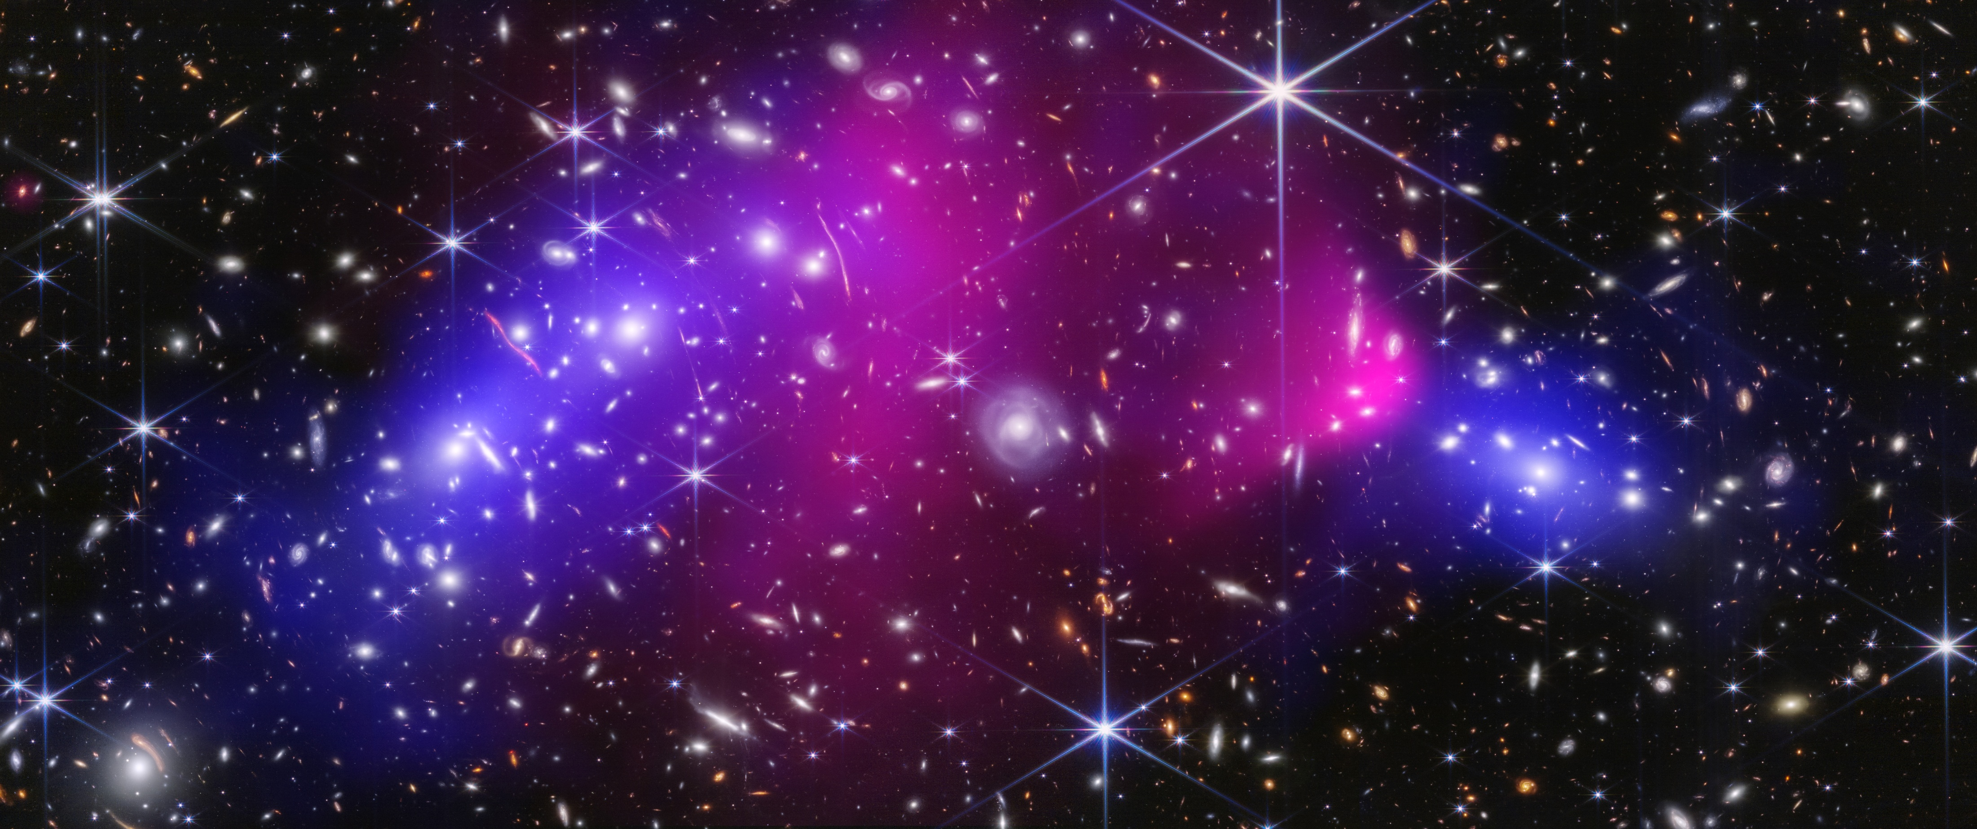
Multi-messenger Astronomy is the Future!

Slide 3
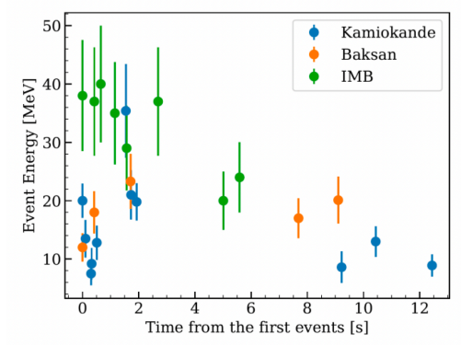
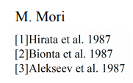

Supernova 1987A
Feb 24, 1987
In Large Magellanic Cloud @ 51.4 kpc
24 total neutrinos detected in 3 experiments
Estimated 2-3 hours before light from supernova reached earth
Demonstrated:
> 99% of gravitational energy converted to neutrinos (all flavours)
Energy scale O(10) MeV
Average Energies:
50% detection efficiency threshold

Slide 4
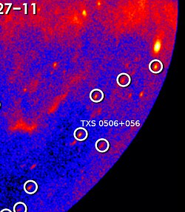

Sept 22, 2017
290 TeV Neutrino Observed by IceCube
Pointed to Blazar:
TXS 0506+056

Slide 5
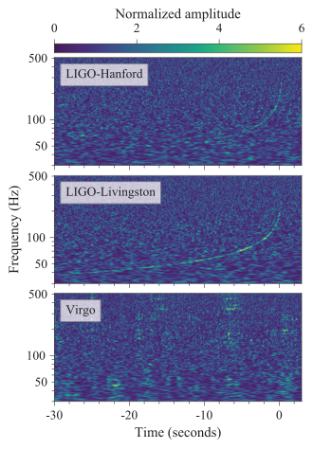
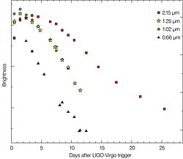
GW170817
Neutron Star Merger
Gravitational Waves observed by LIGO
Short Gamma Ray Burst observed by satellites
Followup in all EM Bands

Slide 6


Slide 7
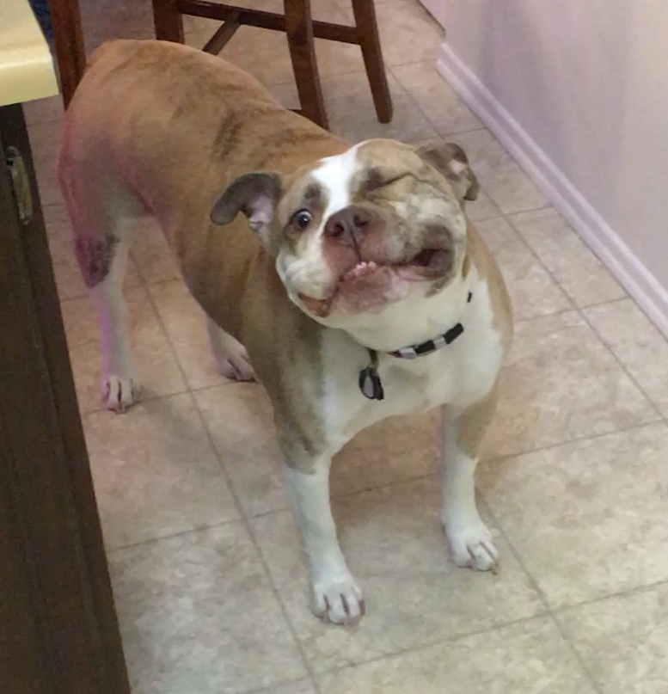

Slide 8
10-40 ms

Slide 9
10-40 ms
GPS system provides few-ns timing worldwide.
How do you get Satellite signals 2 km underground?

Slide 10
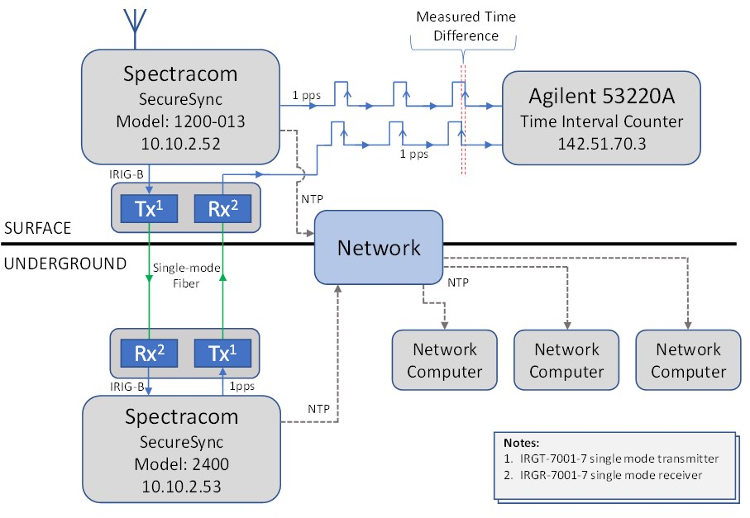
ntp-ag.snoab.ca
PTP
ntp-ug.snoab.ca
BNC Connection

Slide 11
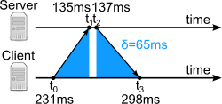
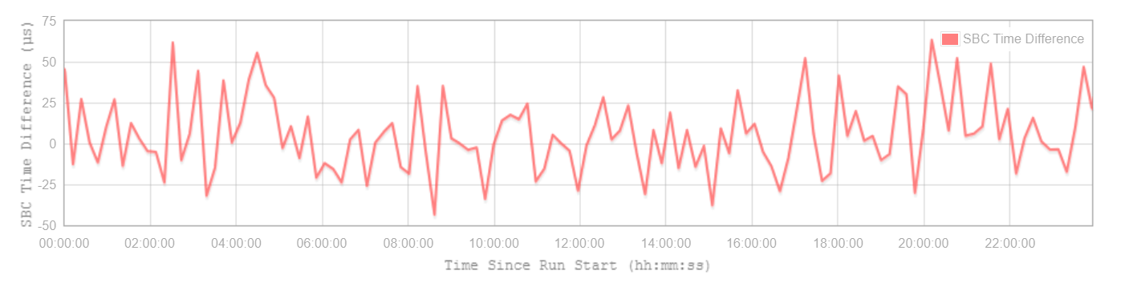
NTP Protocol
Easy
All computers support this
20 us accuracy for HALO
Watch for VLAN issues at SNOLAB
75 us
-50 us

Slide 12
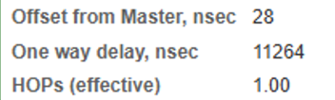
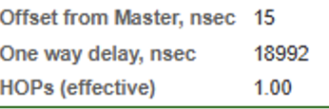
PTP Protocol
“Sub-Microsecond Timing”
Same timing calculation
  But EVERY switch tracks their t₂-t₁ in the chain
NTP-UG is a PTP server (20ns accuracy from surface)
Must coordinate with IT
Seismometer near HALO
1 Switch
Seismometer in LBL
2 Switches

Slide 13
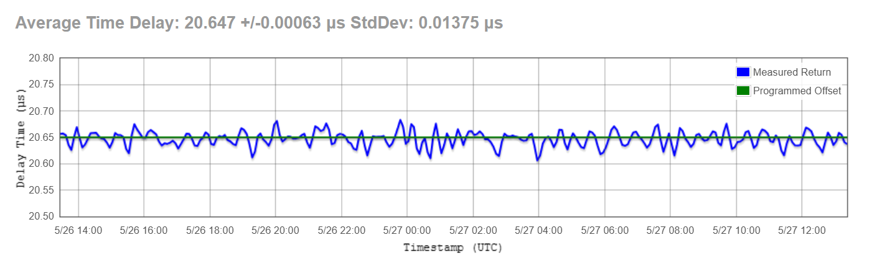
Direct Connection
20 ns accuracy (1PPS, IRIG, other protocols available)
Need a cable from CRU2 + receiver
You are responsible for travel time correction
3 ns Offset
14 ns Standard Deviation
Programmed Offset = 20.65 us

