Slide 1
Operations at SNOLAB
SNOLAB User Meeting 2026
26-May-2026
Richard Ford
SNOLAB Director of Operations​​

Slide 2
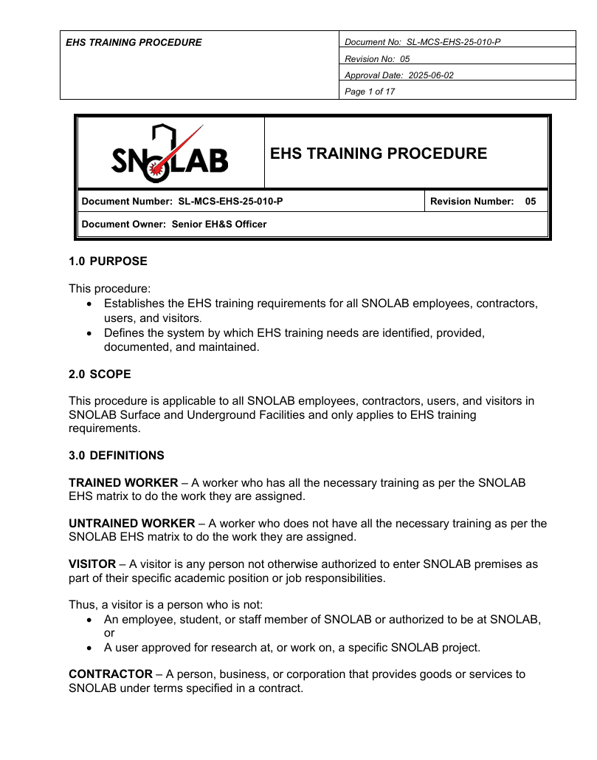
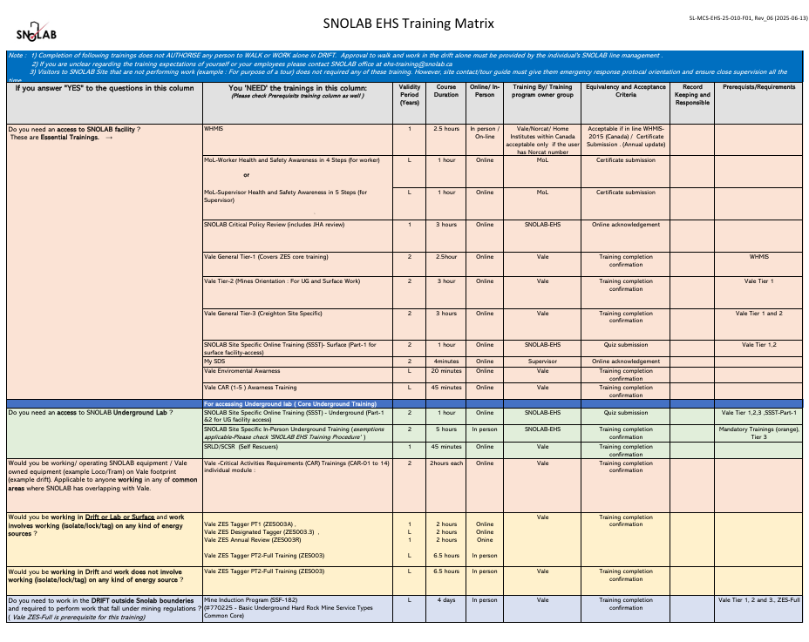
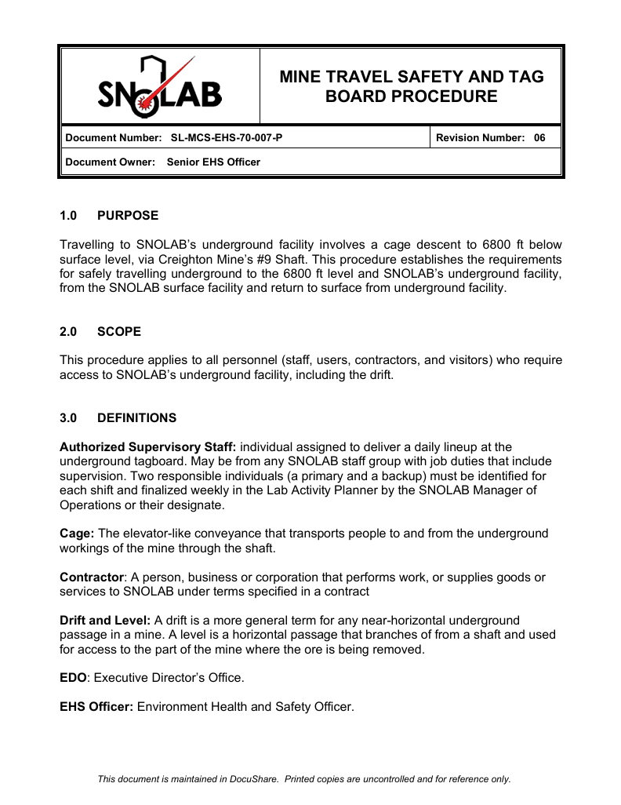
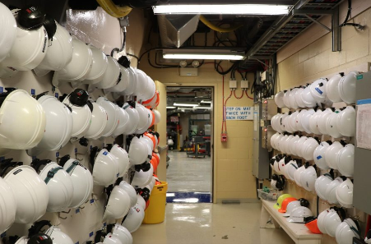
Underground Access
To work underground (UG) at SNOLAB, a user must:
  Have an SNOLAB point of contact
  Have all site-access and UG training as required
  Have an underground supervisor assigned
  Arrive on-time at Line-up for the schedule cage time
  Wearing all PPE

Slide 3
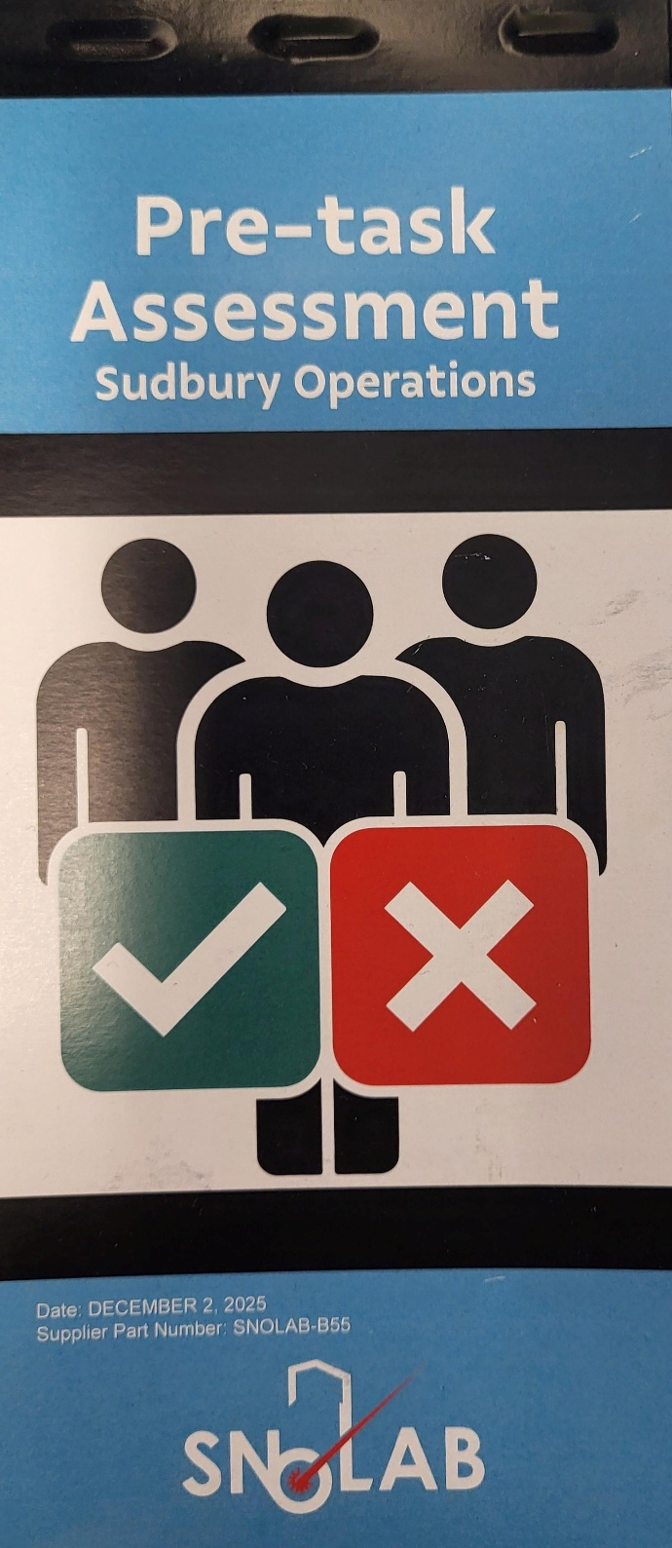
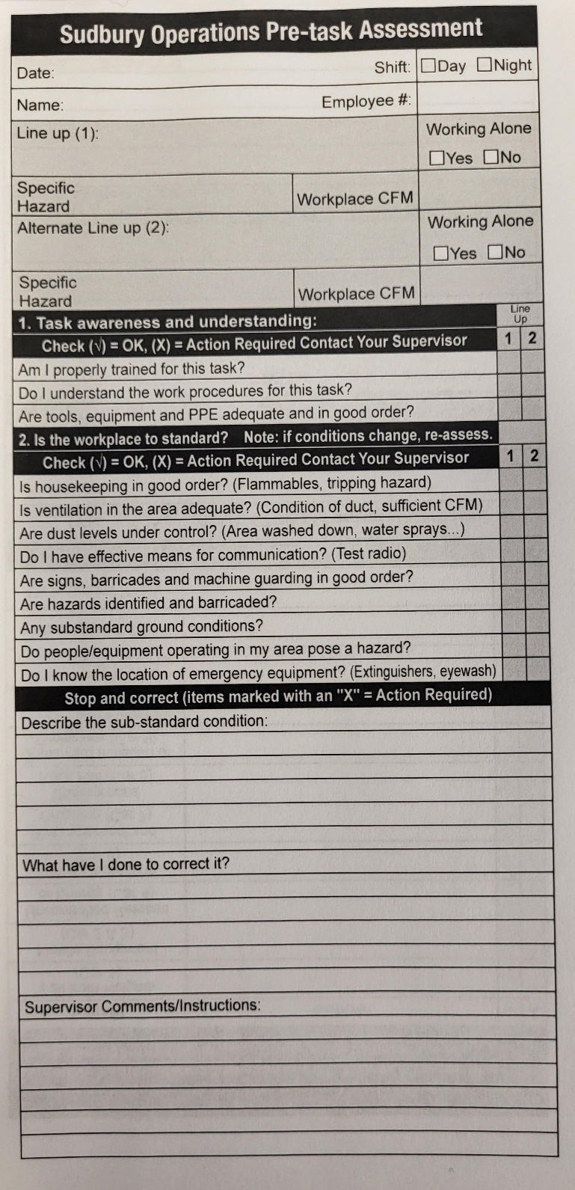
Cage times and line-up
Cage times:
  Note that the Vale cage times have recently changed.
  The SNOLAB cage/shift times for day shift are now 7am – 5pm (10 hr):
      Line-up at 7am, mandatory attendance, in PPE cage ready.
      Cage down 7:20am, no longer line-up at 6800 tag board.
      Cage up 4:55pm (collar time 5pm). Leave lab at 4:15pm.
Line-up:
  The “Line-up” is a regulatory required pre-shift meeting to receive safety instructions from supervisors.
  The line-up meeting is held at the Vale Creighton Mine auditorium, first right at entrance.
  Supervisors are informed of mining and drift conditions via the Creighton Mine safety logbook.
  All “workers” (users and non-supervisory staff) must complete the “pre-task checklist”.
  The pre-task checklist acts as record that line-up safety instructions have been received and understood.
  Workers give the completed checklist to their supervisor at the end of shift, they are filed in records.

Slide 4
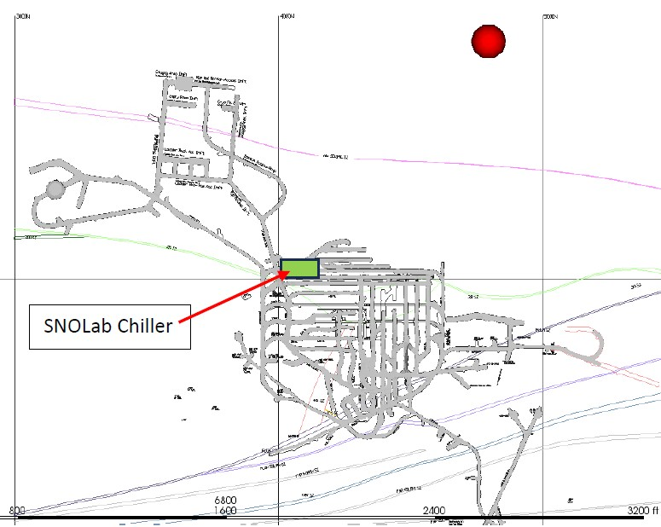
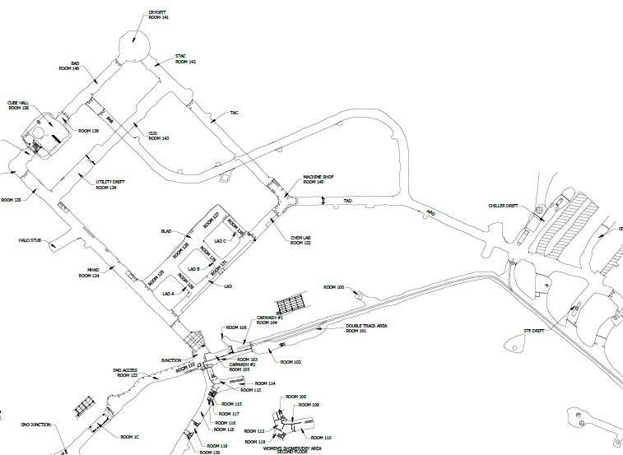
Chiller Drift Updates – Seismic Event
A 4.0 MN (Nuttli) seismic event occurred at 11:20am on 24-Oct-2025, at about 500ft into the hanging wall rock on the 7680 level (about 440 meters from SNOLAB chillers).
SNOLAB incurred some damage to the ground control in the chiller area.
No other damage, except some dust to clean up.

Slide 5
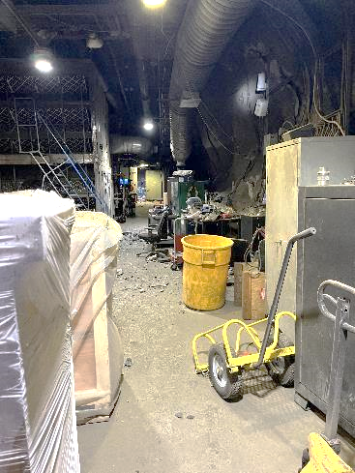
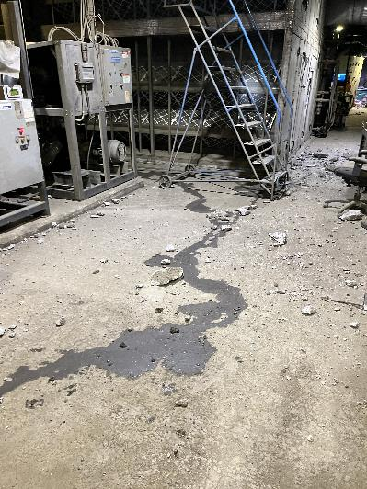
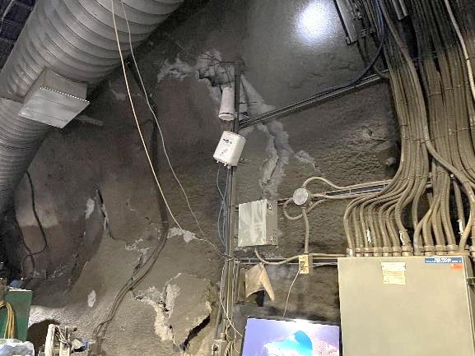
Chiller Drift Updates
Damage to shotcrete behind desk and behind MPC.
Lots of shotcrete bits across the floor
Also damage to chilled water pump,
Cause leak of chilled water.

Slide 6
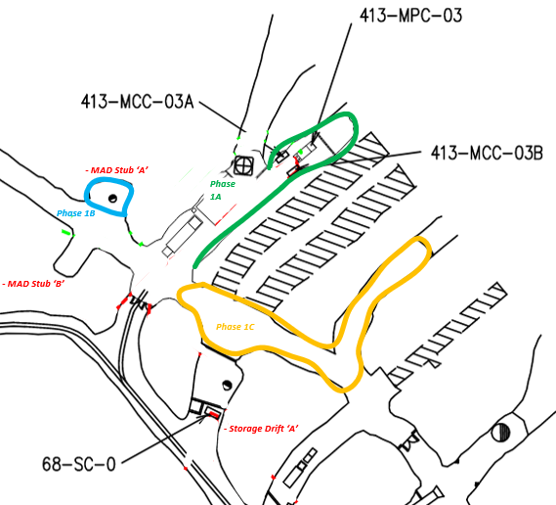
Chiller Drift Rehabilitation Project
Remove MPC#3 and associated electrical equipment to allow ground control repairs, with minimal chiller downtime
Replace aging MCCs; install new MCCs in MAD Stubs A & B with temporary feed from MPC#1
Rehabilitate Stubs A & B and install new flooring
Reconnect chiller and FCF loads sequentially with no outages
Once loads are restored, power down MPC#3 and send it for refurbishment during ongoing ground control work

Slide 7
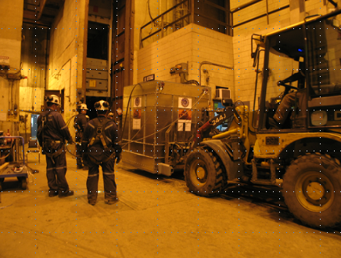
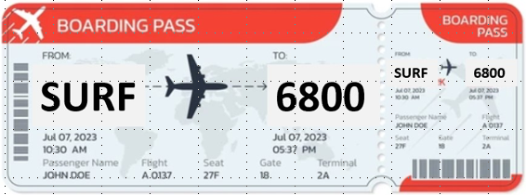
PMP Updates
The 2026 Vale Planned Maintenance Period (PMP) is from July 27th to August 31st (5 weeks). No access July 27th – 30th inc.
Note this is changed since the preliminary schedule reported at the SEF.
Two 11-hour shifts per day (Day/Night), similar to PMP 2025.
UG lab is maintaining operations, but with limited operations for experiments.
We will have very restrictive daily access, but do not yet have shift allocations for SNOLAB. We expect to have a very restricted allocation for the cage, probably only on the night shift.
We will use the Thursday Activity Planner to assign cage stops to specific people and have back-ups to ensure we use our allocations.
Vale is still at the planning stage, changes are possible.
Surface work will be planned as usual.

Slide 8
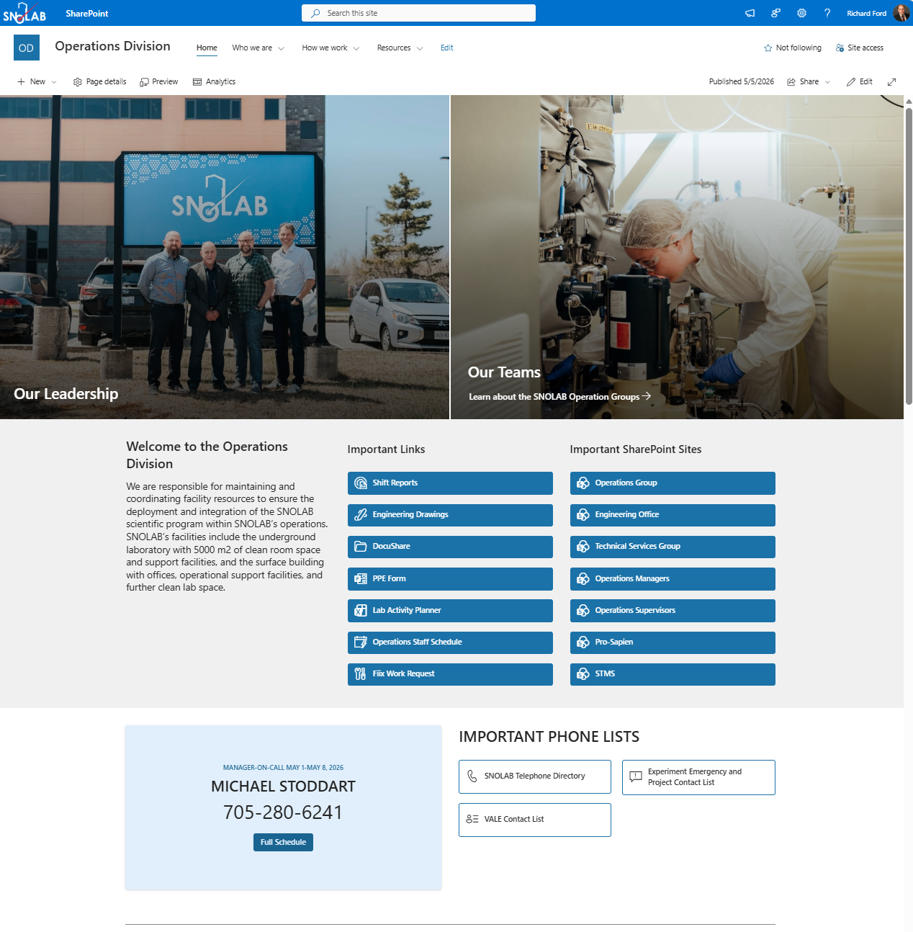
Operations Sharepoint
Operations Division – Home
(snolab.sharepoint.com/sites/OperationsDivision)
      Links to Operations division information and resources:
      Engineering and drawings.
      Manager on call.
      Work order requests and status.
      Schedules and contacts.
      Outages log.
      Much more – go look!

Slide 9
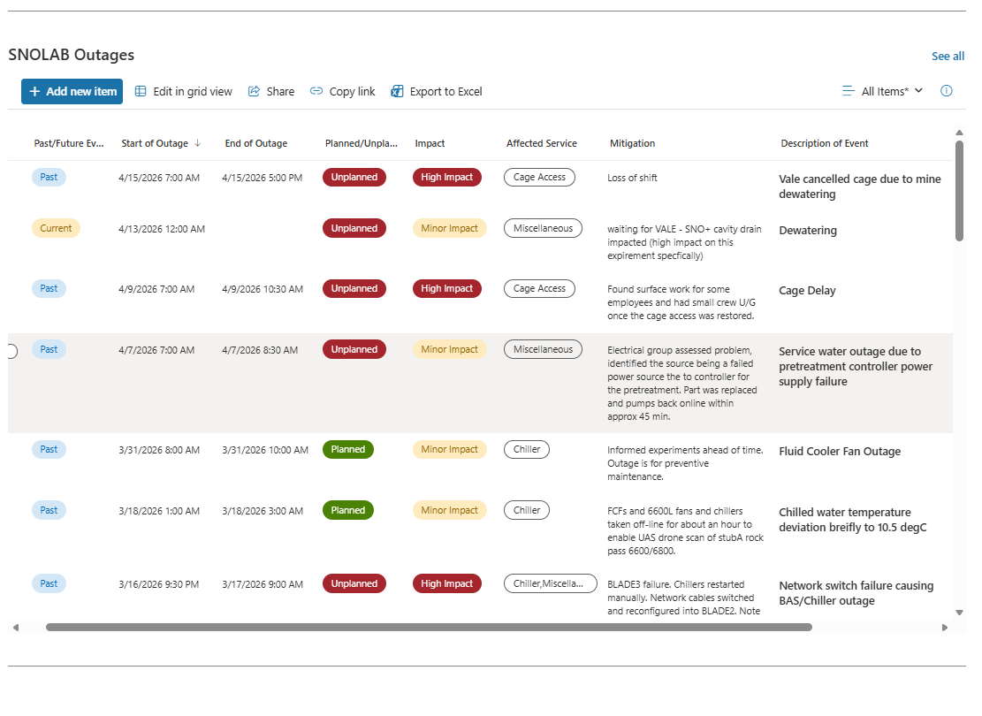
Operations Sharepoint – Outages Log
Operations Division – Home
(snolab.sharepoint.com/sites/OperationsDivision)
      Log of past and planned outages.
Outages in the past year:
Chiller:
2 planned
2 unplanned
Electrical:
3 planned
Water:
1 unplanned
Cage:
2 unplanned

Slide 10
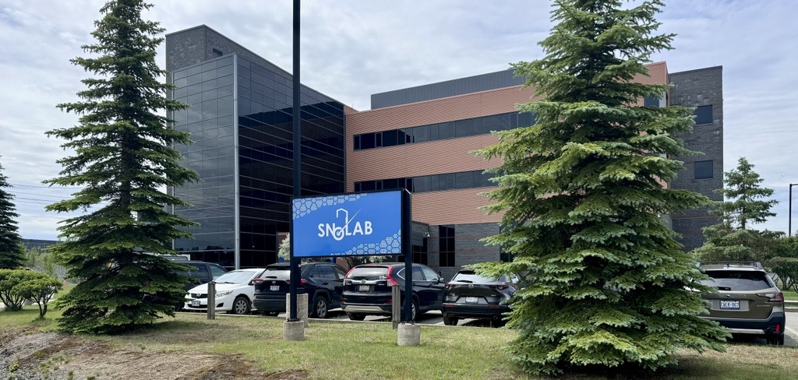
Thank you! Questions?

Slide 11
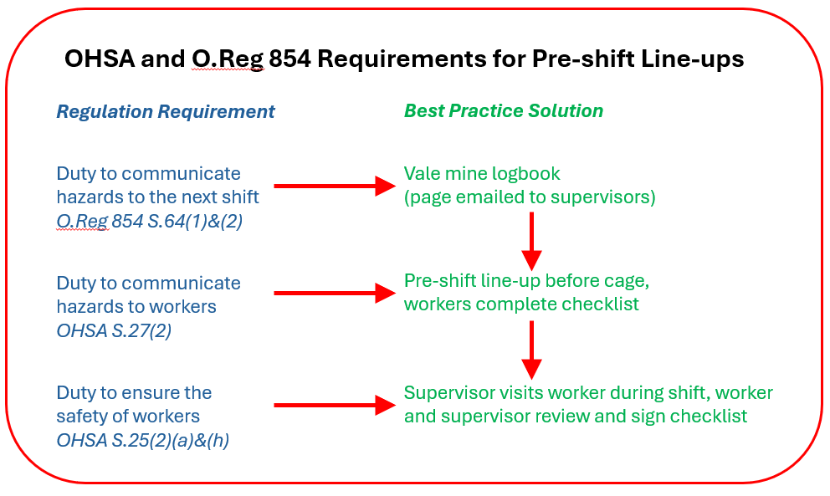
Pre-shift Line-up – Regulatory Framework

Slide 12
Upcoming Events

