Slide 1
Predicting Ambient Neutron Flux Underground with He-3 Counters(NCDs)
Kishan Chaudhary
Research Student, SNOLAB
Co-authors: Ian Lawson, Steffon Luoma, Thomas Sonley, Matt Stukkel, Brianna Binoy

Slide 2
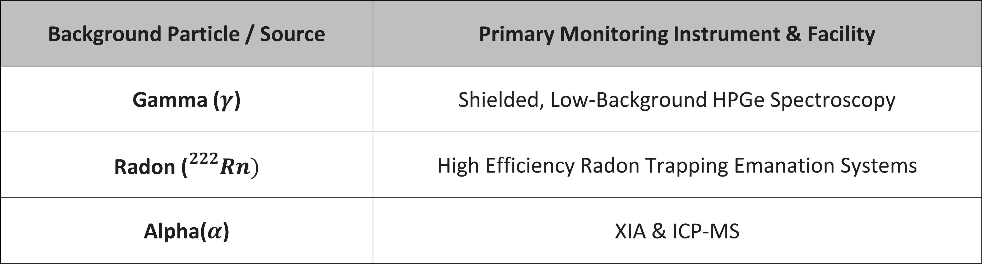
Low Background Team at SNOLAB:
Background Particle / Source | Primary Monitoring Instrument & Facility
Gamma ($γ$) | Shielded, Low-Background HPGe Spectroscopy
Radon (${}_{}^{222}{Rn})$ | High Efficiency Radon Trapping Emanation Systems
Alpha($α$) | XIA & ICP-MS
What about ambient neutrons?
Notes:
The Low Background team at SNOLAB has excellent detectors for studying alphas, gammas and Radon. What about neutron detectors?

Slide 3
My Co-op experience at SNOLAB:
              My experience as a Low Background Student:
              →Summer 2024: Neutron detection, Health Canada Radon Monitoring, HPGe
              →Summer 2025: Neutron detection, HPGe, Radon emanation
              →Fall 2025: Neutron detection
              →Summer 2026: Neutron detection
                Spent >80% time on Neutron Detection Projects
Notes:
I started in Summer of 2024 with several projects and detectors, and over time my focus gravitated towards neutron detectors. In fact, I have spent significant portion of my time at SNOLAB independently working for neutron detector methods. In this talk I will be yapping about recent developments over past few months of an unplanned project, which has made significant progress.

Slide 4
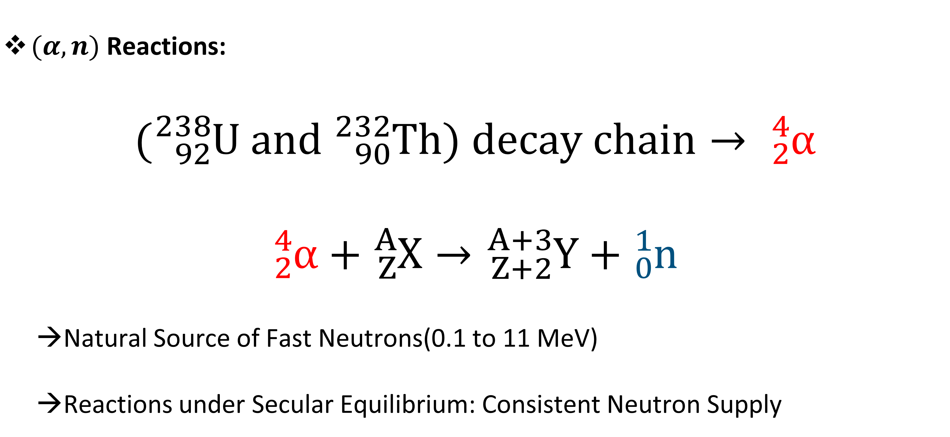
Ambient Neutron Source at SNOLAB:
              $(α,n)$ Reactions:
              $$({}_{92}^{238}U and {}_{90}^{232}{Th}) decay chain→ {}_{2}^{4}α \\ {}_{2}^{4}α+{}_{Z}^{A}X→{}_{Z+2}^{A+3}Y+{}_{0}^{1}n$$
              →Natural Source of Fast Neutrons(0.1 to 11 MeV)
              →Reactions under Secular Equilibrium: Consistent Neutron Supply
Notes:
Just a little background, the ambient neutrons at SNOLAB are result of three kind of independent interactions. But for this work, we only care about the alpha,n reactions in the rock cavern surrounding SNOLAB.
Alphas from U and T decay are energetic, interacts with rock elements like O, Si, C, etc, indirectly creating neutrons

Slide 5
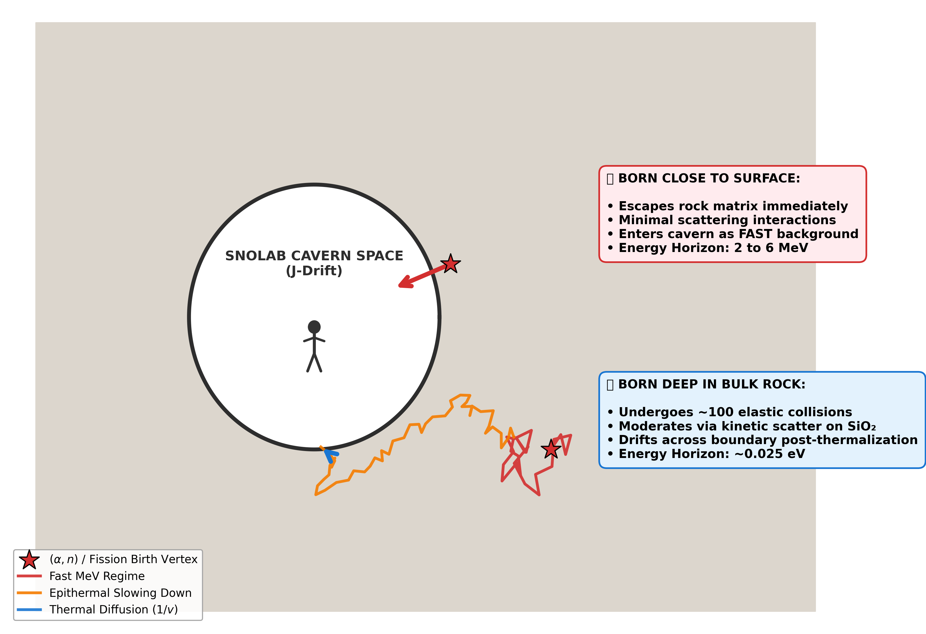
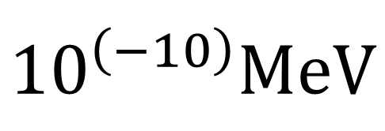
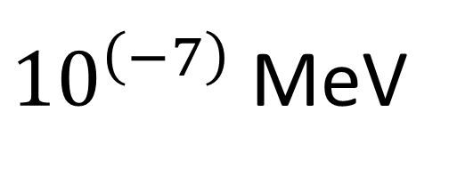
Ambient Neutron Source at SNOLAB:
*Not to scale. Thanks to GEMINI A.I.
${10}^{\left(−10\right)}MeV$
${10}^{\left(−7\right)}$ MeV
0.1 MeV
11 MeV
Thermal neutrons
Epithermal neutrons
Fast neutrons
Notes:
Imagine the SNOLAB J-Drift as this hollow cavity carved out of solid mountain rock. Every cubic centimeter of this norite rock contains trace isotopes of Uranium and Thorium that continuously spit out fast neutrons via $(\alpha,n)$ and spontaneous fission.
If a neutron is born within this thin outer margin right at the cavern face, it has a high probability of jumping clean out of the rock into our open workspace before hitting anything. It enters our environment with its raw, highly dangerous birth energy of several Mega-electronvolts.
However, if a neutron is born just half a meter deeper into the mountain, it has to fight its way out through a dense grid of Silicon and Oxygen. It undergoes over a hundred stochastic billiard-ball collisions, tracing out a winding random walk. By the time it finally drifts across the boundary into the hollow vault, it has completely lost its kinetic energy, thermalizing down to fractions of an electronvolt. Because our cavern naturally integrates both of these depth profiles simultaneously, our detector array is bombarded by a complex superposition of both fast and slow neutrons. We cannot passively separate them; we must utilize our optimized multi-thickness high-density polyethylene configurations to mathematically deconvolve this ambient field."

Slide 6
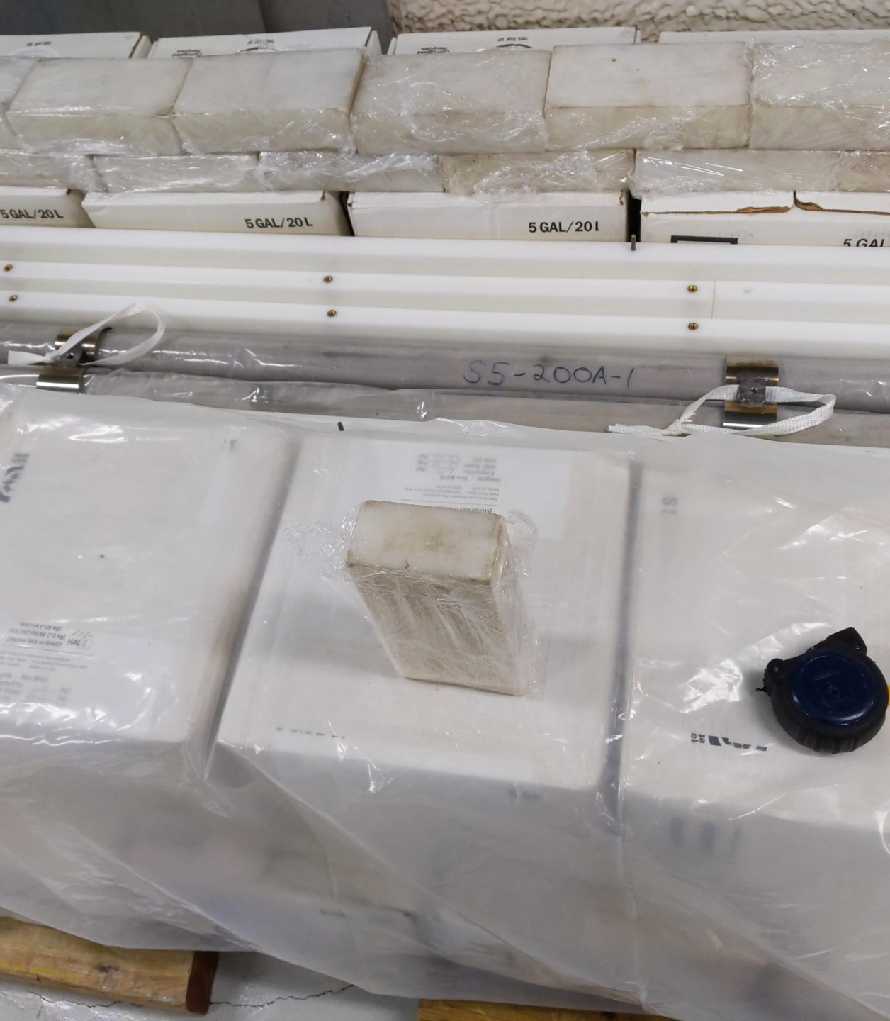
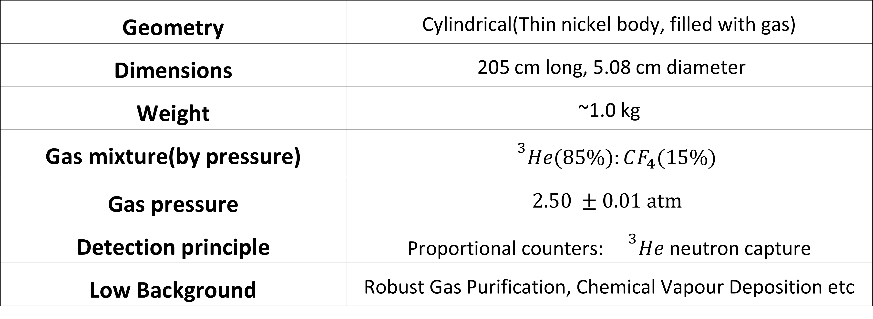
Neutral Current Detectors(NCDs): He-3 Counters
Geometry | Cylindrical(Thin nickel body, filled with gas)
Dimensions | 205 cm long, 5.08 cm diameter
Weight | ~1.0 kg
Gas mixture(by pressure) | $${}^{3}He(85\%):CF_{4}(15\%)$$
Gas pressure | $$2.50 ±0.01 atm$$
Detection principle | Proportional counters: ${}^{3}He$ neutron capture
Low Background | Robust Gas Purification, Chemical Vapour Deposition etc
Notes:
Last year in May, Steffon introduced me to the legendary He-3 Counters, the NCDs
The NCDs are low background neutron capture proportional counters. They are about 2 m long and each NCD is ~93 efficient for thermal neutron detection. These custom counters were built under strict physical constraints to detect neutrons in the SNO experiment for indirect neutral current detection.

Slide 7
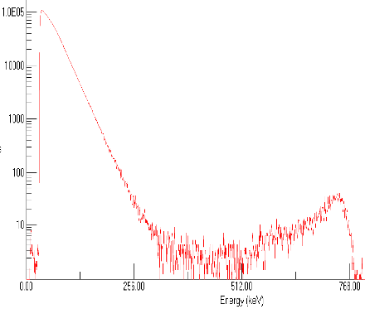
Helium-3 counters: Detection principle
Ionized charges
Triton(H-3)
K.E: 191 keV
Pre-Amplifier
Thermal neutron
Amplifier
Helium-3
Proton(H-1)
K.E: 573 keV
Fig: Neutron capture diagram
Fig: Simplified neutron counting flow diagram
Notes:
The neutrons are captured from He-3 gas, which produces tritons and protons, that in turn ionize the gas. The counters are run at high voltage, enabling Charge based Pre-amp and ampifiers to get a raw smoothed spectrum.

Slide 8
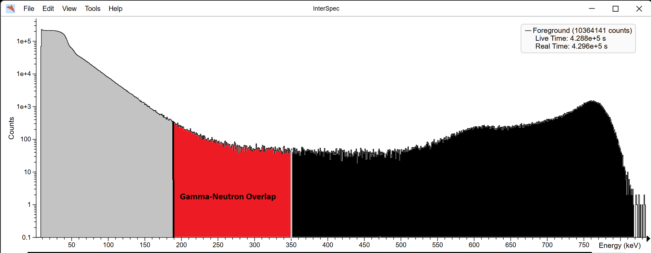
Limitations of NCDs:
Gamma-neutron overlap in ROI(~190 to 900 keV)
→Current solution: Energy Cuts and Count Correction Factor(Browne, 1999).
Fig: Experimental AmBe data, background overlap with neutron capture data
Counts
Gamma Backgrounds
Neutron capture events
Gamma-Neutron Overlap
Energy (keV)
Notes:
The counters have wall effect energy deposition due to geometry, but one limitation of using only a shaping amplifier is that gamma edep overlap with the neutron region of interest for initial energies. We utilized energy cuts and count correction factors from SNO period to deal with the background.

Slide 9
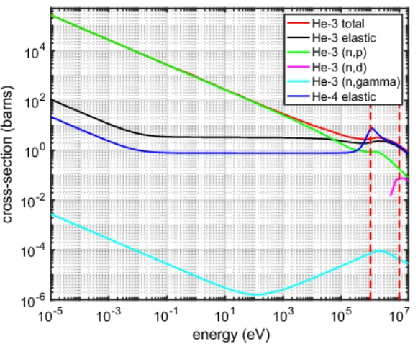
Neutron Capture Cross-section of Helium-3:
→Neutron capture drops rapidly over energy
→NCDs detect ambient thermal + some epithermal neutrons
Cross-section (barns)
Fig(left): Cross-Section plot for He-3 and He-4 interactions (Piscitelli et.al, Eur. Phys. J. Plus 135, 577, 2020)
Energy (eV)
0.0001 eV
0.025 eV
0.1 MeV
11 MeV
Thermal neutrons
Epithermal neutrons
Fast neutrons
Notes:
The plot here shows the microscopic cross section for neutron capture in the green curve here. The cross section is about 5300 barns for thermal neutrons, but logarithmically decreases, making them invisible to late epi-thermal and fast neutrons

Slide 10
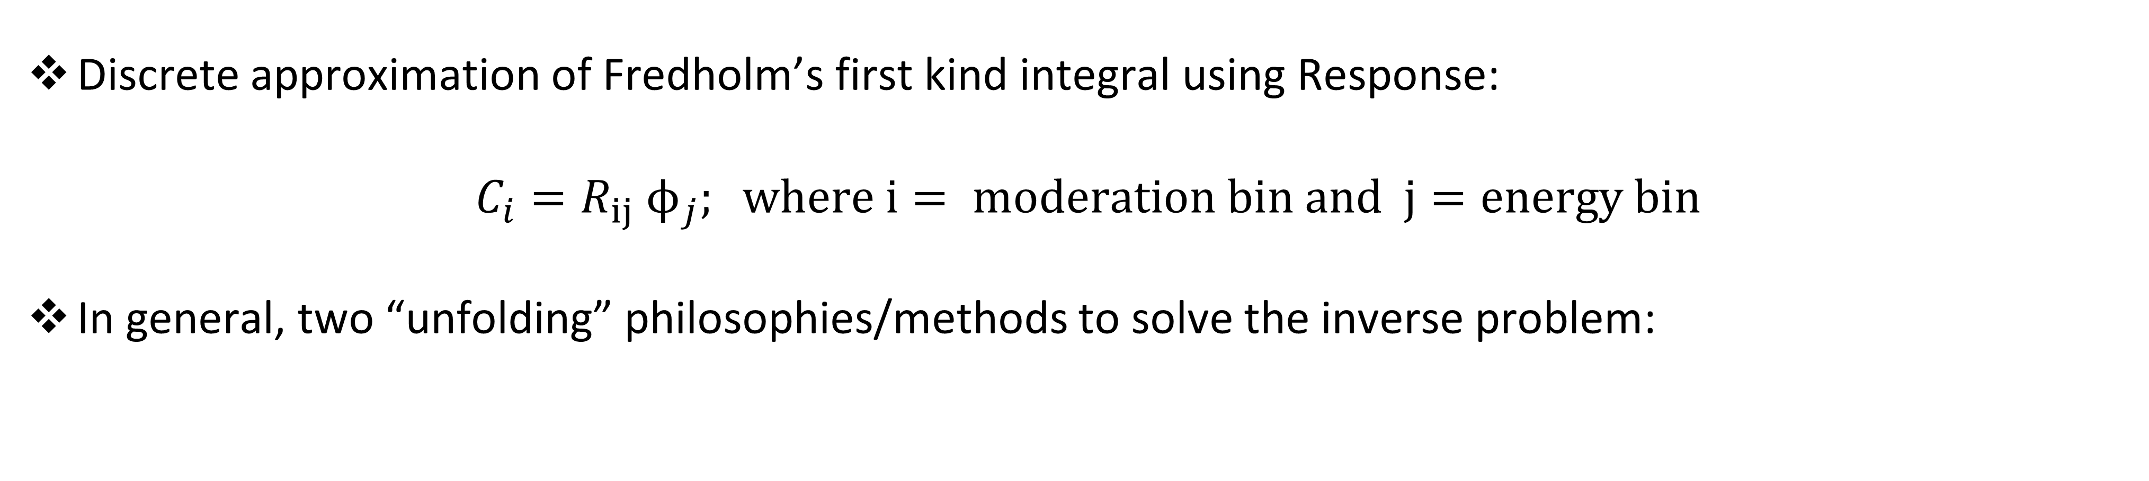
Inverse problem: Moderated Response
Discrete approximation of Fredholm’s first kind integral using Response:
$$C_{i}=R_{ij} ϕ_{j}; where i= moderation bin and j=energy bin$$
In general, two “unfolding” philosophies/methods to solve the inverse problem:
High-Resolution Unfolding | This Work
Energy bins > detector responses | Energy bins = detector responses
Requires priors / regularization | Direct decomposition inversion
MAXED, GRAVEL, MLEM, Bayesian | LU, SVD
High apparent resolution | Stable conditioning analysis
Strong prior dependence | Physically constrained reconstruction
Notes:
To deal with this issue, we began a new project, utilizing moderators to slow down faster neutrons to detect them indirectly. This is a complex inverse problem, where we would have to invert the effect of moderators to get the information regarding initial neutron and some information about their energies.
Many neutron unfolding systems attempt to reconstruct highly resolved spectra using relatively few detector responses. While powerful, these systems are fundamentally underdetermined and therefore rely heavily on regularization, priors, or smoothness assumptions.
In this work, I instead constrained the reconstruction dimensionality to match the effective spectral information available from the moderator system.
This enabled stable inversion using LU and SVD while allowing direct conditioning analysis of the response matrix.
The number of recoverable spectral components is determined by detector information content, not by the number of chosen energy bins.

Slide 11
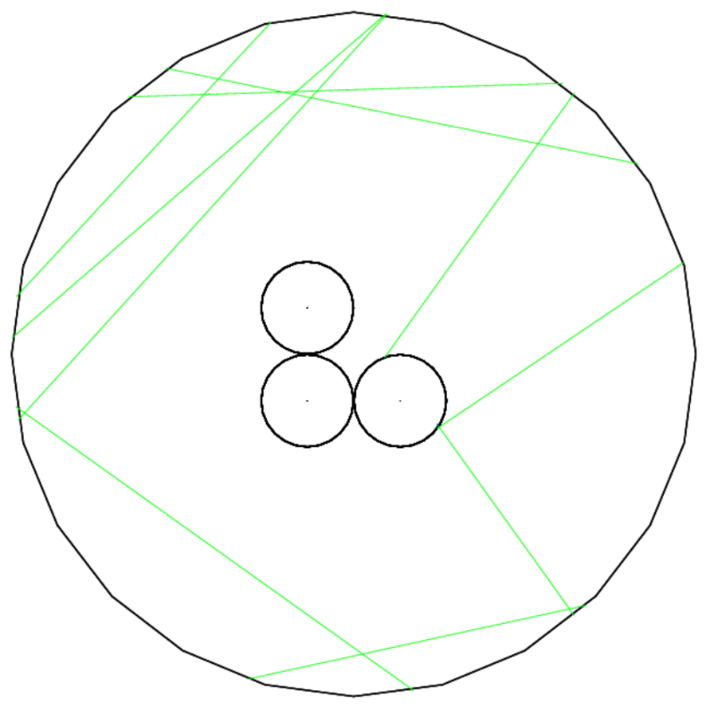
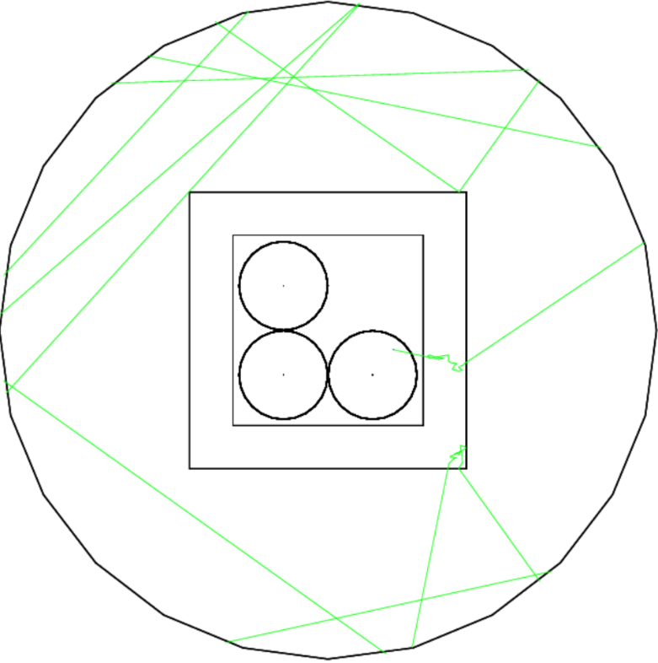
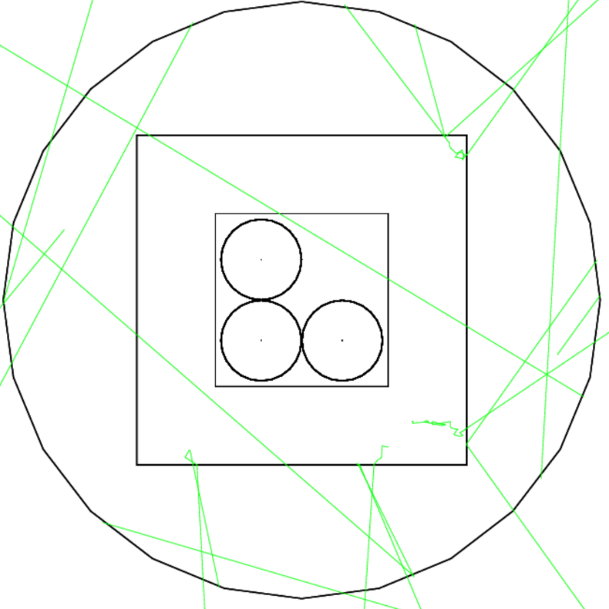
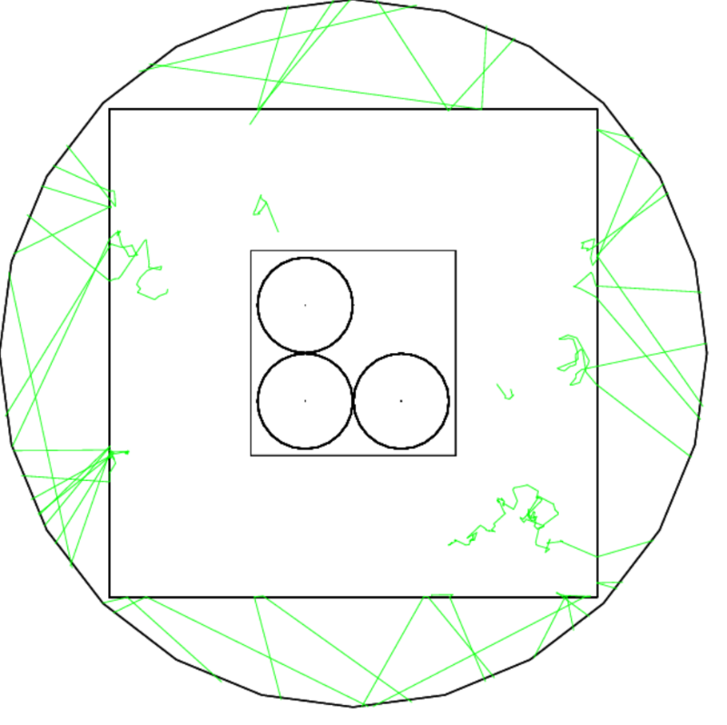
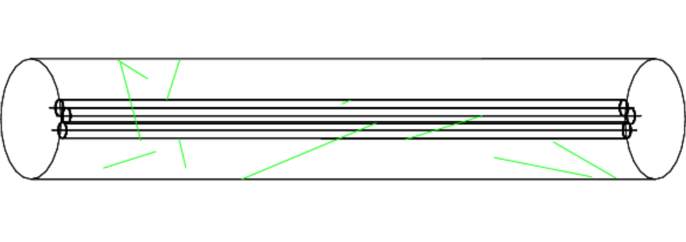
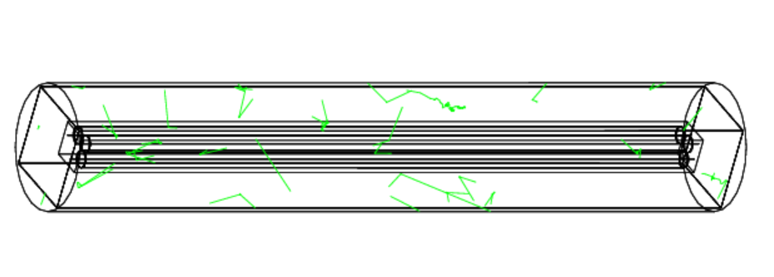
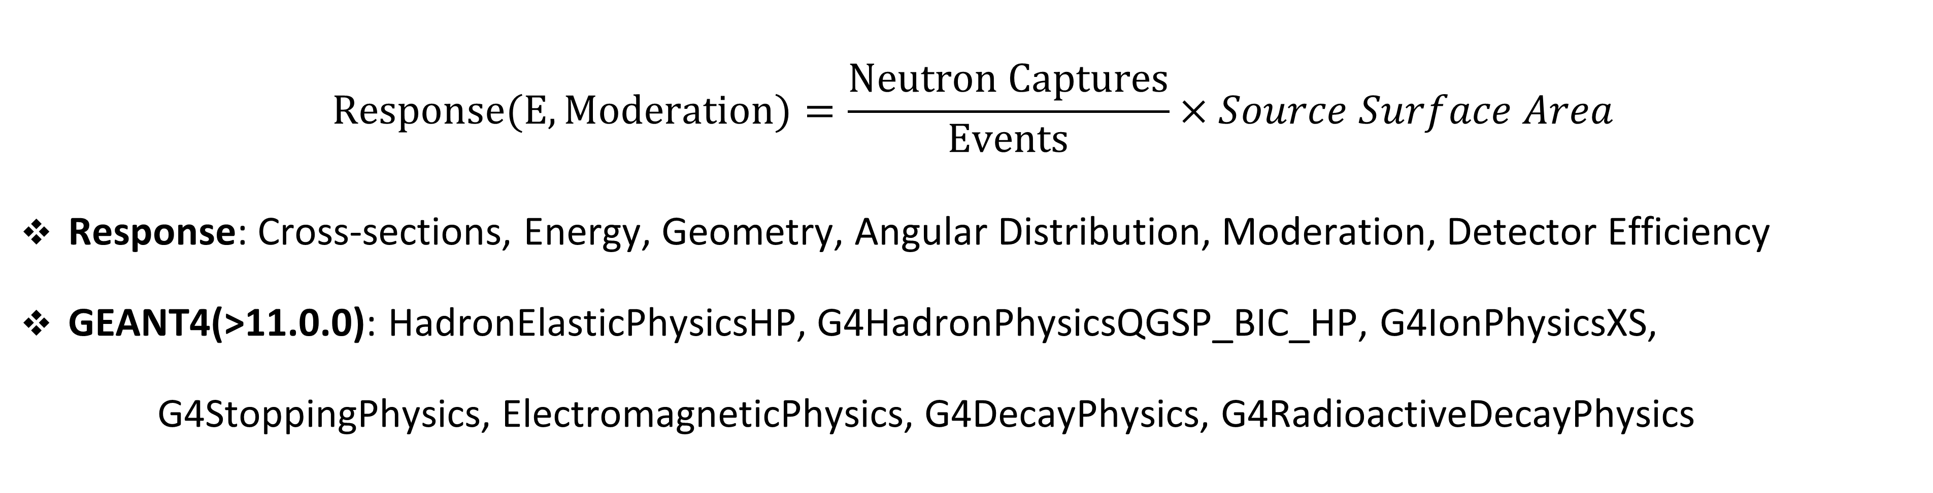
Evaluated Response using GEANT4 on Nibi cluster:
Fig: 1” NCD
Fig: 2” NCD
Fig: Bare NCD
Fig: 3” NCD
$$Response(E, Moderation)=\frac{Neutron Captures}{Events}×Source Surface Area$$
Response: Cross-sections, Energy, Geometry, Angular Distribution, Moderation, Detector Efficiency
GEANT4(>11.0.0): HadronElasticPhysicsHP, G4HadronPhysicsQGSP_BIC_HP, G4IonPhysicsXS, G4StoppingPhysics, ElectromagneticPhysics, G4DecayPhysics, G4RadioactiveDecayPhysics
Notes:
To be able to invert the affect or do backward projection, first I simulated the forward response by making GEANT4 simulations for each configurations. Specifically, I counted tritons produced, to find the response of the configuration over energies. The response is a dense information, which conveys the effective area every incoming neutron from source sees to interact with, which includes details about geometry, neutrons transport, energies, angular distribution etc.

Slide 12
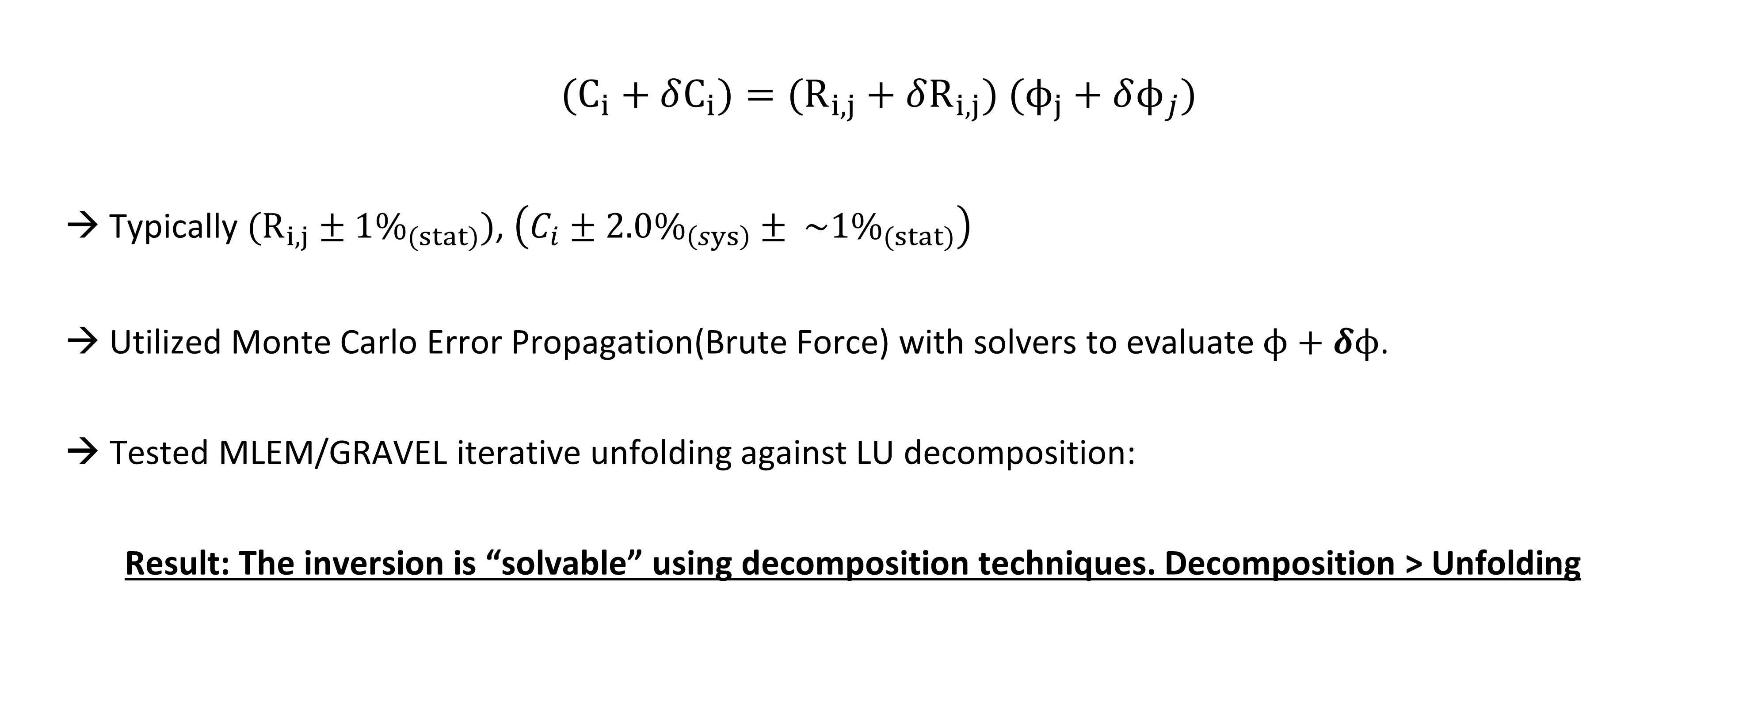
NCD Ambient Flux Inverse Summary(2025):
$$(C_{i}+δC_{i})=(R_{i,j}+δR_{i,j}) (ϕ_{j}+δϕ_{j})$$
→ Typically $(R_{i,j}±1\%_{(stat)})$, $\left(C_{i}±2.0\%_{\left(sys\right)}± \sim 1\%_{(stat)}\right)$
→ Utilized Monte Carlo Error Propagation(Brute Force) with solvers to evaluate$ϕ+δϕ$.
→ Tested MLEM/GRAVEL iterative unfolding against LU decomposition:
Result: The inversion is “solvable” using decomposition techniques. Decomposition > Unfolding
Notes:
To be more specific, the problem is to find the total neutron flux with robust error propagation. I utilized Monte Carlo propagation, meaning I used the given matrices, produced independent samples based on Gaussian perturbation from their standard deviations, then used inverse solvers for each sample independently to propagate the error in flux. Initially I used unfolding algortihms like MLEM(basically same as minuit) and GRAVEL(which is minuit with additional entropy terms for smoother constrained solutions) for unfolding. But I soon learned that the problem was be simplified to using simple decomposition techniques by optimizing moderator geometry and binning. Decomposition techniques are mathematically favorable and are significantly faster(I can do same analysis in 3 second which would take 5 mins with unfolding).

Slide 13
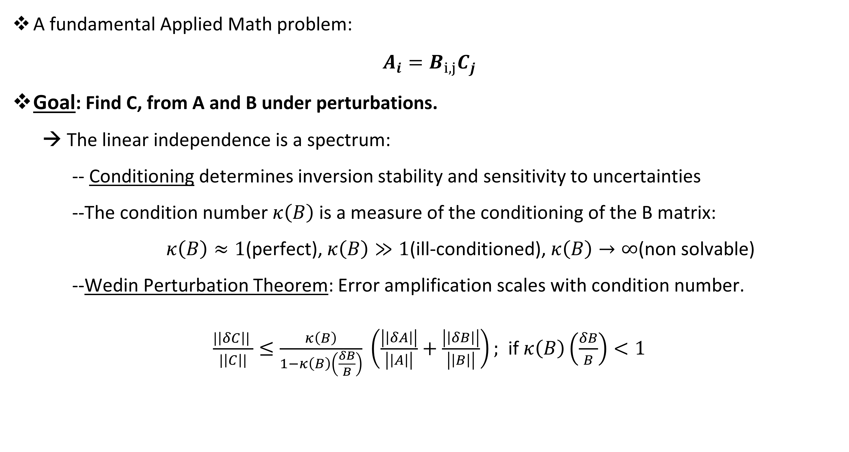
Brief Background from Applied Math:
A fundamental Applied Math problem:
$A_{i}=B_{i,j}C_{j}$
Goal: Find C, from A and B under perturbations.
→ The linear independence is a spectrum:
-- Conditioning determines inversion stability and sensitivity to uncertainties
--The condition number $κ\left(B\right)$is a measure of the conditioning of the B matrix:
$κ\left(B\right)≈1$(perfect), $κ\left(B\right)≫1$(ill-conditioned), $κ\left(B\right)→∞$(non solvable)
--Wedin Perturbation Theorem: Error amplification scales with condition number.
$\frac{|\left|δC\right|| }{|\left|C\right||}≤\frac{κ\left(B\right)}{1−κ\left(B\right)\left(\frac{δB}{B}\right)} \left(\frac{\left|\left|δA\right|\right|}{\left|\left|A\right|\right|}+\frac{\left|\left|δB\right|\right|}{\left|\left|B\right|\right|}\right);$ if $κ\left(B\right)\left(\frac{δB}{B}\right)<1$
Notes:
$κ\left(B\right)=\left|\left|B\right|\right|×\left|\left|B^{−1}\right|\right|=\frac{σ_{max}}{σ_{min}}$,

Slide 14
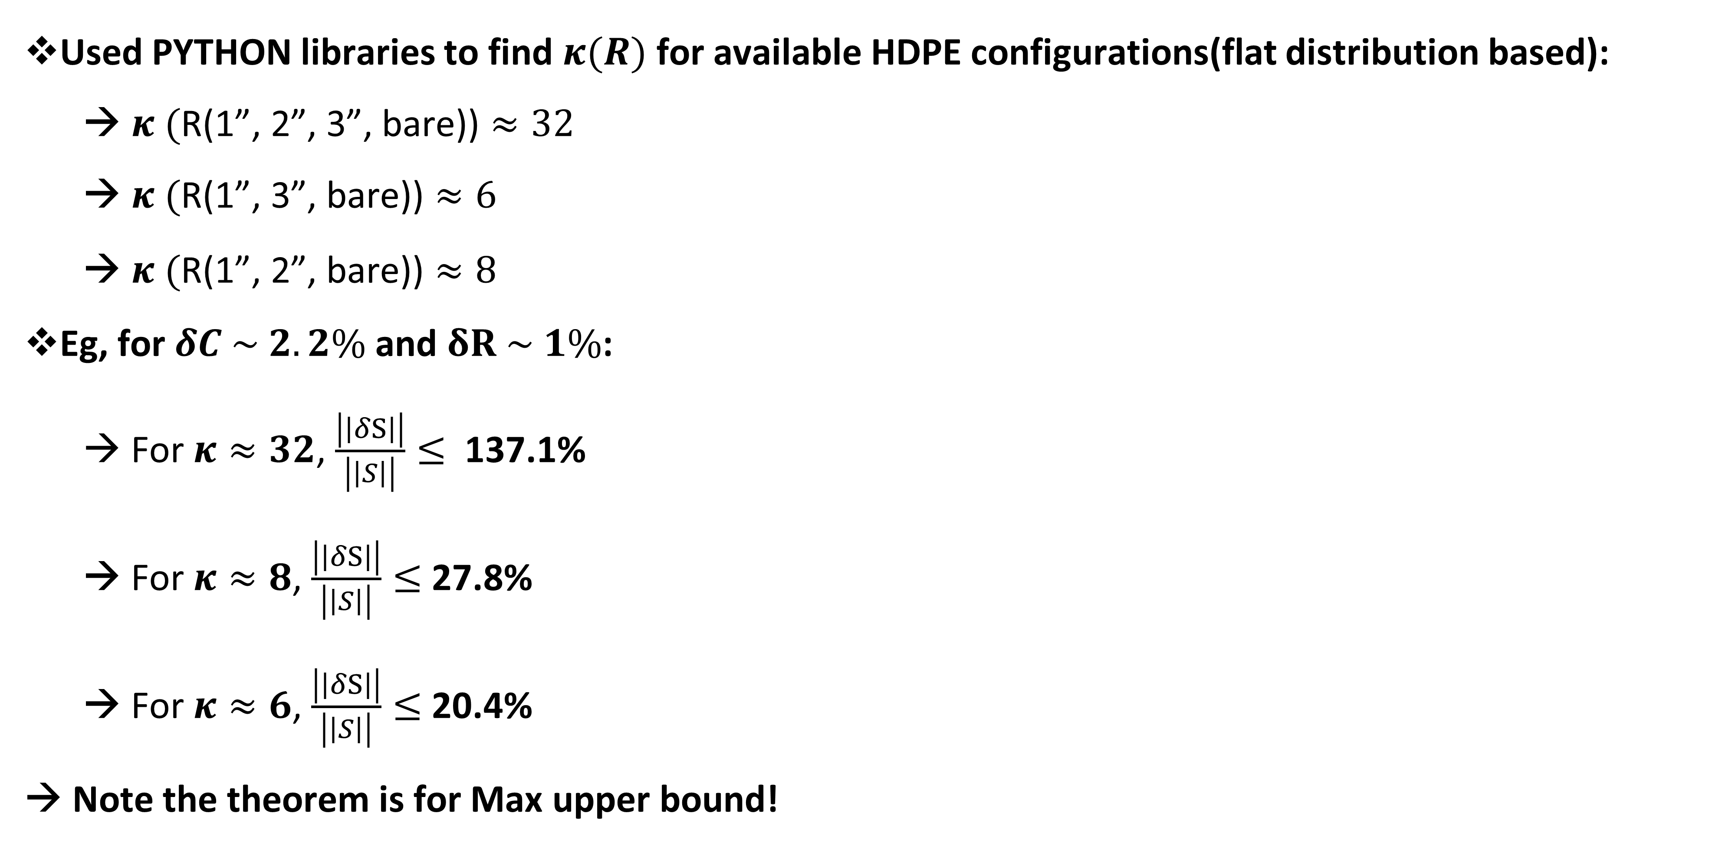
How does SVD help in our inversion:
  Used PYTHON libraries to find $κ(R)$ for available HDPE configurations(flat distribution based):
  → $κ (\text{R}\text{(1”, 2”, 3”, }\text{bare}\text{))}≈32$
  → $κ (\text{R}\text{(1”, 3”, }\text{bare}\text{))}≈\text{6}$
          → $κ (\text{R}\text{(1”, 2”, }\text{bare}\text{))}≈\text{8}$
Eg, for $δC \sim 2.2\%$ and $δR \sim 1\%$:
  → For $κ≈32$, $\frac{\left|\left|δS\right|\right|}{\left|\left|S\right|\right|}≤$ 137.1%
  → For $κ≈8$, $\frac{\left|\left|δS\right|\right|}{\left|\left|S\right|\right|}≤$27.8%
  → For $κ≈6$, $\frac{\left|\left|δS\right|\right|}{\left|\left|S\right|\right|}≤$20.4%
  → Note the theorem is for Max upper bound!
Notes:
Luckily there are several packages to analyse the condition number of matrices. I quickly analyzed matrices of several configurations to finally show that the configuration is very important. In particular we has several polyethylene moderators, but only few sets actually contribute important information to invert to find flux. As example, having 1,2 and 3 HDPE actually results in worse errors than using just 1,2, or 1,3. The difference is massive, the 32 condition number would result in 140% error!, while the other ones have max 20-30%.

Slide 15

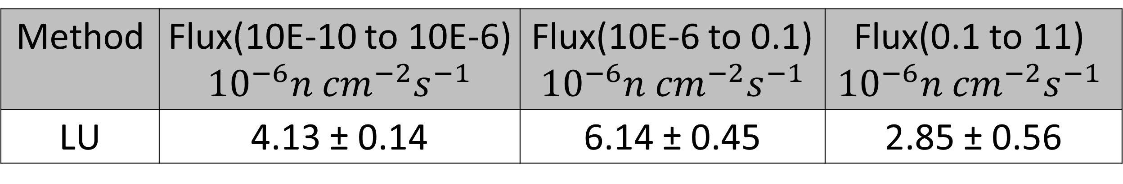
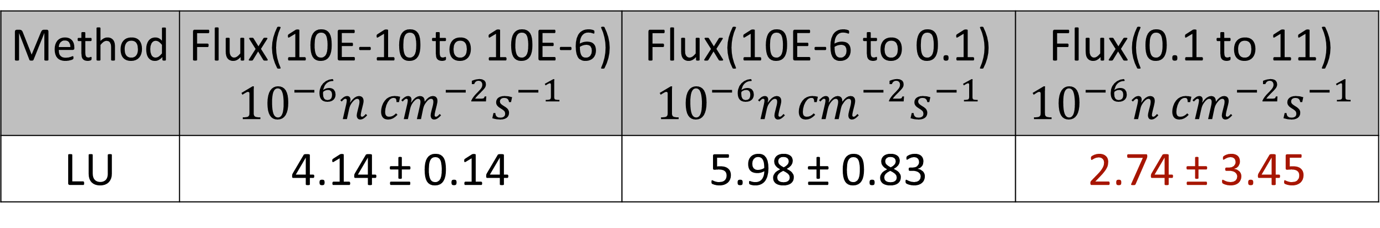
How does SVD help in our inversion:
  Used PYTHON libraries to find $κ(R)$ for available HDPE configurations(flat distribution based):
  → $κ (\text{R}\text{(1”, 2”, 3”, }\text{bare}\text{))}≈32$
  → $κ (\text{R}\text{(1”, 3”, }\text{bare}\text{))}≈\text{6}$
          → $κ (\text{R}\text{(1”, 2”, }\text{bare}\text{))}≈\text{8}$
Eg, for $δC \sim 2.2\%$ and $δR \sim 1\%$:
  → For $κ≈32$, $\frac{\left|\left|δS\right|\right|}{\left|\left|S\right|\right|}≤$ 137.1%
  → For $κ≈8$, $\frac{\left|\left|δS\right|\right|}{\left|\left|S\right|\right|}≤$27.8%
  → For $κ≈6$, $\frac{\left|\left|δS\right|\right|}{\left|\left|S\right|\right|}≤$20.4%
  → Note the theorem is for Max upper bound!
Method | Flux(10E-10 to 10E-6) ${10}^{−6}n {cm}^{−2}s^{−1}$ | Flux(10E-6 to 0.1) $${10}^{−6}n {cm}^{−2}s^{−1}$$ | Flux(0.1 to 11) $${10}^{−6}n {cm}^{−2}s^{−1}$$
LU | 4.14 ± 0.14 | 5.98 ± 0.83 | 2.74 ± 3.45
Method | Flux(10E-10 to 10E-6) ${10}^{−6}n {cm}^{−2}s^{−1}$ | Flux(10E-6 to 0.1) $${10}^{−6}n {cm}^{−2}s^{−1}$$ | Flux(0.1 to 11) $${10}^{−6}n {cm}^{−2}s^{−1}$$
LU | 4.13 ± 0.14 | 6.14 ± 0.45 | 2.85 ± 0.56

Slide 16
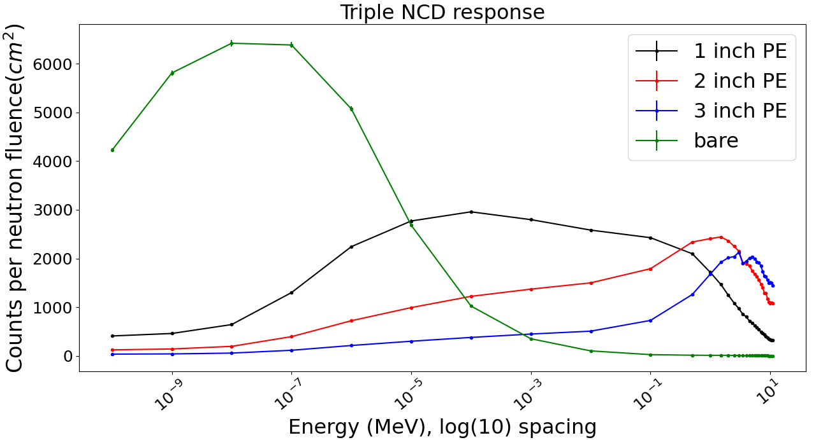
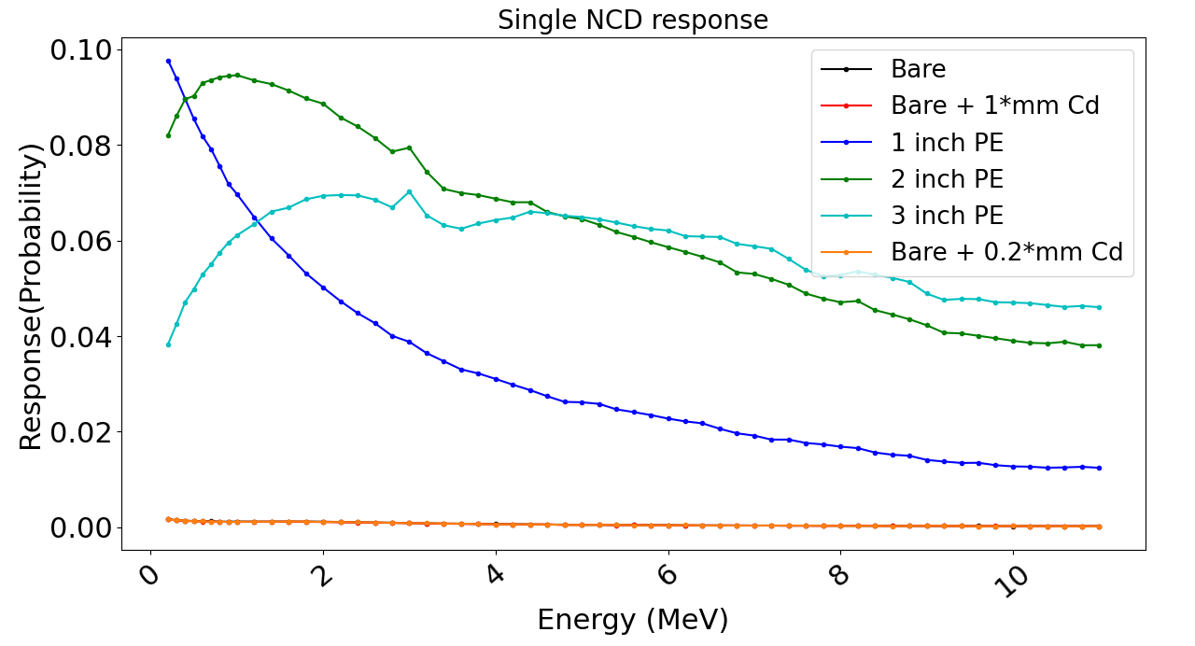
Preliminary / Older Simulations Plots:
Fig: Triple NCD response
Fig: First fast neutron response value plot
→$κ\left(R\right)$ is measure of correlated system:
-- Two variables with same neutron sensitivity are not independent!
Notes:
So, to understand the physics behind the massive errors from applied math, lets take a closer look at the response itself. This plots show the response for configurations over energies. See that the bare and 1” configuration cover the thermal and epithermal, however, the 2” and 3” response are correlated, meaning they kind of have the same information regarding the neutron sensitivity. Two variables in equations with same neutron sensitivity are not independent. That’s why, in particular having the 2 and 3” together exploded the errors.
→Key Takeaway:
-- Moderator thickness optimization remains important.

Slide 17
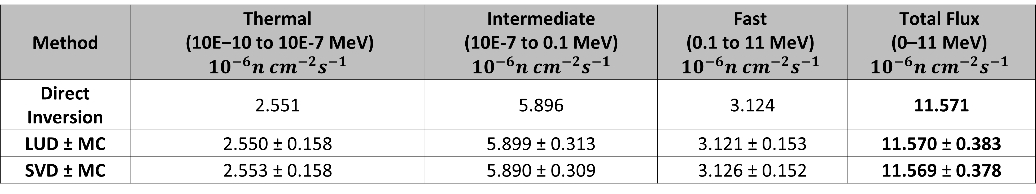
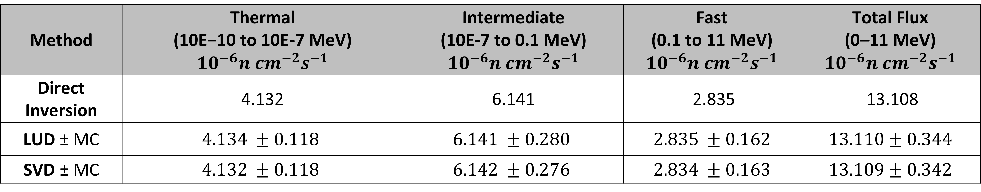
Comparison between two binning techniques:
Table 1: Configuration R6 Analysis (1", 3", Bare | Prior Weight| $κ$: 5.65)
Method | Thermal (10E−10 to 10E-7 MeV) $${10}^{−6}n {cm}^{−2}s^{−1}$$ | Intermediate (10E-7 to 0.1 MeV) $${10}^{−6}n {cm}^{−2}s^{−1}$$ | Fast (0.1 to 11 MeV) $${10}^{−6}n {cm}^{−2}s^{−1}$$ | Total Flux (0–11 MeV) $${10}^{−6}n {cm}^{−2}s^{−1}$$
Direct Inversion | 2.551 | 5.896 | 3.124 | 11.571
LUD ± MC | 2.550 ± 0.158 | 5.899 ± 0.313 | 3.121 ± 0.153 | 11.570 ± 0.383
SVD ± MC | 2.553 ± 0.158 | 5.890 ± 0.309 | 3.126 ± 0.152 | 11.569 ± 0.378
Method | Thermal (10E−10 to 10E-7 MeV) $${10}^{−6}n {cm}^{−2}s^{−1}$$ | Intermediate (10E-7 to 0.1 MeV) $${10}^{−6}n {cm}^{−2}s^{−1}$$ | Fast (0.1 to 11 MeV) $${10}^{−6}n {cm}^{−2}s^{−1}$$ | Total Flux (0–11 MeV) $${10}^{−6}n {cm}^{−2}s^{−1}$$
Direct Inversion | 4.132 | 6.141 | 2.835 | 13.108
LUD ± MC | $$4.134 ±0.118$$ | $$6.141 ±0.280$$ | $$2.835 ±0.162$$ | $$13.110±0.344$$
SVD ± MC | $$4.132 ±0.118$$ | $$6.142 ±0.276$$ | $$2.834 ±0.163$$ | $$13.109±0.342$$
Table 3: Configuration R4 Analysis (1", 3", Bare |Flat Prior| $κ$: 4.66)

Slide 18
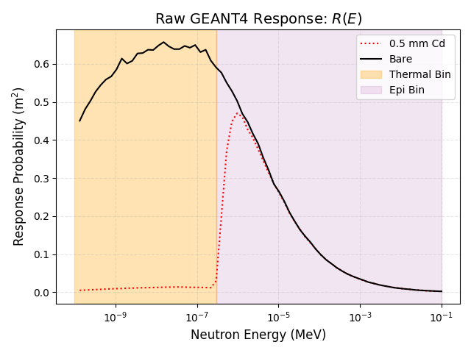
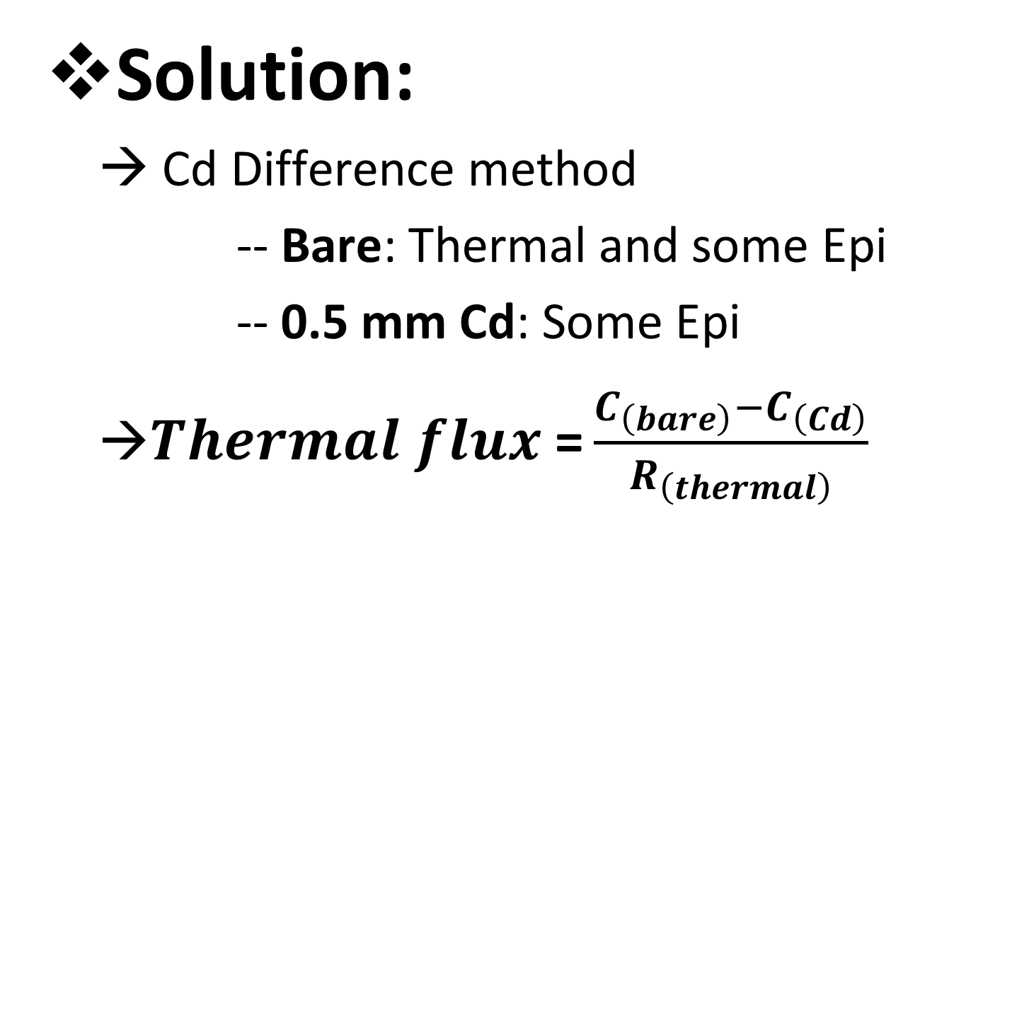
Bare setup has thermal + epithermal contributions
Solution:
→ Cd Difference method
-- Bare: Thermal and some Epi
-- 0.5 mm Cd: Some Epi
→$Thermal flux \text{=}\frac{C_{\left(bare\right)}−C_{\left(Cd\right)}}{R_{\left(thermal\right)}}$
Notes:
I had made assumptions last year that the bare detector has significant epithermal contributions, hindering our ability to measure thermal flux precisely. If we see the response or sensitivity plot of neutrons across energy, the bare setup has declining response over epithermal, but its considerable in the early region. To get more information, Low background team ordered 0.5 mm Cd, which significantly suppresses thermal neutrons relative to bare configuration, and help us get the actual thermal flux

Slide 19
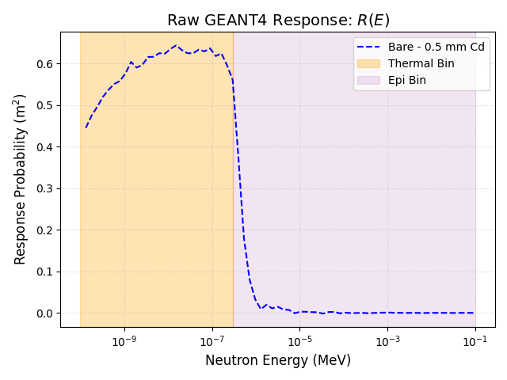
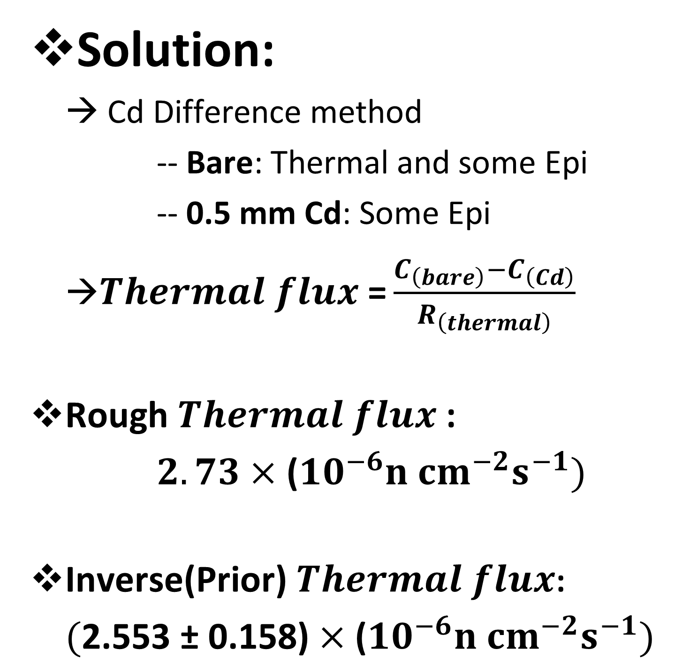
Bare setup has thermal + epithermal contributions
Solution:
→ Cd Difference method
-- Bare: Thermal and some Epi
-- 0.5 mm Cd: Some Epi
→$Thermal flux \text{=}\frac{C_{\left(bare\right)}−C_{\left(Cd\right)}}{R_{\left(thermal\right)}}$
Rough $Thermal flux$:
$2.73×$ (${10}^{−6}n {cm}^{−2}s^{−1})$
Inverse(Prior) $Thermal flux$:
$(\text{2.553} \text{±} \text{0.158}\text{)}×\text{(}{10}^{−6}n {cm}^{−2}s^{−1})$
Notes:
As a reference, we can remove the epithermal contribution using Cd configuration, to get a response like the one shown here, and I roughly calculated thermal flux yesterday, and it a green light for our deconvolution results. I think after I do proper error analysis, it would be within 1 sigma. I believe the thermal flux of inverse results is more accurate.

Slide 20
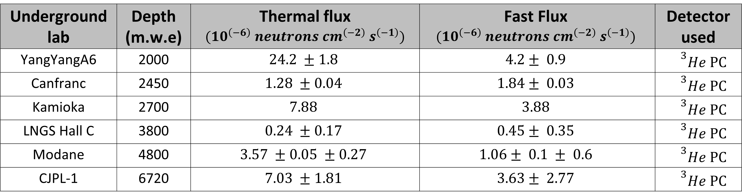
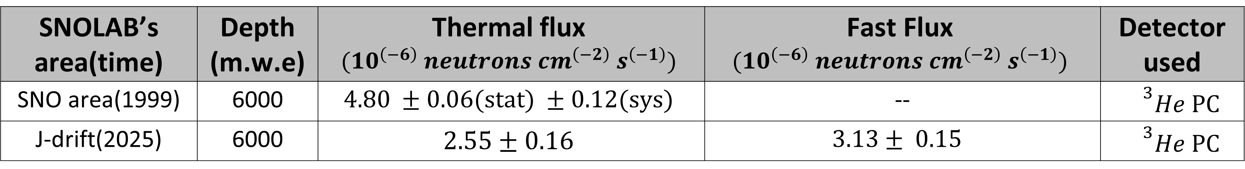
Rough Flux Comparison:
SNOLAB’s area(time) | Depth (m.w.e) | Thermal flux $${(10}^{\left(−6\right)} neutrons cm^{\left(−2\right)} s^{\left(−1\right)})$$ | Fast Flux $${(10}^{\left(−6\right)} neutrons cm^{\left(−2\right)} s^{\left(−1\right)})$$ | Detector used
SNO area(1999) | 6000 | $$4.80 ±0.06(stat) ±0.12(sys)$$ | -- | $${}^{3}He PC$$
J-drift(2025) | 6000 | $$\text{2.55 }\text{±}\text{ 0.1}\text{6}$$ | $$3.13± 0.15$$ | $${}^{3}He PC$$
Underground lab | Depth (m.w.e) | Thermal flux $${(10}^{\left(−6\right)} neutrons cm^{\left(−2\right)} s^{\left(−1\right)})$$ | Fast Flux $${(10}^{\left(−6\right)} neutrons cm^{\left(−2\right)} s^{\left(−1\right)})$$ | Detector used
YangYangA6 | 2000 | $$24.2 ±1.8$$ | $$4.2± 0.9$$ | $${}^{3}He PC$$
Canfranc | 2450 | $$1.28 ±0.04$$ | $$1.84± 0.03$$ | $${}^{3}He PC$$
Kamioka | 2700 | $$7.88$$ | $$3.88$$ | $${}^{3}He PC$$
LNGS Hall C | 3800 | $$0.24 ±0.17$$ | $$0.45± 0.35$$ | $${}^{3}He PC$$
Modane | 4800 | $$3.57 ±0.05 ±0.27$$ | $$1.06± 0.1 ± 0.6$$ | $${}^{3}He PC$$
CJPL-1 | 6720 | $$7.03 ±1.81$$ | $$3.63± 2.77$$ | $${}^{3}He PC$$
Table: Neutron flux for UG labs
(Yoon et al., Astroparticle Physics, 126, 2021)

Slide 21
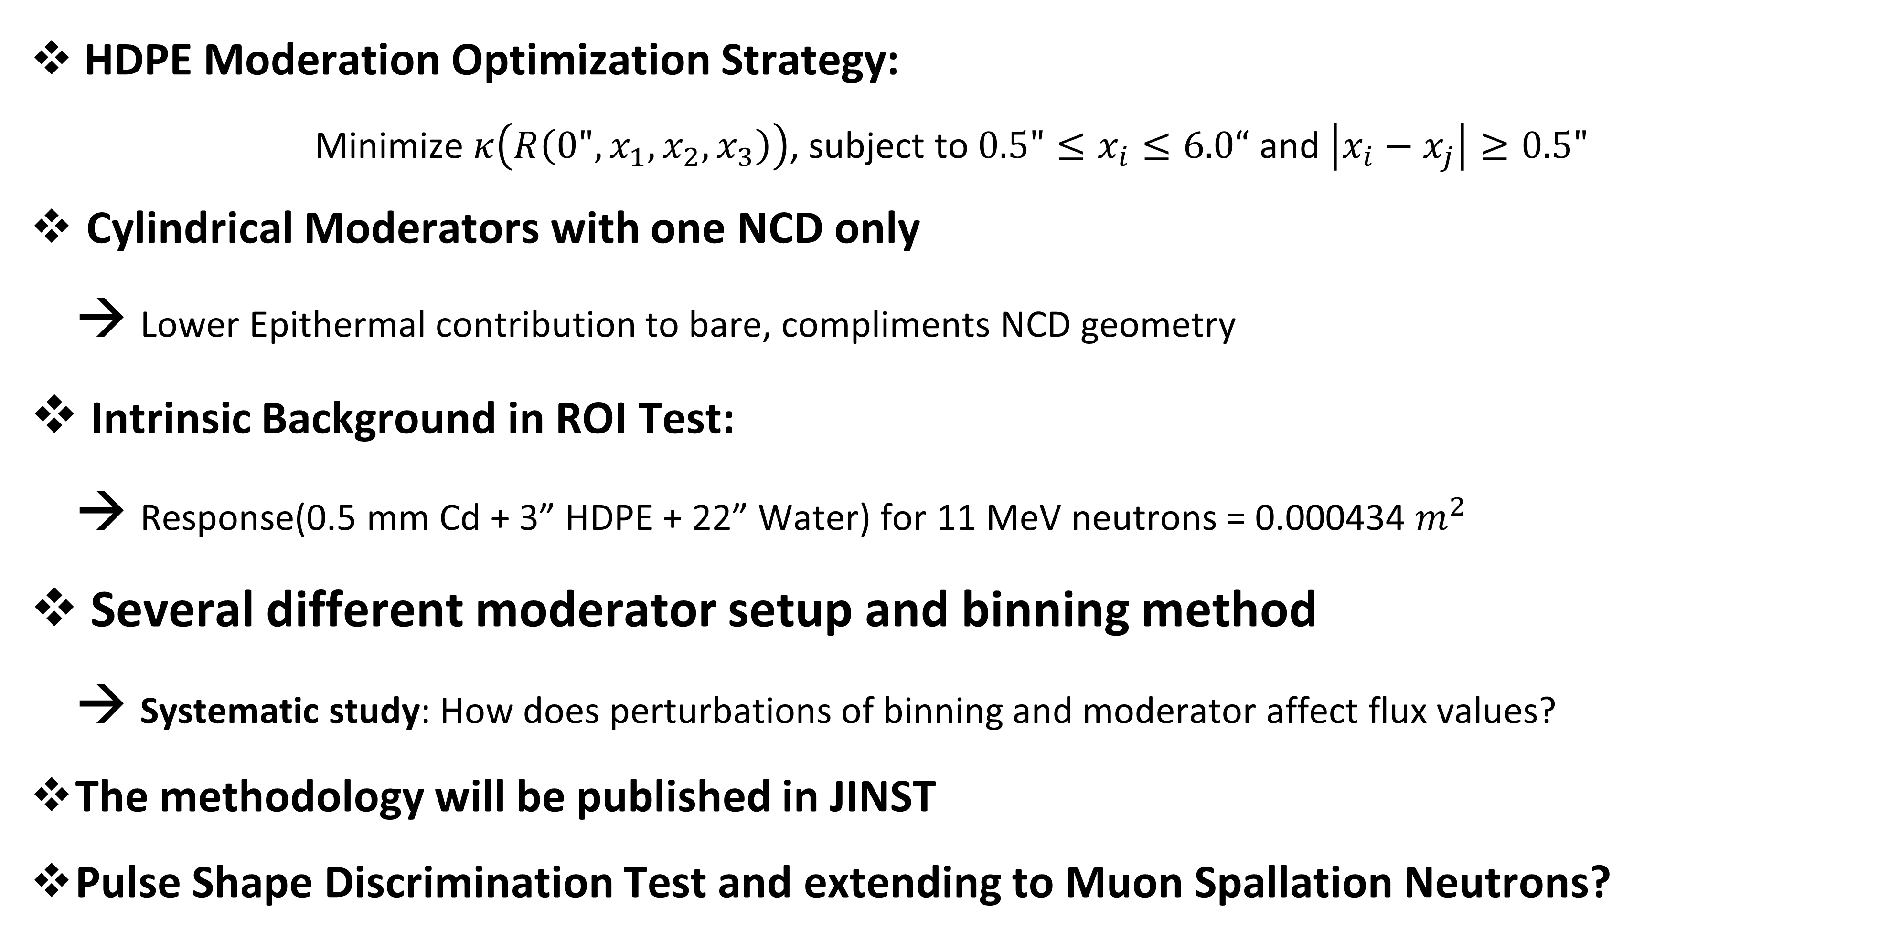
Future Work(Summer 2026):
HDPE Moderation Optimization Strategy:
Minimize $κ\left(R\left(0",x_{1},x_{2},x_{3}\right)\right)$, subject to $0.5"≤x_{i}≤6.0“$ and $\left|x_{i}−x_{j}\right|≥0.5"$
Cylindrical Moderators with one NCD only
→ Lower Epithermal contribution to bare, compliments NCD geometry
Intrinsic Background in ROI Test:
→ Response(0.5 mm Cd + 3” HDPE + 22” Water) for 11 MeV neutrons = 0.000434 $m^{2}$
Several different moderator setup and binning method
→ Systematic study: How does perturbations of binning and moderator affect flux values?
The methodology will be published in JINST
Pulse Shape Discrimination Test and extending to Muon Spallation Neutrons?

Slide 22
Thank you for listening!
Special Thanks to:
→ Thomas Sonley, Ian Lawson, Steffon Luoma, Chris Jillings, Dimpal Chauhan, Matt Stukel, Brianna Liz Binoy, HENSA

Slide 23
Questions?

Slide 24
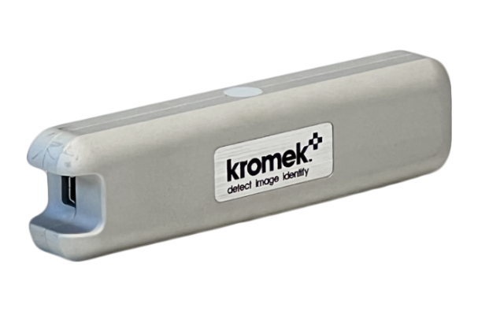
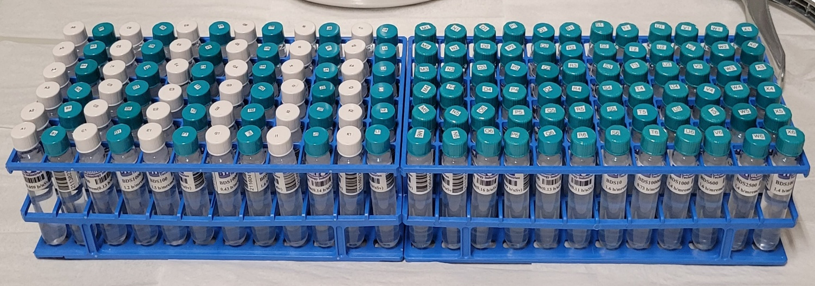
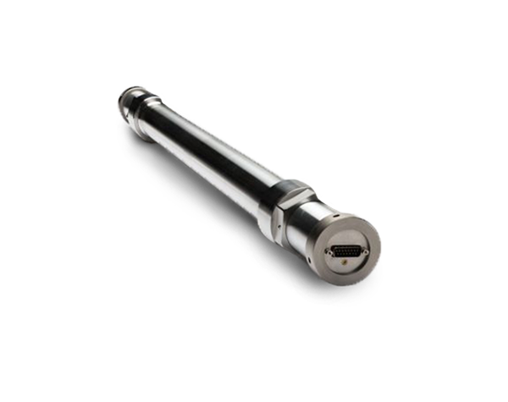
Thermal
Neutron detectors
Epi + Fast
Thermal + Fast
Thermal + Epi + Fast
Notes:
Based on recent developments, there are 4 neutron detectors underground. This other detector is the Arktis S series detector, which uses the ToT analysis He-4 gas scattering from fast neutrons and a Li outer covering for thermal neutron capture. The artis detector project in under Matt Stukel and Brianna. We are hoping that both projects go well and compliment each other to determine neutron flux at SNOLAB.

Slide 25
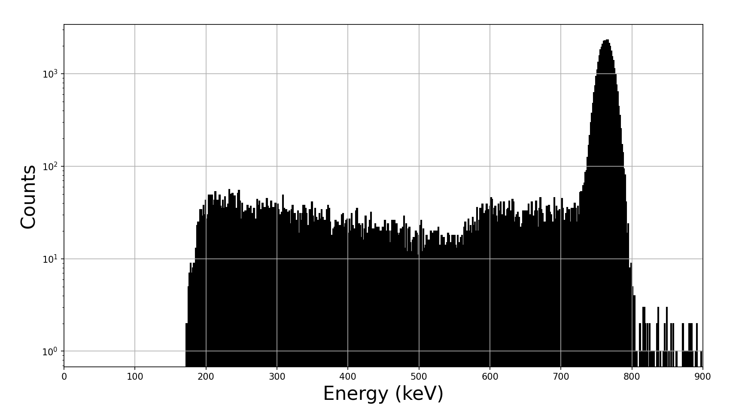
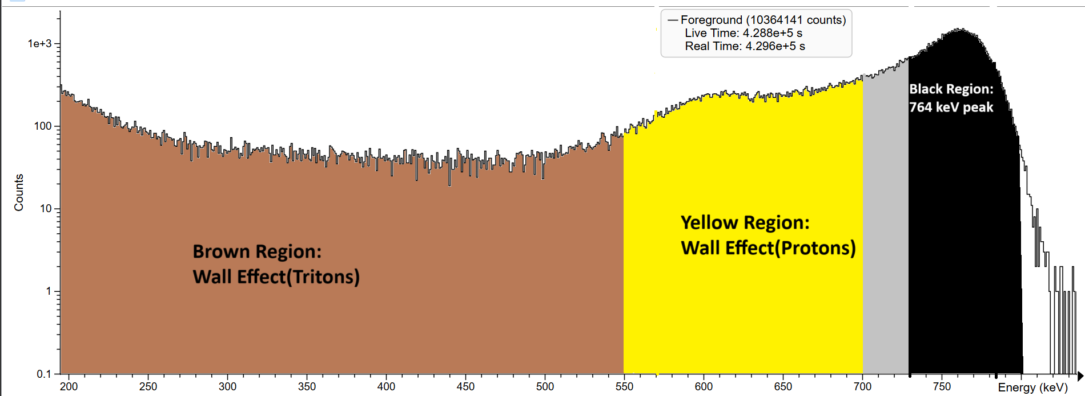
Calculate
“R”
(GEANT4)
Counts
Energy (keV)
Fig: GEANT4’s triton and proton energy deposition per event
with 10 keV gaussian noise
Fig: Experimental Data, 3-inch Polyethylene

Slide 26
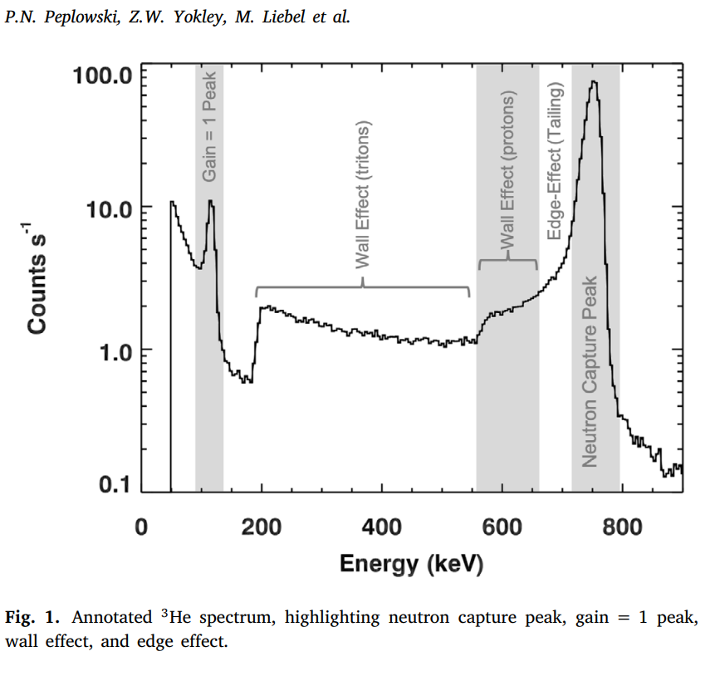
Check simulations validity
Fig: Experimental energy deposition data
(Peplowski et al., NIM A, 982, 164574, 2020)
Fig: GEANT4’s neutron capture energy deposition with 10 keV gaussian noise

Slide 27
Measure “C” for AmBe
(using GEANT4)
Unfolding:
Predicted AmBe counts
“S$"$
Check simulations validity
Calculate “R”
(using GEANT4)
Check results!
GRAVEL algorithm results:
During the test period:
The AmBe source emitted 10 000 000 fast neutrons
The algorithm predicted 9 893 254 fast neutrons, about 99%!
→Takeaway: The Helium-3 counter successfully counts for fast neutrons!

Slide 28
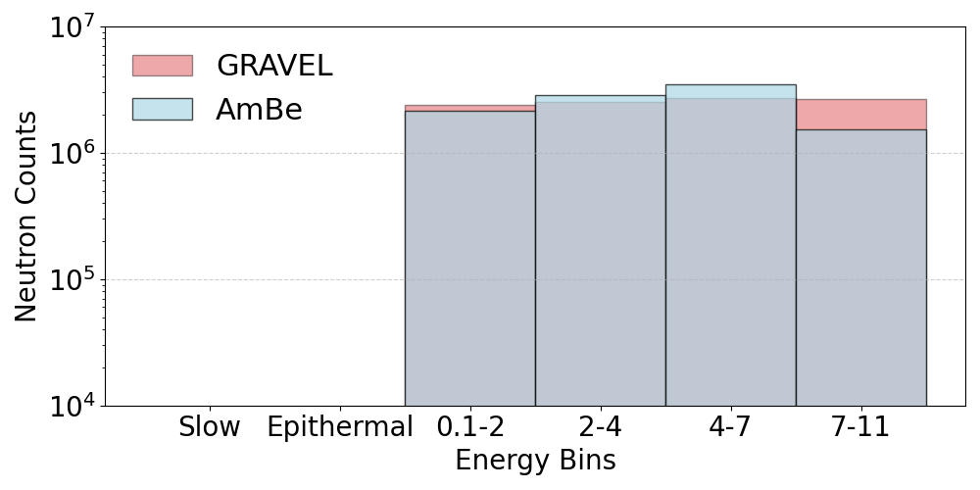
Attempt using simulation and GRAVEL:
Used an AmBe neutron distribution and ran 10 million events
Unfolding for the source gave ~99% accuracy and reasonable initial energies.
Note: This prediction is for the total neutrons released from AmBe source!
Moderation Setup
Bare(No moderation)
1-inch Polyethylene
2-inch Polyethylene
3-inch Polyethylene
4-inch Polyethylene
5-inch Polyethylene
Prediction vs actual AmBe Spectra using GEANT4
Notes:
Next, instead of binning just 29 probabilities energy values into 6 bins, I evaluated response for 68 energy value

Slide 29
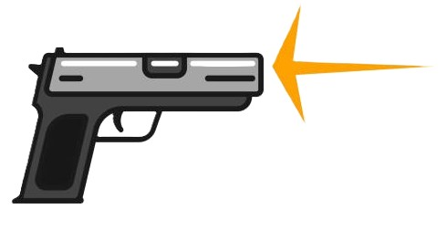
Idea: Moderators

Slide 30
Idea: Moderators
Notes:
Use unfolding along with moderators to detect higher energy neutrons(up to 11 MeV).

Slide 31
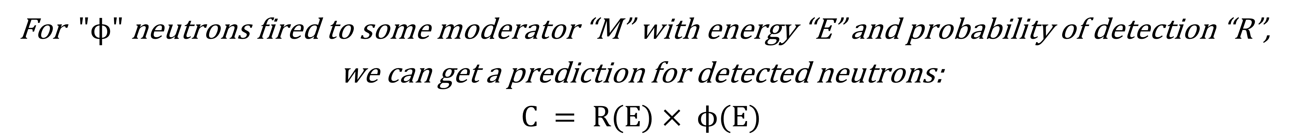
Inference:
For $"ϕ"$ neutrons fired to some moderator “M” with energy “E” and probability of detection “R”,
we can get a prediction for detected neutrons:
$$C = R(E)× ϕ(E)$$
Notes:
Use unfolding along with moderators to detect higher energy neutrons(up to 11 MeV).

Slide 32
Inference:
Notes:
Use unfolding along with moderators to detect higher energy neutrons(up to 11 MeV).

Slide 33
Inference:
Notes:
Use unfolding along with moderators to detect higher energy neutrons(up to 11 MeV).

Slide 34
An Inverse Problem:
Notes:
Use unfolding along with moderators to detect higher energy neutrons(up to 11 MeV).

Slide 35
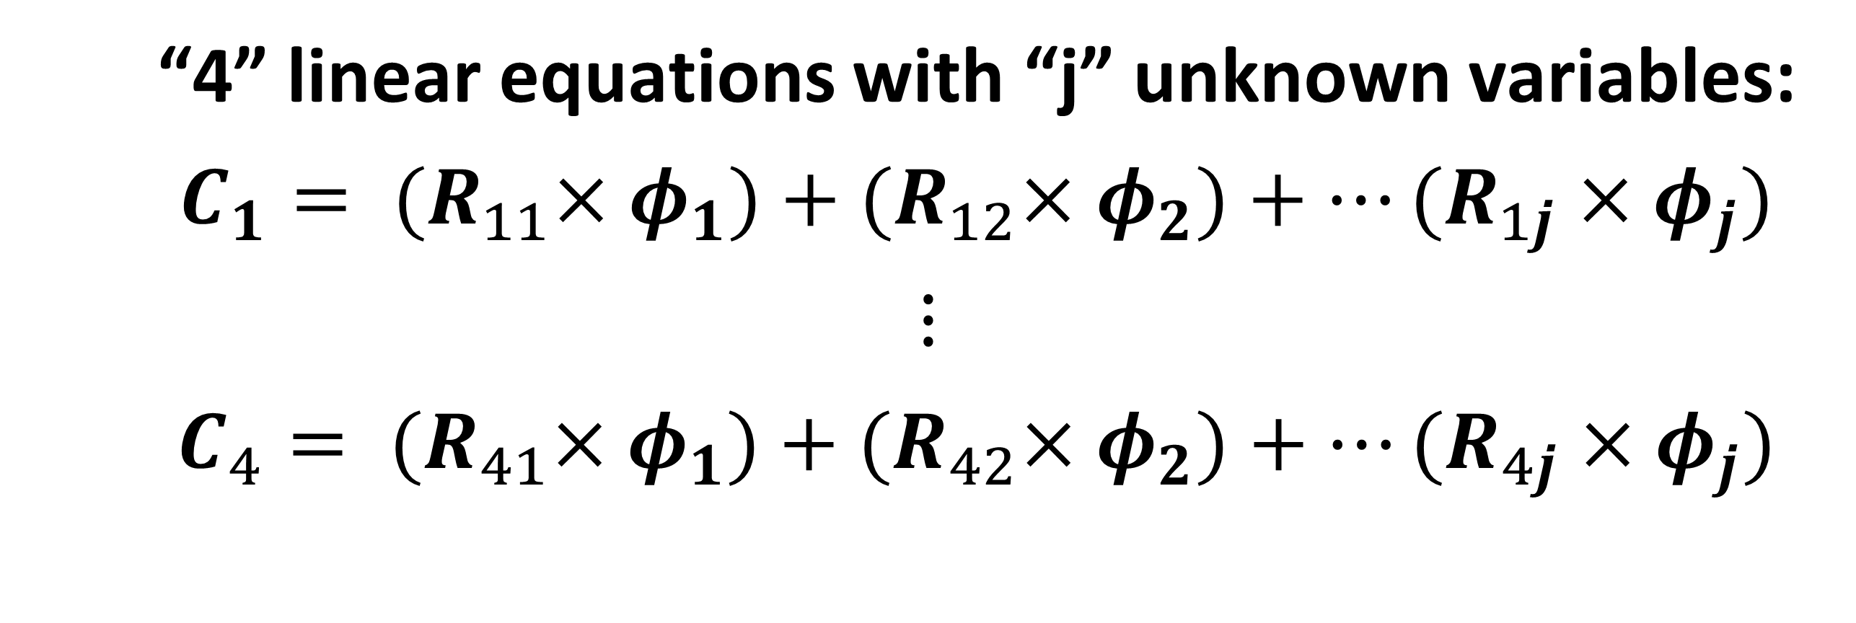
Inverse problem:
Assuming each neutron events are independent from one another, for some moderator setup:
$$C_{i}=R_{ij} ϕ_{j}; where i= moderation bin and j=energy bin$$
“4” linear equations with “j” unknown variables:
$C_{1}= {(R}_{11}×φ_{1})+{(R}_{12}×φ_{2})+…(R_{1j}×φ_{j})$
$$⋮$$
$C_{4}= {(R}_{41}×φ_{1})+{(R}_{42}×φ_{2})+…(R_{4j}×φ_{j})$
Notes:
Use unfolding along with moderators to detect higher energy neutrons(up to 11 MeV).

Slide 36
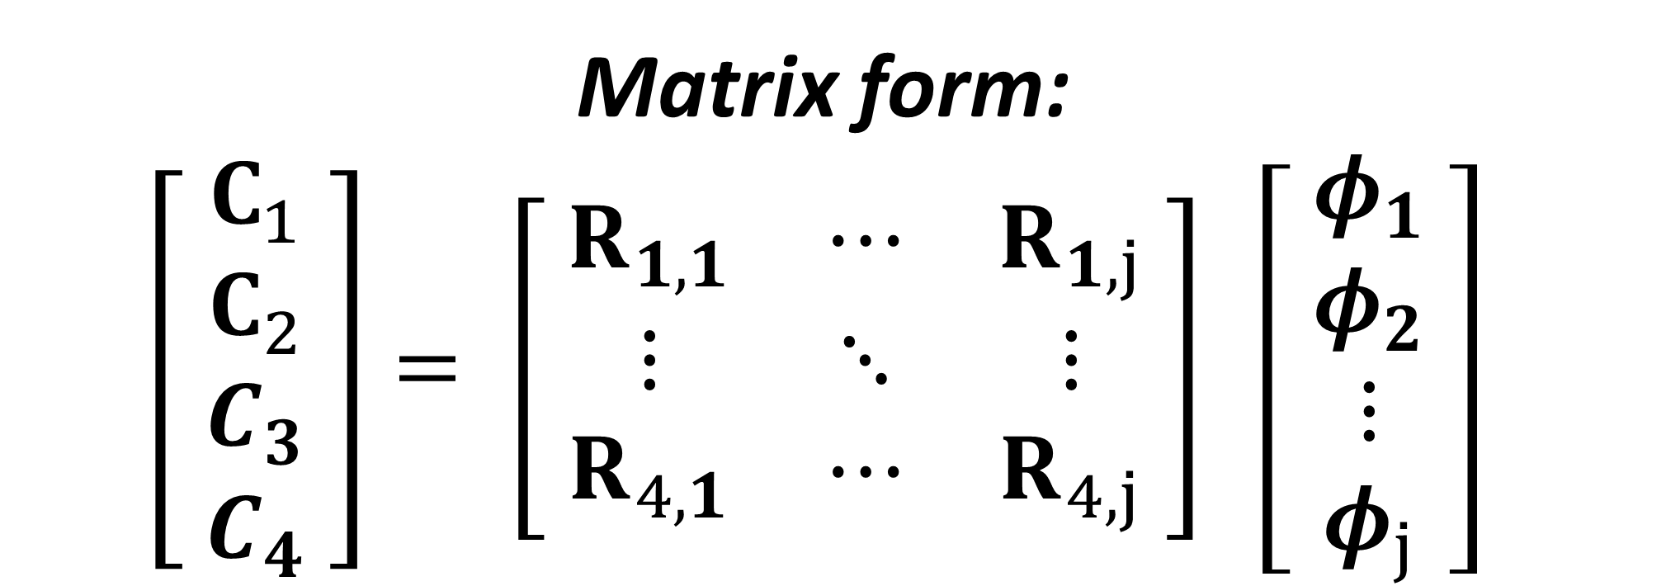
Inverse problem:
Assuming each neutron events are independent from one another, for some moderator setup:
$$C_{i}=R_{ij} ϕ_{j}; where i= moderation bin and j=energy bin$$
Matrix form:
$$\left[ \begin{aligned}C_{1} \\ C_{2} \\ C_{3} \\ C_{4}\end{aligned} \right]= \left[ \begin{matrix}R_{1,1} & ⋯ & R_{1,j} \\ ⋮ & ⋱ & ⋮ \\ R_{4,1} & ⋯ & R_{4,j}\end{matrix} \right] \left[ \begin{aligned}φ_{1} \\ φ_{2} \\ ⋮ \\ φ_{j}\end{aligned} \right]$$
Notes:
Use unfolding along with moderators to detect higher energy neutrons(up to 11 MeV).

Slide 37
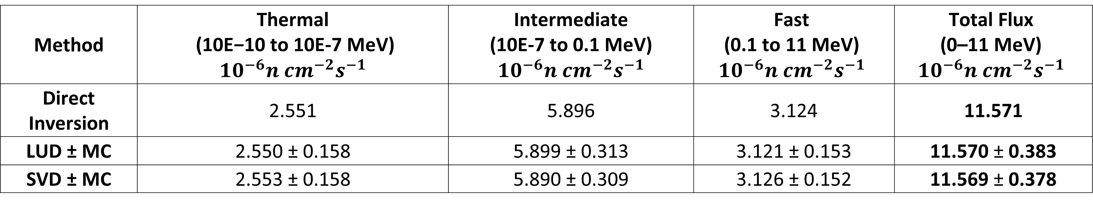
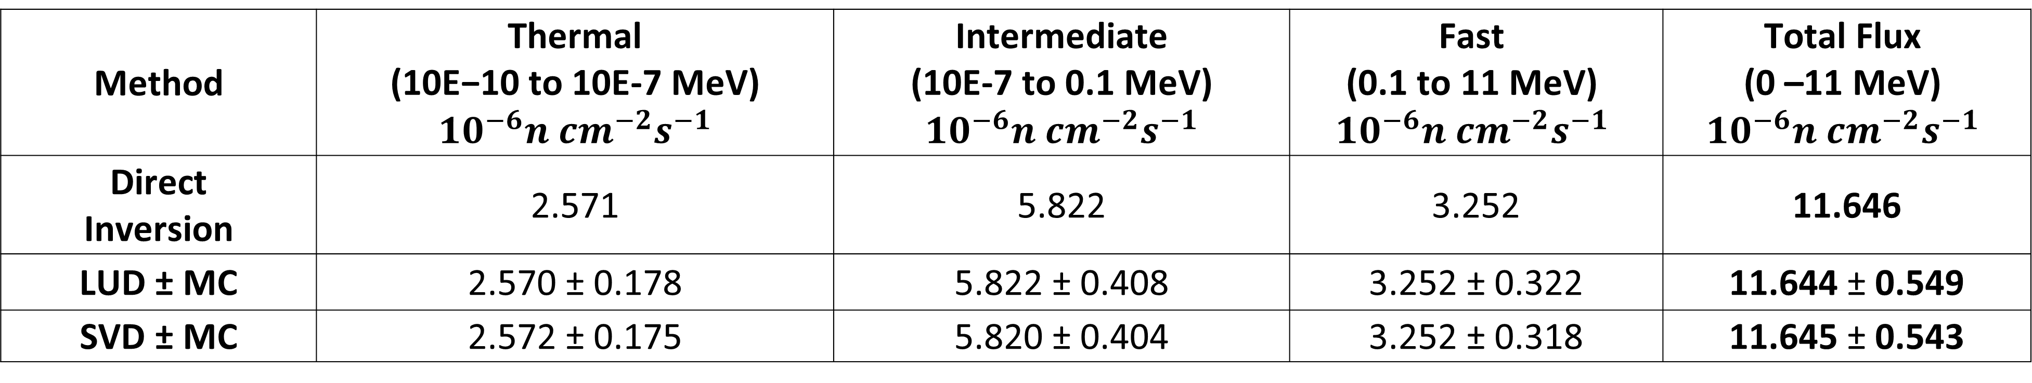
Results:
Table 1: Configuration R6 Analysis (1", 3", Bare | Prior Weight| Condition Number: 5.65)
Method | Thermal (10E−10 to 10E-7 MeV) $${10}^{−6}n {cm}^{−2}s^{−1}$$ | Intermediate (10E-7 to 0.1 MeV) $${10}^{−6}n {cm}^{−2}s^{−1}$$ | Fast (0.1 to 11 MeV) $${10}^{−6}n {cm}^{−2}s^{−1}$$ | Total Flux (0–11 MeV) $${10}^{−6}n {cm}^{−2}s^{−1}$$
Direct Inversion | 2.551 | 5.896 | 3.124 | 11.571
LUD ± MC | 2.550 ± 0.158 | 5.899 ± 0.313 | 3.121 ± 0.153 | 11.570 ± 0.383
SVD ± MC | 2.553 ± 0.158 | 5.890 ± 0.309 | 3.126 ± 0.152 | 11.569 ± 0.378
Method | Thermal (10E−10 to 10E-7 MeV) $${10}^{−6}n {cm}^{−2}s^{−1}$$ | Intermediate (10E-7 to 0.1 MeV) $${10}^{−6}n {cm}^{−2}s^{−1}$$ | Fast (0.1 to 11 MeV) $${10}^{−6}n {cm}^{−2}s^{−1}$$ | Total Flux (0 –11 MeV) $${10}^{−6}n {cm}^{−2}s^{−1}$$
Direct Inversion | 2.571 | 5.822 | 3.252 | 11.646
LUD ± MC | 2.570 ± 0.178 | 5.822 ± 0.408 | 3.252 ± 0.322 | 11.644 ± 0.549
SVD ± MC | 2.572 ± 0.175 | 5.820 ± 0.404 | 3.252 ± 0.318 | 11.645 ± 0.543
Table 2: Configuration R5 Analysis (1", 2", Bare | Prior Weight |Condition Number: 6.71)

Slide 38
Response plot across energies for four moderators:
Fig: Triple NCD response

Slide 39
References:
[1] Piscitelli, F., Mauri, G., Laloni, A. et al. Verification of He-3 proportional counters’ fast neutron sensitivity through a comparison with He-4 detectors. Eur. Phys. J. Plus 135, 577 (2020). https://doi.org/10.1140/epjp/s13360-020-00600-8
[2] Peplowski, P. N., Yokley, Z. W., Liebel, M., Cheng, S., Elphic, R. C., Hoogerheide, S. F., Lawrence, D. J., & Nico, J. S. (2020). Position-dependent neutron detection efficiency loss in 3He gas proportional counters. Nuclear Instruments and Methods in Physics Research Section A, 982, 164574. https://doi.org/10.1016/j.nima.2020.164574
[3] Yoon, Y. S., Kim, J., & Park, H. (2021). Neutron background measurement for rare event search experiments in the YangYang underground laboratory. Astroparticle Physics, 126, 102533. https://doi.org/10.1016/j.astropartphys.2020.102533
[4] Amsbaugh, J. F., Anaya, J. M., Banar, J., Bowles, T. J., Browne, M. C., Bullard, T. V., Burritt, T. H., Cox-Mobrand, G. A., Dai, X., Deng, H., et al. (2007). An array of low-background 3He proportional counters for the Sudbury Neutrino Observatory. Nuclear Instruments and Methods in Physics Research Section A, 579(3), 1054–1080. https://doi.org/10.1016/j.nima.2007.05.321
[5] N. Mont-Geli et.al, https://arxiv.org/html/2511.02333v1
[6] Browne, M. C. (1999). Preparation for deployment of the neutral current detectors (NCDs) for the Sudbury Neutrino Observatory (SNO) (Order No. 9946392). Available from ProQuest Dissertations & Theses Global. (304516243). https://login.librweb.laurentian.ca/login?url=https://www.proquest.com/dissertations-theses/preparation-deployment-neutral-current-detectors/docview/304516243/se-2

