Slide 1
2026/05/26
Communications at SNOLAB
Billy Mekers (he/him)
Chief of Staff

Slide 2
Blaire Flynn
Senior E&O Officer
Mike Whitehouse
Senior PR Officer
Juliette Deloye
E&O Coordinator
Rachel Richardson
E&O Coordinator
TBA
Graphic Design & Communications Coordinator
Communications Group

Slide 3
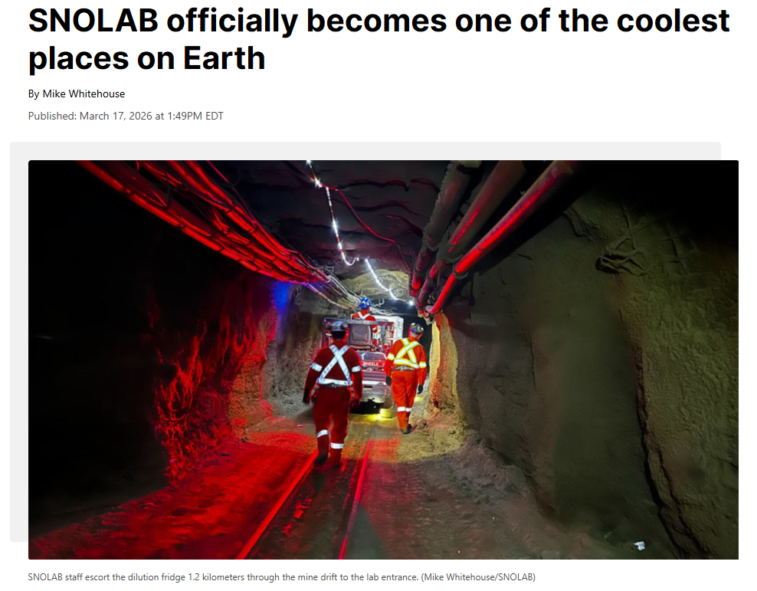
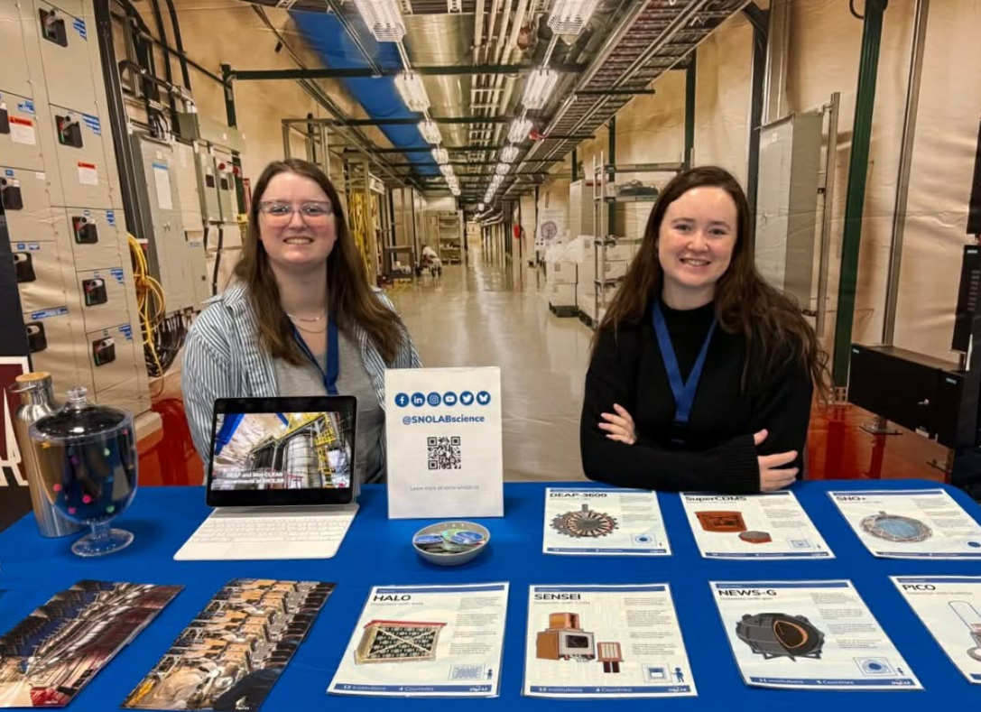
How Do We Support Users?
Amplify the science being done at SNOLAB
  Partner with home institution or collaboration
  Support storytelling
Variety of campaigns and events with opportunities for involvement
Host workshops
Communications SharePoint for guidelines and graphics
“The Underground Times”
Get in Touch! Communications@SNOLAB.ca

Slide 4
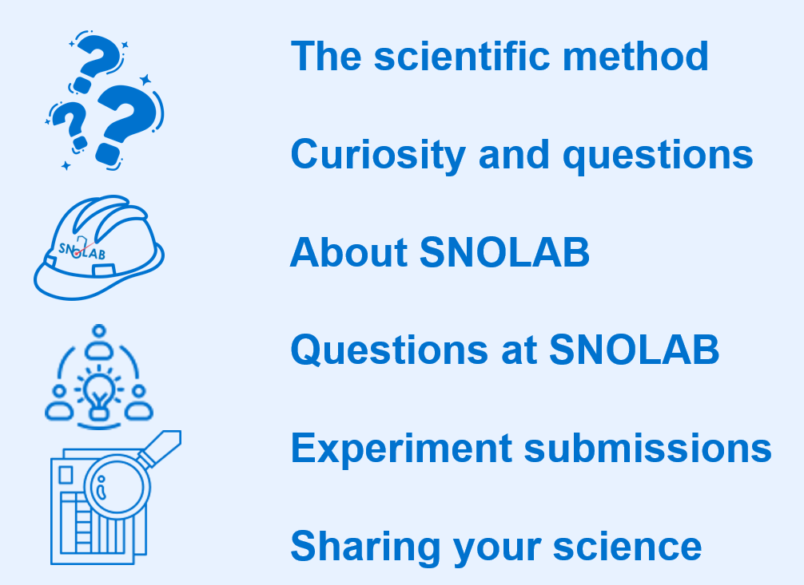
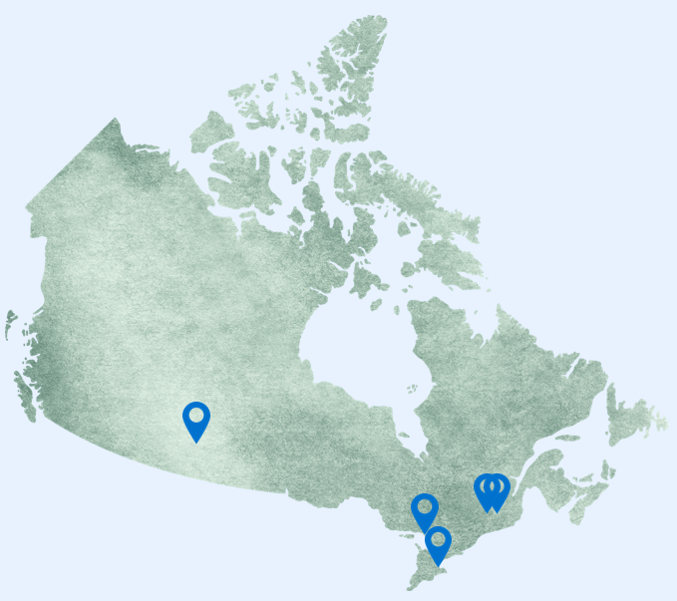
Education & Outreach Spotlight
The SEEDLING Pilot Program

Slide 5
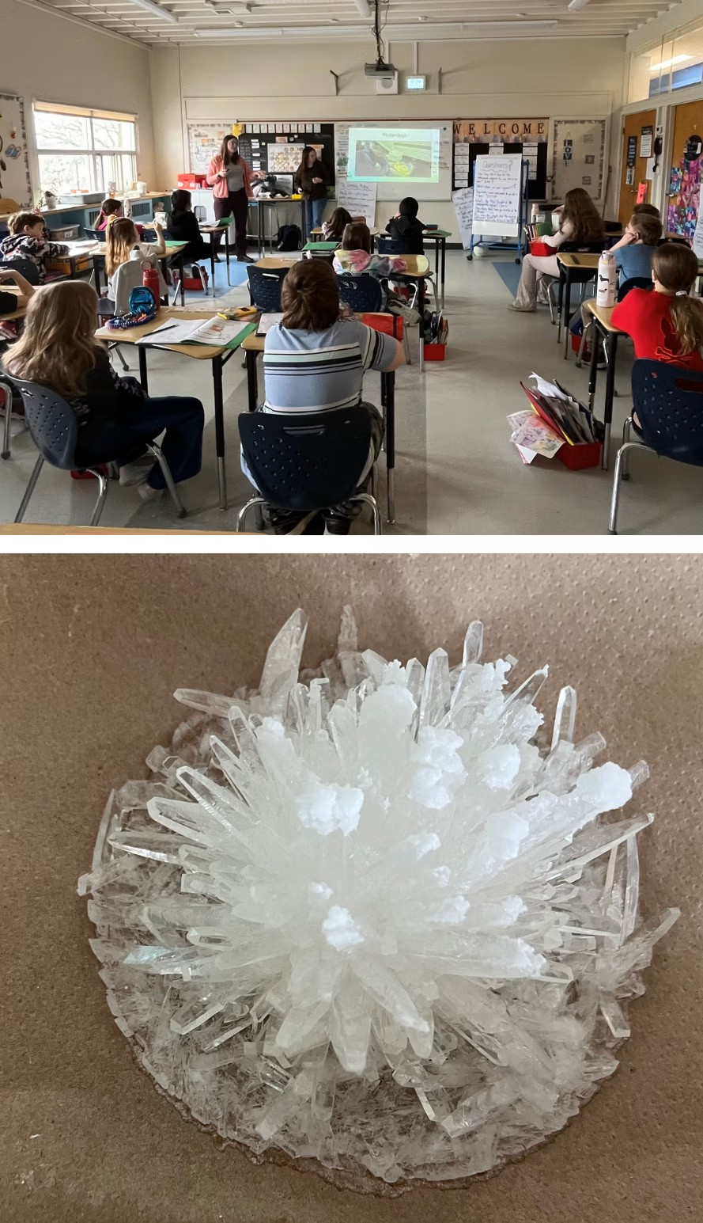
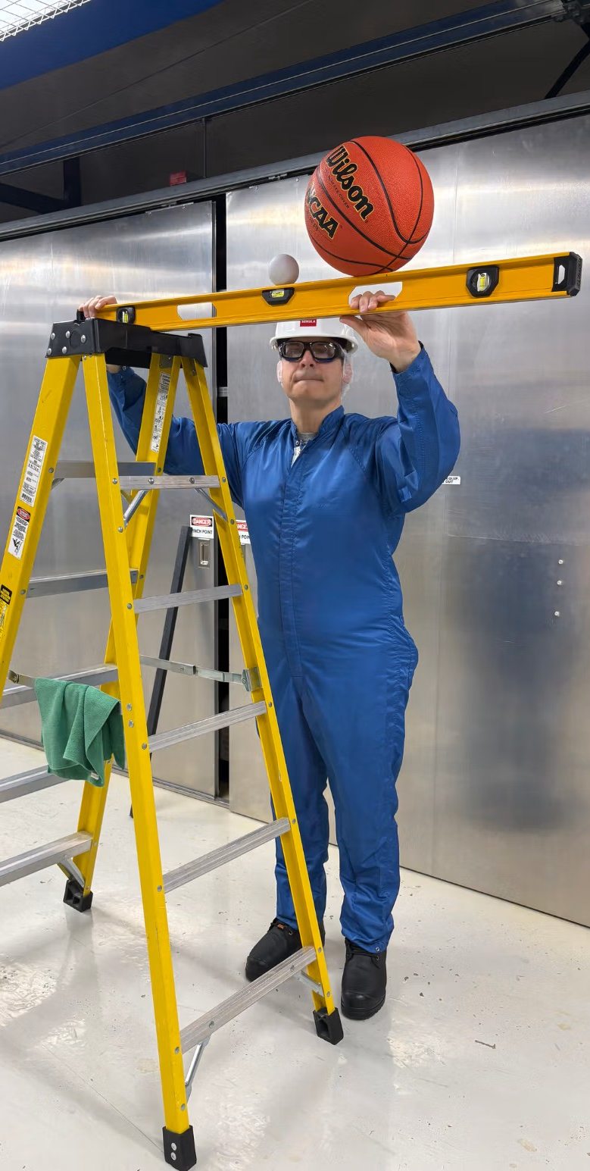
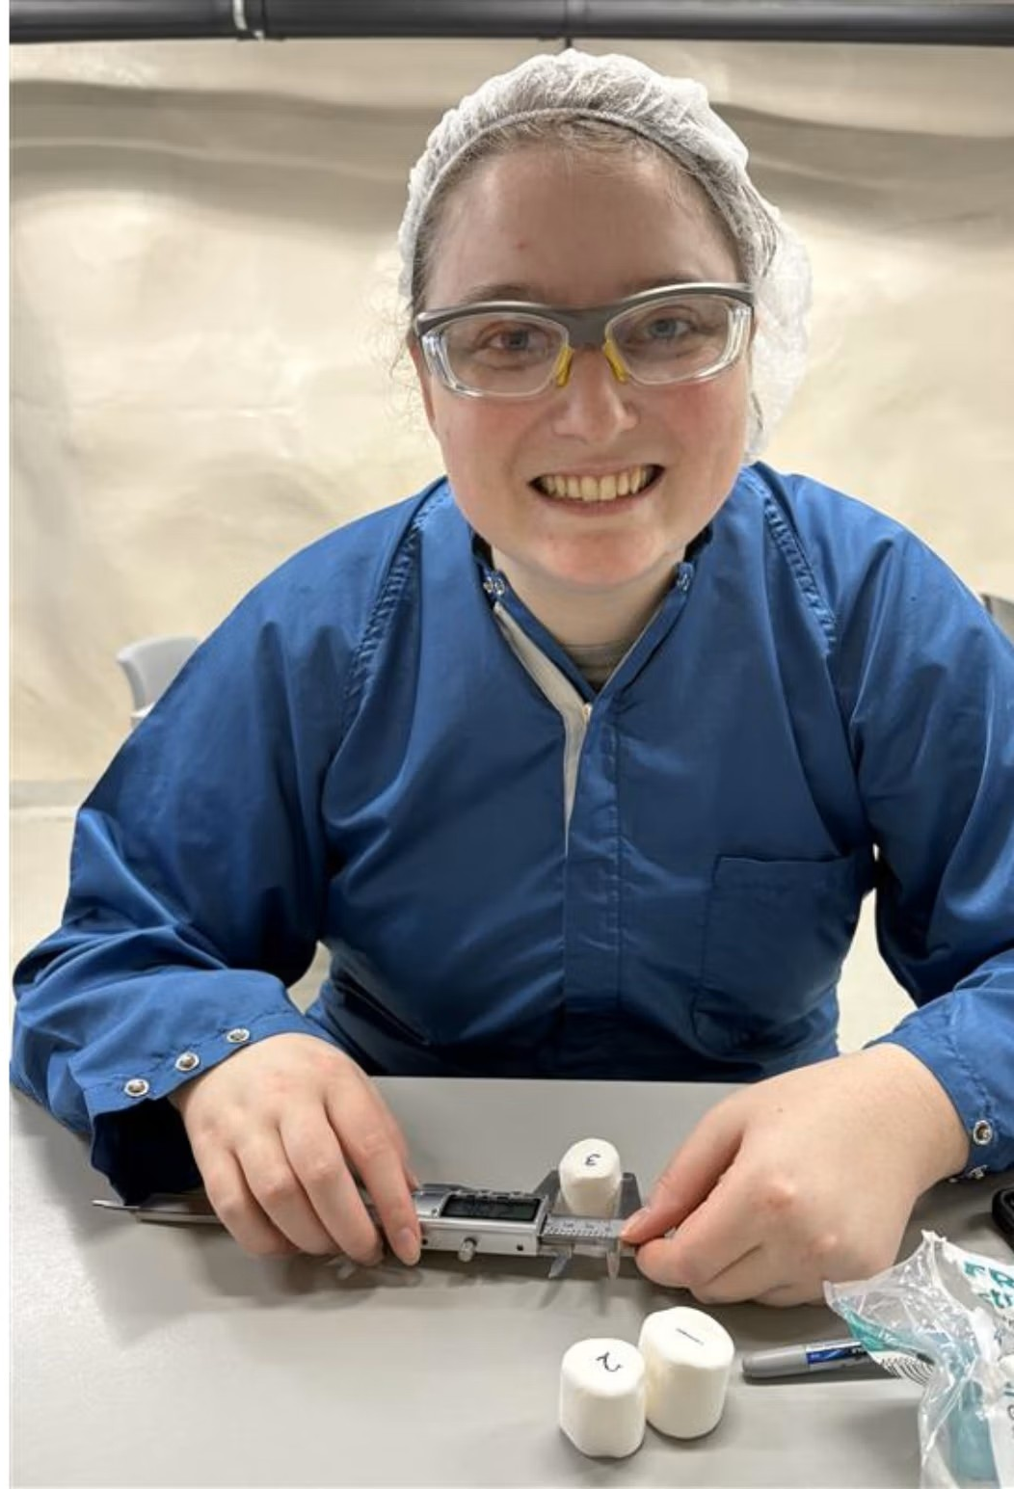

Slide 6

Notes:
Our new name is Wonderground!
We loved this because it was fun and we are helping to bring your questions that students wonder about into our underground lab! We were so excited that we made stickers to share with your teachers for you :)
This is what SEEDLING will be called going forward so you know how to find us if you want to tell your friends!

Slide 7

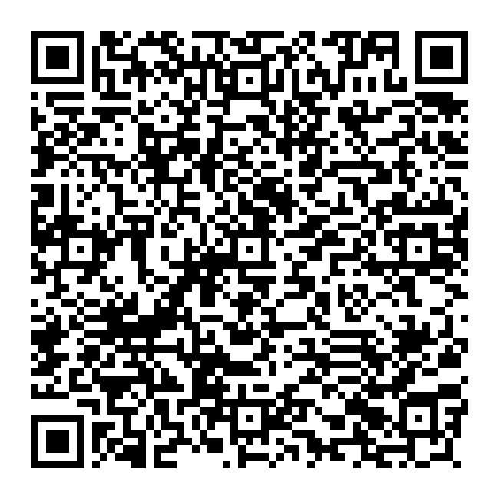
Everbridge Spotlight
Tool to communicate time sensitive information such as site access changes or emergencies
Enhances, does not replace existing tools
Encourage onsite users and supervisors to register
Scan to confirm or have account created

Slide 8

Planned Projects
Streamlining SNOLAB’s SharePoint
Centralizing document access through “DocuSharePoint”
Year 2 of Wonderground

