Slide 1
SNO+ Dark Matter and
Electronics Maintenance
Cody O’Neill
April 17th 2026

Slide 2
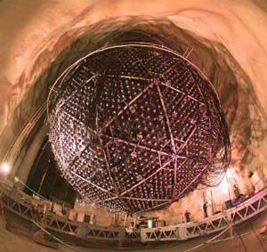
Overview
SNO+ Detector:
Liquid Scintillator Detector
6m radius spherical acrylic vessel
~ 9400 photomultiplier tubes
~ 9m Radius Stainless steel PMT support Structure
Primary goal of detecting 0νββ
Equipment was inherited from SNO
1

Slide 3
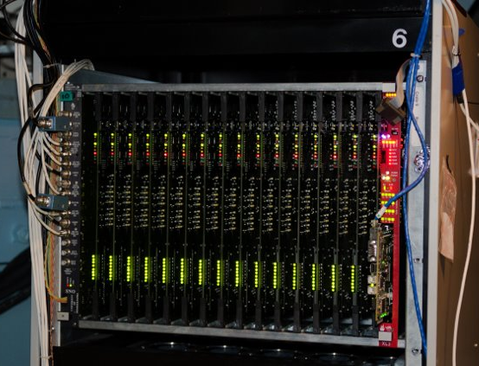
SNO+ Electronics
Inherited Hardware:
8 PMTs per Daughterboard
4 Daughterboards per Front End Card
16 Front End Cards per Crate
19 Crates per one deck
~300 Front End Cards Total
Equipment in use since late 1990s
2

Slide 4
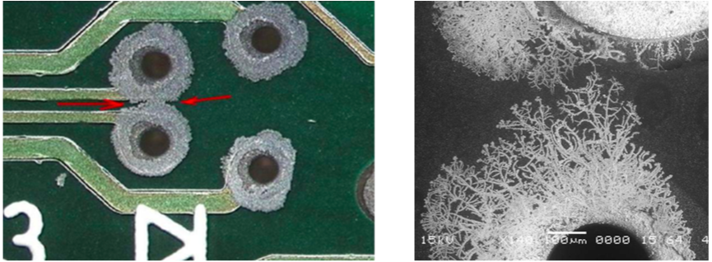
SNO Era “Dark Matter”
“Dark Matter” was first observed during SNO (1999-2006)
Buildup was observed around copper traces and test points
Buildup can bridge or break connections on the boards
Cleaning off the buildup often recovered failing boards
Source: National Instruments (2023).
3

Slide 5
Copper Creep
Hydrogen Sulfide (H₂S) is a byproduct of decomposition and the mining process
Combines with moisture in the air to form sulfuric acid
H₂S_{(g)} + H₂O_{(l)}+ O_{2 (g)} → H₂SO_{4 (aq)}
Which can react with copper to form copper sulfide crystals.
H₂SO_{4 (g)} + Cu_{(s)}→ CuS_{(s)} + H₂O_{(l)}
Source: National Instruments (2023).
4

Slide 6
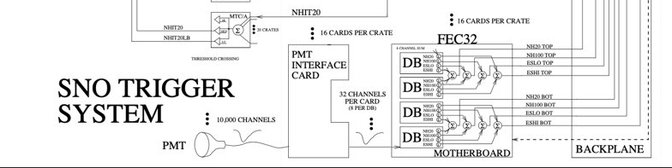
DAQ Hardware
Raw PMT pulses are handled by the Front End Cards and Daughterboards
Daughter Boards: Handles PMT triggers and sums pulse shapes
Front End Cards: Sums pulse shapes into single signal
Signals are then passed downstream for event triggers and summation
5

Slide 7
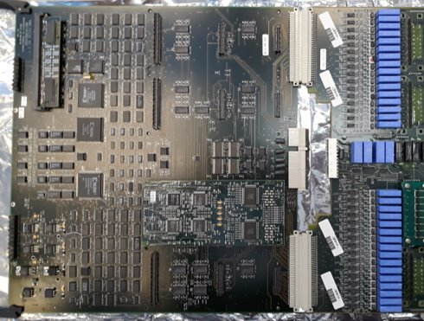
Front End Cards (FECs)
RAM
A failure in any component can result in a loss of all upstream data
Pulling cards affects overall data quality
Boards are extremely complex and dense
Bridged and broken connections can therefore be difficult to diagnose
These do something too
Discriminators set PMT trigger thresholds
Integrators sum signals
Daughterboards
Relays producing low voltage signal

Slide 8
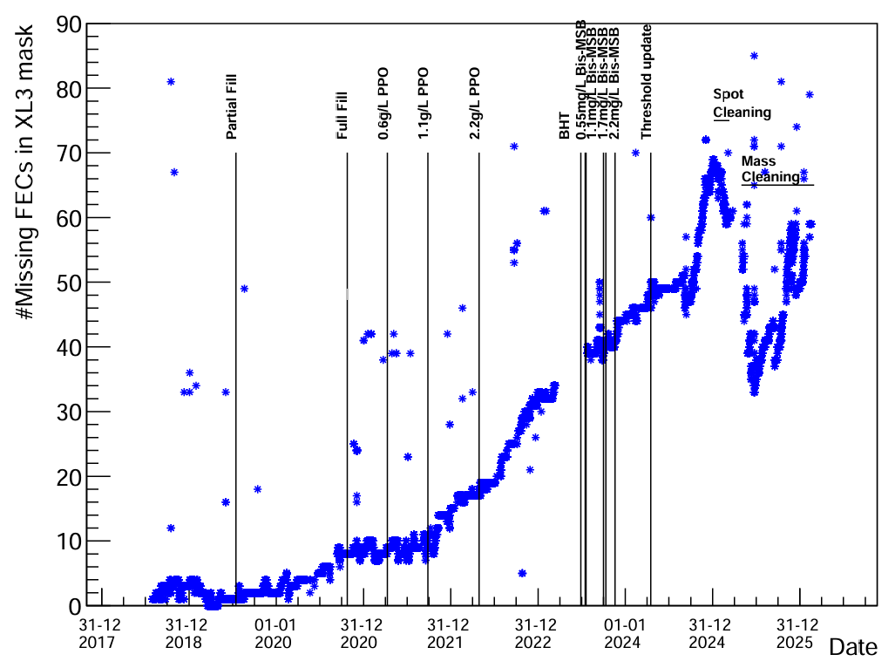
Front End Card Failures
All hardware was cleaned when inherited for SNO+
However FEC failures have accumulated over time
These are accompanied by the buildup of Copper Creep on the board.
How can this be improved?
7

Slide 9
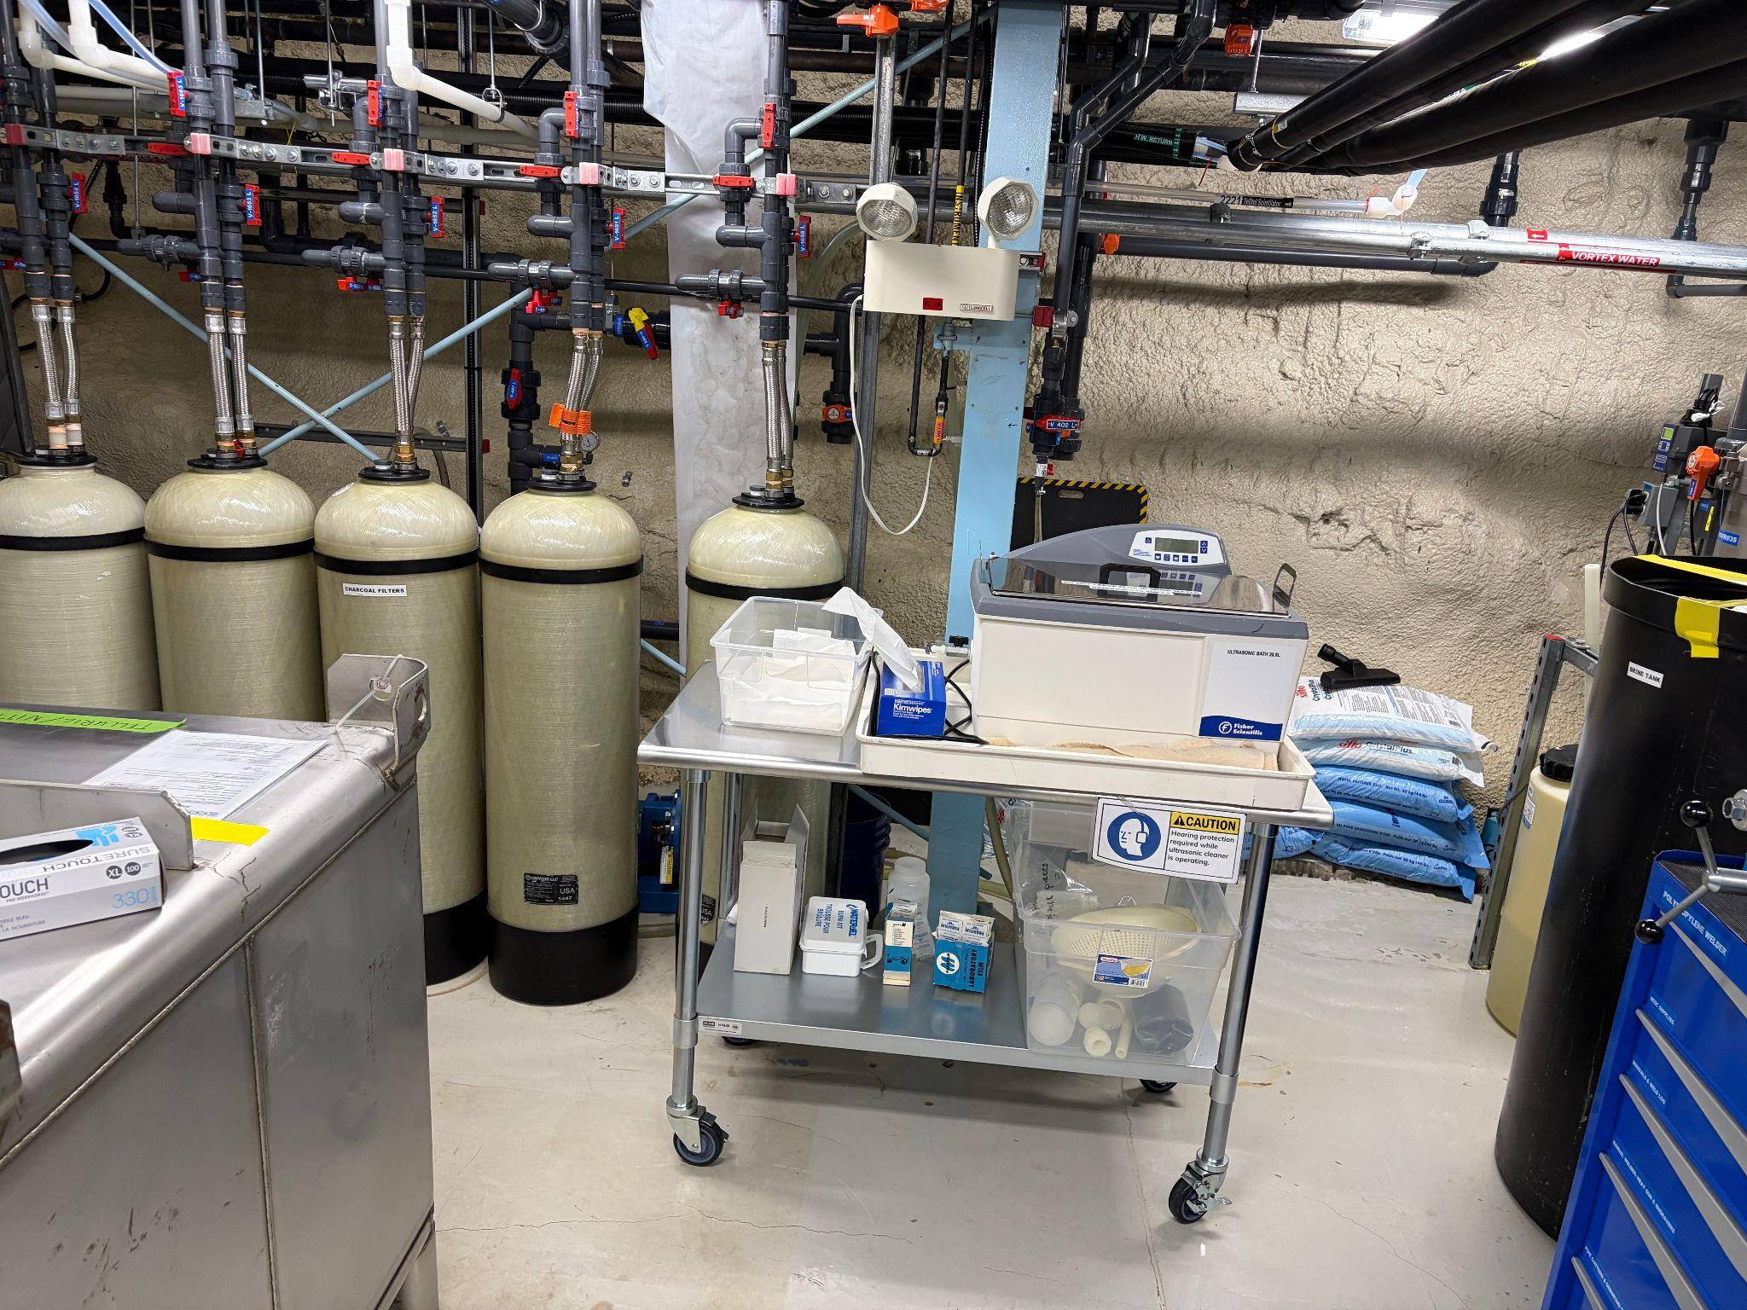
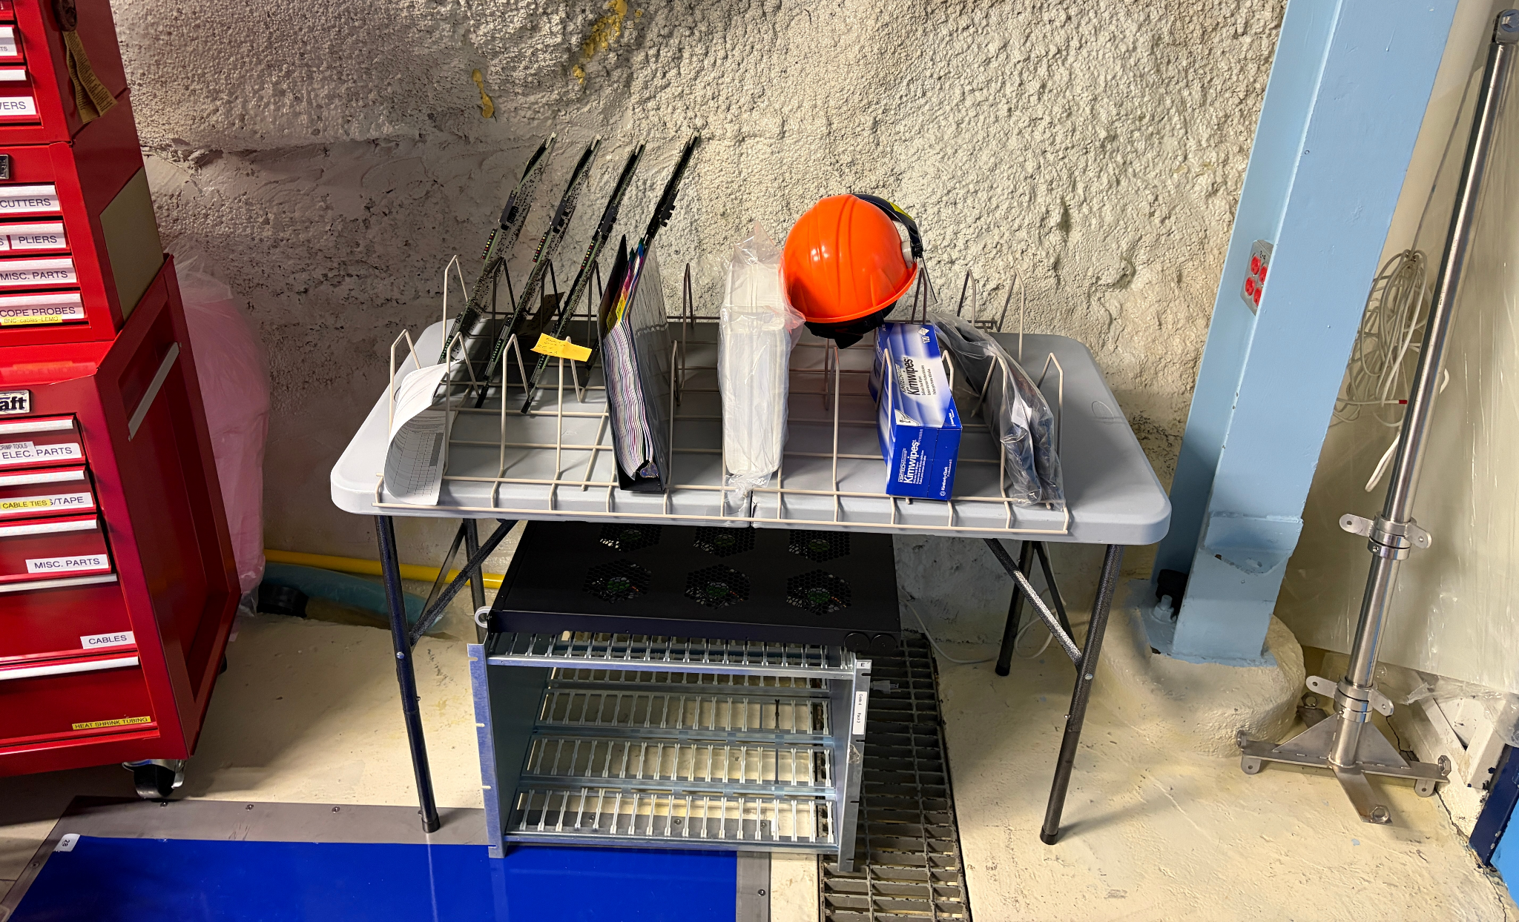
Prevention and Remediation
Activated Charcoal filters were installed on the air handler units to reduce sulfur content in the air
One crate of FECs received conformal coating to test its efficacy in preventing buildup
A test batch of boards were ultrasonically cleaned at Laurentian prior to underground work
8

Slide 10
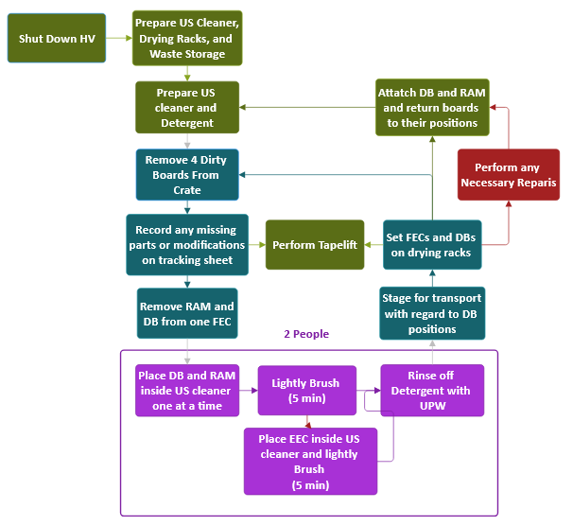
Underground FEC Cleaning
A procedure was developed for cleaning the boards underground
A full crate of 16 front end cards were cleaned and are currently drying
Tapelift samples are being taken throughout the process to assess the state of copper creep buildup on a given board
9

Slide 11
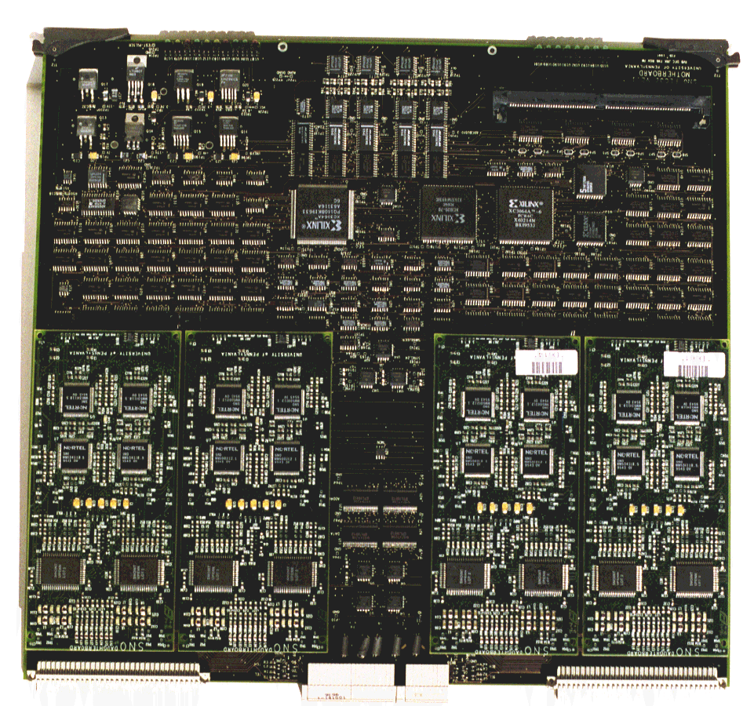
Tapelifts
Samples were taken in various patterns across a selection of front end cards using strips of scotch tape
Comparing samples taken from different positions and boards can give insight into trends across:
Board positions
Crate positions
Deck positions
Tapelift Pattern for Crate 0 Board 0 FEC 0
10

Slide 12
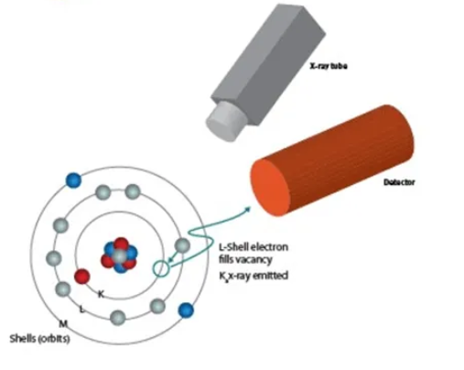
X-Ray Fluorescence
Tapelift Samples are analyzed through X-Ray Fluorescence
An XRF machine uses incident X-Rays to eject inner shell electrons from a sample
As outer shell electrons fill the vacancies they produce X-rays characteristic of the element
11

Slide 13
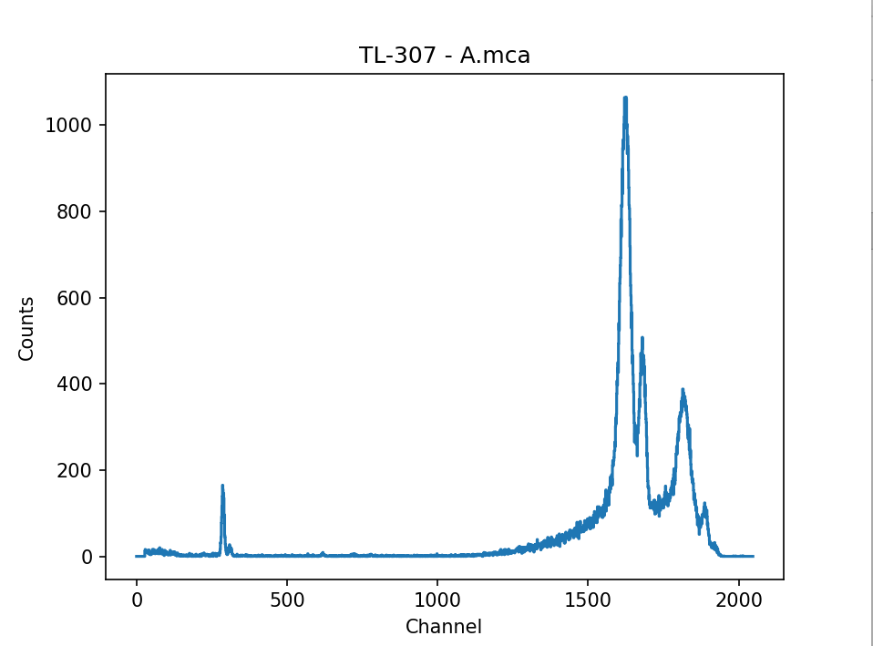
Blank Tapelift
High E continuum from Bremsstrahlung and Generator X-Rays
Smeared low Z elements like carbon
Background Peak from detector Materials
12

Slide 14
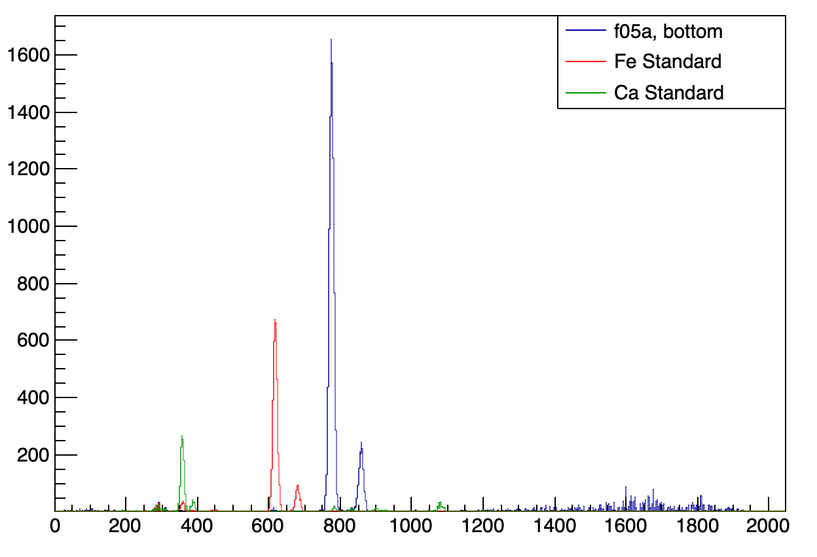
XRF Analysis
Subtracting a Blank Slide from the spectra we see clear defined peaks for a given element
The response of the SNOLAB XRF is well understood for a variety of elements
Using the tables provided by Scientific Support we can identify the peak as Copper
Cu peak
Secondary Cu Peak (other de-exitation modes)
13

Slide 15
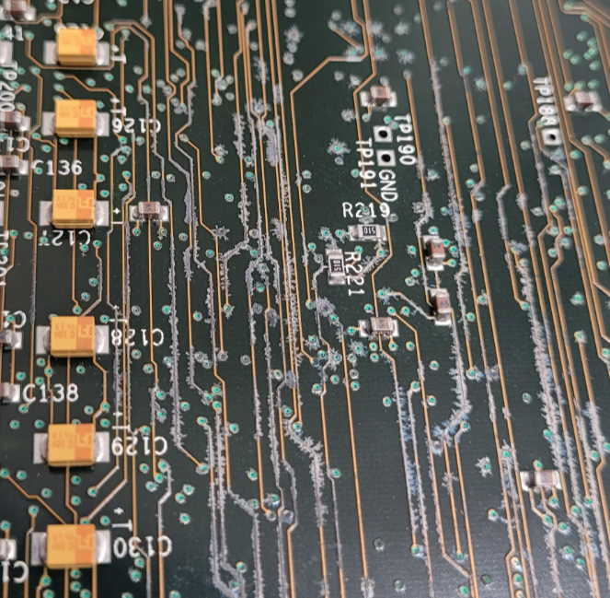
Conclusions
9
Managing Copper creep is crucial to the operations of all underground utilities
Cleaning is an effective way to restore FECs that fail due to Copper Creep
XRF Sampling can give a good measure of the degree of erosion on a given board
14

Slide 16
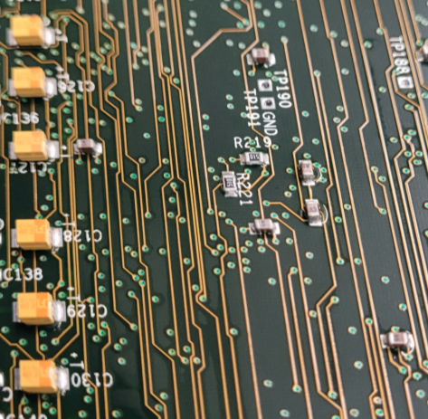
Next Steps (Summer 2026)
9
Each of the Cards will be cleaned and dried before being returned to the detector
Samples will be collected throughout to assess the boards’ status
This work will be done in tandem with the downtime for cavity entry
Cleaned boards that continue to fail can be assessed for repairs after the campaign
15

Slide 17
Questions?
Special thanks to Supervisor Christine Kraus, Scientific Support, and the SNO+ team

