Slide 1
2026/04/17
QUTEbits: Superconducting qubits @ CUTE
Peter Qin (He/Him)
QUTEBits student

Slide 2
QUTEBits introduction

Slide 3
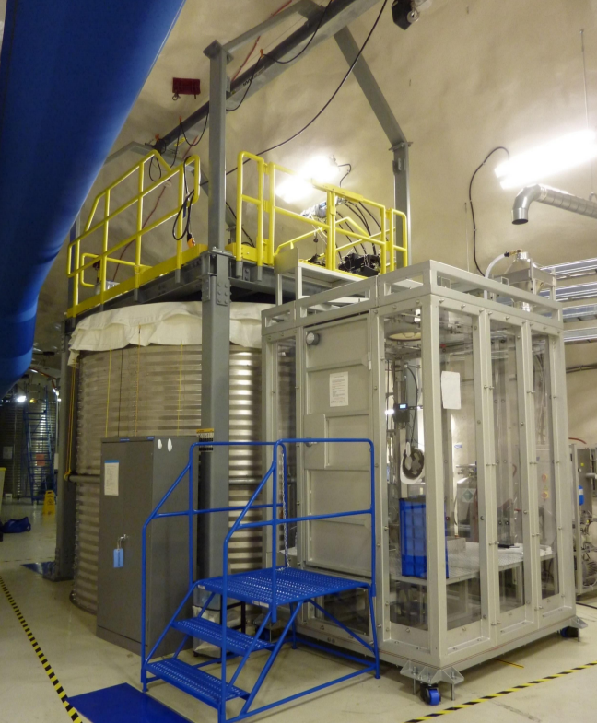
What is CUTE?
The Cryogenic Underground TEst facility (CUTE) at SNOLAB is a platform for testing and operating cryogenic devices
Originally for testing SuperCDMS detectors, now a SNOLAB user facility
Currently hosting QUTEbits

Slide 4
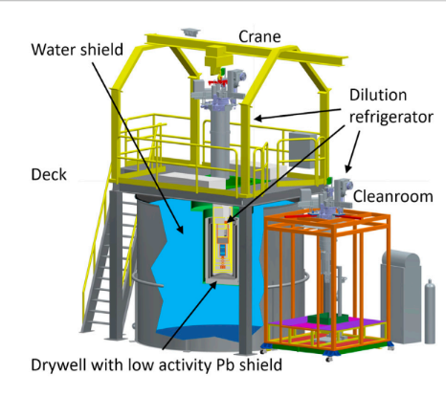
CUTE Facility Diagram

Slide 5



QUTEBits – introduction
CUTEBits collaboration
  SNOLAB
  Chalmers University of Technology
  Institute for Quantum Computing at University of Waterloo
  University of Toronto
Goal
  Study impact of radioactive background on qubit decoherence

Slide 6
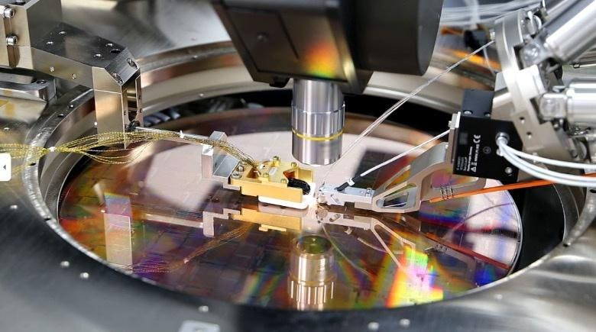
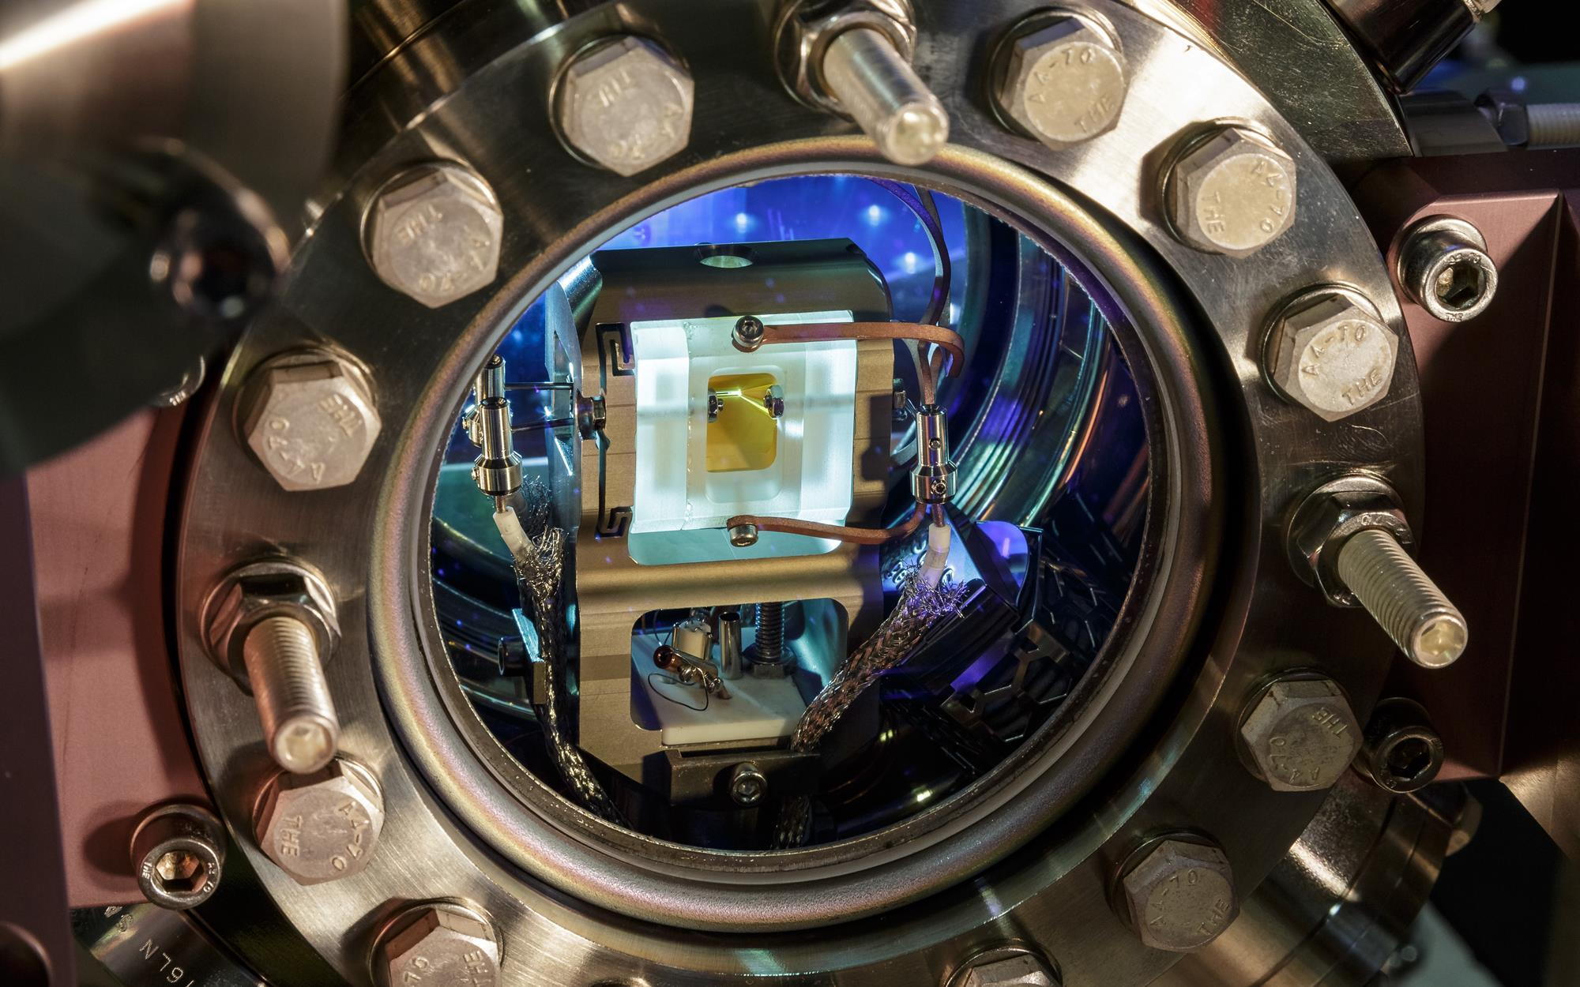
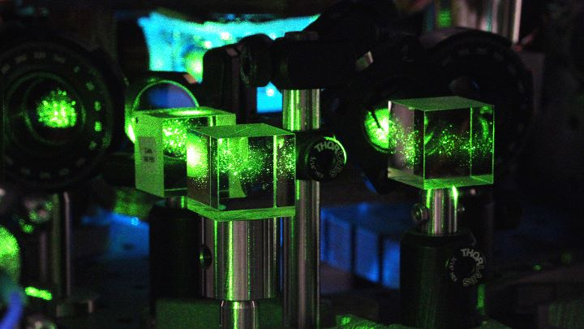
QUTEBits – background
A qubit is the fundamental unit of quantum information processing
Many platforms for qubits exist (eg. photonic, trapped ion, spin qubits)

Slide 7
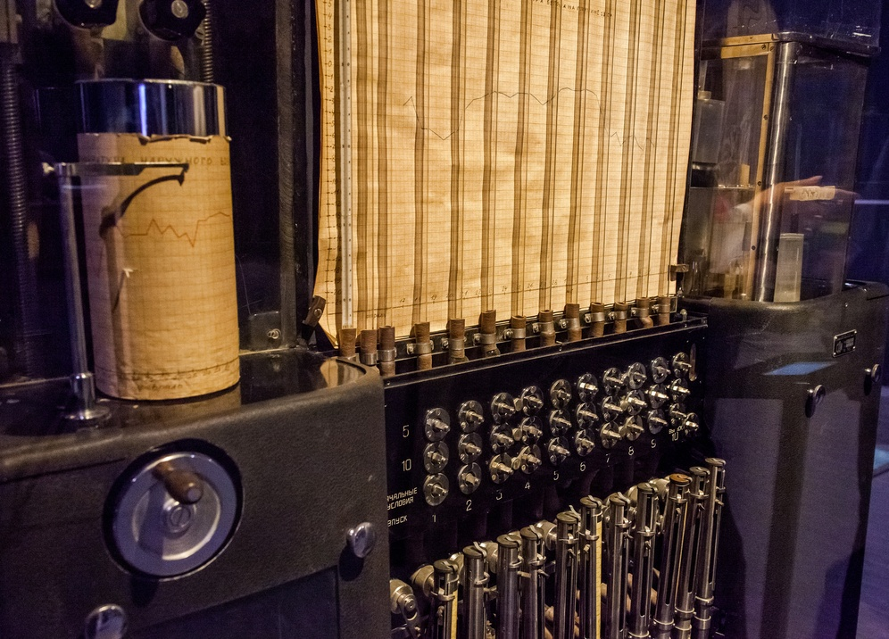
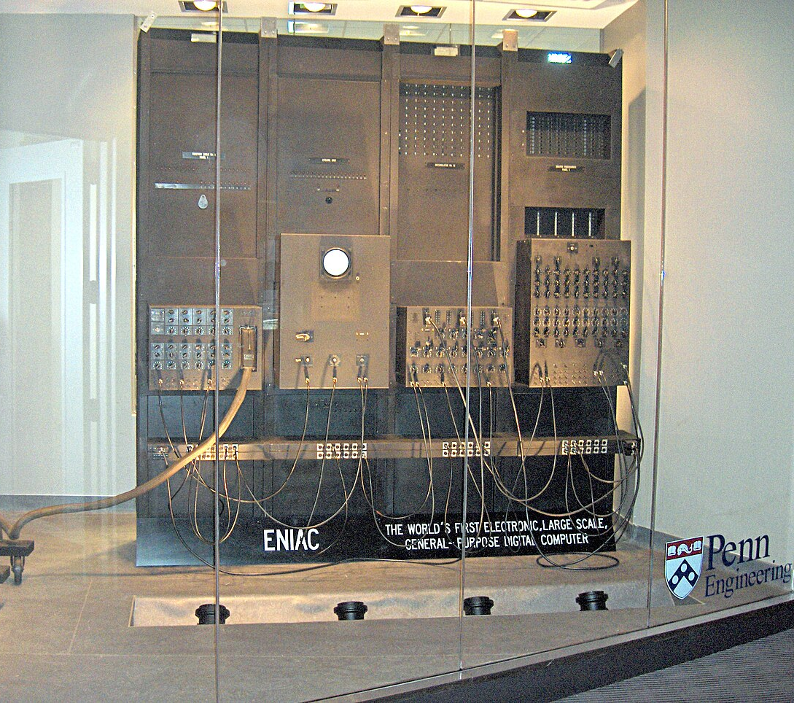
QUTEBits – background
A qubit is the fundamental unit of quantum information processing
Many platforms for qubits exist (eg. photonic, trapped ion, spin qubits)

Slide 8
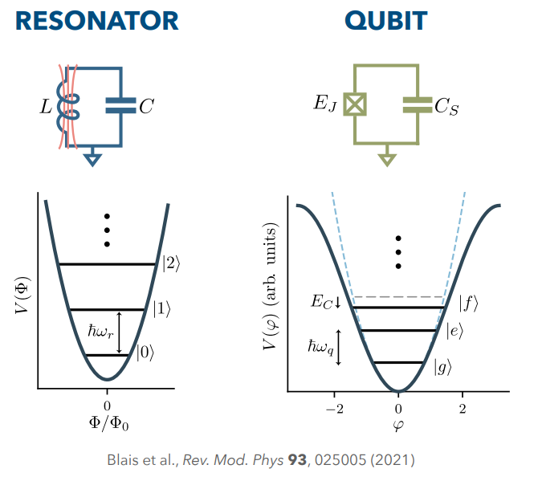
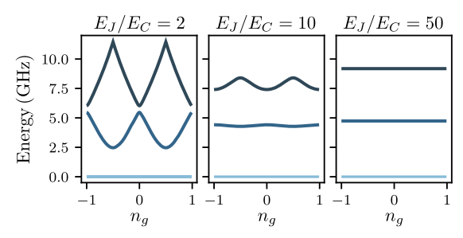
QUTEBits – background
QUTEbits uses transmon – qubit implementation using Josephson junctions
Anharmonic LC circuit where qubit is represented by lowest two energy states

Slide 9
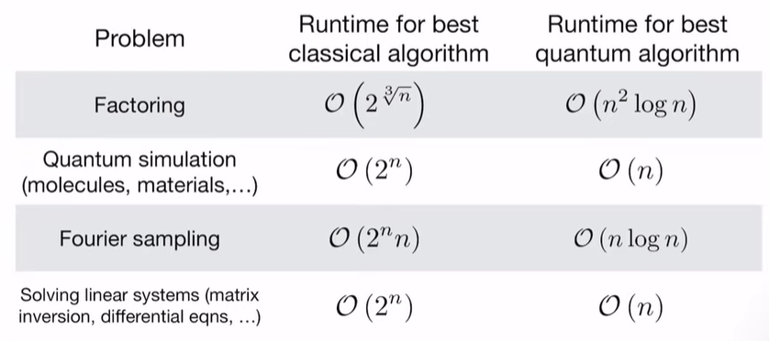
QUTEBits - motivations
Notes:
The project currently occupying the experimental volume under the DU is QUTEBits. The project uses superconducting qubits, which are superconducting circuits w/ josephson junctions used as implementation of qubits. Currently a leading implementation with ~100us coherence times

Slide 10
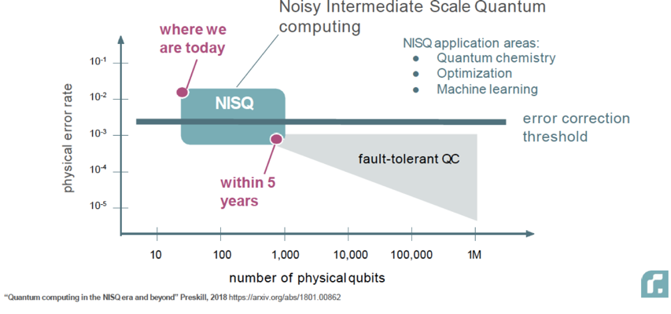
QUTEBits - motivations
…But quantum computers are not yet as stable or fault-tolerant as classical computers
Notes:
The project currently occupying the experimental volume under the DU is QUTEBits. The project uses superconducting qubits, which are superconducting circuits w/ josephson junctions used as implementation of qubits. Currently a leading implementation with ~100us coherence times

Slide 11
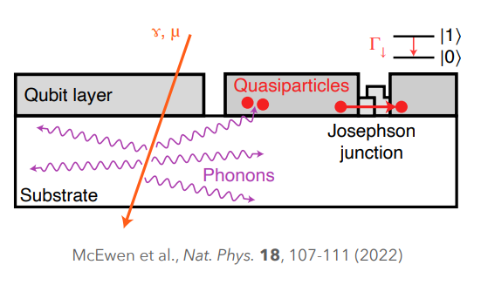
Goal of underground qubit studies
Qubit coherence time has been shown to be negatively affected by radiation
Ionizing radiation can cause simultaneous correlated errors across multiple qubits

Slide 12
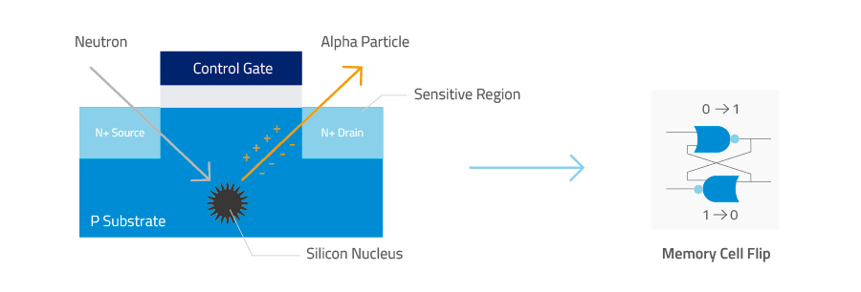
Goal of underground qubit studies
Qubit coherence time has been shown to be negatively affected by radiation
Ionizing radiation can cause simultaneous correlated errors across multiple qubits
~ 1 error per month per 256 Mb RAM

Slide 13
Goal of underground qubit studies
Qubit coherence time has been shown to be negatively affected by radiation
Ionizing radiation can cause simultaneous correlated errors across multiple qubits
CUTE provides an ideal environment for the study of qubits in a low-radiation environment!

Slide 14
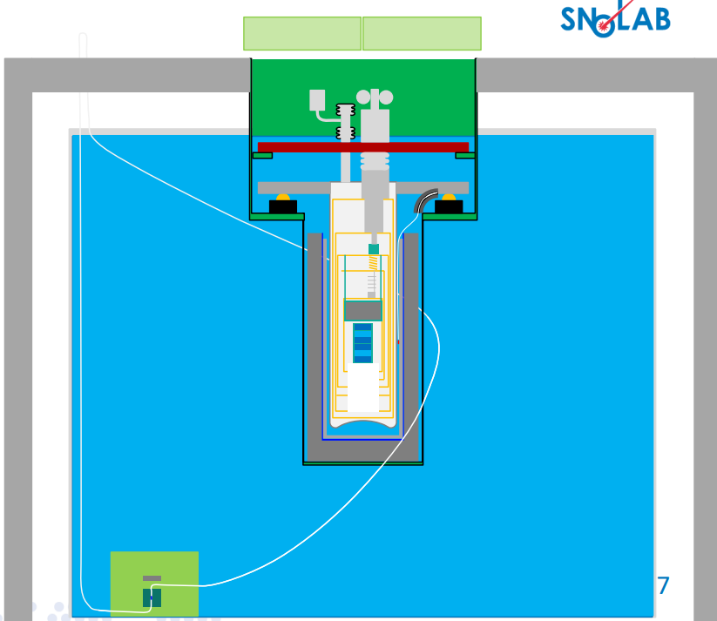
CUTE and QUTEBits: a match made underground
Access to materials screening through LBL
Vibration isolation
Lead shielding in DR
¹³³Ba, ²⁵²Cf calibration sources

Slide 15
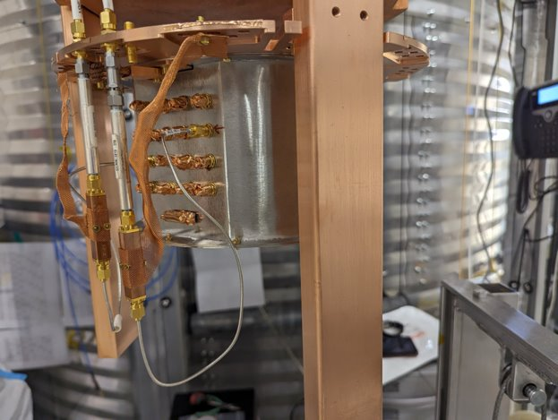
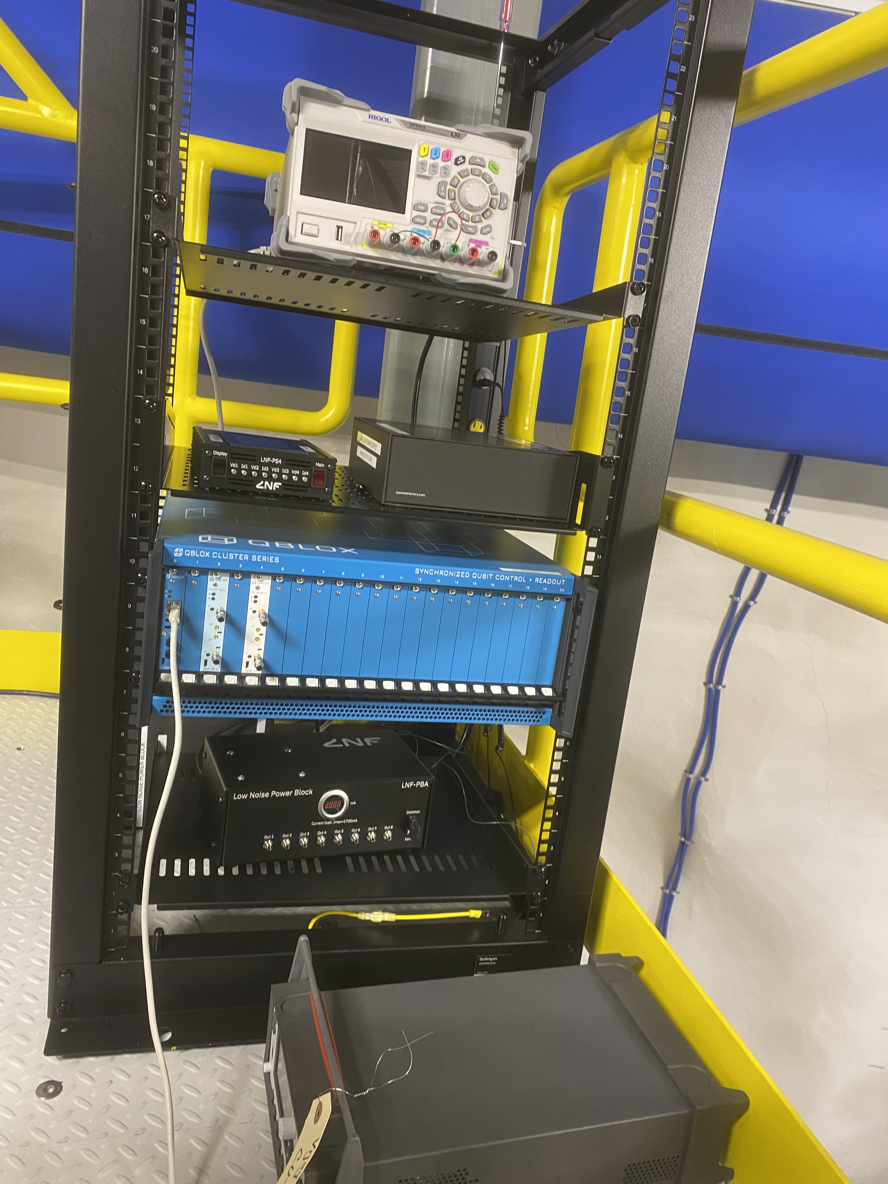
Adapting CUTE for QUTEbits
RF cabling for qubit
New CP, RF plates
Magnetic shielding, qubit sample holder
Control/readout systems

Slide 16
QUTEBits science

Slide 17
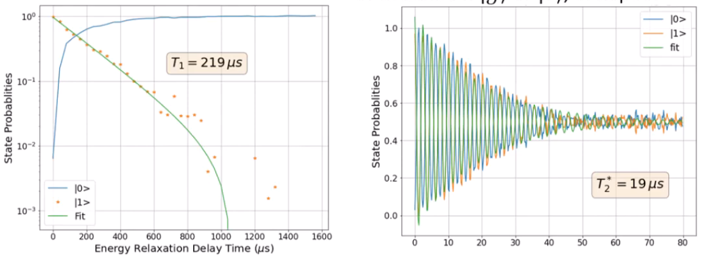
Qubit stability: T1, T2

Slide 18

Qubit stability: T1, T2

Slide 19
Qubit stability: T1, T2
Notes:
If we put the qubit in a superposition between ground and excited state, that state is characterized by a relative phase between ground and excited. At early times, knowing this phase precisely allows us to know which state we’ll measure the qubit in. However, the time of evolution of the phase is sensitive to noise in the environment, such that at later times, we know less the phase with less precision, and at late times we have completely lost the phase and the measurement probabilities are completely unknown

Slide 20
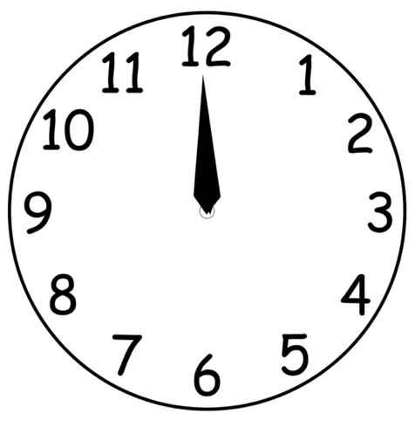

Qubit stability: T1, T2
Notes:
A useful analogy is a clock where the precession of the hand is inconsistent. We look at the clock once and know that exactly where the hand is (at the 12 o’clock position)

Slide 21
Qubit stability: T1, T2
Notes:
We expect it to be at the 6 o’clock position if we look at it in 6 hours

Slide 22
Qubit stability: T1, T2
Notes:
But if there is some noise in the environment, we don’t know with the best precision where we will find the clock hand

Slide 23
Qubit stability: T1, T2
Notes:
And waiting much longer than that, say days, we have no sense at all of where the clock hand is

Slide 24
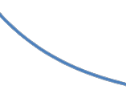

Qubit stability: T1, T2
Notes:
An exponential fit to this envelope describes our loss of knowledge about the phase, is what gives us our T2 time

Slide 25
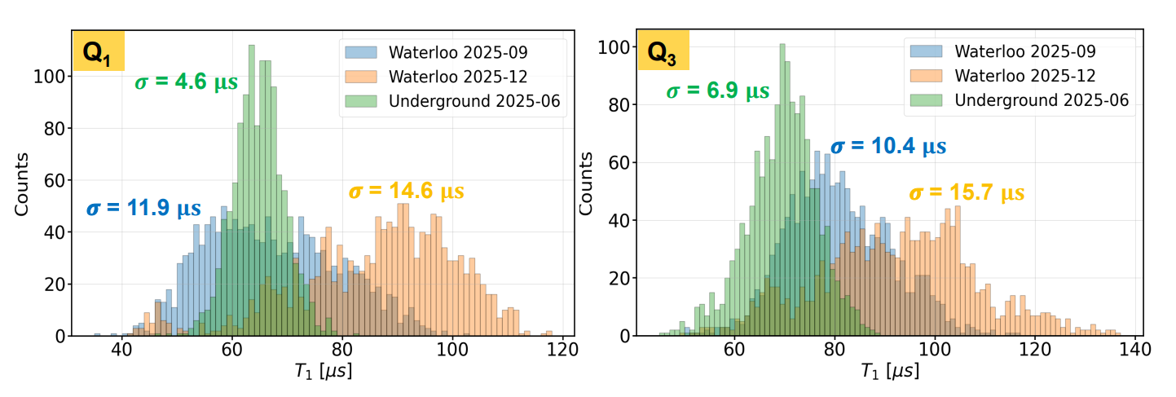
Early results from QUTEbits run 1

Slide 26
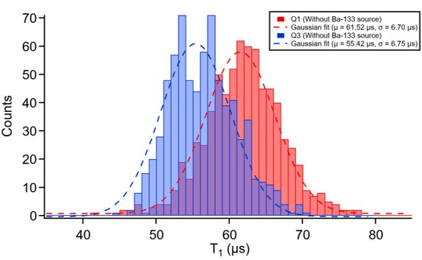
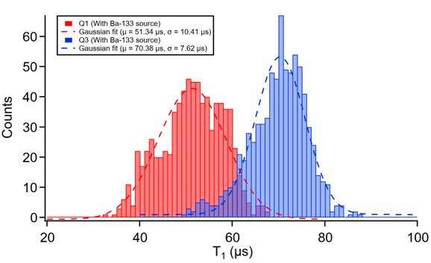
Early results from QUTEbits run 1
No Ba-source
Ba-source deployed

Slide 27
Towards QUTEBits Run 2

Slide 28
Goals for run 2
Replicate run 1 results
More statistics
Testing higher coherence qubits
Improve noise environment

Slide 29
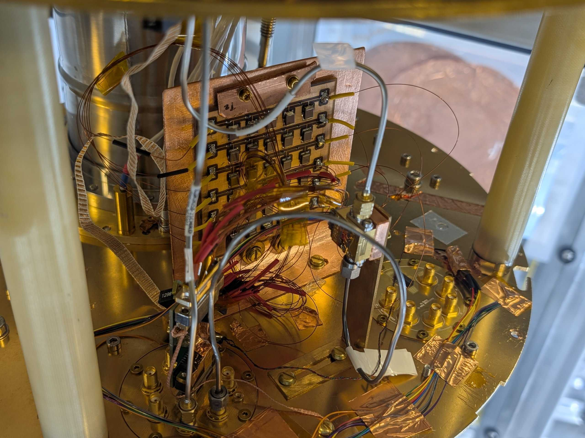
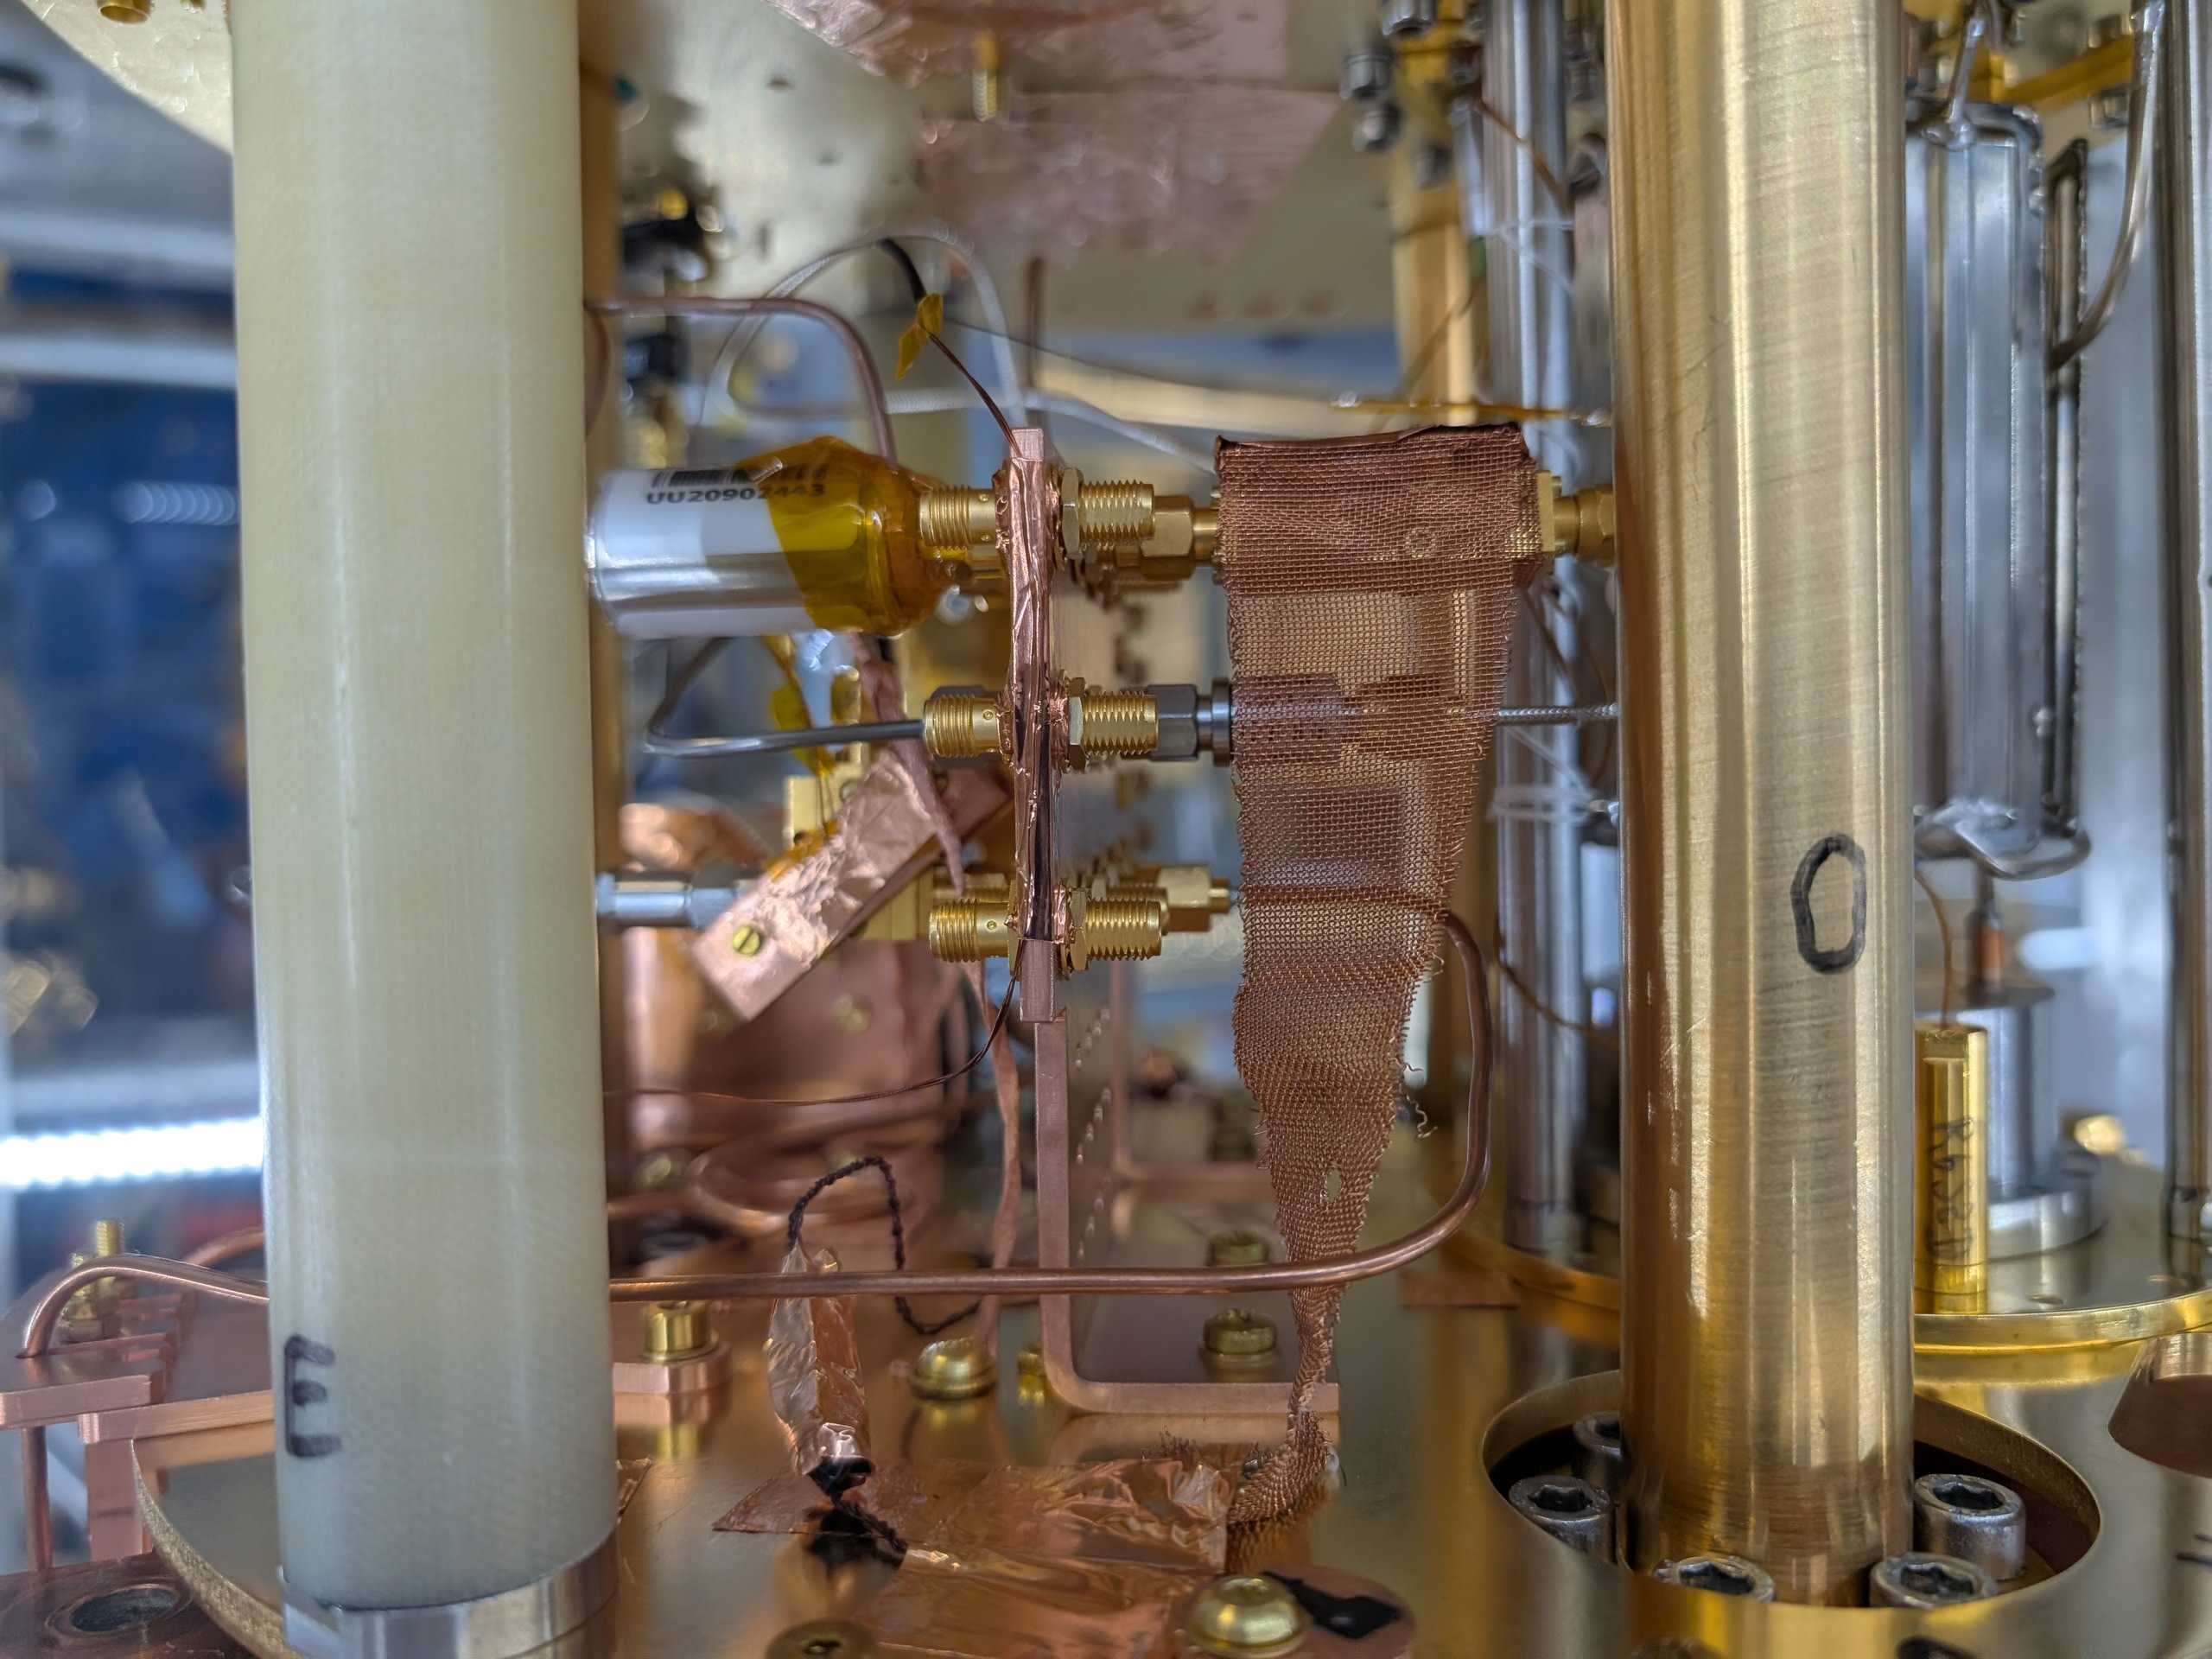
Installation work for run 2
New breakout board
RC filter
Thermal sinking
Low-pass filter
IR filter

Slide 30
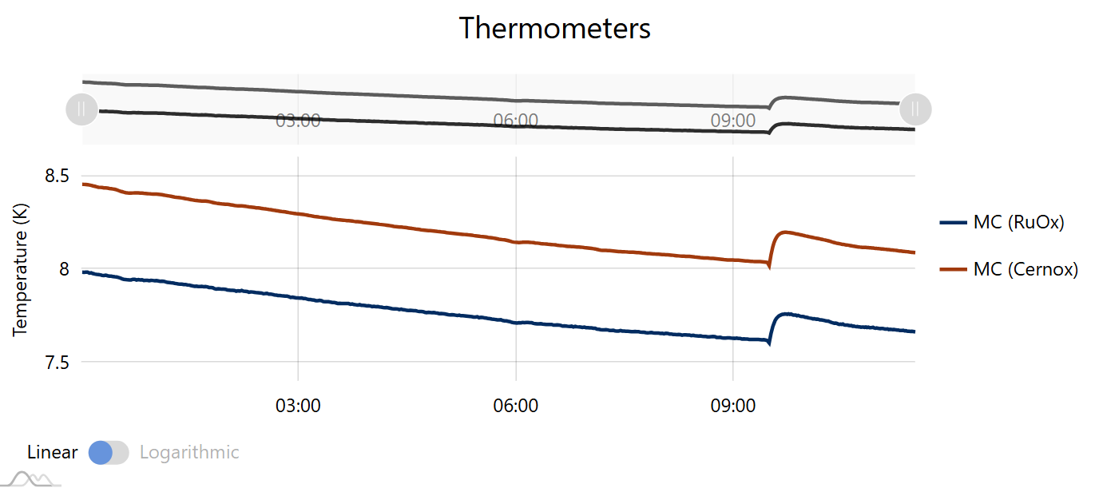
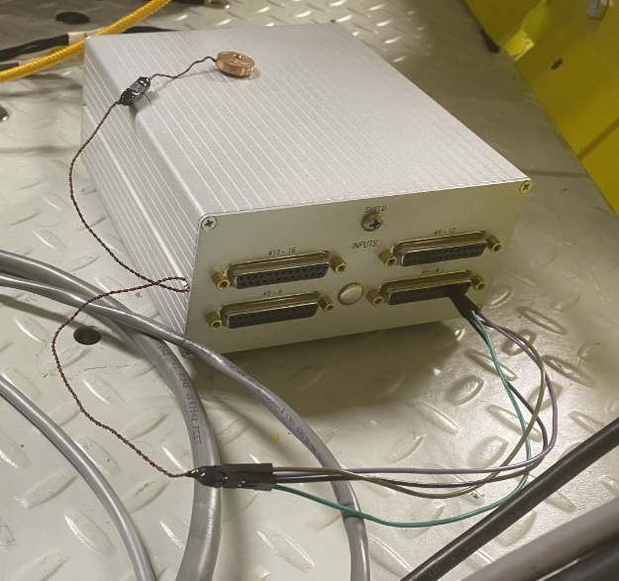
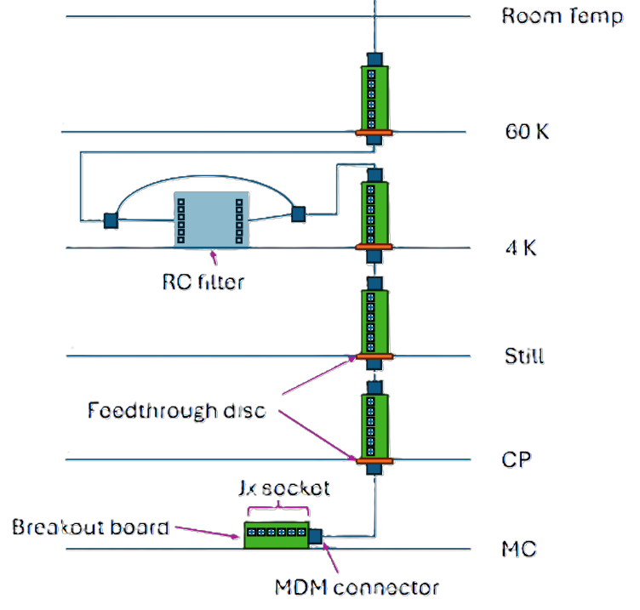
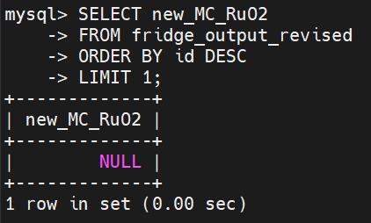
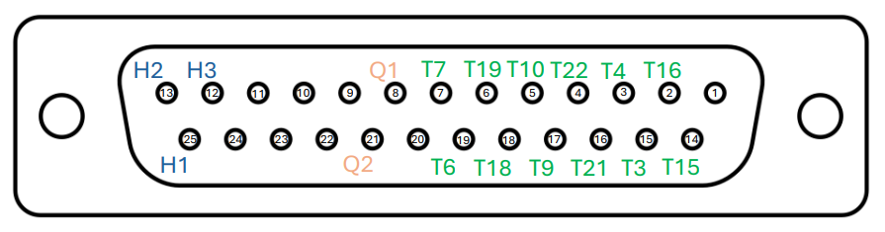
New thermometry

Slide 31
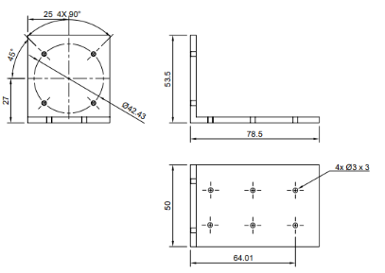
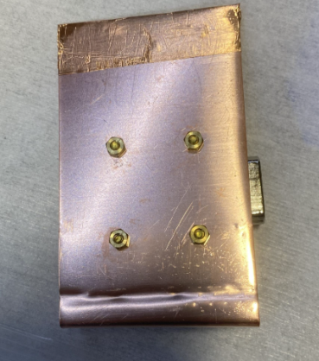
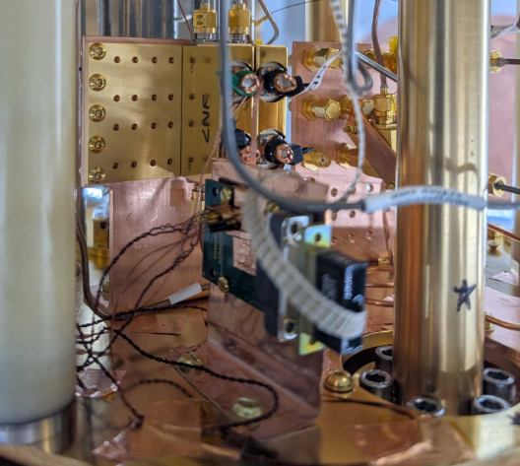
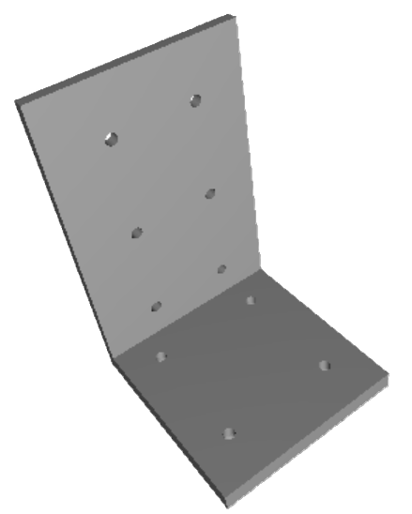
New thermometry

Slide 32
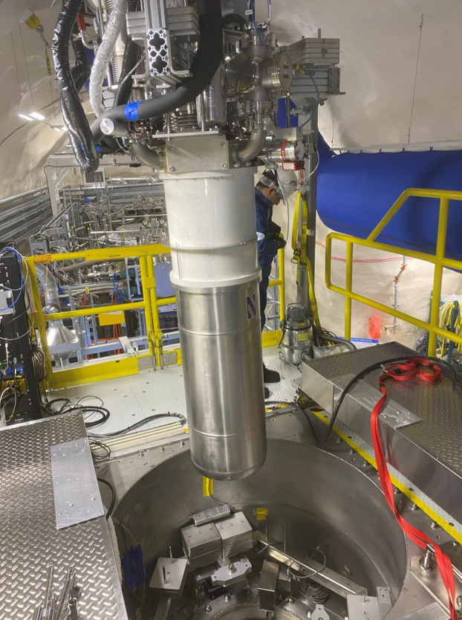
State of QUTEBits and outlook
Installation of EQSL qubits and new hardware has been completed
Currently preparing for fridge cooldown
Run 1 analysis ongoing
Run 2 data-taking soon!

Slide 33
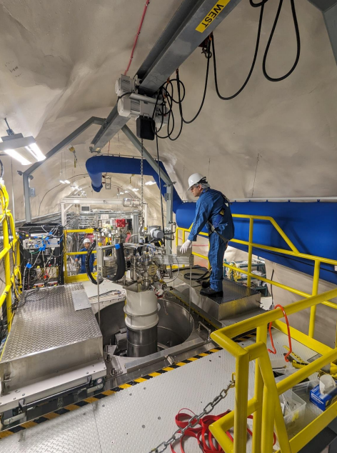
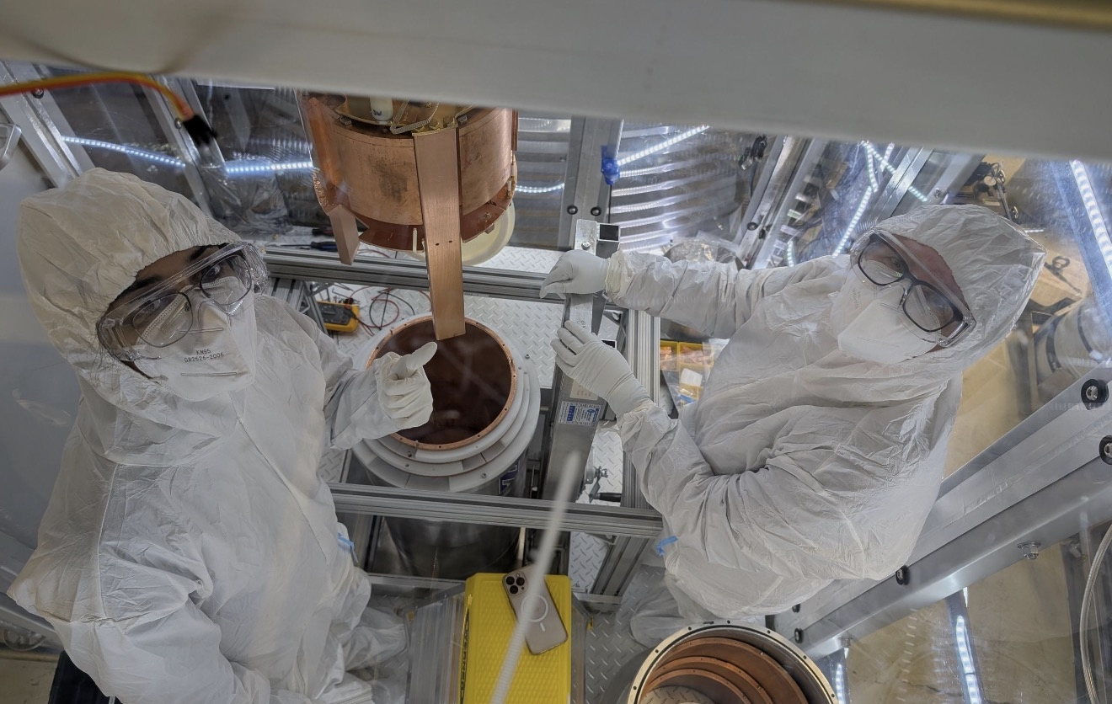
Acknowledgements

Slide 34
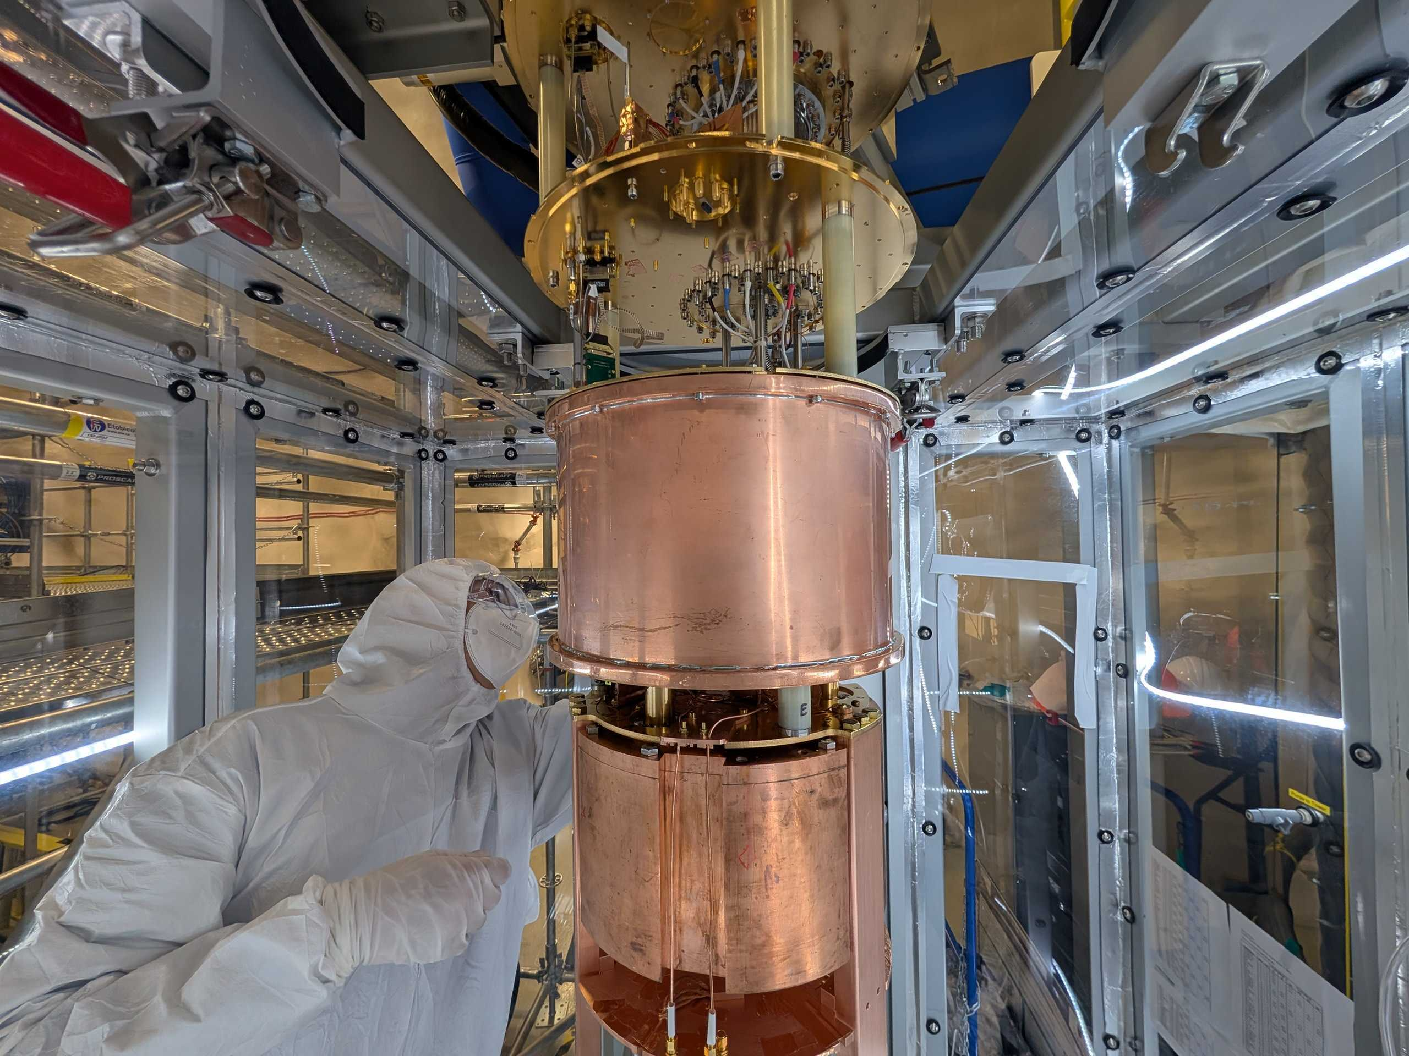
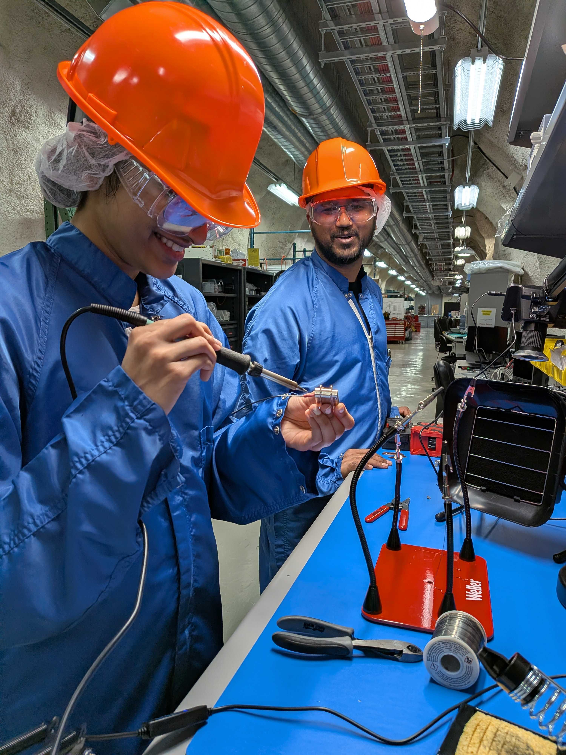
Acknowledgements

Slide 35
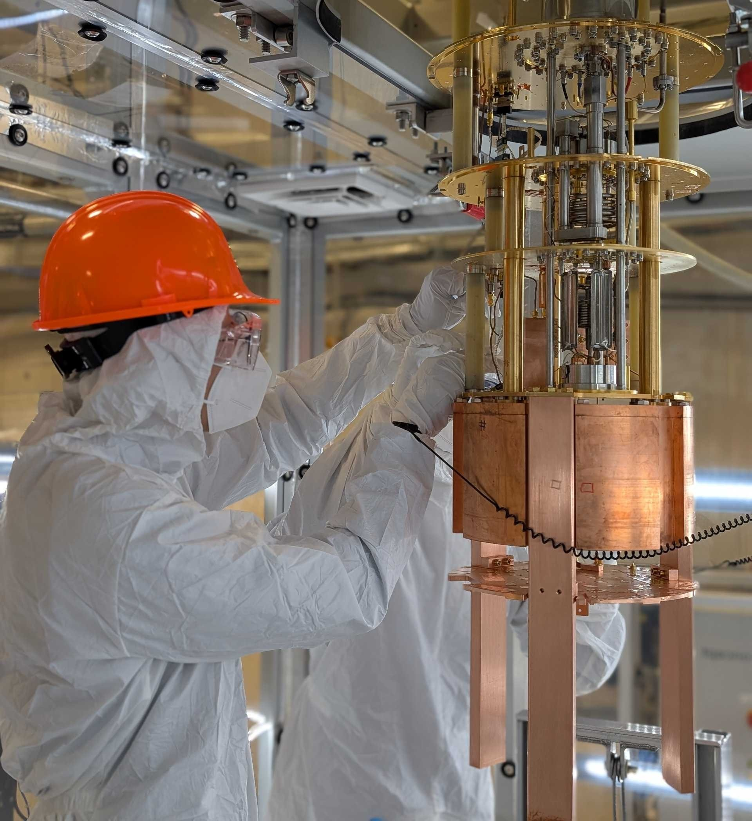
Thank you!

Slide 36
Questions?

Slide 37
Backup slides

Slide 38
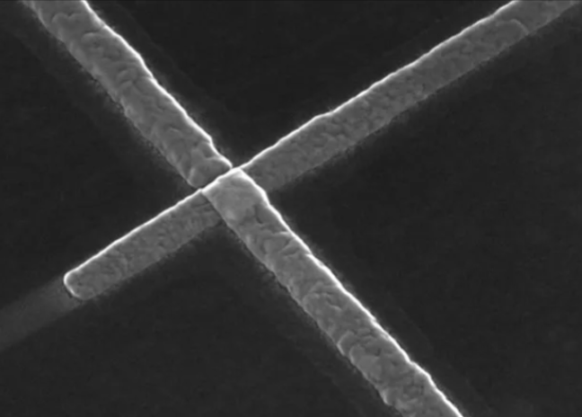
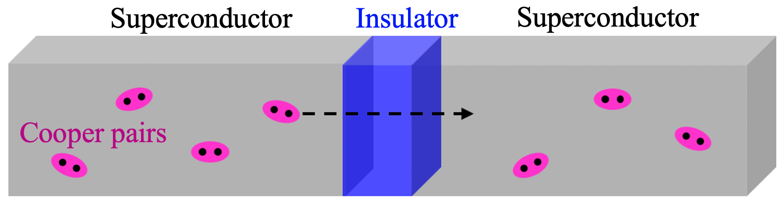
Josephson Junction

Slide 39

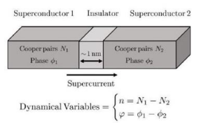
Josephson Junction Hamiltonian
n is the density of Cooper pairs that have tunneled through the Josephson junction relative to some equilibrium level
φ is the Josephson phase corresponding to the phase difference between the wavefunctions of the two superconductors
E_{j} is the Josephson energy, which is the energy associated with a tunneling Cooper pair
E_{c} is the charging energy of a single electron
Manipulating the ratio E_{j}/E_{c} enables us to design a system with properties that are useful for qubits

Slide 40
Josephson Junction Hamiltonian

Slide 41
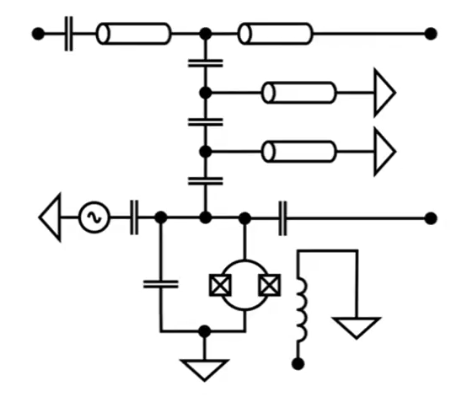
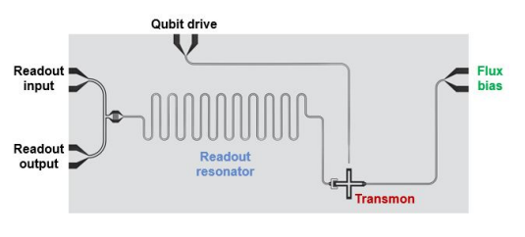
Breakdown of the transmon

Slide 42
Transmon

Slide 43
Flux bias

Slide 44
Microwave drive

Slide 45
Capacitive coupling

Slide 46
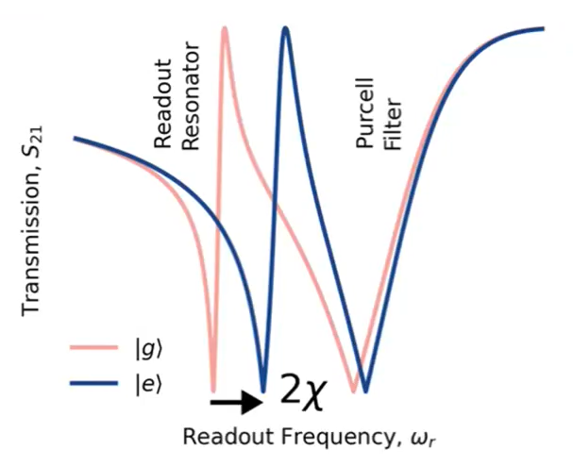
Resonator readout
Purcell filter
Readout resonator

Slide 47
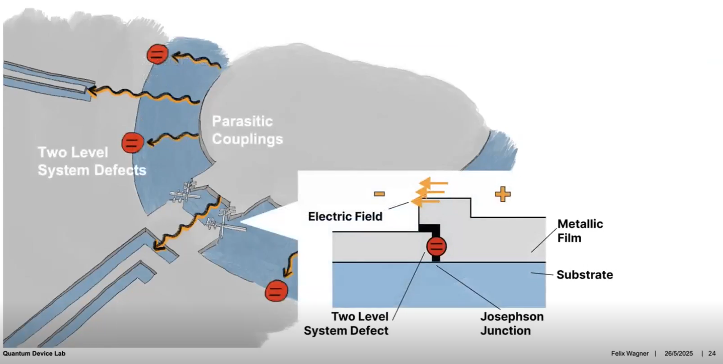
From Felix Wagner’s SNOLAB seminar: “Excesses in Superconducting Qubits”

Slide 48
