Slide 1
2026/04/17
Developing a Quantitative ZnS(Ag) Test System
Connor Stubbs
Radon Assay Student

Slide 2
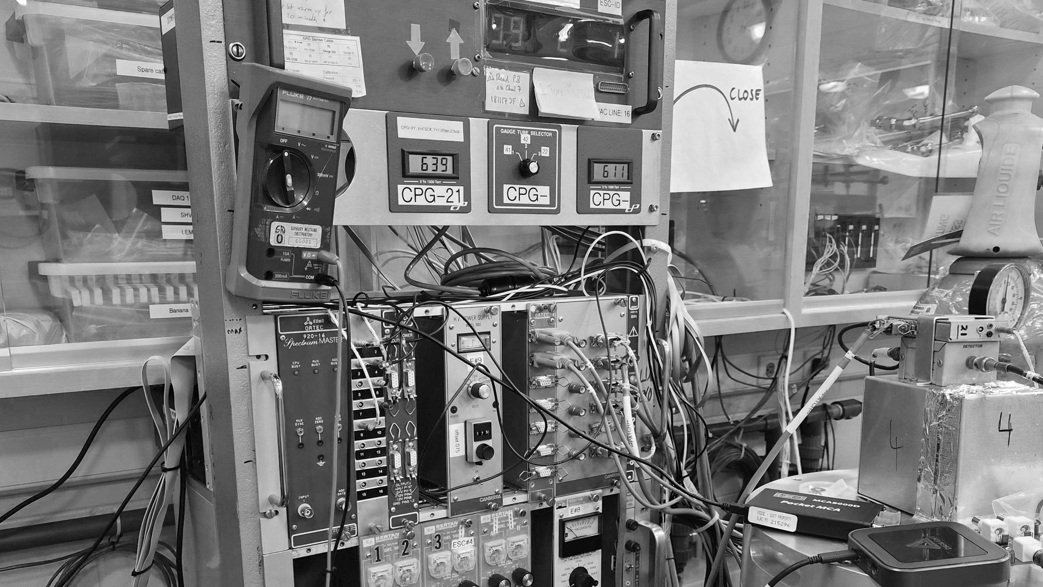

Background
Notes:
Lets start with some background information that motivates this project

Slide 3
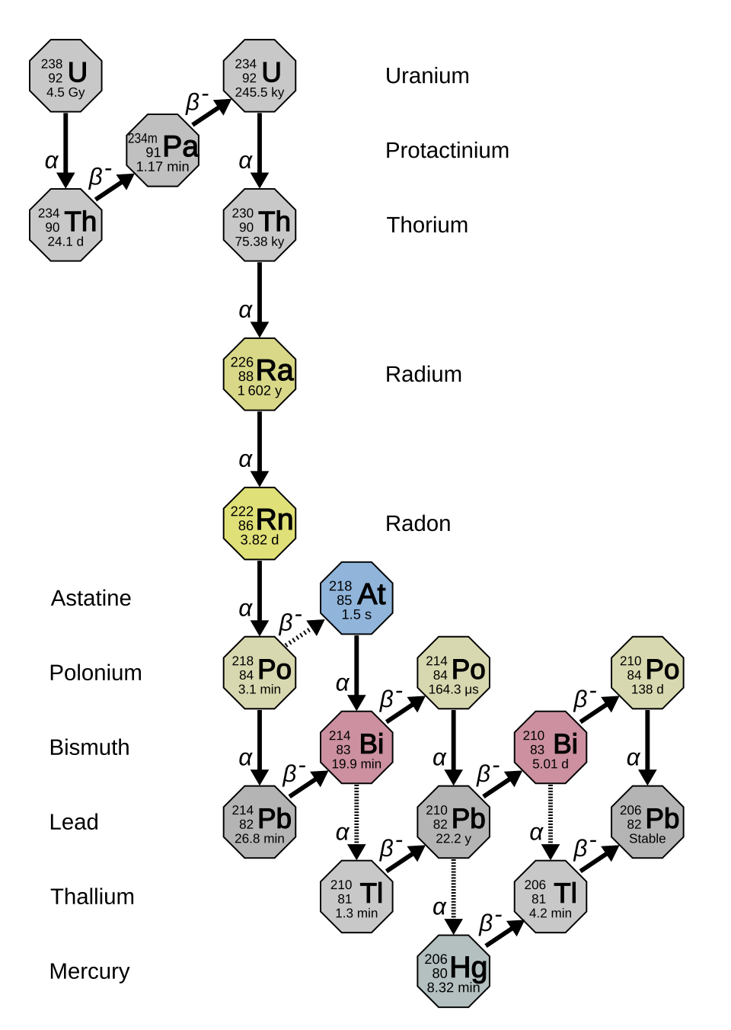
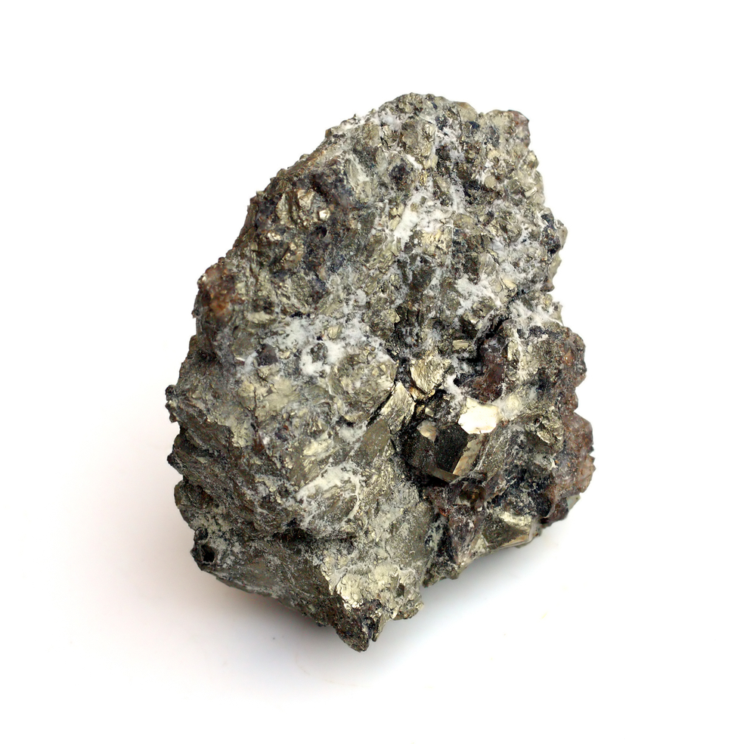
Radon Decay
Odorless, colourless, inert, radioactive gas
Able to travel far from emission source
Notes:
Im sure most of you know the struggles we have with radon, but to give a refresher: radon is an odorless, tasteless, colourless, inert, and radioactive gas that is released from the uranium 238 decay chain. Being surrounded by rock, which contains traces of these long half life elements at the top of the decay chain, radon is a major background for both our dark matter and neutrinoless double beta decay experiments.

Slide 4
Background
Assays
Notes:
That is where the assay team comes in. We trap radon from experiment volumes or items and count the decays to determine the amount of radon that is entering the volme or emanating from the item. We specifically look for these 3 alpha decays that occur in quick succession. One slight issue with this process is that these decays leave behind lead 210 with a 22 year half life, that eventually alpha decays again. This polonium 210 decay is our background.

Slide 5
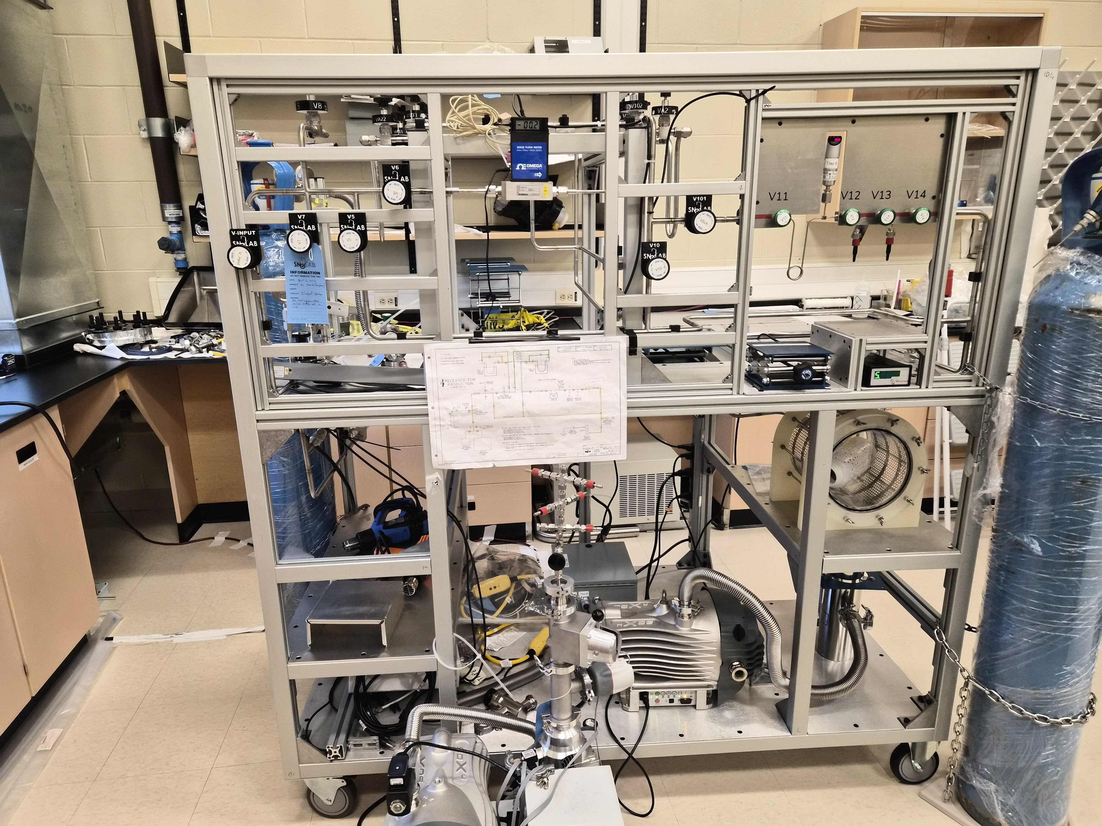
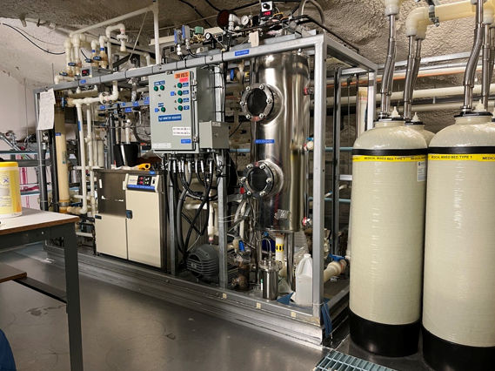
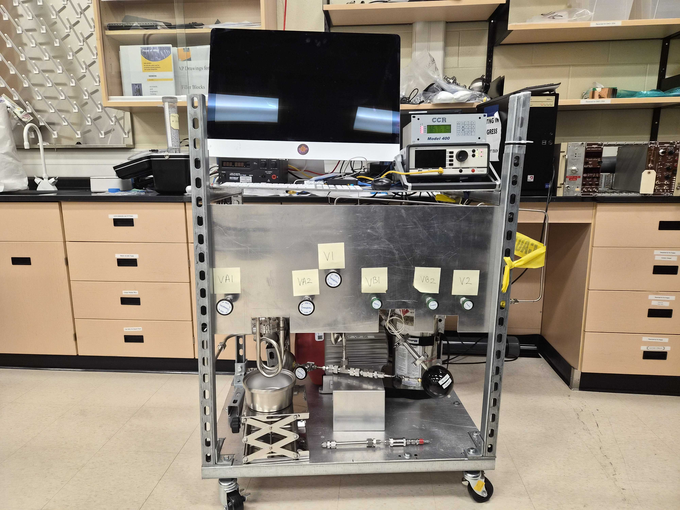
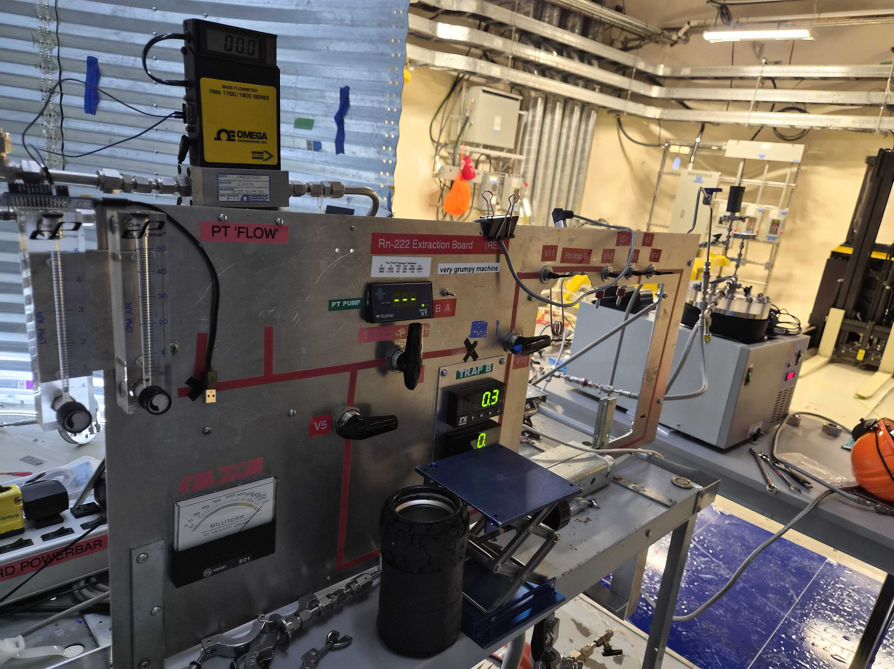
Assays
Surface
Emanation
Underground
UPW
Surface
Sphere
Underground
Mobile Board
Notes:
As mentioned, we assay many different things both on surface and underground through the use of these plumbing panels.

Slide 6
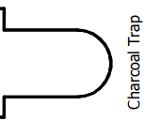
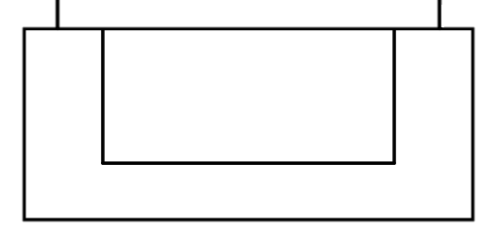
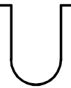


Assays
Cryopump Charcoal Trap to Trap A
Remove water and freeze radon in charcoal trap
Cryopump from Trap A to Trap B
Volume Share to Lucas Cell
Notes:
And to do these assays, a typical process consists of removing water and freezing radon in the first trap by pulling the gas through while it is submerged in liquid nitrogen. The inlet of the first trap is closed, and the gas is pulled into trap A, which is again in ln2, while the first trap is heated. This is repeated into trap B, the concentrator trap, then the gas is volume shared from trap b to the lucas cell

Slide 7
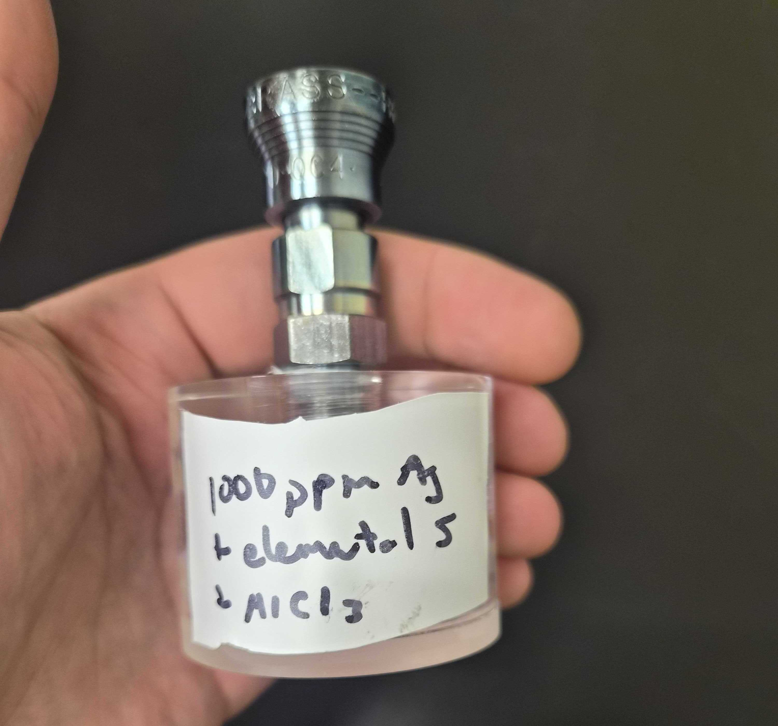
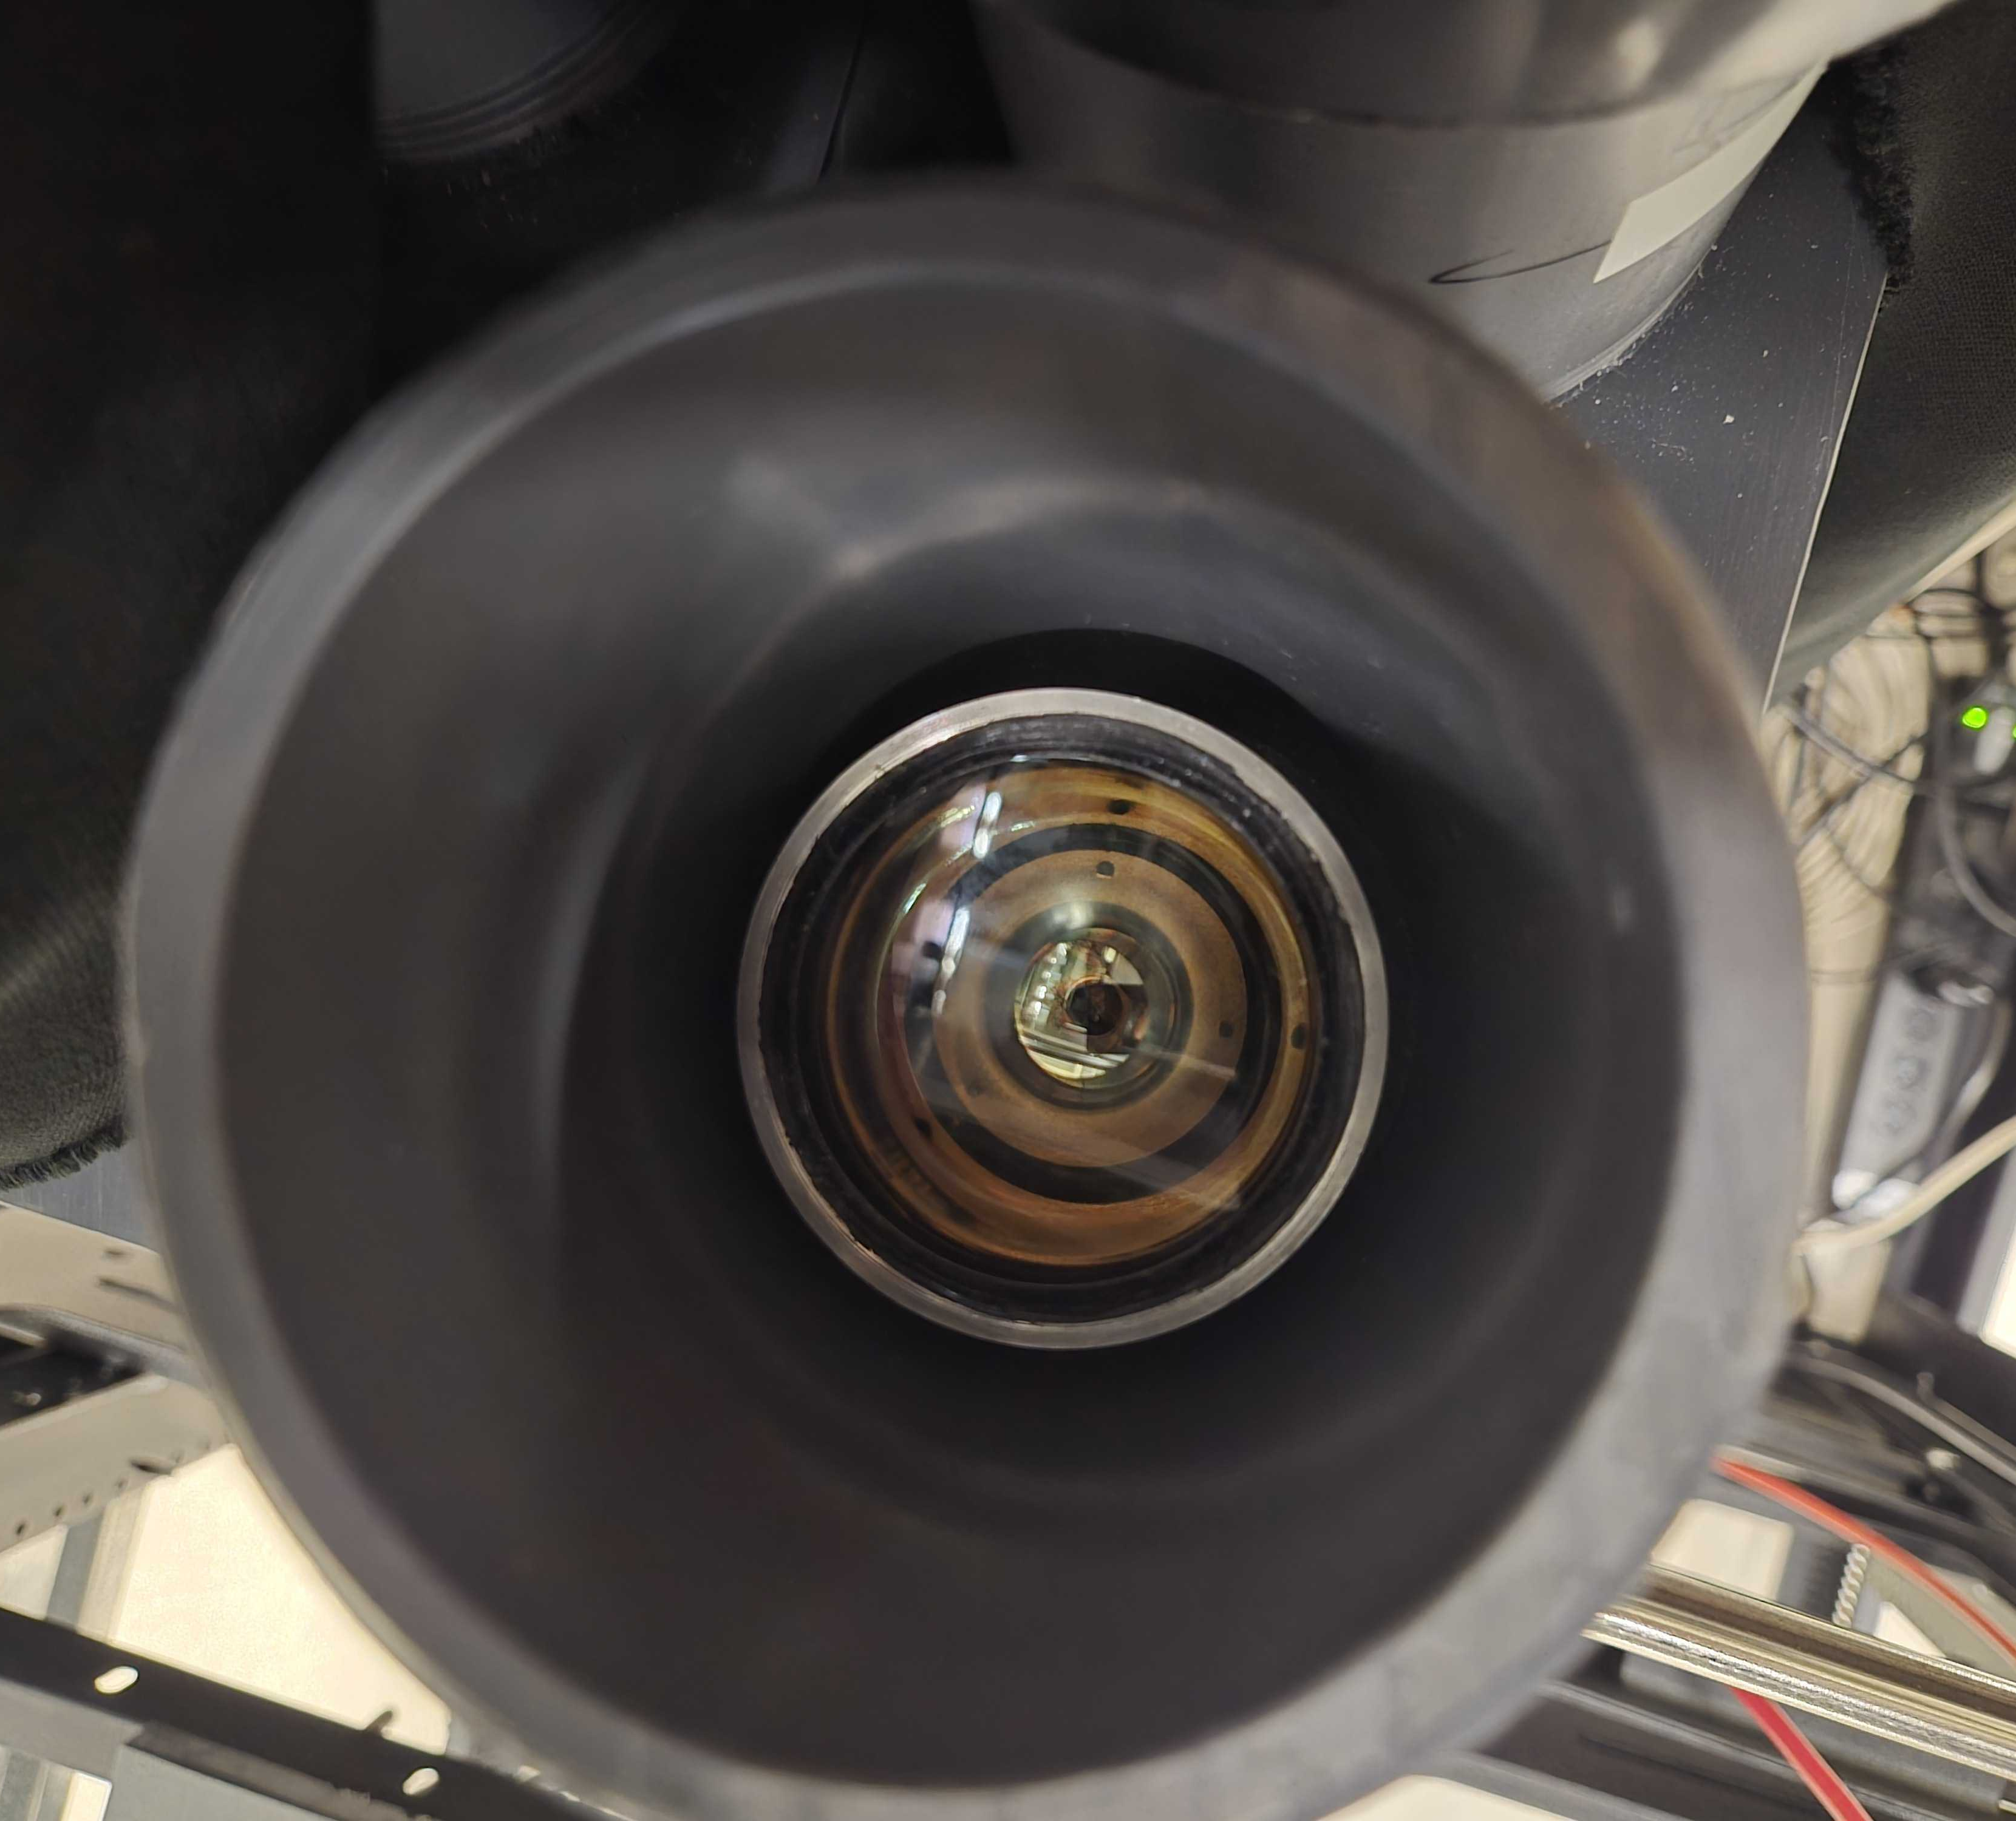
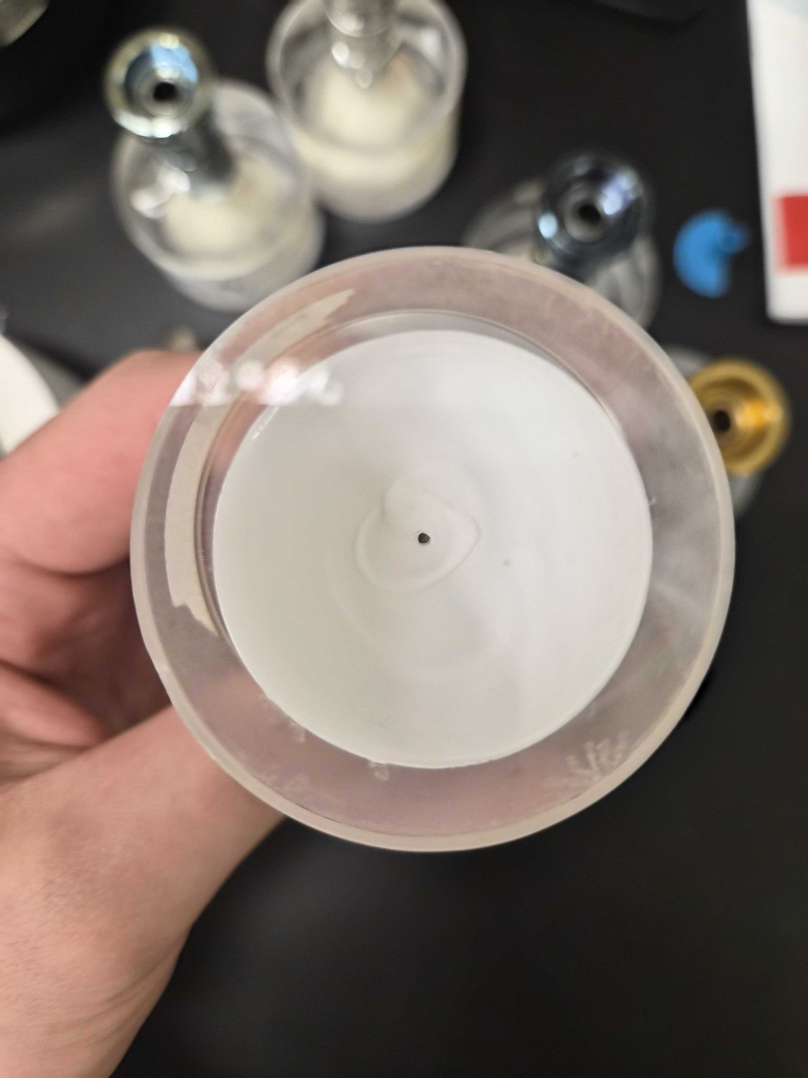
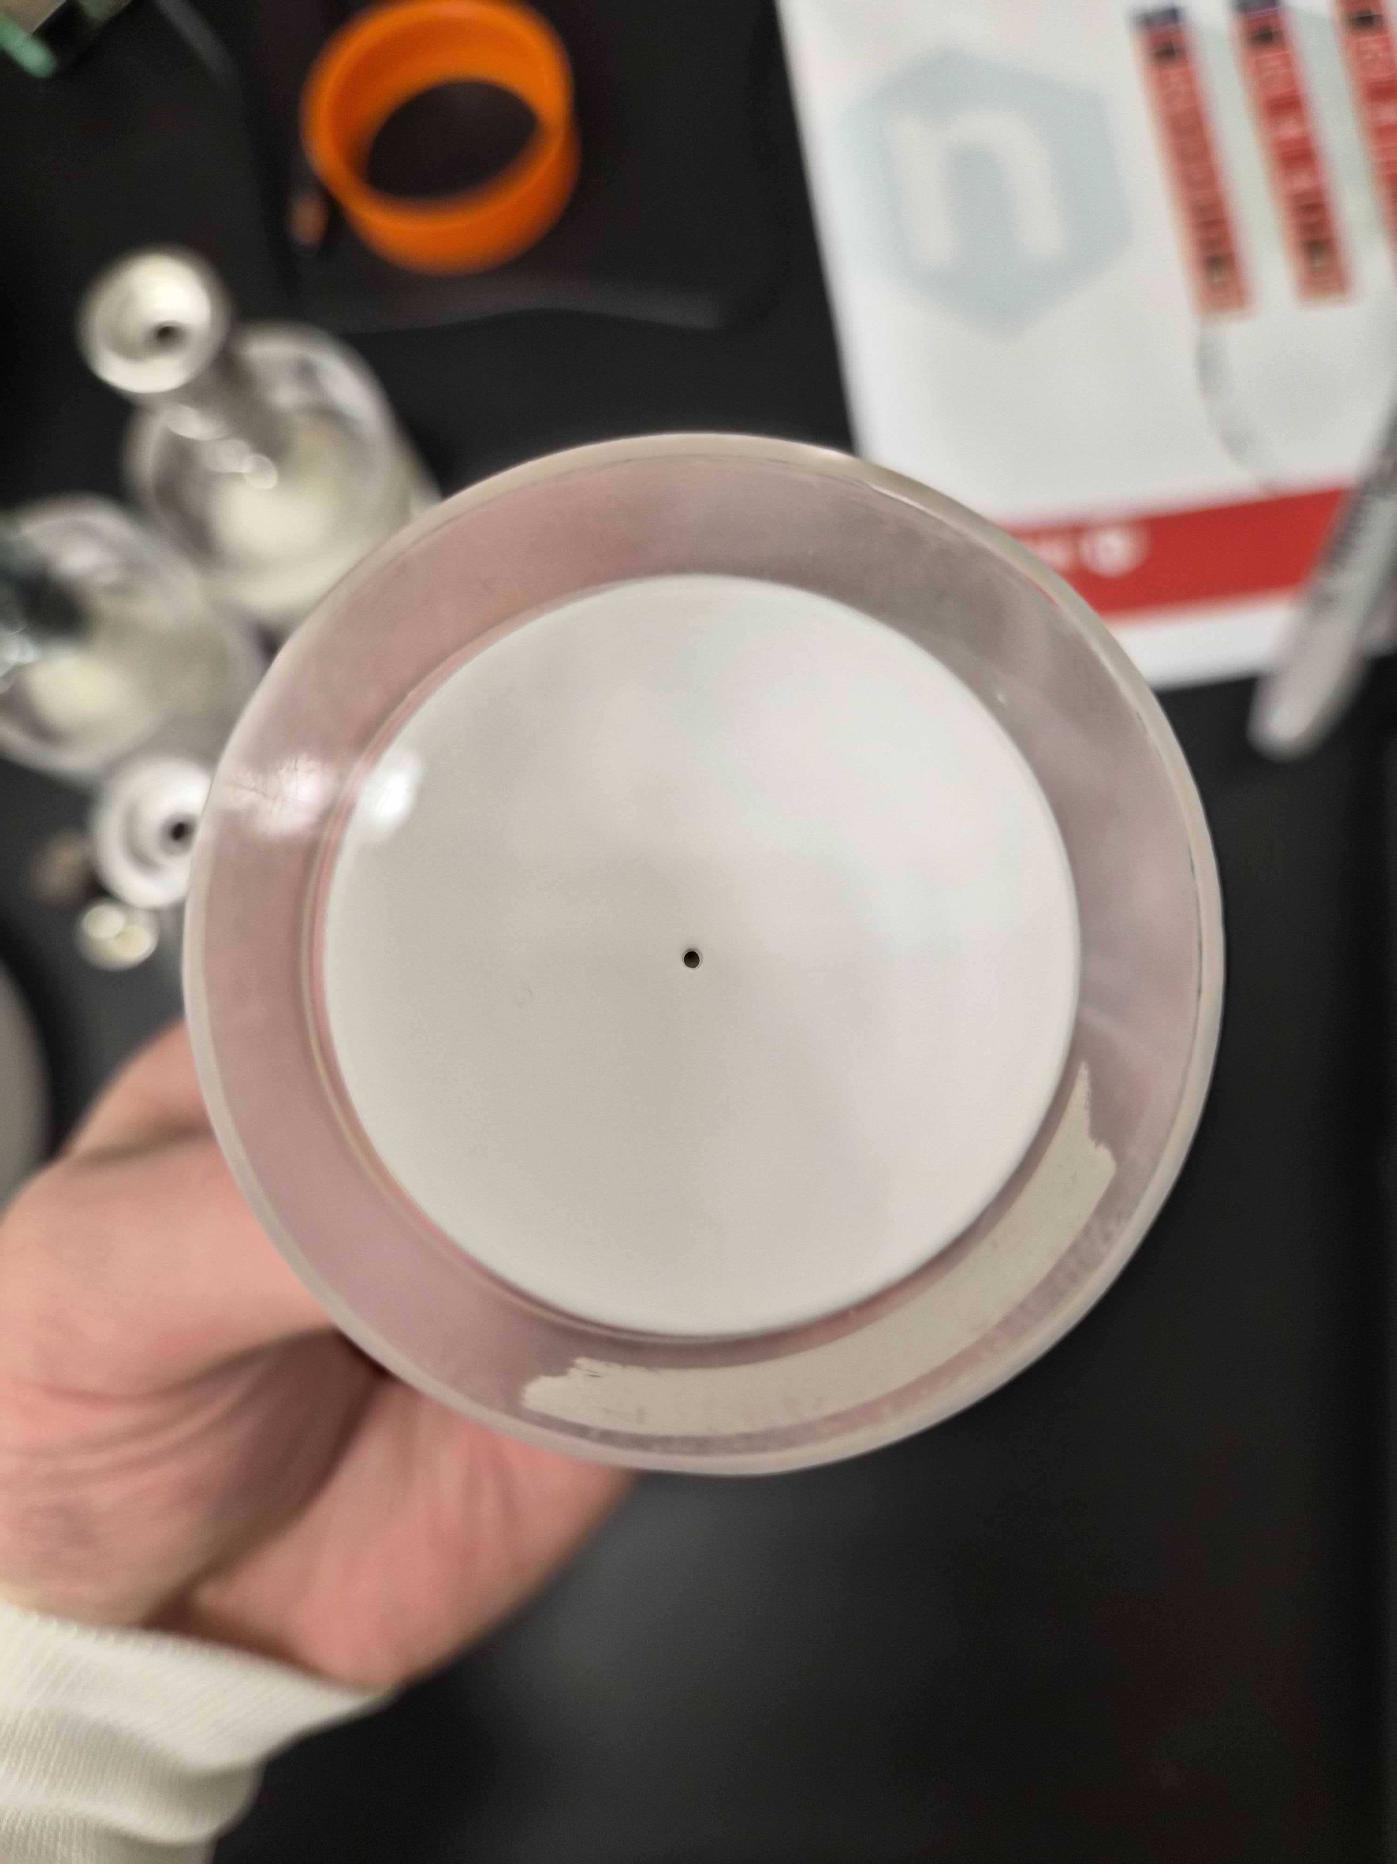
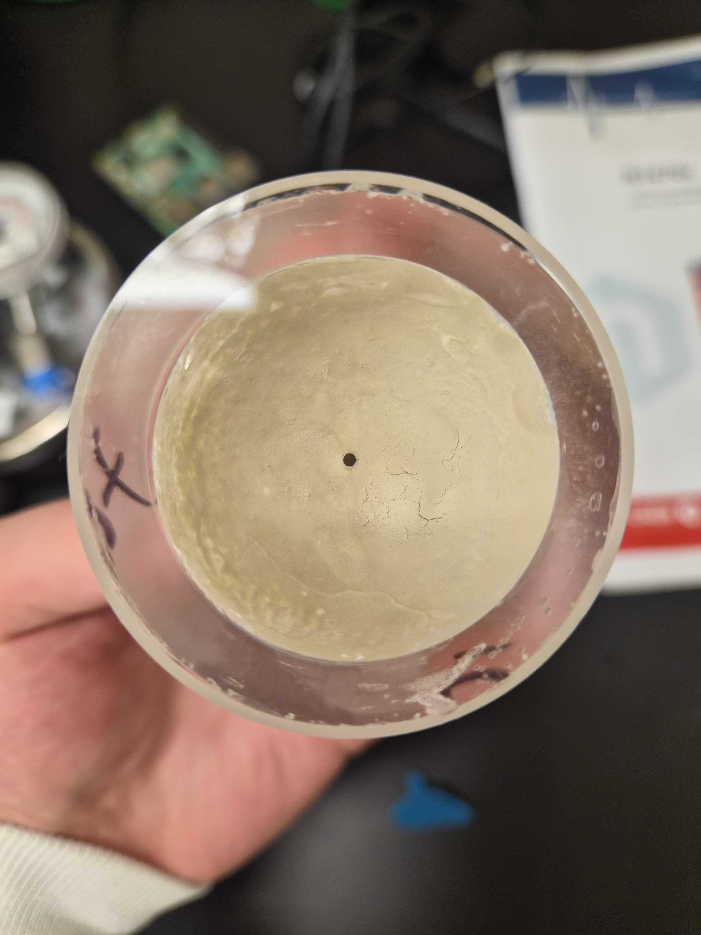
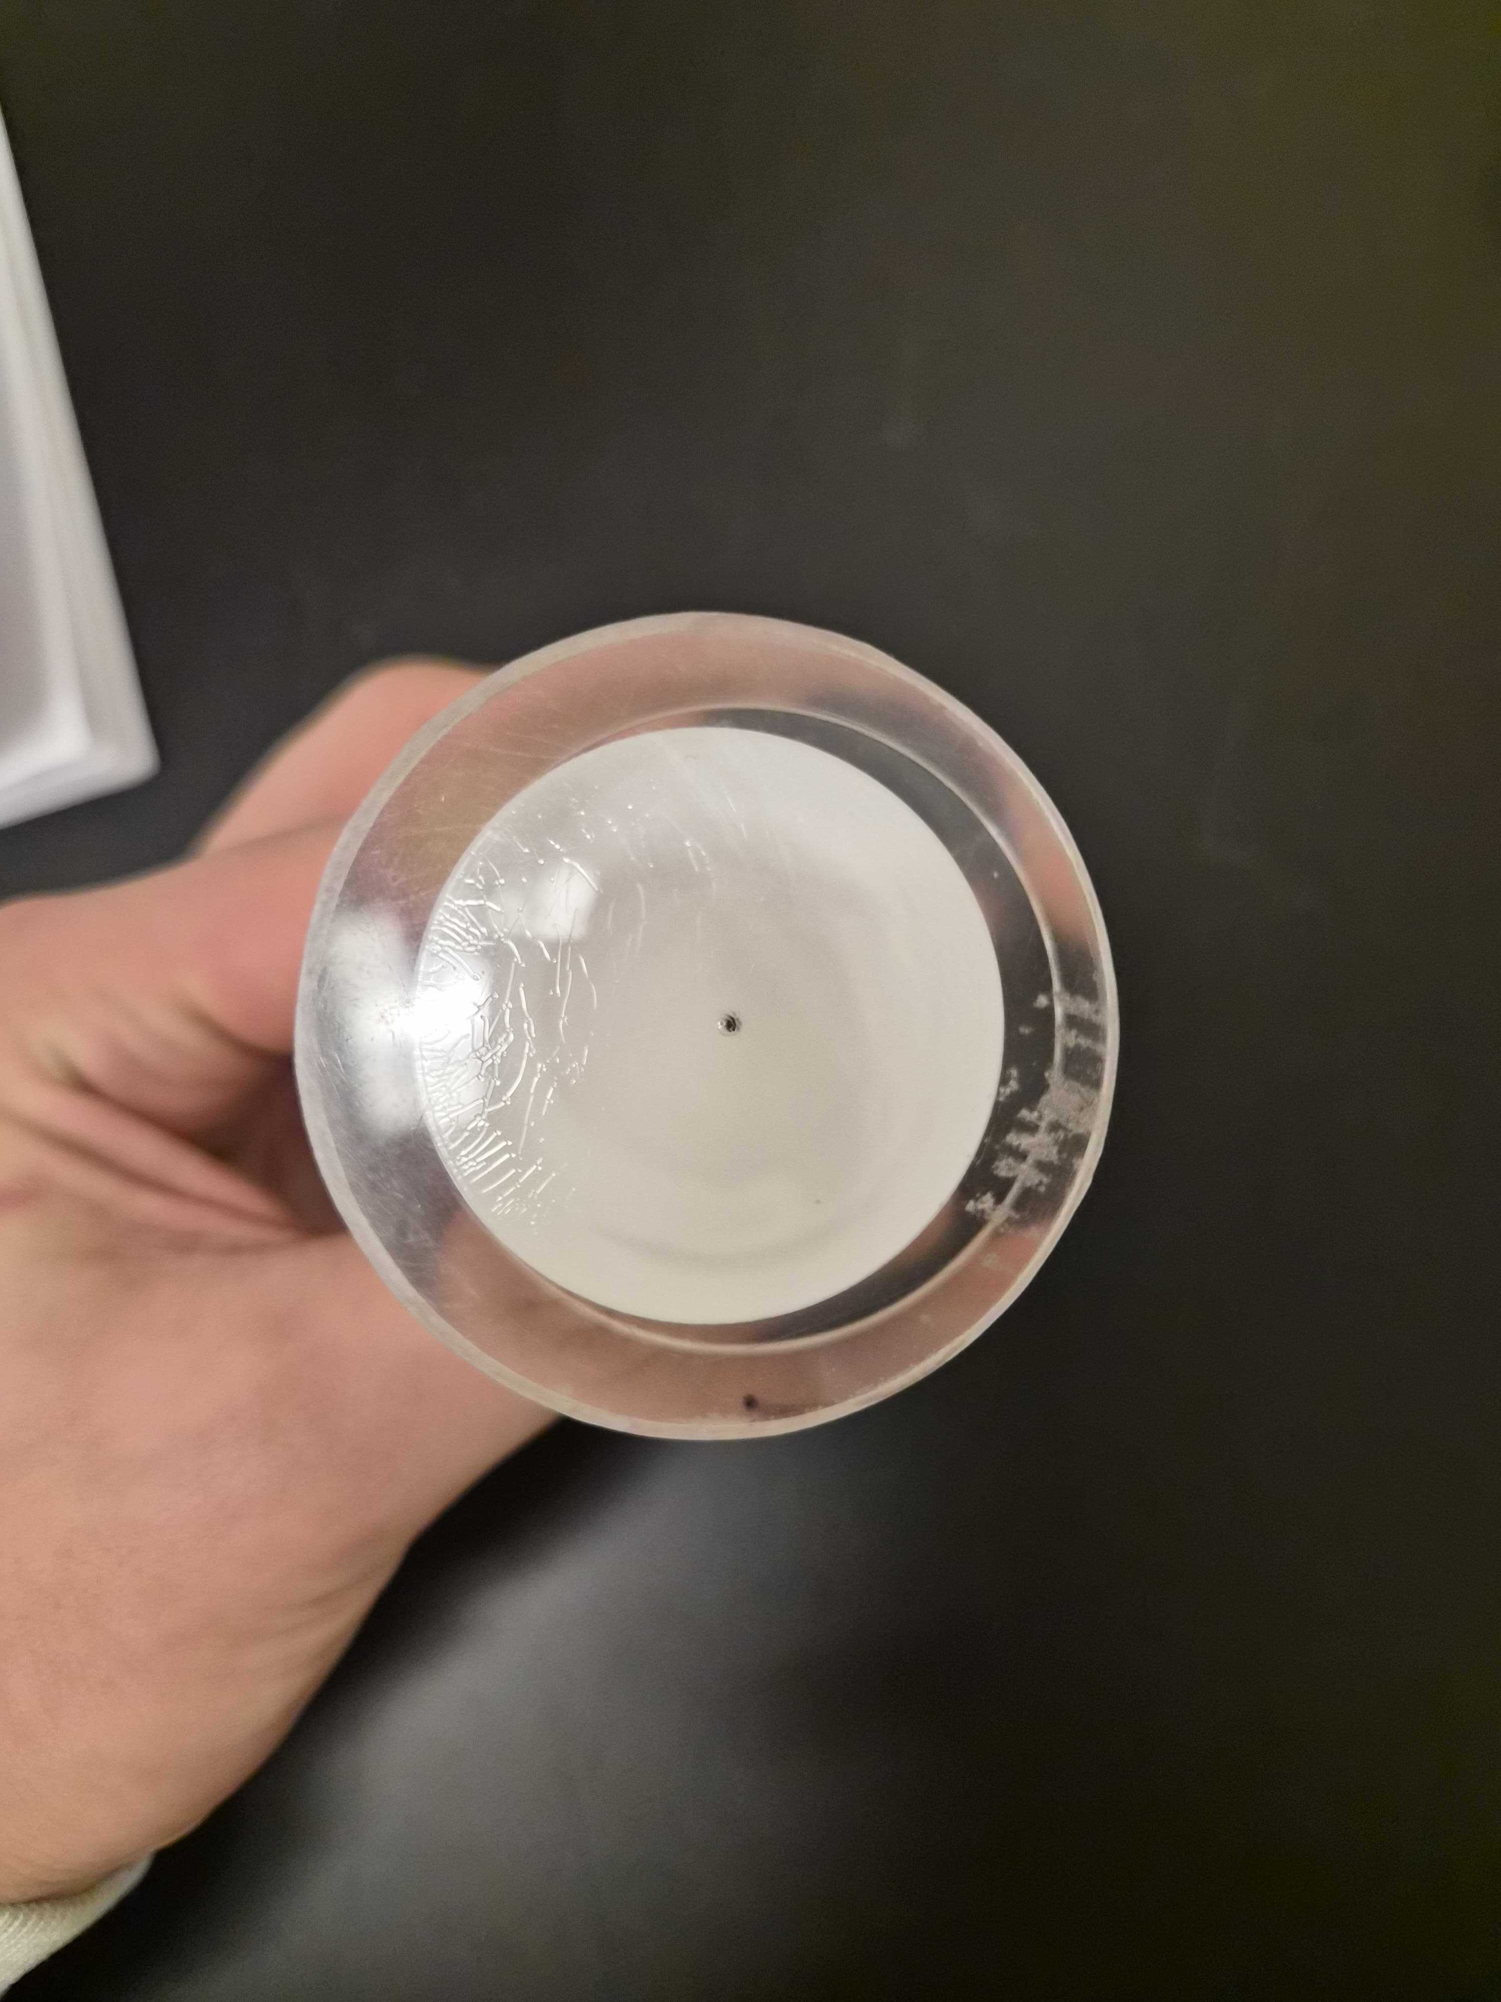
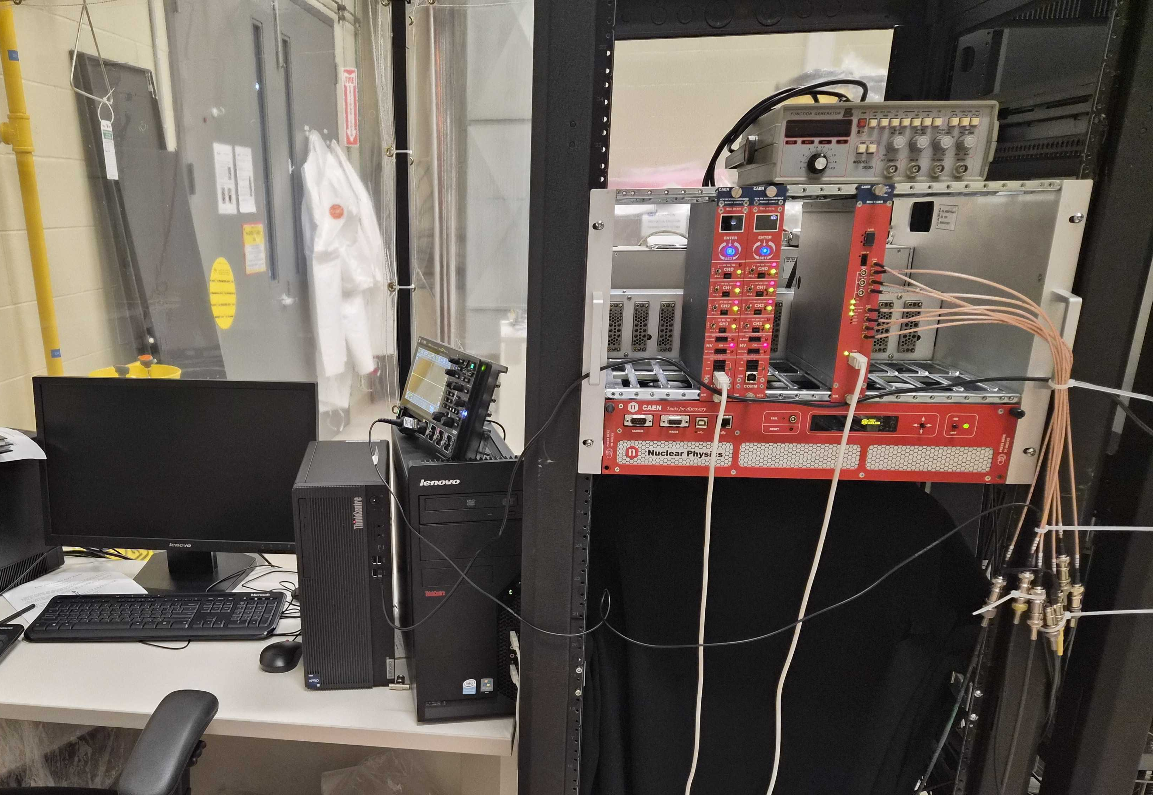
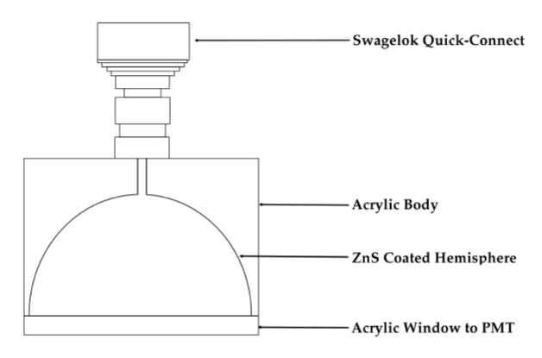
Johnson
Rexon
Lucas Cells
Acrylics hemispheres with alpha scintillator painted on and a quick-connect for gas to come in
Put onto photomultiplier tubes to count alpha decays and relate that to radon atoms
Made at SNOLAB with many different variations of ZnS(Ag)
SNOLAB
Eijean
Notes:
So that brings up another question, what is a lucas cell? These are 2 inch diameter acrylic hemispheres with ZnS, a sensitive alpha scintillator, painted on the inside. This means that when an alpha particle strikes the sides, it emits light. To capture this light, the windows of the lucas cells are placed on photomultiplier tubes like that of the top picture and our data acquisition or daq system below it counts the scintillations. We have many lucas cells here at snolab and continue to make more. Nowadays, we are also attempting to manufacture our own very radiopure ZnS
Add point about comparing

Slide 8
Purpose
Quantify the light yield and efficiency of ZnS(Ag) scintillator that we use for radon assays.
  Monitor the magnitude of alpha pulses
  Use a radon source to put in a number of atoms and count detections
  Need to be able to do this several times a week
Notes:
This finally leads us back to the ZnS test system. As we manufacture our own ZnS, we need a way to compare with the commercial products we already have. There are three main criteria that our test system needs, one being a way to compare light yield, another being a way to compare detection efficiency, and lastly it needs to be a process that takes only a few hours.
Number of entries or charge for y axis, change slide 18 too

Slide 9
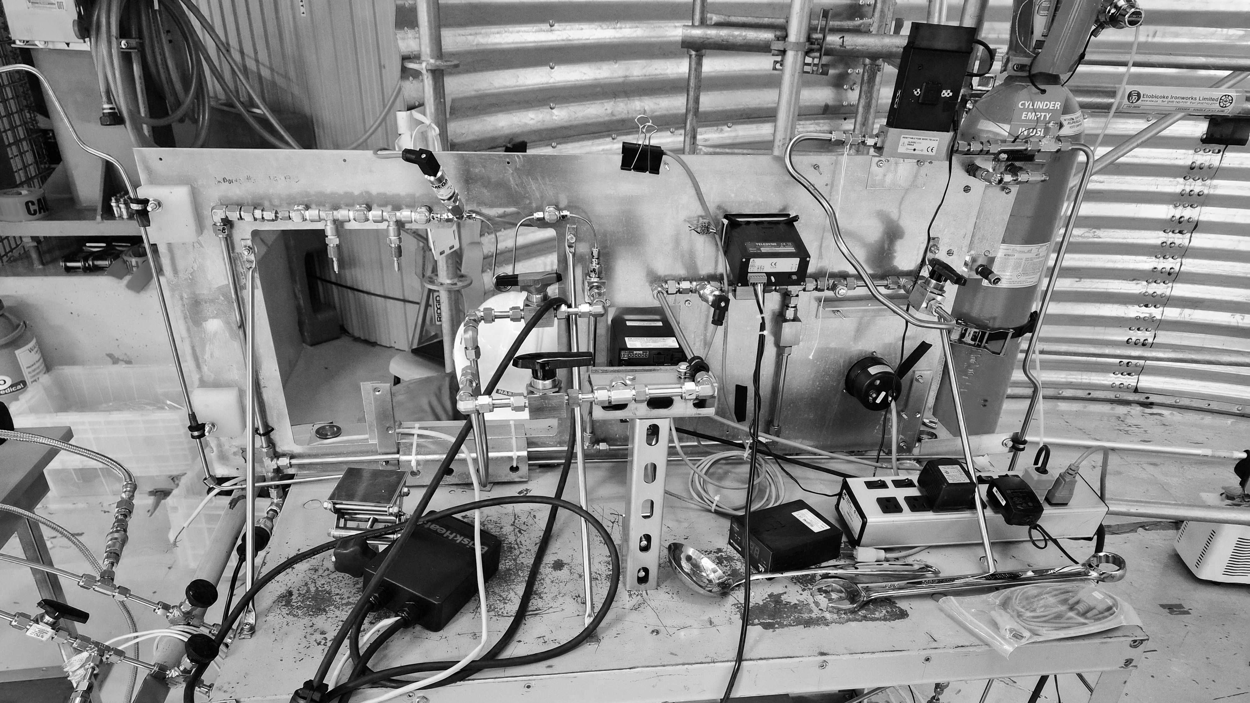
Scintillator Testing

Slide 10
Test Conditions
We want to inject a controlled amount of radon into the Lucas cells, this allows us to achieve our two goals
To minimize variation, the same Lucas cell and PMT are used
Radon Source
0.5µm Filter
Lucas Cell
2bq radium source
4-hour emanation
Notes:
To test the scintillator, we inject a known amount of radon into a lucas cell and count it. We use the same lucas cell and pmt for all trials, and filter the input to avoid contaminating the lucas cell. Mention that it is volume sharing

Slide 11
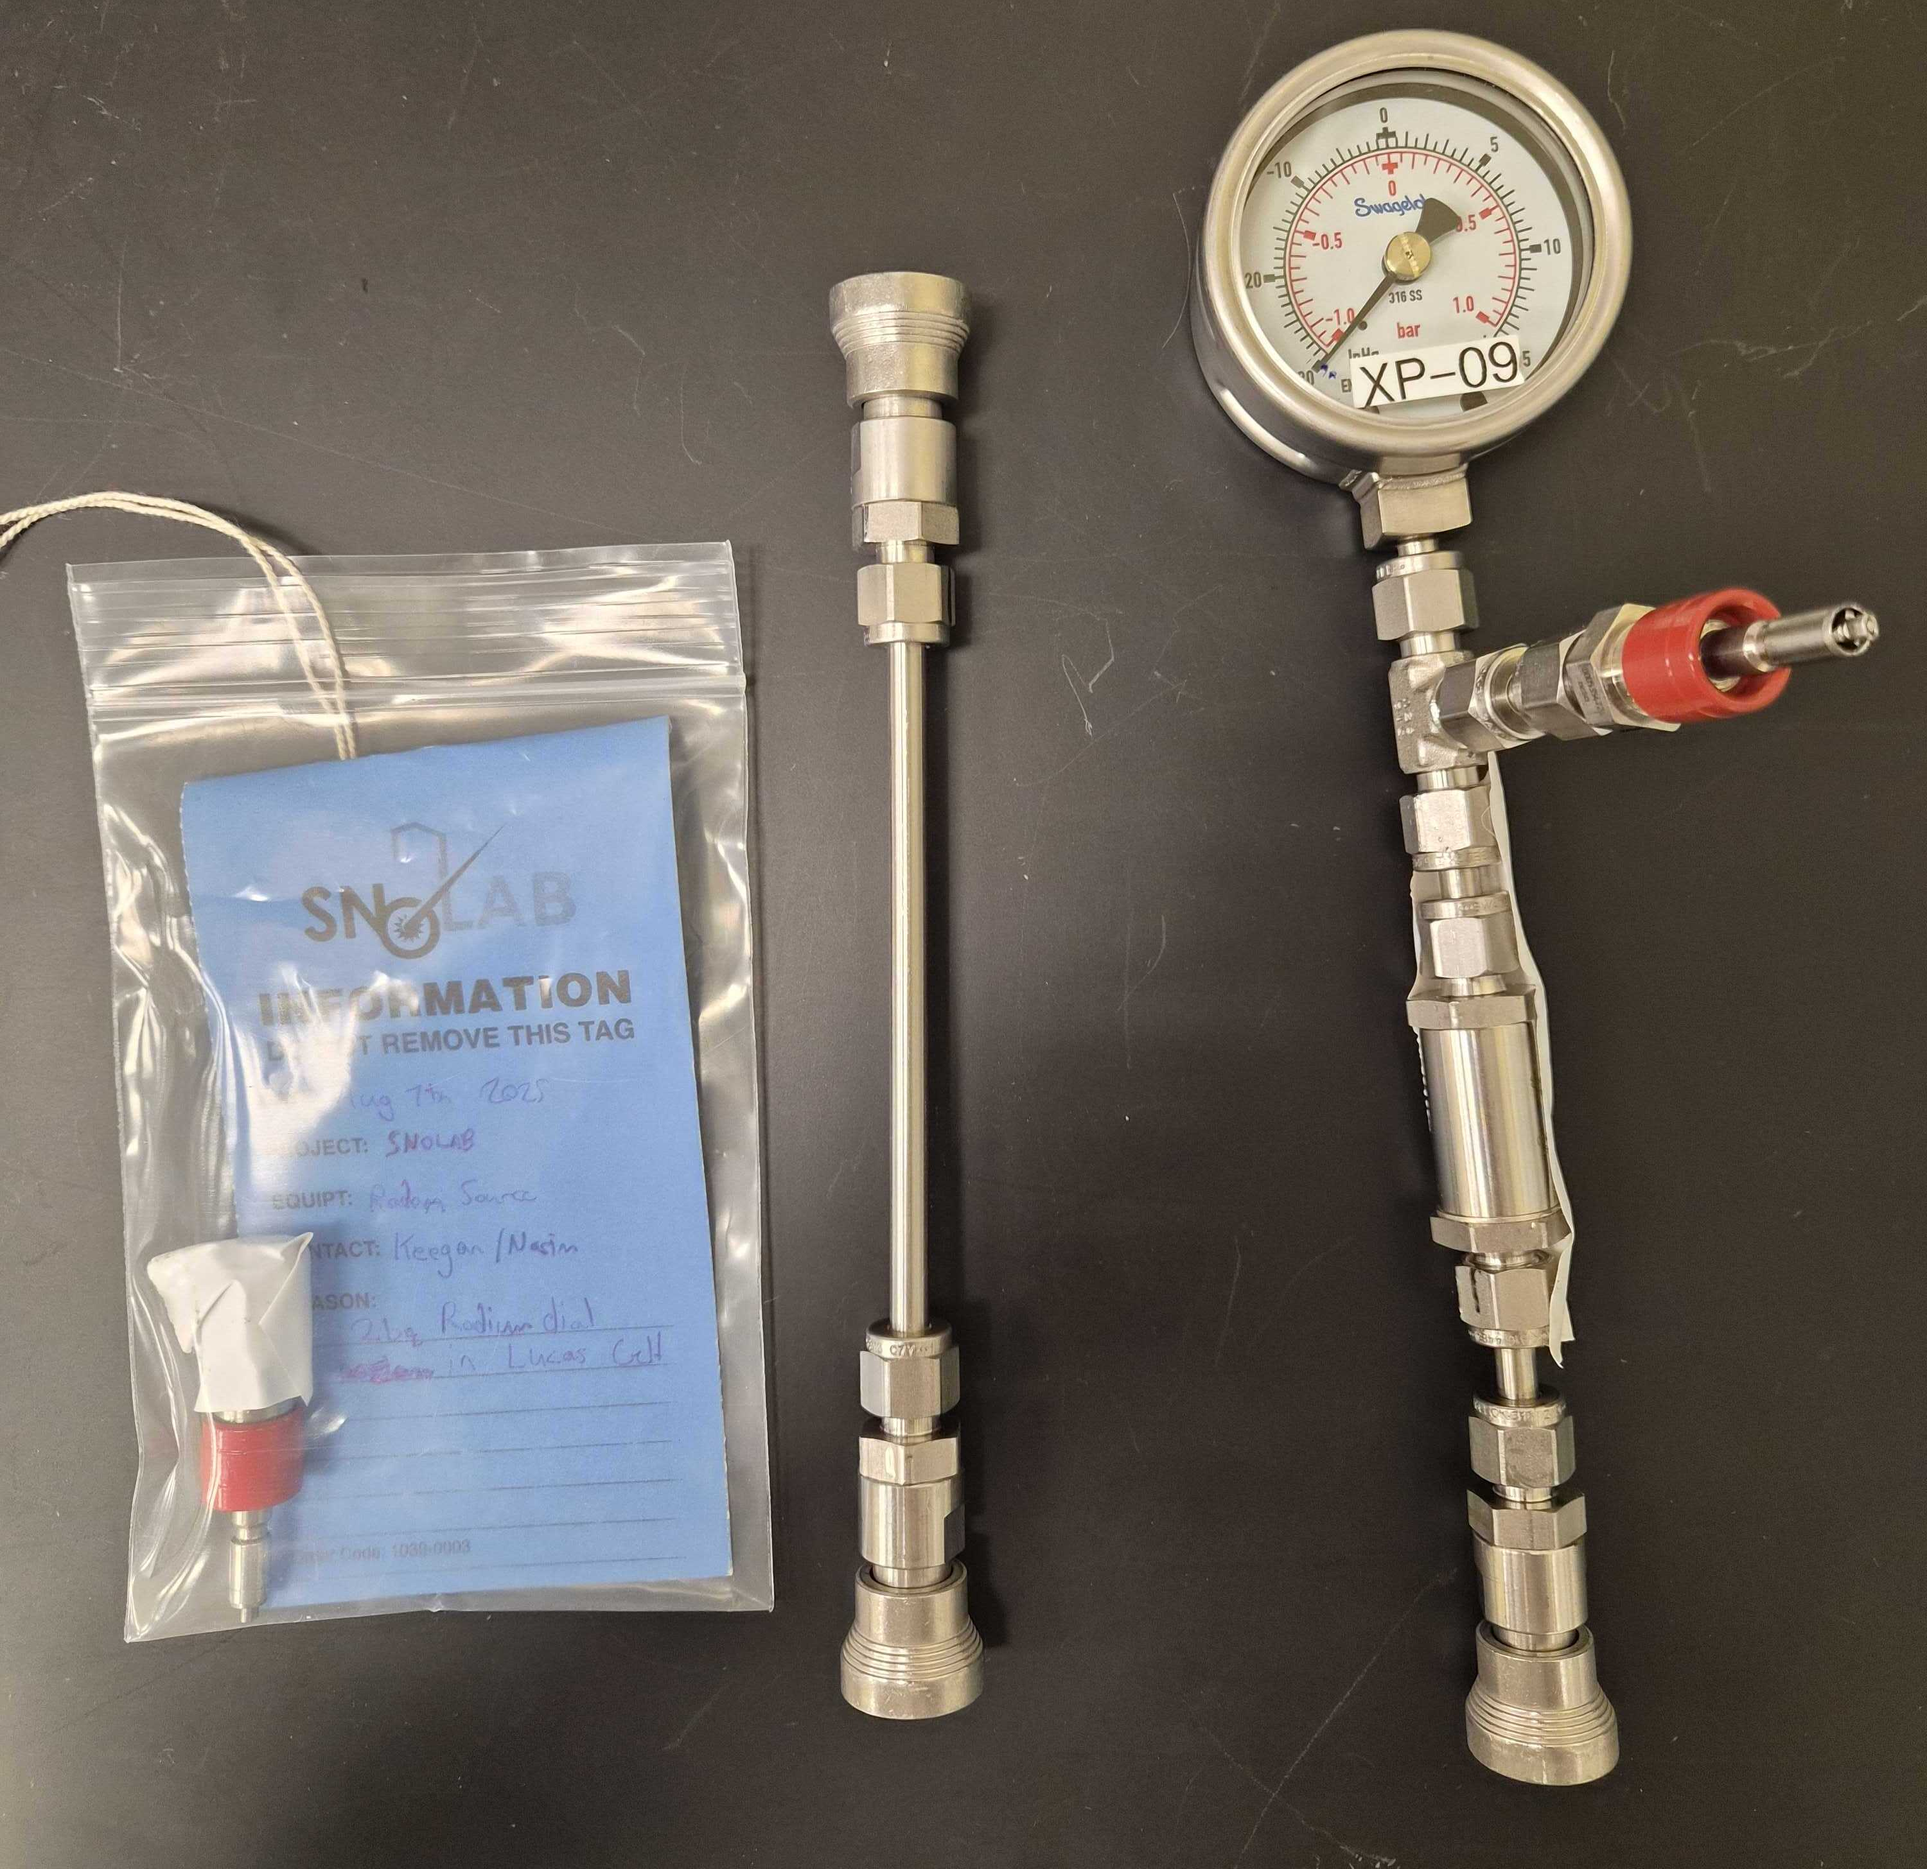
Radon Source
Currently using radium-painted watch dials as a radon source
Allow it to emanate while connected to a Lucas cell
To test efficiency, we need a consistent number of atoms
Notes:
Currently, we use a 2bq radium watch dial as a radon source that were bought by keegan paleshi. The watch dial is the left most item in this picture, it is inside a quick connect fitting, the filter to lucas cell setup is the right most, and the center item is used to connect the plumbing to a vacuum pump

Slide 12
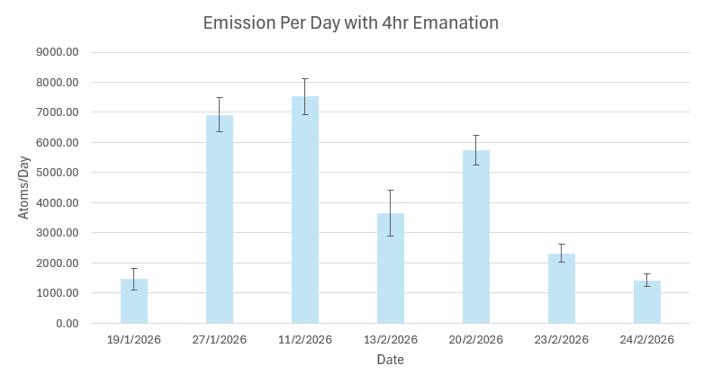
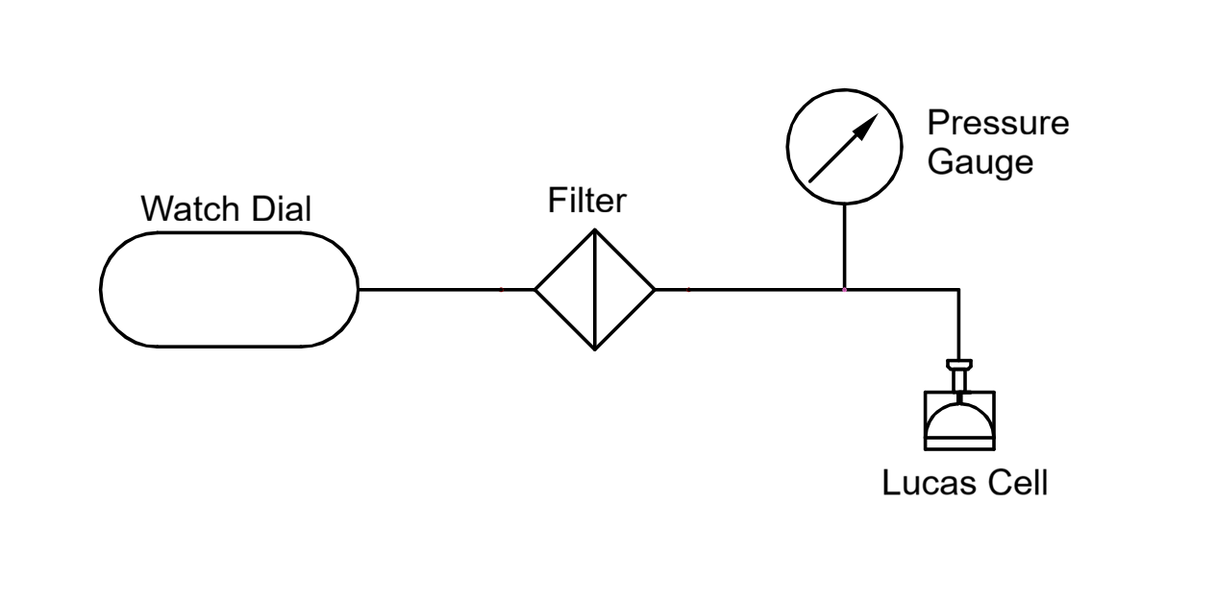
Emanation Procedure
Pumped slightly
less
Thoroughly
pumped
Neglects emanation between trials
Notes:
Our first procedure consists of pumping the Lucas cell thoroughly and pumping the plumbing stack slightly less to maintain a pressure variation pushing gas towards the lucas cell. This data does not look great, and seems to show that there may be a relationship between difference in time between trials corresponds to the emission rate

Slide 13
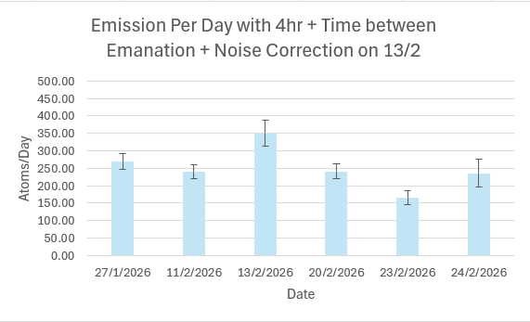
Emanation Procedure
Pumped slightly
less
Thoroughly
pumped
Emanation = 4hr + time between tests
Notes:
Correcting that, it immediately looks more statistically sound but still not perfect
The emanation time is now too long again and not as useful to us, so we must try a new procedure

Slide 14
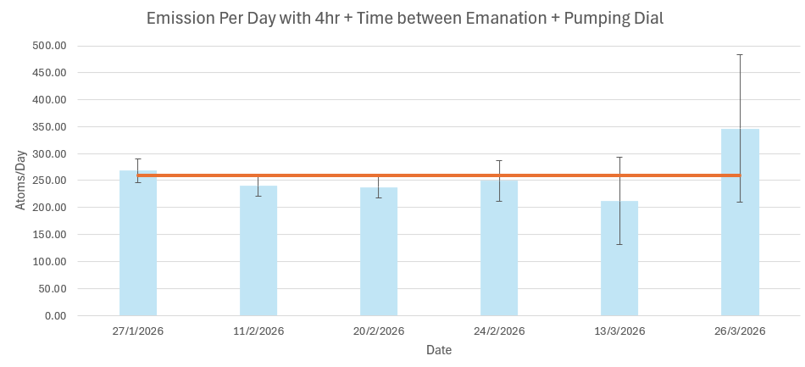
Emanation Procedure
Pumped slightly
less
Thoroughly
pumped
Remove outliers, compare new samples
Notes:
Temporarily, we remove the outliers to get a baseline to compare the new procedure to. We see agreement, but because the uncertainty is proportional to the square root of the number of counts and we are now reducing the counts by 1 or 2 orders of magnitude, the uncertainty is too high for this to be useful. This leads to one final attempt at a new procedure, where the 200bq watch dial is used instead.

Slide 15
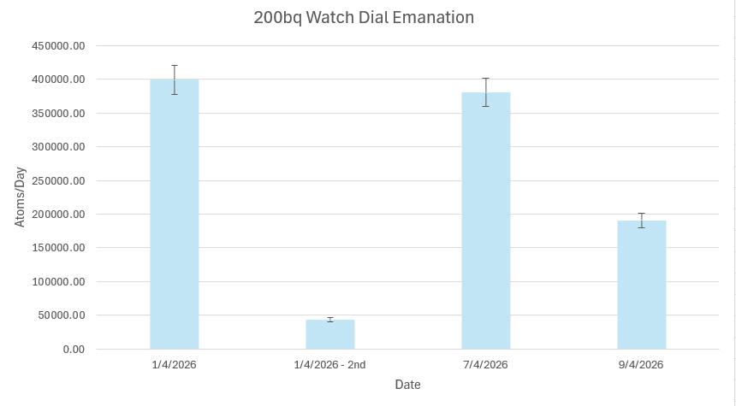
Emanation Procedure
Pumped slightly
less
Thoroughly
pumped
Up the counts with a 1hr emanation of a 200bq watch dial
Notes:
This data is even more sporadic. What could be the cause of this and the outliers we saw in the 2bq samples

Slide 16
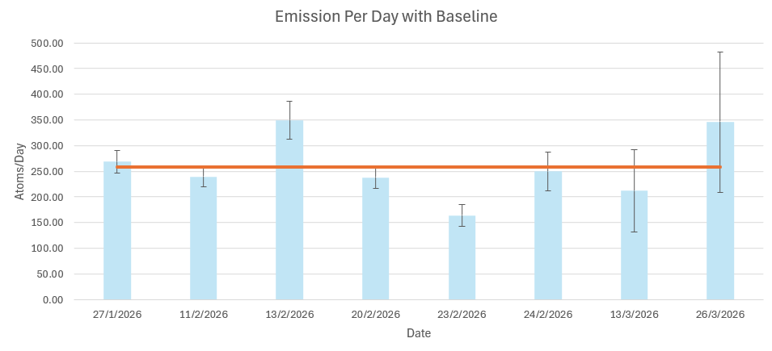
Identifying Systematic Errors
The watch dial is supposed should give consistent results for the same procedure
Why are there inconsistencies?
  Pressure variation
  DAQ stability
Notes:
Pressure – We are volume sharing so that can be very sensitive to difference in pressure between trials and between components
DAQ Stability – changes in bias voltage or electronic noise could cause inconsistent results. We cant really verify the pressure theory now, so we investigate stability more in depth

Slide 17
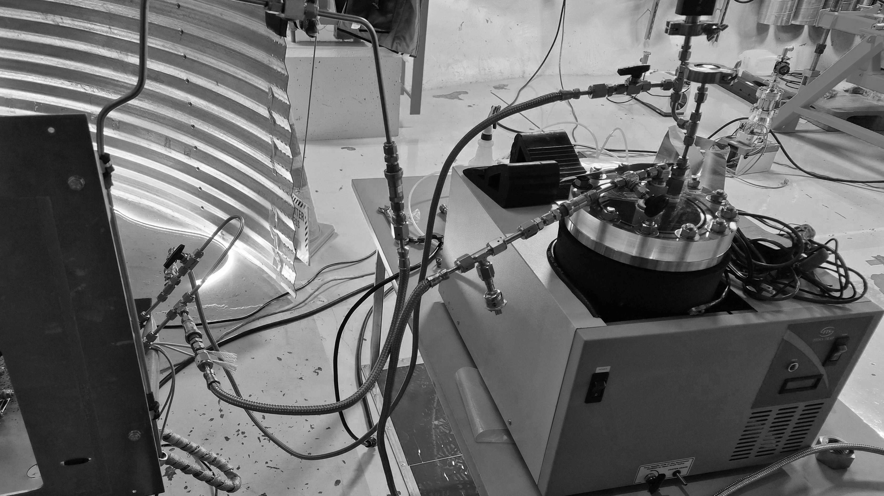
DAQ Stability

Slide 18

Test Procedure
Conduct a background count of one LC in the same channel repeatedly
Create a histogram of integrated pulses
Fitting the peaks of the data and comparing the means gives an instability.
$$\int{dn}$$
Notes:
To test the stability of our acquisition electronics, we use an old lucas cell with a well-known background of approximately 3000 counts a day and count it on the same pmt as the one used for the watch dial tests. We then integrate the pulses into what is essentially the charge of the pulse and plot that in a histogram. Because it’s the same pmt and same lucas cell, the resulting shapes should be near identical.

Slide 19
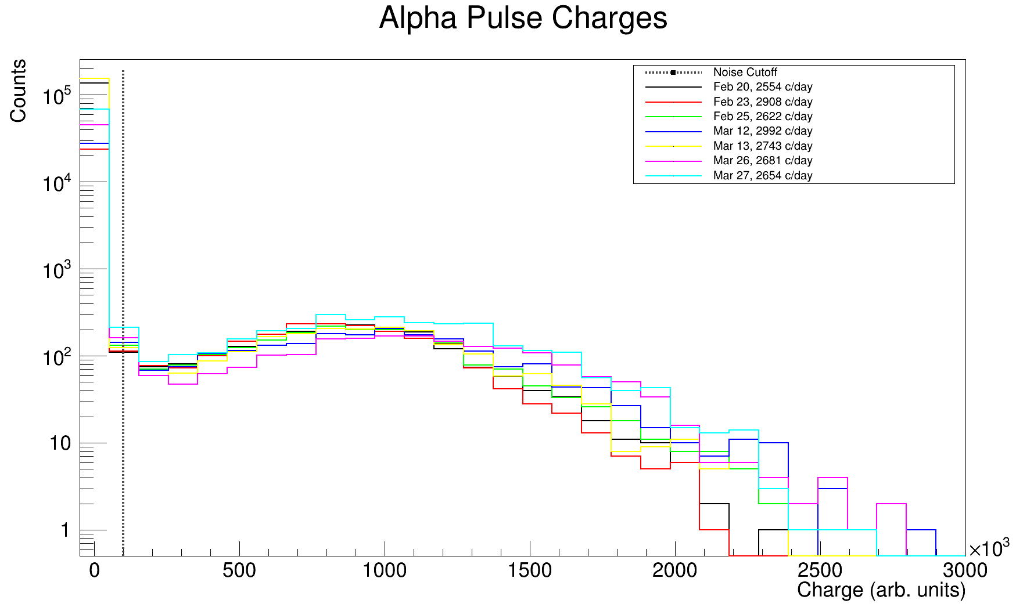
Notes:
This is the raw data plotted of 7 different backgrounds. Mention this lead 210 decay, from an old lucas cell from the SNO days. There is definitely variation between samples, and a surprising amount at that.

Slide 20
Notes:
With each data set fit with a Gaussian and compared, both peak to peak and comparing the mean values of the fits, the variation between the two extremes is about 33%. This is a dramatic result, meaning measurements on this channel have a very high intrinsic uncertainty.

Slide 21
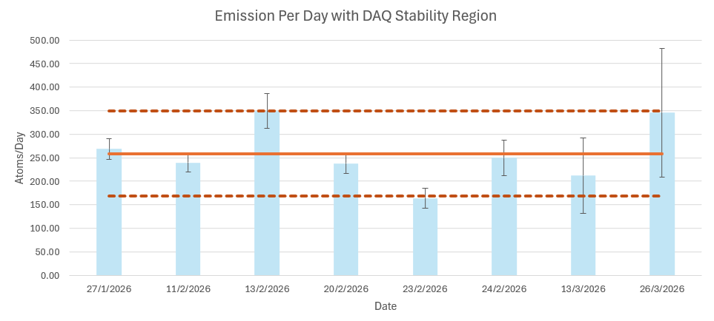
Notes:
With this uncertainty range, it is possible that this instability accounts for the outliers observed in the 2bq tests, but considering the dramatic changes in the 200bq tests, it cannot account for all systematic errors in the procedures. This means we cannot do absolute efficiency measurements, but we can look at shapes to get a relative
Fix date formats

Slide 22
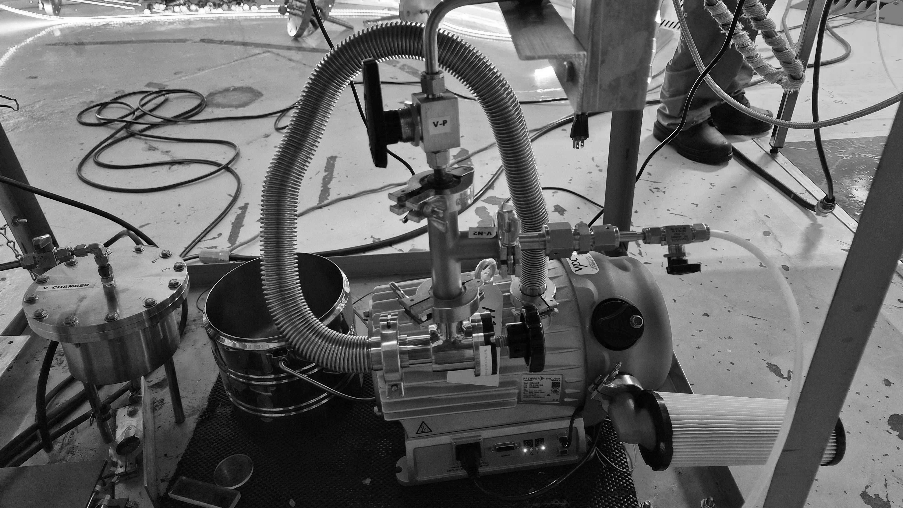
Shape Comparison
Notes:
What we can do with this procedure though, is compare light yield across manufacturers.

Slide 23
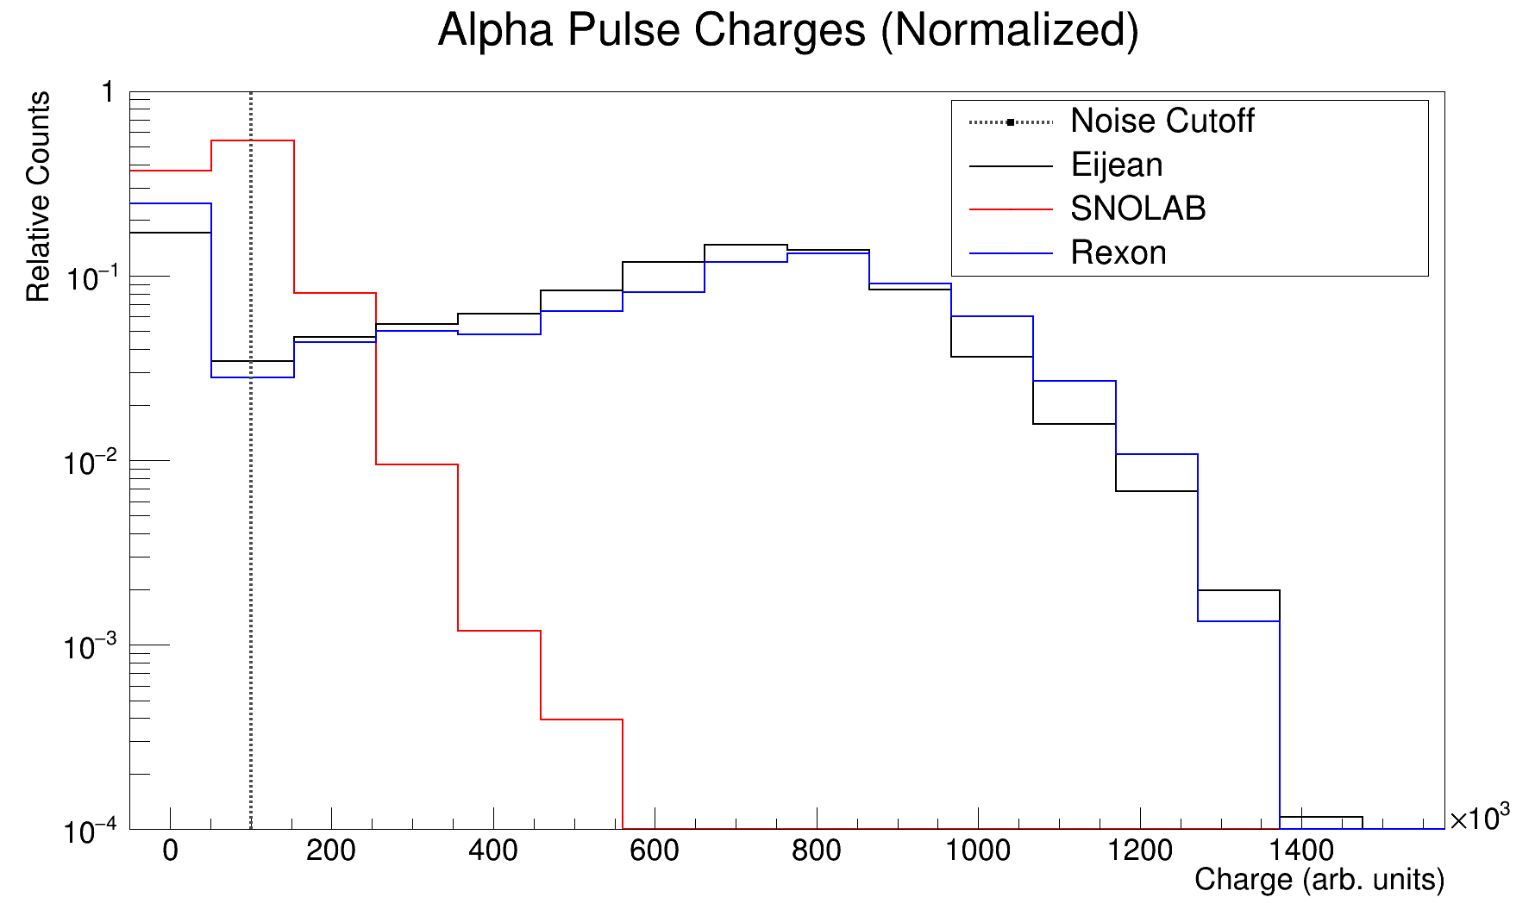
Notes:
This is a normalized view of 3 different manufacturers after a 10 minute, 200 bq emanation. The similarity between the Eijean and Rexon lucas cells gives a good indication that high purity ZnS must have a light yield spectrum similar in shape to this response. This highlights the faults of our current manufacturing capabilities quite clearly, the shift to the left is indicative of a reduced efficiency the oxidization that gives our scintillator its brown colour.

Slide 24
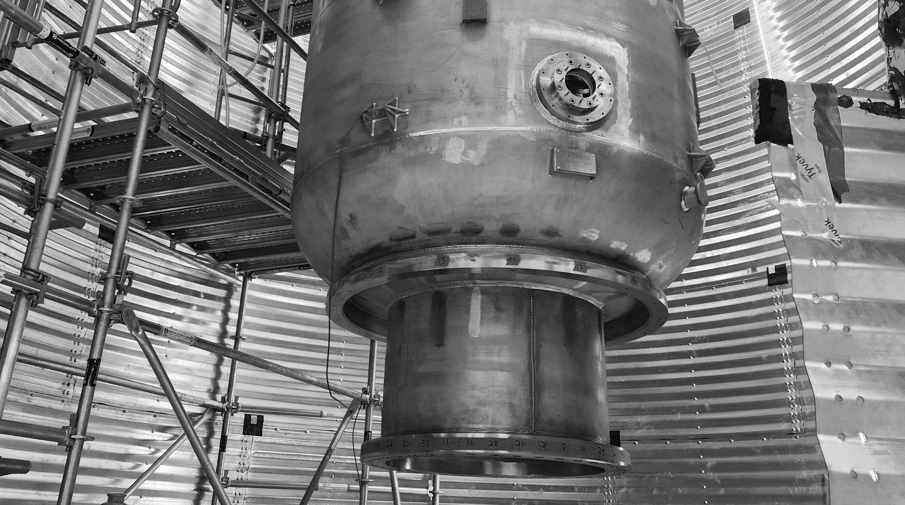
Future Steps

Slide 25
Future Steps
Purchasing a calibrated radon source for reliable efficiency testing.
Evaluate radon source containment.
Re-evaluate trials with a refined cutoff
Purchasing a vacuum furnace to produce higher purity ZnS(Ag) in house.
Evaluate other PMTs for stability.
Notes:
Mention oxidization in our zns
For radon source containment also mention opening it
The uncertainty is currently not reported by channel for pmt
Radon source from pylon, it’s a low source so it should not be too much of a problem for other stuff

Slide 26
Acknowledgements
Thanks to
Nasim Fatemighomi
Steve Maguire
Peter Qin
Keegan Paleshi

