Slide 1
GEANT4: Simulating Our Way Towards the Future
2026/04/17
Liam Hickey
Undergraduate Research Assistant

Slide 2
Why Upgrade SNOLAB's GEANT4 Version?​
Used for experiments at SNOLAB
Our version is ~10 years old (10.2.0)
We need an upgrade!

Slide 3


Why Upgrade SNOLAB's GEANT4 Version?​
Used for experiments at SNOLAB
Our version is ~10 years old (10.2.0)
We need an upgrade!

Slide 4
Why Upgrade SNOLAB's GEANT4 Version?​
Used for experiments at SNOLAB
Our version is ~10 years old (10.2.0)
We need an upgrade!

Slide 5
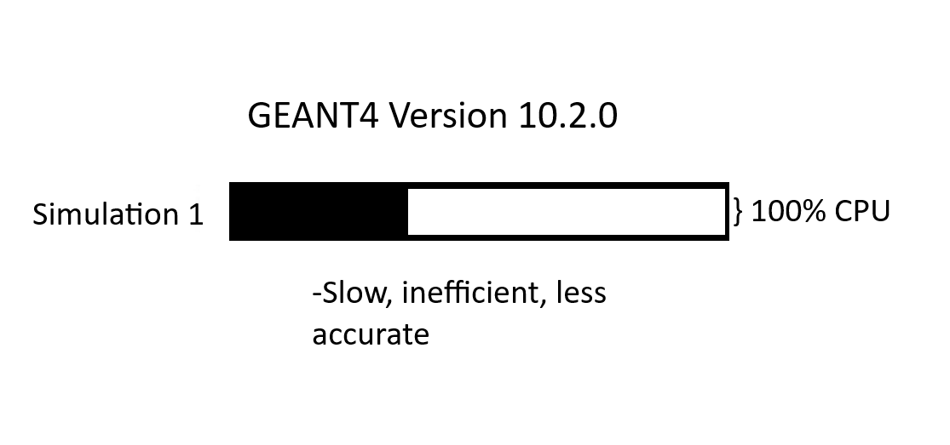
Why Upgrade SNOLAB's GEANT4 Version?​

Slide 6
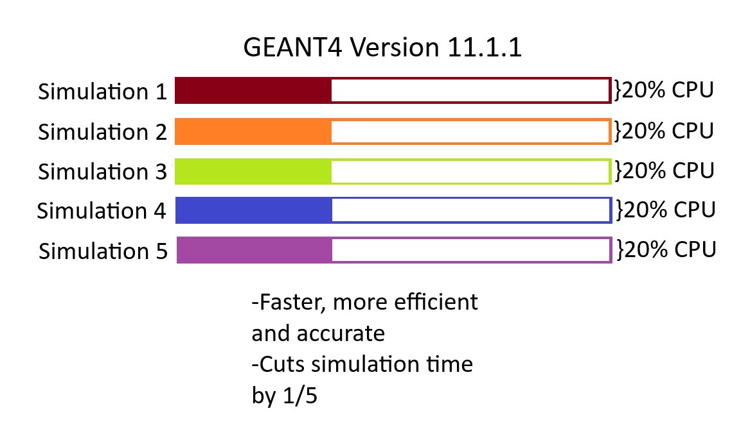
Why Upgrade SNOLAB's GEANT4 Version?​
by 4/5ths

Slide 7
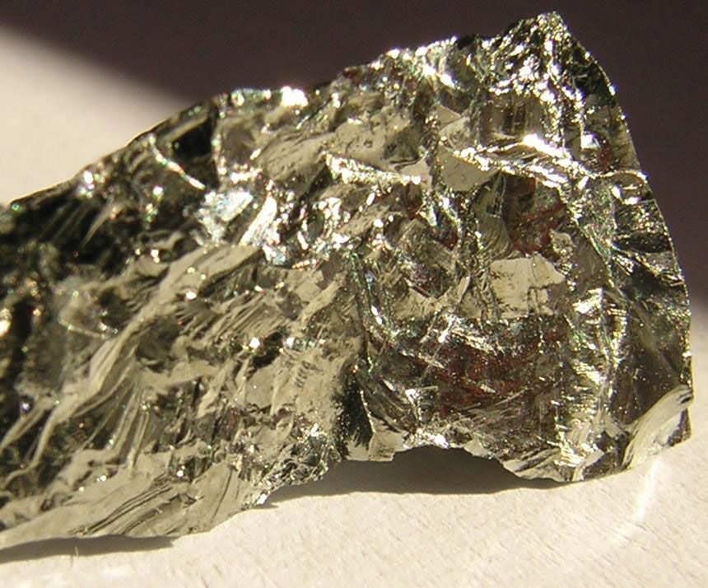
HPGe Detector - Principle of Operation
HPGe = High Purity Germanium. Very sensitive semiconductor
Gammas are characteristic
Gamma energy proportional to PIN diode current

Slide 8
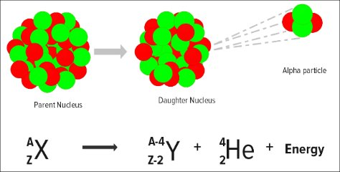
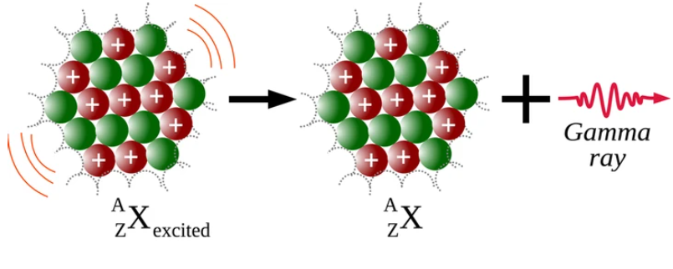
HPGe Detector - Principle of Operation
HPGe = High Purity Germanium. Very sensitive semiconductor
Gammas are characteristic
Gamma energy proportional to PIN diode current

Slide 9
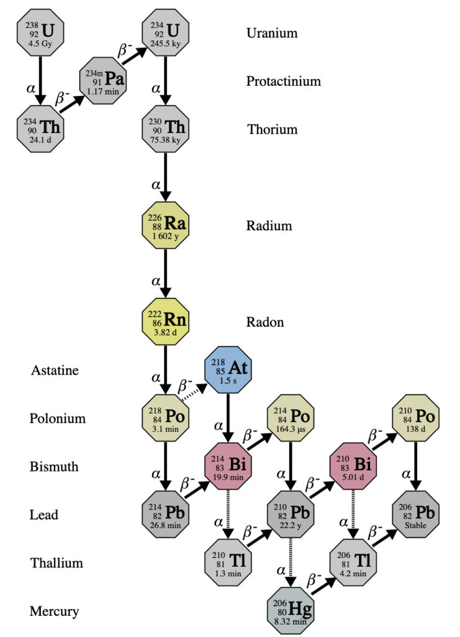
HPGe Detector - Principle of Operation
HPGe = High Purity Germanium. Very sensitive semiconductor
Gammas are characteristic
Gamma energy proportional to PIN diode current

Slide 10

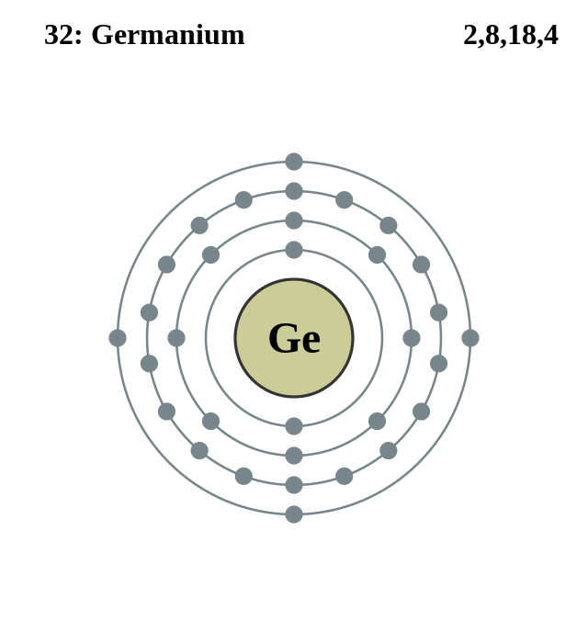
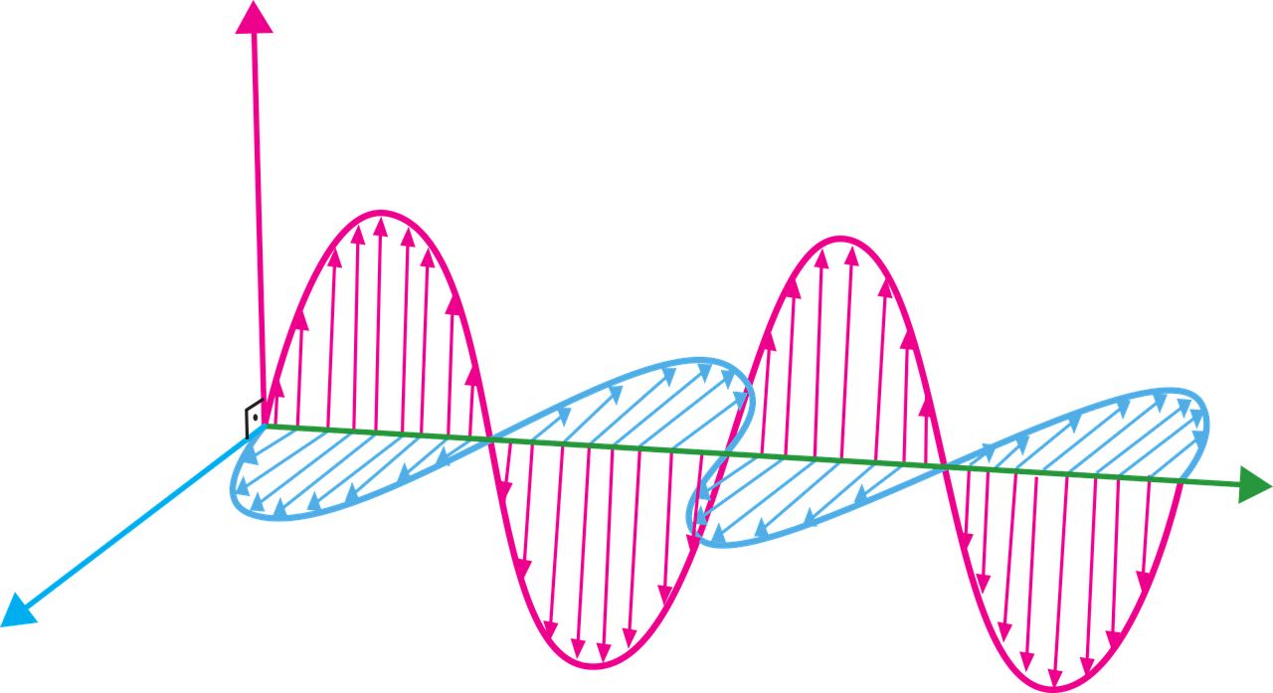
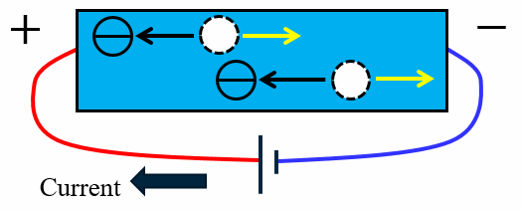
HPGe Detector - Principle of Operation
HPGe = High Purity Germanium. Very sensitive semiconductor
Gammas are characteristic
Gamma energy proportional to PIN diode current
Gamma Ray

Slide 11
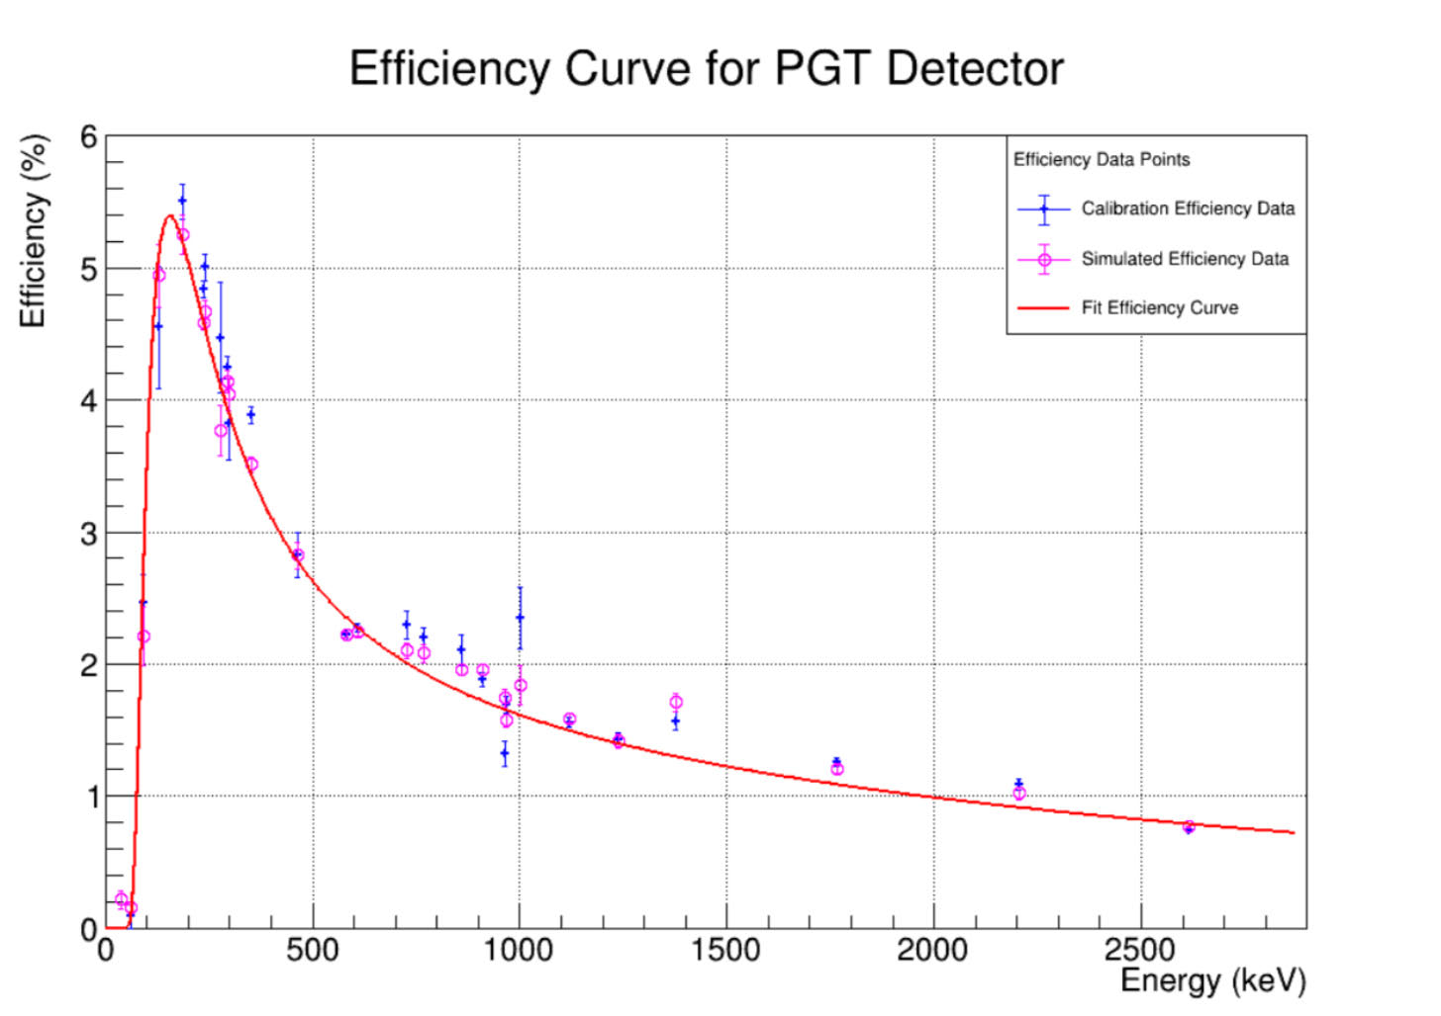
Efficiency and Calibration sources
Detector Energy Efficiency = # of detections/# of decays
Detectors can be selectively sensitive (only photopeaks)
Efficiency curve of given detector calibrated with source of known activity level
Use efficiency to tell actual # of decays that occurred

Slide 12
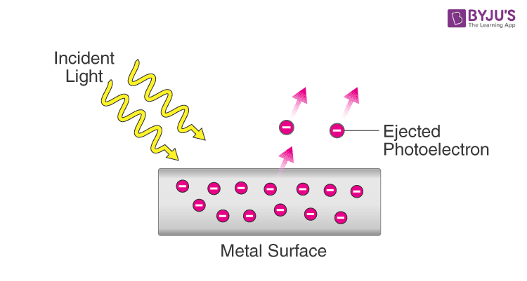
Efficiency and Calibration sources
Detector Energy Efficiency = # of detections/# of decays
Detectors can be selectively sensitive (only photopeaks)
Efficiency curve of given detector calibrated with source of known activity level
Use efficiency to tell actual # of decays that occurred

Slide 13
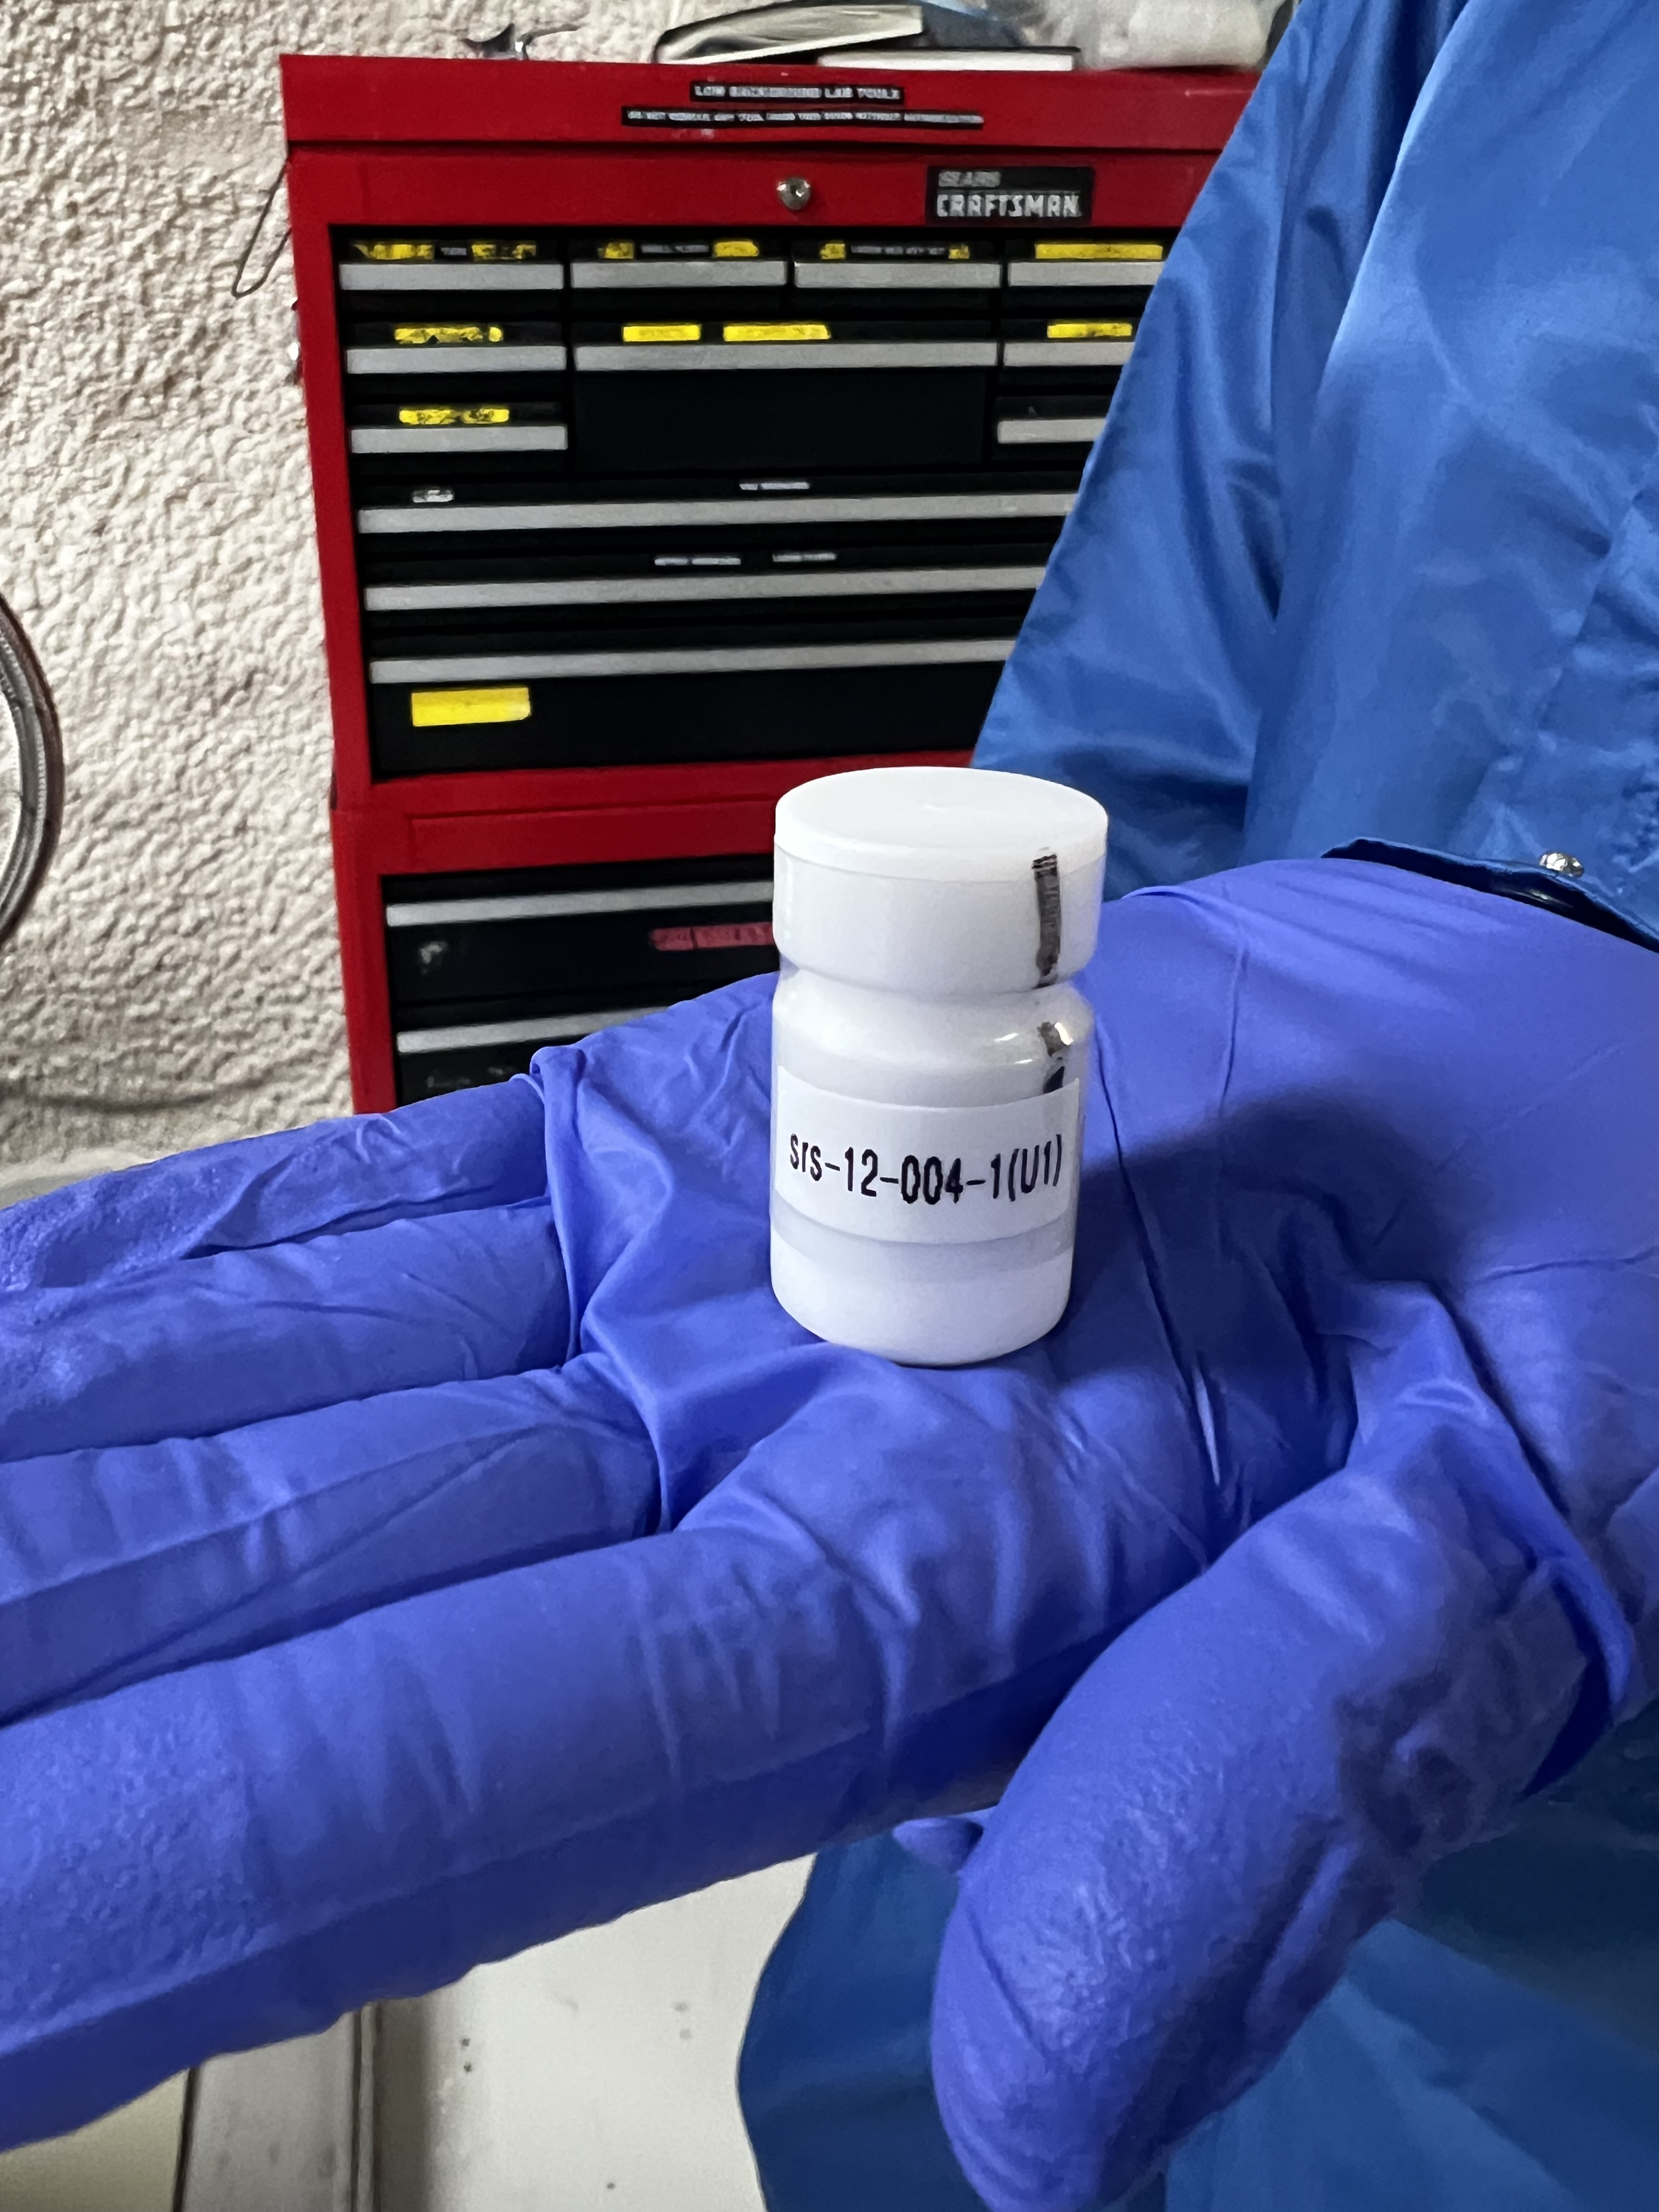
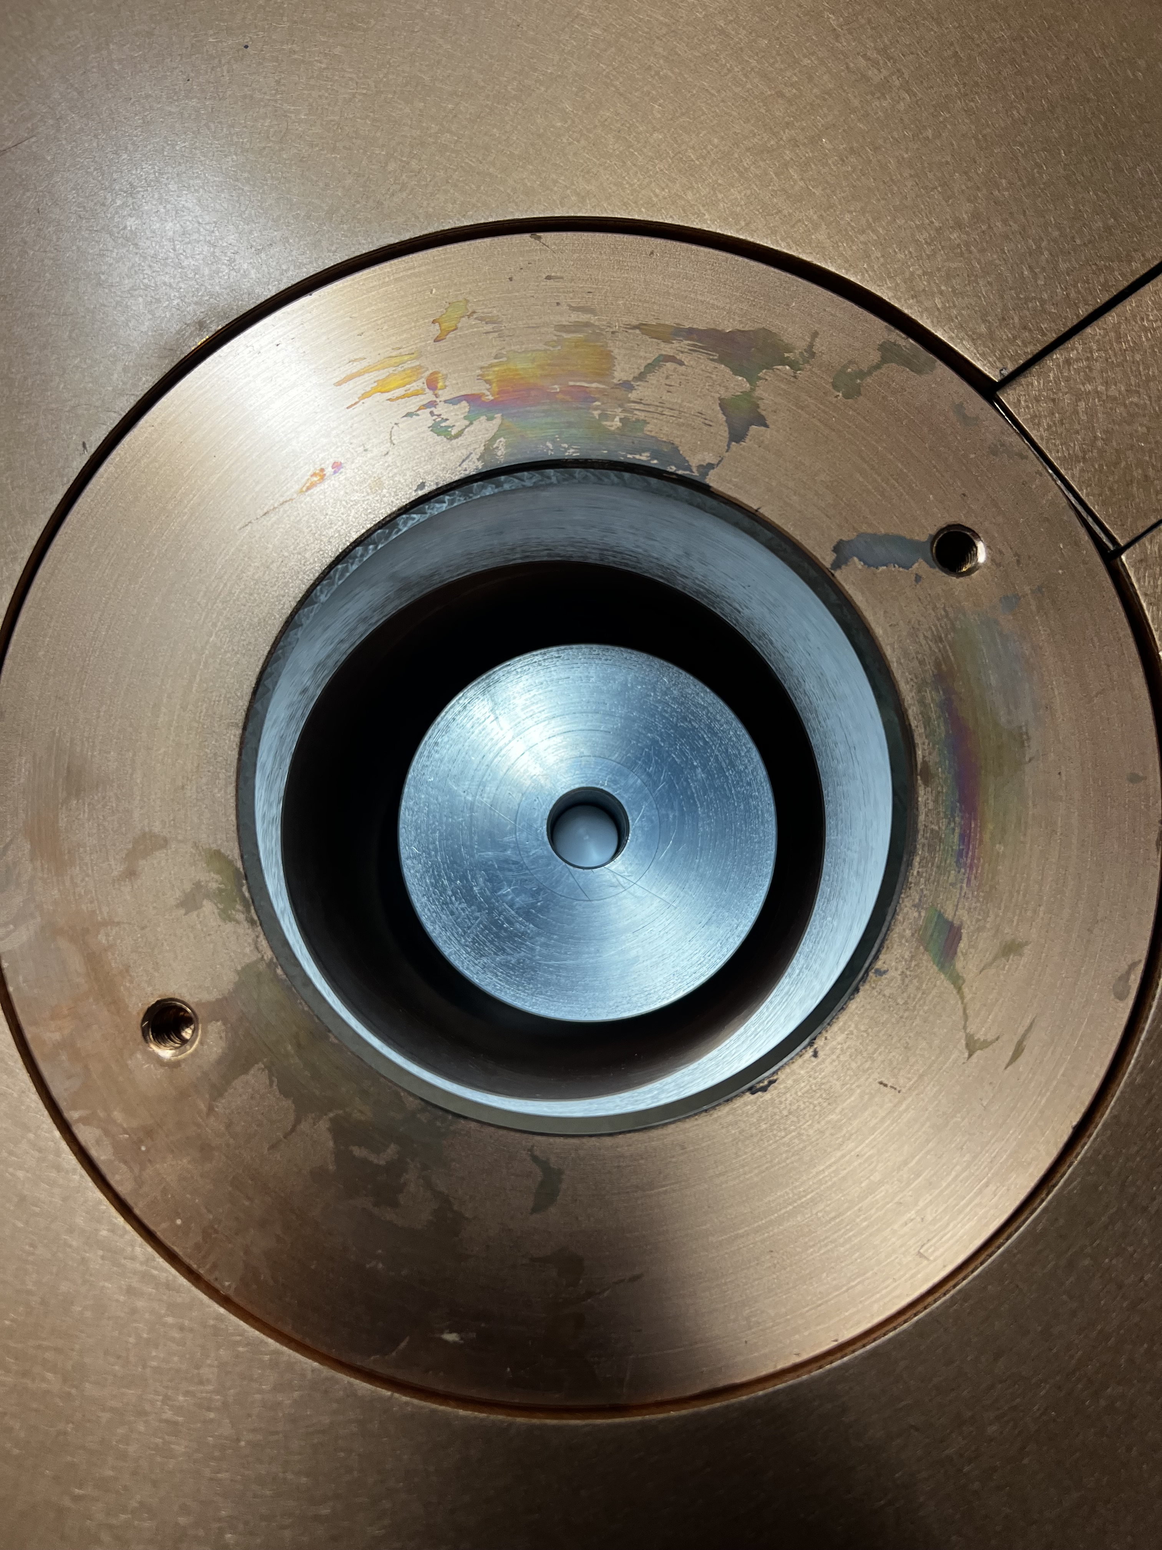
Efficiency and Calibration sources
Detector Energy Efficiency = # of detections/# of decays
Detectors can be selectively sensitive (only photopeaks)
Efficiency curve of given detector calibrated with source of known activity level
Use efficiency to tell actual # of decays that occurred
Uranium and Thorium "Sand"
U & Th "Sand" in Well Detector

Slide 14
How to Upgrade?
1.) Obtain calibration data
2.) Simulate source
3.) Compare efficiency curves
4.) Adjust
5.) Repeat 2.)-4.)

Slide 15
How to Upgrade?
1.) Obtain calibration data
2.) Simulate source in detector
3.) Compare efficiency curves
4.) Adjust
5.) Repeat 2.)-4.)

Slide 16
How to Upgrade?
1.) Obtain calibration data
2.) Simulate source in detector
3.) Compare efficiency curves
4.) Adjust
5.) Repeat 2.)-4.)

Slide 17
How to Upgrade?
1.) Obtain calibration data
2.) Simulate source in detector
3.) Compare efficiency curves
4.) Adjust
5.) Repeat 2.)-4.)

Slide 18
How to Upgrade?
1.) Obtain calibration data
2.) Simulate source in detector
3.) Compare efficiency curves
4.) Adjust
5.) Repeat 2.)-4.)

Slide 19
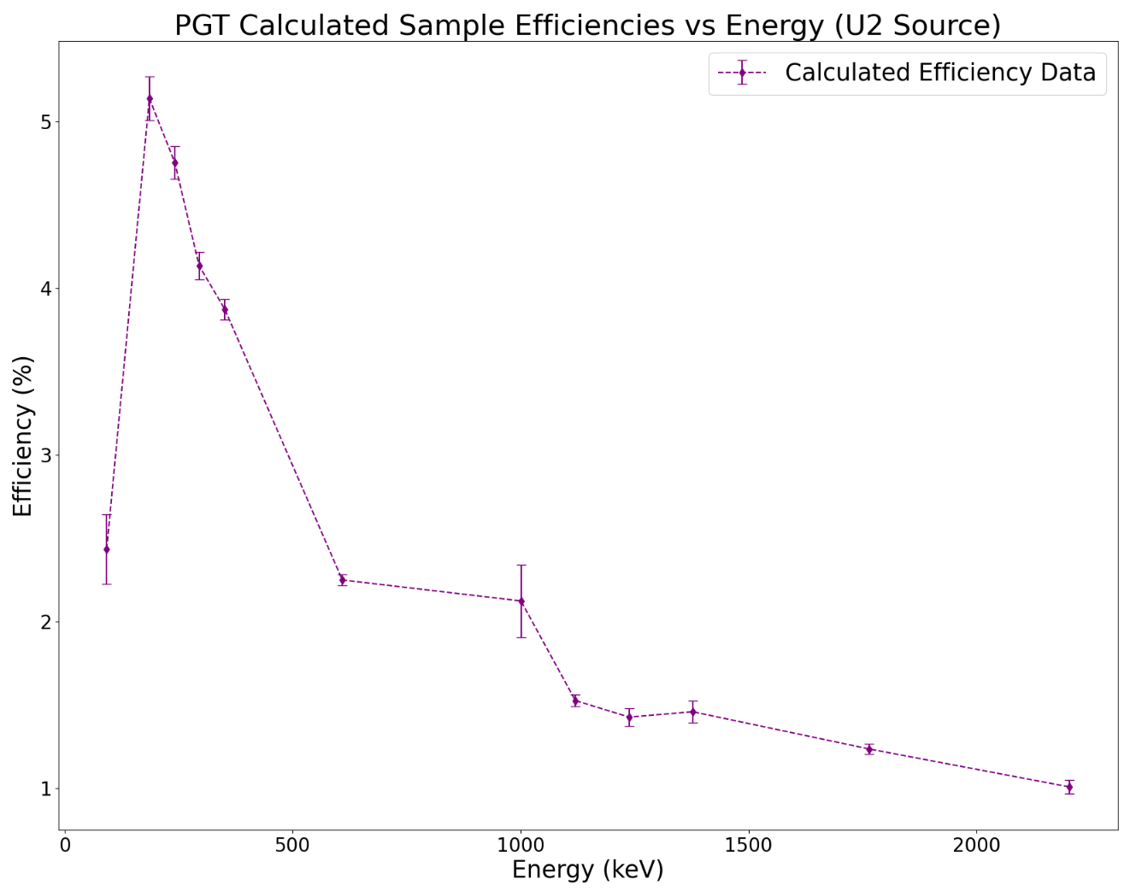
Results
1.) Obtain calibration data

Slide 20
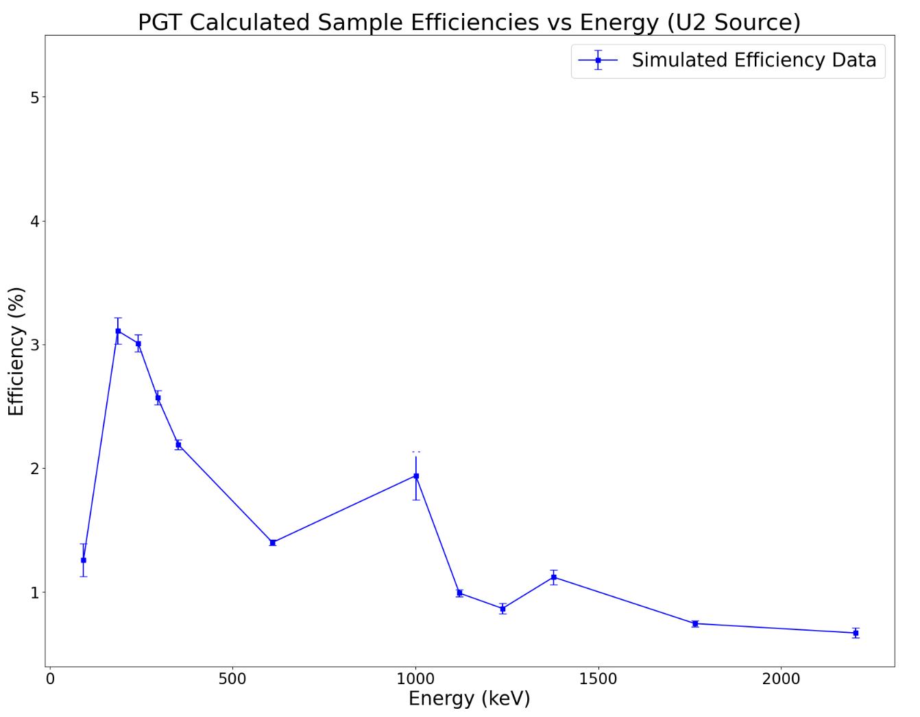
Results
2.) Simulate source

Slide 21
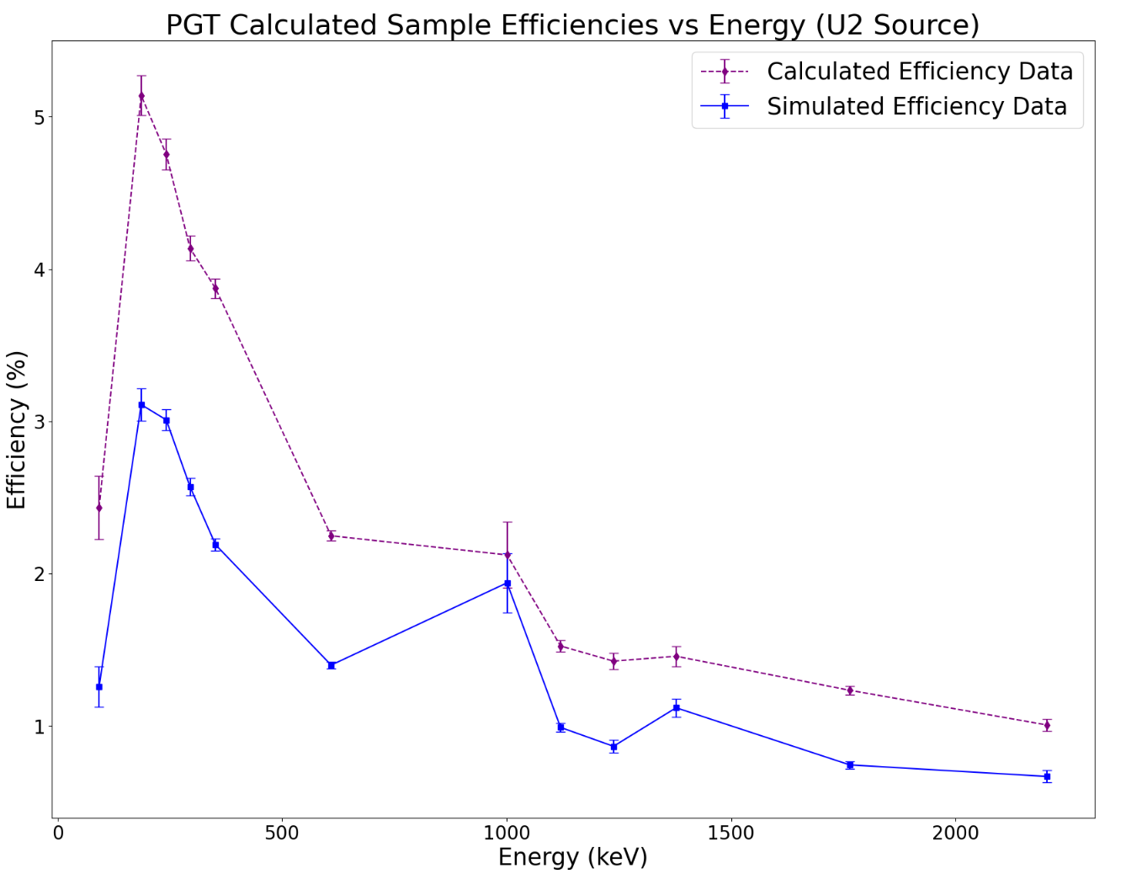
Results
3.) Compare efficiency curves

Slide 22
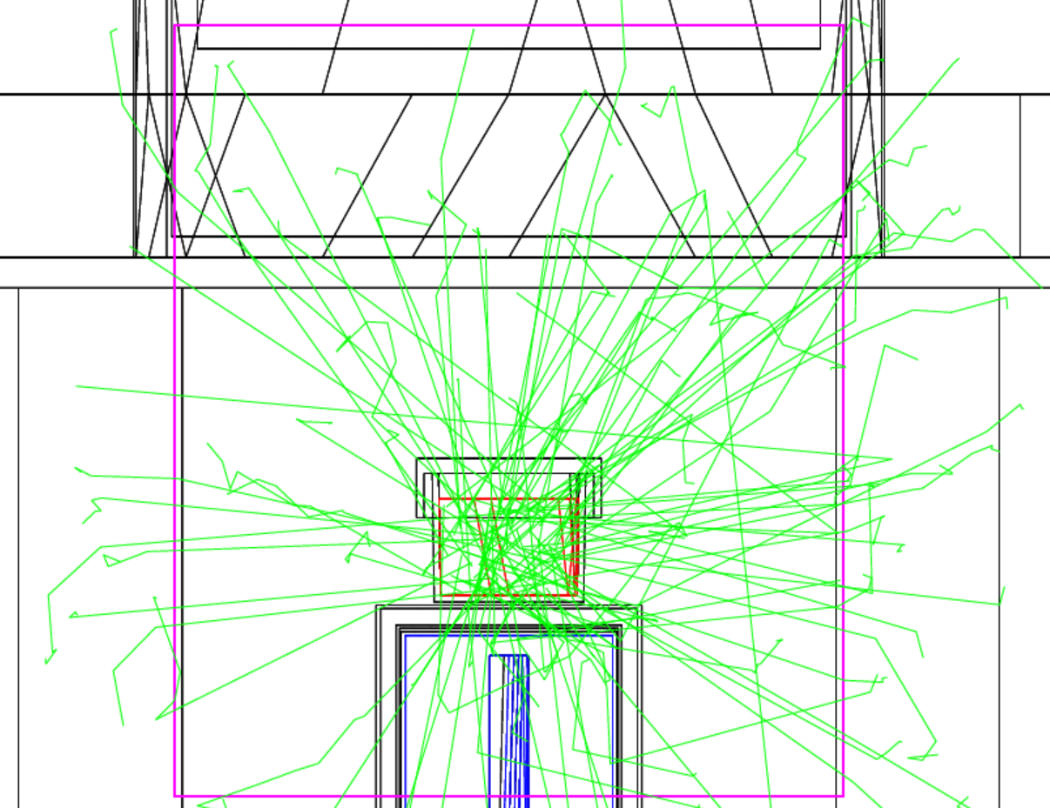
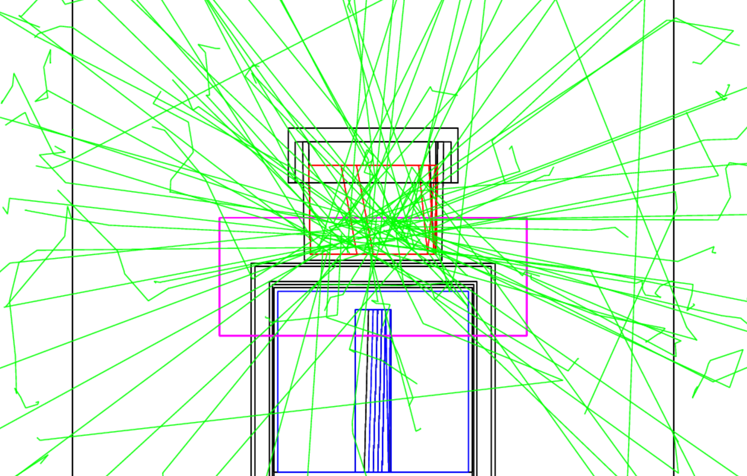
Results
4.) Adjust
Increase Bounding Box size?

Slide 23
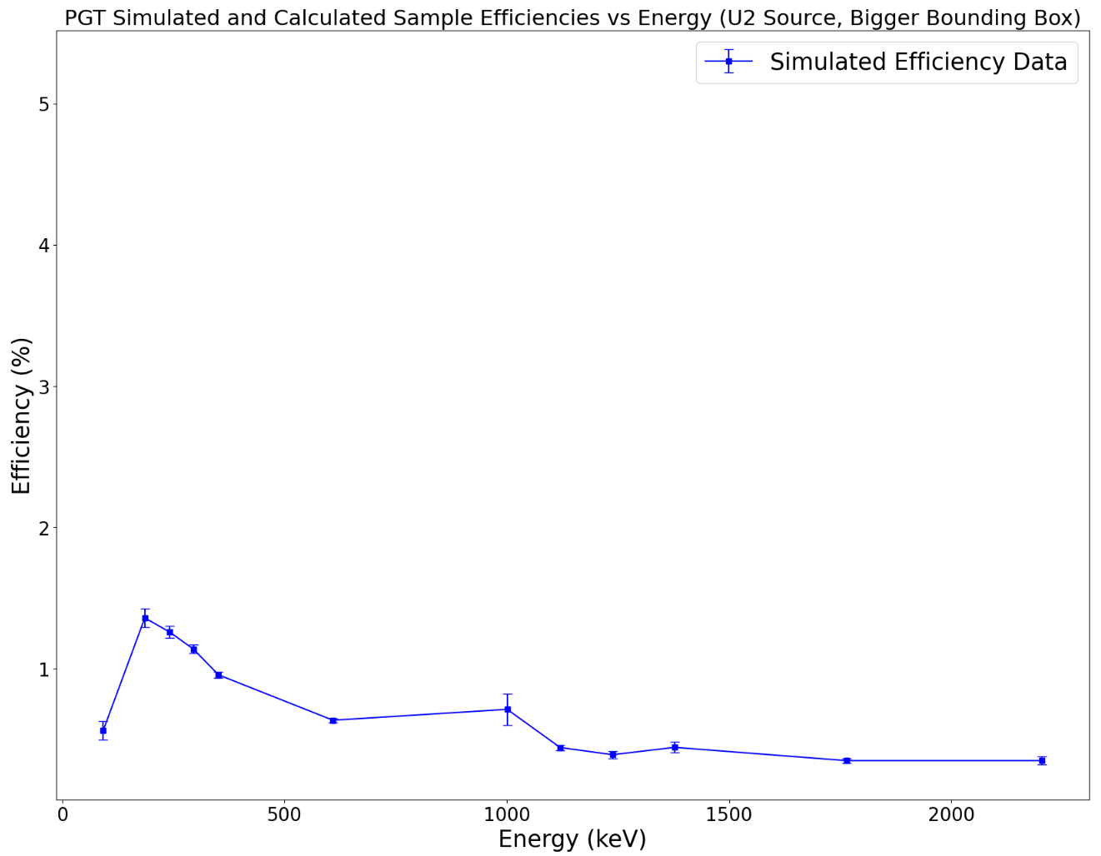
Results
2.) Simulate source (bigger BB)

Slide 24
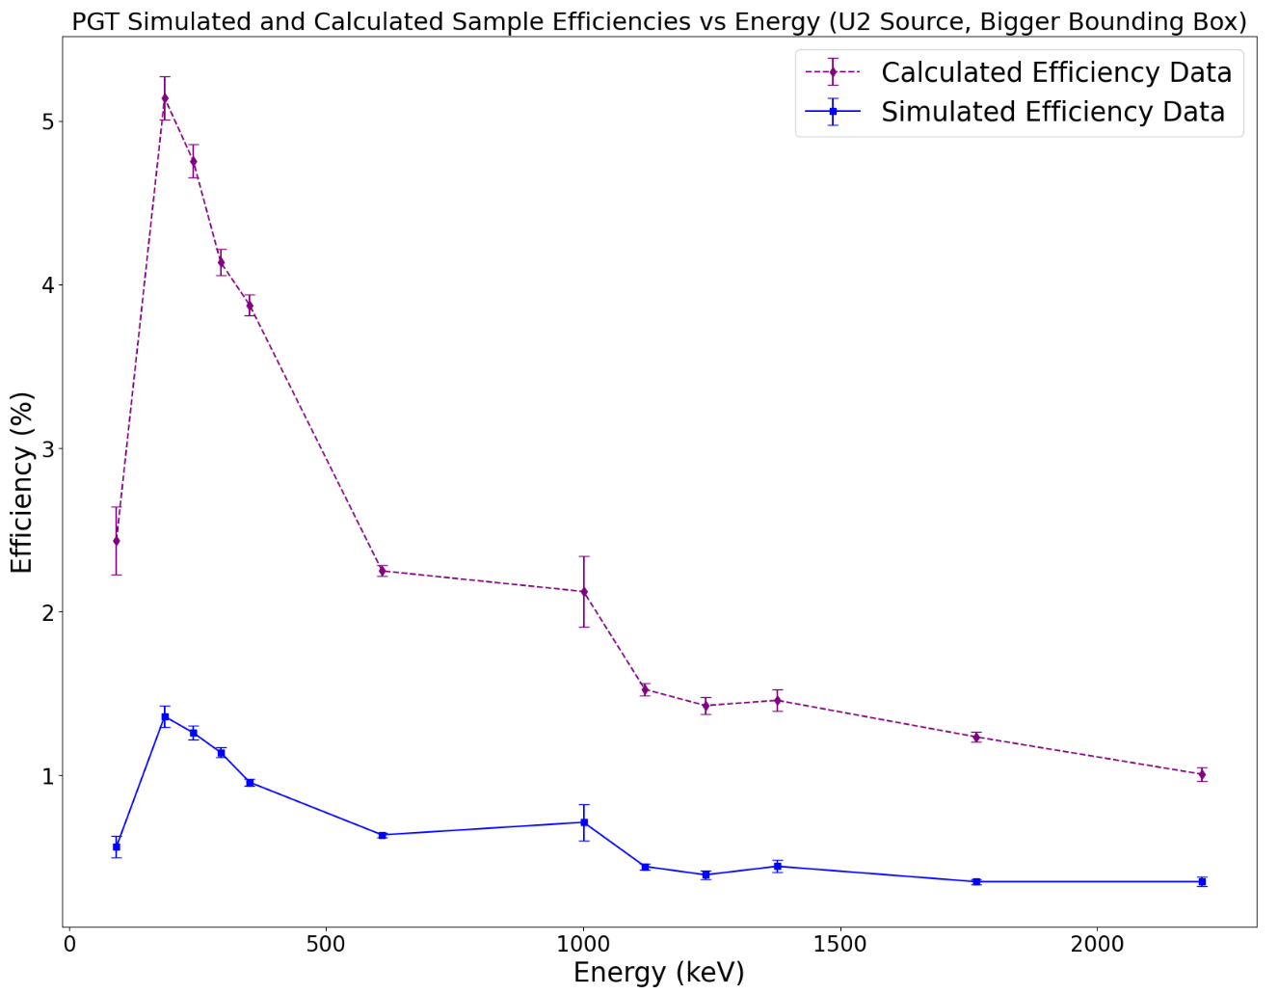
Results
3.) Compare efficiency curves
(bigger BB)

Slide 25
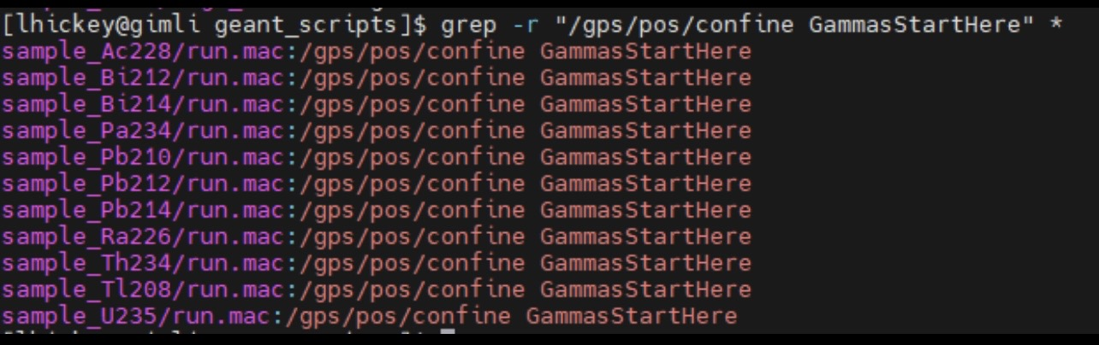
Results
4.) Adjust
What if we named every Source_Solid the same thing?

Slide 26
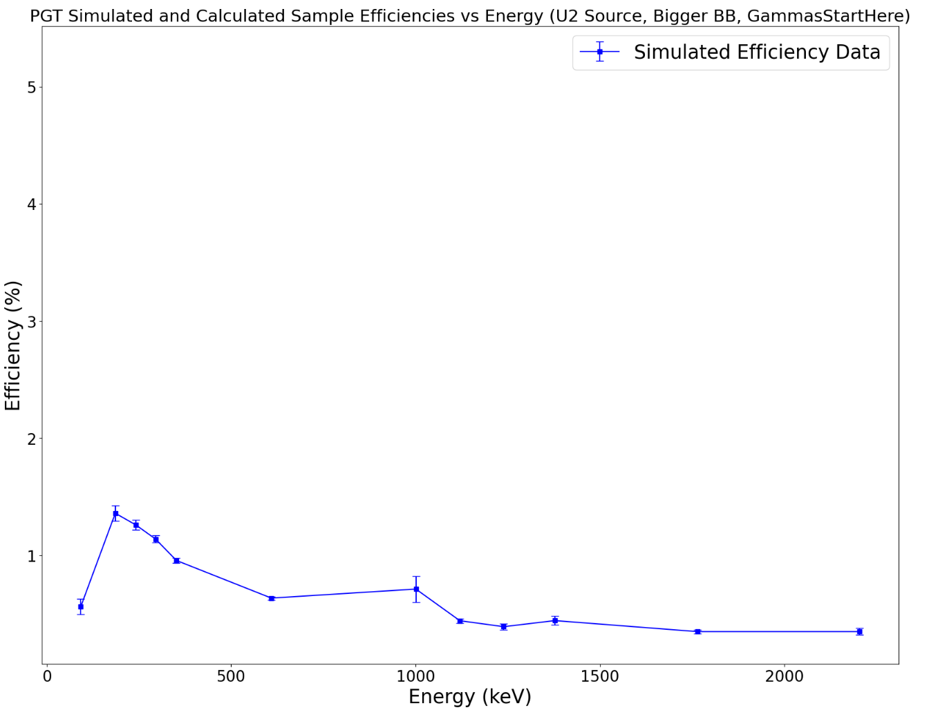
Results
2.) Simulate source
(bigger BB, GammasStartHere)

Slide 27
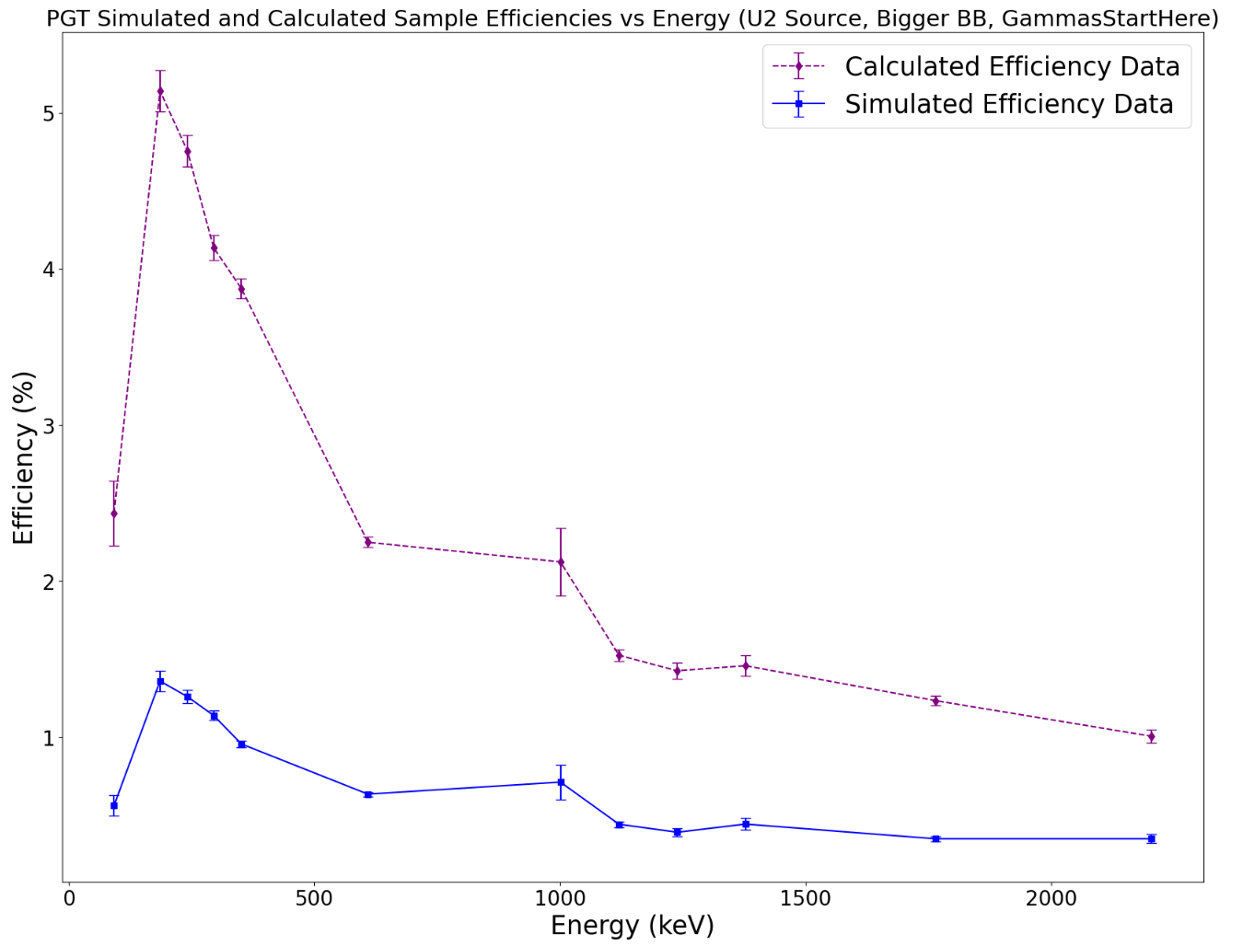
Results
3.) Compare efficiency curves
(bigger BB, GammasStartHere)

Slide 28
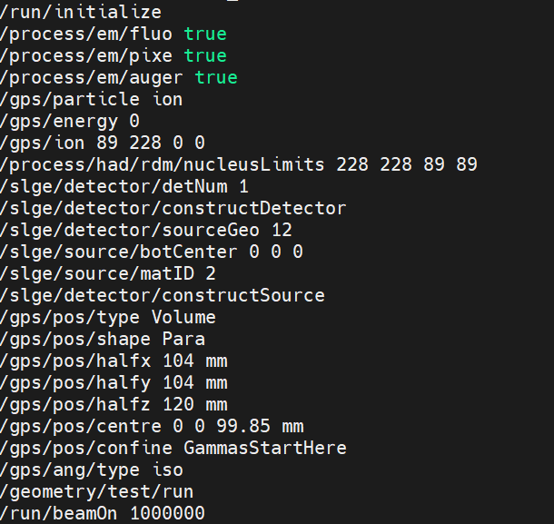
Results
4.) Include line of code in Submit_Batch.pl -
/gps/pos/confine - it was missing!

Slide 29
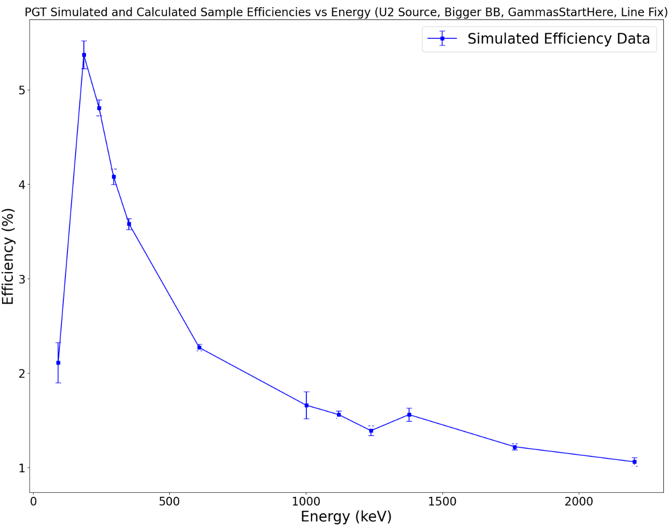
Results
3.) Simulate source
(bigger BB, GammasStartHere, gps/confine/confine included)

Slide 30
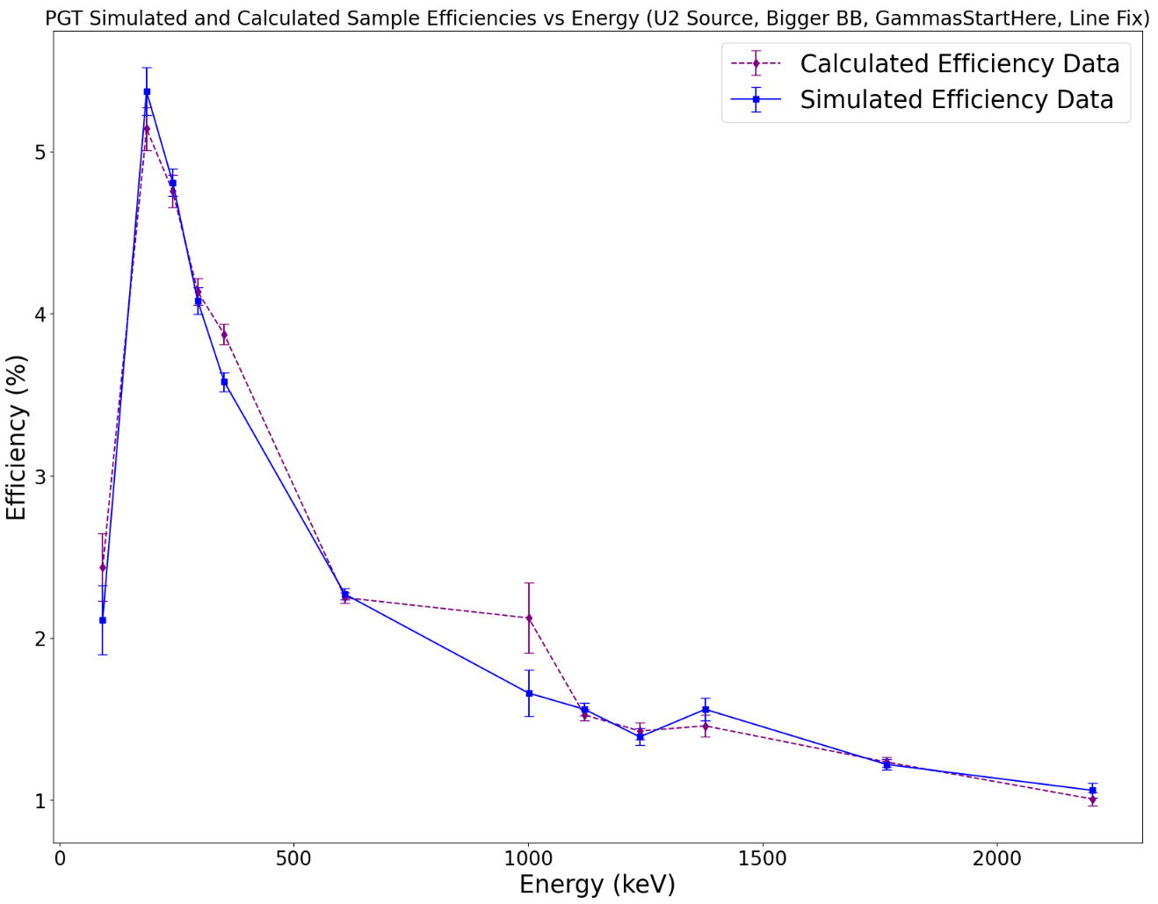
Results
3.) Compare efficiency curves
(bigger BB, GammasStartHere, gps/pos/confine makes a huge difference!)

Slide 31
Results
4.) Adjust: Adjust BB size further? More events?

Slide 32
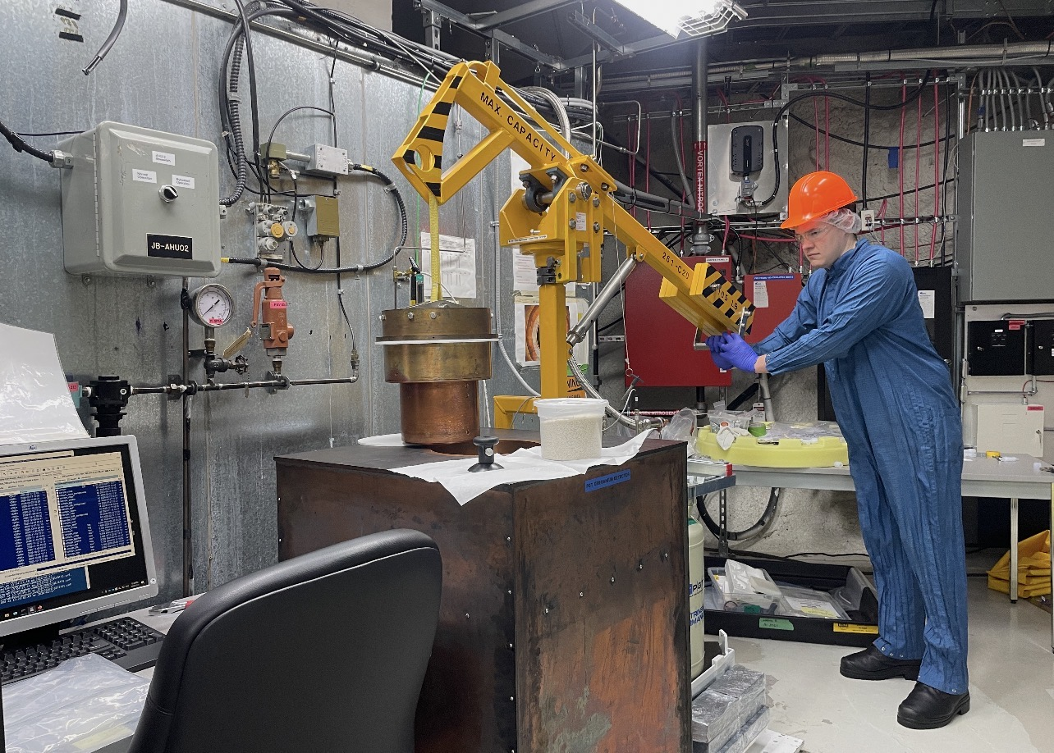
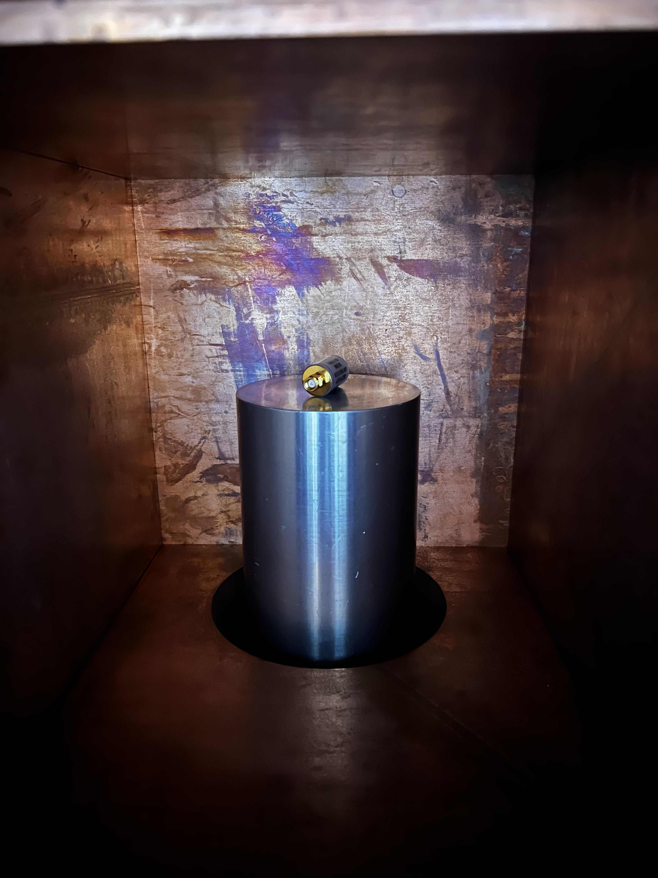
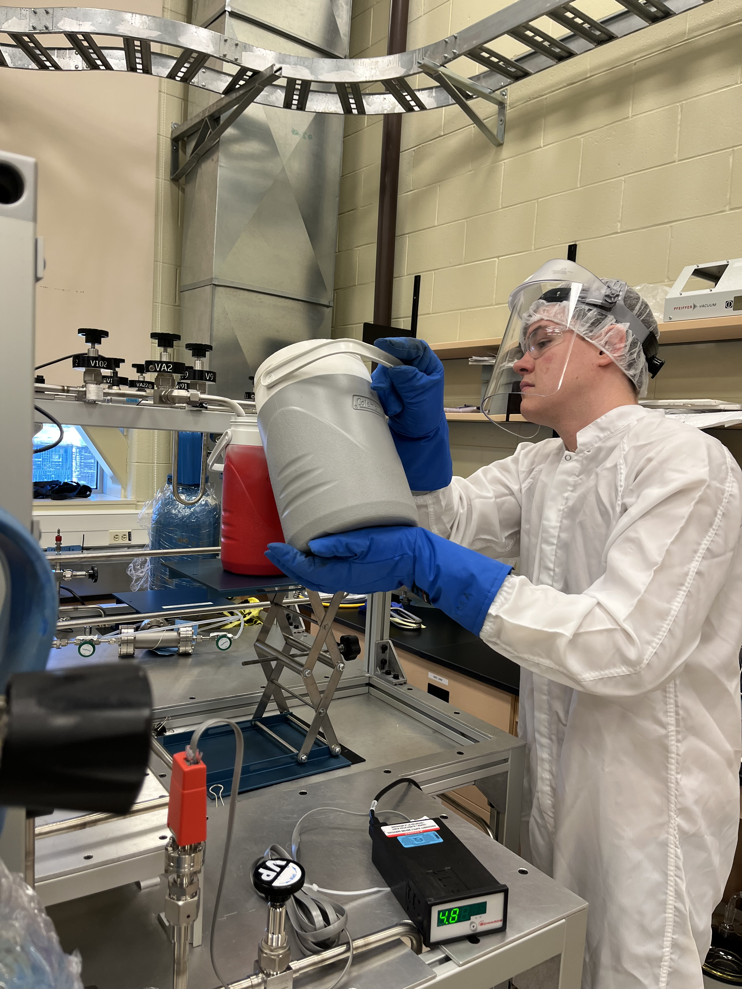
Thank You!

Slide 33
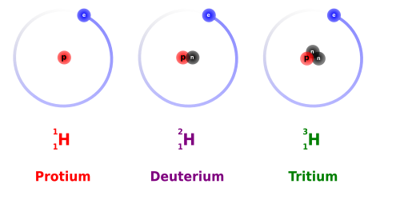
What is Radiation?
-Isotopes are atoms of the same element (same # of protons) but with a different # of neutrons.
-Often unstable due to an improper ratio of nucleons (protons and neutrons).
-Isotopes release discrete # of nucleons to reach transform into a more stable element, called nuclear decay.
-Isotope decays into an excited "daughter" nucleus, which de-excites by releasing a gamma ray (high energy E.M. wave)

Slide 34
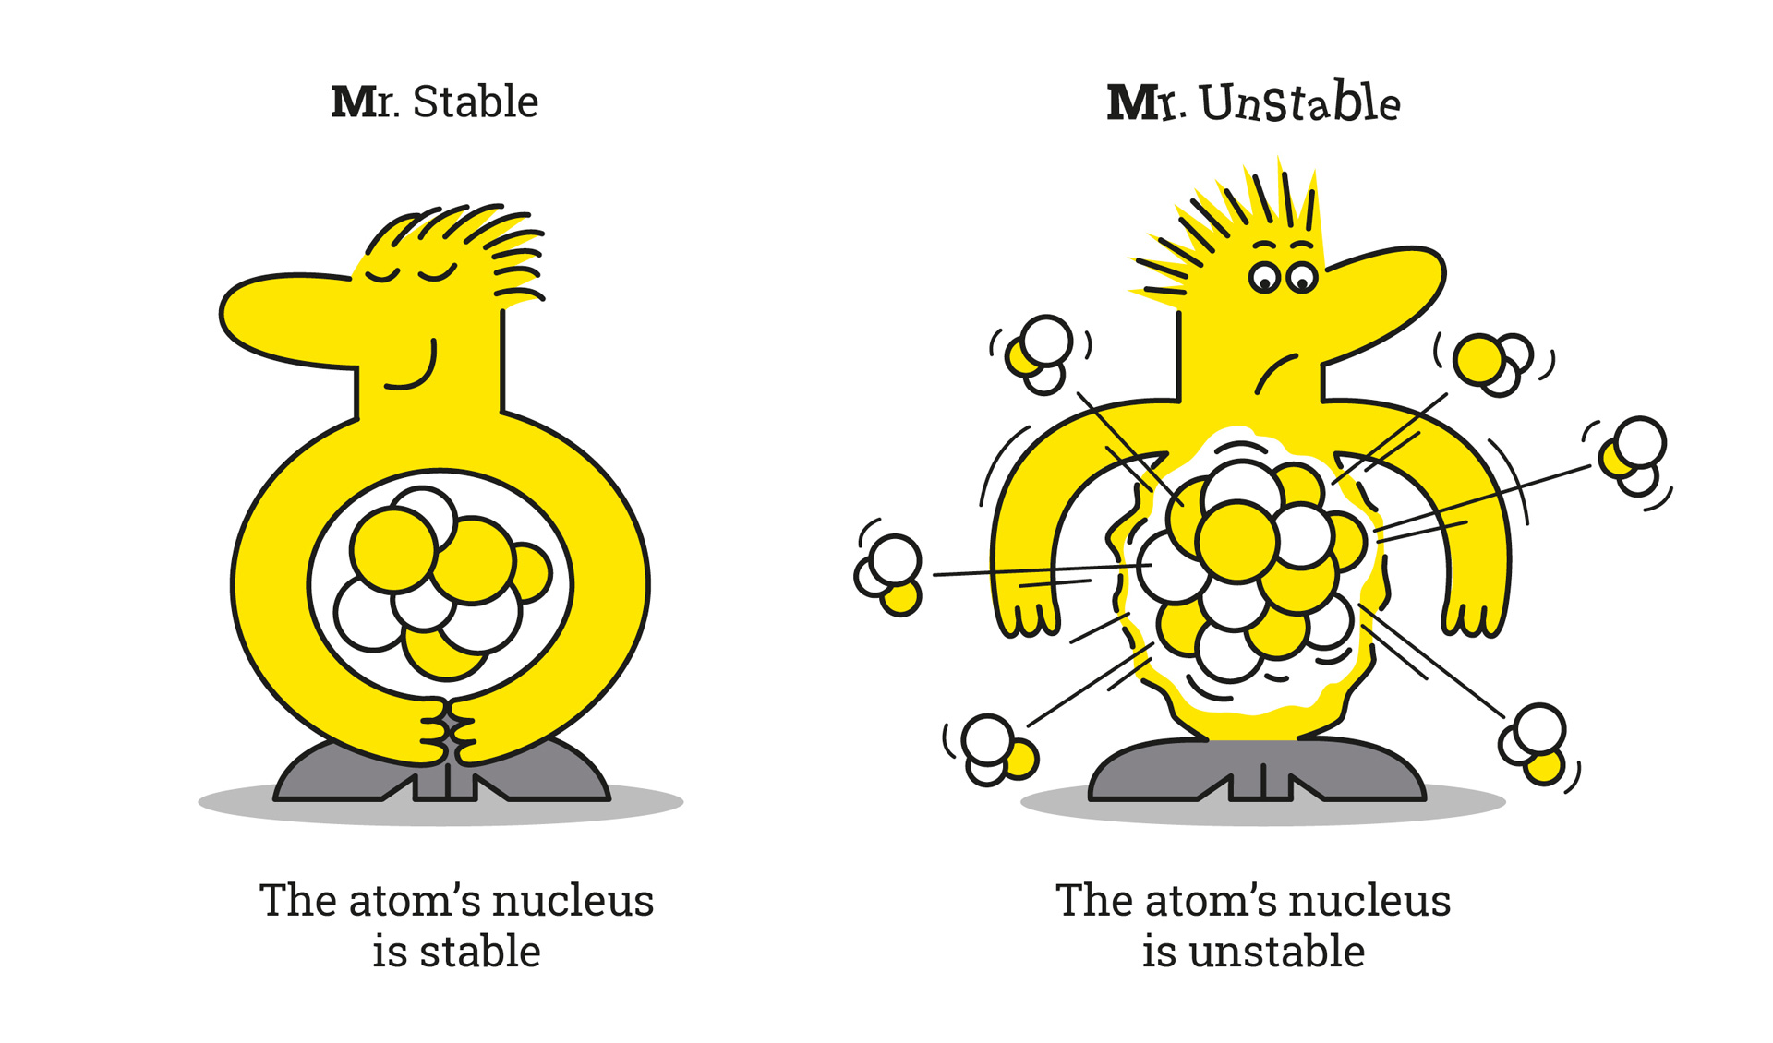
What is Radiation?
-Isotopes are atoms of the same element (same # of protons) but with a different # of neutrons.
-Often unstable due to an improper ratio of nucleons (protons and neutrons).
-Isotopes release discrete # of nucleons to reach transform into a more stable element, called nuclear decay.
-Isotope decays into an excited "daughter" nucleus, which de-excites by releasing a gamma ray (high energy E.M. wave)

Slide 35
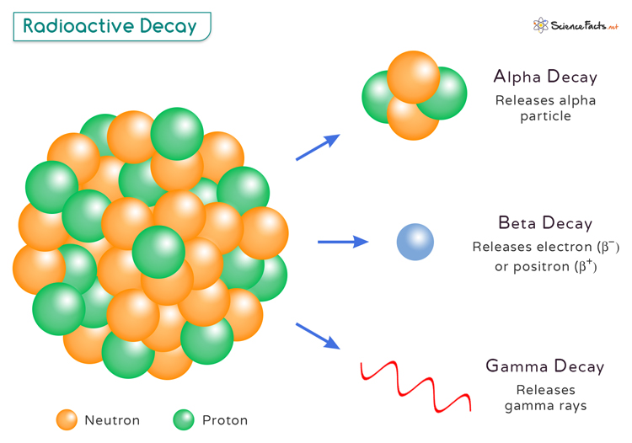
What is Radiation?
-Isotopes are atoms of the same element (same # of protons) but with a different # of neutrons.
-Often unstable due to an improper ratio of nucleons (protons and neutrons).
-Isotopes release discrete # of nucleons to reach transform into a more stable element, called nuclear decay.
-Isotope decays into an excited "daughter" nucleus, which de-excites by releasing a gamma ray (high energy E.M. wave)

Slide 36
What is Radiation?
-Isotopes are atoms of the same element (same # of protons) but with a different # of neutrons.
-Often unstable due to an improper ratio of nucleons (protons and neutrons).
-Isotopes release discrete # of nucleons to reach transform into a more stable element, called nuclear decay.
-Isotope decays into an excited "daughter" nucleus, which de-excites by releasing a gamma ray (high energy E.M. wave)

Slide 37
What is GEANT4?
-Open-source simulation software that simulates particles behaviour in a material.
-Establishes a geometry and places a particles/particle source inside, then measures their interactions
-Used to simulate high energy particle experiments

Slide 38
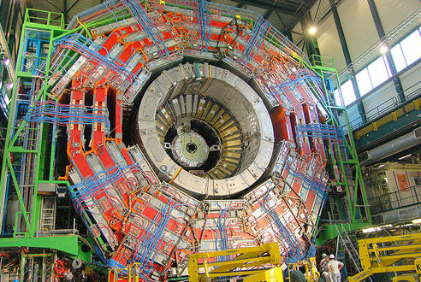
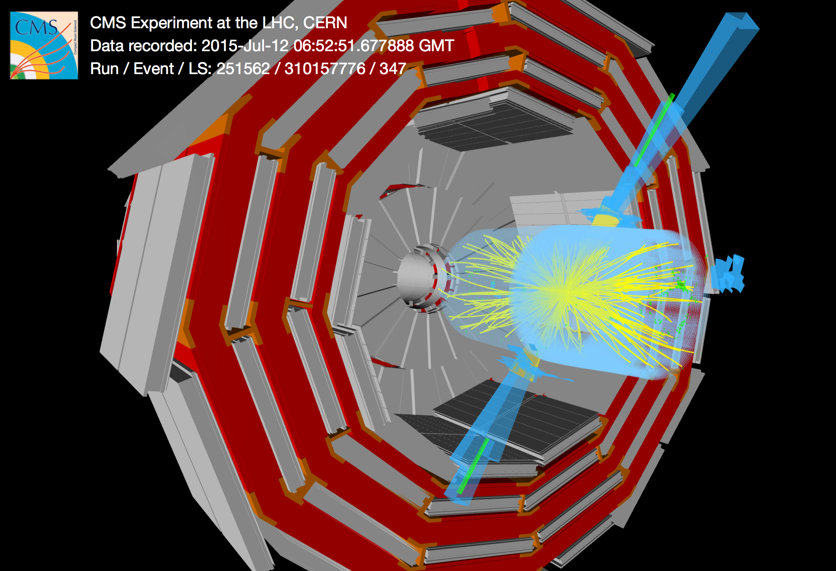
What is GEANT4?
-Open-source simulation software that simulates particles behaviour in a material.
-Establishes a geometry and places a particles/particle source inside, then measures their interactions.
-Used to simulate high energy particle experiments
Real CMS Experiment Apparatus at CERN
GEANT4 Simulation of CMS Apparatus

Slide 39
What is GEANT4?
-Open-source simulation software that simulates particles behaviour in a material.
-Establishes a geometry and places a particles/particle source inside, then measures their interactions.
-Used to simulate high energy particle experiments.
Real CMS Experiment Apparatus at CERN
GEANT4 Simulation of CMS Apparatus

Slide 40
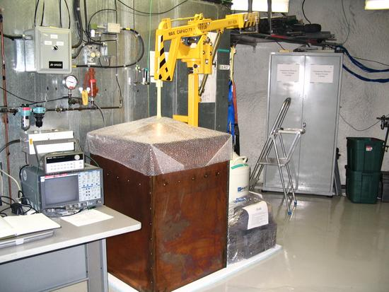
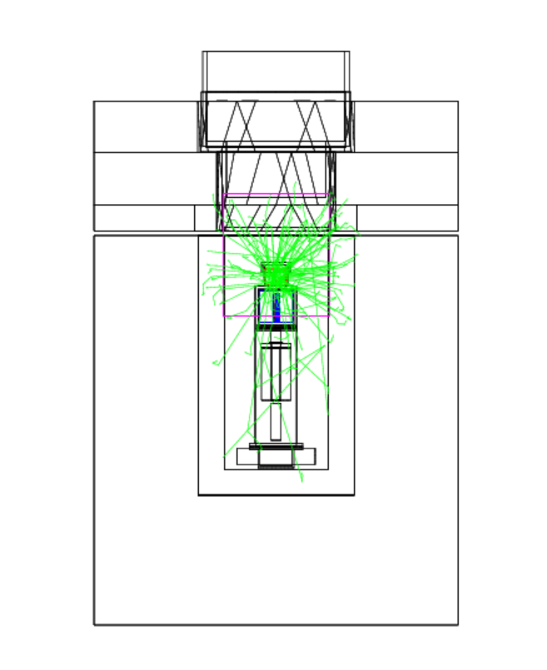
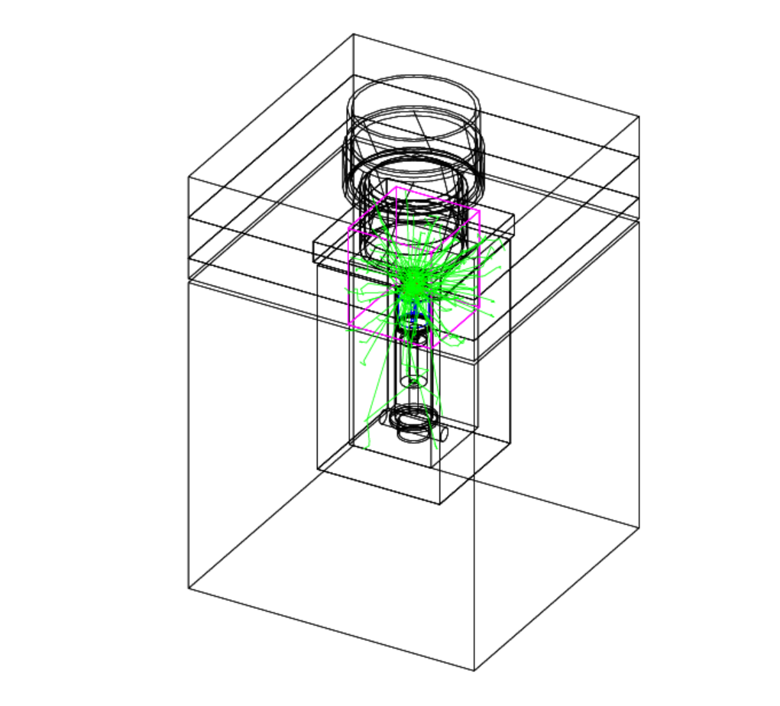
Why/How Does the LBL Use GEANT4?
-GEANT4 simulations allow us to interpret data collected from experiments => Higgs-Boson discovered this way.
-At the LBL, we use GEANT4 to simulate the energy efficiencies of our detectors. -should be in script

