Slide 1
SNOLAB Ambient Fast Neutron studies
Brianna Liz Binoy
Research Assistant, CUTE Supervisors: Dr. Matt Stukel

Slide 2
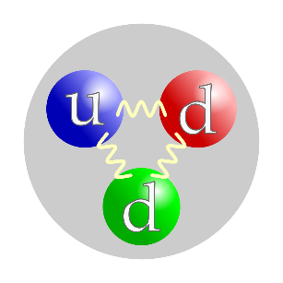
Neutron background at SNOLAB
Being underground doesn’t mean that we’re free of all radiation
2

Slide 3
Cf-252
1. Calibration Sources
Neutron Sources At SNOLAB
2. Surrounding Norite Rock & Shotcrete
(Alpha, n) reactions
Fission reactions
3

Slide 4
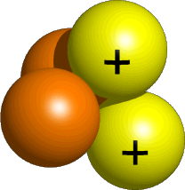
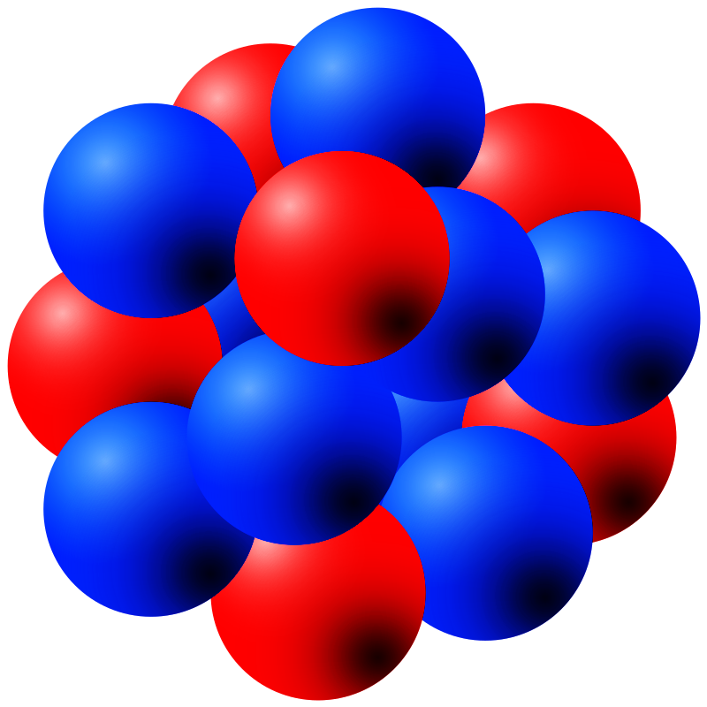
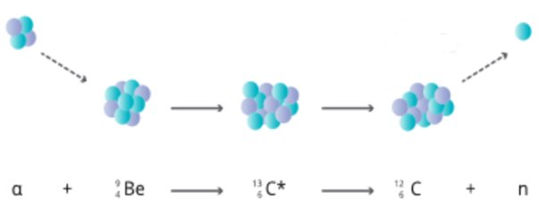
(Alpha, n) reactions
Reacts with elements like Carbon, oxygen and beryllium
Uranium in the rocks
¹₀ n
⁴₂ He
²³⁵₉₂ U
²³¹₉₀ Th
4

Slide 5
Neutron Sources At SNOLAB
2. Surrounding Norite Rock & Shotcrete
(Alpha, n) reactions
Fission reactions
5

Slide 6
Fission reactions
¹₀ n
^{Lighter element}
¹₀ n
¹₀ n
Neutron from other
reactions
²³⁵₉₂ U
¹₀ n
Uranium in the rocks
^{Lighter element}

Slide 7

NEUTRON DETECTION
IT IS IMPORTANT WE DETECT and understand THEM
7

Slide 8
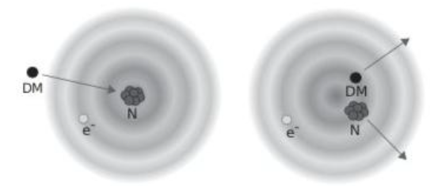
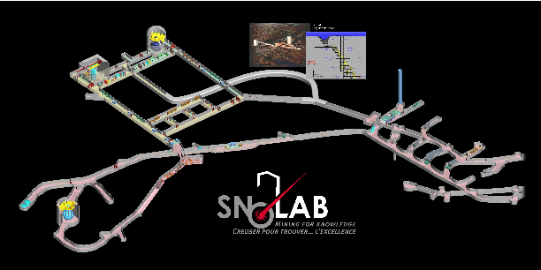
1. Neutron signals similar to dark matter signals
Importance of Neutron Detection At SNOLAB
2. Is the neutron background homogenous across the lab?
8

Slide 9
Neutron classifications
Neutron classifications | Energy
Cold energies | < 0.01 eV
Thermal | 0.01 eV – 0.3 eV
Epithermal | 0.3 eV-10 keV
Fast | 10 keV-20 MeV
Relativistic | > 20MeV
9
Notes:
Spectrum

Slide 10
NEUTRON DETECTOR
The ARKTIS FAST & Thermal NEUTRON DETECTOR
10

Slide 11
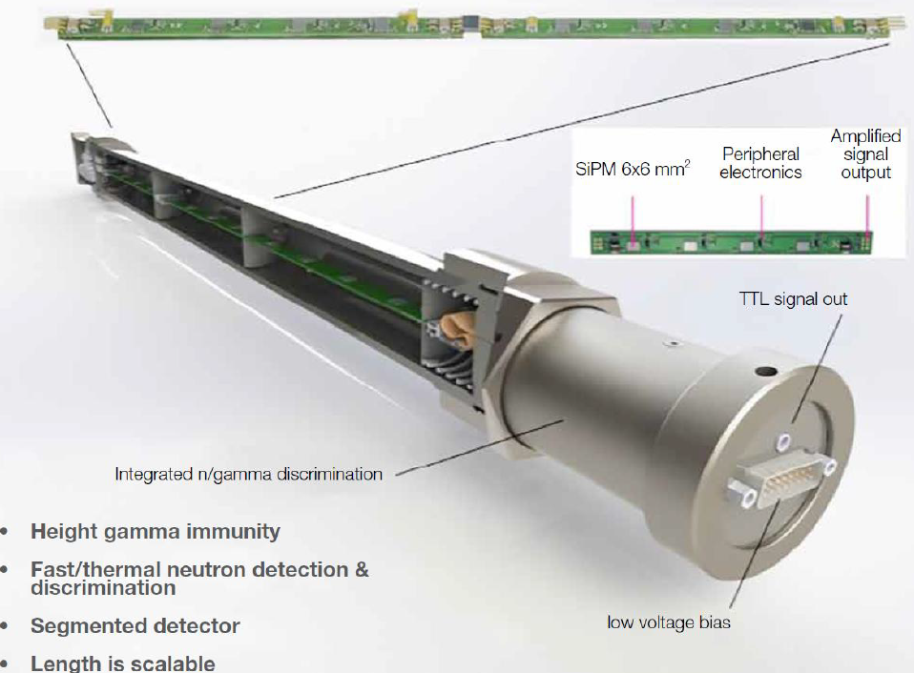
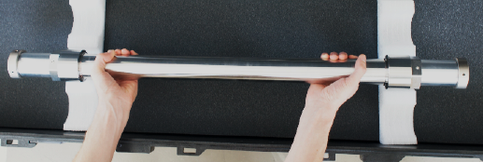
Arktis S670e Detector
Made of stainless steel
Sensitive to fast and thermal neutrons
Fast neutrons: Pressurized Helium-4 gas & Thermal neutrons: Lithium-6 coating
3 optically decoupled segments, each with 8 Silicon Photomultipliers
Arktis S670e Operation Manual
Notes:
Talk to the slide more, point to the detector and show exactly where things are

Slide 12

How Arktis Detects FAST Neutrons
Fast neutron
He-4 nucleus in detector
12
Detector wall

Slide 13
How Arktis Detects FAST Neutrons
Fast neutron
He-4 nucleus in detector
13
Detector wall

Slide 14
How Arktis Detects FAST Neutrons
Fast neutron
----------->
------>
He-4 nucleus in detector
14
Detector wall

Slide 15
How Arktis Detects FAST Neutrons
Electronic board
produces pulses
SiPM
Scintillating light

Slide 16
How Arktis Detects THERMAL Neutrons
Thermal neutron
Li-6 nucleus in detector
16
Detector wall

Slide 17
How Arktis Detects THERMAL Neutrons
Thermal neutron
Li-6 nucleus in detector
17
Detector wall

Slide 18
How Arktis Detects THERMAL Neutrons
---------->
Triton nucleus
--------------->
High-energy alpha particle
18
Detector wall

Slide 19
How Arktis Detects THERMAL Neutrons
Electronic board
produces pulses
Scintillating light
SiPM
High-energy alpha particle
19

Slide 20
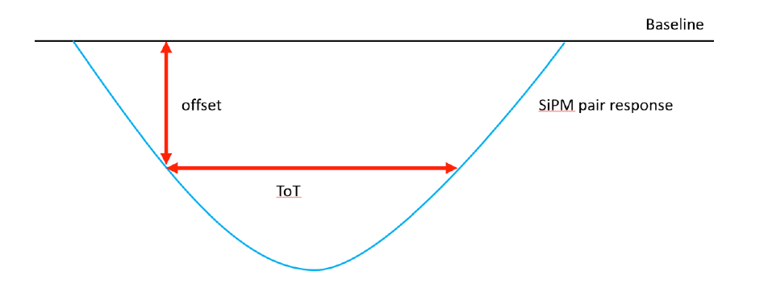
How the signals are detected
The Time over Threshold (ToT) parameter
Measures how long the signal amplitude stays above a certain offset (the “threshold”)
If the signal amplitude is tall and wide—possibly by a neutron.
If it’s small and quick—possibly just noise or a gamma ray
X axis: time (s), y axis: signal amplitude (V)

Slide 21
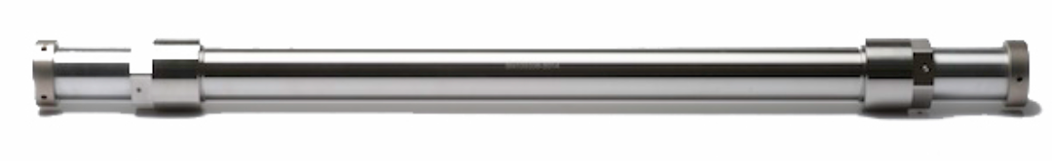
NEUTRON DETECTOR
Experimental data: obtaining on-surface FAST neutron flux
21

Slide 22
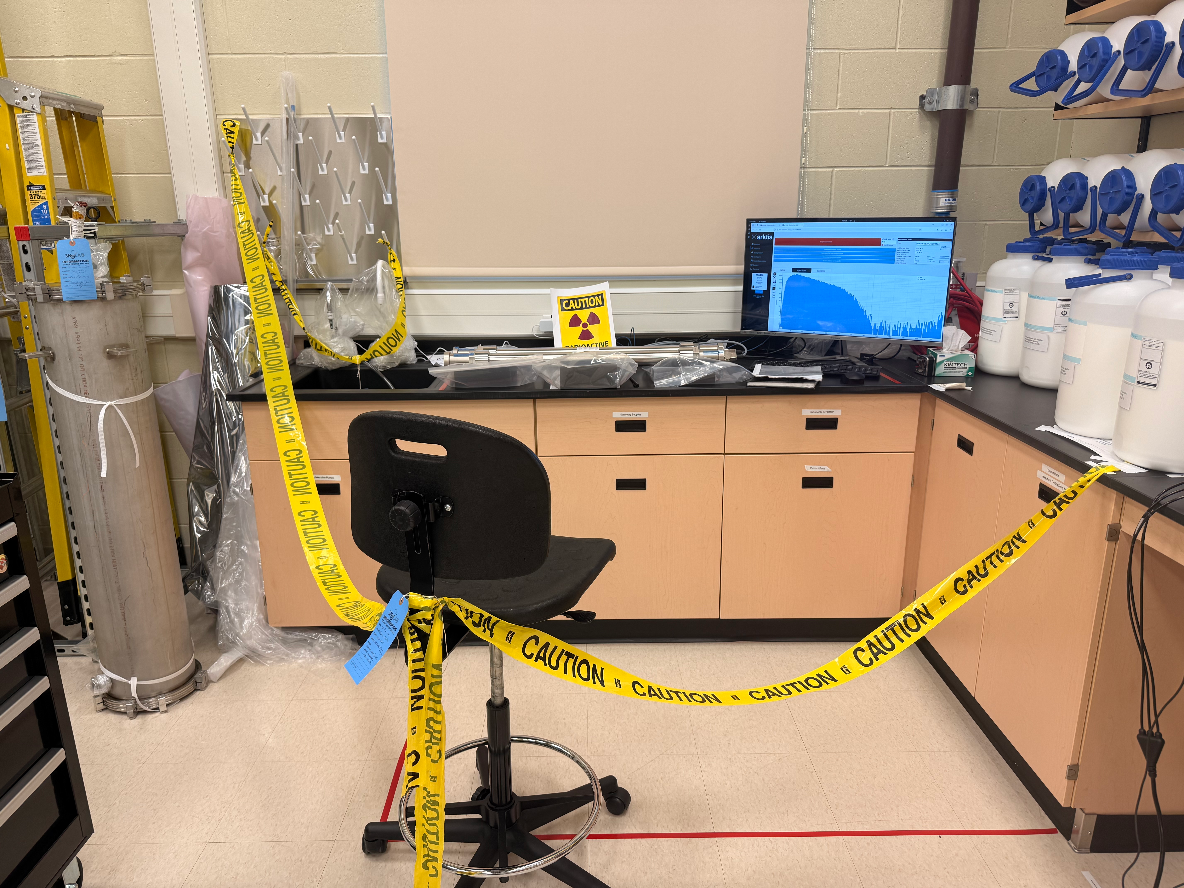
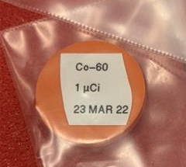
Obtaining on-surface fast neutron flux
Placed Neutron detector in Lab B of the on-surface cleanroom
Took background data
Placed a Co60 gamma source on each segment of the detector and took data
Compared data
Estimated fast neutron flux
Seg3
Seg2
Seg1
Notes:
pictures

Slide 23
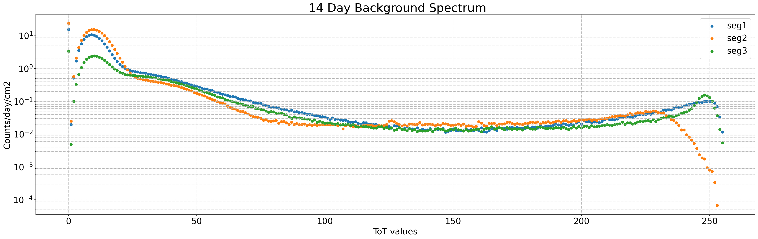
Estimating on-surface neutron flux
Seg3
Seg2
Seg1
Fast neutron counts
Gamma counts
Thermal neutron counts
Notes:
Error bars

Slide 24
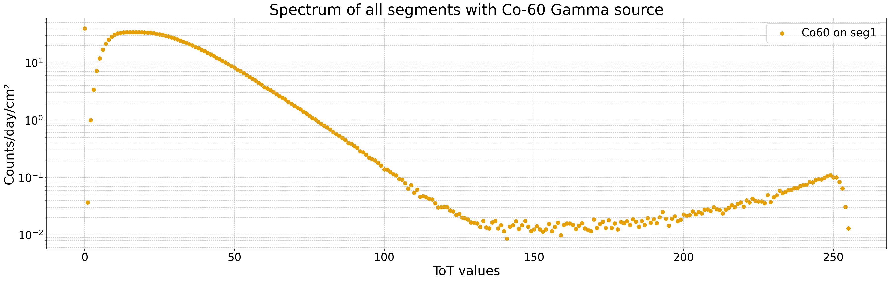
Estimating on-surface neutron flux
Co60
Seg3
Seg2
Seg1
Notes:
Error bars

Slide 25
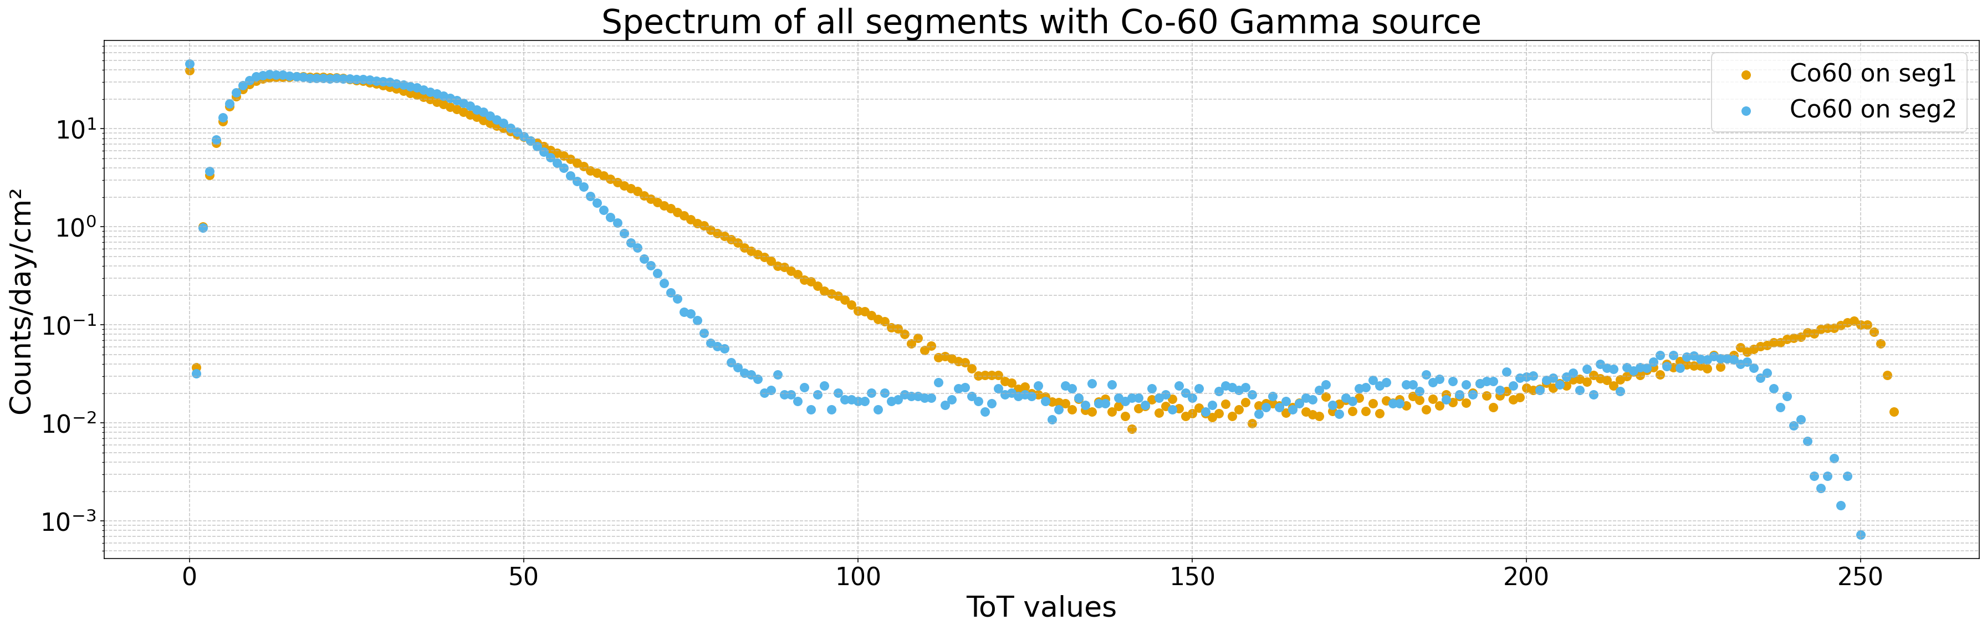
Estimating on-surface neutron flux
Co60
Seg3
Seg2
Seg1
Notes:
Error bars

Slide 26
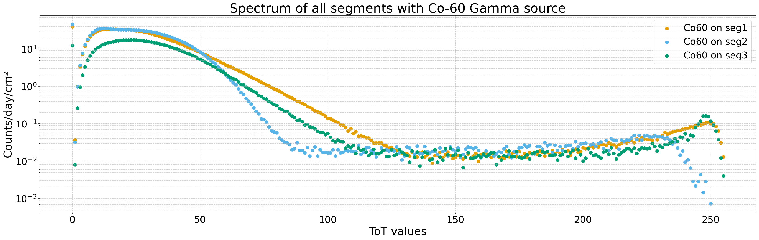
Estimating on-surface neutron flux
Co60
Seg3
Seg2
Seg1
Notes:
Error bars

Slide 27
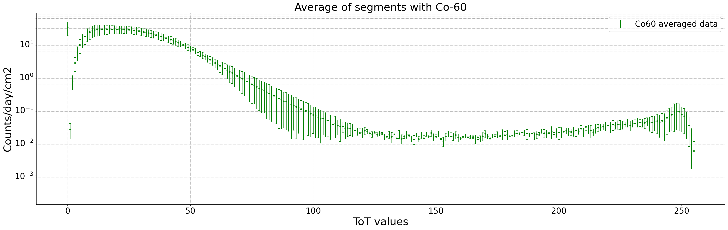
Estimating on-surface neutron flux

Slide 28
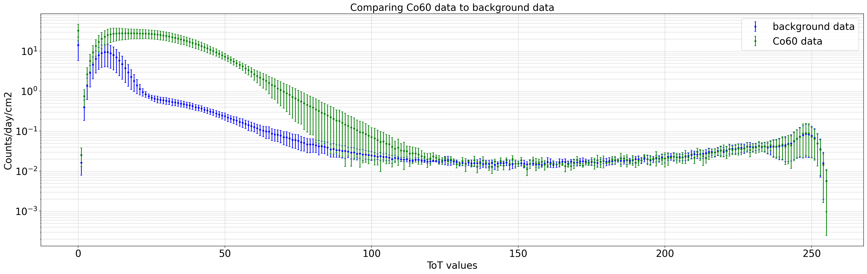
Estimating on-surface neutron flux
Comparing Co60 data to background data
Background flux and gamma flux merging
Gamma counts
neutron counts
ON SURFACE NEUTRON FLUX: 11± 2 neutrons/cm²/day

Slide 29
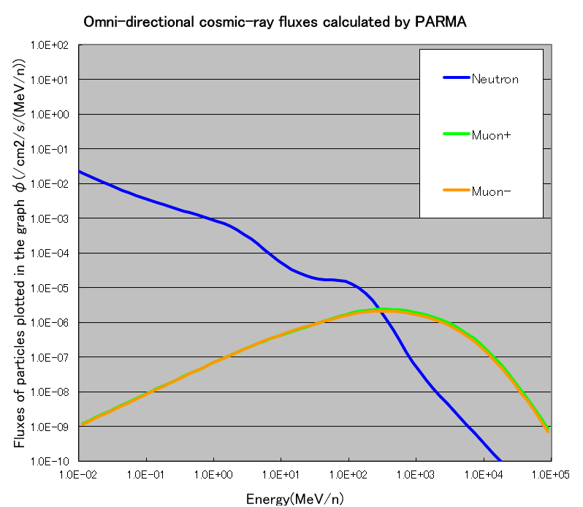
EXPACs Simulation
WHAT IS EXPACS?
EXcel-based Program for calculating Atmospheric Cosmic-ray Spectrum
It is based on the PARMA model: PHITS based Analytical Radiation Model in the Atmosphere
Comprises analytical functions with parameters fitted to reproduce the results of the extensive air shower simulations
ON SURFACE NEUTRON FLUX: 928 neutrons/cm2/day
Notes:
Just show neutrons, muons instead of all of them

Slide 30
NEUTRON DETECTOR
Obtain on surface Fast neutron flux
30

Slide 31
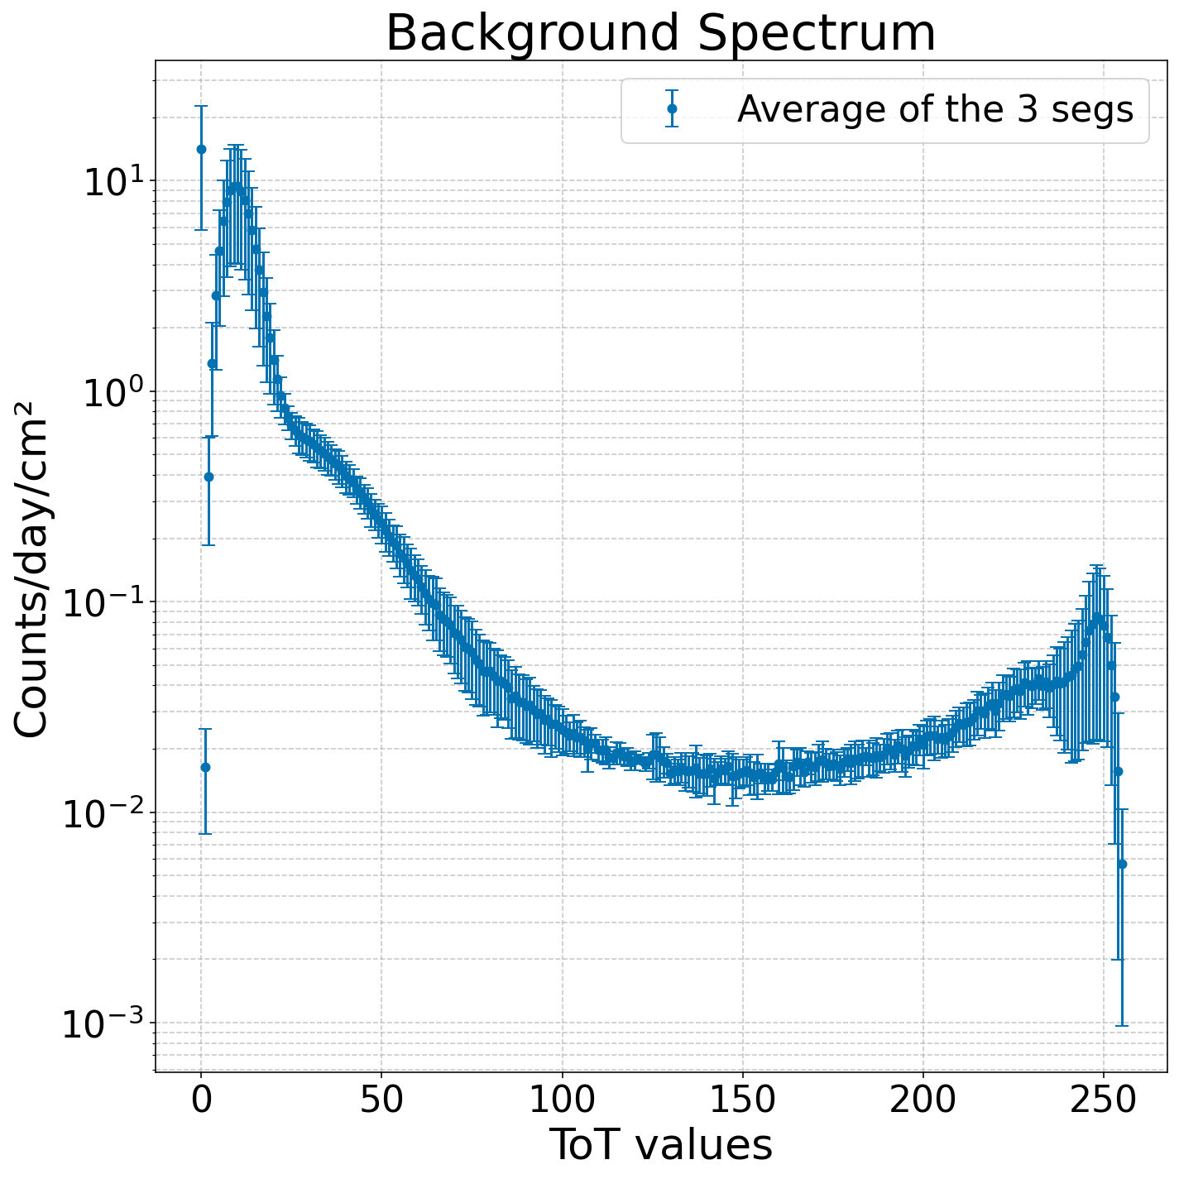
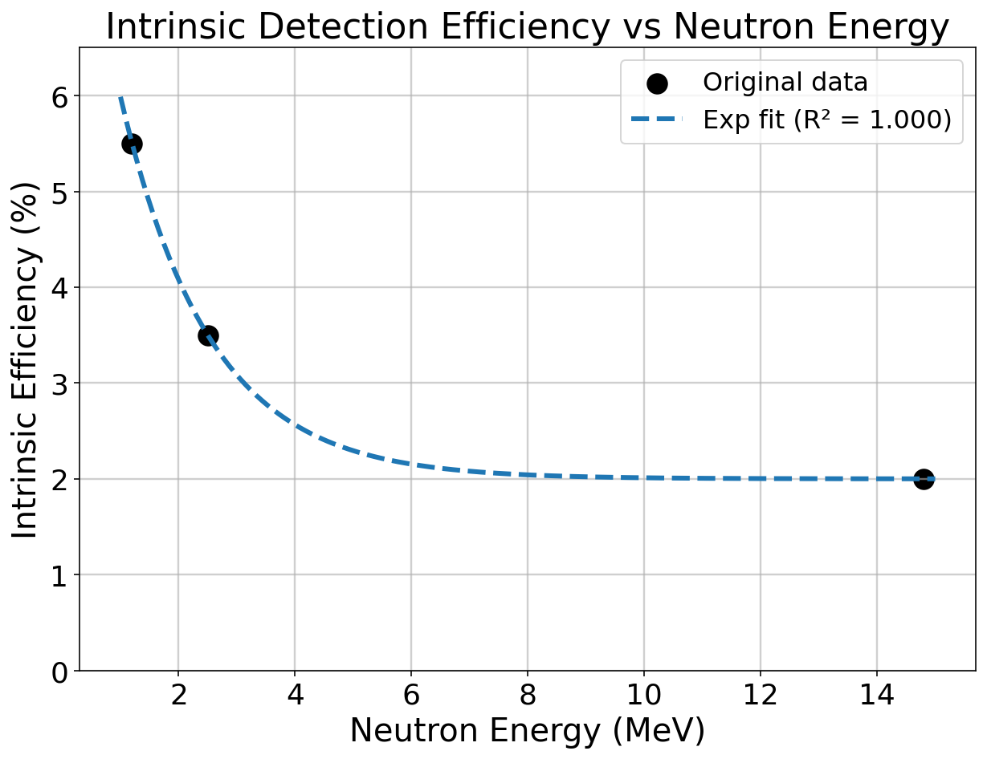
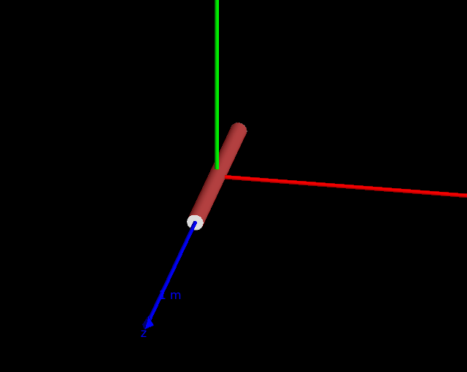
Our experimental data VS EXPACs simulation
Data points
Gamma counts
Thermal neutron counts
Fast neutron counts
EXPACS simulation:
Fast neutron flux: 185 neutrons/cm2/day
cut obtained from literature
3.5 - 9 fast neutrons/cm²/day
DETECTOR data:
6 ± 2.0 fast neutrons/cm²/day
Notes:
Make the numbers very big
title

Slide 32
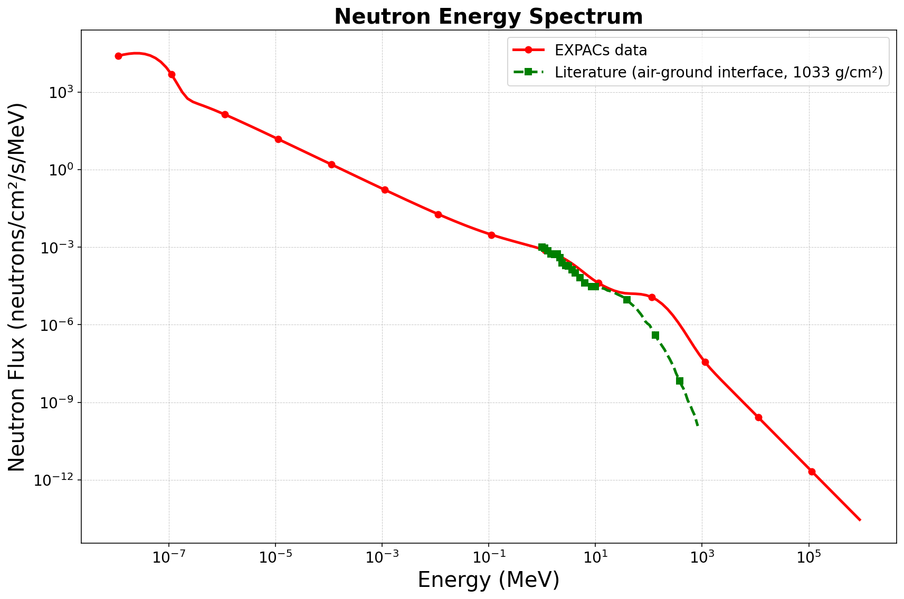
Our experimental data VS literature
Looked at previous experimental fast neutron data from MEASUREMENT OF THE FLUX AND ENERGY SPECTRUM OF COSMIC-INDUCED NEUTRONS ON THE GROUND
Integrated the spectrum
Used my intrinsic efficiency simulation to get fast neutron flux detected by detector
Detector Fast Neutron Flux (neutrons/cm2/day) | Literature’s Fast Neutron Flux (neutrons/cm2/day)
6 ± 2.0 fast neutrons | 2 -7

Slide 33
Summary
Estimated neutron flux on surface
Estimated fast neutron flux on surface
Compared estimations with EXPACs and Literature
Notes:
Cocnluding slide

Slide 34
Next Steps
Do runs with 2 different gamma sources
Take detector underground
Calibrate detector with neutron sources
Obtain neutron flux underground
Notes:
Prepare backup slide maybe for UG campaign

Slide 35
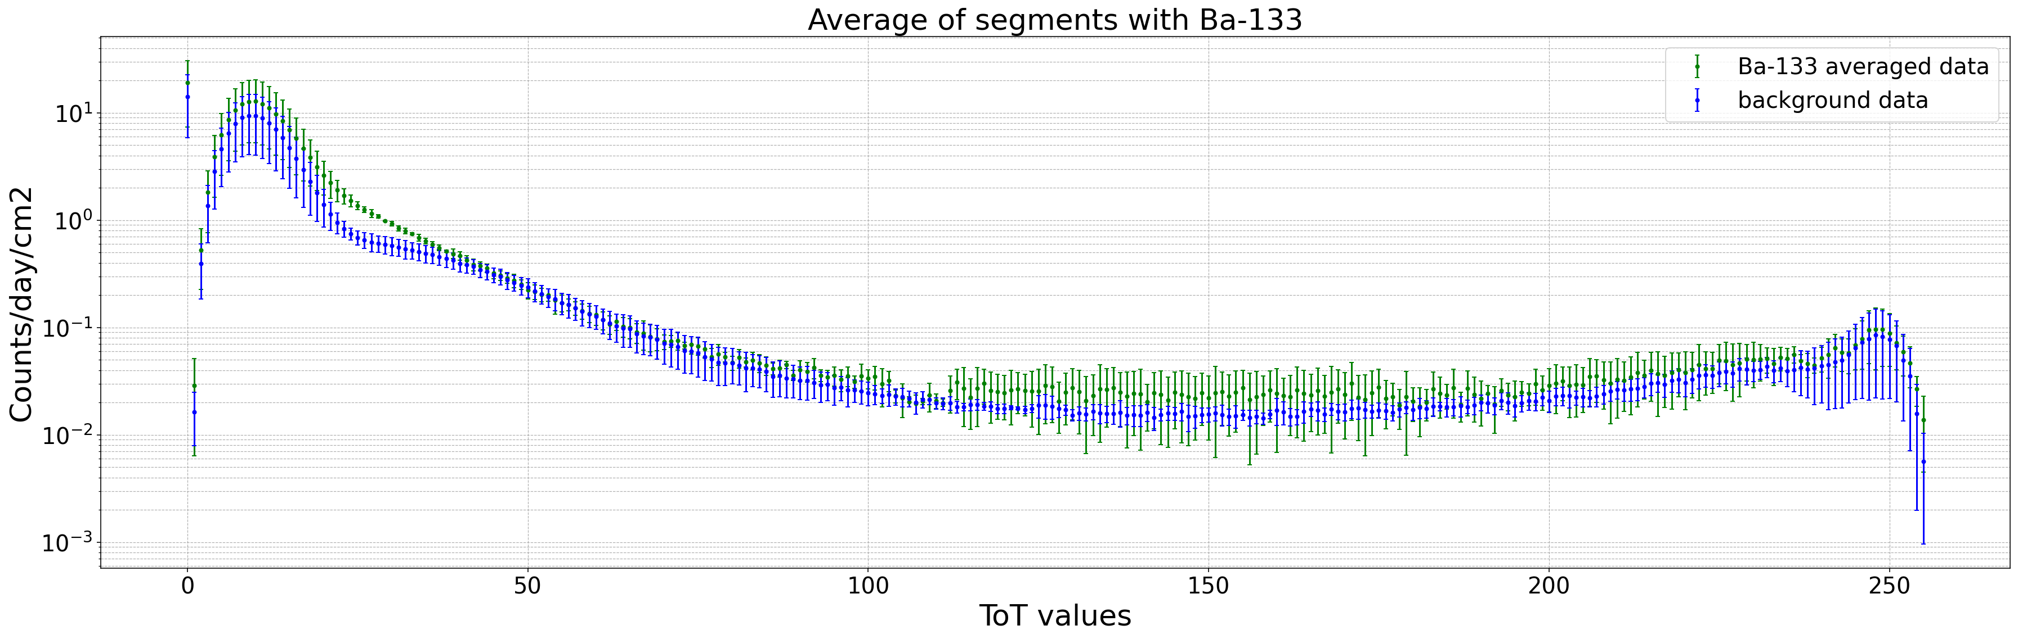

Slide 36
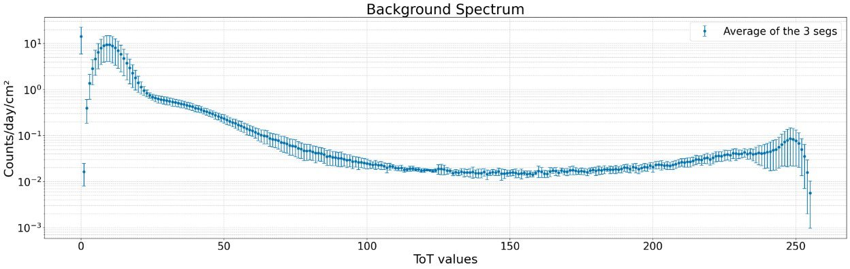

Slide 37
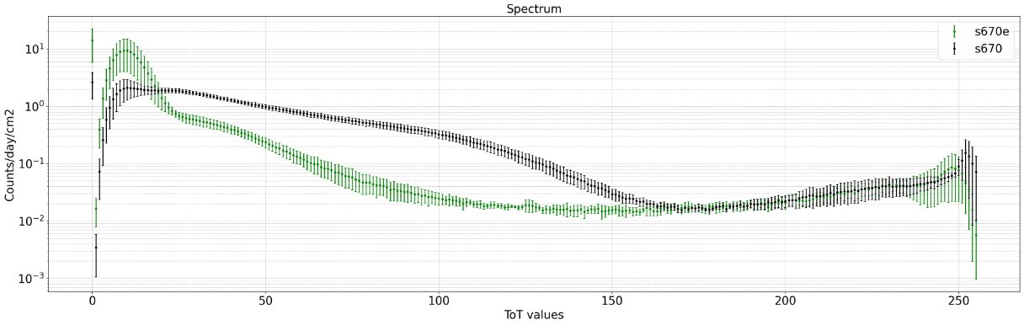

Slide 38
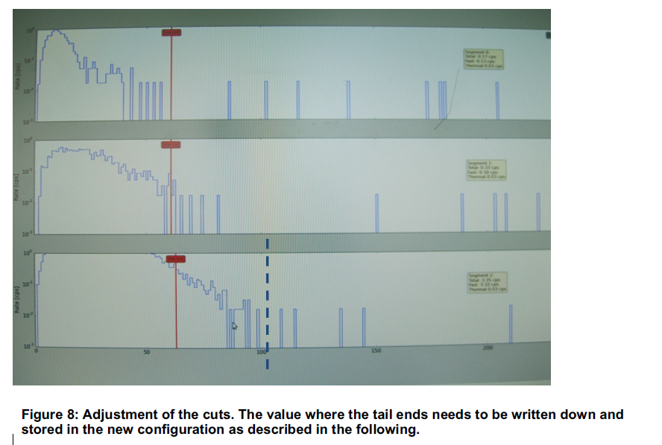

Slide 39
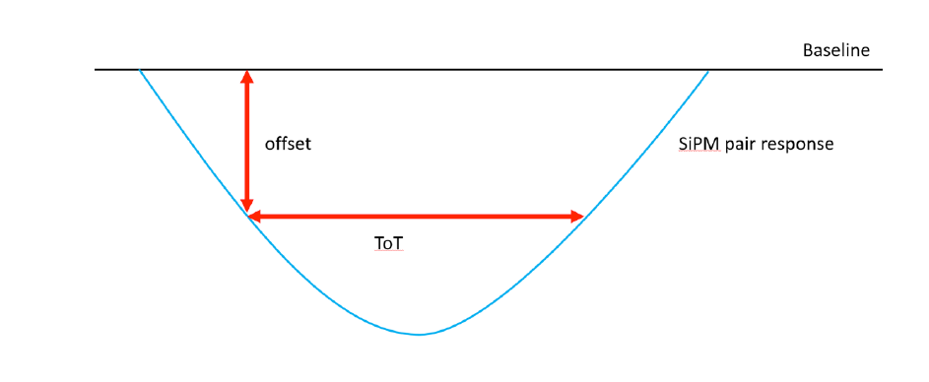
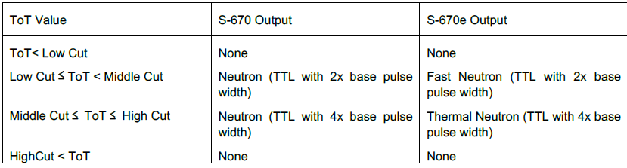
Time over Threshold Parameter
The Time over Threshold (ToT) parameter
Measures how long the signal amplitude stays above a certain offset (the “threshold”)
If the signal amplitude is tall and wide—possibly by a neutron
If it’s small and quick—possibly just noise or a gamma ray
Cuts can be set to determine the characteristic of the neutrons
X axis: time (s), y axis: signal amplitude (V)

Slide 40
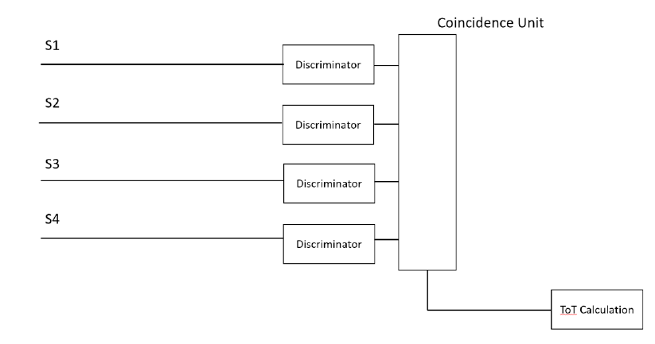
HOW THE SIGNALS ARE DETECTED
SIGNAL CAPTURE
Each SiPM pair sends its signal to a discriminator
THRESHOLD CHECK
If signal > offset threshold → line is set to HIGH in Coincidence Unit
COINCIDENCE REQUIREMENT
If 2 lines are high within 30 ns, ToT counter starts
DECISION
If ToT within the cuts → likely a neutron → pulse produced
If not → not a neutron → no signal sent

Slide 41
NEUTRON DETECTOR
GEANT4 SIMULATIONS OF OUR NEW DETECTOR
41

Slide 42
GEANT4 Simulation of Detector
x
z
LiF coating
y
He-4 gas
42
Notes:
Maybe show the axis or remove them

Slide 43
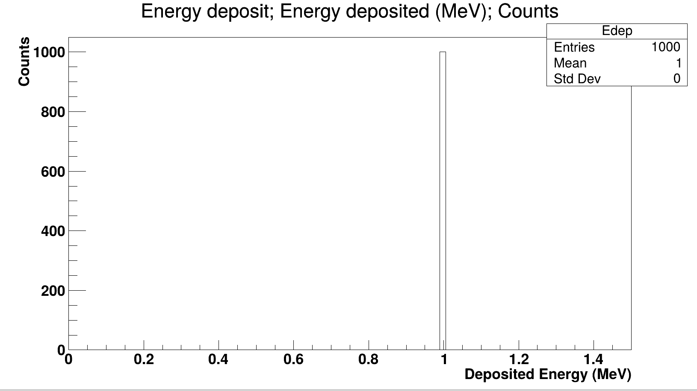
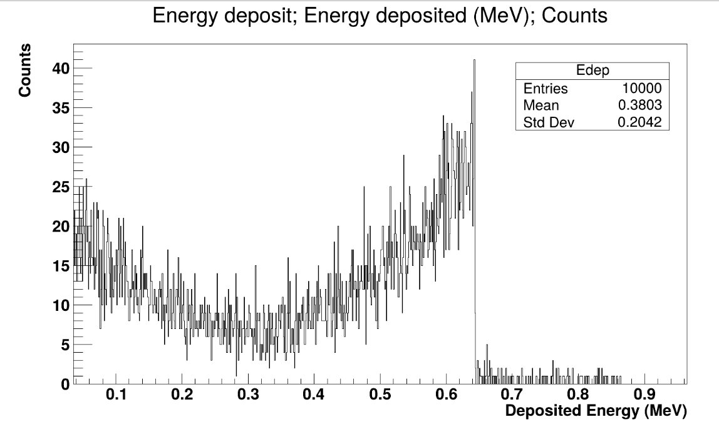
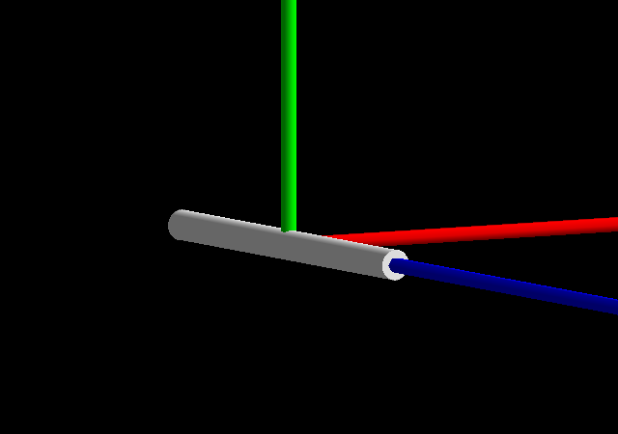
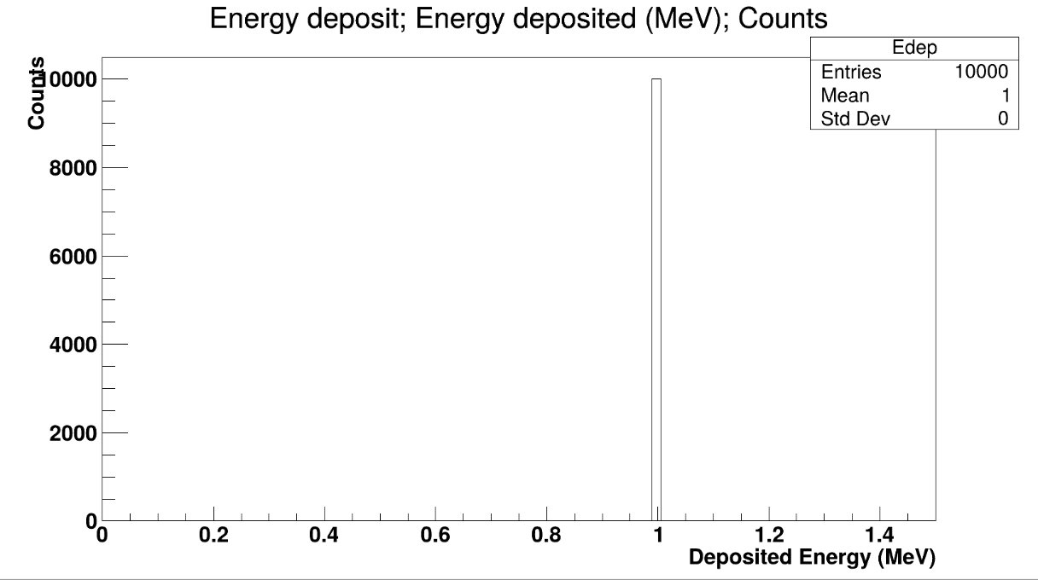
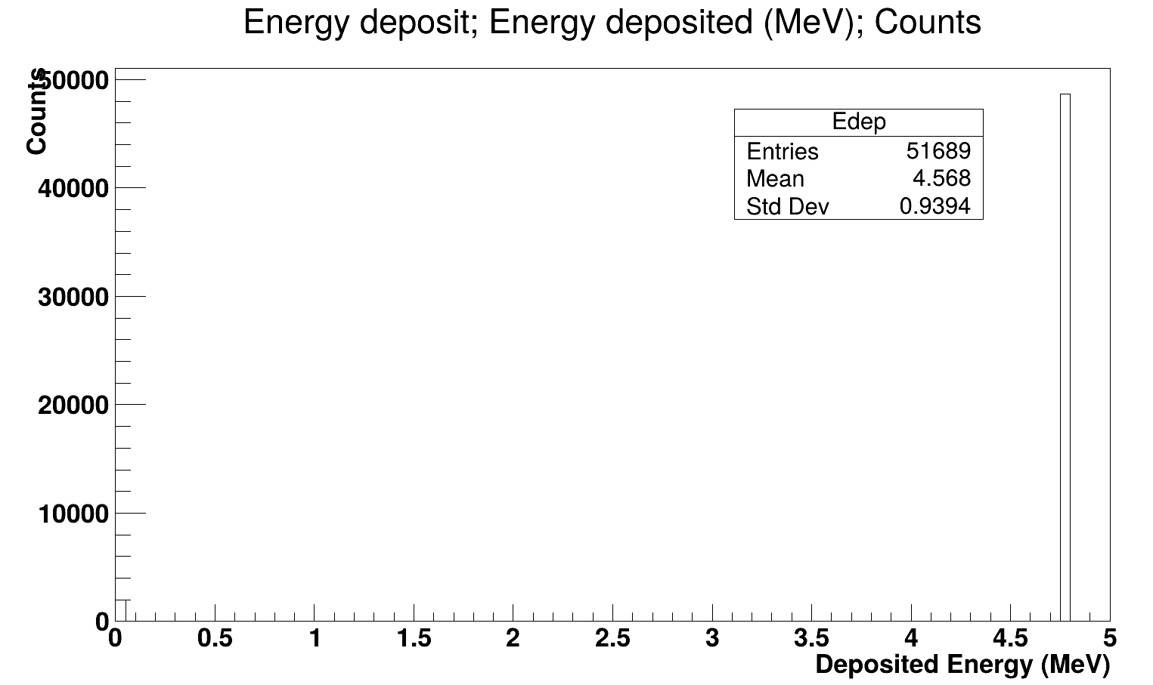
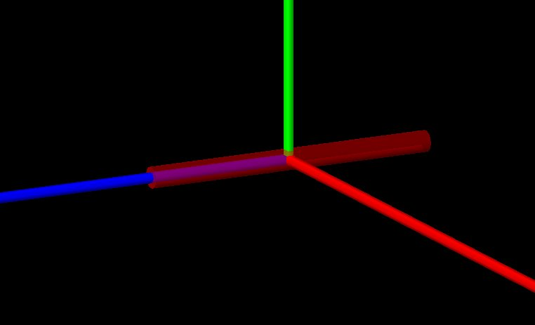
GEANT4 SIMULATIONS OF DETECTOR: alpha and neutrons
He-4 cylinder
He-4 cylinder
1MeV Alpha particles
World Material: Vacuum
1 MeV neutrons
World Material: Vacuum
LiF cylinder
LiF cylinder
1MeV Alpha particles
World Material: Vacuum
25meV neutrons
World Material: Vacuum

Slide 44
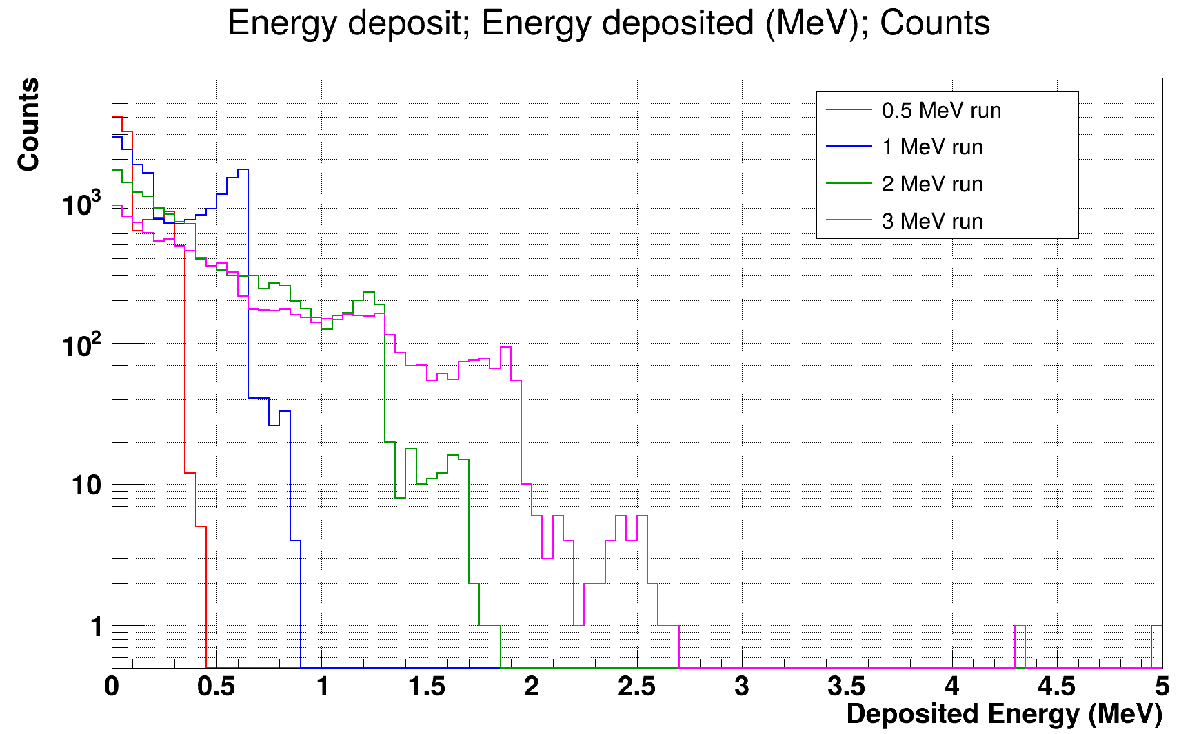
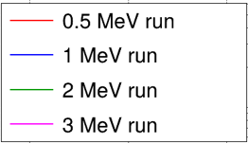
Testing Neutron Detector Simulation
Energy deposited by different neutron energies
Events
Deposited Energy (MeV)
Notes:
Practice what I want to say more, remove the title

Slide 45
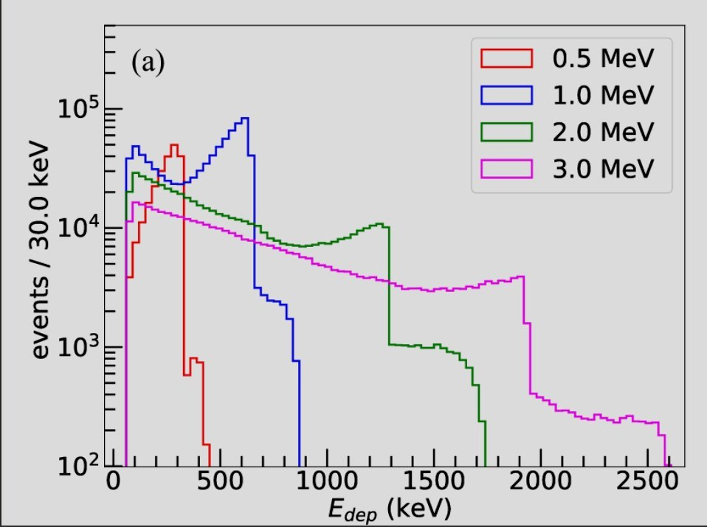
Testing Neutron Detector Simulation
Energy deposited by different neutron energies
Events
Neutron and 𝜸-ray Discrimination by a Pressurized Helium-4 Based Scintillation Detector
Deposited Energy (MeV)
Notes:
point out similarities in the both of them

Slide 46
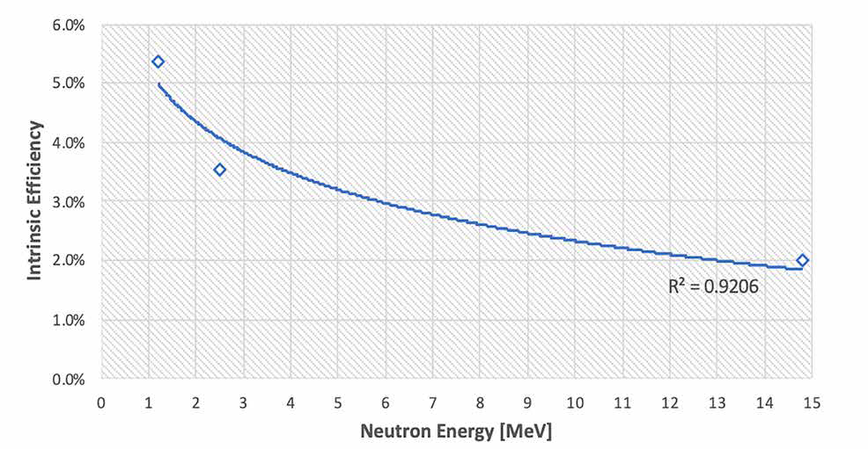
Testing Neutron Detector Efficiency
EXPERIMENT
Fast neutron dose rate monitoring using off the shelf Helium-4 scintillation detectors
Notes:
Paper done previously
Tested the detector by sending neutrons of 3 different energies
See that the intrinicis efficiency decreased with neutron energy
So I did the same with my simulation- tested the efficiency

Slide 47
Testing Neutron Detector Efficiency
SIMULATION
EXPERIMENT
Fast neutron dose rate monitoring using off the shelf Helium-4 scintillation detectors
Notes:
This is the plot I have
You can see that when I sent same energies of neutrons, I got the exact same plot
This probably indicates that the neutron detector has very high efficiency, and the noise in the detector is very low. But we will need to do more analysis to confirm this.

Slide 48
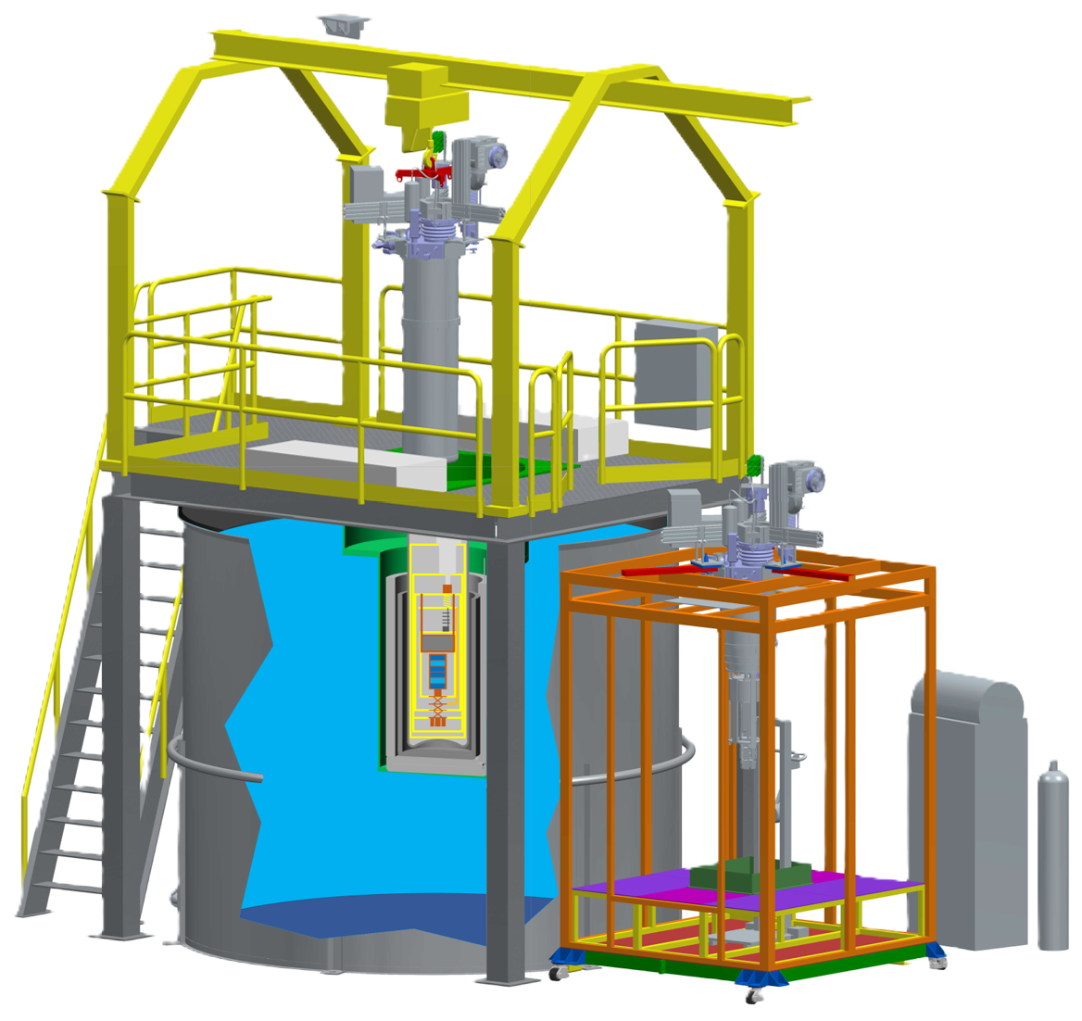
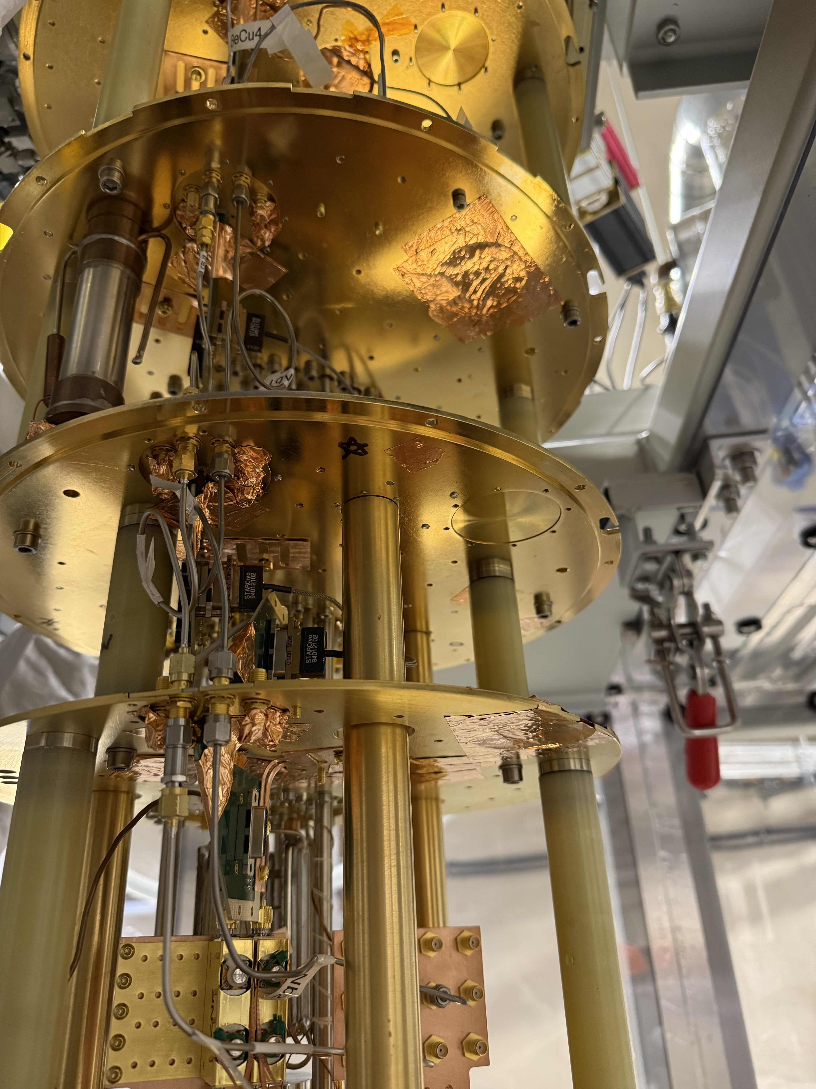
Cryogenic Underground TEst facility
Ultra-pure water
Cleanroom
Dry dilution fridge
48
Notes:
The full form of CUTE is Cryogenic undergroudn testing facitily and it is located 2 kilometers underground at SNOLAB. But CUTE isn’t a detector itself. Instead, it’s a testing ground for experiments like dark matter and qubit characterizations.
CUTE consists of a clean room, a dilution fridge, a big tank of ultra pure water to shield components from neutron radiation
Because it’s so far underground, CUTE is shielded from cosmic radiation. And to test detectors that are supposed to catch very rare signals, we need to make sure the environment is as “quiet” as possible—no noise, no heat, and no shaking. CUTE uses a dilution refrigerator, clever trick with helium-3 and helium-4 gases to reach mind-blowing temperatures—down to 12 millikelvin, or about -273°C.
Formerly used for testing SuperCDMS dark matter detectors, CUTE now examines quantum chip performance in the absence of cosmic radiation.

Slide 49
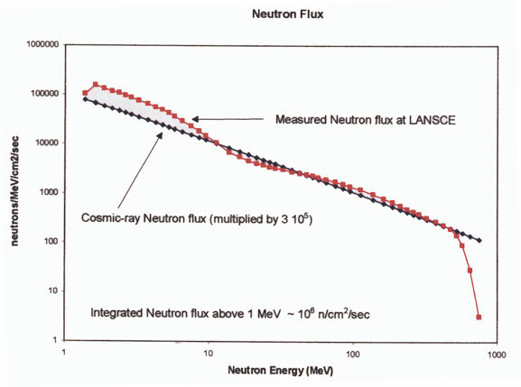
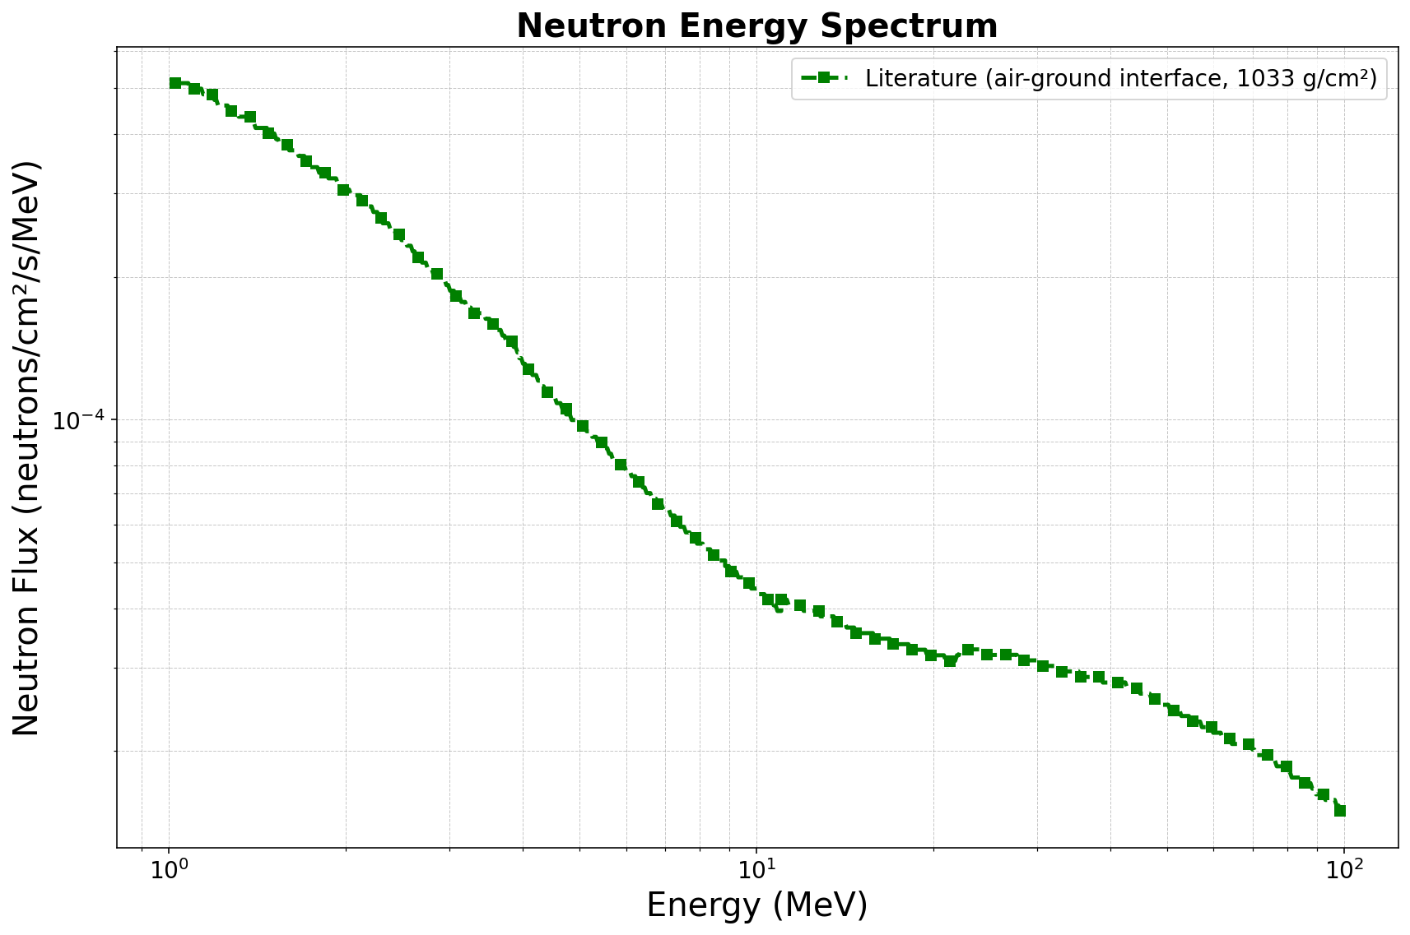
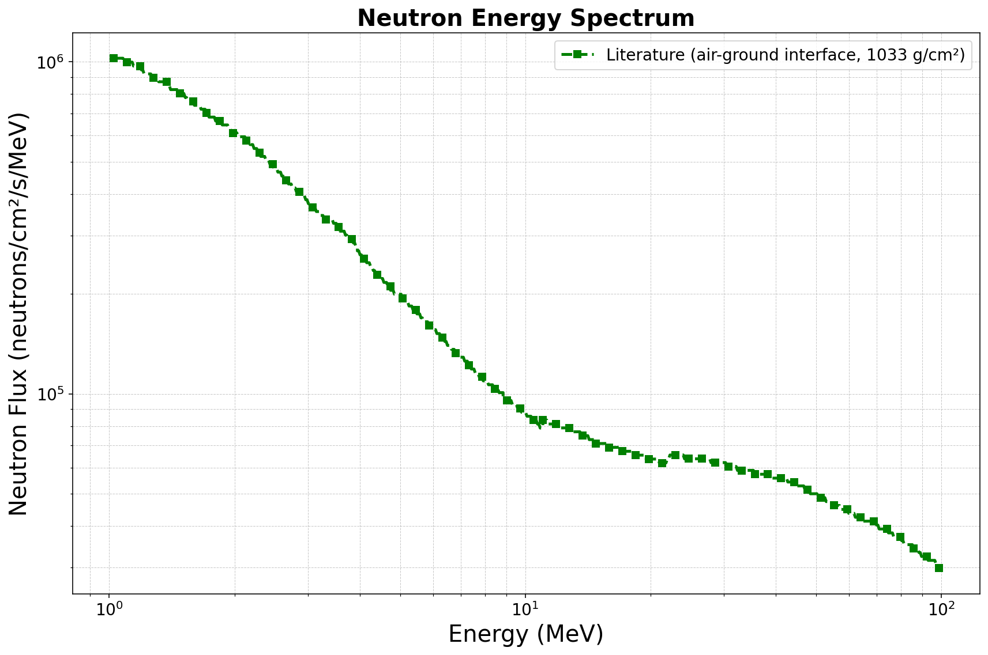

Slide 50
PREVIOUS NEUTRON MEASUREMENTS
50

Slide 51
History of Measuring The Ambient Fast Neutron Flux
1. Found elements in norite rock and shotcrete
2. Use SOURCES4C and GEANT4
Notes:
Estimated fast neutron flux: 4000 neutrons/m2/day (without experimental verification which is the problem)

Slide 52
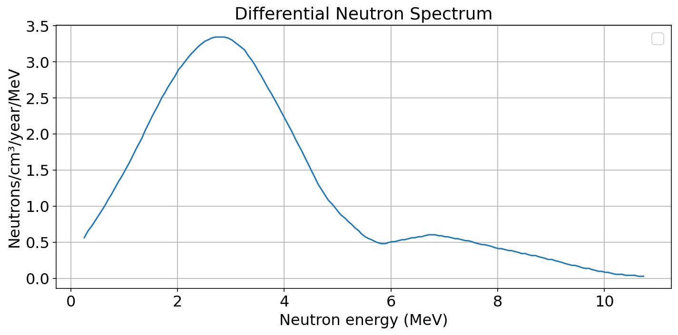
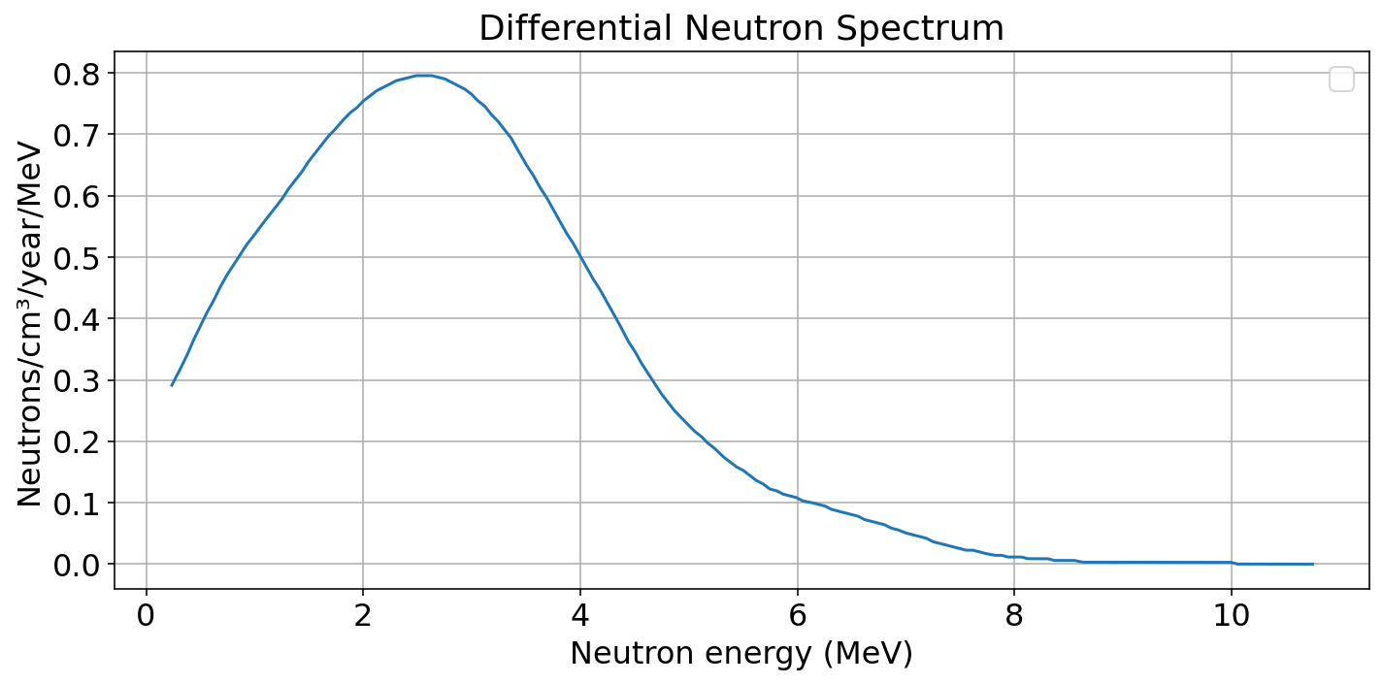
SOURCES4C Plots & Table
NORITE YIELD
SHOTCRETE YIELD
ISOTOPE | NORITE |  | SHOTCRETE
 | Concentration (ppm) | Neutron Flux (neutrons/year/cm3) | Concentration (ppm) | Neutron Flux (neutrons/year/cm3)
Total |  | 12.83 |  | 3.07
GEANT4: Estimated fast neutron flux of 4000 neutrons/m2/day
Notes:
List where you got this information (maybe a source/name of paper)

Slide 53
MY WORK
MY WORK TO OBTAIN THE ESTIMATED FAST NEUTRON SPECTRUM
53

Slide 54
Tried to replicate their work
1. Obtain rock & shotcrete composition
2. Obtain U-238 and Th-232 decay chain information
Notes:
Estimated fast neutron flux: 4000 neutrons/m2/day (without experimental verification which is the problem)

Slide 55
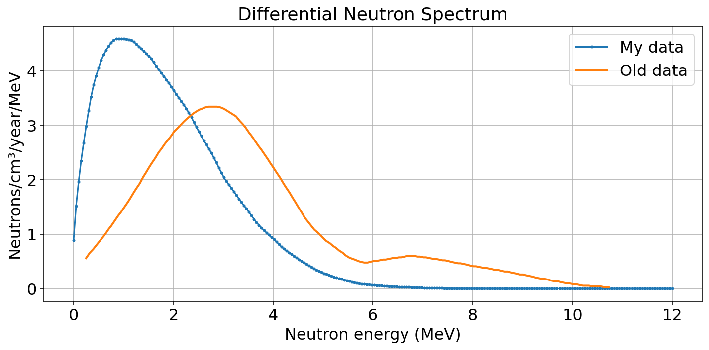
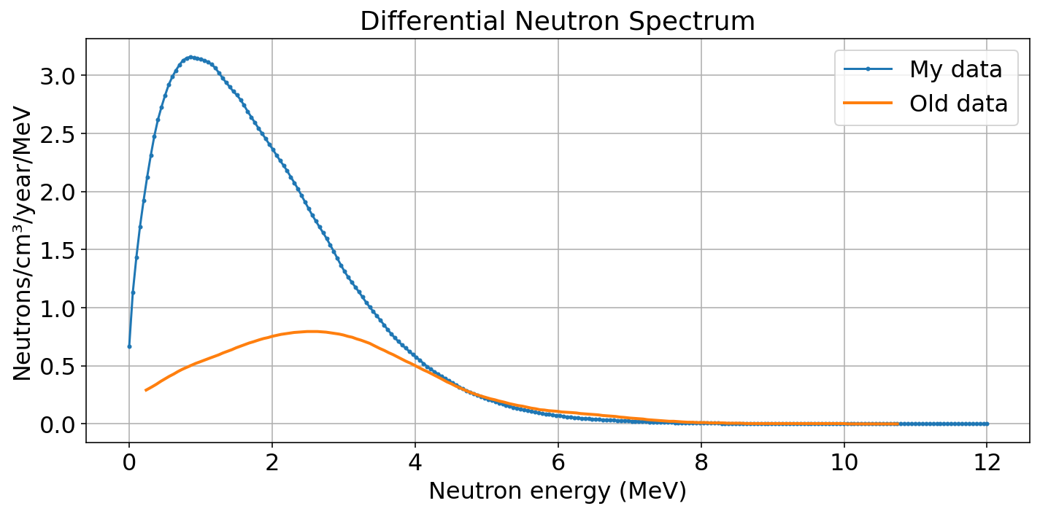
New Theoretical Fast Neutron Spectrum from SOURCES4C
NORITE YIELD
SHOTCRETE YIELD
 | Old Data (Total neutrons/cm3/year) | My Data (Total neutrons/cm3/year)
Norite Yield | 12.83 | 12.97
Shotcrete Yield | 3.07 | 8.70
Notes:
A lot of info on the slides
Remove the references
Speak about the process instead , put the title, then show the slides / break into 2 slides

Slide 56
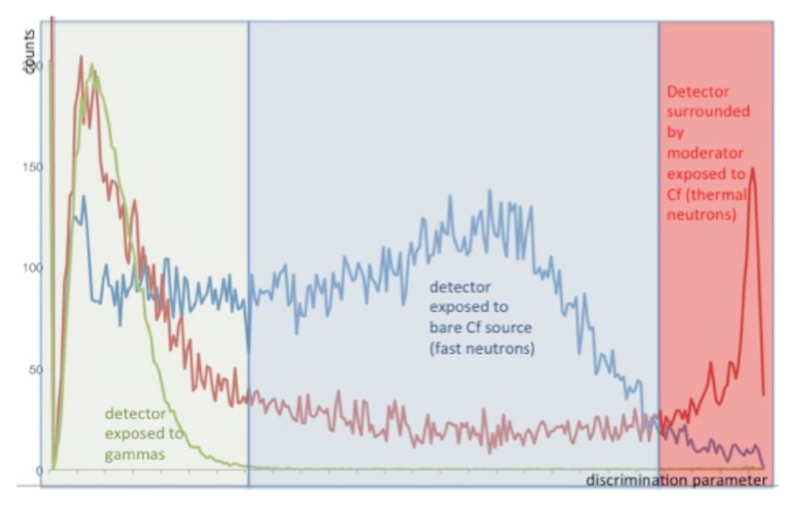
Arktis Discrimination Parameter
56
Arktis S670e Operation Manual
Notes:
Counts as a function of the Time-over-Threshold discrimination parameter. The blue line is
the counts from an un-moderated Cf-252 source; the red one is the counts from a moderated Cf-252
source; and the green one is the pure gamma counts. The cuts to discriminate between the
gammas, fast and thermal neutrons are based on this spectrum.

Slide 57
How Arktis detects FAST neutrons
Electronic board
The S-670e produces TTL pulses of different widths
Fast neutron
He-4 nucleus in detector
SiPM
57

