Slide 1


Improving Performance in Low-Background Cryogenic Experiments
a.k.a…
Wait for it...(5)
Notes:
Today I will be talking about improving performance in low-background cryogenic experiments, a.k.a: Horton Hears at CUTE. As a disclaimer, I own none of Dr. Seuss’s characters. For those of you who have never heard the story Horton Hears a Who, here’s a 10 second summary.

Slide 2
Improving Performance in Low-Background Cryogenic Experiments
a.k.a…
Wait for it...(4)
Notes:
Today I will be talking about improving performance in low-background cryogenic experiments, a.k.a: Horton Hears at CUTE. As a disclaimer, I own none of Dr. Seuss’s characters. For those of you who have never heard the story Horton Hears a Who, here’s a 10 second summary.

Slide 3
Improving Performance in Low-Background Cryogenic Experiments
a.k.a…
Wait for it...(3)
Notes:
Today I will be talking about improving performance in low-background cryogenic experiments, a.k.a: Horton Hears at CUTE. As a disclaimer, I own none of Dr. Seuss’s characters. For those of you who have never heard the story Horton Hears a Who, here’s a 10 second summary.

Slide 4
Improving Performance in Low-Background Cryogenic Experiments
a.k.a…
Wait for it...(2)
Notes:
Today I will be talking about improving performance in low-background cryogenic experiments, a.k.a: Horton Hears at CUTE. As a disclaimer, I own none of Dr. Seuss’s characters. For those of you who have never heard the story Horton Hears a Who, here’s a 10 second summary.

Slide 5
Improving Performance in Low-Background Cryogenic Experiments
a.k.a…
Wait for it...(1)
Notes:
Today I will be talking about improving performance in low-background cryogenic experiments, a.k.a: Horton Hears at CUTE. As a disclaimer, I own none of Dr. Seuss’s characters. For those of you who have never heard the story Horton Hears a Who, here’s a 10 second summary.

Slide 6

Improving Performance in Low-Background Cryogenic Experiments
a.k.a…
Horton Hears at CUTE!
Disclaimer: I do not own any of Dr. Seuss’s characters.
Image: Horton Hears a Who! by Dr. Seuss, © 1954 Random House
Notes:
Today I will be talking about improving performance in low-background cryogenic experiments, a.k.a: Horton Hears at CUTE. As a disclaimer, I own none of Dr. Seuss’s characters. For those of you who have never heard the story Horton Hears a Who, here’s a 10 second summary.

Slide 7

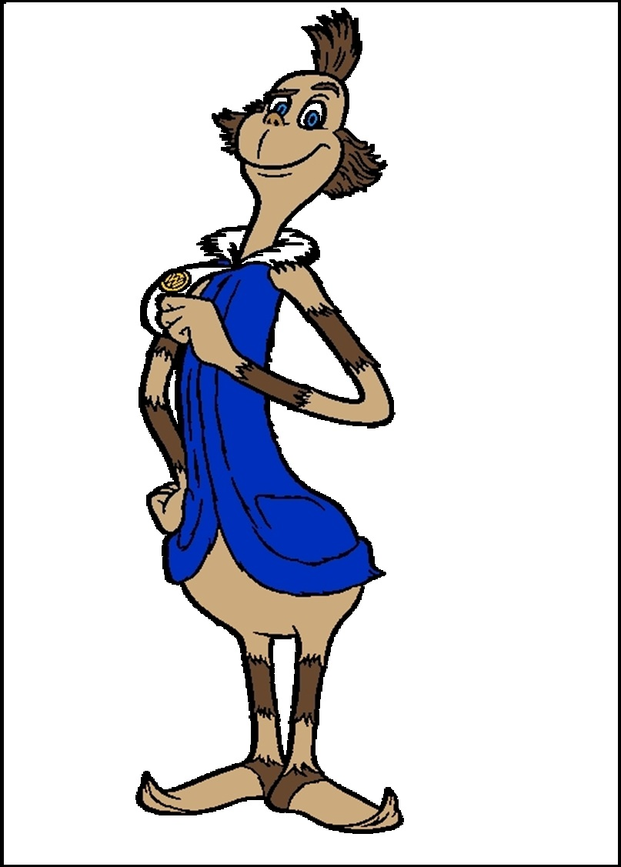
Images: Horton Hears a Who! by Dr. Seuss, © 1954 Random House
Notes:
This is Horton. On the flower he’s holding is a speck of dust, and on that speck of dust is a town called Whoville and it’s full of tiny people called Whos. That’s the mayor, Ned.

Slide 8
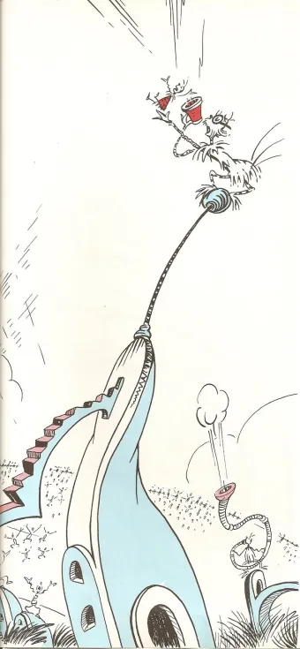
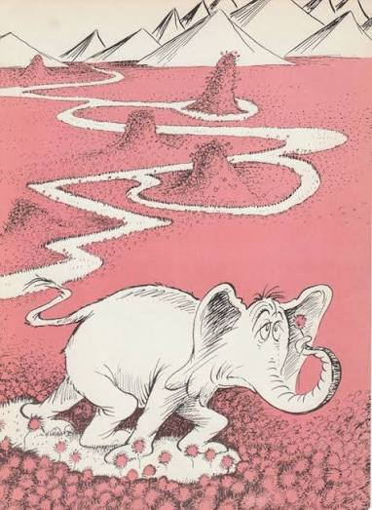

Images: Horton Hears a Who! by Dr. Seuss, © 1954 Random House
NOISE
BACKGROUNDS
ENVIRONMENT
Notes:
Now imagine that Horton is trying to hear specifically what Mayor Ned is saying, but the other Whos start making a bunch of noise, and then Horton loses the flower in a giant field full of identical flowers, and then a storm happens so not only is Horton straining to hear Mayor Ned over the wind and the rain, but the flower is getting all wet and scungy. Just like many experiments, Horton’s ability to hear Mayor Ned is affected by noise, backgrounds and environment.

Slide 9
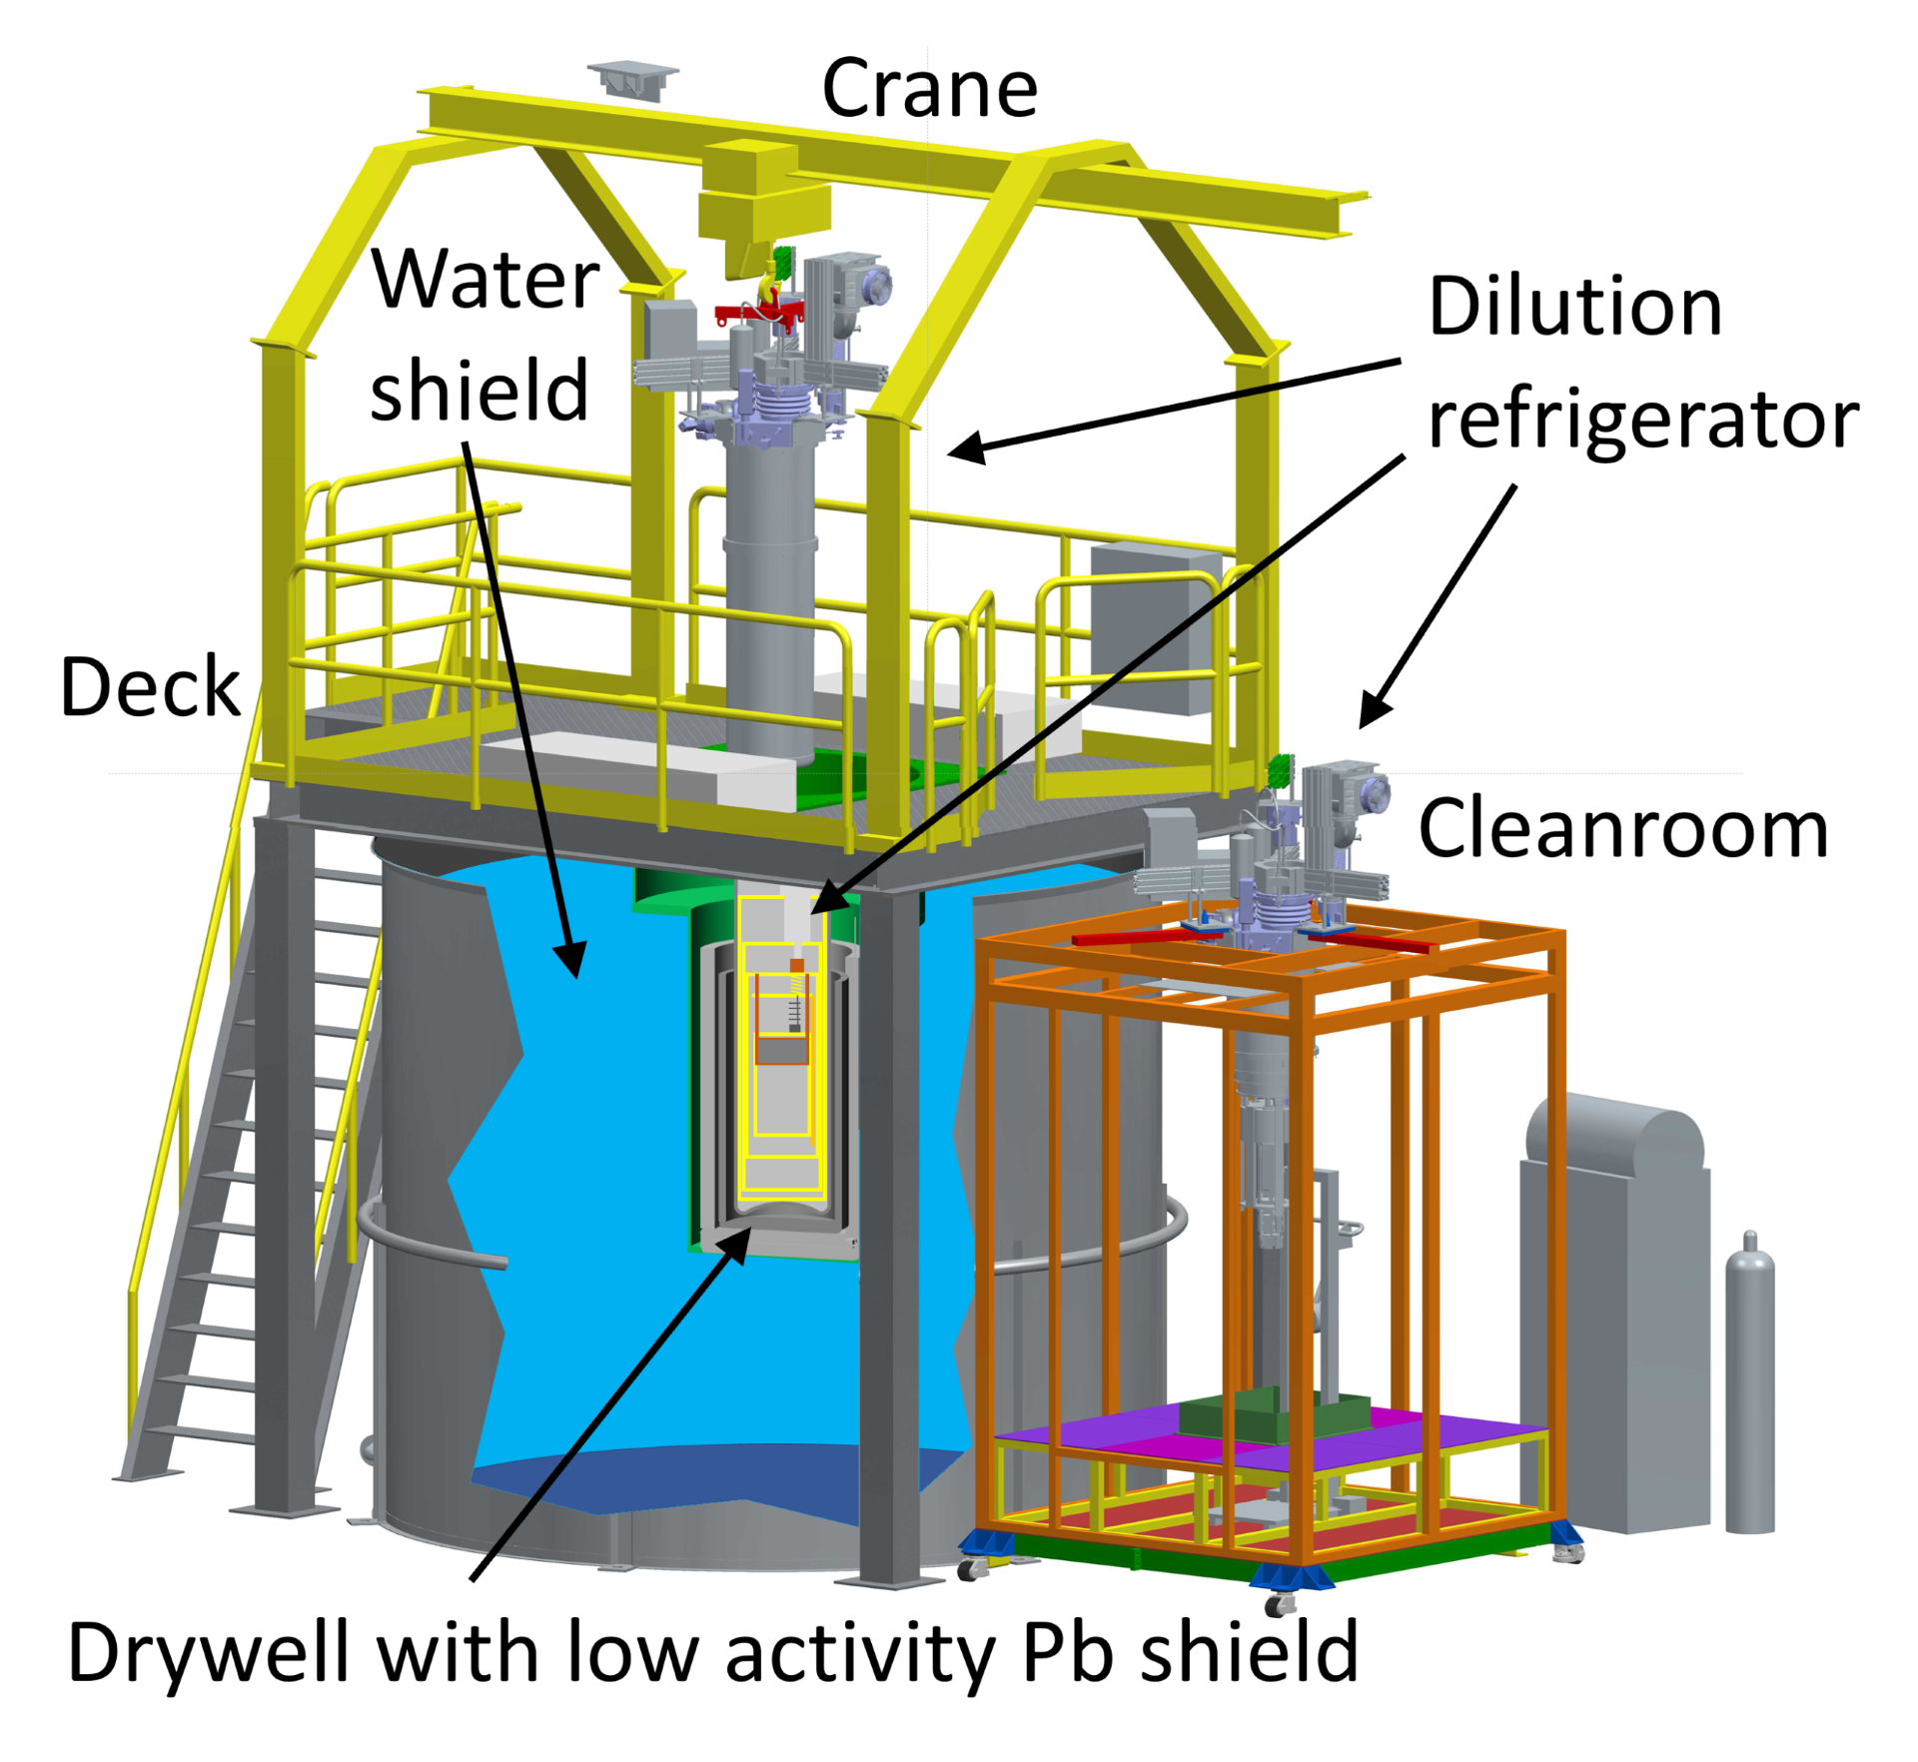

Cryogenic Underground TEsting facility
CryoConcept dilution fridge base temp ~12mK
Water tank & PE cover for neutron shielding
Drywell with 2 layered Pb for gamma ray shielding
μ-metal shield
Gamma calibration source Ba-133, neutron calibration source Cf-252
Image: How the Grinch Stole Christmas by Dr. Seuss, © 1957 Random House
Link to full facility paper: https://l1nq.com/m59pemg
Notes:
So I told my buddy Horton I have the perfect place for him to put his flower to help him pick out the Mayor’s voice, as long as the Who’s don’t mind getting a little cold. CUTE, which is the Cryogenic Underground Testing Facility, was originally designed to test the SCDMS detectors, which use superconducting transition edge sensors that require an operating temperature below 30mK. It is now a user facility for any experiment with cryogenic low-background needs. It consists of a CryoConcept dilution fridge that reaches a base temperature of approximately 12mK. This fridge is kept inside a drywell when it is running, and can be craned into an adjacent cleanroom when work is required on it.
One of the major steps in isolating low signals is shielding from backgrounds. The drywell sits inside a water tank and there is a polyethylene cover on the top for neutron shielding. It has two layers of lead for gamma ray shielding, and in between those two layers is a mu metal shield which reduces the static magnetic flux from the Earth’s magnetic field by about a factor of 50. We can also calibrate for certain backgrounds at CUTE with a gamma source of barium-133 and a neutron source of californium-252.
Not pictured here, the upper part of the fridge is rigidly connected to the drywell, and the lower part is connected to a stainless steel frame that sits on dampers. The two halves are connected by a flexible bellows, and this allows for decoupled vibrational noise isolation.
Possible Question Answers:
mu-metal shield is mainly to mitigate Earth’s magnetic field – alloy of mostly nickel and iron – high magnetic permeability, magnetic field lines “prefer” to travel through it rather than the space inside the shield, “guides” the magnetic field around the volume inside
factor of 50 means that 98% of magnetic field is diverted around the shield, 2% penetrates inside – Earth’s field ~45 microteslas, inside 0.9 microteslas

Slide 10
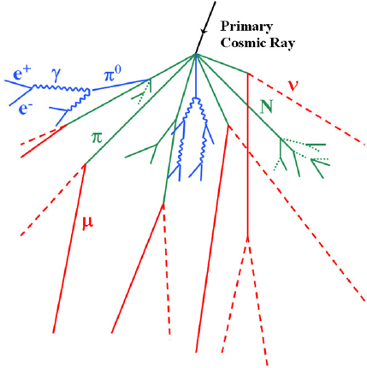
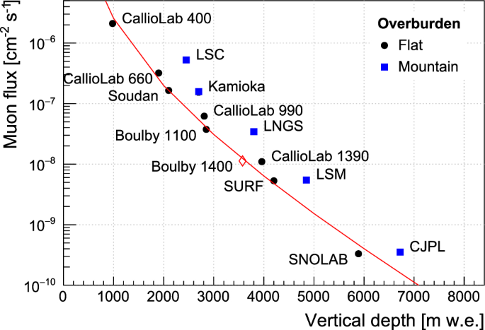
[Eur. J. Phys, doi:10.1088/0143-0807/30/4/003]
[Eur. J. Phys, https://doi.org/10.1140/epjc/s10052-024-12768-9]
Notes:
Continuing with shielding, simply being 2km underground, where our rock overburden is roughly equivalent to about 6000 metres of water, is also helpful in reducing the cosmic ray muon flux by a factor of 50 million. This helps to reduce backgrounds from muon-induced neutrons and mitigate cosmogenic activation of detector materials.

Slide 11
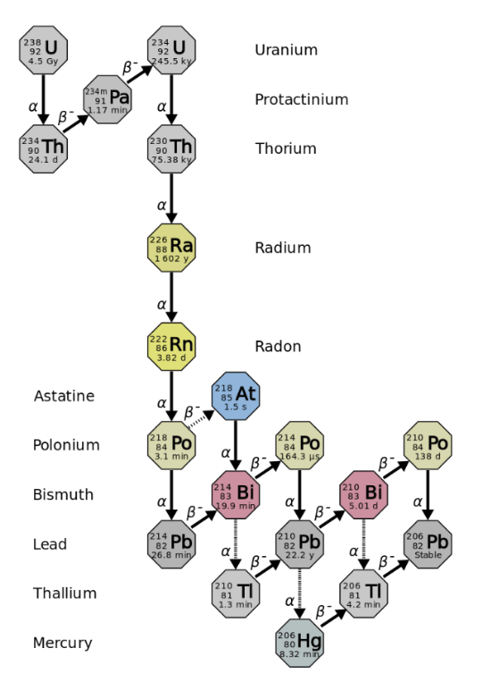
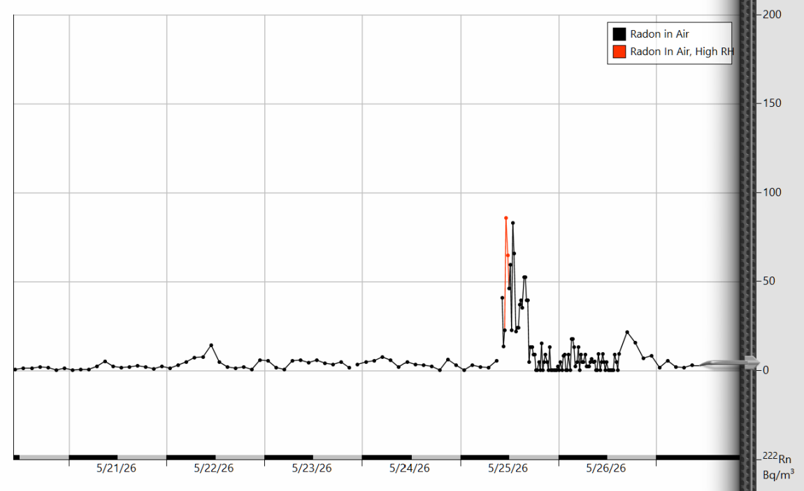
Average radon levels (with air circulation operational): 123.1 +/- 6.2 Bq/m³
[Ian Lawson, CAP Congress 2026]
Compressed air supplied from surface: < 10 Bq/m³
Monitoring – Durridge RAD7
[euronuclear.org]
Notes:
Being underground does expose us to the risk of backgrounds from the uranium and thorium decay chains, radon being a large culprit. The bulk of this come from the rock and the materials used on the lab walls. The amount of radon in the lab fluctuates seasonally, but on average it’s about 123 Bq/m^3. To mitigate this, the materials used for individual experiments can be assayed for low activity, components can be passivated to outgas surface impurities, and in CUTE we use a compressed air line from surface so it has low radon, less than 10 Bq/m^3. This also brings me to another important strategy: environmental monitoring. We have a Durridge RAD7 sniffing the cleanroom that allows us to monitor the radon levels at all times.

Slide 12
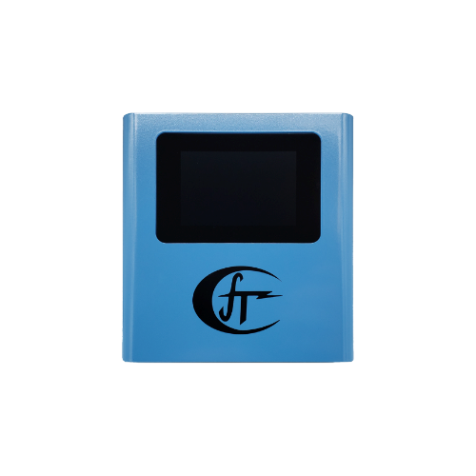
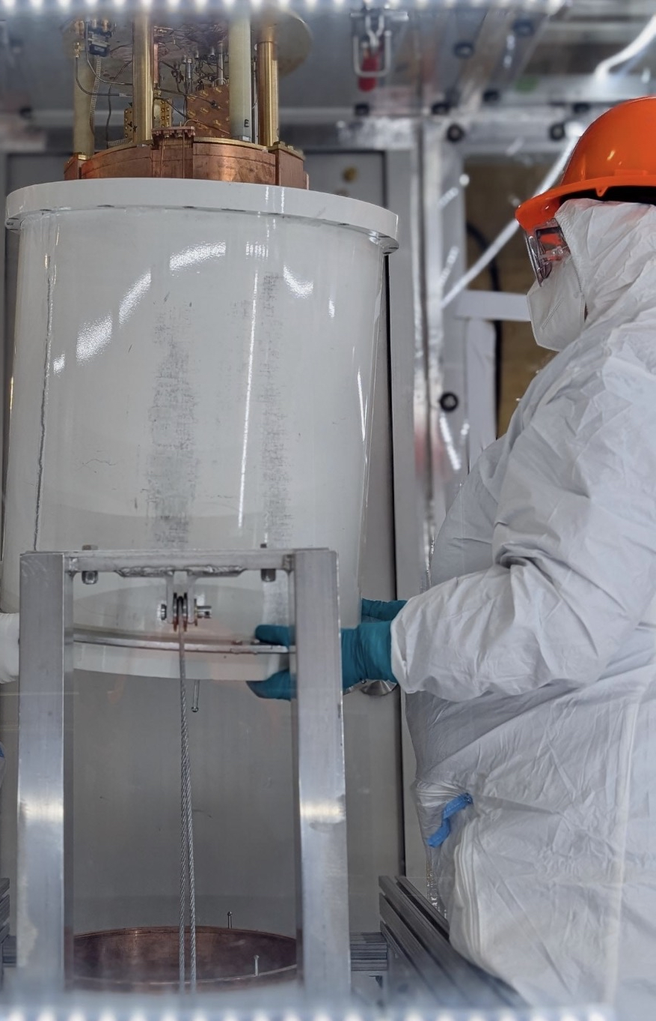
Cleanroom Protocols
PPE
HEPA filtration
Overpressure
femto-TECH CRM-LPT
temperature
humidity
barometric pressure
carbon monoxide & dioxide
particle matter (PM2.5 & PM10)
air quality (VOC)
radon
Bonus: custom firmware!
Handheld Particle Counter
During fridge work:
avg ~220 ≥ 0.5 μm per cubic foot
(Class-300)
Empty:
avg ~110 ≥ 0.5 μm per cubic foot
(Class-200)
SNOLAB: Class-2000
Dräger O2 monitor
CO monitor & alarm
Notes:
We have also purchased a new environmental monitor from a company called femto-TECH that will read out temperature, humidity, pressure, CO and CO2, particle matter, air quality, and act as a secondary radon monitor. I am currently working with an engineer in the company who is giving us a free custom firmware upgrade so that this monitor does everything we need to, and in return we will be testing his radon monitoring code for him in the clean room, which is a neat new partnership. For the safety of both workers and the equipment, we also have an O2 monitor, and a CO monitor and alarm, and follow cleanroom protocols such as extra PPE, using an installed HEPA filter, and keeping the room at a slight overpressure for cleanliness. I have also occasionally tested the room with a handheld particle counter. The room has never been ISO standardized, but following their guidelines when there is active work and people inside the cleanroom we meet the definition of a Class-300 cleanroom, and when it is empty a Class-200, as opposed to the lab in general which is a Class-2000.

Slide 13
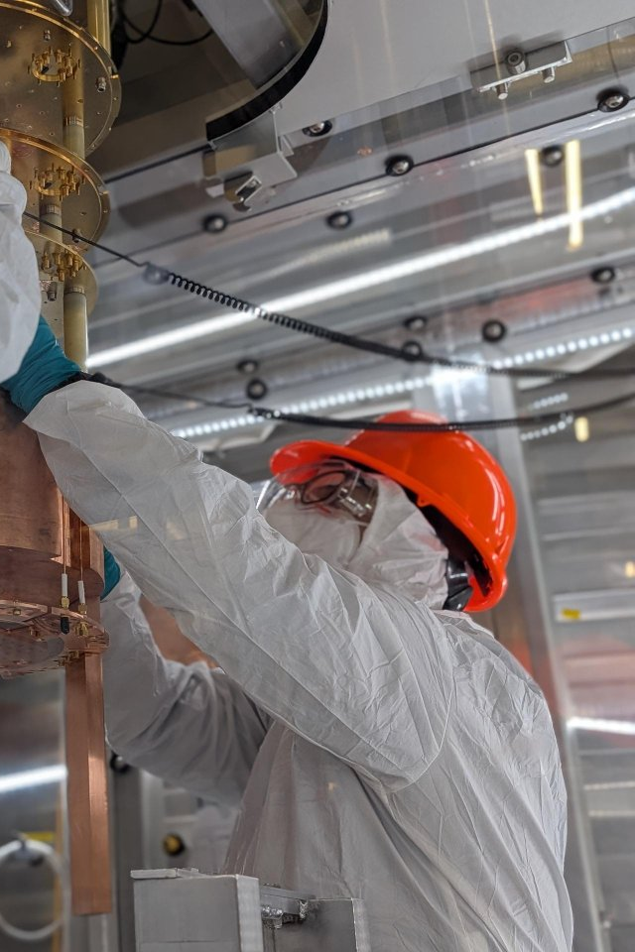
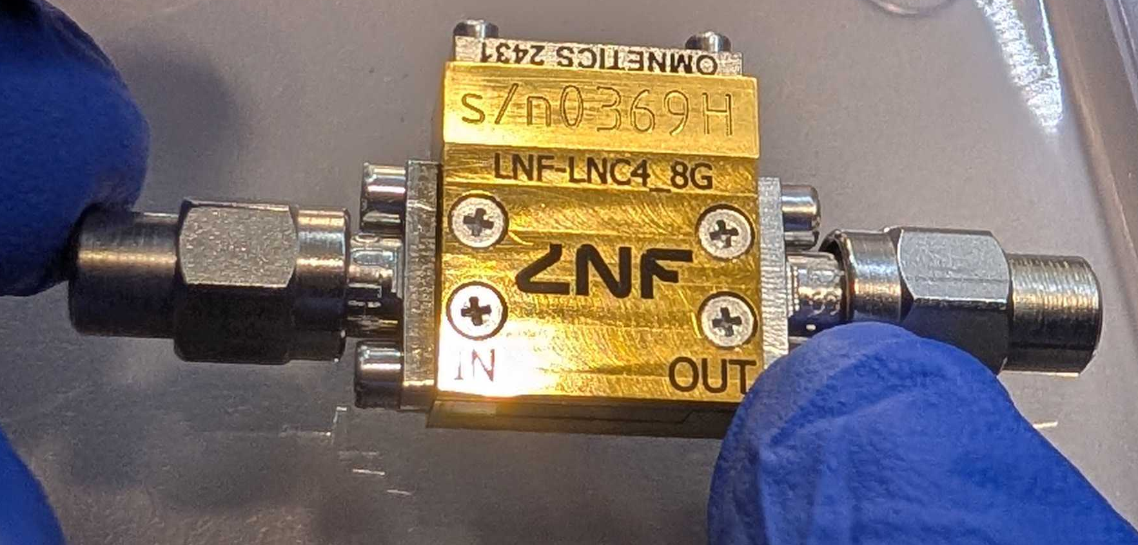
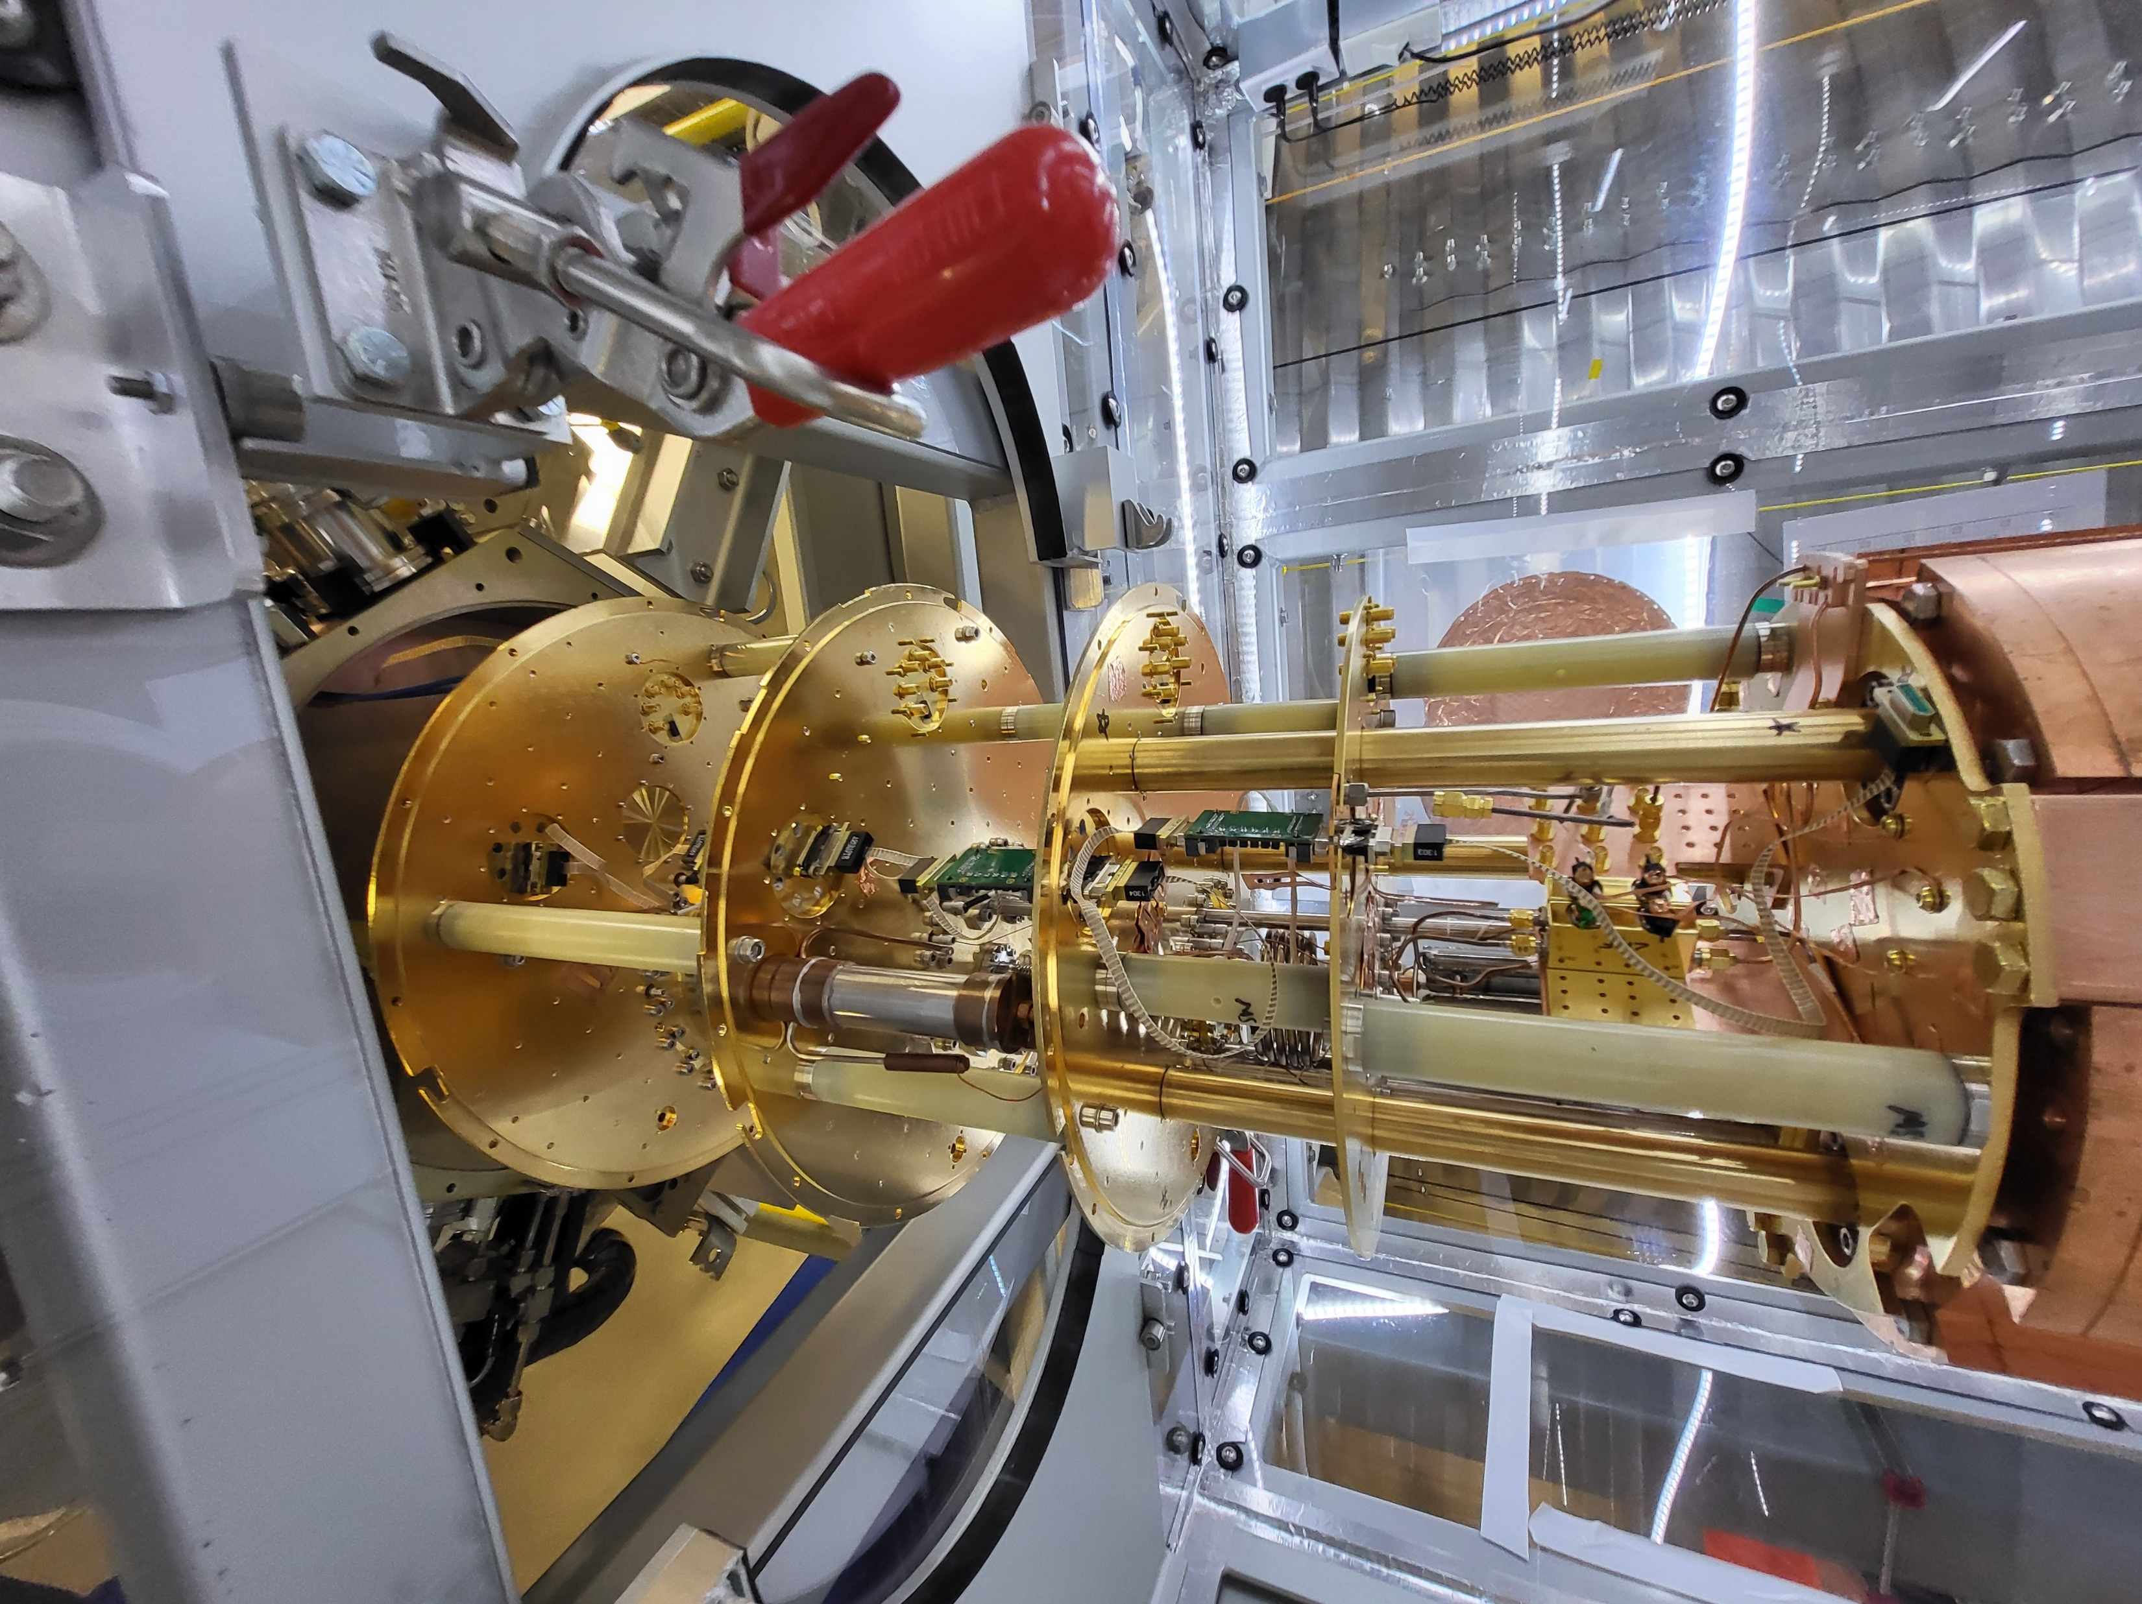
Quantum qubits in CUTE (QUTEbits - Waterloo)
Testing underground performance
Upgrades:
  extra RF lines to support more qubits
  HEMT (high-electron-mobility transistor) for amplifying with low noise
Notes:
Hardware requirements for reducing noise and background signals may depend on the experiment, and CUTE provides existing infrastructure to support a variety of needs. Currently, the quantum qubits project at University of Waterloo is using CUTE to compare the performance of the qubits in an extremely low background environment that being underground provides to their typical performance on surface in terms of variables such as their state relaxation time and phase coherence time. Recent upgrades that I helped with to support that include adding extra RF lines to support the reading of multiple qubits (there are currently 2 installed) and installing a HEMT (high-electron-mobility transistor) used for amplifying the signals from the qubits with low noise.
Now, for the final strategy, and even though I’m mentioning it last, it is probably the first defense against backgrounds that happens before an experiment is even made, and that is doing background simulations. There have been extensive background assays done at SNOLAB, these results are all publicly available at radiopurity.org, but the specific geometry of an experiment contributes significantly. I have been doing background neutron simulations on a potential future candidate for CUTE called
Possible Question Answers:
HEMT – 2 different semiconductive materials – heterojunction – materials have different bandgaps, difference in bandgaps creates a lower-energy conduction band on one side of the junction, electrons naturally move to lower-energy states, electrons naturally collect at interface to create 2D electron gas, donor atoms remain in first layer – allows electrons to move very quickly with minimal scattering off the donor atoms, you get high gain & low intrinsic noise

Slide 14

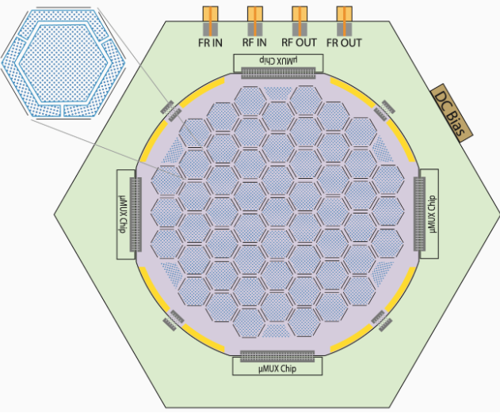
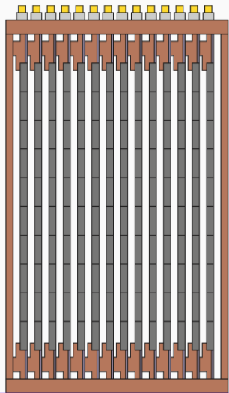
HONEYCOMB
(HOdoscopic
Neutrino
-EnergY
CryOgenic
Multiplexed
Bolometer)
14 Ge wafers
4" diameter
4 mm thickness
Detectors etched into wafers
Copper housing for IR shielding
Target threshold sensitivity ~0.5 eV
Notes:
HONEYCOMB, which is the hodoscopic neutrino-energy multiplexed bolometer. Before anyone asks, yes that is awful, yes that is a backcronym, and no, physicists should not be allowed to name anything. The name comes from the honeycomb shaped pattern of the detectors on the concept design. The original concept is a set of 14 germanium wafers with a 4 inch diameters and 4mm thickness, each with an array of individual detectors etched into the wafer. The wafers are inside a copper housing which acts as IR shielding, and can be mounting inside the fridge. The idea is based on the concept of the HVeV detectors tested by SCDMS, which allow us to aim for a threshold sensitivity of 0.5eV, so we can look for CEvNS, light dark matter candidates, and other rare low-energy interactions.
Possible Question Answers:
deep reactive ion etching – stick the wafer inside a reactor, fill the reactor with gases, a plasma is created in the gas mixture, ionizing the gas, the ions are accelerated towards the wafers where they react with the surface to etch it, then the surface is passivated to stop the reactions – cycle is repeated, allowing for controlled etching steps
- copper as IR shielding – copper has a lot of mobile conducting electrons, they move to oppose incoming EM field, causes most IR radiation to by reflected, the remaining IR is absorbed and then the copper conducts the heat away to the cold stages of the fridge
CEvNS: Coherent elastic neutrino-nucleus scattering - a neutrino bounces off an entire atomic nucleus, causing a tiny nuclear recoil.
hodoscopic: tracks path or trajectory of moving particles – can be used to make the device self-vetoing
measures power of incident electromagnetic radiation by detecting temperature changes

Slide 15
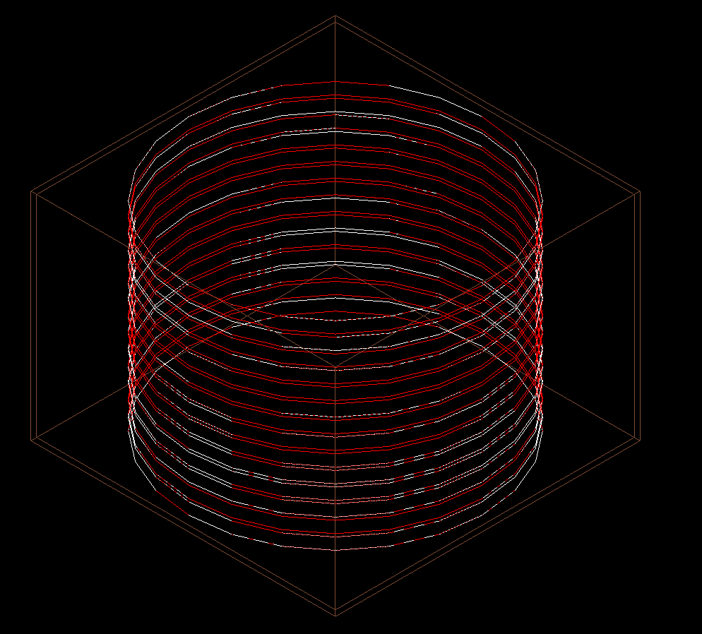
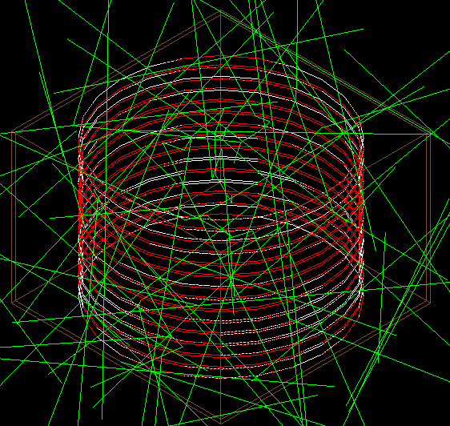
Spherical source
Lambertian distribution
Source: CF-252N
Notes:
So I used GEANT4 for the first time ever, by which I mean I spent significant time crying and pulling my hair out, which is why it’s so short now, and then successfully did a monte carlo simulation sending 100 million neutrons at the wafers from a spherical source surrounding the volume using a Lambertian distribution. I used a californium-252 neutron-only source defined in SCDMS’s supersim package.
Possible Question Answers:
Lambertian distribution – probability of angle emission is proportional to the cosine of the angle – throughout the sphere, more probable that the neutrons will shoot inward toward the detector rather than off at shallow angles

Slide 16
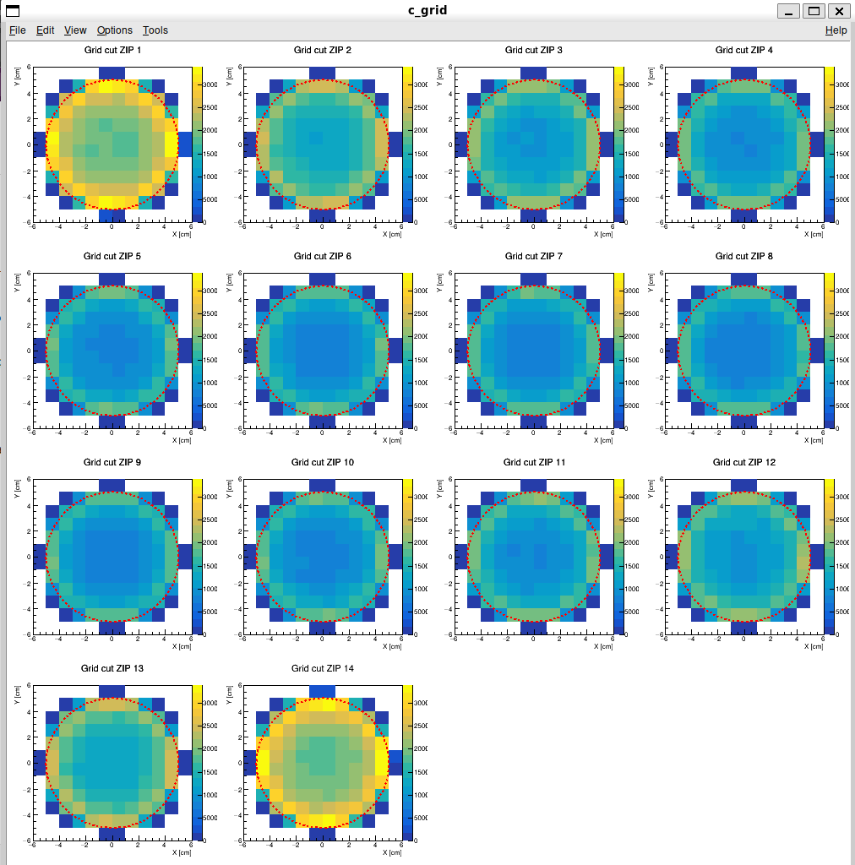
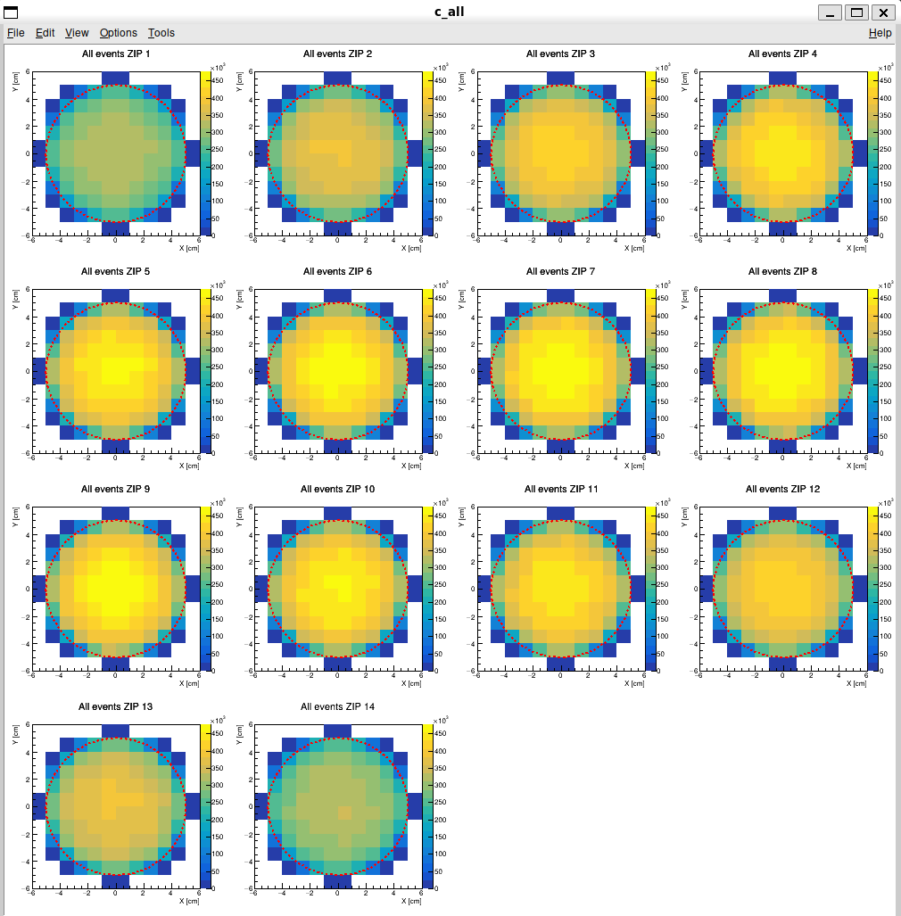
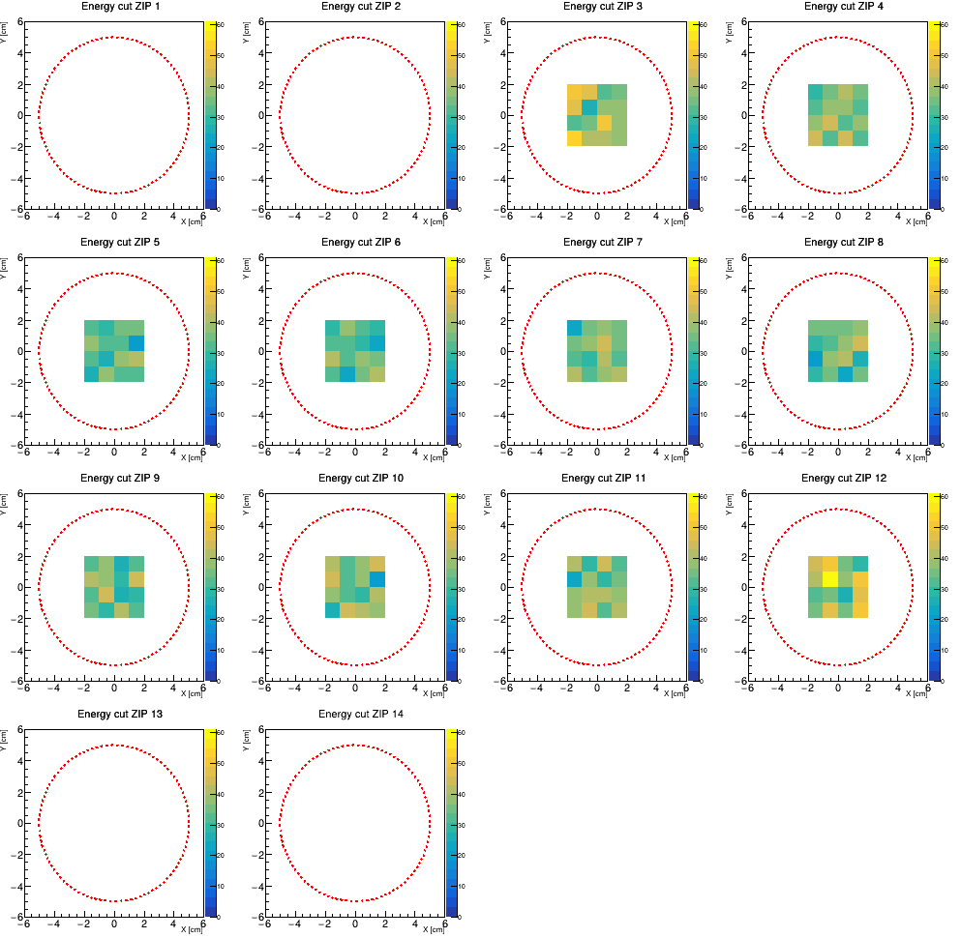
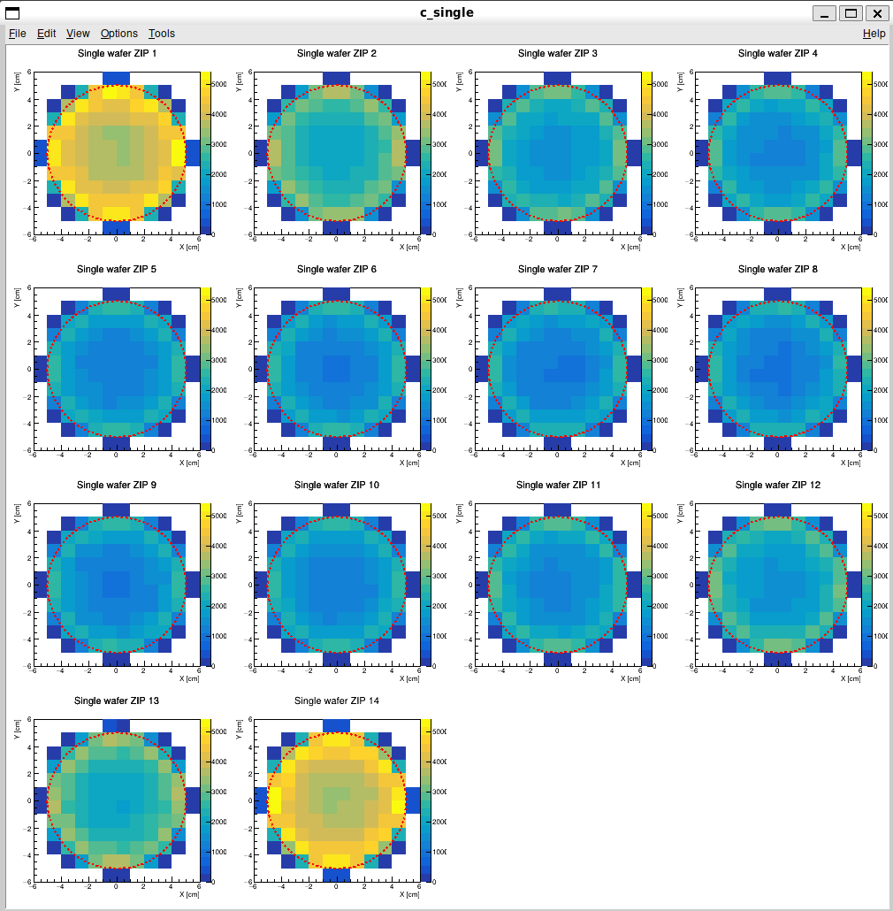
1st cut: reject multiple
wafer hits (DM & v's would not
multi-scatter, BG's
would)
2nd cut: reject hits in same
1 cm x 1 cm region (also for multi-scattering)
3rd cut: fiducial volume - reject top & bottom 2
wafers, keep inner 4 cm
x 4 cm region of
remaining wafers (exclude surface
events where BG's
are high)
4th cut: reject Edep of >100 eV (keep only events within ROI)
Notes:
I then applied a series of cuts to the resulting data. These are occupancy plots showing the distribution of hits across the wafers, this is before any cuts were applied. The first cut rejected events that had hits across multiple wafers as we don’t expect neutrinos or dark matter to interact more than once with detector crystals but we do expect background events to undergo multi-scattering. The next cut is again for multi-scattering, rejecting events that have multiple hits within the same 1cm by 1cm grid square in the same wafer. The third and fourth cut are shown together in the final occupancy plot, the third being a fiducial volume cut where we rejected the top and bottom two wafers and kept only the inner 4cm by 4cm regions of the remaining wafers, and the fourth cut rejecting energy depositions of over 100eV, leaving us only with events within our region of interest.

Slide 17
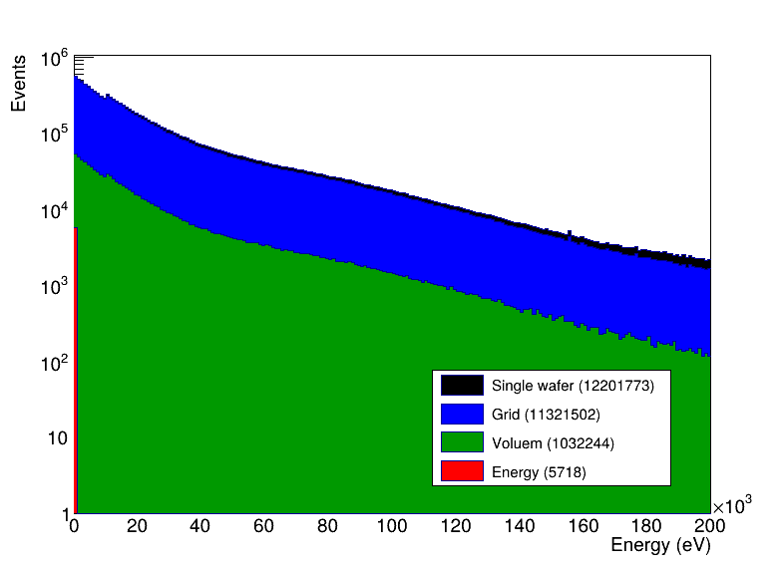
Events kept from those that hit any wafer:
5718 out of 23,379,186 (~0.02%)
Overall neutron background rejection efficiency: ~99.98% within energy ROI
Volume (1032244)
Notes:
From these cuts, I was able to produce an overall neutron background rejection efficiency of about 99.98% within our region of interest of 100eV and less.

Slide 18
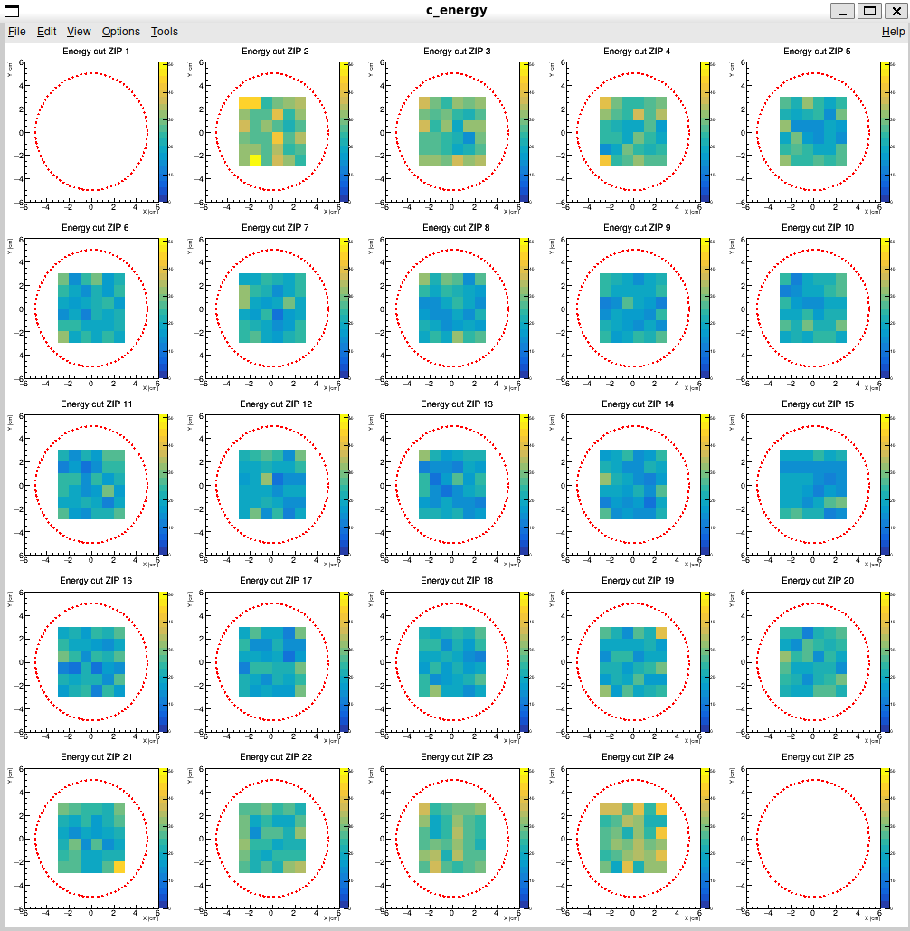
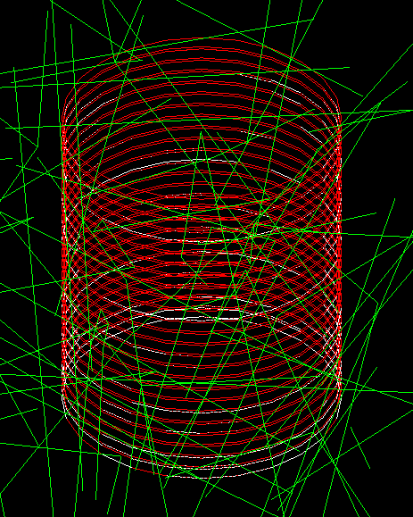
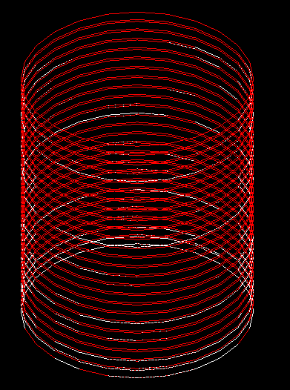
Notes:
Then we realized we were rejecting a lot of active detector volume and started looking at maximizing it. We increased the number of wafers to 25, and applied the same cuts except that the fiducial volume cut now only rejects the top and bottom single wafers and keeps the inner 6cm by 6cm regions of the remaining ones.

Slide 19
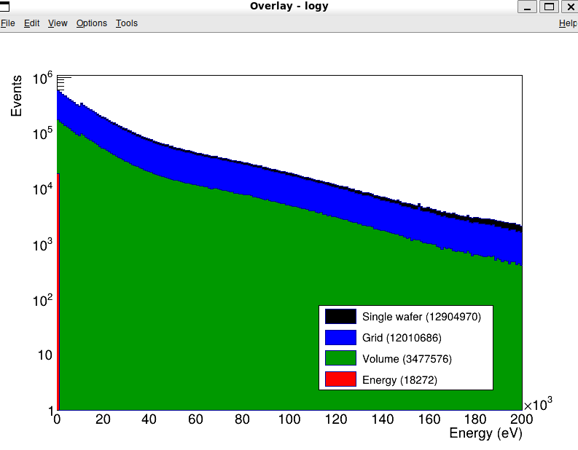
Events kept from those that hit any wafer:
18,272 out of 27,427,453 (~0.07%)
Overall neutron background rejection efficiency: ~99.93% within energy ROI
Notes:
This got me to a neutron background rejection efficiency of about 99.93%. Although the numbers did change, it wasn’t by a significant amount, and this doesn’t account for the existing neutron shielding that CUTE has, which would also help. We are currently working on a concept paper based on our simulation results.

Slide 20
Images: Horton Hears a Who! by Dr. Seuss, © 1954 Random House
Shielding
Environmental Monitoring & Control
Hardware Upgrades & Customization
Background Simulations & Rejection
Notes:
So back to Horton and Mayor Ned. I truly believe that CUTE can help him out, using tools we have available: environmental monitoring and control, hardware upgrades and customization, and background simulations and rejection. These methods, on top of the existing shielding underground and at CUTE specifically, are very effective at combating noise, backgrounds, and environment, and will allow Horton to hear Mayor Ned, who will probably be complaining about how cold it is inside the CUTE fridge.

Slide 21

A signal’s a signal, no matter how small!
Image: Horton Hears a Who! by Dr. Seuss, © 1954 Random House
Notes:
As my good buddy Horton would say after all... A signal’s a signal, no matter how small.

Slide 22
Questions?
Image: Horton Hears a Who! by Dr. Seuss, © 1954 Random House
Notes:
Thank you

Slide 23
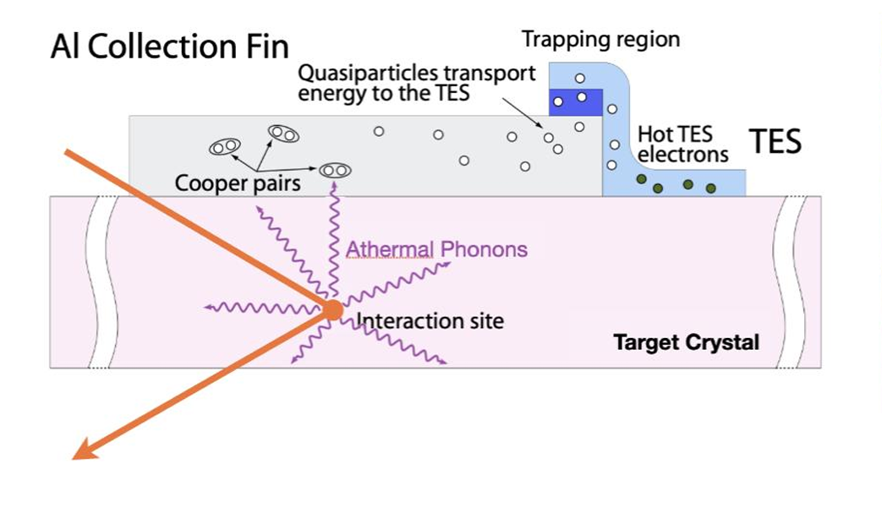
Back-up Slides
Notes:
HVeV detectors:
superconducting thin film of tungsten held at critical temp T_c (Transition Edge Sensor)
incident particle scatters in crystal, generates athermal phonons & e-h pairs, phonons travel to surface, collected by aluminum fins & funnelled into TES
amplified by NTL effect (Neganov-Trofimov-Luke) - bias voltage creates E field, accelerating e-h’s – they collide, secondary NTL phonons
e-h pairs quantized, gives distinct peaks in energy spectrum, gives single-electron resolution
funnelled energy heats TES past critical temp. resistance shoots up, results in current change
current change read out by SQUIDs (Superconducting Quantum Interference Device)
as current changes in TES, creates magnetic flux through adjacent input coil
SQUID is tiny superconducting ring next to coil, cooper pairs tunnel through josephson junctions in loop maintain a quantum phase across it
change in mag flux shifts phase of cooper pairs, electron waves constructively or destructively interfere, changes critical current of ring, causes measurable change in voltage which is the signal
reconstructed deposited energy can correspond to about 0.5eV, statistical measure of the smallest reliably detectable energy

Slide 24
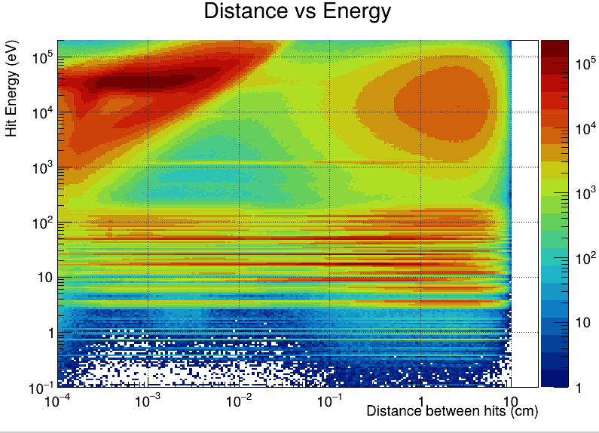
Back-up Slides
Two visible “peaks”:
1st peak at ~10⁻³ cm: multi-scattering events
2nd peak at ~10 cm: geometric limit (diameter of wafers) – high energy neutrons w/subsequent hits far apart would appear here, limit at which those become visible before running out of detector area

Slide 25
Back-up Slides
Simulation Set up:
Geant4 v10.7.4
SuperSim: Geant4-based set of code that implements geometry model:
  Cavern
  Shielding
  Detectors
  Sources & interactions
  Detector configuration to model detector response
Spherical source Cf-252N
R = 8.4cm (14 wafers)
R = 9.9cm (25 wafers)
Lambertian Distribution:
Uses cosine emission law:
I = I₀cosθ
I = intensity of incoming source
θ = angle between incoming source & surface normal
I₀ = max intensity of source (when θ = 0°)
Intensity/probability of incoming source proportional to cosine of angle between source & surface normal
More likely to travel inward toward bulk

