Slide 1
From Signals to Science: Machine Learning for Event Reconstruction in SuperCDMS
Lyssa Dale-Davies
Notes:
Change the picture (I wonder if I should make a quick sketch of the detectors on tablet and use that for creativity points?)

Slide 2
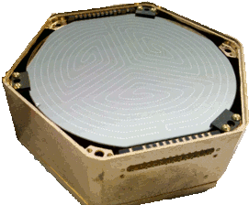
Machine Learning in the SuperCDMS Experiment
They don’t record the location of an interaction
Detectors record a lot of information, which is good!
Knowing position ==> signal and background separation
Machine learning can integrate the information recorded by the detector to reconstruct the position of interactions
Notes:
-record lot info, good
-don’t have position, bad for background delimination
-ml integrate data predict position

Slide 3
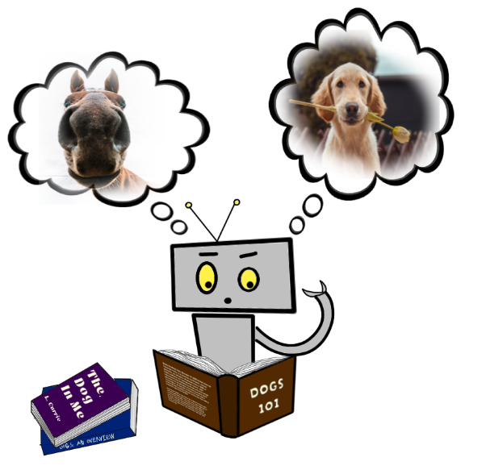
How Does a Machine Learn?
ML models, given training data, use iterative mathematical processes to predict things about the data
How does the machine learning model ‘know’ that it’s learning the training set correctly?
Courtesy of Karim Khakimov
Notes:
-Takes measured data not necessarily correlated with quantities of interest, uses mathematical processes to reconstruct
-like being fed images of animals and predicting if it’s a dog or not
-during training, needs truth info to verify each prediction to ensure model is learning correctly
-real data doesn’t usually have this truth information (eg position), so we’ll need to make it-or simulate it-ourselves…
As the model learns, it needs to check itself against the ‘true’ prediction
But real data doesn’t always have the ‘truth’ information about features we want to predict
We need to fabricate it—or simulate it…
This is unfortunately really wordy, I will need to put in more images I think
I may need to reword things if I want to emphasize the studying analogy?

Slide 4
Simulation
Notes:
I think I might just make this a section header
The simulation we’ll be looking at is of the (cryogenic underground tower test) (CUTE) facility’s test of Germanium HV detectors
-establish what exactly we’re simulating (detectors)

Slide 5
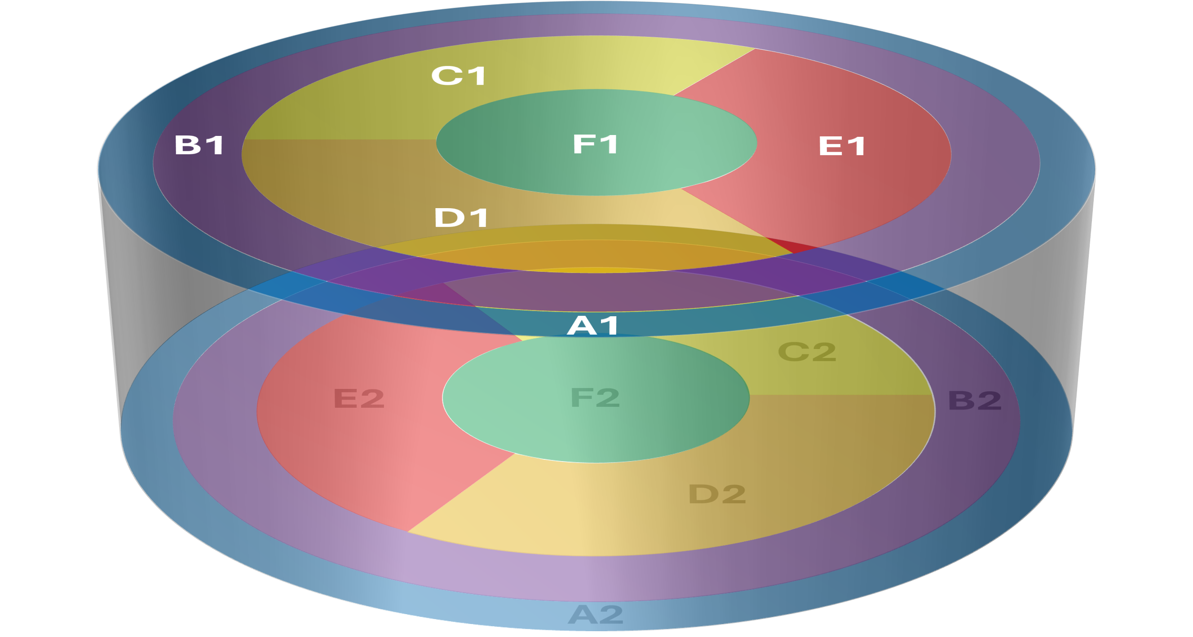
Detector Design
50 mm
33 mm
The detectors we’ll look at are cylindrical Germanium crystals
Notes:
- Cylindrical germanium crystal detectors 50 mm radius 33 mm height

Slide 6
Detector Design
The top and bottom of the detectors are equipped with superconducting sensors
There are 6 sensors on each side, labelled A1-F1 for side 1 and A2-F2 for side 2
Notes:
-top and bottom equipped with 6 sensors each, labelled A1 and 2 through F1 and 2 sides 1 and 2 resp

Slide 7
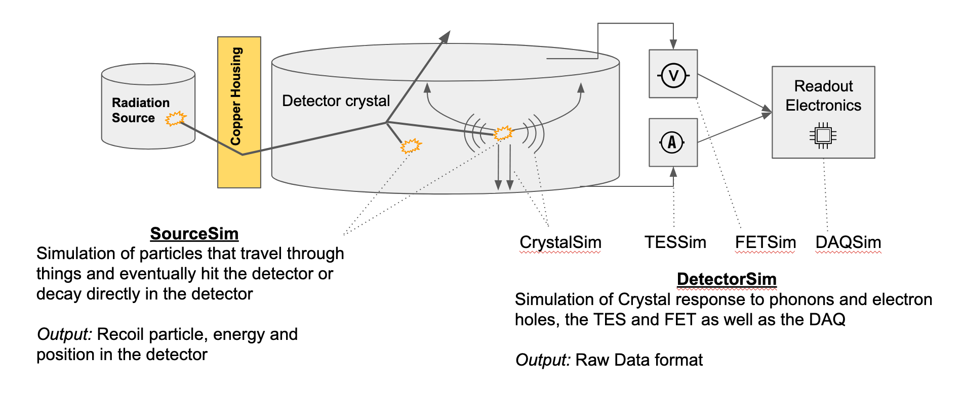
Detector Simulation
Notes:
-let’s talk about the simulation itself – we are simulating CUTE facility testing, which involves exposing the detector to neutron source, which produces 71-ge from the 70-ge of the detector, decays into gallium through electron capture
Simulation of this is split into two steps
Sourcesim simulates the incident particle that hit or decay in the detector
Detectorsim simulates the crystal response to the phonons and electron holes, the sensor response, and the readout system
Output measurements (like amplitudes and delays) same format as real detectors
Radiation source (Cf-252 as a neutron source irradiates the crystal, producing the Ge-71 isotope from the Ge-70 of the crystal. The Ge-71 decays via electron capture to Gallium, which produces the
characteristic energy emission lines we separate the data with) This presentation will be looking at K-shell data?

Slide 8
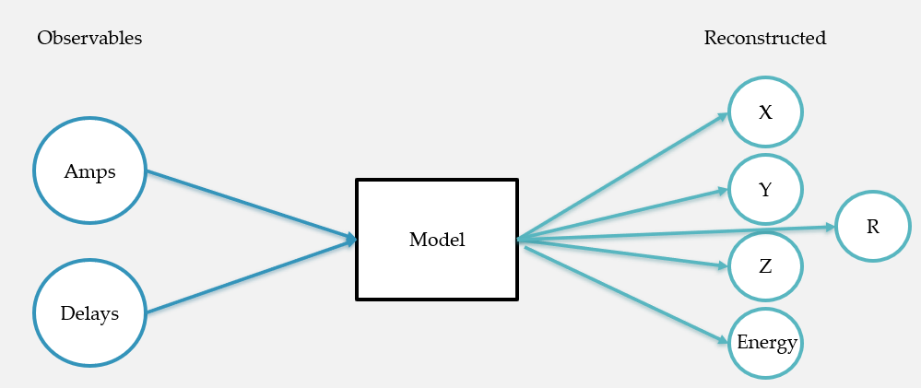
Training on Simulation
Simulation produces observables (amplitudes and delays) as well as truth information (X, Y, Z, R, and Energy)
Let’s see how our model performs!
Notes:
-all in all, simulation produces observables and truth info about where the interaction occurred
-feed our model the simulation sample with the observables and truth info, get a model that predicts position and energy back
-have our model, let’s test our model by validating!

Slide 9
Validation

Slide 10
What is Validation?
Predicted R
True R
Reconstructed Quantities
Model
Observables
Truth
Simulated Validation Sample
Notes:
Train on 80% of the data, use the remaining 20% to validate
I can say we save a fraction of the sample used for training and then once the model is trained, give the observables to the model and compare its predicted quantities with the simulation truth information

Slide 11
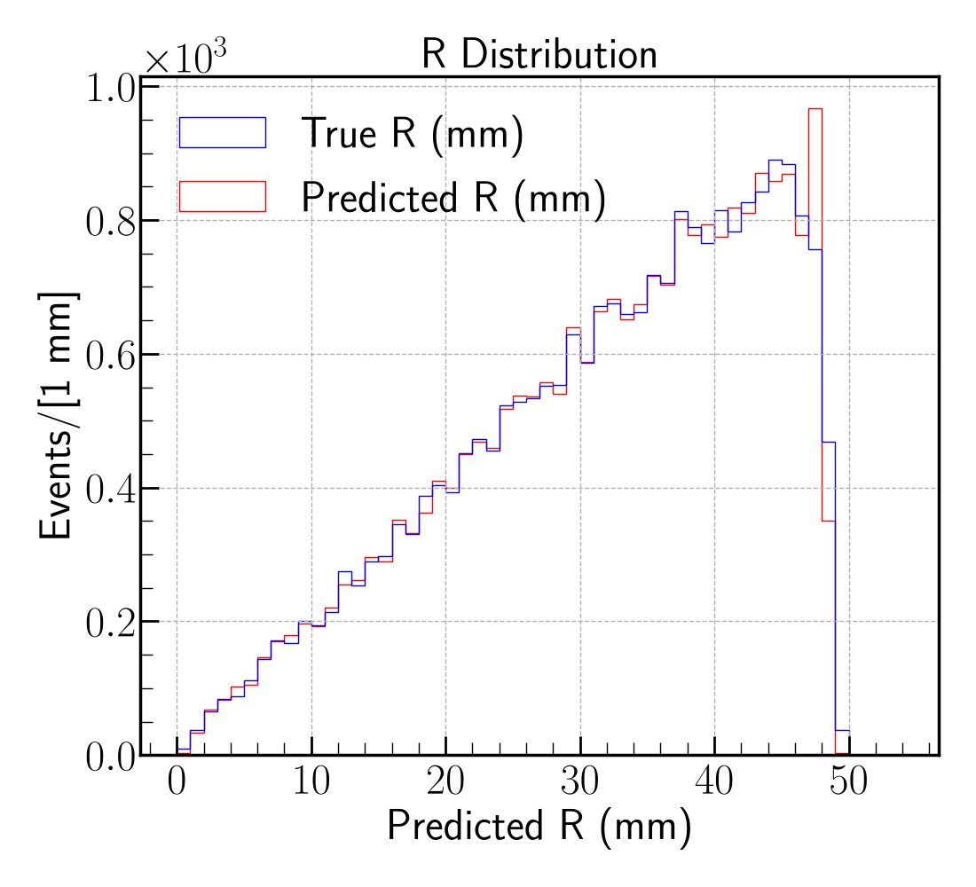
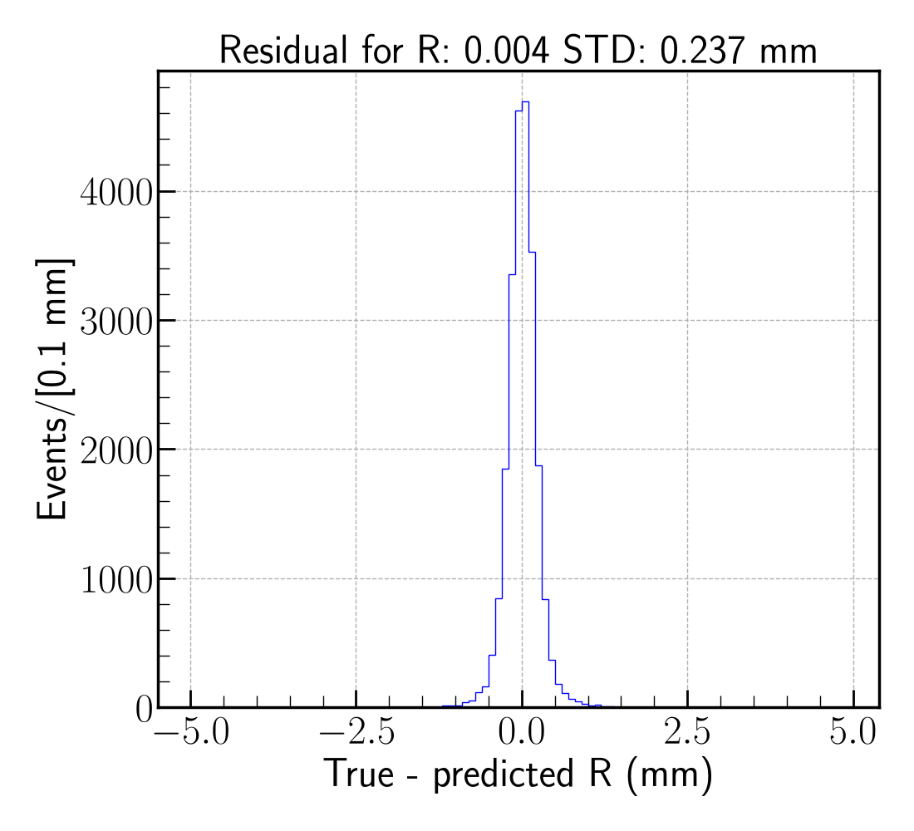
Radial Validation-How Well Does the Model Work?
Validation R Distribution
SuperCDMS Work in Progress
SuperCDMS Work in Progress
Notes:
Focus on what this tells us for validation – first, good overlap. Suggests the model is able to accurately reconstruct the data it’s been given (hooray!)
Why this shape? – simulating random decays so uniform event distribution, increases linearly because (aghaghagh),

Slide 12
Validation – Is It Enough?
Now that we’ve done some validation, do we think our model works?
After all, we're not training it for use on simulated events...we need to look at data

Slide 13
Looking at CUTE Data

Slide 14
What Should We Expect?
Validation R Distribution
How can we tell our model reconstructs real data accurately?
We’ll use the validation done on simulated events
Reminder: The training sample we’re using is the simulation of the CUTE data we’ll be reconstructing.
SuperCDMS Work in Progress
Notes:
A linear trend with events from 0 mm to 50 mm are the features we’re looking to see reconstructed
We can’t compare CUTE predictions to any true data (there is no true position data, only observables like sensor amplitudes and timing delays, so we need to rely on what we know to be true about the detector geometry and the nature of the decays)

Slide 15
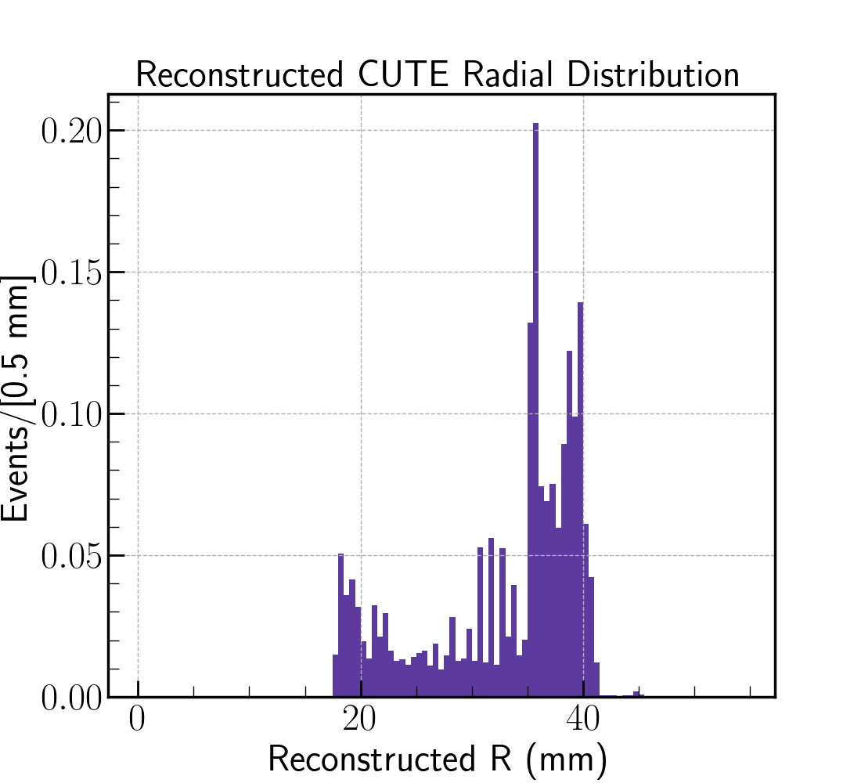
Unexpected Results
No visible trend—certainly not increasing linearly
Minimum is at 17 mm, maximum is at 42 mm. (Recall the detector has a radius of 50 mm).
SuperCDMS Work in Progress
This can’t be correct!
Notes:
Put something on the plot that refers to the 50 mm radius (instead of a question mark)

Slide 16
Unexpected Results
Validation R Distribution
SuperCDMS Work in Progress
SuperCDMS Work in Progress
This can’t be correct!
What we see
What we expect
Notes:
Put something on the plot that refers to the 50 mm radius (instead of a question mark)

Slide 17
What’s Going On?
Validation showed that the model performs well. The fact that the model reconstructs its training data well shows that it’s working as intended…
Is it possible the training sample doesn't match CUTE data?

Slide 18
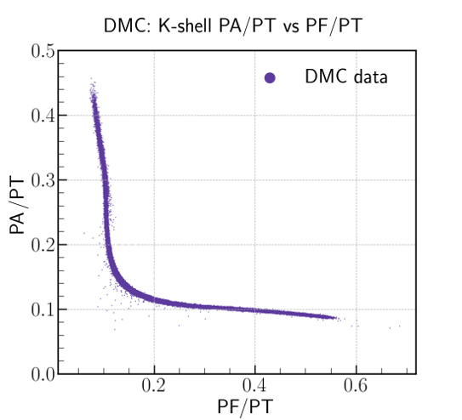
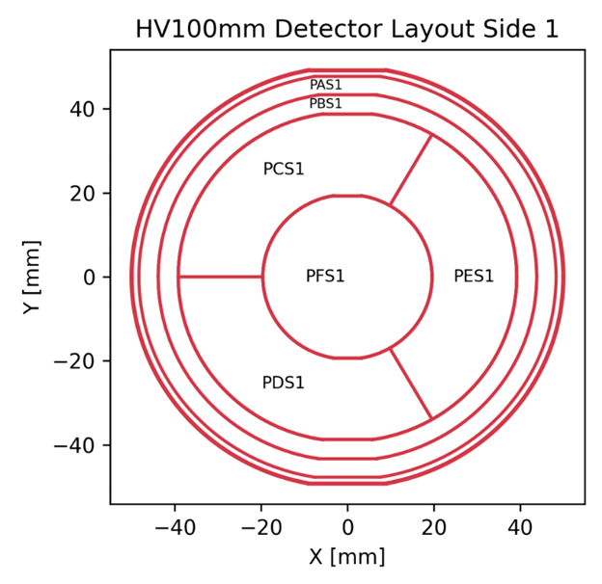
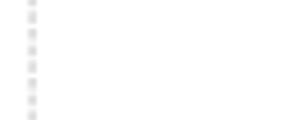


A vs F Sensors in Simulation
SuperCDMS Work in Progress

Slide 19
A vs F Sensors in Simulation
SuperCDMS Work in Progress

Slide 20

A vs F Sensors in Simulation
SuperCDMS Work in Progress

Slide 21
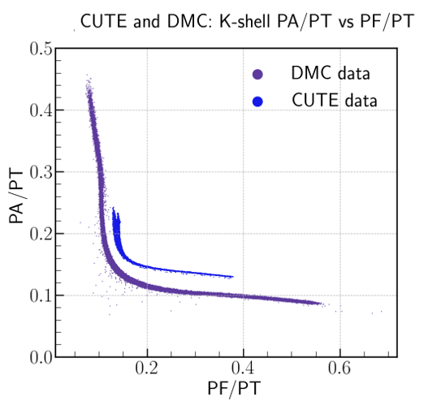
Simulation Does Not Match Real Data!
SuperCDMS Work in Progress
Notes:
- Mention why we’re here (model doesn’t accurately reconstruct cute) this is likely the reason bc simulation fails to model this behaviour in cute

Slide 22
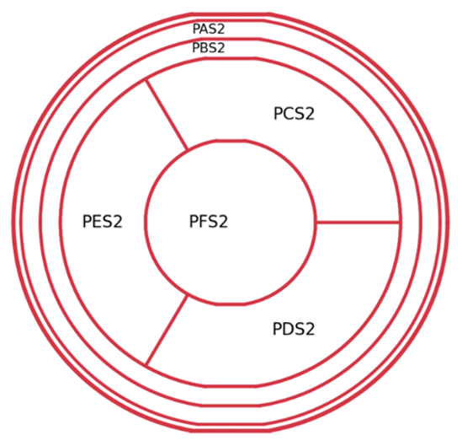
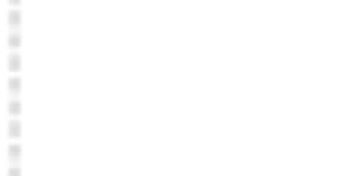
Can We Scale the Sensor Amplitudes?
SuperCDMS Work in Progress
Cui, S. Optimizing Machine Learning Techniques for Dark Matter Detection: Enhancing Position Resolution in SuperCDMS Detectors. SLAC. Conflu
Notes:
Might get rid of the images on the side and replace with bullet points? Or I could leave to remind people that these are the sensors we want to show

Slide 23
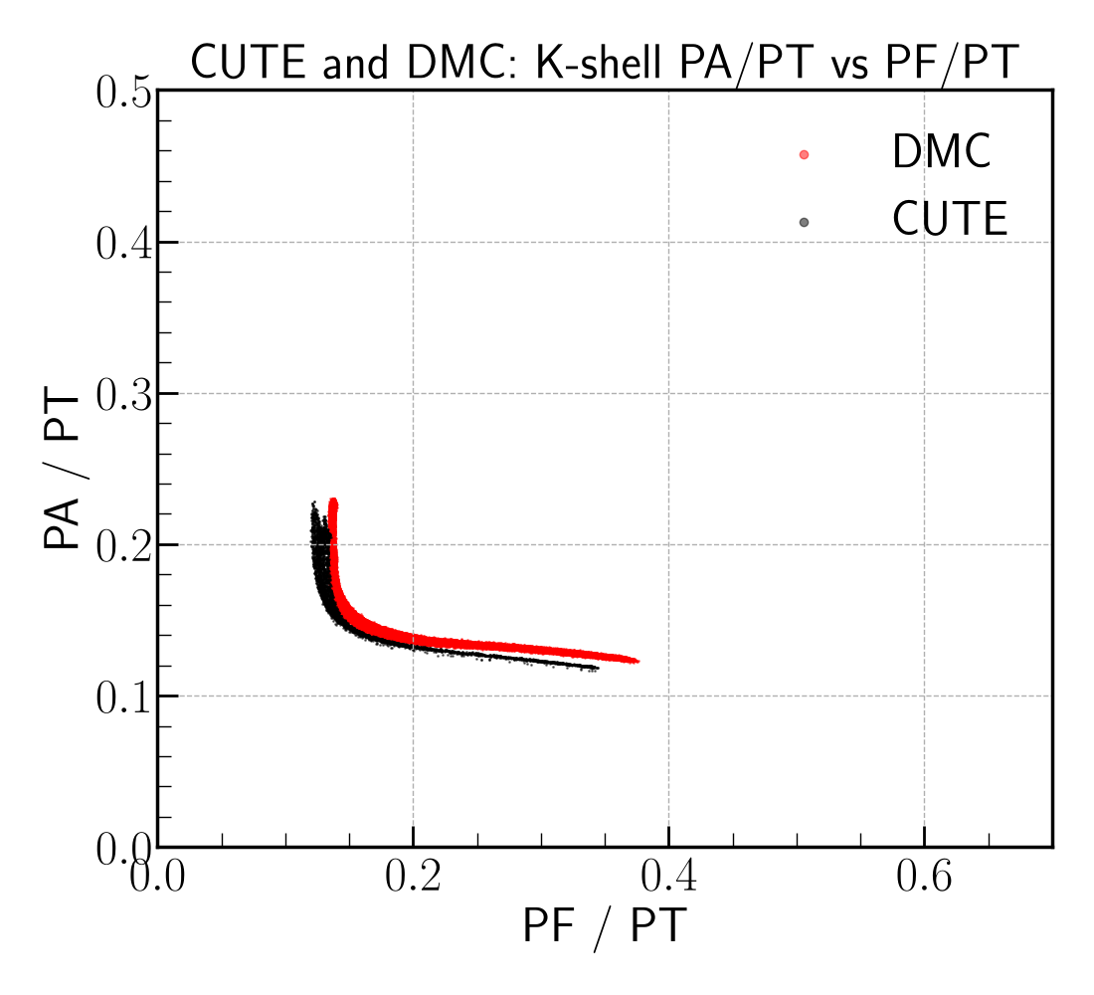
Success With Rescaling
Now the simulation models the energy sharing much better!
Will this improve our radial reconstruction?
SuperCDMS Work in Progress

Slide 24
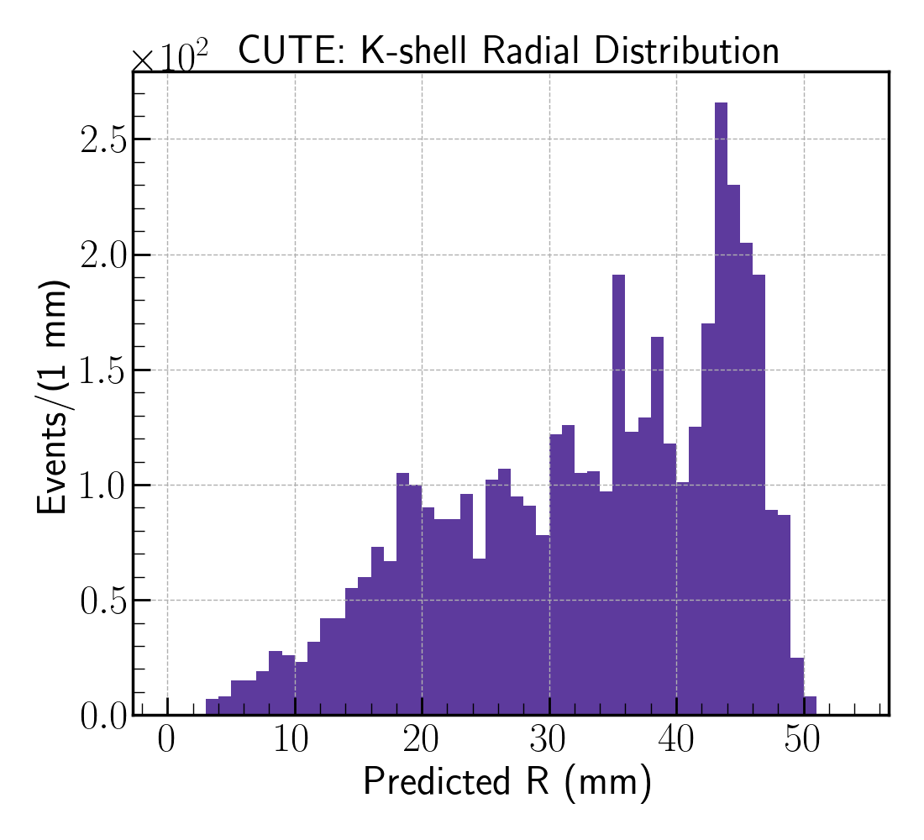
Better Radial Reconstruction!
CUTE R from Training with Rescaled Simulation
The distribution is linear and spans about the full detector radius! The rescaling works!
SuperCDMS Work in Progress
Notes:
Perhaps I

Slide 25
Better Radial Reconstruction!
CUTE R from Training with Uncorrected Simulation
CUTE R from Training with Rescaled Simulation
SuperCDMS Work in Progress
SuperCDMS Work in Progress
Notes:
Perhaps I

Slide 26
Better Radial Reconstruction!
CUTE R from Training with Rescaled Simulation
Validation R Distribution
SuperCDMS Work in Progress
SuperCDMS Work in Progress
Notes:
Perhaps I

Slide 27
Conclusion
Despite the model performing well in validation, it failed to reconstruct real data.
We fixed this by modifying the training sample to more closely match the energy sharing behaviour of the real data.
While a powerful tool, machine learning models are only as good as their training sample.

Slide 28
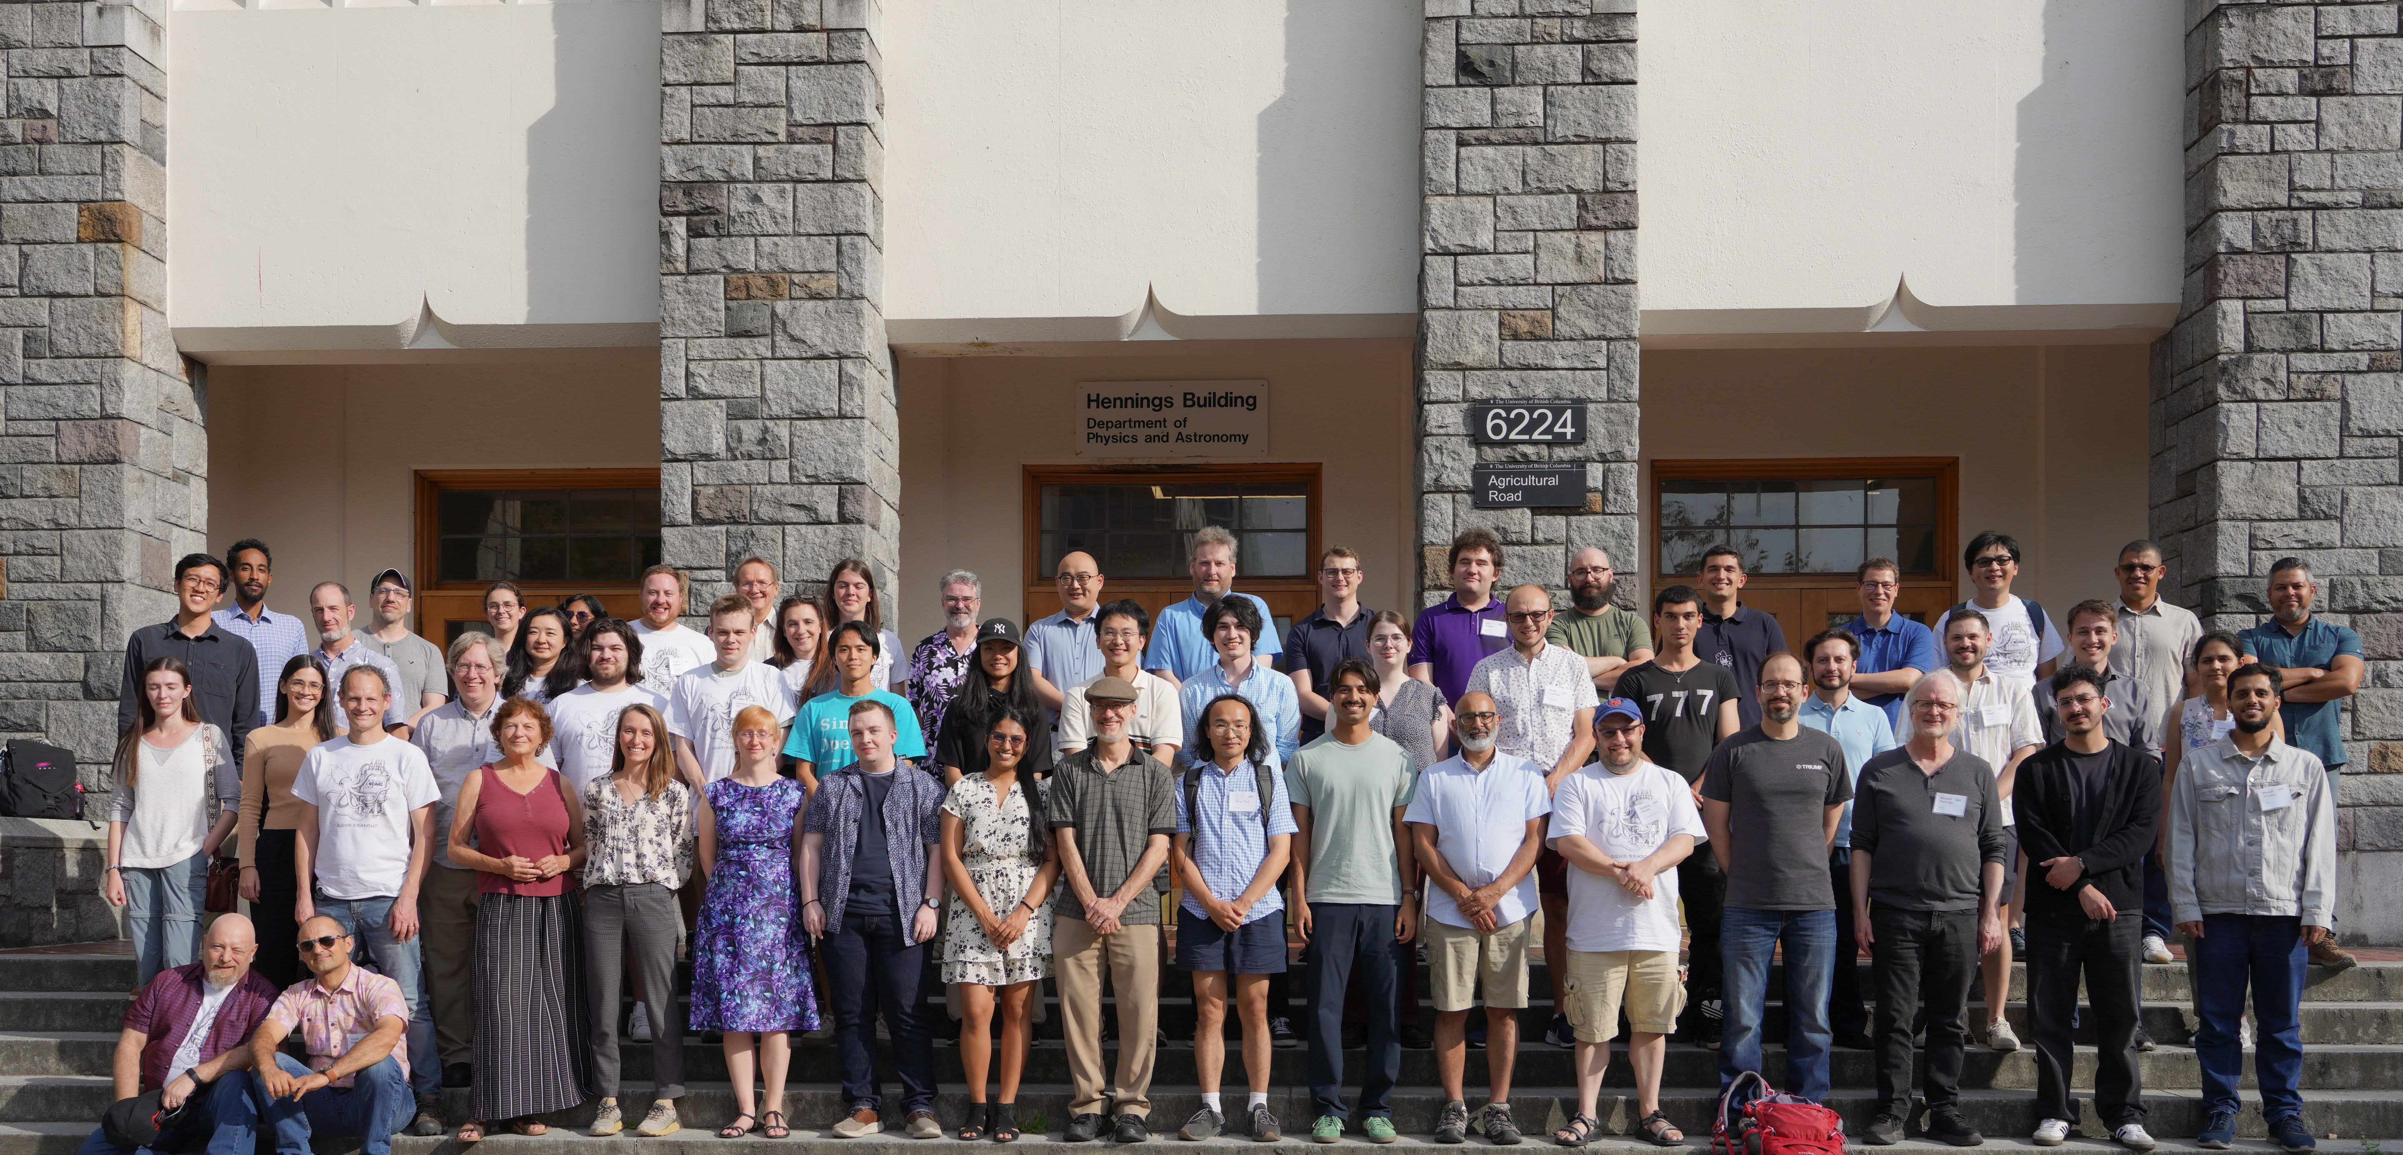
Acknowledgements

Slide 29
Backup Slides

Slide 30
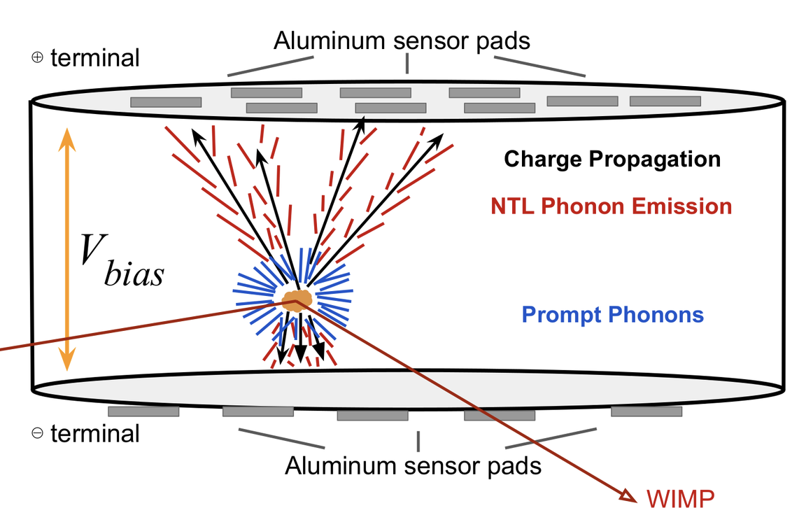
What is an Interaction?
An interaction occurs when an incoming particle collides with a nucleus in the crystal
Notes:
-interaction caused by collision between incoming particle and nucleus
-this produces electron hole pair and prompt phonons that propagate through the detector
-the detectors we’re looking at are called high voltage (HV) detectors due to high bias voltage that amplifies phonon production
-each sensor records the amplitude of interaction, and timing delay. Amplitude is most important to discussion today
A bias voltage (~100 V) is applied to enhance phonon production by creating NTL phonons (named for the Neganov-Trofimov-Luke effect)

Slide 31
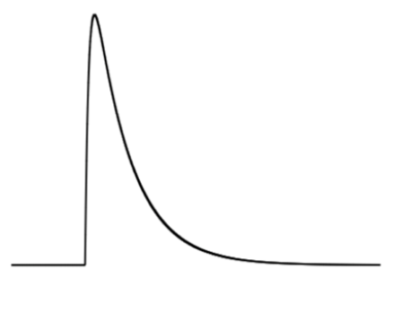
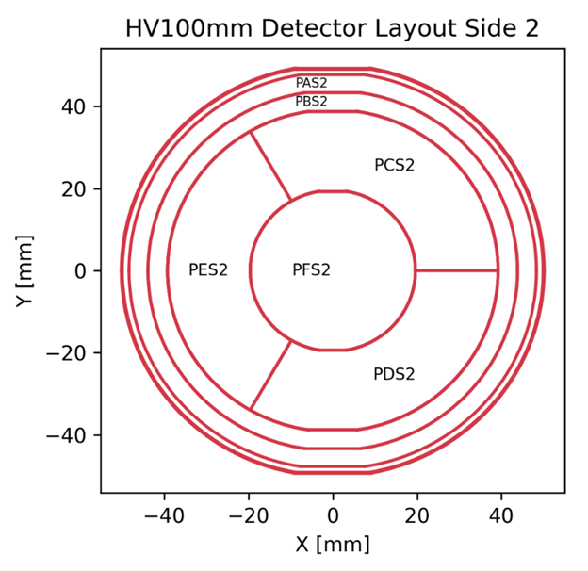
What Measurements are Made?
Each sensor measures amplitude and delay, labelled as P*Ofamps for amplitudes and P*Ofdelays for delays
(*Ranging from AS1 to FS1 for side 1 and AS2 to FS2 for side 2)
Amplitude
Delay
Cui, S. Optimizing Machine Learning Techniques for Dark Matter Detection: Enhancing Position Resolution in SuperCDMS Detectors. SLAC. Conflu
Notes:
Difference in delays is roughly how we figure out the Z position
This slide looks a little unfinished

Slide 32
Splitting the Simulation Sample for Validation
80% of the simulation sample is used to train the model
20% is used for validation
80%
20%
Training
Validation
Notes:
Train on 80% of the data, use the remaining 20% to validate

Slide 33
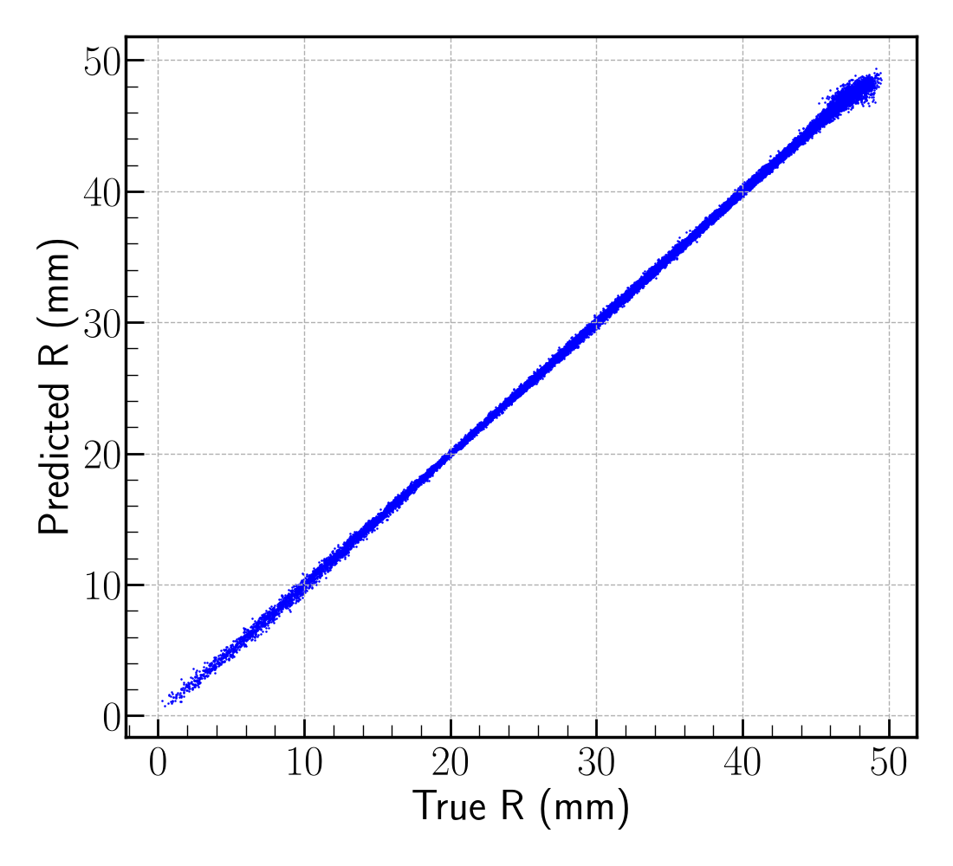
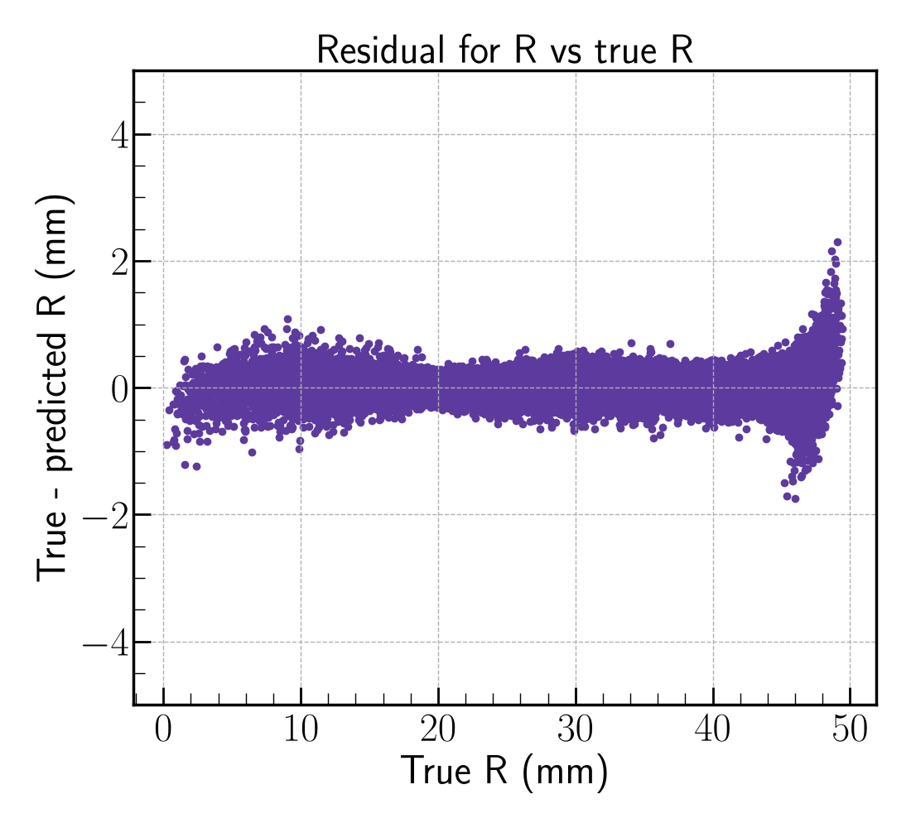
Radial Validation-How Well Does the Model Work?
SuperCDMS Work in Progress
SuperCDMS Work in Progress
Notes:
Should I remove this slide? Residuals are sorta important to show, but I do like the scatterplot
If I can’t fit it in, I will put residuals on the previous page, move scatter to this page, then move the other two plots to the same slide and put it with backup slides

Slide 34
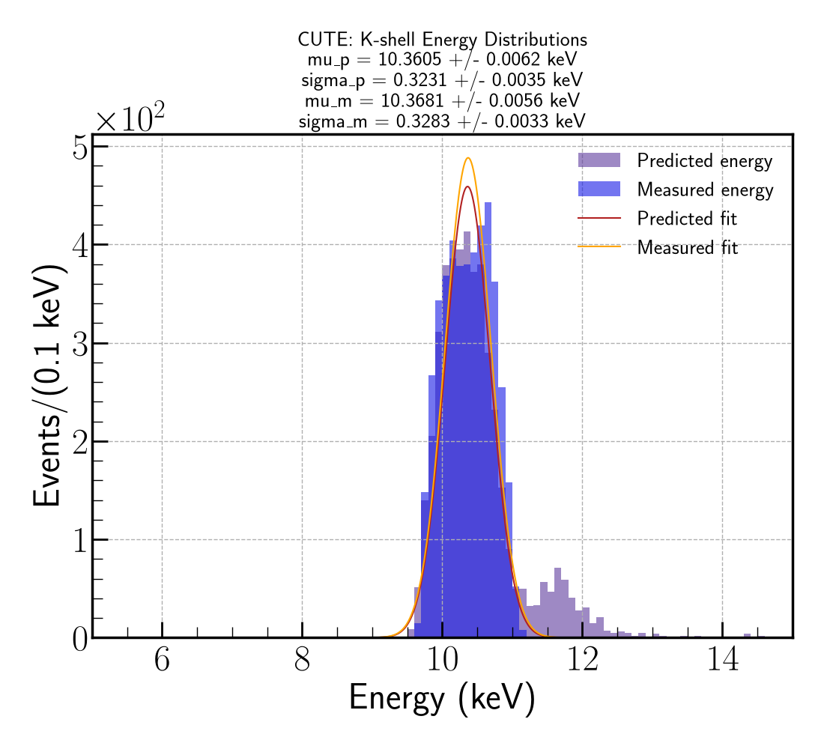
Problems With Energy
SuperCDMS Work in Progress
Notes:
Perhaps I

Slide 35
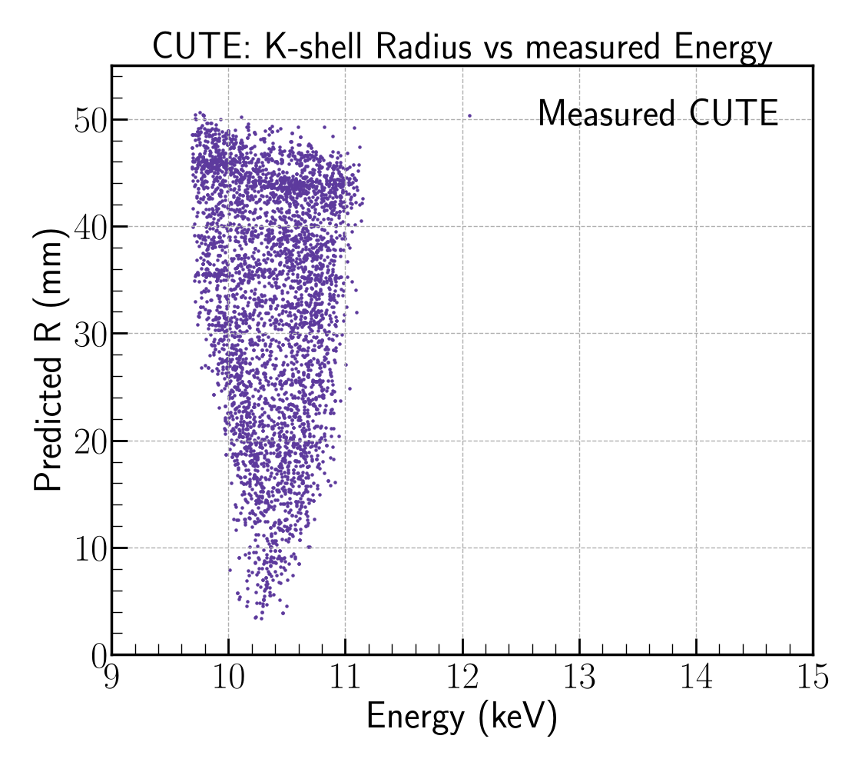
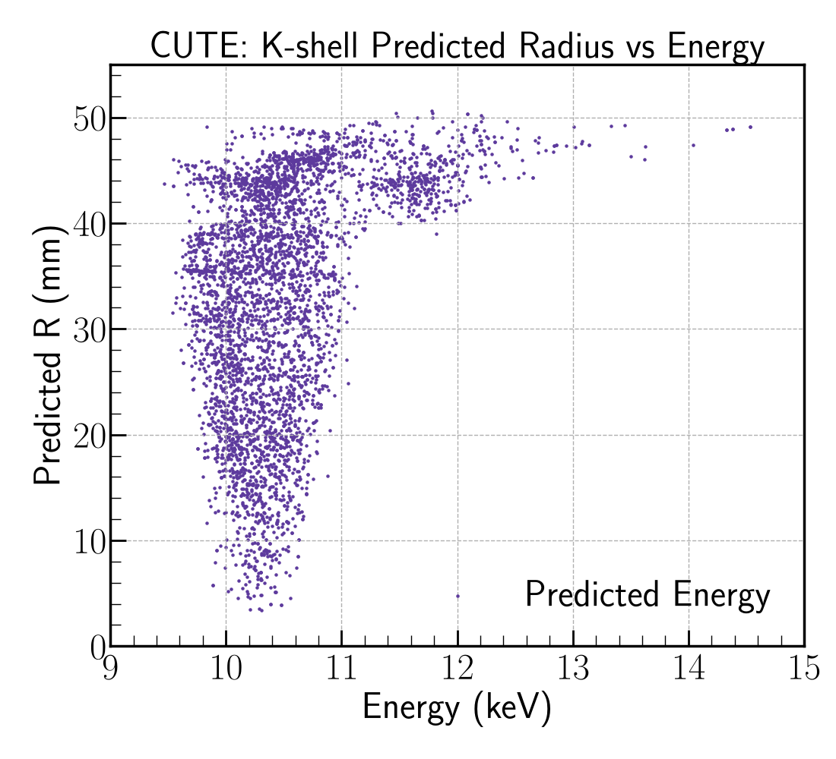
Problems With Energy
SuperCDMS Work in Progress
SuperCDMS Work in Progress
Notes:
Perhaps I

