Slide 1
Another Run Bites the Dust:
Why SNO+ Runs Pass or Fail Run-Selection
Berin Sancakdar
SNO+ Research Student - Supervisor: Dr. Erica Caden
SNO+

Slide 2
What is SNO+?

Slide 3
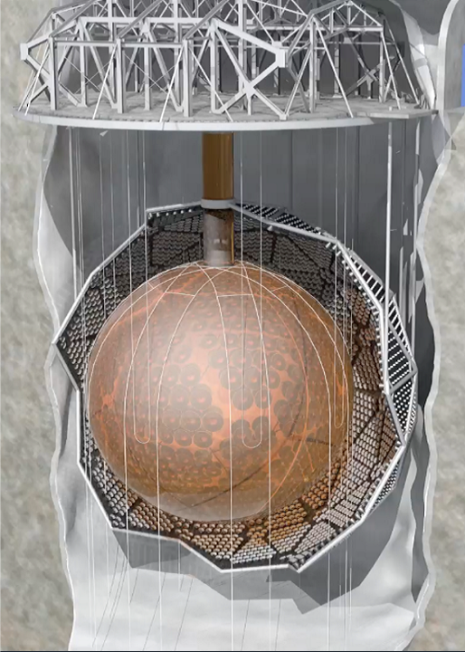
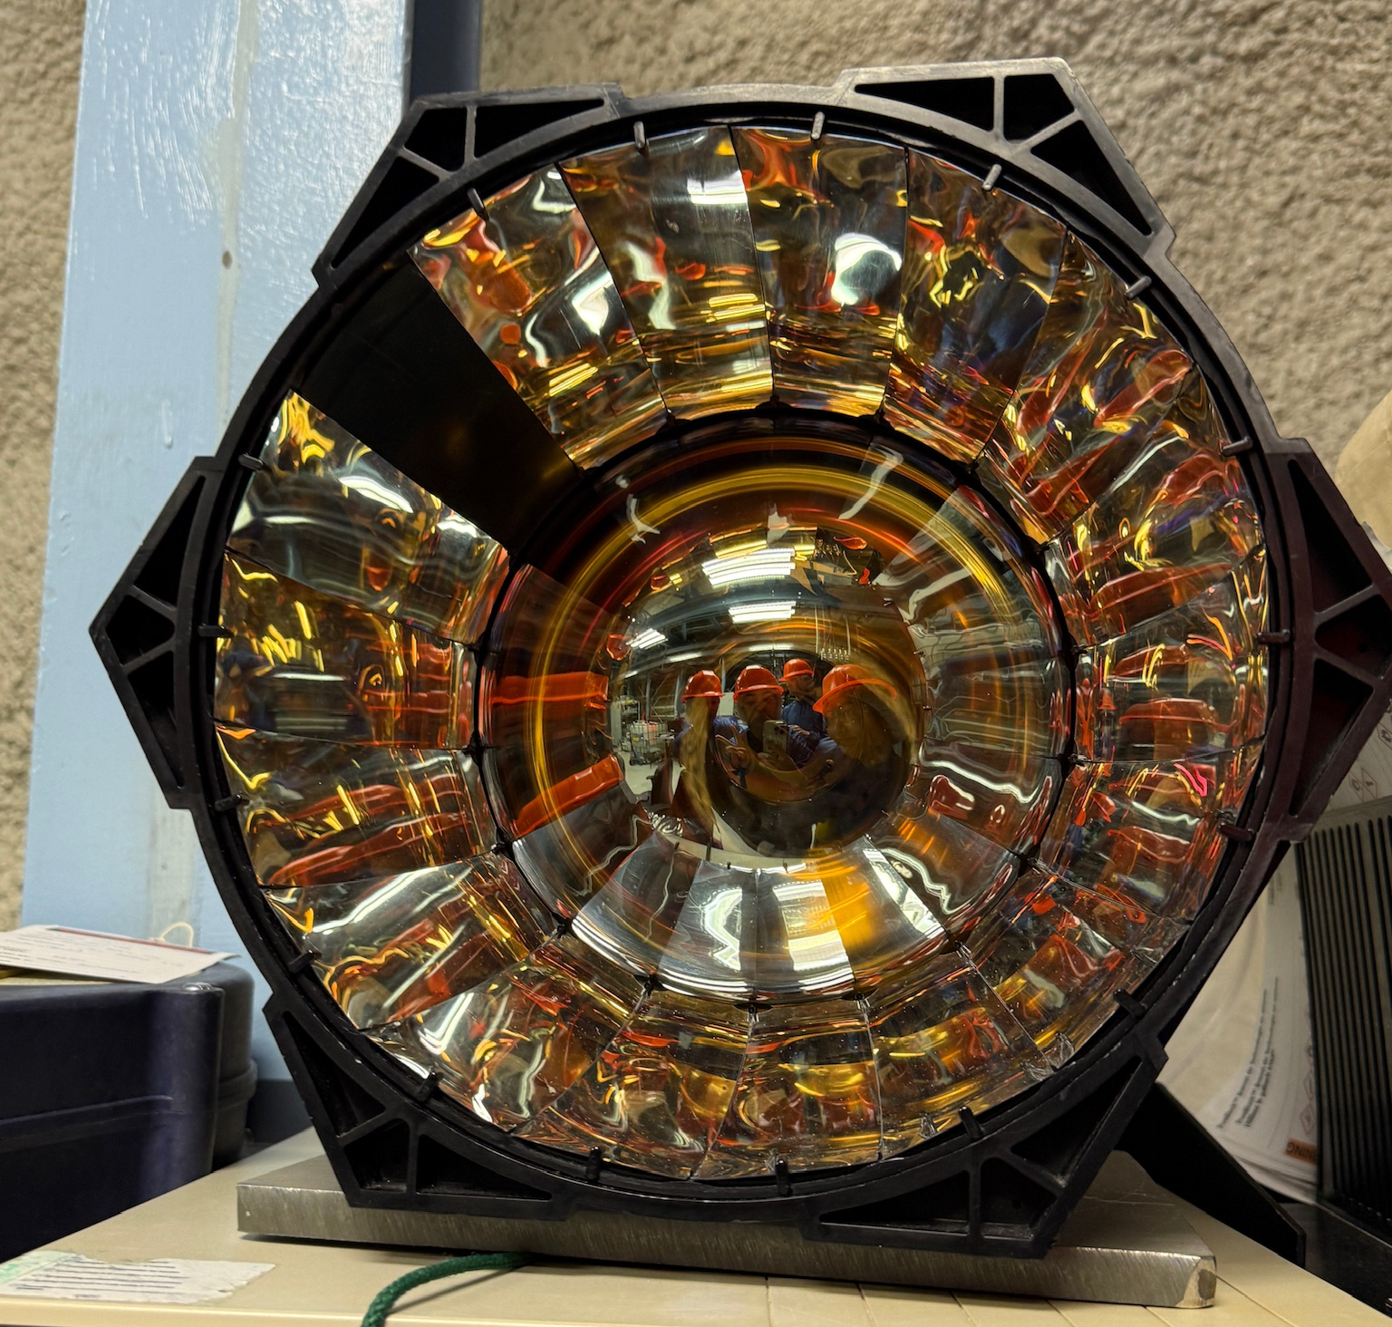
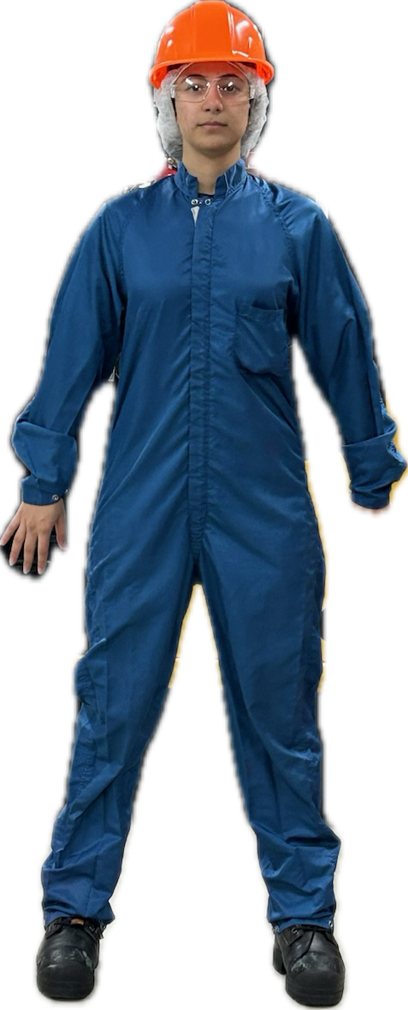
SNO+
Acrylic Vessel
Photomultiplier Tubes (PMTs)
PARTICLES
LIGHT
DATA
SNO+ experiment is a large liquid scintillator detector for studying neutrinos
It is a 12m diameter acrylic sphere, submerged in about 7,000 tonnes of ultra-pure water, surrounded by ~9,000 PMTs
*PMTs are not to scale
1

Slide 4
What is run selection?

Slide 5
What is a run?
Hit = Signal from PMT
SNO+
2

Slide 6
Event
Hit
Hit
Hit
What is a run?
Hit
Hit
SNO+
2

Slide 7
Run ~ 1 hour long collection of events
Event
Hit
Hit
Event
Hit
What is a run?
Hit
Hit
Hit
Hit
SNO+
Hit
Event
Hit
Hit
Hit
Hit
Hit
Hit
Hit
2

Slide 8
Can we trust the data?
SNO+
DATA
PHYSICS!
3

Slide 9
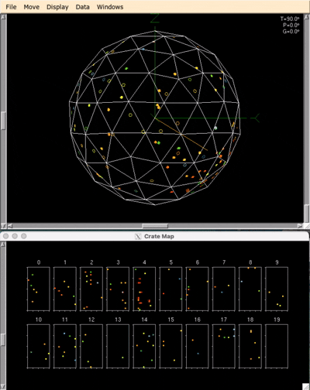
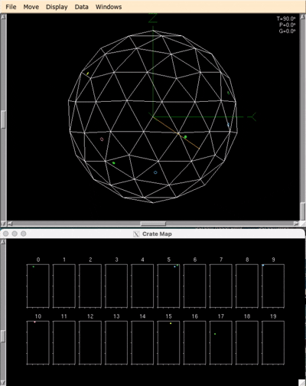

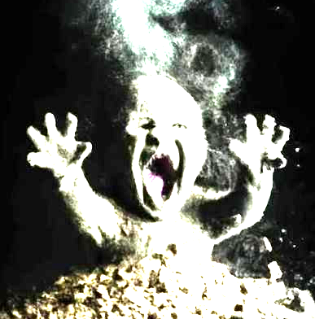
Normal
Breakdown
SNO+
4

Slide 10




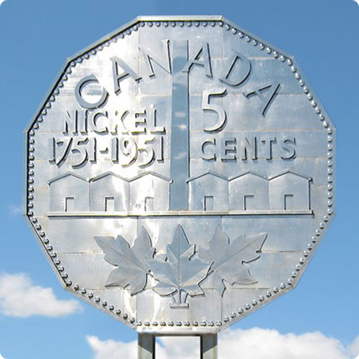
Is the detector detecting events at an expected rate?
Are the data timestamps accurate?
Is data coming out in the correct order?
Run Selection
Are enough PMTs on?
SNO+
DATA
PHYSICS!
Run selection sorts runs into categories:
Gold
This allows for physics analyses that require different levels of data quality
Silver
Bronze
Nickel
5

Slide 11
How does SNO+ detect events?

Slide 12
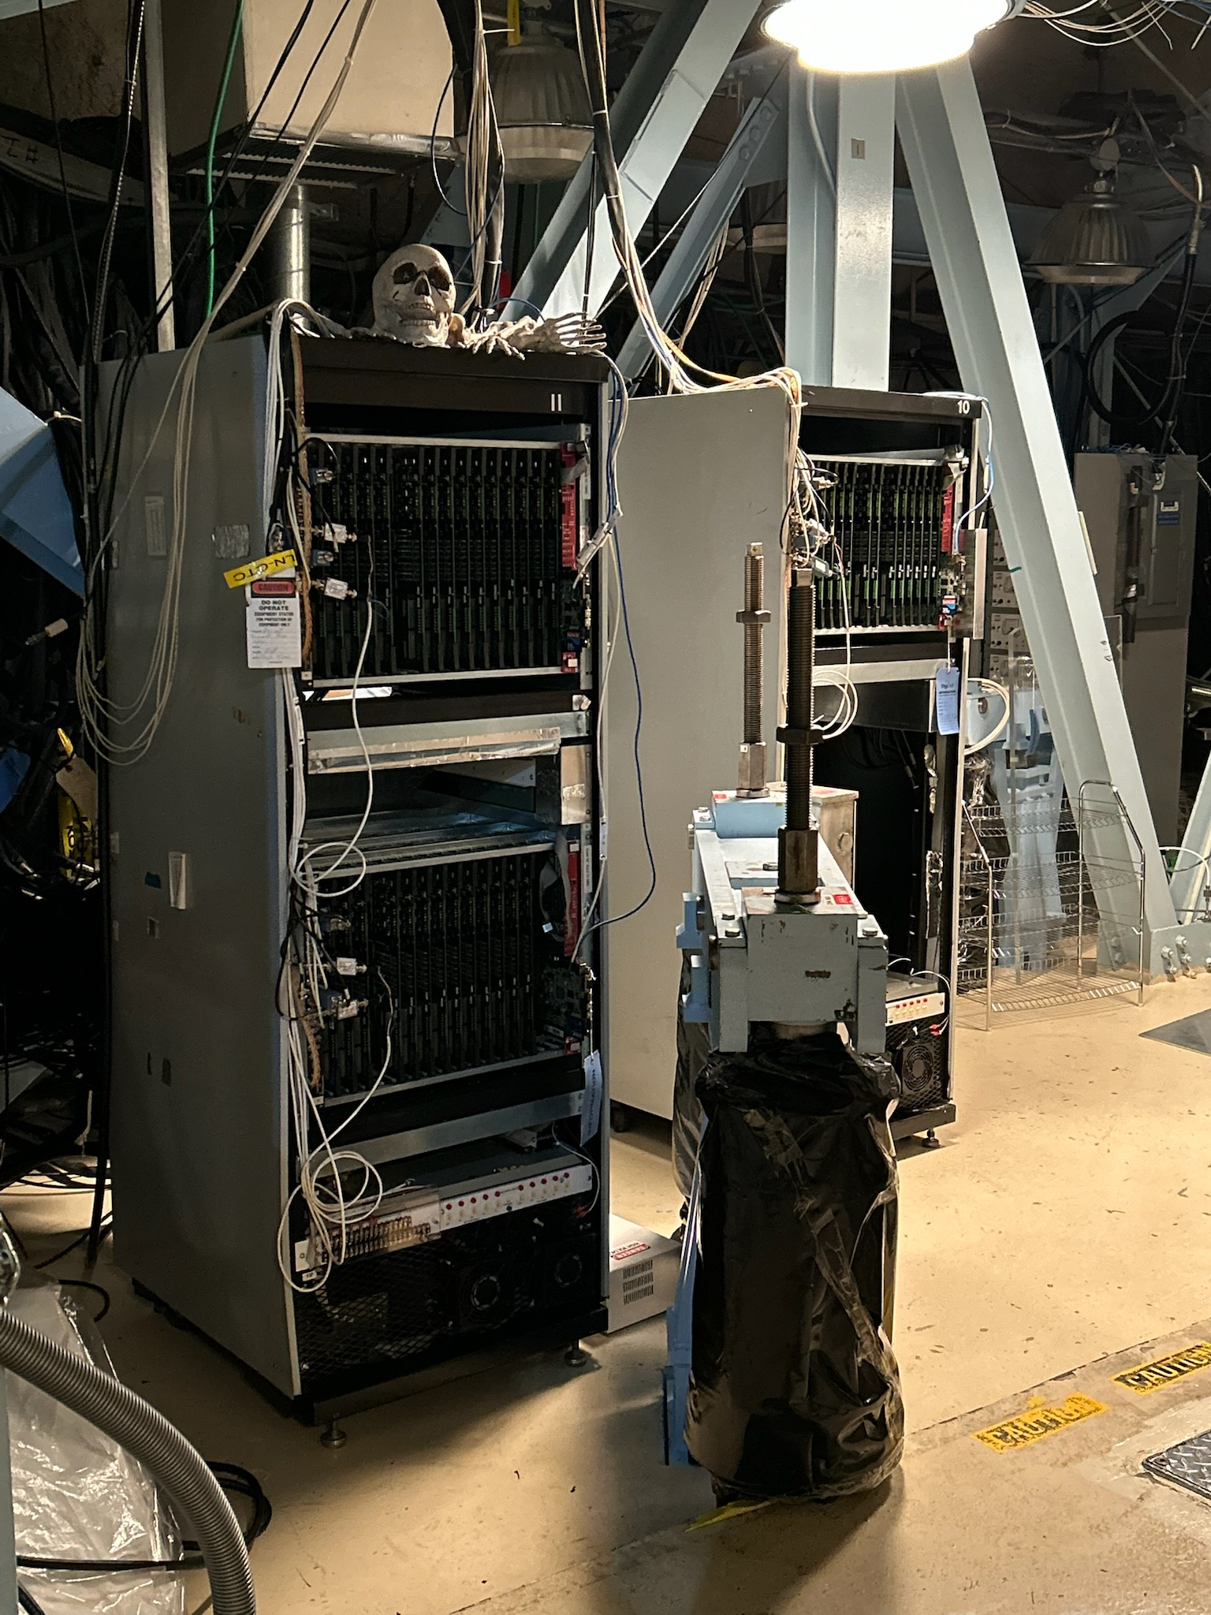
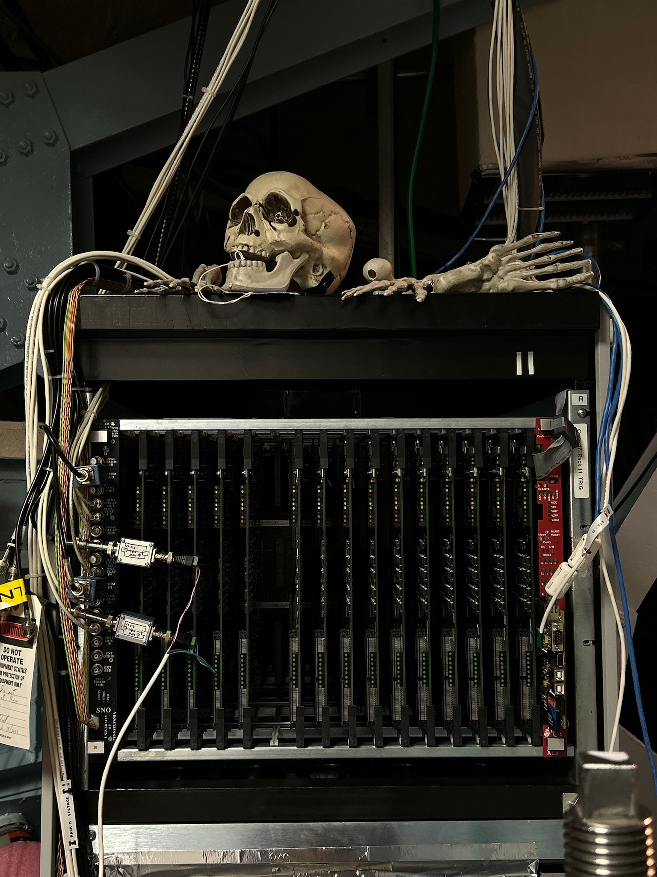
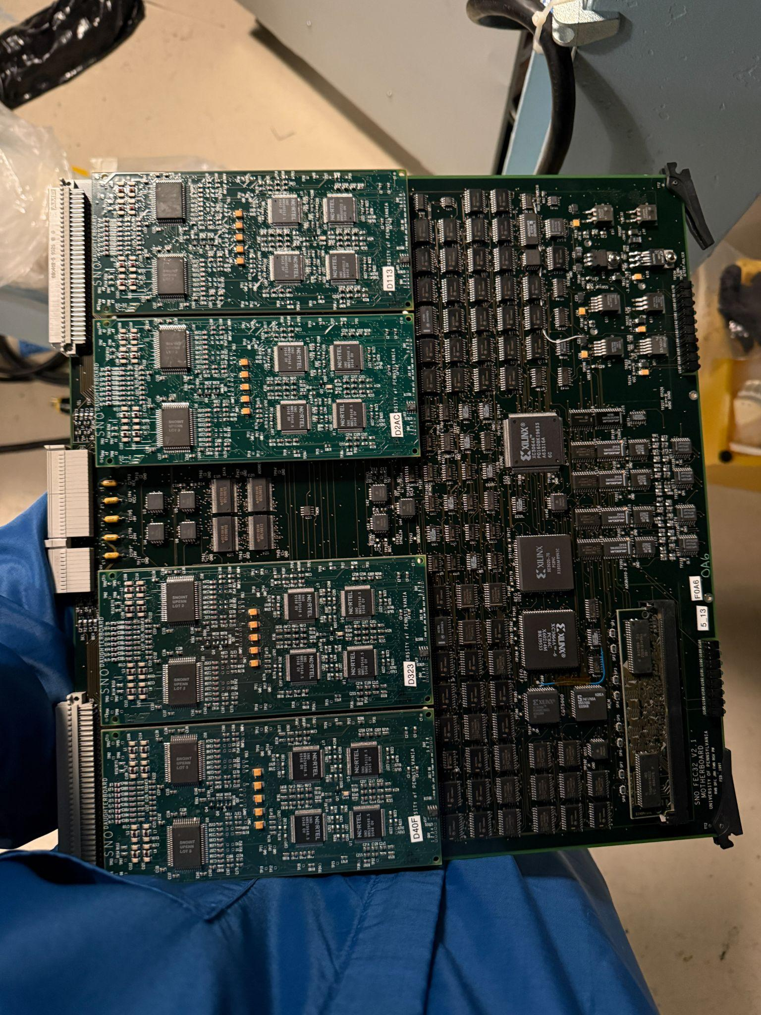

SNO+ Diagram
SNO+ Deck
SNO+
Control Room ->
Rack
DCR
(Deck Clean Room)
Crate
Front-end-card (FEC)
Rack
Rack
Rack
SNO+
6

Slide 13

SNO+ Trigger System
Global Trigger
Detector
Crate
Timing Rack
PMT
PMTIC
FEC
Crate Trigger Card
Master Trigger Card / Analog
Master Trigger Card / Digital
TUB
TUBii
CAEN
8

Slide 14
SNO+ Trigger System
Global Trigger
Detector
Crate
Save data!
Timing Rack
PMT
PMTIC
FEC
Crate Trigger Card
Master Trigger Card / Analog
XL3
Saving data!
Master Trigger Card / Digital
DAQ
Event Builder
TUB
Runs
TUBii
CAEN
9

Slide 15

SNO+ Trigger System
Global Trigger
Detector
Crate
Timing Rack
PMT
PMTIC
FEC
Crate Trigger Card
Master Trigger Card / Analog
XL3
Master Trigger Card / Digital
DAQ
Event Builder
TUB
Runs
TUBii
Run Selection
CAEN
10

Slide 16
Run-Selection Statistics

Slide 17
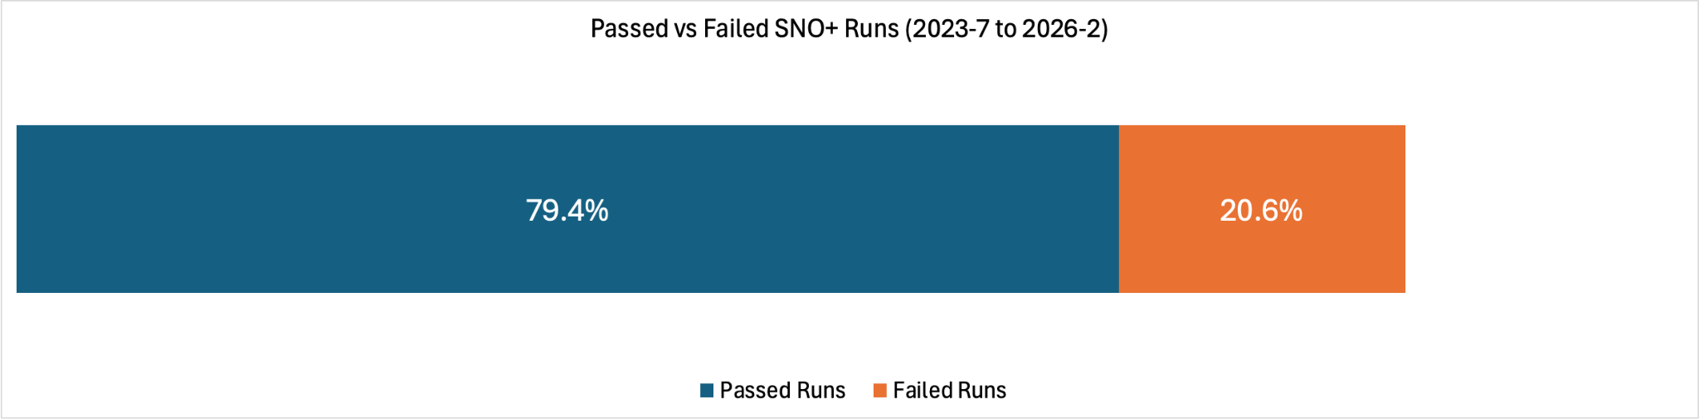
SNO+ Run-Selection Failure Rate
Looking at a collection of 21,232 runs in the “Nickel” list (from 2023-7 to 2026-2):
Only 4,367 runs failed
20.6% overall failure rate
11

Slide 18
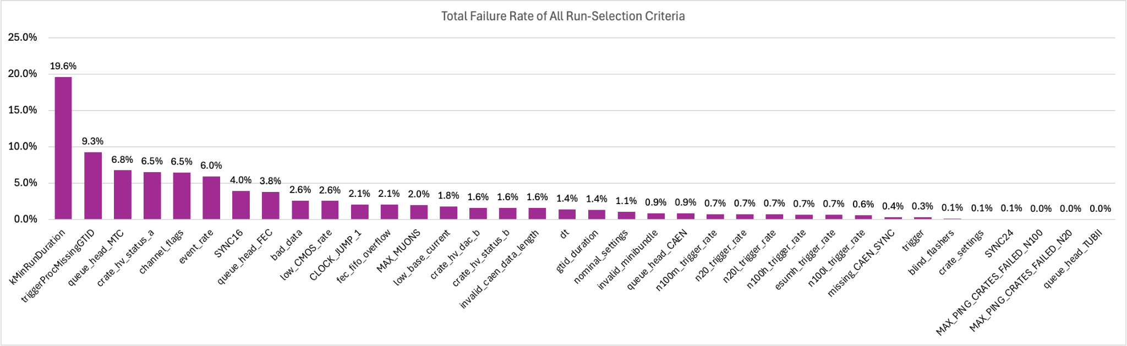
SNO+ Run-Selection Criteria Failure Rates
Top Contributors:
Minimum Run Duration: 19.6%
Missing GTIDs: 9.3%
Master Trigger Card / Digital - Queue Head: 6.8%
Crate High Voltage Status for PMTs: 6.5%
Channel Flags: 6.5%
Event Rate: 6.0%
Criteria that never failed:
clock_forward
crate_hv_dac_a
event_separation
run_header
mtc_settings
10Mhz_UT_comparison
tubii_state
tubii_state_unknown
written_out_of_sequence
ESUMH_OCCUPANCY
_FAILED
Distribution of Run Selection Criteria Among Failed Runs
Percentage of Failed Runs (%)
Run-Selection Criteria
12

Slide 19
How do run selection failures behave over time?

Slide 20
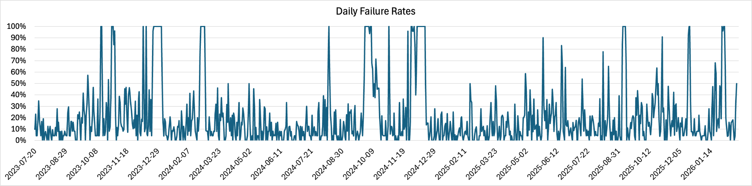
Daily Run-Selection Failure Rates
From 2023 - 7 to 2026 - 2
Runs Failed per Day / Runs Collected per Day (%)
Percentage of Runs Failed (%)
Date
13

Slide 21
Daily Run-Selection Failure Rates: Database Errors
2023 - 10 / 2023 - 12 / 2024 - 2
Crate 4 Supply A - Setpoint discrepancy
Crate 14 and 15 Supply A - Setpoint discrepancy
Runs Failed per Day / Runs Collected per Day (%)
Percentage of Runs Failed (%)
Date
Crate 14 Supply A - Setpoint discrepancy
Crate 1 + 9 Supply A - Setpoint discrepancy + missing data
Crate 2 + 3 Supply A - Setpoint discrepancy
Crate 4 Supply A - Setpoint discrepancy
Crate 11 Supply A - Setpoint discrepancy
14

Slide 22
Daily Run-Selection Failure Rates: Detector Errors
2024 - 12
Runs Failed per Day / Runs Collected per Day (%)
Percentage of Runs Failed (%)
Date
Trigger Check Threshold
Trigger Check Threshold
Trigger Check Threshold
15

Slide 23
Daily Run-Selection Failure Rates: Maintenance
2023 - 12 / 2024 - 10 / 2024 - 11 / 2025 - 12
Runs Failed per Day / Runs Collected per Day (%)
Percentage of Runs Failed (%)
Date
Only one run and it failed due to being too short, the rest are calibration runs
Planned Detector Shutdown
Planned Power Outage
Activity on Deck
16

Slide 24
Daily Failure Rates
From 2023 - 7 to 2026 - 2
Runs Failed per Day / Runs Collected per Day (%)
Percentage of Runs Failed (%)
Date
17

Slide 25
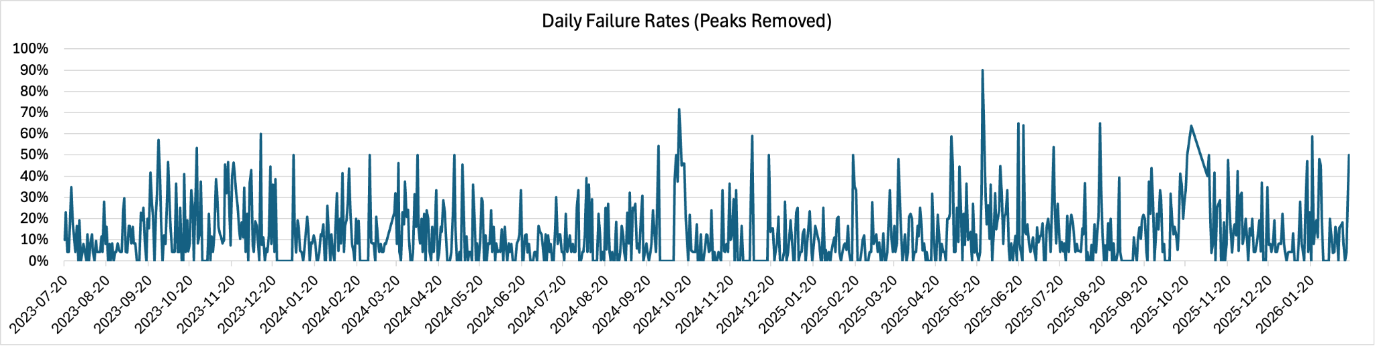
Daily Failure Rates (With Known Issues Accounted For)
From 2023 - 7 to 2026 - 2
Runs Failed per Day / Runs Collected per Day (%) (Known Issues Accounted For)
Percentage of Runs Failed (%)
Date
18

Slide 26
Daily Failure Rates (Peaks Removed): Seismic Events
2023 - 10 / 2023 - 12 / 2024 - 2
Runs Failed per Day / Runs Collected per Day (%) (Known Issues Accounted For)
Percentage of Runs Failed (%)
Date
Seismic Event
Seismic Event
19

Slide 27
How do seismic events affect the detector?

Slide 28
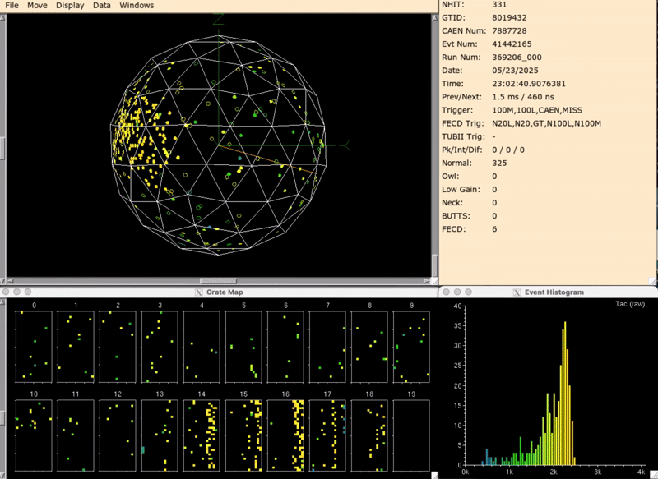
Replay of Seismic Event on 2025-05-24 (2.5 MwN)
20

Slide 29
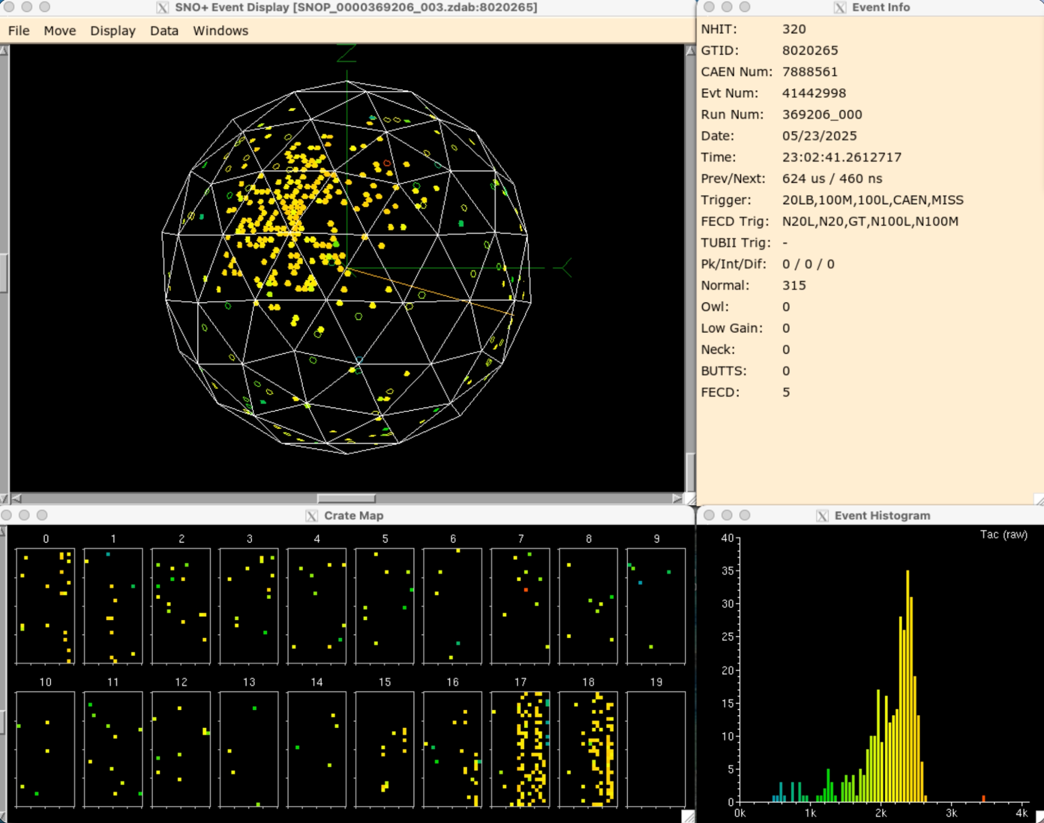
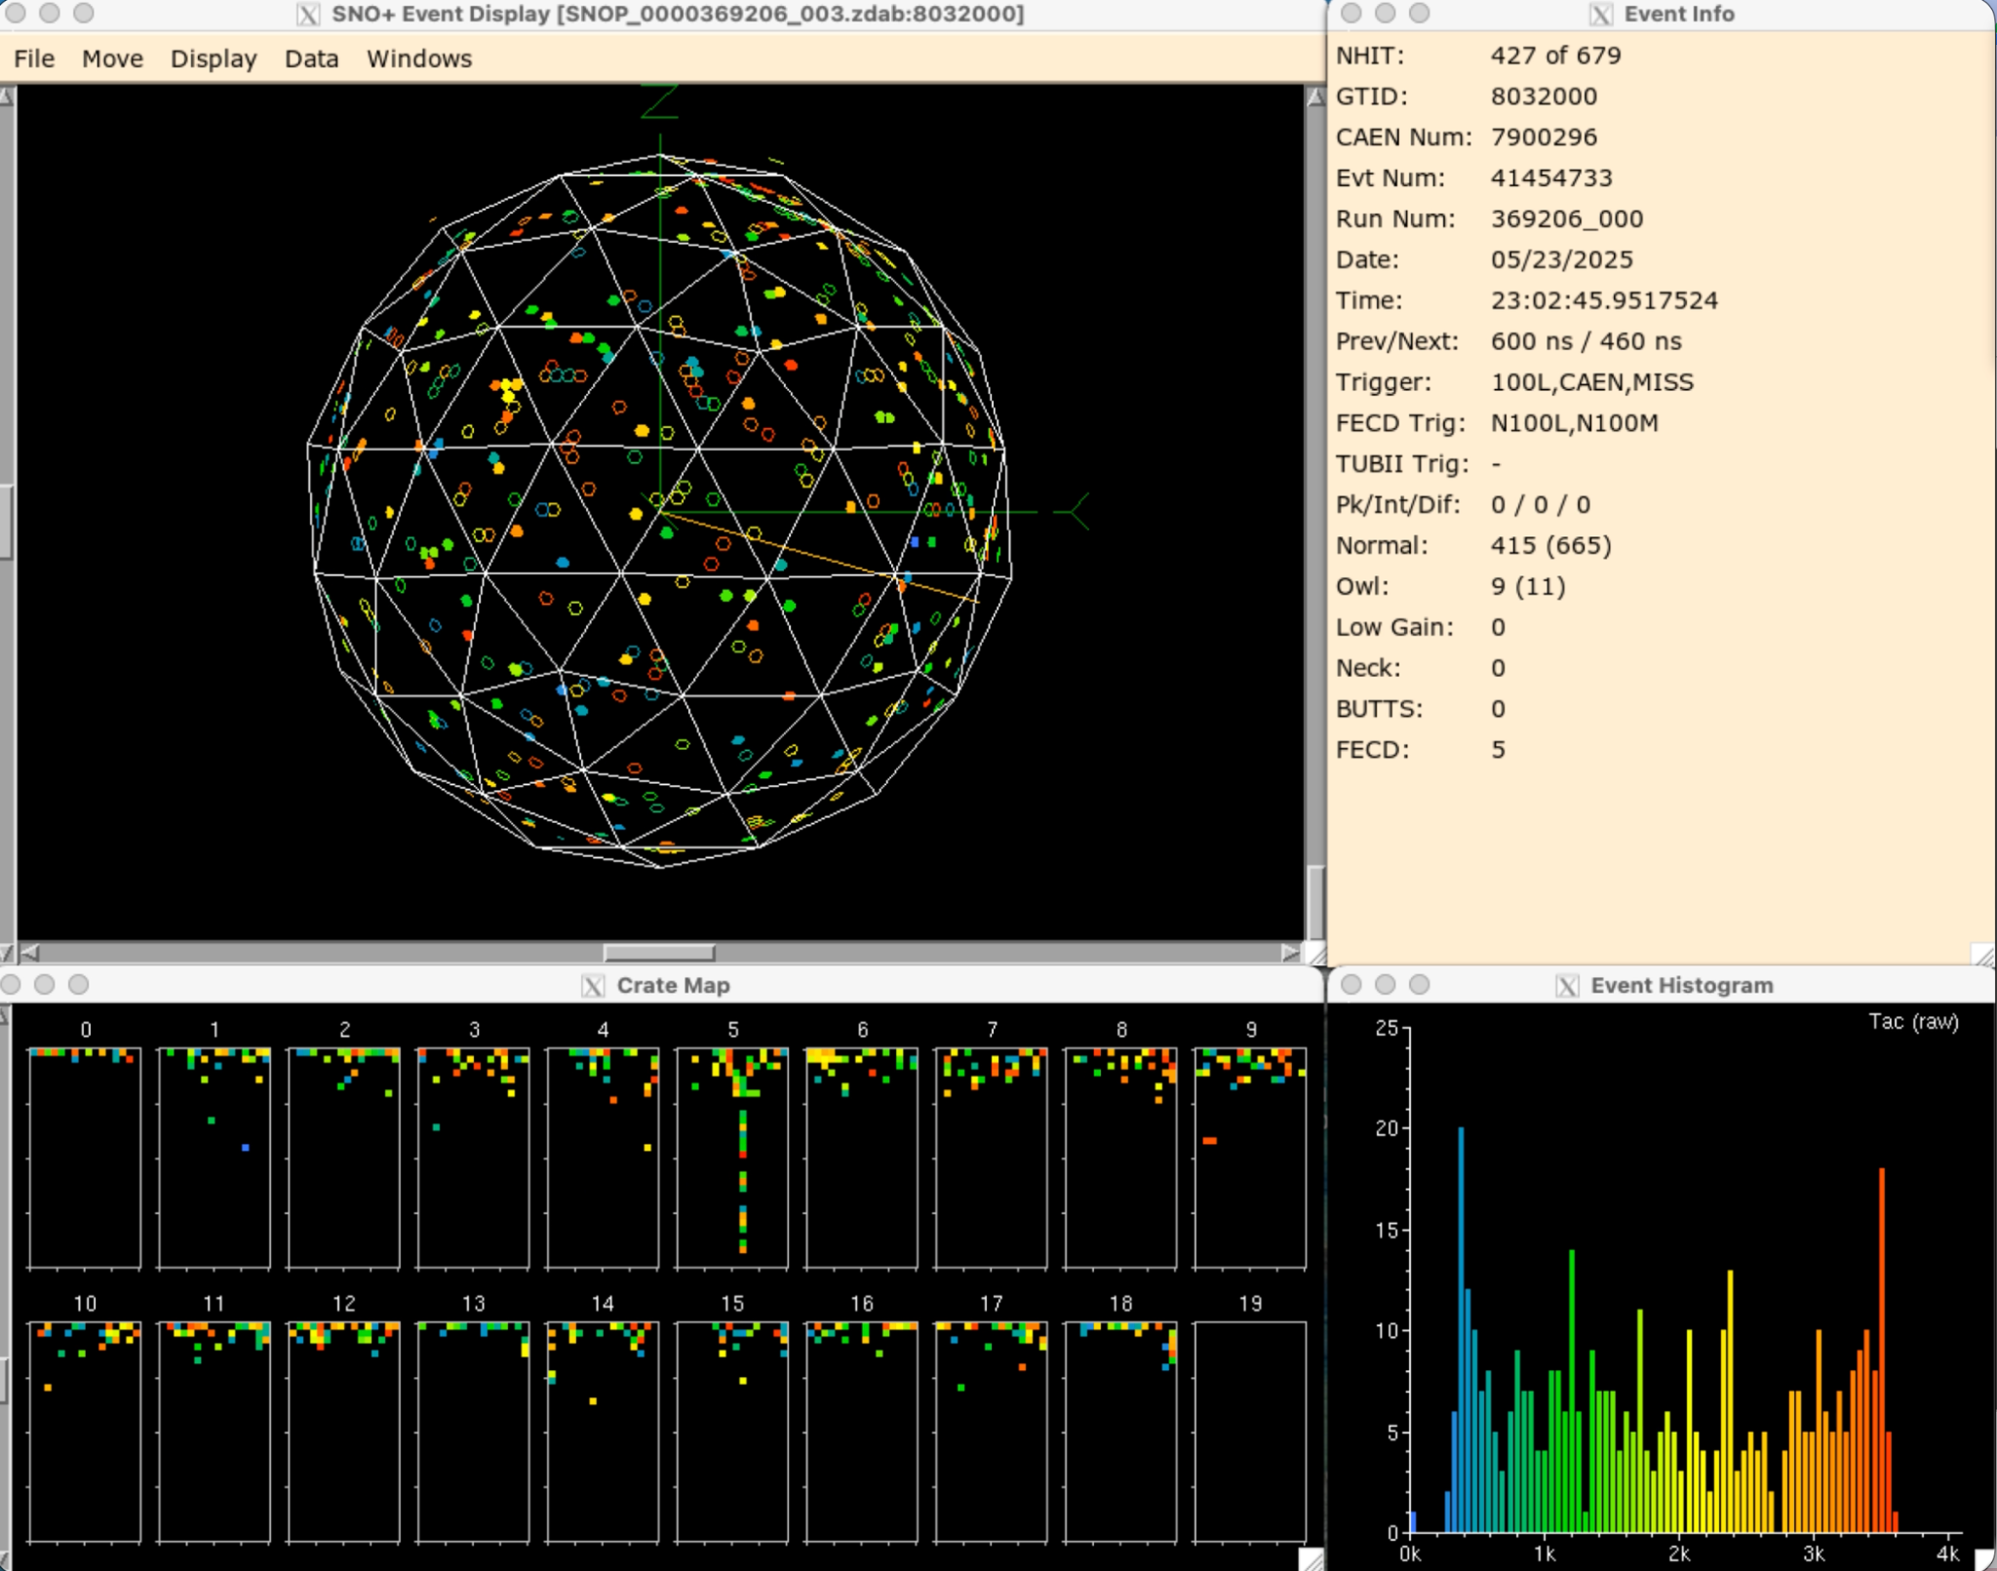
How do seismic events affect the detector?
Regular Scintillator Event
Breakdown
21

Slide 30
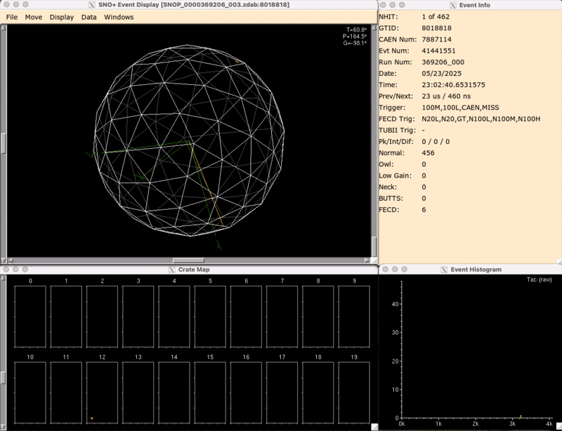
How do seismic events affect the detector?
Regular Scintillator Event
Looking at the TAC histogram we can see a narrow distribution and secondary peaks
22

Slide 31
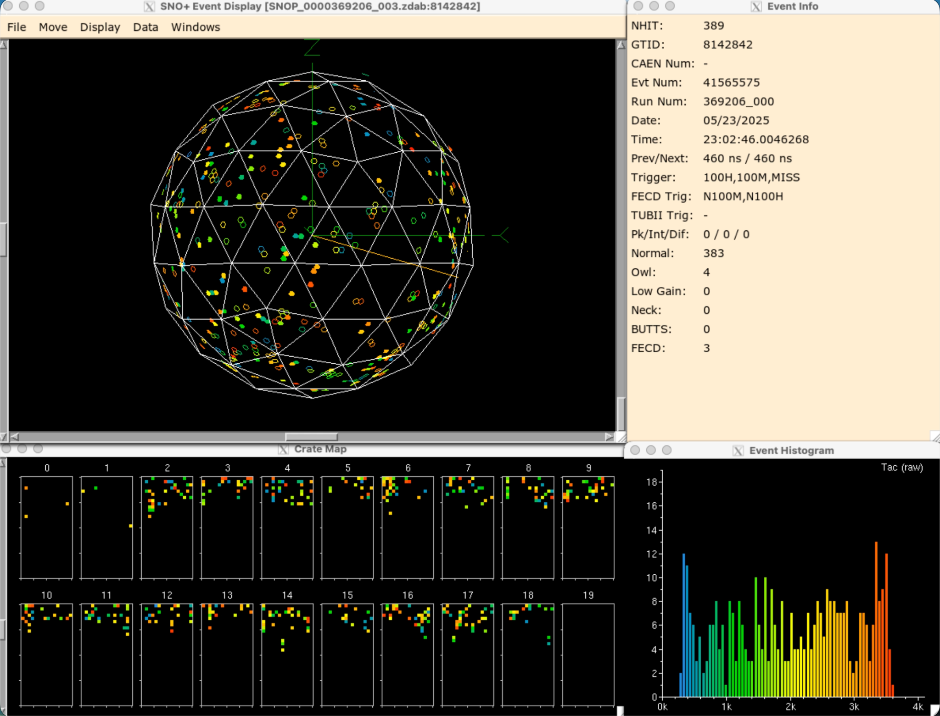
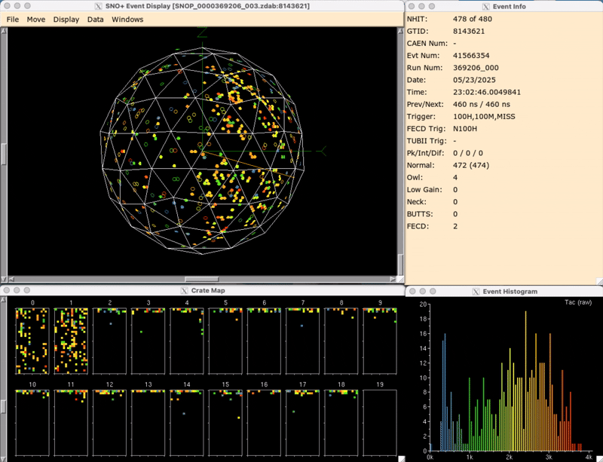
How do seismic events affect the detector?
Dry-End Breakdown
TAC histogram is flat and unphysical
Geometric distribution of light on the detector does not make sense
23

Slide 32
How do seismic events affect the detector?
Rack 3
Rack 4
Rack 2
4
Rack 1
Rack 5
Rack 6
9
Rack 11
10
Rack 7
Rack 10
Rack 8
Rack 9
Signals are concentrated in one rack
24

Slide 33
Why do seismic events cause abnormal detector behavior?
Motion of electronics, cables, and structures can create electronics noise
Increased noise cause an increased rate of hits
Electronics have a lot of incoming data to process
Data readout may not be able to keep up
27

Slide 34
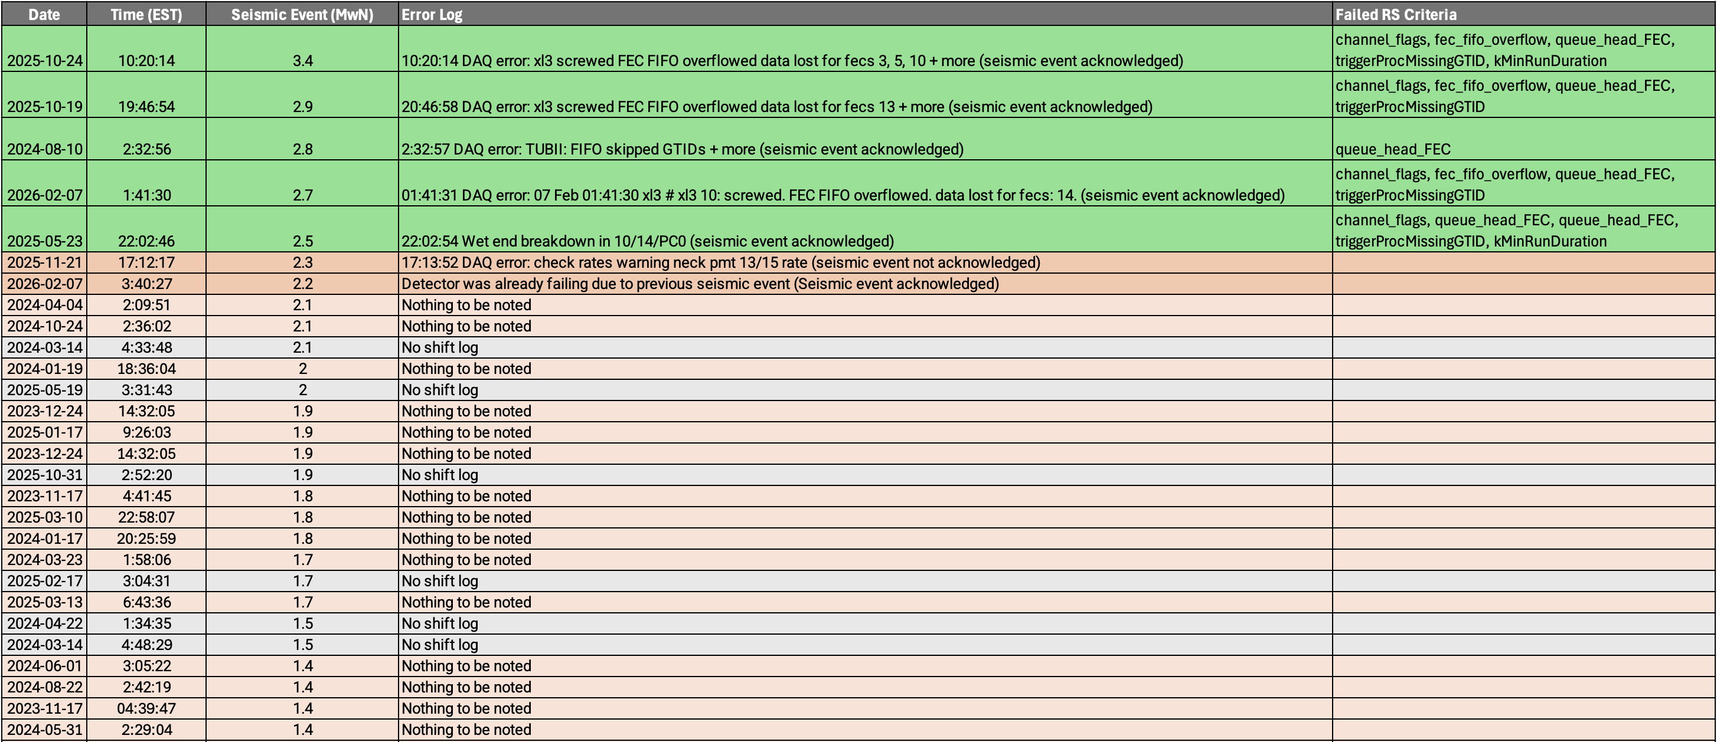
Does run-selection flag abnormal behavior due to seismic activities?
Run selection has detected abnormal detector behavior in all 5 major seismic events (above 2.5 MwN / 5 out of 48 events).
28

Slide 35
Can run-selection flag abnormal behavior due to seismic activities?
Only 8 runs out of 21,232 produce this four-criteria failure signature, 4 of them occur during seismic events.
Magnitude | Run-Selection Criteria Failed
3.4 | Channel Flags, FEC FIFO Overflow, FEC Queue Head, Missing GTIDs, Minimum Run Duration
2.9 | Channel Flags, FEC FIFO Overflow, FEC Queue Head, Missing GTIDs
2.8 | FEC Queue Head
2.7 | Channel Flags, FEC FIFO Overflow, FEC Queue Head, Missing GTIDs
2.5 | Channel Flags, FEC FIFO Overflow, FEC Queue Head, Missing GTIDs, Minimum Run Duration
29

Slide 36
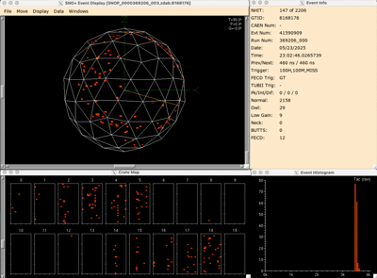
Conclusion:
SNO+ needs high-quality data to achieve its physics goals, run selection monitors this process
Potential simplification of future run selection criteria
~300 hours of data may be recoverable, which reduces overall failure rate to ~19%
Seismic events (>2.5 MwN) are flagged by run selection
Queue Head FEC, FEC FIFO Overflow, Channel Flags, Missing GTIDs, are the criteria most frequently associated with seismic activity related abnormal detector behaviour
30

Slide 37
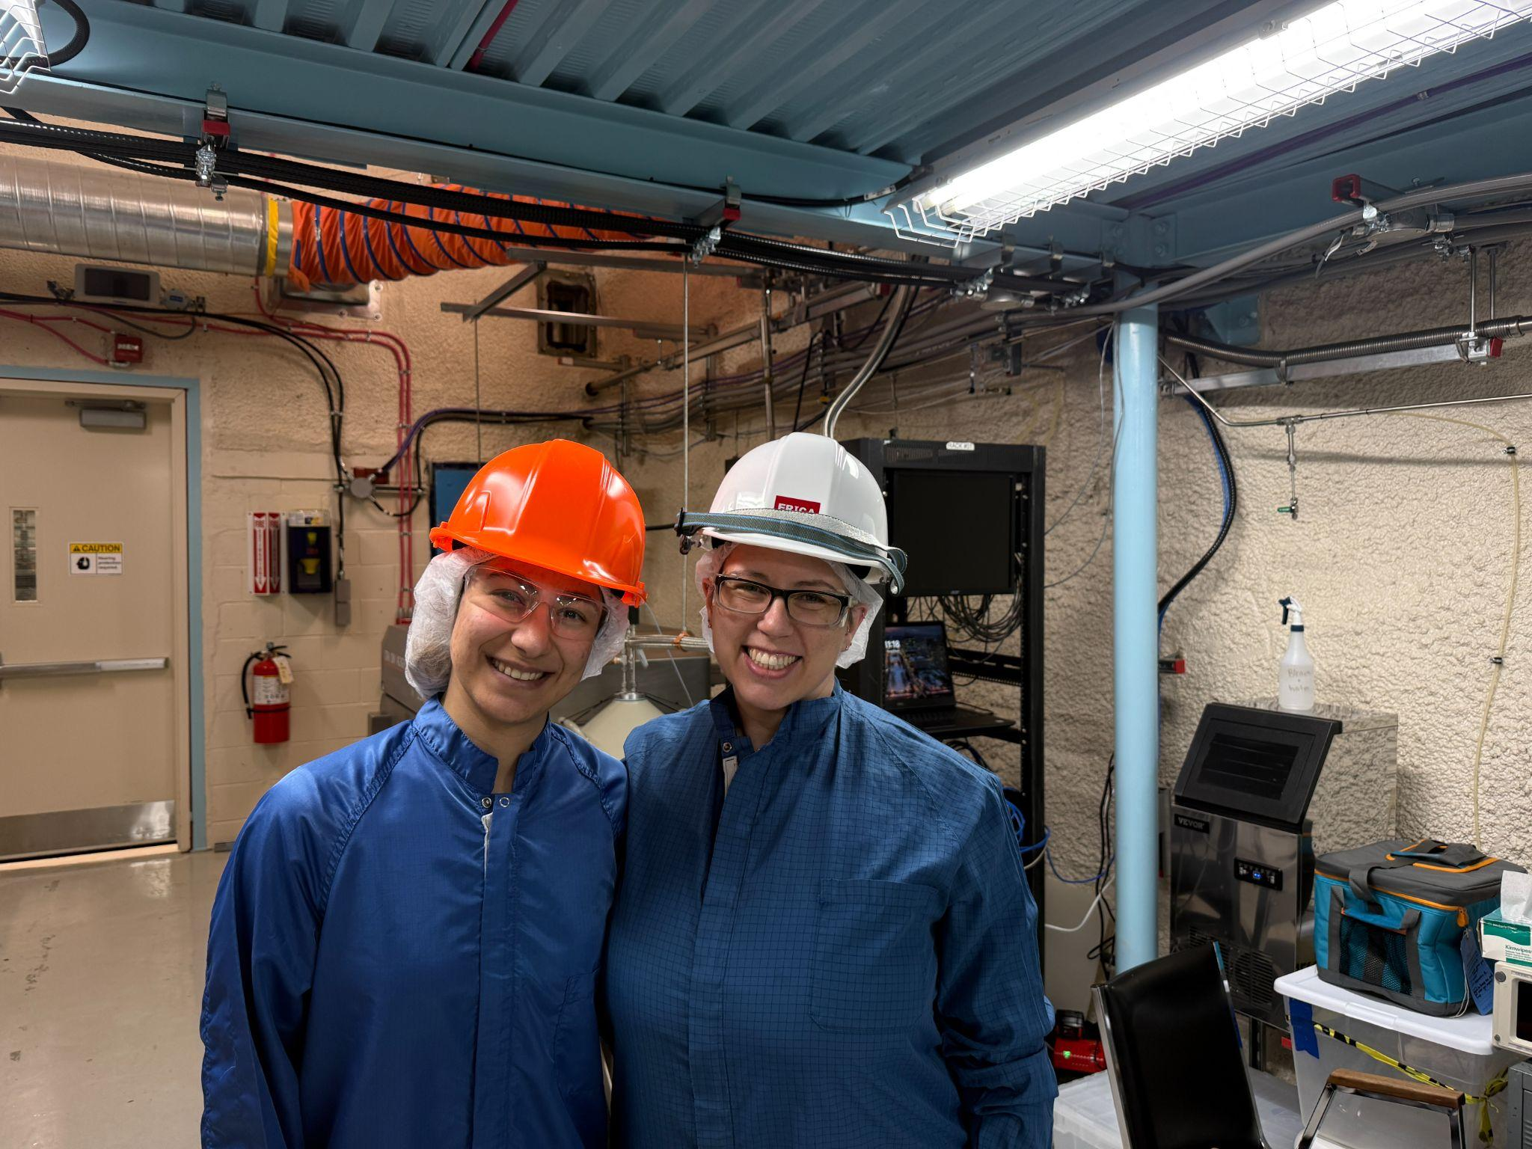
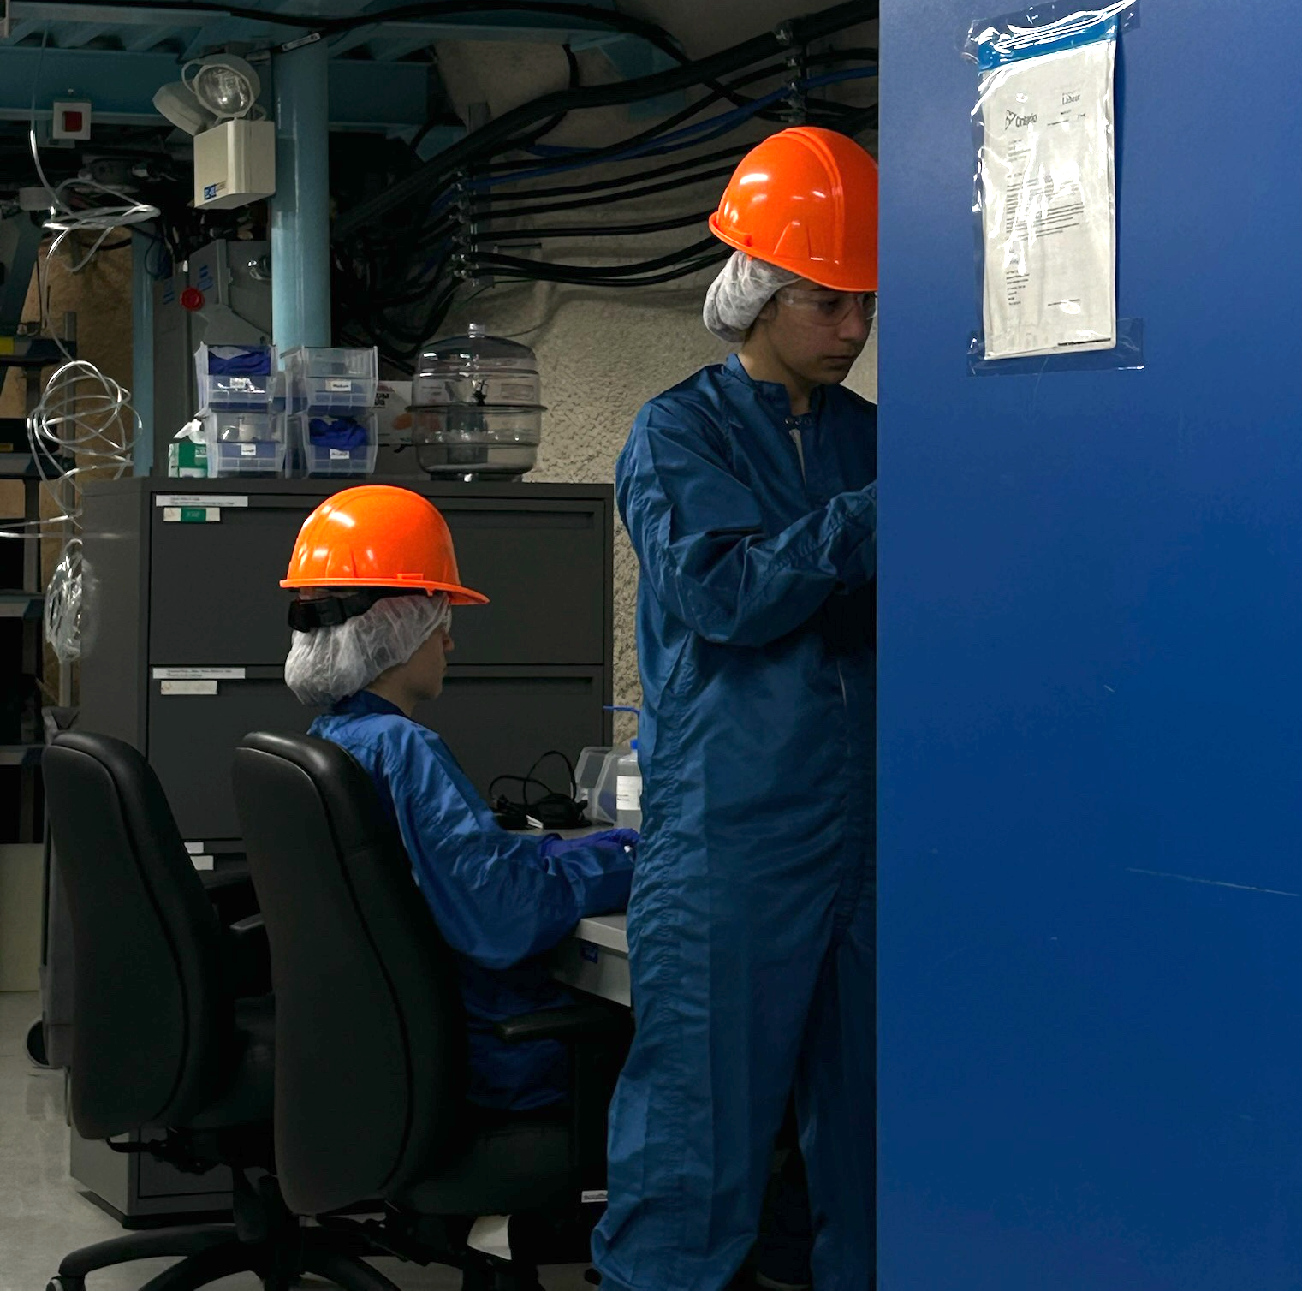
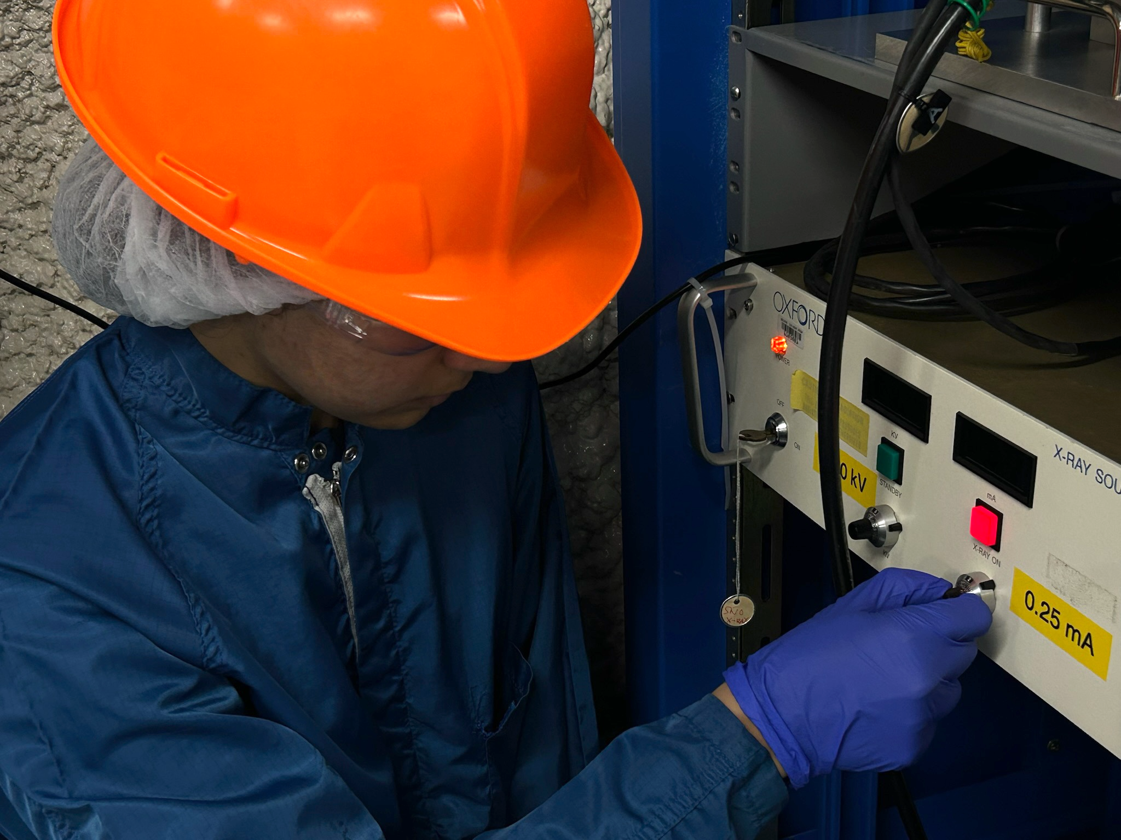
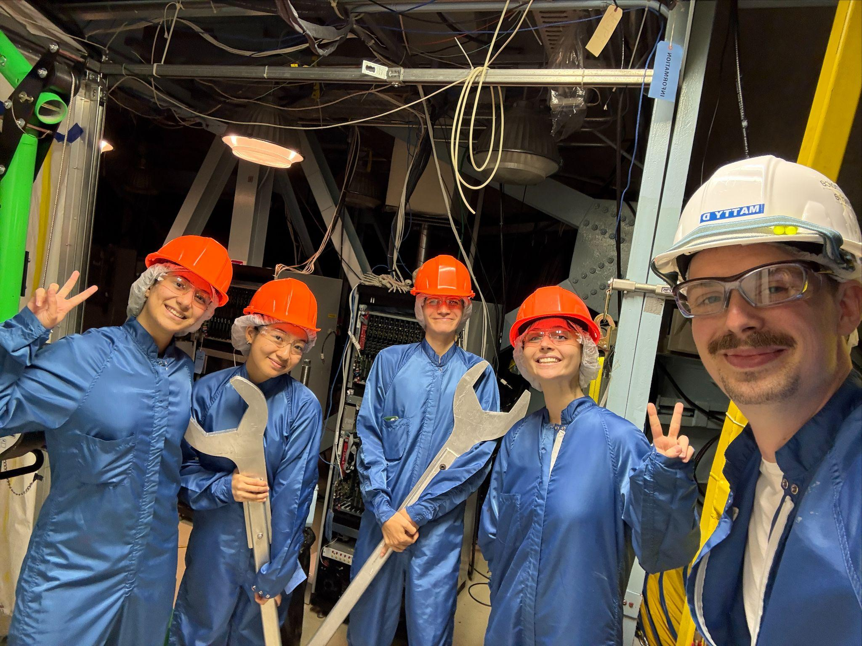
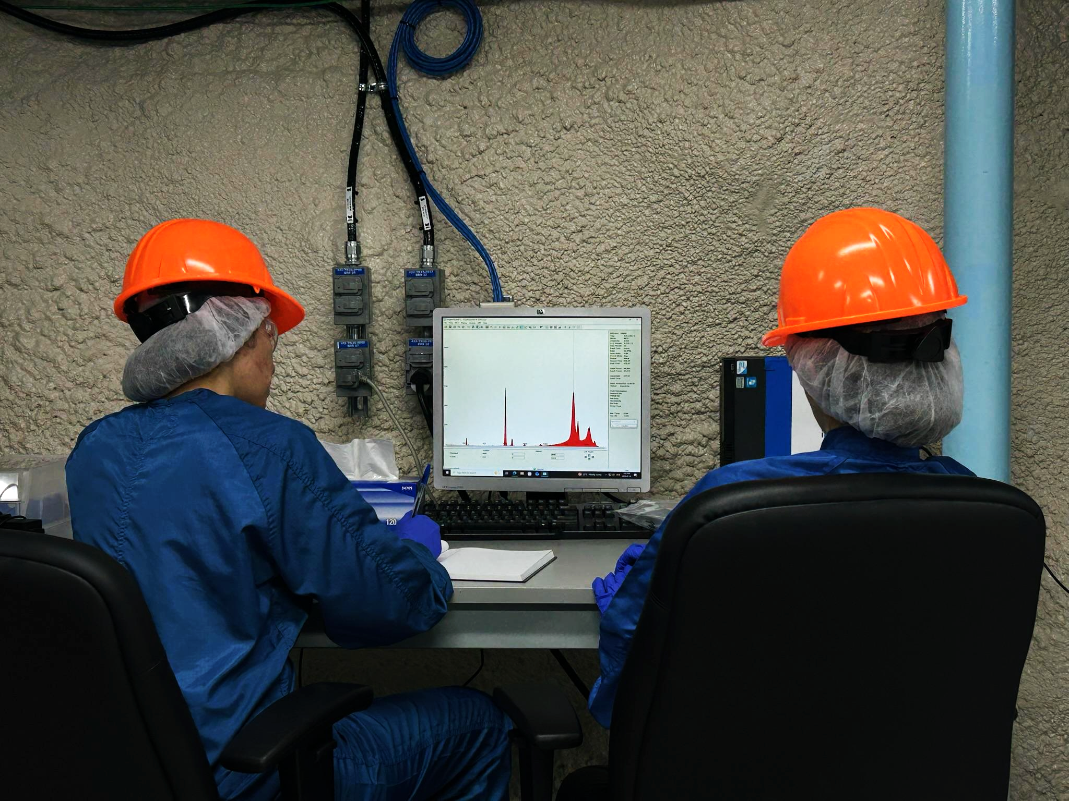
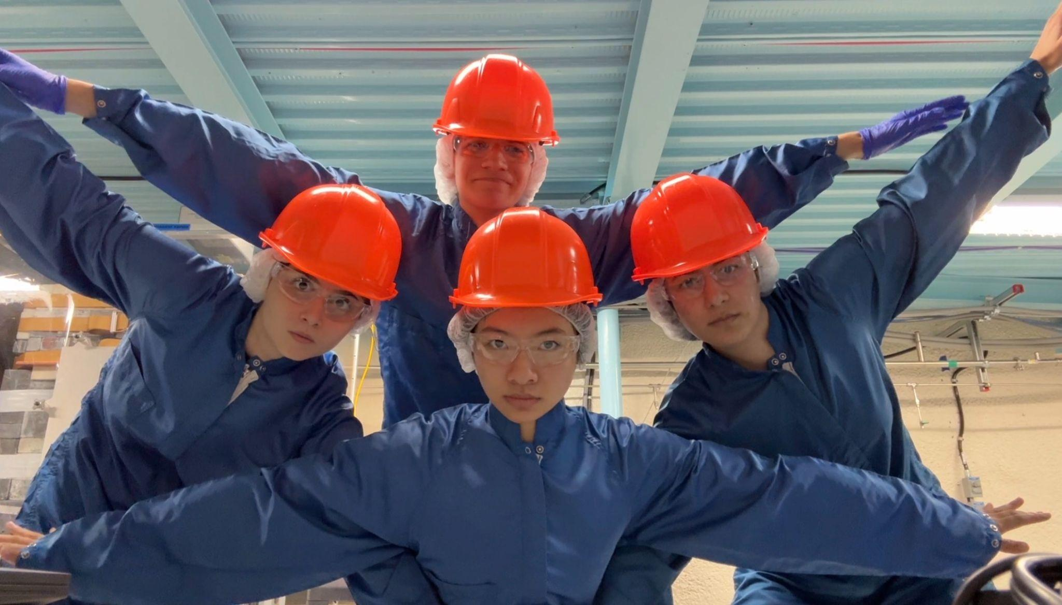
Special Thanks To:
Erica Caden
Matt Depatie
Mark Ward
Ryan Bayes
Christine Kraus
Aleksandra Bialek
Stefan Kaluzienski
Lorna Nolan
Thank You!
Sara Bergevin
Osanna Wong
Julia Gorovitz
Martin Courchesne
& the rest of the crew

Slide 38
Backup Slides:

Slide 39
SNO+ Trigger System
Rack
Crate
Front-end-card (FEC)
Crate
7

Slide 40
SNO+ Trigger System: Run-selection Criteria
SYNC16 / SYNC24
Detector
Crate
Timing Rack
PMT
PMTIC
FEC
Crate Trigger Card
Master Trigger Card / Analog
trigger_rates
XL3
queue_head_FEC
fec_fifo_overflow
Master Trigger Card / Digital
bad_data
queue_head_MTC
crate_hv_status_a
DAQ
triggerProcMissingGTID
invalid_minibundle
crate_hv_status_b
CLOCK_JUMP_1
Event Builder
event_rate
TUB
dt
invalid_caen_data_length
TUBii
queue_head_TUBII
queue_head_CAEN
CAEN

Slide 41
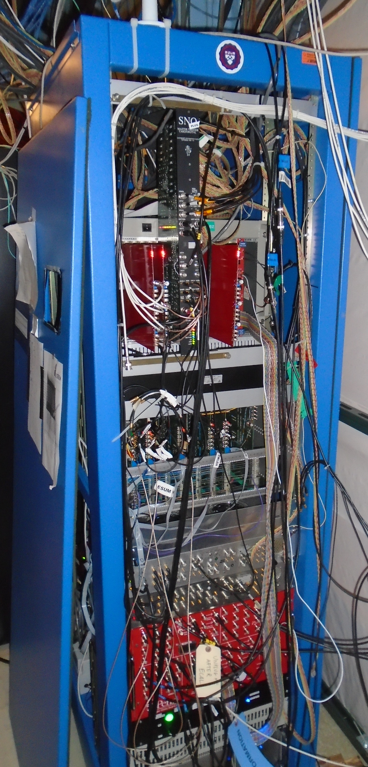
SNO+ Trigger System
Global Trigger
Detector
Crate
Timing Rack
PMT
PMTIC
FEC
Crate Trigger Card
Master Trigger Card / Analog
Master Trigger Card / Digital
Rack
Timing Rack
Crate
Front-end-card (FEC)
TUB
TUBii
CAEN
8

Slide 42
Daily Run-Selection Failure Rates: Database Errors
2024 - 10 / 2026 - 1
Missing Data
Missing Data
Missing Data
Missing Data

Slide 43
Daily Failure Rates (Peaks Removed): Electronics Errors
From 2023 - 7 to 2026 - 2
Wet-End Breakdown in 0/11/PC3, FEC going bad
Electronics work leads to bad data and orphan bursts
Wet-End Breakdown in 14/2/PC2
Event burst associated with crate 17

Slide 44
Daily Failure Rates
From 2023 - 7 to 2026 - 2
The most common causes of run-selection failures:
Software / Database Errors: Supply A setpoint alarms, missing-data, runs added to the backlog
Planned Operations: Maintenance, power outages, activity on deck, replacing FECs
Detector / Electronics Errors: Wet-end breakdowns, bad FECs, orphans, event bursts, crate related electronics problems
External Causes: Seismic events

Slide 45
Can we trust the data?
SNO+
DATA
PHYSICS!
SNO+ is looking for extremely rare events
It requires high data quality
The laboratory conditions and the detector state must be in good condition for taking data
5

Slide 46
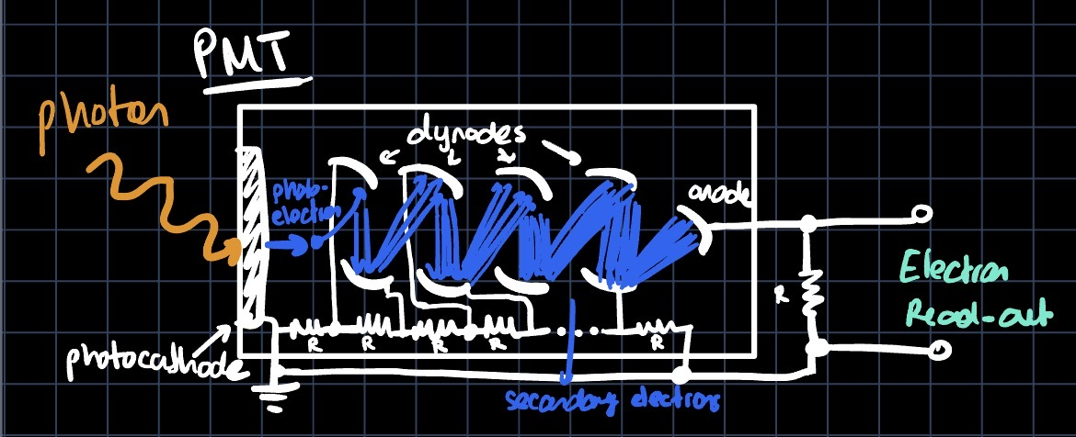
SNO+

Slide 47
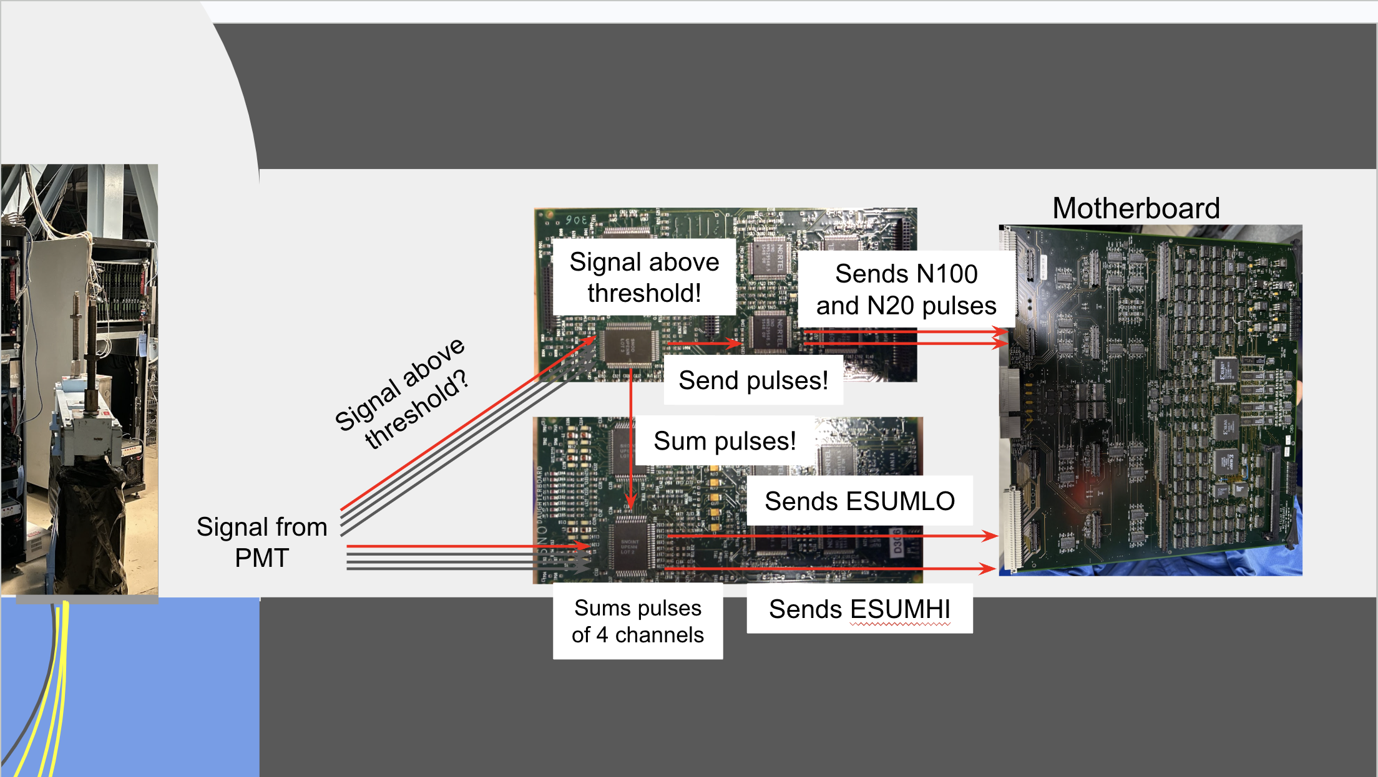

Slide 48
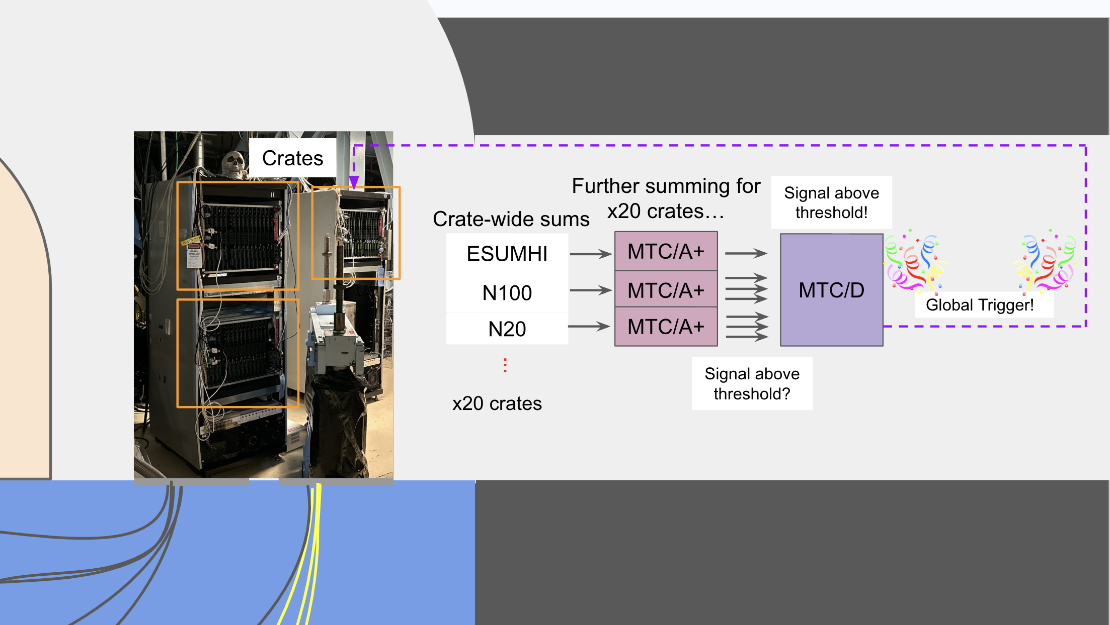

Slide 49
SNO+ Diagram
SNO+ Deck
DCR
(Deck Clean Room)
Rack
SNO+
Control Room ->
PMT Counts
1k
2k
3k
4k
TAC Counts
6

Slide 50
SNO+ Diagram
SNO+ Deck
DCR
(Deck Clean Room)
Rack
SNO+
Control Room ->
PMT Counts
1k
2k
3k
4k
TAC Counts
6

Slide 51
SNO+ Diagram
SNO+ Deck
DCR
(Deck Clean Room)
Rack
SNO+
Control Room ->
PMT Counts
1k
2k
3k
4k
TAC Counts
6

Slide 52
SNO+ Diagram
SNO+ Deck
DCR
(Deck Clean Room)
Rack
SNO+
Control Room ->
PMT Counts
1k
2k
3k
4k
TAC Counts
6

Slide 53
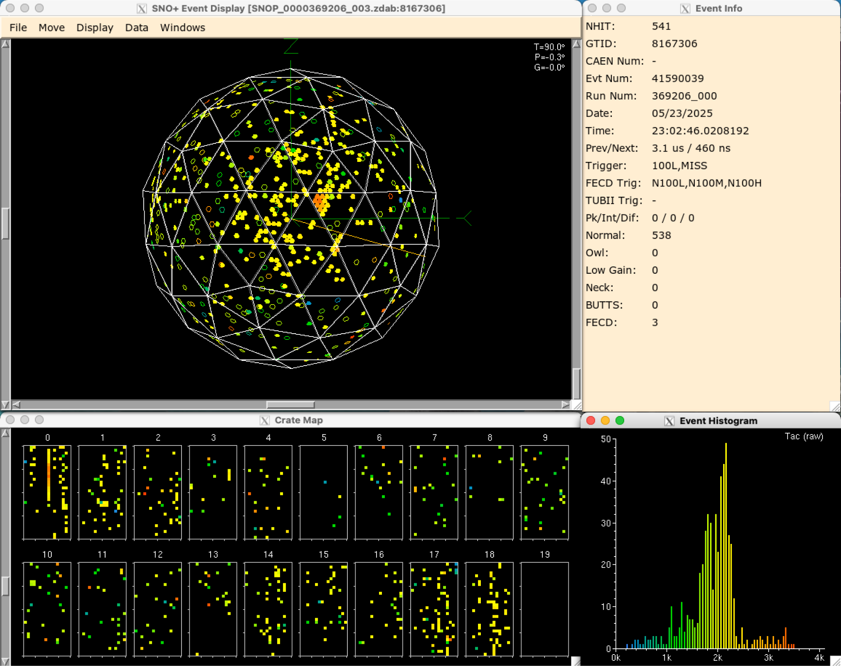
How do seismic events affect the detector?
Regular Scintillator Event?
25

Slide 54
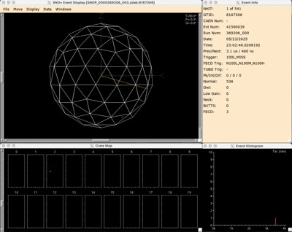
Flasher
Regular Scintillator Event?
How can we tell them apart?
Flashers occur when PMTs break down, resulting in a similar TAC histogram to scintillator events
First light is very highly concentrated around one PMT
26

