Slide 1

2026/08/12
RAMPS and the Search for the Electron Capture of Lu-176
Presenter: Sanjit Patil
Supervisor: Dr. Matt Stukel

Slide 2
RadioActive isotope Measurement Program at SNOLAB
Performing novel, precision or standardization measurements of long lived (highly forbidden) isotopes using or enhancing existing equipment at SNOLAB
Geochronology​
Astrophysics​
Nuclear Physics
Particle Physics​
Notes:
highly forbidden decays are rare, but their rates contain information about nuclear structure and weak interaction physics. In a normal high-rate experiment, rare branches disappear under dominant decay channels. RAMPS is designed to use deep underground conditions and coincidence detection to isolate tiny signals.
For 176Lu, the excited-state EC branch has not been measured directly.
Existing experimental limits are much weaker than many theoretical expectations, so a new underground coincidence measurement can either observe a rare branch or improve the lower limit.
The experimental advantage is the combination of low-background location, existing high-performance detectors,
For the pilot measurement, RAMPS uses a lutetium-containing scintillator crystal as both the radioactive source and the light-producing detector.
This gives event-by-event information about energy deposited inside the source.
A high-purity germanium detector provides the gamma-ray energy measurement with enough resolution to separate nearby lines.

Slide 3
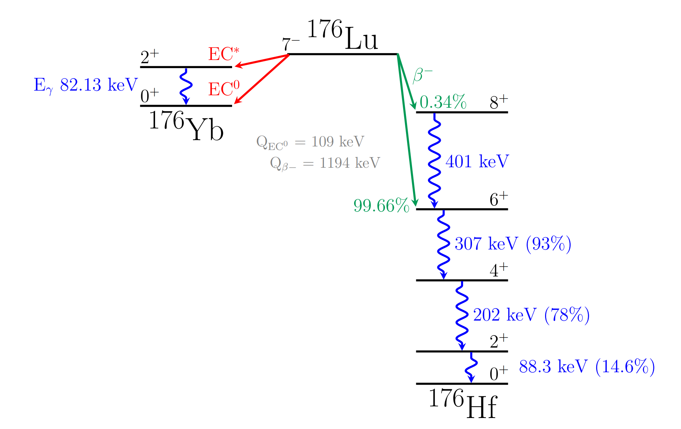
Notes:
In beta decay, the weak interaction connects initial and final nuclear states.
Whether the transition is allowed or forbidden depends on changes in spin, parity, and angular momentum.
Allowed transitions happen relatively often; highly forbidden transitions have much smaller matrix elements and much longer half-lives.
the word “forbidden” is historical shorthand.
The decay can occur quantum mechanically, but the probability is strongly suppressed. Mention fifth-order forbidden decay
This makes direct measurement difficult, but also valuable: if a branch can be measured, it becomes a sensitive probe of the nuclear wavefunctions and the approximations used in forbidden-decay theory.
176Lu has a dominant beta-minus decay path, but the branch of interest is electron capture to an excited state in 176Yb, which is far rarer.
The target is electron capture from 176Lu to the first excited state of 176Yb.
Because the daughter nucleus is excited, it emits a characteristic 82.13 keV gamma ray.
That gamma is the HPGe signature.
The local energy left in the LYSO crystal is small: approximately 109 keV Q-value minus 82.13 keV gamma energy, or 26.87 keV.
27 kev goes into the EC decay. Mention can’t be K-shell because that has a high binding energy
That energy appears as low scintillation light, measured by the SiPM array.
The problem is that 176Lu more commonly beta-minus decays.
Those events deposit a broad beta energy distribution in the LYSO and produce strong gamma features around 88, 202, and 307 keV.
A simple HPGe spectrum alone is dominated by those beta-associated lines and continuum.
RAMPS uses the difference in local scintillation energy to suppress beta-minus background.
The final coincidence selection is therefore conceptually simple: HPGe near 82 keV, SiPM below 27 keV, and matched event timing.

Slide 4
Notes:
In beta decay, the weak interaction connects initial and final nuclear states.
Whether the transition is allowed or forbidden depends on changes in spin, parity, and angular momentum.
Allowed transitions happen relatively often; highly forbidden transitions have much smaller matrix elements and much longer half-lives.
the word “forbidden” is historical shorthand.
The decay can occur quantum mechanically, but the probability is strongly suppressed. Mention fifth-order forbidden decay
This makes direct measurement difficult, but also valuable: if a branch can be measured, it becomes a sensitive probe of the nuclear wavefunctions and the approximations used in forbidden-decay theory.
176Lu has a dominant beta-minus decay path, but the branch of interest is electron capture to an excited state in 176Yb, which is far rarer.
The target is electron capture from 176Lu to the first excited state of 176Yb.
Because the daughter nucleus is excited, it emits a characteristic 82.13 keV gamma ray.
That gamma is the HPGe signature.
The local energy left in the LYSO crystal is small: approximately 109 keV Q-value minus 82.13 keV gamma energy, or 26.87 keV.
27 kev goes into the EC decay. Mention can’t be K-shell because that has a high binding energy
That energy appears as low scintillation light, measured by the SiPM array.
The problem is that 176Lu more commonly beta-minus decays.
Those events deposit a broad beta energy distribution in the LYSO and produce strong gamma features around 88, 202, and 307 keV.
A simple HPGe spectrum alone is dominated by those beta-associated lines and continuum.
RAMPS uses the difference in local scintillation energy to suppress beta-minus background.
The final coincidence selection is therefore conceptually simple: HPGe near 82 keV, SiPM below 27 keV, and matched event timing.

Slide 5
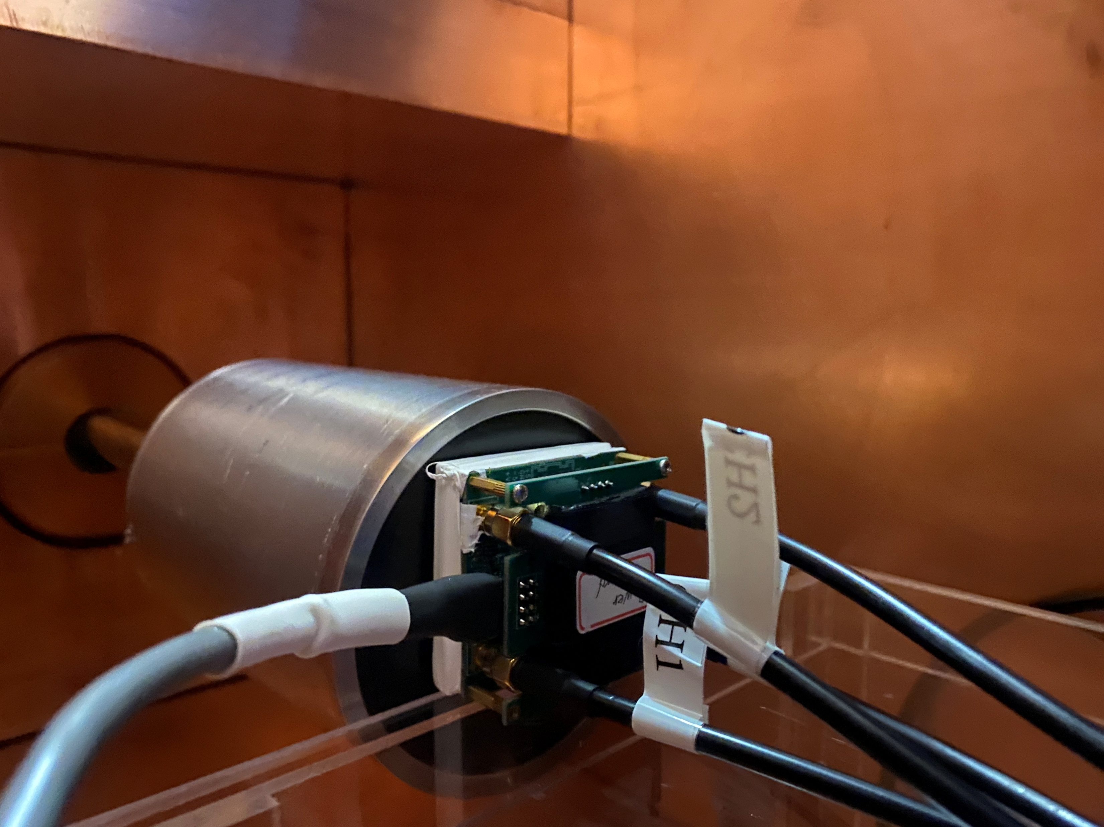
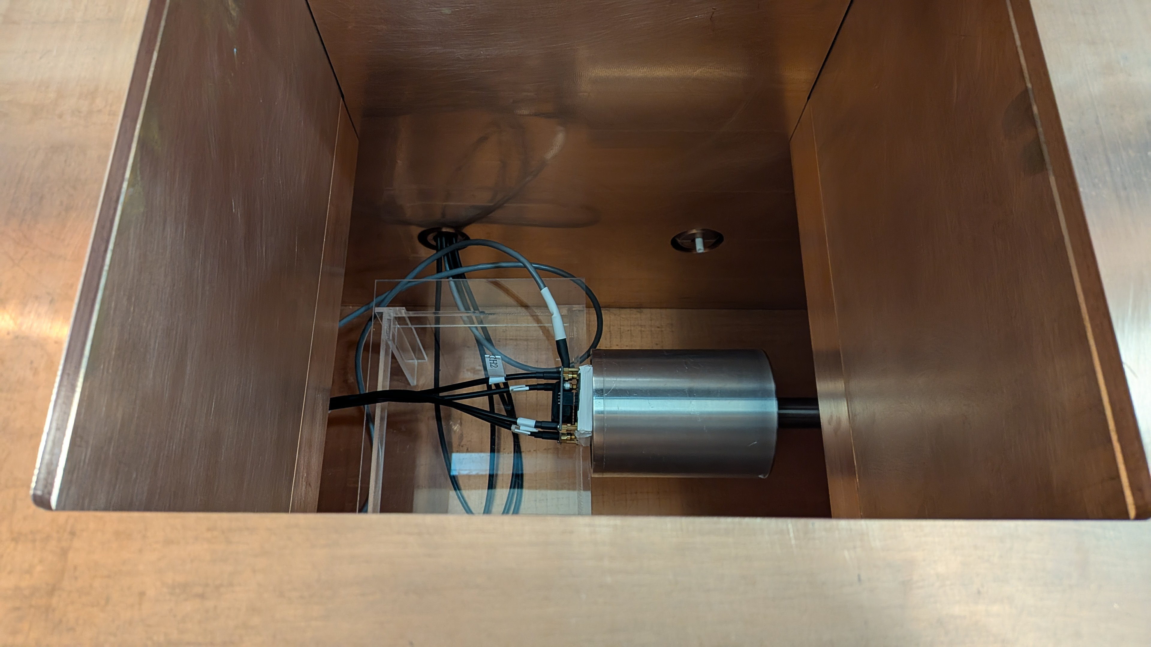
CTBT High Purity Germanium Detector (HPGe)
Silicon Photomultiplier (SiPM)
Notes:
The LYSO crystal contains lutetium, so it is not just a passive detector; it is also the source.
When a decay deposits energy inside the crystal, the crystal scintillates.
The SiPM records that light.
At the same time, if the decay produces a gamma ray that escapes the crystal, the HPGe measures it with good energy resolution.
For the dominant beta-minus branch, the local scintillation energy is broad and can be large, and the gamma lines are associated with the beta decay path: around 88, 202, and 307 keV, with sum features possible.
For the EC* target branch, the local scintillation energy is small, below 27 keV, and the gamma energy is 82.13 keV.
This is why a two-dimensional selection is much more powerful than either detector alone.
The SiPM rejects beta energy, while the HPGe separates 82 keV from nearby gamma backgrounds, especially the 88 keV line.
The HPGe detector and shielding provide gamma-ray spectroscopy.
The SiPM system reads scintillation light from the LYSO crystal.
SNOLAB's underground environment is part of the experimental design, not just the location.
The reduced cosmic-ray background improves the rare-event search sensitivity, especially when combined with coincidence cuts.

Slide 6
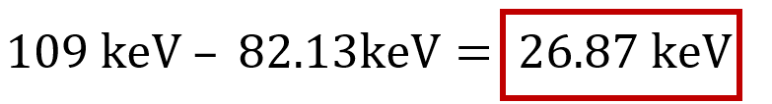


27 keV Cut
SiPM: $E<27 keV$
HPGe: $E_{γ}≈82.13 keV$
Notes:
When measuring with purely our HPGe, the ß⁻ overpowers our signal
How to remove?
EC Q-value = 109 keV
γ ray is 82.13 keV, leaving the rest of the energy to be scintillated as 26.87 keV light
Coincidence helps us with this!
SiPM: It reads the scintillation light produced inside the LYSO crystal. Because the LYSO itself contains 176Lu, it acts as both the radioactive source and the detector. For the excited-state electron-capture signal, the SiPM is expected to measure a small local energy deposit below about 27 keV, coming from the atomic relaxation energy such as X-rays and Auger electrons. Most ordinary 176Lu β− decays deposit much more energy in the crystal, so the SiPM provides a strong background-rejection cut.
HPGe: It detects the gamma ray that escapes from the LYSO crystal. The signal of interest produces a characteristic 82.13 keV gamma ray when the excited 176Yb daughter nucleus de-excites. The HPGe is used because it has very good energy resolution, allowing you to distinguish the 82.13-keV signal from nearby background gamma rays, especially the strong 176Lu line near 88 keV.

Slide 7
Science Run 1
Over 20 Tb of data!
Over 30 hours of science data
Over 12 hours of calibration data (Na22, Ba133, Eu152)

Slide 8
Analysis Pipeline
Raw .bin files
digitized waveforms
Feature extraction
charge, amplitude, timing
Energy calibration
charge → keV for HPGe and SiPM
Coincidence cuts
82 keV HPGe, <27 keV SiPM, timing
Limit / sensitivity
Feldman–Cousins Method
Notes:
First, raw binary waveform files are decoded using the file header structure.
Then each channel is baseline-subtracted using pre-trigger samples.
Next, features are extracted: integrated charge, peak amplitude, timing, and diagnostic quantities such as edge index.
The integrated charge is converted to energy using calibration runs and known gamma peaks.
Only after the energy calibration is stable should the analysis apply the coincidence selection.
That selection requires an HPGe gamma near 82 keV, a low SiPM energy deposit below about 27 keV, and an appropriate timing window between the detectors.
After the cuts, the search becomes a counting experiment: observed events in the signal ROI are compared with an expected background estimate, and Feldman–Cousins intervals are used to report a confidence interval or upper limit on signal counts.
My current work sits in the calibration and quality-control portion of this chain.
This is why the calibration offset issue must be solved before the coincidence analysis is credible.

Slide 9
Pulse Integration and Calibration
Notes:
HPGe pulses can have long plateaus or slow components, so the charge extracted from a waveform depends strongly on the integration window.
If the window includes too much of the plateau, small residual baseline offsets integrate into a large artificial charge shift.
That can distort calibration curves and make different runs appear inconsistent.
The new method detects the HPGe rising edge within the expected trigger region and then applies the same relative integration window to every event: a window starting before the edge and extending after it.
This makes the extracted charge more comparable event-to-event and run-to-run.
The resolution improved as the window length increased from 1000 ns to 4000 ns; the listed values were 202 keV resolution improving from 2.24% to 1.04%, and 307 keV resolution improving from 2.12% to 0.76%.
This provides a data-driven reason for the selected integration method.

Slide 10
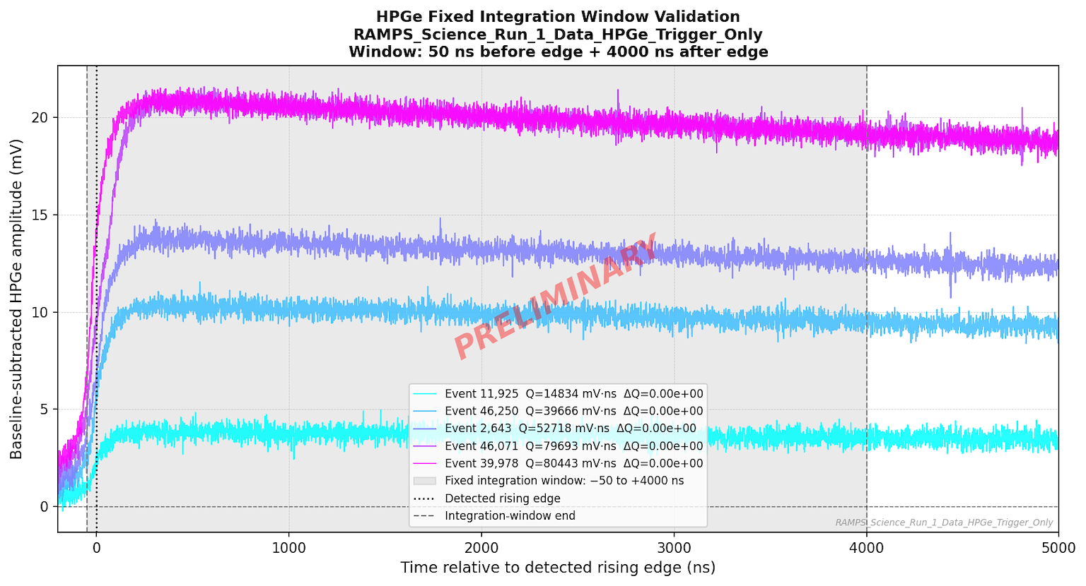
Notes:
Mention higher energy deposition = higher amplitude = higher integrated charge
Mention sudies need to be done on determining the best pre-peak and post peak integration values

Slide 11
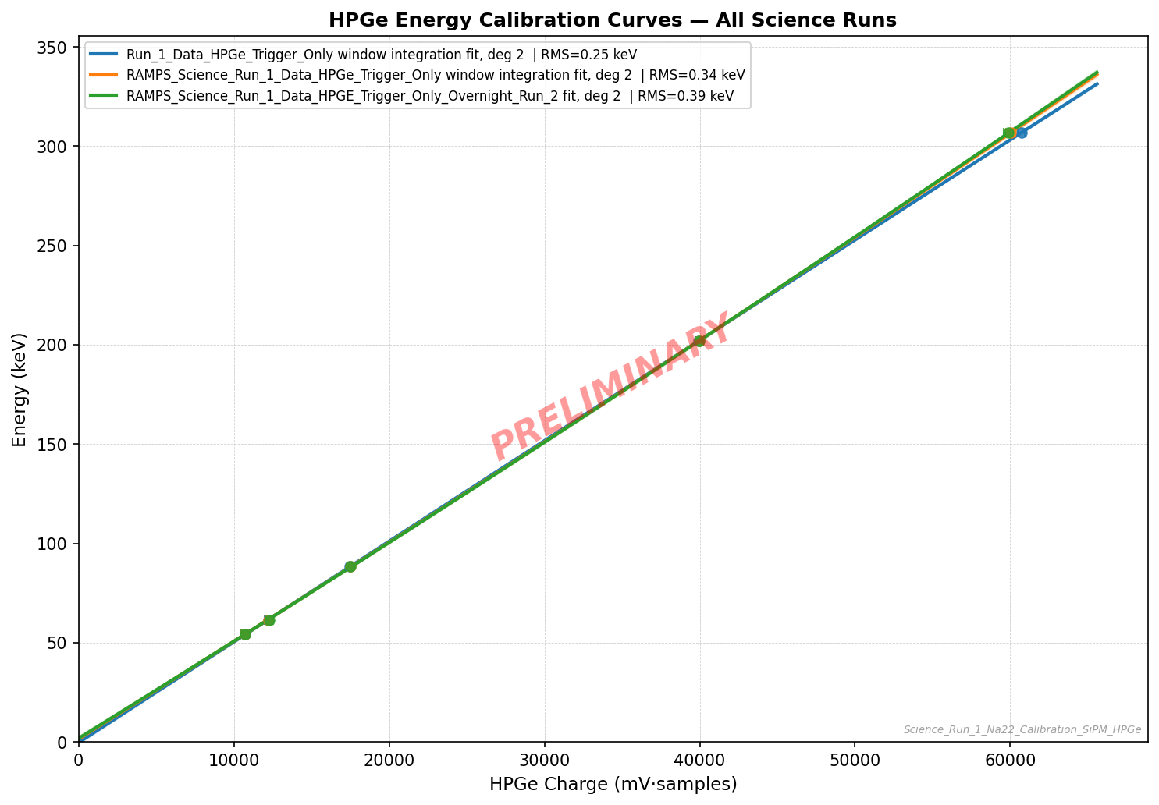
Notes:
Science runs seem to be very repeatable

Slide 12
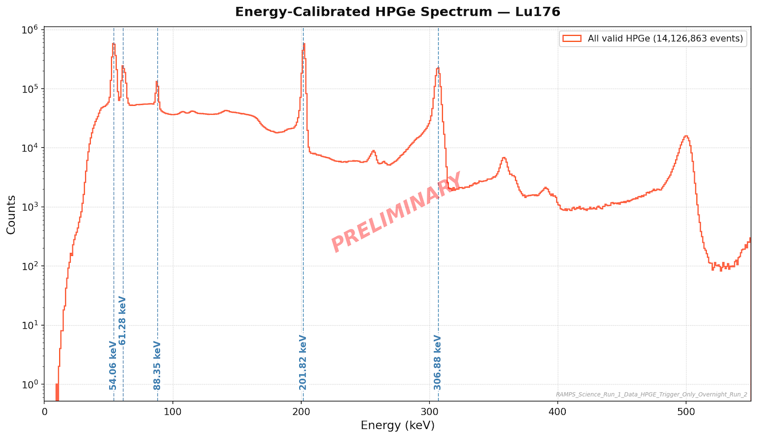
Notes:
Mention the 88 kev peak that is close to the 82 kev peak

Slide 13
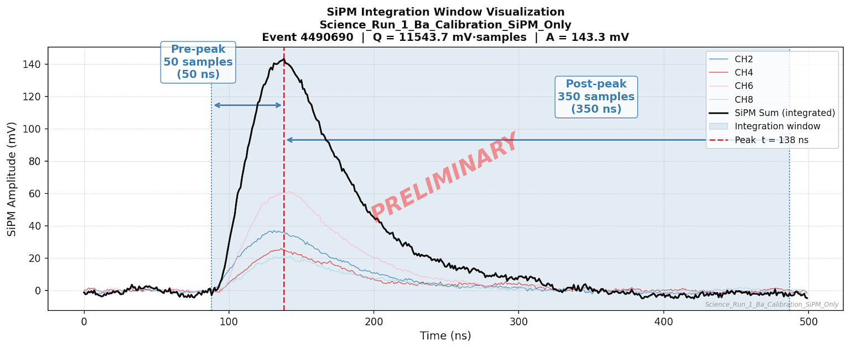
Notes:
The SiPM calibration is central because the signal definition depends on a low-energy threshold of about 27 keV.
The combined Ba-133 and Na-22 calibration shows a coherent global curve, but the offsets in individual calibrations are too high to treat the energy scale as finalized.
if Ba and Na have large offsets but Lu should not, then the analysis must identify whether the issue is source-dependent, integration-dependent, baseline-dependent, or peak-identification-related.
the coincidence analysis should not proceed until the SiPM energy scale is stable, because the <27 keV cut is only meaningful after this calibration gate is passed.

Slide 14
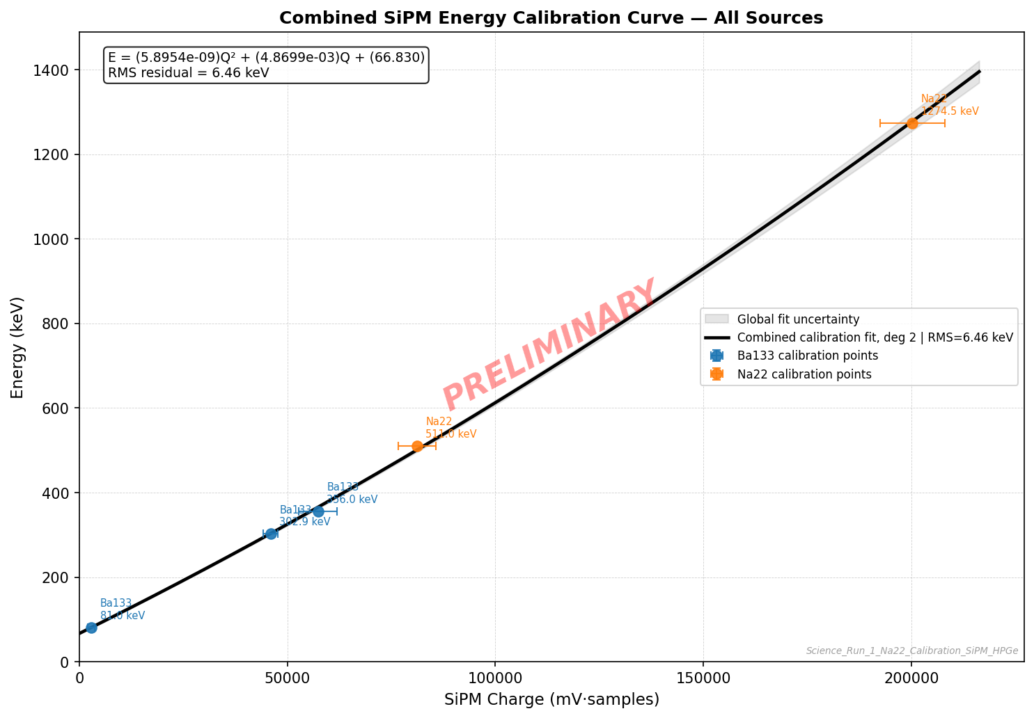
Make a cut at 70 keV instead
Notes:
Mention large offset here

Slide 15
Coincidence Analysis
Notes:
First, the HPGe energy must fall in an ROI around the 82.13 keV gamma.
The width of that ROI should come from HPGe resolution, not a guessed value.
Second, the SiPM energy must be below the expected EC* local energy of about 27 keV, with the threshold and acceptance informed by SiPM calibration and resolution.
Third, the HPGe and SiPM times must agree within a coincidence window determined from timing data.
Fourth, event quality cuts must remove events with invalid baselines, clipped windows, missing edges, or malformed waveforms.
The right-side figure from the preliminary coincidence spectrum shows that the coincidence technique already suppresses much of the beta background and reveals expected features.
The final analysis must formalize that into a reproducible selection: define ROIs, sidebands, timing windows, background estimates, and efficiencies before reporting candidates or limits.
The final product of the analysis is a count of candidate events and a statistically defensible interpretation.
If a significant excess is observed, the analysis can report a branching ratio or half-life measurement.
If not, it reports an upper limit on the signal and a corresponding lower limit on the half-life.
The inputs are: n, the number of observed events in the signal ROI; b, the expected number of background events in that ROI; efficiency terms for the HPGe gamma detection, SiPM energy acceptance, timing acceptance, analysis cuts, and live time; and the number of 176Lu atoms in the LYSO crystal.
The Feldman–Cousins construction is appropriate because it handles small event counts without switching ad hoc between upper limits and two-sided intervals.
The half-life formula is the standard exposure divided by the allowed signal count.
that calibration and cuts feed directly into the efficiency and background terms.
That is why the final statistical result depends on careful detector analysis.

Slide 16
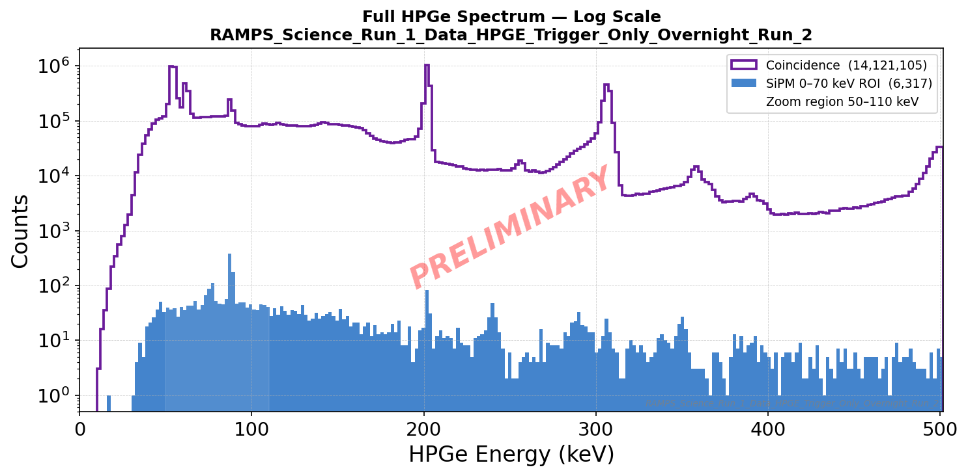
Notes:
Example of a full spectrum of HPGe. And the blue is after the cut has been made
red region is the zoom area

Slide 17
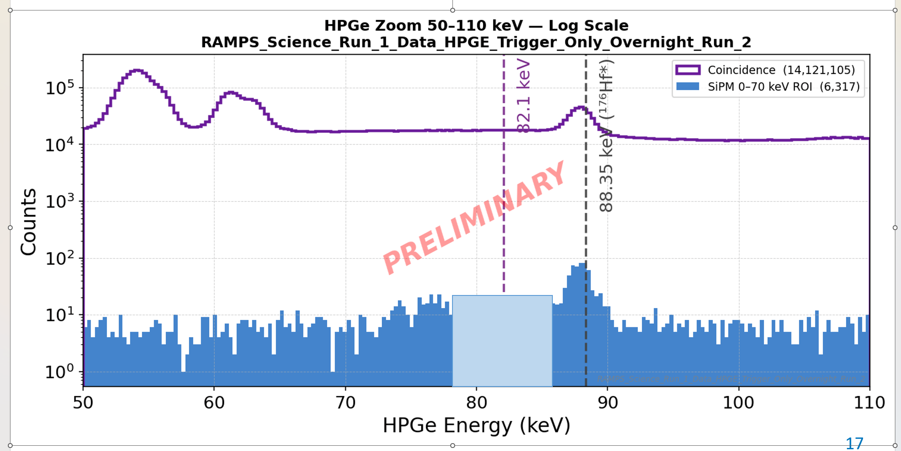
Notes:
The final product of the analysis is a count of candidate events and a statistically defensible interpretation.
If a significant excess is observed, the analysis can report a branching ratio or half-life measurement.
If not, it reports an upper limit on the signal and a corresponding lower limit on the half-life.
The inputs are: n, the number of observed events in the signal ROI; b, the expected number of background events in that ROI; efficiency terms for the HPGe gamma detection, SiPM energy acceptance, timing acceptance, analysis cuts, and live time; and the number of 176Lu atoms in the LYSO crystal.
The Feldman–Cousins construction is appropriate because it handles small event counts without switching ad hoc between upper limits and two-sided intervals.
The half-life formula is the standard exposure divided by the allowed signal count.
that calibration and cuts feed directly into the efficiency and background terms.
That is why the final statistical result depends on careful detector analysis.

Slide 18
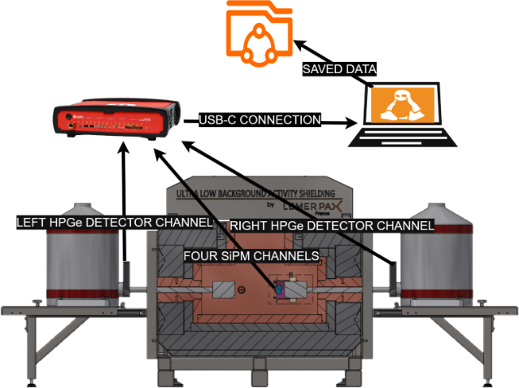
Next Steps
Finalize SiPM calibration
Finish coincidence cuts and analysis
Prepare for Science Run 2

Slide 19
Great Thanks!
Matthew Stukel, Hector Herrera, Ian Lawson, Steffon Luoma, Diba Toyserkani, & everybody else who helped me along the way

