Slide 1

Studying core-collapse supernovae nucleosynthesis with a direct measurement of the ¹³N(α,p)¹⁶O reaction
CASST 2026 Symposium
August 13, 2026
Luka Radulovic

Slide 2
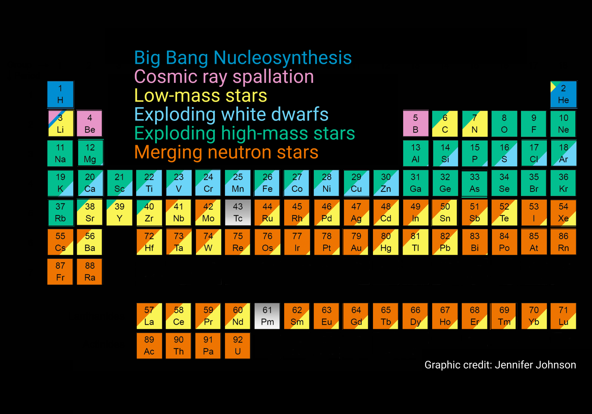
Importance of this experiment:
The core-collapse supernovae and the ¹³N + α → ¹⁶O + p reaction
Core-collapse supernovae are the last evolutionary stage of massive stars
These events are analogous to almost instantaneous explosions that create the many of the heavy elements found in space
We are able to observe these radioactive isotopes using γ-ray space-based telescopes
1. A. Burrows & D. Vartanyan, Nature 589, 29 (2021)
2. H.-T. Janka, Annu. Rev. Nucl. Part. Sci 75, 425 (2025)
3. C.L. Fryer et al., arXiv:2601.04464 [astro-ph] (2026)
2

Slide 3
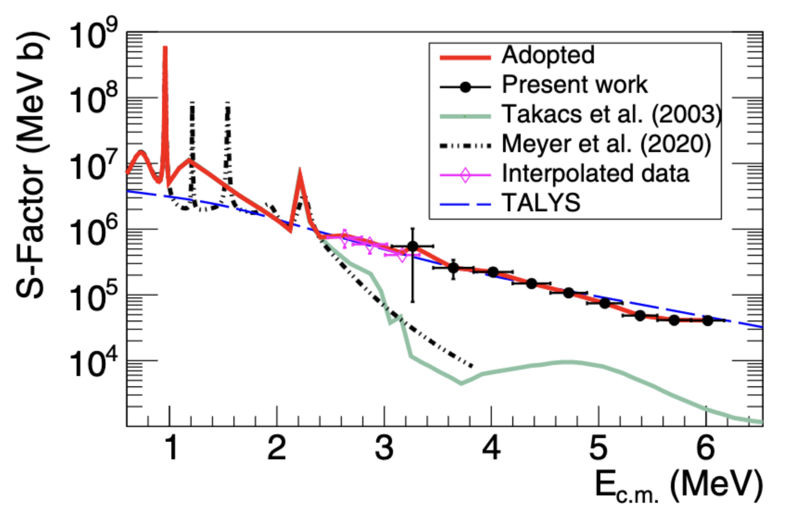
Why is our ¹³N + α → ¹⁶O + p reaction important?
Current results:
The ¹³N(a,p)¹⁶O reaction affects multiple stages of CCSN at varying temperatures
It directly influences the abundances of 13 different elements
Key nuclear reaction rates still have large uncertainties
Large rate uncertainties → uncertain isotope abundances → inaccurate CCSN models
1. Meyer, A. et al. Phys. Rev. C 102, 035803 (2020).
2. Jayatissa, H. et al. Phys. Rev. C 105, L042802 (2022).
3

Slide 4
Why is our ¹³N + α → ¹⁶O + p reaction important?
Current results:
Our reaction has not been measured directly across the full relevant temperature range yet (0.8 – 6 GK)
Our experiment covers this range with higher beam intensity (10³ → 10⁵ pps) and purity (50% → ~90%)
1. Meyer, A. et al. Phys. Rev. C 102, 035803 (2020).
2. Jayatissa, H. et al. Phys. Rev. C 105, L042802 (2022).
4

Slide 5
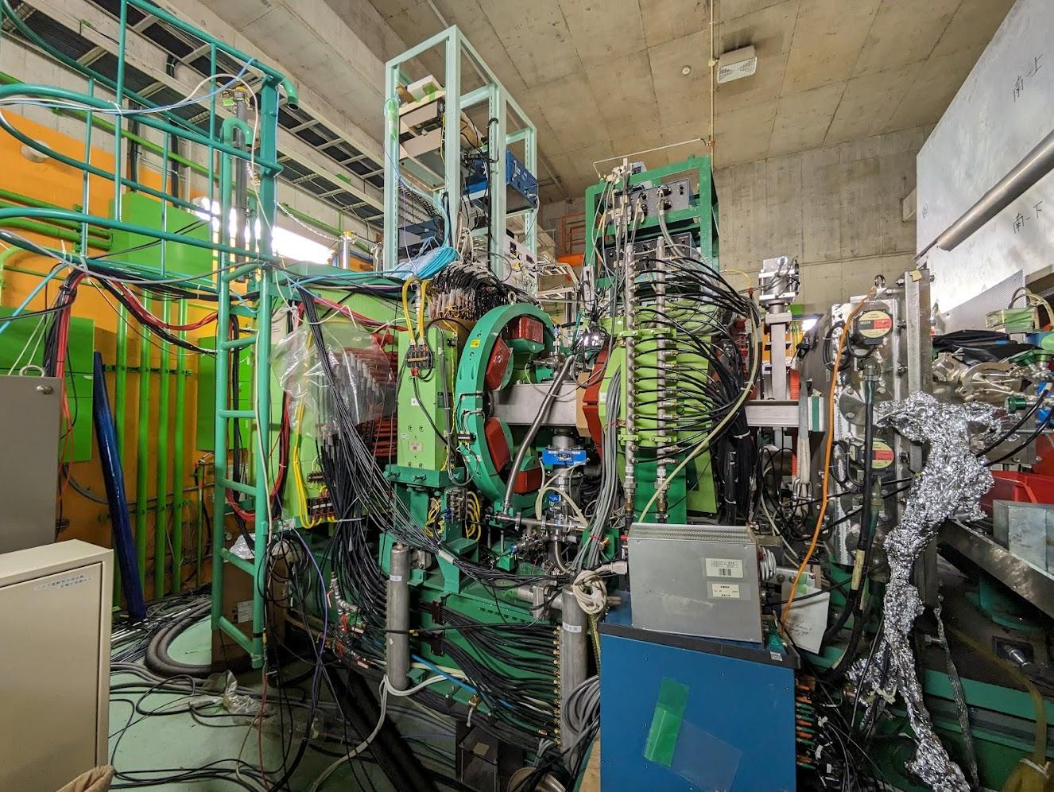
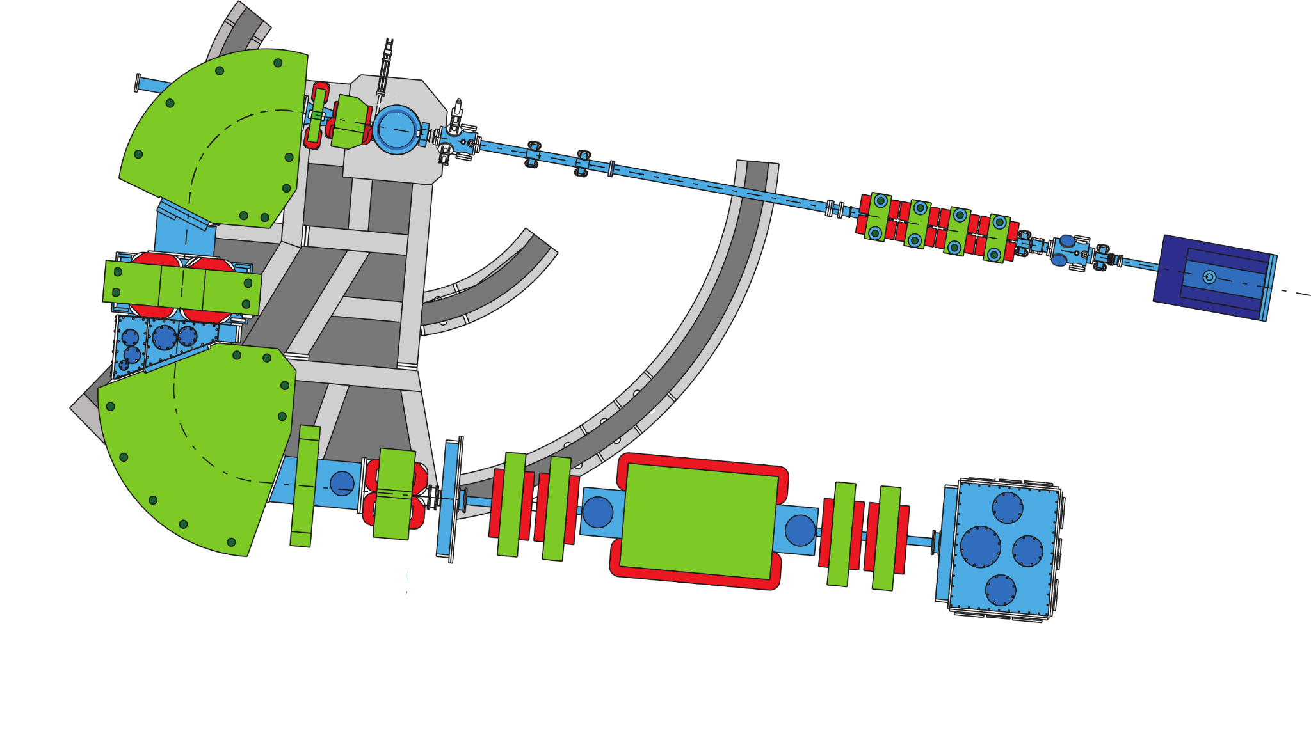
CRIB = CNS RI beam separator
Located at the Center for Nuclear Study, at the University of Tokyo
Production Target
H₂ gas
(300 Torr, 90 K)
¹³C
Primary beam from cyclotron
¹³N (t_{1/2}~10 min)
^{Magnetic Dipole}
^{Wien Filter}
^{Scattering Chamber}
5 m
5
RIBF Proposal NP-AVF69, PI: Psaltis

Slide 6
Understanding how CRIB works
Production Target
H₂ gas
(300 Torr, 90 K)
¹³C
Primary beam from cyclotron
¹³N (t_{1/2}~10 min)
^{Magnetic Dipole}
^{Wien Filter}
^{Scattering Chamber}
5 m
6
RIBF Proposal NP-AVF69, PI: Psaltis

Slide 7
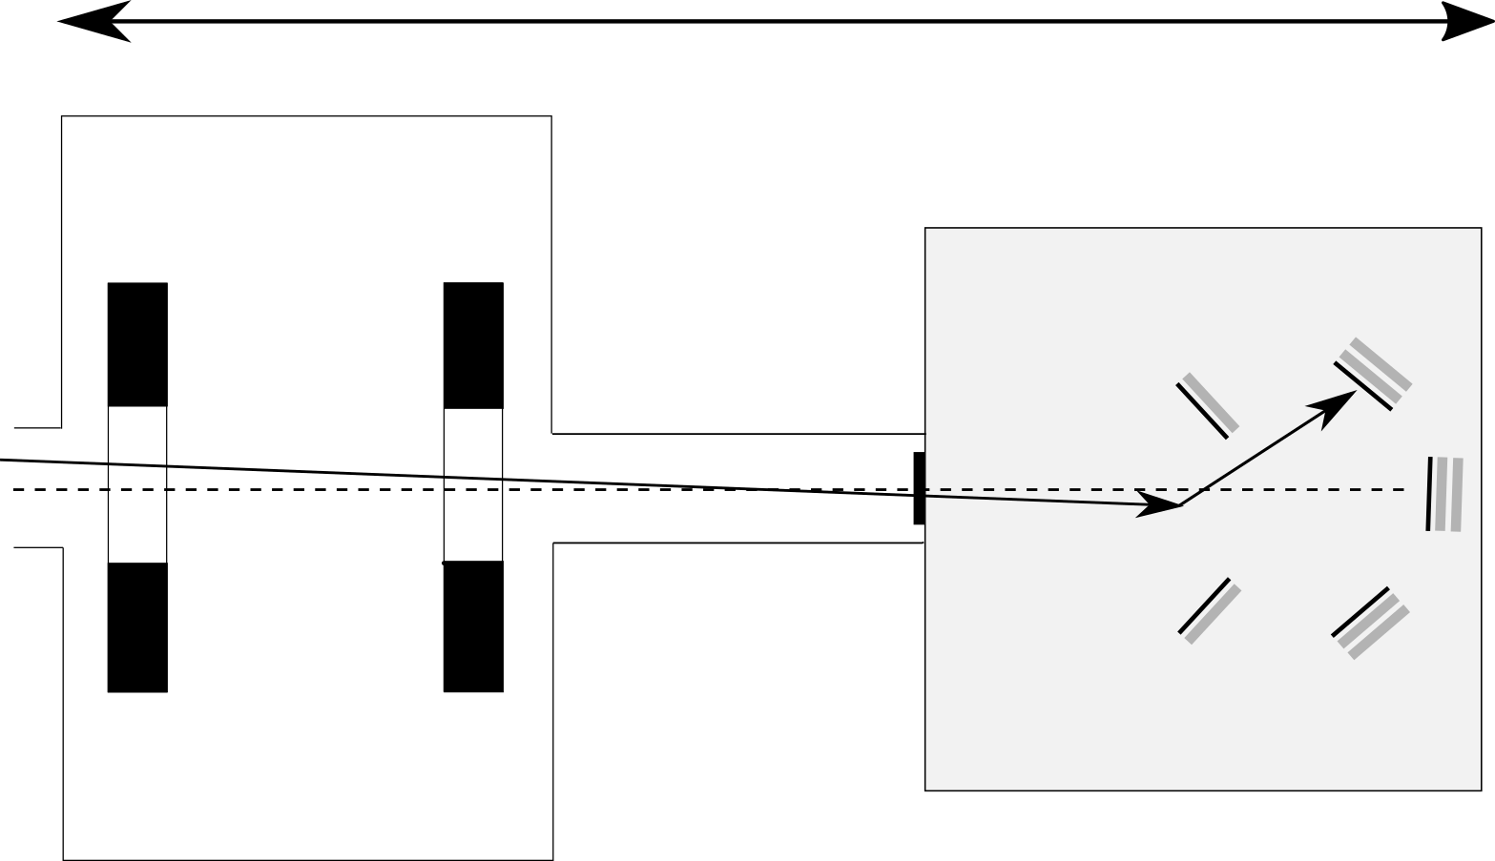
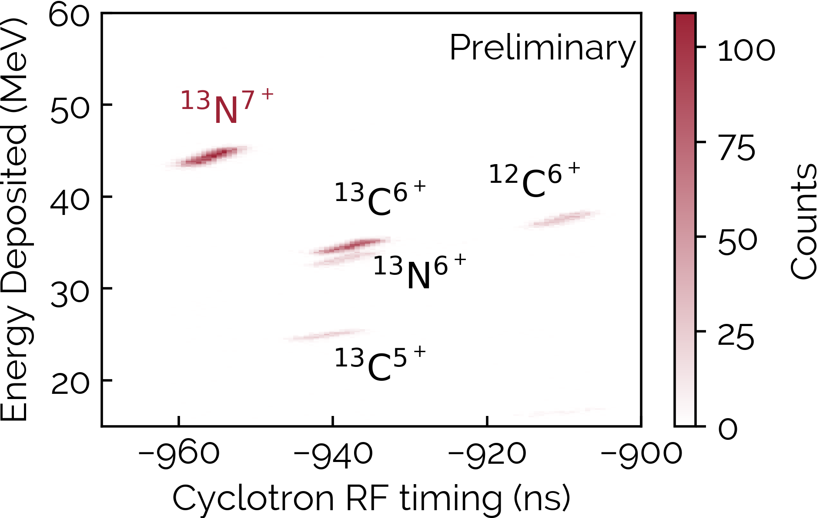
How do we isolate for mostly ¹³N?
1 m
¹³N
p
PPACa
PPACb
7
RIBF Proposal NP-AVF69, PI: Psaltis

Slide 8
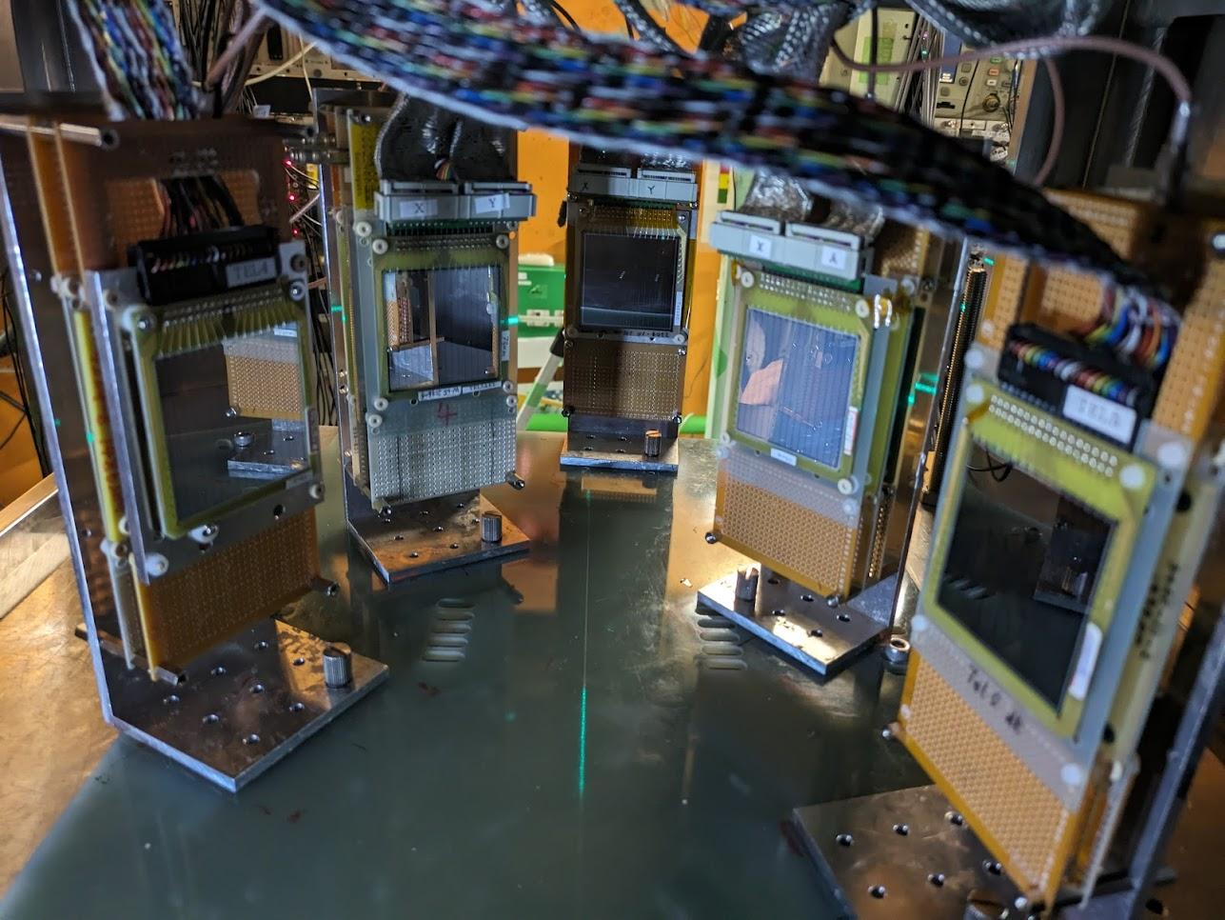
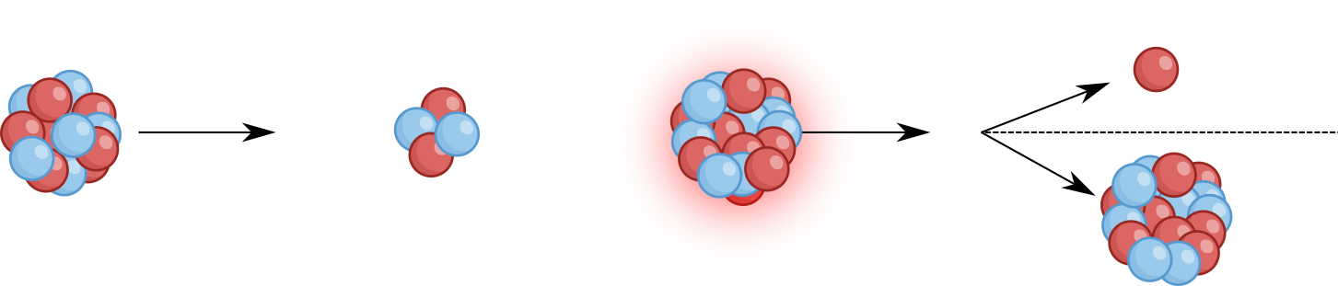
How are protons actually detected?
1 m
⁴He @ 250 Torr
Tel4
Tel2
Tel1
¹³N
Tel2
p
Tel3
Tel1
Tel4
p
10 cm
¹³N
Tel5
Tel5
Tel3
PPACa
PPACb
¹³N ⁴He ¹⁷F p
¹⁶O
8

Slide 9
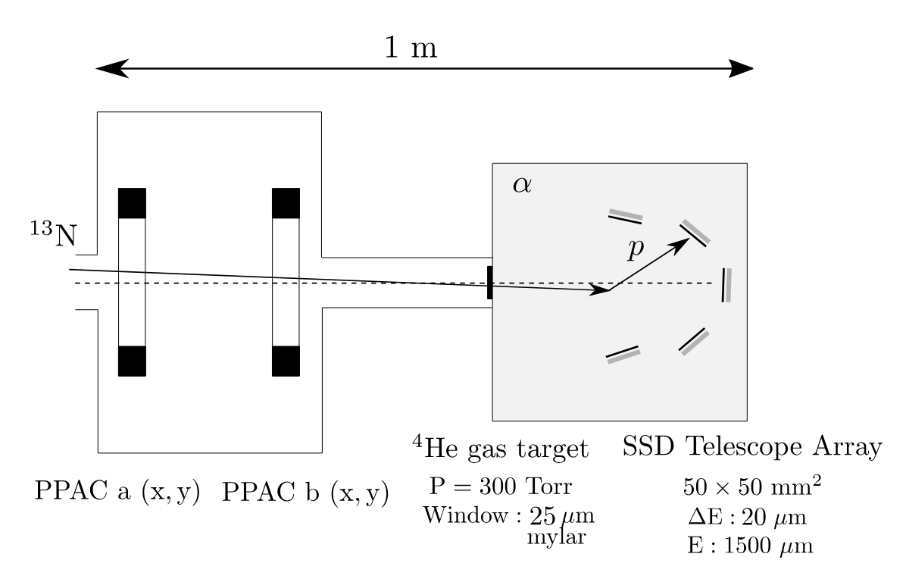
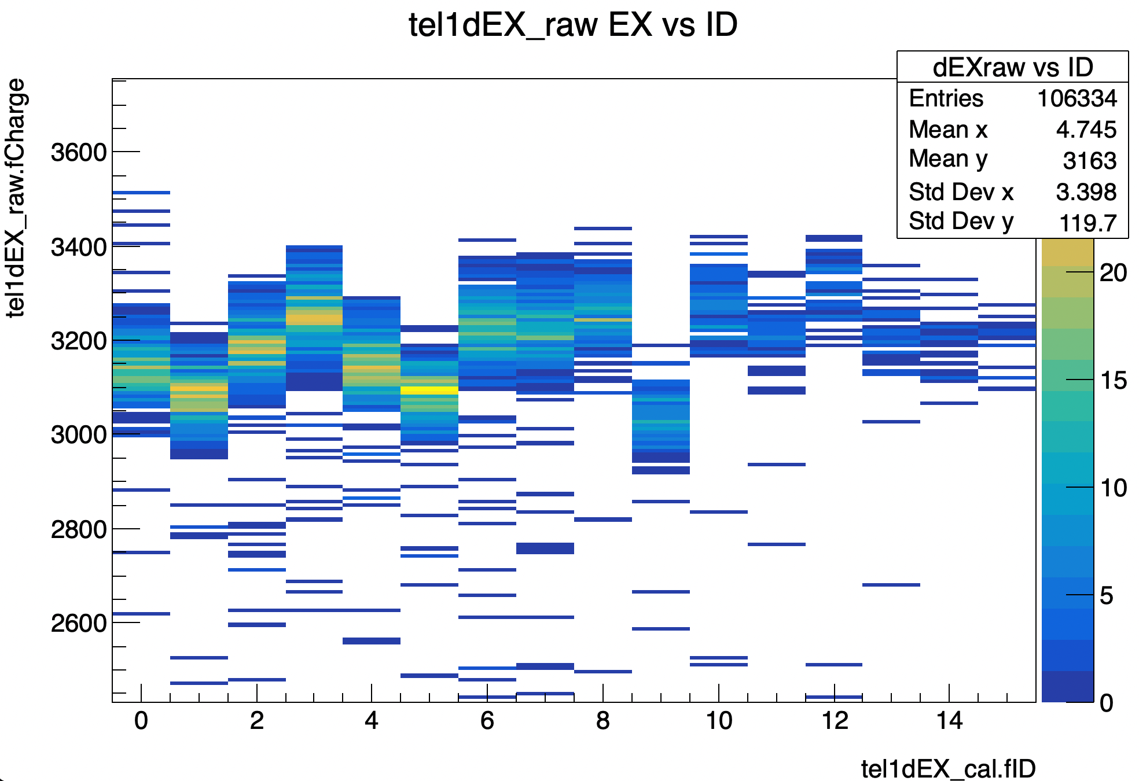
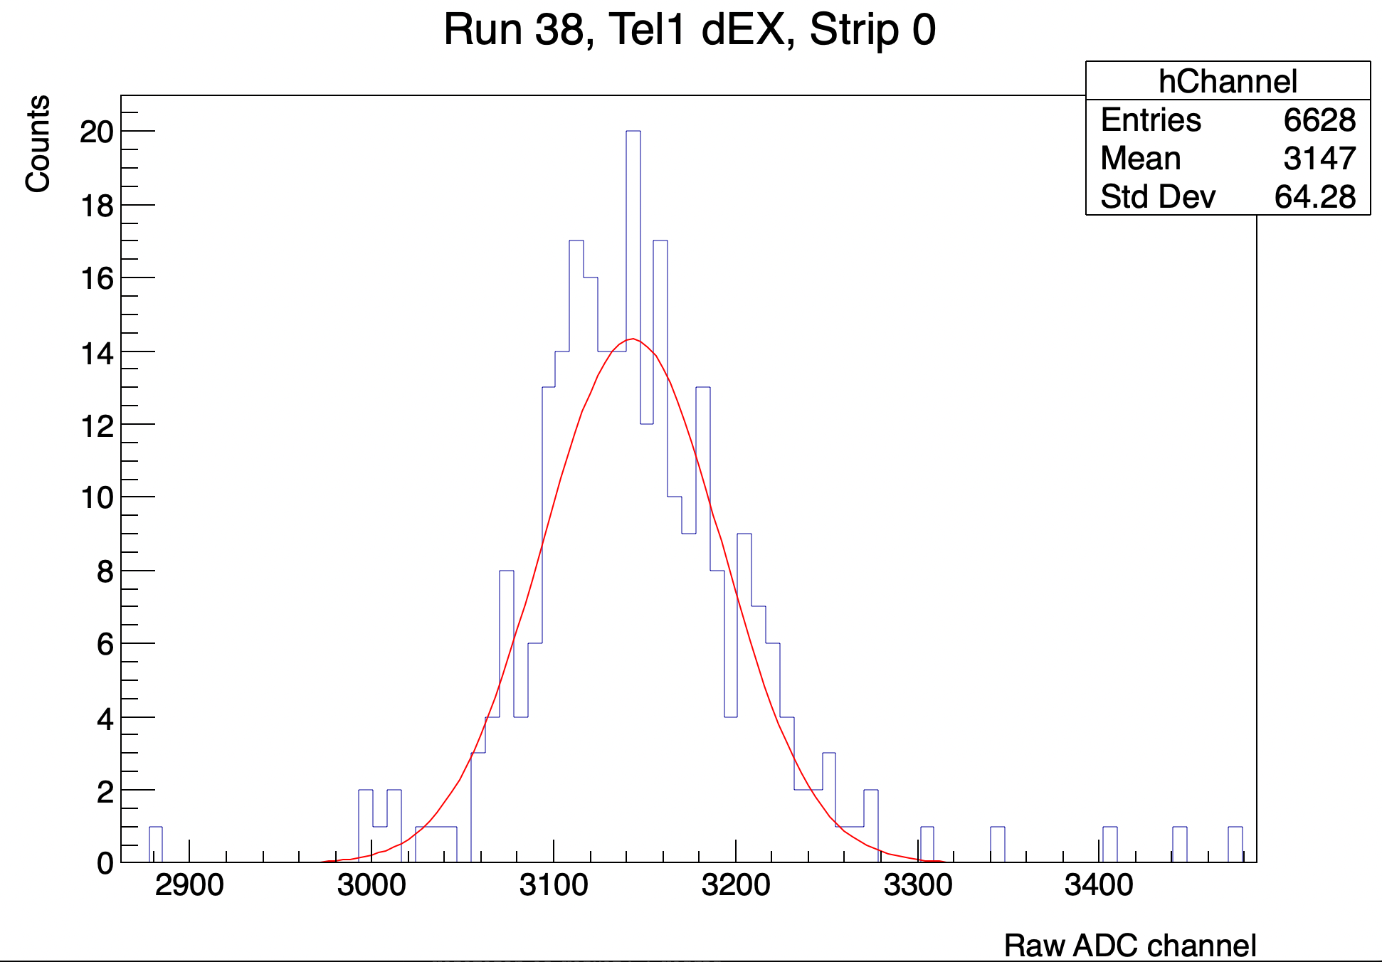
Variation in Detector Strip Response
Each strip has slightly different physical properties, so the same deposited energy can produce different electric charge readings
Each strip is calibrated separately using the fitted peak centroid
This helps us get more accurate energies from the experiment data
9

Slide 10
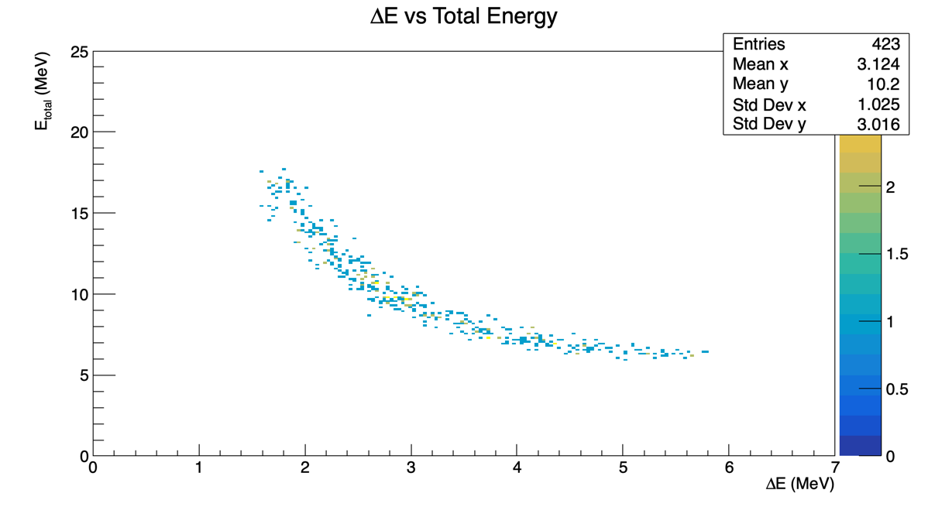
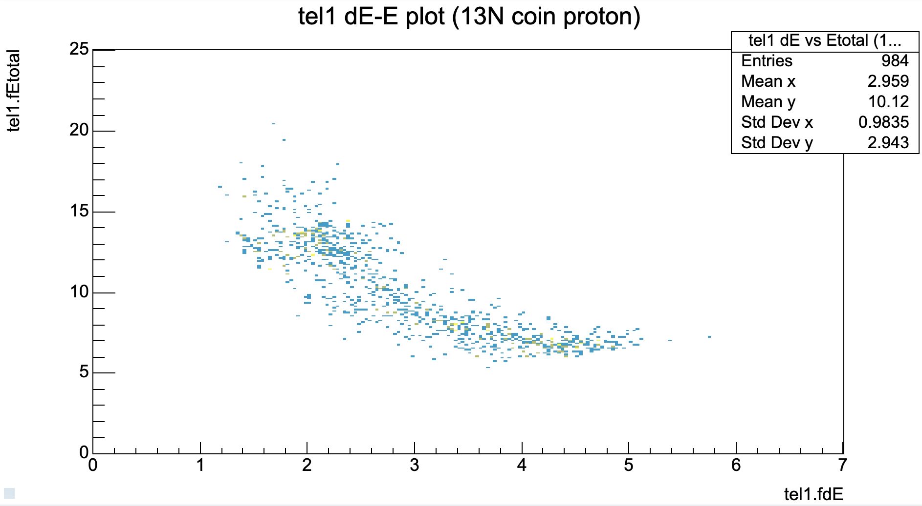
Comparing experimental data energies to simulations
Simulated energy results for one detector
Experiment energy results for one detector
We can also simulate and then compare other information such as how each telescope varies from the others in which protons get detected, the excited states of the corresponding ¹⁶O isotopes, etc.
10

Slide 11
Next steps:
Continue analyzing the experimental data
Determine the reaction rate more accurately
Estimate the uncertainty in this improved reaction rate

Slide 12
Thank you for listening!

