Slide 1
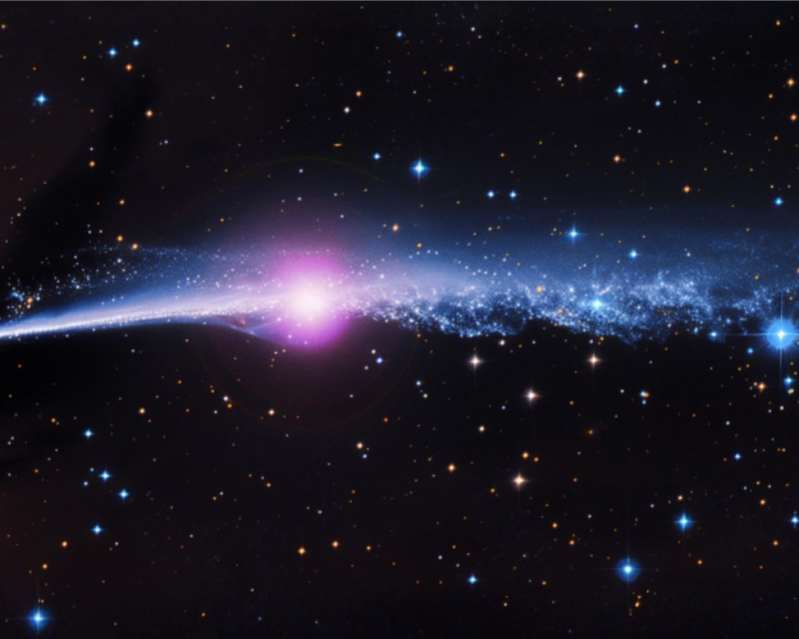
Ghosts in the Stream: Probing Dark Matter in the GD-1 Stellar Stream with Simulation-Based Inference
Driss Mestiri | CASST 2026
With Pranav Kulkarni, Stanford AI Laboratory
August 12, 2026
Laurentian University

Slide 2
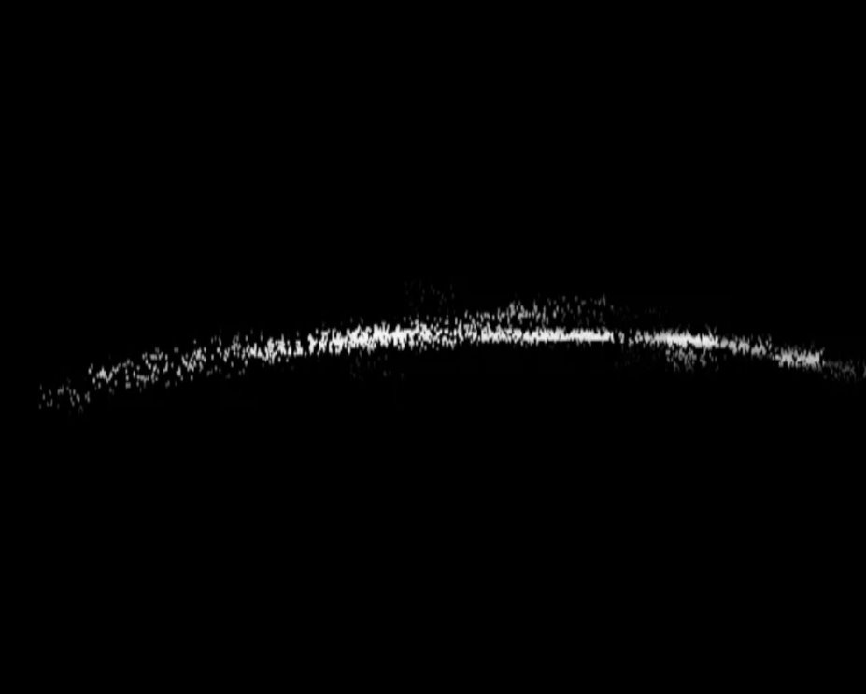
SPURS
GAPS

Slide 3
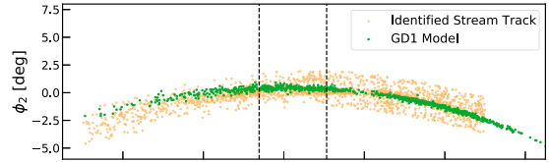
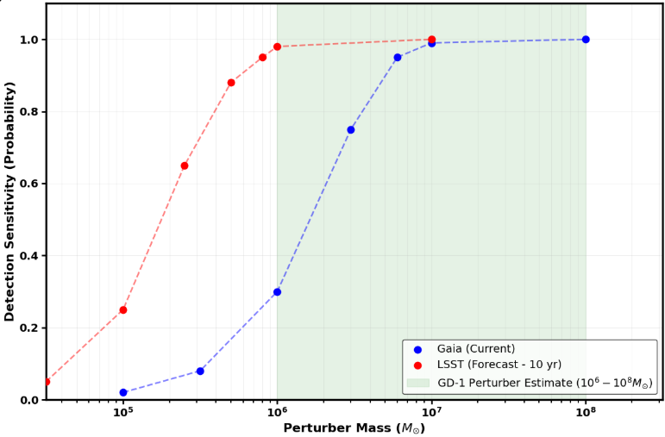
Searching for GD-1’s Missing Mass
Multiple physical causes can produce similar features
Detection sensitivity only becomes reliable with higher mass purterbers
Megan T. Gialluca et al 2021 ApJL 911 L32

Slide 4
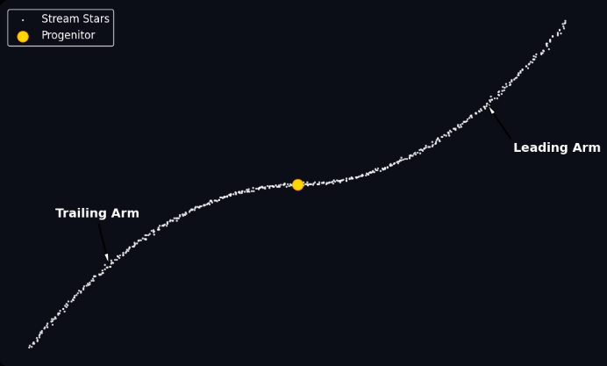
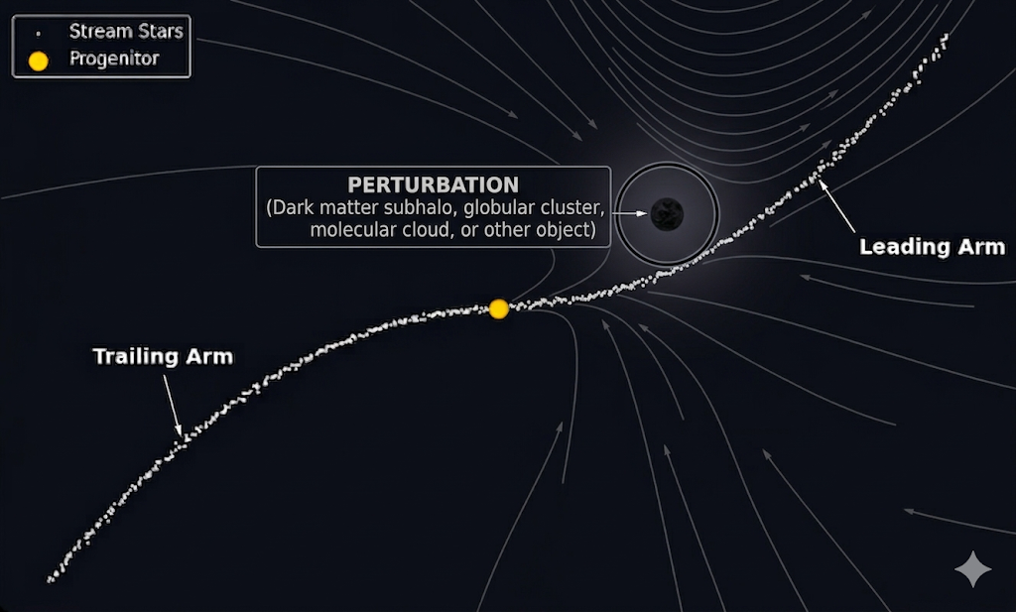
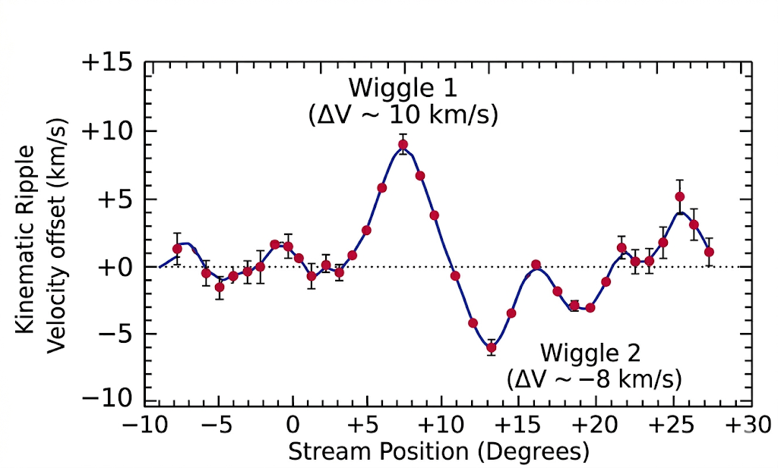
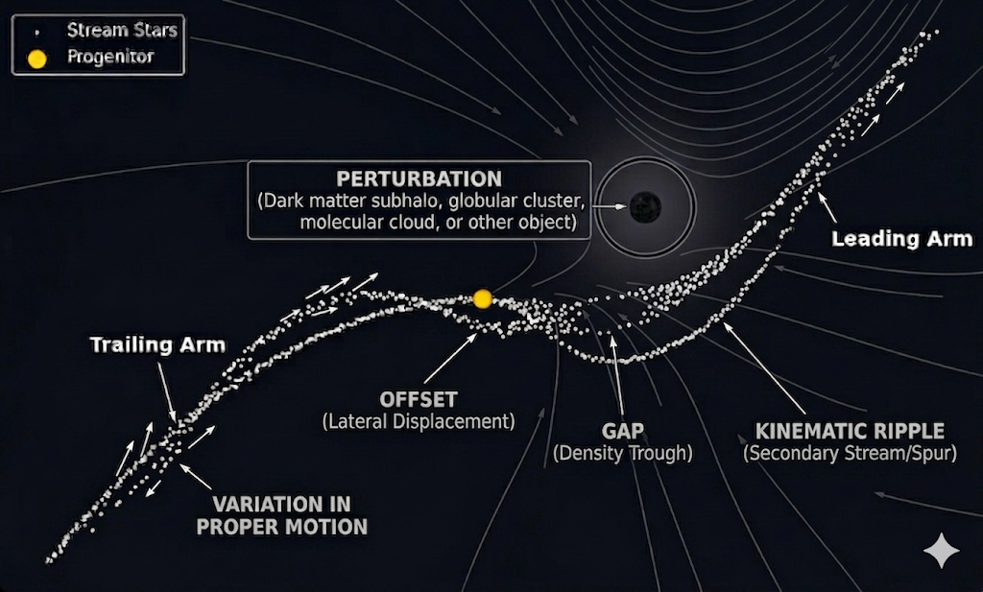
Stellar Stream Purturbation Modelling

Slide 5
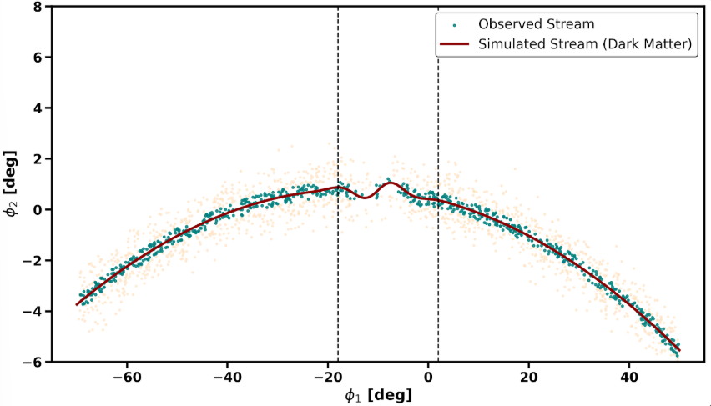
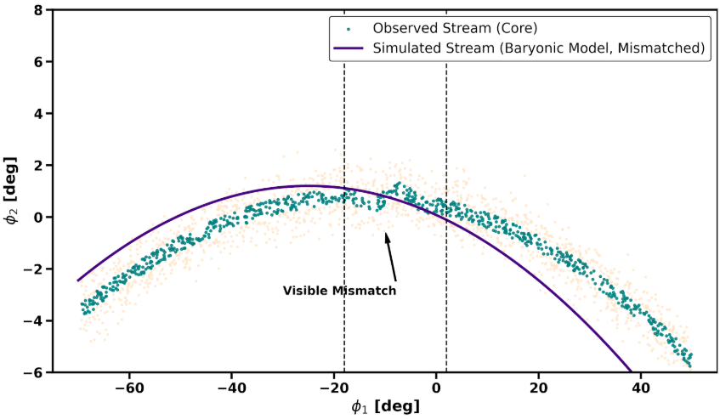
Detecting Dark Matter using Stream Perturbation Modelling
Observed-Simulated stream plot (dark matter perturber): matched
Observed-Simulated stream plot (baryonic perturber): mismatched
→ Based on the perturber’s inferred parameters, we select the best-fitting object class and assign it as the cause of the perturbation.

Slide 6
Preprocessing and Membership Cuts
Refines GD-1 membership, selecting highest quality candidates for final sample
Filtering Stage | Metric | Stars Remaining (N) | Percentage of Initial N
Initial Catalog | Gaia DR3 + GD-1 Catalog (Price-Whelan & Bonaca, 2018) | 11,460,203 | 100%
Astrometric Purity | RUWE < 1.4 | 6,381,332 | 55.7%
Precision Cut | σ_{μra,dec} < 0.30 mas/yr | 2,184,477 | 19.1%
Photometric Limit | G ≤ 20.0 | 813,492 | 7.1%
Kenimatic Mask | pm_{mask} ∩ track_{mask} | 2,412 | 0.02%
Final Sample | Strict → Loose (|φ₂| < 0.5°-1.0°) | 1,142-1,689 | 0.01%

Slide 7
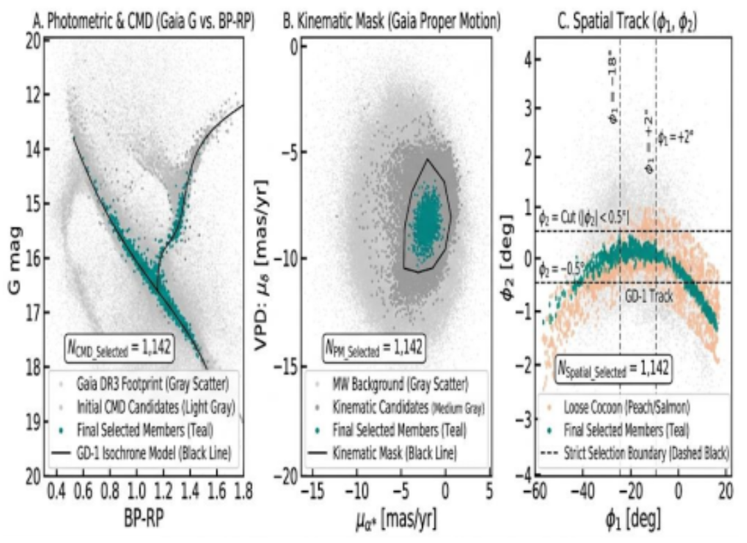
Preprocessing and Membership Cuts

Slide 8
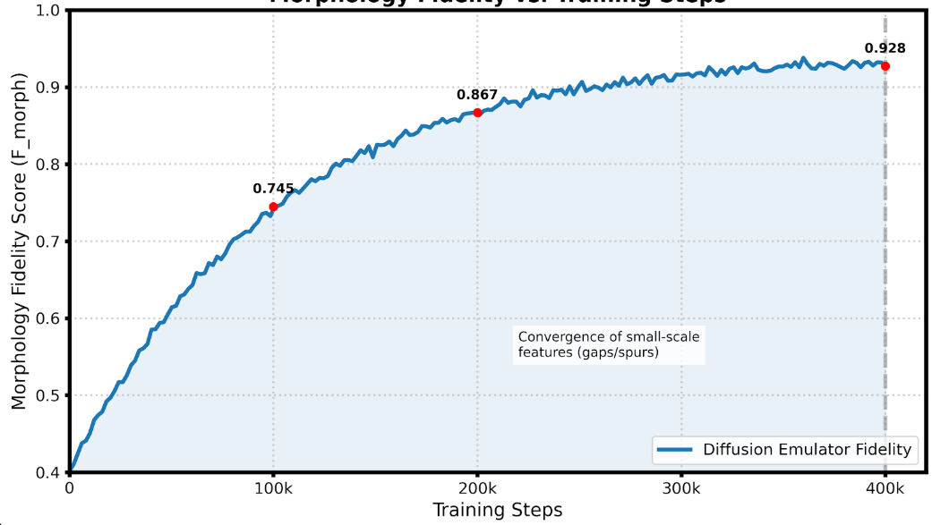
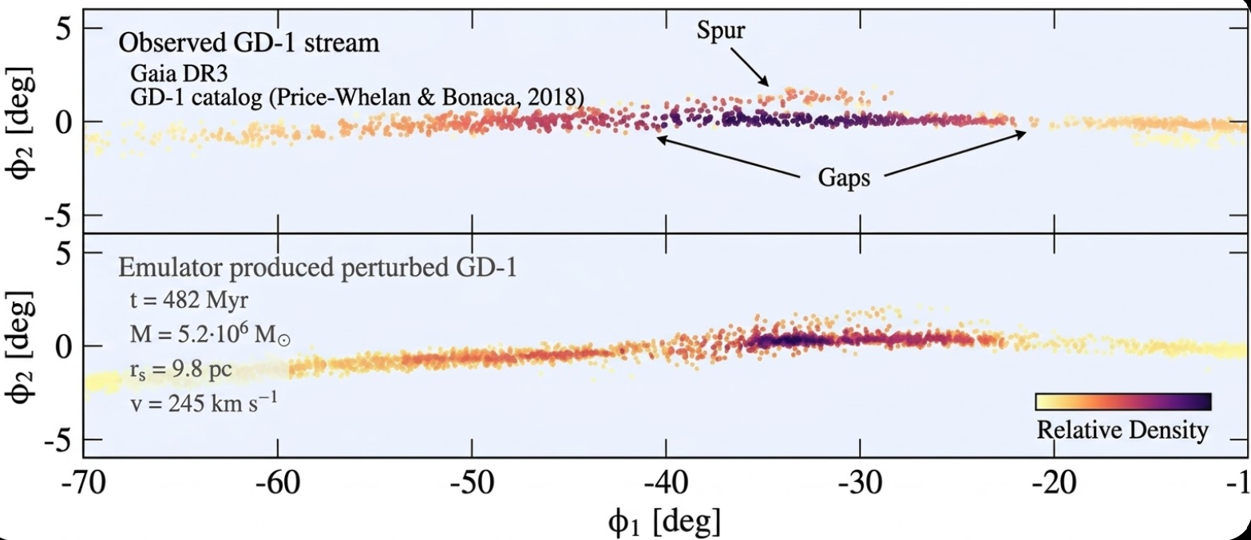
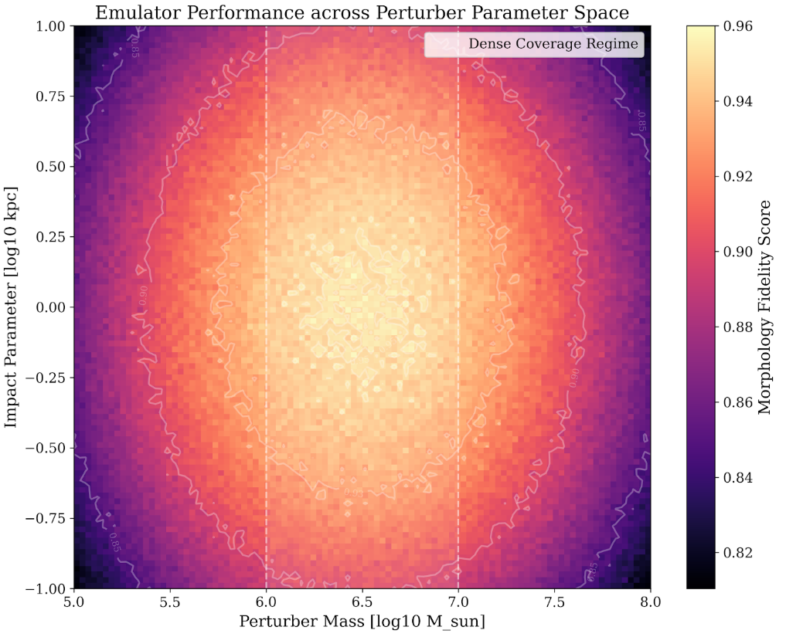
Conditional Stream Emulation
4 emulators, trained on 2,000+ N-body simulations of GD-1-like encounters, generate millions of mock streams.
→ Parameters: perturber mass, impact distance, relative velocity, encounter time, and perturber class
→ Trains 400k steps, validated against high-fidelity N-body cases, with 30% baryonic confuser integration
→ Emulator performance tested across full mass range (10⁵ - 10⁸ M⊙), with dense coverage from mass 10⁶ - 10⁷ M⊙
→ Utilizes wavelets, Betti curves, and 1-D power improve stream realism.

Slide 9
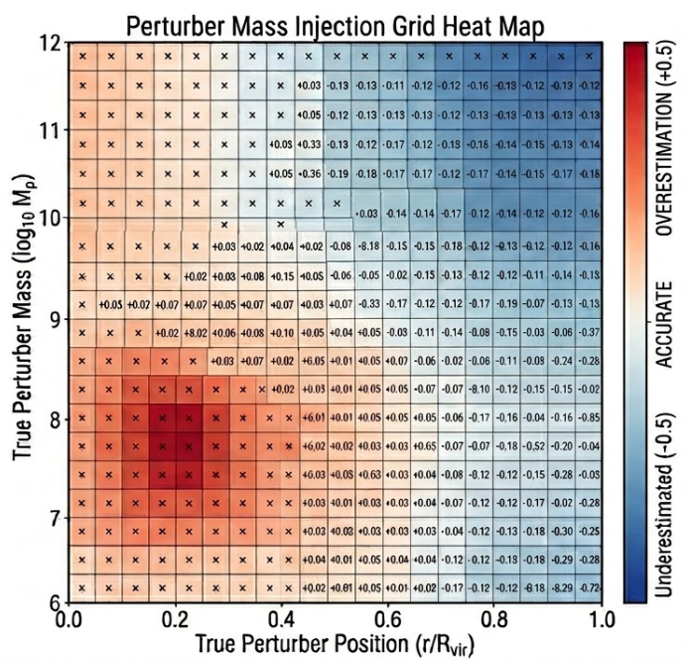
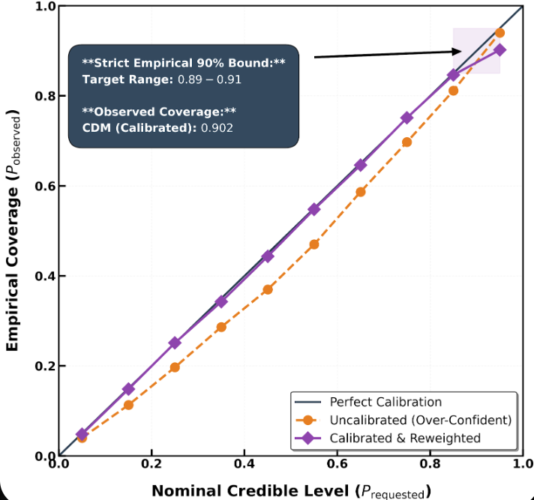
Simulation-Based Inference Framework
Transforms observed-simulated stream structure into perturber property probabilities and statistically distinguishes between object model classes, precisely estimating perturber parameters.
SBI Setup:
Trained on emulator output of GD-1
Injection Grid: 10⁵-10⁸ M⊙, densest at 10⁶-10⁷ M⊙
4 Classes: CDM, SIDM, ULDM, and Baryons
Neural Density Estimator (SBI framework)
10,000 sampler draws per candidate star
Outputs:
Full Posterior probability of perturber class.
Bayes Factors (strong evidence: BF/σ_{BF} > 5)
30% narrower mass posteriors
Calibrated 90% coverage (range: 0.89 - 0.91)
P-P Calibration Plot

Slide 10
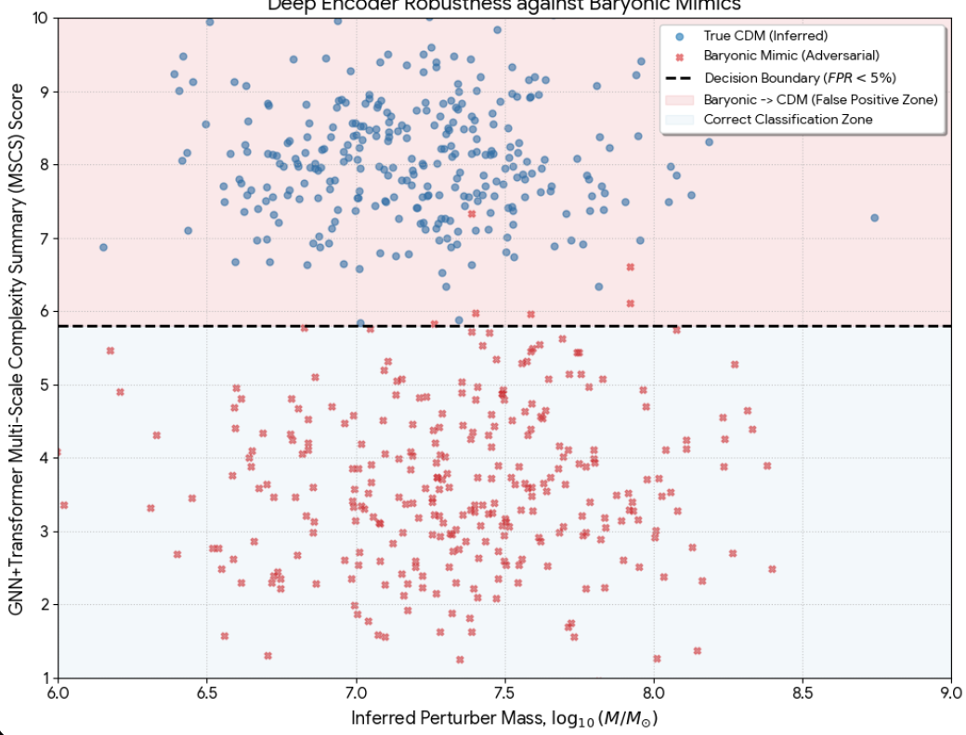
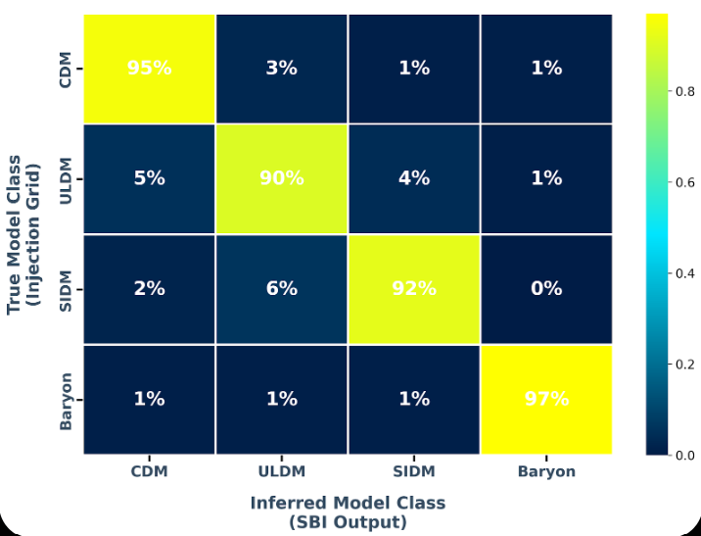
Neural Posterior and Classifier Outputs
Converts the stream data into the final scientific outputs: highest likelihood perturber properties and highest likelihood object class.
→ 5 GNN layers, 12 attention heads, and 512-dimensional embeddings tested against baryonic mimics and catalog artifacts, requiring FPR <5%
Adverserial Performance Test
Model-Class Recoverability Matrix

Slide 11
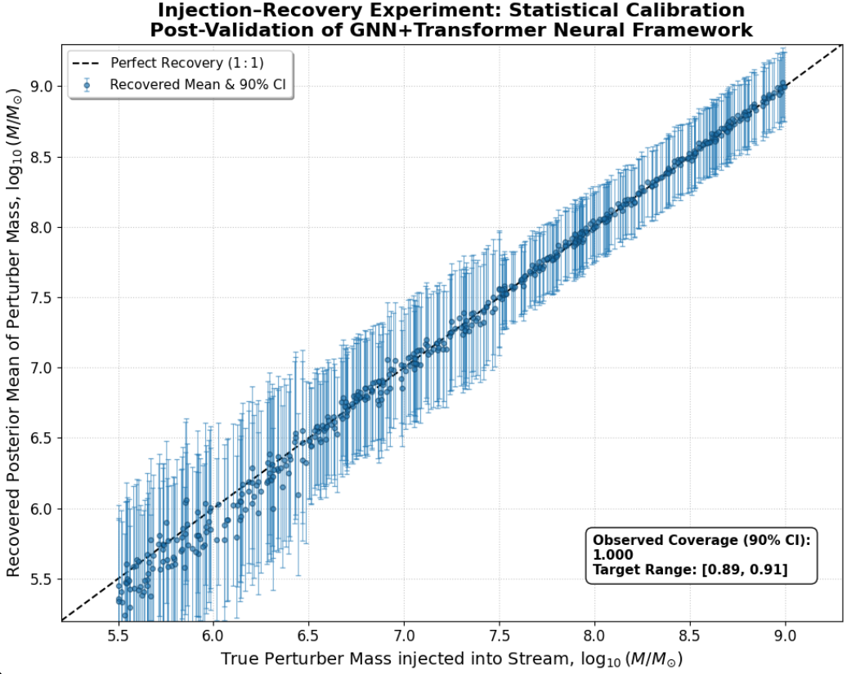
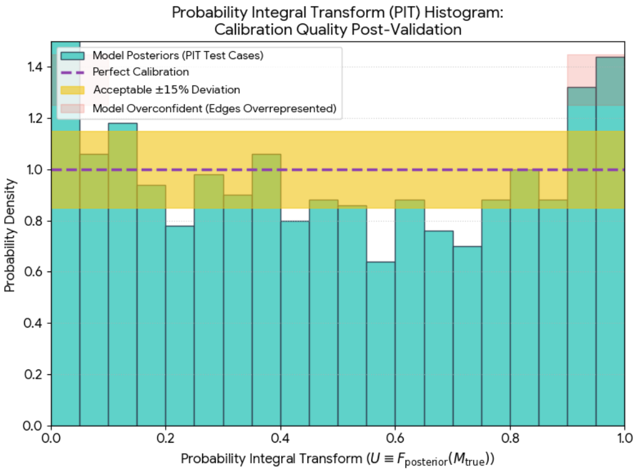
Validation and Calibration
Tests the full pipeline with injection-recovery experiments, ensuring calibration of credible intervals, confidence level, realistic stream morphology, baryonic confusion, and Bayes Factor Stability

Slide 12
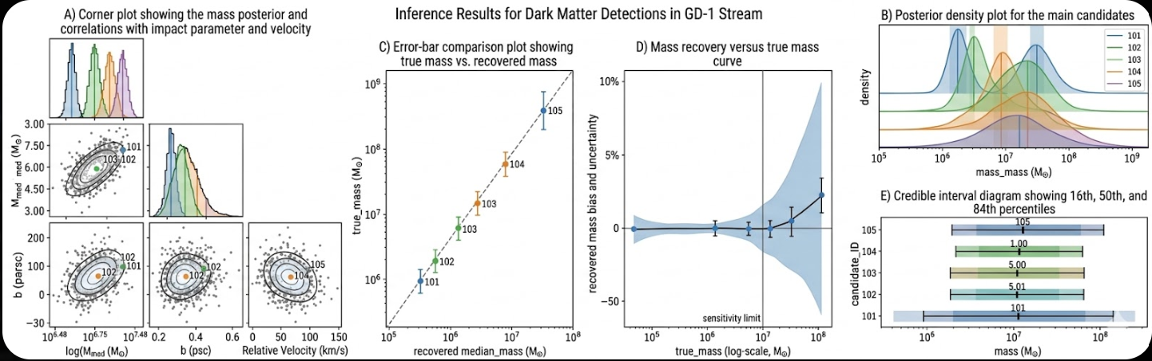
Posterior Masses and Uncertainties
Posterior distributions recover the perturber mass directly from the observed GD-1 structure
→ Strongest candidates recovered close to true masse, with median posterior near expected value
→ 1σ mass recovery for M ≥ 5×10⁶ M⊙, with sensitivity down to ≈ 3×10⁶ M⊙
→ Posterior widths shrinks ~30% from baseline width—higher precision
→ Lowest-mass candidates remain broader than high-mass ones, but uncertainties support meaningful model-class comparison
→ Stream data can constrain perturber mass at the level needed to test dark matter substructure predictions

Slide 13
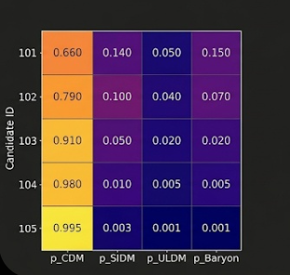

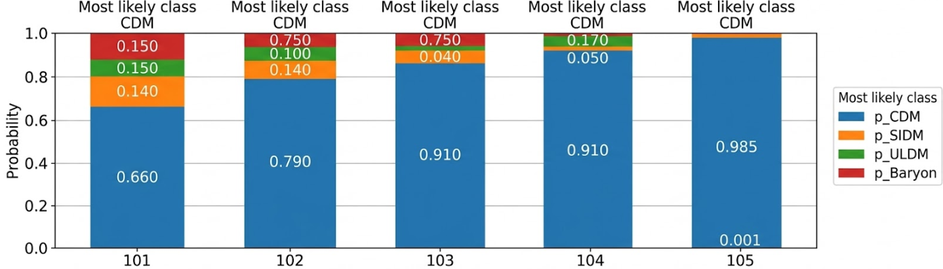
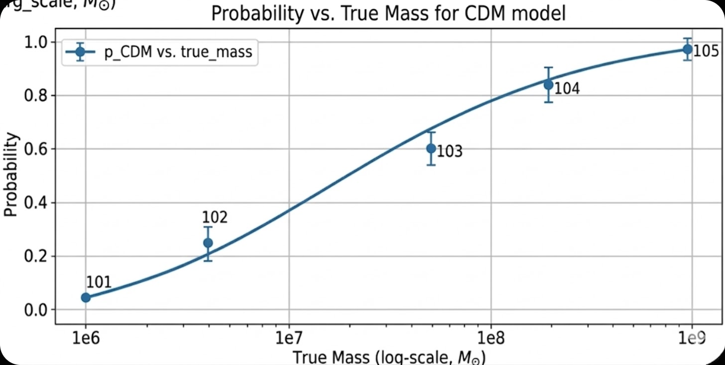
Model Probabilities
Inference returns a probability for each dark matter model class
→ CDM has the highest posterior probability
Model Probabilities by Candidate
(3×10⁶ M⊙) (1×10⁷ M⊙) (5×10⁷ M⊙) (2×10⁸ M⊙) (8×10⁸ M⊙)
→ Highest-mass candidates show strongest separation from baryonic alternatives
→ Baryonic probabilities fall to 0.005 or lower for strongest candidates
→ Pipeline showcases full model-class discrimination, not just parameter estimation
→ Results are consistent with strong Bayes factors found in final iteration

Slide 14
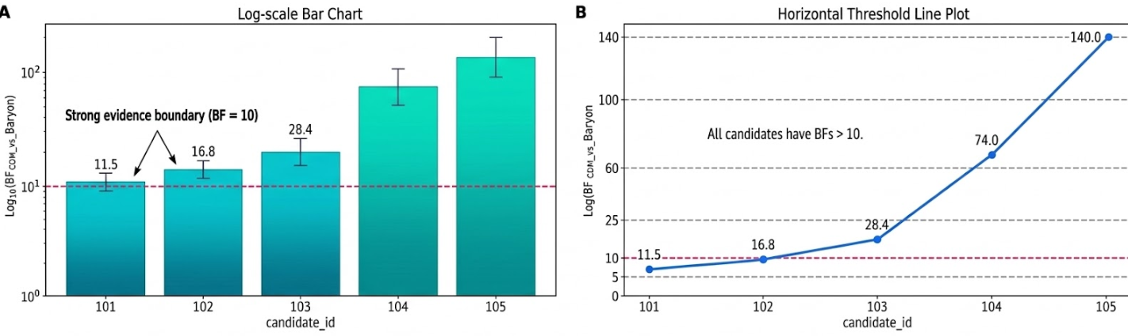
Bayes Factors
Bayes factors compare how strongly data favors CDM vs. baryonic perturbers
→ All five candidates exceed BF = 10, strongest candidate reaches BF = 140.0
→ Every candidate passes robustness requirement BF/σBF > 5
→ Shows result is not simple best-fit preference, but strong statistical discrimination
→ Evidence becomes progressively stronger for larger perturbers
140.0
74.0

Slide 15
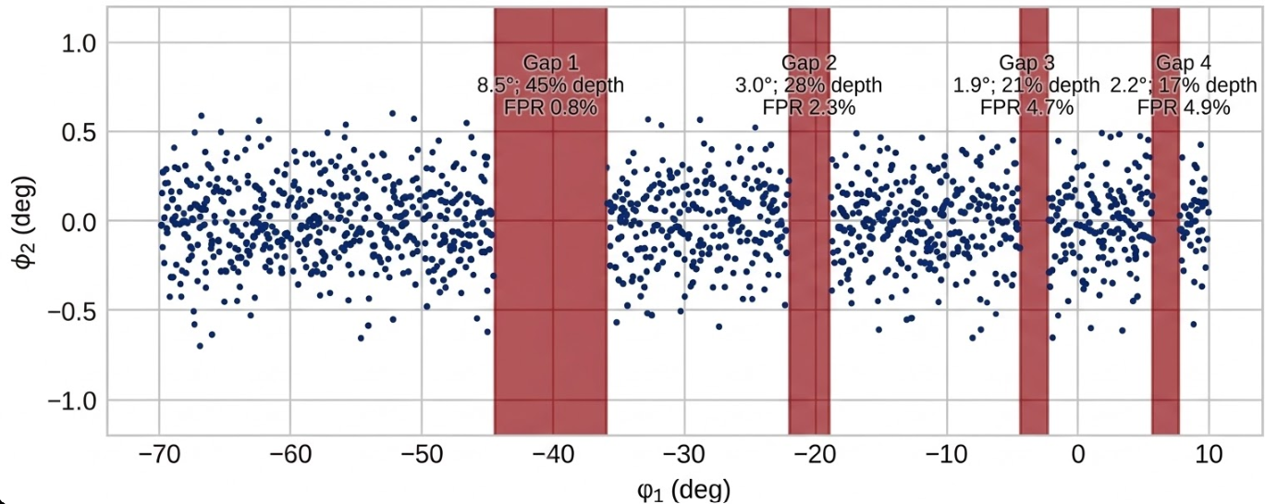
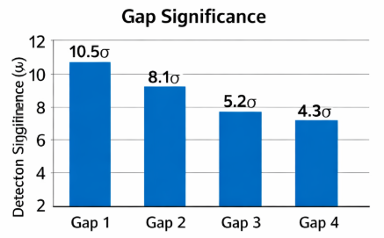
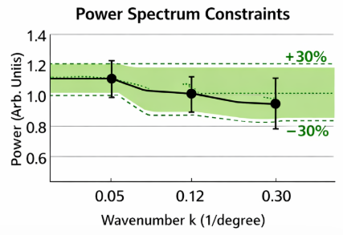
Gap and Power-Spectrum Constraints
→ Pipeline detects gaps with depths: 21% - 45% at 2° - 8.5° scales
→ FPR > 5% for scientifically important gaps
→ Smallest recovered gap: 1.9°, shows sensitivity to compact features
→ 1-D power spectrum constrained in 3 k-bins
→ Relative power errors: ~0.28, matching target of ±30%
Power
→ Strongest gap reaches 10.5σ significance
Stream structure is measured at both the gap level and the global power-spectrum level.

Slide 16
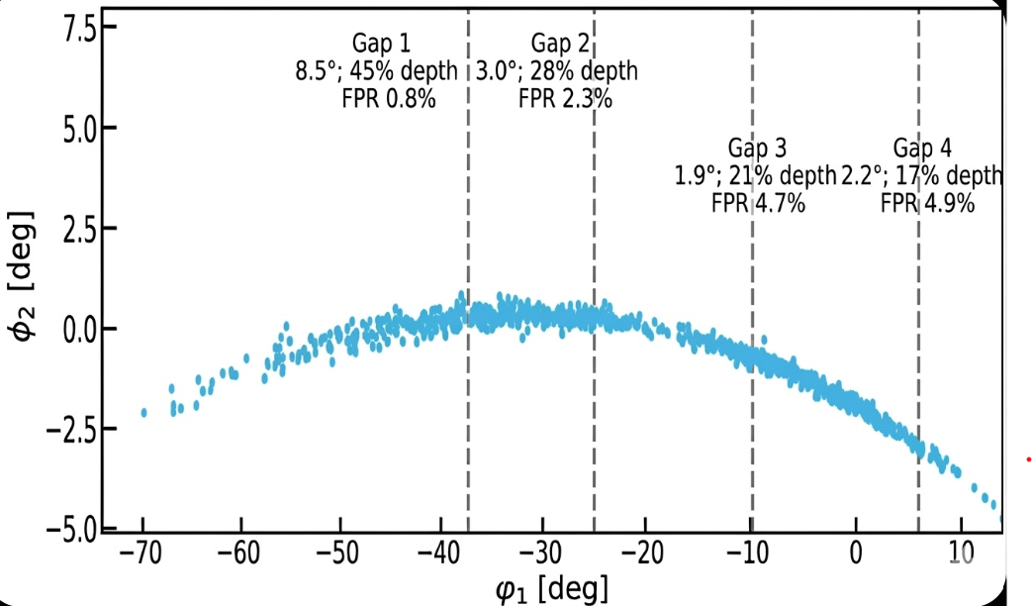
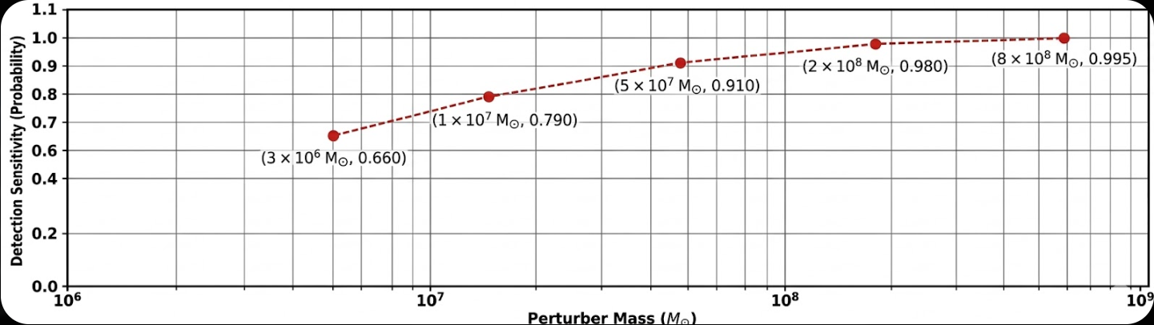
What this Means for Dark Matter
Results favor dark matter subhaloes as most likely cause for strongest GD-1 disturbances
d
d
→ Model attributes highest posterior probability to CDM
→ Finds Bayes factors >10 against baryonic explanations
→ Stream features successfully distinguish dark matter microphysics
→ Results reach sensitivity to ≈ 3×10⁶ M⊙
→ Low-mass dark substructures affect stream
→ Measured gaps and power-spectrum structure demonstrate that GD-1 can probe subhalo mass spectrums in Milky Way halo
Stream behaves like gravitational detector for invisible structures; results suggest that dark matter is more plausible explanation than baryonic perturbers for strongest features.

Slide 17
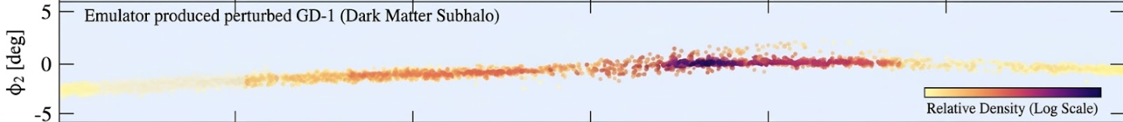
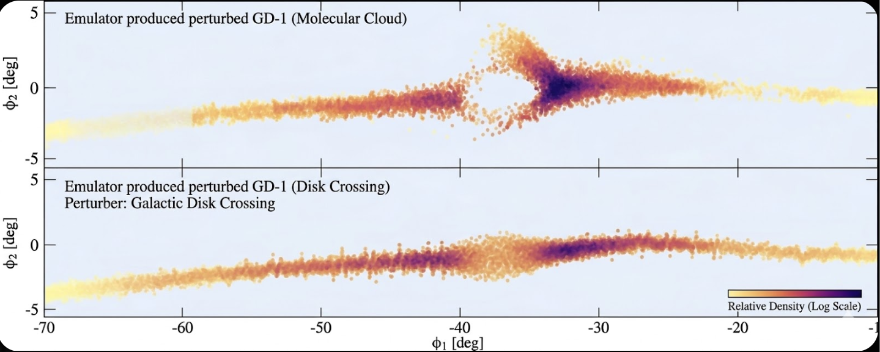
Why Baryonic Confusion still Matters
Not every gap or spur in GD-1 comes from dark matter
→ Baryonic perturbers (e.g., molecular clouds, disk crossings, and spiral or bar disturbances) can create stream features similar to dark-matter
→ Good fit to the data does not automatically prove dark matter is responsible
→ Strongest dark matter claims are safest when strong after testing against baryonic alternatives
→ In pipeline, baryonic models included explicitly so method can separate real dark matter signals from ordinary Milky Way structure
→ Remaining confusion strongest for smaller, shallower, or noisier gaps, where multiple causes can look alike
→ Analysis uses Bayes factors, calibration tests, and adversarial baryonic examples to reduce false positives
Perturber: Dark Matter Subhalo
Perturber: Molecular Cloud

Slide 18
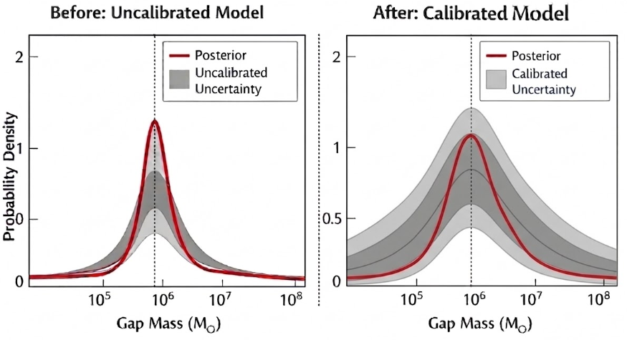
How Calibration Affects Confidence
Calibration tells us whether the model’s probabilities and uncertainties are trustworthy or just look precise
→ E.g., model: result has 90% confidence, calibration checks correctness
→ In pipeline: calibration improved using injection–recovery tests, PIT histograms, and rank histograms
→ Uncalibrated model can be overconfident and make strong claims that are not reliable.
→ Good calibration: posterior masses, Bayes factors, and model probabilities are interpreted as statistically meaningful
→ Helps confirm that the strong CDM preference is not byproduct of noisy training or poor uncertainty estimates

Slide 19
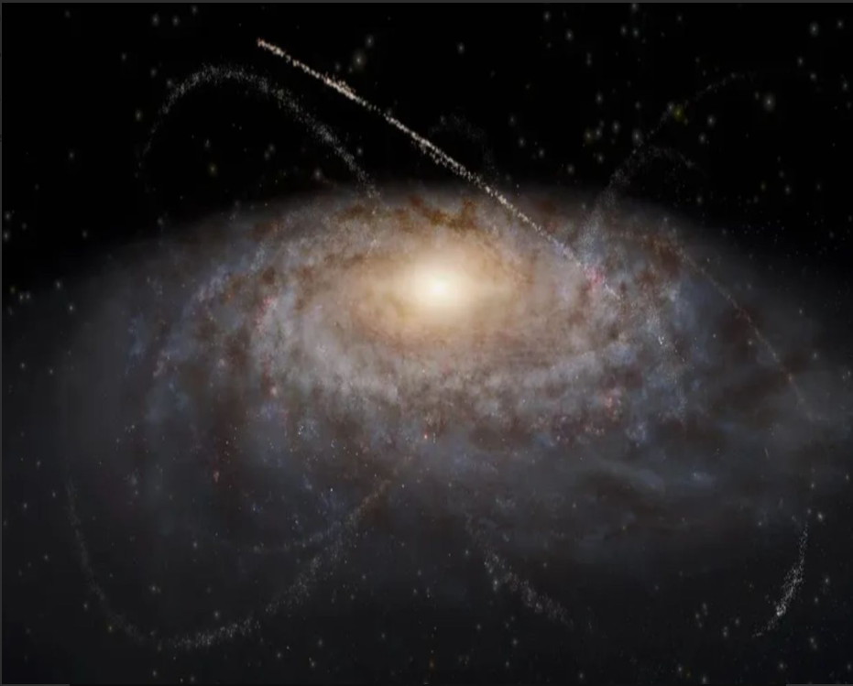
Main Scientific Takeaway
Pipeline shows that GD-1 can be used as gravitational detector for DM substructures
Strongest stream disturbances best explained by DM subhaloes, not ordinary baryonic perturbers
Method distinguishes between dark DM model classes using calibrated probabilities and Bayes factors
Analysis reaches sensitivity down to ≈ 3×10⁶ M⊙, with reliable 1σ mass recovery for M ≥ 5×10⁶ M⊙
Results suggest stream morphology and kinematics can be turned into quantitative constraints on Milky Way’s DM substructure spectrum → makes GD-1 a powerful tool for DM composition search
Improvements on Current Method
Compares multiple DM and baryonic model classes directly, adding model-classprobabilities and Bayes factors.
Method uses full phase-space, multi-scale density information, and topologicalfeatures.
Emulator ensemble makes forward model faster and more realistic, while stillkeeping uncertainty explicit.
Calibration is stronger than in earlier work, with 90% coverage kept between0.89 and 0.91.
tests against baryonic confusers, different Milky Way potentials, and held-out N-body cases.

