Slide 1
August 13, 2026
Letting 0νββ shine:​
How QA supports SNO+'s chemistry from backstage​
Osanna Wong
SNO+ Research Assistant ● Supervisor: Szymon Manecki

Slide 2
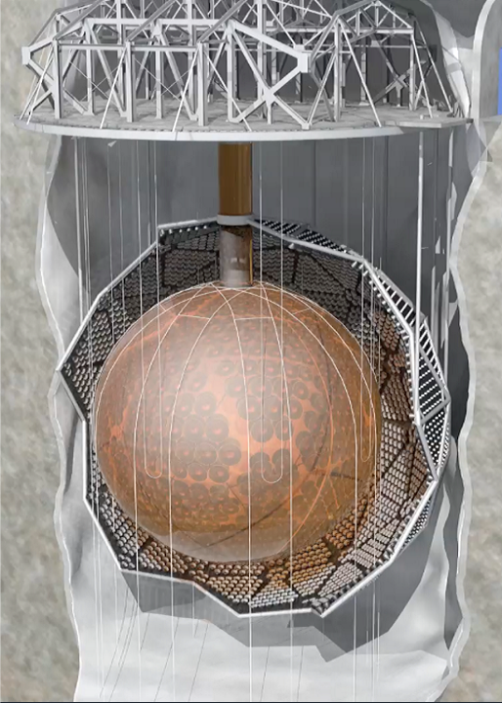
What is SNO+?
Neutrino experiment located 2km underground
In a cleanroom to reduce background radiation
Are neutrinos their own antiparticle?
Search for neutrinoless double beta decay

Slide 3
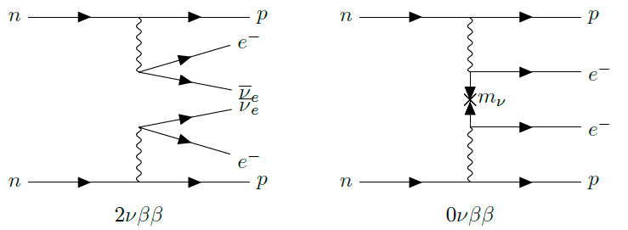
Double Beta Decay
Notes:
Less time

Slide 4
Double Beta Decay
^
Neutrinoless
Notes:
Less time

Slide 5
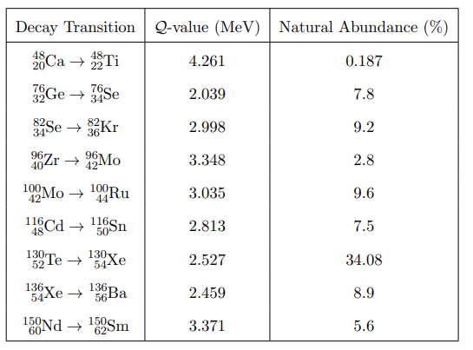
List of commonly considered candidates of 0νββ
Notes:
Long 2vbb half life to not overwhelm 0vbb signal
Lack of absorption lines near ones by scintillator

Slide 6

~9000 photomultiplier tubes →
Acrylic vessel
12m in diameter

Slide 7



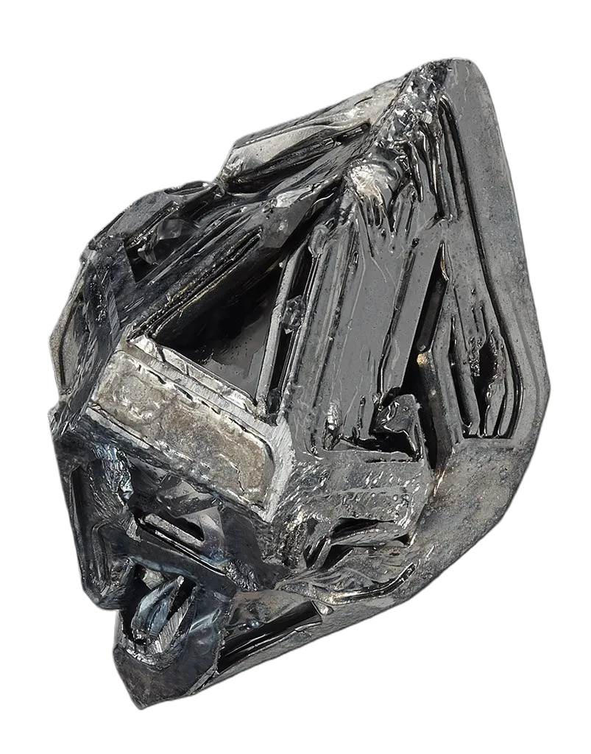
Notes:
- analogy

Slide 8
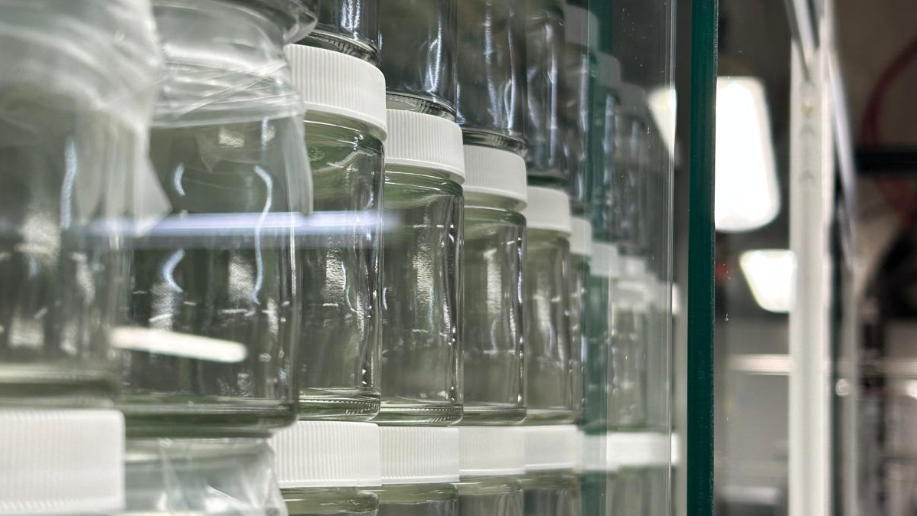

Scintillator:
The Microphone

Slide 9
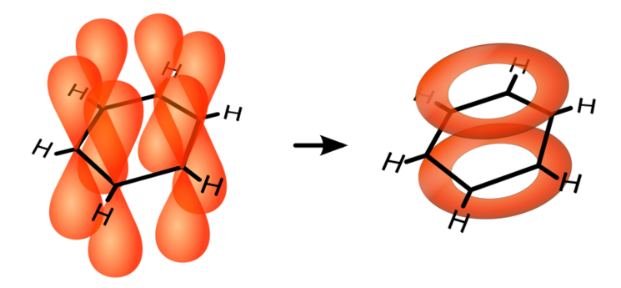
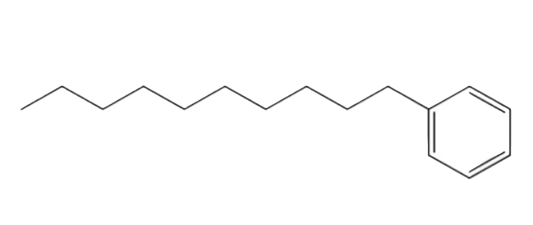
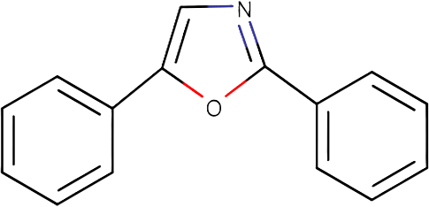
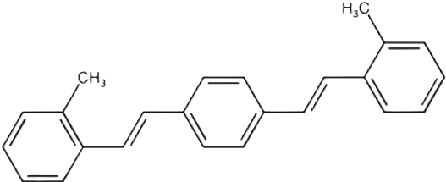
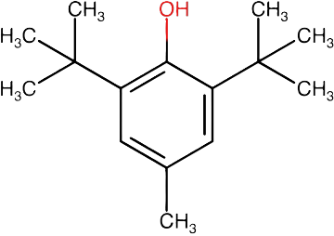
The Scintillator Recipe
780 tonnes Linear Alkylbenzene (LAB):
liquid scintillator solvent; emits UV light
2g/L 2,5-diphenyloxazole (PPO): primary fluor; converts UV to blue light
2mg/L 1,4-Bis(2-methylstyryl)benzene (bis-MSB): wavelength shifter; prevents reabsorption
6mg/L Butylated Hydroxytoluene (BHT): antioxidant
Notes:
Para-benzoquinone

Slide 10
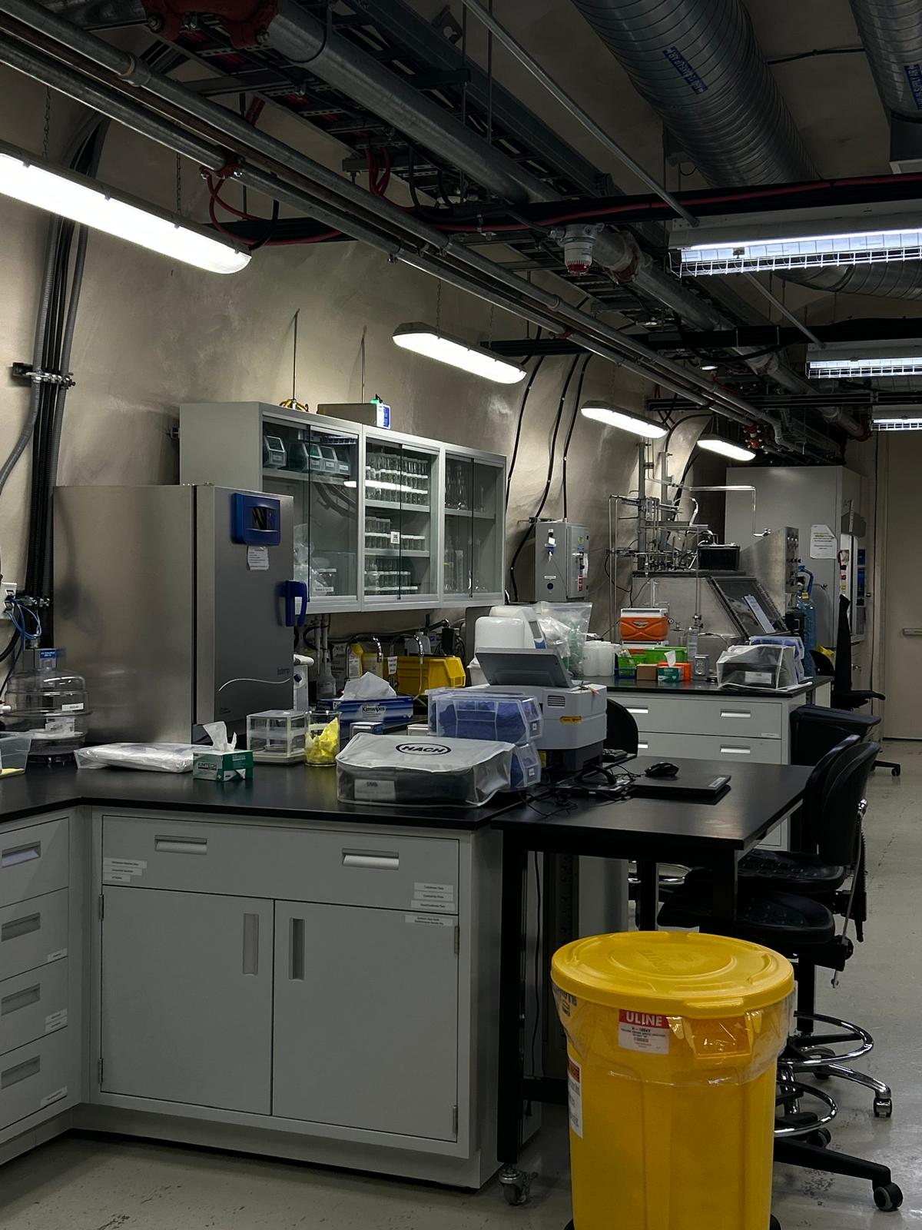
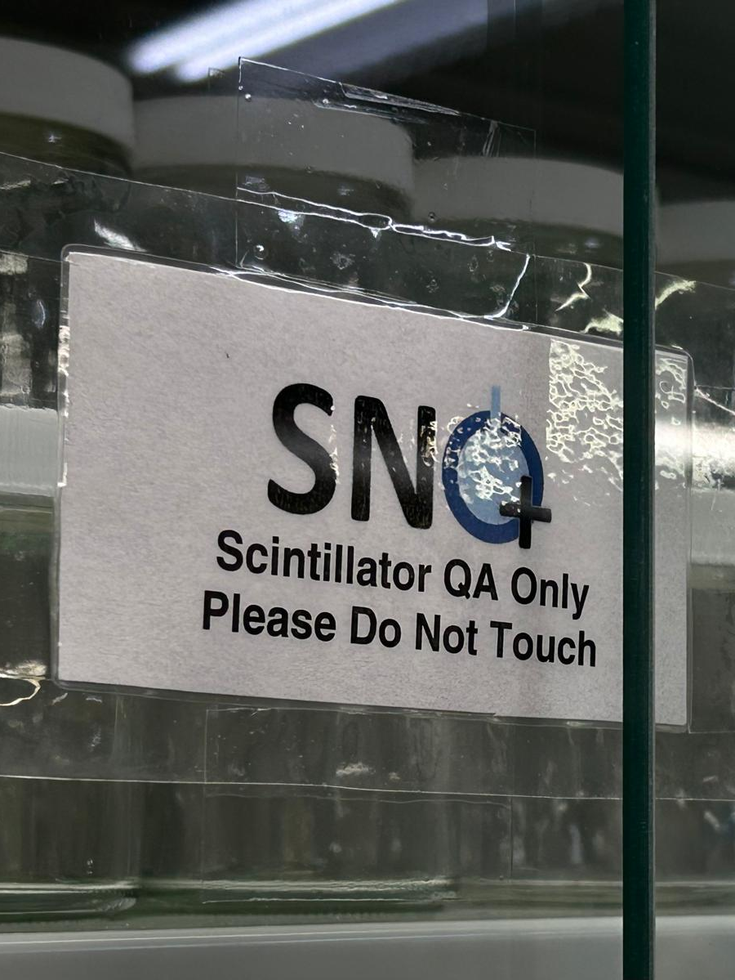
What does QA do?

Slide 11
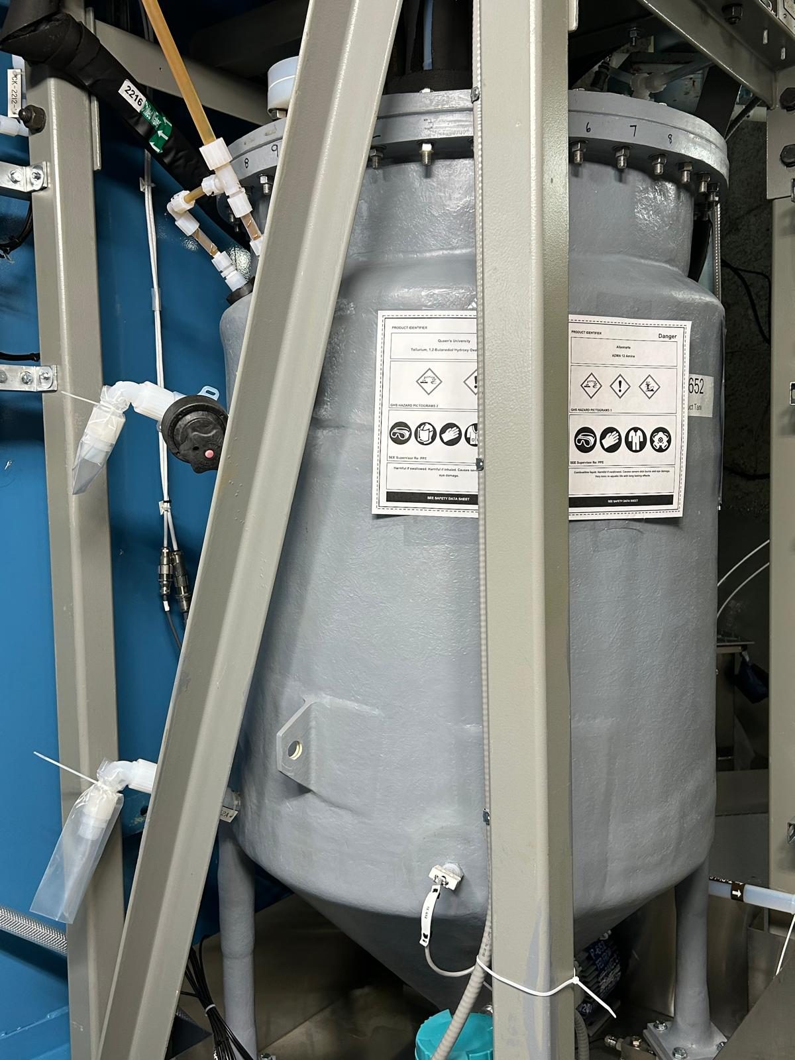
What does QA do?
Sampled from ports on tanks
Notes:
Circle the ports ☺

Slide 12
What does QA do?
Sampled from ports on tanks
Ran turbidity, density, and UV-Vis spectra measurements in chemistry lab
Tested for concentrations

Slide 13
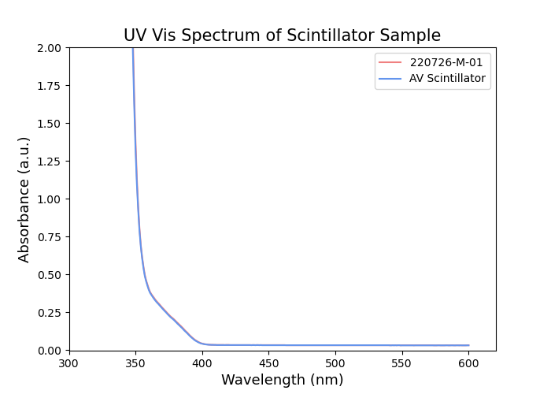
What does QA do?
UV-Vis Spectrum of scintillator sample from Product Tank

Slide 14
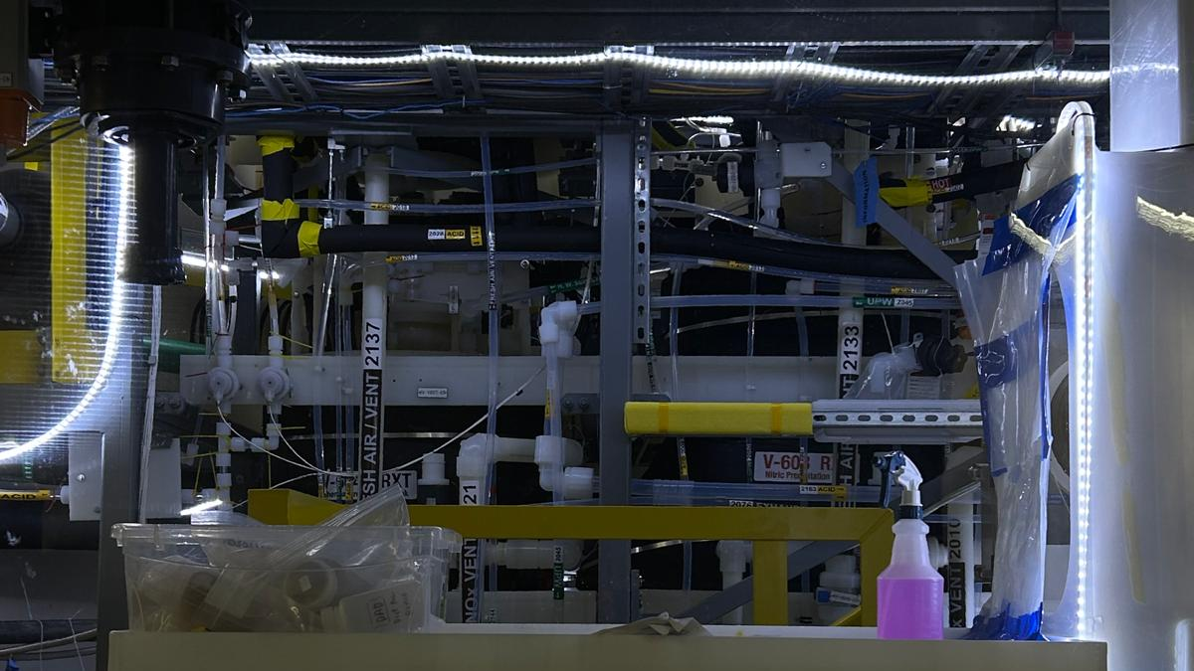
Tellurium:
The Performer

Slide 15
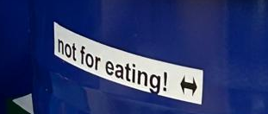
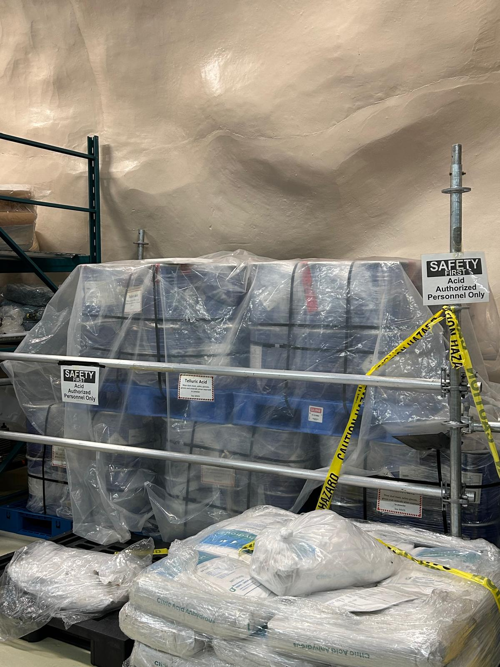
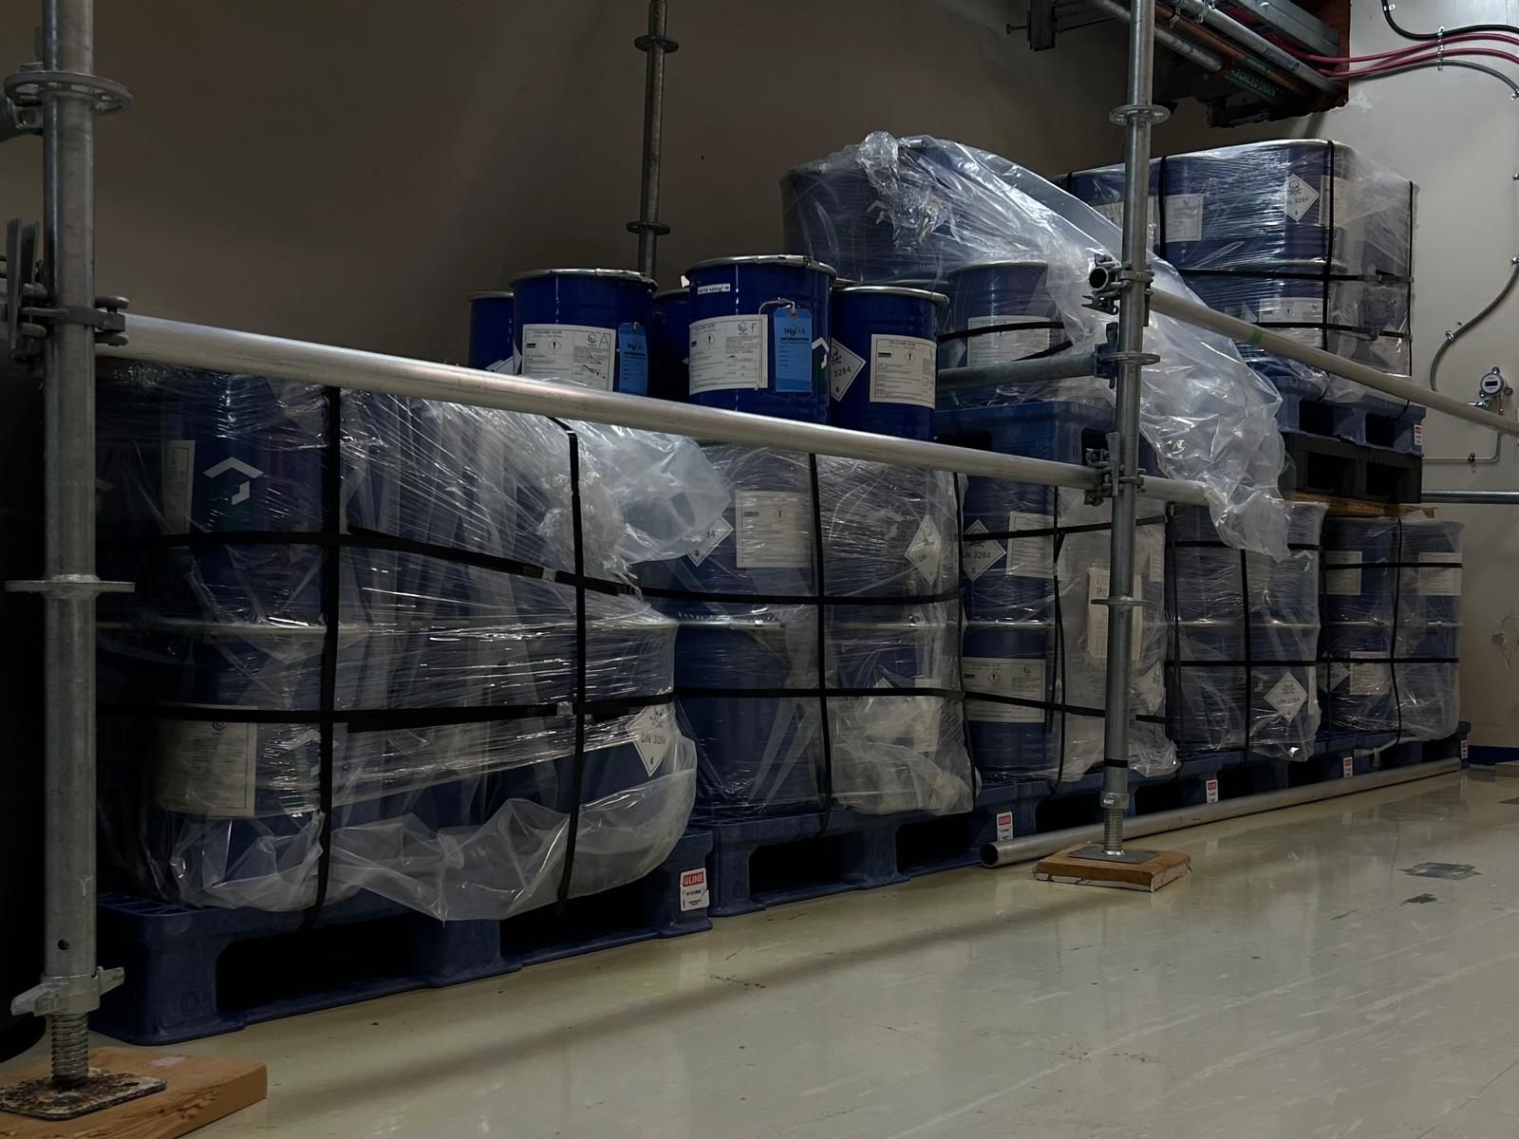
Telluric Acid (TeA)
8 tonnes of TeA stored underground!
Notes:
makeover

Slide 16
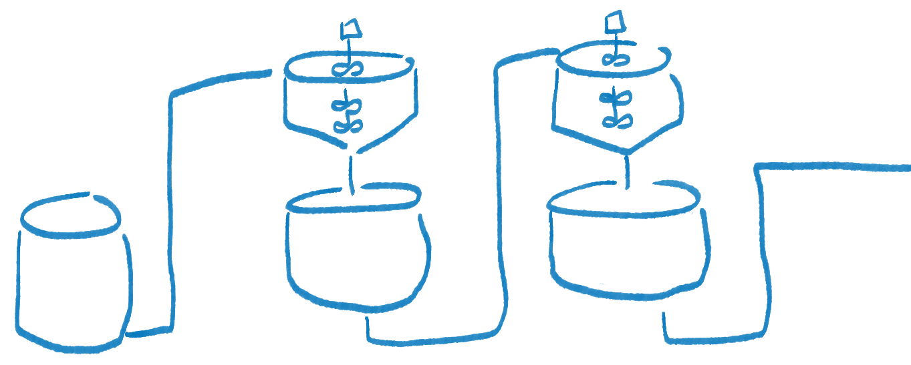
TeA Plant
Nitric Acid Recrystallization
Thermal Recrystallization
TeA + UPW →
Filter
Filter

Slide 17


Slide 18

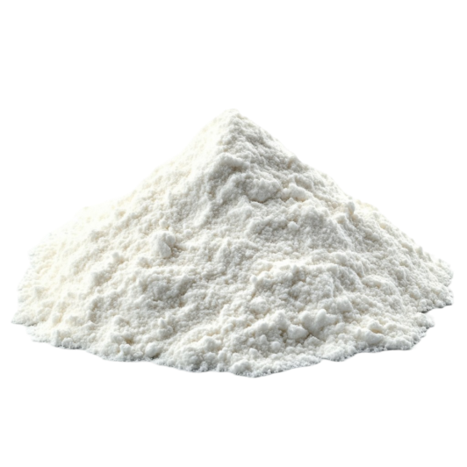

Slide 19
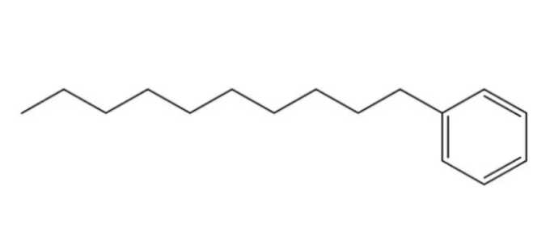

Slide 20
Notes:
Need to give performer outfit fit for the occasion

Slide 21
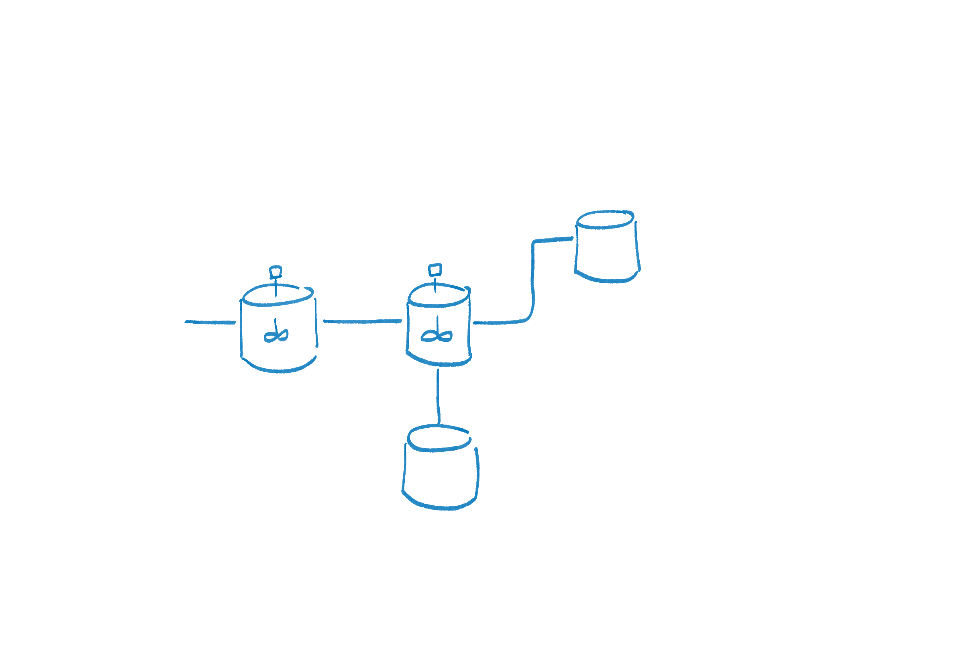
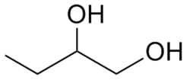
TeDiol Plant
Flash Chamber
Condensate Tank
Batch Tank:
153kg Purified TeA
153kg UPW
178kg Distilled BD
1,2-butanediol (BD)
Product Tank
Notes:
BD as an outfit for Te

Slide 22
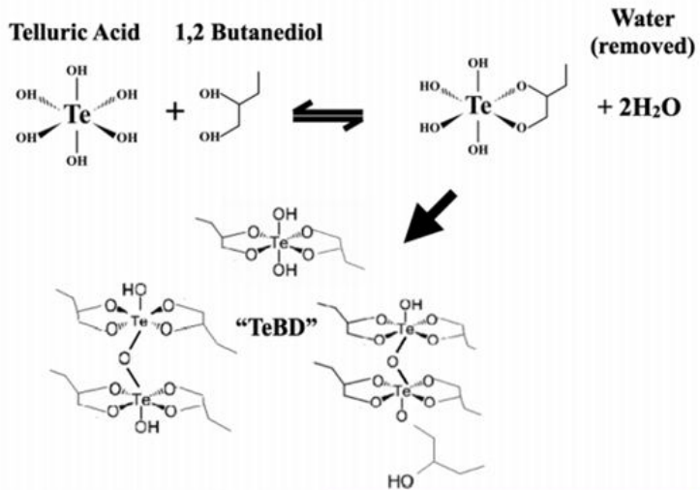
TeDiol Plant
Flash Chamber
Condensate Tank
Batch Tank:
153kg Purified TeA
153kg UPW
178kg Distilled BD
Product Tank

Slide 23
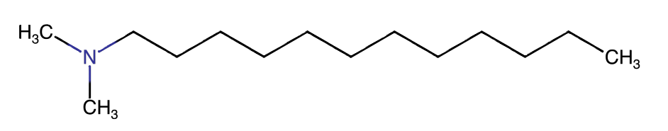
TeDiol Plant
Flash Chamber
Condensate Tank
Batch Tank:
153kg Purified TeA
153kg UPW
178kg Distilled BD
N,N-Dimethyldodecylamine (DDA): Stabilizing amine
Product Tank

Slide 24
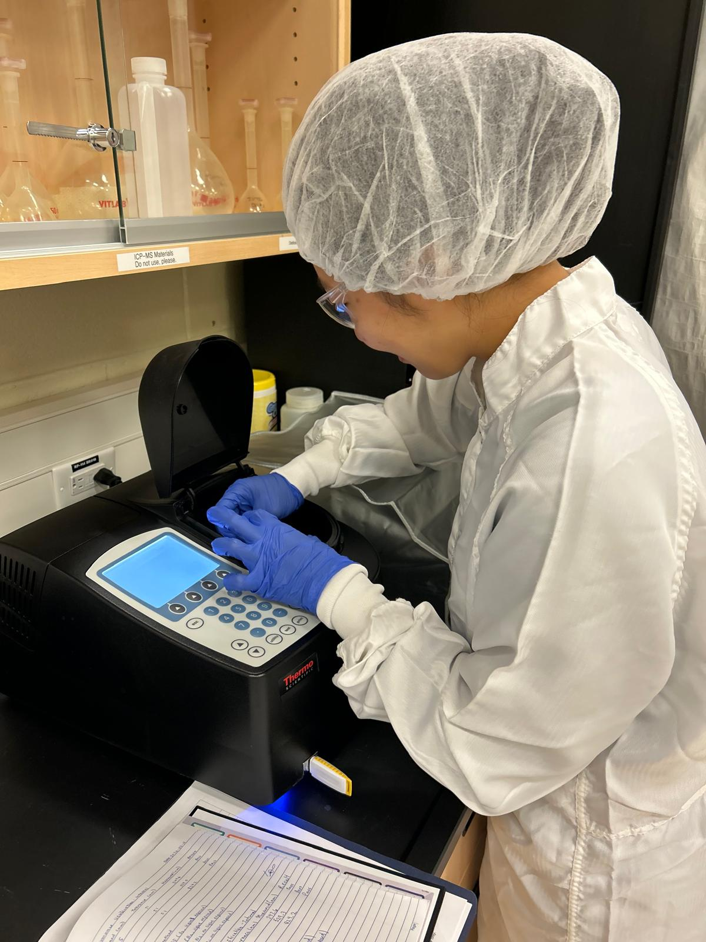
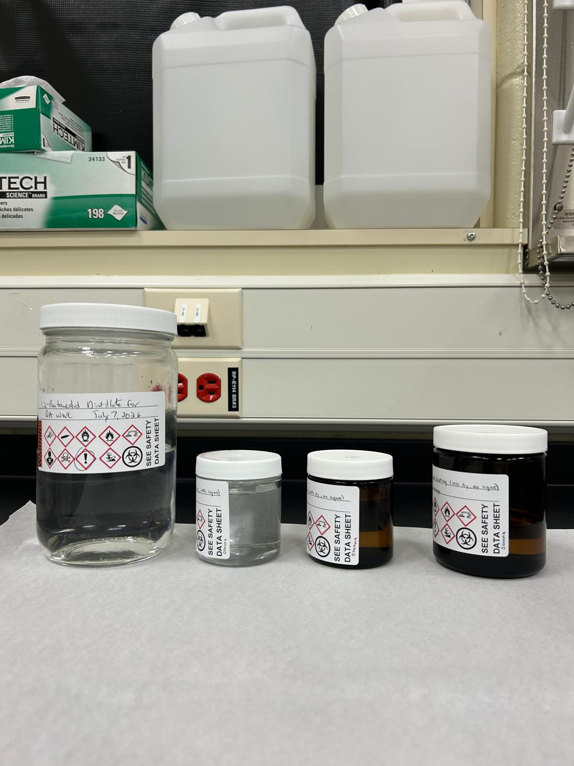
BD Stability Tests
Does storing BD long-term under different conditions change its quality?
N₂ vs O₂; light exposed vs protected

Slide 25
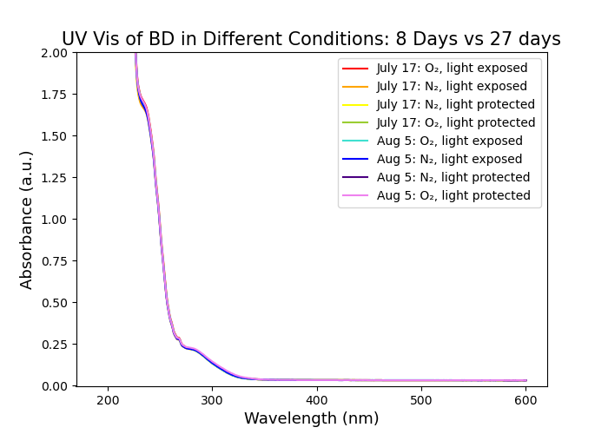
BD Stability Tests
Does storing BD long-term under different conditions change its quality?
N₂ vs O₂; light exposed vs protected

Slide 26
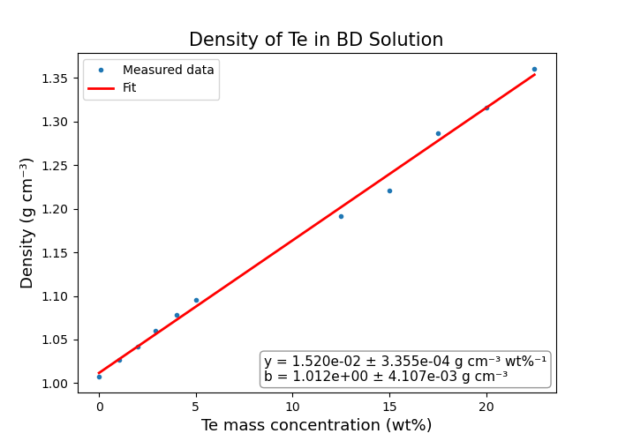
Density Change in Batch Tank
Batch tank adds dissolved TeA to BD until 1:3 molar ratio
Wanted to investigate how density changes
Notes:
THIS ONE!!!!!!

Slide 27
Summary
Quality of scintillator is monitored by testing consistency of certain properties
Studies are still being ran to understand the TeDiol synthesis process
Purity of chemicals needs to be inspected, especially if they have been stored for long periods of time

Slide 28
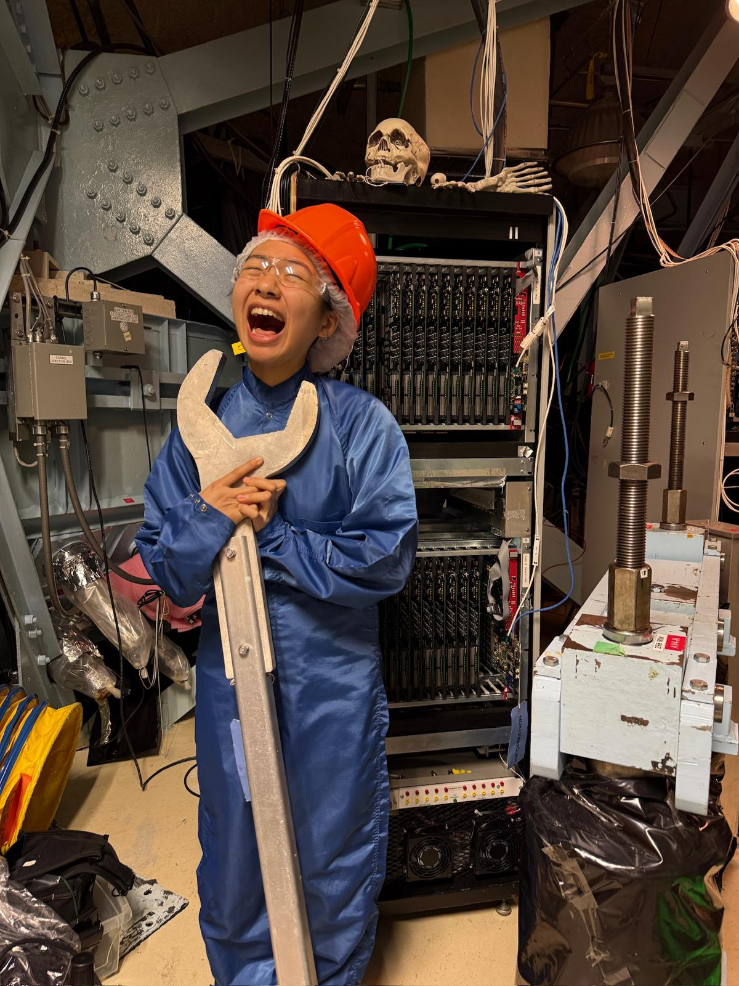
Next steps for QA
TeDiol test batch!
Creating updated standards
Stability tests for all chemicals

Slide 29
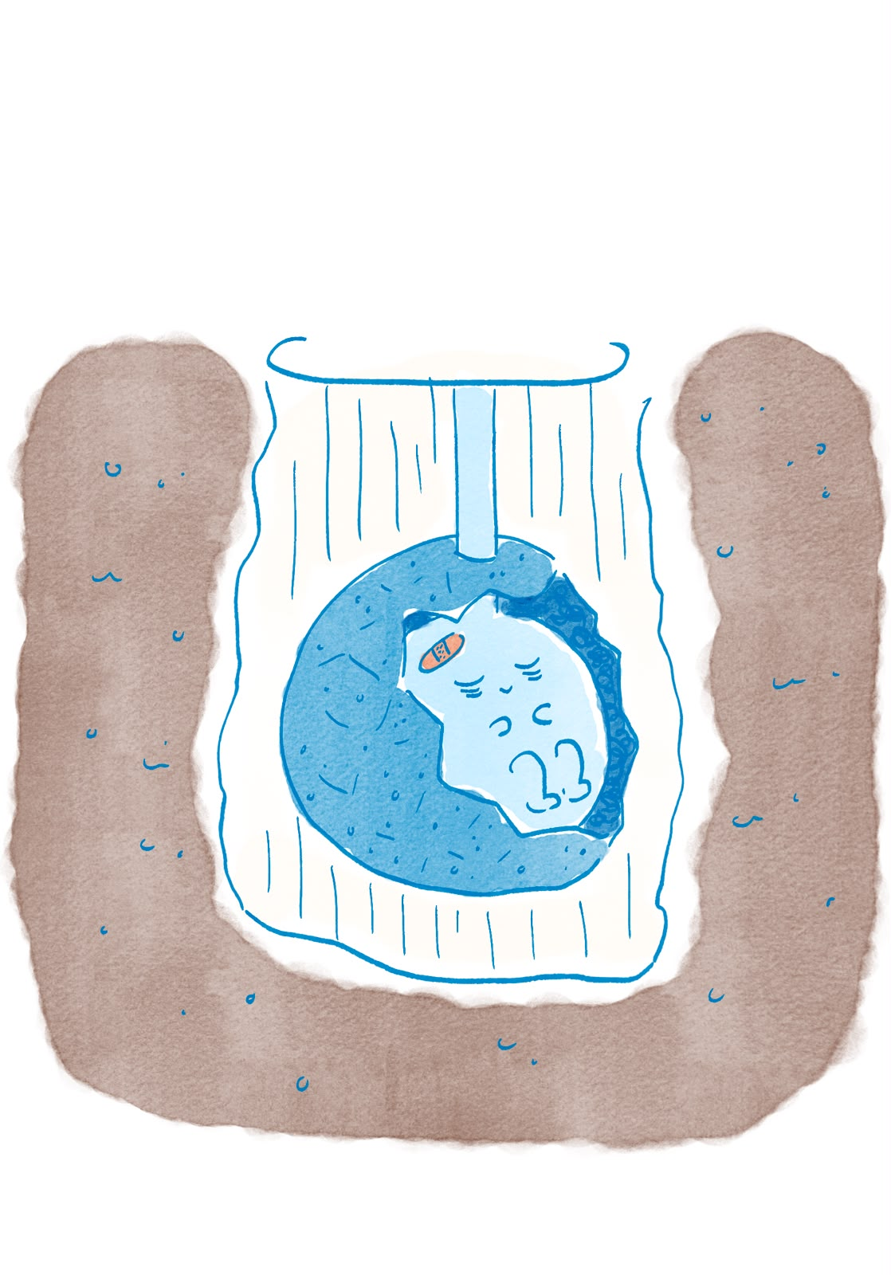
Thank you!
Szymon Manecki
Lorna Nolan
SNO+ research group
Chemists & chem techs
SNOLAB students ☺

Slide 30
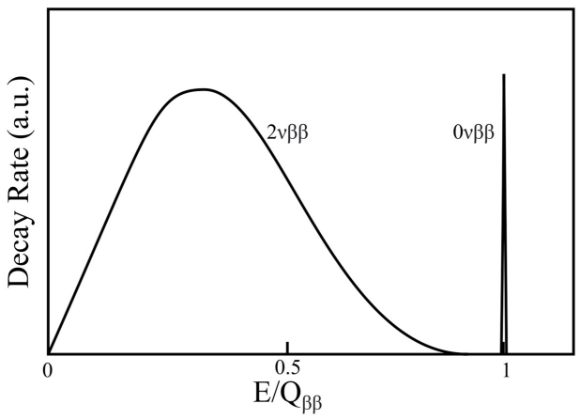
(Neutrinoless) Double Beta Decay
Predicted summed energy spectrum of the two e⁻’s from 2νββ and 0νββ

Slide 31
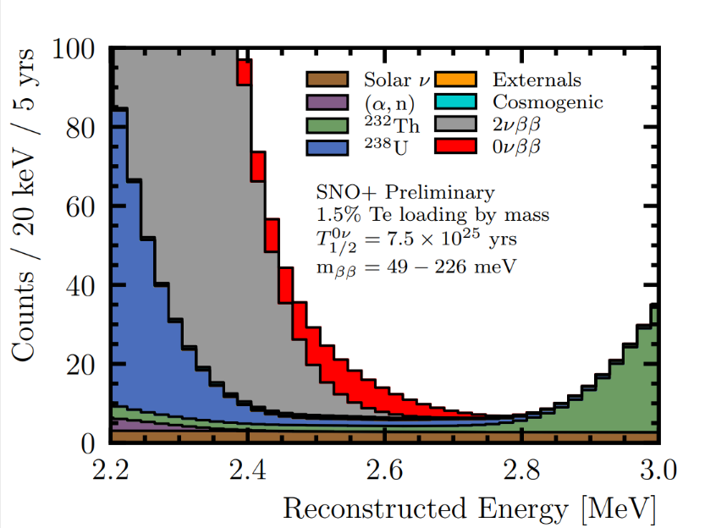

Slide 32
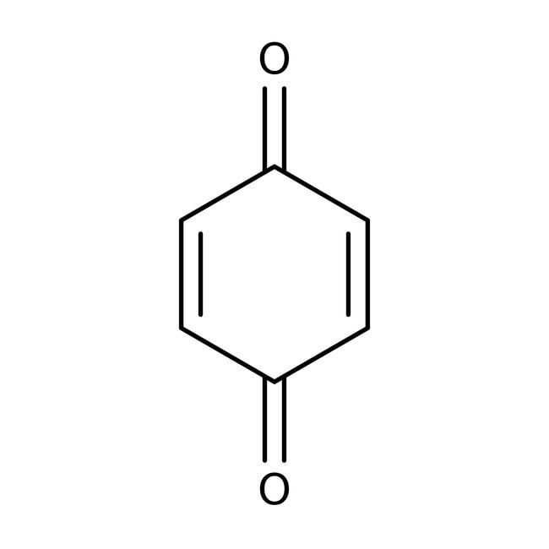
p-benzoquinone

Slide 33
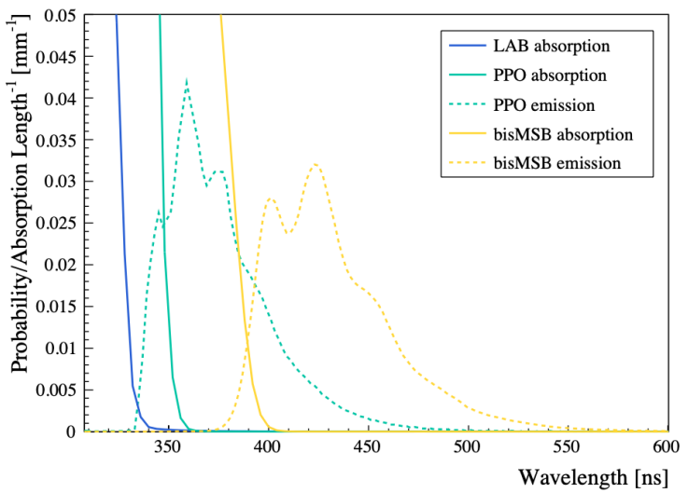

Slide 34
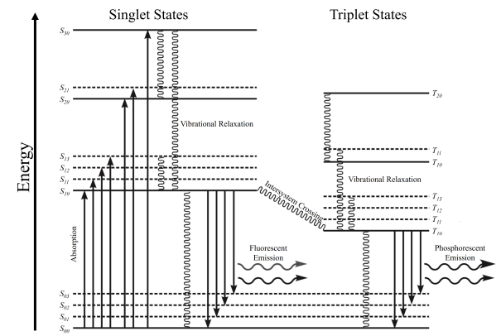

Slide 35
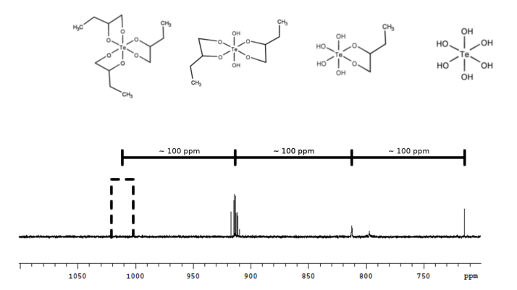
NMR Spectroscopy showing favoring of 2 BD attachments

Slide 36
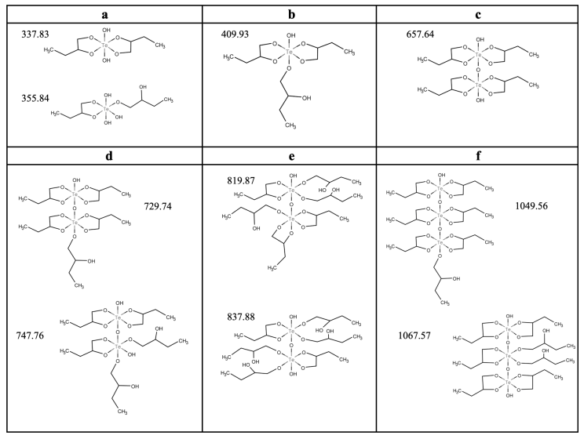
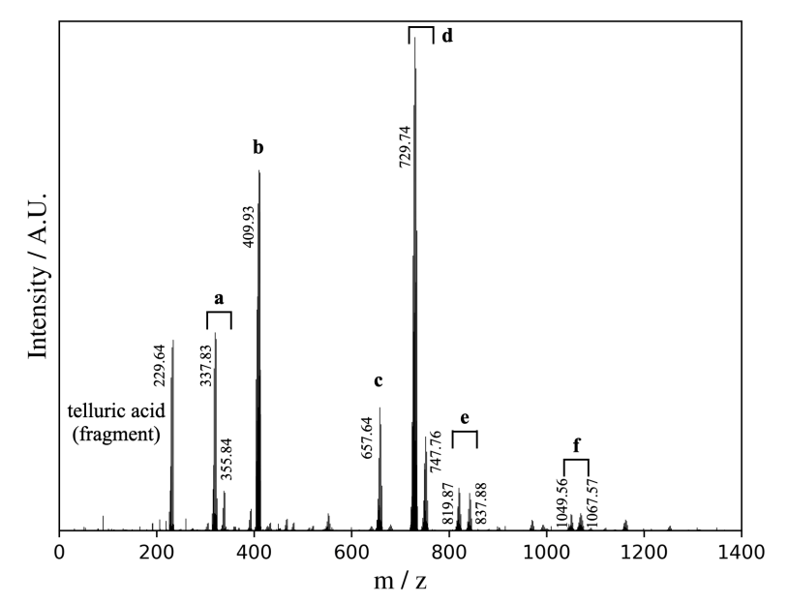
Mass Spectroscopy showing common arrangements of TeDiol

Slide 37
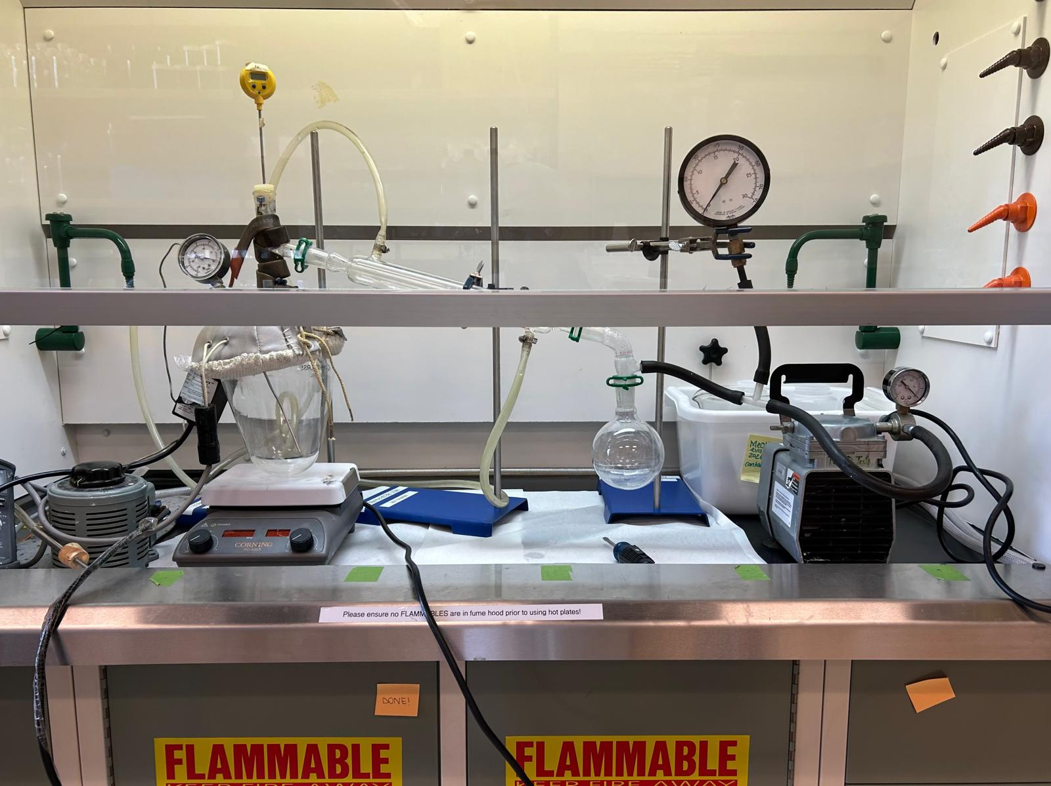
TeDiol Synthesis in Surface Lab

Slide 38
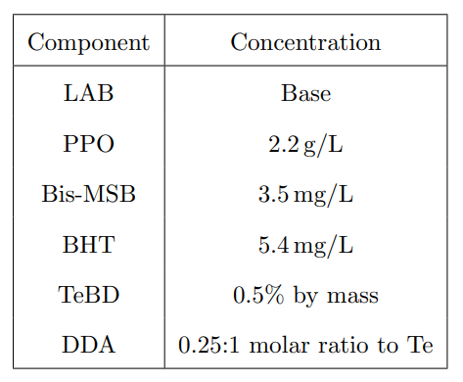

Slide 39
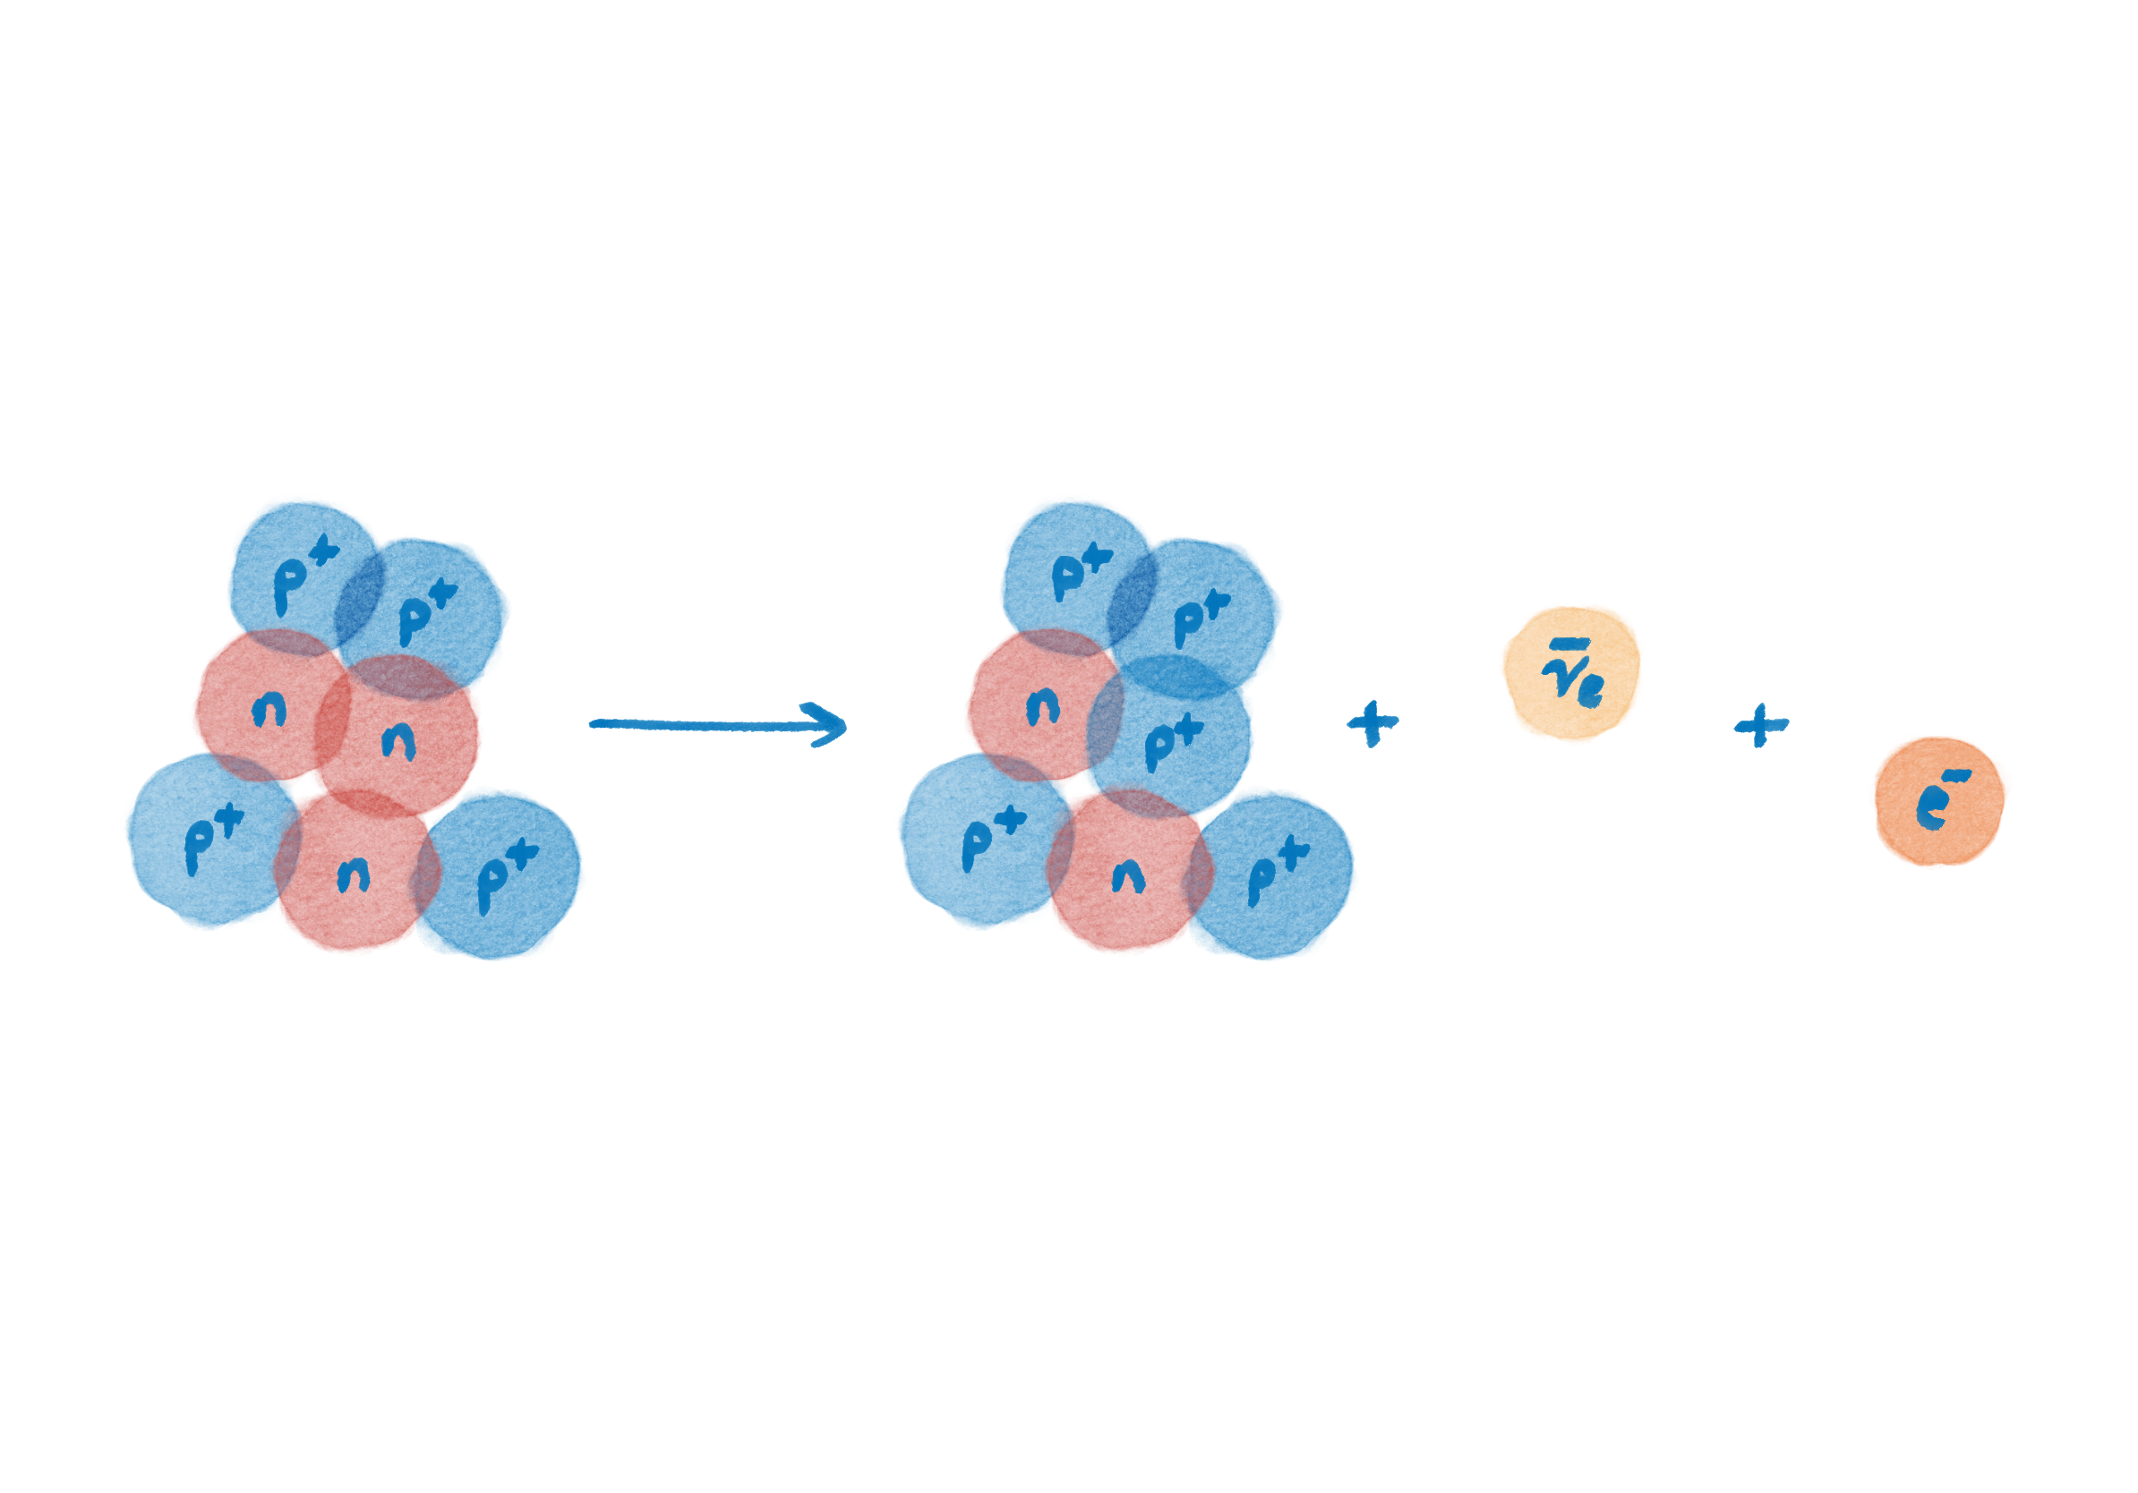
Introduction: Beta Decay

Slide 40
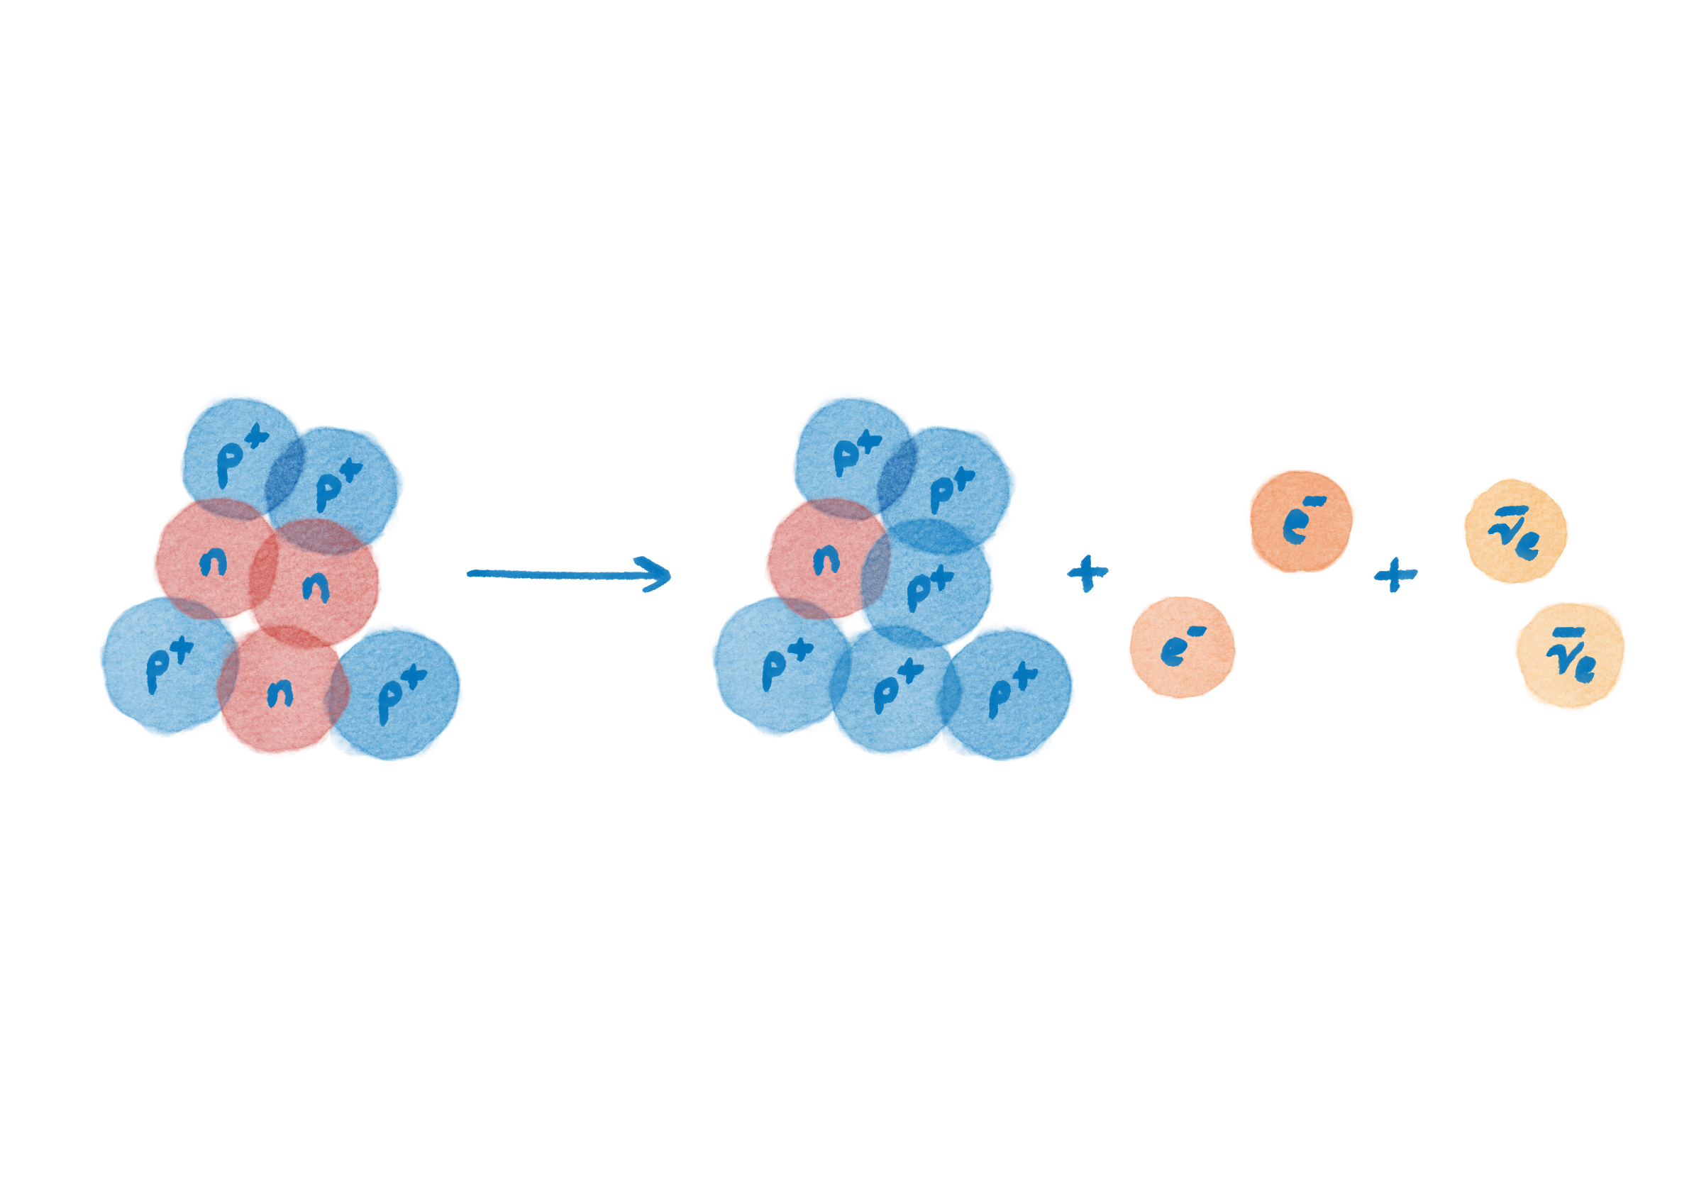
Introduction: Beta Decay
^
Double

Slide 41
Introduction: Beta Decay
^
Double
^
Neutrinoless

